Slide 1
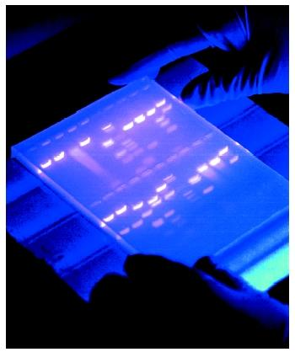
Analysis of Restriction Enzyme Cleavage of Lambda DNA
An Introduction to Restriction Enzymes & Gel Electrophoresis

Slide 2
Objectives
Understand the use of restriction enzymes as biotechnology tools
Become familiar with principles and techniques of agarose gel electrophoresis
Generate a standard curve from a series of DNA size standards
Estimate DNA fragment sizes from agarose gel data

Slide 3
Restriction Enzymes
Restriction enzymes, also known as restriction endonucleases, are biomolecules that cut DNA at specific sites
Restriction enzymes were 1st discovered in bacteria as a defense mechanism against invading viruses called bacteriophages
Any foreign DNA that’s encountered will be cut up by the Res and rendered ineffective

Slide 4
Restriction Enzymes
There are thousands of restriction enzymes and each is named for the bacterium from which it is isolated
We will use 3:
EcoR1: the 1st restriction enzyme isolated from Escherichia coli
HindIII: the 3rd restriction enzyme isolated from Haemophilus influenza
PstI: the 1st restriction enzyme isolated from Providencia stuartii

Slide 5
Restriction Enzymes
Each Restriction enzyme recognizes a specific nucleotide sequence in the DNA called a restriction site and cuts the DNA only at that specific site
Many restriction enzymes leave a short length of unpaired bases called sticky ends at the DNA site where they cut
In general, restriction sites are palindromic, meaning they read the same foreword as they do backwards on opposite strands

Slide 6
Restriction Sites
HindIII
Haemophilus influenza
Draw it yourself!

Slide 7
Restriction Enzyme Mechanism
The three-dimensional structure or shape of a restriction enzyme allows it to fit perfectly in the groove formed by the two strands of a DNA molecule.
When attached to the DNA, the enzyme slides along the double helix until it recognizes a specific sequence of base pairs which signals the enzyme to stop sliding.
The enzyme then chemically separates, or cuts, the DNA molecule at that site — called a restriction site.

Slide 8
Restriction Fragments
If a specific restriction site occurs in more than one location on a DNA molecule, a restriction enzyme will make a cut at each of those sites, resulting in multiple fragments of DNA.
Therefore, if a given piece of linear DNA is cut with a restriction enzyme whose specific recognition sequence is found at five different locations on the DNA molecule, the result will be six fragments of different lengths.
The length of each fragment will depend upon the location of restriction sites on the DNA molecule

Slide 9
Bacteriophage Lambda
Lambda DNA comes from a bacterial virus which attacks bacteria by inserting its nucleic acid into the host bacterial cell
Lambda is a lytic bacteriophage which replicates rapidly in host cells until the cells burst and release more phages to carry out the same infection process in other bacterial cells
It is harmless to eukaryotic organisms making it an ideal source of DNA for experimental study

Slide 10
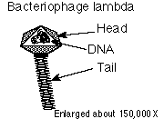
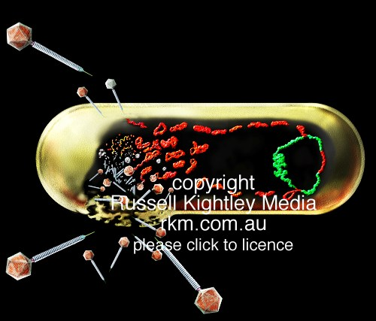
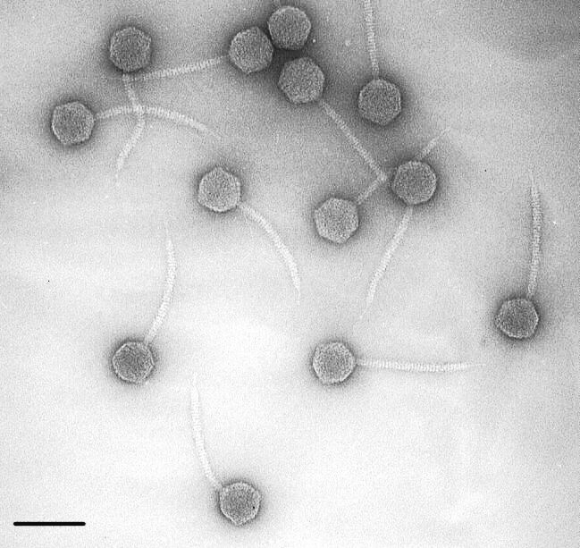
Bacteriophage Lambda
Isolated as a linear molecule from E.coli bacteriophage lambda
Contains about 48,000 base pairs

Slide 11
Electrophoretic Analysis of DNA Fragments
A DNA fragment that has been cut with restriction enzymes can be separated using a process known as agarose gel electrophoresis.
The term electrophoresis means to carry with electricity.
Agarose gel electrophoresis separates DNA fragments by size.
DNA fragments are loaded into an agarose gel slab, which is placed into a chamber filled with a conductive buffer solution.
A direct current is passed between wire electrodes at each end of the chamber.
Since DNA fragments are negatively charged, they will be drawn toward the positive pole (anode) when placed in an electric field.

Slide 12
DNA will “Run to Red”

Slide 13
Electrophoretic Analysis of DNA Fragments
The matrix of the agarose gel acts as a molecular sieve through which smaller DNA fragments can move more easily than larger ones.
Therefore, the rate at which a DNA fragment migrates through the gel is inversely proportional to its size in base pairs.
Over a period of time, smaller DNA fragments will travel farther than larger ones.
Fragments of the same size stay together and migrate in single bands of DNA.
These bands will be seen in the gel after the DNA is stained.

Slide 14
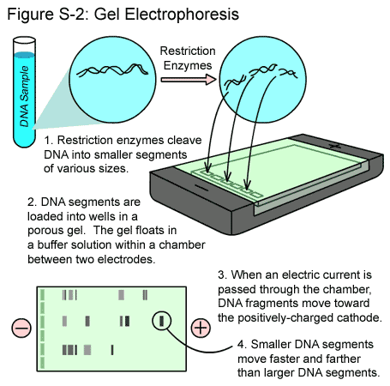

Slide 15
Making DNA Visible
DNA is colorless so DNA fragments in the gel cannot be seen during electrophoresis.
A loading dye containing two blue dyes is added to the DNA solution.
The loading dye does not stain the DNA itself but makes it easier to load the gels and monitor the progress of the DNA electrophoresis.
The dye fronts migrate toward the positive end of the gel, just like the DNA fragments.
The “faster” dye co-migrates with DNA fragments of approximately 500 bp, while the “slower” dye co-migrates with DNA fragments approximately 5 kb in size.

Slide 16
Making DNA Visible
Staining the DNA pinpoints its location on the gel.
When the gel is immersed in Fast Blast DNA stain, the stain molecules attach to the DNA trapped in the agarose gel.
When the bands are visible, you can compare the DNA restriction patterns of the different samples of DNA.

Slide 17
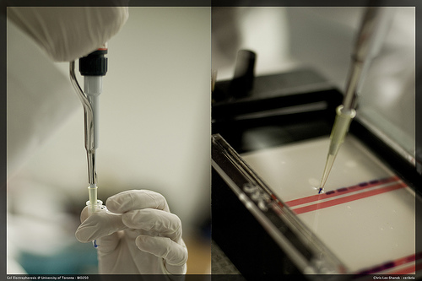
Electrophoresis
Separates mixtures of chemicals by their movement in an electrical field.
Used for proteins and DNA
animation

Slide 18
In Your Lab Notebook
Table of Contents
Title: Restriction Enzyme Cleavage of Lambda DNA & Electrophoresis
P__

Slide 19
Restriction Enzyme Cleavage of DNA & Electrophoresis
Objective: The objective of this experiment is to develop an understanding of the role of restriction enzymes and agarose gel electrophoresis to cut and size DNA

Slide 20
Restriction Enzyme Cleavage of DNA & Electrophoresis
Hypothesis: This is something you must write on your own!
1st: how many bands do you expect to see knowing we are using the lambda phage DNA and EcoR1
2nd will all of the bands move at the same rate through the gel?

Slide 21
Restriction Enzyme Cleavage of DNA & Electrophoresis
Materials:
DNA Ladder
Lambda DNA cut with EcoR1
Lambda DNA cut with HindIII
Lambda DNA cut with PstI
Lambda DNA uncut
Agarose powder
Electrophoresis buffer (concentrated)
100mL graduated cylinder
DI water
Balance

Slide 22
Materials contd.
Microwave
250mL flasks
Hot gloves
Weigh boats
Horizontal gel electrophoresis apparatus
D.C power supply
Micropipets with tips
Disposable lab gloves
Light box
Methylene blue

Slide 23
Procedure
Close off the open ends of a clean gel bed using rubber stopper or masking tape
Place a comb in the 1st set of notches at the end of the gel bed, making sure the comb is sitting firmly and evenly across the bed
Use a 250mL flask to prepare the gel solution according to the following chart

Slide 24
But 1st the most important math equation you’ll ever learn!
C₁V₁=C₂V₂
The Buffer comes in a 50X concentrate (C1)
We need it to be a 1X concentrate (C2)
So what volume of the 50X (V1) do we need to make the 1X (V2)?

Slide 25
C₁V₁=C₂V₂
50 X V2 = 1 X 3000mL
V2 = 3000mL/50
V2= 60mL
But Wait! We’re not done…
So we need 60mL of concentrate but how much water do we add it to?
The final volume needs to be 3000mL
60 of the 3000 will be 50X buffer so
3000mL-60mL = 2,940mL of water

Slide 26
Recommended agarose concentration for gels is 1% agarose for this lab
To make a 1% agarose solution, use 1 gram of agarose for each 100 ml
of 1x TAE electrophoresis buffer.
Individual 1% Agarose Gel
Size of Gel (cm) | Amt of Agarose (g) | Concentrated Buffer (1X) (mL) | Total Volume (mL)
7 X 7 | 0.3 | 30 | 30
8 X 9 | .45 | 45 | 45
7 X 14 | 0.6 | 60 | 60

Slide 27
Procedure Contd
Add all contents to your 250mL flask, and swirl to disperse clumps
Use a permanent marker to indicate the level of the solution volume on the outside of the flask
Cover Flask with plastic wrap and heat mixture in the microwave for 1 minute
Using glove, swirl mixture and then put back into the microwave for 25s intervals until all the agarose is completely dissolved
Solution will appear clear

Slide 28
Procedure
Cool the agarose solution to 60˚C with a careful swirling to promote even dissipation of heat
If detectable evaporation has occurred add DI water to bring solution back up to the original volume as marked on the flask
Pour the cooled agarose solution into the bed, making sure the bed is on a level surface.

Slide 29
Procedure contd.
Allow the gel to completely solidify
It will become firm and cool to touch after about 20min
After the gel is completely solidified, carefully and slowly remove the rubber dams
Remove the comb by slowly and gently pulling straight up
Leaving the gel on its bed, place it into the electrophoresis chamber with the correct orientation as indicated in diagram

Slide 30
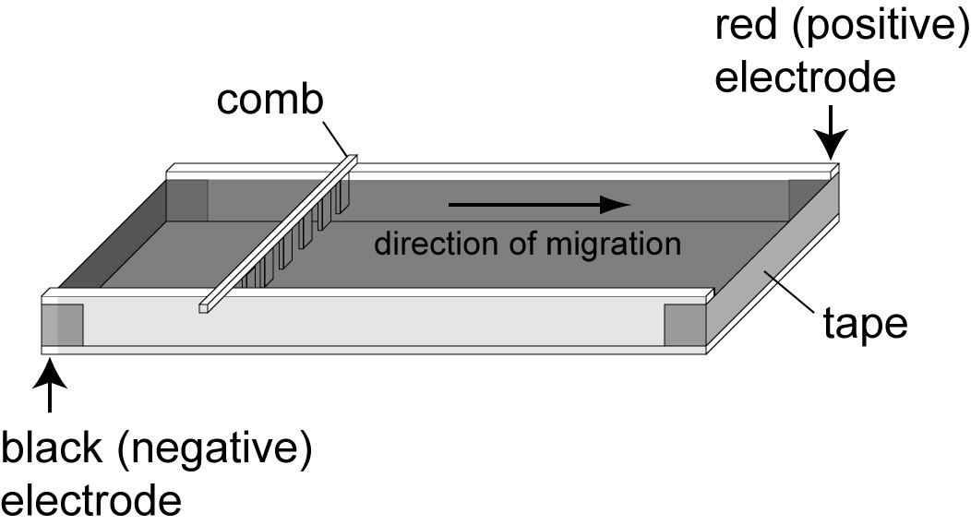
14. Fill the electrophoresis chamber with the appropriate amount of diluted 1X Buffer

Slide 31
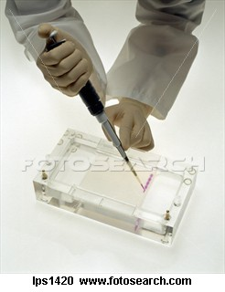
Procedure Contd. Loading the Gel
Make sure Gel is completely submerged under buffer before loading the samples
Using a micropipetor, load the DNA samples into the wells in consecutive order as follows
Lane | Tube
1 | A | Standard DNA Fragment Ladder
2 | B | Lambda DNA cut with EcoR1
3 | C | Lambda DNA (uncut)

Slide 32
Procedure contd. Running the Gel
After DNA samples are loaded, carefully snap the cover down onto the electrode terminals
Make sure that the negative and positive color coded indicators on the cover and apparatus chamber are properly oriented
Insert the plug of the black wire into the black input of the power source (negative input). Insert the plug of the red wire into the red input of the power source (positive input)

Slide 33
Procedure Contd. Running the Gel
Set the power source at the required voltage as indicated below and conduct electrophoresis for the length of time indicated by the chart below
Time & Voltage Reccomendations
Volts | Minimum / Maximum
150 | 15/20 min
125 | 20/30 min
70 | 35/45 min
50 | 50/80 min

Slide 34
Procedure Contd. Running the Gel
Check to see that current is running properly- you should see bubbles forming on the 2 platinum electrodes
After electrophoresis is completed, turn off the power, unplug the power source, disconnect the leads, and remove the cover
Remove the gel from the bed for staining

Slide 35
