Slide 1
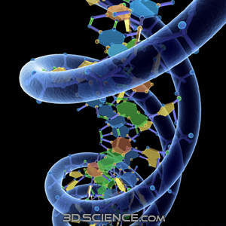
The Molecular Basis of Inheritance

Slide 2
Key Concepts
DNA is the genetic material
Many proteins work together in DNA replication & repair
Chromosomes consist of a DNA molecule packed together with protein

Slide 3
Lifes Operating Instructions
Nucleic acids are unique in their ability to direct their own replication from monomers
Your DNA “program” directs development of all your biochemical, anatomical, physiological, metabolic, and to some extent even behavioral traits

Slide 4
Lifes Operating Instructions
The molecular basis of inheritance is contingent on DNA’s ability to be
Replicated
Repaired
Passed on

Slide 5
The Search for Genetic Material: Scientific Inquiry
Remember Morgan & his fruit flies…
Morgan discovered that genes were on chromosomes
BUT… chromosomes are made of DNA & proteins
No one knew which one actually carried the information

Slide 6
Case for protein being hereditary material was stronger than it was for DNA till 1940’s
Case for Protein
Case Against Nucleic Acids
Had just been classified as a class of macromolecules with great heterogeneity and specificity
More variability than nucleic acids which seems necessary to specify all of lifes instructions
Chemical properties too uniform to account for multitude of specific inherited traits

Slide 7
Scientific Inquery
In 1928 a scientist named Griffith was trying to develop a vaccine against pneumonia
Pneumonia is caused by the bacterias Streptococcus pneumoniae
Griffith had 2 strains of Streptococcus pneumoniae
S strain →Pathogenic (makes you sick)
R Strain →Nonpathogenic (doesn’t make you sick)

Slide 8
Streptococcus pneumoniae
R-strain normal inhabitant of the human upper respiratory tract
S-Strain can cause pneumonia, paranasal sinusitis and meningitis, which is usually secondary to one of the former infections.
It also causes osteomyelitis, septic arthritis, endocarditis, peritonitis, cellulitis and brain abscesses.
Is currently the leading cause of invasive bacterial disease in children and the elderly

Slide 9
Streptococcus pneumoniae
Gram-positive, lancet-shaped cocci (elongated cocci with a slightly pointed outer curvature).
Usually, they are seen as pairs of cocci (diplococci), but they may also occur singly and in short chains.
When cultured on blood agar, they are alpha hemolytic

Slide 10
Streptococcus pneumoniae
S Strain
Smooth strain
Has a protective capsule
very important for survival in the host.
is poorly antigenic and antiphagocytic
is a major virulence factor
acts as a barrier to toxic hydrophobic molecules
can promote adherence to host tissue surfaces
R Strain
Rough strain
Lack a capsule

Slide 11
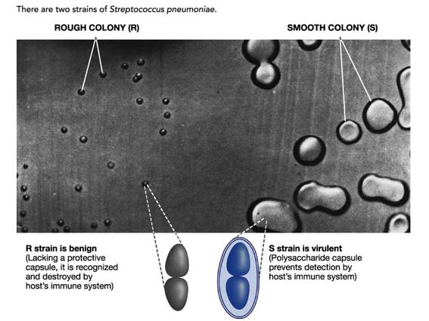

Slide 12
Frederick Griffiths Experiment
inject mice with R strain = mouse fine
inject mice with S strain = mouse dead
Kill S strain with heat & inject in mouse= mouse fine
Kill S strain with heat, mix with R strain, & inject into mouse = mouse dead
Take a sample of bacteria out of mouse & culture→ shows living S strain, not R strain

Slide 13
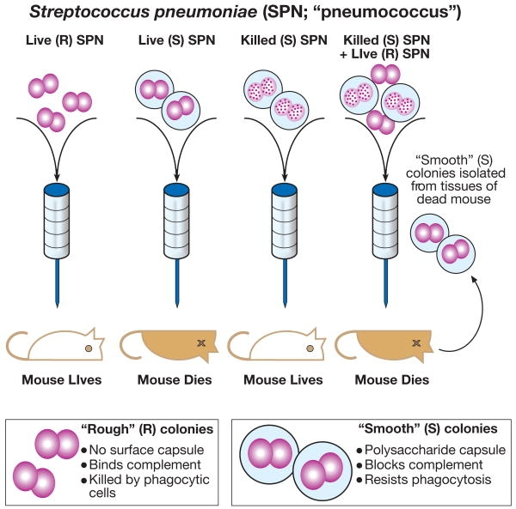

Slide 14
Griffiths Conclusions
The R strain was “transformed” into the pathogenic S strain by some unknown heritable substance
Transformation: a change in genotype and phenotype due to the assimilation of external DNA into a cell
Griffith discovered Transformation, but not the transforming substance

Slide 15
Enter Oswald Avery
Avery: American Bacteriologist who spent 14 years trying to determine which was the transforming substance
DNA
RNA
Or Protein

Slide 16
Averys Experiment
Avery broke open the heat killed DNA and extracted the cellular components
He then tested each individual sample by mixing it with the r strain
Only DNA was able to transform the R strain into the S strain

Slide 17
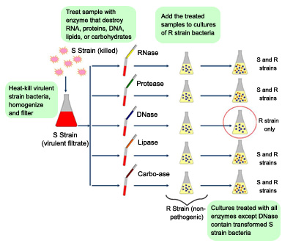
Treat sample with enzymes to destroy RNA, proteins, DNA, lipids, or carbohydrates
Aff treated samples to cultures of
R-strain
S-strain killed
RNase
S & R strains
Heat killed Virulent bacteria, homogenize, and filter
Protease
S & R strains
DNase
R strain only
S-Strain filterate
Lipase
S & R strains
Carbo-ase
S & R strains
R-Strain
nonpathogenic
Cultures treated with all enzymes except Dnase contain transformed S strain bacteria

Slide 18
A Breakthrough in the scientific world… Not so much
In 1944 Avery announced DNA was the heritable material
But…No one believed Avery, too little was known about DNA
More evidence for DNA as the hereditary material

Slide 19
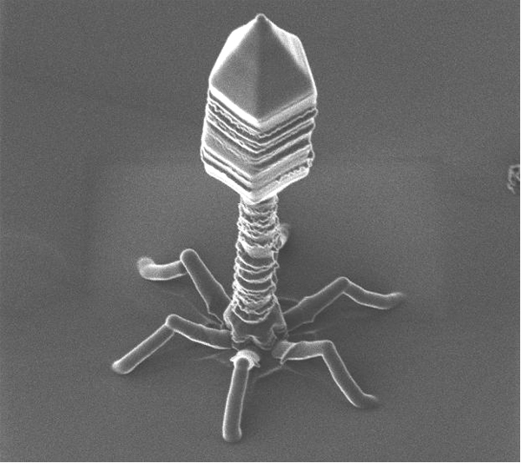
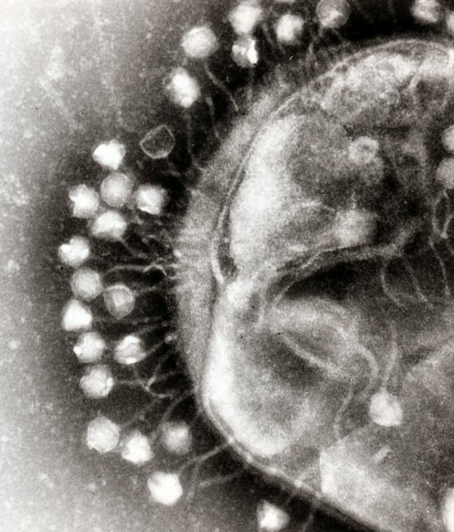
Viral DNA can Program Cells
Viruses that infect bacteria are called bacteriaphage
Literally translates to”Bacteria eater”
phage for short
T4 Bacteriophage infecting a cell

Slide 20
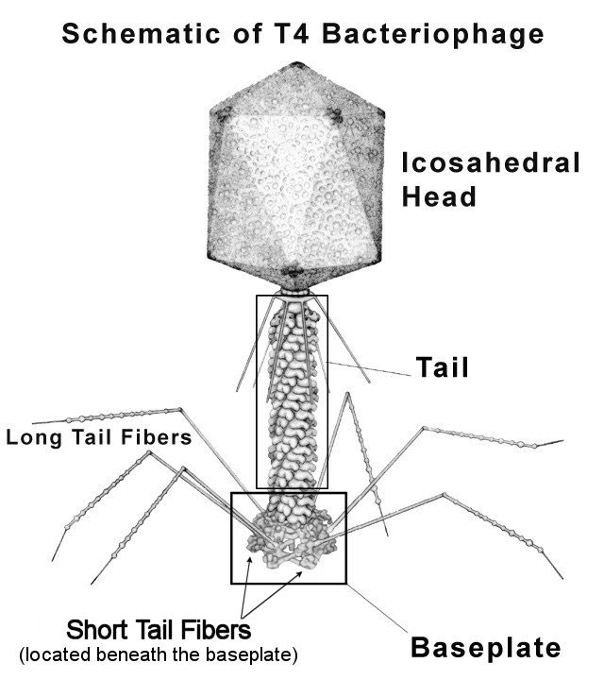
Sheath

Slide 21
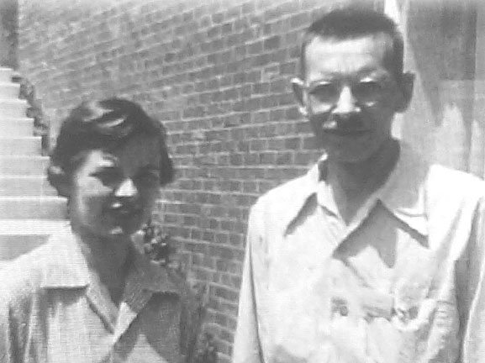
The Hershey Chase Experiment
In 1952 Alfred Hershey & Martha Chase showed without a doubt that DNA was the genetic material of the T2 phage

Slide 22
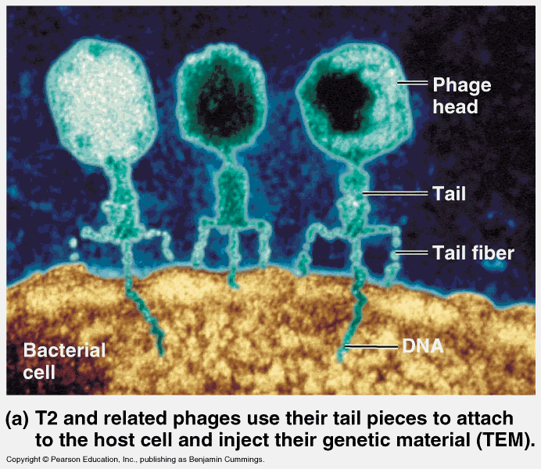
How T2 Phages Work
Phages composed almost entirely of DNA & Protein
T2 phage infects Eschericia coli and quickly turn it into T2 producing factories
This means the T2 has the
information necessary to
reprogram its host cell to
produce viruses

Slide 23
So which component has the reprogramming capabilities?
Viruses are made of 2 main components, protein & DNA
They want to use a radioactive label
They need 2 labels, one for DNA and 1 for protein
Components of DNA: sugar, nitrogenous base, phosphate group
Components of Protein: carbon, hydrogen, oxygen, nitrogen, & sulphur

Slide 24
Hershey Chase Experiment
DNA
Protein
Label the phosphate group with radioactive ³²P
Grow Phage in culture containing ³²P
Mix radioactively labeled phages with bacteria and allow infection
Agitate cells in blender to separate external phage parts from bacterial host cells
Label the protein with radioactive ³⁵S
Grow Phage in culture containing ³⁵S
Mix radioactively labeled phages with bacteria and allow infection
Agitate cells in blender to separate external phage parts from bacterial host cells

Slide 25
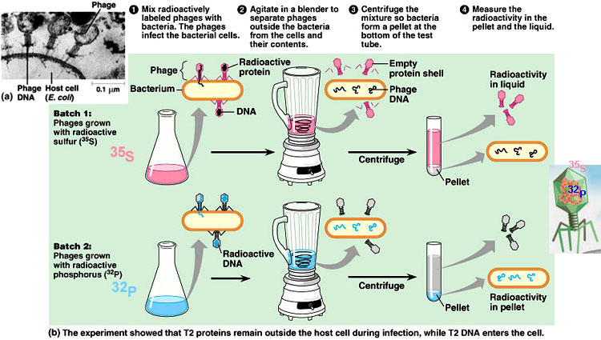

Slide 26
Hershey Chase Experimental Results
DNA
Protein
Radioactivity found in bacterial cell
Hershey & Chase concluded that the DNA of the virus must be injected into the host cell during infection, leaving the protein outside
DNA must be the genetic material!
No radioactivity in bacterial cell
Most radioactivity was found in supernatant
This means phage proteins did not enter bacterial cells

Slide 27
Still More Evidence that DNA is the genetic material
Erwin Chargaff: biochemist studying composition of DNA
DNA is composed of 3 parts
Sugar → Deoxyribose
Phosphate Group
Nitrogenous Base
Adenine
Thymine
Cytosine
Guanine

Slide 28
Chargaffs Rule
Chargaff made the observation that
the number of adenines in a strand of DNA always equaled the number thymines
the number of cytosines in a strand of DNA always equaled the number guanines
Important: we now know A pairs with T, & G pairs with C. However, no one knew this yet and in fact the common conception was that like paired with like… A with A, etc

Slide 29
Chargaffs Rule
It is important to remember here that the structure of DNA was not yet known, in other words, they did not know it was a double helix!
What is now known as Chargaffs rule, that A pairs with T & C pairs with G, came later

Slide 30
Still more evidence DNA is the hereditary material of a cell
Prior to mitosis it is exactly duplicated
During mitosis it is distributed equally to each daughter cell
In a given species all diploid cells have exactly half as much DNA as the haploid cells

Slide 31
Finally Scientists are convinced DNA is in fact the genetic material
So…. What does it look like?
1950’s arrangement of covalent bonds in nucleic acids was established, but the 3 dimensional shape was still unknown
People important in elucidating the structure of DNA
Rosalind Franklin
Watson & Crick

Slide 32
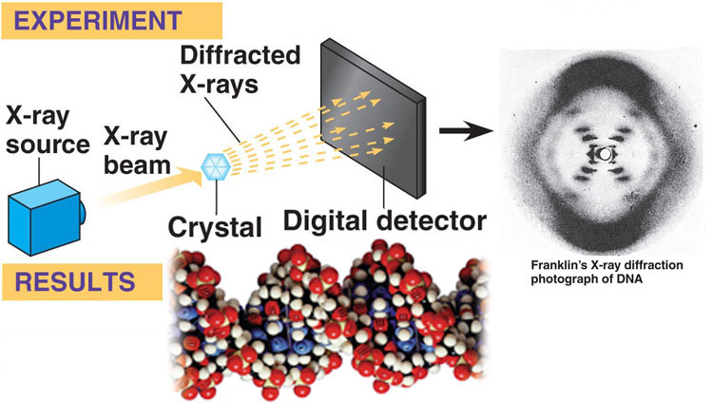
Rosalind Franklin (& then she died of cancer and some other guy got a Nobel prize)
Was an X-ray crystallographer who took the picture that Watson & Crick used to determine the structure of DNA

Slide 33
How X-Ray Crysatallography Works
The spots & smudges are produced by X-rays that are diffracted (deflected) as they passed through aligned fibers of purified DNA
Crystallographers can use math equations to translate the patterns into information about the 3 dimensional shape of a molecule
We now have a machine called a Fourier Transform that does this for us, at the time of Rosalind Franklin, though, it was all done with pencil and paper

Slide 34
Enter Watson & Crick
James Watson takes a trip to Cambridge University where a guy named Francis Crick is studying protein structure using X-ray crystallography → Watson & Crick meet

Slide 35
Watson & Crick
Watson gets a copy of Rosalind Franklins x-ray diffraction of DNA and because he is familiar with the types of patterns helical molecules produce (thanks to working with Crick), he immediately knows DNA is helical
He’s was also able to deduce the width of the helix and the spacing of the nitrogenous basses along it
The width suggested that it was made up of 2 strands (up till now it was believed to be made of 3 strands)

Slide 36
Watson & Crick Build a Double Helix
Franklin had concluded the sugar-phosphate backbones were on the outside of the helix
This arrangement is appealing because it put the hydrophobic nitrogenous bases on the inside where they would be shielded from the aqueous environment
They still thought like paired with like, A-A, T-T, C-C, G-G

Slide 37
Watson & Crick Build a Double Helix
How did they figure out the base pairing?
Trial & Error
The X-ray data suggested the helix had a uniform diameter
Think about the structure of Adenine, Thymine, Cytosine & guanine

Slide 38
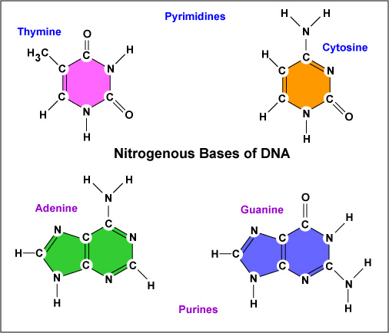
Purines & Pyrimidines
If adenine paired with adenine, and thymine paired with thymine, how would that affect the diameter of the helix?

Slide 39
Watson & Crick Build a Double Helix
Purine-purine pairs are too wide, and pyrimidine-pyrimidine pairs are too narrow
Since adenine is always found in the same amount as thymine, it was determined that adenine would pair with thymine
Coincidentally, adenine can only form hydrogen bonds with thymine, and cytosine can only form H-bonds with guanine

Slide 40
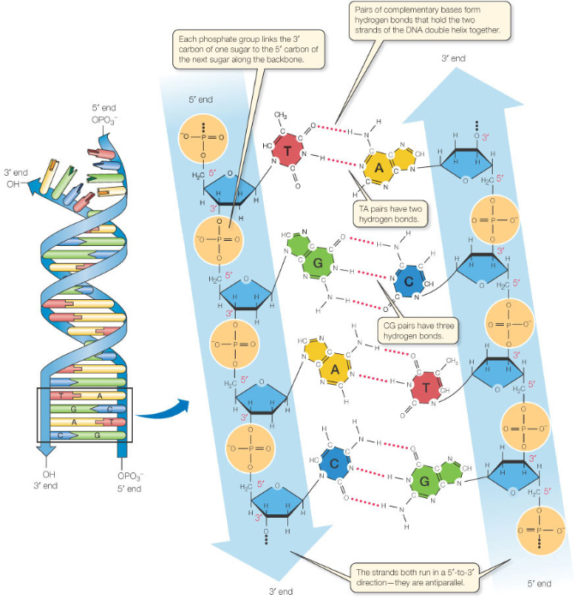
DNA structure animation
TA pairs have 2 hydrogen bonds
CG pairs have 3 hydrogen bonds
Hydrogen bonds between nitrogenous bases form the rungs of the ladder
Note the strands both run in a 5’→3’ direction, but the strands run antiparallel to each other

Slide 41
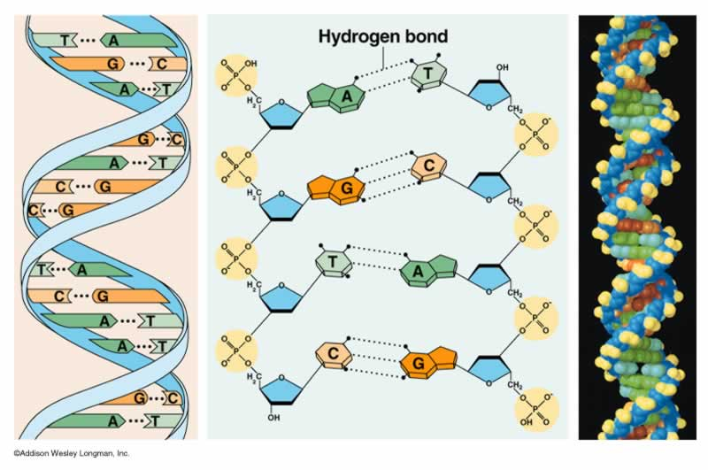
The beautyof the Double Helix Model is that it suggests the basic mechanism for replication
Watson & Crick ended their 1 page paper on the structure of DNA by saying: “It has not escaped our notice that the specific pairing we have postulated immediately suggests a possible copying mechanism for the genetic material.”
DNA Replication Overview

Slide 42
3 possible mechanisms of DNA Replication
Semi-conservative: DNA strands separate → each strand acts as a template to build a new strand on
Each daughter DNA molecule is composed of a parent strand and a new strand
Conservative: DNA strands separate → each strand acts as a template to build a new strand on→ parent strands reassociate with each other, and new strands associate with each other
Dispersive: all 4 strands of DNA following replication are a mixture of old and new DNA

Slide 43
Meselson & Stahl Experiments
1st culture E. coli on a media containing a heavy isotope of nitrogen ¹⁵N
Bacteria incorporate the ¹⁵N into the nitrogenous bases of their DNA
Next, transfer bacteria into culture containing only ¹⁴N
Any new DNA that the bacteria synthesized would be lighter than the parent DNA made in the ¹⁵N

Slide 44
Meselson & Stahl Experiments
Meselson & Stahl could then distinguish DNA of different densities by centrifuging the DNA strands
Heavier Strands would travel farther down then lighter strands

Slide 45
