Slide 1
Key Concepts Review
DNA is the genetic material
Many proteins work together in DNA replication & repair
Chromosomes consist of a DNA molecule packed together with protein
The molecular basis of inheritance is contingent on DNA’s ability to be
Replicated
Repaired
Passed on/ inheritted (mitosis & meiosis)

Slide 2
People to Remember
Thomas Morgan Hunt :
Griffith:
Avery
Hershy & Chase
Rosalind Franklin
Chargaff
Watson & Crick
Meselson & Stahl
Fruit flies → genes are on chromsomes
Discovered transformation using R & S strain streptococci
Used enzymes to break down cellular components and showed that when DN A was digested transformation did not occur
Used isotope labeled bacteriophages to prove once and for all that DNA is the heritable material
Used Xray crystallography to capture the image that Watson & Crick would later use to deduce DNA’s structure
Discovered that adenine was always present in the same quantity as thymine, and cytosine as guanine
Determined the 3-Dimensional structure of DNA is a double helix, with complementary base pairing
Determined DNA replication was semiconservative

Slide 3
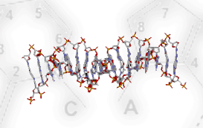
DNA Replication & Repair
http://highered.mcgraw-hill.com/sites/0072437316/student_view0/chapter14/animations.html#

Slide 4
To be The hereditary Material, all of the following criteria must be met
1st A gene must be able to carry information from one generation to the next
2nd A gene has to be able to use that information to determine a heritable characteristic
3rd A gene must be easily copied

Slide 5
Franklin’s X-ray crystallographic images of DNA enabled Watson to deduce that DNA was helical
The X-ray images also enabled Watson to deduce the width of the helix and the spacing of the nitrogenous bases
The pattern in the photo suggested that the DNA molecule was made up of two strands, forming a double helix
© 2011 Pearson Education, Inc.

Slide 6
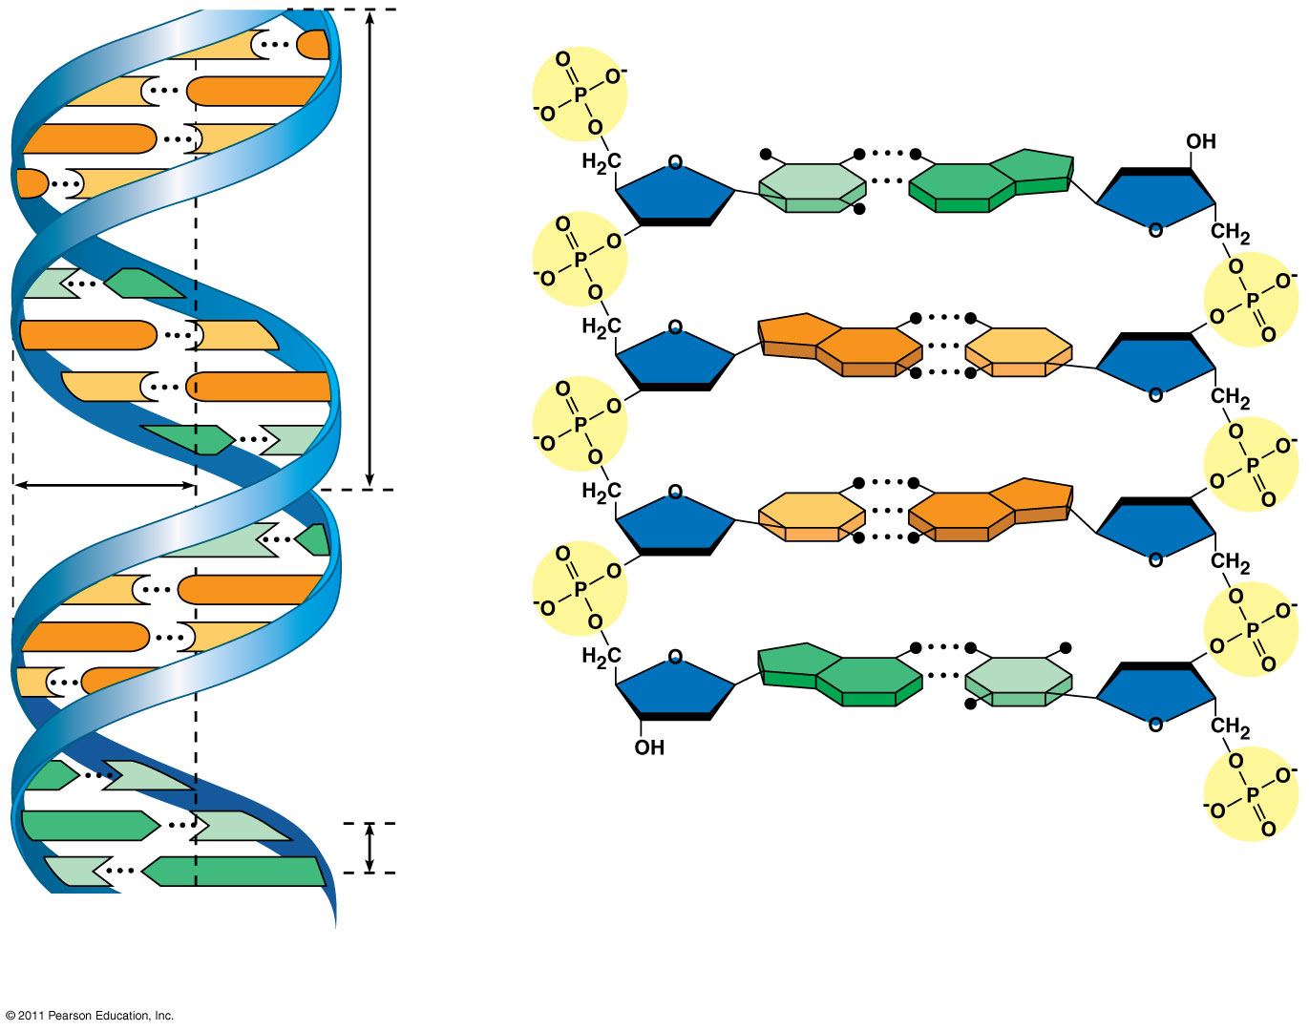
Figure 16.7a
5′ end
(16 19-23))
C
G
C
G
Hydrogen bond
3′ end
G
C
G
C
T
A
3.4 nm
T
A
G
C
G
C
C
G
A
T
1 nm
C
G
T
A
C
G
G
C
C
G
A
T
A
T
3′ end
A
T
0.34 nm
T
A
5′ end
(a)
Key features of DNA structure
(b) Partial chemical structure
Notes:
Figure 16.7 The double helix.

Slide 7
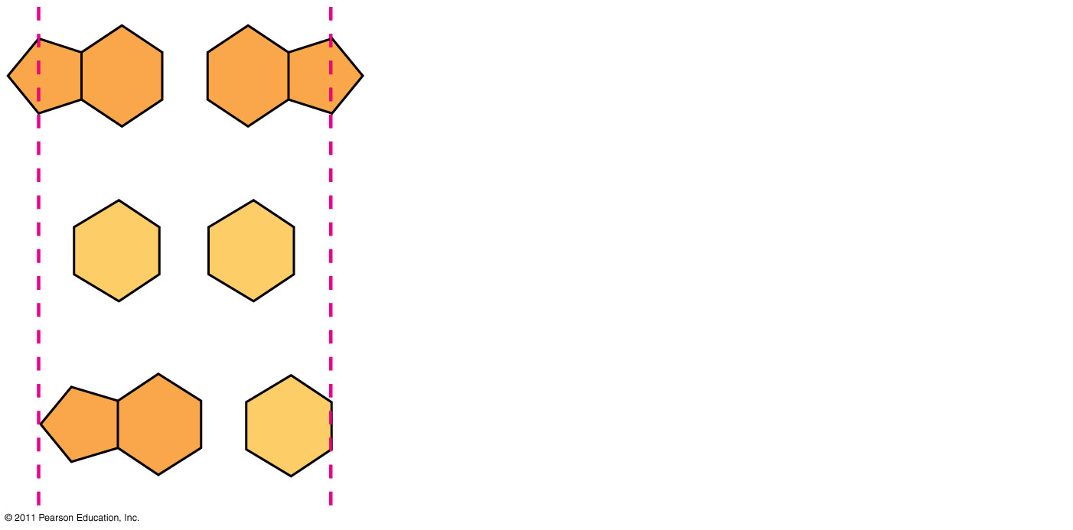
Figure 16.UN01
Purine + purine: too wide
Pyrimidine + pyrimidine: too narrow
Purine + pyrimidine: width consistent with X-ray data
Notes:
Figure 16.UN01 In-text figure, p. 310

Slide 8
Basic Principles of DNA Replication Postulated by Watson & Crick
“Now our model for deoxyribonucleic acid is, in effect, a pair of templates, each of which is complementary to each other. We imagine that prior to duplication the hydrogen bonds are broken, and the two chains unwind and separate. Each chain then acts as a template for the formation onto itself of a new companion chain, so that eventually we shall have two pairs of chains, where we only had one before. Moreover, the sequence of the pairs of bases will have been duplicated exactly.”

Slide 9
Watson and Crick reasoned that the pairing was more specific, dictated by the base structures
They determined that adenine (A) paired only with thymine (T), and guanine (G) paired only with cytosine (C)
The Watson-Crick model explains Chargaff’s rules: in any organism the amount of A = T, and the amount of G = C
© 2011 Pearson Education, Inc.

Slide 10
Concept 16.2: Many proteins work together in DNA replication and repair
The relationship between structure and function is manifest in the double helix
Watson and Crick noted that the specific base pairing suggested a possible copying mechanism for genetic material
© 2011 Pearson Education, Inc.

Slide 11
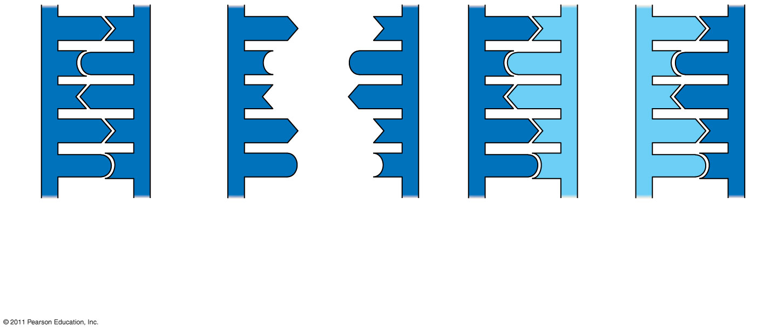
Figure 16.9-3
A
T
A
T
A
T
A
T
C
G
C
G
C
G
C
G
T
A
T
A
T
A
T
A
A
T
A
T
A
T
A
T
G
C
G
C
G
C
G
C
(a) Parent molecule
(b)
Separation of strands
(c)
“Daughter” DNA molecules, each consisting of one parental strand and one new strand
Notes:
Figure 16.9 A model for DNA replication: the basic concept.

Slide 12
Watson and Crick’s semiconservative model of replication predicts that when a double helix replicates, each daughter molecule will have one old strand (derived or “conserved” from the parent molecule) and one newly made strand
Competing models were the conservative model (the two parent strands rejoin) and the dispersive model (each strand is a mix of old and new)
© 2011 Pearson Education, Inc.

Slide 13
DNA Replication: A Closer Look
The copying of DNA is remarkable in its speed and accuracy
More than a dozen enzymes and other proteins participate in DNA replication
© 2011 Pearson Education, Inc.

Slide 14
Getting Started
Replication begins at particular sites called origins of replication (ORI), where the two DNA strands are separated, opening up a replication “bubble”
A eukaryotic chromosome may have hundreds or even thousands of origins of replication
Prokaryotes have only 1
Replication proceeds in both directions from each origin, until the entire molecule is copied (28)
© 2011 Pearson Education, Inc.

Slide 15
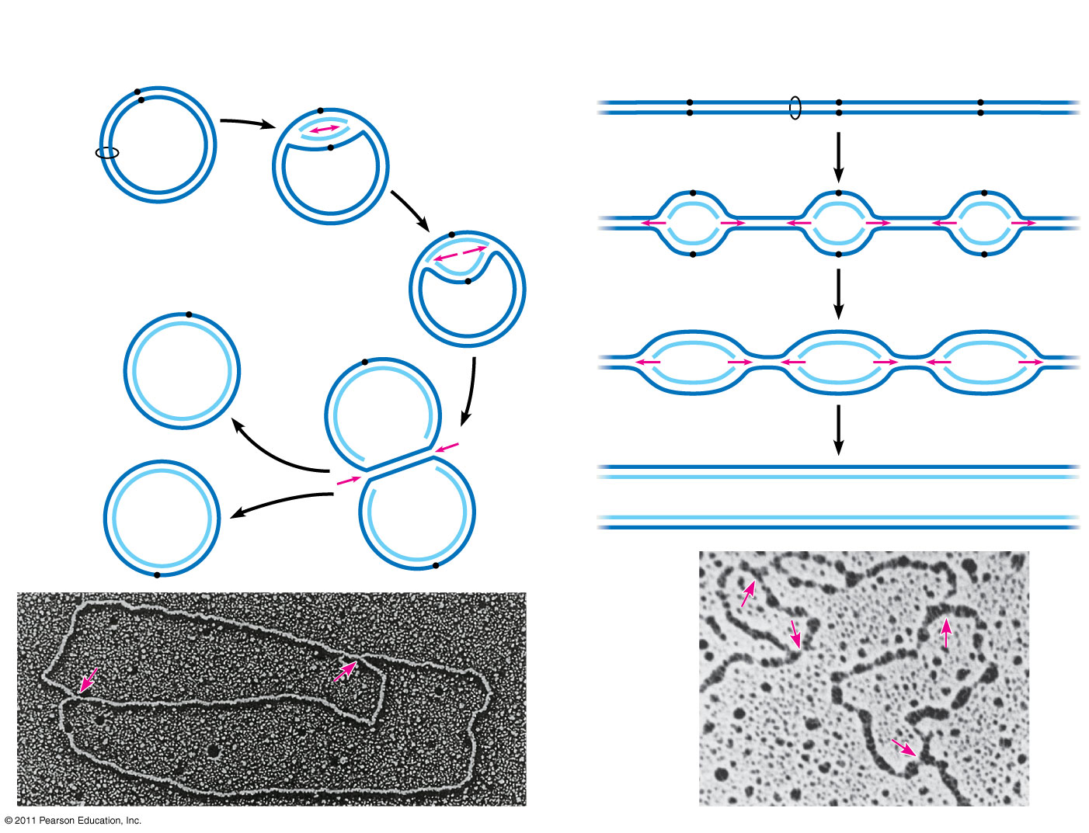
Figure 16.12
(a) Origin of replication in an E. coli cell
(b) Origins of replication in a eukaryotic cell
Origin of replication
Parental (template) strand
Double-stranded DNA molecule
Origin of replication
Daughter (new) strand
Parental (template) strand
Daughter (new) strand
Replication fork
Double- stranded DNA molecule
Replication bubble
Bubble
Replication fork
Two daughter DNA molecules
Two daughter DNA molecules
0.5 μm
0.25 μm
Notes:
Figure 16.12 Origins of replication in E. coli and eukaryotes.

Slide 16
DNA Replication: A Closer Look
E. coli
Human
1 chromosome
4.6 million nucleotide pairs
1 hour to undergo a complete round of DNA replication and binary fission
46 chromosomes
6 billion nucleotide pairs
Few hours to undergo mitosis
Only about 1 error in 10 billion nucleotides

Slide 17
Replication Fork
At the end of each replication bubble is a replication fork, the Y-shaped region where the parental DNA is being unwound
Several Kinds of proteins participate in the unwinding
Helicase: enzymes that break the hydrogen bonds holding the 2 strands together
Single strand binding proteins (SSBP’s): bind the now single stranded DNA to keep the 2 strands from reassociating
Topoisomerases: relieves the strain caused by the untwisting of the DNA molecule by breaking the covalent bonds within the DNA backbone, swiveling, and rejoining the strands

Slide 18
DNA polymerases cannot initiate synthesis of a polynucleotide; they can only add nucleotides to the 3′ end
The initial nucleotide strand is a short RNA primer
An enzyme called primase can start an RNA chain from scratch and adds RNA nucleotides one at a time using the parental DNA as a template
The primer is short (5–10 nucleotides long), and the 3′ end serves as the starting point for the new DNA strand
© 2011 Pearson Education, Inc.

Slide 19
Synthesizing a New DNA Strand
Enzymes called DNA polymerases catalyze the elongation of new DNA at a replication fork
Most DNA polymerases require a primer and a DNA template strand
The rate of elongation is about 500 nucleotides per second in bacteria and 50 per second in human cells
© 2011 Pearson Education, Inc.

Slide 20
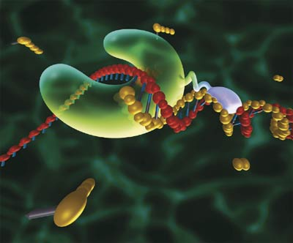
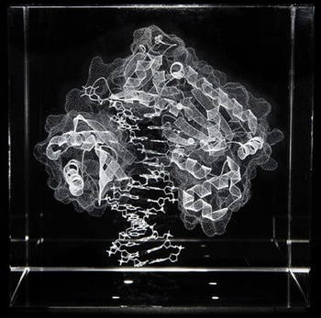
Synthesizing a new Strand of DNA
DNA Polymerases polymerize the synthesis of a new strand of DNA by adding nucleotides to a preexisting strand

Slide 21
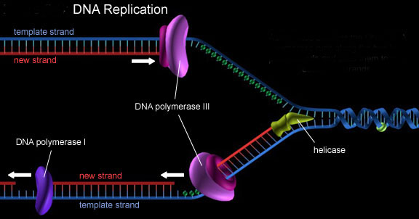
SSBP’s
Topoisomerase
DNA Replication Animation

Slide 22
Each nucleotide that is added to a growing DNA strand is a nucleoside triphosphate
dATP supplies adenine to DNA and is similar to the ATP of energy metabolism
The difference is in their sugars: dATP has deoxyribose while ATP has ribose
As each monomer of dATP joins the DNA strand, it loses two phosphate groups as a molecule of pyrophosphate
© 2011 Pearson Education, Inc.

Slide 23
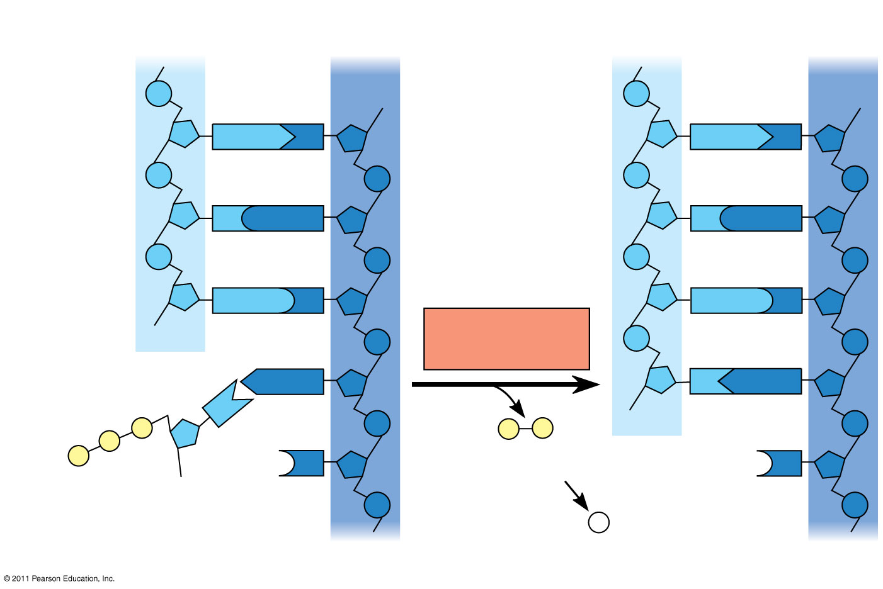
Figure 16.14
New strand
Template strand
5′
3′
5′
3′
Sugar
A
T
A
T
Phosphate
Base
C
G
C
G
G
C
G
C
OH
DNA polymerase
3′
A
T
A
T
P
P
P _{i}
OH
P
P
C
Pyrophosphate
3′
C
OH
Nucleoside triphosphate
2 P _{i}
5′
5′
Notes:
Figure 16.14 Incorporation of a nucleotide into a DNA strand.

Slide 24
DNA is Antiparallel
There are 2 strand in a DNA molecule
Those 2 strands run in opposite directions
An easy way to remember
DNA is composed of a sugar, phosphate group, and a nitrogenous base
The sugar is a 5 carbon sugar shaped like a pentagon
The point of the pentagon points in the 5’ direction

Slide 25
The antiparallel structure of the double helix affects replication
DNA polymerases add nucleotides only to the free 3′ end of a growing strand; therefore, a new DNA strand can elongate only in the 5′ to 3′ direction
Along one template strand of DNA, the DNA polymerase synthesizes a leading strand continuously, moving toward the replication fork
© 2011 Pearson Education, Inc.

Slide 26
To elongate the other new strand, called the lagging strand, DNA polymerase must work in the direction away from the replication fork
The lagging strand is synthesized as a series of segments called Okazaki fragments, which are joined together by DNA ligase

Slide 27
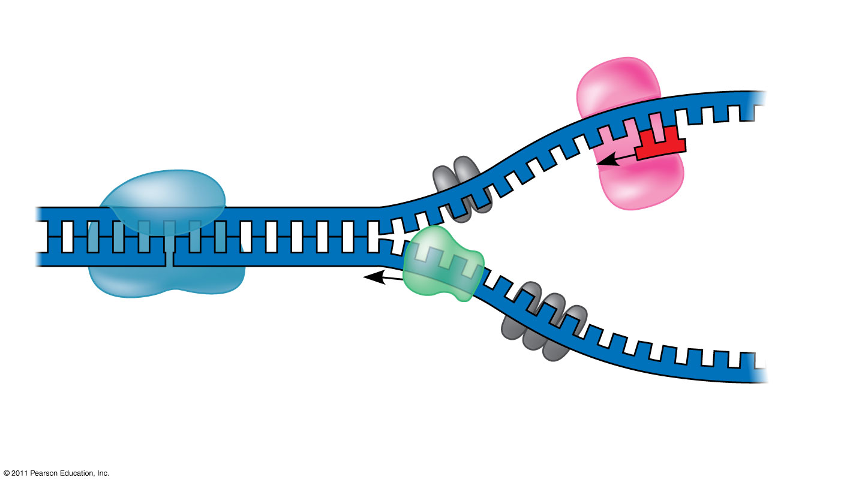
Figure 16.13
(33 part)
Primase
3′
Topoisomerase
5′
RNA primer
3′
5′
3′
Helicase
5′
Single-strand binding proteins
Notes:
Figure 16.13 Some of the proteins involved in the initiation of DNA replication.

Slide 28
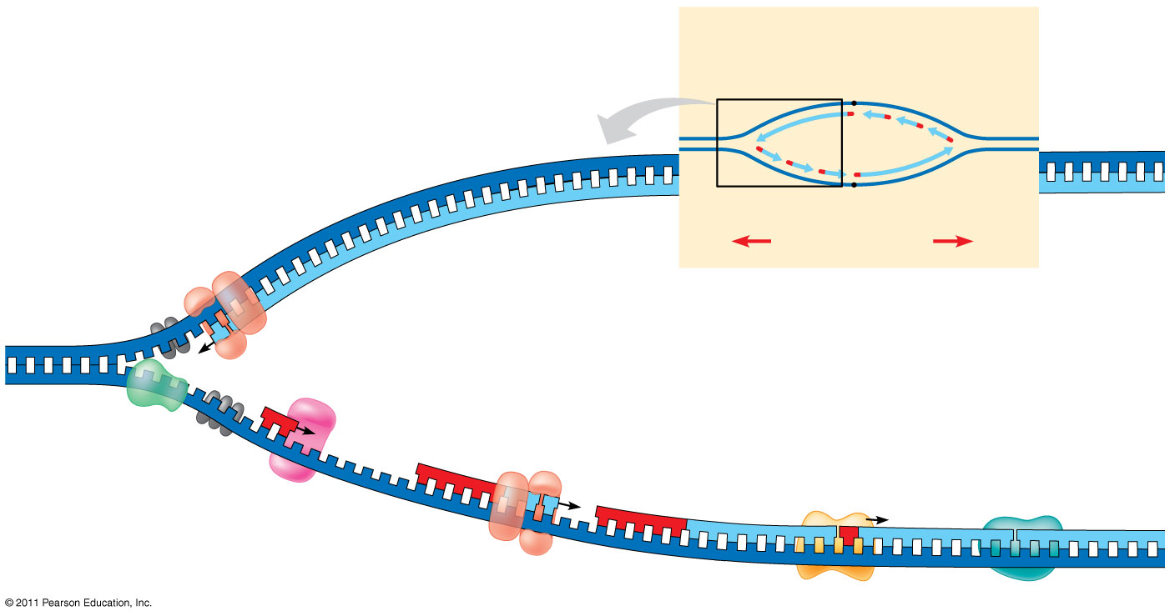
Figure 16.17
Overview
Leading strand
Origin of replication
Lagging strand
Leading strand
Lagging strand
Leading strand
Overall directions of replication
5′
DNA pol III
3′
Primer
Primase
3′
5′
3′
Parental DNA
DNA pol III
Lagging strand
5′
DNA pol I
4
3′
DNA ligase
5′
3′
3
2
1
5′
Notes:
Figure 16.17 A summary of bacterial DNA replication.

Slide 29
The DNA Replication Complex
We tend to think of DNA replication looking something akin to a train moving along a rain track
This is INCORRECT in 2 important ways
First: all of the before mentioned proteins involved in replication do not act individually, but rather together as one large “DNA replication Machine”
Second: this DNA replication complex does not move along the DNA strands, rather the DNA moves through the complex

Slide 30
The DNA Replication Complex
The proteins that participate in DNA replication form a large complex, a “DNA replication machine”
The DNA replication machine may be stationary during the replication process
Recent studies support a model in which DNA polymerase molecules “reel in” parental DNA and “extrude” newly made daughter DNA molecules
© 2011 Pearson Education, Inc.

Slide 31
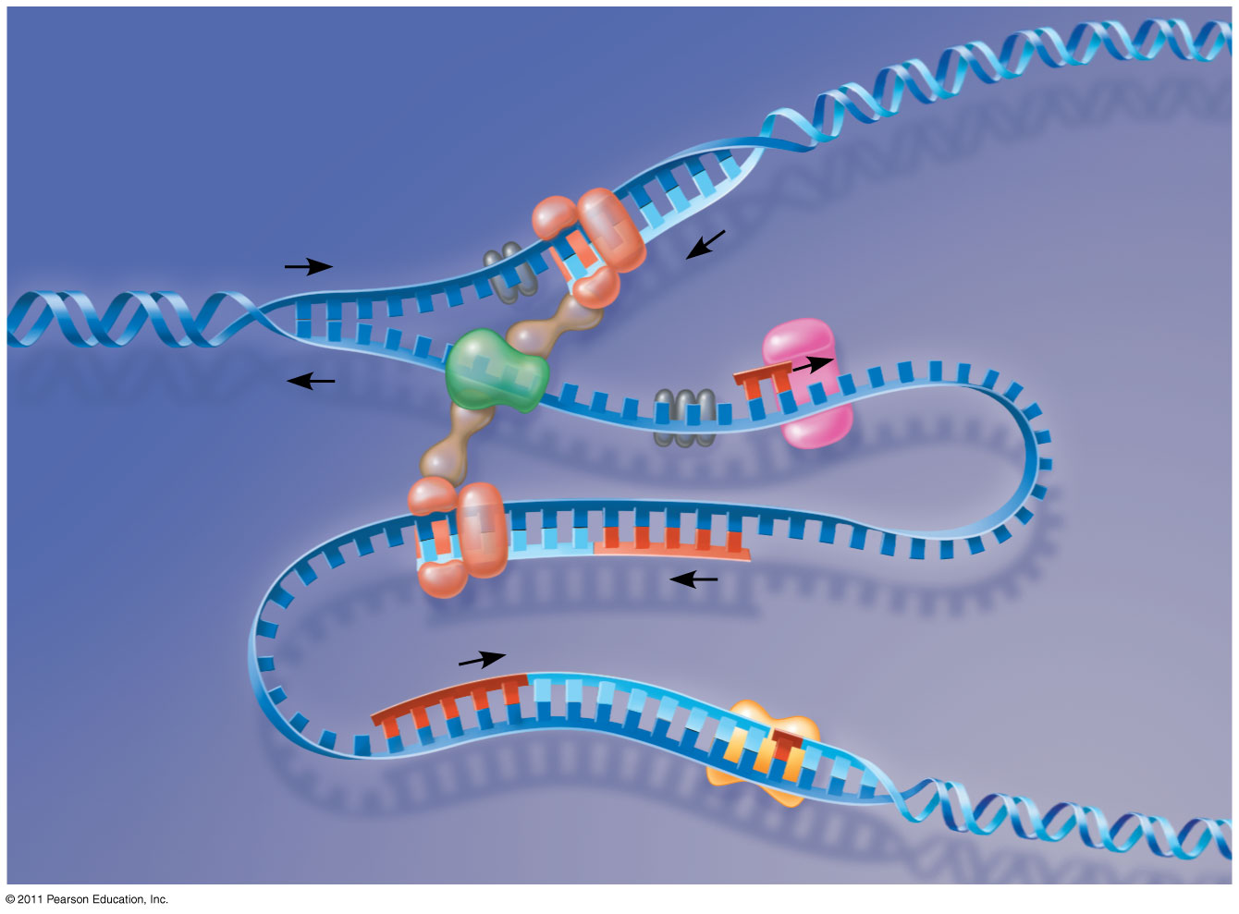
Figure 16.18
DNA pol III
Parental DNA
Leading strand
5′
5′
3′
3′
3′
3′
5′
5′
Connecting protein
Helicase
3′
5′
Lagging strand template
DNA pol III
Lagging strand
5′
3′
http://highered.mcgraw-hill.com/sites/0072437316/student_view0/chapter14/animations.html#
Notes:
Figure 16.18 A current model of the DNA replication complex.

Slide 32
DNA Polymerase
E. coli
Eukarytes
There are several different DNA Polymerases involved in replication
Rate of elongation is about 500 nucleotides per second
2 major DNA Polymerases
DNA Polymerase I
DNA Polymerase III
At least 11 DNA polymerases involved in replication of eukaryotic genomes
Rate of elongation is about 50 nucleotides per second

Slide 33
Proofreading & Repairing DNA
We said earlier the error rate was 1 in 10 billion nucleotides
Initially, the error rate is 1 in 100,000 nucleotides
This means errors in growing DNA strands are 100,000 times more common than they are in the final product
This implies some type of repairing mechanism that must go through and correct the majority of the errors
DNA Polymerase not only adds nucleotides to a growing DNA strand, but also has proofreading capabilities

Slide 34
Proofreading and Repairing DNA
DNA polymerases proofread newly made DNA, replacing any incorrect nucleotides
In mismatch repair of DNA, repair enzymes correct errors in base pairing
DNA can be damaged by exposure to harmful chemical or physical agents such as cigarette smoke and X-rays; UV radiation can lead to T-T dimers (two adjacent Ts on same strand bond)
In nucleotide excision repair, a nuclease cuts out and replaces damaged stretches of DNA
© 2011 Pearson Education, Inc.

Slide 35
Proofreading DNA
Remember how adenine can only form hydrogen bonds with thymine, and cytosine can only form hydrogen bonds with guanine
If a mismatch occurs, it puts a “kink” in DNA strand
This distortion of shape causes the DNA strand to not move through the DNA molecule as quickly as it does when the shape is not distorted
By slowing the DNA progression through the DNA polymerase, it give DNA polymerase the time necessary to remove the mismatched nucleotide and replace it with the correct nucleotide
DNA Proofreading by Polymerases

Slide 36
Evolutionary Significance of Altered DNA Nucleotides
Error rate after proofreading repair is low but not zero (from 1 in 100,000 to 1 in 1,000,000,000)
Sequence changes may become permanent and can be passed on to the next generation
These changes (mutations) are the source of the genetic variation upon which natural selection operates
© 2011 Pearson Education, Inc.

Slide 37
Maintenance of Genetic Information
Incorrectly paired or altered nucleotides can arise after replication
Maintenance of our genetic information requires frequent repair of various kinds of damage to existing DNA
Mutagens: anything that causes changes in the DNA base pairing
Reactive chemicals
UV radiation
Cigarette smoke & other carcinogens

Slide 38
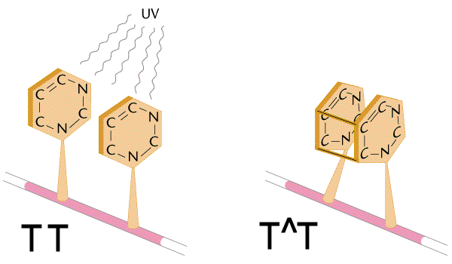
Types of DNA Mutations
Thymine Dimers: if there are two dTTP’s next to each other in a strand of DNA, the thymine nitrogenous bases can become fused through covalent linkage
UV radiation causes this type of mutation
This fusion of 2 thymine bases causes a distortion in the shape of the double helix
Nucleotide Excision Repair
There are other types of mutations that can occur including:
Mismatched pairs
pyrimidine dimers
Double stranded breaks
Damaged bases
Direct Repair Animation

Slide 39
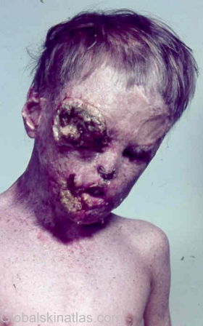
Xeroderma Pigmentosum
Individuals with this disorder are hypersensitive to sunlight
They lack the ability to repair thymine dimers due to a mutation in one or more enzymes involved in their skins nucleotide excision repair system
As a result, mutations build up in their skin cells often leading to various skin cancers

Slide 40
Replicating the Ends of DNA Molecules
Limitations of DNA polymerase create problems for the linear DNA of eukaryotic chromosomes
With repeated rounds of replication the usual replication machinery provides no way to complete the 5′ ends, so repeated rounds of replication produce shorter DNA molecules with uneven ends
This is not a problem for prokaryotes, most of which have circular chromosomes
© 2011 Pearson Education, Inc.

Slide 41
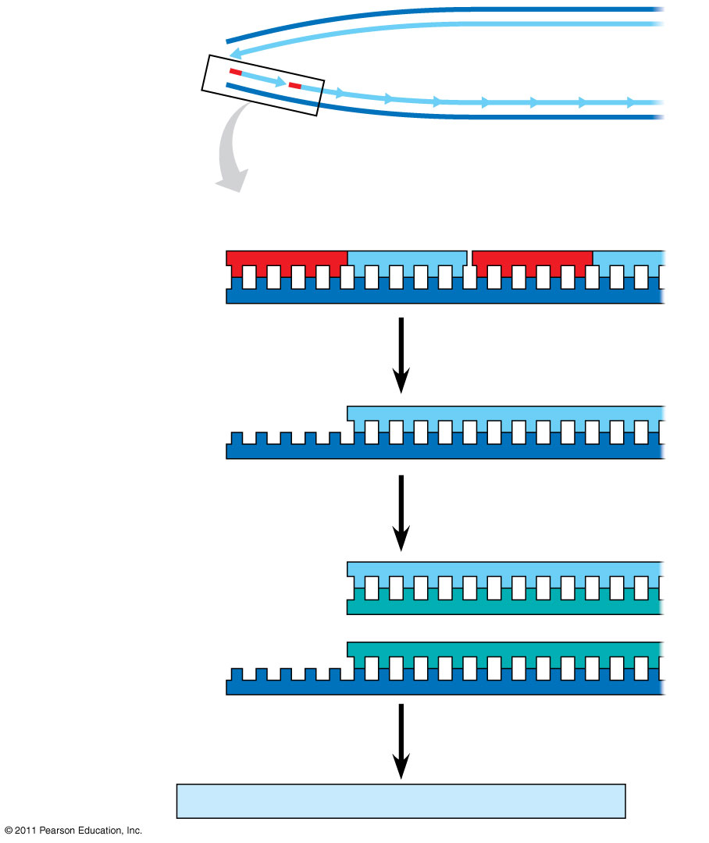
Figure 16.20
5′
Ends of parental DNA strands
Leading strand
Lagging strand
3′
Last fragment
Next-to-last fragment
Lagging strand
RNA primer
5′
3′
Parental strand
Removal of primers and replacement with DNA where a 3′ end is available
5′
3′
Second round of replication
5′
New leading strand
3′
New lagging strand
5′
3′
Further rounds of replication
Shorter and shorter daughter molecules
Notes:
Figure 16.20 Shortening of the ends of linear DNA molecules.

Slide 42
Replicating the Ends of Eukaryotic DNA Molecules
Eukaryotes must have a way to protect their genes from being gradually eroded away
Telomeres: special nucleotide sequences found at the ends of eukaryotic DNA molecules
No genes in telomeres
Telomeres consist of multiple repeated sequences
In humans the sequence is TTAGGG, and is repeated between 100-1,000 times
Telomeric DNA protects the organisms genes!

Slide 43
Telomeres
In general, if DNA is found to have a staggered end it means it is damaged and would usually trigger signal transduction pathways that would ultimately lead to cell cycle arrest or even programmed cell death
Telomeres are associated with proteins that inhibit the cell from activating these signal transduction pathways

Slide 44
Telomeres
Telomeres do not prevent the shortening of DNA molecules, rather, they postpone the erosion of genes near the ends of the molecules
Telomeres become shorter during every round of replication
The shortening of telomeres has been implicated in the aging process
What does this mean for gametes

Slide 45
Gametes & Telomeres
If the cells that give rise to gametes became shorter during each round of replication, eventually essential genes would be impacted
This does not happen, though
Telomerase: an enzyme that catalyzes the lengthening of telomeres in eukaryotic germ cells, thus restoring their original length and compensating for the shortening that occurs during DNA replication
Not active in adult somatic cells
Telomerase activity increased in many cancer cells
Telomerase Function Animation

Slide 46
How DNA is Packaged in a Prokaryote
Remember, prokaryotes have a single circular chromosomes
This chromosome is associated with proteins causing it to be supercoiled, densely packing it so it fills only a small portion of the bacterial cell
This part of the bacterium is called the nucleiod, and is not membrane bound

Slide 47
How DNA is Packaged in a Eukaryote
ONE human cell (each of whichis less then a millimeter long) contains TWO METERS of DNA
If all the DNA in a human was stretched end to end it would travel from earth to the moon and back 6,000 times
How do we fit all of this DNA into our cells?

Slide 48
How DNA is Packaged in a Eukaryote
Eukaryotic DNA is combined with a large amount of protein forming what we call chromatin
Chromatin, a complex of DNA and protein, is found in the nucleus of eukaryotic cells
There are different levels of chromatin packing in a eukaryotic chromosome
DNA the double helix
Histone proteins
Nucleosomes (or beads on a string)
30-nm fiber
Looped domains
Metaphase chromosomes

Slide 49
How DNA is Packaged in a Eukaryote
Double Helix
Histones
The double helix alone is 2nm across
Remember, the phosphate groups in the backbone…what kind of charge do they have? This will be important
Histone proteins are responsible for the 1st level of DNA packing
Histones are composed largely of positively charged amino acids
4 types of histones common in chromatin
Histone structure is highly conserved among eukaryotes, what does this suggest

Slide 50
How DNA is Packaged in a Eukaryote
Nucleosomes
30-nm Fiber
The double helical DNA wraps twice around a histone forming a nucleosome
Each nucleosome is followed by a short sequence of linker DNA, and then another nucleosome
This produces a structure that resembles beads on a string
Interactions between histone tails of one nucleosome and its neighboring nucleosomes cause the DNA to further coil and fold forming a 30-nm fiber

Slide 51
How DNA is Packaged in a Eukaryote
Looped Domains
Metaphase Chromosomes
The 30-nm fiber forms loops called looped domains which attach to a chromosome scaffold made of proteins forming a 300-nm fiber
Looped domains themselves can then coil and fold in a manner not yet understood further compacting the chromosome to form the characteristic metaphase chromosome

Slide 52
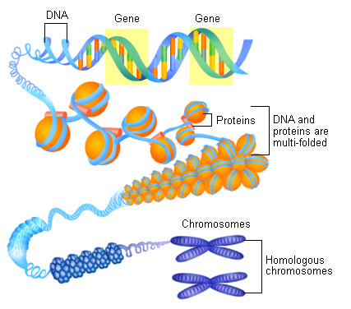
Here’s what it looks like

Slide 53
How DNA is Packaged in a Eukaryote
Heterochromatin
Euchromatin
vs
When during interphase, the centromeres and telomeres of chromosomes (as well as other chromosomal regions) in some cells exist in a highly condensed state similar to that seen in metaphase
“true chromatin”
Less compacted, more dispersed chromatin

Slide 54
Critical Thinking
Which DNA is more likely to be transcribed into RNA, heterochromatin or euchromatin?
Hint: which has DNA more accessible to transcriptional machinery, highly coiled DNA or loosely packed DNA
How can different tissues in the body utilize this property of chromatin condensation in gene regulation?

Slide 55
Most chromatin is loosely packed in the nucleus during interphase and condenses prior to mitosis
Dense packing of the heterochromatin makes it difficult for the cell to express genetic information coded in these regions
Histones can undergo chemical modifications that result in changes in chromatin organization
© 2011 Pearson Education, Inc.

Slide 56
Important Info About Histones
Histones are NOT inert spools around which DNA is wound
Histones have tails which can be chemically modified to effect chromatin organization
Example: phosphorylation of a specific amino acid on histone tails in Drosophila is necessary for proper gamete formation
Mutations in the gene that codes for the enzyme that phosphorylates the A.A. on the histone lead to sterility on the fruit flies
It is hypothesized that the sterility is due to unseccessful meiosis due to abnormal chromosome behavior when the enzyme doesn’t function properly

Slide 57
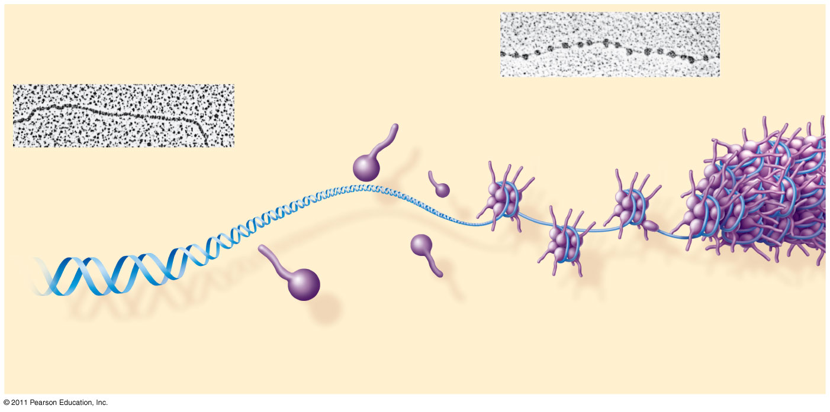
Figure 16.22a
(40 part)
Nucleosome (10 nm in diameter)
DNA double helix (2 nm in diameter)
H1
Histone tail
Histones
Nucleosomes, or “beads on a string” (10-nm fiber)
DNA, the double helix
Histones
Notes:
Figure 16.22 Exploring: Chromatin Packing in a Eukaryotic Chromosome

Slide 58
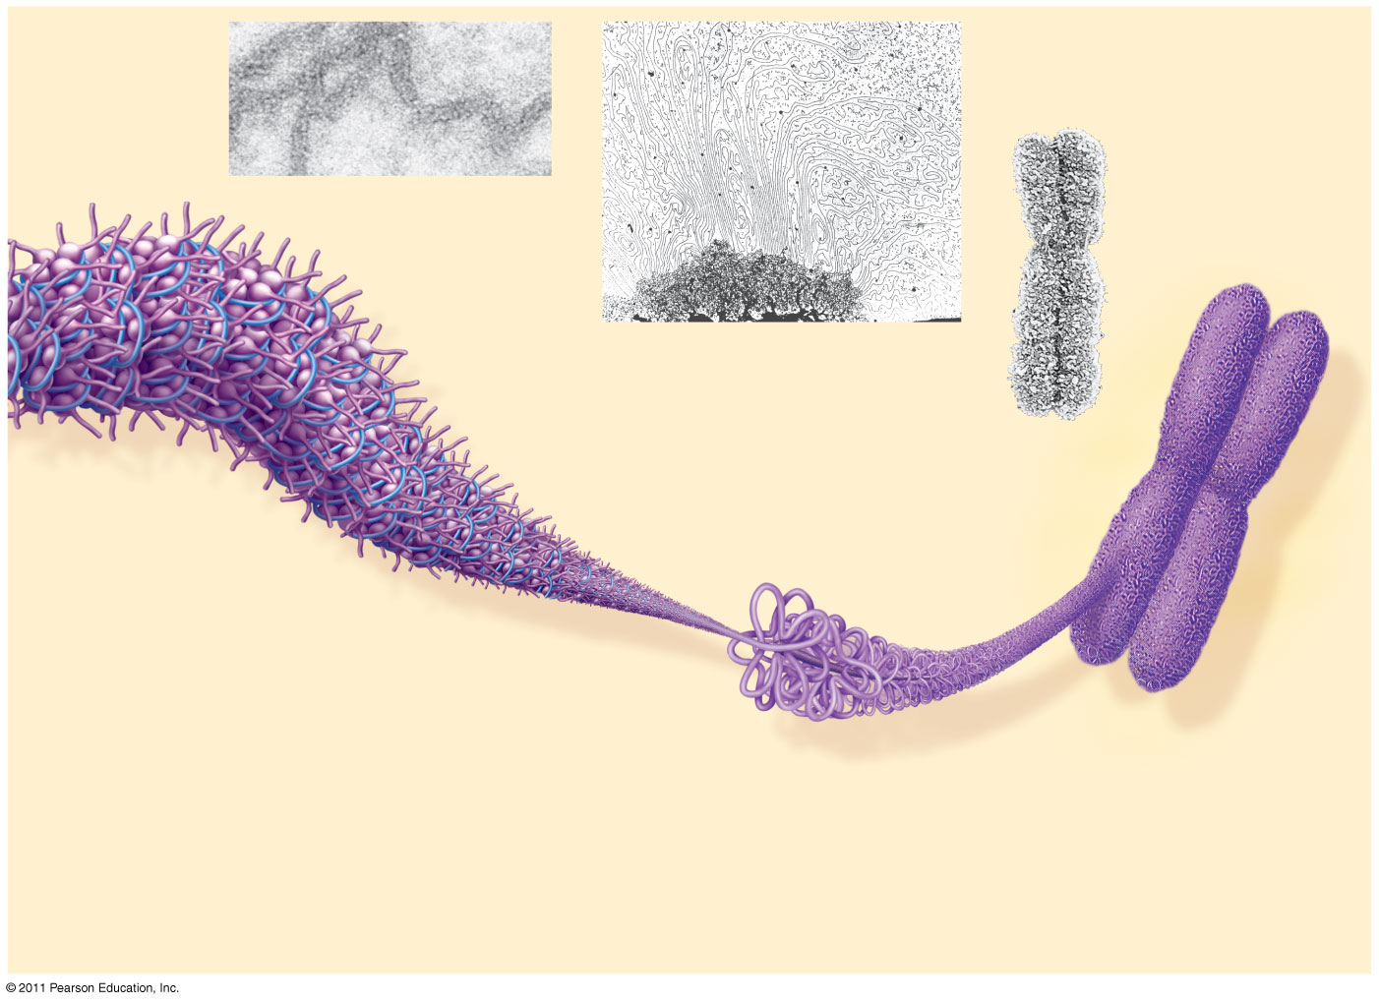
Figure 16.22b
Chromatid (700 nm)
30-nm fiber
Loops
Scaffold
300-nm fiber
30-nm fiber
(40)
Replicated chromosome (1,400 nm)
Looped domains (300-nm fiber)
Metaphase chromosome
Notes:
Figure 16.22 Exploring: Chromatin Packing in a Eukaryotic Chromosome

Slide 59
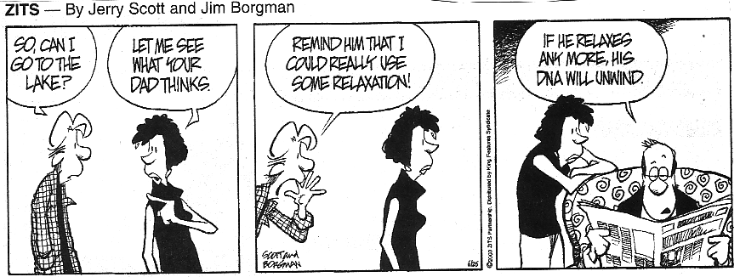
human genome project info

