Slide 1
From Gene to Protein

Slide 2
Overview: The Flow of Genetic Information
The DNA inherited by organisms leads to specific traits by dictating synthesis of proteins
The process by which DNA directs protein synthesis is called Gene Expression
Transcription
Translation
In other words, Proteins are the link between genotype & Phenotype!
We need to 1st look back and examine how the fundamental relationship between genes and proteins was discovered

Slide 3
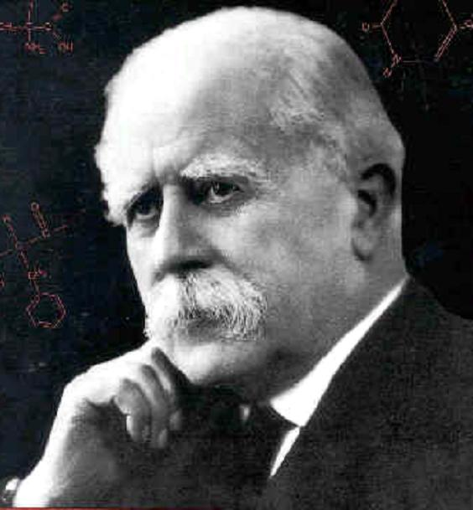
Evidence from the Study of Metabolic Defects Oh Good… More Scientists
Archibald Garrod (1902) British Physician
1st to suggest genes dictate phenotypes through enzymes that catalyze specific chemical reactions in the cell
Postulated that the symptoms of an inherited disease reflect a persons inability to make a particular enzyme
Referred to such diseases as “inborn errors of metabolism”
Linking genes to enzymes required understanding that cells synthesize and degrade molecules in a series
of steps, a metabolic pathway

Slide 4
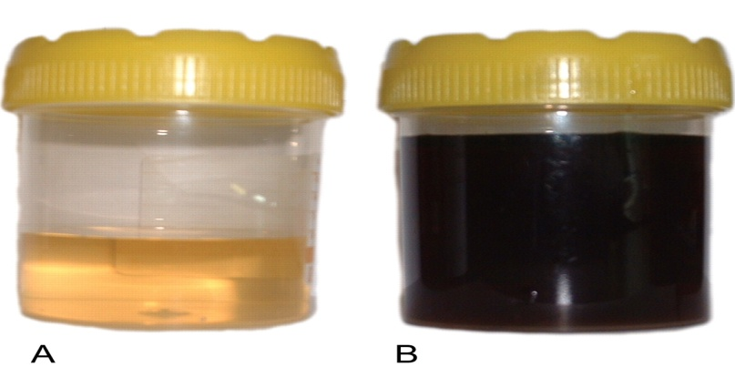
Alkaptonuria
A hereditary condition in which affected individuals produce black urine
Garrod reasoned that urine is black because it contains alkapton which darkens upon exposure to air
Most people have an enzyme which breaks down alkapton
People with alkaptonuria have inherited an inability to make the enzyme that breaks down the alkapton
Garrods Hypothesis: (alkaptonuria)
was a result of a defect in a gene for
an enzyme

Slide 5
Nutritional Mutants in Neurospora
George Beadle & Edward Tatum worked with bread mold Neurospora crassa
Experiment:
Bombard mold with x-rays and screen survivors for mutants that differ in nutritional needs
Wild type neurospora can survive on a minimal medium consisting of agar media containing only salts, glucose and a vitamin biotin
Mutant neurospora could no longer survive on this minimal media, but could survive only on media containing amino acids,a.k.a. a complete medium

Slide 6
Nutritional Mutants in Neurospora
Beadle & Tatum hypothesized that normal neurospora could synthesize the 20 amino acids they needed from the minimal media, while the mutants lacked the ability to synthesize the amino acids and so had to be supplied with them
To characterize the metabolic defect of each nutritional mutant, Beadle & Tatum took samples from the mutant growing on the complete medium and grew it on the minimal medium and a single additional nutrient

Slide 7
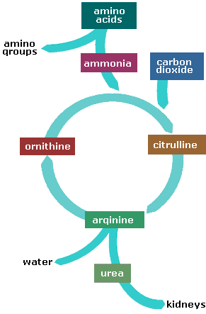
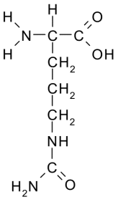
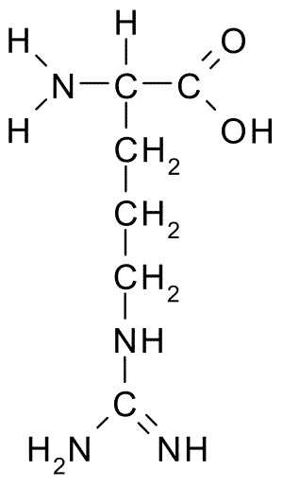
ARGININE SYNTHESIS: Before looking at experiment you need to understand the pathway used to make arginine from minimal media
Some type of precursor nutrient
Ornithine
Citrulline
Arginine
Enzyme A converts precursor into ornithine
Enzyme B converts ornithine into citrulline
Enzyme C converts citrulline into arginine

Slide 8
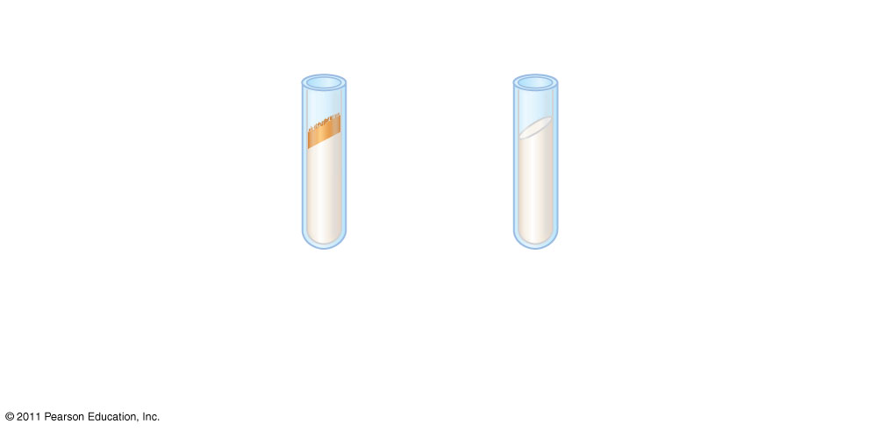
Figure 17.2a
EXPERIMENT
Growth: Wild-type cells growing and dividing
No growth: Mutant cells cannot grow and divide
Minimal medium
Notes:
Figure 17.2 Inquiry: Do individual genes specify the enzymes that function in a biochemical pathway?

Slide 9
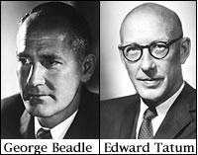
3 Classes of Arginine Neurospora Mutants
Beadle & Tatums work with arginine Neurospora mutants indicated the could be classified into 3 categories of mutants
Each class of mutant had a different mutated gene

Slide 10
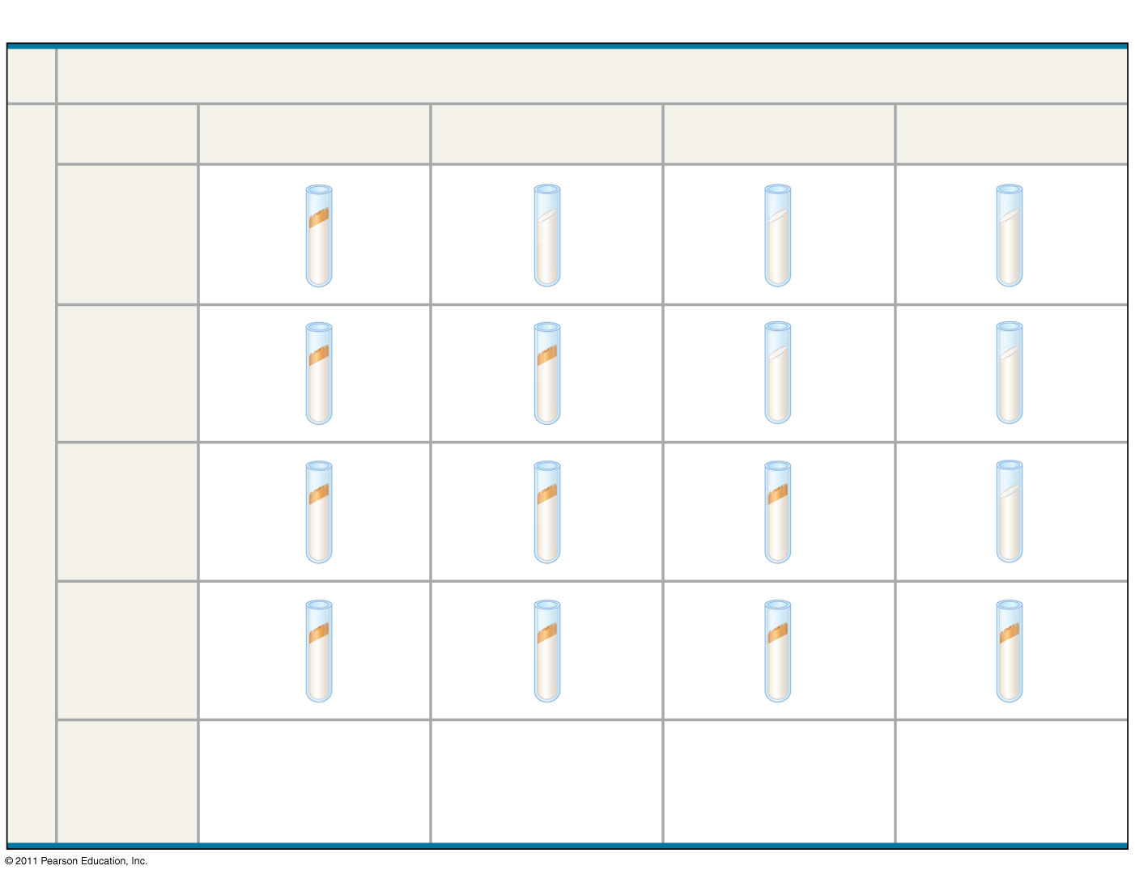
Figure 17.2b
RESULTS
Classes of Neurospora crassa
Wild type
Class I mutants
Class II mutants
Class III mutants
Minimal medium (MM)
(control)
Growth
No growth
MM + ornithine
Condition
MM + citrulline
MM + arginine (control)
Can grow with or without any supplements
Can grow on ornithine, citrulline, or arginine
Can grow only on citrulline or arginine
Require arginine to grow
Summary of results
Notes:
Figure 17.2 Inquiry: Do individual genes specify the enzymes that function in a biochemical pathway?

Slide 11
Nutritional Mutants in Neurospora
The individual nutrient that allowed growth was indicative of the metabolic defect
For example; if the only sample that supported growth was the one containing arginine, the researchers could conclude that the mutant was defective in the pathway that wild type cells use to synthesize arginine
Beadle & Tatum didn’t stop there, they went on to characterize each mutants defect more specifically

Slide 12
3 Classes of Arginine Mutants
These 3 classes of mutants must be blocked at different steps of the pathway!
It is reasonable to assume that each mutant class lacks a functional enzyme to catalyze the next step of the pathway
So which enzyme do each class of mutant probably not have?

Slide 13
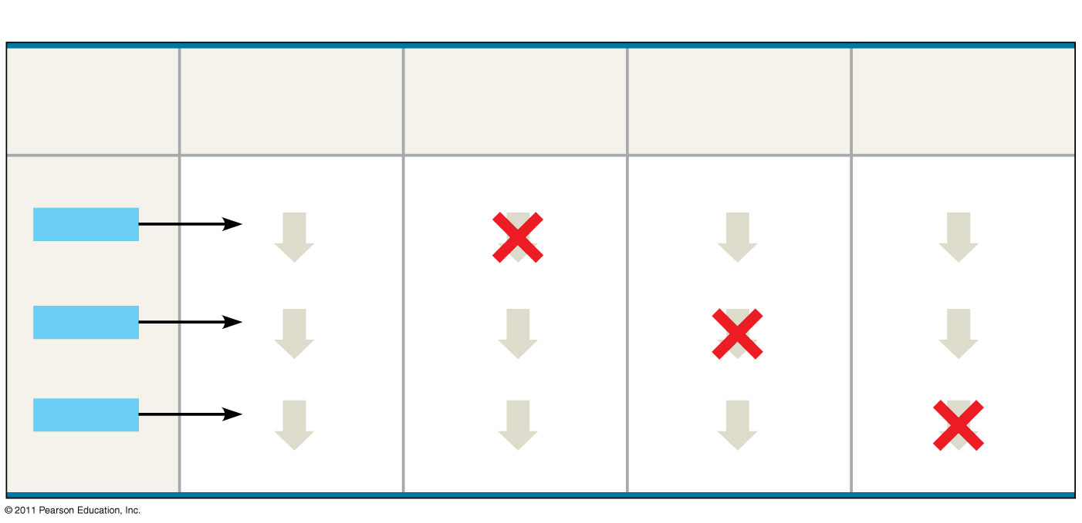
Figure 17.2c
CONCLUSION
Gene (codes for enzyme)
Class I mutants (mutation in gene A)
Class II mutants (mutation in gene B)
Class III mutants (mutation in gene C)
Wild type
Precursor
Precursor
Precursor
Precursor
Gene A
Enzyme A
Enzyme A
Enzyme A
Enzyme A
Ornithine
Ornithine
Ornithine
Ornithine
Gene B
Enzyme B
Enzyme B
Enzyme B
Enzyme B
Citrulline
Citrulline
Citrulline
Citrulline
Gene C
Enzyme C
Enzyme C
Enzyme C
Enzyme C
Arginine
Arginine
Arginine
Arginine
Notes:
Figure 17.2 Inquiry: Do individual genes specify the enzymes that function in a biochemical pathway?

Slide 14
3 Classes of Arginine Mutants
Class 1 can grow on media containing
Arginine
Citrulline
Ornithine
Class 2 can grow on media containing
Arginine
Citrulline
Class 3 can grow only on media containing arginine

Slide 15
1 Gene = 1 Enzyme Hypothesis
Because each enzyme was defective in a single gene, Beadle & Tatums results provided strong support for the 1 gene= 1 Enzyme hypothesis
This basically means that each gene dictates the production of a single individual enzyme

Slide 16
REVIEW: Nutritional Mutants in Neurospora: Scientific Inquiry
George Beadle and Edward Tatum exposed bread mold to X-rays, creating mutants that were unable to survive on minimal media
Using crosses, they and their coworkers identified three classes of arginine-deficient mutants, each lacking a different enzyme necessary for synthesizing arginine
They developed a one gene–one enzyme hypothesis, which states that each gene dictates production of a specific enzyme
© 2011 Pearson Education, Inc.
Notes:
16

Slide 17
The Products of Gene Expression: A Developing Story
Some proteins aren’t enzymes, so researchers later revised the hypothesis: one gene–one protein
Many proteins are composed of several polypeptides, each of which has its own gene
Therefore, Beadle and Tatum’s hypothesis is now restated as the one gene–one polypeptide hypothesis
Genes control phenotypes through the action of proteins is another contribution of their work
© 2011 Pearson Education, Inc.
Notes:
17

Slide 18
Basic Principles of Transcription and Translation
RNA is the bridge between genes and the proteins for which they code
Transcription is the synthesis of RNA under the direction of DNA (DNA to mRNA in nucleus)
Transcription produces messenger RNA (mRNA)
Translation is the synthesis of a polypeptide, using information in the mRNA (mRNA to protein)
Ribosomes are the sites of translation
© 2011 Pearson Education, Inc.
Notes:
18

Slide 19
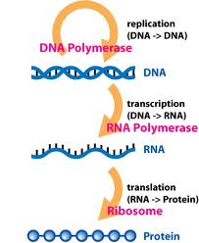
Central Dogma
The central dogma in biology for many years was :
DNA → RNA → protein
It has been modified since due to new discoveries, but it basically remains the same

Slide 20
Basic Principles of Transcription & Translation
Transcription
Translation
The synthesis of a complementary strand of RNA under the direction of DNA template
Same language as DNA → nucleotides
Occurs in the nucleus
The synthesis of an amino acid chain (polypeptide) under the direction of RNA
Change in language → from nucleotides to amino acids
Occurs outside of the nucleus on a ribosome
Secretory proteins are transcribed on ribosomes attached to the ER
Proteins for internal cell use are transcribed on free ribosomes

Slide 21
Why do we need an RNA intermediate?
In other words, why can’t we just use DNA as the template to build a polypeptide
Using RNA provides protection for DNA
Using an RNA intermediate allows for more then one polypeptide to be synthesized at once

Slide 22
A primary transcript is the initial RNA transcript from any gene prior to processing, the mRNA will be modified before it leaves the nucleus to go to ribosome for translation.
The central dogma is the concept that cells are governed by a cellular chain of command: DNA → RNA → protein
DNA
RNA
Protein
© 2011 Pearson Education, Inc.
Notes:
22

Slide 23
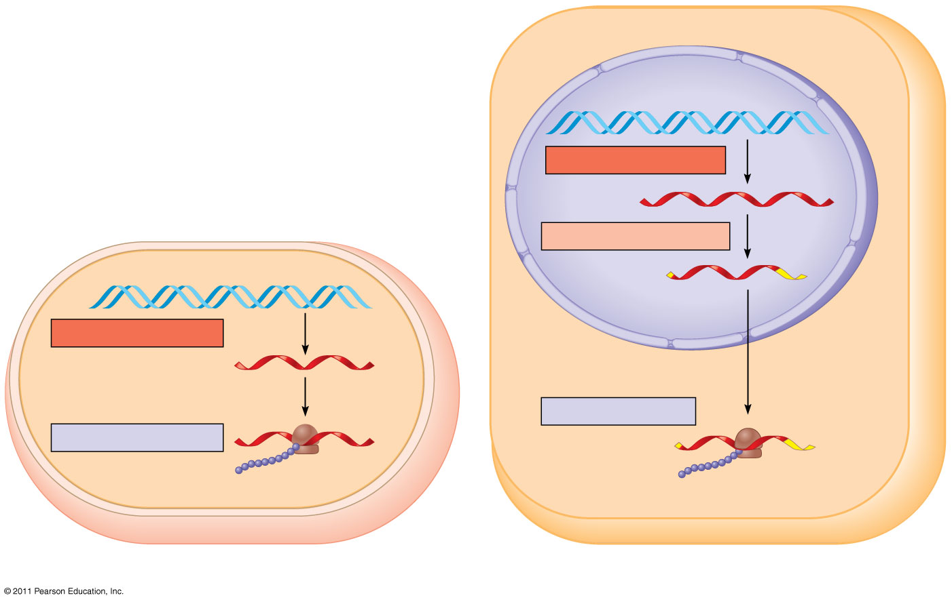
Figure 17.3
Nuclear envelope
TRANSCRIPTION
DNA
RNA PROCESSING
Pre-mRNA
mRNA
TRANSCRIPTION
DNA
mRNA
Ribosome
TRANSLATION
Ribosome
TRANSLATION
Polypeptide
Polypeptide
(a) Bacterial cell
(b) Eukaryotic cell
Notes:
Figure 17.3 Overview: the roles of transcription and translation in the flow of genetic information.

Slide 24
Transcription Overview
DNA is transcribed into pre-messenger RNA by RNA Polymerase in the nucleus
Initiation
Elongation
Termination
This pre-mRNA undergoes RNA processing yielding a finished mRNA
This primary transcript is now ready to leave the nucleus and undergo translation

Slide 25
The Genetic Code
How are the instructions for assembling amino acids into proteins encoded into DNA?
There are 20 amino acids, but there are only four nucleotide bases in DNA
© 2011 Pearson Education, Inc.
Notes:
25

Slide 26
Codons: Triplets of Nucleotides
How many nucleotides correspond to an amino acid?
The flow of information from gene to protein is based on a triplet code: a series of nonoverlapping, three-nucleotide words.
The words of a gene are transcribed into complementary nonoverlaping three-nucleotide words of mRNA
These words are then translated into a chain of amino acids, forming a polypeptide
© 2011 Pearson Education, Inc.
Notes:
26

Slide 27
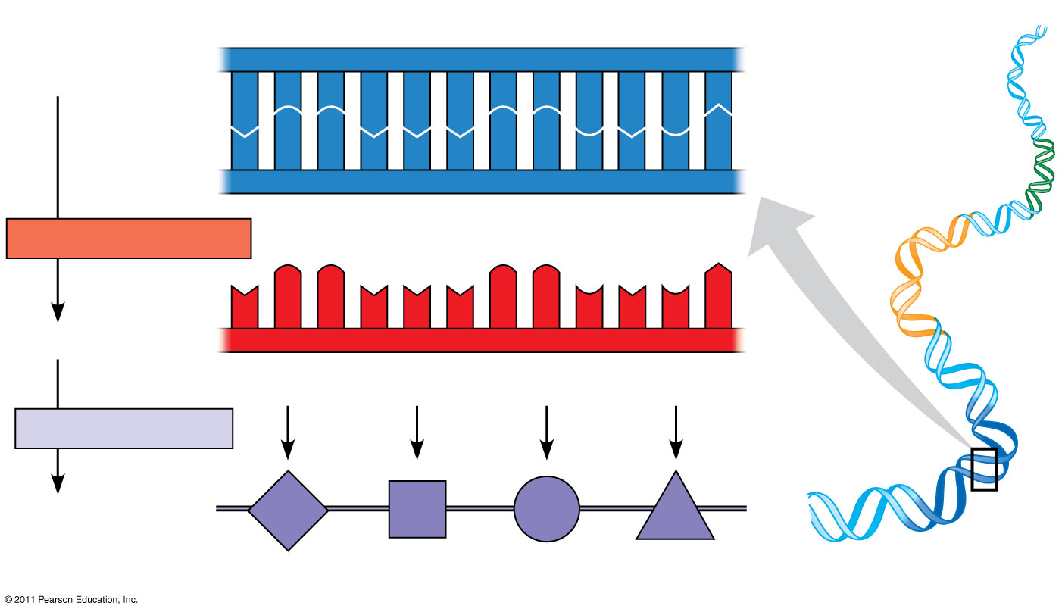
Figure 17.4
Template=non coding strand
Nontemplate=coding strand (20)
DNA template strand
3′
5′
DNA
A
C
C
A
A
A
C
C
G
A
G
T
molecule
T
G
G
T
T
T
G
G
C
T
C
A
Gene 1
5′
3′
TRANSCRIPTION
Gene 2
U
G
G
U
U
U
G
G
C
U
C
A
5′
3′
mRNA
Codon
TRANSLATION
Protein
Trp
Phe
Gly
Ser
Gene 3
Amino acid
Notes:
Figure 17.4 The triplet code.

Slide 28
The Genetic Code
If each arrangement of 3 consecutive bases specifies one amino acid, it is possible to specify up to 64 amino acids (4³)
There are only 20 amino acids, so this immediately indicates that there must be some redundancy within the code
This is an important safety that helps us survive mutations in our DNA!

Slide 29
Codons & Amino Acids
Each nucleotide triplet is called a codon, and each codon specifies only 1 amino acid
Obviously, each amino acid may be specified by more than one codon
Remember, this redundancy is important in our ability to survive DNA mutations
This means that a polypeptide containing 100 amino acids must have a minimum of how many nucleotides?

Slide 30
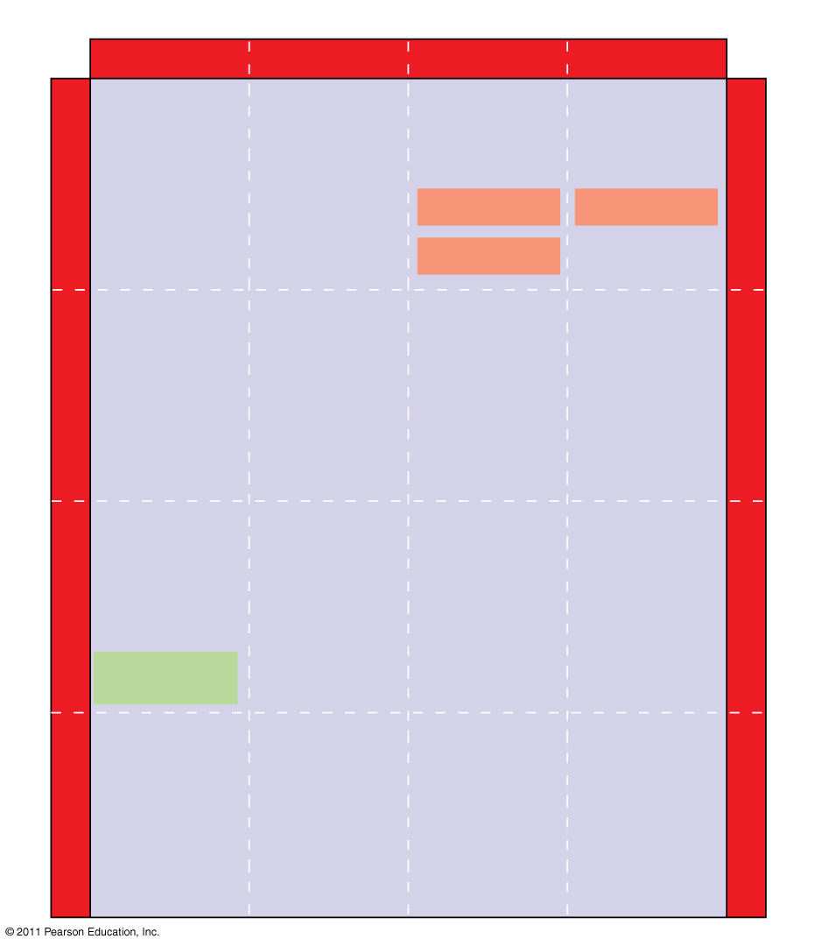
Figure 17.5
Second mRNA base
U
C
A
G
UUU
UCU
UAU
UGU
U
Phe
Tyr
Cys
U
UUC
UCC
UAC
UGC
C
Ser
UUA
UCA
UAA Stop
UGA Stop
A
Leu
UUG
UCG
UAG Stop
UGG
Trp
G
CUU
CCU
CAU
CGU
U
His
C
CUC
CCC
CAC
CGC
C
Leu
Pro
Arg
CUA
CCA
CAA
CGA
A
Gln
CUG
CCG
CAG
CGG
G
First mRNA base (5′ end of codon)
Third mRNA base (3′ end of codon)
AUU
ACU
AAU
AGU
U
Asn
Ser
A
AUC
Ile
ACC
AAC
AGC
C
Thr
AUA
ACA
AAA
AGA
A
Lys
Arg
AUG
Met or start
ACG
AAG
AGG
G
GUU
GCU
GAU
GGU
U
Asp
G
GUC
GCC
GAC
GGC
C
Val
Ala
Gly
Gly
GUA
GCA
GAA
GGA
A
Glu
GUG
GCG
GAG
GGG
G
Notes:
Figure 17.5 The codon table for mRNA.

Slide 31
Evolution of the Genetic Code
The genetic code refers to the “code” of 1 codon specifying 1 amino acid
This genetic code thus far appears to be shared universally among all life forms, from bacteria to mammals
Slight variations exist in organelle genes and in some unicellular eukaryotes
“A shared genetic vocabulary is a reminder of the kinship that bonds life on Earth”

Slide 32
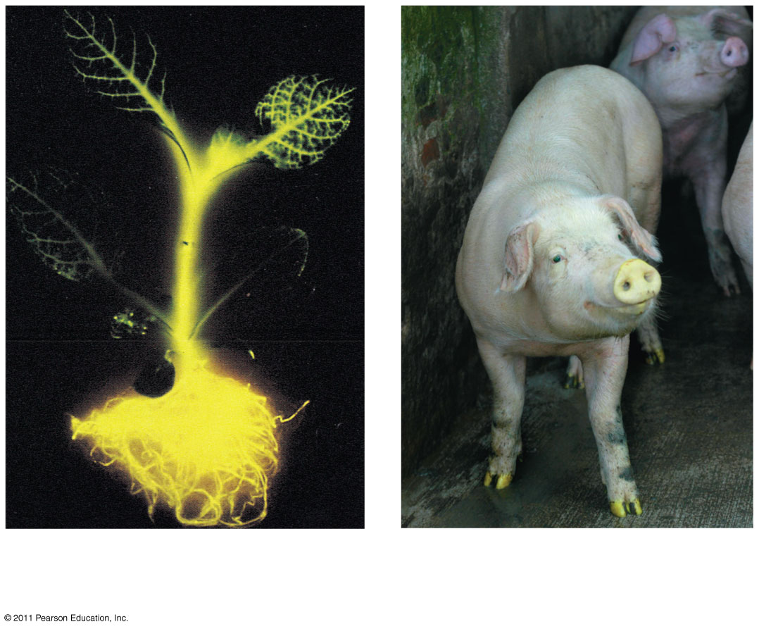
Evolution of the Genetic Code
The genetic code is nearly universal, shared by the simplest bacteria to the most complex animals
Genes can be transcribed and translated after being transplanted from one species to another
Firefly and jellyfish
© 2011 Pearson Education, Inc.
Notes:
32

Slide 33
Cracking the Code
Marshall Nirenburg of the NIH began cracking the genetic code in the early 1960’s
He synthesized an artificial mRNA consisting only of uracil, this way, no matter where translation began it would only have one reading option UUUUUUU…
He then put this in an artificial system designed to undergo translation and what he found was a polypeptide composed solely of the amino acid phenylalanine

Slide 34
Methionine
The codon AUG codes for the amino acid methionine
AUG is known as the start codon, and thus methionine is at the beginning of every polypeptide synthesized
That is not to say that every finished protein has methionine as its 1st amino acid, methionine may be excised later during protein finishing

Slide 35
Molecular Components of Transcription
Transcription is the first stage of gene expression
RNA synthesis is catalyzed by RNA polymerase, which pries the DNA strands apart and hooks together the RNA nucleotides without a primer
RNA Polymerase does NOT need a primer and can start an existing strand from scratch
The RNA is complementary to the DNA template strand
RNA synthesis follows the same base-pairing rules as DNA, except that uracil substitutes for thymine
© 2011 Pearson Education, Inc.
Notes:
35

Slide 36
The DNA sequence where RNA polymerase attaches is called the promoter; in bacteria, the sequence signaling the end of transcription is called the terminator
The stretch of DNA that is transcribed is called a transcription unit
© 2011 Pearson Education, Inc.
Notes:
36

Slide 37
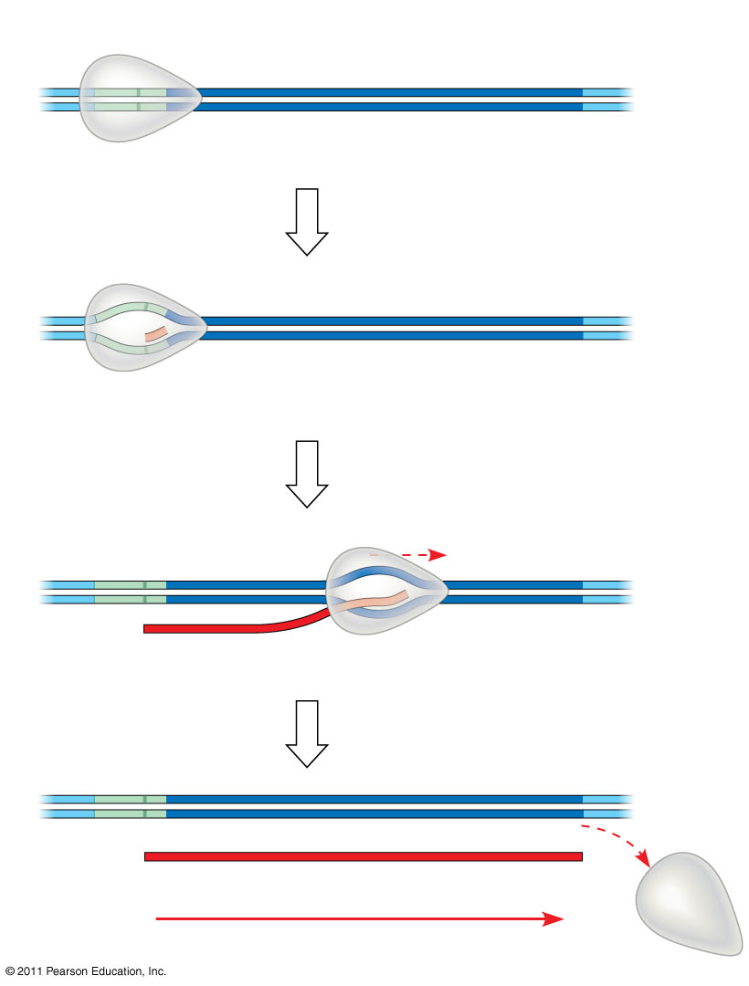
Figure 17.7-4
Promoter
Transcription unit
5′
3′
3′
DNA
5′
Start point
RNA polymerase
1
Initiation
(34)
Nontemplate strand of DNA
5′
3′
3′
5′
RNA transcript
Template strand of DNA
Unwound DNA
2
Elongation
Rewound DNA
5′
3′
3′
3′
5′
5′
RNA transcript
3
Termination
5′
3′
3′
5′
5′
Completed RNA transcript
3′
Direction of transcription (“downstream”)
Notes:
Figure 17.7 The stages of transcription: initiation, elongation, and termination.

Slide 38
Special Sequences in DNA
Promoter: this is a sequence of DNA recognized by RNA Polymerase, marking where the gene begins
This is the site where RNA Polymerase actually attaches and initiates transcription
Terminator (prokaryotes only!) is a sequence that signals the end of transcription

Slide 39
Lingo
Downstream
Upstream
The direction of transcription is said to be downstream
The direction opposite of transcription is said to be upstream
So is the promoter upstream or downstream of the terminator?
Transcription Unit: the entire stretch of DNA that is transcribed is called the transcription unit

Slide 40
Transcription is Divided into 3 Stages
Initiation
RNA Polymerase recognizes and binds to promoter
Elongation
Termination
Stages of Transcription Animation

Slide 41
RNA Polymerase Binding and Initiation of Transcription
Promoters signal the transcriptional start point and usually extend several dozen nucleotide pairs upstream of the start point
Transcription factors mediate the binding of RNA polymerase and the initiation of transcription
The completed assembly of transcription factors and RNA polymerase II bound to a promoter is called a transcription initiation complex
A promoter called a TATA box is crucial in forming the initiation complex in eukaryotes
© 2011 Pearson Education, Inc.
Notes:
41

Slide 42
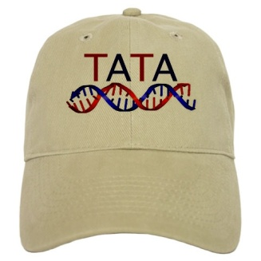
Eukaryotes & the TATA Box
Eukaryotic promoters often include a TATA box, which is the nucleotide sequence TATA located about 25 nucleotides upstream of the transcriptional start point
There are several TF’s that must bind to the DNA in order for RNA polymerase to bind, one of these TF’s has a binding site for the TATA box

Slide 43
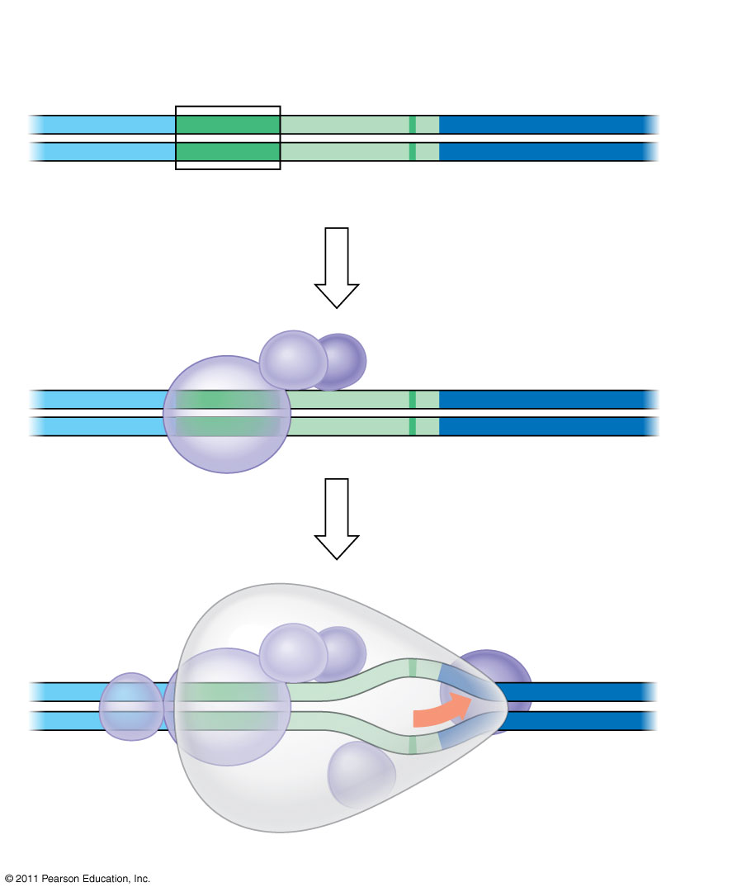
Figure 17.8
1
A eukaryotic promoter
Promoter
Nontemplate strand
DNA
5′
T
A
T
A
A
A
A
3′
3′
A
T
A
T
T
T
T
5′
TATA box
Start point
Template strand
(37-38)
2
Several transcription factors bind to DNA
Transcription factors
5′
3′
3′
5′
3
Transcription initiation complex forms
RNA polymerase II
Transcription factors
5′
3′
3′
3′
5′
5′
RNA transcript
Transcription initiation complex
Notes:
Figure 17.8 The initiation of transcription at a eukaryotic promoter.

Slide 44
Elongation of the RNA Strand
As RNA polymerase moves along the DNA, it untwists the double helix, 10 to 20 bases at a time
Transcription progresses at a rate of 40 nucleotides per second in eukaryotes
A gene can be transcribed simultaneously by several RNA polymerases
Nucleotides are added to the 3′ end of the growing RNA molecule
© 2011 Pearson Education, Inc.
Notes:
44

Slide 45
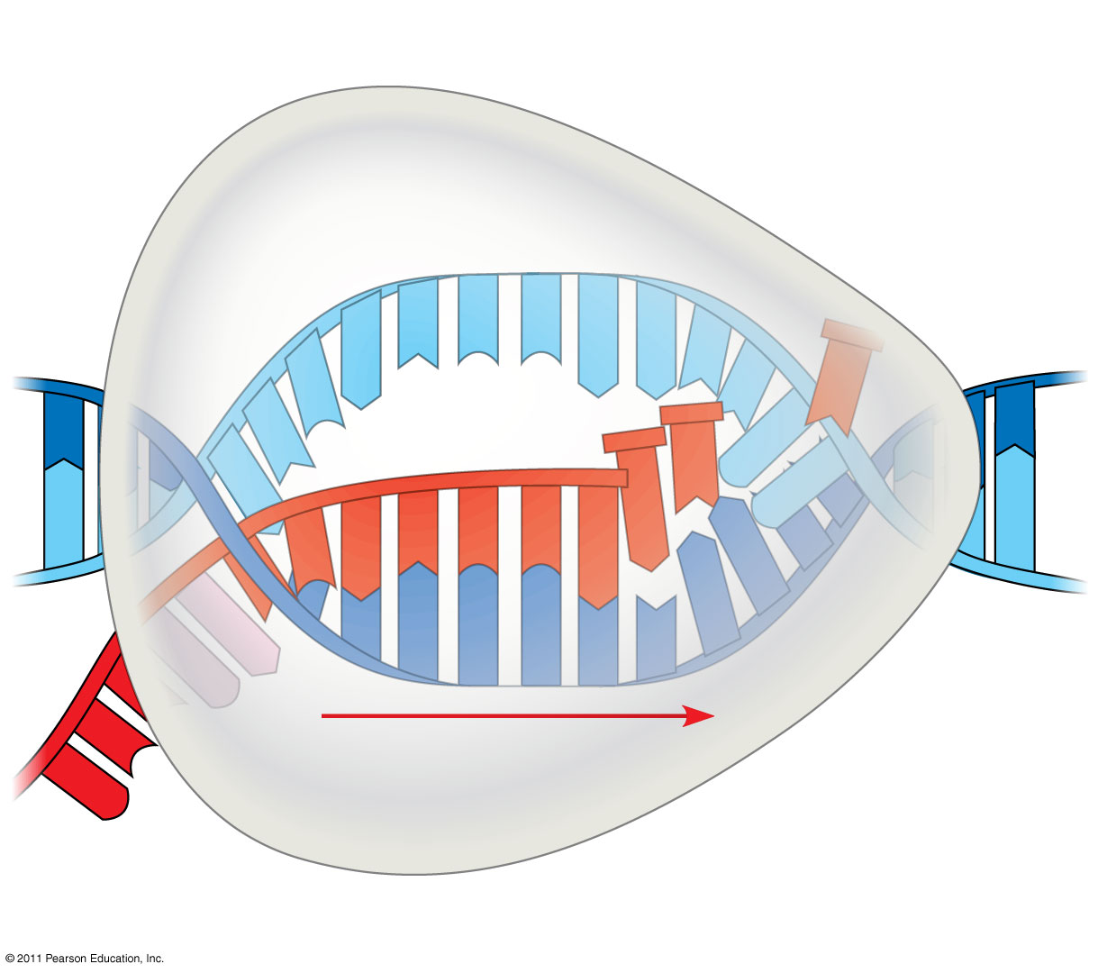
Figure 17.9
Nontemplate strand of DNA
RNA nucleotides
RNA polymerase
A
T
C
C
A
A
3′
T
5′
C
T
U
3′
end
G
T
A
U
G
A
C
C
A
U
C
C
A
C
A
5′
A
3′
T
A
G
G
T
T
5′
Direction of transcription
Template strand of DNA
Newly made RNA
Notes:
Figure 17.9 Transcription elongation.

Slide 46
Elongation
As RNA Polymerase travels down the DNA strand it continues untwisting the DNA and adding nucleotides to the 3’end of a growing nucleotide chain
Unlike DNA replication where the newly synthesized daughter DNA stays associated with the parent DNA strand, the RNA disassociates immediately after the covalent linkage between sugars is made, and DNA reassociates back into its double helix
Transcription progresses at a rate of about 60 nucleotides / second

Slide 47
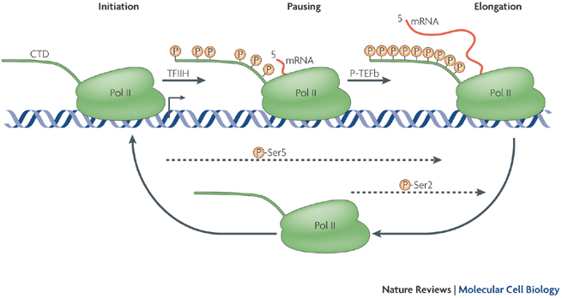
Elongation
A single gene can be transcribed simultaneously by several RNA Polymerases following each other one after another
Transcription Animation

Slide 48
Termination of Transcription
The mechanisms of termination are different in bacteria and eukaryotes
In bacteria, the polymerase stops transcription at the end of the terminator and the mRNA can be translated without further modification
In eukaryotes, RNA polymerase II transcribes the polyadenylation signal sequence; the RNA transcript is released 10–35 nucleotides past this polyadenylation sequence
© 2011 Pearson Education, Inc.
Notes:
48

Slide 49
Termination
Prokaryotes
Eukaryotes
Transcription proceeds until RNA Polymerase reads a terminator sequence in the DNA causing it to detach from the DNA molecule
There is no prokaryotic pre-mRNA, mRNA is available for immediate use by the cell and can actually begin translation while it is still being transcribed!
RNA Polymerase transcribes a polyadenylation signal sequence (AAUAAA)
At about 10-35 nucleotides past this sequence, an enzyme comes and cuts loose the pre-mRNA
RNA Polymerase will continue transcribing perhaps hundreds of nucleotides past the end of the gene until it falls off

Slide 50
Concept 17.3: Eukaryotic cells modify RNA after transcription
Enzymes in the eukaryotic nucleus modify pre-mRNA (RNA processing) before the genetic messages are dispatched to the cytoplasm
During RNA processing, both ends of the primary transcript are usually altered
Also, usually some interior parts of the molecule are cut out, and the other parts spliced together
© 2011 Pearson Education, Inc.
Notes:
50

Slide 51
Alteration of mRNA Ends
Each end of a pre-mRNA molecule is modified in a particular way
The 5′ end receives a modified nucleotide 5′ cap
The 3′ end gets a poly-A tail
These modifications share several functions
They seem to facilitate the export of mRNA
They protect mRNA from hydrolytic enzymes
They help ribosomes attach to the 5′ end
© 2011 Pearson Education, Inc.
Notes:
51

Slide 52
Figure 17.10
Protein-coding segment
Polyadenylation signal
5′
3′
G
P
P
P
AAUAAA
AAA
…
AAA
Cap
5′
Start codon
Stop codon
5′
UTR
3′
UTR
Poly-A tail
Notes:
Figure 17.10 RNA processing: Addition of the 5′ cap and poly-A tail.

Slide 53
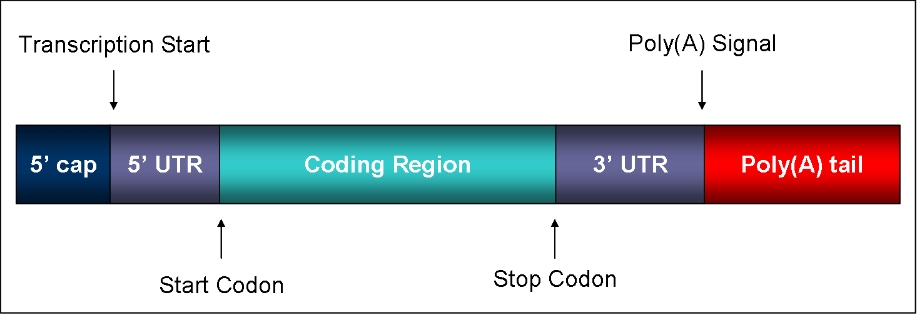
UTR’s
UTR’s are parts of the mRNA that will not be translated into protein, but have other necessary functions such as ribosome binding

Slide 54
Split Genes and RNA Splicing
Most eukaryotic genes and their RNA transcripts have long noncoding stretches of nucleotides that lie between coding regions
These noncoding regions are called intervening sequences, or introns
The other regions are called exons because they are eventually expressed, usually translated into amino acid sequences
RNA splicing removes introns and joins exons, creating an mRNA molecule with a continuous coding sequence
© 2011 Pearson Education, Inc.
Notes:
54

Slide 55
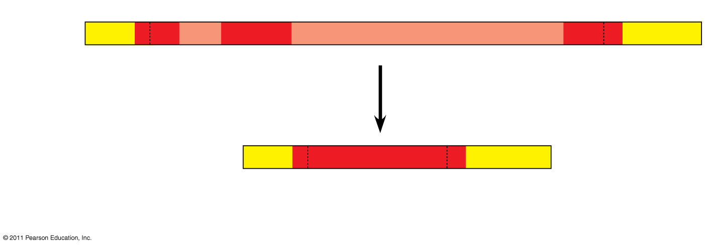
Figure 17.11
(43)
5′
Exon Intron
Exon
Intron
Exon
3′
Pre-mRNA Codon numbers
5′
Cap
Poly-A tail
1−30
31−104
105− 146
Introns cut out and exons spliced together
mRNA
5′
Cap
Poly-A tail
1−146
5′
UTR
3′
UTR
Coding segment
Notes:
Figure 17.11 RNA processing: RNA splicing.

Slide 56
In some cases, RNA splicing is carried out by spliceosomes
Spliceosomes are located in the nucleus
Spliceosomes consist of a variety of proteins and several small nuclear ribonucleoproteins (snRNPs) that recognize the splice sites
Snurps are composed of RNA and protein and recognize short sequences at the end of each intron that needs to be spliced.
© 2011 Pearson Education, Inc.
Notes:
56

Slide 57
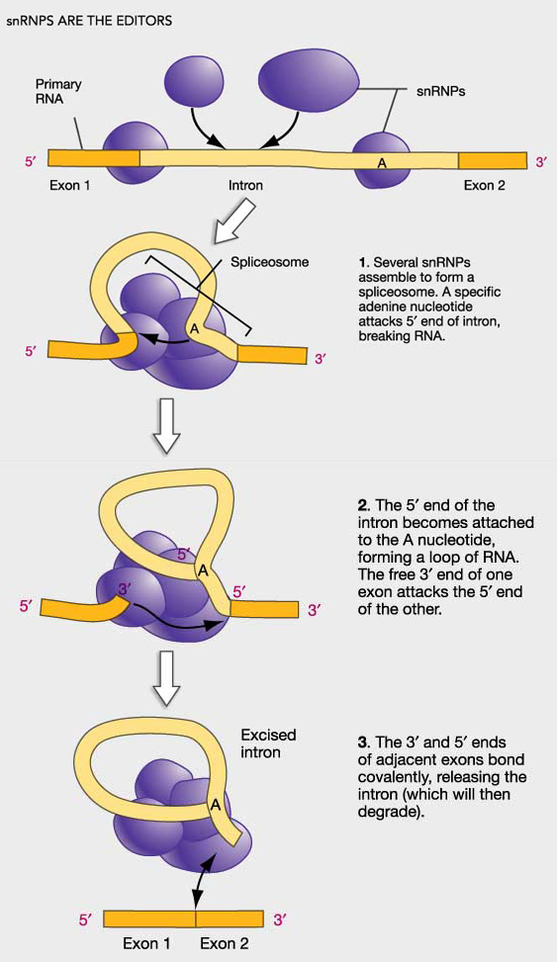
Spliceosome
Several different snRNP’s join with other proteins to form a spliceosome
Spliceosomes are almost as large as a ribosome
The spliceosome interacts with the RNA cutting out the introns and splicing together the exons
Splicing Animation
Spliceosome Animation

Slide 58
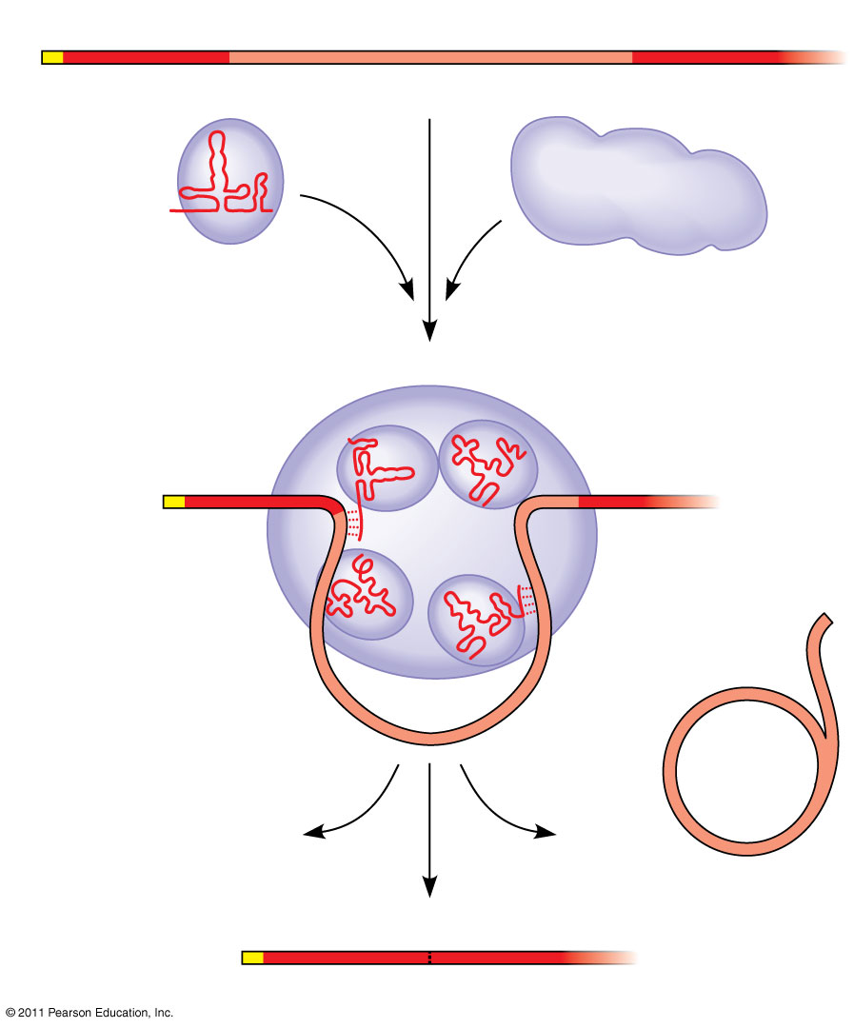
Figure 17.12-3
RNA transcript (pre-mRNA)
5′
Exon 1
Intron
Exon 2
Protein
Other proteins
snRNA
(47)
snRNPs
Spliceosome
5′
Spliceosome components
Cut-out intron
mRNA
5′
Exon 1
Exon 2
Notes:
Figure 17.12 The roles of snRNPs and spliceosomes in pre-mRNA splicing.

Slide 59
Ribozymes
Ribozymes are catalytic RNA molecules that function as enzymes and can splice RNA
The discovery of ribozymes rendered obsolete the belief that all biological catalysts were proteins
In some species, there is no need for protein or even additional RNA molecules, the intron within the mRNA catalyzes its own excision!
© 2011 Pearson Education, Inc.
Notes:
59

Slide 60
Ribozyme Mechanism
Because RNA is single stranded, one portion of an RNA molecule can base pair with another complementary portion of the same molecule
Some of the bases contain functional groups that may participate in catalysis
So… Not all biological catalysts are proteins after all!

Slide 61
Three properties of RNA enable it to function as an enzyme
It can form a three-dimensional structure because of its ability to base-pair with itself
Some bases in RNA contain functional groups that may participate in catalysis
RNA may hydrogen-bond with other nucleic acid molecules
© 2011 Pearson Education, Inc.
Notes:
61

Slide 62
The Functional and Evolutionary Importance of Introns
Some introns contain sequences that may regulate gene expression
Some genes can encode more than one kind of polypeptide, depending on which segments are treated as exons during splicing
This is called alternative RNA splicing
Consequently, the number of different proteins an organism can produce is much greater than its number of genes
© 2011 Pearson Education, Inc.
Notes:
62

Slide 63
Alternative Splicing
A single gene can, in fact, code for more than one polypeptide, depending on which segments are treated as introns and which are treated as exons
Example: the differences between a male and female fruit fly are due mainly to alternative splicing of the same genes
Alternative splicing also provides a possible answer to why we humans get along as well as we do with such little genetic information (we really only have about double that of a fruit fly)

Slide 64
Proteins often have a modular architecture consisting of discrete regions called domains
In many cases, different exons code for the different domains in a protein
Exon shuffling may result in the evolution of new proteins
© 2011 Pearson Education, Inc.
Notes:
64

Slide 65
Exon Shuffling
The presence of introns in a gene may facilitate the evolution of new and potentially useful proteins by increasing the probability of crossing over between the exons of different alleles!
Exon shuffling could lead to new proteins with novel combinations of functions (or it could lead to a completely nonfunctional product, and then you die ☹
http://highered.mcgraw-hill.com/sites/9834092339/student_view0/chapter16/animation_-_exon_shuffling.html

Slide 66
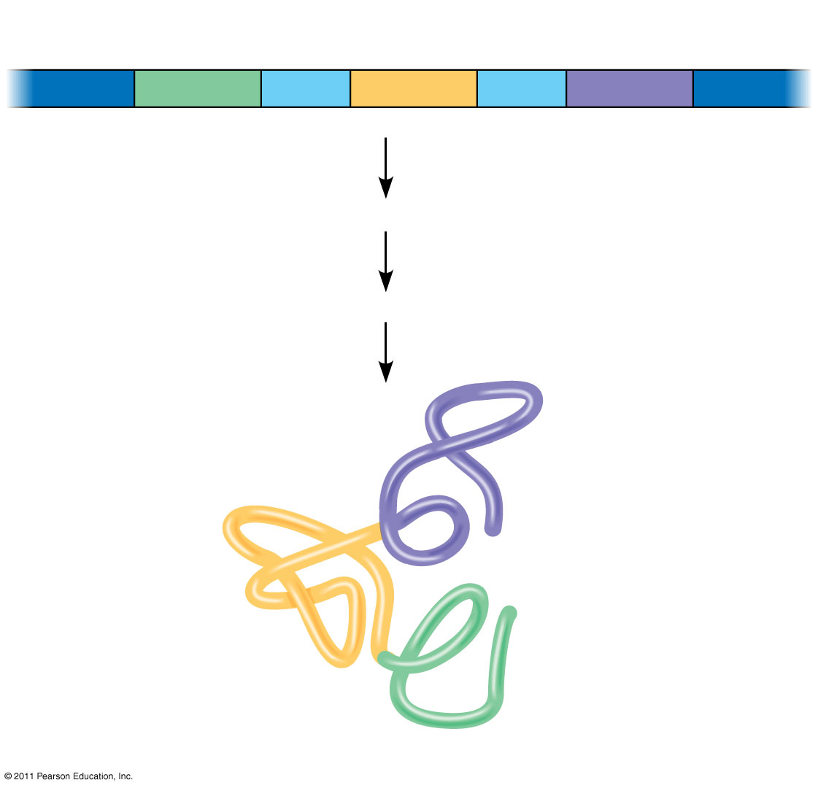
Figure 17.13
Gene
DNA
Exon 1
Intron
Exon 2
Intron
Exon 3
Transcription
RNA processing
Translation
Domain 3
Domain 2
Domain 1
Polypeptide
Notes:
Figure 17.13 Correspondence between exons and protein domains.

