Slide 1
Phylogeny & Systematics

Slide 2
Phylogeny
Phylon = tribe,
geny = genesis or origin
The evolutionary history of a species or a group of related species.

Slide 3
Investigating the Tree of Life
Phylogeny: the evolutionary history of a species or group of species
Systematics: an analytical approach to understanding the diversity and relationships of organisms
Traditionally studies morphological and biochemical resemblances among organisms as a basis for inferring evolutionary relationships
Molecular systematics: uses comparisons in DNA, RNA, and other biomolecules to infer evolutionary relationships
Individual genes
Entire genomes

Slide 4
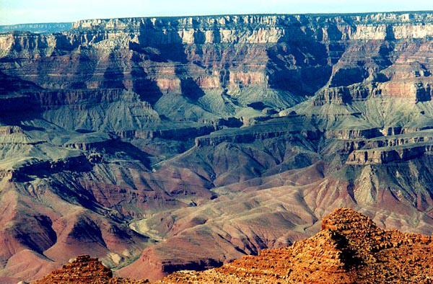
Phylogenies are Based on Common Ancestries
Ancestries are inferred from fossil, morphological, and molecular evidence
Fossil Record
Sedimentary rocks are richest source of fossils
Fossils found in lower layers are older then fossils found higher up in the newly formed layers

Slide 5
Fossil Dating Methods
1. Relative - by a fossil's position in the strata relative to index fossils.
2. Absolute - approximate age on a scale of absolute time.

Slide 6
Absolute - Methods
1. Radioactive
2. Isomer Ratios

Slide 7
Radioactive
Estimated from half-life products in the fossil.
Ex: Carbon – 14
https://www.youtube.com/watch?v=udkQwW6aLik&feature=related
Potassium – 40
See p 424

Slide 8
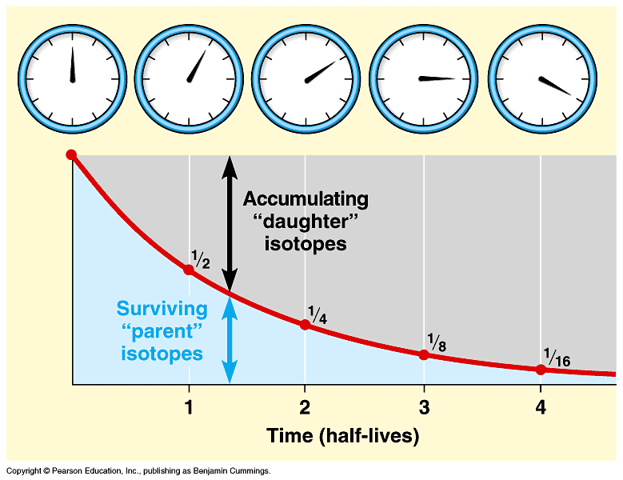

Slide 9
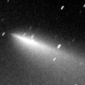
Mass Extinctions
The sudden loss of many species in geologic time.
May be caused by asteroid hits or other disasters.

Slide 10
Examples
Permian Extinction
Cretaceous Extinction

Slide 11
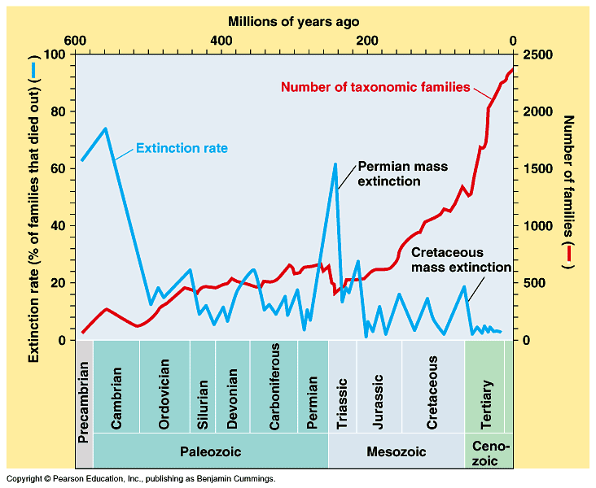

Slide 12
Permian Extinction
250 million years ago.
90% of species lost.

Slide 13
Cretaceous Extinction
65 million years ago.
Loss of the dinosaurs.
Good evidence that this event was caused by an asteroid that hit in the Yucatan, causing a “nuclear winter”.

Slide 14
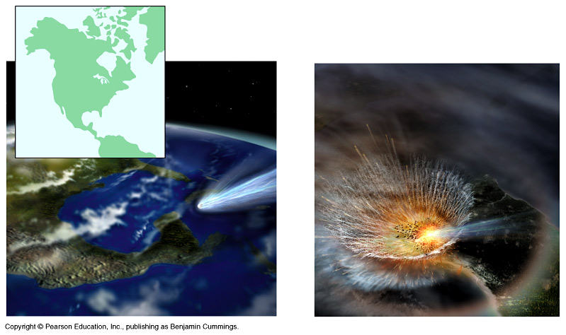

Slide 15
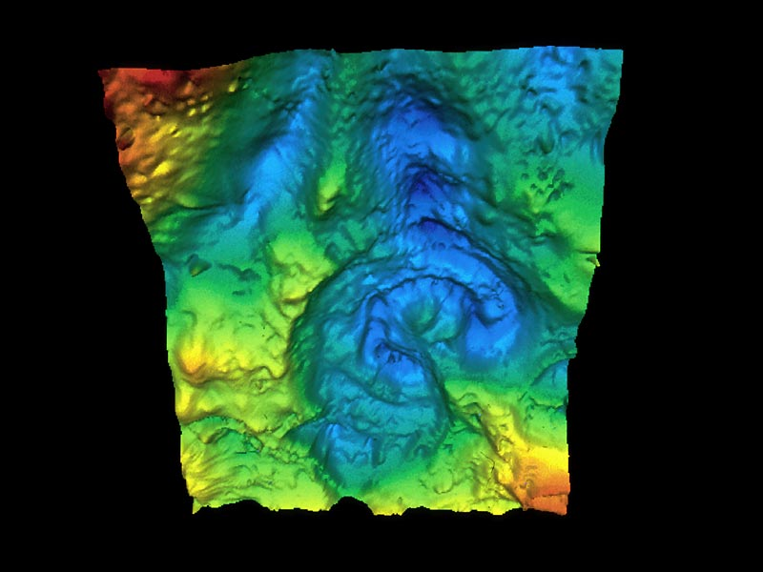
The crater

Slide 16
Result of Mass Extinctions
Climate changes.
Areas are open for the surviving species to exploit.
Rapid period of speciation (adaptive radiation).
Many new species are formed in a very short period of time.

Slide 17
Morphological & Molecular Homologies
Certain morphological and molecular similarities among living organisms can indicate phylogenetic histories
Distinguishing between homology and analogy is critical in constructing phylogenetic trees
Homologous structures
Analagous structures

Slide 18
Systematics
The study of biological diversity.
Uses evidence from the fossil record and other sources to reconstruct phylogeny.

Slide 19
Systematics fuses:
1. Phylogeny- tracing of evolutionary relationships.
2. Taxonomy- the identification and classification of species.

Slide 20
Taxonomy
Natural to humans.
Modern system developed by Linnaeus in the 18th century.

Slide 21
Linnaeus Taxonomy
1. Binomial Nomenclature – two names for each organism.
Ex - Homo sapiens
2. Hierarchical System – arranges life into groups. Ex - Kingdom → Species

Slide 22
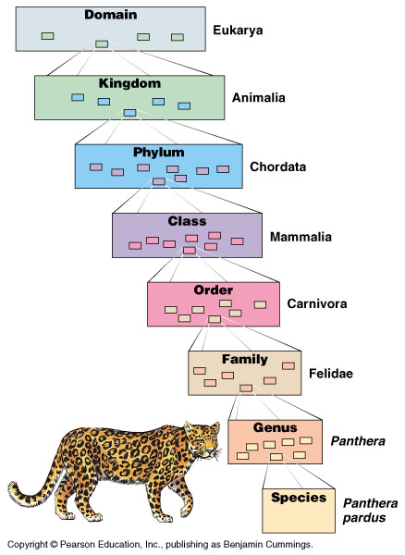

Slide 23
Goal of Systematics
To have Taxonomy reflect the evolutionary affinities or phylogeny of the organisms.

Slide 24
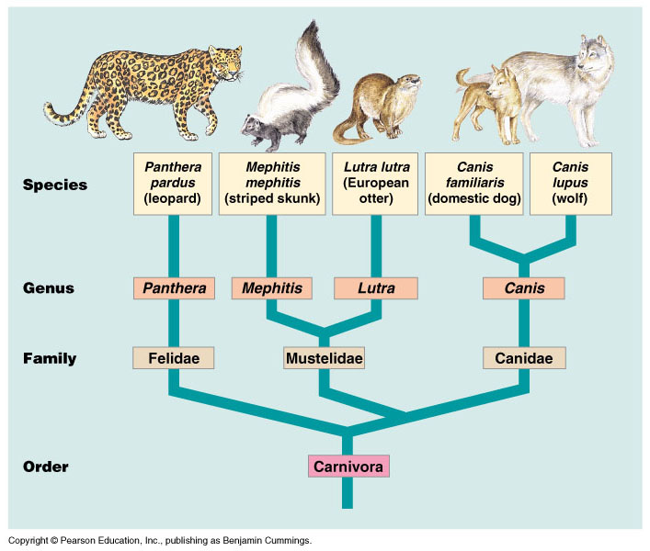
Phylogenetic tree

Slide 25
Question?
How to group taxa so that the phylogenetic relationships are correct ?

Slide 26
Ideal Situation
Monophyletic Grouping - a single ancestor gave rise to all species in the taxon.

Slide 27
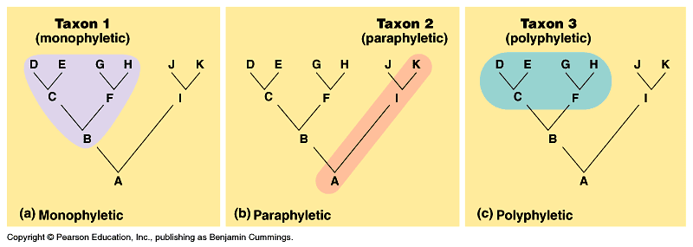

Slide 28
Other Possibilities
Polyphyletic - grouping where members are derived from two or more ancestral forms.
Paraphyletic - grouping that does not include all members from an ancestral form.

Slide 30
Problem
Not all “likeness” is inherited from a common ancestor.
Problem is of homology vs analogy.

Slide 31
Morphological & Molecular Homologies
Homology
Analogy
Divergent evolution leads to homologies
Homologies: similarities due to shared ancestry
Similarities in number and arrangement of bones in forlimbs
The homeobox in the Hox genes and other DNA sequences
Convergent evolution leads to analogous structres
Convergent evolution is when similar environmental pressures leads to similar adaptations in organisms that are not closely related
Birds wings
Bat wings
Insect wings

Slide 32
Convergent Evolution
When unrelated species have similar adaptations to a common environment. A specific example of Analogy.
Ex: Sharks and dolphins

Slide 33
Evaluating Molecular Homologies
If species are very closely related, molecular sequence likely differ at only 1 or a few sites
In distantly related species, nucleic acid sequences usually have different bases at many sites and may even have different lengths
Insertions
Deletions
These pose a very difficult problem, because as you know 1 frameshift mutation can cause 2 very similar sequences to be misaligned due to the absence or presence of just one base

Slide 34
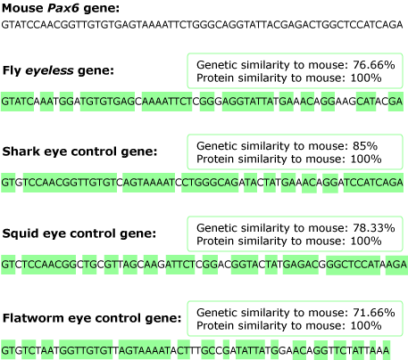
Systematists use computer programs to analyze comparable DNA sequences of differing lengths and to realign them appropriately

Slide 35
Molecular Homoplasy
From the Greek for “to mold in the same way”
Used to describe sequences from organisms that are not closely related, but coincidentally share a high percentage of sequence homology in their DNA for their various analagous structures

Slide 36
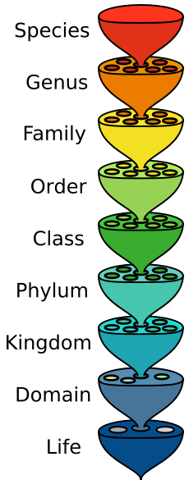
Taxonomy
An ordered division of organisms based on a set of characteristics used to assess similarities and differences
Created by Carolus Linnaeus in 1748 (but modified greatly since)
Binomial Nomenclature: 2 part system for naming organisms
1st name = genus
2nd name = specific epithet which is unique to each species

Slide 37
Linking Classification & Phylogeny
Heirarchical classification is reflected in the progressively finer branching of phylogenetic tree

Slide 38
Schools of Taxonomy
1. Phenetics: Taxonomic affinities based on measurable similarities.
2. Cladistics: Branch points defined by novel characteristics.

Slide 39
Cladogram
A diagram used to depict patterns of shared characteristics
If these shared characteristics are due to common ancestry (in otherwords if they are homologous) then the cladogram forms the basis for the phylogenetic tree
Clade: group of species that includes an ancestral species and all its descendants
Cladistics: the analysis of how species can be grouped into clades

Slide 40
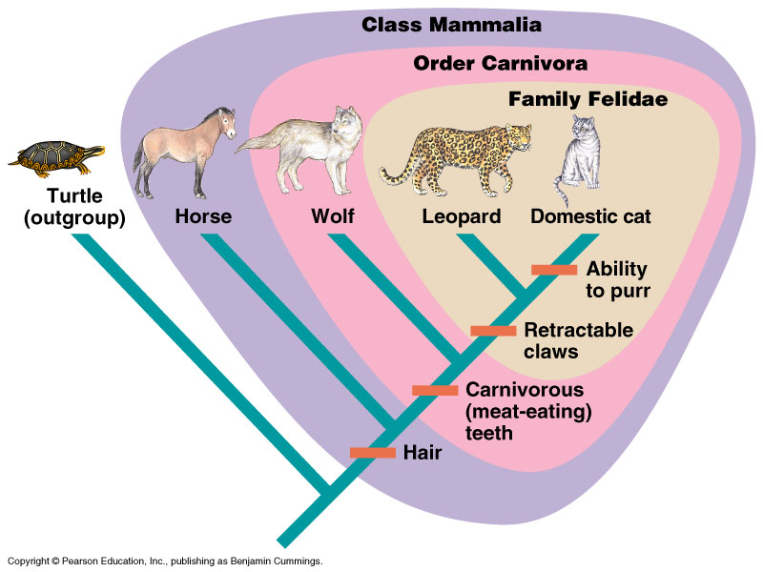
Cladistics

Slide 41
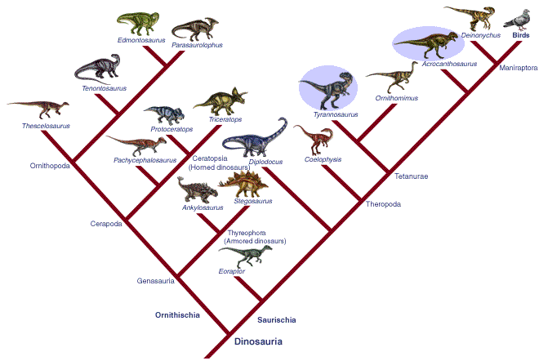

Slide 42
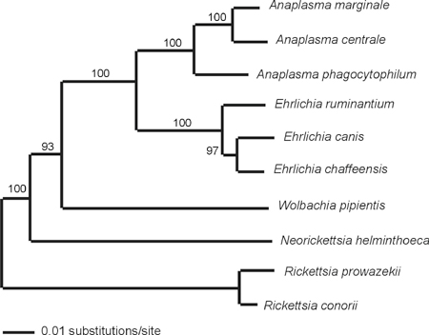
Phylogenetic Trees & Timing
In phylograms the length of the branch is indicative of the number of changes that have taken place in a particular DNA sequence in that lineage

Slide 43
Phylogenetic Trees as Hypotheses
Phylogenetic trees represent a hypothesis about how various organisms in the tree are related to one another
The best hypothesis is the one that fits the most data
Systematics can never be sure of finding the single best tree with such a large data set, but they can narrow the possibilities by applying 2 principles
Maximum parsimony
Maximum liklihood

Slide 44
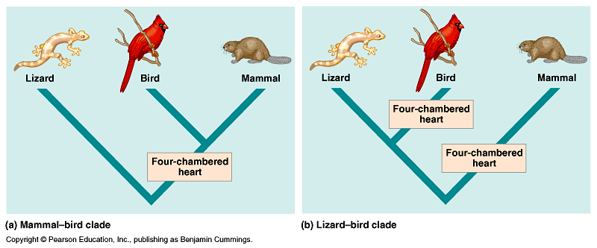
Problem ?

Slide 45
Today’s Systemics:
Uses clues from evolution.
Balances Phenetics and Cladistics.

Slide 46
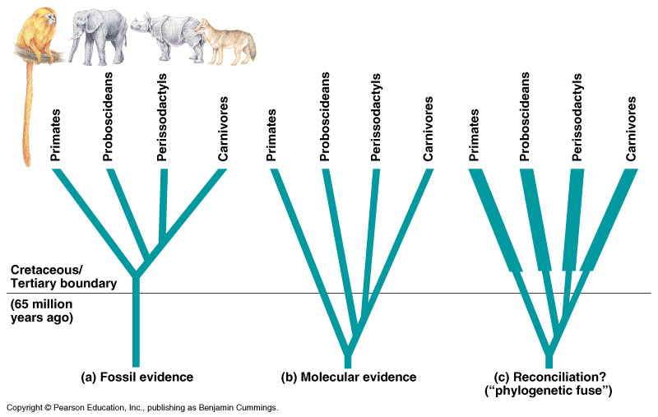

Slide 47
Result
Taxonomy will become Genealogies, reflecting the organism’s "Descent with Modification“.

Slide 48
Constructing the Best Phylogenetic Tree
Maximum parsimony
Maximum liklihood
Occams Razor
The simplest explanation that is consistent with the facts
The arrangement that requires the fewest evolutionary events
See p502-503
Given certain rules about DNA changes over time a tree can be found that reflects the most likely sequence of evolutionary events
Complex and incorporate as much info as possible

Slide 49
An Organisms Evolutionary History is Documented in the Genome
It is possible to reconstruct phylogenies among groups of present day organisms for which we have no fossil record at all based on their genome and molecular systematics
Molecular trees have the ability to encompass both long and short periods of time in history based on the fact that different genes evolve at different rates
Ribosomal DNA accumulates mutation very slowly and so can be used to investigate relationships in species that diverged long ago
Mitochondrial genes accumulate mutations quickly and so can be used to compare more closely related organisms

Slide 50
Gene Duplications & Gene Families
One of the most important types of mutation because it increases the # of genes in the genome providing opportunities for further evolutionary changes
Molecular phylogenies of gene duplications account for repeated duplication of that have resulted in gene families
Gene family: groups of related genes within an organisms genome
May be:
Orthologous
Paralogous

Slide 51
Gene Duplications & Gene Families
Orthologous Genes
Paralogous Genes
Refers to homologous genes that are passed in a straight line from one generation to the next but have ended up in different gene pools due to speciation
Orthologous genes diverge by speciation events
Ex: β Hemoglobin genes in humans & mice
Result from gene duplication so they are found in more than 1 copy in the same genome
Not due to speciation but rather gene duplication
Ex: olfactory receptor genes

Slide 52
Genome Evolution
Orthologous genes are widespread and can extend over huge evolutionary distances
99% of the genes of humans & mice are orthologous with those of yeast
Demonstrates that all living organisms share many biochemical and developmental pathways
The number of genes seems not to have increased through duplication as the same rate of phenotypic complexity
Humans have only about 5X’s the amount of genes as yeast

Slide 53
Molecular Clock
A concept allowing for the measurement of absolute time of evolutionary change based on the observation that some genes and other regions of the genome appear to evolve at constant rates
The assumption underlying the molecular clock is that the number of nucleotide substitutions in orthologous genes is proportional to the time that has elapsed since the species branched off from their common ancestor
In the case of paralagous genes the number of substitutions is proportional to the time since the genes became duplicated

Slide 54
Molecular Clocks
Difficulties with Molecular Clocks: Some DNA changes are favored over others
The regularity of change that allows us to use some genes as molecular clocks raises the possibility that many of the changes in these sequences result from genetic drift
Neutral Theory: much evolutionary change in genes and proteins has no effect on fitness and there for is not influenced by Darwinian selection and so
The rate of change should be regular like a clock
Differences in the rate of the clock in different genes are indicative in the importance of the gene

Slide 55
The Origin of HIV
Molecular clock was used to date the origin of HIV infection in humans
HIV is an RNA virus that undergoes mutation quickly
Phylogenetic analysis shows that HIV is descended from a virus that infects chimps and other primates
These viruses do not cause AIDS like diseases in nonhuman hosts

Slide 56
HIV
We cant pinpoint when HIV made the jump to human hosts as it has happened more than once indicated by the variety of strains
The most common strain is HIV-1 M researchers looked at the viral genome and using a molecular clock determined that the 1st HIV-1 M invasion of humans must have been in the 1930’s

Slide 57
The Universal Tree of Life
Once it was determined that the genetic code was universal, researchers began work on a universal tree of life to attempt to show that all organisms are descended from 1 common ancestor
2 criteria are used to identify regions of DNA that can demonstrate the branching patterns of this tree:
The regions must be able to be sequenced
Must have evolved slowly so that homologies can be detected between even distantly related organisms
rRNA genes meet both these criteria

Slide 58
3 Great Domains
The tree of life consists of 3 great domains
Bacteria
Archaea
Eukarya
The early history of these domains is not yet clear
During early history of life there have been substantial interchanges of genes between organisms of the different domains
Horizontal gene transfer: genes are transferred from one genome to another through mechanisms such as transposable elements and perhaps even fusion of the entire organism
Endosymbiont theory

Slide 59
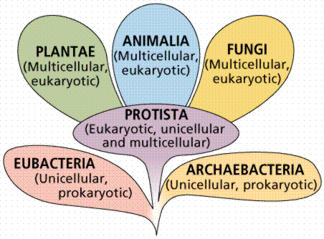

Slide 60
Summary
Recognize the use and limits of fossils.
What happens to evolution in mass extinctions.
What is phylogeny?

Slide 61
Summary
What is a phyletic tree?
How is molecular systematics used in phylogeny?

