Slide 1
Chapter 13
Meiosis and Sexual Life Cycles

Slide 2
Inheritance of Genes
Genes are the units of heredity, and are made up of segments of DNA that code for a protein.
Genes are passed to the next generation via reproductive cells called gametes (sperm and eggs)
Each gene has a specific location called a locus on a certain chromosome
Most DNA is packaged into chromosomes, which are a collection of genes.
© 2011 Pearson Education, Inc.

Slide 3
Comparison of Asexual and Sexual Reproduction
In asexual reproduction, a single individual passes genes to its offspring without the fusion of gametes
A clone is a group of genetically identical individuals from the same parent
In sexual reproduction, two parents give rise to offspring that have unique combinations of genes inherited from the two parents (1 cont.)
Video: Hydra Budding
© 2011 Pearson Education, Inc.

Slide 4
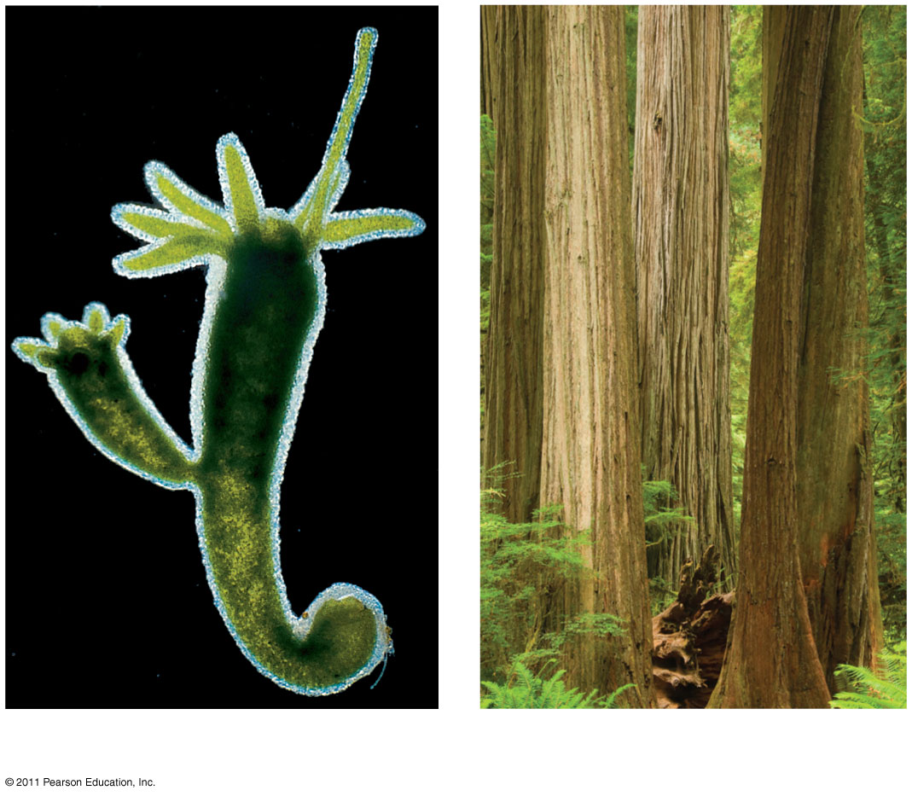
Figure 13.2
0.5 mm
Parent
Bud
(a) Hydra
(b) Redwoods
Notes:
Figure 13.2 Asexual reproduction in two multicellular organisms.

Slide 5
Concept 13.2: Fertilization and meiosis alternate in sexual life cycles
A life cycle is the generation-to-generation sequence of stages in the reproductive history of an organism
© 2011 Pearson Education, Inc.

Slide 6
Sets of Chromosomes in Human Cells
Human somatic cells aka body cells (any cell other than a gamete) have 23 pairs of chromosomes
A karyotype is an ordered display of the pairs of chromosomes from a cell
The two chromosomes in each pair are called homologous chromosomes, or homologs(9)
Chromosomes in a homologous pair are the same length and shape and carry genes controlling the same inherited characters
© 2011 Pearson Education, Inc.

Slide 7
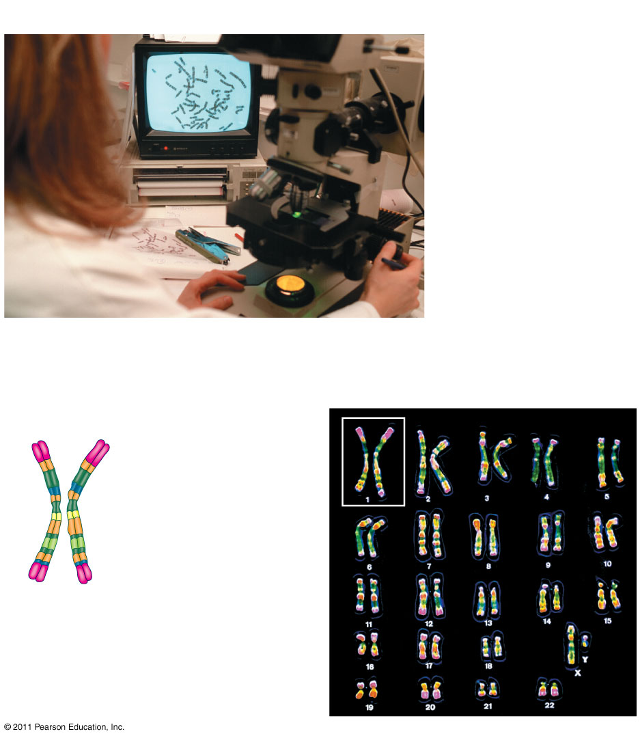
Figure 13.3
APPLICATION
(7 & 8)
TECHNIQUE
Pair of homologous duplicated chromosomes
5 μm
Centromere
Sister chromatids
Metaphase chromosome
Notes:
Figure 13.3 Research Method: Preparing a Karyotype

Slide 8
The sex chromosomes, which determine the sex/gender of the individual, are called X and Y
Human females have a homologous pair of X chromosomes (XX)
Human males have one X and one Y chromosome
The remaining 22 pairs of chromosomes are called autosomes (6)
© 2011 Pearson Education, Inc.

Slide 9
Each pair of homologous chromosomes includes one chromosome from each parent
The 46 chromosomes in a human somatic cell are two sets of 23: one from the mother and one from the father
A diploid cell (2n) has two sets of chromosomes
For humans, the diploid number is 46 (2n = 46)
A haploid cell (n) has one set of chromosomes
© 2011 Pearson Education, Inc.

Slide 10
A gamete (sperm or egg) contains a single set of chromosomes, and is haploid (n)
For humans, the haploid number is 23 (n = 23)
Each set of 23 consists of 22 autosomes and a single sex chromosome
In an unfertilized egg (ovum), the sex chromosome is X
In a sperm cell, the sex chromosome may be either X or Y
© 2011 Pearson Education, Inc.
© 2011 Pearson Education, Inc.

Slide 11
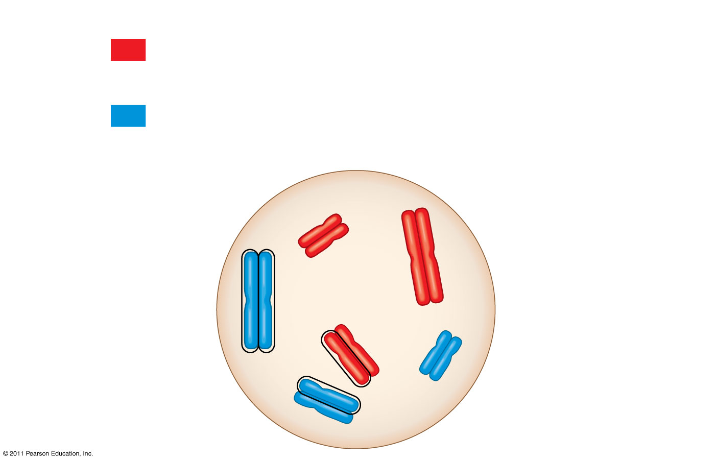
Figure 13.4
Key
Key
(12 & 13)
Maternal set of chromosomes (n = 3)
2n = 6
Paternal set of chromosomes (n = 3)
Sister chromatids of one duplicated chromosome
Centromere
Two nonsister chromatids in a homologous pair
Pair of homologous chromosomes (one from each set)
Notes:
Figure 13.4 Describing chromosomes.

Slide 12
At sexual maturity, the ovaries and testes produce haploid gametes
Gametes are the only types of human cells produced by meiosis, rather than mitosis
Meiosis results in one set of chromosomes in each gamete
Fertilization and meiosis alternate in sexual life cycles to maintain chromosome number (14, 15, & 17)
© 2011 Pearson Education, Inc.

Slide 13
Behavior of Chromosome Sets in the Human Life Cycle
Fertilization is the union of gametes (the sperm and the egg)
The fertilized egg is called a zygote and has one set of chromosomes from each parent
The zygote produces somatic cells by mitosis and develops into an adult (16)
© 2011 Pearson Education, Inc.

Slide 14
The Variety of Sexual Life Cycles
The alternation of meiosis and fertilization is common to all organisms that reproduce sexually
The three main types of sexual life cycles differ in the timing of meiosis and fertilization
© 2011 Pearson Education, Inc.

Slide 15
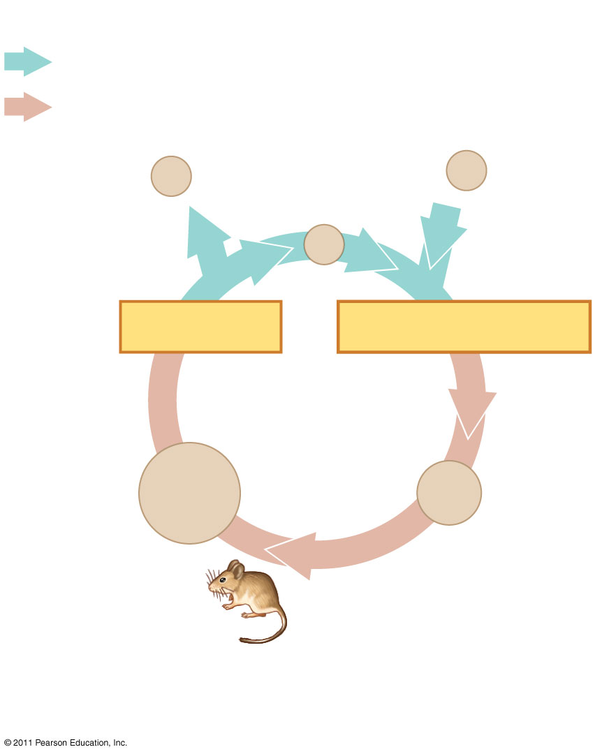
Figure 13.6a
Key
Haploid (n)
Diploid (2n)
n
Gametes
n
n
MEIOSIS
FERTILIZATION
2n
Zygote
2n
Diploid multicellular organism
Mitosis
(a) Animals
Notes:
Figure 13.6 Three types of sexual life cycles.

Slide 16
Plants and some algae exhibit an alternation of generations
This life cycle includes both a diploid and haploid multicellular stage
The diploid organism, called the sporophyte, makes haploid spores by meiosis (18)
© 2011 Pearson Education, Inc.

Slide 17
Each spore grows by mitosis into a haploid organism called a gametophyte
A gametophyte makes haploid gametes by mitosis
Fertilization of gametes results in a diploid sporophyte
© 2011 Pearson Education, Inc.

Slide 18
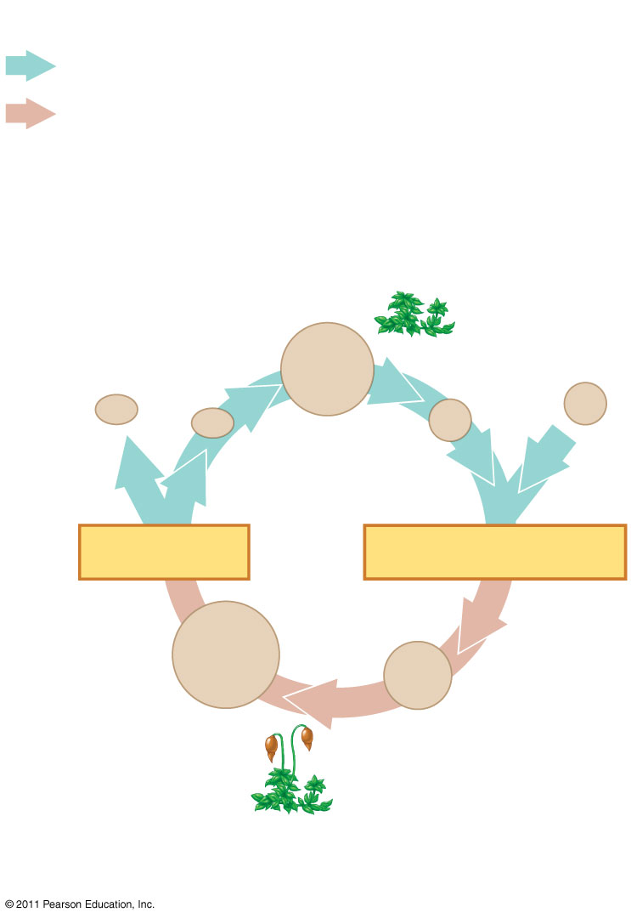
Figure 13.6b
Key
Haploid (n)
Diploid (2n)
(19)
Haploid multi- cellular organism (gametophyte)
Mitosis
n
Mitosis
n
n
n
n
Spores
Gametes
MEIOSIS
FERTILIZATION
2n
Diploid multicellular organism (sporophyte)
2n
Zygote
Mitosis
(b) Plants and some algae
Notes:
Figure 13.6 Three types of sexual life cycles.

Slide 19
In most fungi and some protists, the only diploid stage is the single-celled zygote; there is no multicellular diploid stage
The zygote produces haploid cells by meiosis
Each haploid cell grows by mitosis into a haploid multicellular organism
The haploid adult produces gametes by mitosis
© 2011 Pearson Education, Inc.

Slide 20
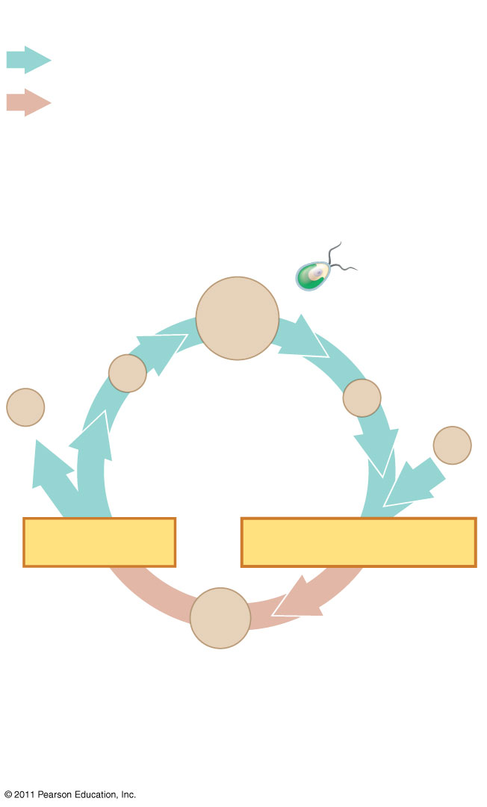
Figure 13.6c
Key
Haploid (n)
Diploid (2n)
Haploid unicellular or multicellular organism
Mitosis
n
Mitosis
n
n
n
Gametes
n
MEIOSIS
FERTILIZATION
2n
Zygote
(c) Most fungi and some protists
Notes:
Figure 13.6 Three types of sexual life cycles.

Slide 21
Concept 13.3: Meiosis reduces the number of chromosome sets from diploid to haploid
The next few slides are an overview of meiosis. There are in here to give you the general idea of the process before we go into specific details. Sit back and take this in as a nice review
© 2011 Pearson Education, Inc.

Slide 22
Concept 13.3: Meiosis reduces the number of chromosome sets from diploid to haploid
Like mitosis, meiosis is preceded by the replication of chromosomes (interphase)
Meiosis takes place in two sets of cell divisions, called meiosis I and meiosis II
The two cell divisions result in four haploid daughter cells, rather than the two diploid daughter cells in mitosis
Each daughter cell has only half as many chromosomes as the parent cell as is genetically different from parent(unlike mitosis)
© 2011 Pearson Education, Inc.

Slide 23
The Stages of Meiosis
After chromosomes duplicate, two divisions follow
Meiosis I (reductional division): homologs pair up and separate, resulting in two haploid daughter cells with replicated chromosomes
Meiosis II (equational division) sister chromatids separate
The result is four haploid daughter cells with unreplicated chromosomes
© 2011 Pearson Education, Inc.

Slide 24
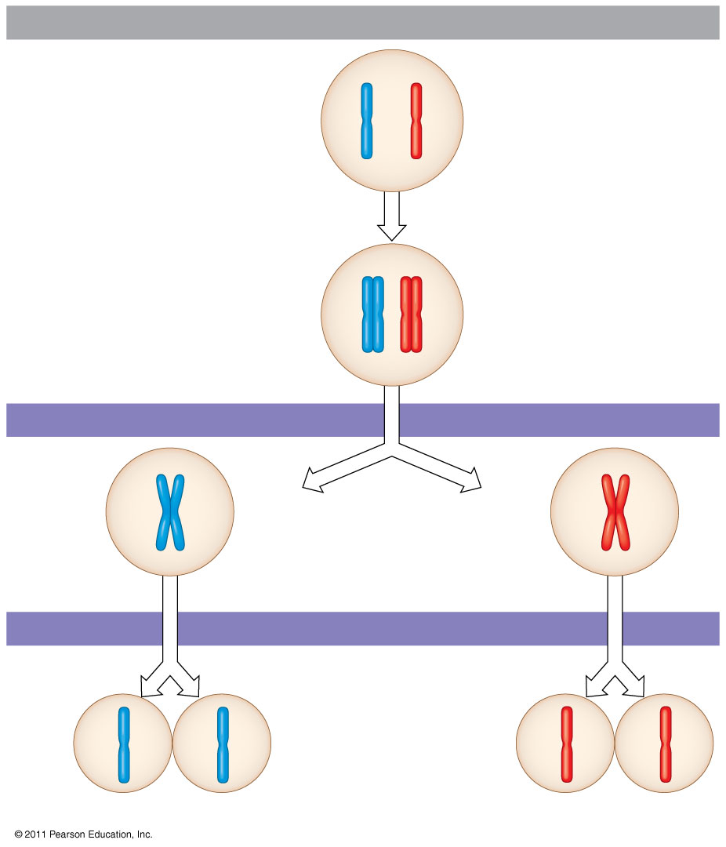
Figure 13.7-3
Interphase
Pair of homologous chromosomes in diploid parent cell
46
Duplicated pair of homologous chromosomes
Chromosomes duplicate
Sister chromatids
92
Diploid cell with duplicated chromosomes
Meiosis I
1
Homologous chromosomes separate
46
Haploid cells with duplicated chromosomes
Meiosis II
2
Sister chromatids separate
23
Haploid cells with unduplicated chromosomes
Notes:
Figure 13.7 Overview of meiosis: how meiosis reduces chromosome number.

Slide 25
Division in meiosis I occurs in four phases
Prophase I
Metaphase I
Anaphase I
Telophase I and cytokinesis
© 2011 Pearson Education, Inc.

Slide 26
Prophase I
Prophase I typically occupies more than 90% of the time required for meiosis
Chromosomes begin to condense
In synapsis, homologous chromosomes loosely pair up, aligned gene by gene
In crossing over, nonsister chromatids exchange DNA segments
Each pair of chromosomes forms a tetrad, a group of four chromatids
Each tetrad usually has one or more chiasmata, X-shaped regions where crossing over occurred (21)
© 2011 Pearson Education, Inc.

Slide 27
Metaphase I
In metaphase I, tetrads line up at the metaphase plate (side by side in homologous pairs), with one chromosome facing each pole
Microtubules from one pole are attached to the kinetochore of one chromosome of each tetrad
Microtubules from the other pole are attached to the kinetochore of the other chromosome
How did the chromosomes line up in metaphase of mitosis?
© 2011 Pearson Education, Inc.

Slide 28
Anaphase I
In anaphase I, pairs of homologous chromosomes separate (23)
One chromosome moves toward each pole, guided by the spindle apparatus
Sister chromatids remain attached at the centromere and move as one unit toward the pole
© 2011 Pearson Education, Inc.

Slide 29
Telophase I and Cytokinesis
In the beginning of telophase I, each half of the cell has a haploid set of chromosomes; each chromosome still consists of two sister chromatids*****(24)
Cytokinesis usually occurs simultaneously, forming two haploid daughter cells
© 2011 Pearson Education, Inc.

Slide 30
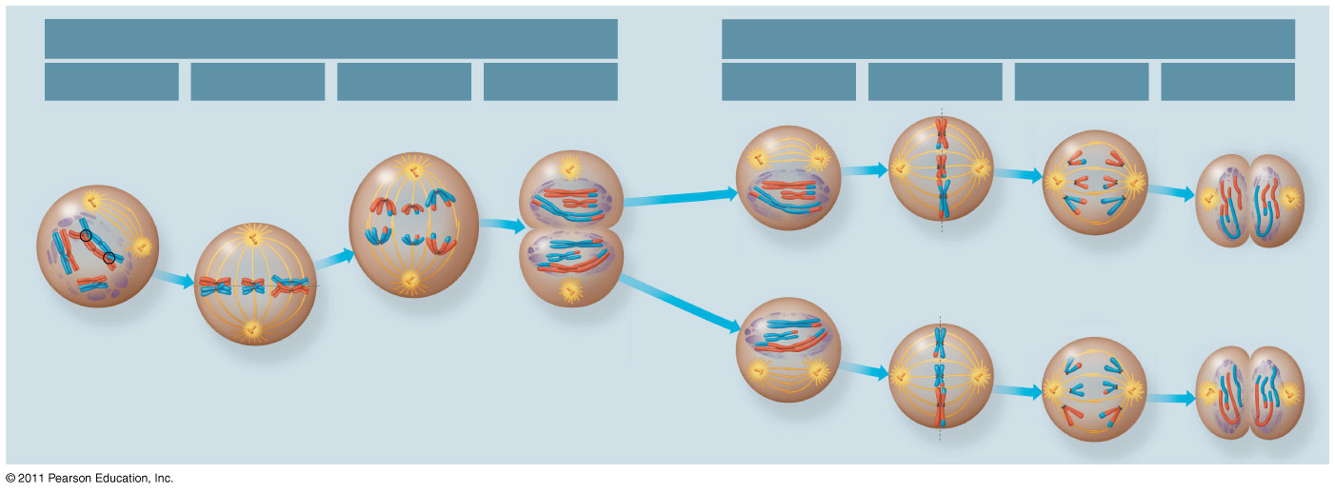
Figure 13.8
MEIOSIS I: Separates homologous chromosomes
MEIOSIS I: Separates sister chromatids
Prophase I
Metaphase I
Anaphase I
Telophase I and Cytokinesis
Prophase II
Metaphase II
Anaphase II
Telophase II and Cytokinesis
Centrosome (with centriole pair)
Sister chromatids remain attached
Sister chromatids
Chiasmata
Centromere (with kinetochore)
Spindle
Metaphase plate
Cleavage furrow
During another round of cell division, the sister chromatids finally separate; four haploid daughter cells result, containing unduplicated chromosomes.
Homologous chromosomes
Fragments of nuclear envelope
Homologous chromosomes separate
Sister chromatids separate
Haploid daughter cells forming
Microtubule attached to kinetochore
Each pair of homologous chromosomes separates.
Two haploid cells form; each chromosome still consists of two sister chromatids.
Duplicated homologous chromosomes (red and blue) pair and exchange segments; 2n = 6 in this example.
Chromosomes line up by homologous pairs.
Notes:
Figure 13.8 Exploring: Meiosis in an Animal Cell

Slide 31
In animal cells, a cleavage furrow forms; in plant cells, a cell plate forms
No chromosome replication occurs between the end of meiosis I and the beginning of meiosis II because the chromosomes are already replicated
© 2011 Pearson Education, Inc.

Slide 32
Division in meiosis II also occurs in four phases
Prophase II
Metaphase II
Anaphase II
Telophase II and cytokinesis
Meiosis II is very similar to mitosis
It will separate sister chromatids
© 2011 Pearson Education, Inc.

Slide 33
Prophase II
In prophase II, a spindle apparatus forms
In late prophase II, chromosomes (each still composed of two chromatids) move toward the metaphase plate
© 2011 Pearson Education, Inc.

Slide 34
Metaphase II
In metaphase II, the sister chromatids are arranged at the metaphase plate
Because of crossing over in meiosis I, the two sister chromatids of each chromosome are no longer genetically identical
The kinetochores of sister chromatids attach to microtubules extending from opposite poles
© 2011 Pearson Education, Inc.

Slide 35
Anaphase II
In anaphase II, the sister chromatids separate
The sister chromatids of each chromosome now move as two newly individual chromosomes toward opposite poles
© 2011 Pearson Education, Inc.

Slide 36
Telophase II and Cytokinesis
In telophase II, the chromosomes arrive at opposite poles
Nuclei form, and the chromosomes begin decondensing
http://highered.mcgraw-hill.com/sites/0072495855/student_view0/chapter28/animation__how_meiosis_works.html
http://highered.mcgraw-hill.com/sites/0072495855/student_view0/chapter28/animation__stages_of_meiosis.html
© 2011 Pearson Education, Inc.

Slide 37
Cytokinesis separates the cytoplasm
At the end of meiosis, there are four daughter cells, each with a haploid set of unreplicated chromosomes
Each daughter cell is genetically distinct from the others and from the parent cell
© 2011 Pearson Education, Inc.

Slide 38
A Comparison of Mitosis and Meiosis
Mitosis conserves the number of chromosome sets, producing cells that are genetically identical to the parent cell
Meiosis reduces the number of chromosomes sets from two (diploid) to one (haploid), producing cells that differ genetically from each other and from the parent cell
© 2011 Pearson Education, Inc.

Slide 39
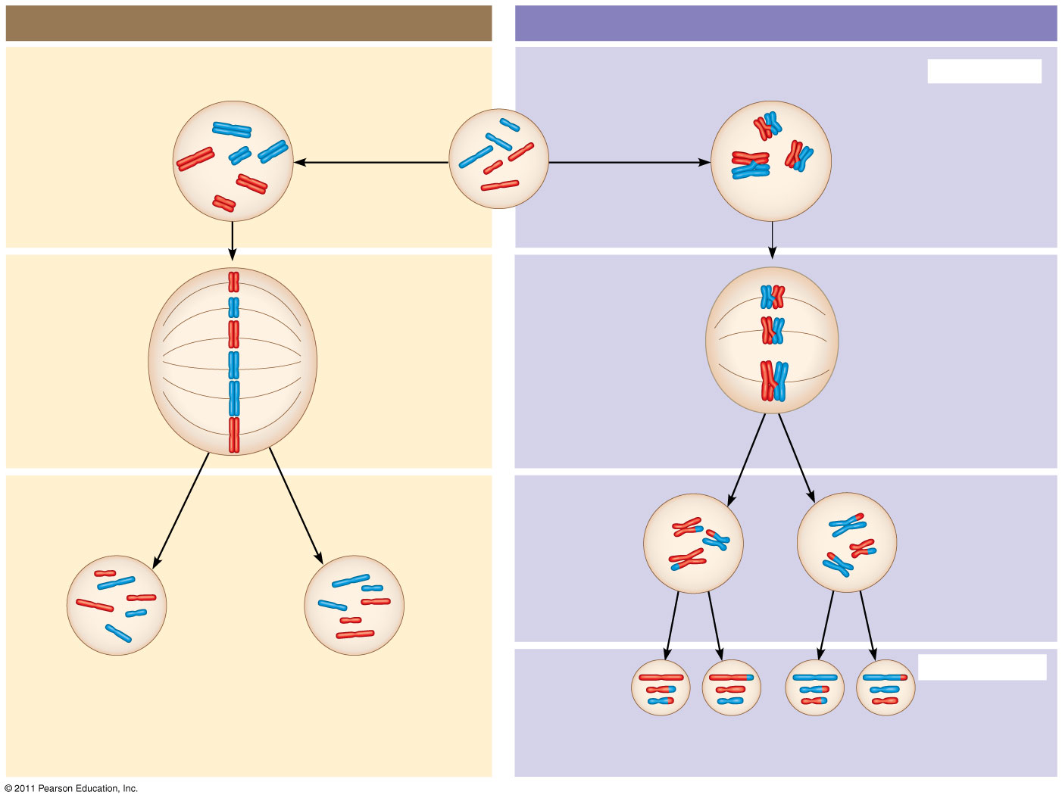
Figure 13.9a
MITOSIS
MEIOSIS
(27)
Parent cell
Chiasma
MEIOSIS I
Prophase
Prophase I
Duplicated chromosome
Chromosome duplication
Chromosome duplication
Homologous chromosome pair
2n = 6
Metaphase
Metaphase I
Anaphase Telophase
Anaphase I
Telophase I
Daughter cells of meiosis I
Haploid n = 3
2n
2n
MEIOSIS II
Daughter cells of mitosis
n
n
n
n
Daughter cells of meiosis II
Notes:
Figure 13.9 A comparison of mitosis and meiosis in diploid cells.

Slide 40
Figure 13.9b
http://highered.mcgraw-hill.com/sites/0072495855/student_view0/chapter28/animation__comparison_of_meiosis_and_mitosis__quiz_1_.html
SUMMARY
Property
Mitosis
Meiosis
DNA replication
Occurs during interphase before mitosis begins
Occurs during interphase before meiosis I begins
Number of divisions
One, including prophase, metaphase, anaphase, and telophase
Two, each including prophase, metaphase, anaphase, and telophase
Synapsis of homologous chromosomes
Does not occur
Occurs during prophase I along with crossing over between nonsister chromatids; resulting chiasmata hold pairs together due to sister chromatid cohesion
Number of daughter cells and genetic composition
Two, each diploid (2n) and genetically identical to the parent cell
Four, each haploid (n), containing half as many chromosomes as the parent cell; genetically different from the parent cell and from each other
Role in the animal body
Enables multicellular adult to arise from zygote; produces cells for growth, repair, and, in some species, asexual reproduction
Produces gametes; reduces number of chromosomes by half and introduces genetic variability among the gametes
Notes:
Figure 13.9 A comparison of mitosis and meiosis in diploid cells.

Slide 41
Three events are unique to meiosis, and all three occur in meiosis l
Synapsis and crossing over in prophase I: Homologous chromosomes physically connect and exchange genetic information
At the metaphase plate, there are paired homologous chromosomes (tetrads), instead of individual replicated chromosomes
At anaphase I, it is homologous chromosomes, instead of sister chromatids, that separate
© 2011 Pearson Education, Inc.

Slide 42
Concept 13.4: Genetic variation produced in sexual life cycles contributes to evolution
Mutations (changes in an organism’s DNA) are the original source of genetic diversity
Mutations create different versions of genes called alleles (20)
Reshuffling of alleles during sexual reproduction produces genetic variation
© 2011 Pearson Education, Inc.

Slide 43
Origins of Genetic Variation Among Offspring
The behavior of chromosomes during meiosis and fertilization is responsible for most of the variation that arises in each generation
Three mechanisms contribute to genetic variation
Independent assortment of chromosomes
Crossing over
Random fertilization
© 2011 Pearson Education, Inc.

Slide 44
Independent Assortment of Chromosomes
Homologous pairs of chromosomes orient randomly at metaphase I of meiosis
In independent assortment, each pair of chromosomes sorts maternal and paternal homologues into daughter cells independently of the other pairs
http://highered.mcgraw-hill.com/sites/0072495855/student_view0/chapter28/animation__random_orientation_of_chromosomes_during_meiosis.html
© 2011 Pearson Education, Inc.

Slide 45
The number of combinations possible when chromosomes assort independently into gametes is 2^{n}, where n is the haploid number
For humans (n = 23), there are more than 8 million (2²³) possible combinations of chromosomes
© 2011 Pearson Education, Inc.

Slide 46
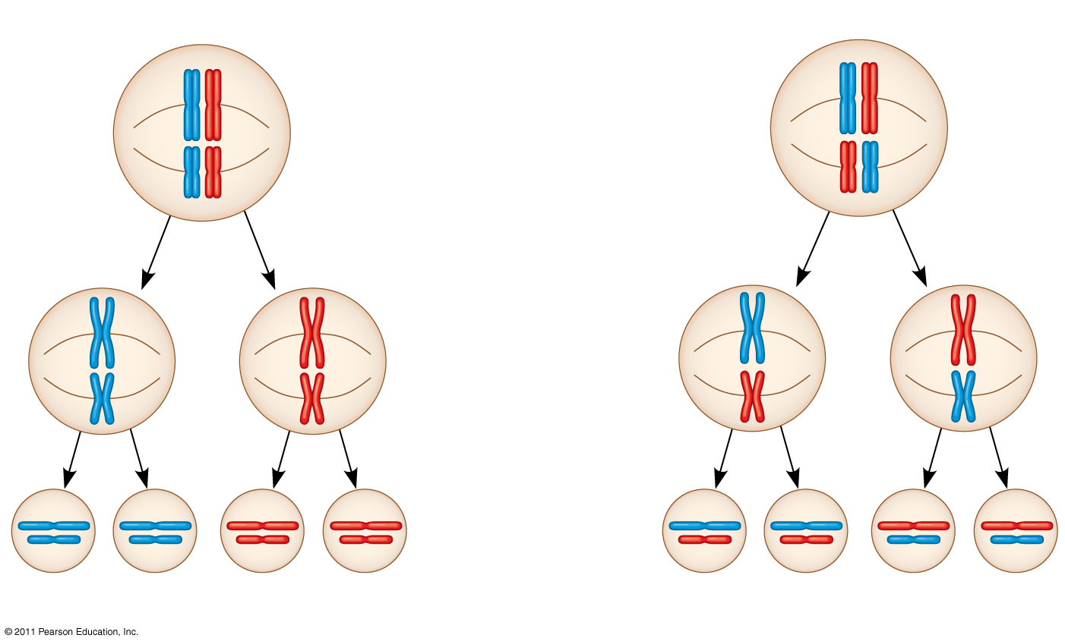
Figure 13.10-3
Possibility 1
Possibility 2
Two equally probable arrangements of chromosomes at metaphase I
Metaphase II
Daughter cells
Combination 1
Combination 2
Combination 3
Combination 4
Notes:
Figure 13.10 The independent assortment of homologous chromosomes in meiosis.

Slide 47
Crossing Over
Crossing over produces recombinant chromosomes, which combine DNA inherited from each parent
Crossing over begins very early in prophase I, as homologous chromosomes pair up gene by gene (31)
© 2011 Pearson Education, Inc.

Slide 48
In crossing over, homologous portions of two nonsister chromatids trade places
Crossing over contributes to genetic variation by combining DNA from two parents into a single chromosome
© 2011 Pearson Education, Inc.

Slide 49
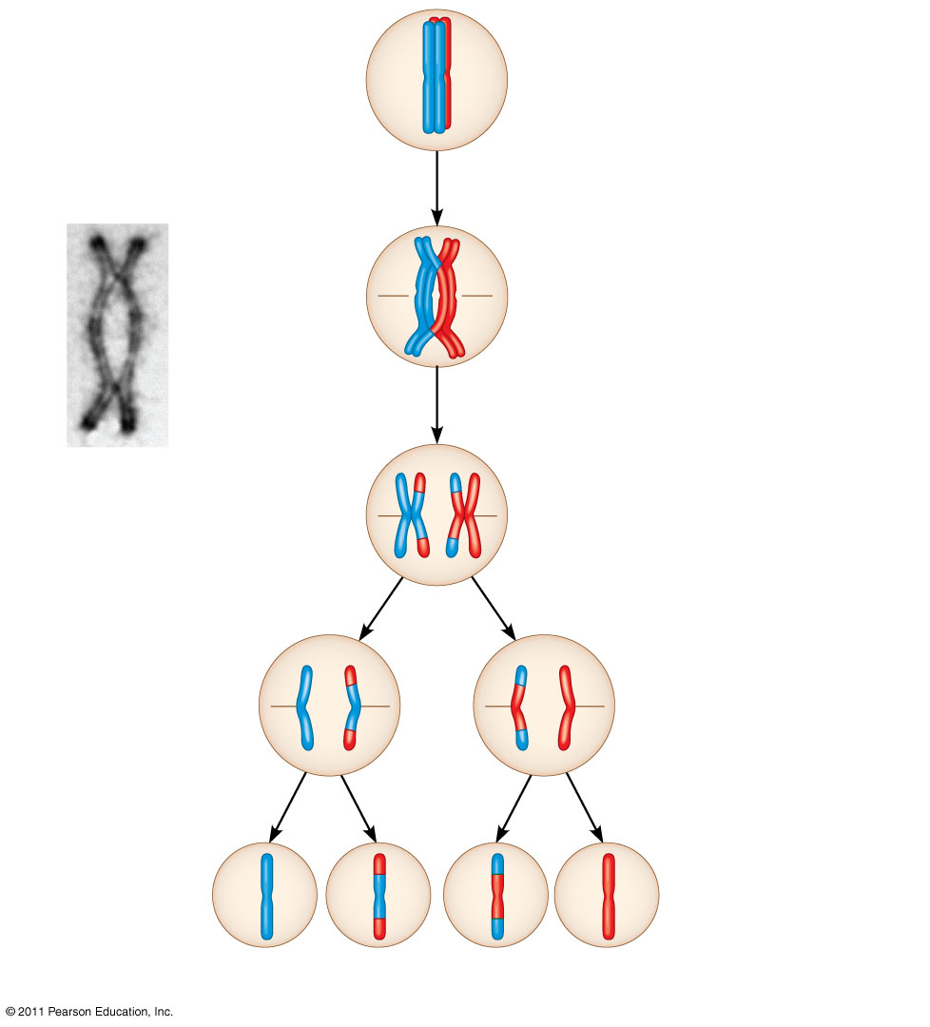
Figure 13.11-5
Prophase I of meiosis
Nonsister chromatids held together during synapsis
Pair of homologs
Chiasma
Centromere
TEM
Anaphase I
Anaphase II
Daughter cells
Recombinant chromosomes
Notes:
Figure 13.11 The results of crossing over during meiosis.

Slide 50
Random Fertilization
Random fertilization adds to genetic variation because any sperm can fuse with any ovum (unfertilized egg)
The fusion of two gametes (each with 8.4 million possible chromosome combinations from independent assortment) produces a zygote with any of about 70 trillion diploid combinations
http://highered.mcgraw-hill.com/sites/0072495855/student_view0/chapter28/animation__unique_features_of_meiosis.html
© 2011 Pearson Education, Inc.

Slide 51
Crossing over adds even more variation
Each zygote has a unique genetic identity
Animation: Genetic Variation
© 2011 Pearson Education, Inc.

Slide 52
The Evolutionary Significance of Genetic Variation Within Populations
Natural selection results in the accumulation of genetic variations favored by the environment
Sexual reproduction contributes to the genetic variation in a population, which originates from mutations
© 2011 Pearson Education, Inc.

