Slide 1
Chapter 6
A Tour of the Cell

Slide 2
Overview: The Cell Theory
All organisms are made of cells
The basic unit of life is the cell
All cells come from preexisting cells
© 2011 Pearson Education, Inc.
Notes:
For the Discovery Video Cells, go to Animation and Video Files.

Slide 3
History of Cells
Robert Hooke - Observed cells in cork.
Coined the term "cells” in 1665
1838 - M.J. Schleiden, all plants are made of cells.
1839 - T. Schwann, all animals are made of cells.

Slide 4
Concept 6.1: Biologists use microscopes and the tools of biochemistry to study cells
Though usually too small to be seen by the unaided eye, cells can be complex
Three important parameters of microscopy
Magnification, the ratio of an object’s image size to its real size
Resolution, the measure of the clarity of the image, or the minimum distance of two distinguishable points
Contrast, visible differences in parts of the sample (1)
© 2011 Pearson Education, Inc.

Slide 5
Three important parameters of microscopy
Magnification, the ratio of an object’s image size to its real size
Resolution, the measure of the clarity of the image, or the minimum distance of two distinguishable points
Contrast, visible differences in parts of the sample
© 2011 Pearson Education, Inc.

Slide 6
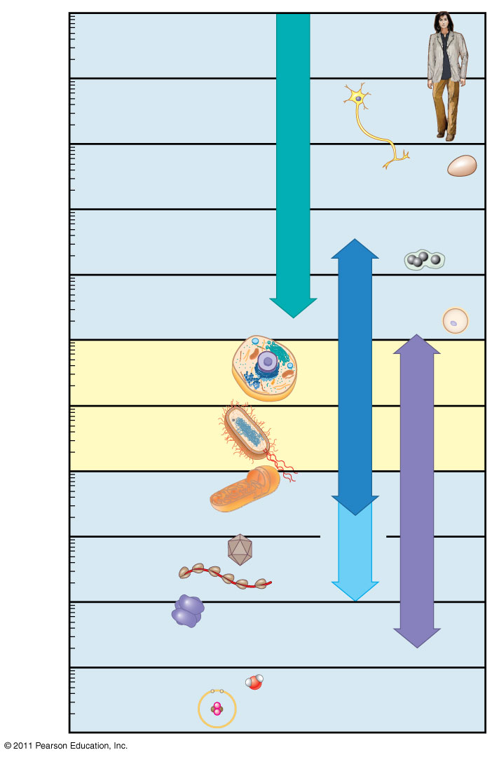
Figure 6.2
10 m
Human height
1 m
Length of some nerve and muscle cells
0.1 m
Unaided eye
Chicken egg
1 cm
Frog egg
1 mm
100 μm
Human egg
Most plant and animal cells
Light microscopy
10 μm
Nucleus
Most bacteria
1 μm
Mitochondrion
Smallest bacteria
Electron microscopy
100 nm
Super- resolution microscopy
Viruses
Ribosomes
10 nm
Proteins
Lipids
1 nm
Small molecules
0.1 nm
Atoms
Notes:
Figure 6.2 The size range of cells.

Slide 7
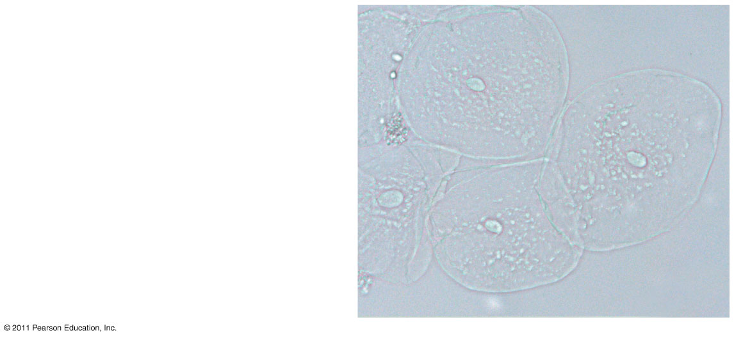
Figure 6.3a
Brightfield
(unstained specimen)
50 μm
Notes:
Figure 6.3 Exploring: Microscopy

Slide 8
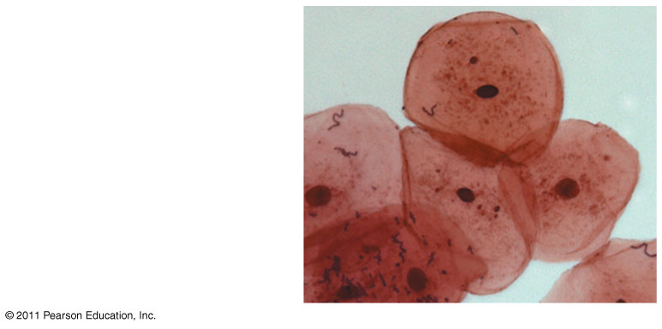
Figure 6.3b
Brightfield
(stained specimen)
Notes:
Figure 6.3 Exploring: Microscopy

Slide 9
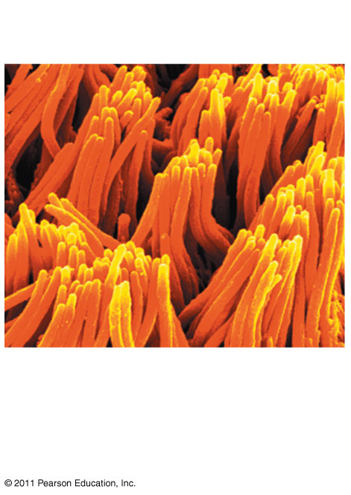
Figure 6.3i
Cilia
2 μm
Scanning electron microscopy (SEM) (2 & 3)
Notes:
Figure 6.3 Exploring: Microscopy

Slide 10
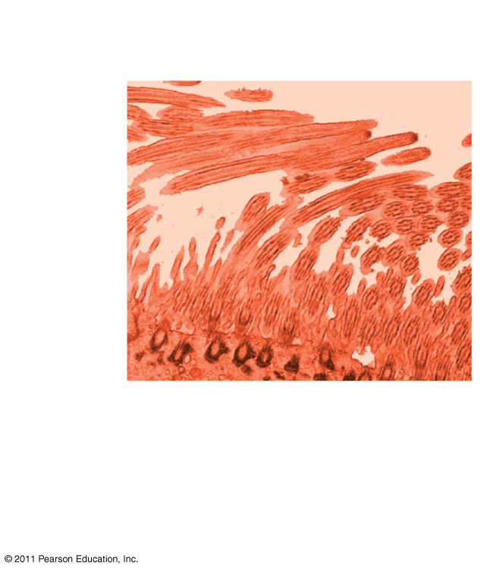
Figure 6.3j
Longitudinal section of cilium
Cross section of cilium
2 μm
Transmission electron microscopy (TEM) (2 & 3)
Notes:
Figure 6.3 Exploring: Microscopy

Slide 11
Cell Fractionation
Cell fractionation takes cells apart and separates the major organelles from one another
Centrifuges fractionate cells into their component parts
Cell fractionation enables scientists to determine the functions of organelles
Biochemistry and cytology help correlate cell function with structure
© 2011 Pearson Education, Inc.

Slide 12
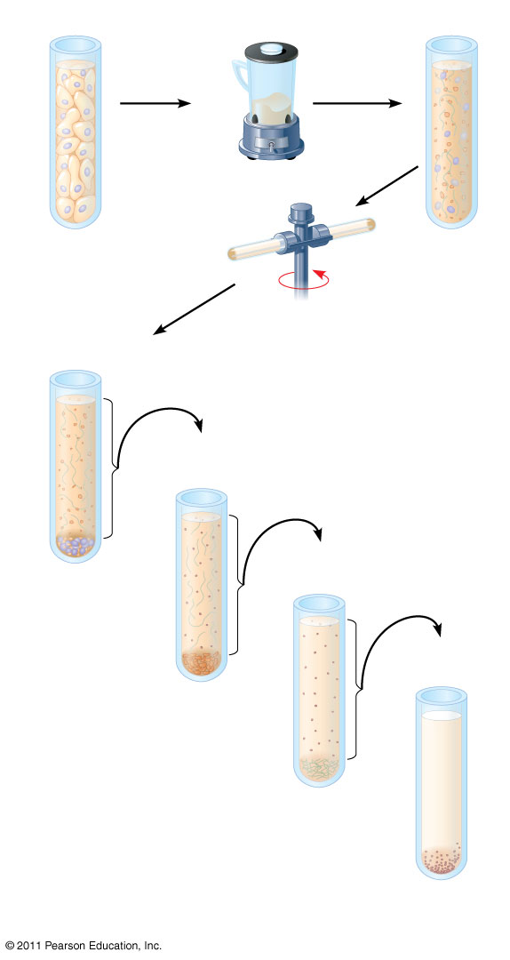
Figure 6.4
TECHNIQUE
(4)
Homogenization
Tissue cells
Centrifuged at 1,000 g (1,000 times the force of gravity) for 10 min
Homogenate
Centrifugation
Supernatant poured into next tube
Differential centrifugation
20,000 g
20 min
80,000 g
Pellet rich in nuclei and cellular debris
60 min
150,000 g
3 hr
Pellet rich in mitochondria (and chloro- plasts if cells are from a plant)
Pellet rich in “microsomes” (pieces of plasma membranes and cells’ internal membranes)
Pellet rich in ribosomes
Notes:
Figure 6.4 Research Method: Cell Fractionation

Slide 13
Concept 6.2: Eukaryotic cells have internal membranes that compartmentalize their functions
The basic structural and functional unit of every organism is one of two types of cells: prokaryotic or eukaryotic
Only organisms of the domains Bacteria and Archaea consist of prokaryotic cells (5)
Protists, fungi, animals, and plants all consist of eukaryotic cells
© 2011 Pearson Education, Inc.

Slide 14
Comparing Prokaryotic and Eukaryotic Cells
Basic features of all cells
Plasma membrane
Semifluid substance called cytosol
Chromosomes (carry genes)
Ribosomes (make proteins)
© 2011 Pearson Education, Inc.

Slide 15
Eukaryotic cells are characterized by having
DNA in a nucleus that is bounded by a membranous nuclear envelope
Membrane-bound organelles
Cytoplasm in the region between the plasma membrane and nucleus
Eukaryotic cells are generally much larger than prokaryotic cells
© 2011 Pearson Education, Inc.

Slide 16
Prokaryotic cells are characterized by having
No nucleus
DNA in an unbound region called the nucleoid (unlike eukaryotes; in nucleus) (6)
No membrane-bound organelles
Cytoplasm bound by the plasma membrane
© 2011 Pearson Education, Inc.

Slide 17
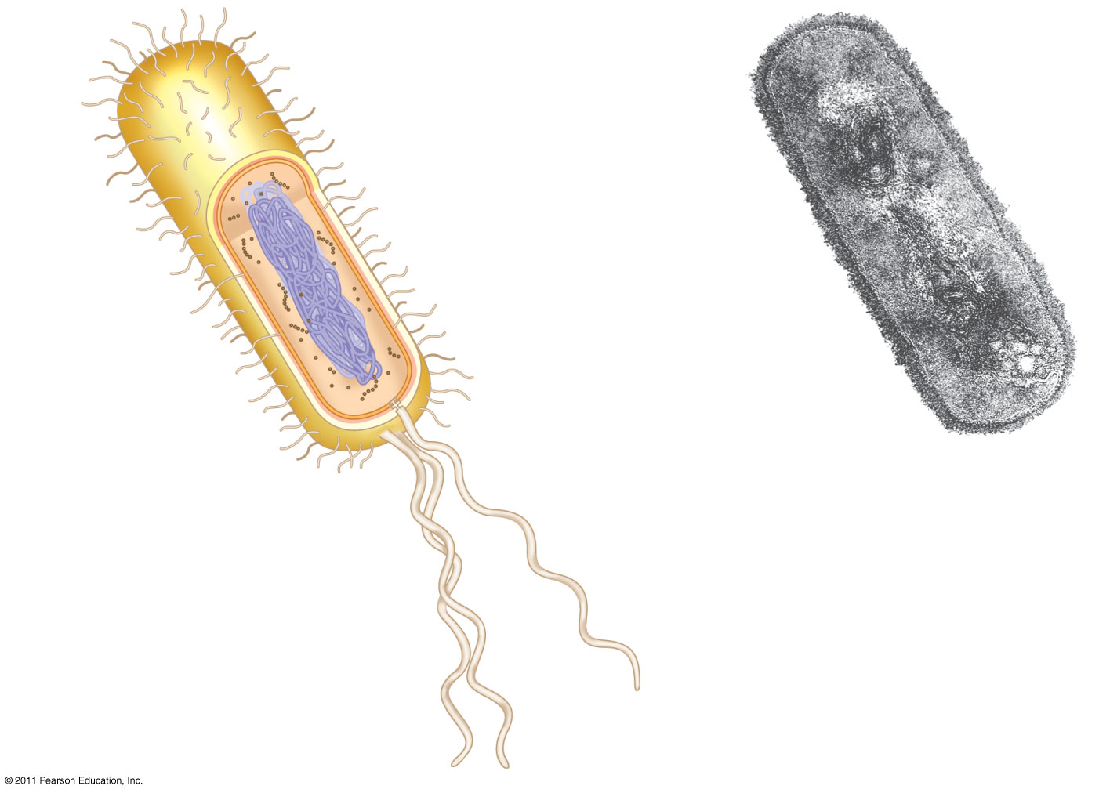
Figure 6.5
Fimbriae
7.
Nucleoid
Ribosomes
Plasma membrane
Bacterial chromosome
Cell wall
Capsule
0.5 μm
(a)
A typical rod-shaped bacterium
Flagella
(b)
A thin section through the bacterium Bacillus coagulans (TEM)
Notes:
Figure 6.5 A prokaryotic cell.

Slide 18
Metabolic requirements set upper limits on the size of cells
The surface area to volume ratio of a cell is critical
As the surface area increases by a factor of n², the volume increases by a factor of n³
Small cells have a greater surface area relative to volume
(8)
© 2011 Pearson Education, Inc.

Slide 19
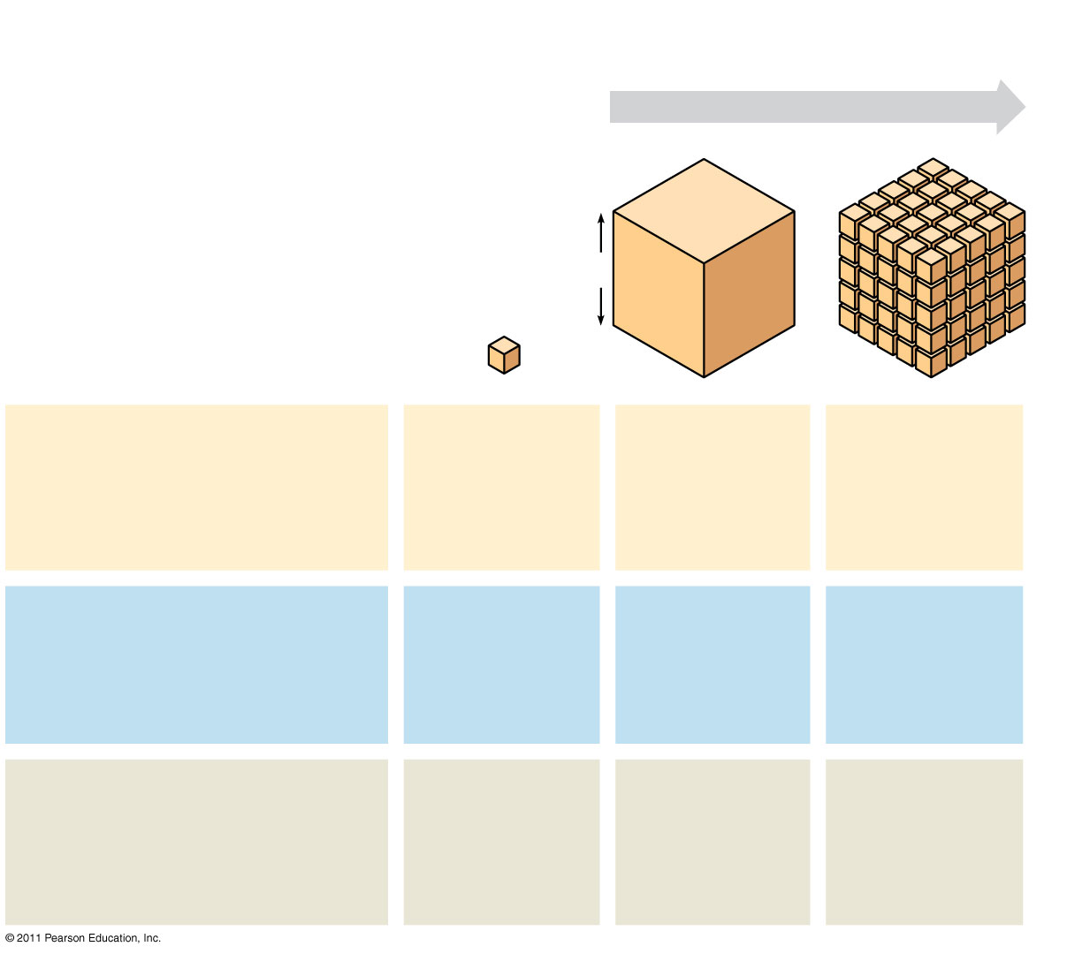
Figure 6.7
Surface area increases while total volume remains constant
5
1
1
Total surface area [sum of the surface areas (height × width) of all box sides × number of boxes]
6
150
750
Total volume [height × width × length × number of boxes]
1
125
125
Surface-to-volume (S-to-V) ratio [surface area ÷ volume]
6
1.2
6
Notes:
Figure 6.7 Geometric relationships between surface area and volume.

Slide 20
A Panoramic View of the Eukaryotic Cell
A eukaryotic cell has internal membranes that partition the cell into organelles
Plant and animal cells have most of the same organelles
VCAC Animation
© 2011 Pearson Education, Inc.

Slide 21
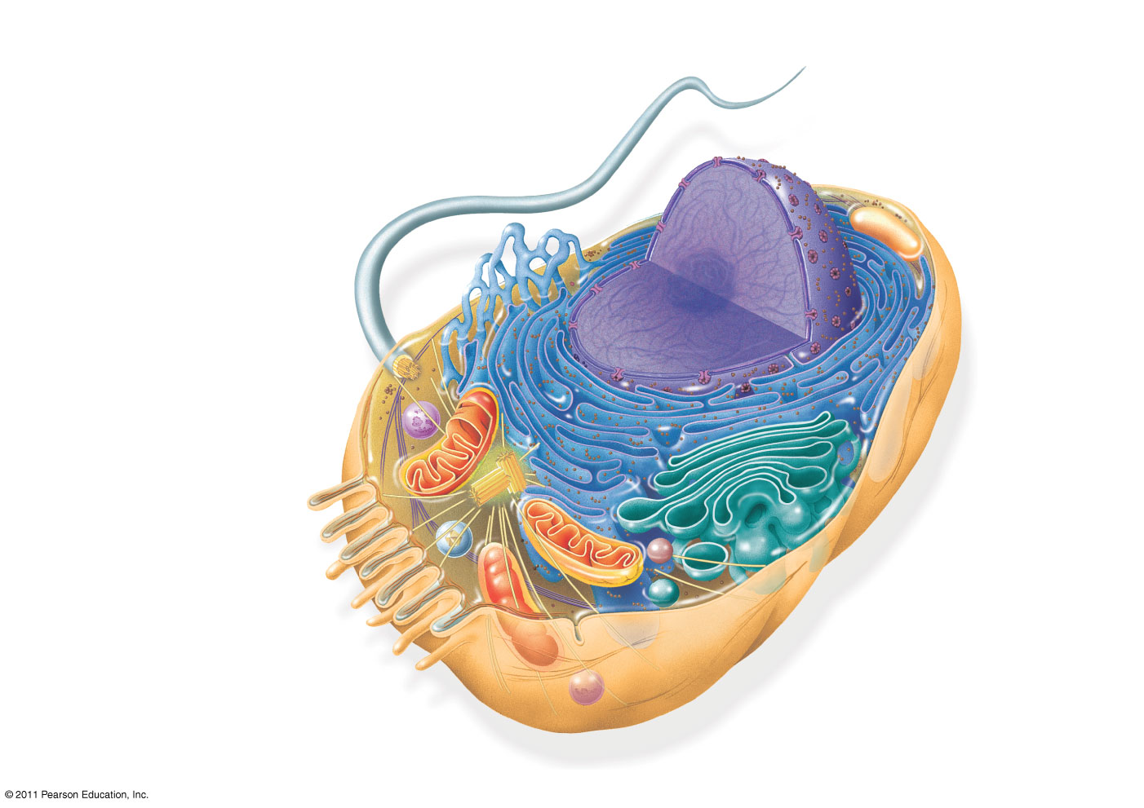
Figure 6.8a
ENDOPLASMIC RETICULUM (ER)
Smooth ER
Nuclear envelope
9.
Rough ER
Flagellum
NUCLEUS
Nucleolus
Chromatin
Centrosome
Plasma membrane
CYTOSKELETON:
Microfilaments
Intermediate filaments
Microtubules
Ribosomes
Microvilli
Golgi apparatus
Peroxisome
Mitochondrion
Lysosome
Notes:
Figure 6.8 Exploring: Eukaryotic Cells

Slide 22
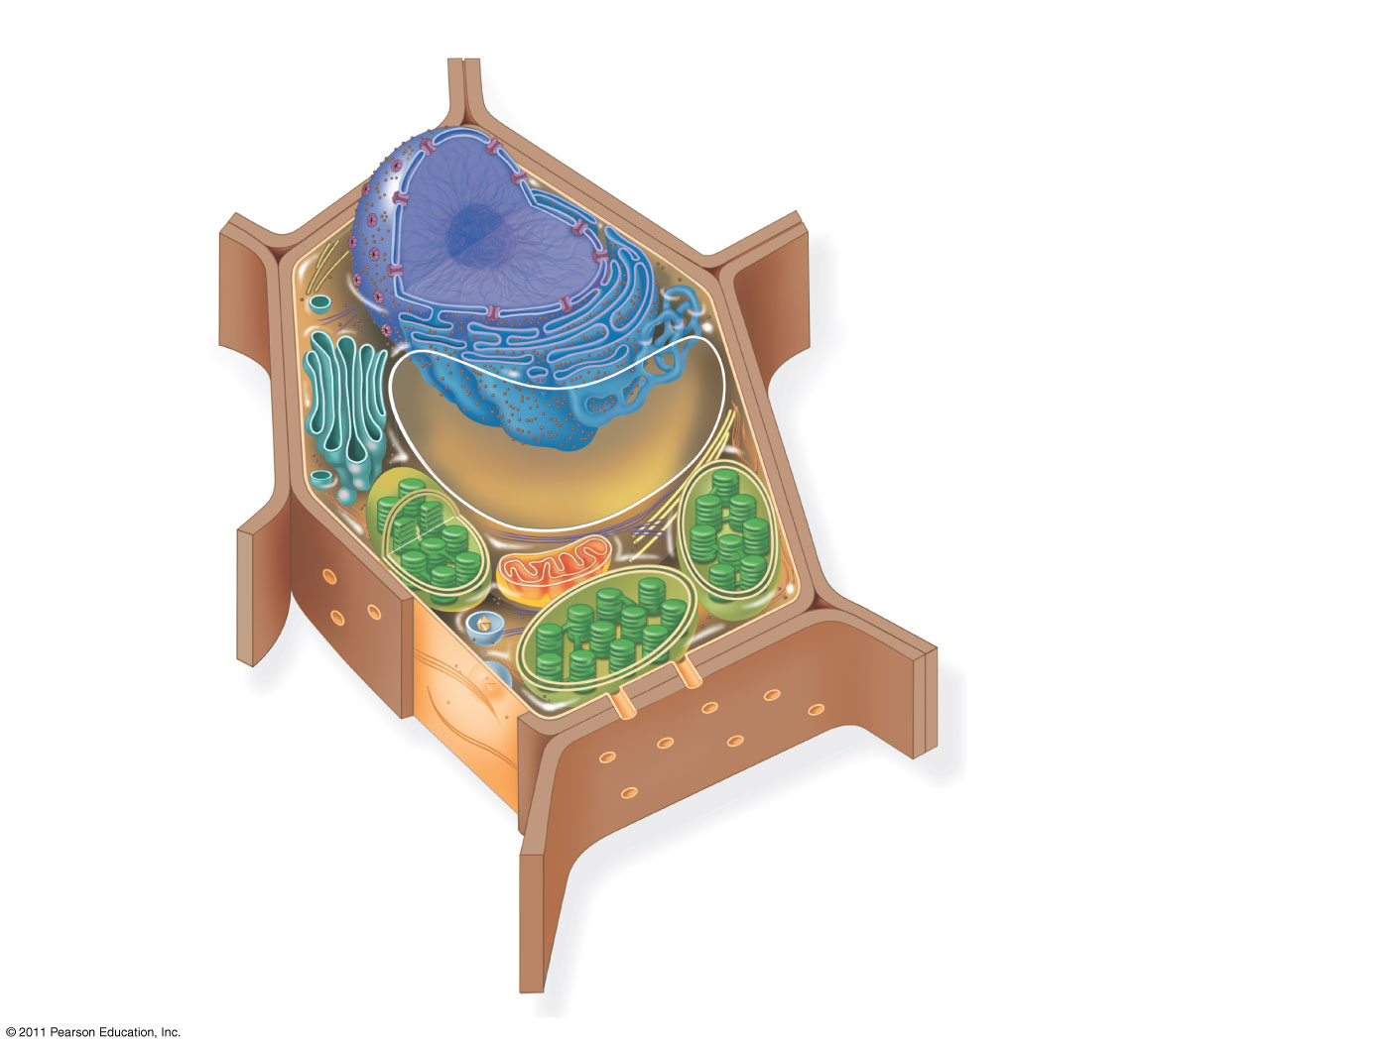
Figure 6.8c
Nuclear envelope
Rough endoplasmic reticulum
NUCLEUS
Smooth endoplasmic reticulum
Nucleolus
Chromatin
Ribosomes
Central vacuole
Golgi apparatus
Microfilaments
Intermediate filaments
CYTOSKELETON
Microtubules
Mitochondrion
Peroxisome
Plasma membrane
Chloroplast
Cell wall
Plasmodesmata
Wall of adjacent cell
Notes:
Figure 6.8 Exploring: Eukaryotic Cells

Slide 23
Concept 6.3: The eukaryotic cell’s genetic instructions are housed in the nucleus and carried out by the ribosomes
The nucleus contains most of the DNA in a eukaryotic cell
Ribosomes use the information from the DNA to make proteins
© 2011 Pearson Education, Inc.

Slide 24
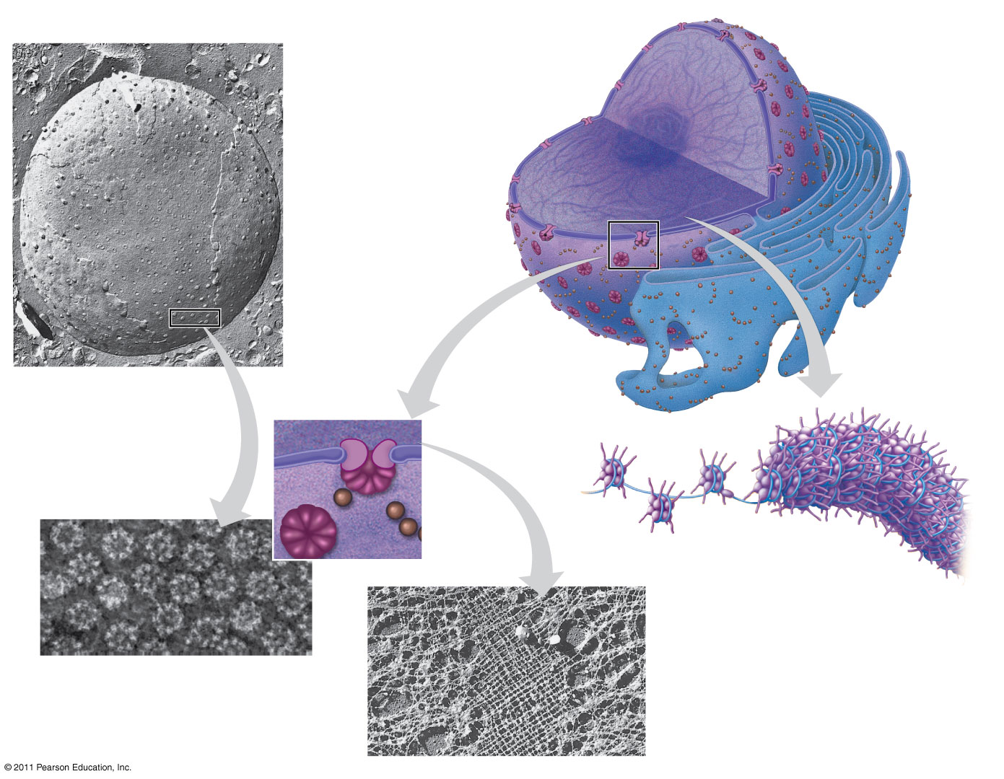
Figure 6.9
1 μm
10 11
14
Nucleus
Nucleolus
Chromatin
Nuclear envelope:
Inner membrane
Outer membrane
Nuclear pore
Rough ER
Pore complex
Surface of nuclear envelope
Ribosome
Close-up of nuclear envelope
0.25 μm
Chromatin
1 μm
Pore complexes (TEM)
Nuclear lamina (TEM)
Notes:
Figure 6.9 The nucleus and its envelope.

Slide 25
Pores regulate the entry and exit of molecules from the nucleus
The shape of the nucleus is maintained by the nuclear lamina, which is composed of protein
the nuclear matrix is the network of fibers found throughout the inside of a cell nucleus and is somewhat analogous to the cell cytoskeleton
(12)
© 2011 Pearson Education, Inc.

Slide 26
In the nucleus, DNA is organized into discrete units called chromosomes
Each chromosome is composed of a single DNA molecule associated with proteins
The DNA and proteins of chromosomes are together called chromatin
Chromatin condenses to form discrete chromosomes as a cell prepares to divide
The nucleolus is located within the nucleus and is the site of ribosomal RNA (rRNA) synthesis (13)
© 2011 Pearson Education, Inc.

Slide 27
Ribosomes: Protein Factories
Ribosomes are particles made of ribosomal RNA and protein
Ribosomes carry out protein synthesis in two locations
In the cytosol (free ribosomes)-”in house” proteins
On the outside of the endoplasmic reticulum or the nuclear envelope (bound ribosomes)-secreted proteins
(15 & 16)
© 2011 Pearson Education, Inc.
Notes:
For the Cell Biology Video Staining of Endoplasmic Reticulum, go to Animation and Video Files.

Slide 28
Concept 6.4: The endomembrane system regulates protein traffic and performs metabolic functions in the cell
Components of the endomembrane system (17)
Nuclear envelope
Endoplasmic reticulum
Golgi apparatus
Lysosomes
Vacuoles
Plasma membrane
These components are either continuous or connected via transfer by vesicles
© 2011 Pearson Education, Inc.

Slide 29
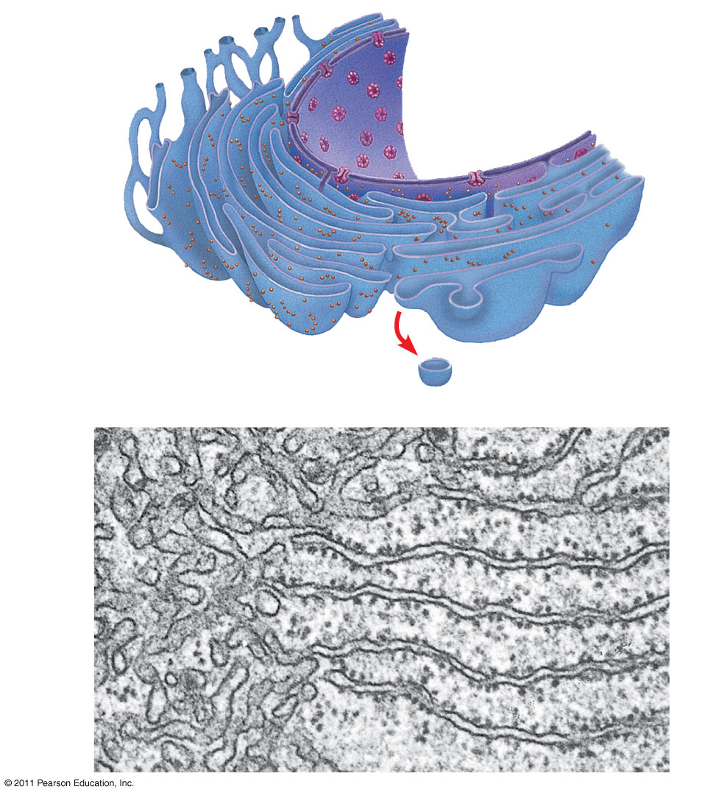
Figure 6.11
Smooth ER
Nuclear envelope
Rough ER
18
ER lumen
Cisternae
Transitional ER
Ribosomes
Transport vesicle
200 nm
Smooth ER
Rough ER
Notes:
Figure 6.11 Endoplasmic reticulum (ER).

Slide 30
Functions of Smooth ER
The smooth ER
Synthesizes lipids
Metabolizes carbohydrates
Detoxifies drugs and poisons
Stores calcium ions
(19 & 20)
© 2011 Pearson Education, Inc.

Slide 31
Functions of Rough ER
The rough ER
Has bound ribosomes, which secrete glycoproteins (proteins covalently bonded to carbohydrates)
Distributes transport vesicles, proteins surrounded by membranes
Is a membrane factory for the cell
(21 & 22)
© 2011 Pearson Education, Inc.

Slide 32
The Golgi Apparatus: Shipping and Receiving Center
The Golgi apparatus consists of flattened membranous sacs called cisternae
Functions of the Golgi apparatus
Modifies products of the ER
Manufactures certain macromolecules
Sorts and packages materials into transport vesicles
© 2011 Pearson Education, Inc.
Notes:
For the Cell Biology Video ER to Golgi Traffic, go to Animation and Video Files.
For the Cell Biology Video Golgi Complex in 3D, go to Animation and Video Files.
For the Cell Biology Video Secretion From the Golgi, go to Animation and Video Files.

Slide 33
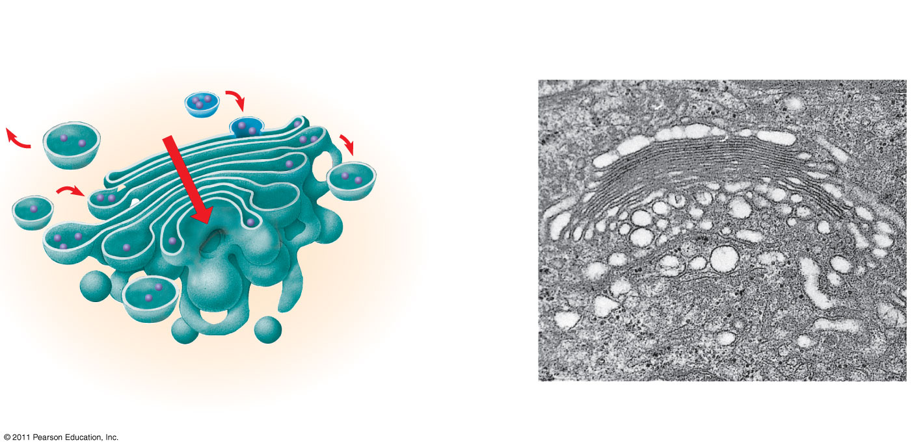
Figure 6.12
23
cis face (“receiving” side of Golgi apparatus)
0.1 μm
Cisternae
trans face (“shipping” side of Golgi apparatus)
TEM of Golgi apparatus
Notes:
Figure 6.12 The Golgi apparatus.

Slide 34
Lysosomes: Digestive Compartments
A lysosome is a membranous sac of hydrolytic enzymes that can digest macromolecules
Lysosomal enzymes can hydrolyze proteins, fats, polysaccharides, and nucleic acids
Lysosomal enzymes work best in the acidic environment inside the lysosome
(24)
© 2011 Pearson Education, Inc.

Slide 35
Some types of cell can engulf another cell by phagocytosis; this forms a food vacuole
Ex. Macrophages (25)
A lysosome fuses with the food vacuole and digests the molecules
Lysosomes also use enzymes to recycle the cell’s own organelles and macromolecules, a process called autophagy (26)
Tay Sach’s is a lysosomal disorder that results in the buildup of a lipid in nerve cells impairing their function.(27)
© 2011 Pearson Education, Inc.
Notes:
For the Cell Biology Video Phagocytosis in Action, go to Animation and Video Files.

Slide 36
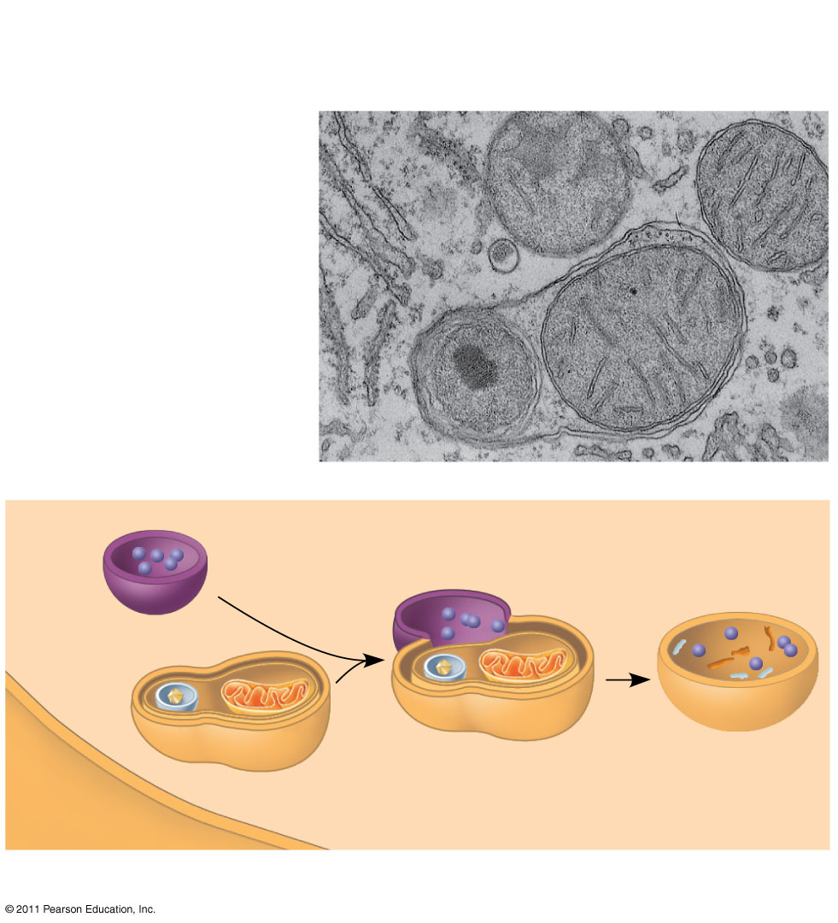
Figure 6.13b
Vesicle containing two damaged organelles
1 μm
Mitochondrion fragment
Peroxisome fragment
Lysosome
Peroxisome
Mitochondrion
Digestion
Vesicle
(b) Autophagy
Notes:
Figure 6.13 Lysosomes.

Slide 37
Vacuoles: Diverse Maintenance Compartments
A plant cell or fungal cell may have one or several vacuoles, derived from endoplasmic reticulum and Golgi apparatus
Food vacuoles are formed by phagocytosis
Contractile vacuoles, found in many freshwater protists, pump excess water out of cells
Central vacuoles, found in many mature plant cells, hold organic compounds and water
© 2011 Pearson Education, Inc.

Slide 38
The Endomembrane System: A Review
The endomembrane system is a complex and dynamic player in the cell’s compartmental organization
Next slide (29)
© 2011 Pearson Education, Inc.

Slide 39
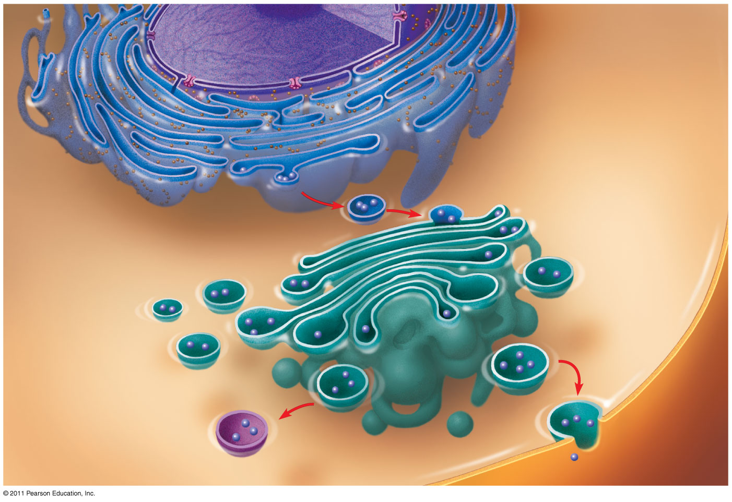
Figure 6.15-3
Nucleus
Rough ER
Smooth ER
cis Golgi
Plasma membrane
trans Golgi
Notes:
Figure 6.15 Review: relationships among organelles of the endomembrane system.

Slide 40
Concept 6.5: Mitochondria and chloroplasts change energy from one form to another
Mitochondria are the sites of cellular respiration, a metabolic process that uses oxygen to generate ATP
Chloroplasts, found in plants and algae, are the sites of photosynthesis
Peroxisomes are oxidative organelles
© 2011 Pearson Education, Inc.
Notes:
For the Cell Biology Video ER and Mitochondria in Leaf Cells, go to Animation and Video Files.
For the Cell Biology Video Mitochondria in 3D, go to Animation and Video Files.
For the Cell Biology Video Chloroplast Movement, go to Animation and Video Files.

Slide 41
The Endosymbiont theory
endosymbiont-“internal symbiont”
An early ancestor of eukaryotic cells engulfed a nonphotosynthetic prokaryotic cell, which formed an endosymbiont relationship with its host
The host cell and endosymbiont merged into a single organism, a eukaryotic cell with a mitochondrion
At least one of these cells may have taken up a photosynthetic prokaryote, becoming the ancestor of cells that contain chloroplasts
(30 & 31)
© 2011 Pearson Education, Inc.

Slide 42
The Evolutionary Origins of Mitochondria and Chloroplasts
Mitochondria and chloroplasts have similarities with bacteria
Enveloped by a double membrane
Contain free ribosomes and circular DNA molecules
Grow and reproduce somewhat independently in cells (31)
© 2011 Pearson Education, Inc.

Slide 43
Mitochondria: Chemical Energy Conversion
Mitochondria are in nearly all eukaryotic cells
They have a smooth outer membrane and an inner membrane folded into cristae
The inner membrane creates two compartments: intermembrane space and mitochondrial matrix
Some metabolic steps of cellular respiration are catalyzed in the mitochondrial matrix
Cristae present a large surface area for enzymes that synthesize ATP (32, 34, & 36 Next slide)
© 2011 Pearson Education, Inc.

Slide 44
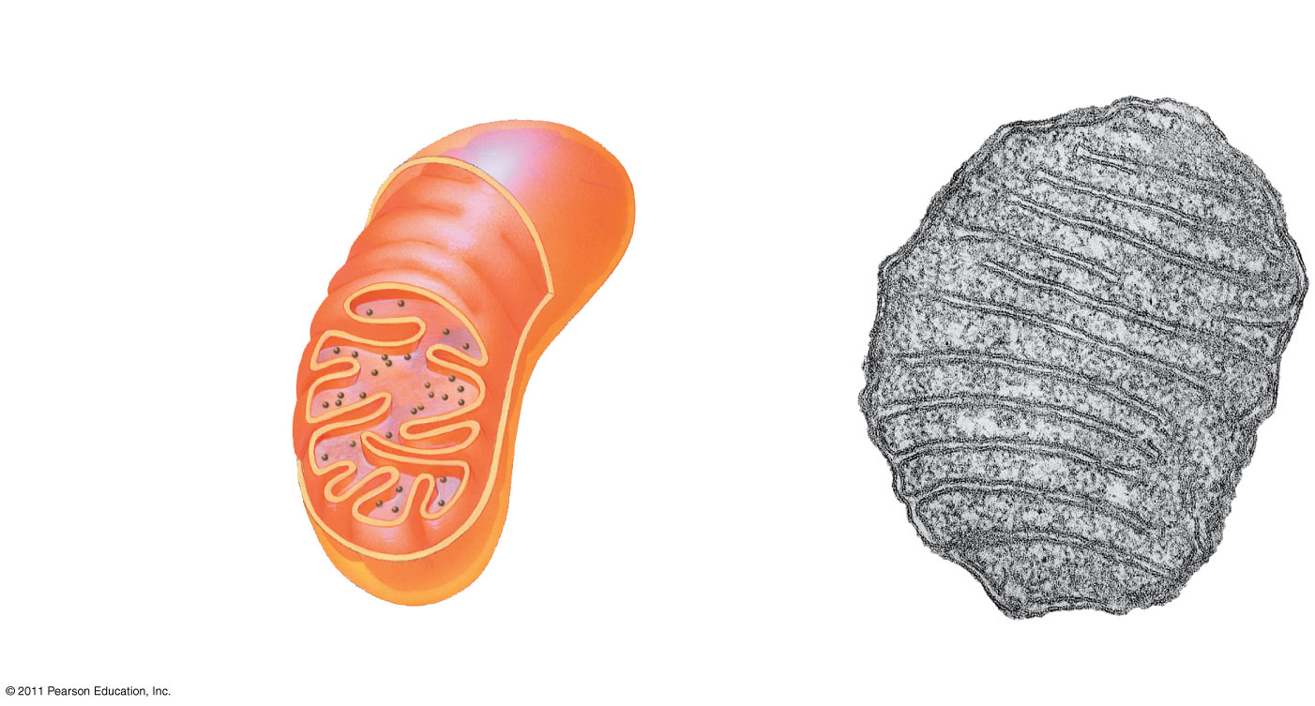
Figure 6.17a
Intermembrane space
Outer
membrane
DNA
Inner
Free ribosomes in the mitochondrial matrix
membrane
Cristae
Matrix
0.1 μm
(a) Diagram and TEM of mitochondrion
Notes:
Figure 6.17 The mitochondrion, site of cellular respiration.

Slide 45
Chloroplast structure includes
Thylakoids, membranous sacs, stacked to form a granum
Stroma, the internal fluid
The chloroplast is one of a group of plant organelles, called plastids
© 2011 Pearson Education, Inc.

Slide 46
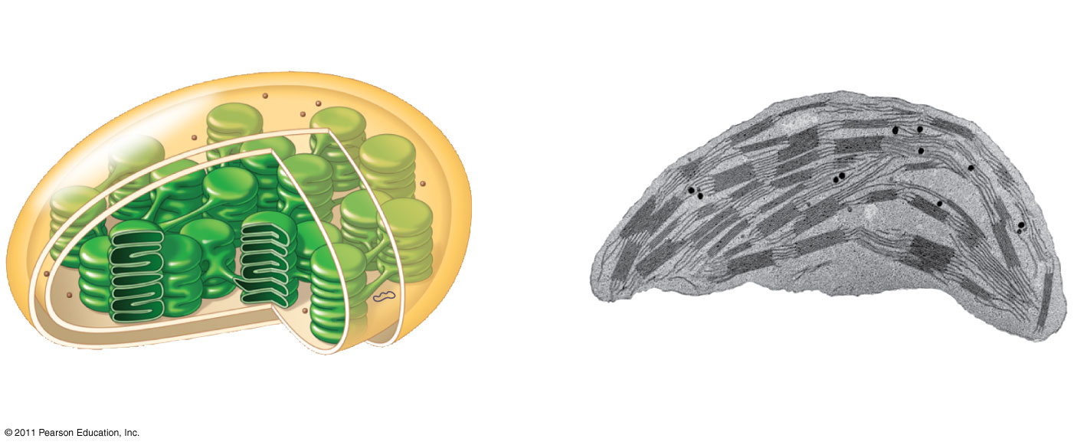
Figure 6.18a
Ribosomes
Stroma
Inner and outer
membranes
Granum
DNA
Thylakoid
Intermembrane space
1 μm
(a) Diagram and TEM of chloroplast
Notes:
Figure 6.18 The chloroplast, site of photosynthesis.

Slide 47
Peroxisomes: Oxidation
Peroxisomes are specialized metabolic compartments bounded by a single membrane
Peroxisomes produce hydrogen peroxide and convert it to water
Peroxisomes perform reactions with many different functions
(37)
© 2011 Pearson Education, Inc.

Slide 48
Concept 6.6: The cytoskeleton is a network of fibers that organizes structures and activities in the cell
The cytoskeleton is a network of fibers extending throughout the cytoplasm
It organizes the cell’s structures and activities, anchoring many organelles
It is composed of three types of molecular structures
Microtubules
Microfilaments
Intermediate filaments (38, 39, & 40)
© 2011 Pearson Education, Inc.
Notes:
For the Cell Biology Video The Cytoskeleton in a Neuron Growth Cone, go to Animation and Video Files
For the Cell Biology Video Cytoskeletal Protein Dynamics, go to Animation and Video Files.

Slide 49
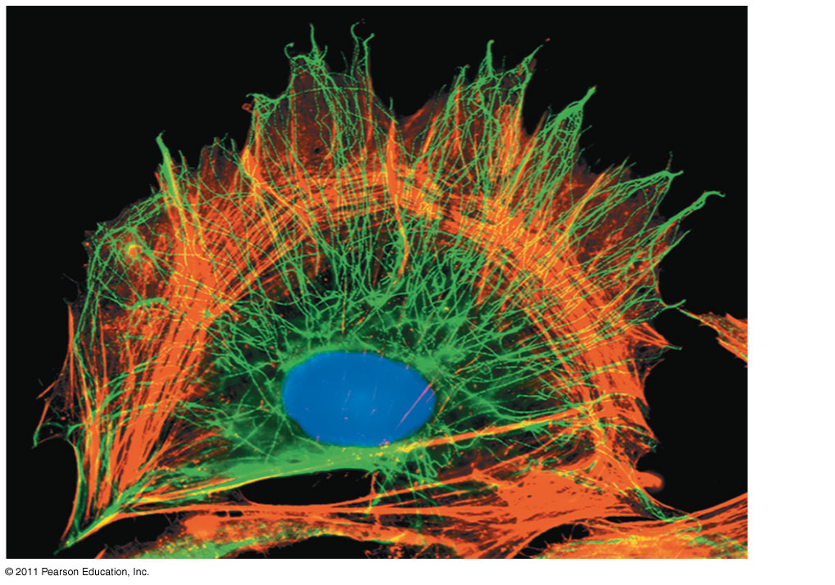
Figure 6.20
10 μm
Notes:
Figure 6.20 The cytoskeleton.

Slide 50
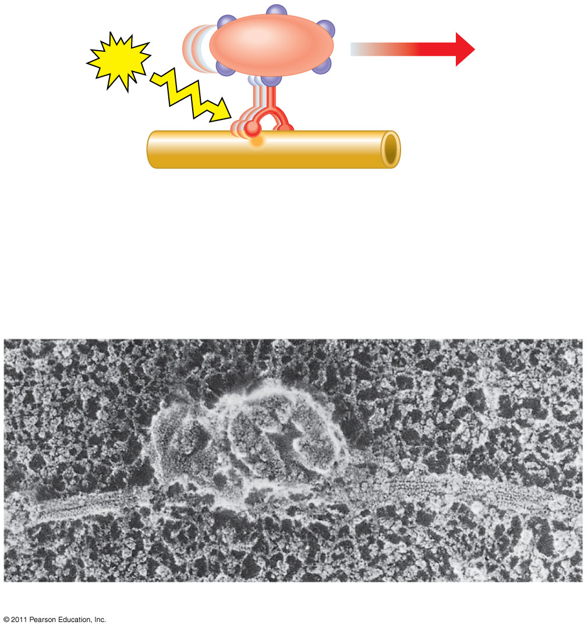
Figure 6.21
Vesicle
ATP
Receptor for motor protein
Motor protein (ATP powered)
Microtubule of cytoskeleton
(a)
Microtubule
Vesicles
0.25 μm
(b)
Notes:
Figure 6.21 Motor proteins and the cytoskeleton.

Slide 51
Table 6.1a
10 μm
41
Column of tubulin dimers
25 nm
α
β
Tubulin dimer
Notes:
Table 6.1 The Structure and Function of the Cytoskeleton

Slide 52
Microtubules
Microtubules are hollow rods about 25 nm in diameter and about 200 nm to 25 microns long
Functions of microtubules
Shaping the cell
Guiding movement of organelles
Separating chromosomes during cell division
© 2011 Pearson Education, Inc.
Notes:
For the Cell Biology Video Transport Along Microtubules, go to Animation and Video Files.
For the Cell Biology Video Movement of Organelles in Vivo, go to Animation and Video Files.
For the Cell Biology Video Movement of Organelles in Vitro, go to Animation and Video Files.

Slide 53
Centrosomes and Centrioles
In many cells, microtubules grow out from a centrosome near the nucleus
The centrosome is a “microtubule-organizing center”
In animal cells, the centrosome has a pair of centrioles, each with nine triplets of microtubules arranged in a ring that are “thought” to be involved with cell division
(41)
© 2011 Pearson Education, Inc.

Slide 54
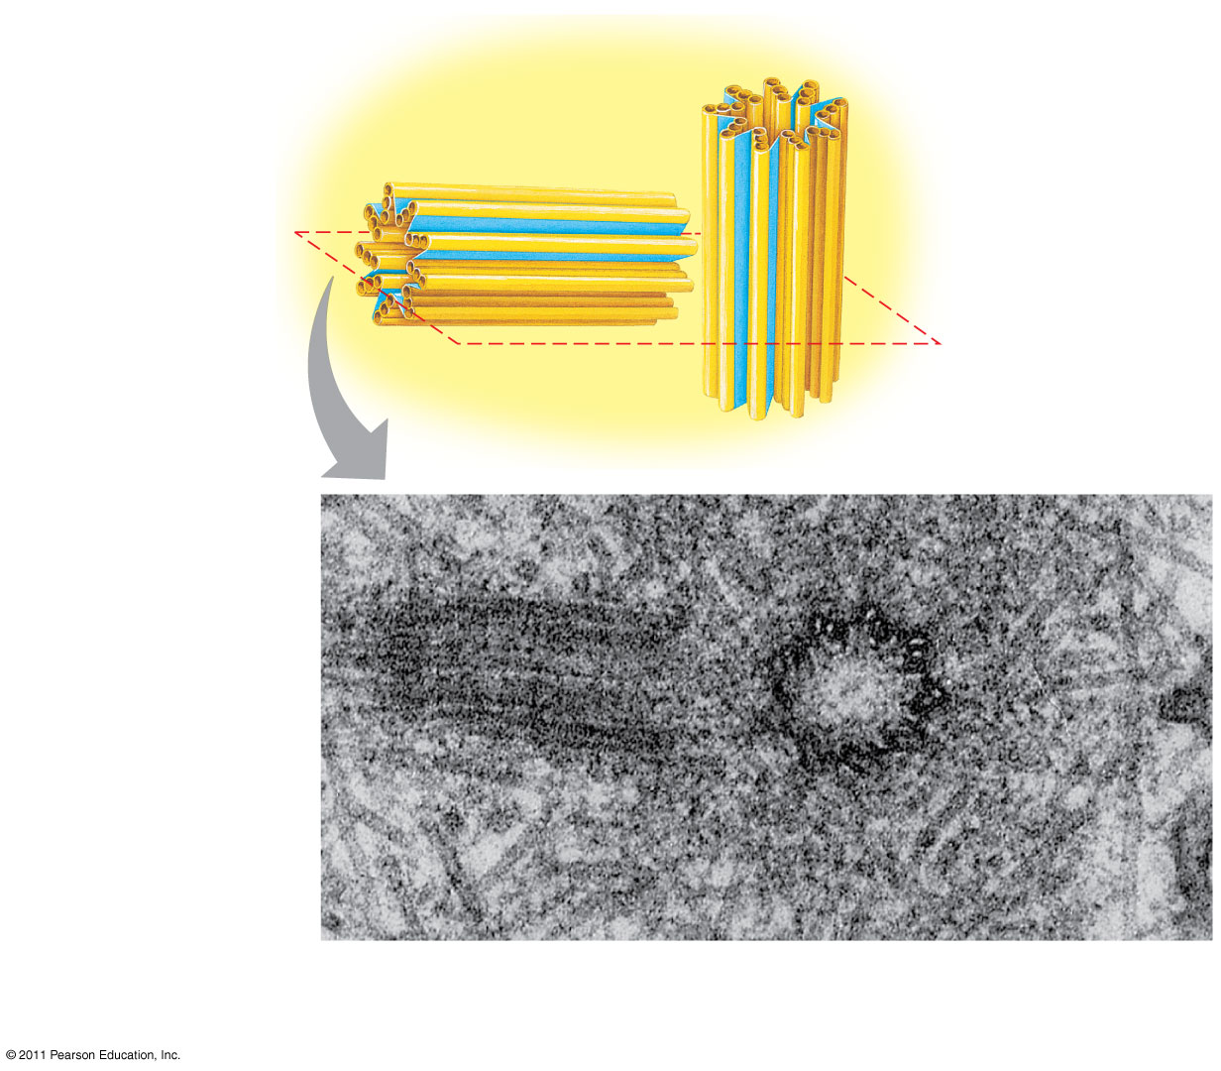
Figure 6.22
Centrosome
Microtubule
Centrioles
43
0.25 μm
Longitudinal section of one centriole
Microtubules
Cross section of the other centriole
Notes:
Figure 6.22 Centrosome containing a pair of centrioles.

Slide 55
Cilia and Flagella
Microtubules control the beating of cilia and flagella, locomotor appendages of some cells
Cilia and flagella differ in their beating patterns
© 2011 Pearson Education, Inc.

Slide 56
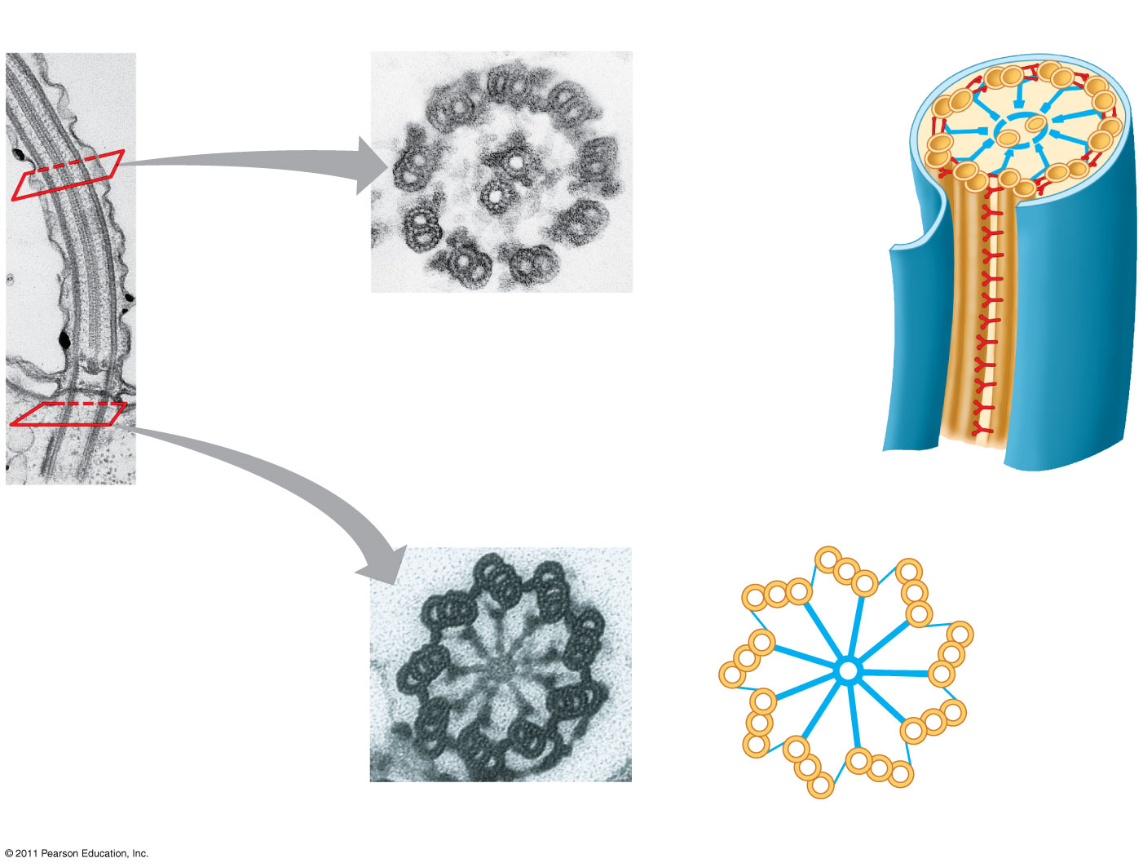
Figure 6.24
0.1 μm
Outer microtubule doublet
Plasma membrane
44
Dynein proteins
Central microtubule
Radial spoke
Microtubules
Cross-linking proteins between outer doublets
(b)
Cross section of motile cilium
Plasma membrane
Basal body
0.5 μm
0.1 μm
(a)
Longitudinal section of motile cilium
Triplet
(c)
Cross section of basal body
Notes:
Figure 6.24 Structure of a flagellum or motile cilium.

Slide 57
Cilia and flagella share a common structure
A core of microtubules sheathed by the plasma membrane
A basal body that anchors the cilium or flagellum
A motor protein called dynein, which drives the bending movements of a cilium or flagellum
Their actual motions are different (sperm/intestines move)
© 2011 Pearson Education, Inc.

Slide 58
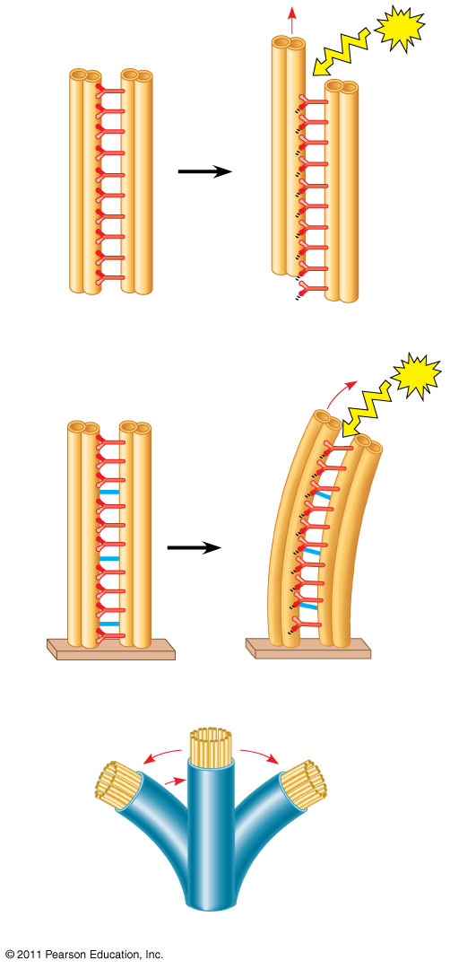
Figure 6.25
Microtubule doublets
ATP
How dynein “walking” moves flagella and cilia
Dynein arms alternately grab, move, and release the outer microtubules
Protein cross-links limit sliding
Forces exerted by dynein arms cause doublets to curve, bending the cilium or flagellum (46)
Dynein protein
(a) Effect of unrestrained dynein movement
Cross-linking proteins between outer doublets
ATP
Anchorage in cell
(b) Effect of cross-linking proteins
1
3
2
(c) Wavelike motion
Notes:
Figure 6.25 How dynein “walking” moves flagella and cilia.

Slide 59
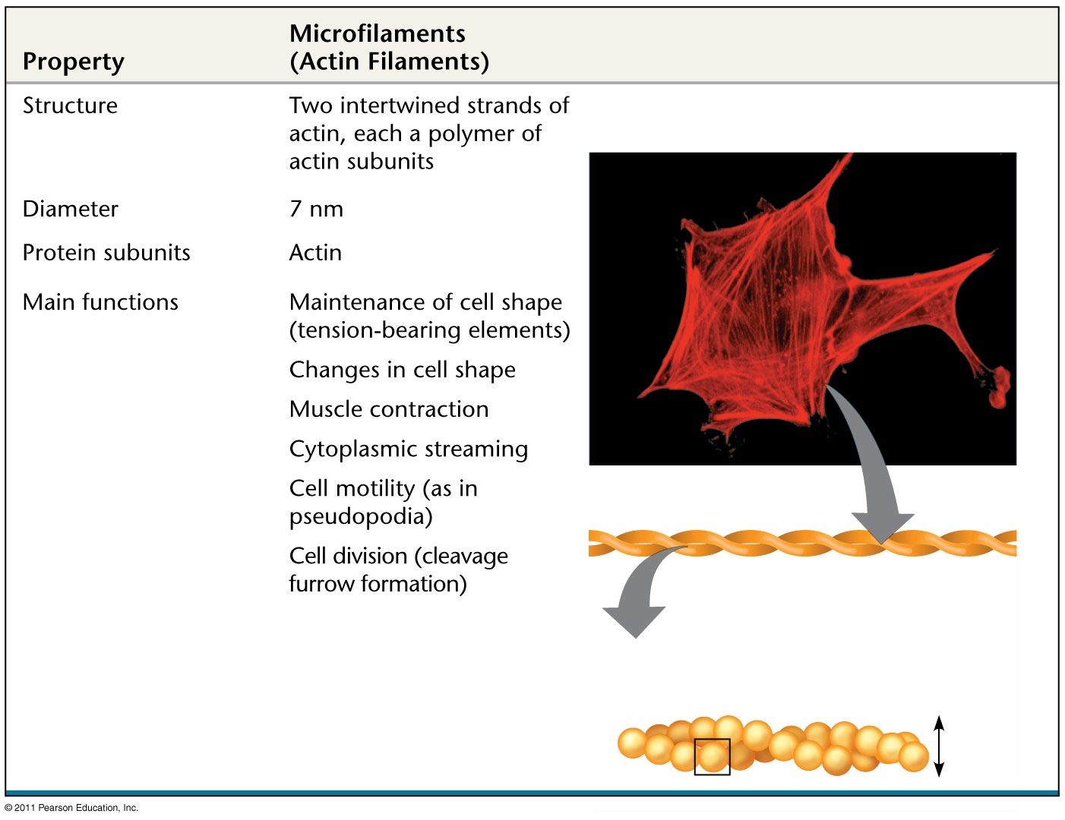
Table 6.1b
10 μm
47
Actin subunit
7 nm
Notes:
Table 6.1 The Structure and Function of the Cytoskeleton

Slide 60
Microfilaments that function in cellular motility contain the protein myosin in addition to actin
In muscle cells, thousands of actin filaments are arranged parallel to one another
Thicker filaments composed of myosin interdigitate with the thinner actin fibers
(48)
© 2011 Pearson Education, Inc.

Slide 61
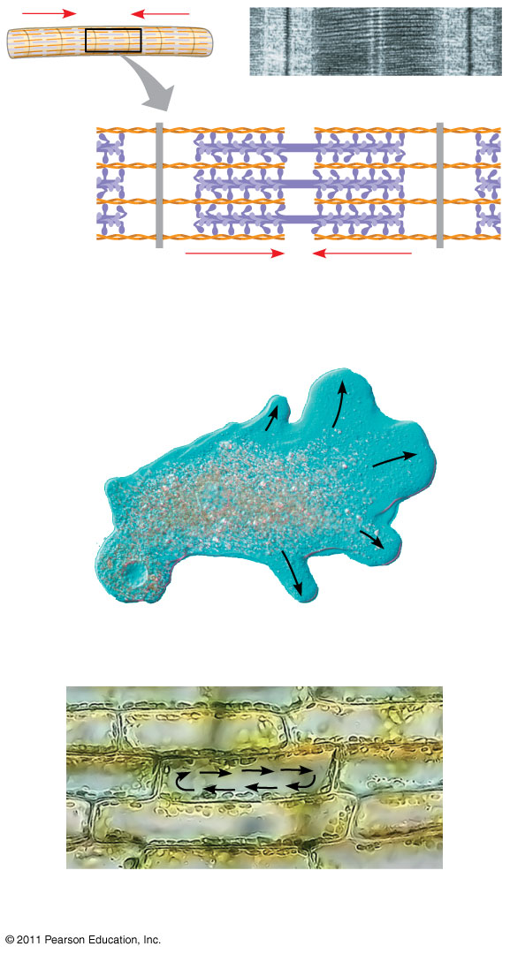
Figure 6.27
Muscle cell
0.5 μm
Actin
filament
Myosin
filament
Myosin
head
(a) Myosin motors in muscle cell contraction
Cortex (outer cytoplasm): gel with actin network
100 μm
Inner cytoplasm: sol with actin subunits
Extending pseudopodium
(b) Amoeboid movement
Chloroplast
30 μm
(c) Cytoplasmic streaming in plant cells
Notes:
Figure 6.27 Microfilaments and motility.

Slide 62
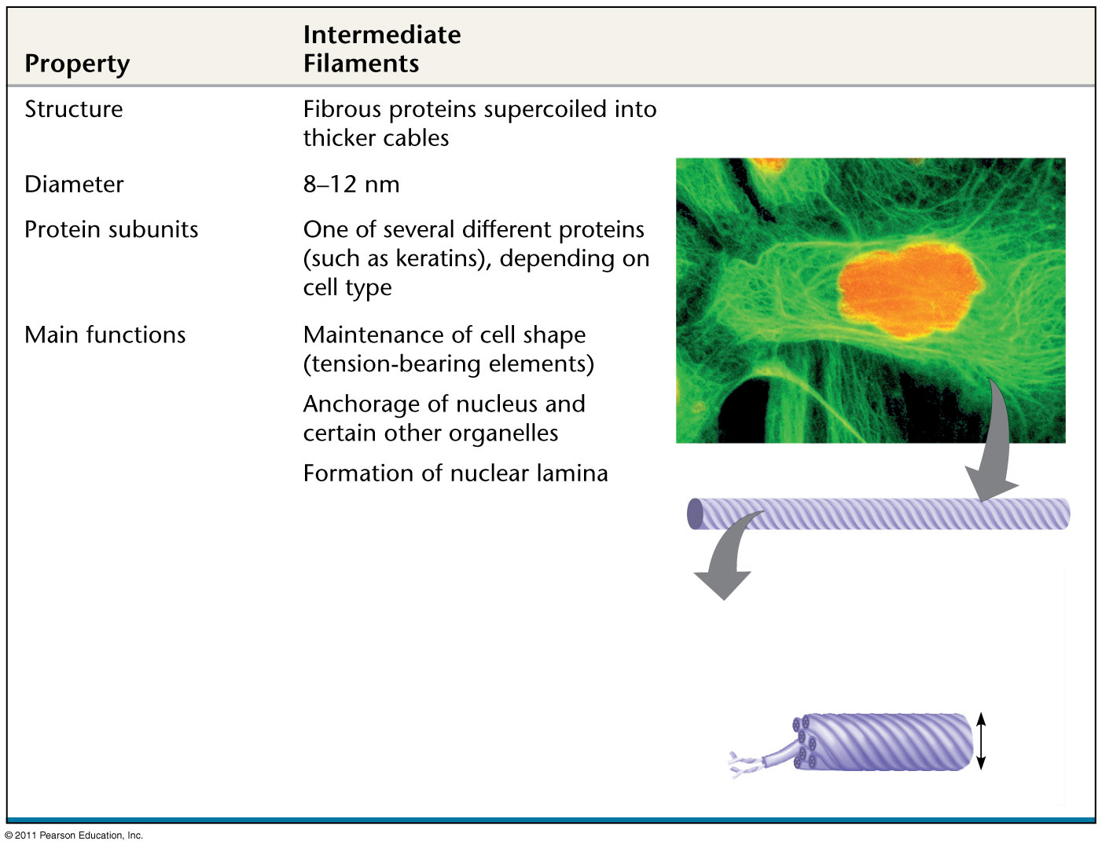
Table 6.1c
5 μm
Keratin proteins
Fibrous subunit (keratins coiled together)
49
8−12 nm
Notes:
Table 6.1 The Structure and Function of the Cytoskeleton

Slide 63
Concept 6.7: Cell Walls
The cell wall is an extracellular structure that distinguishes plant cells from animal cells
Prokaryotes, fungi, and some protists also have cell walls
The cell wall protects the plant cell, maintains its shape, and prevents excessive uptake of water
Plant cell walls are made of cellulose and fungi chitin.
© 2011 Pearson Education, Inc.

Slide 64
Plant cell walls may have multiple layers
Primary cell wall: relatively thin and flexible
Middle lamella: thin layer between primary walls of adjacent cells
Secondary cell wall (in some cells): added between the plasma membrane and the primary cell wall
Plasmodesmata are channels between adjacent plant cells
© 2011 Pearson Education, Inc.
Notes:
For the Cell Biology Video E-cadherin Expression, go to Animation and Video Files.

Slide 65
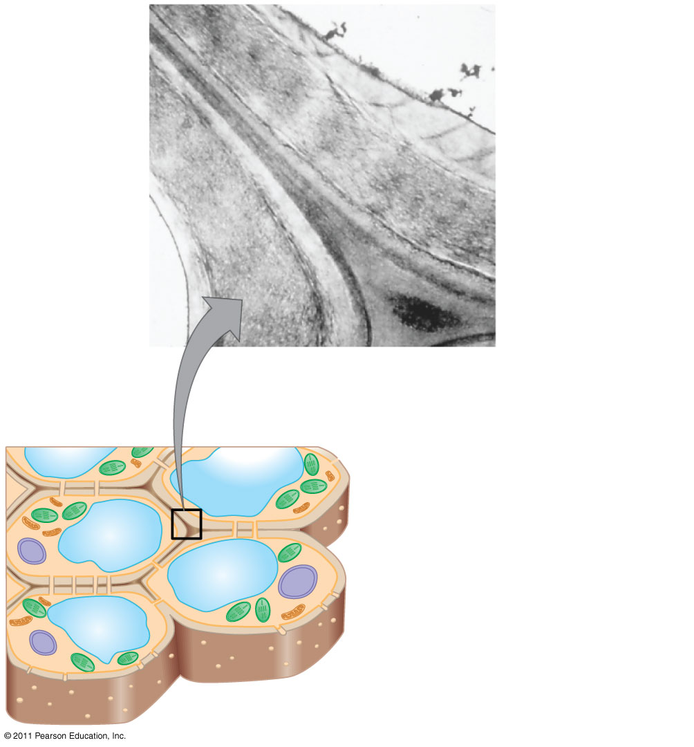
Figure 6.28
Secondary cell wall
Primary cell wall
55
Middle lamella
1 μm
Central vacuole
Cytosol
Plasma membrane
Plant cell walls
Plasmodesmata
Notes:
Figure 6.28 Plant cell walls.

Slide 66
The Extracellular Matrix (ECM) of Animal Cells
Animal cells lack cell walls but are covered by an elaborate extracellular matrix (ECM)
The ECM is made up of glycoproteins such as collagen, proteoglycans, and fibronectin
ECM proteins bind to receptor proteins in the plasma membrane called integrins
© 2011 Pearson Education, Inc.
Notes:
For the Cell Biology Video Cartoon Model of a Collagen Triple Helix, go to Animation and Video Files.
For the Cell Biology Video Staining of the Extracellular Matrix, go to Animation and Video Files.
For the Cell Biology Video Fibronectin Fibrils, go to Animation and Video Files.

Slide 67
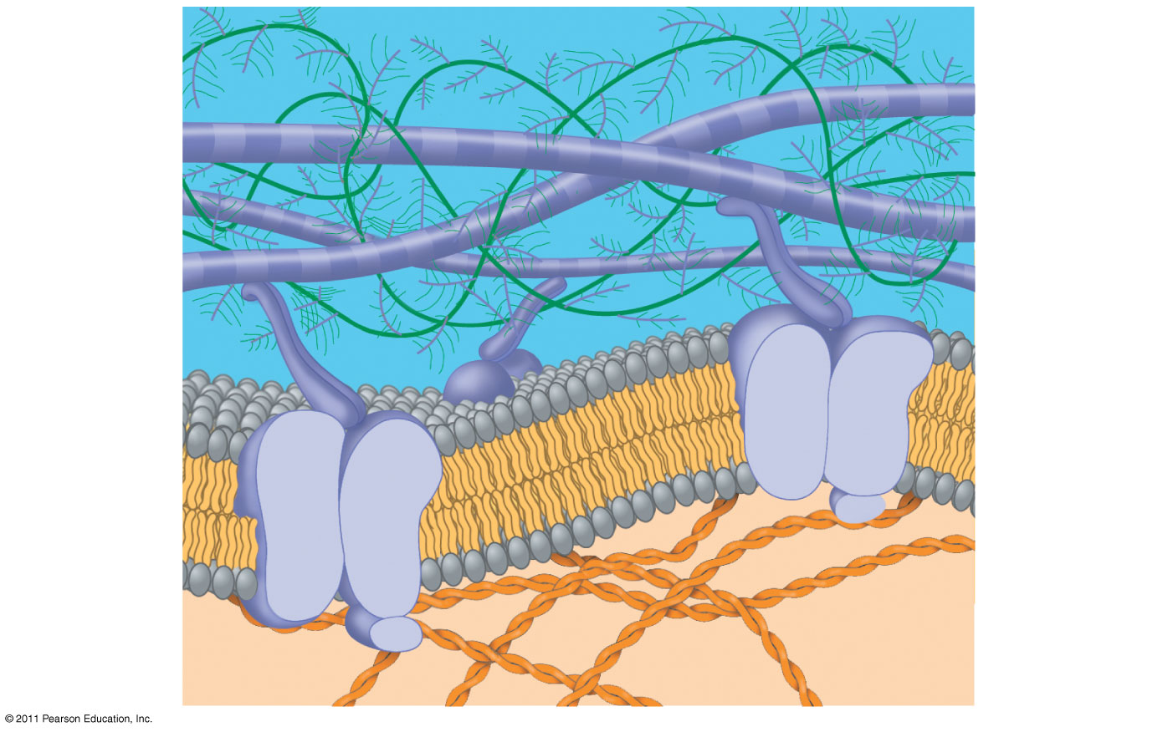
Figure 6.30a
56
Collagen
EXTRACELLULAR FLUID
Proteoglycan complex
Fibronectin
Integrins
Functions of the ECM
Support
Adhesion
Movement
Regulation
Plasma membrane
Micro-
filaments
CYTOPLASM
Notes:
Figure 6.30 Extracellular matrix (ECM) of an animal cell.

Slide 68
Cell Junctions
Neighboring cells in tissues, organs, or organ systems often adhere, interact, and communicate through direct physical contact
Intercellular junctions facilitate this contact
There are several types of intercellular junctions
Plasmodesmata
Tight junctions
Desmosomes
Gap junctions
© 2011 Pearson Education, Inc.

Slide 69
Plasmodesmata in Plant Cells
Plasmodesmata are channels that perforate plant cell walls
Through plasmodesmata, water and small solutes (and sometimes proteins and RNA) can pass from cell to cell (57)
© 2011 Pearson Education, Inc.

Slide 70
Tight Junctions, Desmosomes, and Gap Junctions in Animal Cells
At tight junctions, membranes of neighboring cells are pressed together, preventing leakage of extracellular fluid
Desmosomes (anchoring junctions) fasten cells together into strong sheets
Gap junctions (communicating junctions) provide cytoplasmic channels between adjacent cells
(Next slide 58)
© 2011 Pearson Education, Inc.

Slide 71
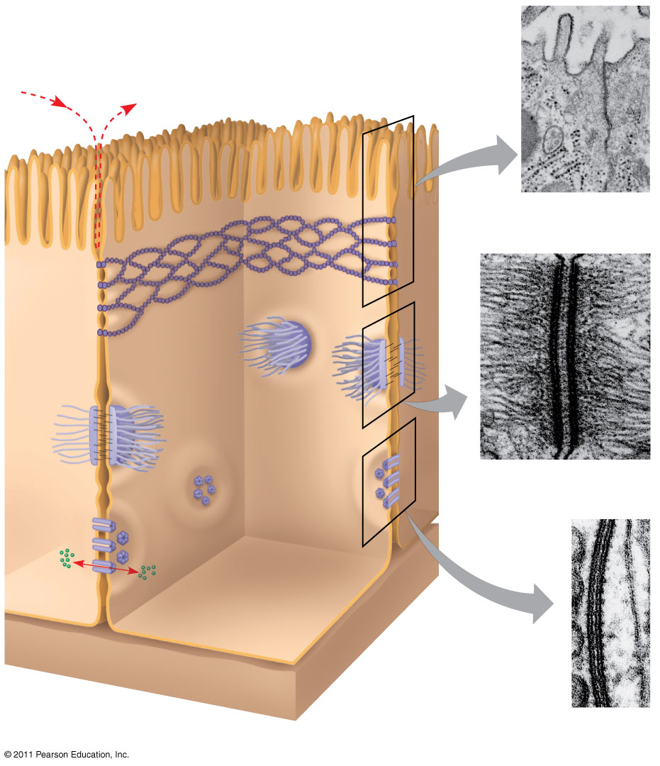
Figure 6.32
Tight junctions prevent fluid from moving across a layer of cells
Tight junction
TEM
0.5 μm
Tight junction
Intermediate filaments
Desmosome
TEM
1 μm
Gap junction
Ions or small molecules
Space between cells
Extracellular matrix
TEM
Plasma membranes of adjacent cells
0.1 μm
Notes:
Figure 6.32 Exploring: Cell Junctions in Animal Tissues

