Slide 1
Chapter 10
Photosynthesis

Slide 2
Overview: The Process That Feeds the Biosphere
Photosynthesis is the process that converts solar energy into chemical energy
Directly or indirectly, photosynthesis nourishes almost the entire living world
Autotrophs sustain themselves without eating anything derived from other organisms
Almost all plants are photoautotrophs, using the energy of sunlight to make organic molecules (1)
© 2011 Pearson Education, Inc.

Slide 3
Heterotrophs obtain their organic material from other organisms
Heterotrophs are the consumers of the biosphere
Almost all heterotrophs, including humans, depend on photoautotrophs for food and O₂
© 2011 Pearson Education, Inc.

Slide 4
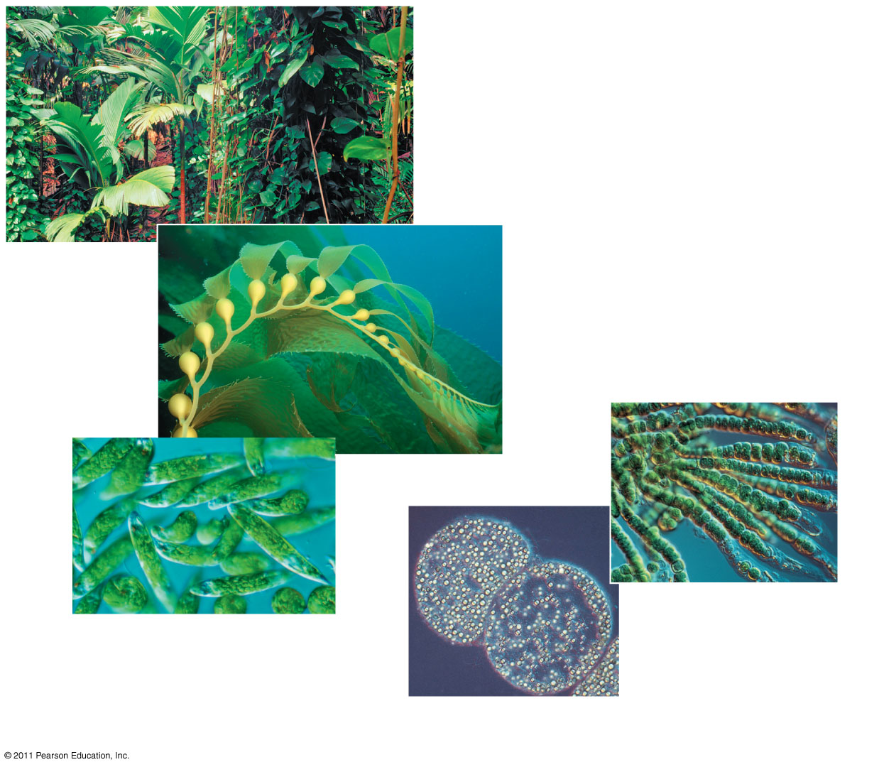
Figure 10.2
(b)
Multicellular alga
(a) Plants
(d) Cyanobacteria
40 μm
(c)
Unicellular protists
10 μm
(e)
Purple sulfur bacteria
1 μm
Notes:
4
Figure 10.2 Photoautotrophs.

Slide 5
Chloroplasts: The Sites of Photosynthesis in Plants
Leaves are the major locations of photosynthesis
Their green color is from chlorophyll, the green pigment within chloroplasts
Chloroplasts are found mainly in cells of the mesophyll, the interior tissue of the leaf
Each mesophyll cell contains 30–40 chloroplasts
© 2011 Pearson Education, Inc.

Slide 6
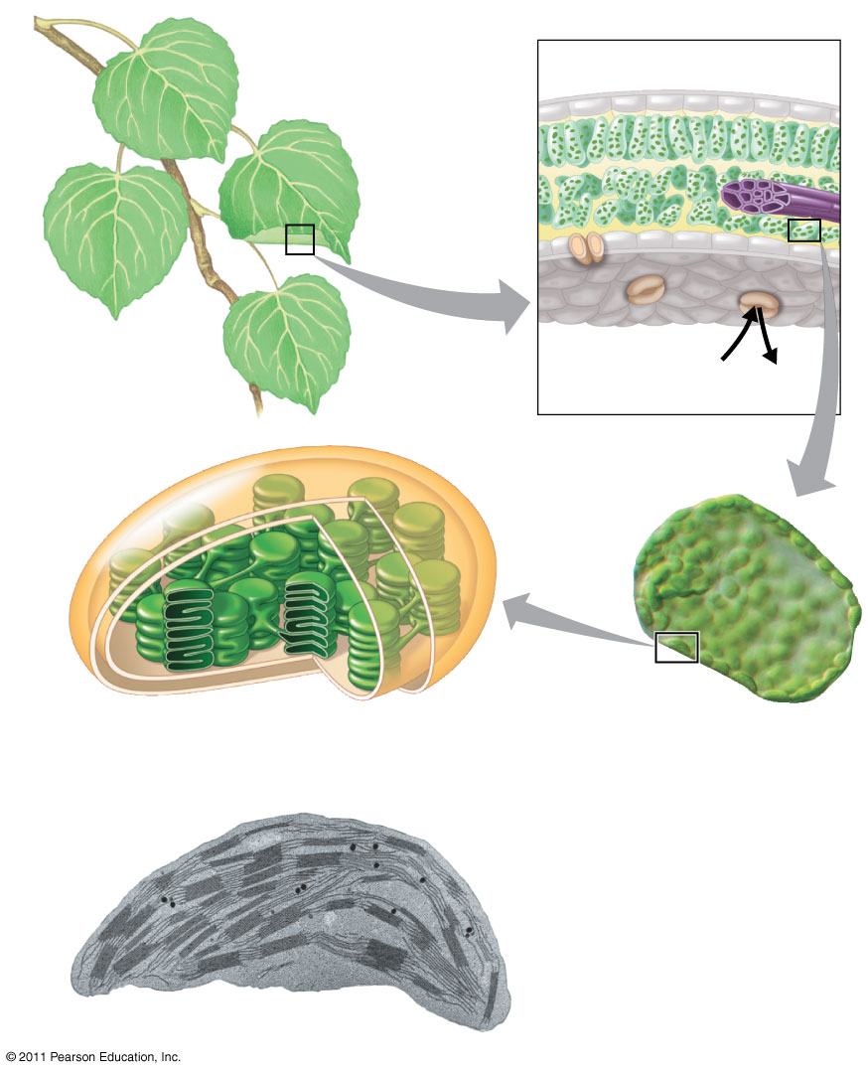
Figure 10.4
Leaf cross section
Chloroplasts
Vein
Mesophyll
Stomata
CO₂
O₂
2
Chloroplast
Mesophyll cell
Outer membrane
Thylakoid
Intermembrane space
Stroma
Granum
Thylakoid space
20 μm
Inner membrane
1 μm
Notes:
6
Figure 10.4 Zooming in on the location of photosynthesis in a plant.

Slide 7
Tracking Atoms Through Photosynthesis: Scientific Inquiry
Photosynthesis is a complex series of reactions that can be summarized as the following equation:
6 CO₂ + 12 H₂O + Light energy → C₆H₁₂O₆ + 6 O₂ + 6 H₂O
(3)
© 2011 Pearson Education, Inc.

Slide 8
The Splitting of Water
Chloroplasts split H₂O into hydrogen and oxygen, incorporating the electrons of hydrogen into sugar molecules and releasing oxygen as a by-product
© 2011 Pearson Education, Inc.

Slide 9
Figure 10.5
Reactants:
6 CO₂
12 H₂O
Products:
C₆H₁₂O₆
6 H₂O
6 O₂
Isotopes have been used to track atoms through photosynthesis. (4)
Notes:
9
Figure 10.5 Tracking atoms through photosynthesis.

Slide 10
Photosynthesis as a Redox Process
Photosynthesis reverses the direction of electron flow compared to respiration
Photosynthesis is a redox process in which H₂O is oxidized and CO₂ is reduced
Photosynthesis is an endergonic process; the enery boost is provided by light
© 2011 Pearson Education, Inc.

Slide 11
The Two Stages of Photosynthesis: A Preview
Photosynthesis consists of the light reactions (the photo part) and Calvin cycle (the synthesis part)
The light reactions (in the thylakoids)
Split H₂O
Release O₂
Reduce NADP⁺ to NADPH
Generate ATP from ADP by photophosphorylation (5a)
© 2011 Pearson Education, Inc.

Slide 12
The Calvin cycle (in the stroma) forms sugar from CO₂, using ATP and NADPH
The Calvin cycle begins with carbon fixation, incorporating CO₂ into organic molecules (5b)
© 2011 Pearson Education, Inc.

Slide 13
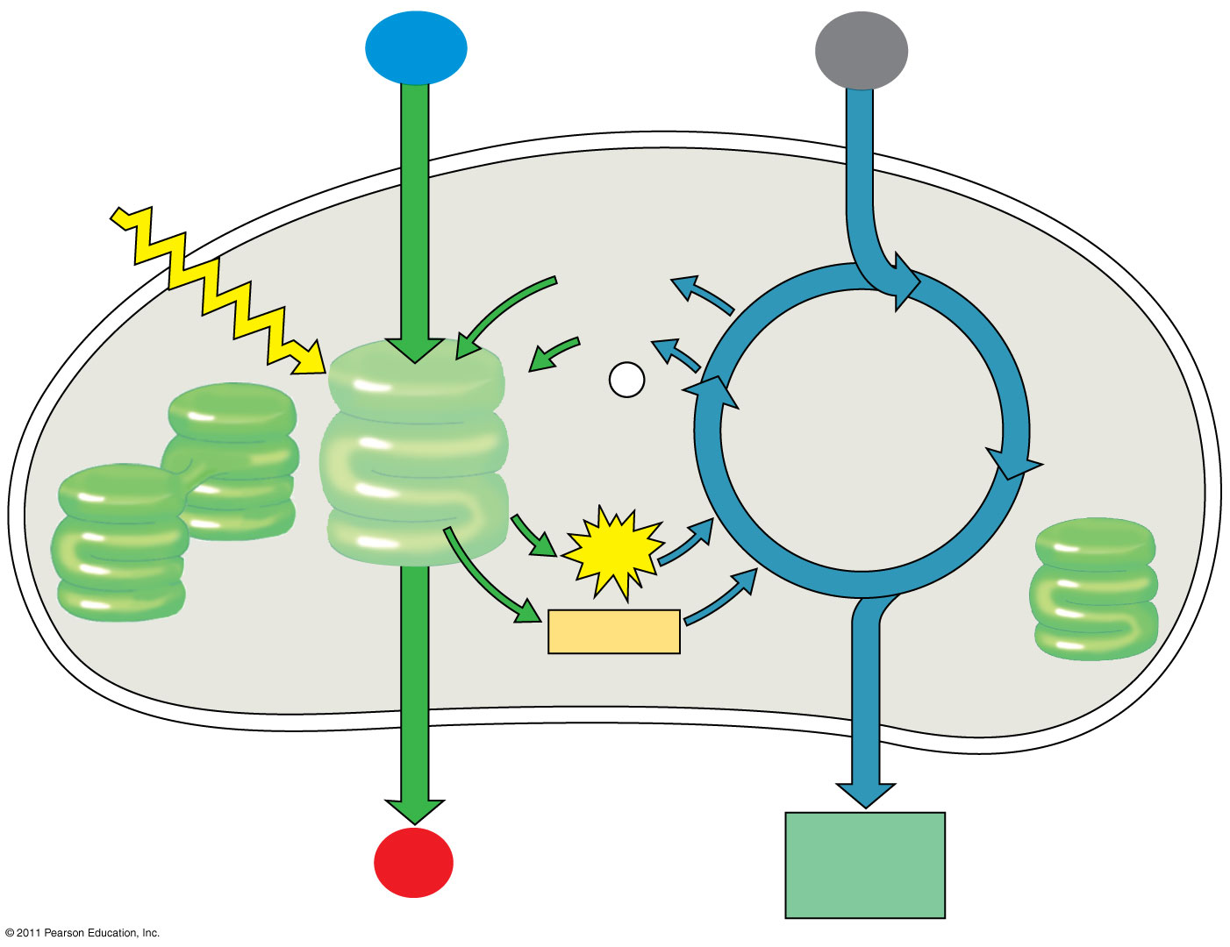
Figure 10.6-4
H₂O
CO₂
6
Light
NADP⁺
ADP
+ P _{i}
Calvin Cycle
Light Reactions
ATP
NADPH
Chloroplast
O₂
[CH₂O] (sugar)
Notes:
13
Figure 10.6 An overview of photosynthesis: cooperation of the light reactions and the Calvin cycle.

Slide 14
Concept 10.2: The light reactions convert solar energy to the chemical energy of ATP and NADPH
Chloroplasts are solar-powered chemical factories
Their thylakoids transform light energy into the chemical energy of ATP and NADPH
© 2011 Pearson Education, Inc.

Slide 15
The electromagnetic spectrum is the entire range of electromagnetic energy, or radiation
Visible light consists of wavelengths (including those that drive photosynthesis) that produce colors we can see
Light also behaves as though it consists of discrete particles, called photons
© 2011 Pearson Education, Inc.

Slide 16
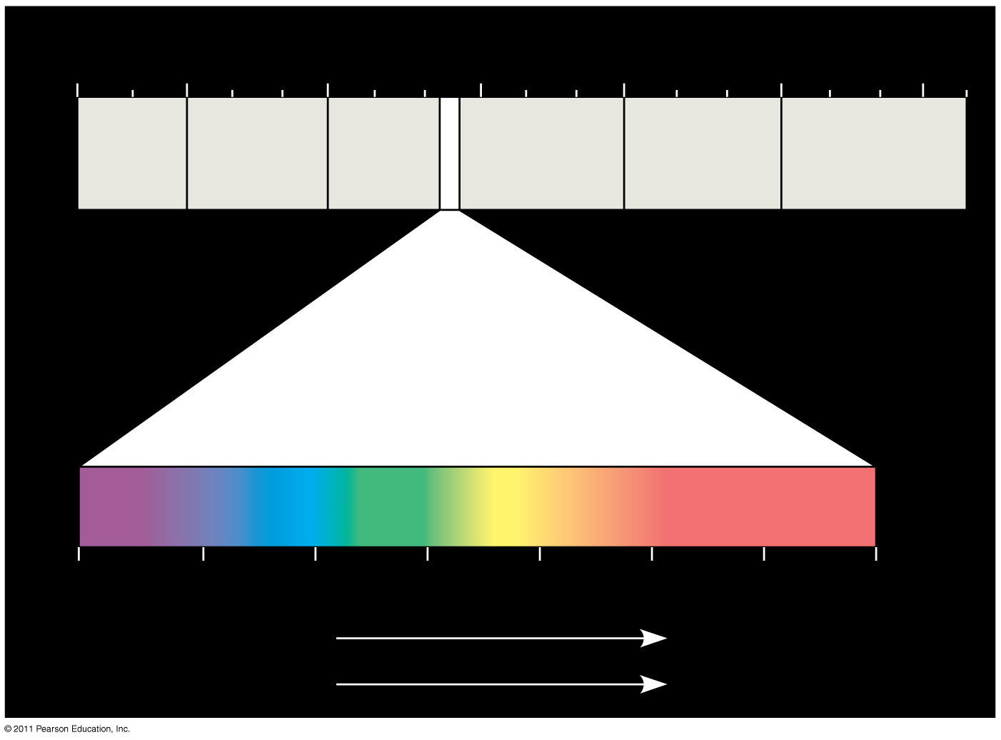
Figure 10.7
(7 & 8)
1 m
10⁻⁵ nm
10⁻³ nm
1 nm
10³ nm
10⁶ nm
(10⁹ nm)
10³ m
Gamma rays
Micro- waves
Radio waves
X-rays
UV
Infrared
Visible light
380
450
500
550
600
650
700
750 nm
Shorter wavelength
Longer wavelength
Higher energy
Lower energy
Notes:
16
Figure 10.7 The electromagnetic spectrum.

Slide 17
Photosynthetic Pigments: The Light Receptors
Pigments are substances that absorb visible light
Different pigments absorb different wavelengths
Wavelengths that are not absorbed are reflected or transmitted
Leaves appear green because chlorophyll reflects and transmits green light
Animation: Light and Pigments
© 2011 Pearson Education, Inc.

Slide 18
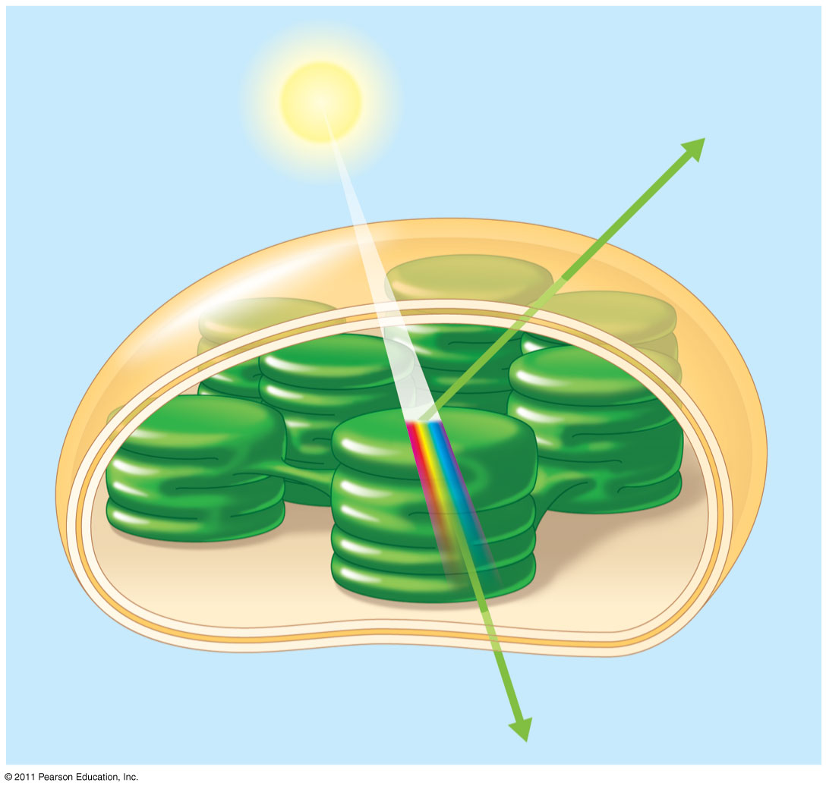
Figure 10.8
Light
Reflected light
Chloroplast
Absorbed light
Granum
Transmitted light
Notes:
18
Figure 10.8 Why leaves are green: interaction of light with chloroplasts.

Slide 19
A spectrophotometer measures a pigment’s ability to absorb various wavelengths
This machine sends light through pigments and measures the fraction of light transmitted at each wavelength
© 2011 Pearson Education, Inc.

Slide 20
An absorption spectrum is a graph plotting a pigment’s light absorption versus wavelength
The absorption spectrum of chlorophyll a suggests that violet-blue and red light work best for photosynthesis
An action spectrum profiles the relative effectiveness of different wavelengths of radiation in driving a process (9)
© 2011 Pearson Education, Inc.
Notes:
For the Cell Biology Video Space-Filling Model of Chlorophyll a, go to Animation and Video Files.

Slide 21
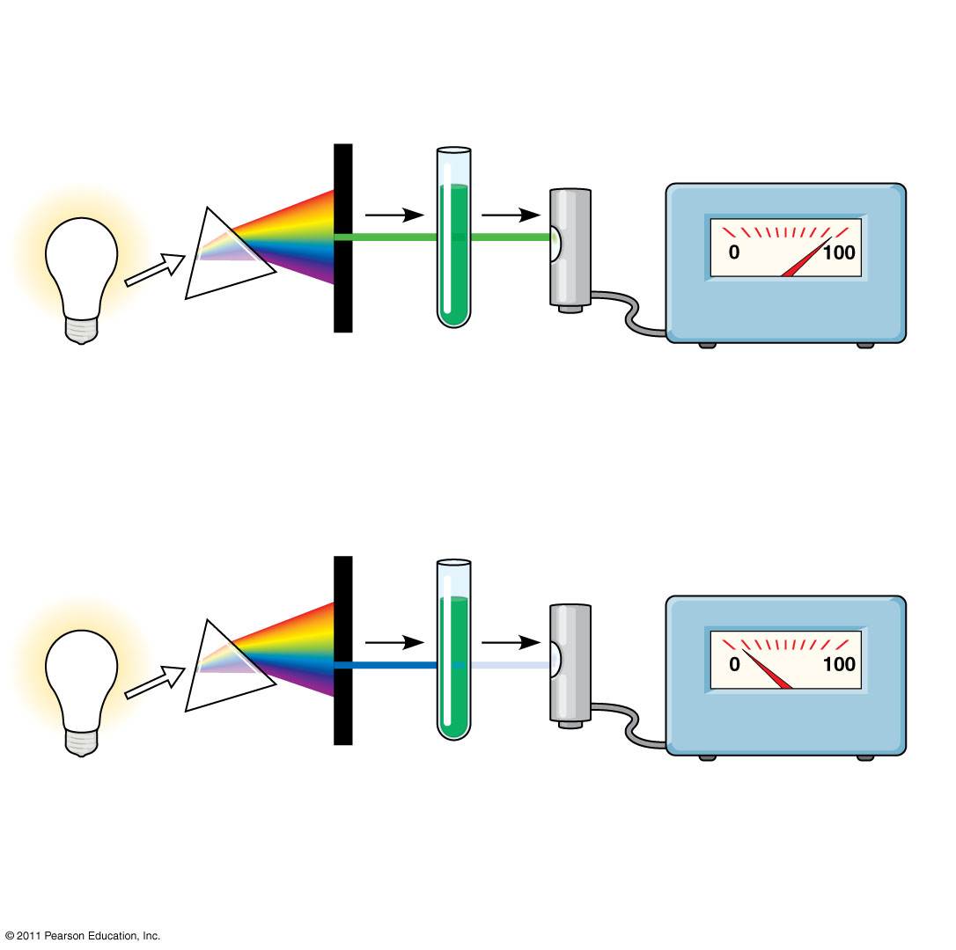
Figure 10.9
TECHNIQUE
Refracting prism
Chlorophyll solution
Photoelectric tube
White light
Galvanometer
High transmittance (low absorption): Chlorophyll absorbs very little green light.
Slit moves to pass light of selected wavelength.
Green light
Low transmittance (high absorption): Chlorophyll absorbs most blue light.
Blue light
Notes:
21
Figure 10.9 Research Method: Determining an Absorption Spectrum

Slide 22
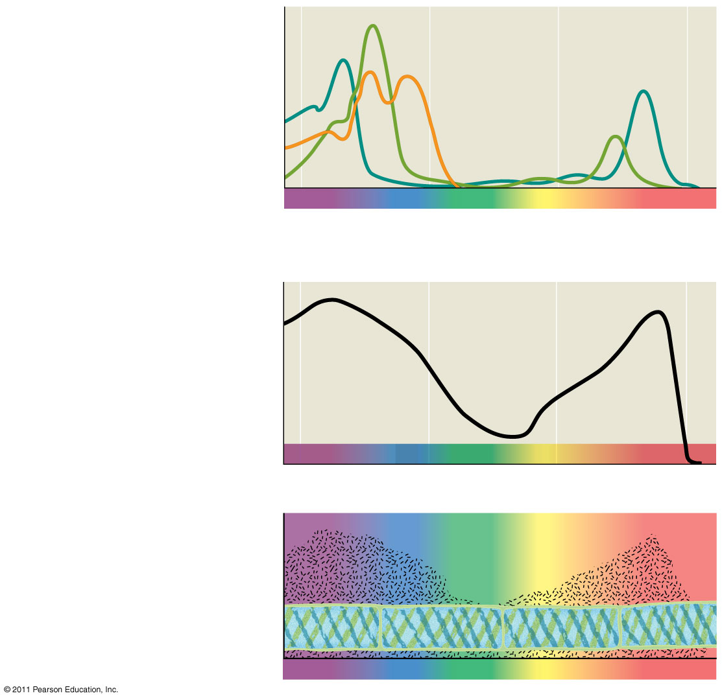
Figure 10.10
RESULTS
Chloro- phyll a
Chlorophyll b
Absorption of light by chloroplast pigments
Carotenoids
(a)
Absorption spectra
400
500
600
700
Wavelength of light (nm)
Rate of photosynthesis (measured by O₂ release)
(b) Action spectrum
400
500
600
700
Aerobic bacteria
Filament of alga
(c)
Engelmann’s experiment
400
500
600
700
Notes:
22
Figure 10.10 Inquiry: Which wavelengths of light are most effective in driving photosynthesis?

Slide 23
The action spectrum of photosynthesis was first demonstrated in 1883 by Theodor W. Engelmann
In his experiment, he exposed different segments of a filamentous alga to different wavelengths
Areas receiving wavelengths favorable to photosynthesis produced excess O₂
He used the growth of aerobic bacteria clustered along the alga as a measure of O₂ production (10)
© 2011 Pearson Education, Inc.

Slide 24
A Photosystem: A Reaction-Center Complex Associated with Light-Harvesting Complexes
A photosystem consists of a reaction-center complex (a type of protein complex) surrounded by light-harvesting complexes
The light-harvesting complexes (pigment molecules bound to proteins) transfer the energy of photons to the reaction center (11 12a 12b)
© 2011 Pearson Education, Inc.

Slide 25
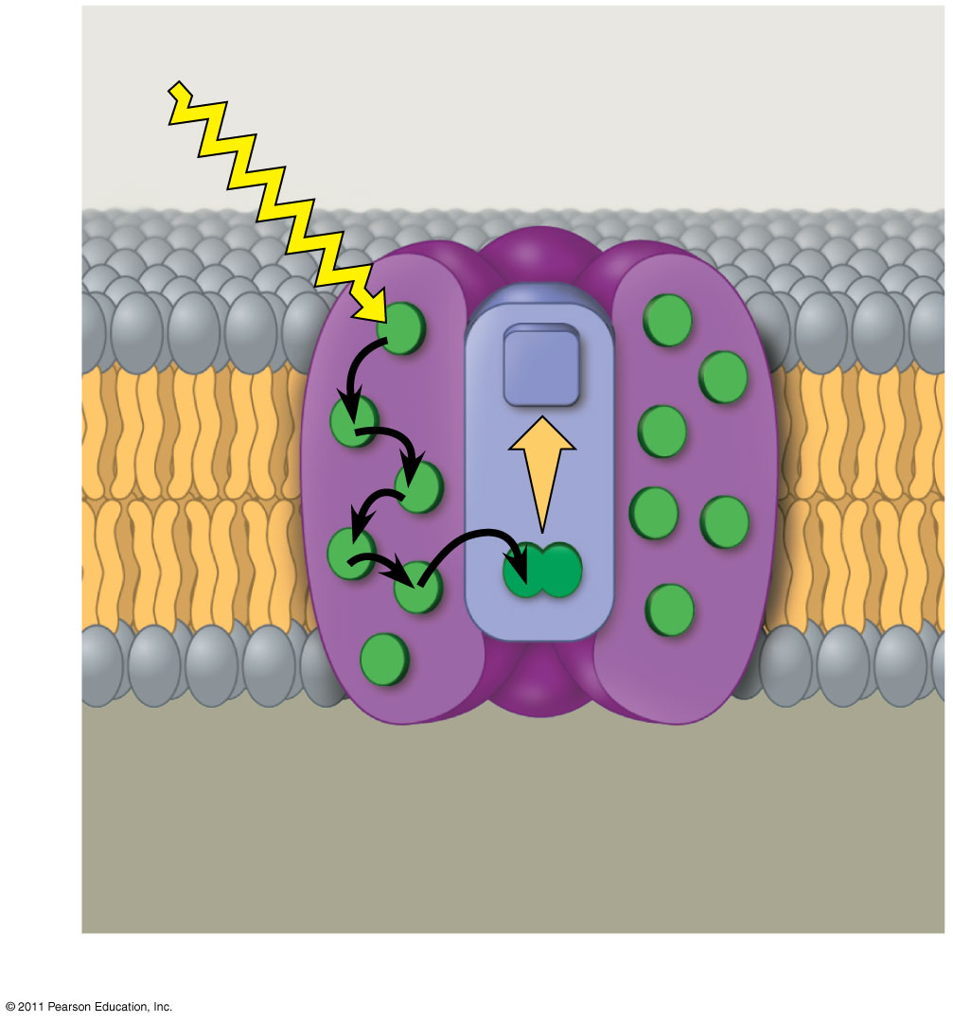
Figure 10.13a
Photosystem
STROMA
Photon
Light- harvesting complexes
Reaction- center complex
Primary electron acceptor
12
e⁻
Thylakoid membrane
Transfer of energy
Special pair of chlorophyll a molecules
Pigment molecules
THYLAKOID SPACE (INTERIOR OF THYLAKOID)
(a) How a photosystem harvests light
Notes:
25
Figure 10.13 The structure and function of a photosystem.

Slide 26
A primary electron acceptor in the reaction center accepts excited electron and is reduced as a result
Solar-powered transfer of an electron from a chlorophyll a molecule to the primary electron acceptor is the first step of the light reactions (12c)
© 2011 Pearson Education, Inc.

Slide 27
There are two types of photosystems in the thylakoid membrane
Photosystem II (PS II) functions first (the numbers reflect order of discovery) and is best at absorbing a wavelength of 680 nm
The reaction-center chlorophyll a of PS II is called P680
Photosystem I (PS I) is best at absorbing a wavelength of 700 nm
The reaction-center chlorophyll a of PS I is called P700 (13 14)
© 2011 Pearson Education, Inc.

Slide 28
Linear Electron Flow
During the light reactions, there are two possible routes for electron flow: cyclic and linear
Linear electron flow, the primary pathway, involves both photosystems and produces ATP and NADPH using light energy
© 2011 Pearson Education, Inc.

Slide 29
A photon hits a pigment and its energy is passed among pigment molecules until it excites P680
An excited electron from P680 is transferred to the primary electron acceptor (we now call it P680⁺)
© 2011 Pearson Education, Inc.

Slide 30
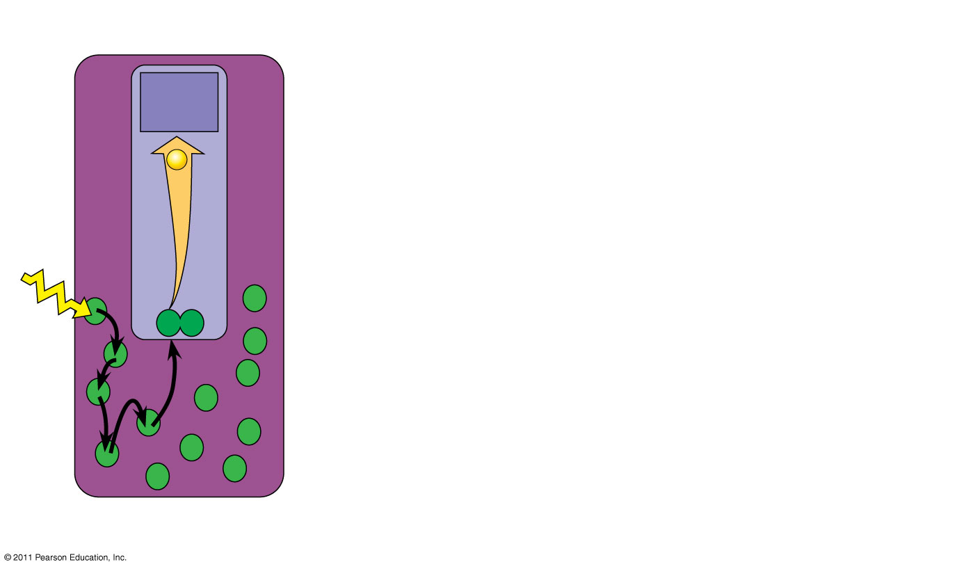
Figure 10.14-1
Primary acceptor
2
e⁻
P680
1
Light
Pigment molecules
Photosystem II (PS II)
Notes:
30
Figure 10.14 How linear electron flow during the light reactions generates ATP and NADPH.

Slide 31
P680⁺ is a very strong oxidizing agent
H₂O is split by enzymes, and the electrons are transferred from the hydrogen atoms to P680⁺, thus reducing it to P680
O₂ is released as a by-product of this reaction
© 2011 Pearson Education, Inc.

Slide 32
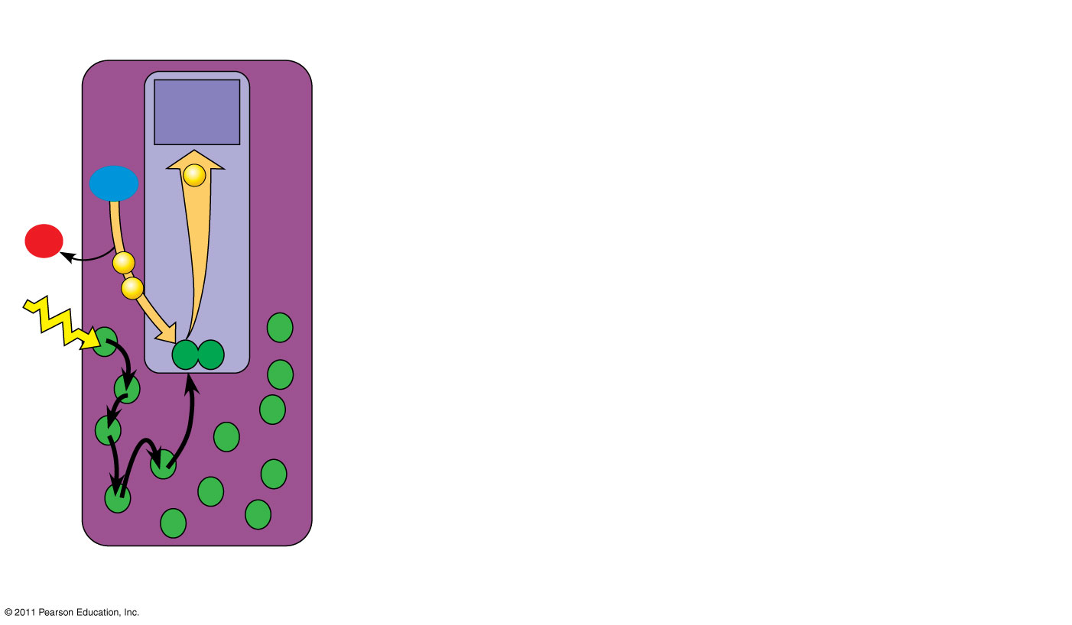
Figure 10.14-2
Primary acceptor
2
(16a b c)
H₂O
e⁻
2 H⁺
+
3
¹/₂
O₂
e⁻
e⁻
P680
1
Light
Pigment molecules
Photosystem II (PS II)
Notes:
32
Figure 10.14 How linear electron flow during the light reactions generates ATP and NADPH.

Slide 33
Each electron “falls” down an electron transport chain from the primary electron acceptor of PS II to PS I
Energy released by the fall drives the creation of a proton gradient across the thylakoid membrane
Diffusion of H⁺ (protons) across the membrane drives ATP synthesis (16d)
© 2011 Pearson Education, Inc.

Slide 34
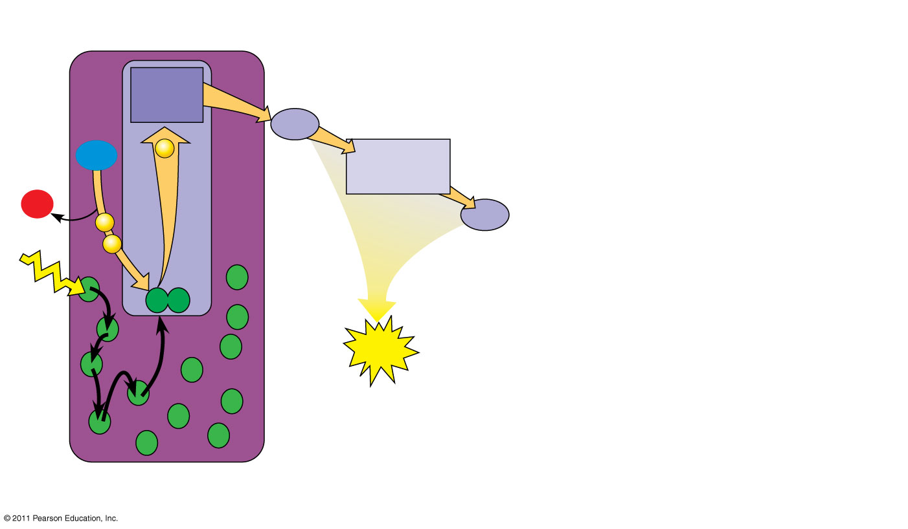
Figure 10.14-3
Primary acceptor
4
Pq
Electron transport chain
2
H₂O
e⁻
Cytochrome complex
2 H⁺
+
3
¹/₂
O₂
Pc
e⁻
e⁻
P680
5
1
Light
ATP
Pigment molecules
Photosystem II (PS II)
Notes:
34
Figure 10.14 How linear electron flow during the light reactions generates ATP and NADPH.

Slide 35
In PS I (like PS II), transferred light energy excites P700, which loses an electron to an electron acceptor
P700⁺ (P700 that is missing an electron) accepts an electron passed down from PS II via the electron transport chain
© 2011 Pearson Education, Inc.

Slide 36
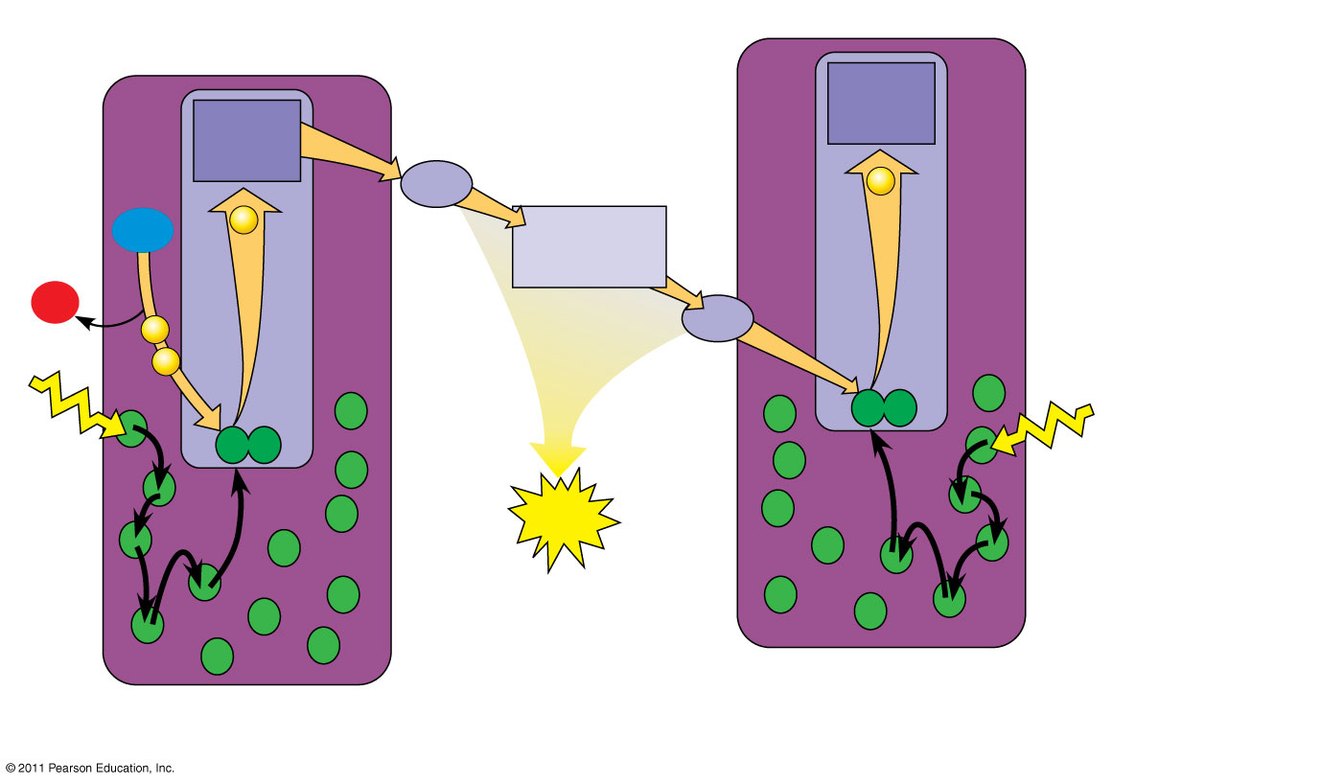
Figure 10.14-4
Primary acceptor
Primary acceptor
4
Pq
Electron transport chain
e⁻
2
H₂O
e⁻
Cytochrome complex
2 H⁺
+
3
¹/₂
O₂
Pc
e⁻
e⁻
P700
P680
5
Light
1
Light
6
ATP
Pigment molecules
Photosystem I (PS I)
Photosystem II (PS II)
Notes:
36
Figure 10.14 How linear electron flow during the light reactions generates ATP and NADPH.

Slide 37
Each electron “falls” down an electron transport chain from the primary electron acceptor of PS I to the protein ferredoxin (Fd)
The electrons are then transferred to NADP⁺ and reduce it to NADPH
The electrons of NADPH are available for the reactions of the Calvin cycle
This process also removes an H⁺ from the stroma (16e)
© 2011 Pearson Education, Inc.

Slide 38
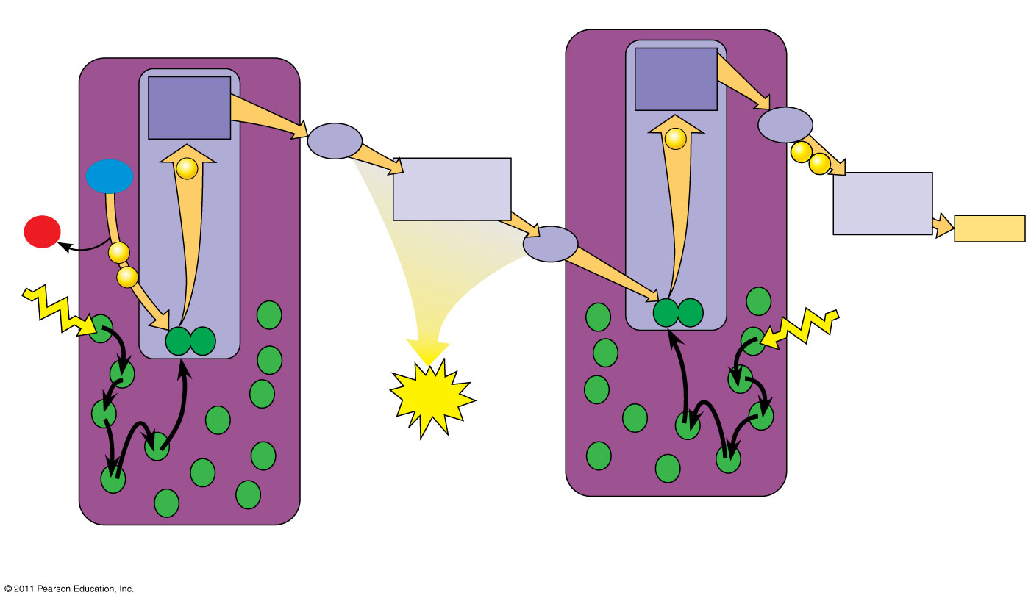
Figure 10.14-5
(15)
Electron transport chain
Primary acceptor
Primary acceptor
4
7
Pq
Electron transport chain
e⁻
Fd
2
e⁻
e⁻
8
H₂O
e⁻
Cytochrome complex
NADP⁺
2 H⁺
NADP⁺ reductase
+ H⁺
+
3
¹/₂
O₂
Pc
NADPH
e⁻
e⁻
P700
P680
5
Light
1
Light
6
ATP
Pigment molecules
Photosystem I (PS I)
Photosystem II (PS II)
Notes:
38
Figure 10.14 How linear electron flow during the light reactions generates ATP and NADPH.

Slide 39
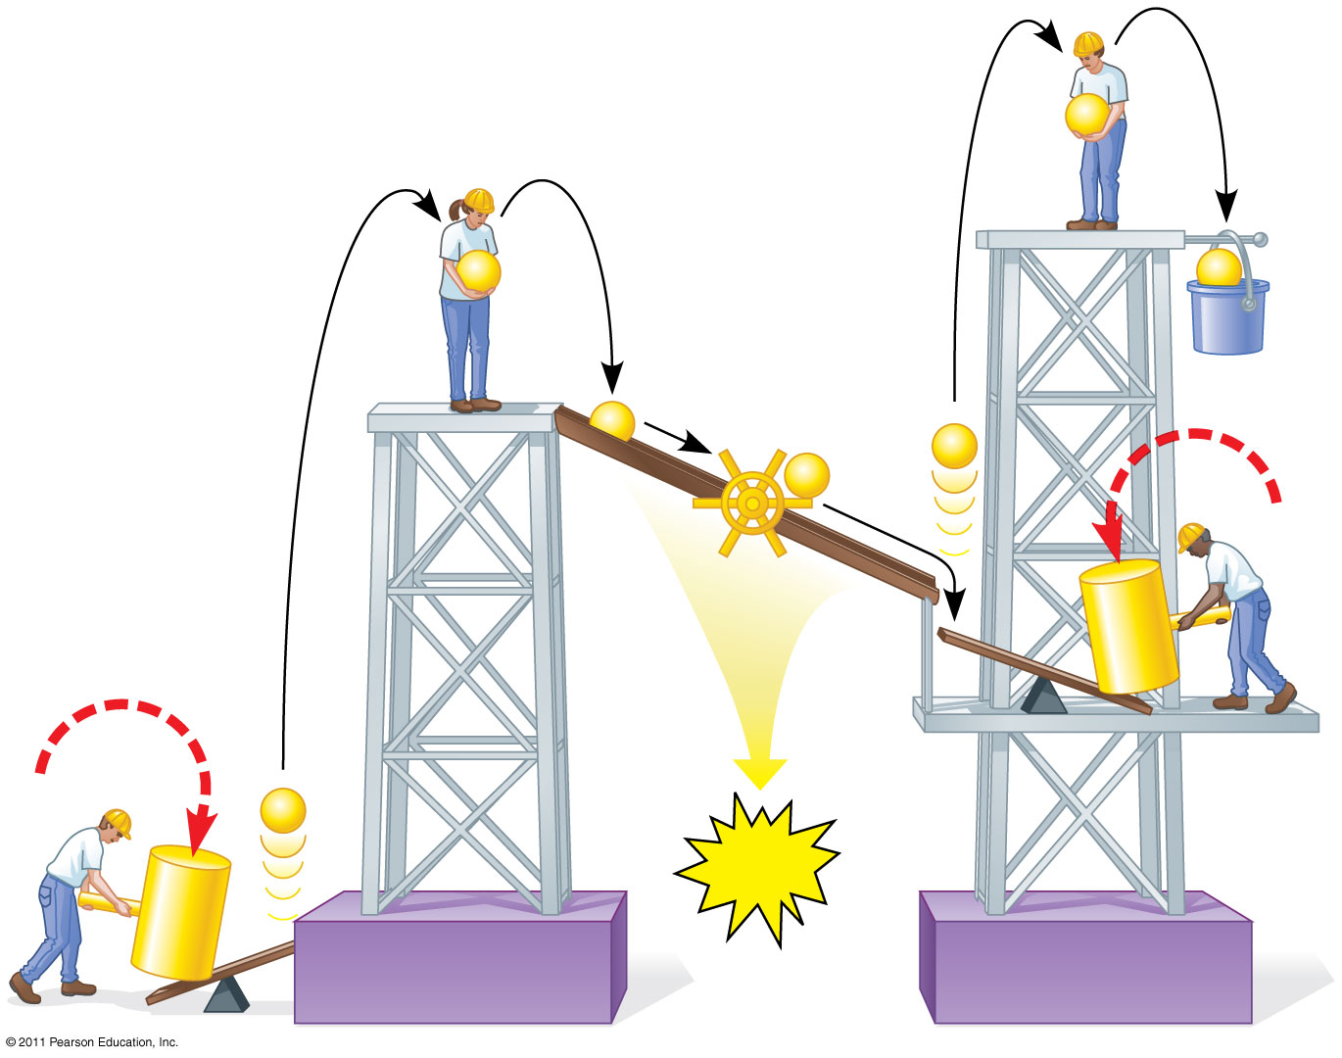
Figure 10.15
e⁻
e⁻
e⁻
Mill makes ATP
NADPH
e⁻
e⁻
e⁻
Photon
e⁻
ATP
Photon
Photosystem II
Photosystem I
Notes:
39
Figure 10.15 A mechanical analogy for linear electron flow during the light reactions.

Slide 40
Cyclic Electron Flow
Cyclic electron flow uses only photosystem I and produces ATP, but not NADPH
No oxygen is released
Cyclic electron flow generates surplus ATP, satisfying the higher demand in the Calvin cycle
(17)
© 2011 Pearson Education, Inc.

Slide 41
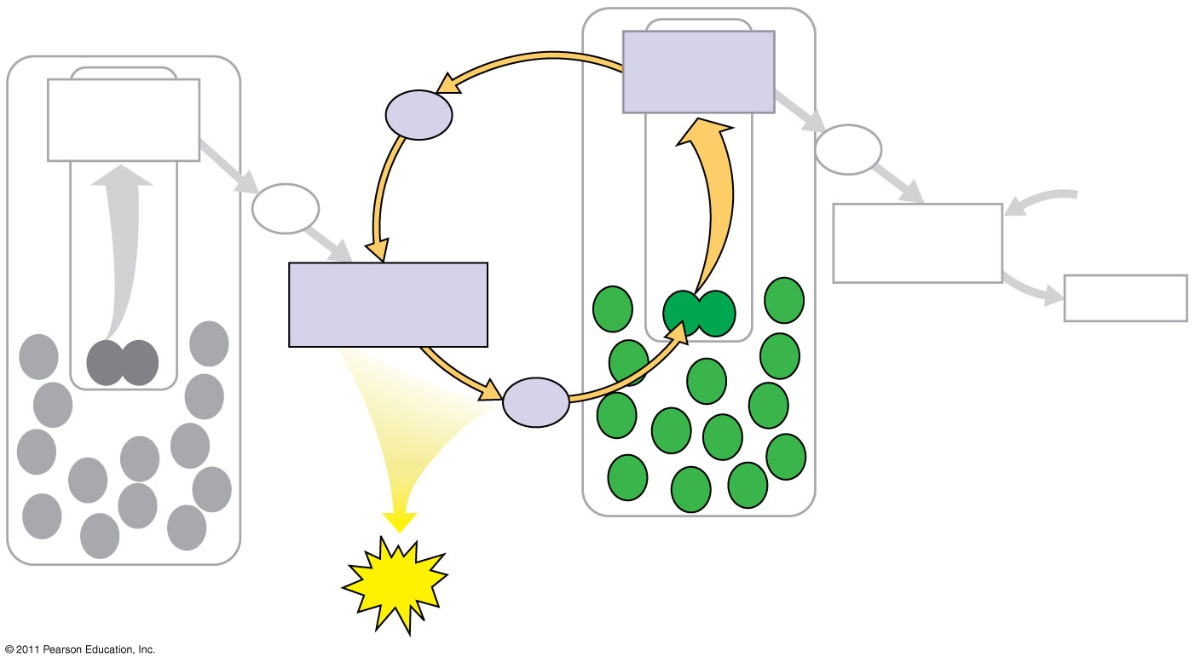
Figure 10.16
Primary acceptor
Primary acceptor
Fd
Fd
Pq
NADP⁺ + H⁺
NADP⁺ reductase
Cytochrome complex
NADPH
Pc
Photosystem I
Photosystem II
ATP
Notes:
41
Figure 10.16 Cyclic electron flow.

Slide 42
Some organisms such as purple sulfur bacteria have PS I but not PS II
Cyclic electron flow is thought to have evolved before linear electron flow
Cyclic electron flow may protect cells from light-induced damage
© 2011 Pearson Education, Inc.

Slide 43
A Comparison of Chemiosmosis in Chloroplasts and Mitochondria
Chloroplasts and mitochondria generate ATP by chemiosmosis, but use different sources of energy
Mitochondria transfer chemical energy from food to ATP; chloroplasts transform light energy into the chemical energy of ATP
Spatial organization of chemiosmosis differs between chloroplasts and mitochondria but also shows similarities (don’t need 4 for 18 & 19)
© 2011 Pearson Education, Inc.

Slide 44
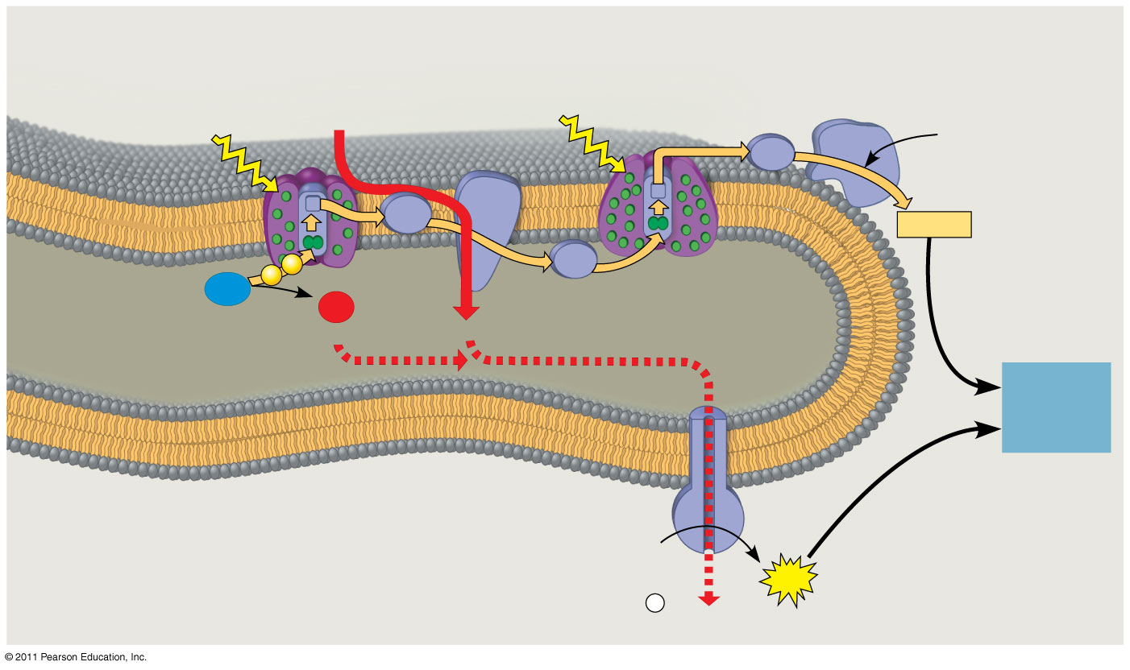
Figure 10.18
(20 skip 21)
STROMA (low H⁺ concentration)
Cytochrome complex
NADP⁺ reductase
Photosystem II
Light
Photosystem I
Light
4 H⁺
3
NADP⁺ + H⁺
Fd
Pq
NADPH
2
Pc
H₂O
O₂
1
¹/₂
THYLAKOID SPACE (high H⁺ concentration)
+2 H⁺
4 H⁺
To Calvin Cycle
Thylakoid membrane
ATP synthase
ADP + P _{i}
STROMA (low H⁺ concentration)
ATP
H⁺
Notes:
44
Figure 10.18 The light reactions and chemiosmosis: the organization of the thylakoid membrane.

Slide 45
ATP and NADPH are produced on the side facing the stroma, where the Calvin cycle takes place
In summary, light reactions generate ATP and increase the potential energy of electrons by moving them from H₂O to NADPH (22)
© 2011 Pearson Education, Inc.

Slide 46
Carbon enters the cycle as CO₂ and leaves as a sugar named glyceraldehyde 3-phospate (G3P)
For net synthesis of 1 G3P, the cycle must take place three times, fixing 3 molecules of CO₂
The Calvin cycle has three phases
Carbon fixation (catalyzed by rubisco)
Reduction
Regeneration of the CO₂ acceptor (RuBP)
(23)
© 2011 Pearson Education, Inc.

Slide 47
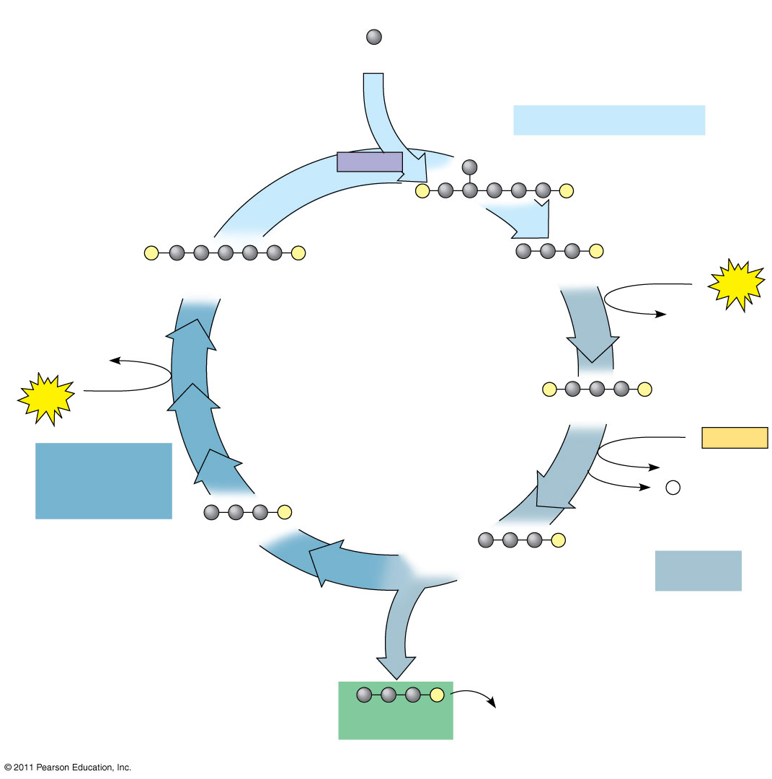
Figure 10.19-3
Input
3
(Entering one at a time)
(24-30)
CO₂
Phase 1: Carbon fixation
Rubisco
3
P
P
Short-lived intermediate
3
P
P
6
P
Ribulose bisphosphate (RuBP)
3-Phosphoglycerate
6
ATP
6 ADP
3 ADP
Calvin Cycle
3
ATP
6
P
P
1,3-Bisphosphoglycerate
6 NADPH
Phase 3: Regeneration of the CO₂ acceptor (RuBP)
6 NADP⁺
6 P _{i}
5
P
G3P
6
P
Glyceraldehyde 3-phosphate (G3P)
Phase 2: Reduction
1
P
G3P (a sugar)
Glucose and other organic compounds
Output
Notes:
47
Figure 10.19 The Calvin cycle.

Slide 48
Concept 10.4: Alternative mechanisms of carbon fixation have evolved in hot, arid climates
Dehydration is a problem for plants, sometimes requiring trade-offs with other metabolic processes, especially photosynthesis
On hot, dry days, plants close stomata, which conserves H₂O but also limits photosynthesis
The closing of stomata reduces access to CO₂ and causes O₂ to build up
These conditions favor an apparently wasteful process called photorespiration
© 2011 Pearson Education, Inc.

Slide 49
Photorespiration: An Evolutionary Relic?
In most plants (C₃ plants), initial fixation of CO₂, via rubisco, forms a three-carbon compound (3-phosphoglycerate)
In photorespiration, rubisco adds O₂ instead of CO₂ in the Calvin cycle, producing a two-carbon compound
Photorespiration consumes O₂ and organic fuel and releases CO₂ without producing ATP or sugar (31, 32, and 33 from thinking)
© 2011 Pearson Education, Inc.

Slide 50
Photorespiration may be an evolutionary relic because rubisco first evolved at a time when the atmosphere had far less O₂ and more CO₂
Photorespiration limits damaging products of light reactions that build up in the absence of the Calvin cycle
In many plants, photorespiration is a problem because on a hot, dry day it can drain as much as 50% of the carbon fixed by the Calvin cycle
© 2011 Pearson Education, Inc.

Slide 51
C₄ Plants
C₄ plants minimize the cost of photorespiration by incorporating CO₂ into four-carbon compounds in mesophyll cells
This step requires the enzyme PEP carboxylase
PEP carboxylase has a higher affinity for CO₂ than rubisco does; it can fix CO₂ even when CO₂ concentrations are low
These four-carbon compounds are exported to bundle-sheath cells, where they release CO₂ that is then used in the Calvin cycle (34 & 35)
© 2011 Pearson Education, Inc.

Slide 52
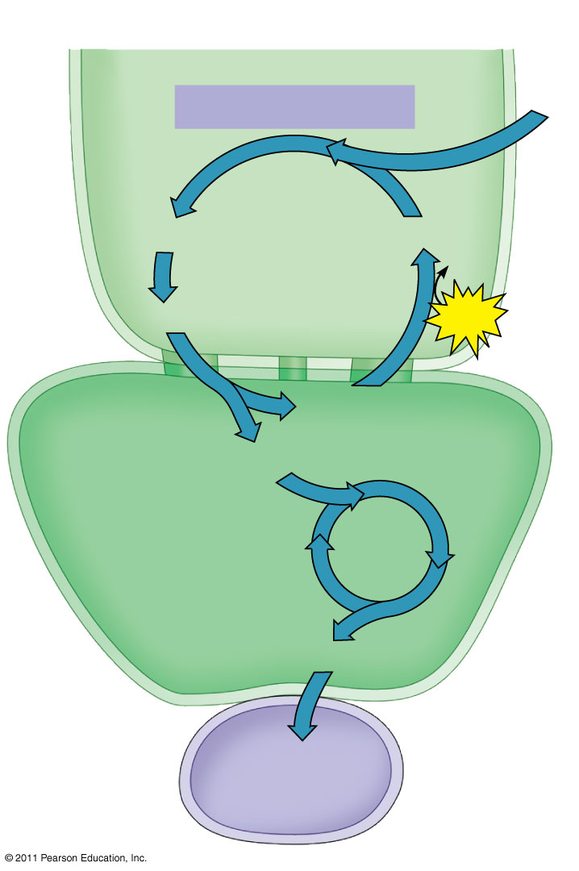
Figure 10.20b
The C₄ pathway
Mesophyll cell
CO₂
PEP carboxylase
(skip 36, 37)
Oxaloacetate (4C)
PEP (3C)
ADP
Malate (4C)
ATP
Pyruvate (3C)
Bundle- sheath cell
CO₂
Calvin Cycle
Sugar
Vascular tissue
Notes:
52
Figure 10.20 C₄ leaf anatomy and the C₄ pathway.

Slide 53
CAM Plants
Some plants, including succulents, use crassulacean acid metabolism (CAM) to fix carbon (1 key difference 38)
CAM plants open their stomata at night, incorporating CO₂ into organic acids
Stomata close during the day, and CO₂ is released from organic acids and used in the Calvin cycle
© 2011 Pearson Education, Inc.

Slide 54
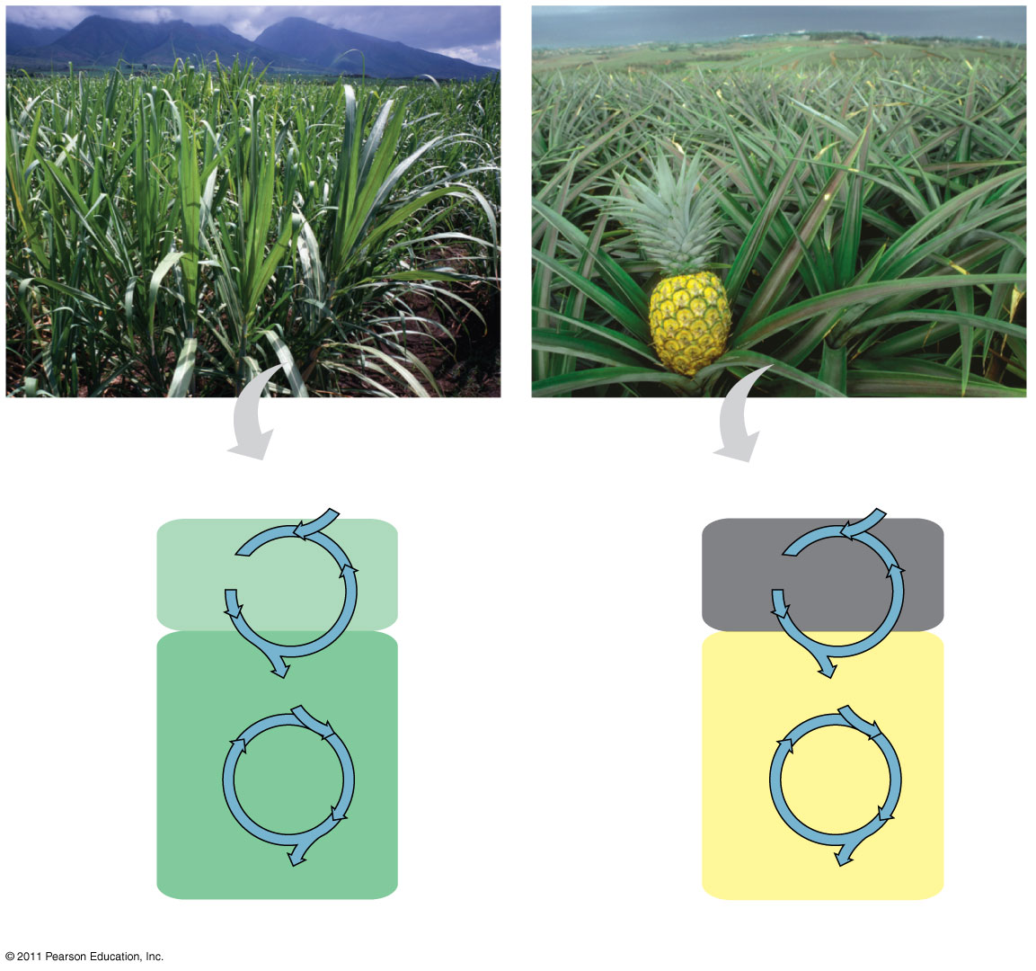
Figure 10.21
Sugarcane
Pineapple
(rest of 38)
C₄
CO₂
CAM
CO₂
1
CO₂ incorporated (carbon fixation)
Mesophyll cell
Organic acid
Organic acid
Night
CO₂
CO₂
Bundle- sheath cell
2
CO₂ released to the Calvin cycle
Day
Calvin Cycle
Calvin Cycle
Sugar
Sugar
(a) Spatial separation of steps
(b) Temporal separation of steps
Notes:
54
Figure 10.21 C₄ and CAM photosynthesis compared.

Slide 55
The Importance of Photosynthesis: A Review
The energy entering chloroplasts as sunlight gets stored as chemical energy in organic compounds
Sugar made in the chloroplasts supplies chemical energy and carbon skeletons to synthesize the organic molecules of cells
Plants store excess sugar as starch in structures such as roots, tubers, seeds, and fruits
In addition to food production, photosynthesis produces the O₂ in our atmosphere
(Implied 39)
© 2011 Pearson Education, Inc.

Slide 56
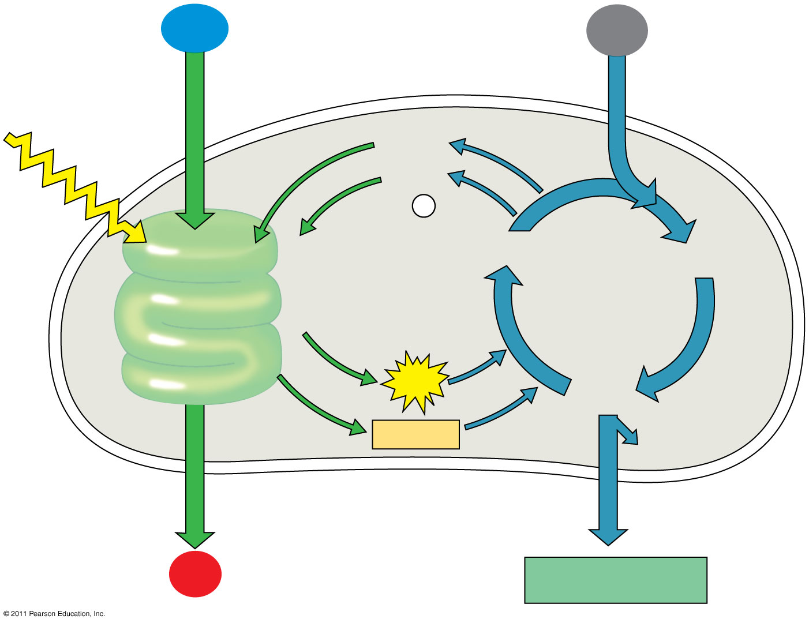
Figure 10.22
H₂O
CO₂
(40)
Light
NADP⁺
ADP
+ P _{i}
Light Reactions:
Photosystem II Electron transport chain Photosystem I Electron transport chain
RuBP
3-Phosphoglycerate
Calvin Cycle
ATP
G3P
Starch (storage)
NADPH
Chloroplast
O₂
Sucrose (export)
Notes:
56
Figure 10.22 A review of photosynthesis.

