Slide 1
Chapter 16
The Molecular Basis of Inheritance

Slide 2
The Search for the Genetic Material: Scientific Inquiry
When T. H. Morgan’s group showed that genes are located on chromosomes, the two components of chromosomes—DNA and protein—became candidates for the genetic material
The key factor in determining the genetic material was choosing appropriate experimental organisms
The role of DNA in heredity was first discovered by studying bacteria and the viruses that infect them
Protein and amino acid diversity is greater compared to nucleic acid/nucleotides so they were thought to be the likely genetic material (1 & 2)
© 2011 Pearson Education, Inc.

Slide 3
Evidence That DNA Can Transform Bacteria
The discovery of the genetic role of DNA began with research by Frederick Griffith in 1928
Griffith worked with two strains of a bacterium, one pathogenic and one harmless
R-Strain-Non-pathogenic
S-Strain-Pathogenic*His goal was to make vaccine
The Difference lies in the presence or absence of a capsule
Capsule helps cause disease by aiding in adherence to target cells and resisiting phagocytosis from immune cells (3 & 4)
© 2011 Pearson Education, Inc.

Slide 4
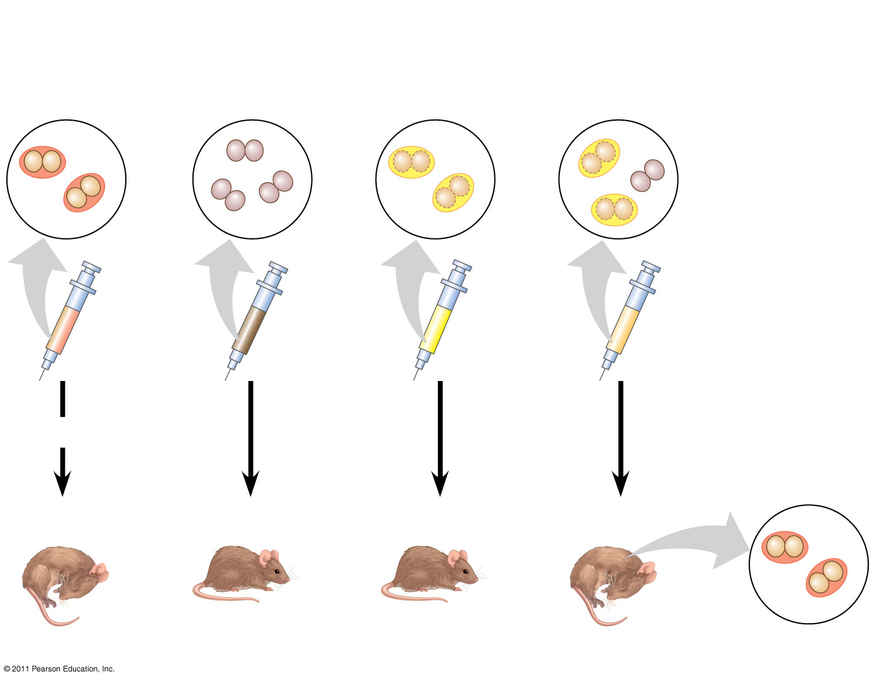
Figure 16.2
EXPERIMENT
Mixture of heat-killed S cells and living R cells
Heat-killed S cells (control)
Living S cells (control)
Living R cells (control)
(5)
RESULTS
Mouse dies
Mouse healthy
Mouse healthy
Mouse dies
Living S cells
Notes:
Figure 16.2 Inquiry: Can a genetic trait be transferred between different bacterial strains?

Slide 5
When he mixed heat-killed remains of the pathogenic strain with living cells of the harmless strain, some living cells became pathogenic
He called this phenomenon transformation, now defined as a change in genotype and phenotype due to assimilation of foreign DNA (6)
© 2011 Pearson Education, Inc.

Slide 6
In 1944, Oswald Avery, Maclyn McCarty, and Colin MacLeod announced that the transforming substance was DNA
Their conclusion was based on experimental evidence that only DNA worked in transforming harmless bacteria into pathogenic bacteria
Many biologists remained skeptical, mainly because little was known about DNA (7)
© 2011 Pearson Education, Inc.

Slide 7
Evidence That Viral DNA Can Program Cells
More evidence for DNA as the genetic material came from studies of viruses that infect bacteria
Such viruses, called bacteriophages (or phages), are widely used in molecular genetics research
*Does not eat bacteria……..bacteriophages destroy cells by turning them into a virus producing factory that eventually bursts from the thousands of viruses it produces. (9)
© 2011 Pearson Education, Inc.

Slide 8
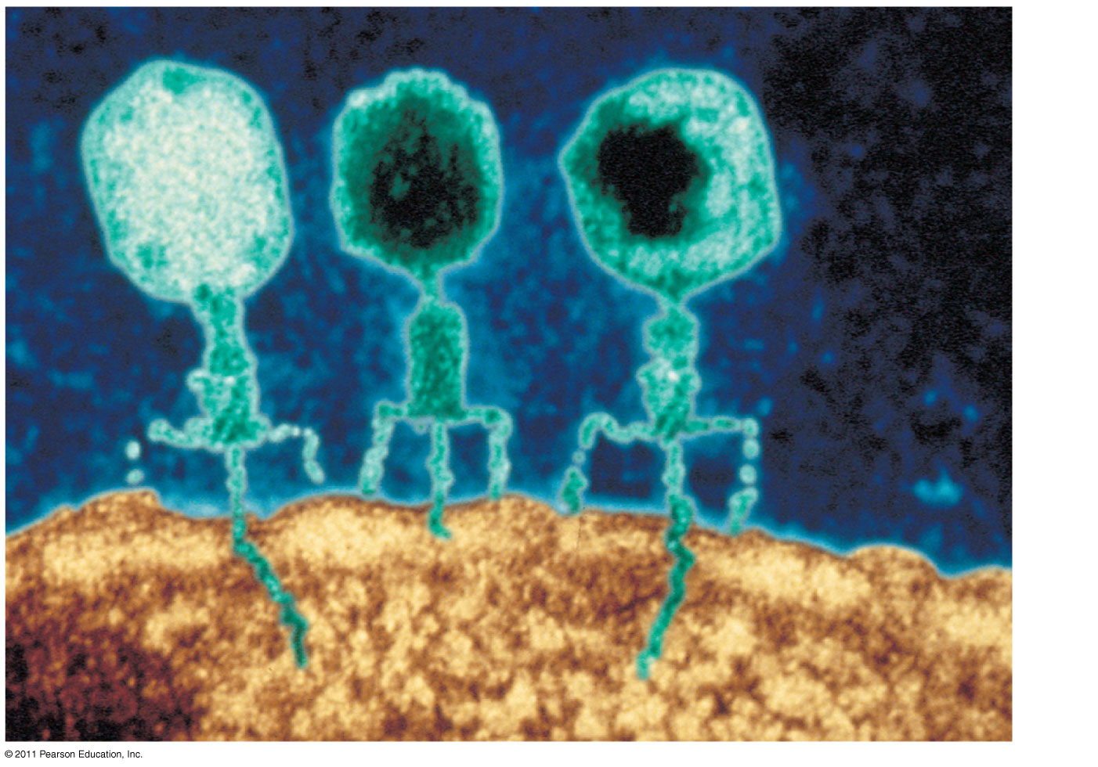
Figure 16.3
Phage head
(8)
Tail sheath
Tail fiber
DNA
100 nm
Bacterial cell
Notes:
Figure 16.3 Viruses infecting a bacterial cell.

Slide 9
In 1952, Alfred Hershey and Martha Chase performed experiments showing that DNA is the genetic material of a phage known as T2
To determine this, they designed an experiment showing that only one of the two components of T2 (DNA or protein) enters an E. coli cell during infection
They concluded that the injected DNA of the phage provides the genetic information
© 2011 Pearson Education, Inc.

Slide 10
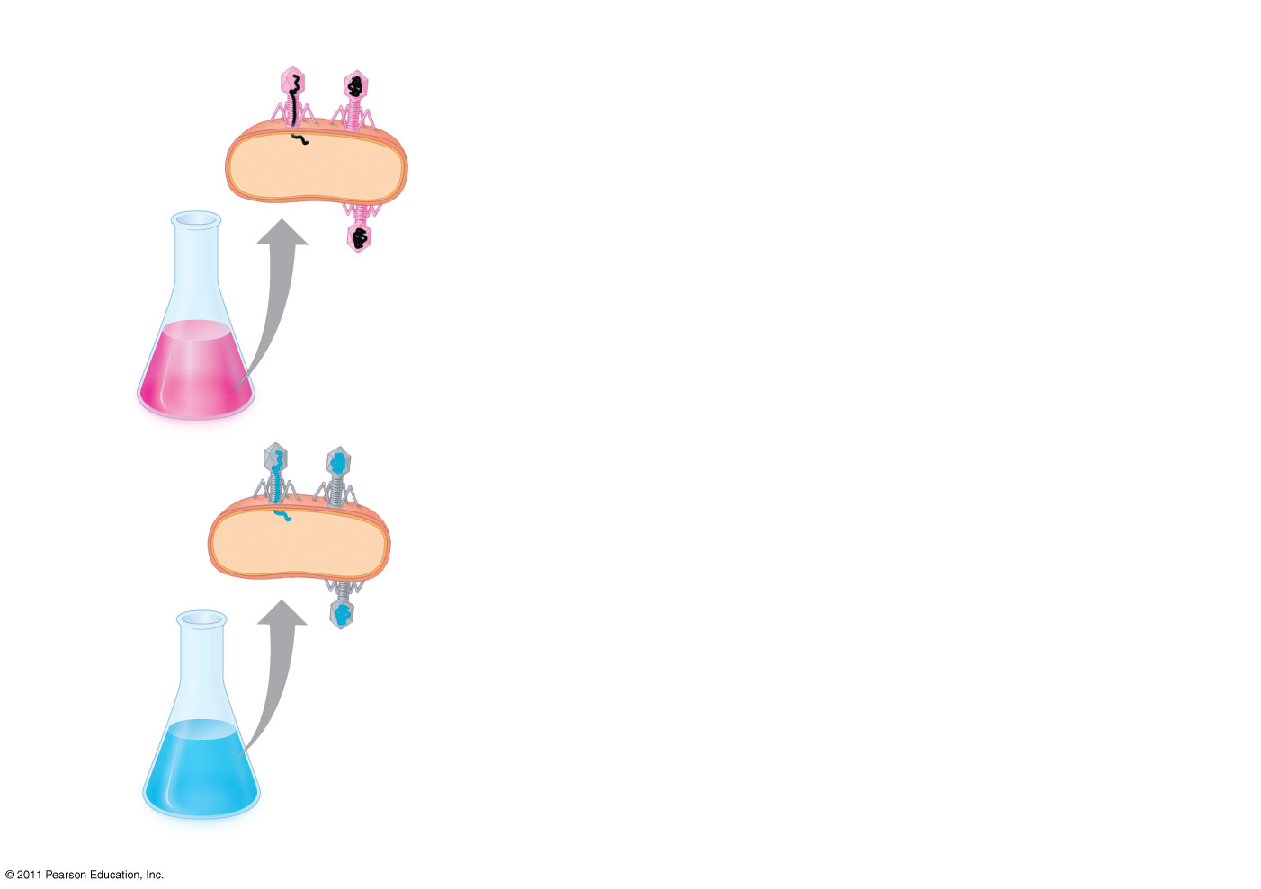
Figure 16.4-1
EXPERIMENT
Radioactive protein
Phage
Bacterial cell
(10)
Batch 1: Radioactive sulfur (³⁵S)
DNA
Radioactive DNA
Batch 2: Radioactive phosphorus (³²P)
Notes:
Figure 16.4 Inquiry: Is protein or DNA the genetic material of phage T2?

Slide 11
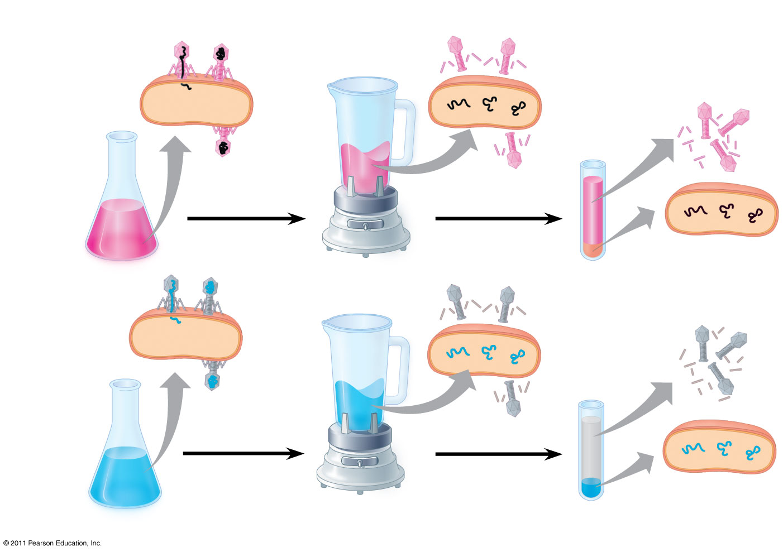
Figure 16.4-3
EXPERIMENT
(11)
Radioactive protein
Empty protein shell
Phage
Radioactivity (phage protein) in liquid
Bacterial cell
Batch 1: Radioactive sulfur (³⁵S)
DNA
Phage DNA
Centrifuge
Radioactive DNA
Pellet (bacterial cells and contents)
Batch 2: Radioactive phosphorus (³²P)
Centrifuge
Radioactivity (phage DNA) in pellet
Pellet
Notes:
Figure 16.4 Inquiry: Is protein or DNA the genetic material of phage T2?

Slide 12
Additional Evidence That DNA Is the Genetic Material
It was known that DNA is a polymer of nucleotides, each consisting of a nitrogenous base, a sugar, and a phosphate group
In 1950, Erwin Chargaff reported that DNA composition varies from one species to the next
This evidence of diversity made DNA a more credible candidate for the genetic material
(13)
© 2011 Pearson Education, Inc.

Slide 13
Two findings became known as Chargaff’s rules
The base composition of DNA varies between species
In any species the number of A and T bases are equal and the number of G and C bases are equal
The basis for these rules was not understood until the discovery of the double helix (12)
© 2011 Pearson Education, Inc.

Slide 14
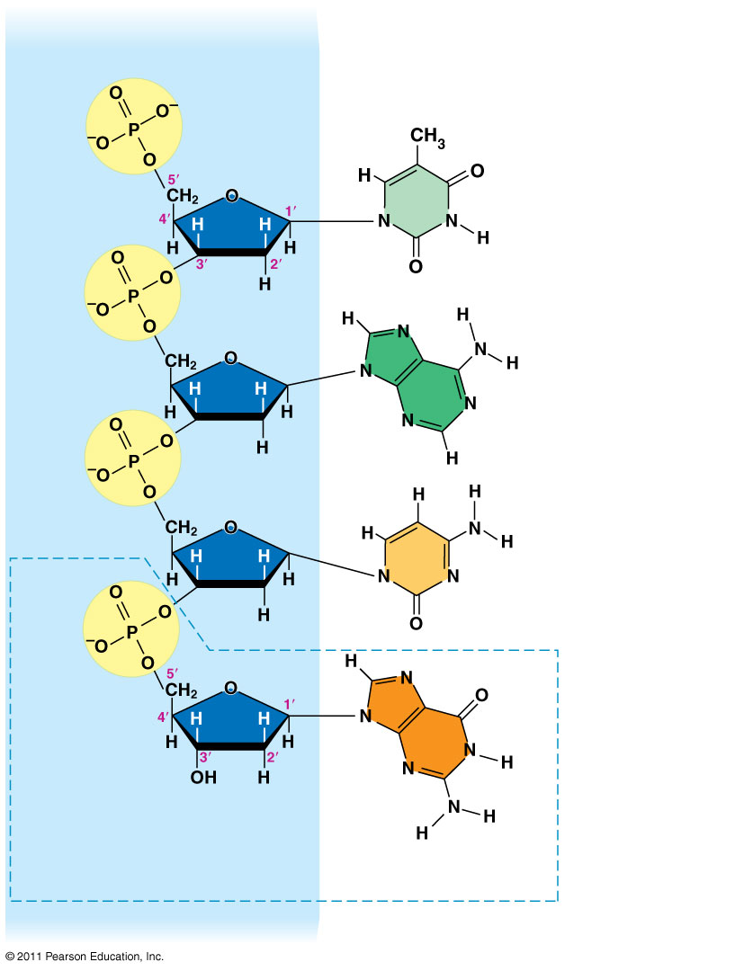
Figure 16.5
Sugar–phosphate backbone
Nitrogenous bases
5′ end
Thymine (T)
Adenine (A)
Cytosine (C)
Phosphate
Guanine (G)
Sugar (deoxyribose)
DNA nucleotide
Nitrogenous base
3′ end
Notes:
Figure 16.5 The structure of a DNA strand.

Slide 15
Building a Structural Model of DNA: Scientific Inquiry
Watson & Crick were awarded the Nobel prize for their molecular model of DNA
After DNA was accepted as the genetic material, the challenge was to determine how its structure accounts for its role in heredity
Maurice Wilkins and Rosalind Franklin were using a technique called X-ray crystallography to study molecular structure
Franklin produced a picture of the DNA molecule using this technique (14 & 15)
© 2011 Pearson Education, Inc.

Slide 16
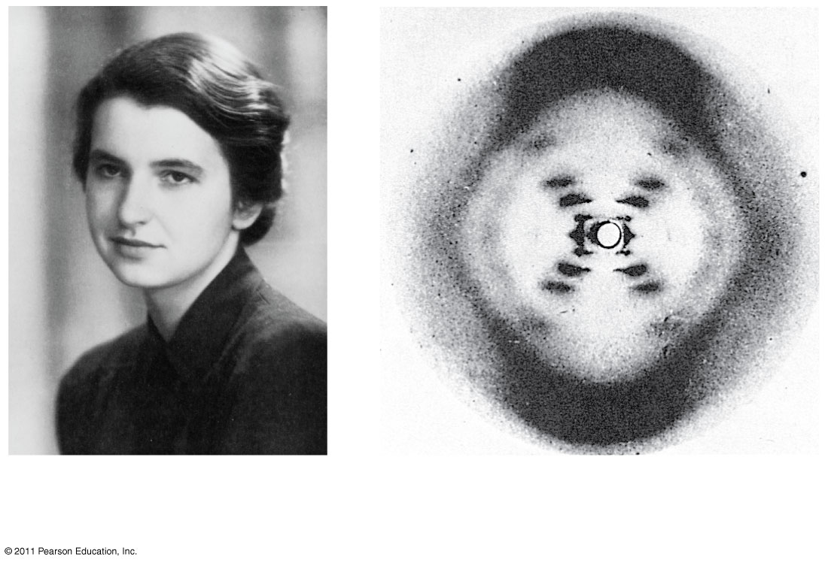
Figure 16.6
(a) Rosalind Franklin
(b)
Franklin’s X-ray diffraction photograph of DNA
Notes:
Figure 16.6 Rosalind Franklin and her X-ray diffraction photo of DNA.

Slide 17
Franklin’s X-ray crystallographic images of DNA enabled Watson to deduce that DNA was helical
The X-ray images also enabled Watson to deduce the width of the helix and the spacing of the nitrogenous bases
The pattern in the photo suggested that the DNA molecule was made up of two strands, forming a double helix
© 2011 Pearson Education, Inc.

Slide 18
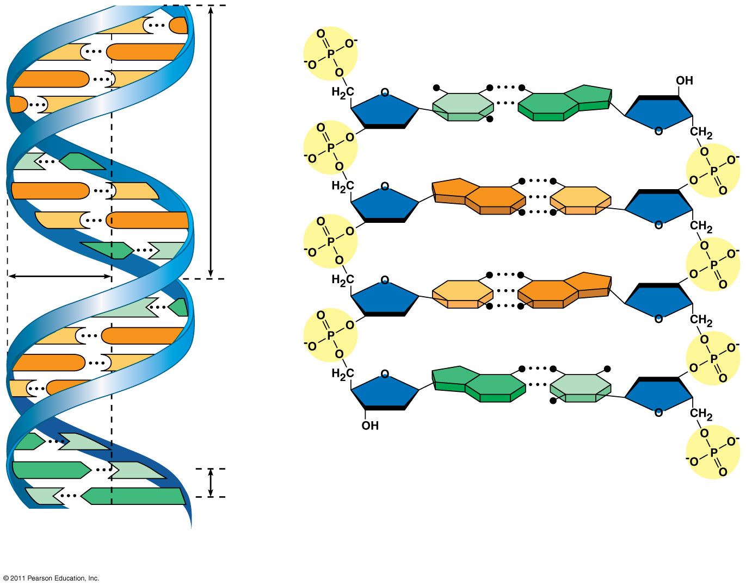
Figure 16.7a
5′ end
(16 19-23))
C
G
C
G
Hydrogen bond
3′ end
G
C
G
C
T
A
3.4 nm
T
A
G
C
G
C
C
G
A
T
1 nm
C
G
T
A
C
G
G
C
C
G
A
T
A
T
3′ end
A
T
0.34 nm
T
A
5′ end
(a)
Key features of DNA structure
(b) Partial chemical structure
Notes:
Figure 16.7 The double helix.

Slide 19
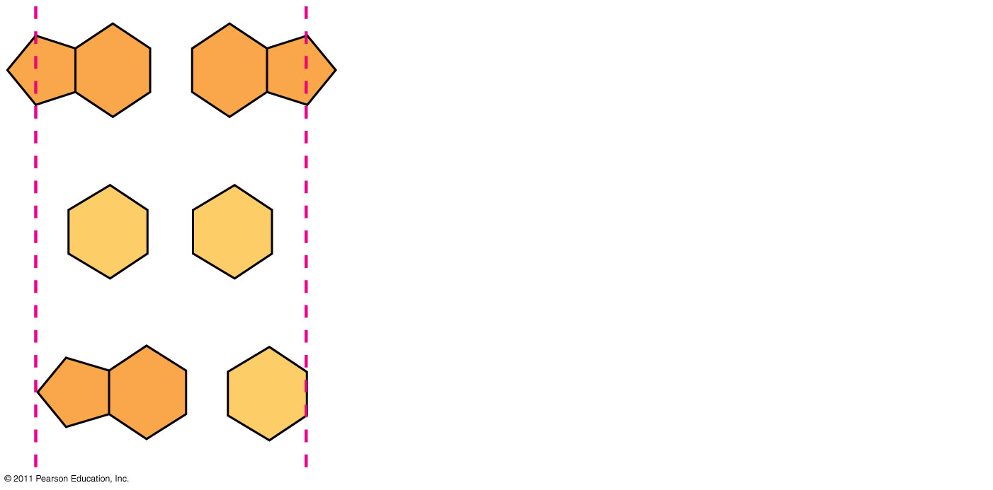
Figure 16.UN01
Purine + purine: too wide
Pyrimidine + pyrimidine: too narrow
Purine + pyrimidine: width consistent with X-ray data
Notes:
Figure 16.UN01 In-text figure, p. 310

Slide 20
Watson and Crick reasoned that the pairing was more specific, dictated by the base structures
They determined that adenine (A) paired only with thymine (T), and guanine (G) paired only with cytosine (C)
The Watson-Crick model explains Chargaff’s rules: in any organism the amount of A = T, and the amount of G = C
(17 & 18 apply knowledge)
© 2011 Pearson Education, Inc.

Slide 21
Concept 16.2: Many proteins work together in DNA replication and repair
The relationship between structure and function is manifest in the double helix
Watson and Crick noted that the specific base pairing suggested a possible copying mechanism for genetic material
© 2011 Pearson Education, Inc.

Slide 22
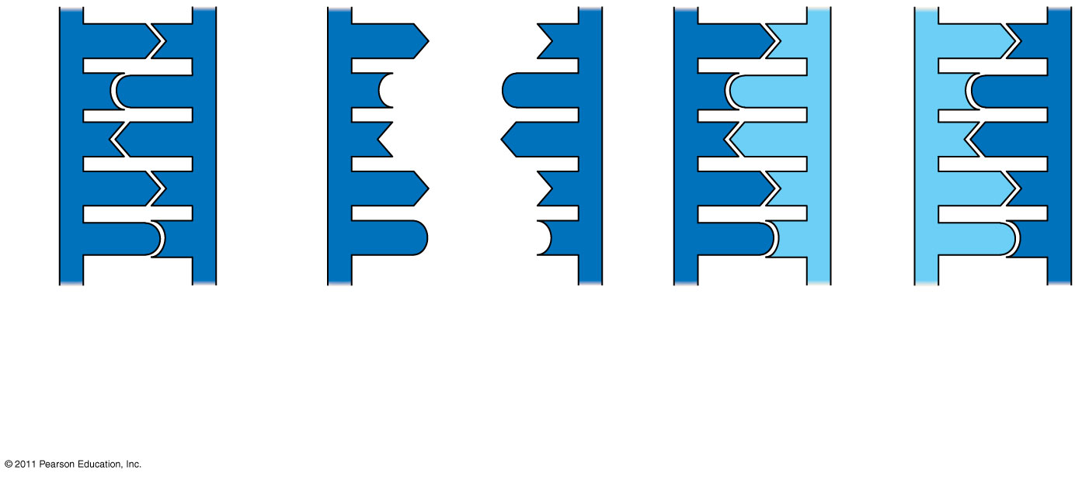
Figure 16.9-3
A
T
A
T
A
T
A
T
C
G
C
G
C
G
C
G
T
A
T
A
T
A
T
A
A
T
A
T
A
T
A
T
G
C
G
C
G
C
G
C
(a) Parent molecule
(b)
Separation of strands
(c)
“Daughter” DNA molecules, each consisting of one parental strand and one new strand
Notes:
Figure 16.9 A model for DNA replication: the basic concept.

Slide 23
Watson and Crick’s semiconservative model of replication predicts that when a double helix replicates, each daughter molecule will have one old strand (derived or “conserved” from the parent molecule) and one newly made strand
Competing models were the conservative model (the two parent strands rejoin) and the dispersive model (each strand is a mix of old and new)
(24)
© 2011 Pearson Education, Inc.

Slide 24
Experiments by Matthew Meselson and Franklin Stahl supported the semiconservative model
They labeled the nucleotides of the old strands with a heavy isotope of nitrogen, while any new nucleotides were labeled with a lighter isotope
N14 and N15 isotopes. (25 & 26)
© 2011 Pearson Education, Inc.

Slide 25
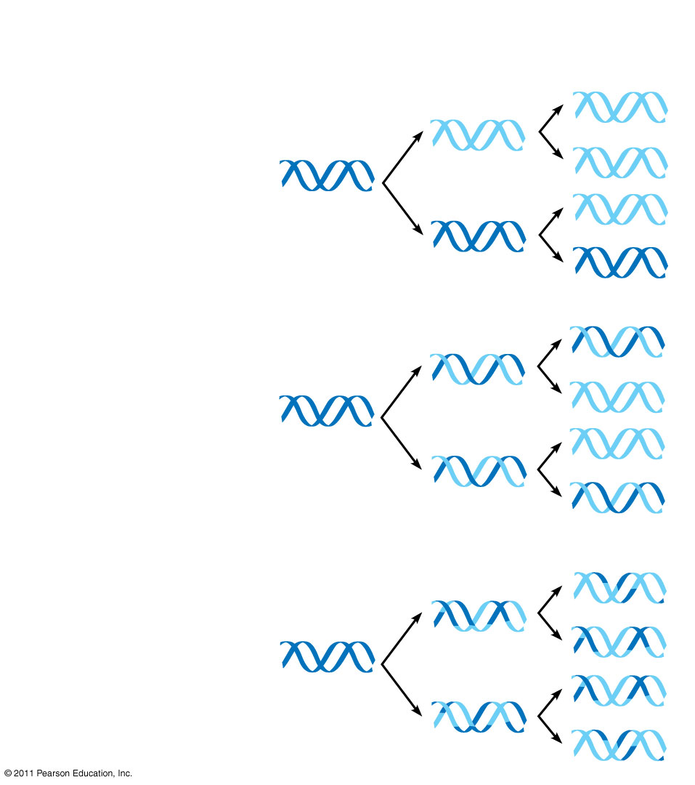
Figure 16.10
Parent cell
First replication
Second replication
(a)
Conservative model
(b)
Semiconservative model
(c) Dispersive model
Notes:
Figure 16.10 Three alternative models of DNA replication.

Slide 26
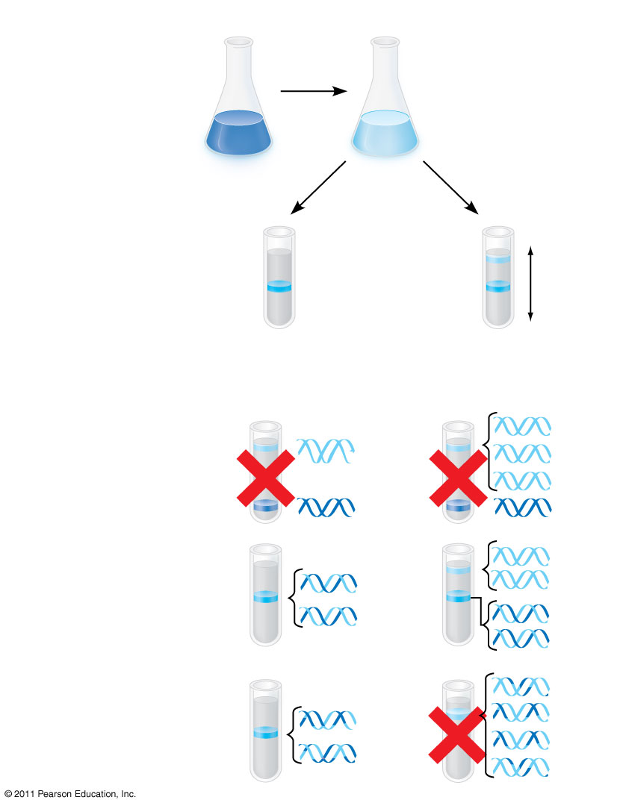
Figure 16.11
EXPERIMENT
1
Bacteria cultured in medium with ¹⁵N (heavy isotope)
2
Bacteria transferred to medium with ¹⁴N (lighter isotope)
RESULTS
(27)
3
DNA sample centrifuged after first replication
4
DNA sample centrifuged after second replication
Less dense
More dense
CONCLUSION
Predictions:
First replication
Second replication
Conservative model
Semiconservative model
Dispersive model
Notes:
Figure 16.11 Inquiry: Does DNA replication follow the conservative, semiconservative, or dispersive model?

Slide 27
DNA Replication: A Closer Look
The copying of DNA is remarkable in its speed and accuracy
More than a dozen enzymes and other proteins participate in DNA replication
© 2011 Pearson Education, Inc.

Slide 28
Getting Started
Replication begins at particular sites called origins of replication, where the two DNA strands are separated, opening up a replication “bubble”
A eukaryotic chromosome may have hundreds or even thousands of origins of replication
Replication proceeds in both directions from each origin, until the entire molecule is copied (28)
© 2011 Pearson Education, Inc.

Slide 29
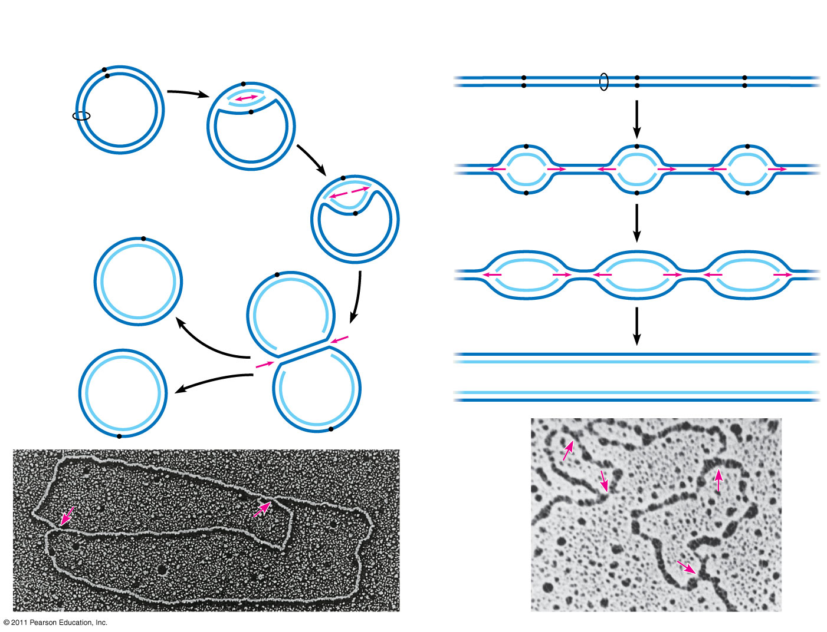
Figure 16.12
(a) Origin of replication in an E. coli cell
(b) Origins of replication in a eukaryotic cell
Origin of replication
Parental (template) strand
Double-stranded DNA molecule
Origin of replication
Daughter (new) strand
Parental (template) strand
Daughter (new) strand
Replication fork
Double- stranded DNA molecule
Replication bubble
Bubble
Replication fork
Two daughter DNA molecules
Two daughter DNA molecules
0.5 μm
0.25 μm
Notes:
Figure 16.12 Origins of replication in E. coli and eukaryotes.

Slide 30
At the end of each replication bubble is a replication fork, a Y-shaped region where new DNA strands are elongating
Helicases are enzymes that untwist the double helix at the replication forks
Single-strand binding proteins bind to and stabilize single-stranded DNA
Topoisomerase corrects “overwinding” ahead of replication forks by breaking, swiveling, and rejoining DNA strands (32 part)
© 2011 Pearson Education, Inc.

Slide 31
DNA polymerases cannot initiate synthesis of a polynucleotide; they can only add nucleotides to the 3′ end
The initial nucleotide strand is a short RNA primer
An enzyme called primase can start an RNA chain from scratch and adds RNA nucleotides one at a time using the parental DNA as a template
The primer is short (5–10 nucleotides long), and the 3′ end serves as the starting point for the new DNA strand (32)
© 2011 Pearson Education, Inc.

Slide 32
Synthesizing a New DNA Strand
Enzymes called DNA polymerases catalyze the elongation of new DNA at a replication fork
Most DNA polymerases require a primer and a DNA template strand
The rate of elongation is about 500 nucleotides per second in bacteria and 50 per second in human cells (32)
© 2011 Pearson Education, Inc.

Slide 33
Each nucleotide that is added to a growing DNA strand is a nucleoside triphosphate
dATP supplies adenine to DNA and is similar to the ATP of energy metabolism
The difference is in their sugars: dATP has deoxyribose while ATP has ribose
As each monomer of dATP joins the DNA strand, it loses two phosphate groups as a molecule of pyrophosphate
© 2011 Pearson Education, Inc.

Slide 34
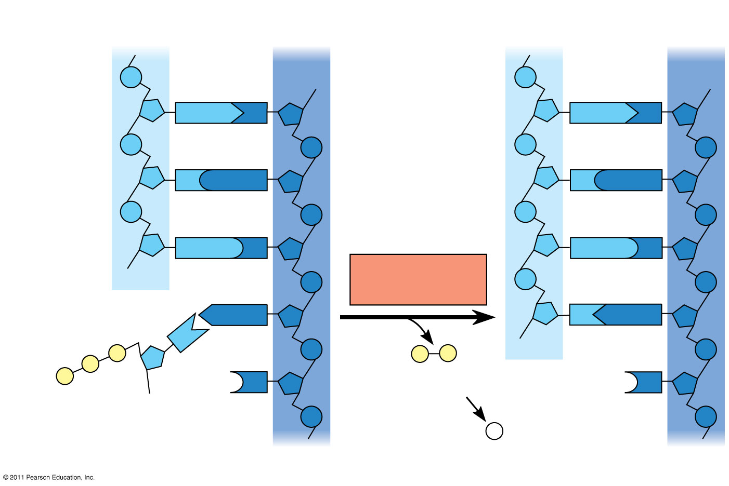
Figure 16.14
New strand
Template strand
5′
3′
5′
3′
Sugar
A
T
A
T
Phosphate
Base
C
G
C
G
G
C
G
C
OH
DNA polymerase
3′
A
T
A
T
P
P
P _{i}
OH
P
P
C
Pyrophosphate
3′
C
OH
Nucleoside triphosphate
2 P _{i}
5′
5′
Notes:
Figure 16.14 Incorporation of a nucleotide into a DNA strand.

Slide 35
The antiparallel structure of the double helix affects replication
DNA polymerases add nucleotides only to the free 3′ end of a growing strand; therefore, a new DNA strand can elongate only in the 5′ to 3′ direction
Along one template strand of DNA, the DNA polymerase synthesizes a leading strand continuously, moving toward the replication fork
To elongate the other new strand, called the lagging strand, DNA polymerase must work in the direction away from the replication fork
The lagging strand is synthesized as a series of segments called Okazaki fragments, which are joined together by DNA ligase (29-32)
© 2011 Pearson Education, Inc.

Slide 36
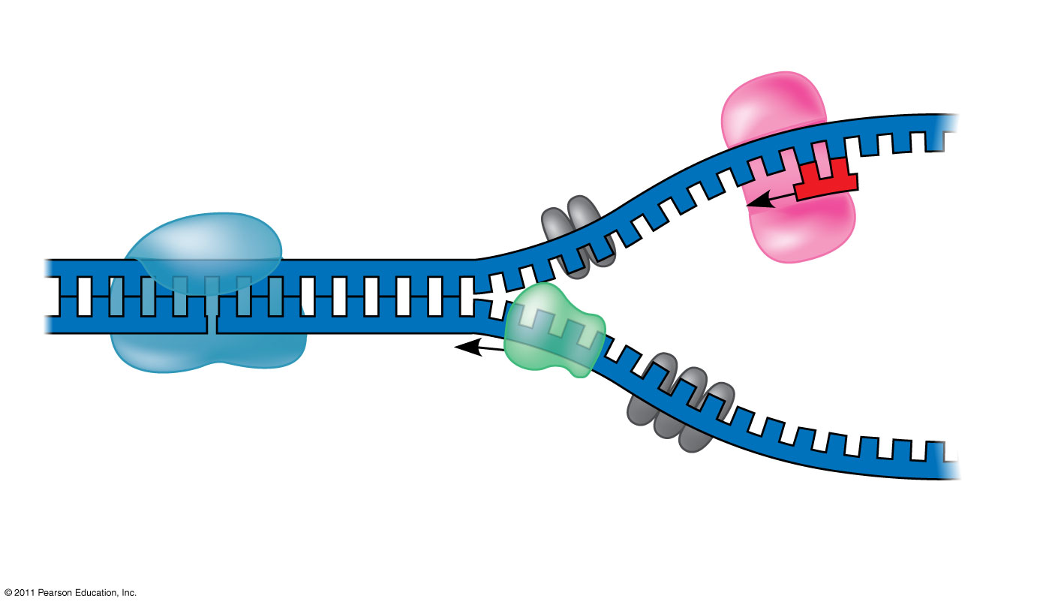
Figure 16.13
(33 part)
Primase
3′
Topoisomerase
5′
RNA primer
3′
5′
3′
Helicase
5′
Single-strand binding proteins
Notes:
Figure 16.13 Some of the proteins involved in the initiation of DNA replication.

Slide 37
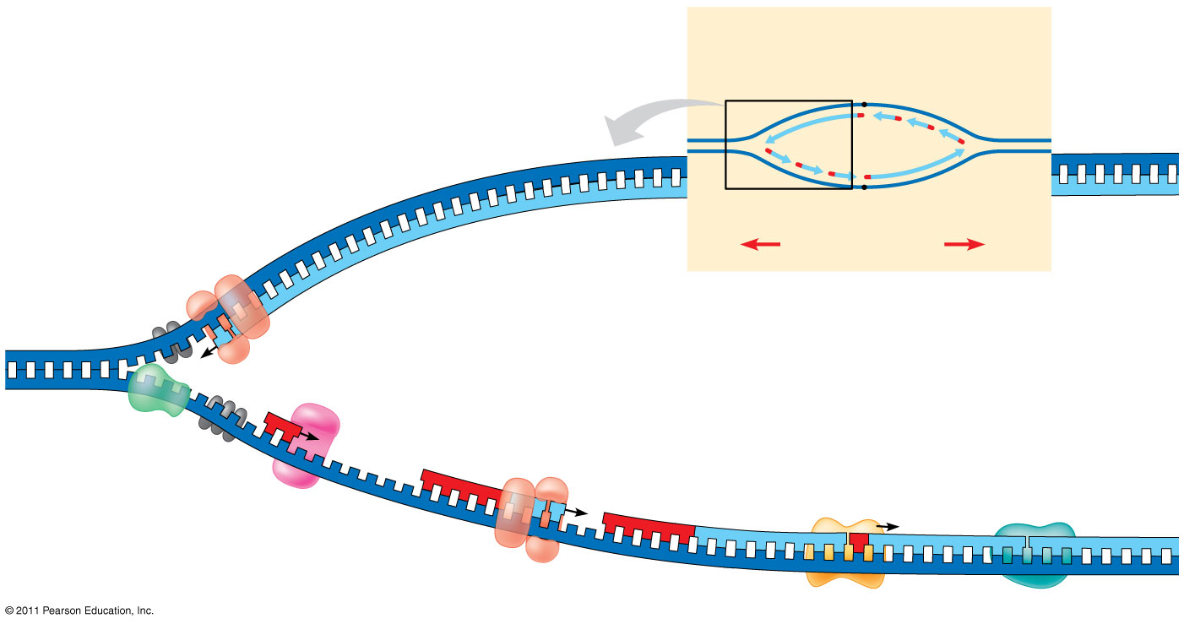
Figure 16.17
(33 & 34 on own)
Overview
Leading strand
Origin of replication
Lagging strand
Leading strand
Lagging strand
Leading strand
Overall directions of replication
5′
DNA pol III
3′
Primer
Primase
3′
5′
3′
Parental DNA
DNA pol III
Lagging strand
5′
DNA pol I
4
3′
DNA ligase
5′
3′
3
2
1
5′
Notes:
Figure 16.17 A summary of bacterial DNA replication.

Slide 38
The DNA Replication Complex
The proteins that participate in DNA replication form a large complex, a “DNA replication machine”
The DNA replication machine may be stationary during the replication process
Recent studies support a model in which DNA polymerase molecules “reel in” parental DNA and “extrude” newly made daughter DNA molecules
© 2011 Pearson Education, Inc.

Slide 39
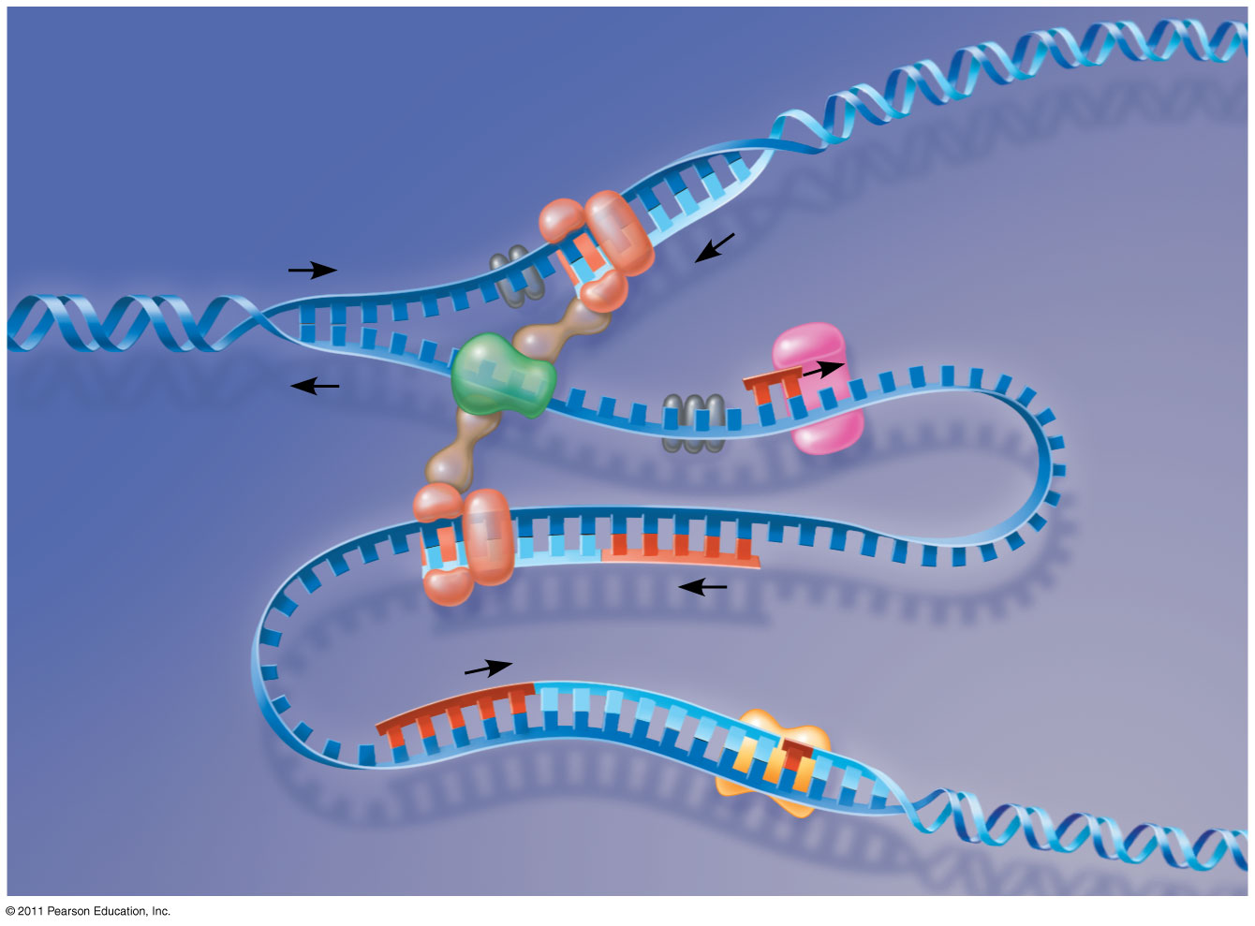
Figure 16.18
DNA pol III
Parental DNA
Leading strand
5′
5′
3′
3′
3′
3′
5′
5′
Connecting protein
Helicase
3′
5′
Lagging strand template
DNA pol III
Lagging strand
5′
3′
Notes:
Figure 16.18 A current model of the DNA replication complex.

Slide 40
Proofreading and Repairing DNA
DNA polymerases proofread newly made DNA, replacing any incorrect nucleotides
In mismatch repair of DNA, repair enzymes correct errors in base pairing
DNA can be damaged by exposure to harmful chemical or physical agents such as cigarette smoke and X-rays; UV radiation can lead to T-T dimers (two adjacent Ts on same strand bond)
In nucleotide excision repair, a nuclease cuts out and replaces damaged stretches of DNA (35 & 36)
© 2011 Pearson Education, Inc.

Slide 41
Evolutionary Significance of Altered DNA Nucleotides
Error rate after proofreading repair is low but not zero (from 1 in 100,000 to 1 in 1,000,000,000)
Sequence changes may become permanent and can be passed on to the next generation
These changes (mutations) are the source of the genetic variation upon which natural selection operates
© 2011 Pearson Education, Inc.

Slide 42
Replicating the Ends of DNA Molecules
Limitations of DNA polymerase create problems for the linear DNA of eukaryotic chromosomes
The usual replication machinery provides no way to complete the 5′ ends, so repeated rounds of replication produce shorter DNA molecules with uneven ends
This is not a problem for prokaryotes, most of which have circular chromosomes
© 2011 Pearson Education, Inc.

Slide 43
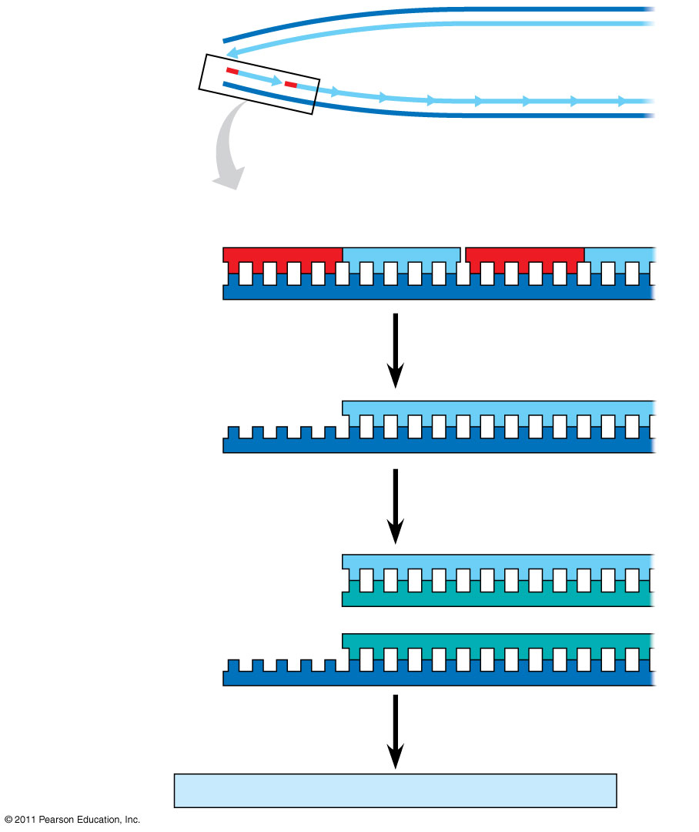
Figure 16.20
5′
Ends of parental DNA strands
Leading strand
Lagging strand
3′
Last fragment
Next-to-last fragment
Lagging strand
RNA primer
5′
3′
Parental strand
Removal of primers and replacement with DNA where a 3′ end is available
5′
3′
Second round of replication
5′
New leading strand
3′
New lagging strand
5′
3′
Further rounds of replication
Shorter and shorter daughter molecules
Notes:
Figure 16.20 Shortening of the ends of linear DNA molecules.

Slide 44
Eukaryotic chromosomal DNA molecules have special nucleotide sequences at their ends called telomeres
Telomeres do not prevent the shortening of DNA molecules, but they do postpone the erosion of genes near the ends of DNA molecules
It has been proposed that the shortening of telomeres is connected to aging
If chromosomes of germ cells became shorter in every cell cycle, essential genes would eventually be missing from the gametes they produce
An enzyme called telomerase catalyzes the lengthening of telomeres in germ cells (38 simplify 37)
© 2011 Pearson Education, Inc.

Slide 45
The shortening of telomeres might protect cells from cancerous growth by limiting the number of cell divisions
There is evidence of telomerase activity in cancer cells, which may allow cancer cells to persist (39)
© 2011 Pearson Education, Inc.

Slide 46
Chromatin, a complex of DNA and protein, is found in the nucleus of eukaryotic cells
Chromosomes fit into the nucleus through an elaborate, multilevel system of packing
© 2011 Pearson Education, Inc.
Notes:
For the Cell Biology Video Cartoon and Stick Model of a Nucleosomal Particle, go to Animation and Video Files.

Slide 47
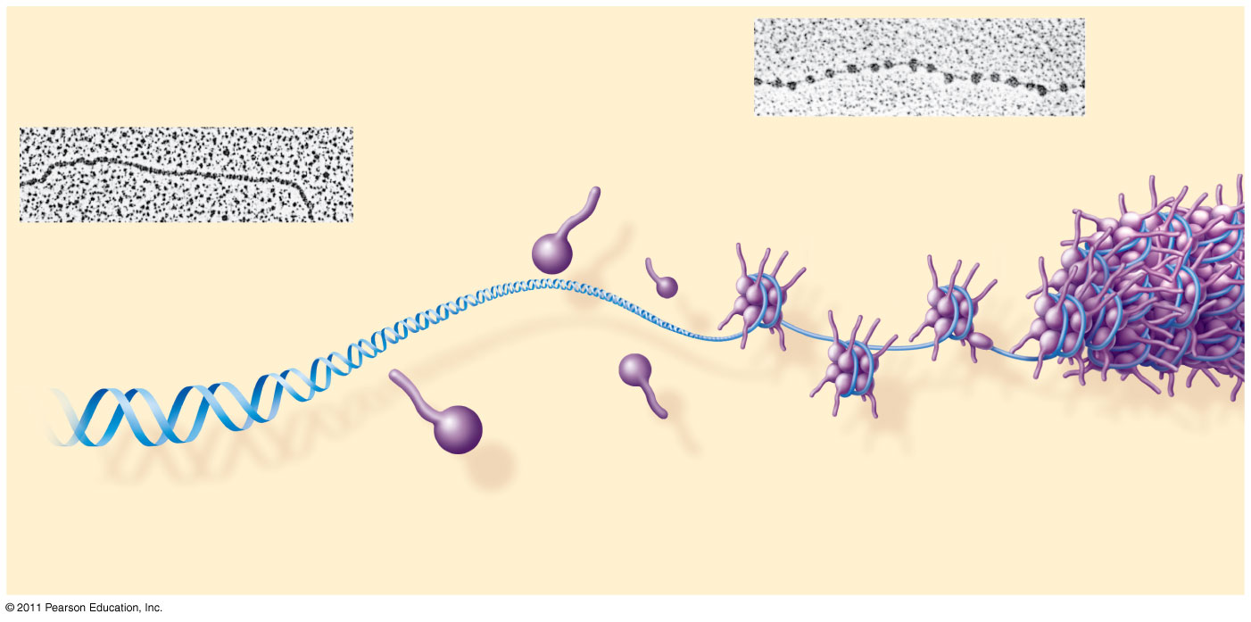
Figure 16.22a
(40 part)
Nucleosome (10 nm in diameter)
DNA double helix (2 nm in diameter)
H1
Histone tail
Histones
Nucleosomes, or “beads on a string” (10-nm fiber)
DNA, the double helix
Histones
Notes:
Figure 16.22 Exploring: Chromatin Packing in a Eukaryotic Chromosome

Slide 48
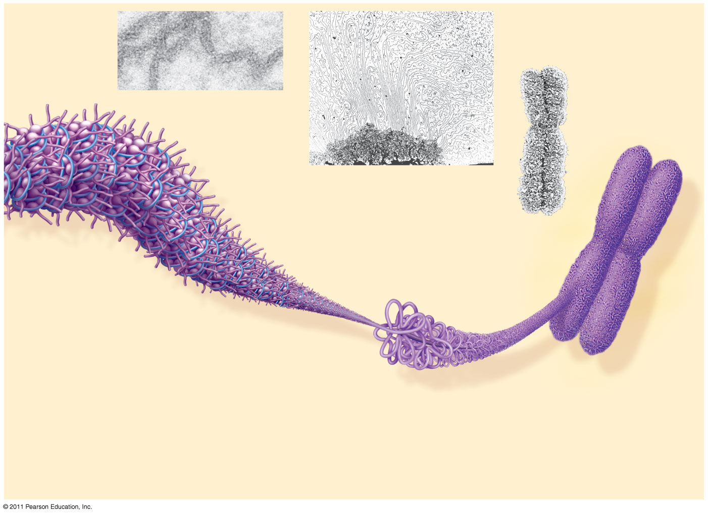
Figure 16.22b
Chromatid (700 nm)
30-nm fiber
Loops
Scaffold
300-nm fiber
30-nm fiber
(40)
Replicated chromosome (1,400 nm)
Looped domains (300-nm fiber)
Metaphase chromosome
Notes:
Figure 16.22 Exploring: Chromatin Packing in a Eukaryotic Chromosome

Slide 49
Most chromatin is loosely packed in the nucleus during interphase and condenses prior to mitosis
Loosely packed chromatin is called euchromatin
During interphase a few regions of chromatin (centromeres and telomeres) are highly condensed into heterochromatin
Dense packing of the heterochromatin makes it difficult for the cell to express genetic information coded in these regions
Histones can undergo chemical modifications that result in changes in chromatin organization
© 2011 Pearson Education, Inc.

