Slide 1
Chapter 17
From Gene to Protein
Part II

Slide 2
Concept 17.4: Translation is the RNA-directed synthesis of a polypeptide: a closer look
DNA’s genetic information flows to protein through the process of translation. (53)
Type of RNA | Description | Function
mRNA | (Messenger) | Carries DNA’s code for proteins to ribosomes
tRNA | (Transfer) | Translates mRNA codons to amino acids
rRNA | (Ribosomal) | Plays catalytic and structural roles in ribosomes
© 2011 Pearson Education, Inc.
Notes:
2

Slide 3
Molecular Components of Translation
A cell translates an mRNA message into protein with the help of transfer RNA (tRNA)
tRNA transfer amino acids to the growing polypeptide in a ribosome
Molecules of tRNA are not identical
Each carries a specific amino acid on one end
Each has an anticodon on the other end; the anticodon base-pairs with a complementary codon on mRNA (54)
© 2011 Pearson Education, Inc.
Notes:
3

Slide 4
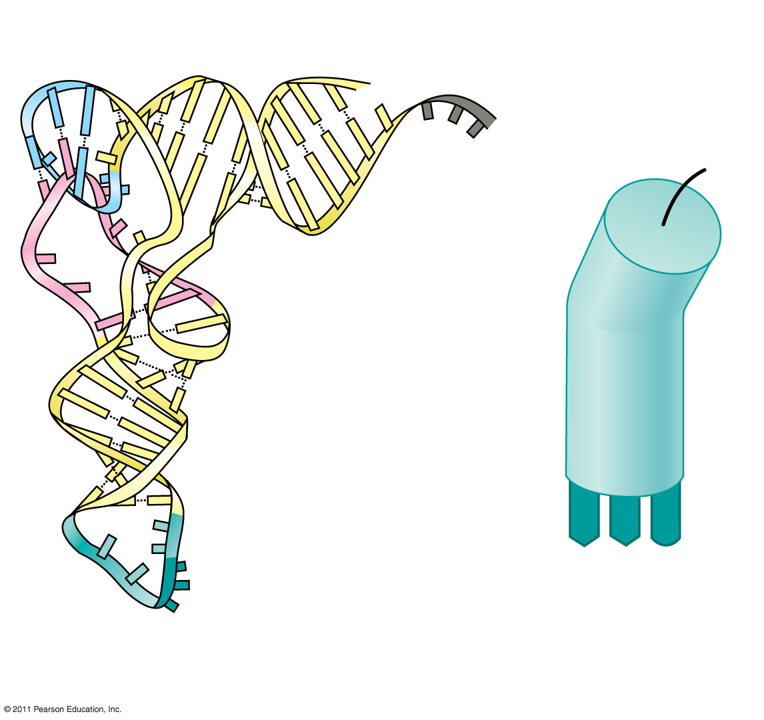
Amino acid attachment site
5′
3′
(55)
Hydrogen bonds
BioFlix: Protein Synthesis
A
A
G
3′
5′
Anticodon
Anticodon
(c) Symbol used
(b) Three-dimensional structure
in this book
© 2011 Pearson Education, Inc.
Notes:
4

Slide 5
Accurate translation requires two steps
First: a correct match between a tRNA and an amino acid, done by the enzyme aminoacyl-tRNA synthetase
Second: a correct match between the tRNA anticodon and an mRNA codon
aminoacyl-tRNA synthetase animation
There are 20 aminoacyl-tRNA synthetases (1 for each amino acid) and 45 different tRNAs.
Flexible pairing at the third base of a codon is called wobble and allows some tRNAs to bind to more than one codon (56, 57)
© 2011 Pearson Education, Inc.
Notes:
5

Slide 6
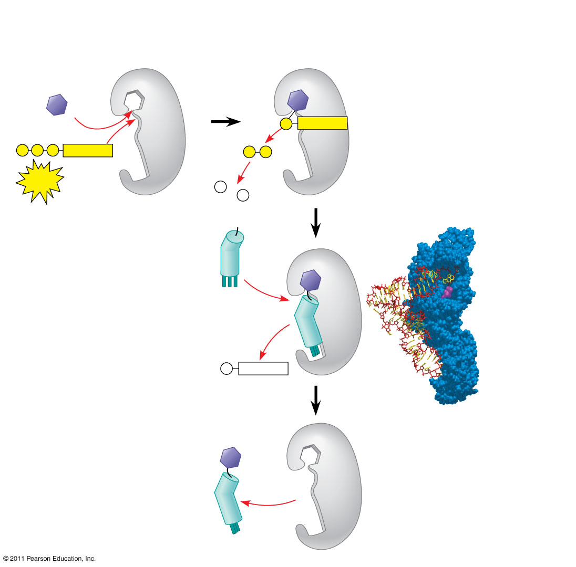
Figure 17.16-4
Aminoacyl-tRNA synthetase (enzyme)
Amino acid
P
Adenosine
P
P
P
Adenosine
P
P
i
ATP
Aminoacyl-tRNA synthetase
P
i
P
tRNA
i
tRNA
(58)
Amino acid
P
Adenosine
AMP
Computer model
Aminoacyl tRNA (“charged tRNA”)
Notes:
Figure 17.16 An aminoacyl-tRNA synthetase joining a specific amino acid to a tRNA.

Slide 7
Ribosomes
Ribosomes facilitate specific coupling of tRNA anticodons with mRNA codons in protein synthesis
The two ribosomal subunits (large and small) are made of proteins and ribosomal RNA (rRNA)
Bacterial and eukaryotic ribosomes have are somewhat similar but have different sized sub units and other differences(signficance?)
Some antibiotic drugs specifically target bacterial ribosomes without harming eukaryotic ribosomes
© 2011 Pearson Education, Inc.
Notes:
7

Slide 8
Ribosomes
Facilitate the specific coupling of tRNA anticodons with mRNA codons during protein synthesis
There are 2 ribosomal subunits, each composed of ribosomal RNA or rRNA
Genes on chromosomal DNA are transcribed, and the RNA is processed and assembled with proteins imported from the cytoplasm
This occurs in the nucleolus
The completed ribosomal subunits are then exported through a nuclear pore

Slide 9
Ribosomes
In both prokaryotes and eukaryotes both ribosomal subunits only join to form a complete functional ribosome when attached to an mRNA

Slide 10
Ribosomes are always composed of 2 subunits, a large subunit and a small subunit
Prokaryotic
Eukaryotic
Large subunit is called the 50s
Composed of 2 strands of rRNA
Small subunit is called the 30s
Composed of 1 strand of rRNA
= a complete ribosome of ____?_____
70s ribosome
Large subunit is called the 60s
Composed of 3 strands of rRNA
Small subunit is called the 40s
Composed of 1 strand of rRNA
= a complete ribosome of ____?_____
80s ribosome

Slide 11
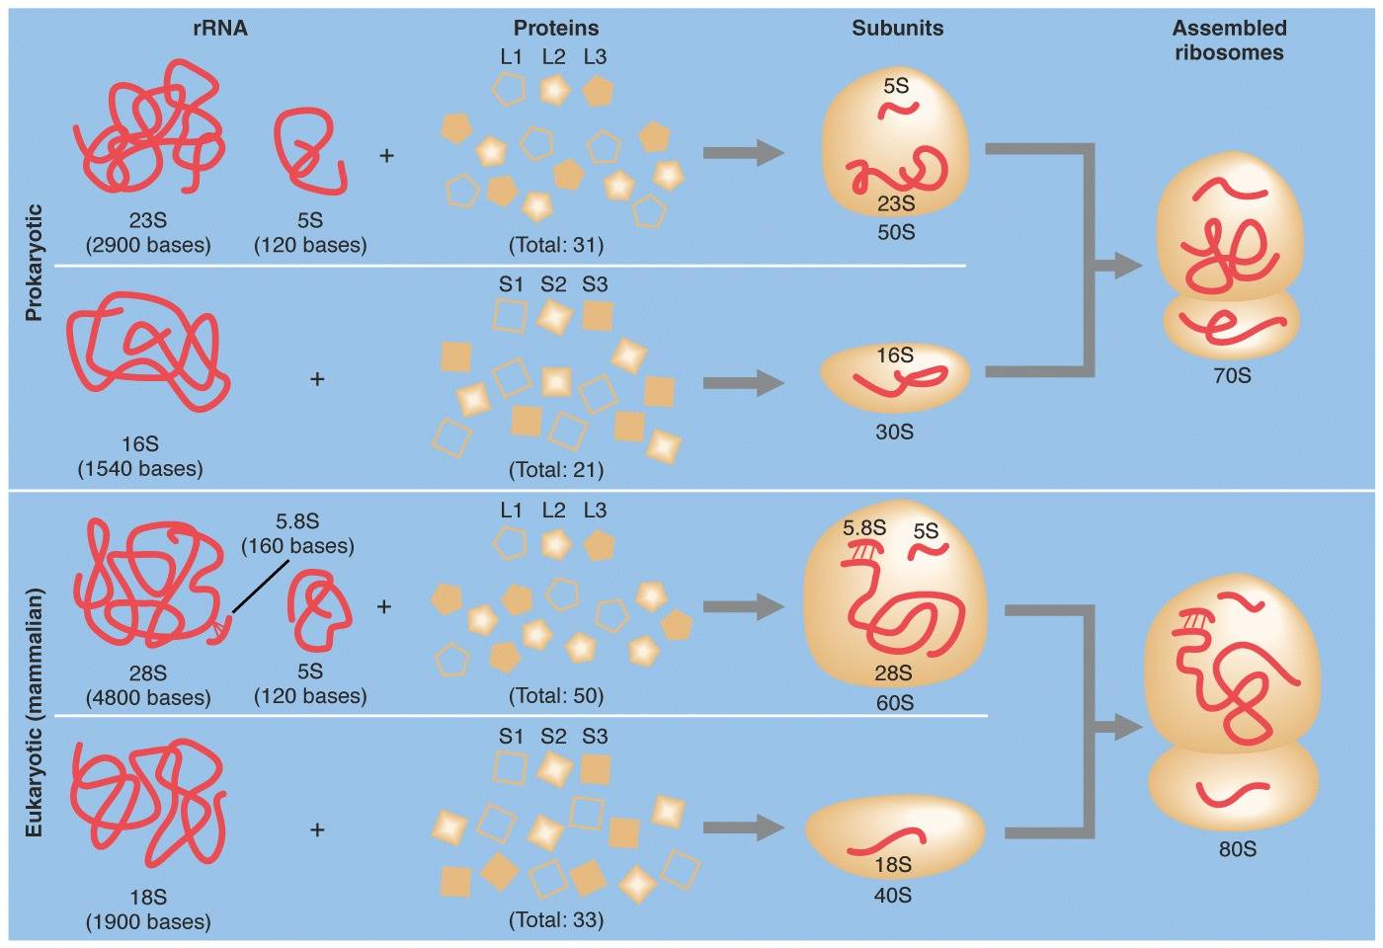

Slide 12
Significance
The differences between prokaryotic and eukaryotic ribosomes are small but significant
Many of our antibacterial drugs work by inactivating bacterial ribosomes without inhibiting eukaryotic ribosomes
Tetracycline
Streptomycin
Binds to the S12 Protein of the 30S subunit of the bacterial ribosome, interfering with the binding of formyl-methionyl-tRNA to the 30S subunit.
This prevents initiation of protein synthesis and leads to death of microbial cells

Slide 13
Figure 17.17b
P site (Peptidyl-tRNA binding site)
Exit tunnel
A site (Aminoacyl- tRNA binding site)
E site (Exit site)
E
P
A
Large subunit
mRNA binding site
Small subunit
(b) Schematic model showing binding sites
(61)
Notes:
Figure 17.17 The anatomy of a functioning ribosome.

Slide 14
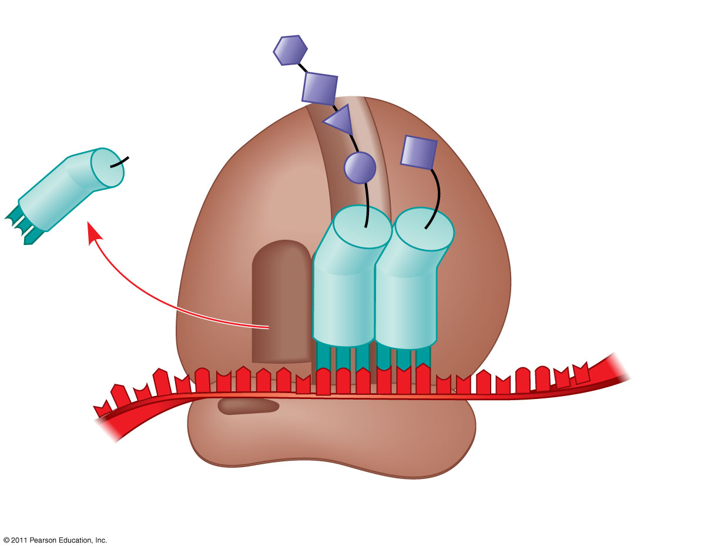
Figure 17.17c
Growing polypeptide
Amino end
Next amino acid to be added to polypeptide chain
E
tRNA
mRNA
3′
5′
Codons
(c) Schematic model with mRNA and tRNA
Notes:
Figure 17.17 The anatomy of a functioning ribosome.

Slide 15
Building a Polypeptide
The three stages of translation
Initiation
Elongation
Termination
All three stages require protein “factors” that aid in the translation process
© 2011 Pearson Education, Inc.
Notes:
15

Slide 16
Ribosome Association and Initiation of Translation
The initiation stage of translation brings together mRNA, a tRNA with the first amino acid, and the two ribosomal subunits
First, a small ribosomal subunit binds with mRNA and a special initiator tRNA
Then the small subunit moves along the mRNA until it reaches the start codon (AUG)
Proteins called initiation factors bring in the large subunit that completes the translation initiation complex (63 described diagram on next slide)
© 2011 Pearson Education, Inc.
Notes:
16

Slide 17
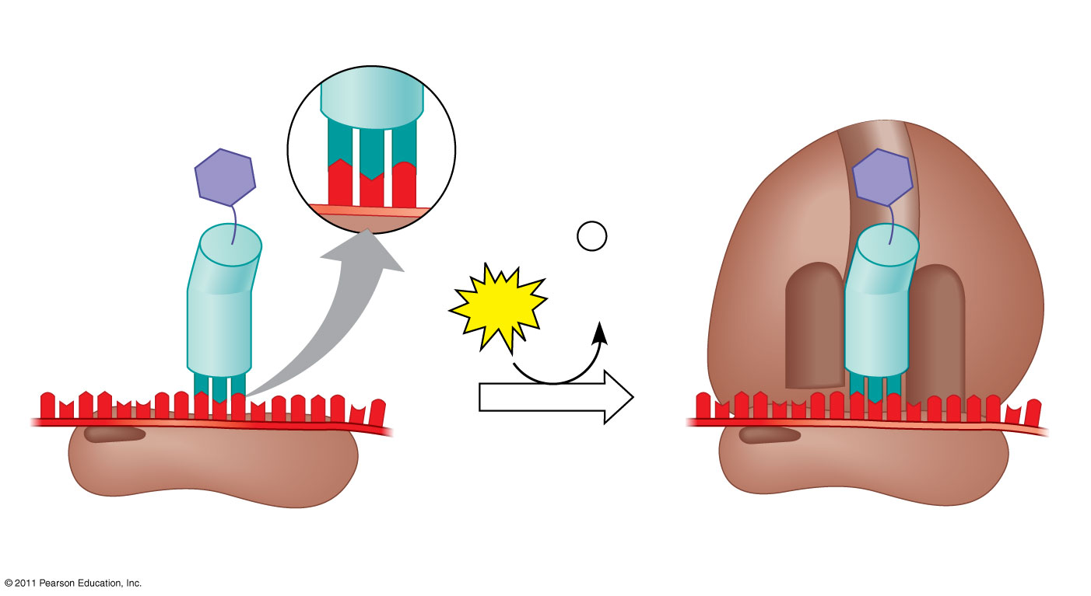
Figure 17.18
(63-64)
Large ribosomal subunit
3′
U
A
C
5′
P site
Met
5′
A
U
G
3′
Met
P
i
Initiator tRNA
+
GTP
GDP
E
A
mRNA
5′
5′
3′
3′
Start codon
Small ribosomal subunit
mRNA binding site
Translation initiation complex
Translation Initiation Animation
Notes:
Figure 17.18 The initiation of translation.

Slide 18
Elongation of the Polypeptide Chain
During the elongation stage, amino acids are added one by one to the preceding amino acid at the C-terminus of the growing chain
Each addition involves proteins called elongation factors and occurs in three steps: codon recognition, peptide bond formation, and translocation
Translation proceeds along the mRNA in a 5′ to 3′ direction
© 2011 Pearson Education, Inc.
Notes:
18

Slide 19
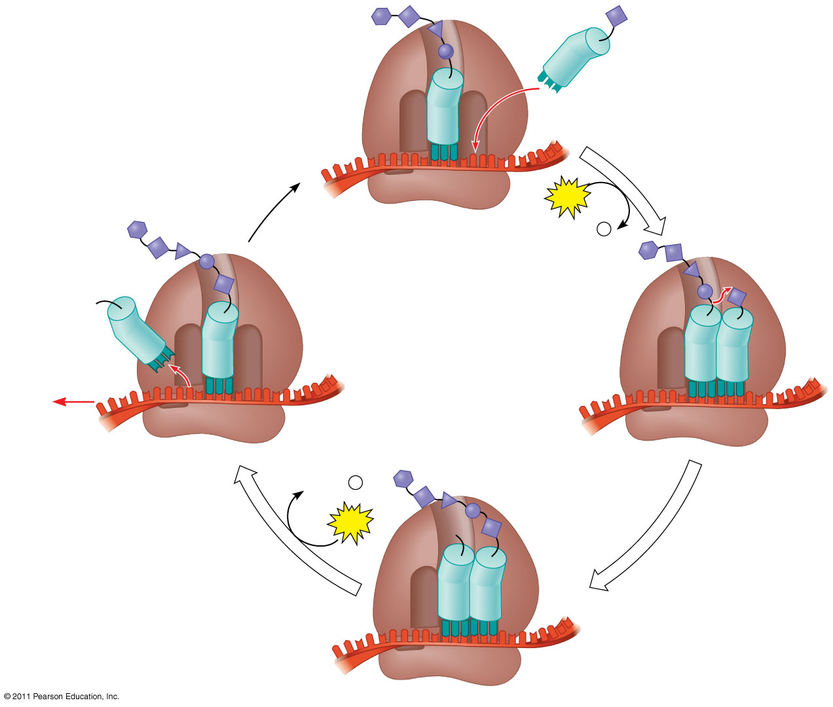
Figure 17.19-4
Amino end of polypeptide
E
3′
mRNA
Ribosome ready for next aminoacyl tRNA
P site
A site
5′
GTP
GDP
+
P
i
E
E
P
A
P
A
GDP
+
P
i
(65)
GTP
E
P
A
Notes:
Figure 17.19 The elongation cycle of translation.

Slide 20
3 Steps of Elongation
1st is Codon Recognition
Requires hydrolysis of GTP
2nd Peptide Bond Formation between amino acids in the A and P sites, catalyzed by the ribosome
Removes the amino acid from the tRNA that carried it
3rd Translocation of tRNA in the A site to the P site, while at the same time moving the tRNA in the P site to the E site
mRNA is moved through the ribosome 5’end 1st
Translation Elongation Animation

Slide 21
Termination of Translation
Termination occurs when a stop codon in the mRNA reaches the A site of the ribosome
The A site accepts a protein called a release factor
The release factor causes the addition of a water molecule instead of an amino acid
This reaction releases the polypeptide, and the translation assembly then comes apart (66)
Translation Termination Animation
© 2011 Pearson Education, Inc.
Notes:
21

Slide 22
Figure 17.20-3
Release factor
Free polypeptide
5′
3′
3′
5′
5′
2
GTP
3′
Stop codon
2
GDP
+
2
P
i
(UAG, UAA, or UGA)
Notes:
Figure 17.20 The termination of translation.

Slide 23
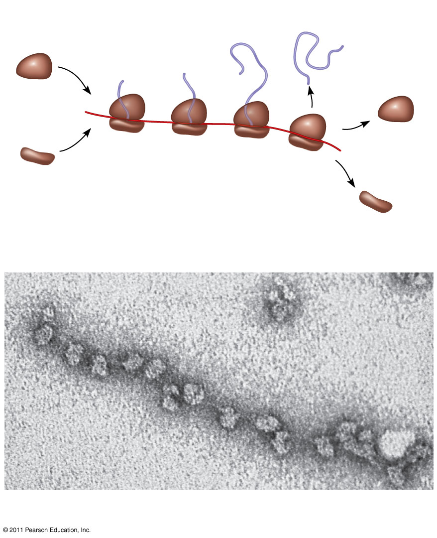
Figure 17.21
Completed polypeptide
Growing polypeptides
Incoming ribosomal subunits
A number of ribosomes can translate a single mRNA simultaneously, forming a polyribosome (or polysome) (67)
Polyribosome
Start of mRNA (5′ end)
End of mRNA (3′ end)
(a)
Ribosomes
mRNA
(b)
0.1 μm
Notes:
Figure 17.21 Polyribosomes.

Slide 24
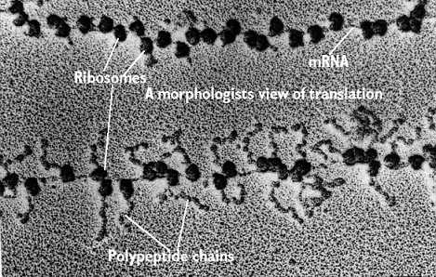
Polyribosomes
mRNA
Ribosomes
Polypeptide chains
As seen with an electron microscope

Slide 25
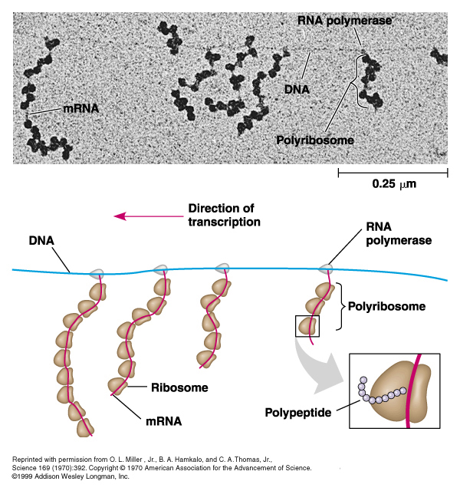
What kind of cell is this & how do you know?

Slide 26
Comparing Prokaryotes to Eukaryotes
Processing of Gene Information Animation

Slide 27
Protein Folding and Post-Translational Modifications
During and after synthesis, a polypeptide chain spontaneously coils and folds into its three-dimensional shape
Proteins may also have amino acids modified to attach sugars, lipids, phosphate groups etc.
Some polypeptides are activated by enzymes that cleave them
Other polypeptides are brought together to form the subunits of a multi-domained protein
(68 list-69)
© 2011 Pearson Education, Inc.
Notes:
27

Slide 28
Targeting Polypeptides to Specific Locations
Two populations of ribosomes are evident in cells: free ribsomes (in the cytosol) and bound ribosomes (attached to the ER)
Free ribosomes mostly synthesize proteins that function in the cytosol
Bound ribosomes make proteins of the endomembrane system and proteins that are secreted from the cell
Ribosomes are identical and can switch from free to bound
© 2011 Pearson Education, Inc.
Notes:
28

Slide 29
Polypeptide synthesis always begins in the cytosol
Synthesis finishes in the cytosol unless the polypeptide signals the ribosome to attach to the ER
Polypeptides destined for the ER or for secretion are marked by a signal peptide
A signal-recognition particle (SRP) binds to the signal peptide
The SRP brings the signal peptide and its ribosome to the ER (70 description figure on next slide)
© 2011 Pearson Education, Inc.
Notes:
29

Slide 30
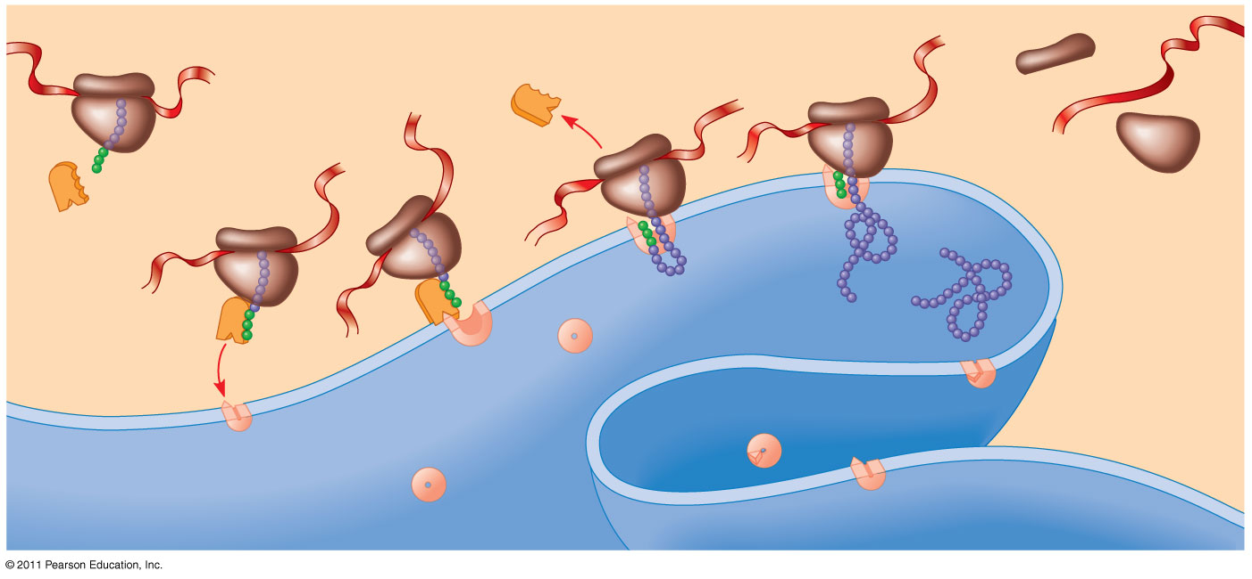
Figure 17.22
(70)
1
Ribosome
5
mRNA
4
Signal peptide
ER membrane
3
Signal peptide removed
SRP
Protein
6
2
SRP receptor protein
CYTOSOL
ER LUMEN
Translocation complex
Notes:
Figure 17.22 The signal mechanism for targeting proteins to the ER.

Slide 31
Concept 17.5: Mutations of one or a few nucleotides can affect protein structure and function
Mutations are changes in the genetic material of a cell or virus
Point mutations are chemical changes in just one base pair of a gene
Frameshift mutations change the reading frame (insertions or deletions)
The change of a single nucleotide in a DNA template strand can lead to the production of an abnormal protein (71-74)
© 2011 Pearson Education, Inc.
Notes:
31

Slide 32
Sickle Cell Anemia
Sickle cell is a group of disorders inherited codominantly in humans due to a point mutation
Sickle-cell anemia is most common in people of African descent
About 1 in 12 African Americans are heterozygous for the disease
Individuals with this mutation produce a hemoglobin molecule that is different by only 1 amino acid

Slide 33
Sickle Cell
Sickle Cell-anemia
Sickle Cell-trait
Both copies of genes are defective
Mutated hemoglobin forms crystal like structures that change the shape of the red blood cells
Normal red blood cells are disc shaped
Affected red blood cells are sickle, or half moon shaped
Individuals who are heterozygous produce both normal and sickled hemoglobin
They produce enough normal hemoglobin that they do not have the serious health problems of those homozygous for the disease
They are said to have the sickle cell trait because they show some signs of the disease

Slide 34
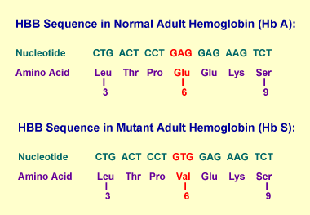
The change in shape occurs after the hemoglobin delivers oxygen to the cells, in the narrow capillaries
Abnormally shaped blood cells slow blood flow, block small vessels, and result in tissue damage
Sickle-Cell Anemia is very painful and can shorten a persons life span

Slide 35
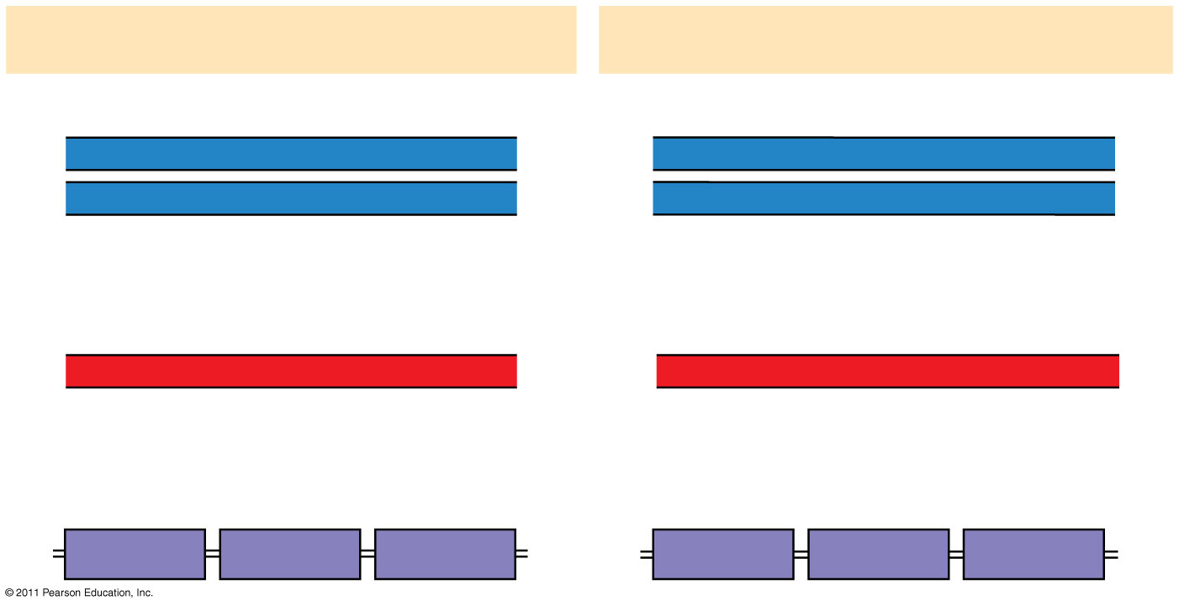
Figure 17.23
Wild-type hemoglobin
Sickle-cell hemoglobin
Wild-type hemoglobin DNA
Mutant hemoglobin DNA
3′
C
T
T
5′
3′
C
A
T
5′
5′
G
A
A
3′
5′
G
T
A
3′
mRNA
mRNA
5′
G
A
A
3′
5′
G
U
A
3′
Normal hemoglobin
Sickle-cell hemoglobin
Glu
Val
Notes:
Figure 17.23 The molecular basis of sickle-cell disease: a point mutation.

Slide 37
Substitutions
A nucleotide-pair substitution replaces one nucleotide and its partner with another pair of nucleotides
Silent mutations have no effect on the amino acid produced by a codon because of redundancy in the genetic code
Missense mutations still code for an amino acid, but not the correct amino acid
Nonsense mutations change an amino acid codon into a stop codon, nearly always leading to a nonfunctional protein (75-76)
© 2011 Pearson Education, Inc.
Notes:
37

Slide 38
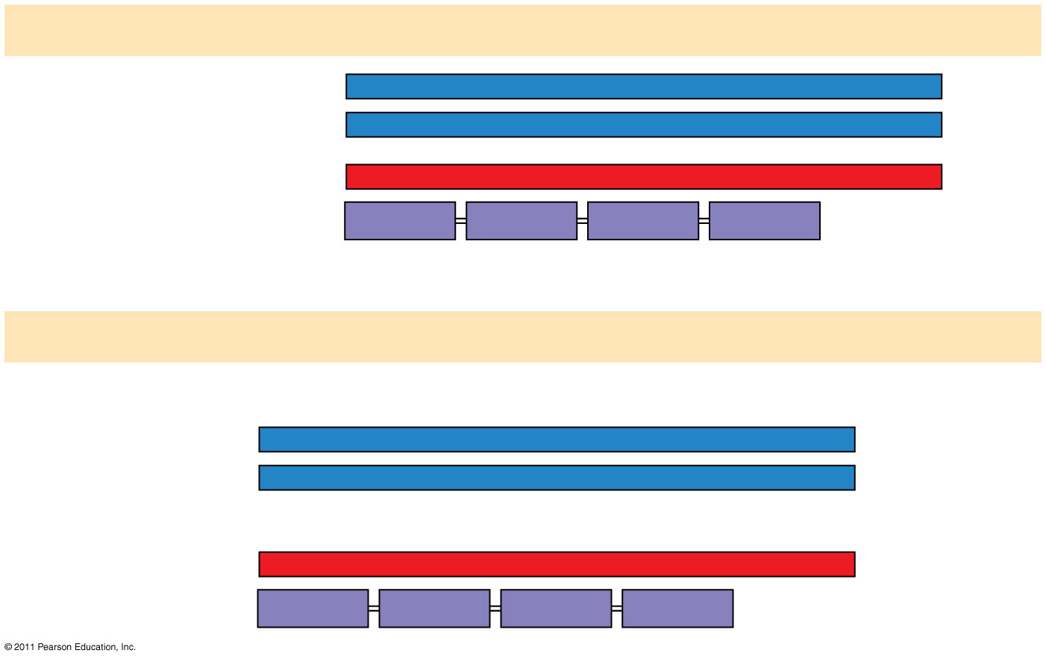
Figure 17.24a
Wild type
DNA template strand
3′
T
A
C
T
T
C
A
A
A
C
C
G
A
T
T
5′
5′
A
T
G
A
A
G
T
T
T
G
G
C
T
A
A
3′
mRNA5′
A
U
G
A
A
G
U
U
U
G
G
C
U
A
A
3′
Protein
Met
Lys
Phe
Gly
Stop
Amino end
Carboxyl end
(a) Nucleotide-pair substitution: silent
A instead of G
3′
T
A
C
T
T
C
A
A
A
C
C
A
A
T
T
5′
5′
A
T
G
A
A
G
T
T
T
G
G
T
T
A
A
3′
U instead of C
5′
A
U
G
A
A
G
U
U
U
G
G
U
U
A
A
3′
Met
Lys
Phe
Gly
Stop
Notes:
Figure 17.24 Types of small-scale mutations that affect mRNA sequence.

Slide 39
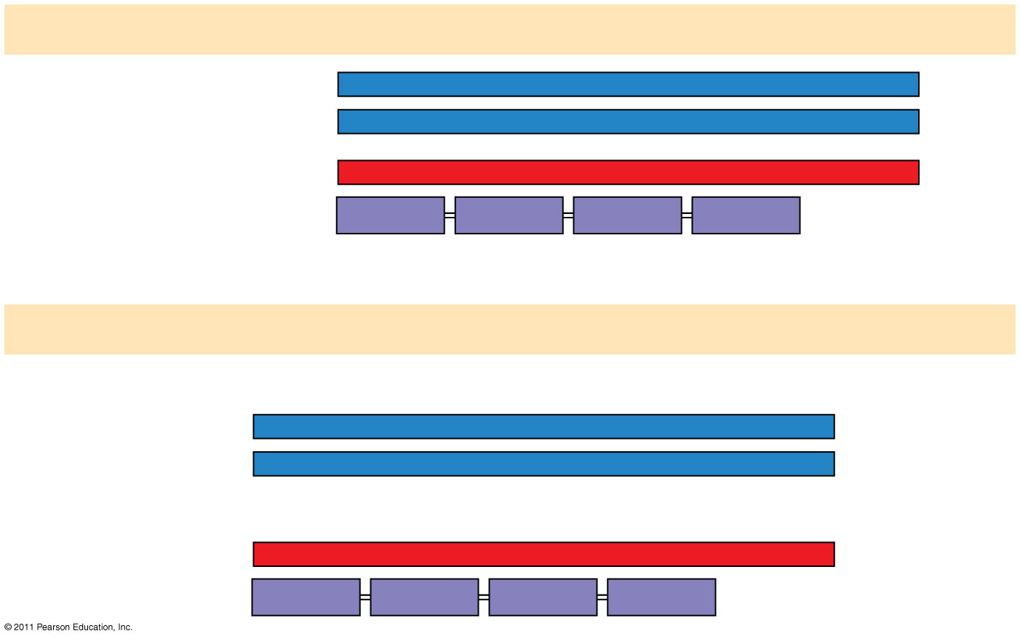
Figure 17.24b
Wild type
DNA template strand
3′
T
A
C
T
T
C
A
A
A
C
C
G
A
T
T
5′
5′
A
T
G
A
A
G
T
T
T
G
G
C
T
A
A
3′
mRNA5′
A
U
G
A
A
G
U
U
U
G
G
C
U
A
A
3′
Protein
Met
Lys
Phe
Gly
Stop
Amino end
Carboxyl end
(a) Nucleotide-pair substitution: missense
T instead of C
3′
T
A
C
T
T
C
A
A
A
T
C
G
A
T
T
5′
5′
A
T
G
A
A
G
T
T
T
A
G
C
T
A
A
3′
A instead of G
5′
A
U
G
A
A
G
U
U
U
A
G
C
U
A
A
3′
Met
Lys
Phe
Ser
Stop
Notes:
Figure 17.24 Types of small-scale mutations that affect mRNA sequence.

Slide 40
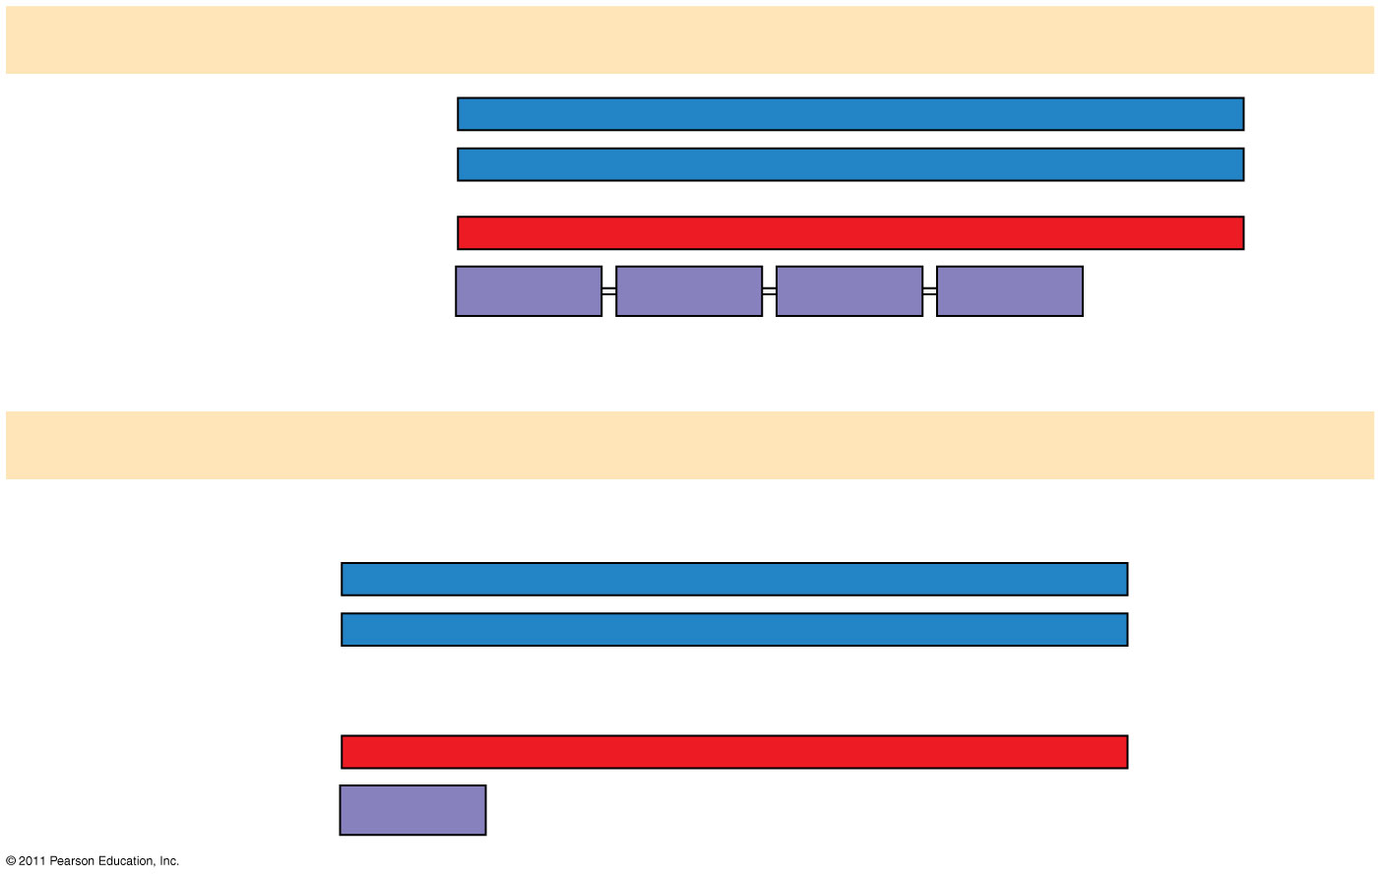
Figure 17.24c
Wild type
DNA template strand
3′
T
A
C
T
T
C
A
A
A
C
C
G
A
T
T
5′
5′
A
T
G
A
A
G
T
T
T
G
G
C
T
A
A
3′
mRNA5′
A
U
G
A
A
G
U
U
U
G
G
C
U
A
A
3′
Protein
Met
Lys
Phe
Gly
Stop
Amino end
Carboxyl end
(a) Nucleotide-pair substitution: nonsense
A instead of T
T instead of C
3′
T
A
C
A
T
C
A
A
A
C
C
G
A
T
T
5′
5′
A
T
G
T
A
G
T
T
T
G
G
C
T
A
A
3′
U instead of A
5′
A
U
G
U
A
G
U
U
U
G
G
C
U
A
A
3′
Met
Stop
Notes:
Figure 17.24 Types of small-scale mutations that affect mRNA sequence.

Slide 41
Mutagens
Spontaneous mutations can occur during DNA replication, recombination, or repair
Mutagens are physical or chemical agents that can cause mutations
Physical-Xrays, UV rays etc.
Chemicals-they can cause existing bases to pair incorrectly, be substituted into the DNA as bases, or cause DNA shape distortions. (77-78)
© 2011 Pearson Education, Inc.
Notes:
41

Slide 42
2 main types of mutagens
Radiation
X-rays
UV radiation
animation
Chemical
Base analogs: chemicals that are similar to normal DNA bases but that pair incorrectly
Chemicals that interfere with correct DNA replication by inserting themselves into the double helix and distorting the shape
Chemicals that cause bases to undergo tautomerization and so interefer with their ability to pair properly

Slide 43
Comparing Gene Expression in Bacteria, Archaea, and Eukarya
Bacteria and eukarya differ in their RNA polymerases, termination of transcription, and ribosomes; archaea tend to resemble eukarya in these respects
Bacteria can simultaneously transcribe and translate the same gene
In eukarya, transcription and translation are separated by the nuclear envelope
In archaea, transcription and translation are likely coupled (79)
© 2011 Pearson Education, Inc.
Notes:
43

Slide 44
What Is a Gene? Revisiting the Question
The idea of the gene has evolved through the history of genetics
We have considered a gene as
A discrete unit of inheritance
A region of specific nucleotide sequence in a chromosome
A DNA sequence that codes for a specific polypeptide chain (80)
© 2011 Pearson Education, Inc.
Notes:
44

Slide 45
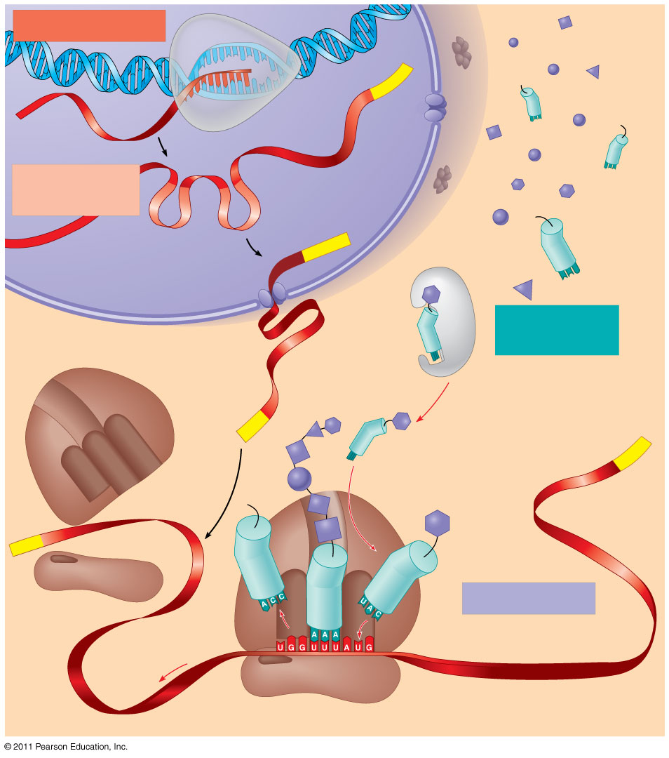
Figure 17.26
TRANSCRIPTION
DNA
3′
Poly-A
RNA
5′
RNA
polymerase
transcript
Exon
RNA
RNA transcript
PROCESSING
(pre-mRNA)
Intron
Aminoacyl-
Poly-A
tRNA synthetase
NUCLEUS
Amino acid
tRNA
AMINO ACID
CYTOPLASM
ACTIVATION
mRNA
Growing polypeptide
(81)
5′ Cap
3′
A
Aminoacyl (charged) tRNA
Poly-A
P
E
Ribosomal
subunits
5′ Cap
TRANSLATION
E
A
Anticodon
Codon
Ribosome
Notes:
Figure 17.26 A summary of transcription and translation in a eukaryotic cell.

