Slide 1
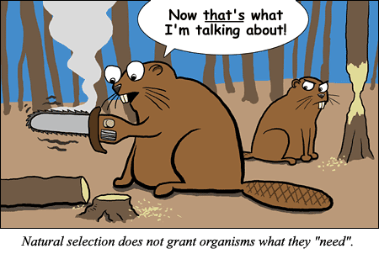
The Evolution of Populations
Chapter 23

Slide 2
Variation Makes Evolution Possible
Natural Selection operates on heritable differences among individuals in a population
2 processes produce variation in gene pools that contribute to these differences
Mutation
Produce new genes/ alleles
Changes in nucleotide sequence in DNA
Less important
Sexual recombination
More important

Slide 3
Mutations
DNA Mutations
Chromosomal Mutations
Frame shift
Addition
Deletion
Base substitution
Silent
Nonsense
missense
Translocation
Duplication
Deletion
Inversion

Slide 4
Mutations
All mutations must occur in gametes to be passed on!
Most probably harmless
Noncoding DNA
Redundancy of the genetic code
Organisms reflect thousands of years of past selection, a single mutational change is about as likely to improve the genome as blindly firing a gun through the hood of a car is likely to improve engine performance
Rarely, a mutant allele may make an organism better suited to its environment
More likely when the environment is changing and mutations that were once selected against become favorable
Point Mutations

Slide 5
Mutations
Mutations that Alter Gene # or Sequence
Chromosomal mutations that delete, disrupt, or rearrange many loci at once are almost certain to be harmful
If genes are left intact, effect on organism may be neutral
Gene Duplication: important source of variation
Duplication of chromosome segments is almost always harmful
Smaller pieces of DNA introduced into the genome through the activity of transposable elements may, over generations, provide expanded genome with new loci that may take on new functions by further mutation and selection
New genes may arise through exon shuffling

Slide 6
Mutation Rates
Plants & Animals
Prokaryotes & Viruses
Long generation spans makes mutation rates low
About 1 mutation in every 100,000 genes per generation
Short generation spans mean mutations rapidly generate variation
Example HIV:
Generation span = 2 days
RNA genome has higher mutation rate than DNA genome
Makes single drug treatments an impossibility

Slide 7
Sexual Recombination
Refers to recombinational shuffling of already existing alleles in the gene pool
Note:This allelic variation did originate from past mutation
Sexual recombination is far more important than mutation on a generation-to-generation time scale in producing variation that make adaptation possible
Sexual reproduction rearranges alleles into fresh combinations every generation

Slide 8
Prokaryotes & Viruses
Can also undergo recombination, though they do so less often than sexually reproducing organisms
Can often undergo recombination that allows them to cross species barriers
This can make them especially dangerous!

Slide 9
Overview: The Smallest Unit of Evolution
One misconception is that organisms evolve during their lifetimes
Natural selection acts on individuals, but only populations evolve
Consider, for example, a population of medium ground finches on Daphne Major Island
During a drought, large-beaked birds were more likely to crack large seeds and survive
The finch population evolved by natural selection
© 2011 Pearson Education, Inc.

Slide 10
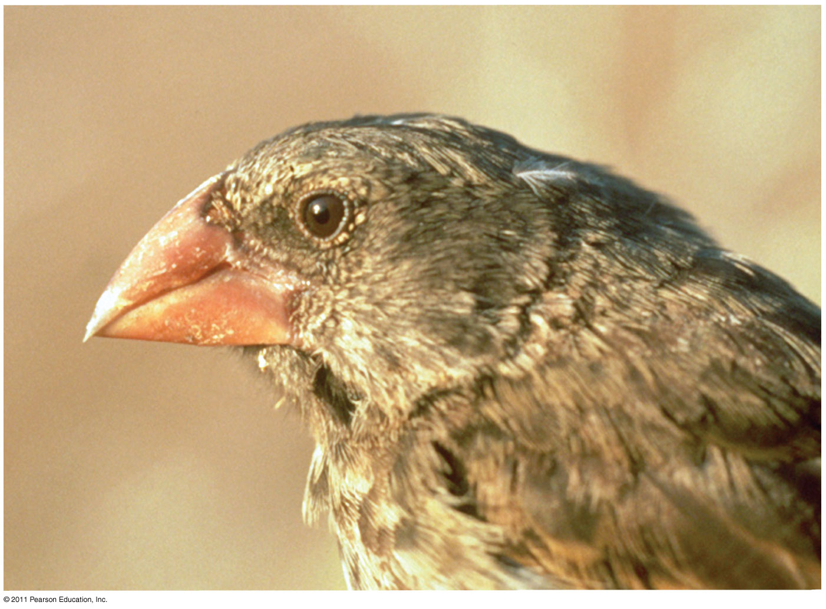
Figure 23.1
Notes:
Figure 23.1 Is this finch evolving?

Slide 11
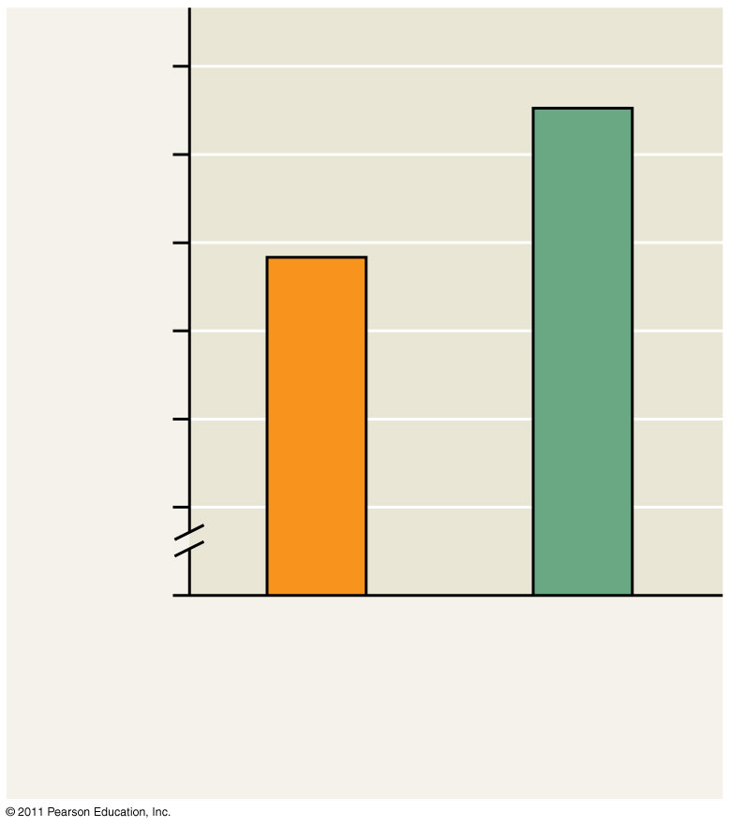
Figure 23.2
10
9
Average beak depth (mm)
8
0
1976
(similar to the
prior 3 years)
1978
(after
drought)
Notes:
Figure 23.2 Evidence of selection by food source.

Slide 12
Microevolution is a change in allele frequencies in a population over generations
Three mechanisms cause allele frequency change:
Natural selection
Genetic drift
Gene flow
Only natural selection causes adaptive evolution (1,2,3)
© 2011 Pearson Education, Inc.

Slide 13
Concept 23.1: Genetic variation makes evolution possible
Variation in heritable traits is a prerequisite for evolution
Mendel’s work on pea plants provided evidence of discrete heritable units (genes)
Genetic variation among individuals is caused by differences in genes or other DNA segments
Phenotype is the product of inherited genotype and environmental influences
Natural selection can only act on variation with a genetic component
© 2011 Pearson Education, Inc.

Slide 14
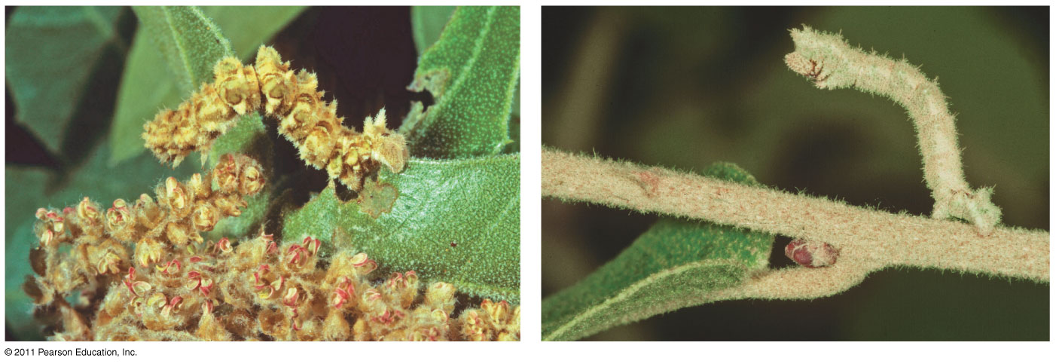
Figure 23.3 Nonheritable variation.
(a)
(b)
Notes:
Figure 23.3 Nonheritable variation.

Slide 15
Variation Within a Population
Both discrete and quantitative characters contribute to variation within a population
Discrete characters can be classified on an either-or basis
Quantitative characters vary along a continuum within a population (4)
© 2011 Pearson Education, Inc.

Slide 16
Genetic variation can be measured as gene variability or nucleotide variability
For gene variability, average heterozygosity measures the average percent of loci that are heterozygous in a population
Nucleotide variability is measured by comparing the DNA sequences of pairs of individuals (5)
© 2011 Pearson Education, Inc.

Slide 17
Variation Between Populations
Most species exhibit geographic variation, differences between gene pools of separate populations
Some examples of geographic variation occur as a cline, which is a graded change in a trait along a geographic axis
A cline means different environments, thus different selection pressures suggesting natural selection (6)
For example, mummichog fish vary in a cold-adaptive allele along a temperature gradient
This variation results from natural selection
© 2011 Pearson Education, Inc.

Slide 18
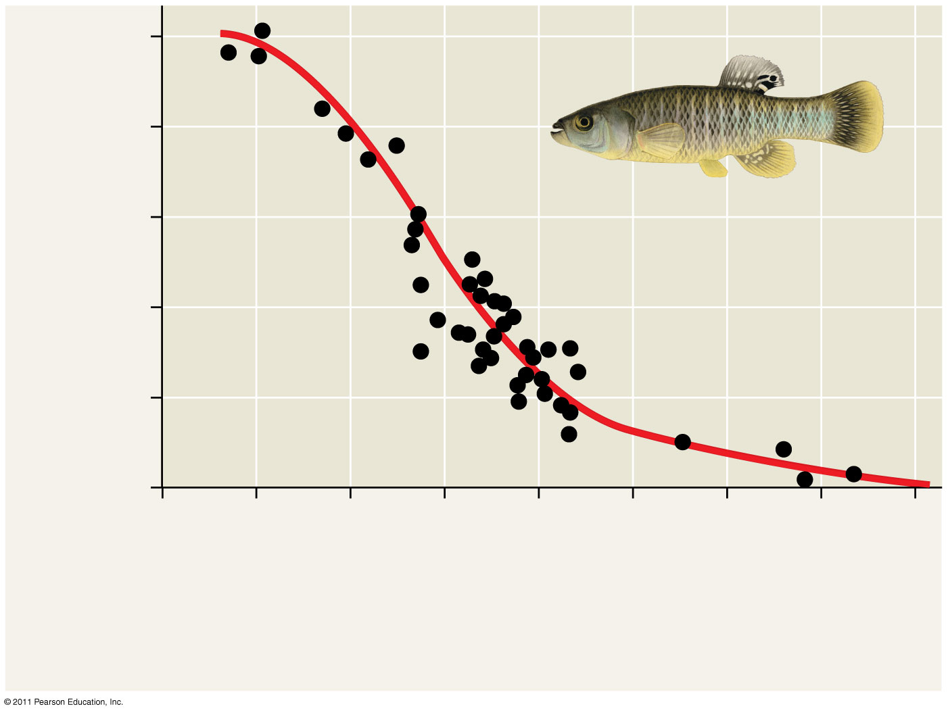
Figure 23.5 A cline determined by temperature.
1.0
0.8
0.6
Ldh-B^{b} allele frequency
0.4
0.2
0
46
44
42
40
38
36
34
32
30
Latitude (ºN)
Maine
Cold (6°C)
Georgia
Warm (21ºC)
Notes:
Figure 23.5 A cline determined by temperature.

Slide 19
Sources of Genetic Variation
New genes and alleles can arise by mutation or gene duplication and are only passed on through gametes.
Point mutations change a single base of DNA. This may not have any effect on phenotype due to codon redundancy and the mutation could occur in a non coding region of DNA.
Translocations rearrange the positions of genes on chromosomes could be beneficial or harmful. (7-9)
How genetic diversity is created in meiosis
© 2011 Pearson Education, Inc.

Slide 20
Altering Gene Number or Position
Chromosomal mutations that delete, disrupt, or rearrange many loci are typically harmful
Duplication of small pieces of DNA increases genome size and is usually less harmful, duplications can happen during DNA replication.
Duplicated genes can take on new functions by further mutation (10)
An ancestral odor-detecting gene has been duplicated many times: humans have 1,000 copies of the gene, mice have 1,300
© 2011 Pearson Education, Inc.

Slide 21
Sexual Reproduction
Sexual reproduction can shuffle existing alleles into new combinations
1. Crossing Over
2. Independent Assortment
3. Random Fertilization
In organisms that reproduce sexually, recombination of alleles is more important than mutation in producing the genetic differences that make adaptation possible (11)
© 2011 Pearson Education, Inc.

Slide 22
Concept 23.2: The Hardy-Weinberg equation can be used to test whether a population is evolving
The first step in testing whether evolution is occurring in a population is to clarify what we mean by a population
A population is a localized group of individuals capable of interbreeding and producing fertile offspring
A gene pool consists of all the alleles for all loci in a population
A locus is fixed if all individuals in a population are homozygous for the same allele (12-14)
© 2011 Pearson Education, Inc.

Slide 23
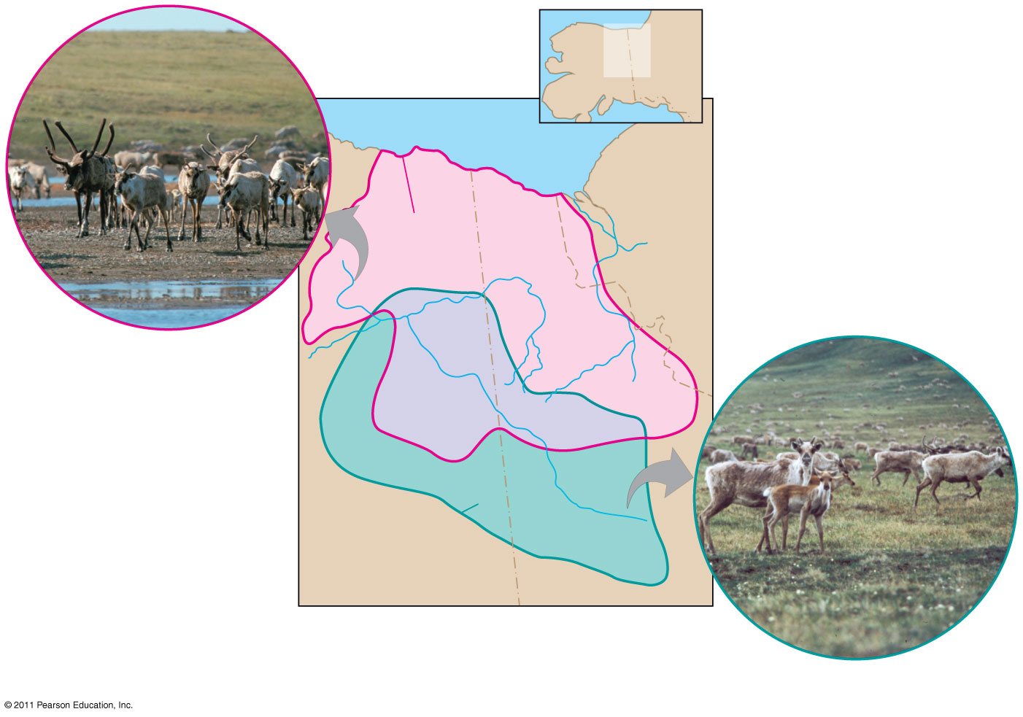
Figure 23.6
MAP
AREA
CANADA
ALASKA
Beaufort Sea
NORTHWEST
TERRITORIES
Porcupine
herd range
Porcupine herd
Fortymile
herd range
ALASKA
YUKON
Fortymile herd
Notes:
Figure 23.6 One species, two populations.

Slide 24
Hardy-Weinberg Equilibrium
The Hardy-Weinberg principle states that frequencies of alleles and genotypes in a population remain constant from generation to generation
In a given population where gametes contribute to the next generation randomly, allele frequencies will not change
Mendelian inheritance preserves genetic variation in a population
If a population does not meet the criteria of the Hardy-Weinberg principle, it can be concluded that the population is evolving (15)
© 2011 Pearson Education, Inc.

Slide 25
Conditions for Hardy-Weinberg Equilibrium
The Hardy-Weinberg theorem describes a hypothetical population that is not evolving
In real populations, allele and genotype frequencies do change over time
© 2011 Pearson Education, Inc.

Slide 26
The five conditions for nonevolving populations are rarely met in nature:
No mutations
Random mating
No natural selection
Extremely large population size
No gene flow (16)
© 2011 Pearson Education, Inc.

Slide 27
The frequency of an allele in a population can be calculated (next several slides will set up the background info necessary to do 17-18)
For diploid organisms, the total number of alleles at a locus is the total number of individuals times 2
The total number of dominant alleles at a locus is 2 alleles for each homozygous dominant individual plus 1 allele for each heterozygous individual; the same logic applies for recessive alleles
By convention, if there are 2 alleles at a locus, p and q are used to represent their frequencies. p=dominant allele q=recessive allele
© 2011 Pearson Education, Inc.

Slide 28
The frequency of all alleles in a population will add up to 1
For example, p + q = 1
For example, consider a population of wildflowers that is incompletely dominant for color:
320 red flowers (C^{R}C^{R})
160 pink flowers (C^{R}C^{W})
20 white flowers (C^{W}C^{W})
Calculate the number of copies of each allele:
C^{R} = (320 × 2) + 160 = 800
C^{W} = (20 × 2) + 160 = 200
© 2011 Pearson Education, Inc.

Slide 29
To calculate the frequency of each allele:
p = freq C^{R} = 800 / (800 + 200) = 0.8
q = freq C^{W} = 200 / (800 + 200) = 0.2
The sum of alleles is always 1
0.8 + 0.2 = 1
Given above, you could work backwards and calculate the frequency of genotypes
p² + 2pq + q² = 1
C^{R}C^{R} = p² = (0.8)² = 0.64=homozygous dominant
C^{R}C^{W} = 2pq = 2(0.8)(0.2) = 0.32=heterozygous
C^{W}C^{W} = q² = (0.2)² = 0.04=homozygous recessive
The frequency of genotypes can be confirmed using a Punnett square
© 2011 Pearson Education, Inc.

Slide 30
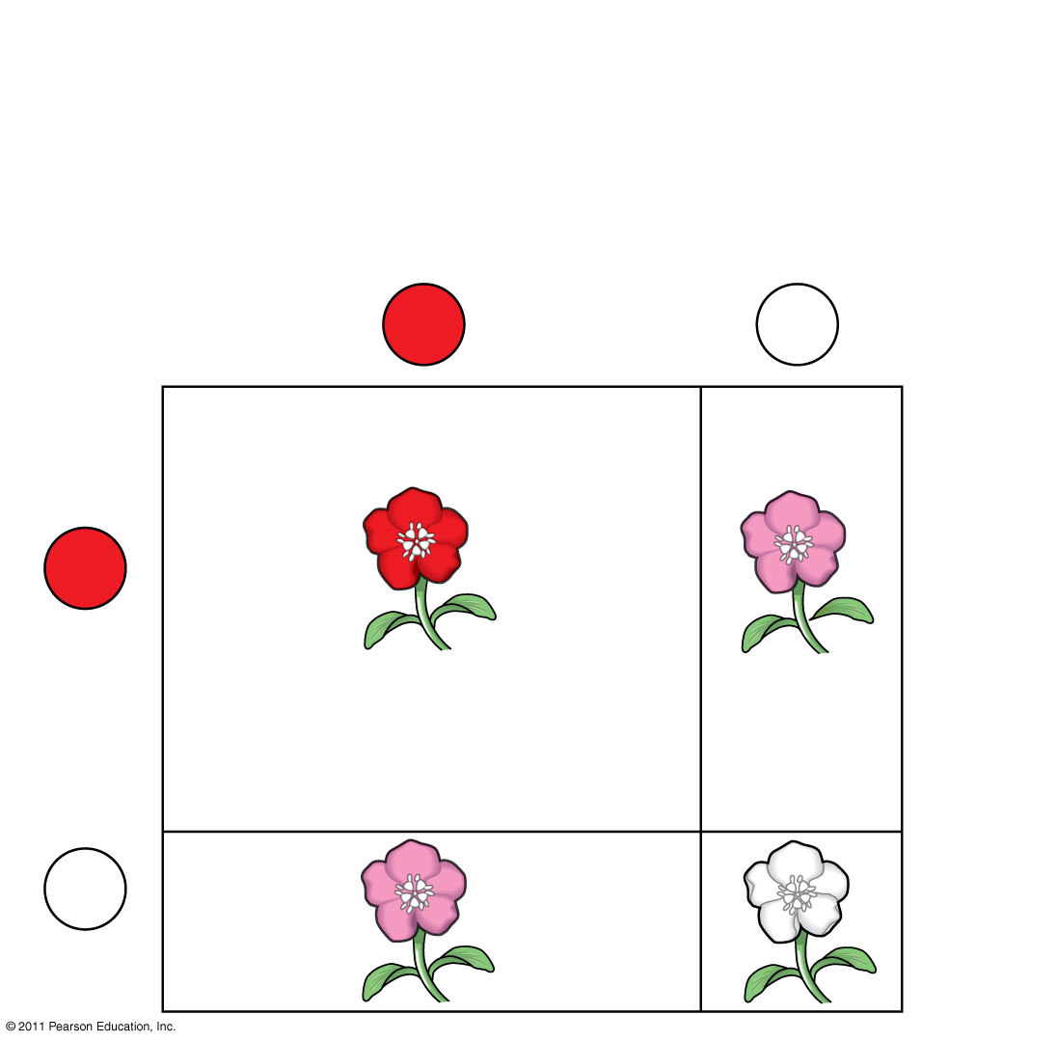
Figure 23.8a
80% C^{R} (p = 0.8)
20% C^{W} (q = 0.2)
Sperm
C^{R}
(80%)
C^{W}
(20%)
C^{R}
(80%)
64% (p²)
C^{R}C^{R}
16% (pq)
C^{R}C^{W}
Eggs
C^{W}
16% (qp)
C^{R}C^{W}
4% (q²)
C^{W}C^{W}
(20%)
Notes:
Figure 23.8 The Hardy-Weinberg principle.

Slide 31
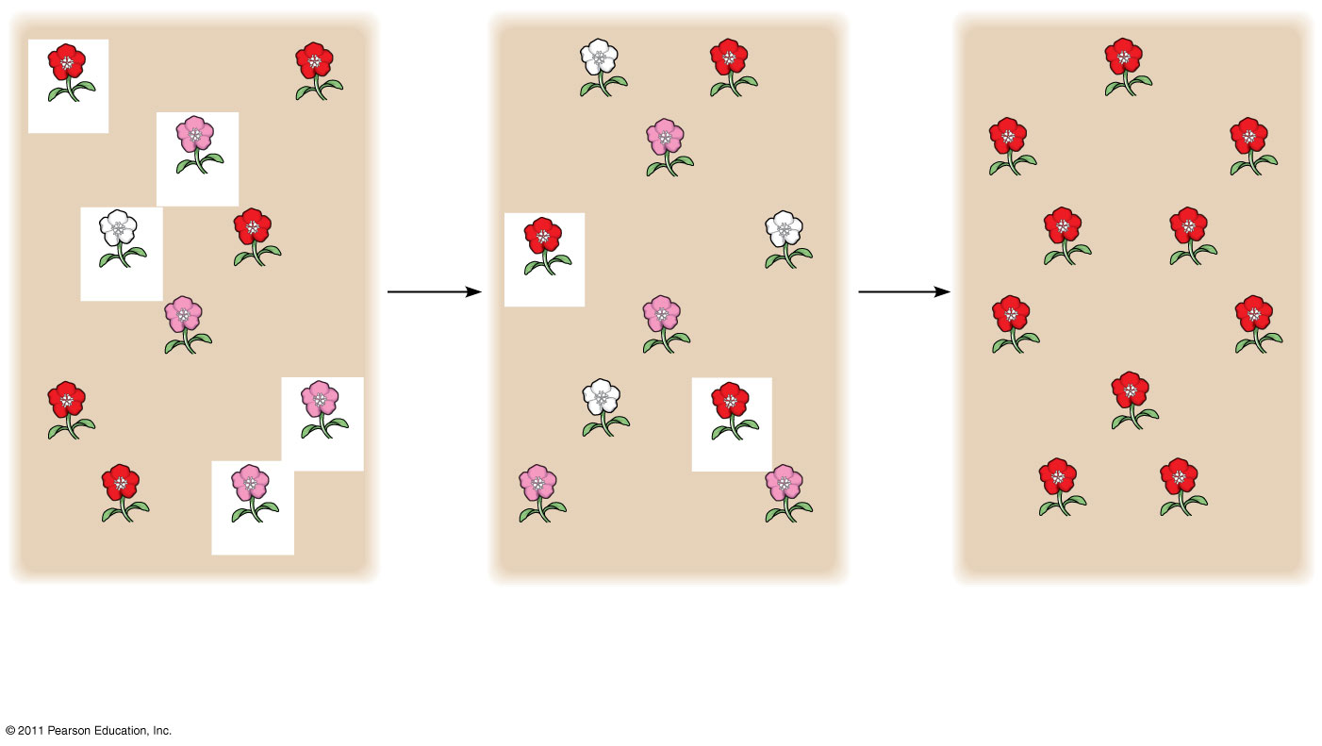
Figure 23.9-3
C^{R}C^{R}
5
plants
leave
off-
spring
C^{W}C^{W}
C^{R}C^{R}
2
plants
leave
off-
spring
C^{R}C^{R}
C^{R}C^{R}
C^{R}C^{W}
C^{R}C^{W}
C^{R}C^{R}
C^{R}C^{R}
C^{W}C^{W}
C^{R}C^{R}
C^{R}C^{R}
C^{W}C^{W}
C^{R}C^{R}
C^{R}C^{R}
C^{R}C^{W}
C^{R}C^{W}
C^{R}C^{R}
C^{R}C^{R}
C^{R}C^{R}
C^{R}C^{W}
C^{W}C^{W}
C^{R}C^{R}
C^{R}C^{R}
C^{R}C^{R}
C^{R}C^{W}
C^{R}C^{W}
C^{R}C^{W}
C^{R}C^{R}
C^{R}C^{R}
Generation 1
Generation 2
Generation 3
p (frequency of C^{R}) = 0.7
p = 0.5
p = 1.0
q (frequency of C^{W}) = 0.3
q = 0.5
q = 0.0
Notes:
Figure 23.9 Genetic drift.

Slide 32
Natural populations can evolve at some loci, while being in Hardy-Weinberg equilibrium at other loci….think about humans and PKU
© 2011 Pearson Education, Inc.

Slide 33
Applying the Hardy-Weinberg Principle
We can assume the locus that causes phenylketonuria (PKU) is in Hardy-Weinberg equilibrium given that:
The PKU gene mutation rate is low
Mate selection is random with respect to whether or not an individual is a carrier for the PKU allele
Natural selection can only act on rare homozygous individuals who do not follow dietary restrictions
The population is large
Migration has no effect as many other populations have similar allele frequencies
© 2011 Pearson Education, Inc.

Slide 34
The occurrence of PKU is 1 per 10,000 births
q² = 0.0001
q = 0.01
The frequency of normal alleles is
p = 1 – q = 1 – 0.01 = 0.99
The frequency of carriers is
2pq = 2 × 0.99 × 0.01 = 0.0198
or approximately 2% of the U.S. population
© 2011 Pearson Education, Inc.

Slide 35
Concept 23.3: Natural selection, genetic drift, and gene flow can alter allele frequencies in a population
Three major factors alter allele frequencies and bring about most evolutionary change:
Natural selection
Genetic drift
Gene flow
(19 Listed-defined on next several slides)
© 2011 Pearson Education, Inc.

Slide 36
Natural Selection
Differential success in reproduction results in certain alleles being passed to the next generation in greater proportions
For example, an allele that confers resistance to DDT increased in frequency after DDT was used widely in agriculture (22)
© 2011 Pearson Education, Inc.

Slide 37
Gene Flow
Gene flow consists of the movement of alleles among populations
Alleles can be transferred through the movement of fertile individuals or gametes (for example, pollen)
Gene flow tends to reduce variation among populations over time (21)
© 2011 Pearson Education, Inc.

Slide 38
Genetic Drift
The smaller a sample, the greater the chance of deviation from a predicted result
Genetic drift describes how allele frequencies fluctuate unpredictably from one generation to the next
Genetic drift tends to reduce genetic variation through losses of alleles (20)
Animation: Causes of Evolutionary Change
http://highered.mcgraw-hill.com/sites/9834092339/student_view0/chapter20/animation_-_mechanisms_of_evolution.html
© 2011 Pearson Education, Inc.

Slide 39
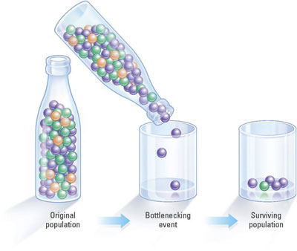
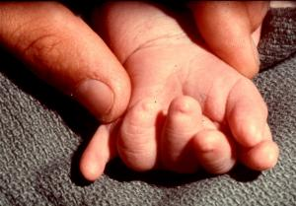
Genetic Drift
Because the founding gene pool was so small, polydactyl is common among the Amish
Bottleneck Effect
Founder Effect
A population bottleneck is a significant reduction in the size of a population that causes the extinction of many genetic lineages within that population, thus decreasing genetic diversity.
Genetic drift that occurs as a result of a drastic reduction in population by an event having little to do with the usual forces of natural selection.
The term "founder effect" refers to the observation that when a small group of individuals breaks off from a larger population and establishes a new population, chance plays a large role in determining which alleles are represented in the new population. The particular alleles may not be representative of the larger population. As the new population grows, the allele frequencies will usually continue to reflect the original small group.

Slide 40
Genetic drift and gene flow do not consistently lead to adaptive evolution as they can increase or decrease the match between an organism and its environment
© 2011 Pearson Education, Inc.

Slide 41
The Founder Effect
The founder effect occurs when a few individuals become isolated from a larger population
Allele frequencies in the small founder population can be different from those in the larger parent population (23)
© 2011 Pearson Education, Inc.

Slide 42
The Bottleneck Effect
The bottleneck effect is a sudden reduction in population size due to a change in the environment
The resulting gene pool may no longer be reflective of the original population’s gene pool
If the population remains small, it may be further affected by genetic drift (24)
© 2011 Pearson Education, Inc.

Slide 43
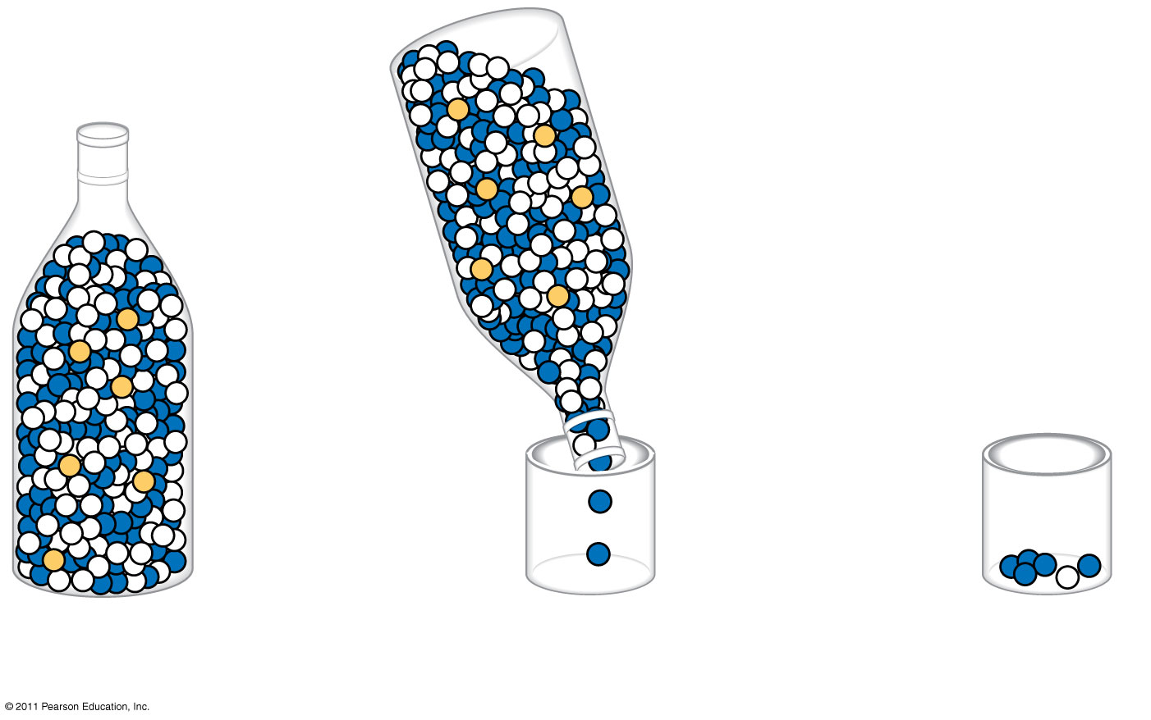
Figure 23.10-3
Original
population
Bottlenecking
event
Surviving
population
Notes:
Figure 23.10 The bottleneck effect.

Slide 44
Case Study: Impact of Genetic Drift on the Greater Prairie Chicken
Loss of prairie habitat caused a severe reduction in the population of greater prairie chickens in Illinois
The surviving birds had low levels of genetic variation, and only 50% of their eggs hatched
© 2011 Pearson Education, Inc.

Slide 45
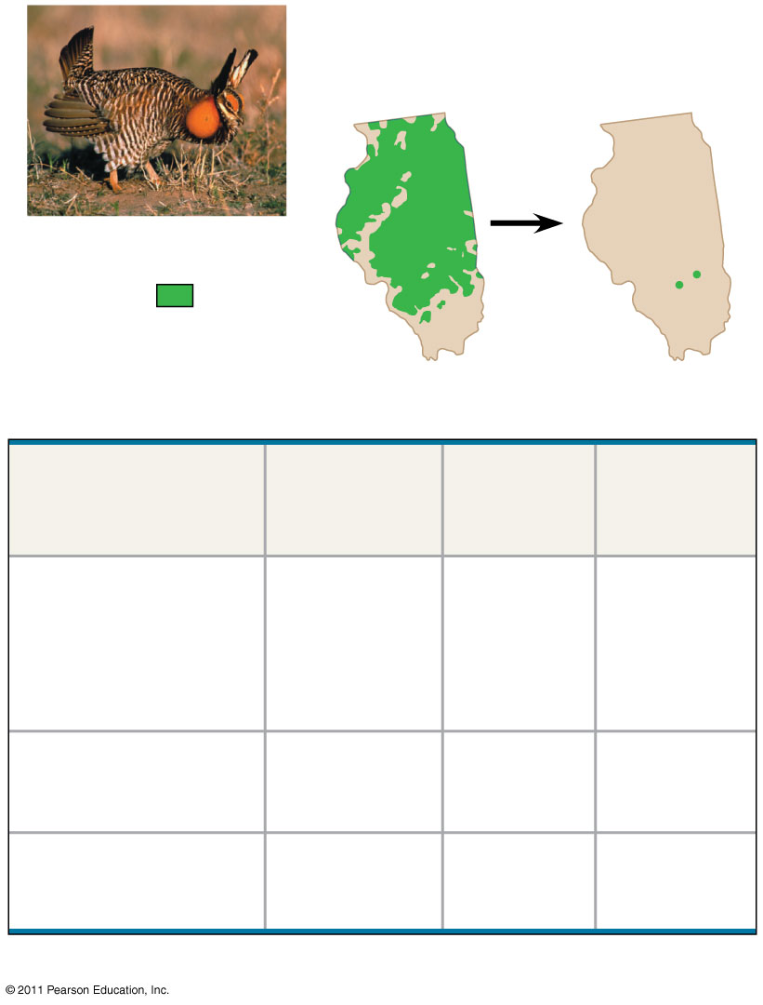
Figure 23.11
Pre-bottleneck
(Illinois, 1820)
Post-bottleneck
(Illinois, 1993)
Greater prairie chicken
Range
of greater
prairie
chicken
(a)
Population
size
Number
of alleles
per locus
Percentage
of eggs
hatched
Location
Illinois
1930–1960s
1993
1,000–25,000
<50
5.2
3.7
93
<50
Kansas, 1998
(no bottleneck)
750,000
5.8
99
Nebraska, 1998
(no bottleneck)
75,000–
200,000
5.8
96
(b)
Notes:
Figure 23.11 Genetic drift and loss of genetic variation.

Slide 46
Concept 23.4: Natural selection is the only mechanism that consistently causes adaptive evolution
Evolution by natural selection involves both change and “sorting”
New genetic variations arise by chance
Beneficial alleles are “sorted” and favored by natural selection
Only natural selection consistently results in adaptive evolution
© 2011 Pearson Education, Inc.

Slide 47
Relative Fitness
The phrases “struggle for existence” and “survival of the fittest” are misleading as they imply direct competition among individuals
Reproductive success is generally more subtle and depends on many factors
Relative fitness is the contribution an individual makes to the gene pool of the next generation, relative to the contributions of other individuals
Selection favors certain genotypes by acting on the phenotypes of certain organisms (24-25)
© 2011 Pearson Education, Inc.

Slide 48
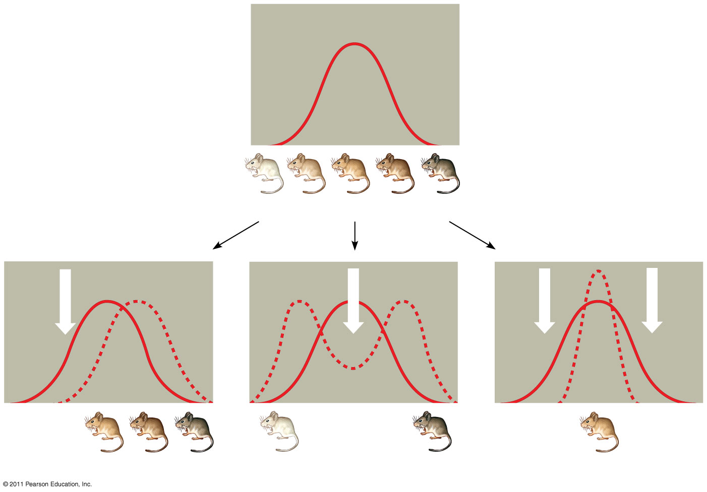
Figure 23.13
(26 here and on next slide)
Original population
Frequency of
individuals
Original
population
Evolved
population
Phenotypes (fur color)
(a) Directional selection
(b) Disruptive selection
(c) Stabilizing selection
Notes:
Figure 23.13 Modes of selection.

Slide 49
Directional, Disruptive, and Stabilizing Selection
Three modes of selection:
Directional selection favors individuals at one end of the phenotypic range
Disruptive selection favors individuals at both extremes of the phenotypic range
Stabilizing selection favors intermediate variants and acts against extreme phenotypes
© 2011 Pearson Education, Inc.

Slide 50
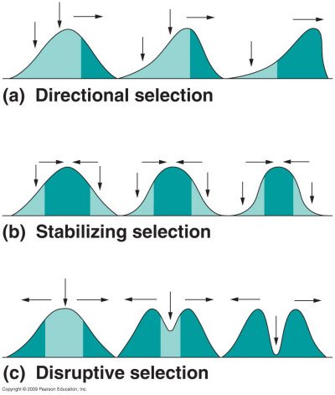
3 Types of Natural Selection
Directional
Disruptive
Stabilizing

Slide 51
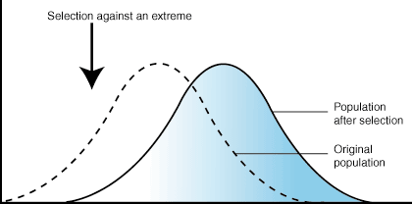
Directional Selection
Most common when a populations environment changes or when members migrate to a new habitat
Shifts frequency curve in one direction

Slide 52
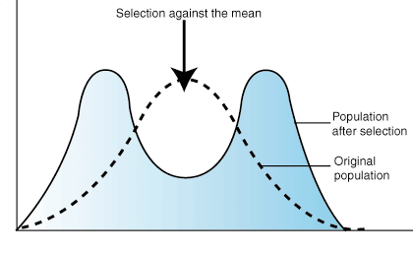
Disruptive Selection
When disruptive selection operates, individuals at the extremes contribute more offspring than those in the center, producing two peaks in the distribution of a particular trait

Slide 53
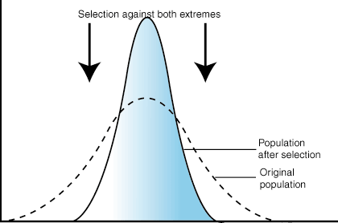
Stabilizing Selection
type of natural selection in which genetic diversity decreases as the population stabilizes on a particular trait value.
extreme values of the character are selected against.
probably the most common mechanism of action for natural selection.

Slide 54
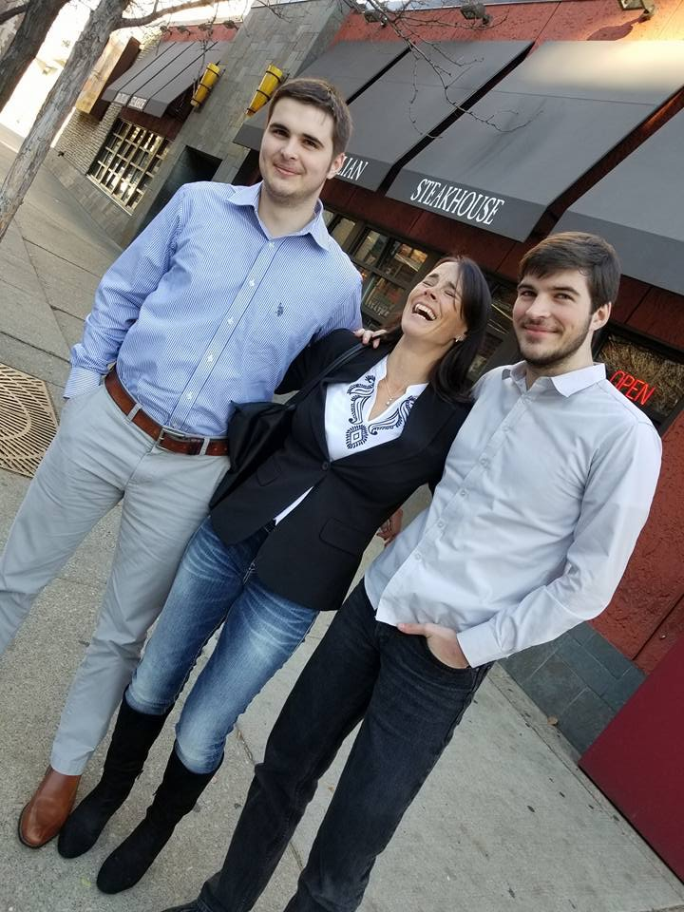
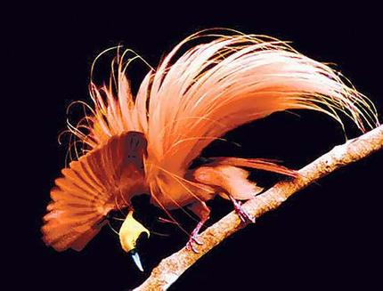
Sexual Selection
No Facial Hair
Sexual selection is natural selection for mating success
It can result in sexual dimorphism, marked differences between the sexes in secondary sexual characteristics which are not directly associated in reproduction
Size
Color
Ornamentation …
Facial Hair

Slide 55
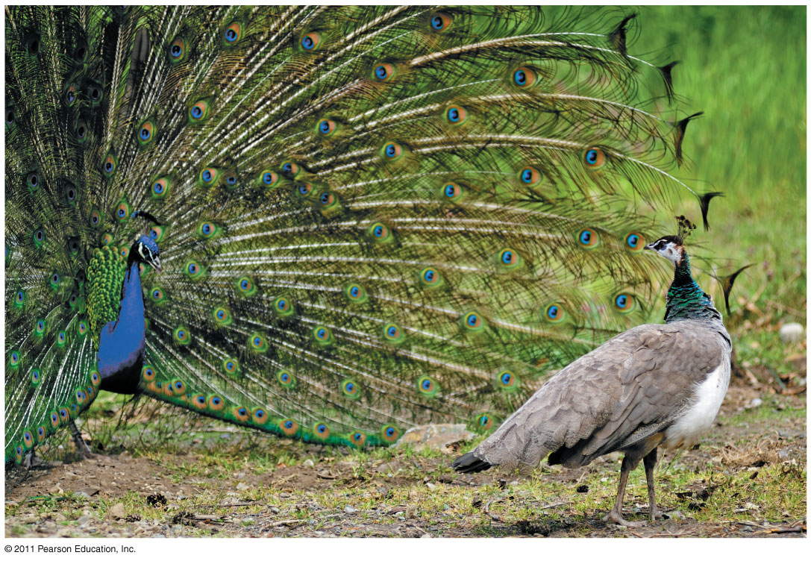
Figure 23.15
Hey Lailani look at these big feathers I have!!!
Seriously Rene?!
Notes:
Figure 23.15 Sexual dimorphism and sexual selection.

Slide 56
Intrasexual selection is competition among individuals of one sex (often males) for mates of the opposite sex
Intersexual selection, often called mate choice, occurs when individuals of one sex (usually females) are choosy in selecting their mates
Male showiness due to mate choice can increase a male’s chances of attracting a female, while decreasing his chances of survival (28)
© 2011 Pearson Education, Inc.

Slide 57
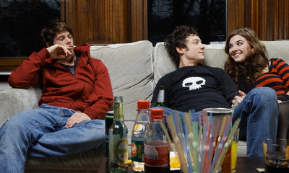
Sexual Selection: Intrasexual Selection
As soon as the laxative I put in his drink kicks in He’ll be in the bathroom all night and that’s when I’ll make my move!
Selection within the same sex
Direct competition among individuals of one sex for mates of the opposite sex most obvious in males

Slide 58
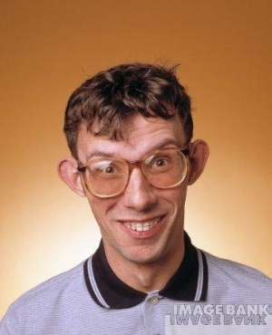
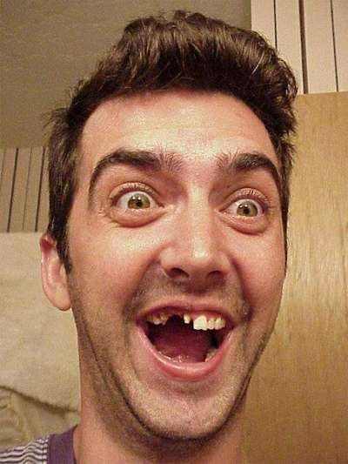
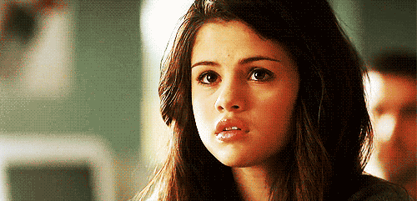
Sexual Selection: Intersexual Selection
You’ve got to be kidding me!
Who will be my prince charming
Mate choice
Individuals of one sex (usually females) being choosey in selecting their mates
Now that’s more like it!

Slide 59
The Preservation of Genetic Variation
Various mechanisms help to preserve genetic variation in a population
Balancing Selection
Balancing selection occurs when natural selection maintains stable frequencies of two or more phenotypic forms in a population
Diploidy
Diploidy maintains genetic variation in the form of hidden recessive alleles
Heterozygotes can carry recessive alleles that are hidden from the effects of selection (29)
© 2011 Pearson Education, Inc.

Slide 60
Heterozygote Advantage
Heterozygote advantage occurs when heterozygotes have a higher fitness than do both homozygotes
Natural selection will tend to maintain two or more alleles at that locus
The sickle-cell allele causes mutations in hemoglobin but also confers malaria resistance
(30)
© 2011 Pearson Education, Inc.

Slide 61
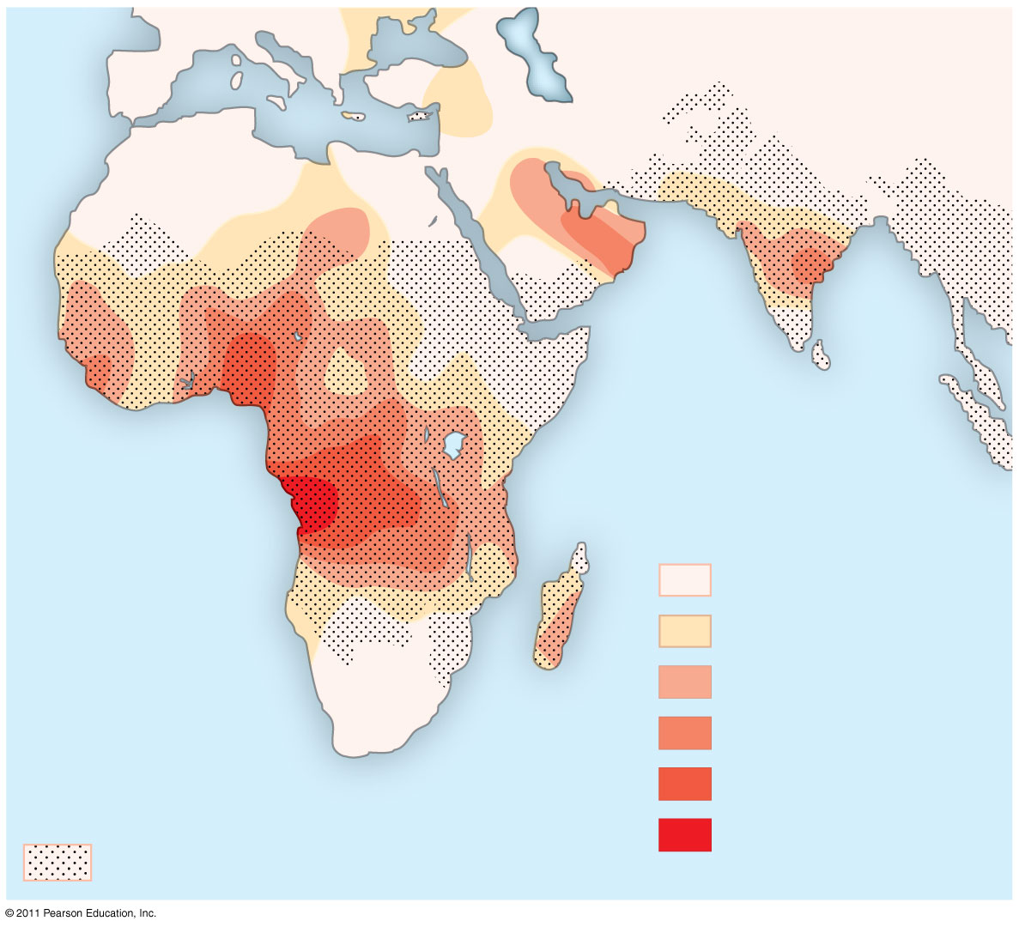
Figure 23.17
Key
Frequencies of the
sickle-cell allele
0–2.5%
2.5–5.0%
Distribution of
malaria caused by
Plasmodium falciparum
(a parasitic unicellular eukaryote)
5.0–7.5%
7.5–10.0%
10.0–12.5%
>12.5%
Notes:
Figure 23.17 Mapping malaria and the sickle-cell allele.

Slide 62
Why Natural Selection Cannot Fashion Perfect Organisms
Selection can act only on existing variations
Evolution is limited by historical constraints
Adaptations are often compromises
Chance, natural selection, and the environment interact (31)
© 2011 Pearson Education, Inc.

Slide 63
THE END

