Slide 1
Chapter 2
The Chemical Context of Life

Slide 2
Overview: A Chemical Connection to Biology
Biology is a multidisciplinary science
Living organisms are subject to basic laws of physics and chemistry
© 2011 Pearson Education, Inc.

Slide 3
Concept 2.1: Matter consists of chemical elements in pure form and in combinations called compounds
Organisms are composed of matter
Matter is anything that takes up space and has mass
© 2011 Pearson Education, Inc.

Slide 4
Elements and Compounds
Matter is made up of elements
An element is a substance that cannot be broken down to other substances by chemical reactions
A compound is a substance consisting of two or more elements in a fixed ratio
A compound has characteristics different from those of its elements
© 2011 Pearson Education, Inc.

Slide 5
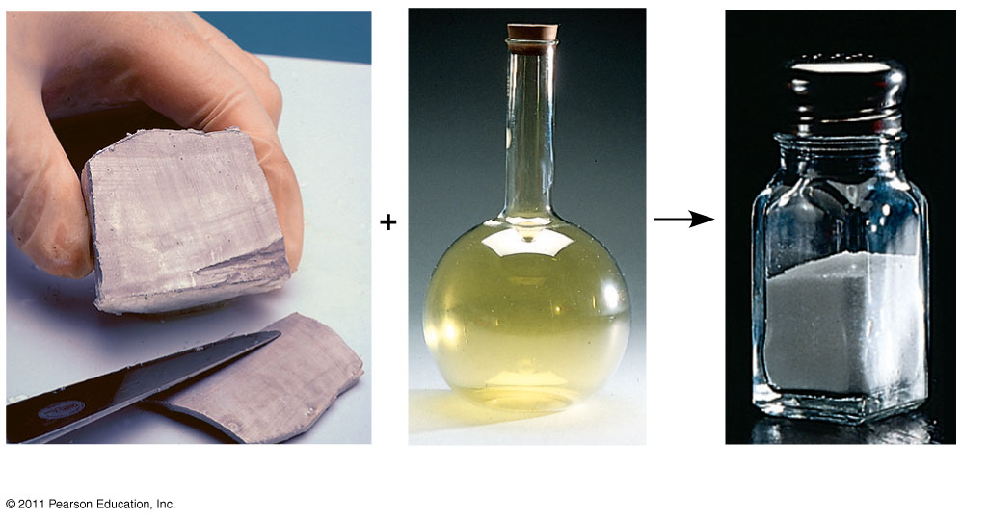
Figure 2.3
Sodium
Chlorine
Sodium chloride
Notes:
5
Figure 2.3 The emergent properties of a compound.

Slide 6
The Elements of Life
About 20–25% of the 92 elements are essential to life
Carbon, hydrogen, oxygen, and nitrogen make up 96% of living matter
Most of the remaining 4% consists of calcium, phosphorus, potassium, and sulfur
Trace elements are those required by an organism in minute quantities
© 2011 Pearson Education, Inc.

Slide 7
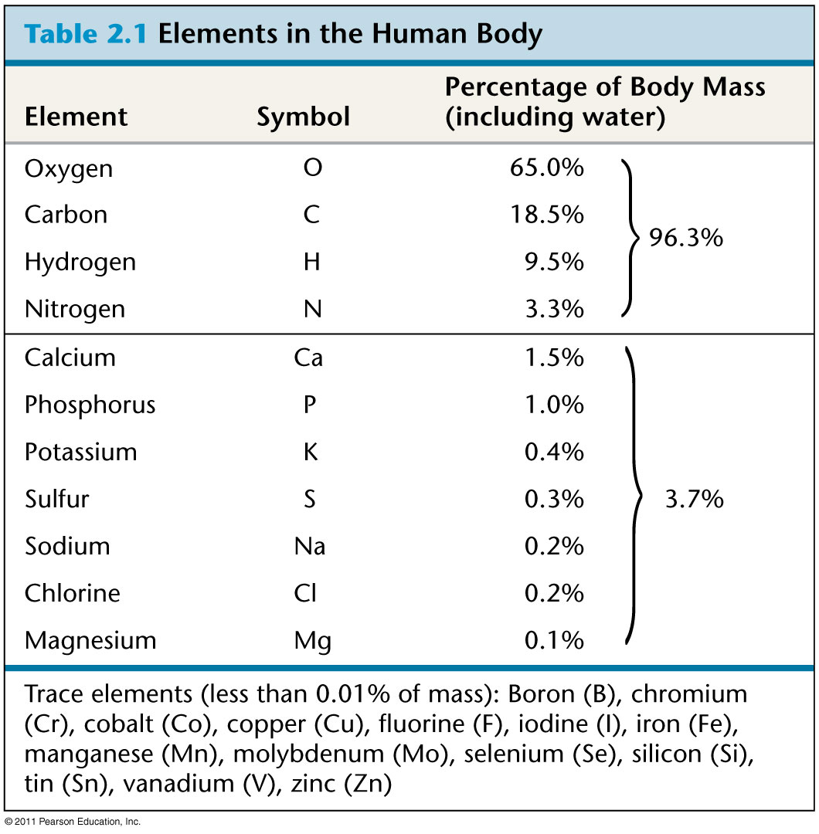
Table 2.1
Notes:
7
Table 2.1 Elements in the Human Body

Slide 8
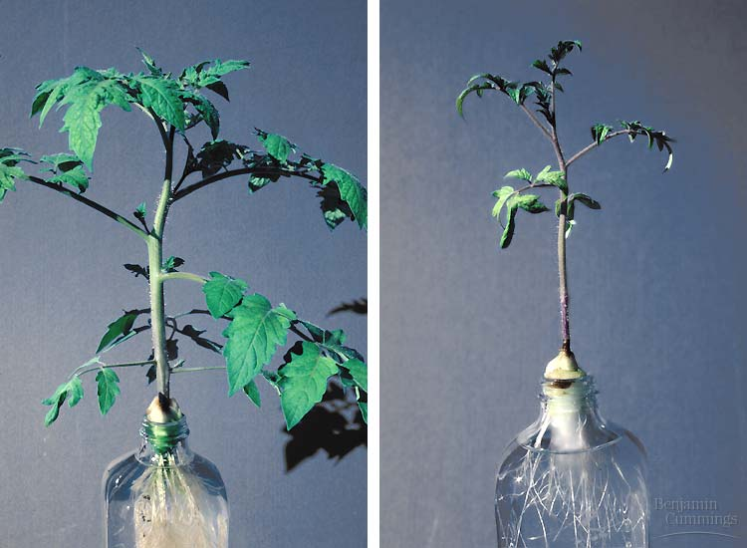
Effects of Essential Element Deficiencies
Goiters are enlarged thyroid glands caused by an iodine deficiency
Plant grown with Nitrogen
Vs. Plant grown without Nitrogen

Slide 9
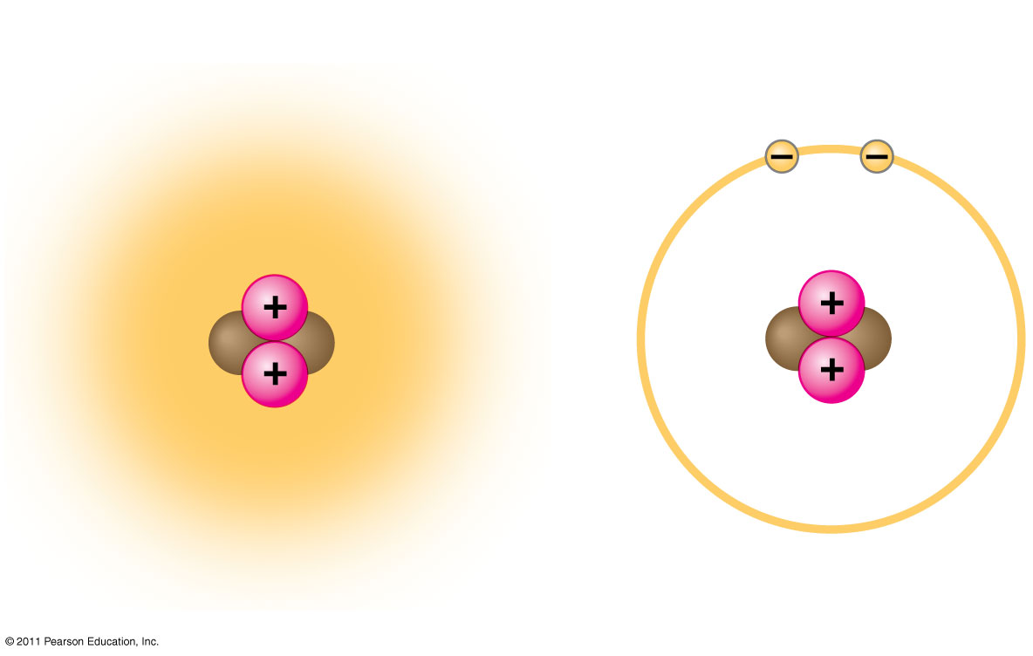
Figure 2.5
Cloud of negative
charge (2 electrons)
Electrons
Nucleus
(a)
(b)
Notes:
9
Figure 2.5 Simplified models of a helium (He) atom.

Slide 10
Concept 2.2: An element’s properties depend on the structure of its atoms
Each element consists of unique atoms
An atom is the smallest unit of matter that still retains the properties of an element
© 2011 Pearson Education, Inc.

Slide 11
Subatomic Particles
Atoms are composed of subatomic particles
Relevant subatomic particles include
Neutrons (no electrical charge)
Protons (positive charge)
Electrons (negative charge)
© 2011 Pearson Education, Inc.

Slide 12
Atomic Number and Atomic Mass
Atoms of the various elements differ in number of subatomic particles
An element’s atomic number is the number of protons in its nucleus
An element’s mass number is the sum of protons plus neutrons in the nucleus
Atomic mass, the atom’s total mass, can be approximated by the mass number
An electron’s state of potential energy is called its energy level, or electron shell
© 2011 Pearson Education, Inc.

Slide 13
Isotopes
All atoms of an element have the same number of protons but may differ in number of neutrons
Isotopes are two atoms of an element that differ in number of neutrons
Radioactive isotopes decay spontaneously, giving off particles and energy
© 2011 Pearson Education, Inc.

Slide 14
Some applications of radioactive isotopes in biological research are
Dating fossils
Tracing atoms through metabolic processes
Diagnosing medical disorders
© 2011 Pearson Education, Inc.

Slide 15
Figure 2.7
Cancerous
throat
tissue
Notes:
15
Figure 2.7 A PET scan, a medical use for radioactive isotopes.

Slide 16
The Energy Levels of Electrons
Energy is the capacity to cause change
Potential energy is the energy that matter has because of its location or structure
The electrons of an atom differ in their amounts of potential energy
© 2011 Pearson Education, Inc.

Slide 17
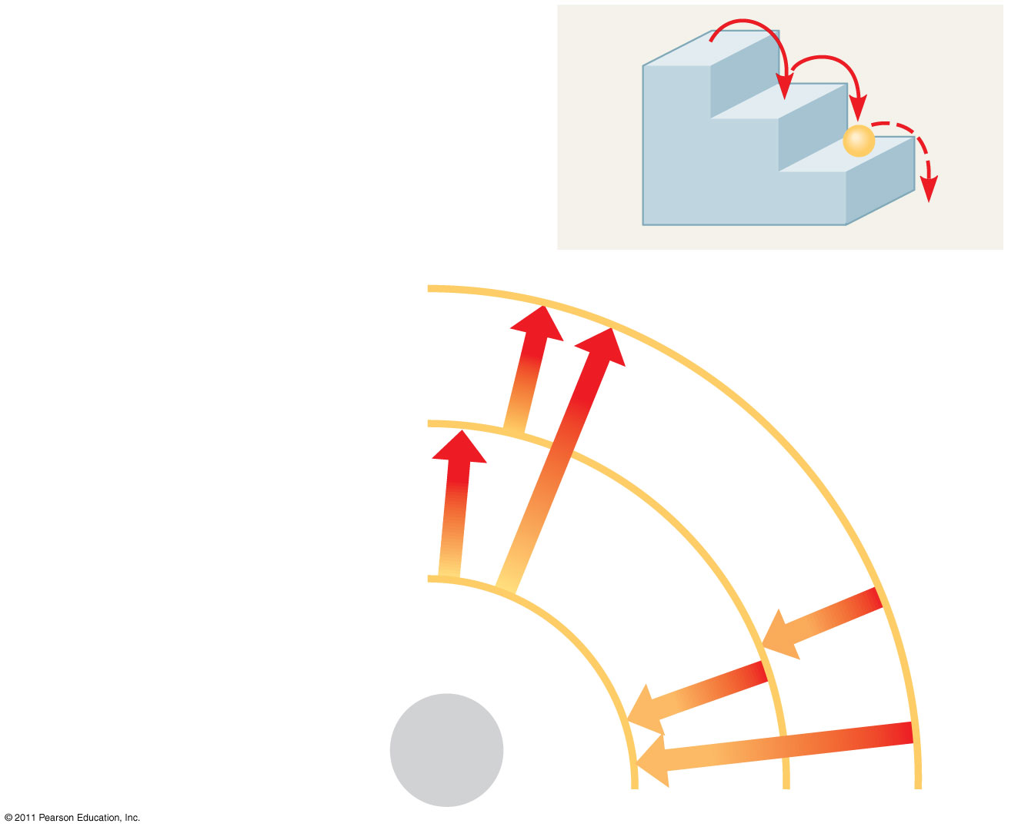
Figure 2.8
(a)
A ball bouncing down a flight
of stairs provides an analogy
for energy levels of electrons.
Third shell (highest energy
level in this model)
Second shell (higher
energy level)
Energy
absorbed
First shell (lowest energy
level)
Energy
lost
Atomic
nucleus
(b)
Notes:
17
Figure 2.8 Energy levels of an atom’s electrons.

Slide 18
Electron Distribution and Chemical Properties
The chemical behavior of an atom is determined by the distribution of electrons in electron shells
The periodic table of the elements shows the electron distribution for each element
Link to a great Periodic Table
http://www.touchspin.com/chem/DisplayTable.html
© 2011 Pearson Education, Inc.

Slide 19
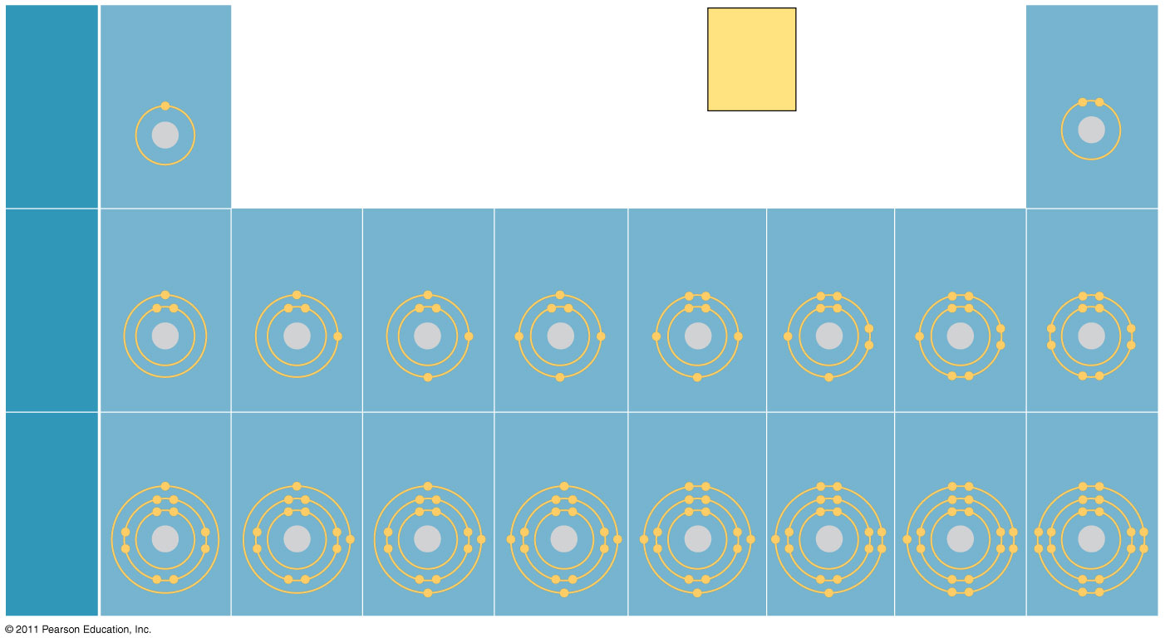
Figure 2.9
Hydrogen
₁H
2
He
4.00
Atomic number
Helium
₂He
First
shell
Mass number
Element symbol
Electron
distribution
diagram
Lithium
₃Li
Beryllium
₄Be
Boron
₅B
Carbon
₆C
Nitrogen
₇N
Oxygen
₈O
Fluorine
₉F
Neon
₁₀Ne
Second
shell
Sodium
₁₁Na
Magnesium
₁₂Mg
Aluminum
₁₃Al
Silicon
₁₄Si
Phosphorus
₁₅P
Sulfur
₁₆S
Chlorine
₁₇Cl
Argon
₁₈Ar
Third
shell
Notes:
19
Figure 2.9 Electron distribution diagrams for the first 18 elements in the periodic table.

Slide 20
Valence electrons are those in the outermost shell, or valence shell
The chemical behavior of an atom is mostly determined by the valence electrons
Elements with a full valence shell are chemically inert
© 2011 Pearson Education, Inc.

Slide 21
A molecule consists of two or more atoms held together by covalent bonds
A single covalent bond, or single bond, is the sharing of one pair of valence electrons
A double covalent bond, or double bond, is the sharing of two pairs of valence electrons
© 2011 Pearson Education, Inc.

Slide 22
The notation used to represent atoms and bonding is called a structural formula
For example, H—H
This can be abbreviated further with a molecular formula
For example, H₂
Animation: Covalent Bonds
© 2011 Pearson Education, Inc.

Slide 23
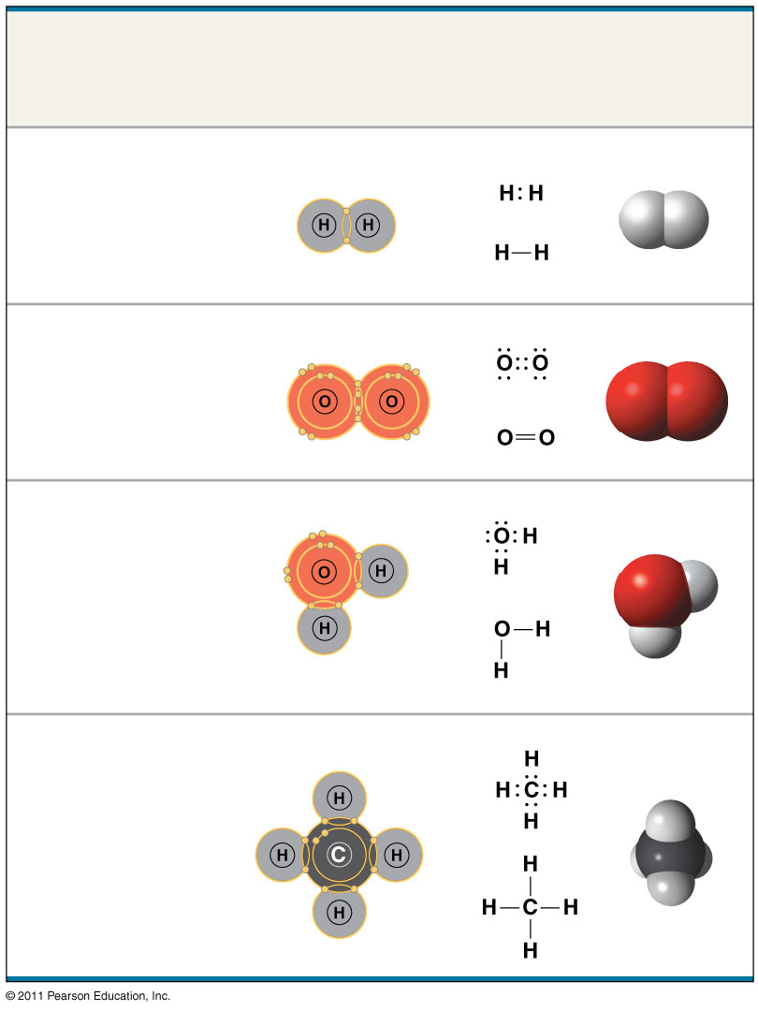
Figure 2.12
Name and
Molecular
Formula
Electron
Distribution
Diagram
Lewis Dot
Structure and
Structural
Formula
Space-
Filling
Model
(a) Hydrogen (H₂)
(b) Oxygen (O₂)
(c) Water (H₂O)
(d) Methane (CH₄)
Notes:
23
Figure 2.12 Covalent bonding in four molecules.

Slide 24
Covalent bonds can form between atoms of the same element or atoms of different elements
A compound is a combination of two or more different elements
Bonding capacity is called the atom’s valence
© 2011 Pearson Education, Inc.

Slide 25
Atoms in a molecule attract electrons to varying degrees
Electronegativity is an atom’s attraction for the electrons in a covalent bond
The more electronegative an atom, the more strongly it pulls shared electrons toward itself
© 2011 Pearson Education, Inc.

Slide 26
In a nonpolar covalent bond, the atoms share the electron equally
In a polar covalent bond, one atom is more electronegative, and the atoms do not share the electron equally
Unequal sharing of electrons causes a partial positive or negative charge for each atom or molecule
© 2011 Pearson Education, Inc.

Slide 27
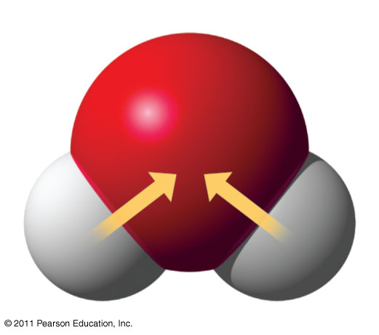
Figure 2.13
δ–
O
H
H
δ+
δ+
H₂O
Notes:
27
Figure 2.13 Polar covalent bonds in a water molecule.

Slide 28
Ionic Bonds
Atoms sometimes strip electrons from their bonding partners
An example is the transfer of an electron from sodium to chlorine
After the transfer of an electron, both atoms have charges
A charged atom (or molecule) is called an ion
Ionic bonding
© 2011 Pearson Education, Inc.

Slide 29
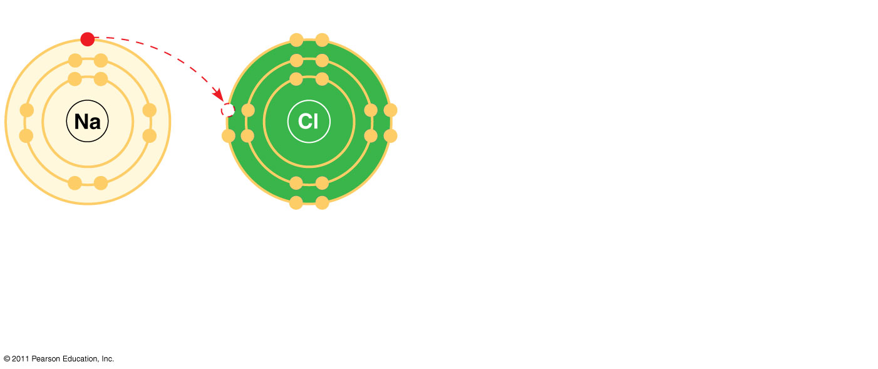
Figure 2.14-1
Na
Sodium atom
Cl
Chlorine atom
Notes:
29
Figure 2.14 Electron transfer and ionic bonding.

Slide 30
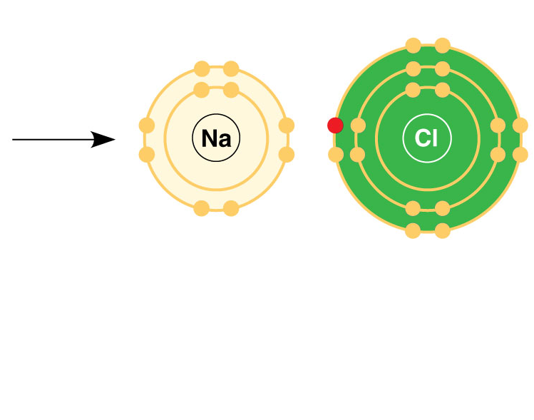
Figure 2.14-2
+
–
Na
Sodium atom
Cl
Chlorine atom
Na⁺
Sodium ion
(a cation)
Cl–
Chloride ion
(an anion)
Sodium chloride (NaCl)
Notes:
30
Figure 2.14 Electron transfer and ionic bonding.

Slide 31
A cation is a positively charged ion
An anion is a negatively charged ion
An ionic bond is an attraction between an anion and a cation
Animation: Ionic Bonds
© 2011 Pearson Education, Inc.

Slide 32
Hydrogen Bonds
A hydrogen bond forms when a hydrogen atom covalently bonded to one electronegative atom is also attracted to another electronegative atom
In living cells, the electronegative partners are usually oxygen or nitrogen atoms
© 2011 Pearson Education, Inc.

Slide 33
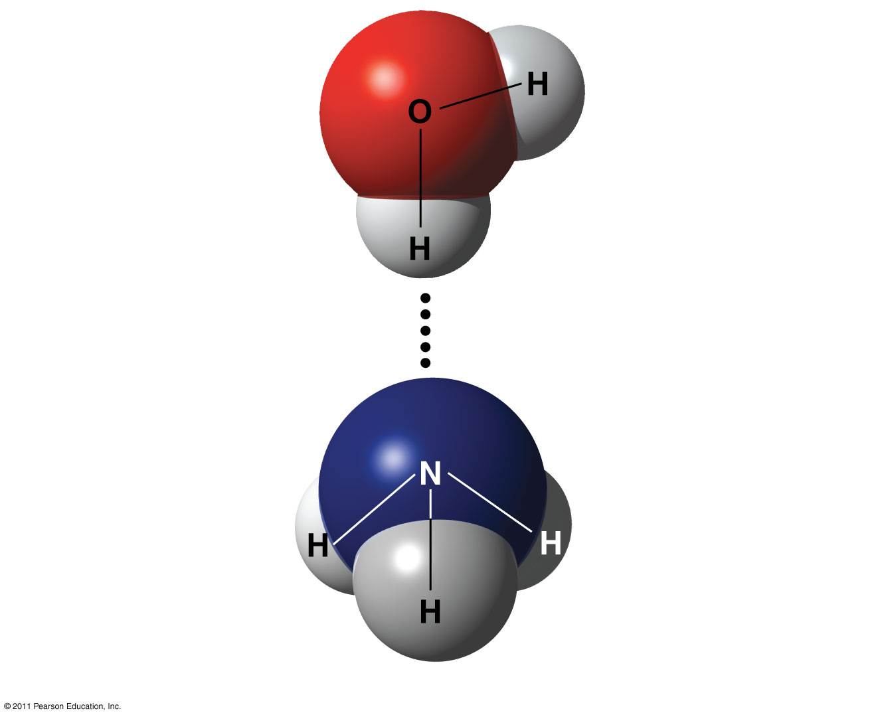
Figure 2.16
δ–
δ+
Water (H₂O)
δ+
Hydrogen bond
δ–
Ammonia (NH₃)
δ+
δ+
δ+
Notes:
33
Figure 2.16 A hydrogen bond.

Slide 34
Van der Waals Interactions
If electrons are distributed asymmetrically in molecules or atoms, they can result in “hot spots” of positive or negative charge
Van der Waals interactions are attractions between molecules that are close together as a result of these charges
© 2011 Pearson Education, Inc.

Slide 35
Weak Chemical Bonds
Most of the strongest bonds in organisms are covalent bonds that form a cell’s molecules
Weak chemical bonds, such as ionic bonds and hydrogen bonds, are also important
Weak chemical bonds reinforce shapes of large molecules and help molecules adhere to each other
© 2011 Pearson Education, Inc.

Slide 36
Biological molecules recognize and interact with each other with a specificity based on molecular shape
Molecules with similar shapes can have similar biological effects
Example: Endorphin
Endorphins bind to receptors on the surface of brain cells producing euphoria and relieving pain
© 2011 Pearson Education, Inc.

Slide 37
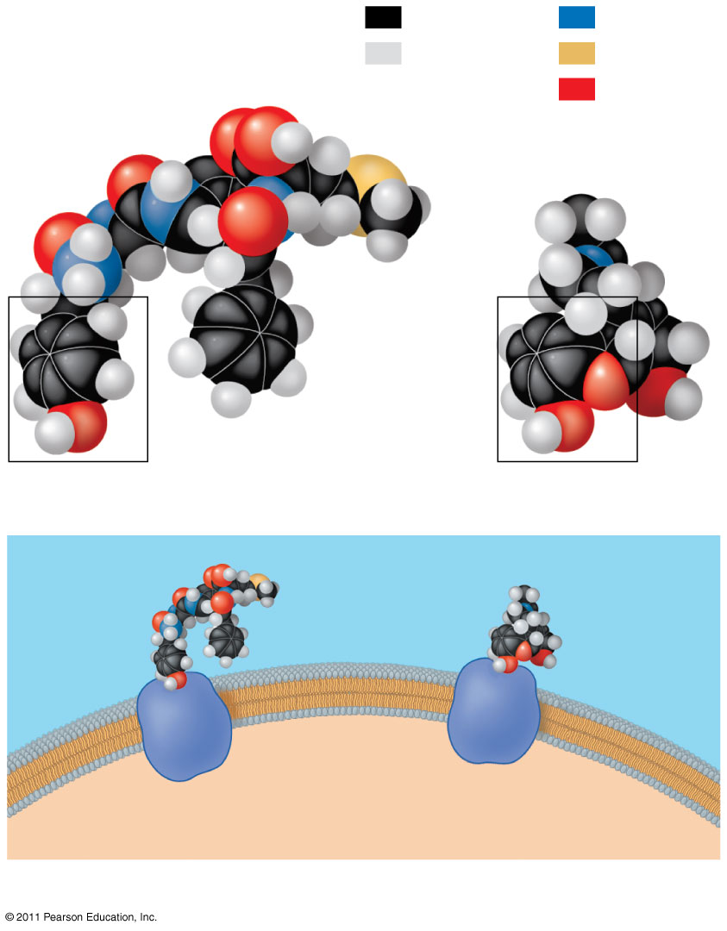
Figure 2.18
Carbon
Nitrogen
Hydrogen
Sulfur
Natural endorphin
Oxygen
Morphine
(a) Structures of endorphin and morphine
Natural
endorphin
Morphine
Endorphin
receptors
Brain cell
(b) Binding to endorphin receptors
Notes:
37
Figure 2.18 A molecular mimic.

Slide 38
Molecular Mimicry
Morphine, heroine, and other opiates mimic endorphins by binding to endorphin receptors in the brain affecting both pain perception & emotional state
It turn out that molecules with similar shapes, structural homology, have similar effects

Slide 39
Concept 2.4: Chemical reactions make and break chemical bonds
Chemical reactions are the making and breaking of chemical bonds
The starting molecules of a chemical reaction are called reactants
The final molecules of a chemical reaction are called products
© 2011 Pearson Education, Inc.

Slide 40
Photosynthesis is an important chemical reaction
Sunlight powers the conversion of carbon dioxide and water to glucose and oxygen
6 CO₂ + 6 H₂0 → C₆H₁₂O₆ + 6 O₂
© 2011 Pearson Education, Inc.

Slide 41
All chemical reactions are reversible: products of the forward reaction become reactants for the reverse reaction
Chemical equilibrium (dynamic) is reached when the forward and reverse reaction rates are equal
© 2011 Pearson Education, Inc.

Slide 42
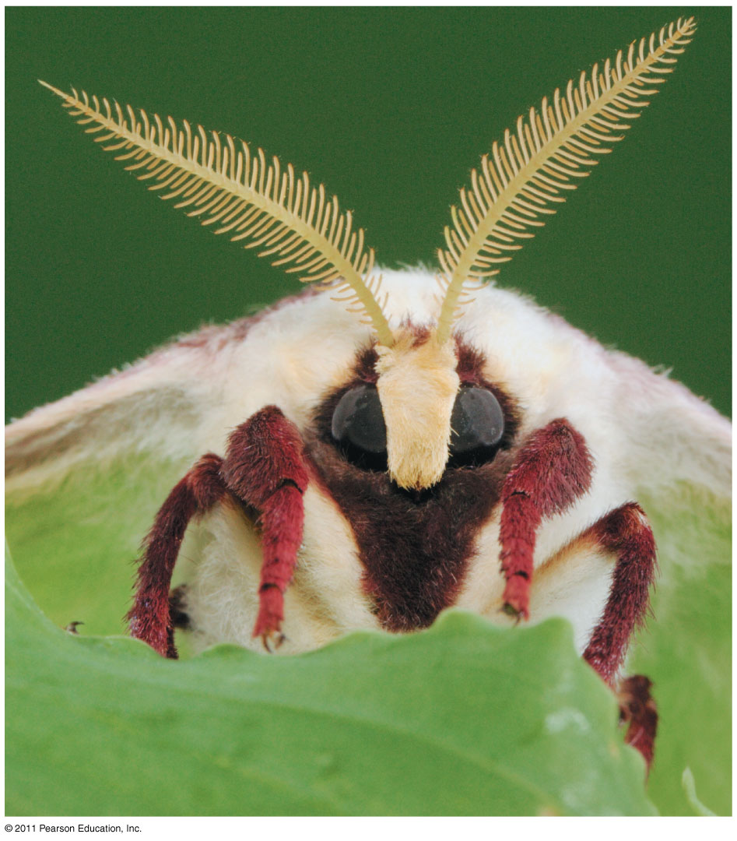
Figure 2.UN08
Female silkworm moths (Bombyx mori) attract males by emitting chemical signals that spread through the air. A male hundereads of meters away can detect these molecules and fly towards their source. The sensory organs responsible for this behavior are the comb like antennae visible in the photograph. Each filament of an antenna is equipped with thousands of receptor cells that detect the sex attractant. Based on what you learned, propose a hypothesis to account for the ability of the male moth to detect specific molecules in the air. What predictions does you hypothesis make? Design an experimen to test one of these predictons.
Notes:
42
Figure 2.UN08 Test Your Understanding, question 11

