Slide 1
Chapter 52
An Introduction to Ecology and the Biosphere

Slide 2
Overview: Discovering Ecology
Ecology is the scientific study of the interactions between organisms and the environment
These interactions determine distribution of organisms and their abundance
Modern ecology includes observation and experimentation (1)
© 2011 Pearson Education, Inc.

Slide 3
Global Ecology
The biosphere is the global ecosystem, the sum of all the planet’s ecosystems
Global ecology examines the influence of energy and materials on organisms across the biosphere (2 on next several slides)
© 2011 Pearson Education, Inc.

Slide 4
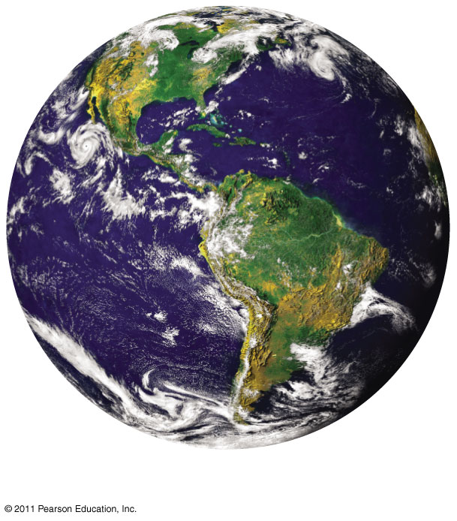
Figure 52.2a
Global ecology
Notes:
Figure 52.2 Exploring: The Scope of Ecological Research

Slide 5
Landscape Ecology
A landscape or seascape is a mosaic of connected ecosystems
Landscape ecology focuses on the exchanges of energy, materials, and organisms across multiple ecosystems
© 2011 Pearson Education, Inc.

Slide 6
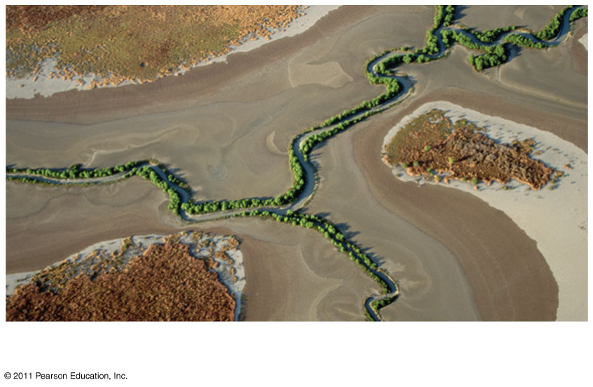
Figure 52.2b
Landscape ecology
Notes:
Figure 52.2 Exploring: The Scope of Ecological Research

Slide 7
Ecosystem Ecology
An ecosystem is the community of organisms in an area and the physical factors with which they interact
Ecosystem ecology emphasizes energy flow and chemical cycling among the various biotic and abiotic components
© 2011 Pearson Education, Inc.

Slide 8
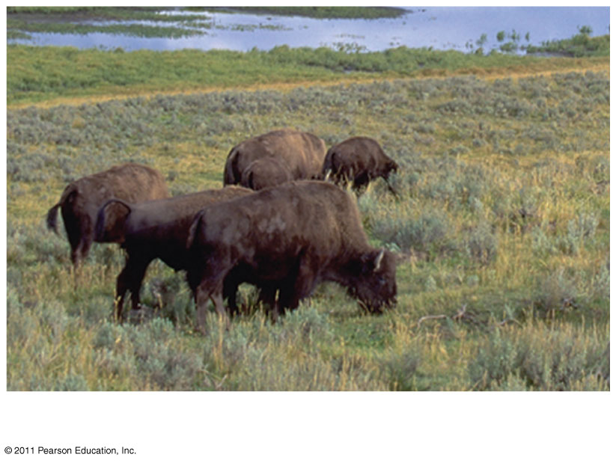
Figure 52.2c
Ecosystem ecology
Notes:
Figure 52.2 Exploring: The Scope of Ecological Research

Slide 9
Community Ecology
A community is a group of populations of different species in an area
Community ecology deals with the whole array of interacting species in a community
© 2011 Pearson Education, Inc.

Slide 10
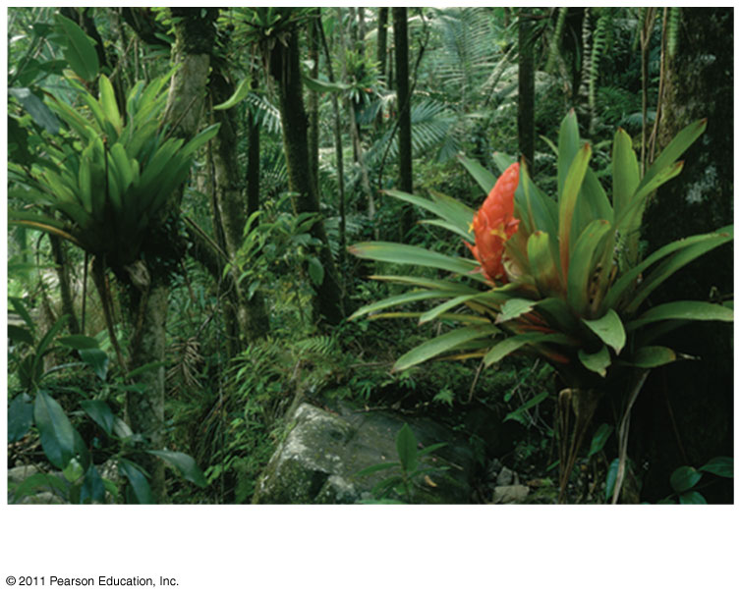
Figure 52.2d
Community ecology
Notes:
Figure 52.2 Exploring: The Scope of Ecological Research

Slide 11
Population Ecology
A population is a group of individuals of the same species living in an area
Population ecology focuses on factors affecting population size over time
© 2011 Pearson Education, Inc.

Slide 12
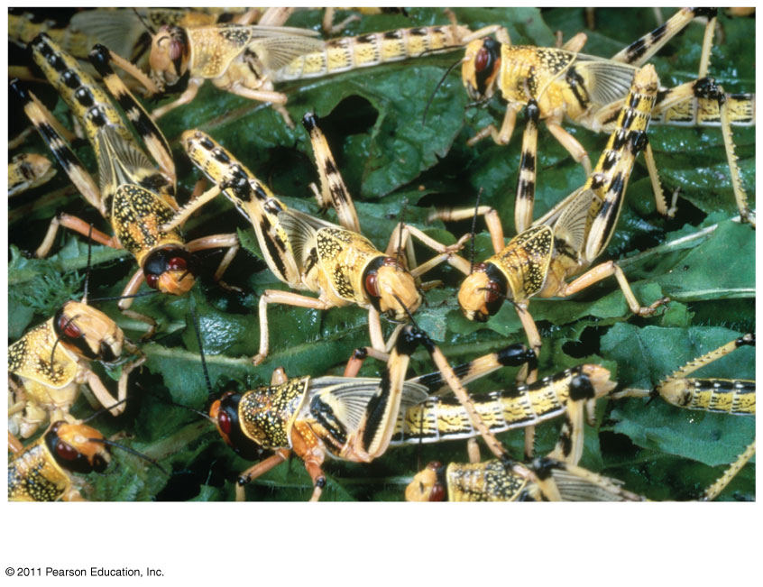
Figure 52.2e
Population ecology
Notes:
Figure 52.2 Exploring: The Scope of Ecological Research

Slide 13
Organismal Ecology
Organismal ecology studies how an organism’s structure, physiology, and (for animals) behavior meet environmental challenges
Organismal ecology includes physiological, evolutionary, and behavioral ecology
© 2011 Pearson Education, Inc.

Slide 14
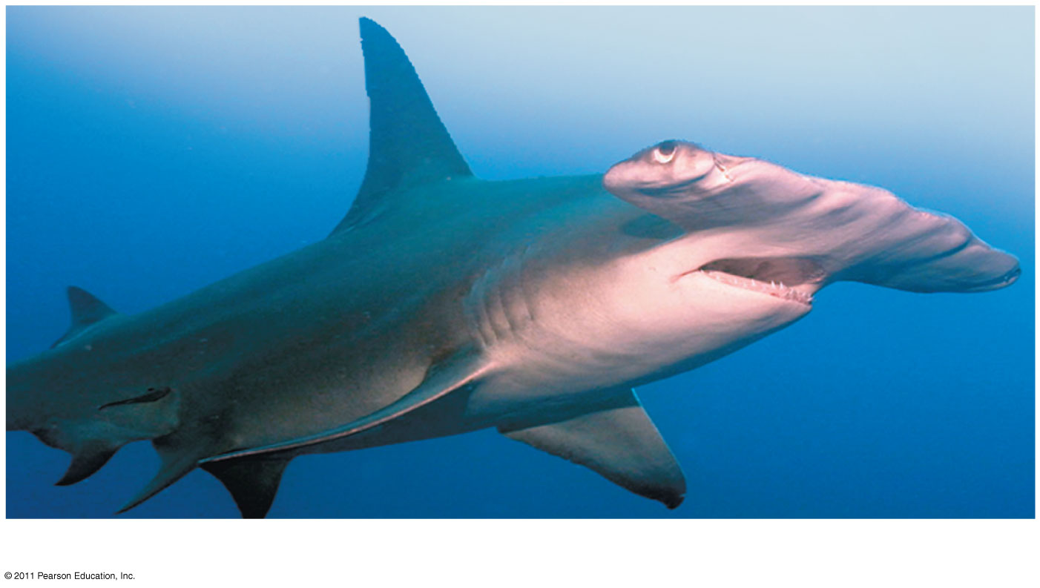
Figure 52.2f
Organismal ecology
Notes:
Figure 52.2 Exploring: The Scope of Ecological Research

Slide 15
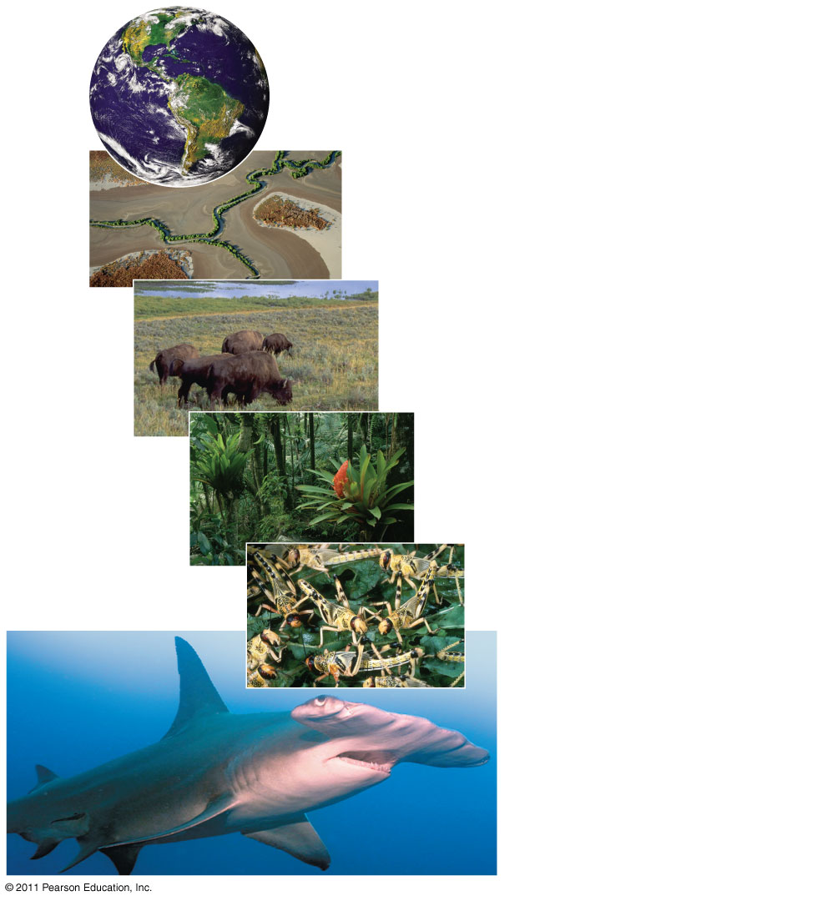
Figure 52.2
Global ecology
Landscape ecology
Ecosystem ecology
Community ecology
Population ecology
Organismal ecology
Notes:
Figure 52.2 Exploring: The Scope of Ecological Research

Slide 16
Concept 52.1: Earth’s climate varies by latitude and season and is changing rapidly
The long-term prevailing weather conditions in an area constitute its climate
Four major abiotic components of climate are temperature, precipitation, sunlight, and wind
Macroclimate consists of patterns on the global, regional, and landscape level
Microclimate consists of very fine patterns, such as those encountered by the community of organisms underneath a fallen log (3-4)
© 2011 Pearson Education, Inc.

Slide 17
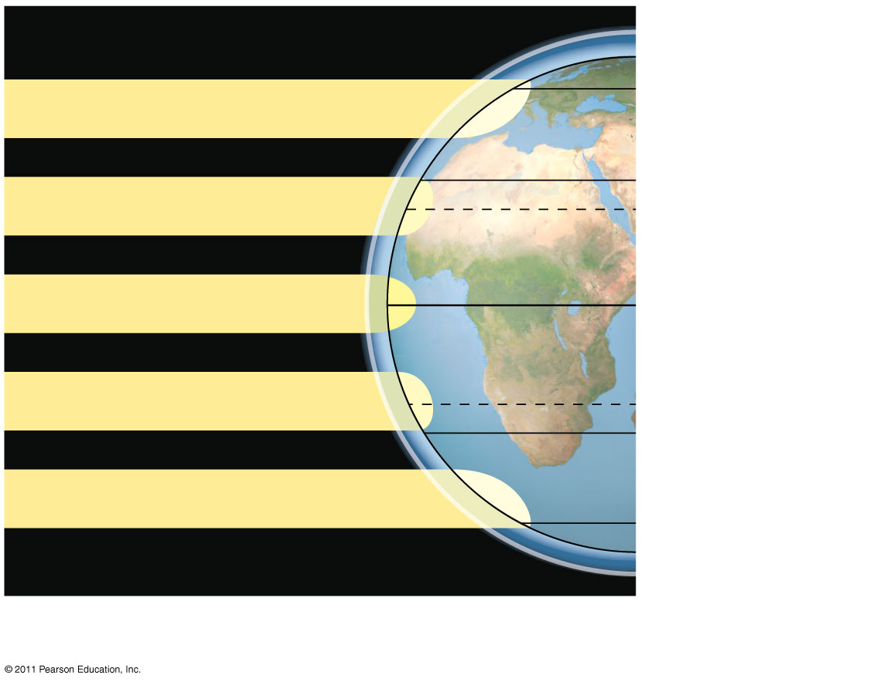
Figure 52.3a
Atmosphere
90°N (North Pole)
60°N
Low angle of incoming sunlight
30°N
23.5°N (Tropic of
Cancer
Sun overhead at equinoxes
0° (Equator)
23.5°S (Tropic of
Capricorn)
30°S
Low angle of incoming sunlight
60°S
90°S (South Pole)
Latitudinal variation in sunlight intensity (5 partial)
Notes:
Figure 52.3 Exploring: Global Climate Patterns

Slide 18
Seasonality
Seasonal variations of light and temperature increase steadily toward the poles
Seasonality at high latitudes is caused by the tilt of Earth’s axis of rotation and its annual passage around the sun
Belts of wet and dry air straddling the equator shift throughout the year with the changing angle of the sun
Changing wind patterns affect ocean currents
© 2011 Pearson Education, Inc.

Slide 19
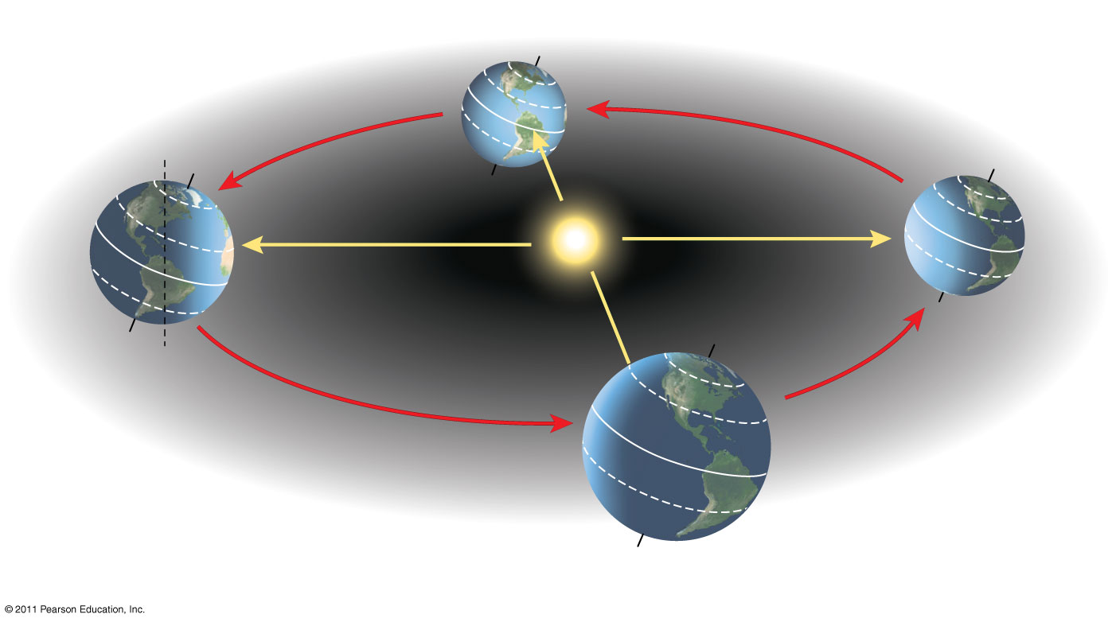
Figure 52.4
March equinox
December
solstice
60°N
Constant tilt
of 23.5°
30°N
June solstice
0° (equator)
30°S
September equinox
Notes:
Figure 52.4 Seasonal variation in sunlight intensity.

Slide 20
Rising air masses release water and cause high precipitation, especially in the tropics
Dry, descending air masses create arid climates, especially near 30°
Air flowing close to Earth’s surface creates predictable global wind patterns
Cooling trade winds blow from east to west in the tropics; prevailing westerlies blow from west to east in the temperate zones (6 explained on next few slides)
© 2011 Pearson Education, Inc.

Slide 21
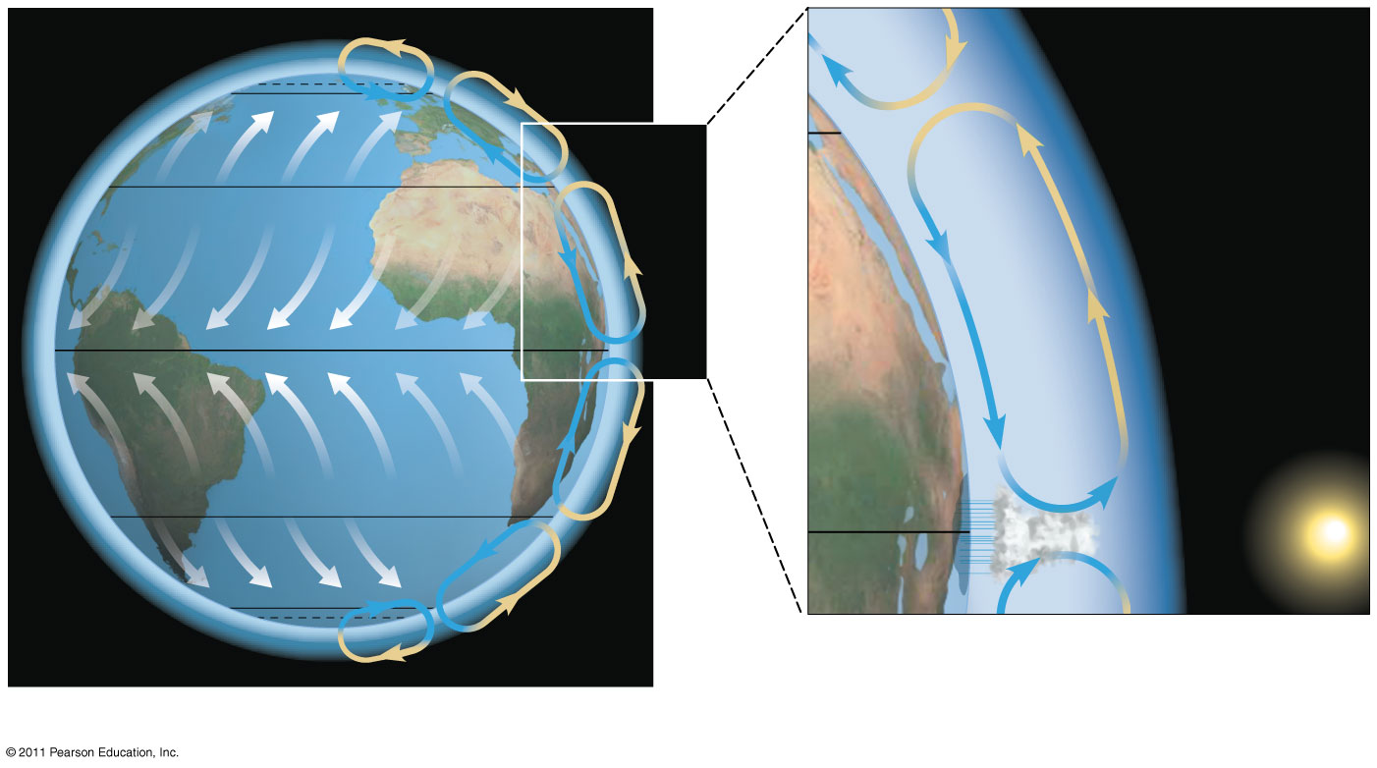
Figure 52.3b
66.5°N (Arctic Circle)
60°N
Descending
dry air
absorbs
moisture.
30°N
Westerlies
ARID ZONE
30°N
Northeast trades
Ascending
moist air
releases
moisture.
0°
Southeast trades
30°S
0°
Westerlies
60°S
66.5°S (Antarctic Circle)
Global air circulation and precipitation patterns
Notes:
Figure 52.3 Exploring: Global Climate Patterns

Slide 22
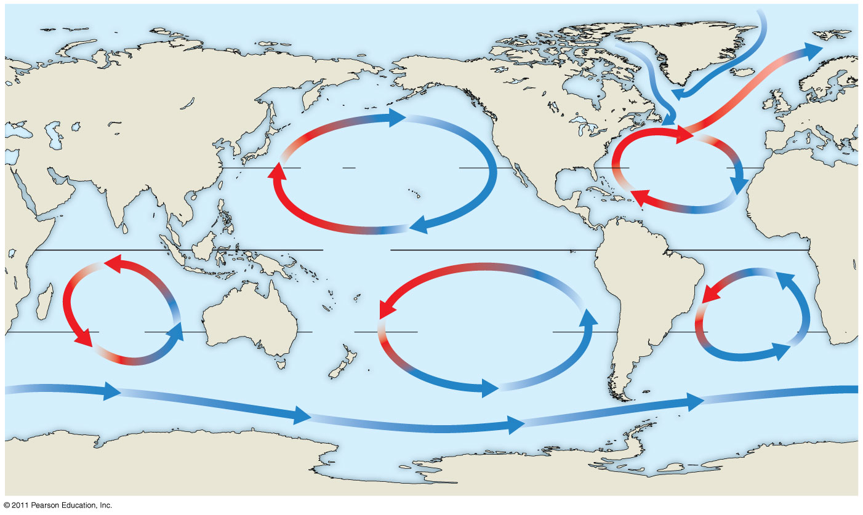
Figure 52.5
Labrador Current
California Current
Gulf Stream
30°N
North Pacific
Subtropical Gyre
North Atlantic
Subtropical
Gyre
Equator
Indian
Ocean
Subtropical
Gyre
South
Atlantic
Subtropical
Gyre
South Pacific
Subtropical Gyre
30°S
Antarctic Circumpolar Current
Notes:
Figure 52.5 Global circulation of surface water in the oceans.

Slide 23
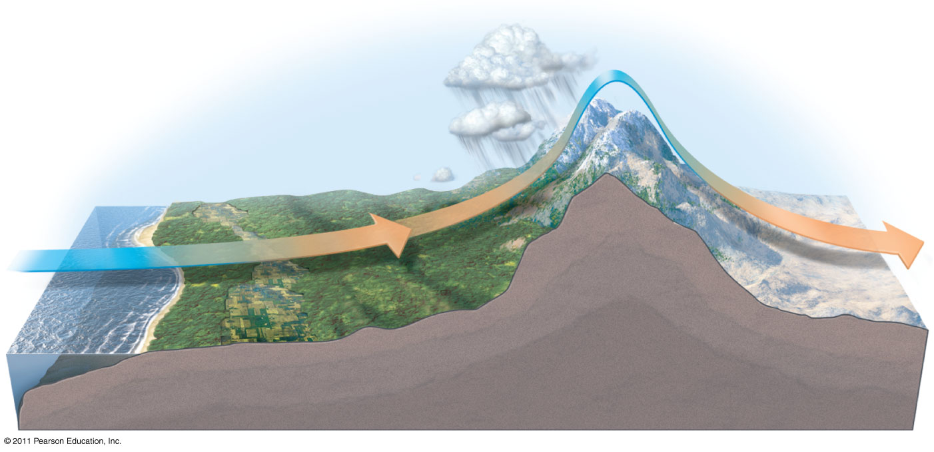
Figure 52.6
Leeward side
of mountains
Air flow
Mountain
range
Ocean
Notes:
Figure 52.6 How large bodies of water and mountains affect climate.

Slide 24
Mountains
Rising air releases moisture on the windward side of a peak and creates a “rain shadow” as it absorbs moisture on the leeward side
Mountains affect the amount of sunlight reaching an area
In the Northern Hemisphere, south-facing slopes receive more sunlight than north-facing slopes
Every 1,000 m increase in elevation produces a temperature drop of approximately 6°C (7-8)
© 2011 Pearson Education, Inc.

Slide 25
Microclimate
Microclimate is determined by fine-scale differences in the environment that affect light and wind patterns
Every environment is characterized by differences in
Abiotic factors, including nonliving attributes such as temperature, light, water, and nutrients
Biotic factors, including other organisms that are part of an individual’s environment (9)
© 2011 Pearson Education, Inc.

Slide 26
Global Climate Change
Changes in Earth’s climate can profoundly affect the biosphere
One way to predict the effects of future global climate change is to study previous changes
As glaciers retreated 16,000 years ago, tree distribution patterns changed
As climate changes, species that have difficulty dispersing may have smaller ranges or could become extinct (10 from understanding)
© 2011 Pearson Education, Inc.

Slide 27
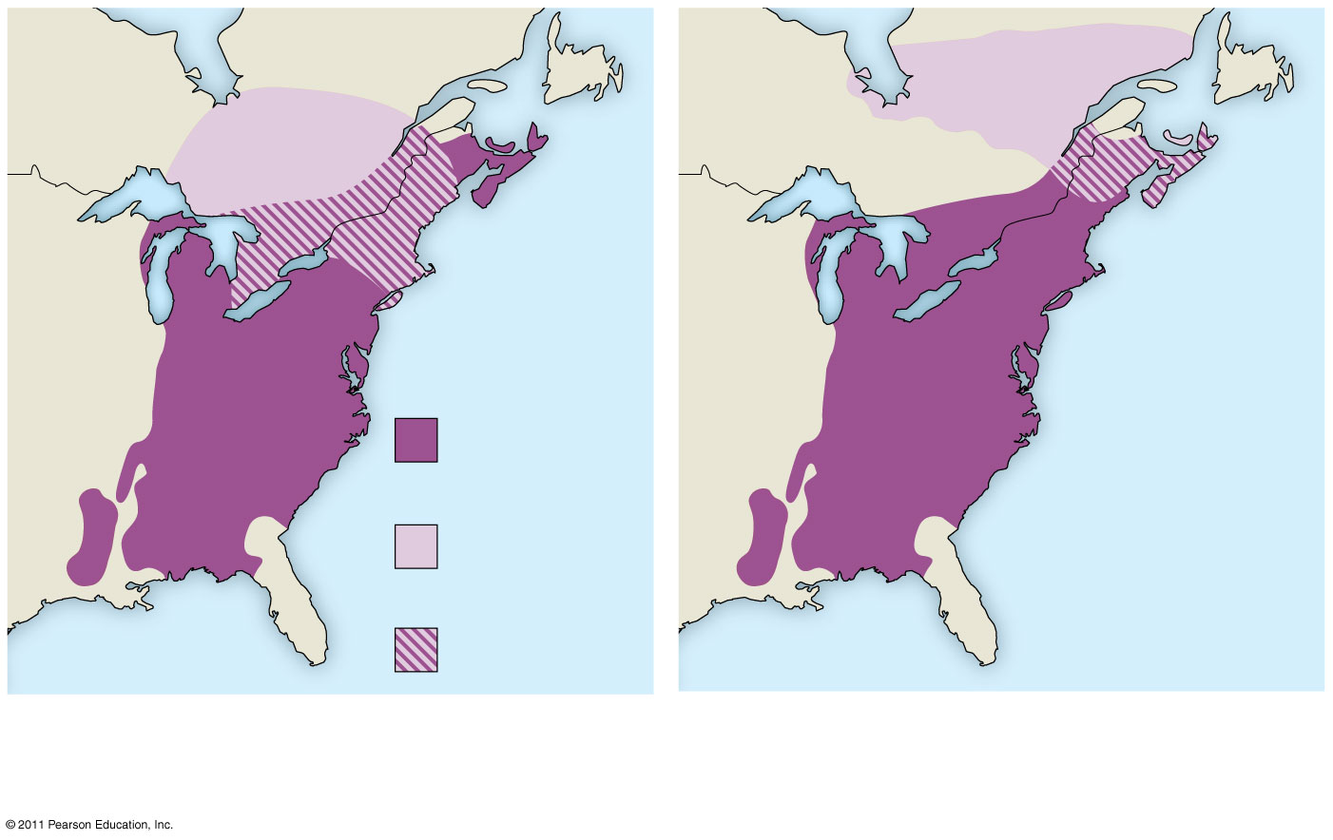
Figure 52.7
Current
range
Predicted
range
Overlap
(a) 4.5°C warming over next
century
(b) 6.5°C warming over next
century
Notes:
Figure 52.7 Current range and predicted range for the American beech under two climate-change scenarios.

Slide 28
Concept 52.2: The structure and distribution of terrestrial biomes are controlled by climate and disturbance
Biomes are major life zones characterized by vegetation type (terrestrial biomes) or physical environment (aquatic biomes)
Climate is very important in determining why terrestrial biomes are found in certain areas (11)
© 2011 Pearson Education, Inc.

Slide 29
A climograph plots the temperature and precipitation in a region
Biomes are affected not just by average temperature and precipitation, but also by the pattern of temperature and precipitation through the year
© 2011 Pearson Education, Inc.

Slide 30
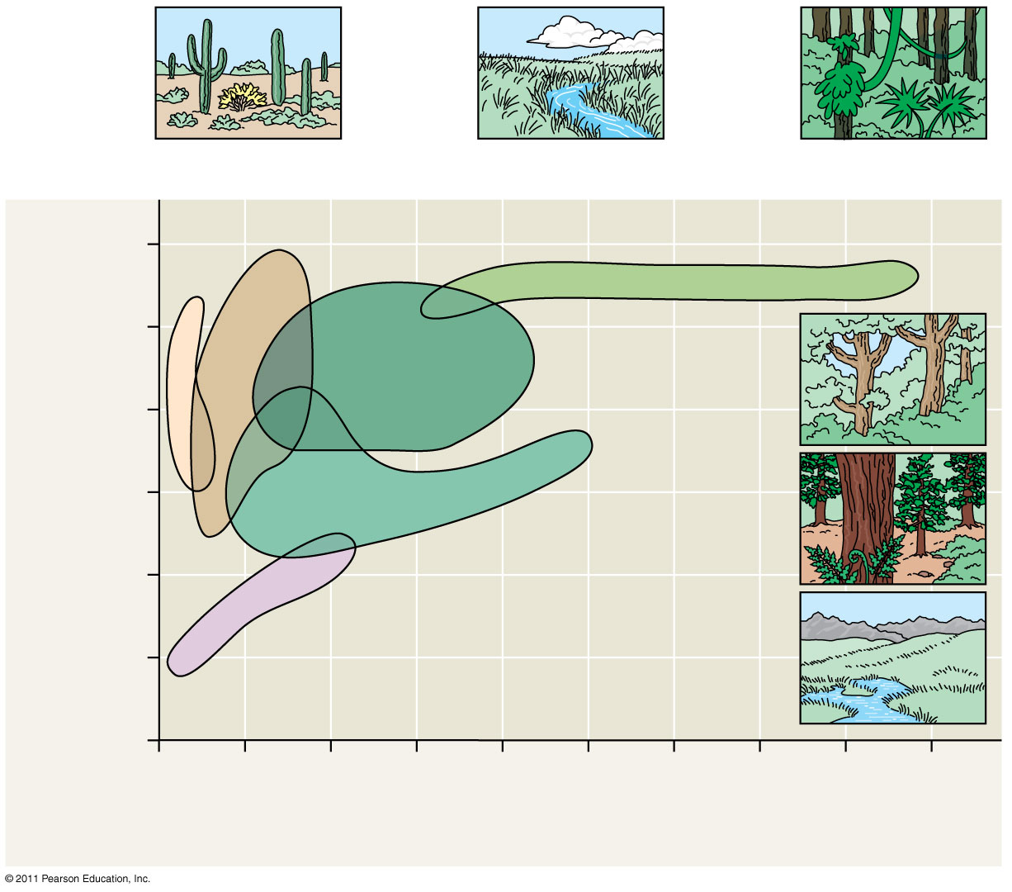
Figure 52.10
(12-13)
Desert
Temperate grassland
Tropical forest
30
Temperate
broadleaf
forest
15
Annual mean temperature (°C)
Northern
coniferous
forest
0
Arctic and
alpine
tundra
−15
0
100
200
300
400
Annual mean precipitation (cm)
Notes:
Figure 52.10 A climograph for some major types of biomes in North America.

Slide 31
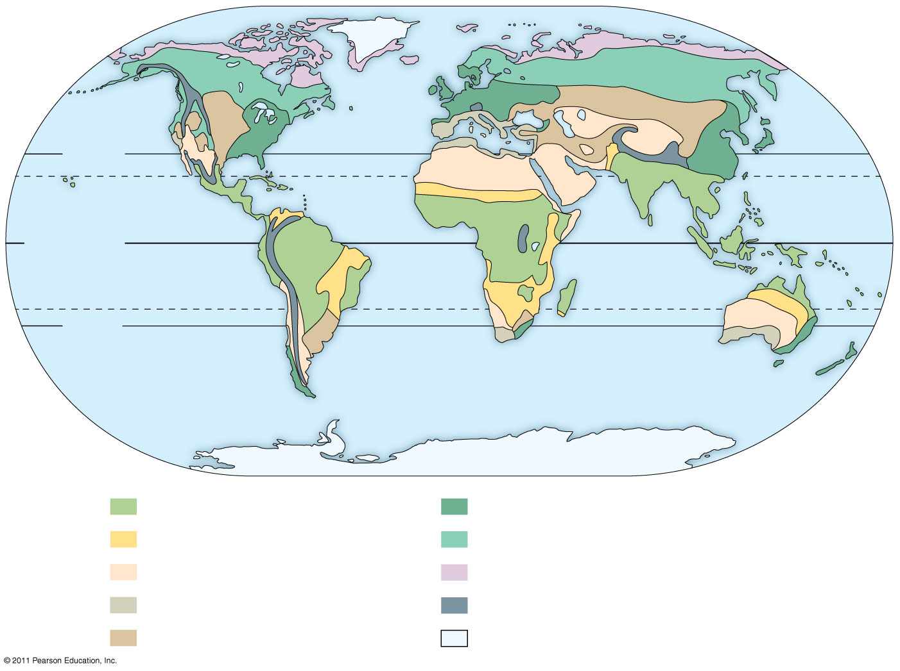
Figure 52.9
30°N
Tropic of
Cancer
Equator
Tropic of Capricorn
30°S
Tropical forest
Savanna
Desert
Chaparral
Temperate grassland
Temperate broadleaf forest
Northern coniferous forest
Tundra
High mountains
Polar ice
Notes:
Figure 52.9 The distribution of major terrestrial biomes.

Slide 32
Tropical Forest
Distribution is in equatorial and subequatorial regions
In tropical rain forests, rainfall is relatively constant, while in tropical dry forests precipitation is highly seasonal
Temperature is high year-round (25–29°C) with little seasonal variation (14 Next several slides)
© 2011 Pearson Education, Inc.

Slide 33
Tropical forests are vertically layered and competition for light is intense
Tropical forests are home to millions of animal species, including an estimated 5–30 million still undescribed species of insects, spiders, and other arthropods
Rapid human population growth is now destroying many tropical forests
© 2011 Pearson Education, Inc.

Slide 34
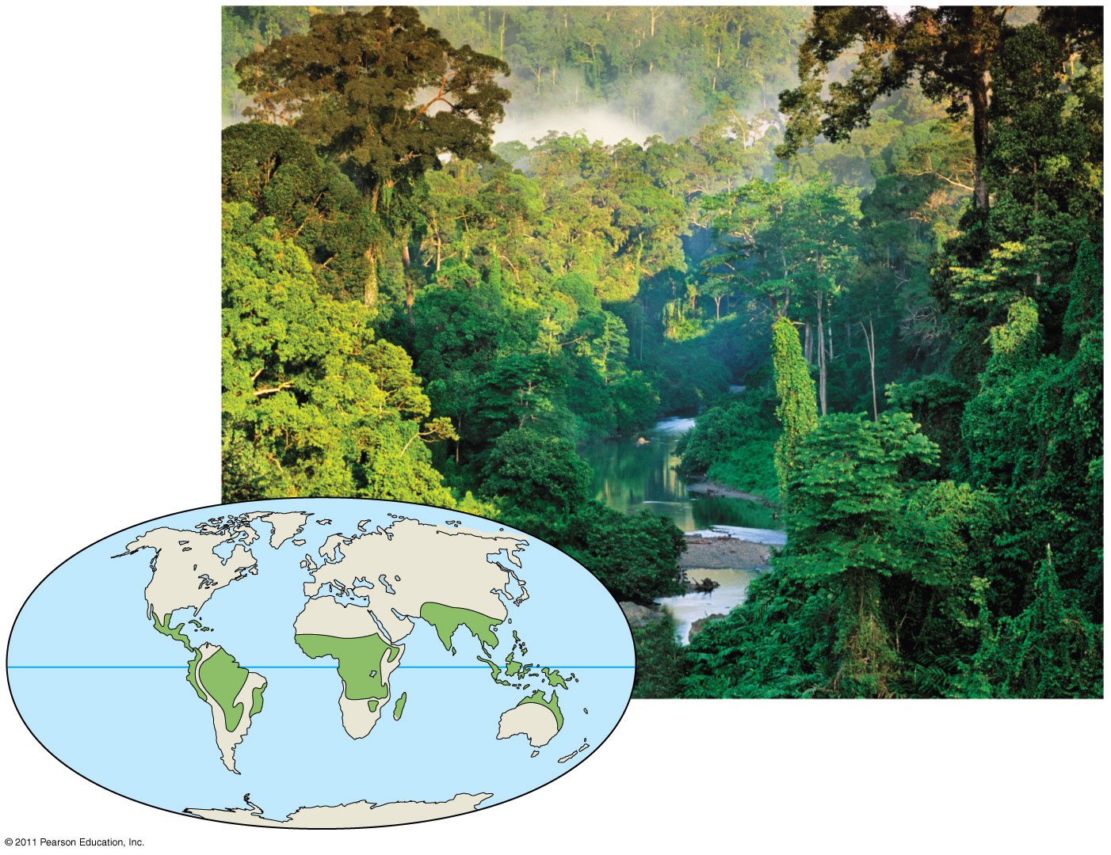
Figure 52.12a
A tropical rain forest in Borneo
Notes:
Figure 52.12 Exploring: Terrestrial Biomes

Slide 35
Desert
Deserts occur in bands near 30° north and south of the Equator, and in the interior of continents
Precipitation is low and highly variable, generally less than 30 cm per year
Deserts may be hot or cold
© 2011 Pearson Education, Inc.

Slide 36
Desert plants are adapted for heat and desiccation tolerance, water storage, and reduced leaf surface area
Common desert animals include many kinds of snakes and lizards, scorpions, ants, beetles, migratory and resident birds, and seed-eating rodents; many are nocturnal
Ubanization and irrigation have reduced the natural biodiversity of some deserts
© 2011 Pearson Education, Inc.

Slide 38
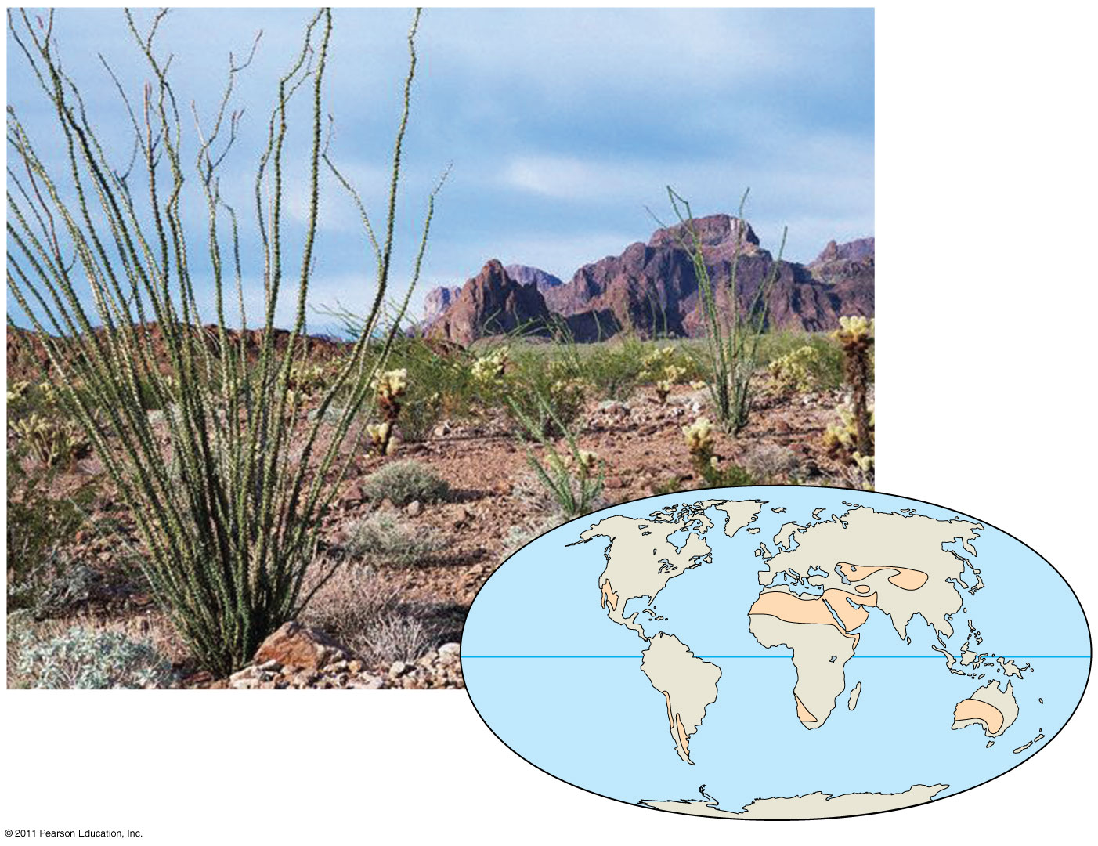
Figure 52.12b
A desert in the southwestern
United States
Notes:
Figure 52.12 Exploring: Terrestrial Biomes

Slide 39
Savanna
Equatorial and subequatorial regions
Savanna precipitation is seasonal
Temperature is warm year-round (24–29°C) but more seasonally variable than the tropics
© 2011 Pearson Education, Inc.

Slide 40
Grasses and forbs make up most of the ground cover
The dominant plant species are fire-adapted and tolerant of seasonal drought
Common inhabitants include insects and mammals such as wildebeests, zebras, lions, and hyenas
Fires set by humans may help maintain this biome
© 2011 Pearson Education, Inc.

Slide 41
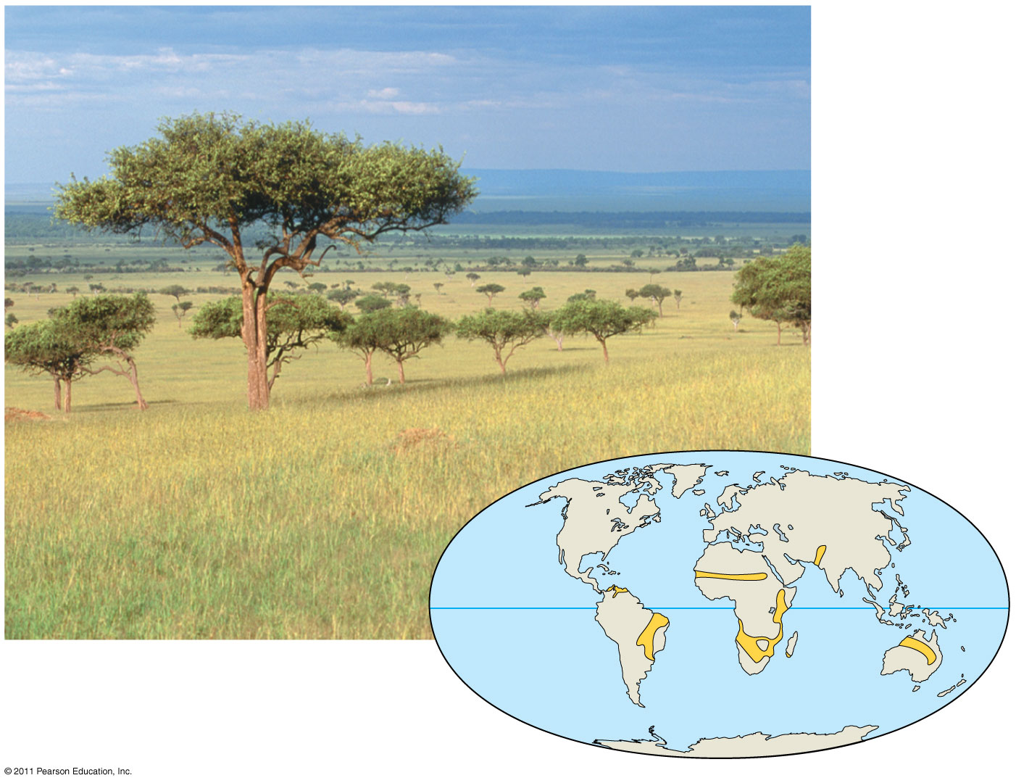
Figure 52.12c
A savanna in Kenya
Notes:
Figure 52.12 Exploring: Terrestrial Biomes

Slide 42
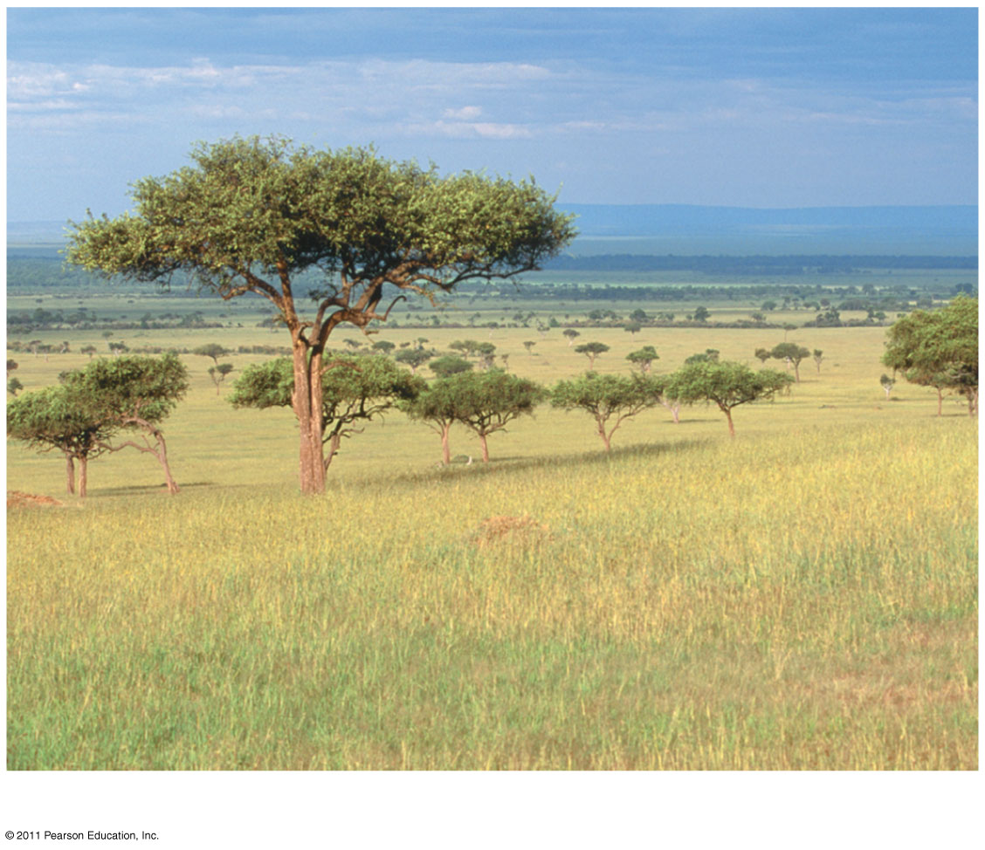
Figure 52.12ca
A savanna in Kenya
Notes:
Figure 52.12 Exploring: Terrestrial Biomes

Slide 43
Chaparral
Chaparral occurs in midlatitude coastal regions on several continents
Precipitation is highly seasonal with rainy winters and dry summers
Summer temperature is hot (30°C+) while fall, winter, and spring are cool (10–12°C)
© 2011 Pearson Education, Inc.

Slide 44
The chaparral is dominated by shrubs, small trees, grasses, and herbs; many plants are adapted to fire and drought
Animals include amphibians, birds and other reptiles, insects, small mammals and browsing mammals
Humans have reduced chaparral areas through agriculture and urbanization
© 2011 Pearson Education, Inc.

Slide 45
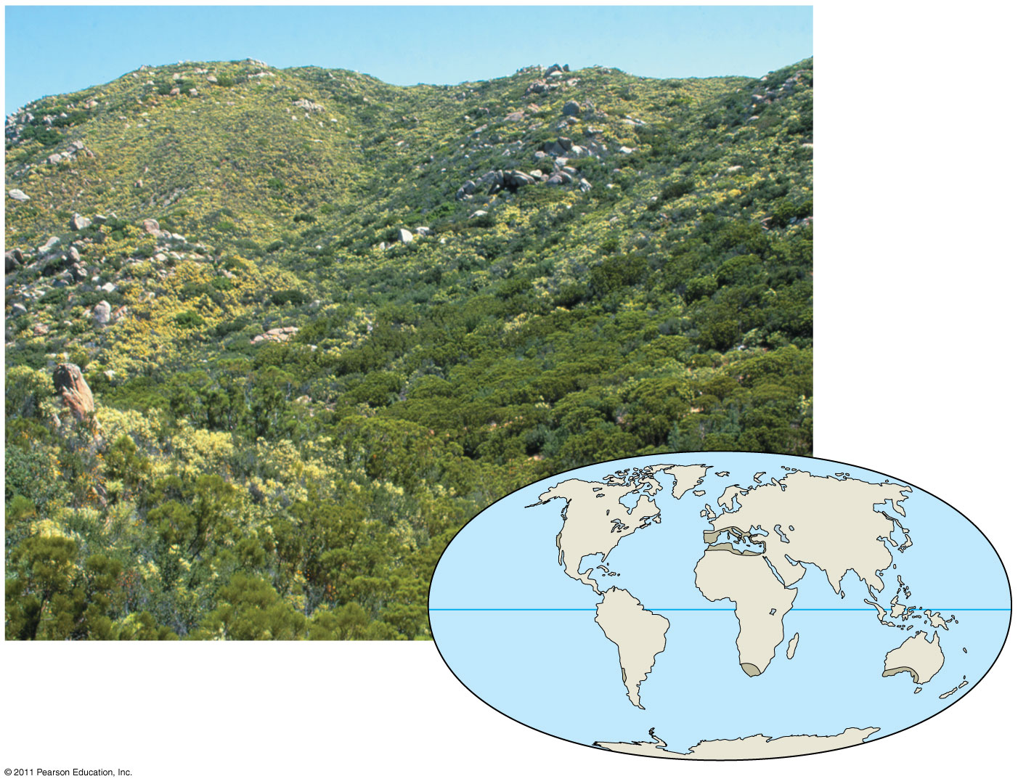
Figure 52.12d
An area of chaparral
in California
Notes:
Figure 52.12 Exploring: Terrestrial Biomes

Slide 46
Temperate Grassland
Temperate grasslands are found on many continents
Precipitation is highly seasonal
Winters are cold (often below –10°C) and dry, while summers are hot (often near 30°C) and wet
© 2011 Pearson Education, Inc.

Slide 47
The dominant plants, grasses and forbs, are adapted to droughts and fire
Native mammals include large grazers such as bison and wild horses and small burrowers such as prairie dogs
Most grasslands have been converted to farmland
© 2011 Pearson Education, Inc.

Slide 48
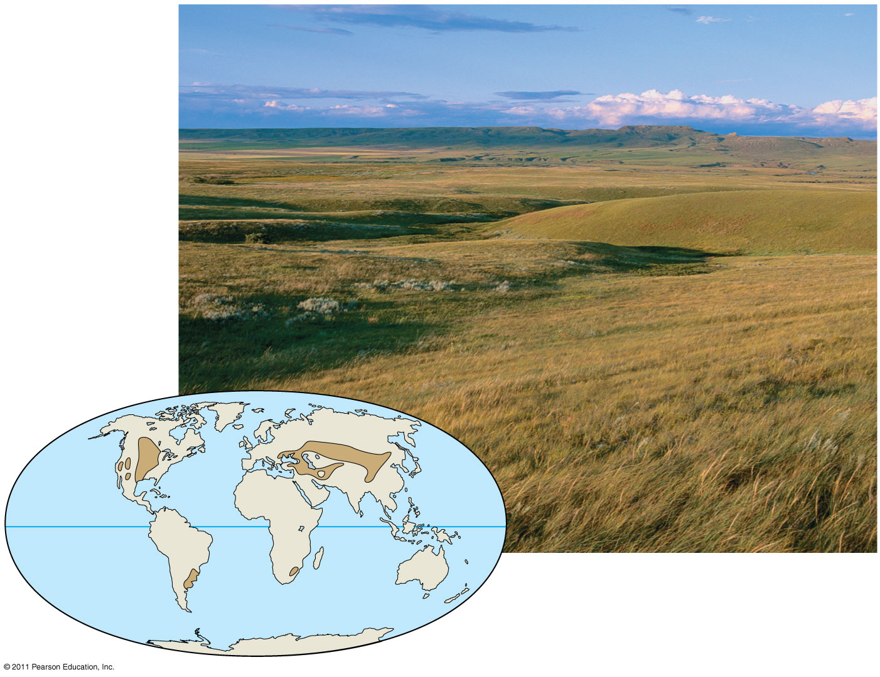
Figure 52.12e
Grasslands National Park,
Saskatchewan
Notes:
Figure 52.12 Exploring: Terrestrial Biomes

Slide 49
Northern Coniferous Forest
The northern coniferous forest, or taiga, spans northern North America and Eurasia and is the largest terrestrial biome on Earth
Precipitation varies; some have periodic droughts and others, especially near coasts, are wet
Winters are cold and long while summers may be hot (e.g., Siberia ranges from –50°C to 20°C)
© 2011 Pearson Education, Inc.

Slide 50
Conifers such as pine, spruce, fir, and hemlock dominate
The conical shape of conifers prevents too much snow from accumulating and breaking their branches
Animals include migratory and resident birds, and large mammals such as moose, brown bears, and Siberian tigers
Some forests are being logged at an alarming rate
© 2011 Pearson Education, Inc.

Slide 51
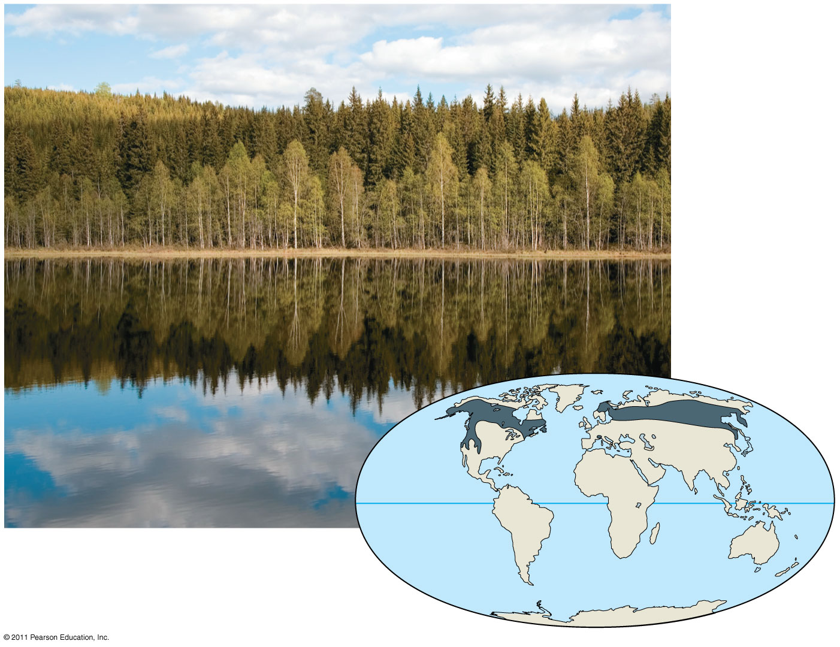
Figure 52.12f
A forest in Norway
Notes:
Figure 52.12 Exploring: Terrestrial Biomes

Slide 52
Temperate Broadleaf Forest
Temperate broadleaf forest is found at midlatitudes in the Northern Hemisphere, with smaller areas in Chile, South Africa, Australia, and New Zealand
Significant amounts of precipitation fall during all seasons as rain or snow
Winters average 0°C, while summers are hot and humid (near 35°C)
© 2011 Pearson Education, Inc.

Slide 53
Vertical layers are dominated by deciduous trees in the Northern Hemisphere and evergreen eucalyptus in Australia
Mammals, birds, and insects make use of all vertical layers in the forest
In the Northern Hemisphere, many mammals hibernate in the winter
These forests have been heavily settled on all continents, but are recovering in places
© 2011 Pearson Education, Inc.

Slide 54
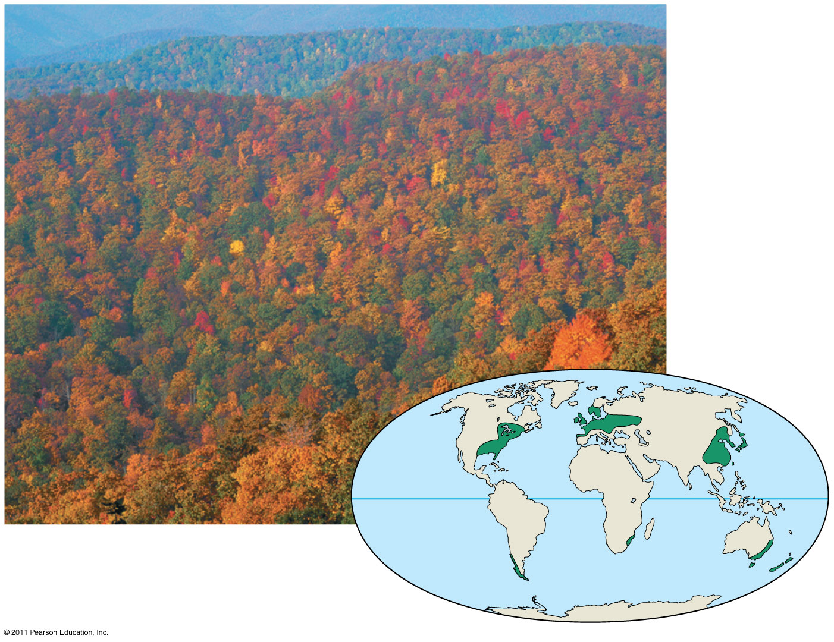
Figure 52.12g
Great Smoky Mountains
National Park in
North Carolina, in autumn
Notes:
Figure 52.12 Exploring: Terrestrial Biomes

Slide 55
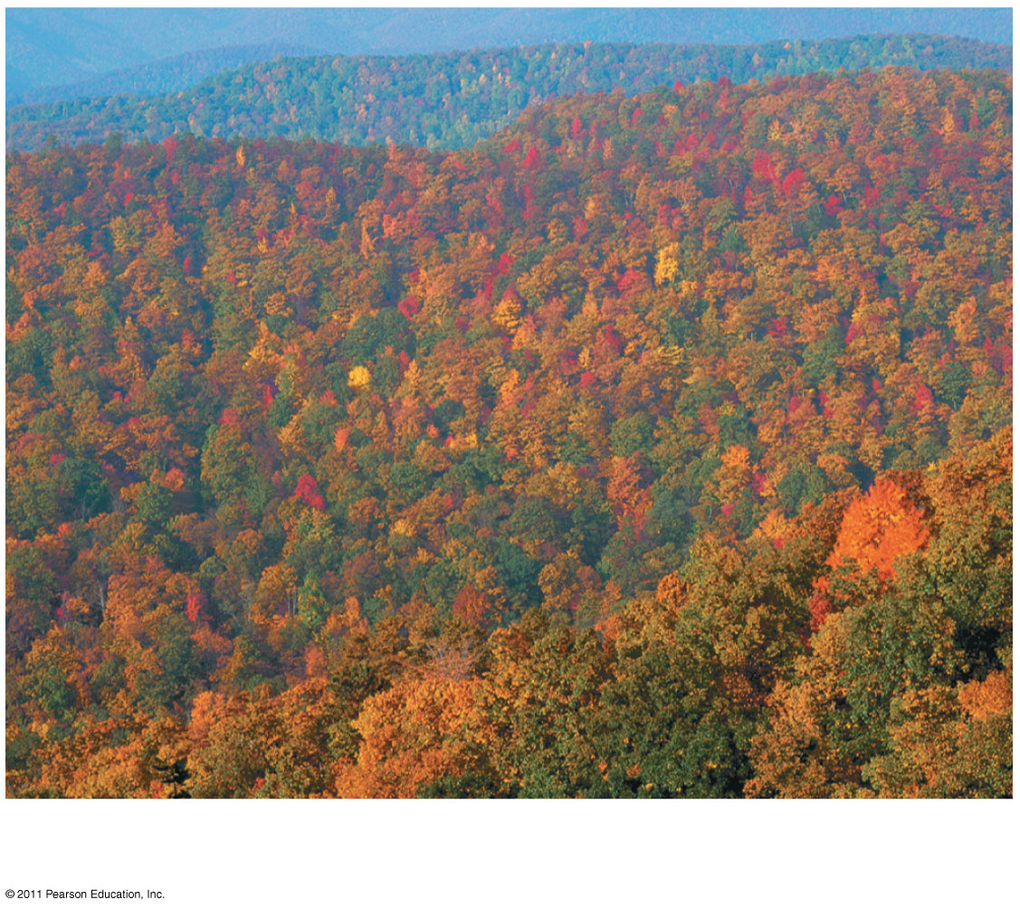
Figure 52.12ga
Great Smoky Mountains National Park in North Carolina,
in autumn
Notes:
Figure 52.12 Exploring: Terrestrial Biomes

Slide 56
Tundra
Tundra covers expansive areas of the Arctic; alpine tundra exists on high mountaintops at all latitudes
Precipitation is low in arctic tundra, and higher in alpine tundra
Winters are long and cold (below –30°C) while summers are relatively cool (less than 10°C)
© 2011 Pearson Education, Inc.

Slide 57
Permafrost, a permanently frozen layer of soil, prevents water infiltration
Vegetation is herbaceous (mosses, grasses, forbs, dwarf shrubs and trees, and lichen) and supports birds, grazers, and their predators
Mammals include musk oxen, caribou, reindeer, bears, wolves, and foxes; many migratory bird species nest in the summer
Settlement is sparse, but tundra has become the focus of oil and mineral extraction
© 2011 Pearson Education, Inc.

Slide 58
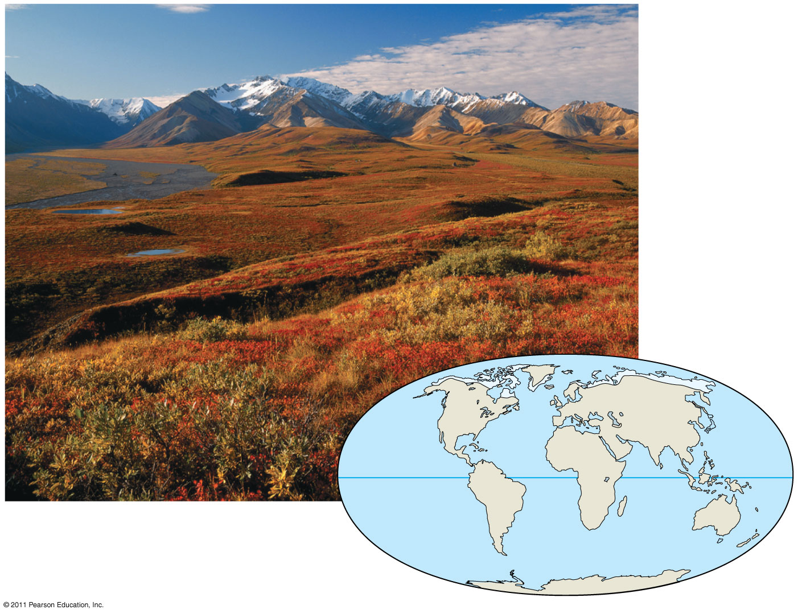
Figure 52.12h
Denali National Park, Alaska,
in autumn
Notes:
Figure 52.12 Exploring: Terrestrial Biomes

Slide 59
Concept 52.3: Aquatic biomes are diverse and dynamic systems that cover most of Earth
Aquatic biomes account for the largest part of the biosphere in terms of area
They show less latitudinal variation than terrestrial biomes
Marine biomes have salt concentrations of about 3%
The largest marine biome is made of oceans which cover about 75% of Earth’s surface and have an enormous impact on the biosphere (15)
© 2011 Pearson Education, Inc.

Slide 60
Zonation in Aquatic Biomes
Many aquatic biomes are stratified into zones or layers defined by light penetration, temperature, and depth
The upper photic zone has sufficient light for photosynthesis while the lower aphotic zone receives little light
The photic and aphotic zones make up the pelagic zone
Deep in the aphotic zone lies the abyssal zone with a depth of 2,000 to 6,000 m (16 on next several slides)
© 2011 Pearson Education, Inc.

Slide 61
The organic and inorganic sediment at the bottom of all aquatic zones is called the benthic zone
The communities of organisms in the benthic zone are collectively called the benthos
Detritus, dead organic matter, falls from the productive surface water and is an important source of food
© 2011 Pearson Education, Inc.

Slide 62
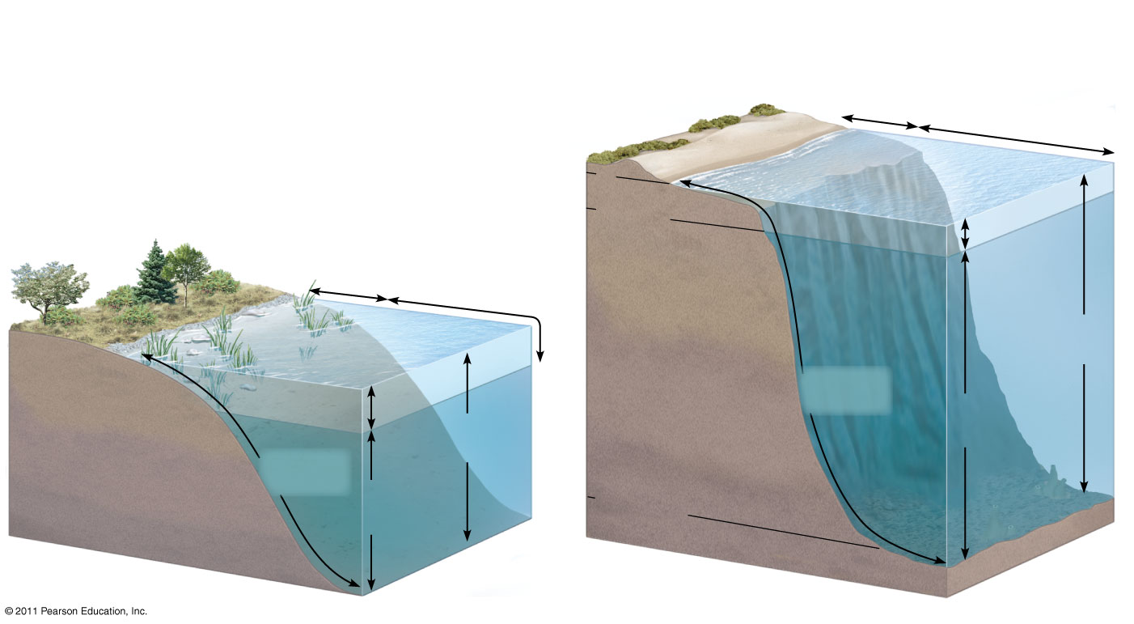
Figure 52.13
(b) Marine zonation
Intertidal zone
Neritic
zone
Oceanic zone
0
(a) Zonation in a lake
200 m
Photic
zone
Littoral
zone
Limnetic
zone
Continental
shelf
Pelagic
zone
Photic
zone
Benthic
zone
Pelagic
zone
Aphotic
zone
Benthic
zone
Aphotic
zone
2,000−
6,000 m
Abyssal
zone
Notes:
Figure 52.13 Zonation in aquatic environments.

Slide 63
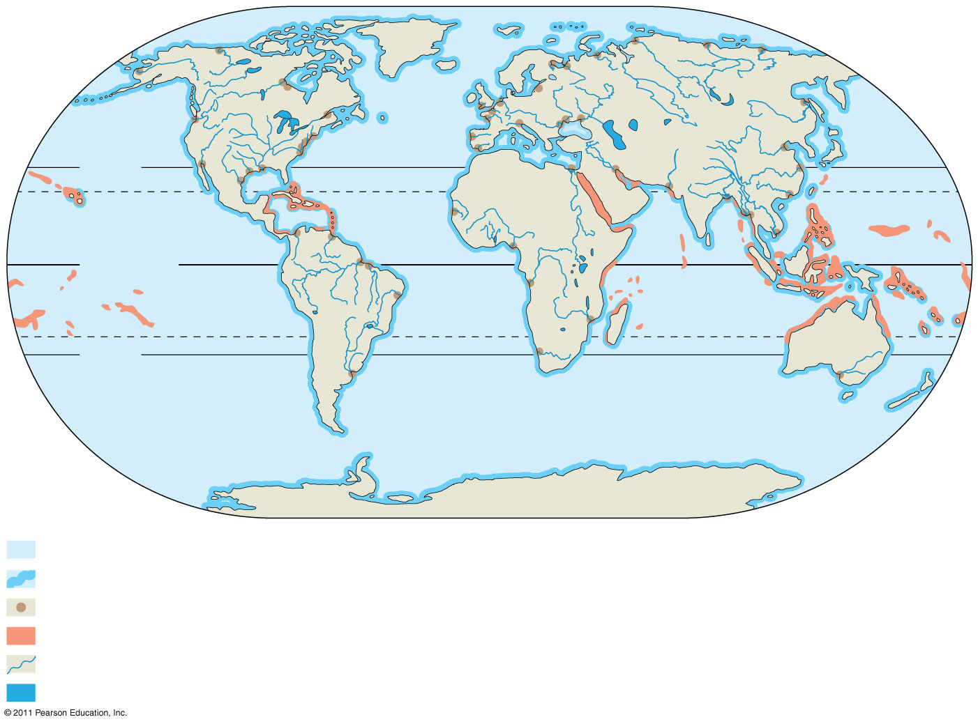
Figure 52.15
30°N
Tropic of
Cancer
Equator
Tropic of
Capricorn
30°S
Oceanic pelagic and benthic zones
Intertidal zones
Estuaries
Coral reefs
Rivers
Lakes
Notes:
Figure 52.15 The distribution of major aquatic biomes.

Slide 64
Lakes
Size varies from small ponds to very large lakes
Temperature lakes may have a seasonal thermocline; tropical lowland lakes have a year-round thermocline
Oligotrophic lakes are nutrient-poor and generally oxygen-rich
Eutrophic lakes are nutrient-rich and often depleted of oxygen if ice covered in winter
© 2011 Pearson Education, Inc.

Slide 65
Eutrophic lakes have more surface area relative to depth than oligotrophic lakes
Rooted and floating aquatic plants live in the shallow and well-lighted littoral zone close to shore
Water is too deep in the limnetic zone to support rooted aquatic plants; small drifting animals called zooplankton graze on the phytoplankton (Starts 17 on next several slides)
© 2011 Pearson Education, Inc.

Slide 66
Zooplankton are drifting heterotrophs that graze on the phytoplankton
Invertebrates live in the benthic zone
Fishes live in all zones with sufficient oxygen
Human induced nutrient enrichment can lead to algal blooms, oxygen depletion, and fish kills
© 2011 Pearson Education, Inc.

Slide 67
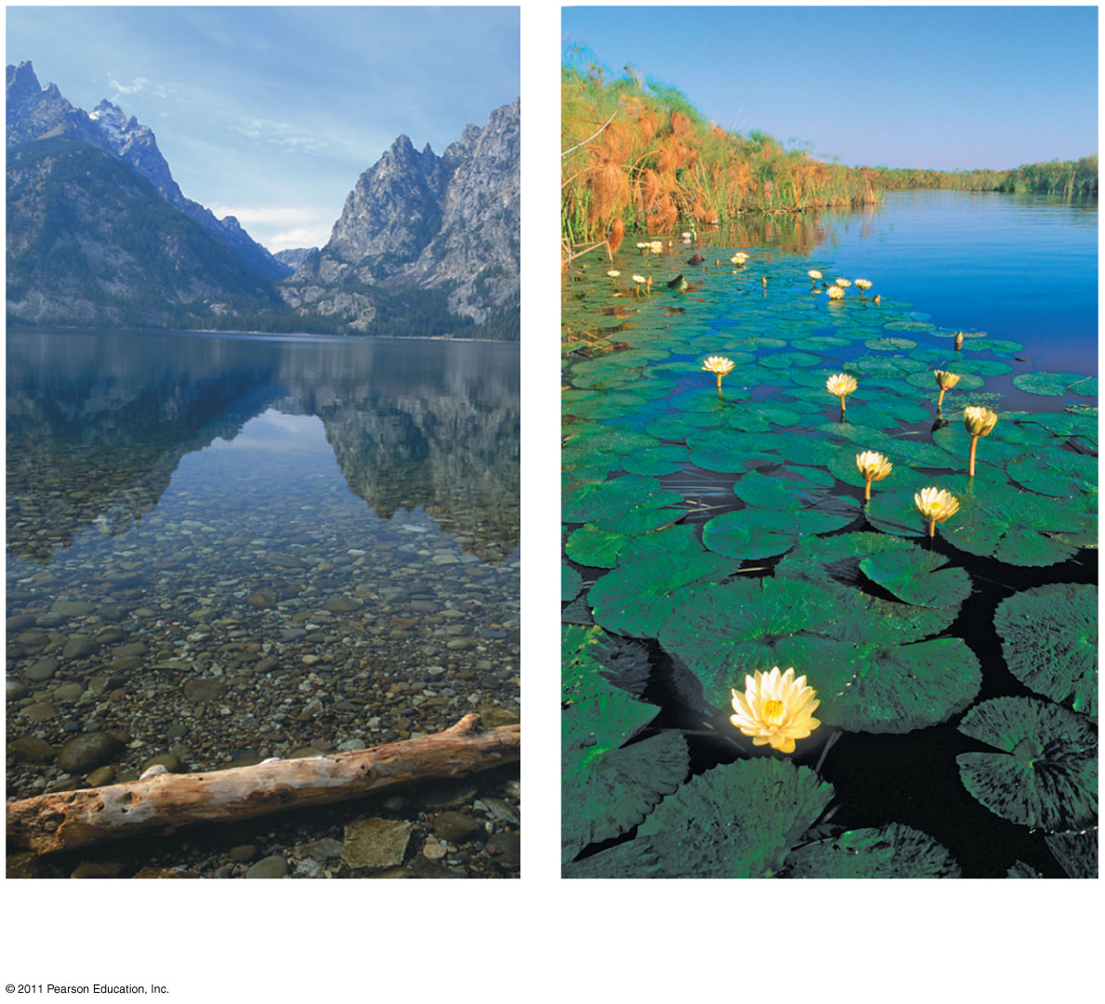
Figure 52.16a
An oligotrophic lake in Grand
Teton National Park, Wyoming
A eutrophic lake in the Okavango
Delta, Botswana
Notes:
Figure 52.16 Exploring: Aquatic Biomes

Slide 68
Wetlands
A wetland is a habitat that is inundated by water at least some of the time and that supports plants adapted to water-saturated soil
Wetlands have high organic production and decomposition and have low dissolved oxygen
Wetlands can develop in shallow basins, along flooded river banks, or on the coasts of large lakes and seas
© 2011 Pearson Education, Inc.

Slide 69
Wetlands are among the most productive biomes on Earth
Plants include lilies, cattails, sedges, tamarack, and black spruce
Wetlands are home to diverse invertebrates and birds, as well as otters, frogs, and alligators
Humans have destroyed up to 90% of wetlands; wetlands purify water and reduce flooding
Video: Swans Taking Flight
© 2011 Pearson Education, Inc.

Slide 70
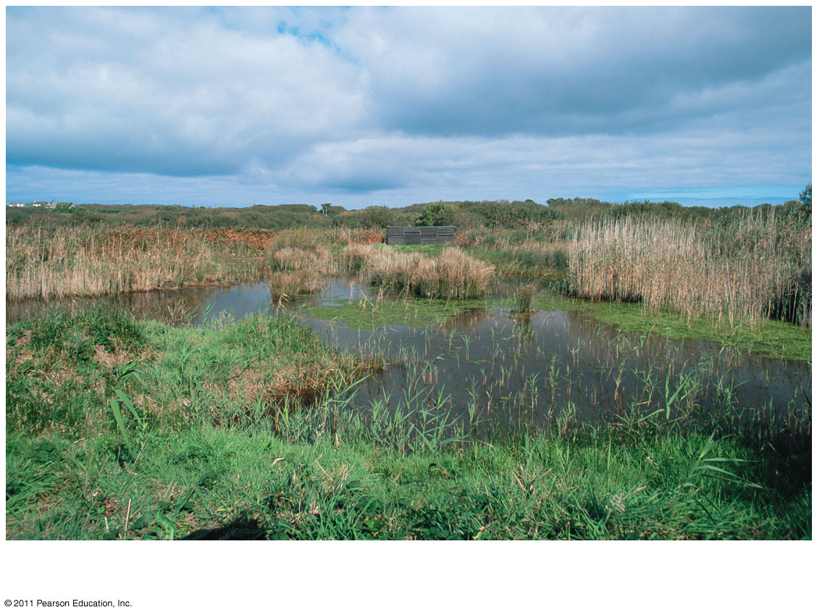
Figure 52.16b
A basin wetland in the United Kingdom
Notes:
Figure 52.16 Exploring: Aquatic Biomes

Slide 71
Streams and Rivers
The most prominent physical characteristic of streams and rivers is current
Headwaters are generally cold, clear, turbulent, swift, and oxygen rich; they are often narrow and rocky
Downstream waters form rivers and are generally warmer, more turbid, and more oxygenated; they are often wide, meandering, and have silty bottoms
© 2011 Pearson Education, Inc.

Slide 72
They may contain phytoplankton or rooted aquatic plants
A diversity of fishes and invertebrates inhabit unpolluted rivers and streams
Pollution degrades water quality and kills aquatic organisms
Damming and flood control impair natural functioning of stream and river ecosystems
© 2011 Pearson Education, Inc.

Slide 73
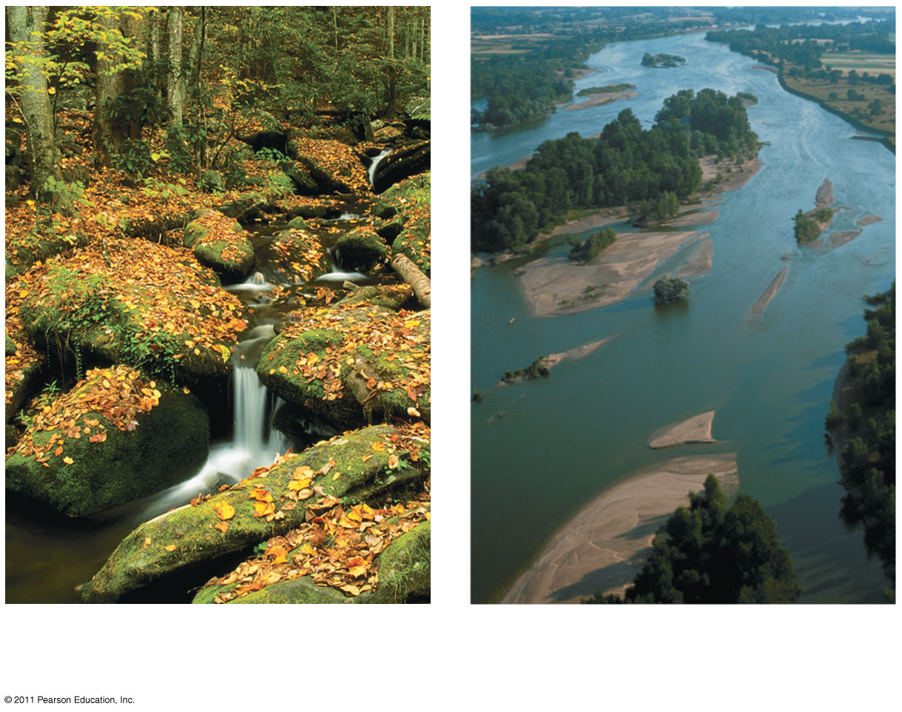
Figure 52.16c
A headwater stream in the Great
Smoky Mountains
The Loire river (in France) far
from its headwaters
Notes:
Figure 52.16 Exploring: Aquatic Biomes

Slide 74
Estuaries
An estuary is a transition area between river and sea
Salinity varies with the rise and fall of the tides
Estuaries are nutrient rich and highly productive
Estuaries include a complex network of tidal channels, islands, natural levees, and mudflats
© 2011 Pearson Education, Inc.

Slide 75
Saltmarsh grasses and algae are the major producers
An abundant supply of food attracts marine invertebrates, fish, waterfowl, and marine mammals
Humans consume oysters, crabs, and fish
Human interference upstream has disrupted estuaries worldwide
Video: Flapping Geese
© 2011 Pearson Education, Inc.

Slide 76
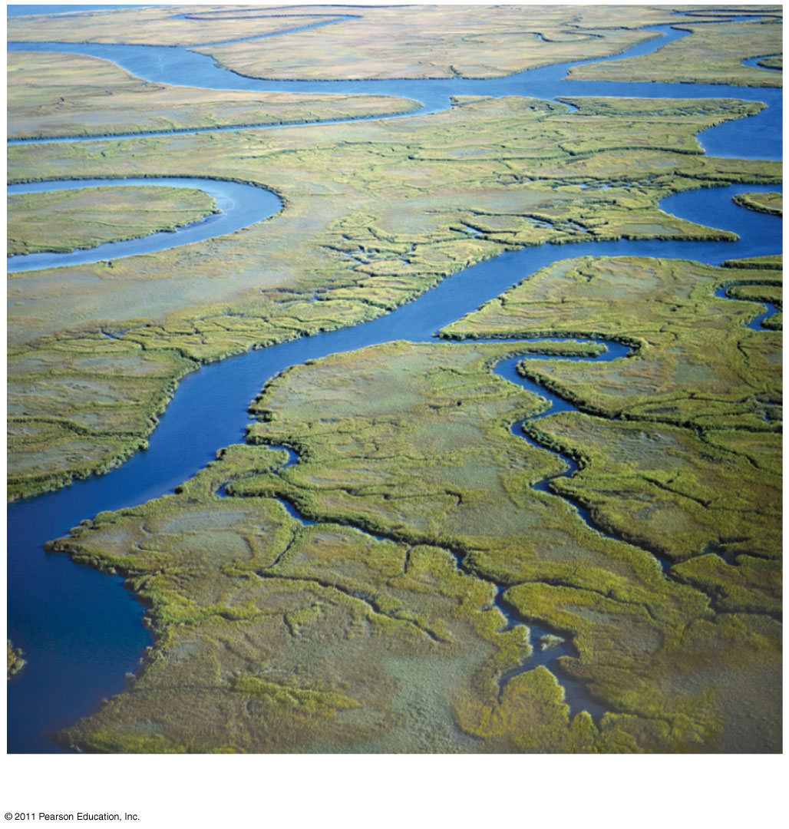
Figure 52.16d
An estuary in the southeastern United States
Notes:
Figure 52.16 Exploring: Aquatic Biomes

Slide 77
Intertidal Zones
An intertidal zone is periodically submerged and exposed by the tides
Intertidal organisms are challenged by variations in temperature and salinity and by the mechanical forces of wave action
Oxygen and nutrient levels are high
Substrate varies from rocky to sandy
© 2011 Pearson Education, Inc.

Slide 78
Sandy zones support sea grass and algae; rocky zones support attached marine algae
In rocky zones, many animals have structural adaptation for attaching to the hard substrate
In sandy zones worms, clams, and crustaceans bury themselves in sand
Other animals include sponges, sea anemones, echinoderms, and small fishes
Oil pollution has disrupted many intertidal areas
© 2011 Pearson Education, Inc.

Slide 79
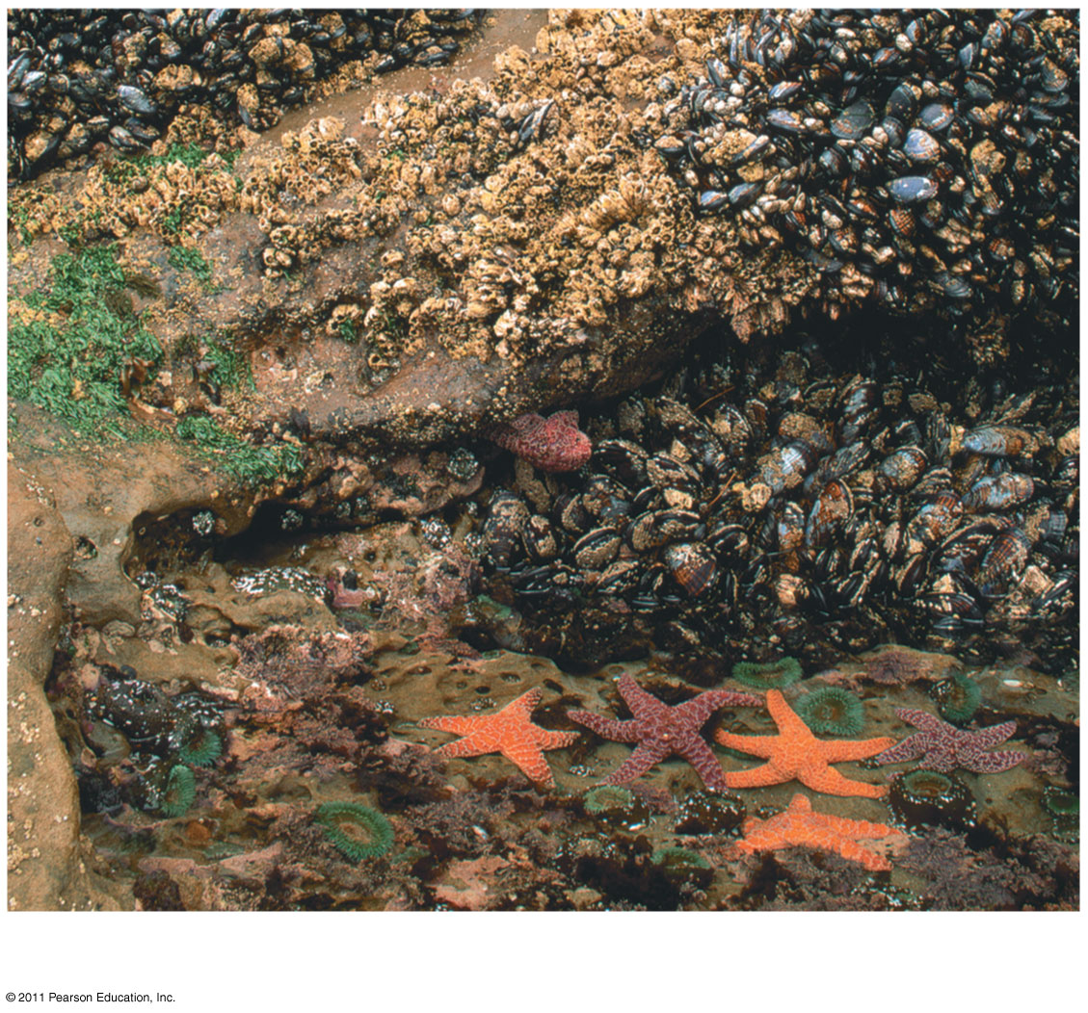
Figure 52.16e
Rocky intertidal zone on the Oregon coast
Notes:
Figure 52.16 Exploring: Aquatic Biomes

Slide 80
Oceanic Pelagic Zone
The oceanic pelagic biome is constantly mixed by wind-driven oceanic currents
Oxygen levels are high
Turnover in temperate oceans renews nutrients in the photic zones; year-round stratification in tropical oceans leads to lower nutrient concentrations
This biome covers approximately 70% of Earth’s surface
© 2011 Pearson Education, Inc.

Slide 81
Phytoplankton and zooplankton are the dominant organisms in this biome; also found are free-swimming animals
Zooplankton includes protists, worms, copepods, krill, jellies, and invertebrate larvae
Other animals include squids, fishes, sea turtles, and marine mammals
Overfishing has depleted fish stocks
Humans have polluted oceans with dumping of waste
Video: Shark Eating a Seal
© 2011 Pearson Education, Inc.

Slide 82
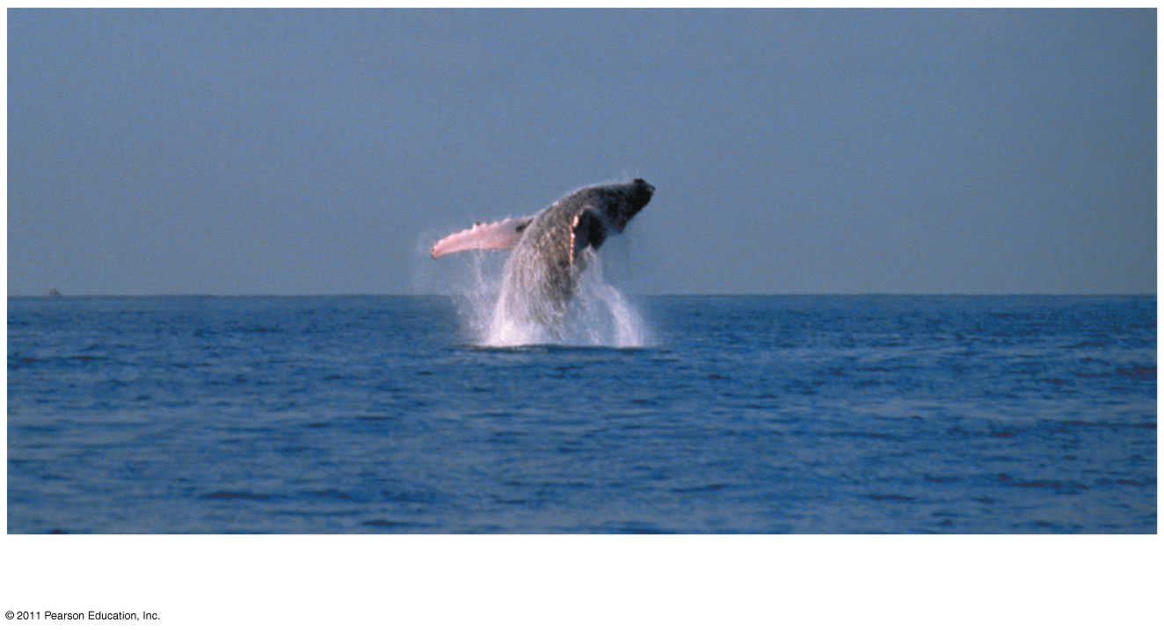
Figure 52.16f
Open ocean off the island of Hawaii
Notes:
Figure 52.16 Exploring: Aquatic Biomes

Slide 83
Coral Reefs
Coral reefs are formed from the calcium carbonate skeletons of corals (cnidarians)
Shallow reef-building corals lie in the photic zone in clear water about 20–30°C; deep sea corals live at 200–1,500 m
Corals require high oxygen and a solid substrate for attachment
A coral reef progresses from a fringing reef, to a barrier reef, then a coral atoll
© 2011 Pearson Education, Inc.

Slide 84
Unicellular algae live within the tissues of the corals and form a mutualistic relationship that provides the corals with organic molecules
Fish and invertebrate diversity is exceptionally high
Global warming and pollution may be contributing to large-scale coral death
Collecting of coral skeletons and overfishing have reduced populations of corals and reef fishes
Video: Coral Reef
Video: Clownfish and Anemone
© 2011 Pearson Education, Inc.

Slide 85
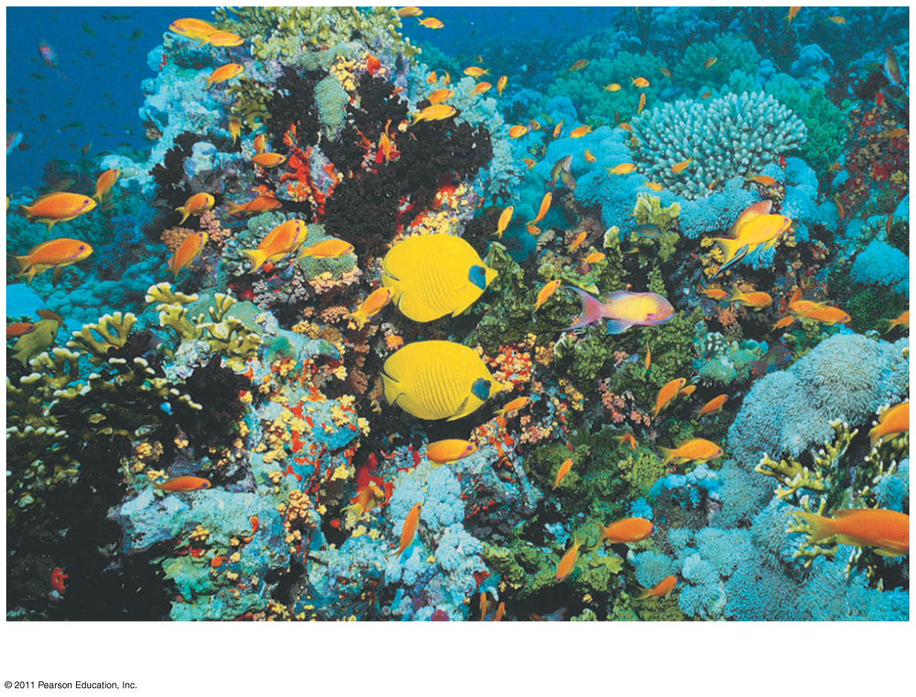
Figure 52.16g
A coral reef in the Red Sea
Notes:
Figure 52.16 Exploring: Aquatic Biomes

Slide 86
Marine Benthic Zone
The marine benthic zone consists of the seafloor below the surface waters of the coastal, or neritic, zone and the offshore pelagic zone
Organisms in the very deep benthic (abyssal) zone are adapted to continuous cold and extremely high water pressure
Substrate is mainly soft sediments; some areas are rocky
© 2011 Pearson Education, Inc.

Slide 87
Shallow areas contain seaweeds and filamentous algae
Deep-sea hydrothermal vents of volcanic origin on mid-oceanic ridges are surrounded by unique chemoautotrophic prokaryotes, as well as echinoderms and arthropods
Neritic benthic communities include invertebrates and fishes
Overfishing and dumping of waste have depleted fish populations
Video: Hydrothermal Vent
Video: Tubeworms
© 2011 Pearson Education, Inc.

Slide 88
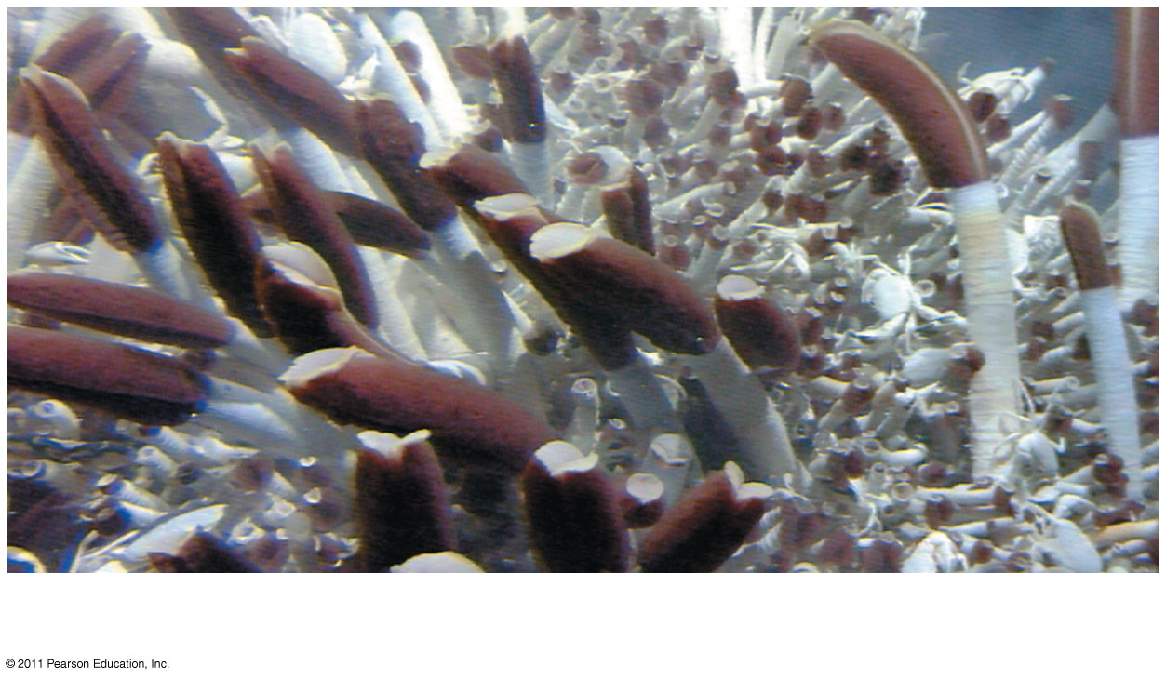
Figure 52.16h
A deep-sea hydrothermal vent community
Notes:
Figure 52.16 Exploring: Aquatic Biomes

Slide 89
Concept 52.4: Interactions between organisms and the environment limit the distribution of species
Species distributions are the result of ecological and evolutionary interactions through time
Ecological time in the minute-to-minute time frame of interactions between organisms and the environment
Evolutionary time spans many generations and captures adaptation through natural selection
© 2011 Pearson Education, Inc.

Slide 90
Dispersal and Distribution
Dispersal is movement of individuals away from centers of high population density or from their area of origin
Dispersal contributes to global distribution of organisms (18)
© 2011 Pearson Education, Inc.

Slide 91
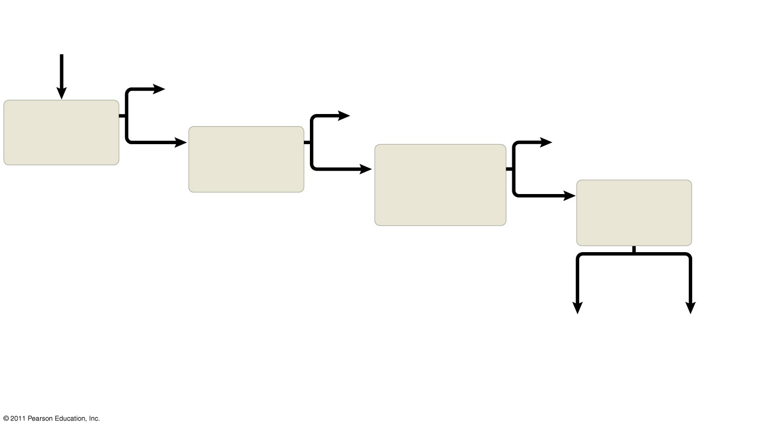
Figure 52.18
Why is species
X absent
from an area?
Yes
Area inaccessible
or insufficient time
Yes
Predation,
parasitism,
competition,
disease
Does dispersal
limit its
distribution?
Habitat selection
Yes
Does behavior
limit its
distribution?
No
Do biotic factors
(other species)
limit its
distribution?
No
Do abiotic
factors limit its
distribution?
No
Physical
factors
Chemical
factors
Temperature
Light
Soil structure
Fire
Moisture, etc.
Water
Oxygen
Salinity
pH
Soil nutrients,
etc.
Notes:
Figure 52.18 Flowchart of factors limiting geographic distribution.

Slide 92
Biotic Factors
Biotic factors that affect the distribution of organisms may include
Predation
Herbivory
For example, sea urchins can limit the distribution of seaweeds
Competition
© 2011 Pearson Education, Inc.

Slide 93
Abiotic Factors
Abiotic factors affecting distribution of organisms include
Temperature
Water
Sunlight
Wind
Rocks and soil
Most abiotic factors vary in space and time
© 2011 Pearson Education, Inc.

