Slide 1
Chapter 22
Descent with Modification:
A Darwinian View of Life

Slide 2
History of Evolution
November 24th 1859 forever changed the course of Biology.
Charles Darwin published On the Origin of Species by Means of Natural Selection.
This has lead to what we know call the theory of evolution.
Evolution is a controversial topic in today’s society that brings about many different images…….

Slide 3
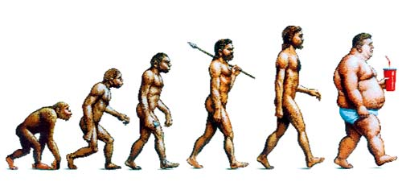

Slide 4
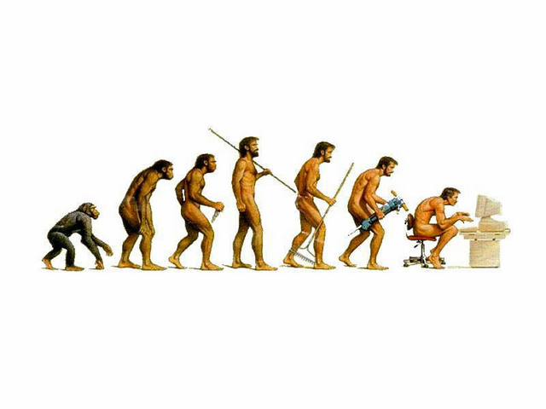

Slide 5
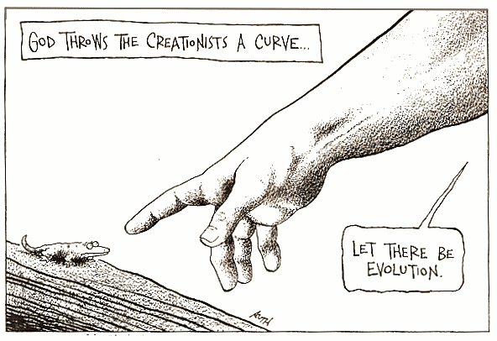

Slide 6
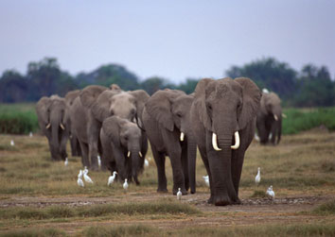
The theory of Evolution
Evolution is known as the gradual change in the genotypic frequency of a species over time.
A species being a group of organisms whose members look alike and successfully reproduce among themselves.

Slide 7
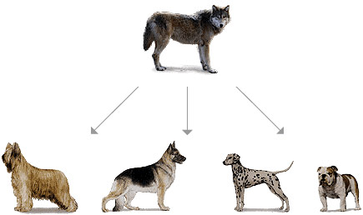
2 Main Types of Evolution
Micro-Changes in DNA that occur within a species that leads to differences but not new species.

Slide 8
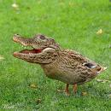
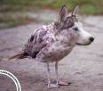
2 Main Types of Evolution (Cont.)
Macro Evolution-Changes in DNA of a population so dramatic that it leads to the formation of new species.
Much more rarely documented, but few examples…
Louisianna Swamp Duck
Alaskan Wolf Bird

Slide 9
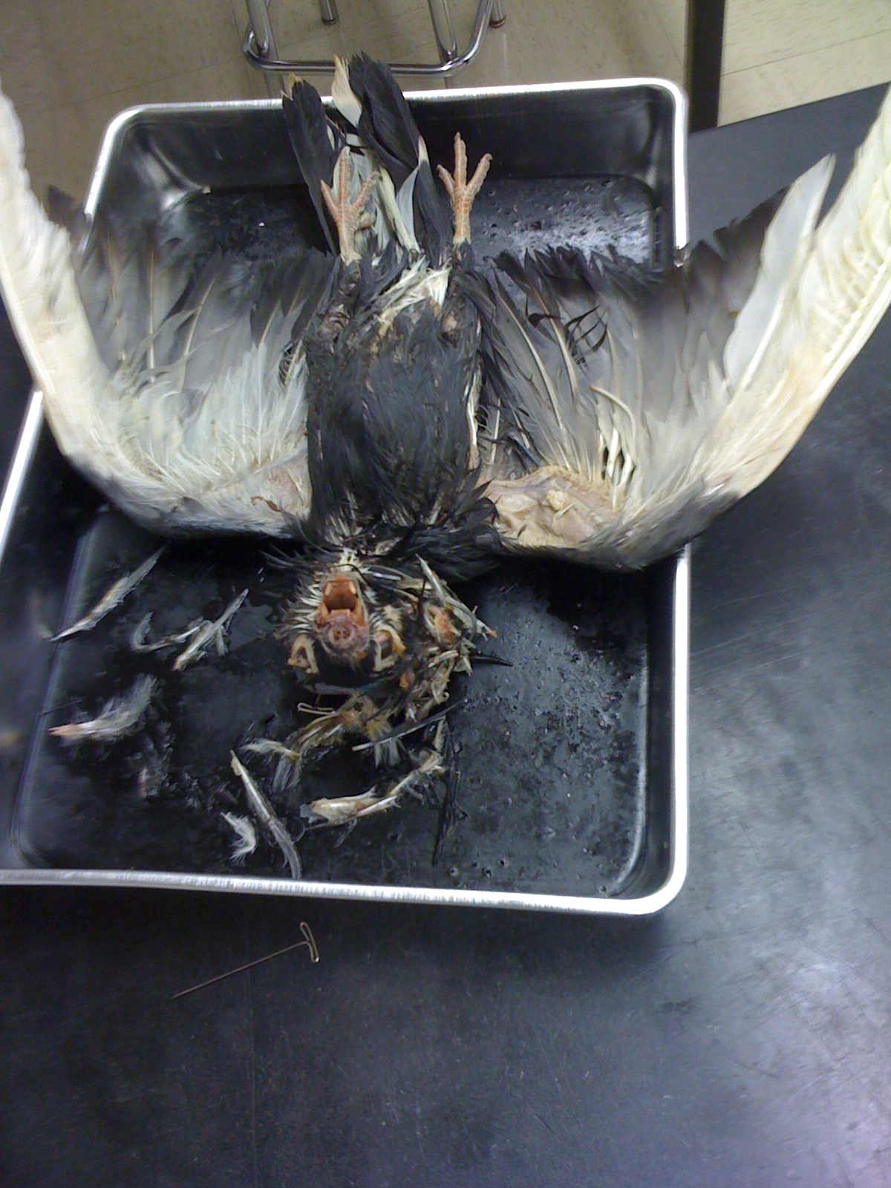

Slide 10
Overview: Endless Forms Most Beautiful
A new era of biology began in 1859 when Charles Darwin published The Origin of Species
Darwin noted that current species are descendants of ancestral species
Evolution can be broadly defined by Darwin’s phrase descent with modification
More specifically, evolution is the change in genotypic frequency of a population over time. (1)
© 2011 Pearson Education, Inc.

Slide 11
Concept 22.1: The Darwinian revolution challenged traditional views of a young Earth inhabited by unchanging species
Darwin’s ideas had deep historical roots
© 2011 Pearson Education, Inc.

Slide 12
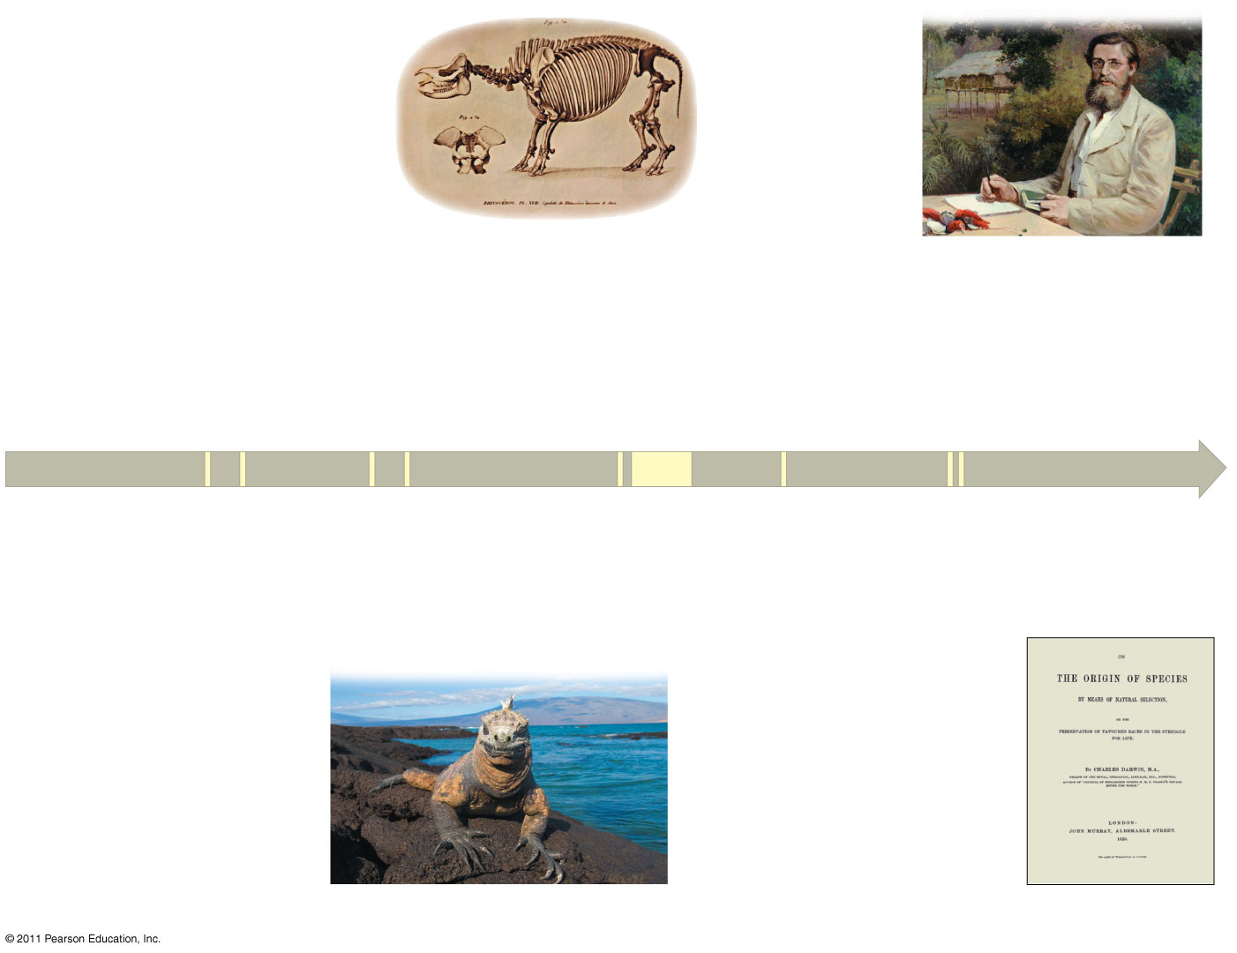
Figure 22.2
1809
Lamarck publishes his
hypothesis of evolution.
1798
Malthus publishes
“Essay on the Principle
of Population.”
1812
Cuvier publishes his extensive
studies of vertebrate fossils.
1858
1795
While studying species
in the Malay Archipelago,
Wallace sends Darwin
his hypothesis of natural
selection.
Hutton proposes
his principle of
gradualism.
1830
Lyell publishes
Principles of Geology.
1790
1870
1809
1831−36
1859
Charles Darwin
is born.
Darwin travels around
the world on HMS
Beagle.
On the Origin of
Species is published.
1844
Darwin writes his
essay on descent
with modification.
The Galápagos Islands
Notes:
Figure 22.2 The intellectual context of Darwin’s ideas.

Slide 13
Scala Naturae and Classification of Species
The Greek philosopher Aristotle viewed species as fixed and arranged them on a scala naturae
The Old Testament holds that species were individually designed by God
Carolus Linnaeus interpreted organismal adaptations as evidence that the Creator had designed each species for a specific purpose
Linnaeus was the founder of taxonomy, the branch of biology concerned with classifying organisms
He developed the binomial nomenclature, the format for naming species (for example, Homo sapiens) (2)
© 2011 Pearson Education, Inc.

Slide 14

Ideas About Change over Time
Fossils also provide evidence for evolution. Fossils are the remains of once-living things that are preserved in Earth’s rocks.
The study of fossils helped to lay the groundwork for Darwin’s ideas
Fossils are remains or traces of organisms from the past, usually found in sedimentary rock, which appears in layers or strata
They are a partial “snapshot” into life at that time. (3)
Video: Grand Canyon
© 2011 Pearson Education, Inc.

Slide 15
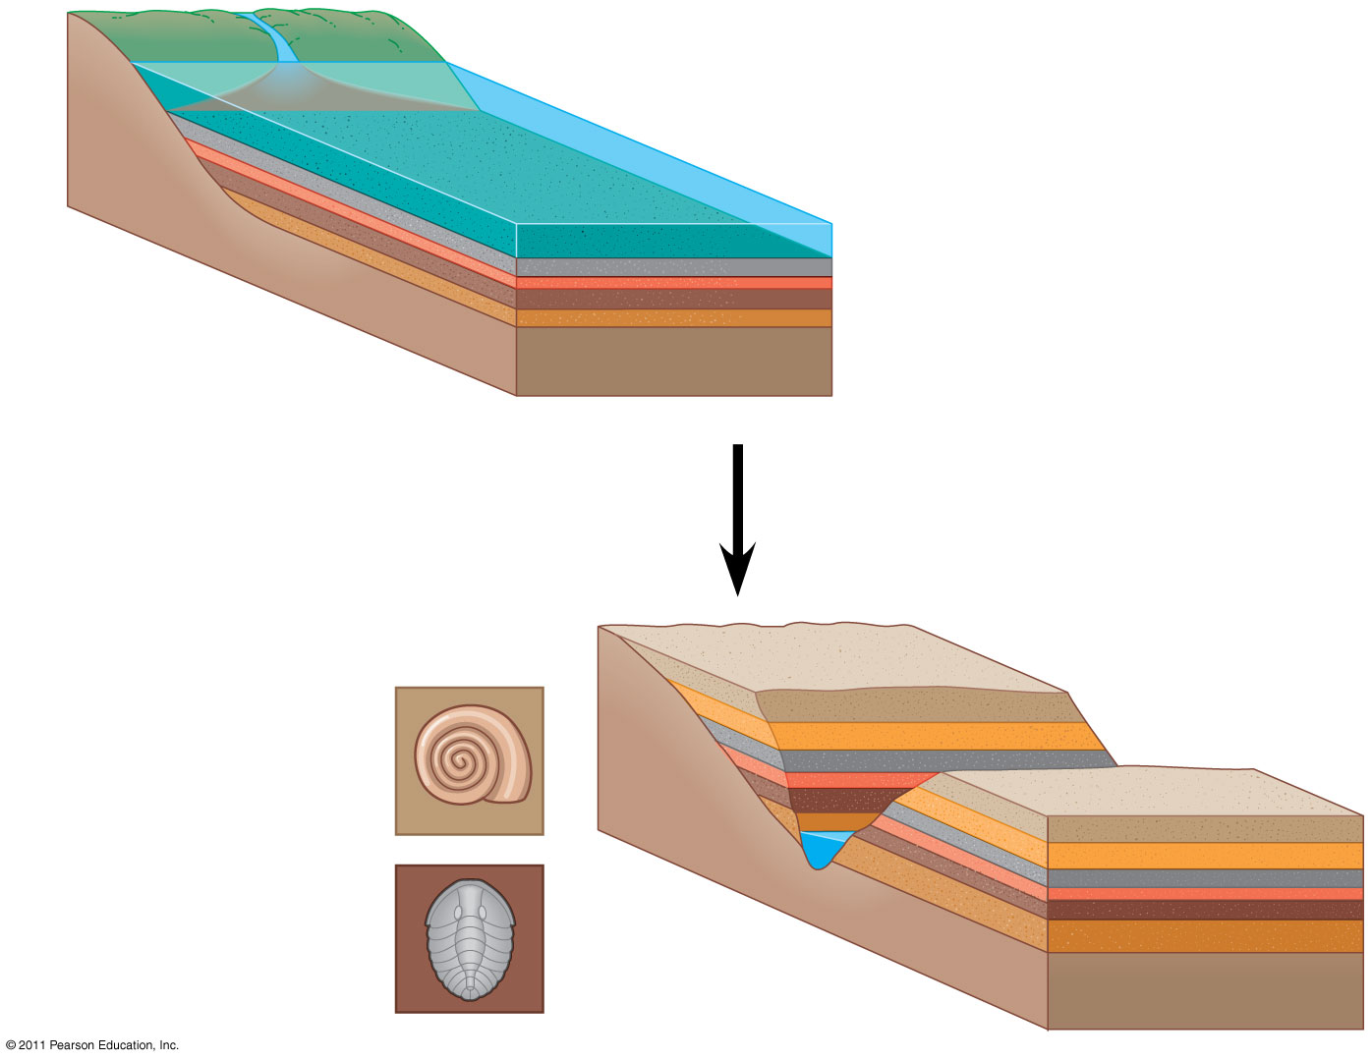
Figure 22.3
Sedimentary rock
layers (strata)
Younger stratum
with more recent
fossils
Older stratum
with older fossils
Notes:
Figure 22.3 Formation of sedimentary strata with fossils.

Slide 16
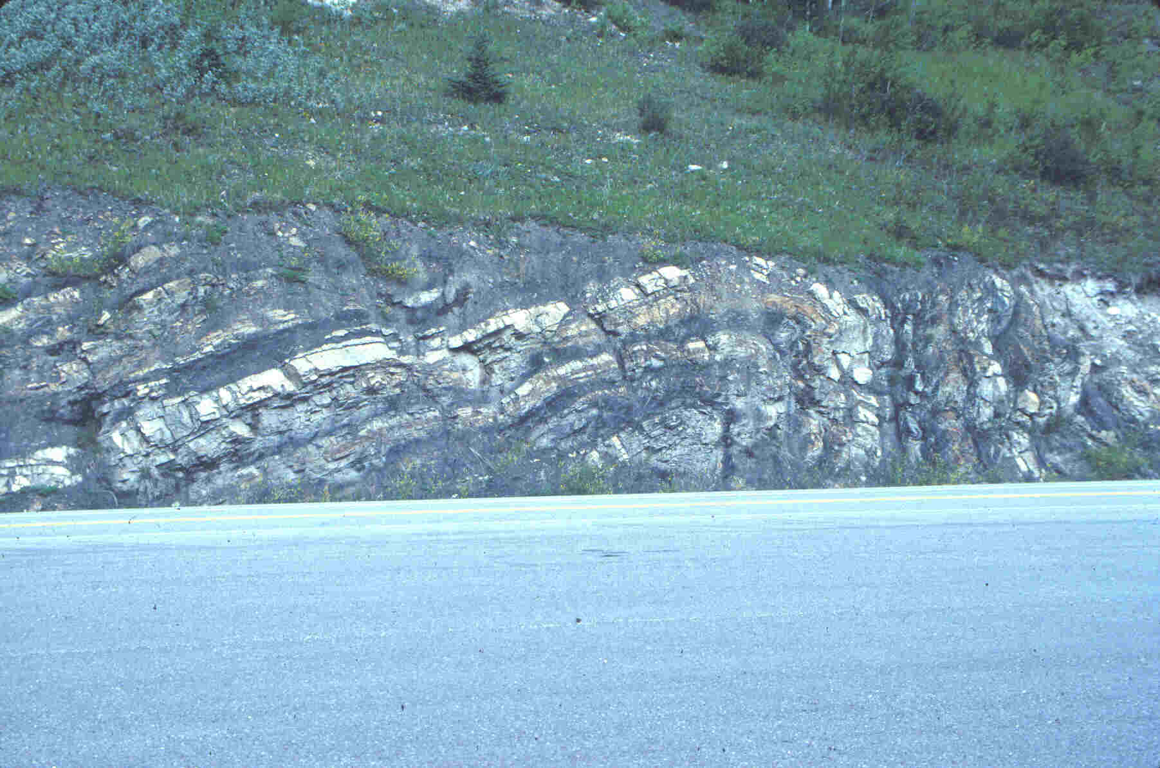
Evidence for Evolution
Fossils have found that many simpler life forms exist early in Earth’s history.
The oldest fossils found are bacteria that lived 3.8 billion years ago.

Slide 17
Types of Fossils
Trace Fossil
  indirect evidence left by an animal, like a footprint, trail, or burrow
Cast
  when minerals in rock fill a space left by a decayed organism
Mold
  When organism buried in sediment decays and leaves a space
Petrified or Premineralized
  when minerals fill in an organism
Amber or ice preserved
  when an entire organism is trapped in amber or ice

Slide 18
Paleontology, the study of fossils, was largely developed by French scientist Georges Cuvier
Cuvier advocated catastrophism, speculating that each boundary between strata represents a catastrophe
This goes well with the idea of punctuated equilibrium; there can be long periods of no change followed by rapid bursts of evolution and adaptation. (4)
© 2011 Pearson Education, Inc.

Slide 19
Geologists James Hutton and Charles Lyell perceived that changes in Earth’s surface can result from slow continuous actions still operating today
Lyell’s principle of uniformitarianism states that the mechanisms of change are constant over time. Hutton agreed and an almost synonymous term of gradualism was applied.
This view strongly influenced Darwin’s thinking and demonstrated that small incremental changes can add up to something big over time.(5-6)
© 2011 Pearson Education, Inc.

Slide 20
Lamarck’s Hypothesis of Evolution
Lamarck hypothesized that species evolve through use and disuse of body parts and the inheritance of acquired characteristics
The mechanisms he proposed are unsupported by evidence, but he did propose a mechanism for evolution. (7-8)
© 2011 Pearson Education, Inc.

Slide 21
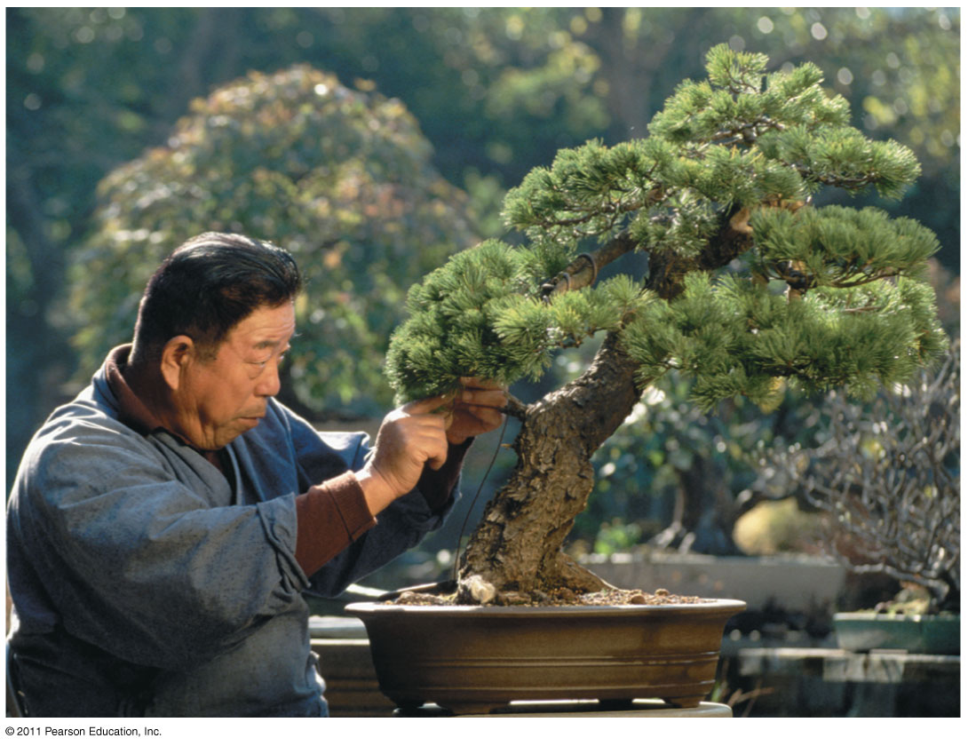
Figure 22.4 Acquired traits cannot be inherited.
Notes:
Figure 22.4 Acquired traits cannot be inherited.

Slide 22
Darwin’s Research
As a boy and into adulthood, Charles Darwin had a consuming interest in nature
Darwin first studied medicine (unsuccessfully), and then theology at Cambridge University
After graduating, he took an unpaid position as naturalist and companion to Captain Robert FitzRoy for a 5-year around the world voyage on the Beagle
© 2011 Pearson Education, Inc.

Slide 23
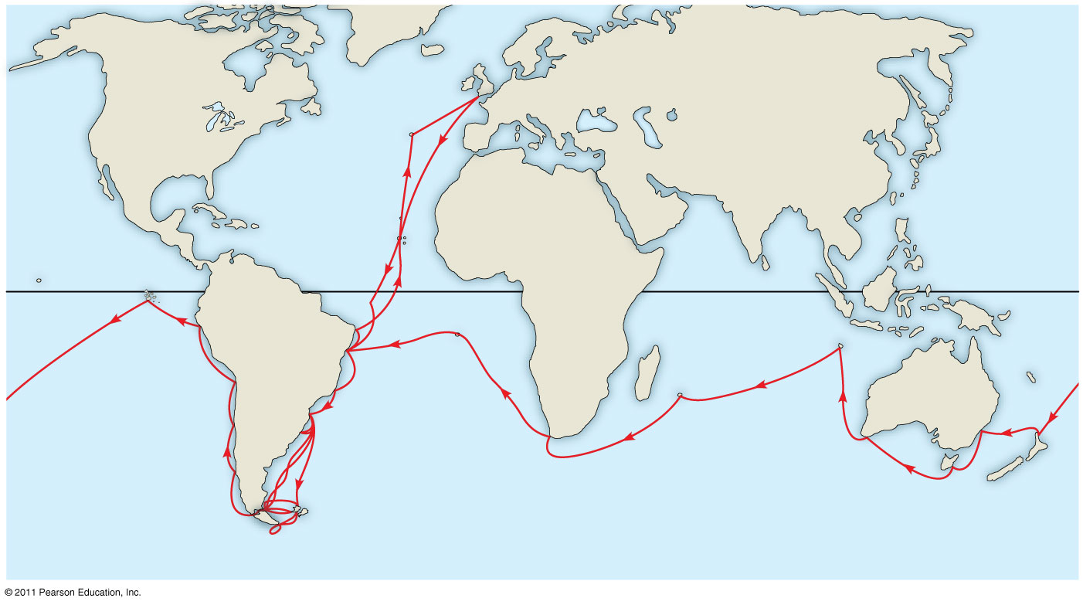
Figure 22.5a
Great
Britain
EUROPE
NORTH
AMERICA
ATLANTIC
OCEAN
The
Galápagos
Islands
AFRICA
Equator
Malay Archipelago
SOUTH
AMERICA
PACIFIC
OCEAN
Chile
Brazil
AUSTRALIA
PACIFIC
OCEAN
Andes Mtns.
Cape of
Good Hope
Argentina
Tasmania
Cape Horn
New
Zealand
Notes:
Figure 22.5 The voyage of HMS Beagle.

Slide 24
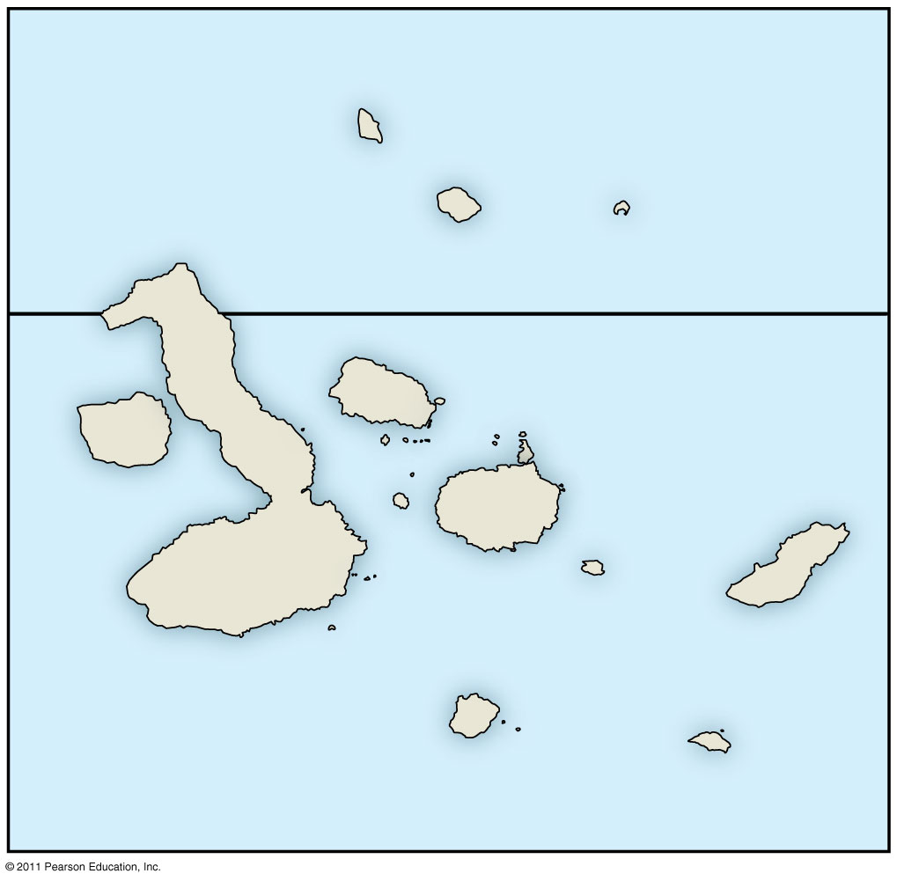
Figure 22.5c
The
Galápagos
Islands
PACIFIC
OCEAN
Pinta
Genovesa
Marchena
Equator
Santiago
Daphne
Islands
Fernandina
Pinzón
Isabela
Santa
Cruz
Santa
Fe
San
Cristobal
0
20
40
Florenza
Española
Kilometers
Notes:
Figure 22.5 The voyage of HMS Beagle.

Slide 25
Darwin’s Focus on Adaptation
In reassessing his observations, Darwin perceived adaptation to the environment and the origin of new species as closely related processes
Adaptation: A form or structure modification to fit a changed environment
Finches
From studies made years after Darwin’s voyage, biologists have concluded that this is what happened to the Galápagos finches
© 2011 Pearson Education, Inc.

Slide 26
In 1844, Darwin wrote an essay on natural selection as the mechanism of descent with modification, but did not introduce his theory publicly
Natural selection is a process in which individuals with favorable inherited traits are more likely to survive and reproduce
In June 1858, Darwin received a manuscript from Alfred Russell Wallace, who had developed a theory of natural selection similar to Darwin’s
Darwin quickly finished The Origin of Species and published it the next year (10
© 2011 Pearson Education, Inc.

Slide 27
Descent with Modification
Darwin never used the word evolution in the first edition of The Origin of Species
The phrase descent with modification summarized Darwin’s perception of the unity of life
The phrase refers to the view that all organisms are related through descent from an ancestor that lived in the remote past
© 2011 Pearson Education, Inc.

Slide 28
The Theory of Evolution
On the Origin of Species made two major points
  1. Many species living on Earth have descended from ancestral species that are different from the modern ones around today. (descent with modification)
  2. The mechanism for these changes is natural selection.

Slide 29
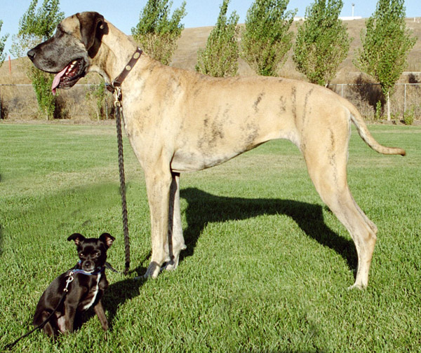
Artificial Selection, Natural Selection, and Adaptation
Darwin noted that humans have modified other species by selecting and breeding individuals with desired traits, a process called artificial selection
Darwin drew two inferences from four observations (11 and 12 on next few slides)
© 2011 Pearson Education, Inc.

Slide 30
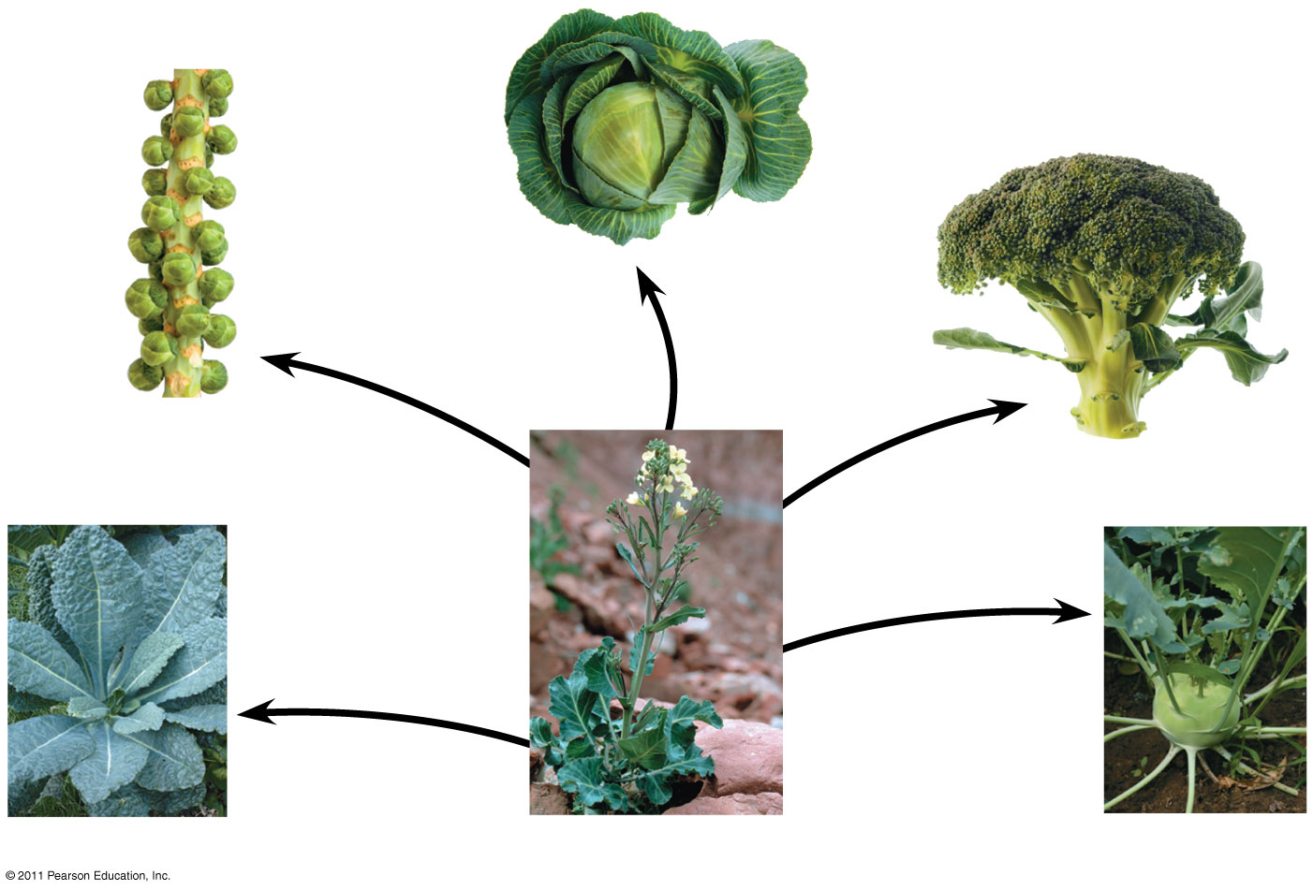
Figure 22.9
Cabbage
Selection for
apical (tip) bud
Brussels
sprouts
Selection for
axillary (side)
buds
Broccoli
Selection
for flowers
and stems
Selection
for stems
Selection
for leaves
Kale
Wild mustard
Kohlrabi
Notes:
Figure 22.9 Artificial selection.

Slide 31
Observation #1: Members of a population often vary in their inherited traits
Obersvation #2 These variations are heritable
© 2011 Pearson Education, Inc.

Slide 32
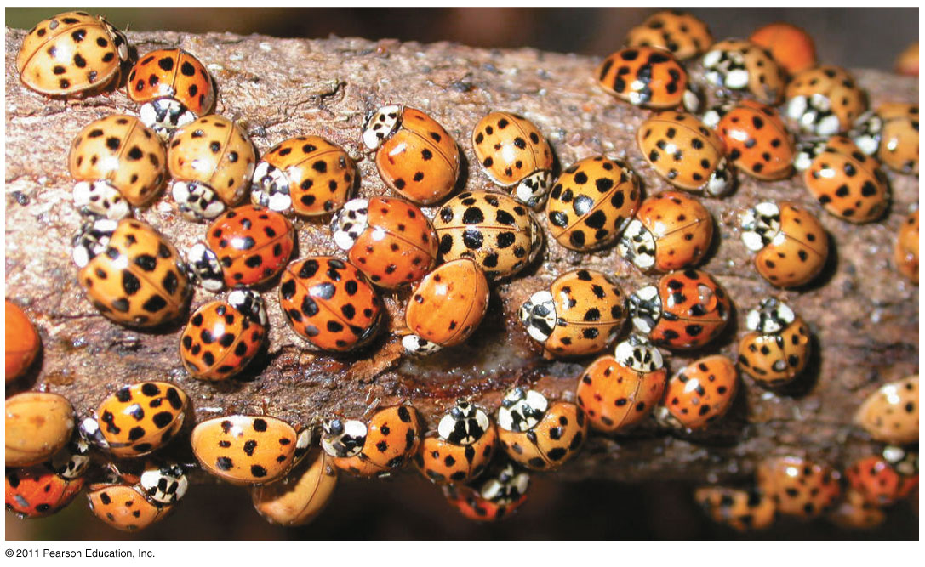
Figure 22.10
Notes:
Figure 22.10 Variation in a population.

Slide 33
Observation #3: All species can produce more offspring than the environment can support,
Observation #4 Competition for limited resources; and many offspring fail to survive and reproduce
© 2011 Pearson Education, Inc.

Slide 34
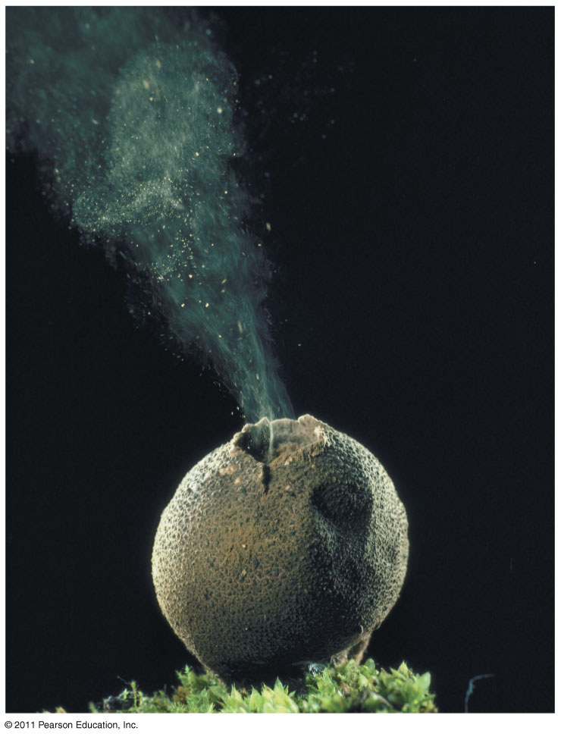
Figure 22.11
Spore
cloud
Notes:
Figure 22.11 Overproduction of offspring.

Slide 35
Inference #1: Individuals whose inherited traits give them a higher probability of surviving and reproducing in a given environment tend to leave more offspring than other individuals
Inference #2: This unequal ability of individuals to survive and reproduce will lead to the accumulation of favorable traits in the population over generations
© 2011 Pearson Education, Inc.

Slide 36
Natural Selection: A Summary
Individuals with certain heritable characteristics survive and reproduce at a higher rate than other individuals
Natural selection increases the adaptation of organisms to their environment over time
If an environment changes over time, natural selection may result in adaptation to these new conditions and may give rise to new species (13)
Video: Seahorse Camouflage
© 2011 Pearson Education, Inc.

Slide 37
Note that individuals do not evolve; populations evolve over time
Natural selection can only increase or decrease heritable traits that vary in a population
Adaptations vary with different environments (14)
© 2011 Pearson Education, Inc.

Slide 38
Direct Observations of Evolutionary Change
Two examples provide evidence for natural selection: natural selection in response to introduced plant species, and the evolution of drug-resistant bacteria
© 2011 Pearson Education, Inc.

Slide 39
Let’s See an Example of Natural Selection in Action……….

Slide 40
Imagine that there are 10 bacteria growing on your hand.

Slide 41
You use Germ-x to clean your hand everyday.

Slide 42
After 4 days, there are still 3 bacteria on your hands that have survived.

Slide 43
Is there anything special about these bacteria?
Well only to the point that their DNA had some differences that allowed them to survive.
** Key Point The bacteria did not instantly evolve new DNA, rather some rare DNA combination was suddenly favored.

Slide 44
Those 3 that are “resistant” will undergo asexual reproduction.

Slide 45
And after a short period of time, your hands will be covered with tons of bacteria that are ALL resistant to Germ-X. ☺

Slide 46
The Evolution of Drug-Resistant Bacteria
The bacterium Staphylococcus aureus is commonly found on people
One strain, methicillin-resistant S. aureus (MRSA) is a dangerous pathogen (16)
S. aureus became resistant to penicillin in 1945, two years after it was first widely used
S. aureus became resistant to methicillin in 1961, two years after it was first widely used
It also gained adaptations for increased disease and colonization on human tissue(17).
© 2011 Pearson Education, Inc.

Slide 47
Natural Selection in Response to Introduced Plant Species
Soapberry bugs use their “beak” to feed on seeds within fruits
In southern Florida soapberry bugs feed on balloon vine with larger fruit; they have longer beaks
In central Florida they feed on goldenrain tree with smaller fruit; they have shorter beaks
Correlation between fruit size and beak size has also been observed in Louisiana, Oklahoma, and Australia (15)
© 2011 Pearson Education, Inc.

Slide 48
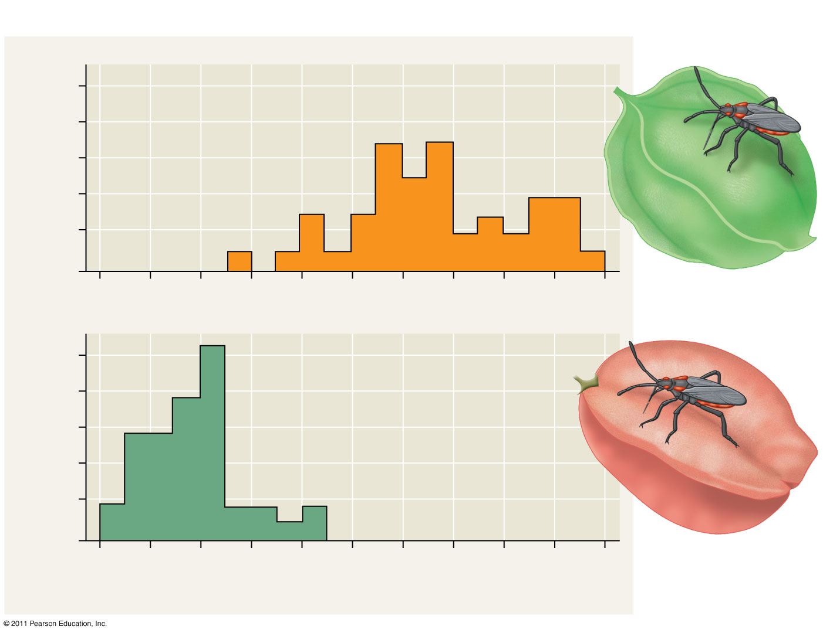
Figure 22.13b
RESULTS
Beak
10
On native species,
southern Florida
8
6
4
2
0
Number of individuals
Museum-specimen average
10
8
On introduced species,
central Florida
6
4
2
0
6
7
8
9
10
11
Beak length (mm)
Notes:
Figure 22.13 Inquiry: Can a change in a population’s food source result in evolution by natural selection?

Slide 49
Natural selection does not create new traits, but edits or selects for traits already present in the population
The local environment determines which traits will be selected for or selected against in any specific population
It “selects” for pre-existing variants; this is an important concept. (18 skip 19)
© 2011 Pearson Education, Inc.

Slide 50
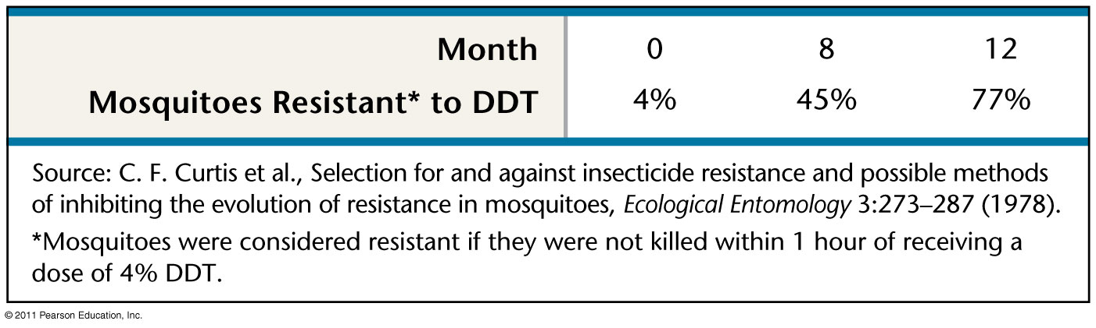
Figure 22.UN03
Notes:
Figure 22.UN03 Test Your Understanding, question 7

Slide 51
Evidence for Evolution
All living things contain similar DNA, RNA, and proteins.
By comparing DNA sequences of two organisms, scientists can determine whether or not the organisms are closely related.
The relationship can then be used to construct evolutionary pathways.

Slide 52
Homology
Homology is similarity resulting from common ancestry
The fossil record shows homology; organisms in the fossil record are “similar” to their modern day species, but yet distinctly different in some features. (20)
© 2011 Pearson Education, Inc.

Slide 53
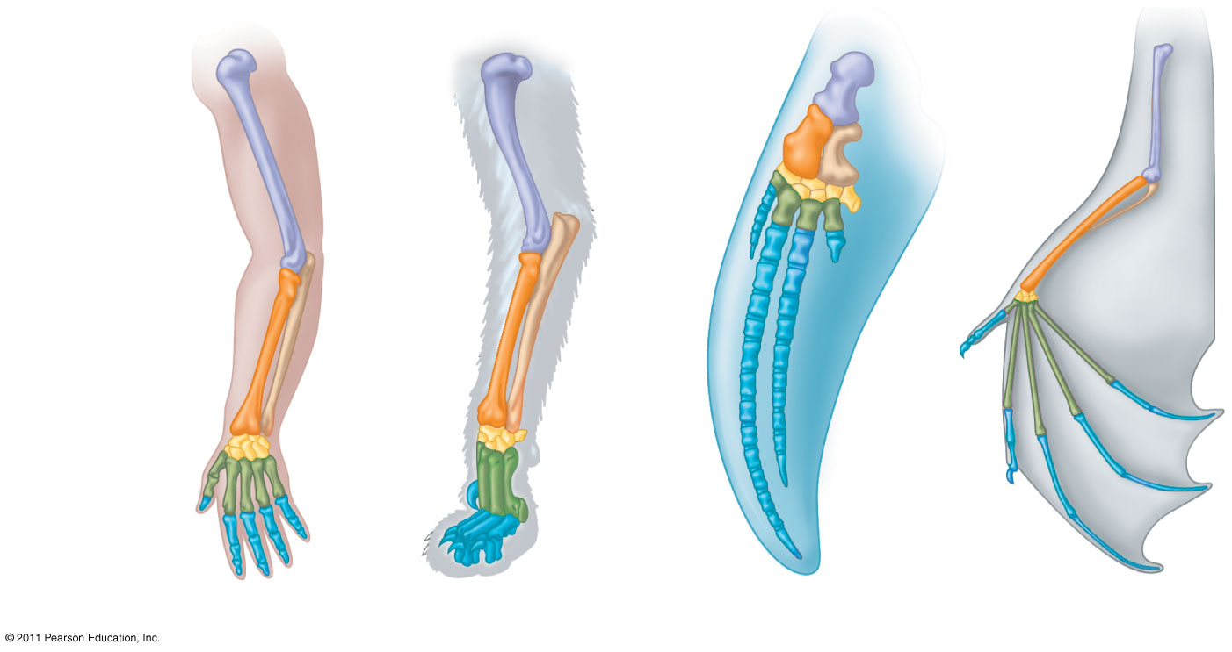
Figure 22.15
Homologous structures are anatomical resemblances that represent variations on a structural theme present in a common ancestor (21 partial and 22 from inference)
Humerus
Radius
Ulna
Carpals
Metacarpals
Phalanges
Human
Cat
Whale
Bat
Notes:
Figure 22.15 Mammalian forelimbs: homologous structures.

Slide 54
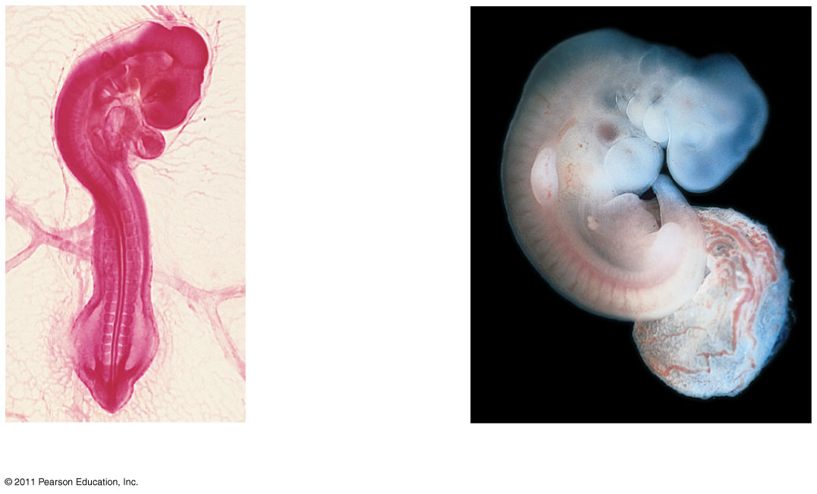
Comparative embryology reveals anatomical homologies not visible in adult organisms
Pharyngeal
pouches
Post-anal
tail
Chick embryo (LM)
Human embryo
© 2011 Pearson Education, Inc.

Slide 55
Vestigial structures are remnants of features that served important functions in the organism’s ancestors
Examples of homologies at the molecular level are genes shared among organisms inherited from a common ancestor (21 partial)
© 2011 Pearson Education, Inc.

Slide 56
A Different Cause of Resemblance: Convergent Evolution
Convergent evolution is the evolution of similar, or analogous structures/features in distantly related groups
Analogous traits arise when groups independently adapt to similar environments in similar ways
Convergent evolution does not provide information about ancestry (21 and 28)
© 2011 Pearson Education, Inc.

Slide 57
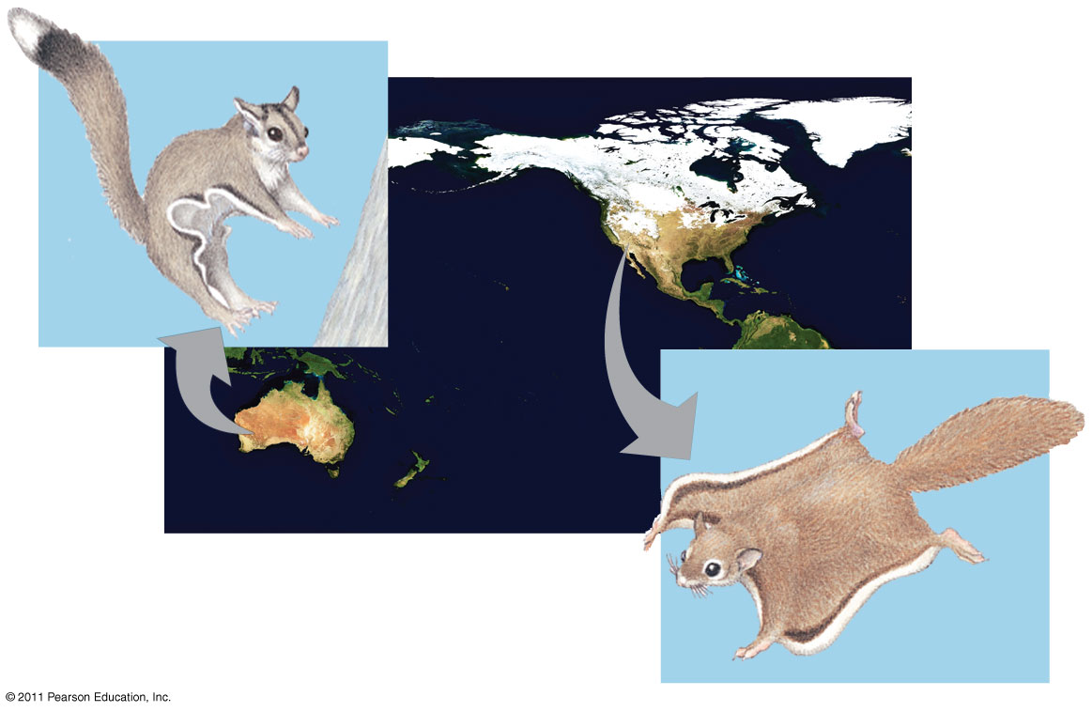
Anatomical
Analogous structures have body parts that are similar in function but different in structure. These indicate that the organisms had different yet related ancestors.

Slide 58
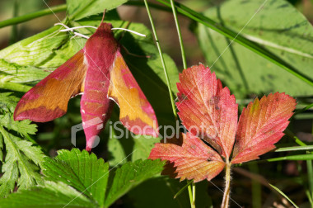
Anatomical
Some adaptations involve changes in the structure of body parts: mimicry and camouflage.
  Mimicry enables an organism to copy the appearance of another species.

Slide 59
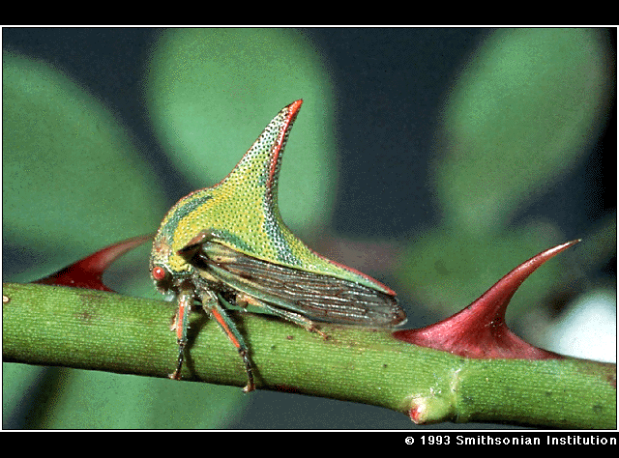
MIMICRY

Slide 60
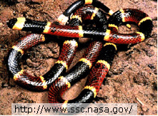
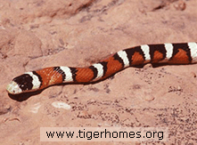
Milk Snake
Coral Snake

Slide 61
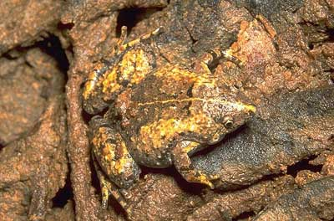
Anatomical
Some adaptations involve changes in the structure of body parts: mimicry and camouflage.
  Camouflage is a structural adaptation that enables an organism to blend in with its surroundings.

Slide 62
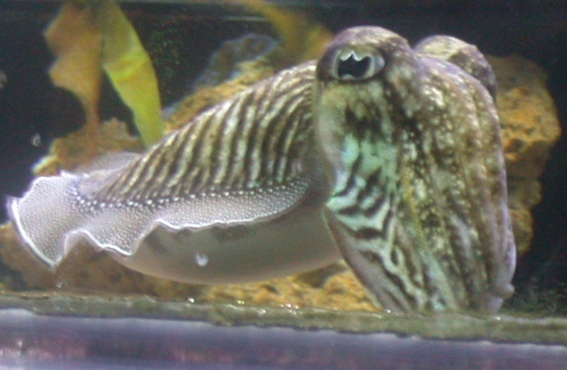
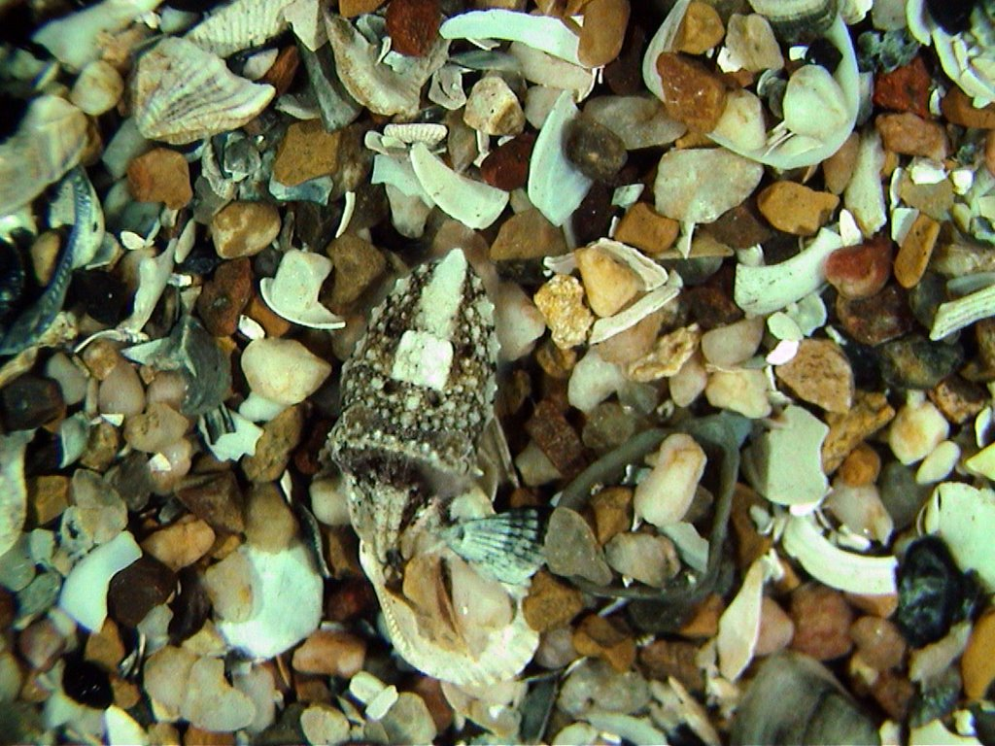
CAMOUFLAGE

Slide 63
Homologies and “Tree Thinking”
Evolutionary trees are hypotheses about the relationships among different groups
Homologies form nested patterns in evolutionary trees
Evolutionary trees can be made using different types of data, for example, anatomical and DNA sequence data (23)
© 2011 Pearson Education, Inc.

Slide 64
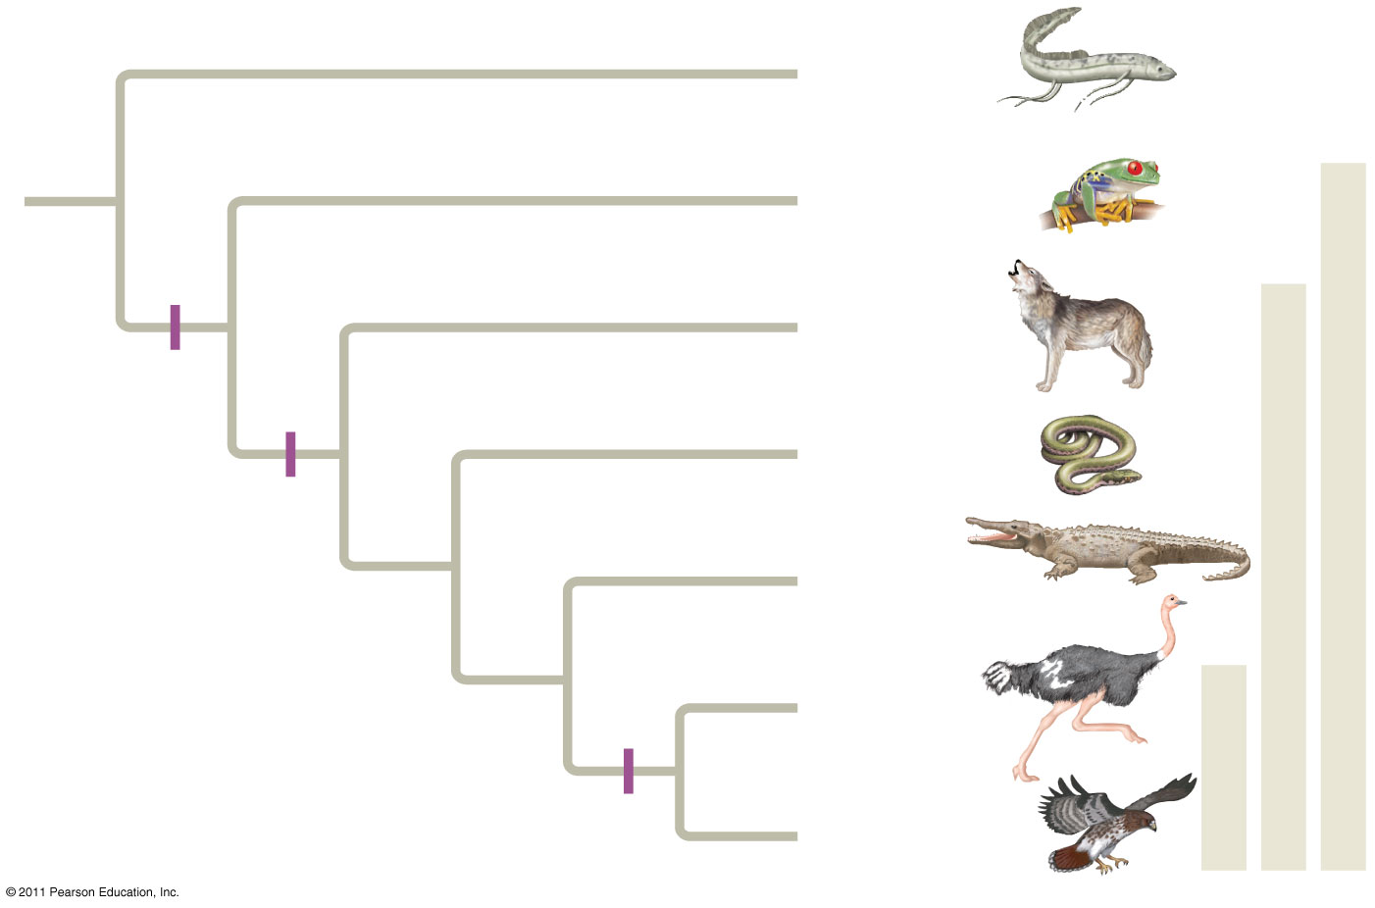
Figure 22.17
(24-27)
Branch point
Lungfishes
1
Amphibians
Tetrapods
2
Mammals
Digit-
bearing
limbs
Amniotes
3
Lizards
and snakes
Amnion
4
Crocodiles
Homologous
characteristic
5
Ostriches
6
Birds
Feathers
Hawks and
other birds
Notes:
Figure 22.17 Tree thinking: information provided in an evolutionary tree.

Slide 65
Biogeography
Biogeography, the geographic distribution of species, provides evidence of evolution
Earth’s continents were formerly united in a single large continent called Pangaea, but have since separated by continental drift
An understanding of continent movement and modern distribution of species allows us to predict when and where different groups evolved (30 here and on next slide)
© 2011 Pearson Education, Inc.

Slide 66
Endemic species are species that are not found anywhere else in the world
Islands have many endemic species that are often closely related to species on the nearest mainland or island
Darwin explained that species on islands gave rise to new species as they adapted to new environments
© 2011 Pearson Education, Inc.

