Slide 1
Title: ATP
9-25-13

Slide 2
ATP
ATP Stands for Adenosine Triphosphate
ATP is a nucleotide
Nucleotides are made of a
Sugar
Phosphate group
Nitrogenous base

Slide 3
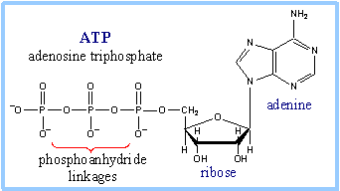
ATP
ATP is made of
The sugar Ribose
3 phosphate groups
The nitrogenous base Adenine
Energy is stored in the bonds between phosphate groups
Phosphate Groups
ATP is the main source of energy for all living things!

Slide 4
Hydrolysis of ATP Releases Energy
When the phosphate group breaks off and attaches to the water, energy is released
This is an example of an exothermic reaction

Slide 5
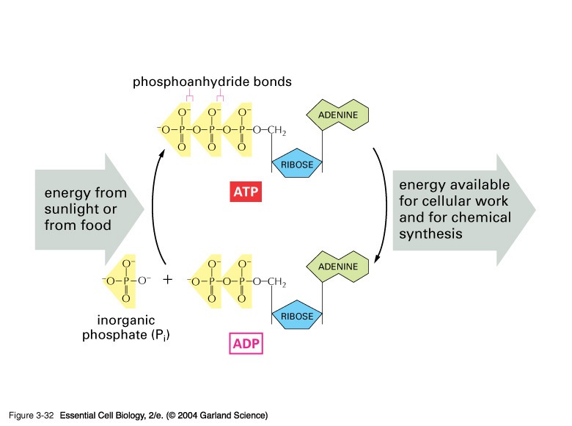
Phosphate groups are like little batteries, whatever they attach to becomes energized

