Slide 1
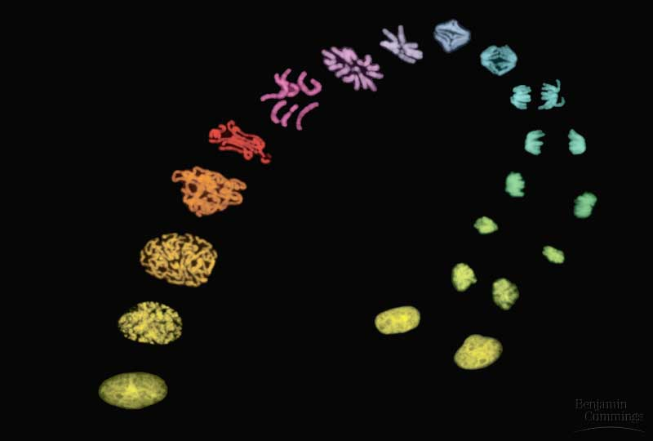
Chapter 12
The Cell Cycle

Slide 2
Review Over Cells
Cell Theory
All living things are made up of one or more cells.
The cell is the most basic unit of structure and function for an organism.
Cells come from prexisting cells.

Slide 3
In unicellular organisms, division of one cell reproduces the entire organism
Multicellular organisms depend on cell division for
Development from a fertilized cell
Growth
Repair
Cell division is an integral part of the cell cycle, the life of a cell from formation to its own division
© 2011 Pearson Education, Inc.

Slide 4
Concept 1: Most cell division results in genetically identical daughter cells
Most cell division results in daughter cells with identical genetic information, DNA
Somatic Cells (Body cells)
Most Numerous
Can be highly specialized
The exception is meiosis, a special type of division that can produce sperm and egg cells
Sex Cells
Gametes
Sperm andEgg
Pollen

Slide 5
What Process Do Our Cells Use to Divide?
Somatic Cells
Mitosis
Asexual Reproduction
Sex Cells
Meiosis
Sexual Reproduction

Slide 6
Cellular Organization of the Genetic Material
All the DNA in a cell constitutes the cell’s genome
A genome can consist of a single DNA molecule (common in prokaryotic cells) or a number of DNA molecules (common in eukaryotic cells)
DNA molecules in a cell are packaged into chromosomes
Segments of DNA that code for a single protein are called a gene.
© 2011 Pearson Education, Inc.

Slide 7
DNA Packaging
Because mitosis is the division of the nucleus, we must talk about what in the nucleus is divided
. DNA is wrapped around special proteins called histones.
A strand of DNA wraps twice around each histone protein, followed by a space of DNA, and another histone.
This forms a structure that resembles beads on a string.
These further condense and coil forming what we know as a chromosome

Slide 8
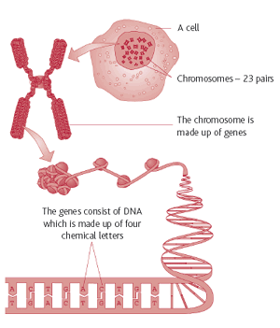

Slide 9
Eukaryotic chromosomes consist of chromatin, a complex of DNA and protein that condenses during cell division to form visible chromosomes.
Every eukaryotic species has a characteristic number of chromosomes in each cell nucleus
Humans have 23 pairs of chromosomes.
Somatic cells (nonreproductive body cells) have two sets of chromosomes (diploid)
Gametes (reproductive cells: sperm and eggs) have half as many chromosomes as somatic cells
(haploid)
© 2011 Pearson Education, Inc.

Slide 10
Distribution of Chromosomes During Eukaryotic Cell Division
In preparation for cell division, DNA is replicated and the chromosomes condense
Each duplicated chromosome has two sister chromatids (joined copies of the original chromosome), which separate during cell division
The centromere is the narrow “waist” of the duplicated chromosome, where the two chromatids are most closely attached (part of 11)
© 2011 Pearson Education, Inc.

Slide 11
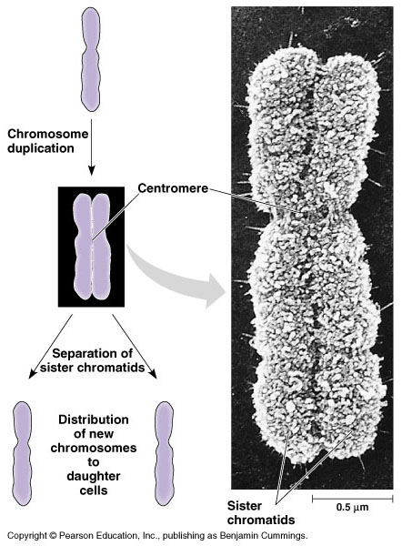

Slide 12
During cell division, the two sister chromatids of each duplicated chromosome separate and move into two nuclei
Once separate, the chromatids are called chromosomes
© 2011 Pearson Education, Inc.

Slide 13
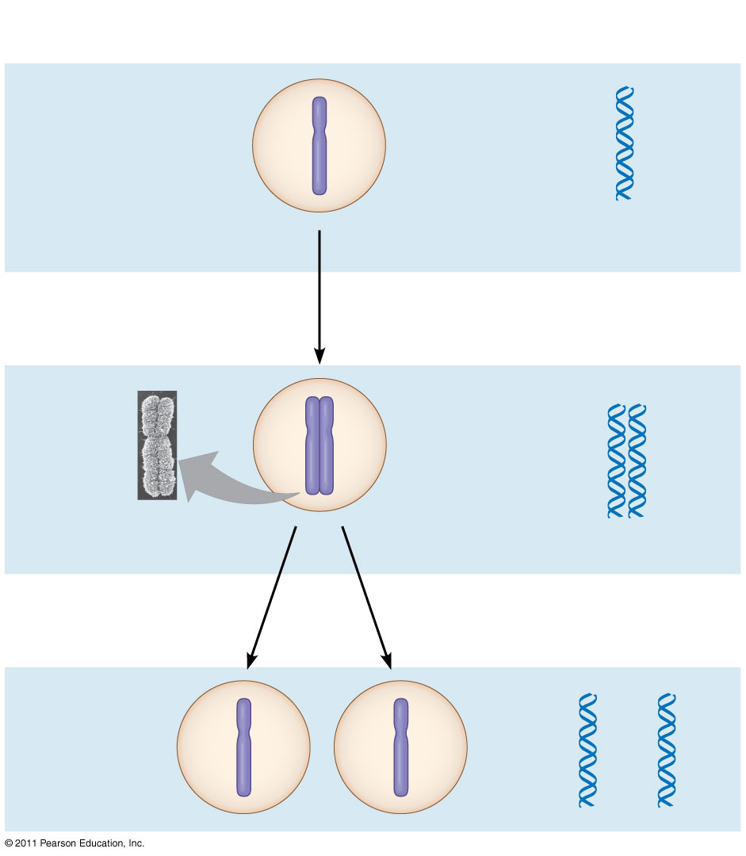
Figure 12.5-3
Chromosomal DNA molecules
Chromosomes
1
Centromere
(12)
Chromosome arm
Chromosome duplication (including DNA replication) and condensation
2
Sister chromatids
Separation of sister chromatids into two chromosomes
3
Notes:
Figure 12.5 Chromosome duplication and distribution during cell division.

Slide 14
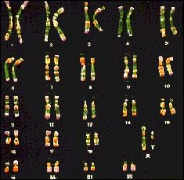
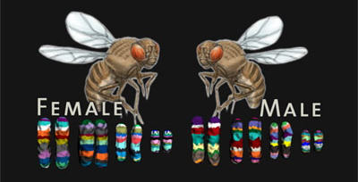
Different Organisms Have Different Amounts of Chromosomes
Humans have 46 chromosomes
That’s 23 pairs
Fruit flies have 8 chromosomes
That’s only 4 pairs

Slide 15
Eukaryotic cell division consists of
Mitosis, the division of the genetic material in the nucleus
Cytokinesis, the division of the cytoplasm
Gametes are produced by a variation of cell division called meiosis
Meiosis yields nonidentical daughter cells that have only one set of chromosomes, half as many as the parent cell (13-16)
© 2011 Pearson Education, Inc.

Slide 16
Concept 2: The mitotic phase alternates with interphase in the cell cycle
The cell cycle consists of
Mitotic (M) phase (mitosis and cytokinesis)
Interphase (cell growth and copying of chromosomes in preparation for cell division)
Interphase (about 90% of the cell cycle) can be divided into subphases
G₁ phase (“first gap”)
S phase (“synthesis”)
G₂ phase (“second gap”)
The cell grows during all three phases, but chromosomes are duplicated only during S(17)
© 2011 Pearson Education, Inc.

Slide 17
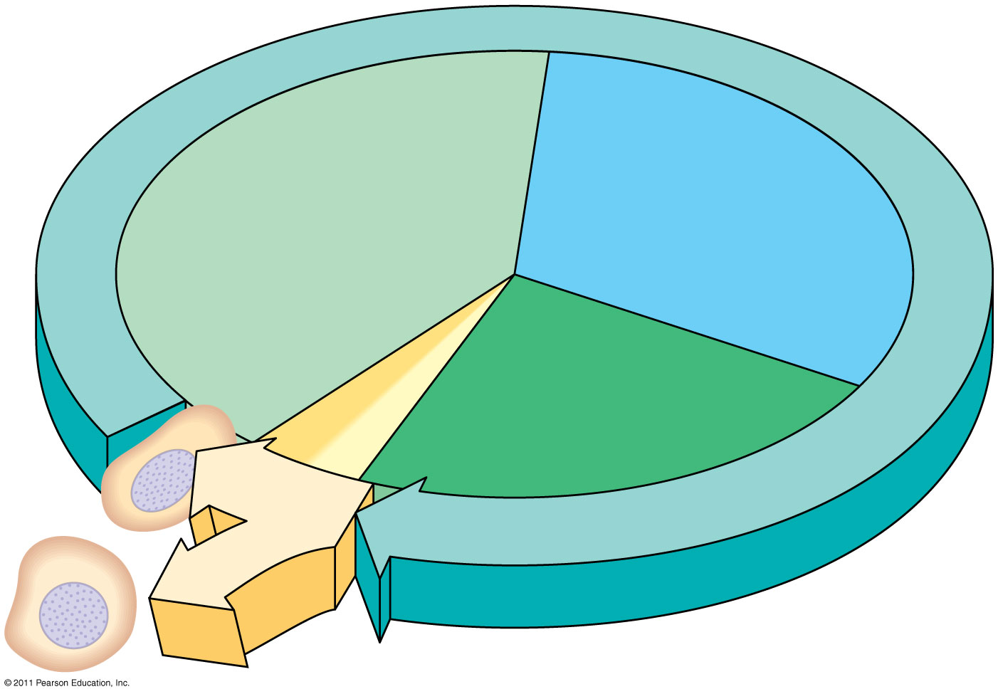
Figure 12.6
INTERPHASE
(17)
S (DNA synthesis)
G₁
Cytokinesis
G₂
Mitosis
MITOTIC (M) PHASE
Notes:
Figure 12.6 The cell cycle.

Slide 18
Mitosis - Purpose
To divide the 2 copies of the DNA equally.
To separate the sister chromatids into separate cells.

Slide 19
Mitosis is conventionally divided into 4/5 phases
Prophase
Prometaphase
Metaphase
Anaphase
Telophase
Cytokinesis overlaps the latter stages of mitosis
BioFlix: Mitosis
© 2011 Pearson Education, Inc.
Notes:
For the Cell Biology Video Myosin and Cytokinesis, go to Animation and Video Files.

Slide 20
The Mitotic Spindle: A Closer Look
The mitotic spindle is a structure made of microtubules that controls chromosome movement during mitosis
In animal cells, assembly of spindle microtubules begins in the centrosome, the microtubule organizing center
The centrosome replicates during interphase, forming two centrosomes that migrate to opposite ends of the cell during prophase and prometaphase
© 2011 Pearson Education, Inc.
Notes:
For the Cell Biology Video Spindle Formation During Mitosis, go to Animation and Video Files.

Slide 21
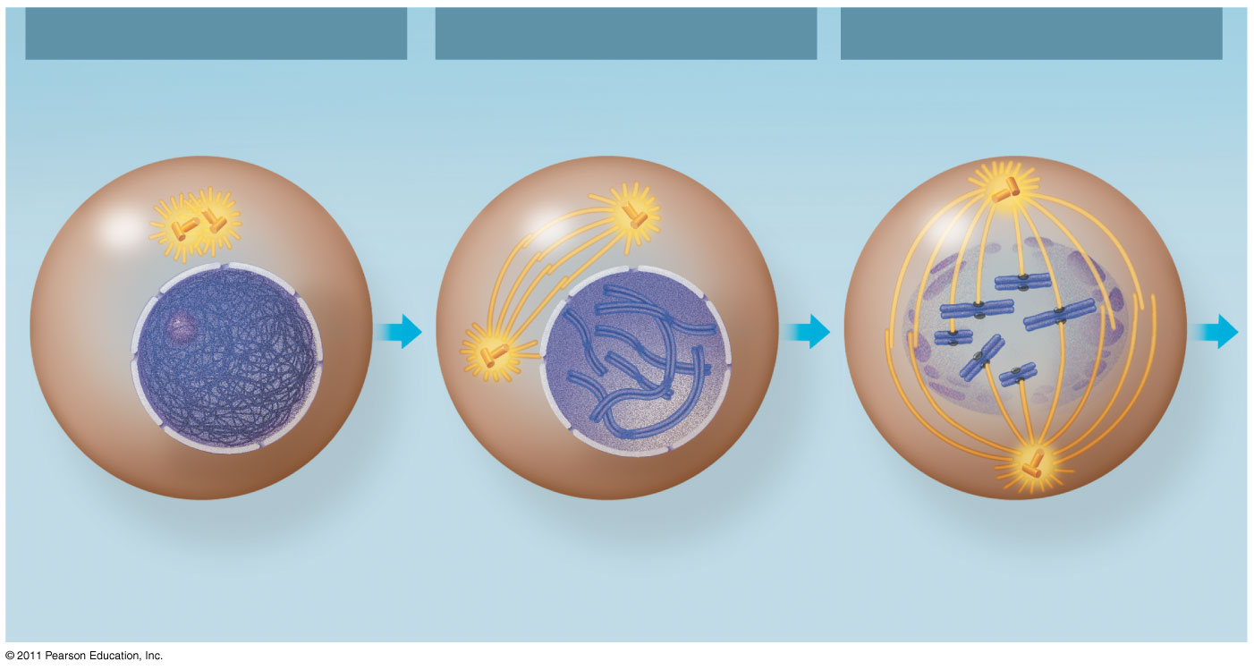
Figure 12.7a
G₂ of Interphase
Prophase
Prometaphase
Centrosomes (with centriole pairs)
Fragments of nuclear envelope
Chromatin (duplicated)
Early mitotic spindle
Aster
Nonkinetochore microtubules
Centromere
Plasma membrane
Nucleolus
Chromosome, consisting of two sister chromatids
Kinetochore
Kinetochore microtubule
Nuclear envelope
Notes:
Figure 12.7 Exploring: Mitosis in an Animal Cell

Slide 22
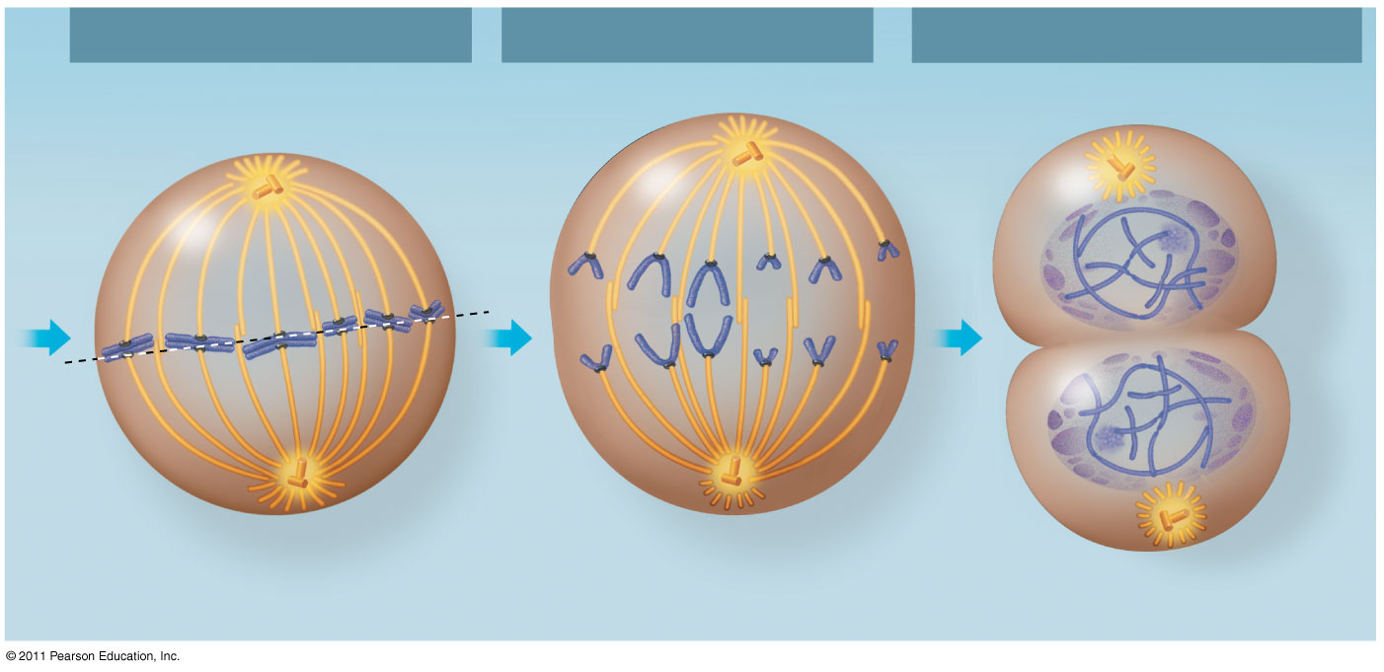
Figure 12.7b
Metaphase
Anaphase
Telophase and Cytokinesis
Metaphase plate
Cleavage furrow
Nucleolus forming
Spindle
Centrosome at one spindle pole
Daughter chromosomes
Nuclear envelope forming
Notes:
Figure 12.7 Exploring: Mitosis in an Animal Cell

Slide 23
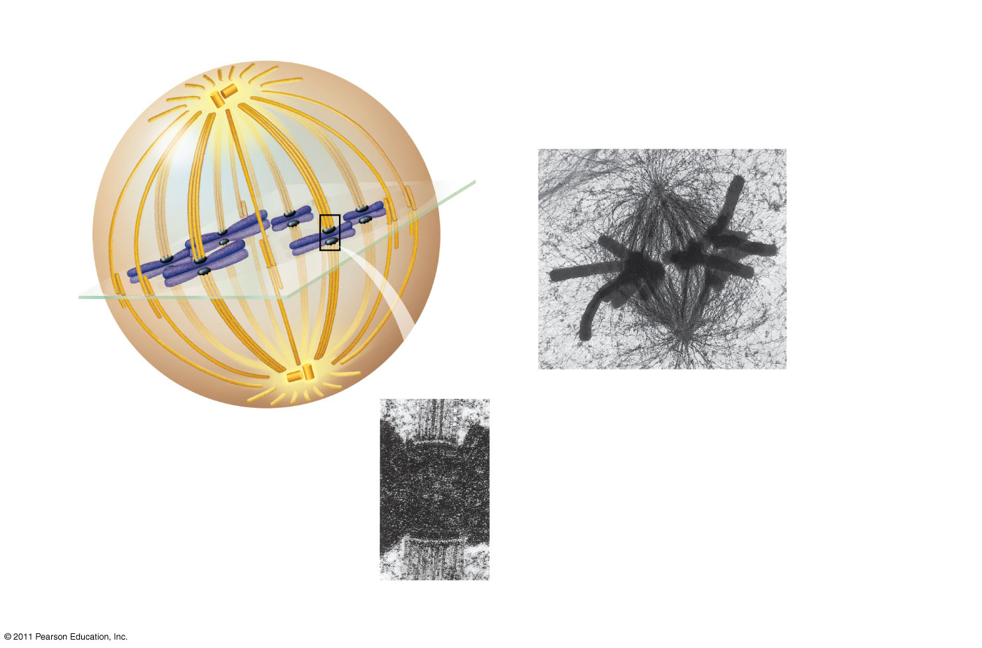
Figure 12.8
(20)
Centrosome
Aster
Metaphase plate (imaginary)
Sister chromatids
Microtubules
Chromosomes
Kineto- chores
Centrosome
1 μm
Overlapping nonkinetochore microtubules
Kinetochore microtubules
0.5 μm
Notes:
Figure 12.8 The mitotic spindle at metaphase.

Slide 24
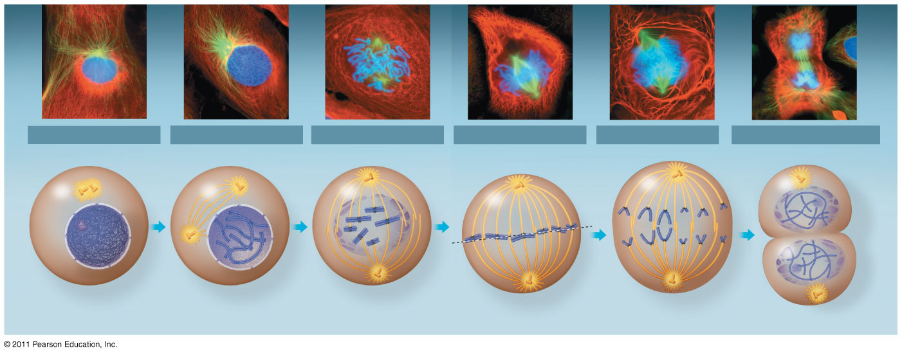
Figure 12.7
10 μm
G₂ of Interphase
Prophase
Prometaphase
Metaphase
Anaphase
Telophase and Cytokinesis
Centrosomes (with centriole pairs)
Chromatin (duplicated)
Early mitotic spindle
Aster
Fragments of nuclear envelope
Nonkinetochore microtubules
Metaphase plate
Cleavage furrow
Nucleolus forming
Centromere
Nucleolus
Nuclear envelope
Plasma membrane
Chromosome, consisting of two sister chromatids
Kinetochore
Kinetochore microtubule
Nuclear envelope forming
Spindle
Centrosome at one spindle pole
Daughter chromosomes
Notes:
Figure 12.7 Exploring: Mitosis in an Animal Cell

Slide 25
During prometaphase, some spindle microtubules attach to the kinetochores of chromosomes and begin to move the chromosomes
Kinetochores are protein complexes associated with centromeres
At metaphase, the chromosomes are all lined up at the metaphase plate, an imaginary structure at the midway point between the spindle’s two poles
Nonkinetochore microtubules from opposite poles overlap and push against each other, elongating the cell
© 2011 Pearson Education, Inc.

Slide 26
In anaphase, sister chromatids separate and move along the kinetochore microtubules toward opposite ends of the cell
The microtubules shorten by depolymerizing at their kinetochore ends
© 2011 Pearson Education, Inc.
Notes:
For the Cell Biology Video Microtubules in Anaphase, go to Animation and Video Files.

Slide 27
In telophase, genetically identical daughter nuclei form at opposite ends of the cell
Cytokinesis begins during anaphase or telophase and the spindle eventually disassembles
mitosis & cytokinesis animation
© 2011 Pearson Education, Inc.
Notes:
For the Cell Biology Video Microtubules in Cell Division, go to Animation and Video Files.

Slide 28
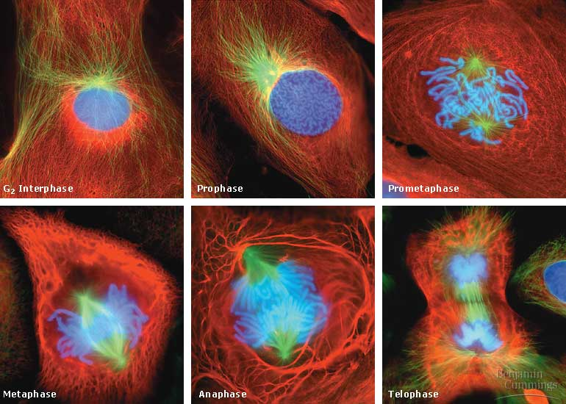
Cell Division

Slide 29
Cytokinesis: A Closer Look
In animal cells, cytokinesis occurs by a process known as cleavage, forming a cleavage furrow
In plant cells, a cell plate forms during cytokinesis
This cell plate forms from the combining of cell wall and plasma membrane components carried in Golgi derived endosomal vesicles.
New cell wall developed around the cell plate.
Cytokinesis is the dividing of the cytoplasm and its contents.
© 2011 Pearson Education, Inc.

Slide 30
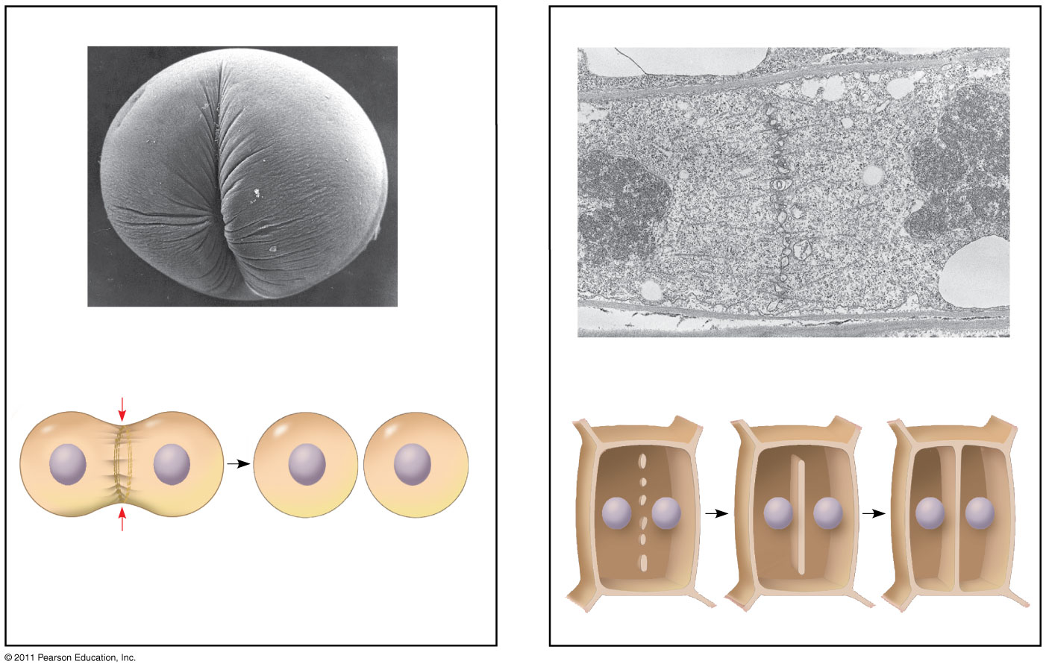
Figure 12.10
(a) Cleavage of an animal cell (SEM)
(b) Cell plate formation in a plant cell (TEM)
100 μm
Cleavage furrow
Vesicles forming cell plate
Wall of parent cell
1 μm
Cell plate
New cell wall
Contractile ring of microfilaments
Daughter cells
Daughter cells
Notes:
Figure 12.10 Cytokinesis in animal and plant cells.

Slide 31
Binary Fission in Bacteria
Prokaryotes (bacteria and archaea) reproduce by a type of cell division called binary fission
In binary fission, the chromosome replicates (beginning at the origin of replication), and the two daughter chromosomes actively move apart
The plasma membrane pinches inward, dividing the cell into two
© 2011 Pearson Education, Inc.

Slide 32
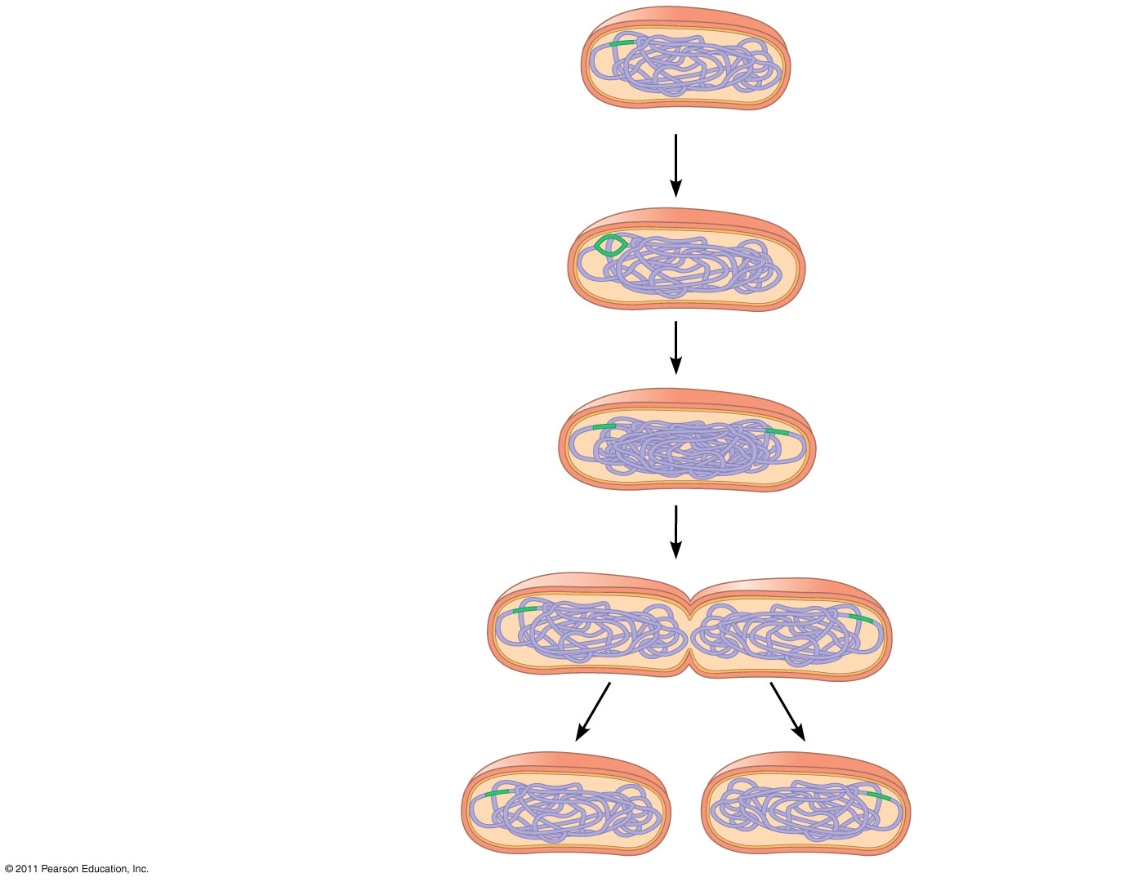
Figure 12.12-4
Origin of replication
Cell wall
Plasma membrane
E. coli cell
Bacterial chromosome
1
Chromosome replication begins.
Two copies of origin
2
Replication continues.
Origin
Origin
3
Replication finishes.
4
Two daughter cells result.
Notes:
Figure 12.12 Bacterial cell division by binary fission.

Slide 33
Concept 3: The eukaryotic cell cycle is regulated by a molecular control system
The frequency of cell division varies with the type of cell
These differences result from regulation at the molecular level
Cancer cells manage to escape the usual controls on the cell cycle
© 2011 Pearson Education, Inc.

Slide 34
The Cell Cycle Control System
The sequential events of the cell cycle are directed by a distinct cell cycle control system, which is similar to a clock
The cell cycle control system is regulated by both internal and external controls
The clock has specific checkpoints where the cell cycle stops until a go-ahead signal is received
© 2011 Pearson Education, Inc.

Slide 35
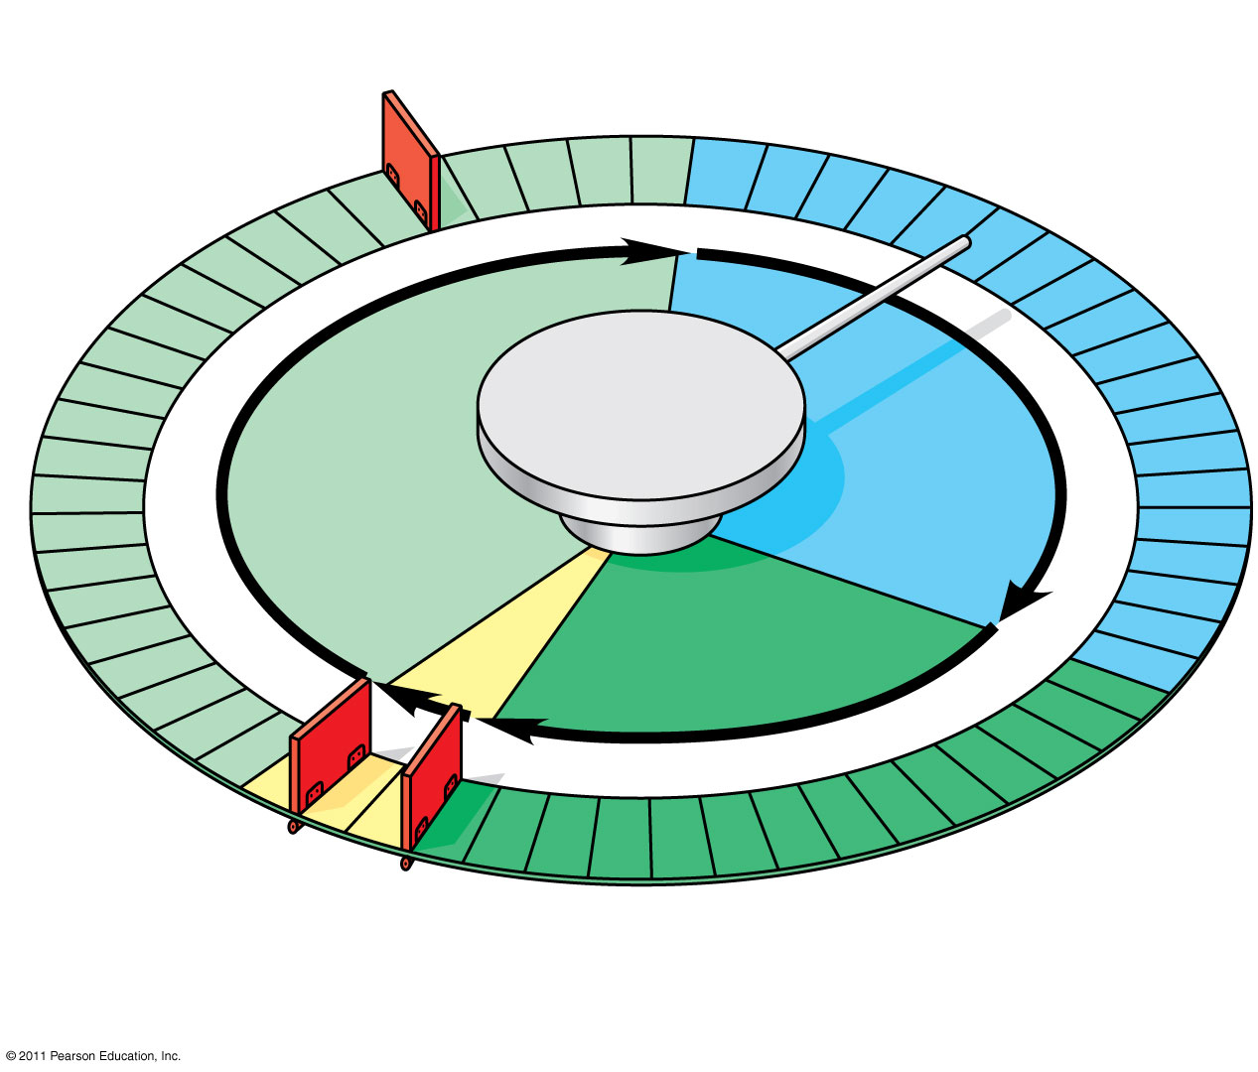
Figure 12.15
G₁ checkpoint
Control system
S
G₁
M
G₂
M checkpoint
G₂ checkpoint
Notes:
Figure 12.15 Mechanical analogy for the cell cycle control system.

Slide 36
Checkpoints: In checkpoints the standard or default signal is stop.
Signal transduction pathways are used to create proteins that say “go”
G1-Cell determines whether it will go to G0 or move to S phase.
Controlled by multiple cyclins and CDks.
G2-Cell decides whether or not to enter mitosis.
Controlled by presence of MPF.
M-Initiate anaphase (chromosome separation). Controlled by all kinetochores being “bound” to chromosomes.

Slide 37
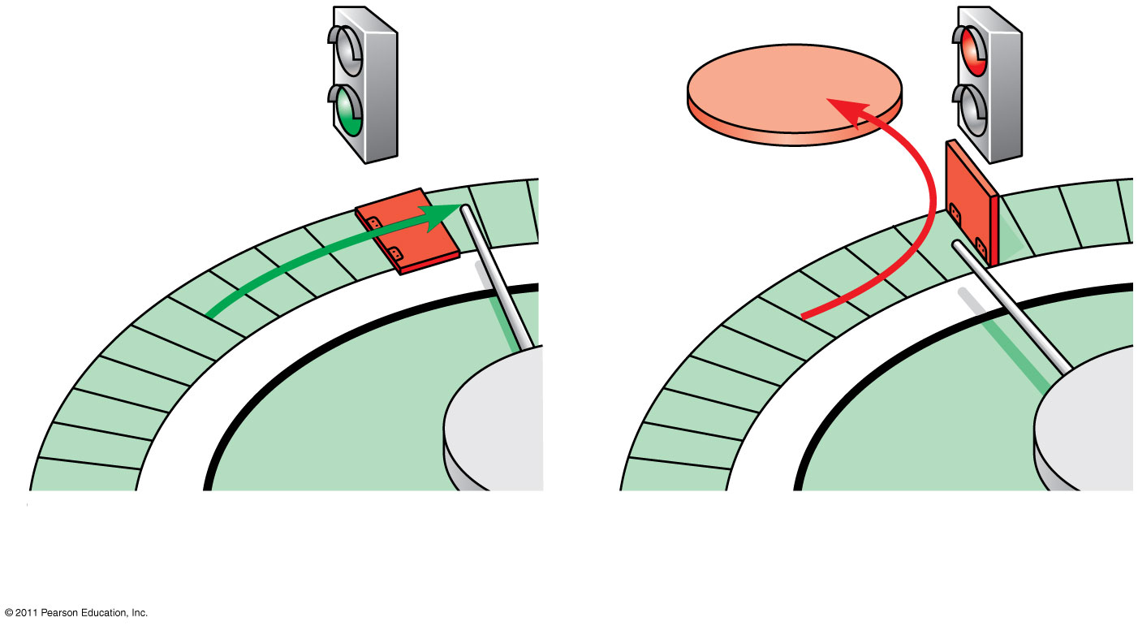
Figure 12.16
G₀
G₁ checkpoint
G₁
G₁
(a) Cell receives a go-ahead signal.
(b) Cell does not receive a go-ahead signal.
Notes:
Figure 12.16 The G₁ checkpoint.

Slide 38
For many cells, the G₁ checkpoint seems to be the most important
If a cell receives a go-ahead signal at the G₁ checkpoint, it will usually complete the S, G₂, and M phases and divide
If the cell does not receive the go-ahead signal, it will exit the cycle, switching into a nondividing state called the G₀ phase
© 2011 Pearson Education, Inc.

Slide 39
The Cell Cycle Clock: Cyclins and Cyclin-Dependent Kinases
Two types of regulatory proteins are involved in cell cycle control: cyclins and cyclin-dependent kinases (Cdks)
Cdks activity fluctuates during the cell cycle because it is controled by cyclins, so named because their concentrations vary with the cell cycle
MPF (maturation-promoting factor) is a cyclin-Cdk complex that triggers a cell’s passage past the G₂ checkpoint into the M phase
http://highered.mcgraw-hill.com/sites/0072437316/student_view0/chapter11/animations.html#

Slide 40
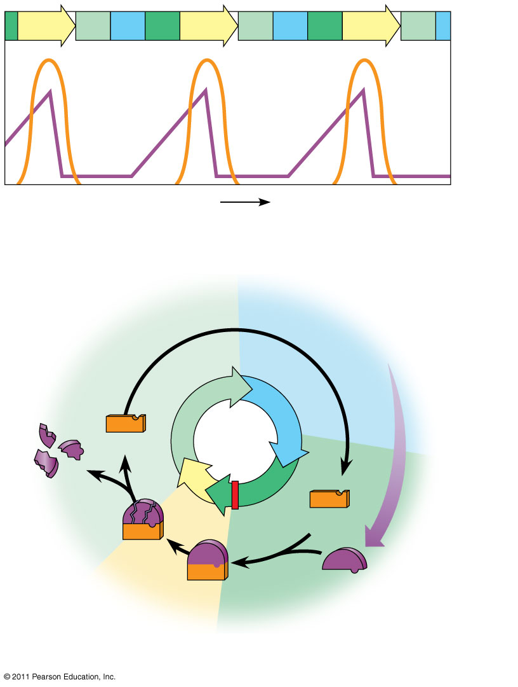
Figure 12.17
M
G₁
S
G₂
M
G₁
S
G₂
M
G₁
MPF activity
Cyclin concentration
Time
(a) Fluctuation of MPF activity and cyclin concentration during the cell cycle
G₁
S
Cdk
Cyclin accumulation
Degraded cyclin
M
G₂
G₂ checkpoint
Cdk
Cyclin is degraded
MPF
Cyclin
(b) Molecular mechanisms that help regulate the cell cycle
Notes:
Figure 12.17 Molecular control of the cell cycle at the G₂ checkpoint.

Slide 41
Stop and Go Signs: Internal and External Signals at the Checkpoints
An example of an internal signal is that kinetochores not attached to spindle microtubules send a molecular signal that delays anaphase
Some external signals are growth factors, proteins released by certain cells that stimulate other cells to divide
For example, platelet-derived growth factor (PDGF) stimulates the division of human fibroblast cells in culture
© 2011 Pearson Education, Inc.

Slide 42
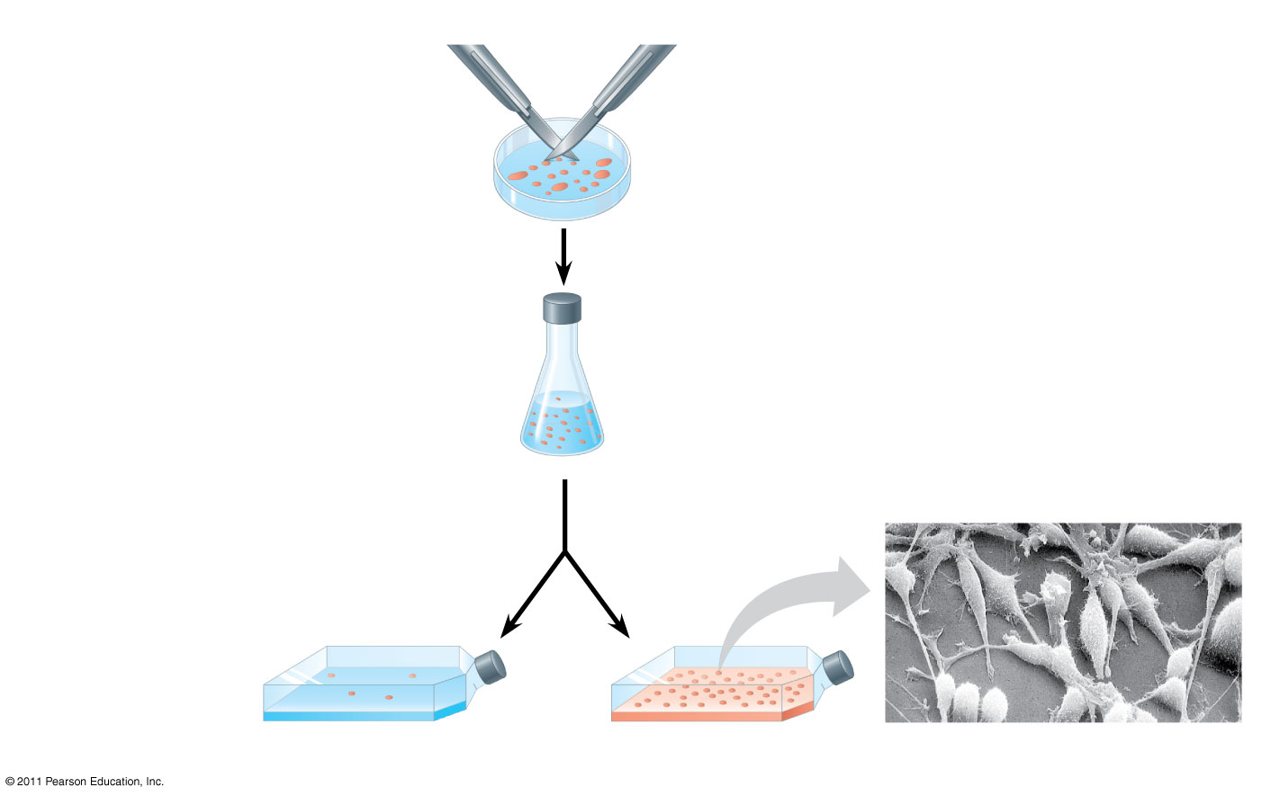
Figure 12.18
1
A sample of human connective tissue is cut up into small pieces.
Scalpels
PDGF is a ligand for RTKs and results in division …wounds secrete this to stimulate division/healing (41)
Petri dish
2
Enzymes digest the extracellular matrix, resulting in a suspension of free fibroblasts.
4
PDGF is added to half the vessels.
10 μm
3
Cells are transferred to culture vessels.
Without PDGF
With PDGF
Notes:
Figure 12.18 The effect of platelet-derived growth factor (PDGF) on cell division.

Slide 43
A clear example of external signals is density-dependent inhibition, in which crowded cells stop dividing
Most animal cells also exhibit anchorage dependence, in which they must be attached to a substratum in order to divide
Cancer cells exhibit neither density-dependent inhibition nor anchorage dependence
© 2011 Pearson Education, Inc.

Slide 44
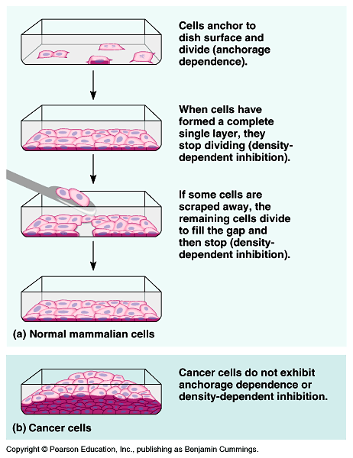

Slide 45
Loss of Cell Cycle Controls in Cancer Cells
Cancer cells do not respond normally to the body’s control mechanisms
Cancer cells may not need growth factors to grow and divide
They may make their own growth factor
They may convey a growth factor’s signal without the presence of the growth factor
They may have an abnormal cell cycle control system
© 2011 Pearson Education, Inc.

Slide 46
A normal cell is converted to a cancerous cell by a process called transformation
Cancer cells that are not eliminated by the immune system, form tumors, masses of abnormal cells within otherwise normal tissue
If abnormal cells remain at the original site, the lump is called a benign tumor
Malignant tumors invade surrounding tissues and can metastasize, exporting cancer cells to other parts of the body, where they may form additional tumors
© 2011 Pearson Education, Inc.

Slide 47
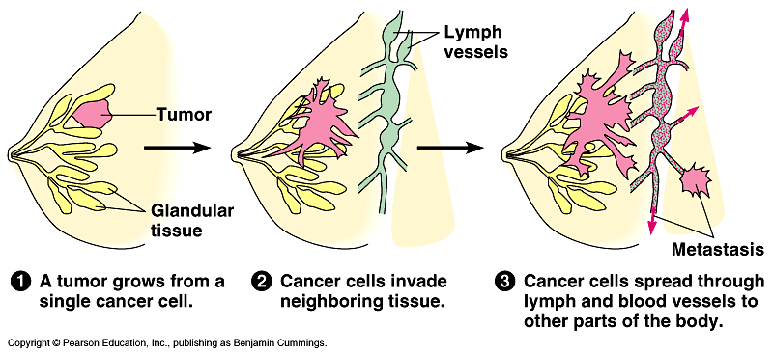
http://www.hhmi.org/biointeractive/cancer/angiogenesis.html

Slide 48
Comment
Regulation of cell division is a balance between:
Mitosis - making new cells.
Apoptosis - cell suicide or death
Cancer can result if either process doesn’t work.

Slide 49
Causes of Cancer
Genetic and environmental factors are involved in causing cancer
Cigarettes, air & water pollution, & exposure to UV rays from the sun are all known to damage genes which control the cell cycle
Cancer may also be caused by viral infections like HPV
http://www.cancerquest.org/cancer-biology-animations.html#

