Slide 1
Chapter 2.1
The Chemical Context of Life

Slide 2
How dare you ... let our kids play in lead and arsenic soil,' says mom to Indiana officials
https://www.cnn.com/2016/08/30/health/indiana-lead-contamination/index.html

Slide 3
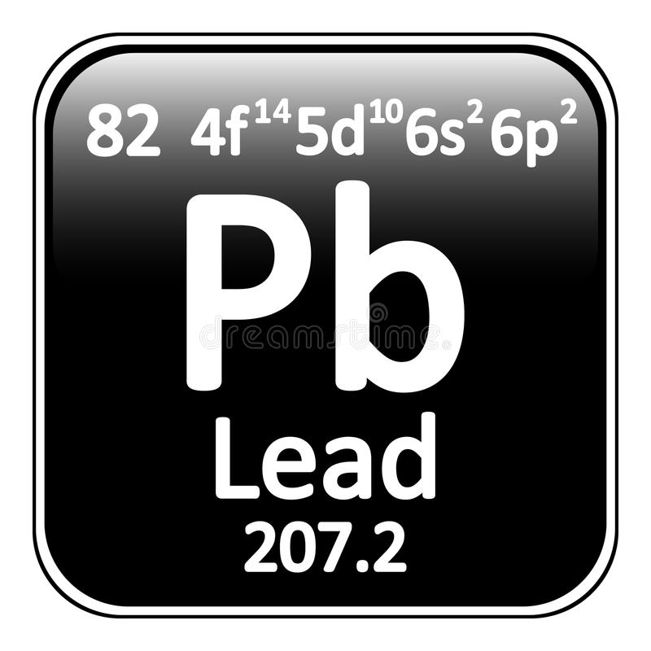
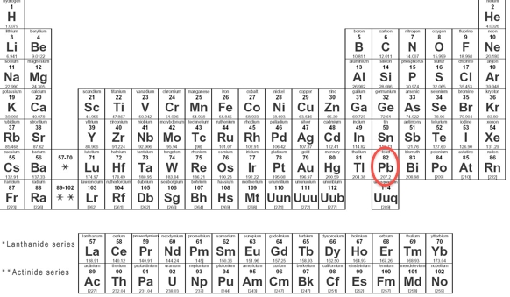

Slide 4
Concept 2.1: Matter consists of chemical elements in pure form and in combinations called compounds
Organisms are composed of matter
Matter is made up of elements
An element is a substance that cannot be broken down to other substances by chemical reactions
A compound is a substance consisting of two or more elements in a fixed ratio
A compound has characteristics different from those of its elements
© 2011 Pearson Education, Inc.

Slide 5
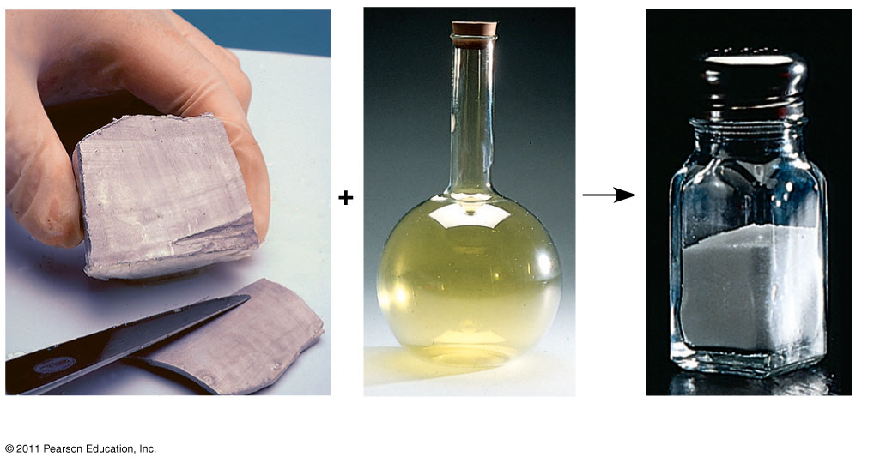
Figure 2.3
Sodium
Chlorine
Sodium chloride
Notes:
5
Figure 2.3 The emergent properties of a compound.

Slide 6
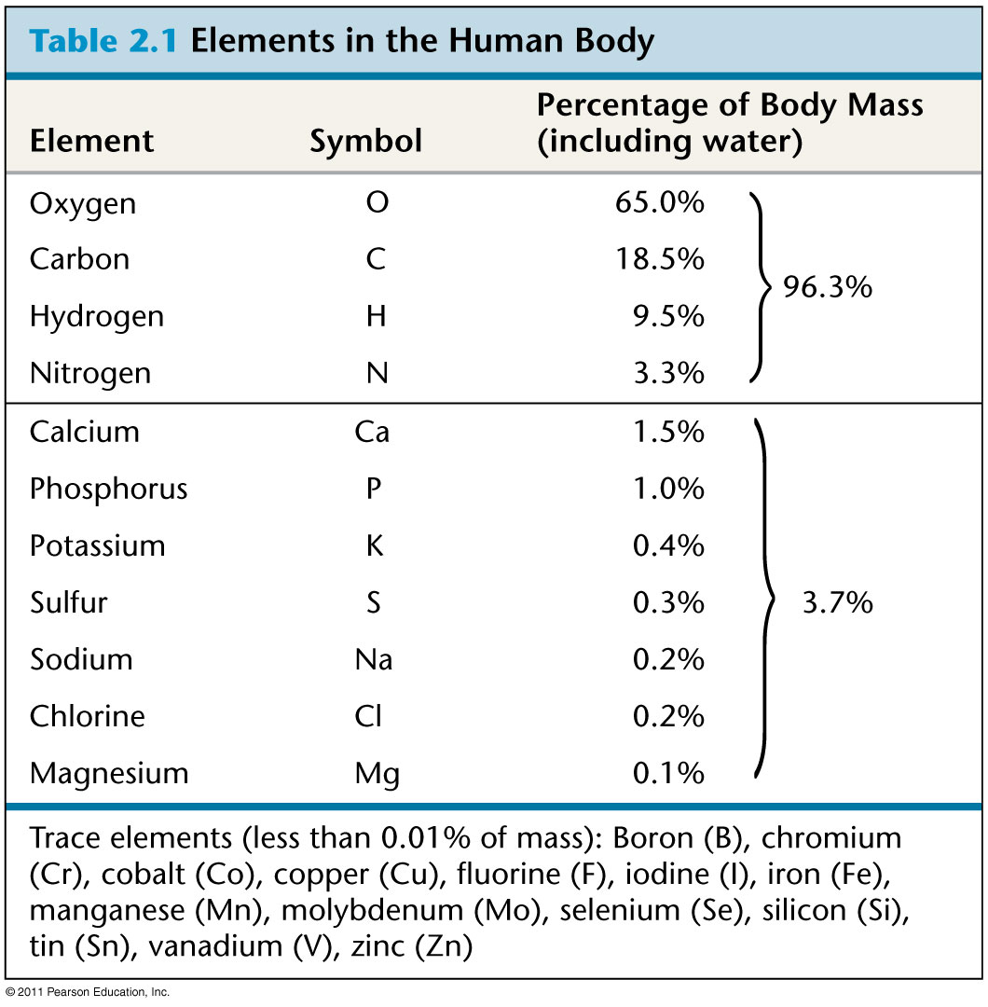
Table 2.1
Notes:
6
Table 2.1 Elements in the Human Body

Slide 7
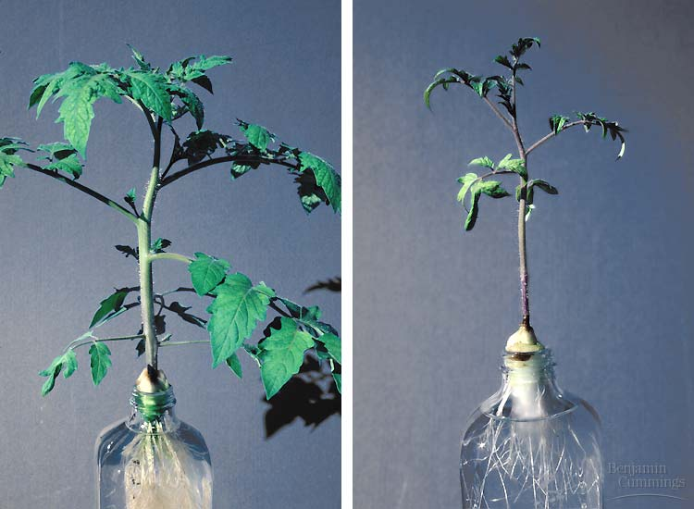
Effects of Essential Element Deficiencies
Goiters are enlarged thyroid glands caused by an iodine deficiency
Plant grown with Nitrogen
Vs. Plant grown without Nitrogen

Slide 8
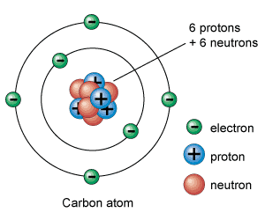
Concept 2.2: An element’s properties depend on the structure of its atoms
Each element consists of unique atoms
An atom is the smallest unit of matter that still retains the properties of an element
Atoms are composed of subatomic particles
Relevant subatomic particles include
Neutrons (no electrical charge)
Protons (positive charge)
Electrons (negative charge)
© 2011 Pearson Education, Inc.

Slide 9
Atomic Number and Atomic Mass
Atoms of the various elements differ in number of subatomic particles
An element’s atomic number is the number of protons in its nucleus
An element’s mass number is the sum of protons plus neutrons in the nucleus
Atomic mass, the atom’s total mass, can be approximated by the mass number
An electron’s state of potential energy is called its energy level, or electron shell
© 2011 Pearson Education, Inc.

Slide 10
The Energy Levels of Electrons
Energy is the capacity to cause change
Potential energy is the energy that matter has because of its location or structure
The electrons of an atom differ in their amounts of potential energy
The chemical behavior of an atom is determined by the distribution of electrons in electron shells
© 2011 Pearson Education, Inc.

Slide 11
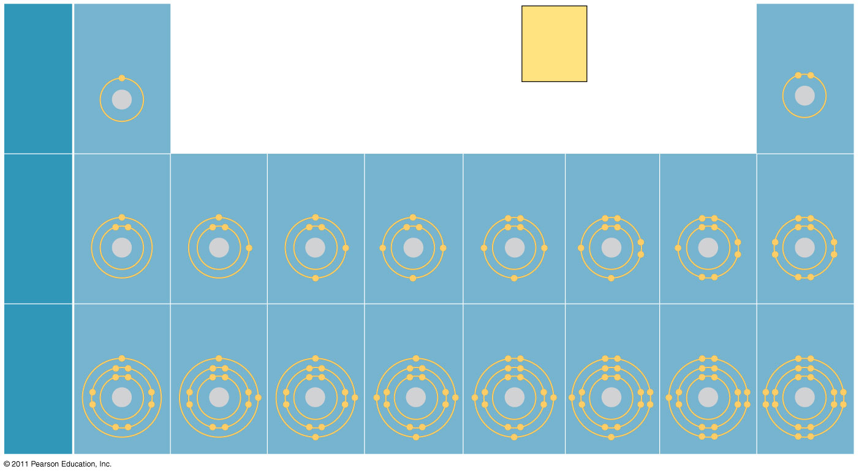
Figure 2.9
Hydrogen
₁H
2
He
4.00
Atomic number
Helium
₂He
First
shell
Mass number
Element symbol
Electron
distribution
diagram
Lithium
₃Li
Beryllium
₄Be
Boron
₅B
Carbon
₆C
Nitrogen
₇N
Oxygen
₈O
Fluorine
₉F
Neon
₁₀Ne
Second
shell
Sodium
₁₁Na
Magnesium
₁₂Mg
Aluminum
₁₃Al
Silicon
₁₄Si
Phosphorus
₁₅P
Sulfur
₁₆S
Chlorine
₁₇Cl
Argon
₁₈Ar
Third
shell
Notes:
11
Figure 2.9 Electron distribution diagrams for the first 18 elements in the periodic table.

Slide 12
Valence electrons are those in the outermost shell, or valence shell
The chemical behavior of an atom is mostly determined by the valence electrons
Elements with a full valence shell are chemically inert
© 2011 Pearson Education, Inc.

Slide 13
A molecule consists of two or more atoms held together by covalent bonds
A single covalent bond, or single bond, is the sharing of one pair of valence electrons
A double covalent bond, or double bond, is the sharing of two pairs of valence electrons
© 2011 Pearson Education, Inc.

Slide 14
The notation used to represent atoms and bonding is called a structural formula
For example, H—H
This can be abbreviated further with a molecular formula
For example, H₂
© 2011 Pearson Education, Inc.

Slide 15
Atoms Gain, Lose, or Share Electrons to Become Stable
Covalent bonds can form between atoms of the same element or atoms of different elements
A compound is a combination of two or more different elements
Bonding capacity is called the atom’s valence
© 2011 Pearson Education, Inc.

Slide 16
Atoms in a molecule attract electrons to varying degrees
Electronegativity is an atom’s attraction for the electrons in a covalent bond
The more electronegative an atom, the more strongly it pulls shared electrons toward itself
© 2011 Pearson Education, Inc.

Slide 17
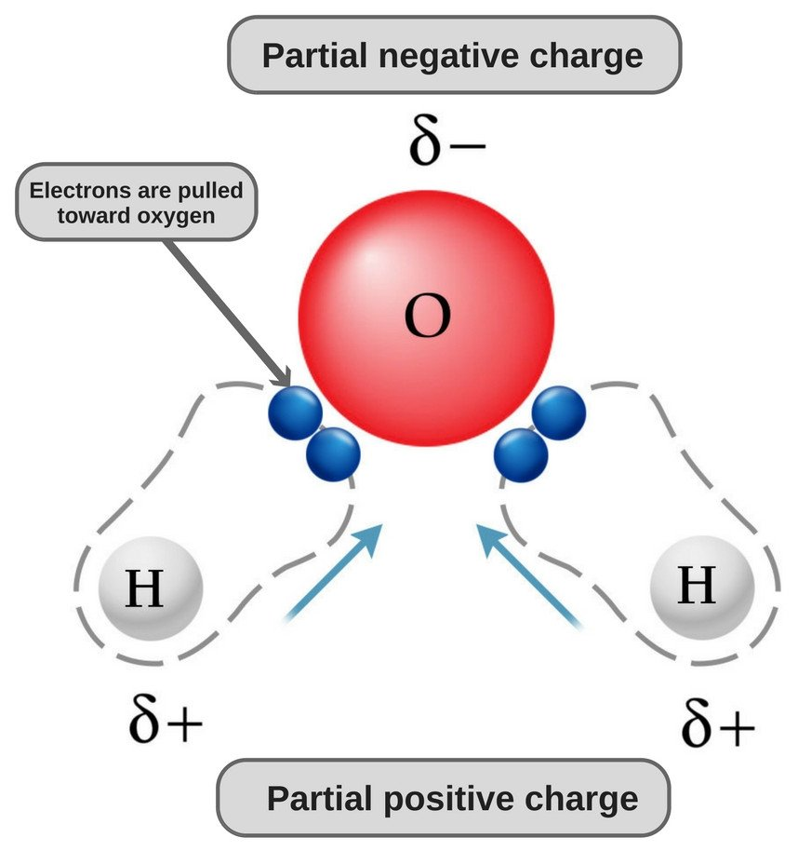
In a nonpolar covalent bond, the atoms share the electron equally
In a polar covalent bond, one atom is more electronegative, and the atoms do not share the electron equally
Unequal sharing of electrons causes a partial positive or negative charge for each atom or molecule
© 2011 Pearson Education, Inc.

Slide 18
Ionic Bonds
Atoms sometimes strip electrons from their bonding partners
An example is the transfer of an electron from sodium to chlorine
After the transfer of an electron, both atoms have charges
A charged atom (or molecule) is called an ion
Ionic bonding
© 2011 Pearson Education, Inc.

Slide 19
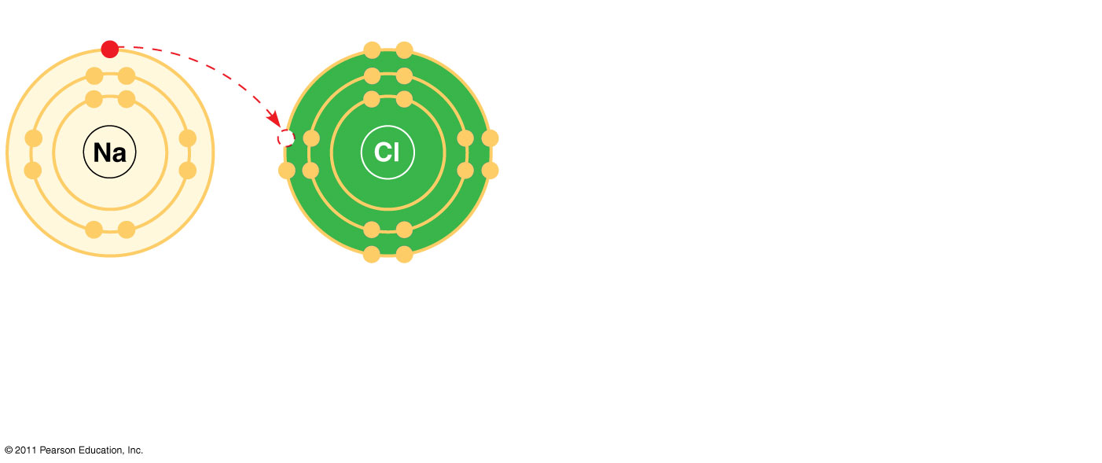
Figure 2.14-1
Na
Sodium atom
Cl
Chlorine atom
Notes:
19
Figure 2.14 Electron transfer and ionic bonding.

Slide 20
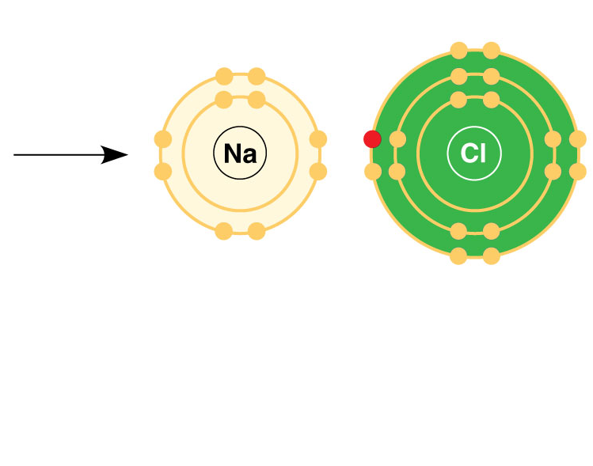
Figure 2.14-2
+
–
Na
Sodium atom
Cl
Chlorine atom
Na⁺
Sodium ion
(a cation)
Cl–
Chloride ion
(an anion)
Sodium chloride (NaCl)
Notes:
20
Figure 2.14 Electron transfer and ionic bonding.

Slide 21
A cation is a positively charged ion
An anion is a negatively charged ion
An ionic bond is an attraction between an anion and a cation
Animation: Ionic Bonds
© 2011 Pearson Education, Inc.

Slide 22
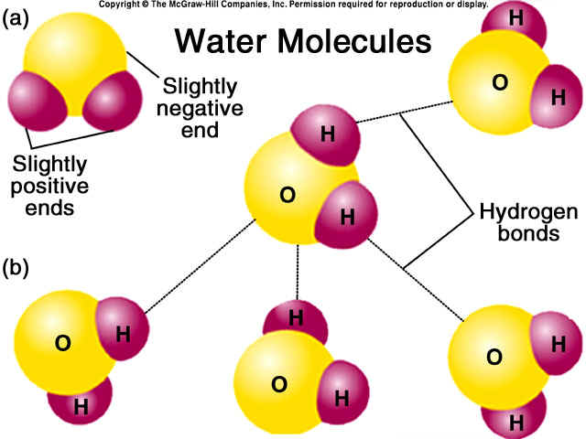
Hydrogen Bonds
A hydrogen bond forms when a hydrogen atom covalently bonded to one electronegative atom is also attracted to another electronegative atom
In living cells, the electronegative partners are usually oxygen or nitrogen atoms
© 2011 Pearson Education, Inc.

Slide 23
Weak Chemical Bonds
Most of the strongest bonds in organisms are covalent bonds that form a cell’s molecules
Weak chemical bonds, such as ionic bonds and hydrogen bonds, are also important
Weak chemical bonds reinforce shapes of large molecules and help molecules adhere to each other
© 2011 Pearson Education, Inc.

Slide 24
Biological molecules recognize and interact with each other with a specificity based on molecular shape
Molecules with similar shapes can have similar biological effects
Example: Endorphin
Endorphins bind to receptors on the surface of brain cells producing euphoria and relieving pain
© 2011 Pearson Education, Inc.

Slide 25
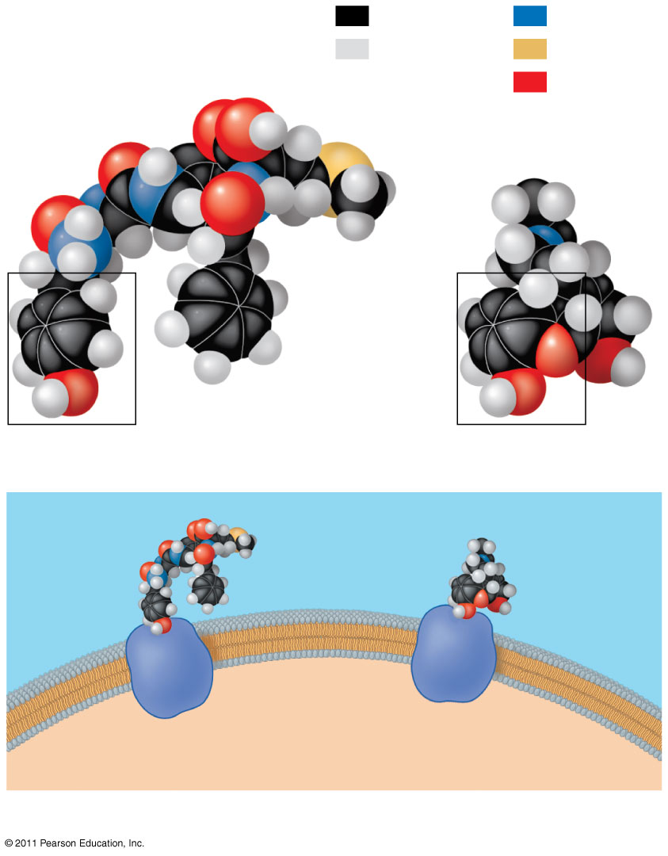
Figure 2.18
Carbon
Nitrogen
Hydrogen
Sulfur
Natural endorphin
Oxygen
Morphine
(a) Structures of endorphin and morphine
Natural
endorphin
Morphine
Endorphin
receptors
Brain cell
(b) Binding to endorphin receptors
Notes:
25
Figure 2.18 A molecular mimic.

Slide 26
Molecular Mimicry
Morphine, heroine, and other opiates mimic endorphins by binding to endorphin receptors in the brain affecting both pain perception & emotional state
It turn out that molecules with similar shapes, structural homology, have similar effects

Slide 27
Concept 2.4: Chemical reactions make and break chemical bonds
Chemical reactions are the making and breaking of chemical bonds
The starting molecules of a chemical reaction are called reactants
The final molecules of a chemical reaction are called products
© 2011 Pearson Education, Inc.

Slide 28
Photosynthesis is an important chemical reaction
Sunlight powers the conversion of carbon dioxide and water to glucose and oxygen
6 CO₂ + 6 H₂0 → C₆H₁₂O₆ + 6 O₂
© 2011 Pearson Education, Inc.

Slide 29
All chemical reactions are reversible: products of the forward reaction become reactants for the reverse reaction
Chemical equilibrium (dynamic) is reached when the forward and reverse reaction rates are equal
© 2011 Pearson Education, Inc.

Slide 30
Chapter 2.2
Water and Life

Slide 31
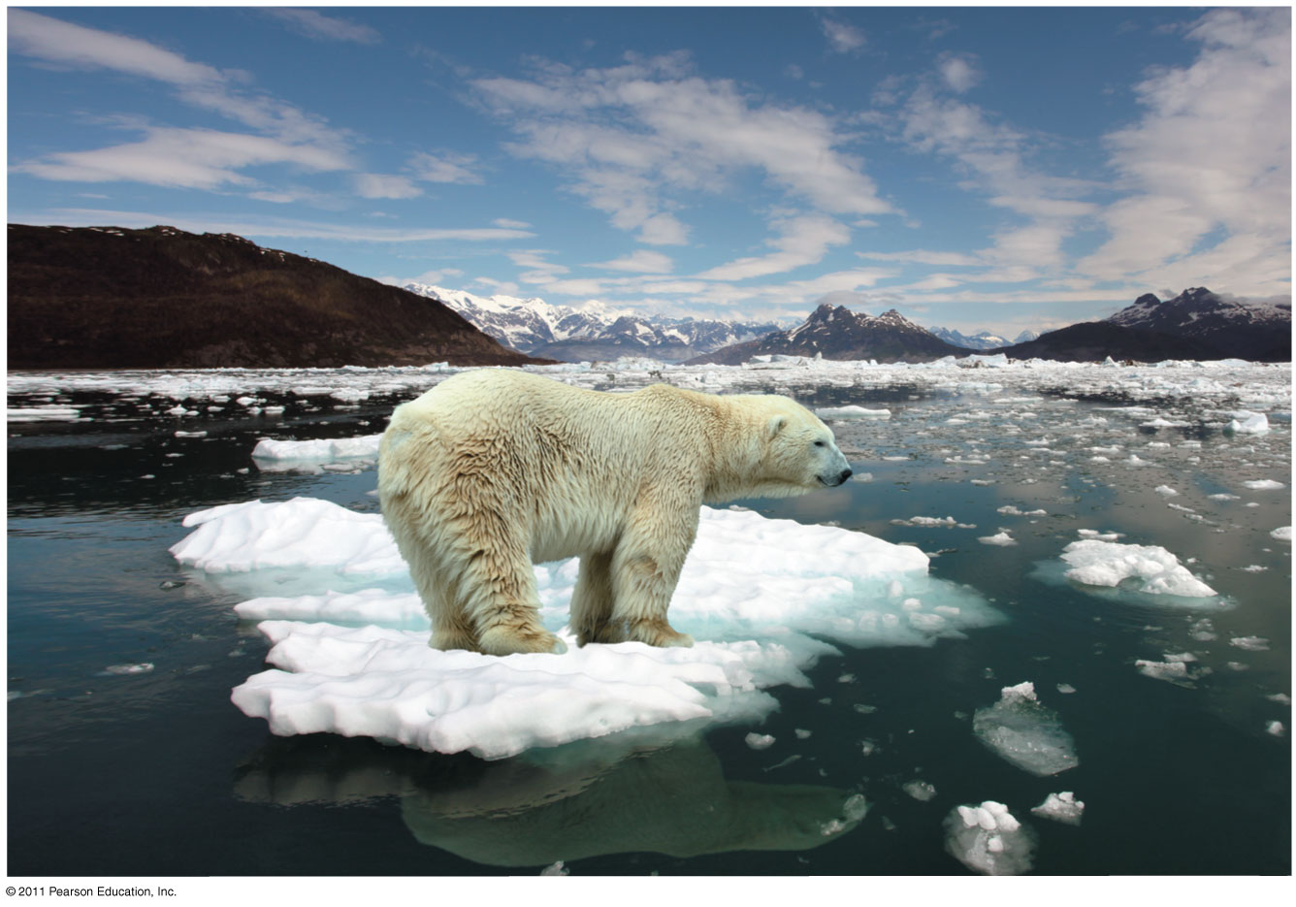
Figure 3.1
How does the habitat of a polar bear depend on the chemistry of water?
I think I see a mermaid
Notes:
31
Figure 3.1 How does the habitat of a polar bear depend on the chemistry of water?

Slide 32
Overview: The Molecule That Supports All of Life
Water is the biological medium on Earth
All living organisms require water more than any other substance
Most cells are surrounded by water, and cells themselves are about 70–95% water
The abundance of water is the main reason the Earth is habitable
© 2011 Pearson Education, Inc.

Slide 33
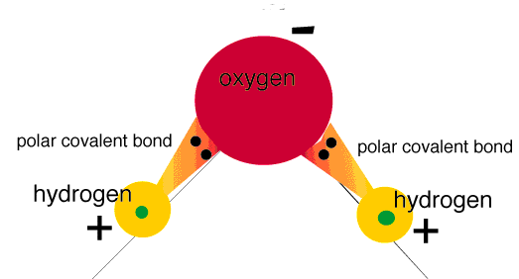
Polar covalent bonds in water molecules result in hydrogen bonding
The water molecule is a polar molecule: the opposite ends have opposite charges
Polarity allows water molecules to form hydrogen bonds with each other
© 2011 Pearson Education, Inc.

Slide 34
Four emergent properties of water contribute to Earth’s suitability for life
Four of water’s properties that facilitate an environment for life are
Cohesive behavior
Ability to moderate temperature
Expansion upon freezing
Versatility as a solvent
© 2011 Pearson Education, Inc.

Slide 35
Cohesion of Water Molecules
Collectively, hydrogen bonds hold water molecules together, a phenomenon called cohesion
Cohesion helps the transport of water against gravity in plants
Adhesion is an attraction between different substances, for example, between water and plant cell walls
Animation: Water Transport
© 2011 Pearson Education, Inc.

Slide 36
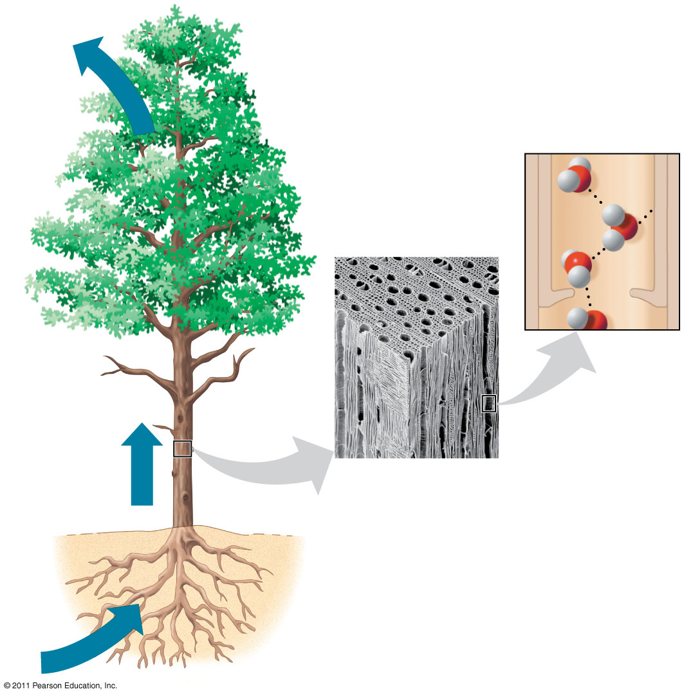
Figure 3.3
Adhesion
Two types of
water-conducting
cells
Cohesion
Direction
of water
movement
300 μm
Notes:
36
Figure 3.3 Water transport in plants.

Slide 37
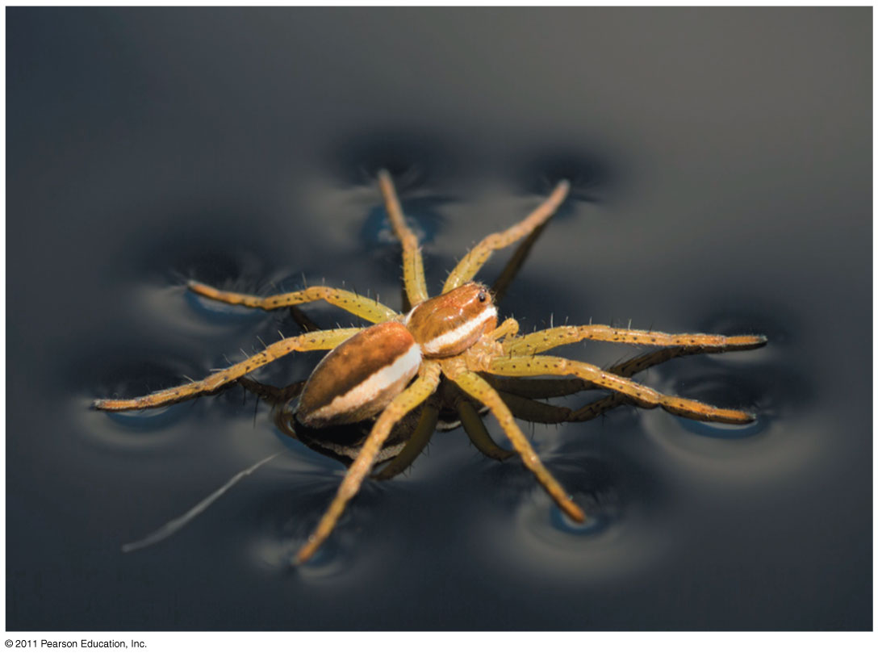
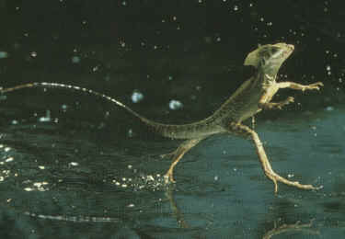
Surface tension is a measure of how hard it is to break the surface of a liquid
Surface tension is related to cohesion
© 2011 Pearson Education, Inc.

Slide 38
Moderation of Temperature by Water
Water absorbs heat from warmer air and releases stored heat to cooler air
Water can absorb or release a large amount of heat with only a slight change in its own temperature
© 2011 Pearson Education, Inc.

Slide 39
Water’s High Specific Heat
The specific heat of a substance is the amount of heat that must be absorbed or lost for 1 g of that substance to change its temperature by 1ºC
The specific heat of water is 1 cal/g/ºC
Water resists changing its temperature because of its high specific heat
© 2011 Pearson Education, Inc.

Slide 40
Water’s high specific heat can be traced to hydrogen bonding
Heat is absorbed when hydrogen bonds break
Heat is released when hydrogen bonds form
The high specific heat of water minimizes temperature fluctuations to within limits that permit life
© 2011 Pearson Education, Inc.

Slide 41
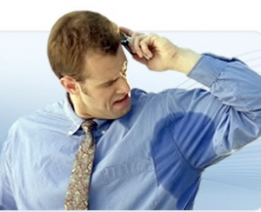
Evaporative Cooling
Evaporation is transformation of a substance from liquid to gas
Heat of vaporization is the heat a liquid must absorb for 1 g to be converted to gas
As a liquid evaporates, its remaining surface cools, a process called evaporative cooling
Evaporative Cooling: the process in which the surface of an object becoming cooler during evaporation
Evaporative cooling of water helps stabilize temperatures in organisms and bodies of water
© 2011 Pearson Education, Inc.

Slide 42
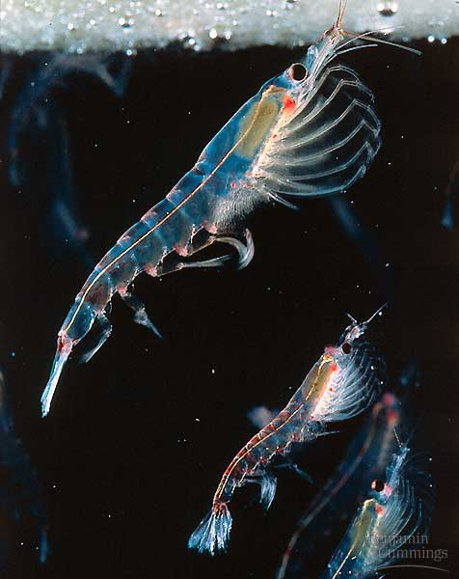
Floating of Ice on Liquid Water
Ice floats in liquid water because hydrogen bonds in ice are more “ordered,” making ice less dense
Water reaches its greatest density at 4°C
If ice sank, all bodies of water would eventually freeze solid, making life impossible on Earth
© 2011 Pearson Education, Inc.

Slide 43
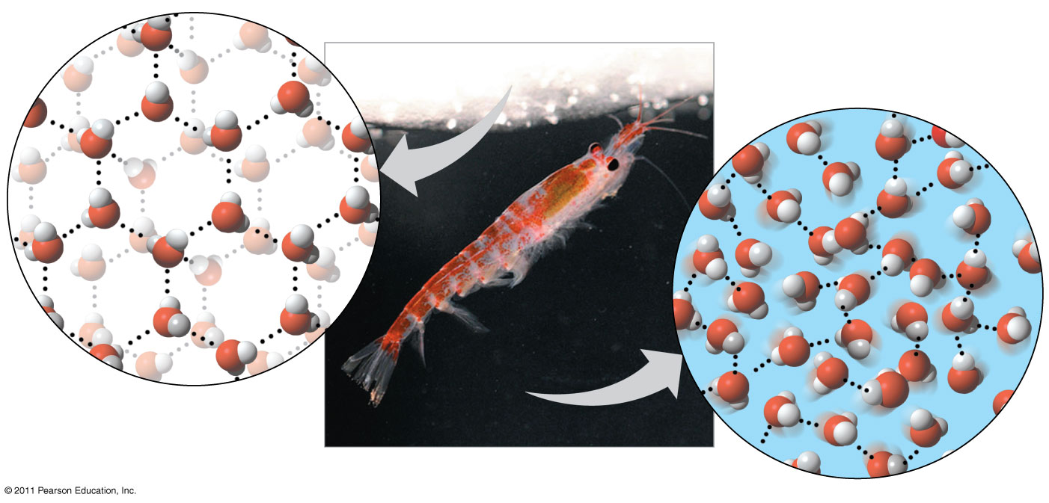
Figure 3.6
Hydrogen bond
Liquid water:
Hydrogen bonds
break and re-form
Ice:
Hydrogen bonds
are stable
Notes:
43
Figure 3.6 Ice: crystalline structure and floating barrier.

Slide 44
Water: The Solvent of Life
A solution is a liquid that is a homogeneous mixture of substances
A solvent is the dissolving agent of a solution
The solute is the substance that is dissolved
An aqueous solution is one in which water is the solvent
© 2011 Pearson Education, Inc.

Slide 45
Water is a versatile solvent due to its polarity, which allows it to form hydrogen bonds easily
When an ionic compound is dissolved in water, each ion is surrounded by a sphere of water molecules called a hydration shell
© 2011 Pearson Education, Inc.

Slide 46
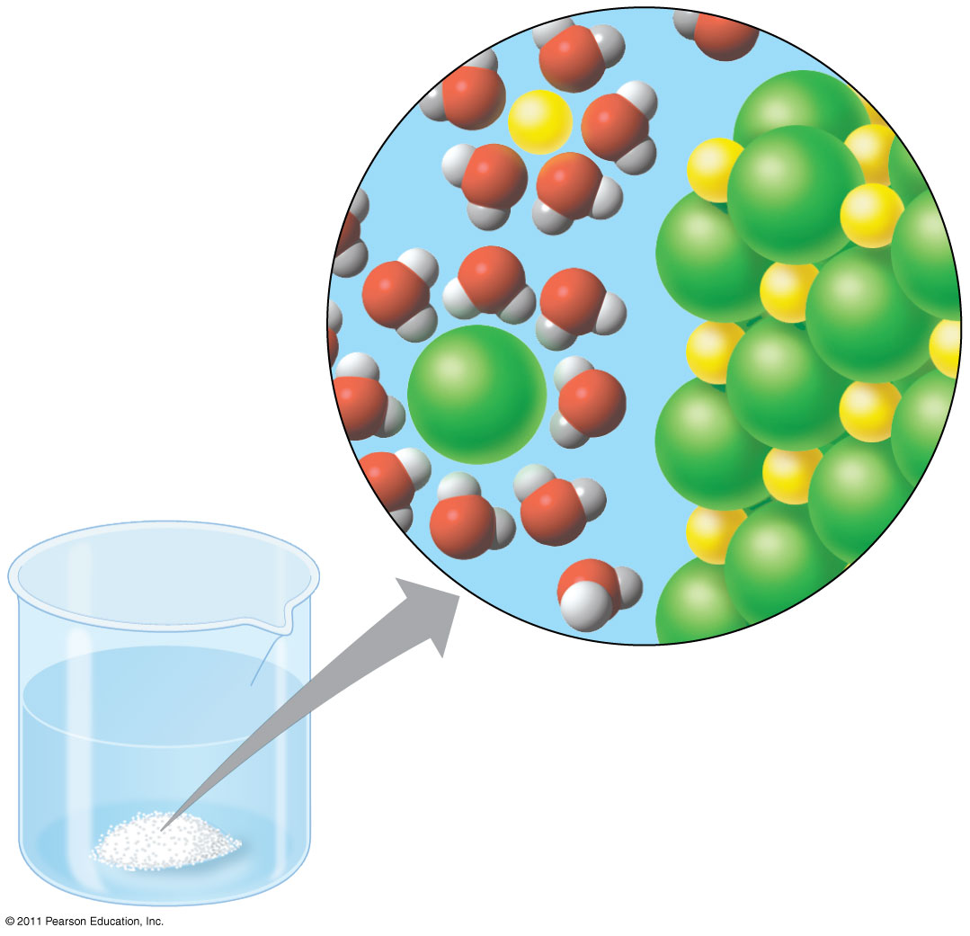
Figure 3.7
−
Na⁺
⁺
−
⁺
−
−
⁺
−
Na⁺
−
⁺
⁺
Cl⁻
Cl⁻
−
−
⁺
⁺
−
⁺
−
−
Notes:
46
Figure 3.7 Table salt dissolving in water.

Slide 47
Hydrophilic and Hydrophobic Substances
A hydrophilic substance is one that has an affinity for water
A hydrophobic substance is one that does not have an affinity for water
Oil molecules are hydrophobic because they have relatively nonpolar bonds
A colloid is a stable suspension of fine particles in a liquid
© 2011 Pearson Education, Inc.

Slide 48
Concept 2.3: Acidic and basic conditions affect living organisms
A hydrogen atom in a hydrogen bond between two water molecules can shift from one to the other
The hydrogen atom leaves its electron behind and is transferred as a proton, or hydrogen ion (H⁺)
The molecule with the extra proton is now a hydronium ion (H₃O⁺), though it is often represented as H⁺
The molecule that lost the proton is now a hydroxide ion (OH–)
© 2011 Pearson Education, Inc.

Slide 49
Acids and Bases
An acid is any substance that increases the H⁺ concentration of a solution
A base is any substance that reduces the H⁺ concentration of a solution
© 2011 Pearson Education, Inc.

Slide 50
Concentrations of H⁺ and OH– are equal in pure water
Adding certain solutes, called acids and bases, modifies the concentrations of H⁺ and OH–
Biologists use something called the pH scale to describe whether a solution is acidic or basic (the opposite of acidic)
© 2011 Pearson Education, Inc.

Slide 51
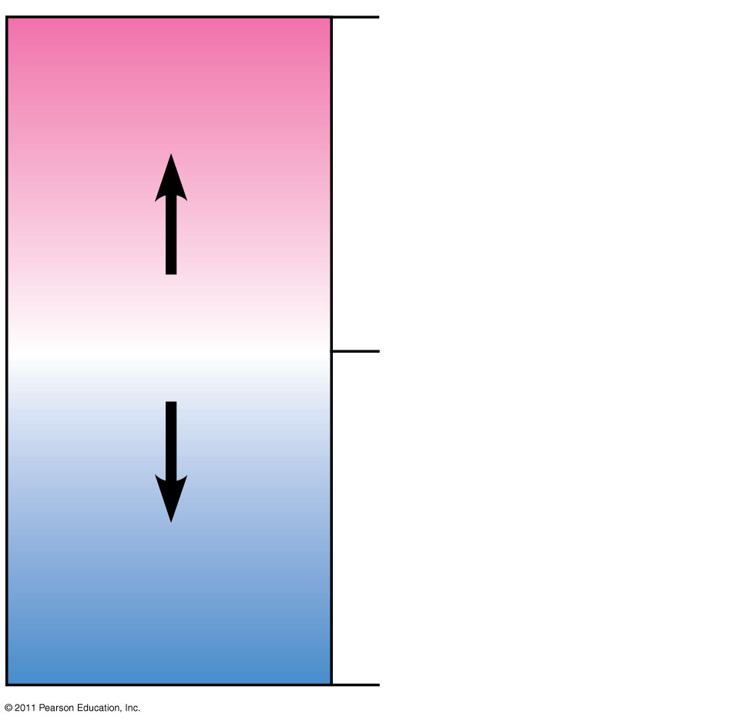
Figure 3.UN05
0
Acidic
[H⁺] > [OH⁻]
Acids donate H⁺ in
aqueous solutions.
Neutral
[H⁺] = [OH⁻]
7
Bases donate OH⁻
or accept H⁺ in
aqueous solutions
Basic
[H⁺] < [OH⁻]
14
Notes:
51
Figure 3.UN05 Summary figure, Concept 3.3

Slide 52
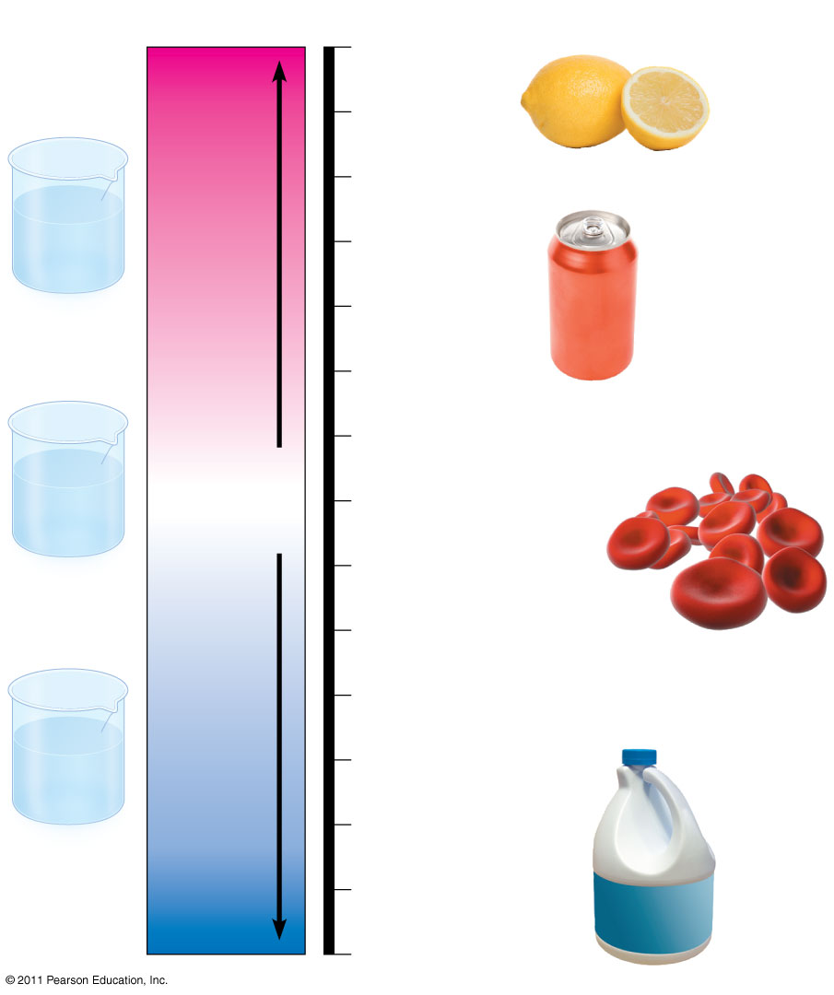
Figure 3.10
pH Scale
0
1
Battery acid
2
Gastric juice, lemon juice
H⁺
H⁺
H⁺
OH⁻
H⁺
Increasingly Acidic
[H⁺] > [OH⁻]
3
Vinegar, wine,
cola
OH⁻
H⁺
H⁺
H⁺
H⁺
4
Acidic
solution
Tomato juice
Beer
5
Black coffee
Rainwater
6
Urine
OH⁻
OH⁻
Neutral
[H⁺] = [OH⁻]
Saliva
H⁺
H⁺
OH⁻
7
Pure water
OH⁻
OH⁻
H⁺
Human blood, tears
H⁺
H⁺
8
Neutral
solution
Seawater
Inside of small intestine
9
Increasingly Basic
[H⁺] < [OH⁻]
10
OH⁻
Milk of magnesia
OH⁻
11
OH⁻
H⁺
OH⁻
Household ammonia
OH⁻
H⁺
OH⁻
OH⁻
12
Basic
solution
13
Household
bleach
Oven cleaner
14
Notes:
52
Figure 3.10 The pH scale and pH values of some aqueous solutions.

Slide 53
Buffers
The internal pH of most living cells must remain close to pH 7
Buffers are substances that minimize changes in concentrations of H⁺ and OH– in a solution
Most buffers consist of an acid-base pair that reversibly combines with H⁺
© 2011 Pearson Education, Inc.

Slide 54
Acidification: A Threat to Water Quality
Human activities such as burning fossil fuels threaten water quality
CO₂ is the main product of fossil fuel combustion
About 25% of human-generated CO₂ is absorbed by the oceans
CO2 dissolved in sea water forms carbonic acid; this process is called ocean acidification
© 2011 Pearson Education, Inc.

Slide 55
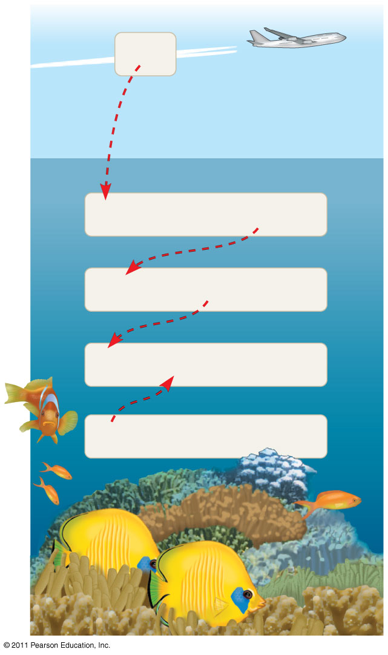
Figure 3.11
CO₂
CO₂ + H₂O
H₂CO₃
H₂CO₃
H⁺ + HCO₃⁻
H⁺ + CO₃²⁻
HCO₃⁻
CO₃²⁻ +
Ca²⁺
CaCO₃
Notes:
55
Figure 3.11 Atmospheric CO₂ from human activities and its fate in the ocean.

Slide 56
The burning of fossil fuels is also a major source of sulfur oxides and nitrogen oxides
These compounds react with water in the air to form strong acids that fall in rain or snow
Acid precipitation is rain, fog, or snow with a ph lower than 5.2
Acid precipitation damages life in lakes and streams and changes soil chemistry on land
© 2011 Pearson Education, Inc.

Slide 57
Acid Rain

Slide 58
Problem
Most organisms require a fairly stable pH to maintain homeostasis
Metabolism constantly produces acids and bases as byproducts of the chemical reactions
Additionally, animals often ingest or are exposed to acids and bases from their environment

Slide 59
Blood Buffers
The body maintains a pH range of between 7.35-7.45 using buffers
The key buffer in human blood is an acid base pair consisting of carbonic acid and bicarbonate
CO₂ + H₂O H₂CO₃ HCO₃ ⁻ + H⁺
_{Carbonic Acid Bicarbonate}

Slide 60
Chapter 3
Carbon and the Molecular Diversity of Life

Slide 61
Overview: Carbon: The Backbone of Life
Living organisms consist mostly of carbon-based compounds
Carbon is unparalleled in its ability to form large, complex, and diverse molecules
Proteins, DNA, carbohydrates, and other molecules that distinguish living matter are all composed of carbon compounds
© 2011 Pearson Education, Inc.

Slide 62
Organic chemistry is the study of carbon compounds
Organic chemistry is the study of compounds that contain carbon
Organic compounds range from simple molecules to colossal ones
Most organic compounds contain hydrogen atoms in addition to carbon atoms
© 2011 Pearson Education, Inc.

Slide 63
The Formation of Bonds with Carbon
With four valence electrons, carbon can form four covalent bonds with a variety of atoms
This ability makes large, complex molecules possible
In molecules with multiple carbons, each carbon bonded to four other atoms has a tetrahedral shape
Carbon can form single, double, or triple bonds.
© 2011 Pearson Education, Inc.

Slide 64
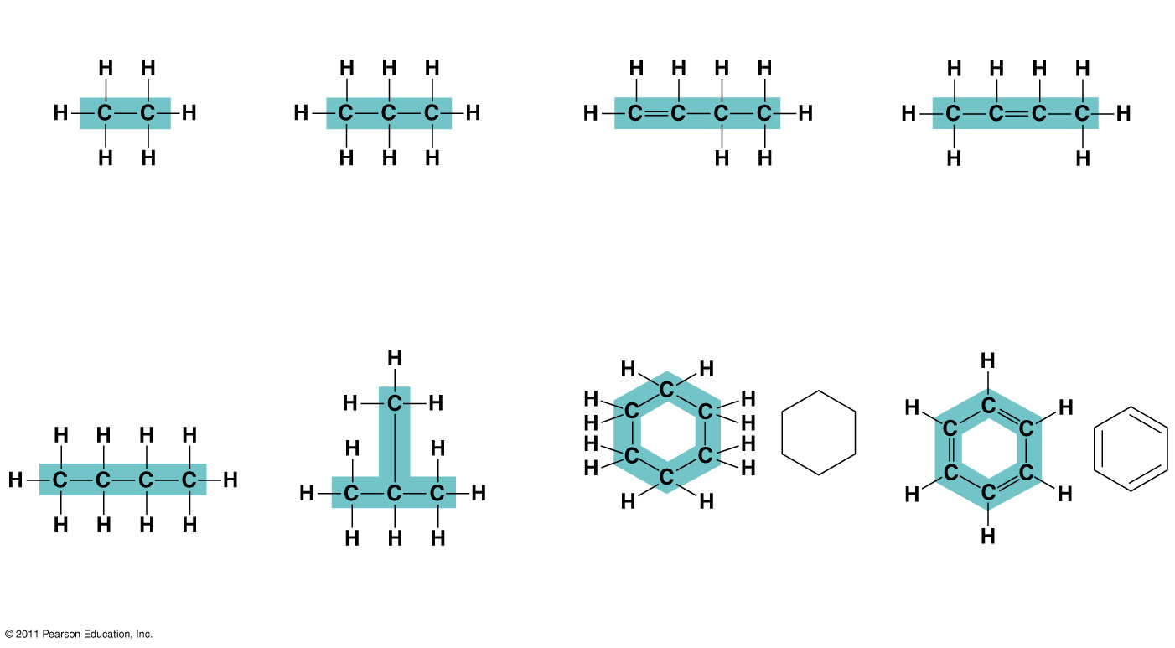
Molecular Diversity Arising from Carbon Skeleton Variation
Carbon chains form the skeletons of most organic molecules
Carbon chains vary in length and shape
Animation: Carbon Skeletons
© 2011 Pearson Education, Inc.

Slide 65
The Chemical Groups Most Important in the Processes of Life
Functional groups are the components of organic molecules that are most commonly involved in chemical reactions
The number and arrangement of functional groups give each molecule its unique properties
© 2011 Pearson Education, Inc.

Slide 66
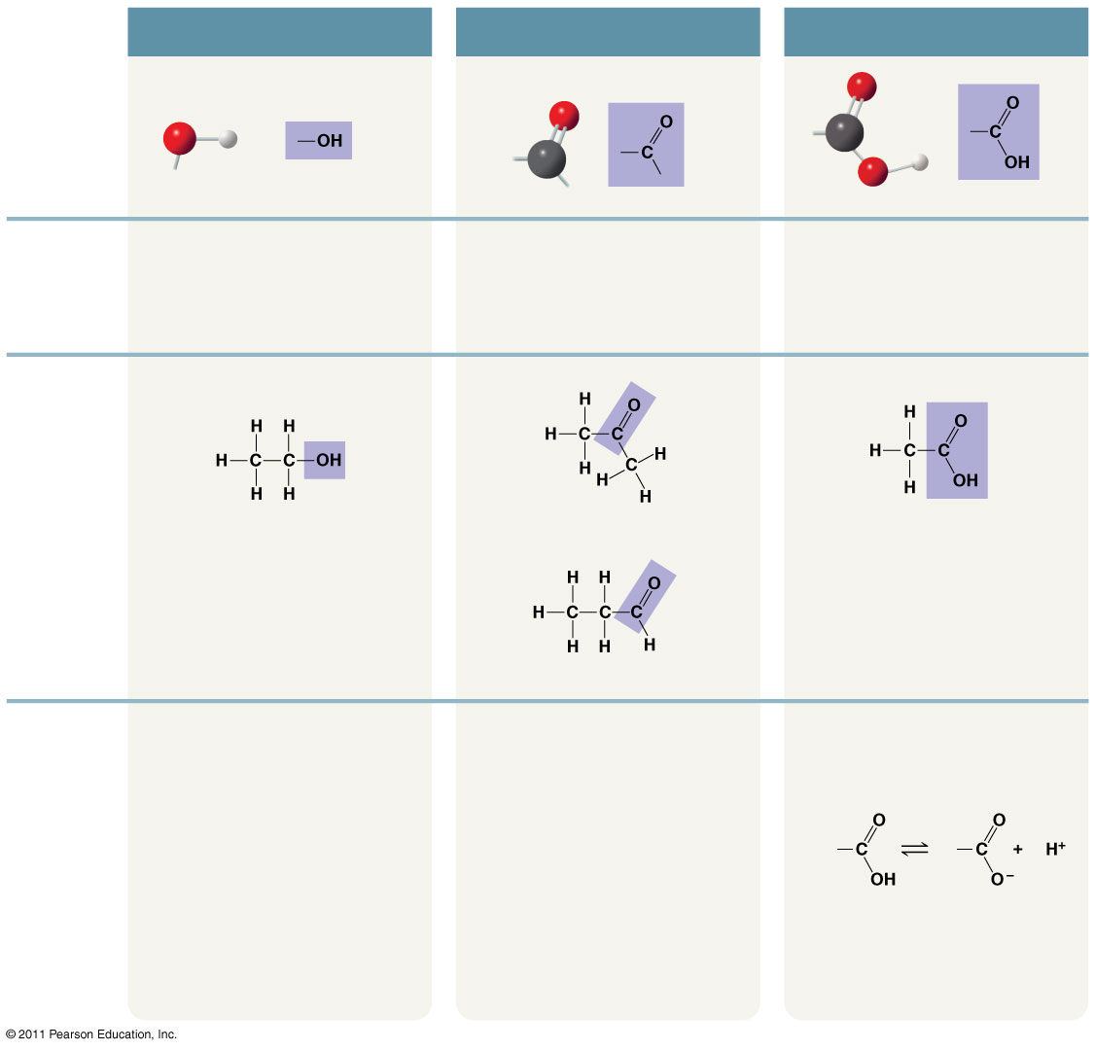
Figure 4.9-a
CHEMICAL
GROUP
Hydroxyl
Carbonyl
Carboxyl
STRUCTURE
(may be written HO—)
NAME OF
COMPOUND
Alcohols (Their specific names usually end in -ol.)
Ketones if the carbonyl group is within a carbon skeleton
Carboxylic acids, or organic acids
Aldehydes if the carbonyl group is at the end of the carbon skeleton
EXAMPLE
Ethanol
Acetone
Acetic acid
Propanal
FUNCTIONAL
PROPERTIES
• Is polar as a result of the electrons spending more time near the electronegative oxygen
atom.
• A ketone and an aldehyde may be structural isomers with different
properties, as is the case for acetone and propanal.
• Acts as an acid; can donate an
H⁺ because the covalent bond
between oxygen and hydrogen
is so polar:
• Can form hydrogen bonds with water molecules, helping dissolve
organic compounds such as sugars.
• Ketone and aldehyde groups are also found in sugars, giving rise to two major groups of sugars:
ketoses (containing ketone
groups) and aldoses (containing
aldehyde groups).
Nonionized
Ionized
• Found in cells in the ionized form
with a charge of 1− and called a
carboxylate ion.
Notes:
Figure 4.9 Exploring: Some Biologically Important Chemical Groups

Slide 67
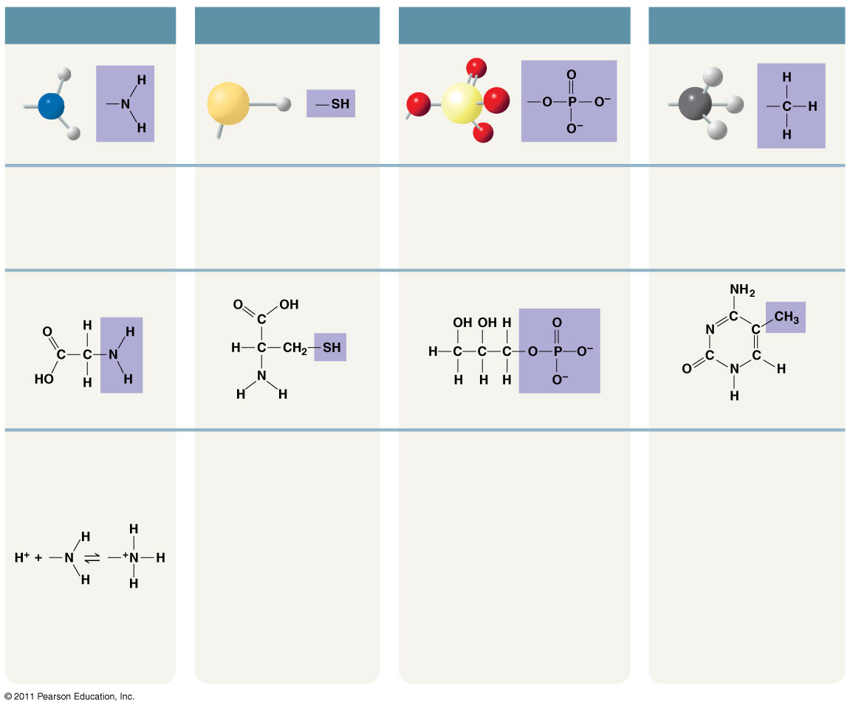
Figure 4.9-b
Amino
Sulfhydryl
Phosphate
Methyl
(may be written HS—)
Amines
Thiols
Organic phosphates
Methylated compounds
Glycine
Cysteine
Glycerol phosphate
5-Methyl cytidine
• Acts as a base; can
pick up an H⁺ from the
surrounding solution (water, in living
organisms):
• Two sulfhydryl groups can react, forming a covalent
bond. This “cross-linking”
helps stabilize protein
structure.
• Contributes negative charge to
the molecule of which it is a part
(2– when at the end of a molecule,
as above; 1– when located
internally in a chain of
phosphates).
• Addition of a methyl group
to DNA, or to molecules
bound to DNA, affects the
expression of genes.
• Arrangement of methyl
groups in male and female
sex hormones affects their
shape and function.
• Cross-linking of cysteines
in hair proteins maintains
the curliness or straightness
of hair. Straight hair can be
“permanently” curled by
shaping it around curlers
and then breaking and
re-forming the cross-linking
bonds.
• Molecules containing phosphate
groups have the potential to react
with water, releasing energy.
Nonionized
Ionized
• Found in cells in the
ionized form with a
charge of 1+.
Notes:
Figure 4.9 Exploring: Some Biologically Important Chemical Groups

Slide 68
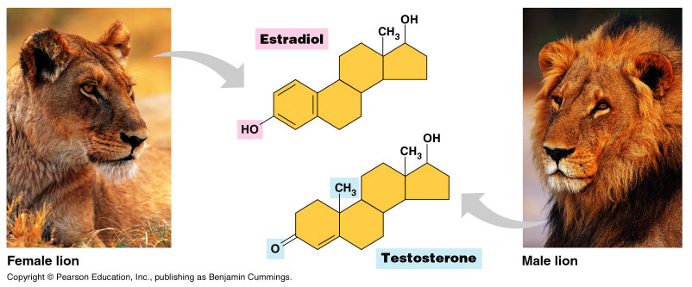
Importance of Functional Groups

Slide 69
ATP: An Important Source of Energy for Cellular Processes
One phosphate molecule, adenosine triphosphate (ATP), is the primary energy-transferring molecule in the cell
ATP consists of an organic molecule called adenosine attached to a string of three phosphate groups
© 2011 Pearson Education, Inc.

Slide 70
Figure 4. UN05
Reacts
with H₂O
Adenosine
Adenosine
Energy
ATP
Inorganic
phosphate
ADP
Notes:
Figure 4.UN05 In-text figure, p. 66

Slide 71
Chapter 3.2
The Structure and Function of Large Biological Molecules

Slide 72
Overview: The Molecules of Life
All living things are made up of four classes of large biological molecules: carbohydrates, lipids, proteins, and nucleic acids
Macromolecules are large molecules composed of thousands of covalently connected atoms
Molecular structure and function are inseparable
© 2011 Pearson Education, Inc.

Slide 73
Macromolecules are polymers, built from monomers
A polymer is a long molecule consisting of many similar building blocks
These small building-block molecules are called monomers
© 2011 Pearson Education, Inc.

Slide 74
The Synthesis and Breakdown of Polymers
A dehydration reaction occurs when two monomers bond together through the loss of a water molecule
Polymers are disassembled to monomers by hydrolysis, a reaction that is essentially the reverse of the dehydration reaction
Animation: Polymers
© 2011 Pearson Education, Inc.

Slide 75
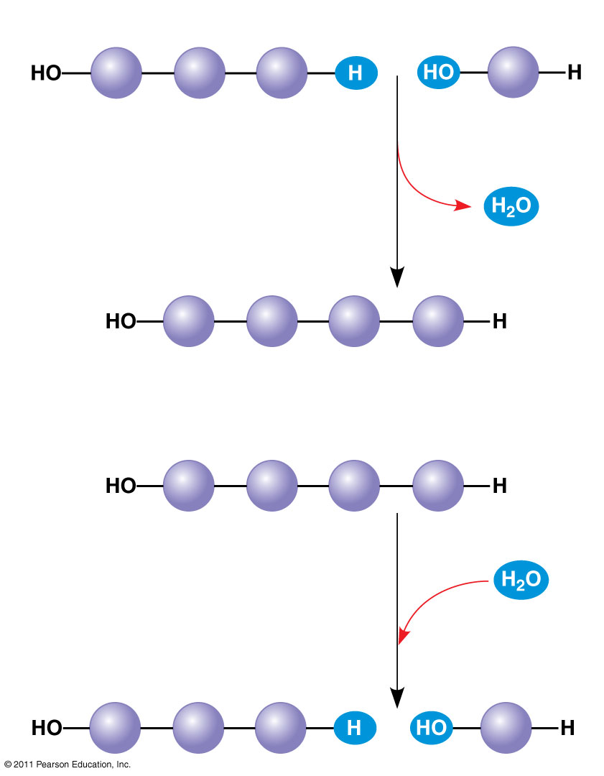
Figure 5.2
(a) Dehydration reaction: synthesizing a polymer
1
2
3
Short polymer
Unlinked monomer
Dehydration removes a water molecule, forming a new bond.
1
2
3
4
Longer polymer
(b) Hydrolysis: breaking down a polymer
1
2
3
4
Hydrolysis adds a water molecule, breaking a bond.
1
2
3
Notes:
Figure 5.2 The synthesis and breakdown of polymers.

Slide 76
Carbohydrates serve as fuel and building material
Carbohydrates include sugars and the polymers of sugars
The simplest carbohydrates are monosaccharides, or single sugars
Carbohydrate macromolecules are polysaccharides, polymers composed of many sugar building blocks
© 2011 Pearson Education, Inc.

Slide 77
Sugars
Monosaccharides have molecular formulas that are usually multiples of CH₂O (1:2:1)
Glucose (C₆H₁₂O₆) is the most common monosaccharide
A disaccharide is formed when a dehydration reaction joins two monosaccharides
This covalent bond is called a glycosidic linkage
© 2011 Pearson Education, Inc.

Slide 78
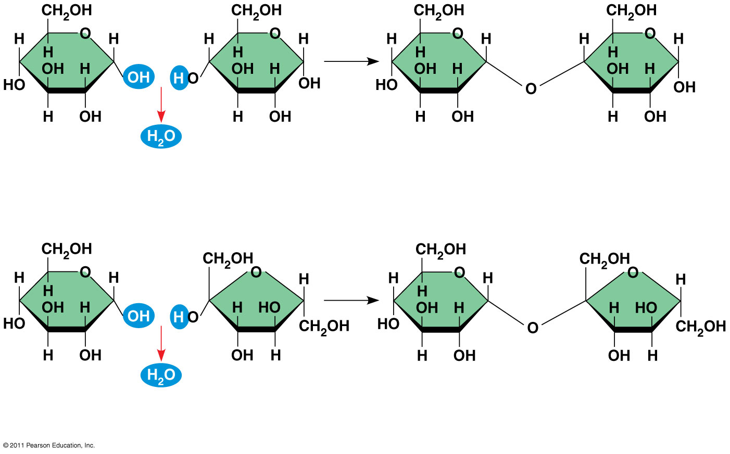
Figure 5.5
1–4 glycosidic linkage
1
4
Glucose
Glucose
Maltose
(a) Dehydration reaction in the synthesis of maltose
1–2 glycosidic linkage
1
2
Glucose
Fructose
Sucrose
(b) Dehydration reaction in the synthesis of sucrose
Notes:
Figure 5.5 Examples of disaccharide synthesis.

Slide 79
Polysaccharides
Polysaccharides, the polymers of sugars, have storage and structural roles
The structure and function of a polysaccharide are determined by its sugar monomers and the positions of glycosidic linkages
© 2011 Pearson Education, Inc.

Slide 80
Storage Polysaccharides
In Plants
In Animals
Starch, a storage polysaccharide of plants, consists entirely of glucose monomers
Plants store surplus starch as granules within chloroplasts and other plastids
The simplest form of starch is amylose
Glycogen is a storage polysaccharide in animals
Humans and other vertebrates store glycogen mainly in liver and muscle cells
© 2011 Pearson Education, Inc.

Slide 81
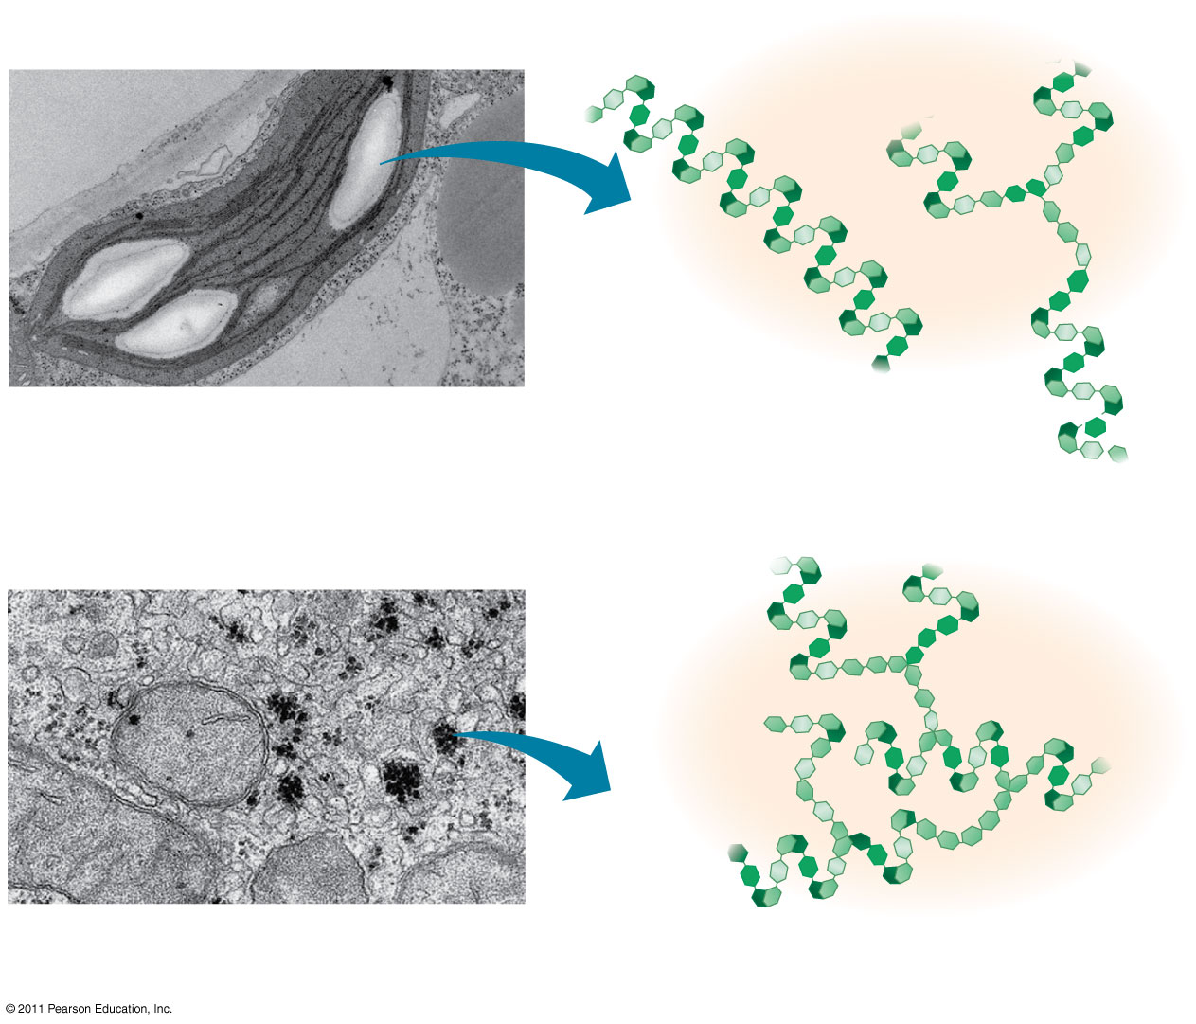
Figure 5.6
Chloroplast
Starch granules
Amylopectin
Amylose
(a) Starch: a plant polysaccharide
1 μm
Mitochondria
Glycogen granules
Glycogen
(b) Glycogen: an animal polysaccharide
0.5 μm
Notes:
Figure 5.6 Storage polysaccharides of plants and animals.

Slide 82
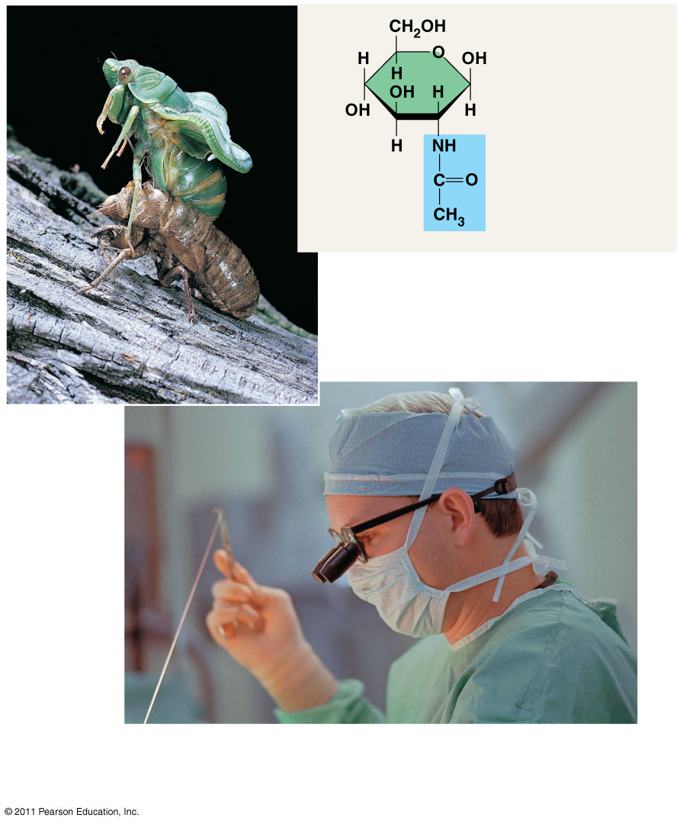
Structural Polysaccharides
The structure of the chitin monomer
In Plants
In Animals & Fungi
The polysaccharide cellulose is a major component of the tough wall of plant cells
Like starch, cellulose is a polymer of glucose, but the glycosidic linkages differ
Chitin, another structural polysaccharide, is found in the exoskeleton of arthropods
Chitin also provides structural support for the cell walls of many fungi
Chitin is used to make a strong and flexible surgical thread that decomposes after the wound or incision heals.
© 2011 Pearson Education, Inc.
(c) Cellulose: 1–4 linkage of β glucose monomers
(b) Starch: 1–4 linkage of α glucose monomers

Slide 83
Lipids are a diverse group of hydrophobic molecules
Lipids are the one class of large biological molecules that do not form polymers
The unifying feature of lipids is having little or no affinity for water
Lipids are hydrophobic because they consist mostly of hydrocarbons, which form nonpolar covalent bonds
The most biologically important lipids are fats, phospholipids, and steroids
© 2011 Pearson Education, Inc.

Slide 84
Fats
Fats are constructed from two types of smaller molecules: glycerol and fatty acids
Glycerol is a three-carbon alcohol with a hydroxyl group attached to each carbon
A fatty acid consists of a carboxyl group attached to a long carbon skeleton
© 2011 Pearson Education, Inc.

Slide 85
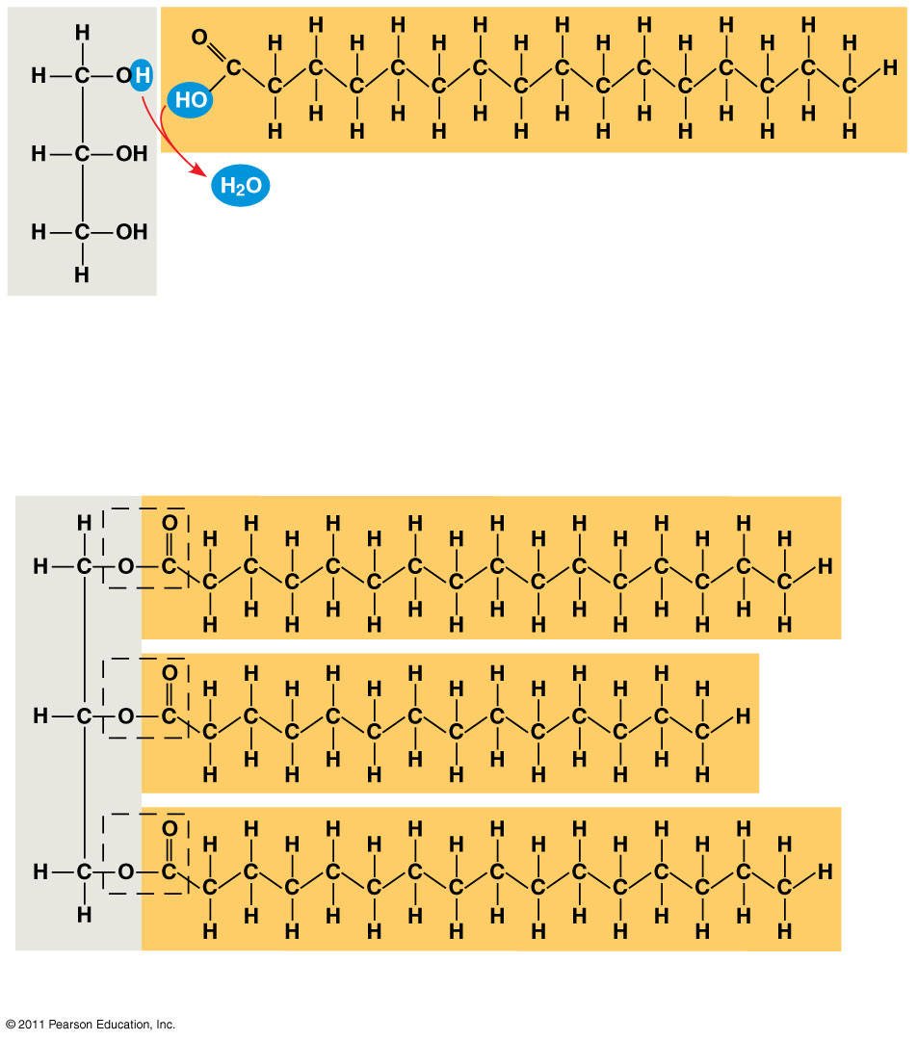
Figure 5.10
Fatty acid (in this case, palmitic acid)
Glycerol
(a) One of three dehydration reactions in the synthesis of a fat
Ester linkage
(b) Fat molecule (triacylglycerol)
Notes:
Figure 5.10 The synthesis and structure of a fat, or triacylglycerol.

Slide 86
Fatty acids vary in length (number of carbons) and in the number and locations of double bonds
Saturated fatty acids have the maximum number of hydrogen atoms possible and no double bonds
Unsaturated fatty acids have one or more double bonds
© 2011 Pearson Education, Inc.

Slide 87
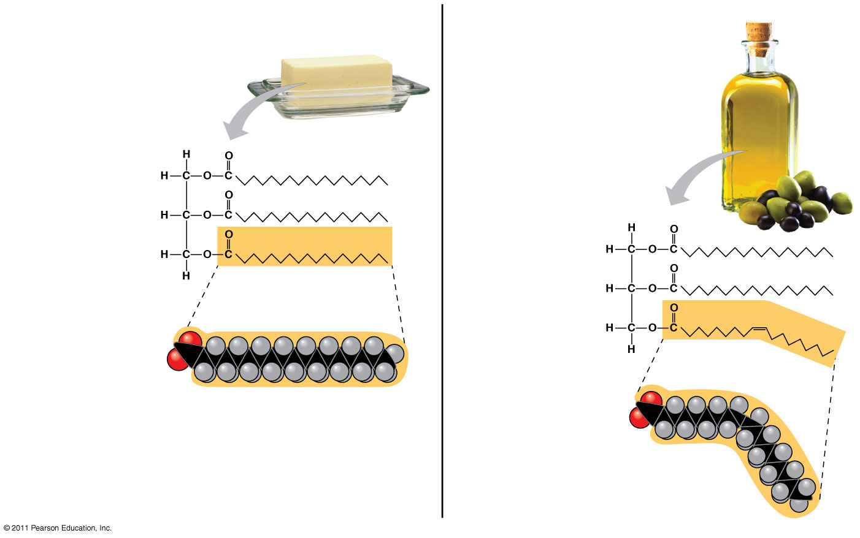
Figure 5.11
(a) Saturated fat
(b) Unsaturated fat
Structural formula of a saturated fat molecule
Structural formula of an unsaturated fat molecule
Space-filling model of stearic acid, a saturated fatty acid
Space-filling model of oleic acid, an unsaturated fatty acid
Cis double bond causes bending.
Notes:
Figure 5.11 Saturated and unsaturated fats and fatty acids.

Slide 88
Fats made from saturated fatty acids are called saturated fats, and are solid at room temperature
Most animal fats are saturated
Fats made from unsaturated fatty acids are called unsaturated fats or oils, and are liquid at room temperature
Plant fats and fish fats are usually unsaturated
© 2011 Pearson Education, Inc.

Slide 89
A diet rich in saturated fats may contribute to cardiovascular disease through plaque deposits
Hydrogenation is the process of converting unsaturated fats to saturated fats by adding hydrogen
Hydrogenating vegetable oils also creates unsaturated fats with trans double bonds
These trans fats may contribute more than saturated fats to cardiovascular disease
© 2011 Pearson Education, Inc.

Slide 90
The major function of fats is energy storage
Fat also serves as insulation, vitamin carriers, and hunger suppressors.
Humans and other mammals store their fat in adipose cells
Adipose tissue also cushions vital organs and insulates the body
© 2011 Pearson Education, Inc.

Slide 91
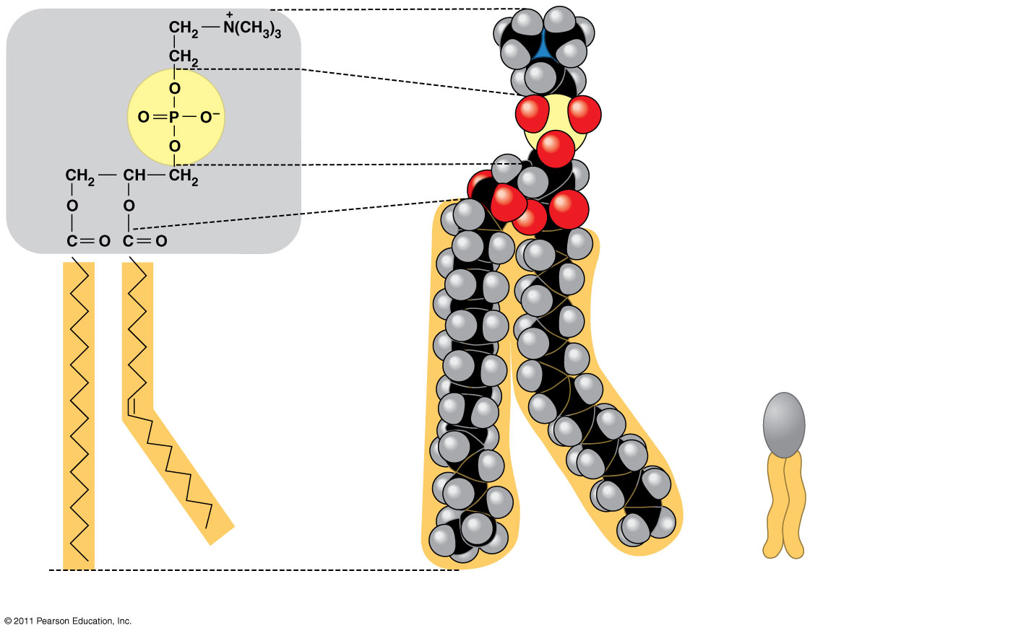
Figure 5.12
In a phospholipid, two fatty acids and a phosphate group are attached to glycerol
Choline
Hydrophilic head
Phosphate
Glycerol
Fatty acids
Hydrophobic tails
Hydrophilic head
Hydrophobic tails
(a) Structural formula
(b) Space-filling model
(c) Phospholipid symbol
Notes:
The two fatty acid tails are hydrophobic, but the phosphate group and its attachments form a hydrophilic head

Slide 92
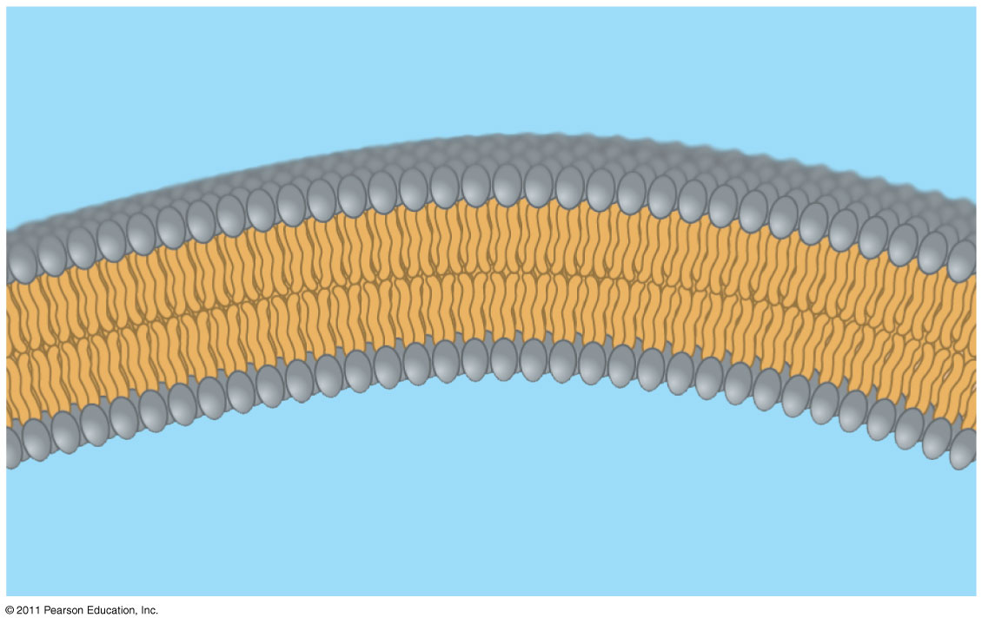
When phospholipids are added to water, they self-assemble into a bilayer, with the hydrophobic tails pointing toward the interior
The structure of phospholipids results in a bilayer arrangement found in cell membranes
Phospholipids are the major component of all cell membranes
Hydrophilic head
WATER
Hydrophobic tail
WATER
Notes:
Figure 5.13 Bilayer structure formed by self-assembly of phospholipids in an aqueous environment.

Slide 93
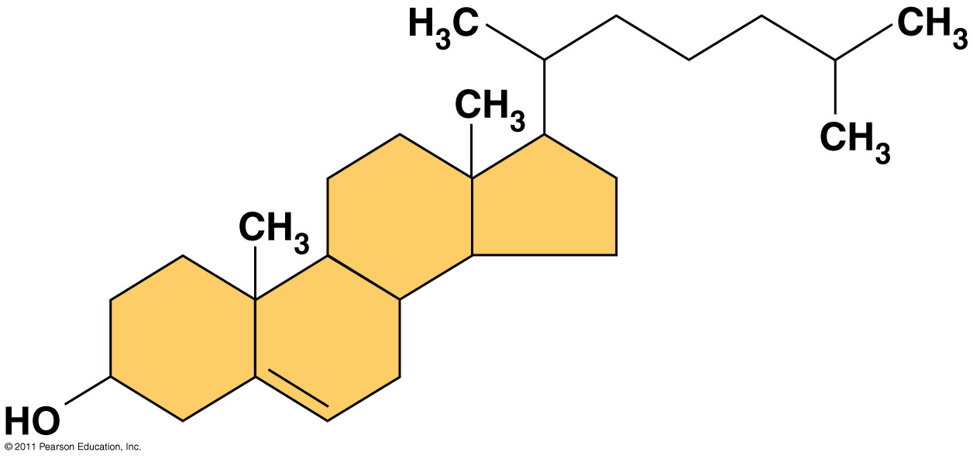
Steroids
Steroids are lipids characterized by a carbon skeleton consisting of four fused rings
Cholesterol, an important steroid, is a component in animal cell membranes
Although cholesterol is essential in animals, high levels in the blood may contribute to cardiovascular disease
© 2011 Pearson Education, Inc.
Notes:
For the Cell Biology Video Space Filling Model of Cholesterol, go to Animation and Video Files.
For the Cell Biology Video Stick Model of Cholesterol, go to Animation and Video Files.

Slide 94
Concept 5.4: Proteins include a diversity of structures, resulting in a wide range of functions
Proteins account for more than 50% of the dry mass of most cells
Protein functions include structural support, storage, transport, cellular communications, movement, and defense against foreign substances
© 2011 Pearson Education, Inc.

Slide 95
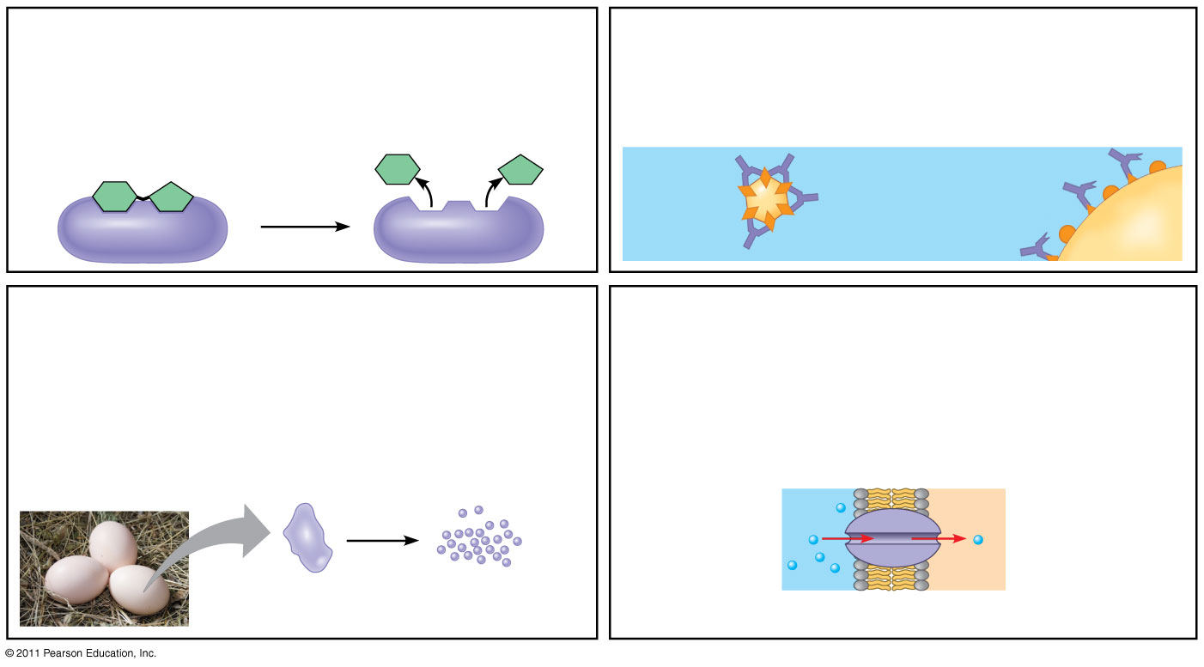
Figure 5.15-a
Enzymatic proteins
Defensive proteins
Function: Selective acceleration of chemical reactions
Function: Protection against disease
Example: Digestive enzymes catalyze the hydrolysis of bonds in food molecules.
Example: Antibodies inactivate and help destroy viruses and bacteria.
Antibodies
Enzyme
Virus
Bacterium
Storage proteins
Transport proteins
Function: Storage of amino acids
Function: Transport of substances
Examples: Casein, the protein of milk, is the major source of amino acids for baby mammals. Plants have storage proteins in their seeds. Ovalbumin is the protein of egg white, used as an amino acid source for the developing embryo.
Examples: Hemoglobin, the iron-containing protein of vertebrate blood, transports oxygen from the lungs to other parts of the body. Other proteins transport molecules across cell membranes.
Transport protein
Ovalbumin
Amino acids for embryo
Cell membrane
Notes:
Figure 5.15 An overview of protein functions.

Slide 96
Enzymes are a type of protein that acts as a catalyst to speed up chemical reactions
Enzymes can perform their functions repeatedly, functioning as workhorses that carry out the processes of life
Animation: Enzymes
© 2011 Pearson Education, Inc.

Slide 97
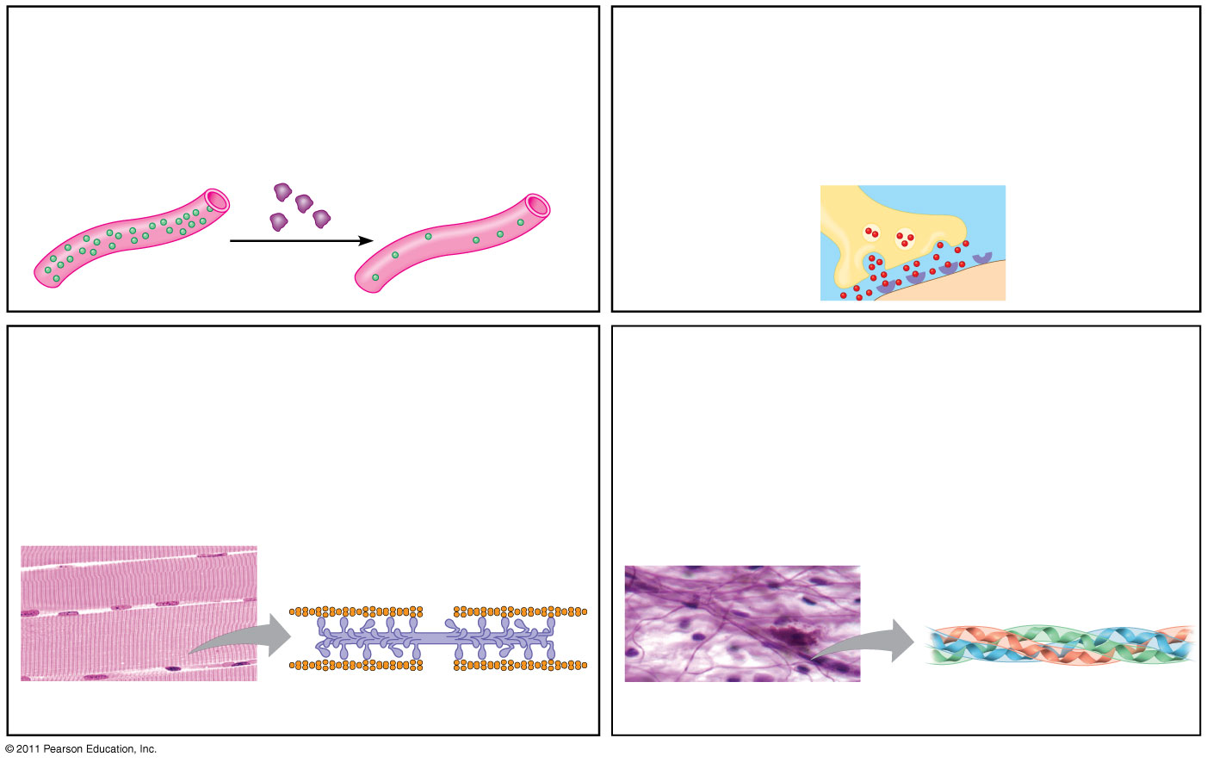
Figure 5.15-b
Hormonal proteins
Receptor proteins
Function: Coordination of an organism’s activities
Function: Response of cell to chemical stimuli
Example: Insulin, a hormone secreted by the pancreas, causes other tissues to take up glucose, thus regulating blood sugar concentration
Example: Receptors built into the membrane of a nerve cell detect signaling molecules released by other nerve cells.
Receptor protein
High blood sugar
Insulin secreted
Normal blood sugar
Signaling molecules
Contractile and motor proteins
Structural proteins
Function: Movement
Function: Support
Examples: Motor proteins are responsible for the undulations of cilia and flagella. Actin and myosin proteins are responsible for the contraction of muscles.
Examples: Keratin is the protein of hair, horns, feathers, and other skin appendages. Insects and spiders use silk fibers to make their cocoons and webs, respectively. Collagen and elastin proteins provide a fibrous framework in animal connective tissues.
Actin
Myosin
Collagen
Muscle tissue
100 μm
Connective tissue
60 μm
Notes:
Figure 5.15 An overview of protein functions.

Slide 98
Amino Acid Monomers
Amino acids are organic molecules with carboxyl and amino groups
Amino acids differ in their properties due to differing side chains, called R groups
© 2011 Pearson Education, Inc.

Slide 99
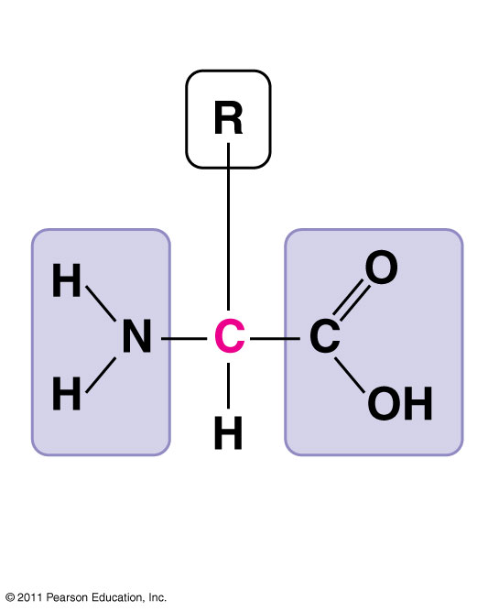
Figure 5.UN01
Side chain (R group)
α carbon
Amino group
Carboxyl group
Notes:
Figure 5.UN01 In-text figure, p. 78

Slide 100
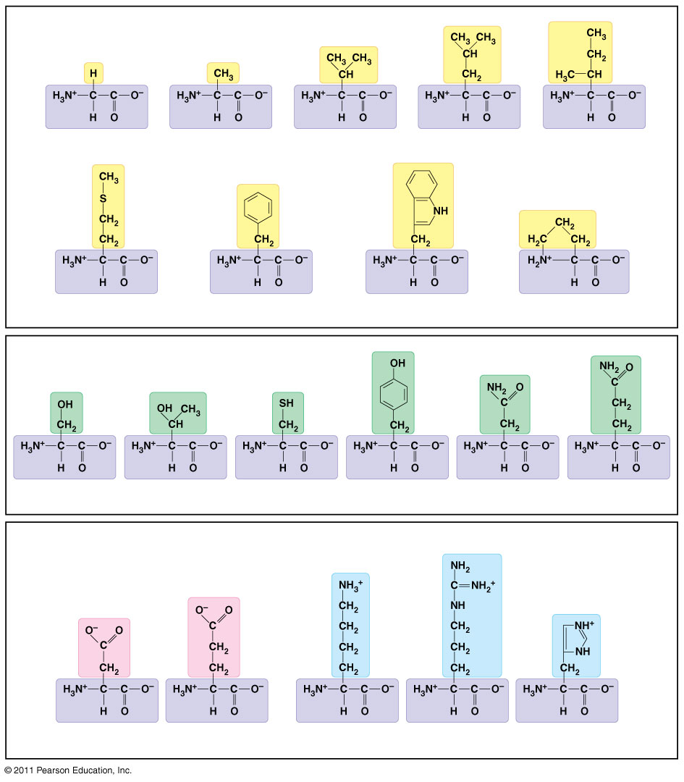
Figure 5.16
Nonpolar side chains; hydrophobic
Side chain (R group)
Glycine (Gly or G)
Alanine (Ala or A)
Valine (Val or V)
Leucine (Leu or L)
Isoleucine (Ile or I)
Methionine (Met or M)
Phenylalanine (Phe or F)
Tryptophan (Trp or W)
Proline (Pro or P)
Polar side chains; hydrophilic
Serine (Ser or S)
Threonine (Thr or T)
Cysteine (Cys or C)
Tyrosine (Tyr or Y)
Asparagine (Asn or N)
Glutamine (Gln or Q)
Electrically charged side chains; hydrophilic
Basic (positively charged)
Acidic (negatively charged)
Aspartic acid (Asp or D)
Glutamic acid (Glu or E)
Lysine (Lys or K)
Arginine (Arg or R)
Histidine (His or H)
Notes:
Figure 5.16 The 20 amino acids of proteins.

Slide 101
Amino Acid Polymers
Amino acids are linked by peptide bonds
A polypeptide is a polymer of amino acids
Polypeptides range in length from a few to more than a thousand monomers
Each polypeptide has a unique linear sequence of amino acids, with a carboxyl end (C-terminus) and an amino end (N-terminus)
Peptide Bond Formation via condensation reaction (aka Dehydration Synthesis)
© 2011 Pearson Education, Inc.

Slide 102
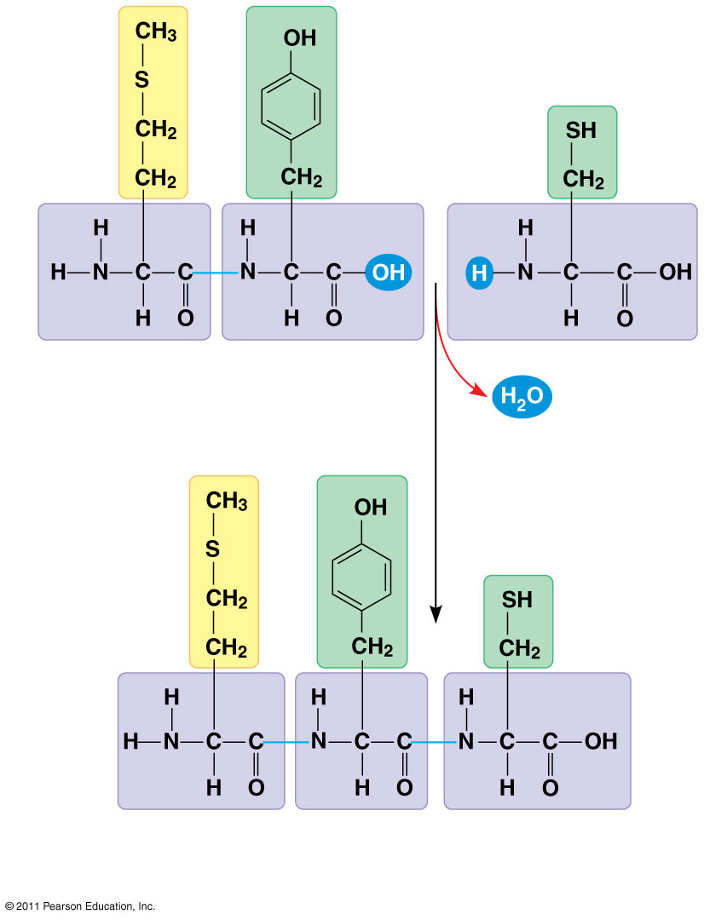
Figure 5.17
Peptide bond
New peptide bond forming
Side
chains
Back- bone
Amino end (N-terminus)
Peptide bond
Carboxyl end (C-terminus)
Notes:
Figure 5.17 Making a polypeptide chain.

Slide 103
Four Levels of Protein Structure
The primary structure of a protein is its unique sequence of amino acids
Secondary structure, found in most proteins, consists of coils and folds in the polypeptide chain
Tertiary structure is determined by interactions among various side chains (R groups)
Quaternary structure results when a protein consists of multiple polypeptide chains
Animation: Protein Structure Introduction
© 2011 Pearson Education, Inc.
Notes:
A functional protein consists of one or more polypeptides precisely twisted, folded, and coiled into a unique shape

Slide 104
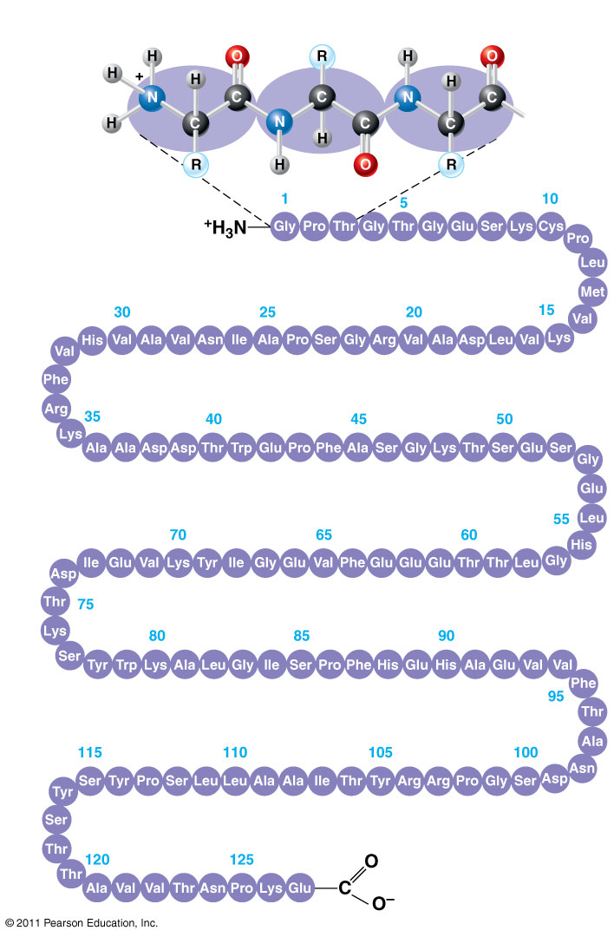
Figure 5.20a
Primary structure
Amino acids
Amino end
Primary structure of transthyretin
Carboxyl end
Notes:
Figure 5.20 Exploring: Levels of Protein Structure

Slide 105
Primary structure, the sequence of amino acids in a protein, is like the order of letters in a long word
Primary structure is determined by inherited genetic information
Animation: Primary Protein Structure
© 2011 Pearson Education, Inc.

Slide 106
The coils and folds of secondary structure result from hydrogen bonds between repeating constituents of the polypeptide backbone
Typical secondary structures are a coil called an α helix and a folded structure called a β pleated sheet
Animation: Secondary Protein Structure
© 2011 Pearson Education, Inc.
Notes:
For the Cell Biology Video An Idealized Alpha Helix: No Sidechains, go to Animation and Video Files.
For the Cell Biology Video An Idealized Alpha Helix, go to Animation and Video Files.
For the Cell Biology Video An Idealized Beta Pleated Sheet Cartoon, go to Animation and Video Files.
For the Cell Biology Video An Idealized Beta Pleated Sheet, go to Animation and Video Files.

Slide 107
Tertiary structure is determined by interactions between R groups, rather than interactions between backbone constituents
These interactions between R groups include hydrogen bonds, ionic bonds, hydrophobic interactions, and van der Waals interactions
Strong covalent bonds called disulfide bridges may reinforce the protein’s structure
Animation: Tertiary Protein Structure
© 2011 Pearson Education, Inc.

Slide 108
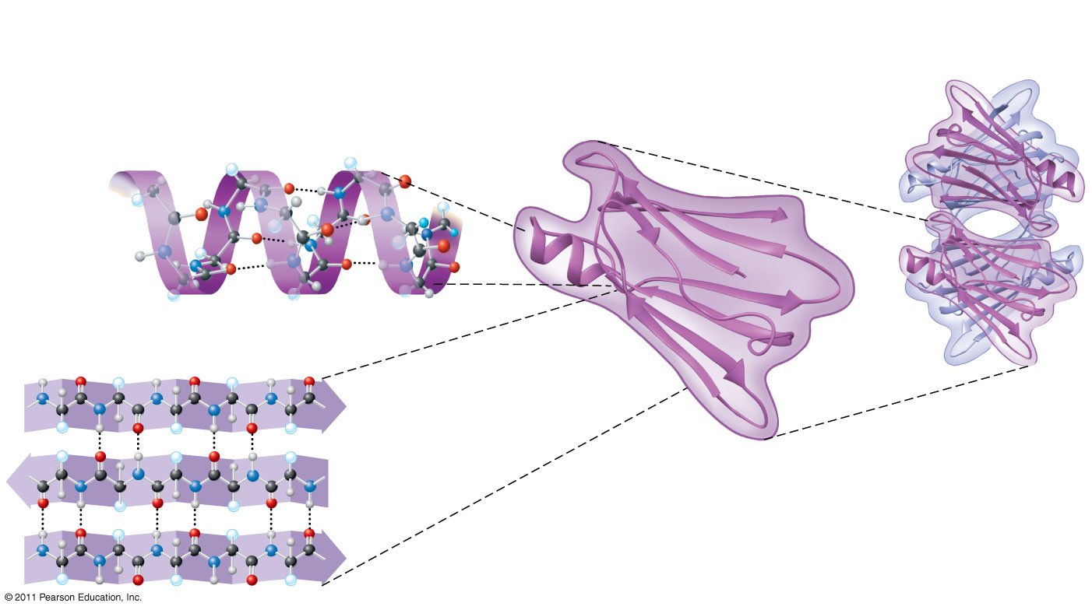
Figure 5.20b
Secondary structure
Tertiary structure
Quaternary structure
α helix
Hydrogen bond
β pleated sheet
β strand
Transthyretin protein
Hydrogen bond
Transthyretin polypeptide
Notes:
Figure 5.20 Exploring: Levels of Protein Structure

Slide 109
Quaternary structure results when two or more polypeptide chains form one macromolecule
Collagen is a fibrous protein consisting of three polypeptides coiled like a rope
Hemoglobin is a globular protein consisting of four polypeptides: two alpha and two beta chains
Animation: Quaternary Protein Structure
© 2011 Pearson Education, Inc.

Slide 110
Sickle-Cell Disease: A Change in Primary Structure
A slight change in primary structure can affect a protein’s structure and ability to function
Sickle-cell disease, an inherited blood disorder, results from a single amino acid substitution in the protein hemoglobin
© 2011 Pearson Education, Inc.

Slide 111
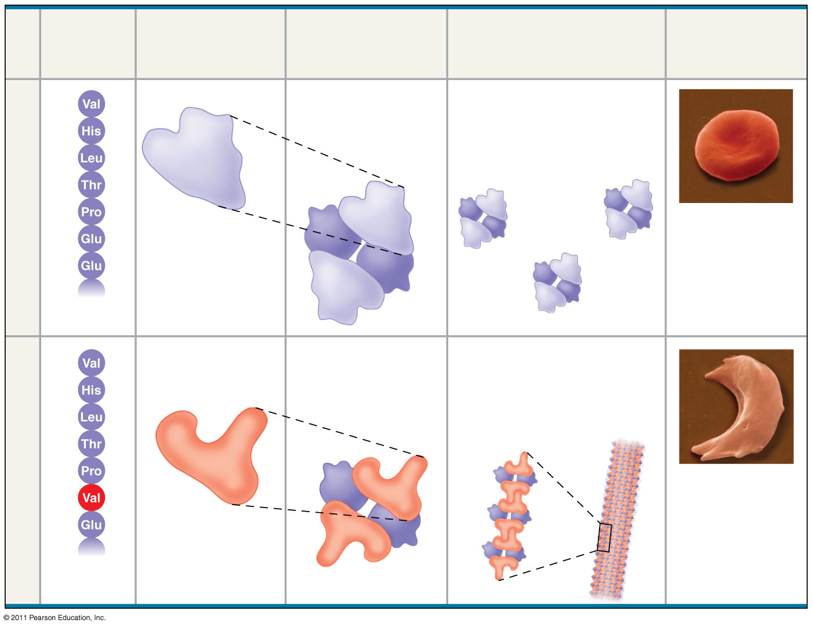
Figure 5.21
Primary Structure
Secondary and Tertiary Structures
Quaternary Structure
Red Blood Cell Shape
Function
1
Normal hemoglobin
Molecules do not associate with one another; each carries oxygen.
2
3
4
Normal hemoglobin
5
α
6
β subunit
β
10 μm
7
α
β
1
Exposed hydrophobic region
Sickle-cell hemoglobin
Molecules crystallize into a fiber; capacity to carry oxygen is reduced.
2
3
4
Sickle-cell hemoglobin
5
α
6
β
10 μm
7
β subunit
α
β
Notes:
Figure 5.21 A single amino acid substitution in a protein causes sickle-cell disease.

Slide 112
What Determines Protein Structure?
In addition to primary structure, physical and chemical conditions can affect structure
Alterations in pH, salt concentration, temperature, or other environmental factors can cause a protein to unravel
This loss of a protein’s native structure is called denaturation
A denatured protein is biologically inactive
© 2011 Pearson Education, Inc.

Slide 113
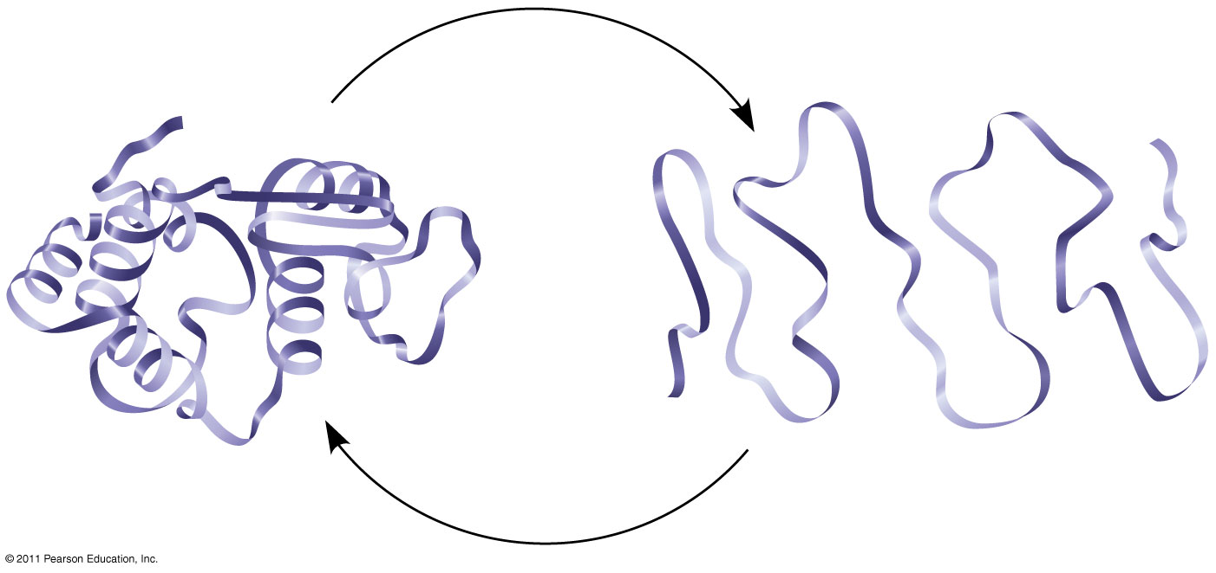
Figure 5.22
De
n
a
tu
r
a
t
i
on
Normal protein
Re
n
i
on
Denatured protein
a
t
u
r
a
t
Notes:
Figure 5.22 Denaturation and renaturation of a protein.

Slide 114
Protein Folding in the Cell
It is hard to predict a protein’s structure from its primary structure
Most proteins probably go through several stages on their way to a stable structure
Chaperonins are protein molecules that assist the proper folding of other proteins
Diseases such as Alzheimer’s, Parkinson’s, and mad cow disease are associated with misfolded proteins
© 2011 Pearson Education, Inc.

Slide 115
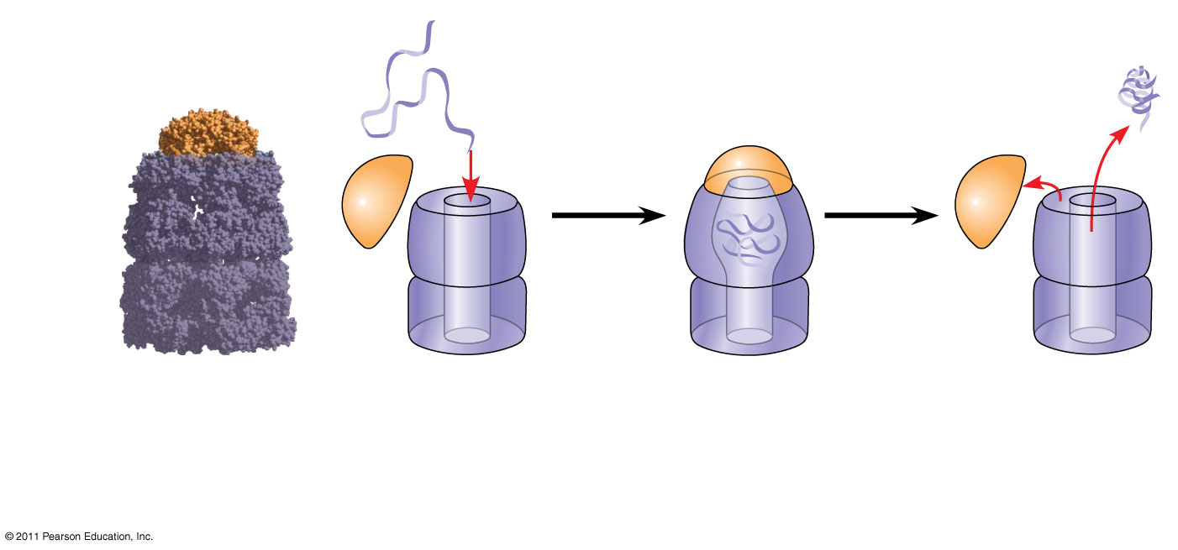
Figure 5.23
Correctly folded protein
Polypeptide
Cap
Hollow cylinder
Chaperonin (fully assembled)
Steps of Chaperonin Action:
2
The cap attaches, causing the cylinder to change shape in such a way that it creates a hydrophilic environment for the folding of the polypeptide.
3
The cap comes off, and the properly folded protein is released.
1
An unfolded poly- peptide enters the cylinder from one end.
Notes:
Figure 5.23 A chaperonin in action.

Slide 116
Nucleic acids store, transmit, and help express hereditary information
The amino acid sequence of a polypeptide is programmed by a unit of inheritance called a gene
Genes are made of DNA, a nucleic acid made of monomers called nucleotides
© 2011 Pearson Education, Inc.

Slide 117
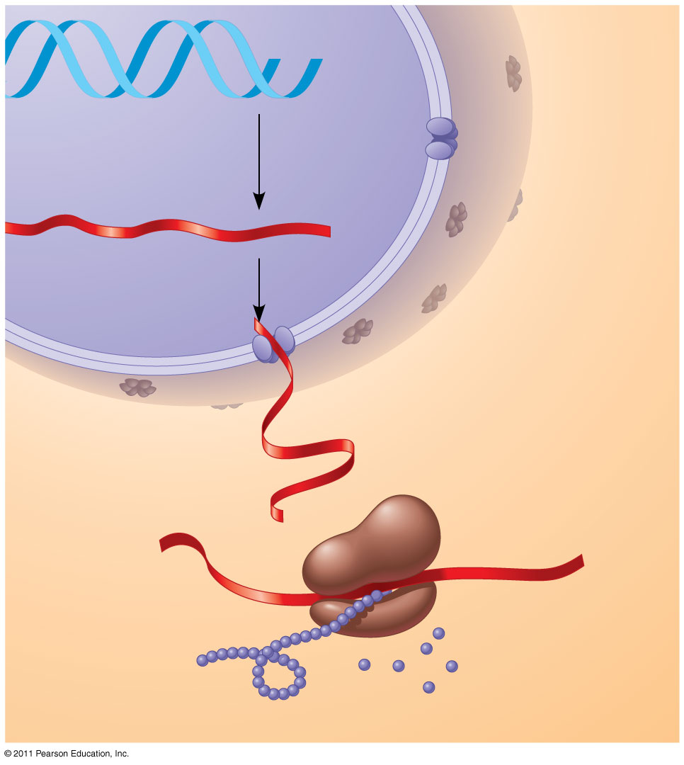
Figure 5.25-3
DNA
1
Synthesis of mRNA
mRNA
NUCLEUS
CYTOPLASM
mRNA
2
Movement of mRNA into cytoplasm
Ribosome
3
Synthesis of protein
Amino acids
Polypeptide
Notes:
Figure 5.25 DNA → RNA → protein.

Slide 118
The Components of Nucleic Acids
Nucleic acids are polymers called polynucleotides
Each polynucleotide is made of monomers called nucleotides
Each nucleotide consists of a nitrogenous base, a pentose sugar, and one or more phosphate groups
The portion of a nucleotide without the phosphate group is called a nucleoside
© 2011 Pearson Education, Inc.

Slide 119
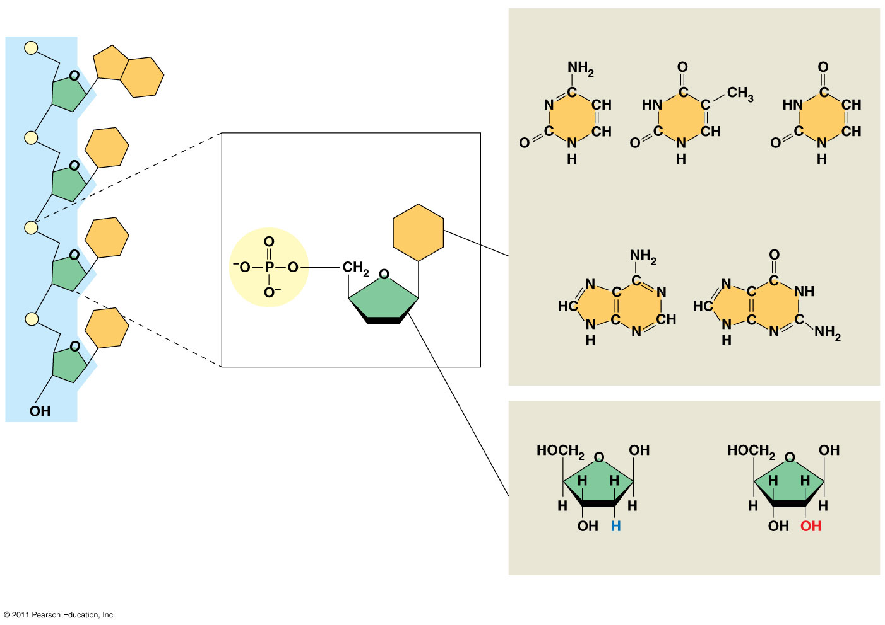
Figure 5.26
5′ end
Sugar-phosphate backbone
Nitrogenous bases
Pyrimidines
5′C
3′C
Nucleoside
Nitrogenous base
Cytosine (C)
Thymine (T, in DNA)
Uracil (U, in RNA)
5′C
Purines
1′C
Phosphate group
3′C
5′C
Sugar (pentose)
3′C
Adenine (A)
Guanine (G)
(b) Nucleotide
3′ end
Sugars
(a) Polynucleotide, or nucleic acid
Deoxyribose (in DNA)
Ribose (in RNA)
(c) Nucleoside components
Notes:
Figure 5.26 Components of nucleic acids.

Slide 120
There are two families of nitrogenous bases
Pyrimidines (cytosine, thymine, and uracil) have a single six-membered ring
Purines (adenine and guanine) have a six-membered ring fused to a five-membered ring
In DNA, the sugar is deoxyribose; in RNA, the sugar is ribose
Nucleotide = nucleoside + phosphate group
© 2011 Pearson Education, Inc.

Slide 121
Nucleotide Polymers
Nucleotide polymers are linked together to build a polynucleotide
Adjacent nucleotides are joined by covalent bonds that form between the –OH group on the 3′ carbon of one nucleotide and the phosphate on the 5′ carbon on the next
These links create a backbone of sugar-phosphate units with nitrogenous bases as appendages
The sequence of bases along a DNA or mRNA polymer is unique for each gene
© 2011 Pearson Education, Inc.

Slide 122
The Structures of DNA and RNA Molecules
RNA molecules usually exist as single polypeptide chains
DNA molecules have two polynucleotides spiraling around an imaginary axis, forming a double helix
In the DNA double helix, the two backbones run in opposite 5′→ 3′ directions from each other, an arrangement referred to as antiparallel
One DNA molecule includes many genes
© 2011 Pearson Education, Inc.

Slide 123
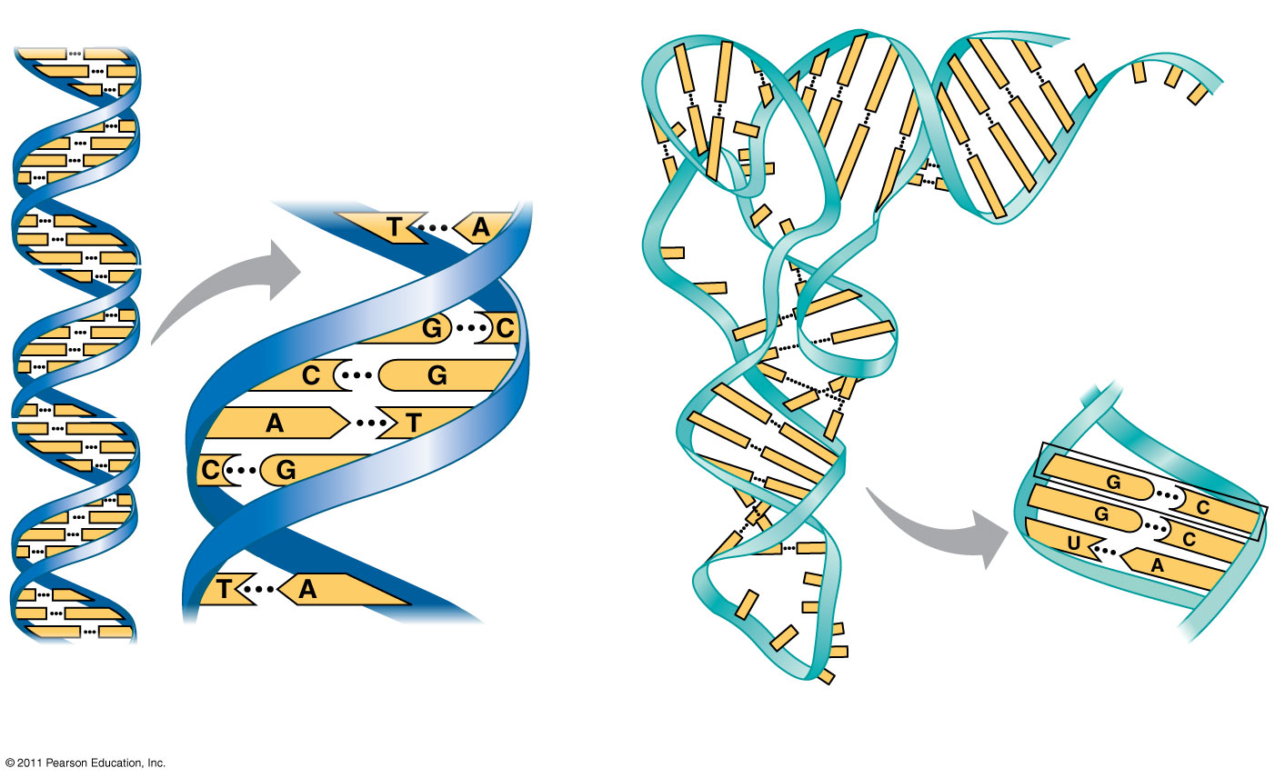
Figure 5.27
5′
3′
Sugar-phosphate backbones
Hydrogen bonds
Base pair joined by hydrogen bonding
3′
5′
Base pair joined by hydrogen bonding
(a) DNA
(b) Transfer RNA
Notes:
Figure 5.27 The structures of DNA and tRNA molecules.

Slide 124
Macromolecules Animation

