Slide 1
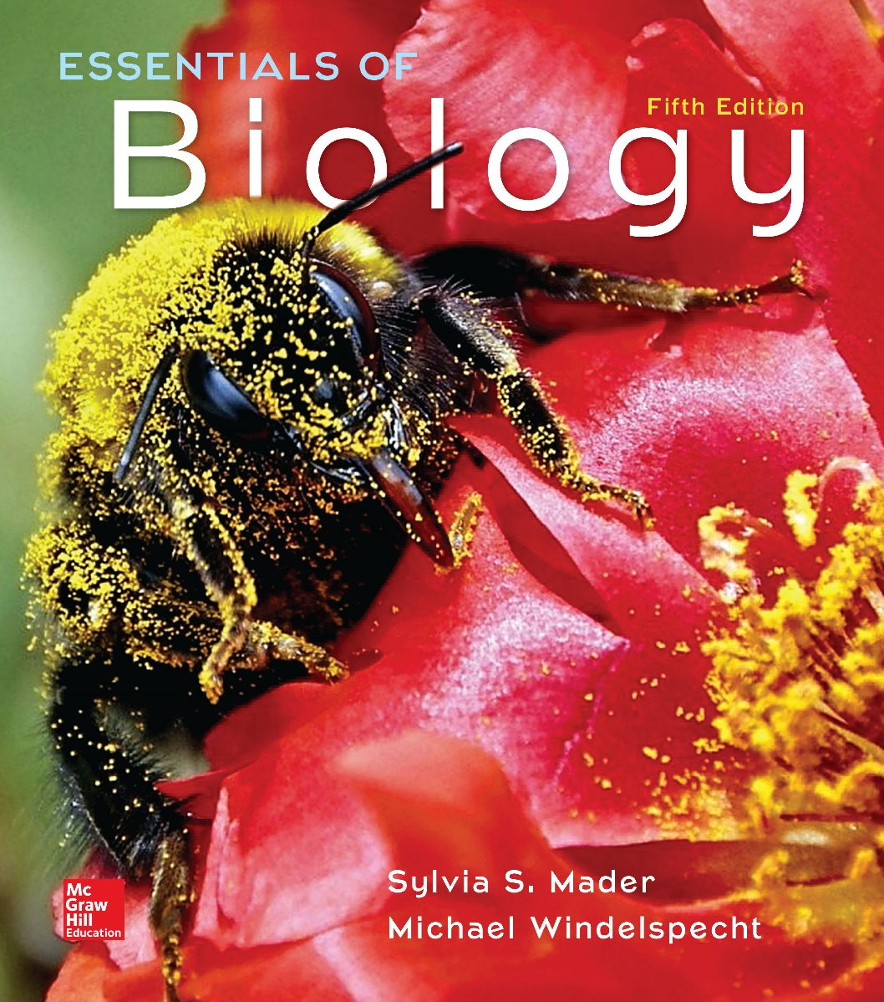
Essentials of Biology
Sylvia S. Mader Michael Windelspecht
Chapter 31
Communities and Ecosystems
Lecture Outline
See separate FlexArt PowerPoint slides for all figures and tables pre-inserted into PowerPoint without notes.
Copyright © McGraw-Hill Education. All rights reserved. Authorized only for instructor use in the classroom. No reproduction or distribution without the prior written consent of McGraw-Hill Education.
Notes:
1

Slide 2
31.1 Ecology of Communities
Community—assemblages of populations of multiple species interacting with one another within a single environment
Communities come in different sizes.
Relationships and interactions between species form over time.
Coevolution—evolutionary change in one species results in an evolutionary change in another.

Slide 3
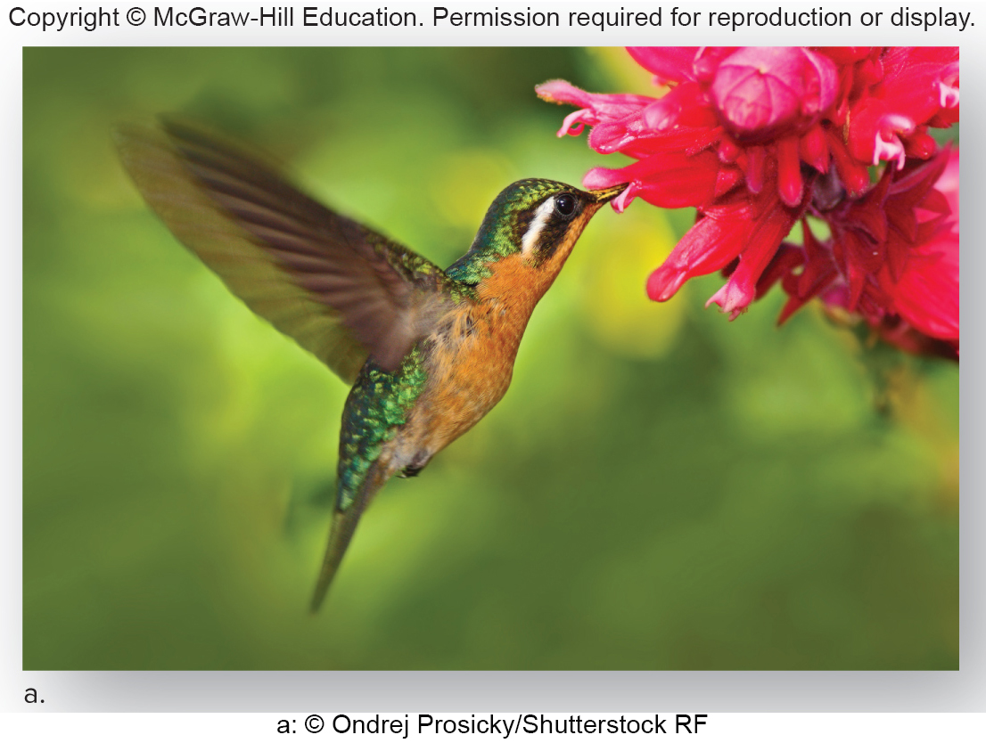
Figure 31.1a Coevolution, Hummingbirds and Flowers
a: © Ondrej Prosicky/Shutterstock RF
Hummingbird-pollinated flowers are usually red, a color that these birds can see, and the petals are recurved to allow the stamens to dust the birds’ heads.

Slide 4
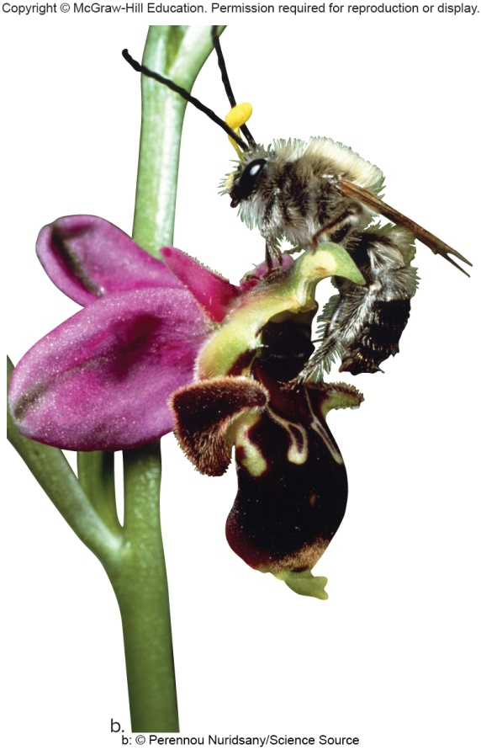
Figure 31.1b Coevolution, Wasps and Orchids
b: © Perennou Nuridsany/Science Source
The reward offered by the flower is not always food. This orchid looks and smells like the female of this wasp’s species. The male tries to copulate with flower after flower and in the process transfers pollen.

Slide 5
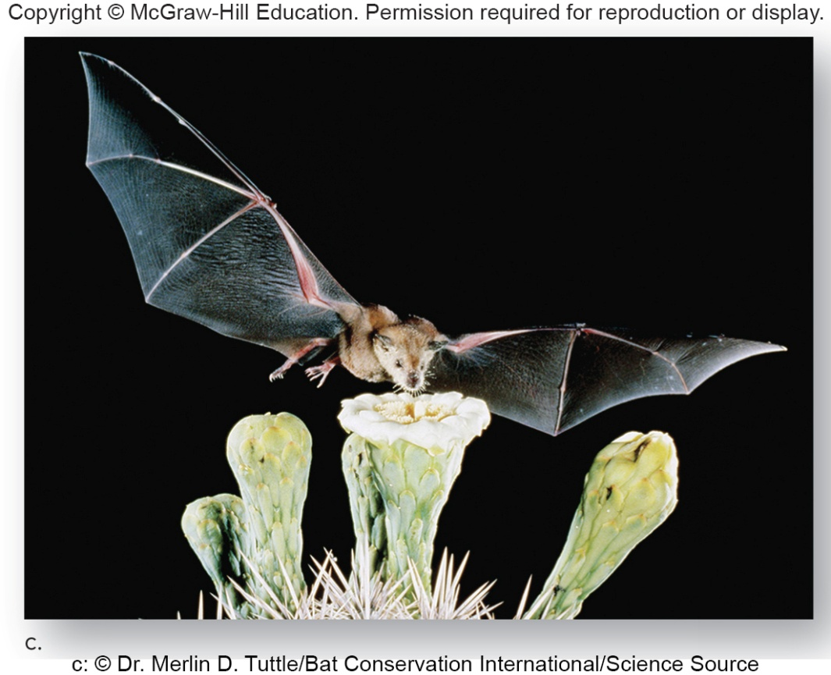
Figure 31.1c Coevolution, Bats and Cacti Flowers
c: © Dr. Merlin D. Tuttle/Bat Conservation International/Science Source
Bats are nocturnal, and the flowers they pollinate are white or light-colored, making them visible in moonlight. The flowers smell like bats and are large and sturdy, enabling them to withstand insertion of the bat’s head as it uses its long, bristly tongue to lap up nectar and pollen.

Slide 6
Ecology of Communities
All species in a community possess adaptations suitable to the conditions of their particular physical environment.
Ecosystem—species interacting with each other and the physical environment
If the physical environment changes, corresponding changes will occur in species and their relationships with each other.
Extinction can occur when change is too rapid for suitable adaptations to occur.

Slide 7
Community Composition and Diversity
Can compare communities based on these
Species richness—species composition of a community
Simply a listing of various species in that community
Coniferous forest has a different species composition than a tropical rain forest.
Types and number of plants and animals also differ between the two.
Two communities differ in species composition and tropical rain forest supports more species (higher species richness).

Slide 8
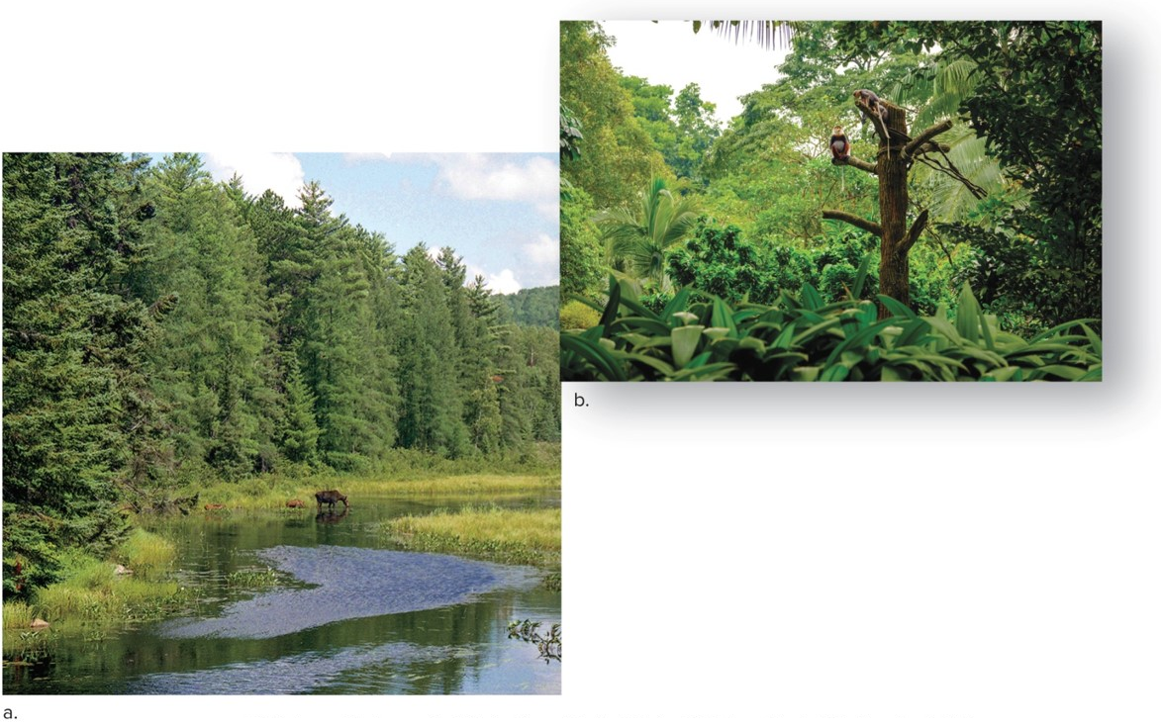
Figure 31.2 Community Species Composition
a: © Yi Jiang Photography/Flickr Open/Getty RF; b: © Nejron Photo/Shutterstock RF

Slide 9
Diversity
Diversity—goes beyond species richness to include species distribution and relative abundance
If a forest has 77 trees
76 poplar trees and one American elm—less diverse
36 poplar trees and 41 American elms—more diverse
Same species richness—two species
Higher diversity value in second example

Slide 10
Ecological Succession
Community species composition and diversity do change over time.
Change is slow so may not be noticeable for few decades.
Natural forces (glaciers, volcanic eruptions, fires, hurricanes, and floods) are disturbances that can change the community.
Ecological succession—more or less orderly process of community change
Ecologists have model to explain why succession occurs and predict patterns.

Slide 11
Climax-Pattern Model
Climate of an area always leads to the same stable climax community.
Specific assemblage of bacterial, fungal, plant, and animal species

Slide 12
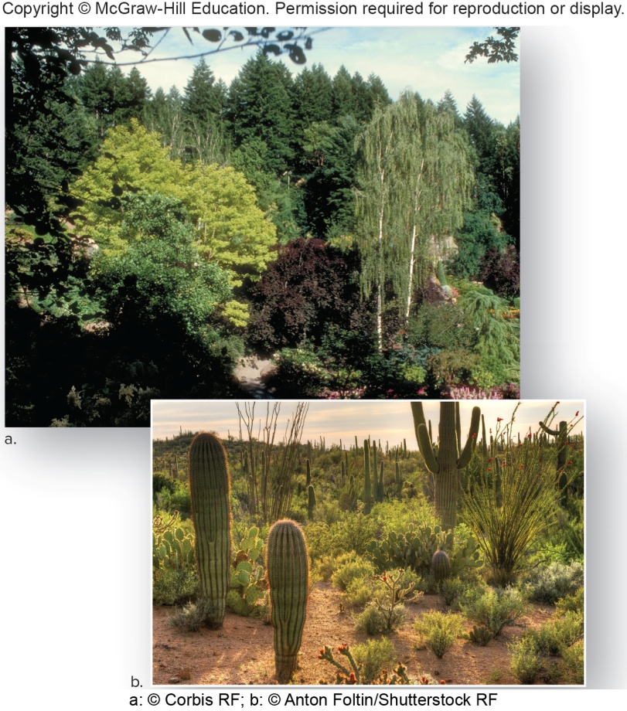
Figure 31.3 Climax Communities
a: © Corbis RF; b: © Anton Foltin/Shutterstock RF
Temperate forest occurs where there is adequate rainfall. Deserts occur where rainfall is minimal. Assemblages of organisms are dependent on migration and communities will vary.

Slide 13
Two Types of Succession
Primary succession
Occurs where soil has not yet formed
On hardened lava flows or bedrock scraped by glaciers
Secondary succession
For example, begins in a cultivated field that is no longer farmed (soil already present)
Both types have a progression of species over time.

Slide 14
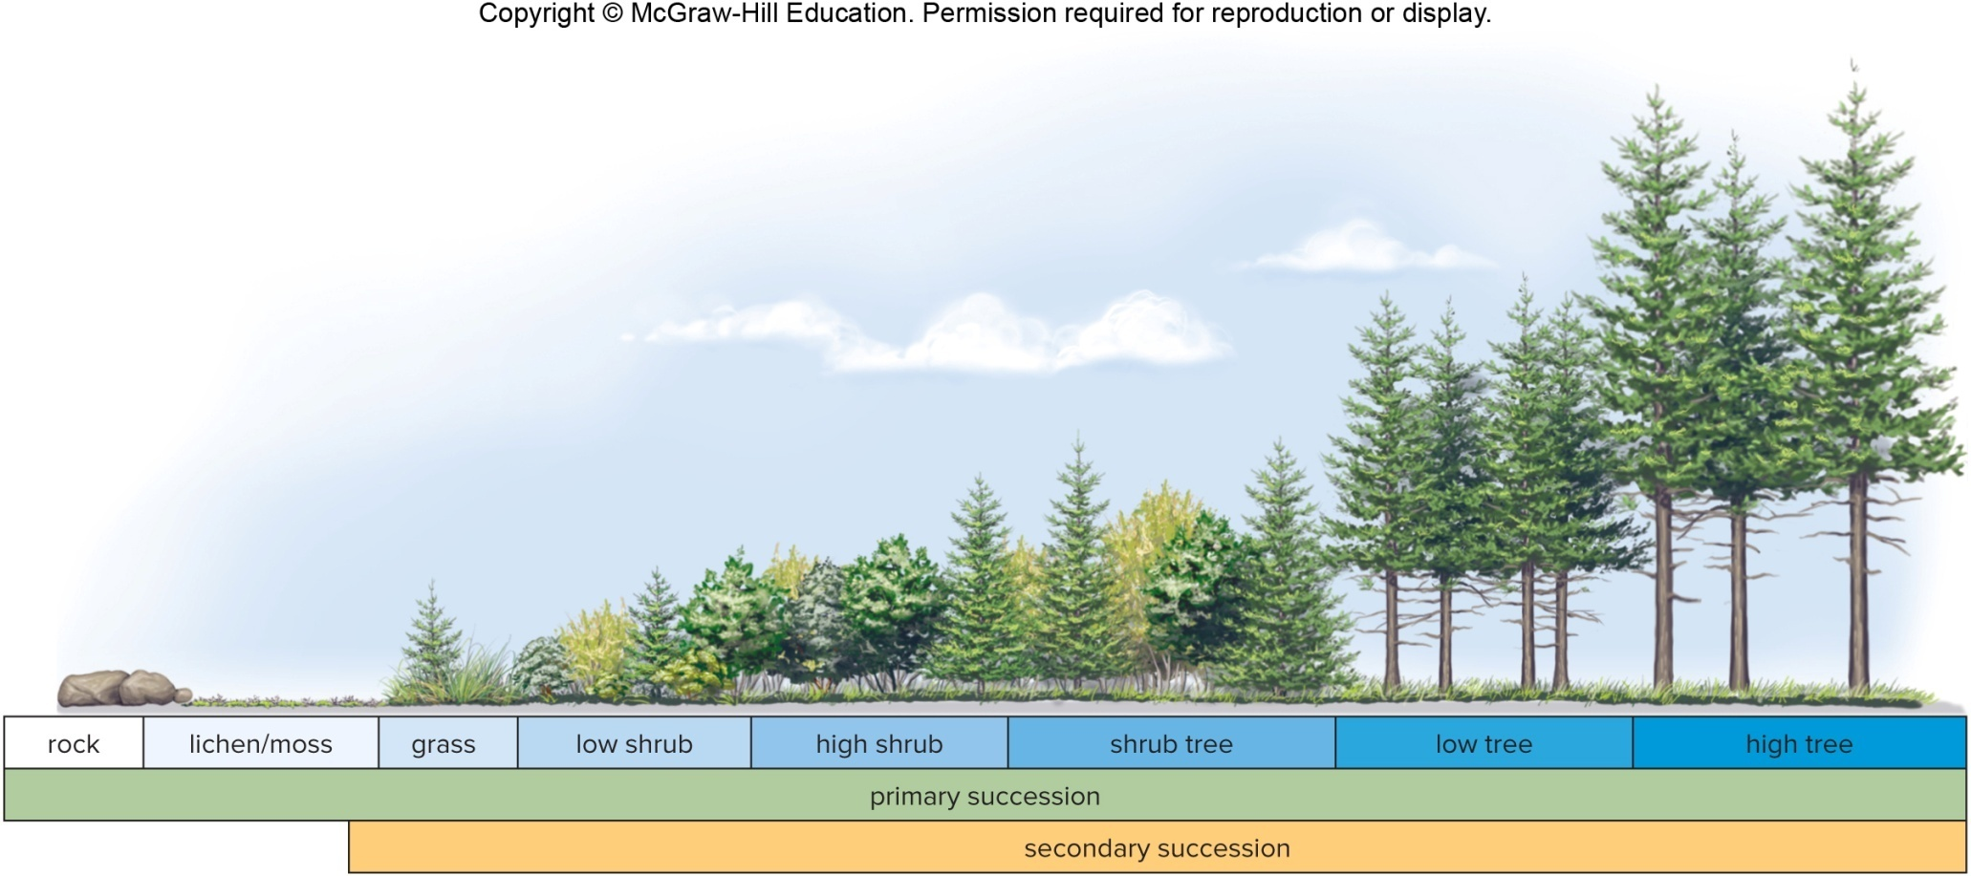
Figure 31.4 Primary and Secondary Succession

Slide 15
Opportunistic Pioneer and Equilibrium Species
First species in an area undergoing primary or secondary succession are called opportunistic pioneer species.
Small in stature, short-lived, quick to mature, and produce numerous offspring per reproductive event
First pioneer species are photosynthetic organisms like lichens or mosses.
Lichens are two organisms (fungal and algal partners) living as one organism.
Pioneer herbivores and the carnivores follow.
Equilibrium species come later—larger in size, long-lived, slow to mature, and produce few offspring per reproductive event.

Slide 16
Figure 31.5 Secondary Succession
Glacier/lichen stage
Shrub stage
Low tree stage
High tree stage
a: (glacier): © Kevin Smith/Design Pics; a: (lichen): © Background Abstracts/Getty RF; b: (shrub stage): © Don Paulson/Alamy RF; b: (Dryas plant): © Martin Fowler/Shutterstock RF; c: © Bruce Heinemann/Getty RF; d: © Don Paulson/Alamy RF
The progression of secondary succession changes in a western Pennsylvania field over 20 years.

Slide 17
Interactions in Communities
Competition
Between two species for limited resources has a negative effect on the abundance of both species
Predation
Predator feeds on prey.
Parasitism
Parasite obtains nutrients from host but does not kill host.
Commensalism
One species benefits while the other is not harmed.
Mutualism
Two species interact so that they both benefit.

Slide 18
Table 31.1 Species Interaction
Table 31.1 Species Interactions
Interaction | Expected Outcome
Competition (- -) | Abundance of both species decreases.
Predation (+ -) | Abundance of predator increases, and abundance of prey decreases.
Parasitism (+ -) | Abundance of parasite increases, and abundance of host decreases.
Commensalism (+ 0) | Abundance of one species increases, and the other is not affected.
Mutualism (+ +) | Abundance of both species increases.

Slide 19
Ecological Niche
Each species occupies a particular position in the community, both in a spatial and a functional sense.
Habitat—spatially, species live in a particular area of the community, such as underground, in the trees, or in shallow water.
Functionally, each species plays a role, such as whether it is a photosynthesizer, predator, prey, or parasite.
Ecological niche of a species
Incorporates the role the species plays in its community, its habitat, and its interactions with other species
Includes the living and nonliving resources that individuals in the population need to meet their energy, nutrient, and survival demands

Slide 20
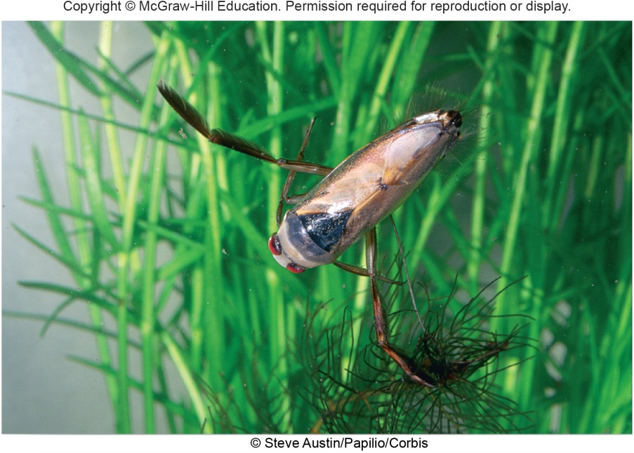
Figure 31.6 Niche of a Backswimmer
Backswimmer (insect)
Habitat is a pond or lake, where it eats other insects
Pond or lake must contain vegetation where the backswimmer can hide from its predators, including fish and birds.
Pond water must be clear enough for the backswimmer to see its prey and warm enough for it to maintain a good metabolic rate.
© Steve Austin/Papilio/Corbis

Slide 21
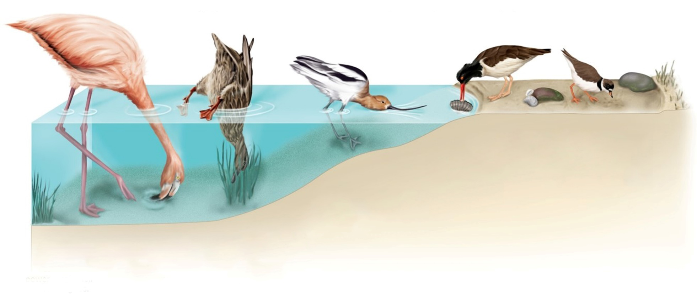
Figure 31.7 Feeding Niches for Wading Birds
Oystercatchers pry open bivalve shells with their knifelike bills and probe sand for worms and crabs.
Plovers dart around on beaches and grasslands, hunting for insects and small invertebrates.
Avocets feed on insects, small marine invertebrates, and seeds by sweeping their bills from side to side in shallow water.
Flamingos feed on small molluscs, crustaceans, and vegetable matter strained from mud pumped through their bills by their powerful tongues.
Dabbling ducks feed by tipping, tail up, to reach aquatic plants, seeds, snails, and insects.
Since it is difficult to describe and measure the total niche of a species in a community, ecologists often focus on a certain aspect of a species’ niche.

Slide 22
Competition
Competition for resources contributes to the niche of each species and structures the community.
Competitive exclusion principle
No two species can occupy same niche at same time.
1930s experiments on two species of Paramecium in a test tube containing a fixed amount of food
Although populations of each species survived when grown in separate test tubes, only one species, Paramecium aurelia, survived when the two species were grown together.
P. aurelia acquired more of the food resource and had a higher population growth rate than did P. caudatum.
Eventually, as the P. aurelia population grew and obtained an increasingly greater proportion of the food resource, the number of P. caudatum individuals decreased, and the population died out.

Slide 23
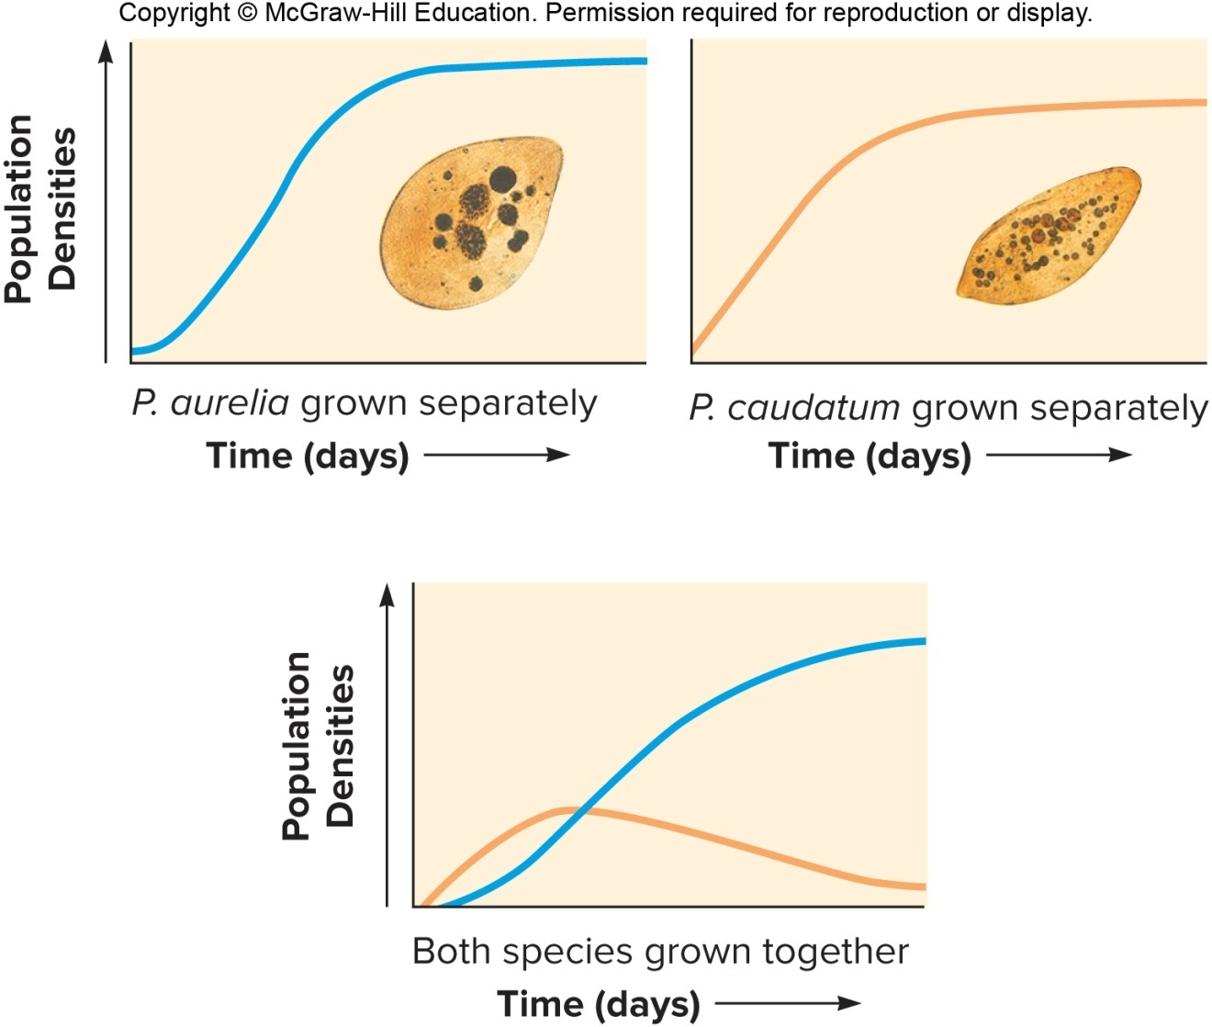
Figure 31.8 Competitive Exclusion Principle Demonstrated by Paramecium

Slide 24
Niche Specialization, 1
Competition for resources does not always lead to localized extinction of a species.
Multiple species can coexist by partitioning resources.
Resource partitioning decreases competition between the species.

Slide 25
Niche Specialization, 2
When three species of ground finches of the Galápagos Islands live on the same islands, their beak sizes differ, and each feeds on a different-sized seed.
When the finches live on separate islands, their beaks tend to be the same intermediate size, enabling each to feed on a wider range of seeds.
Character displacement often is viewed as evidence that competition and resource partitioning have taken place.

Slide 26
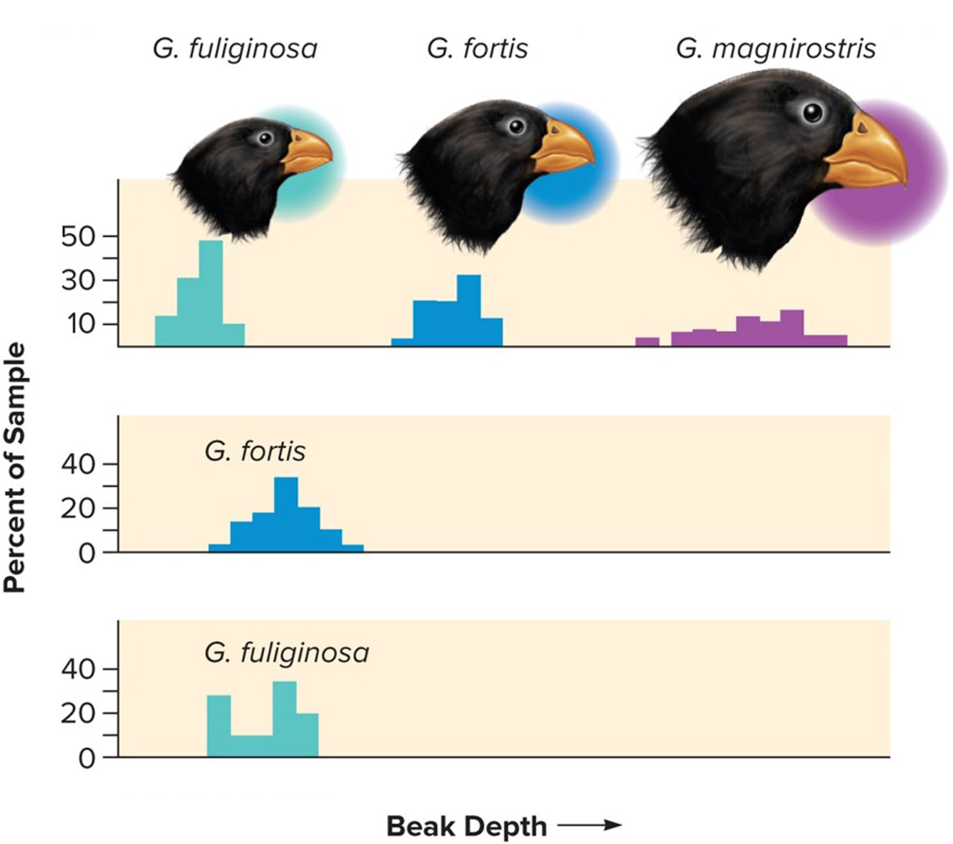
Figure 31.9 Character Displacement in Finches on the Galápagos Islands
Abingdon, Bindloe, James, Jervis Islands
Daphne Island
Crossman Island

Slide 27
Mutualism, 1
Symbiotic relationship in which both members benefit
Recognized to be at least as important as competition in shaping community structure
Relationship between plants and pollinators
Lichens—fungal and algal partners living together
Can live on rocks since fungal partner leaches minerals valuable to algal partner and algal partner photosynthesizes to provide food for both

Slide 28
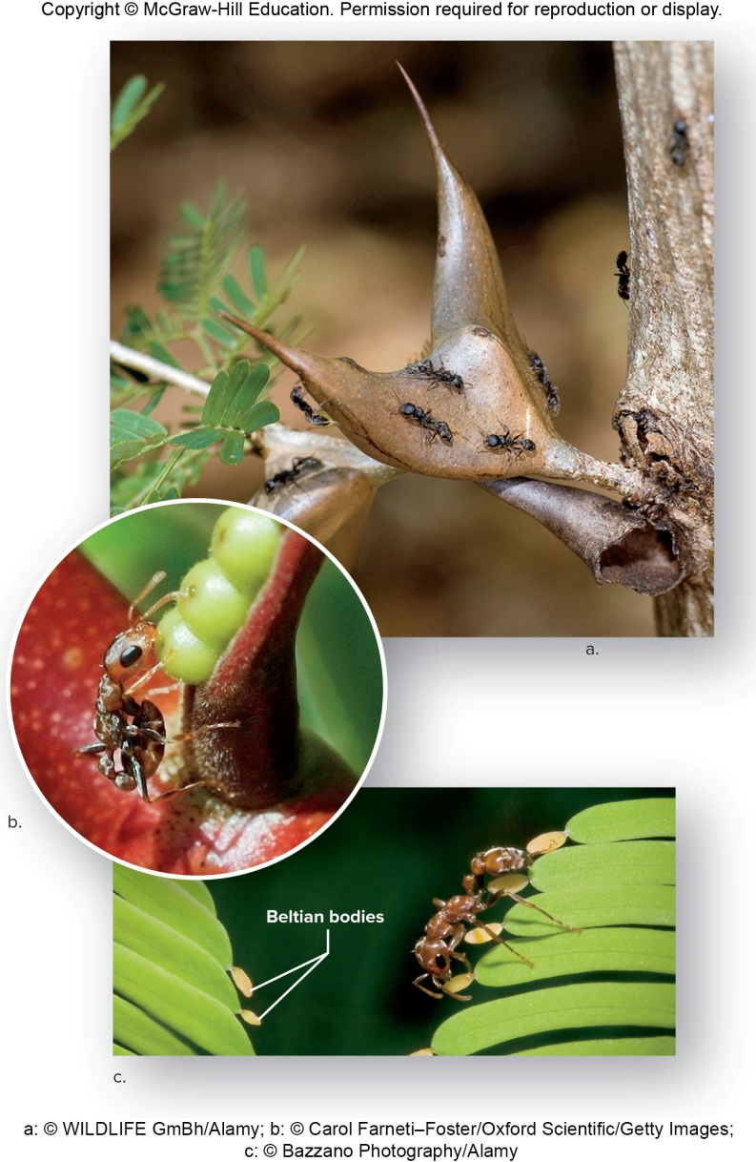
Figure 31.10 Mutualism
Bullhorn acacia tree provides homes for Pseudomyrmex ferruginea (ants).
Swollen thorns have hollow interior where ants live.
Acacias also have nectaries and Beltian bodies to feed ants.
In return, ants protect trees from herbivores.
a: © WILDLIFE GmBh/Alamy; b: © Carol Farneti-Foster/Oxford Scientific/Getty Images; c: © Bazzano Photography/Alamy

Slide 29
Mutualism, 2
In western United States, branches and cones of whitebark pine are tuned upward (seeds do not fall to the ground when cone opens).
Clark’s nutcrackers eat the whitebark pine seeds and store them in the ground.
Birds are critical seed dispersers for the tree.
Grizzly bears find seed stores and eat them.
Whitebark pine seeds do not germinate unless exposed to fire.
Without fire, the whitebark pine population decreases along with Clark’s nutcracker and grizzly bear populations.

Slide 30
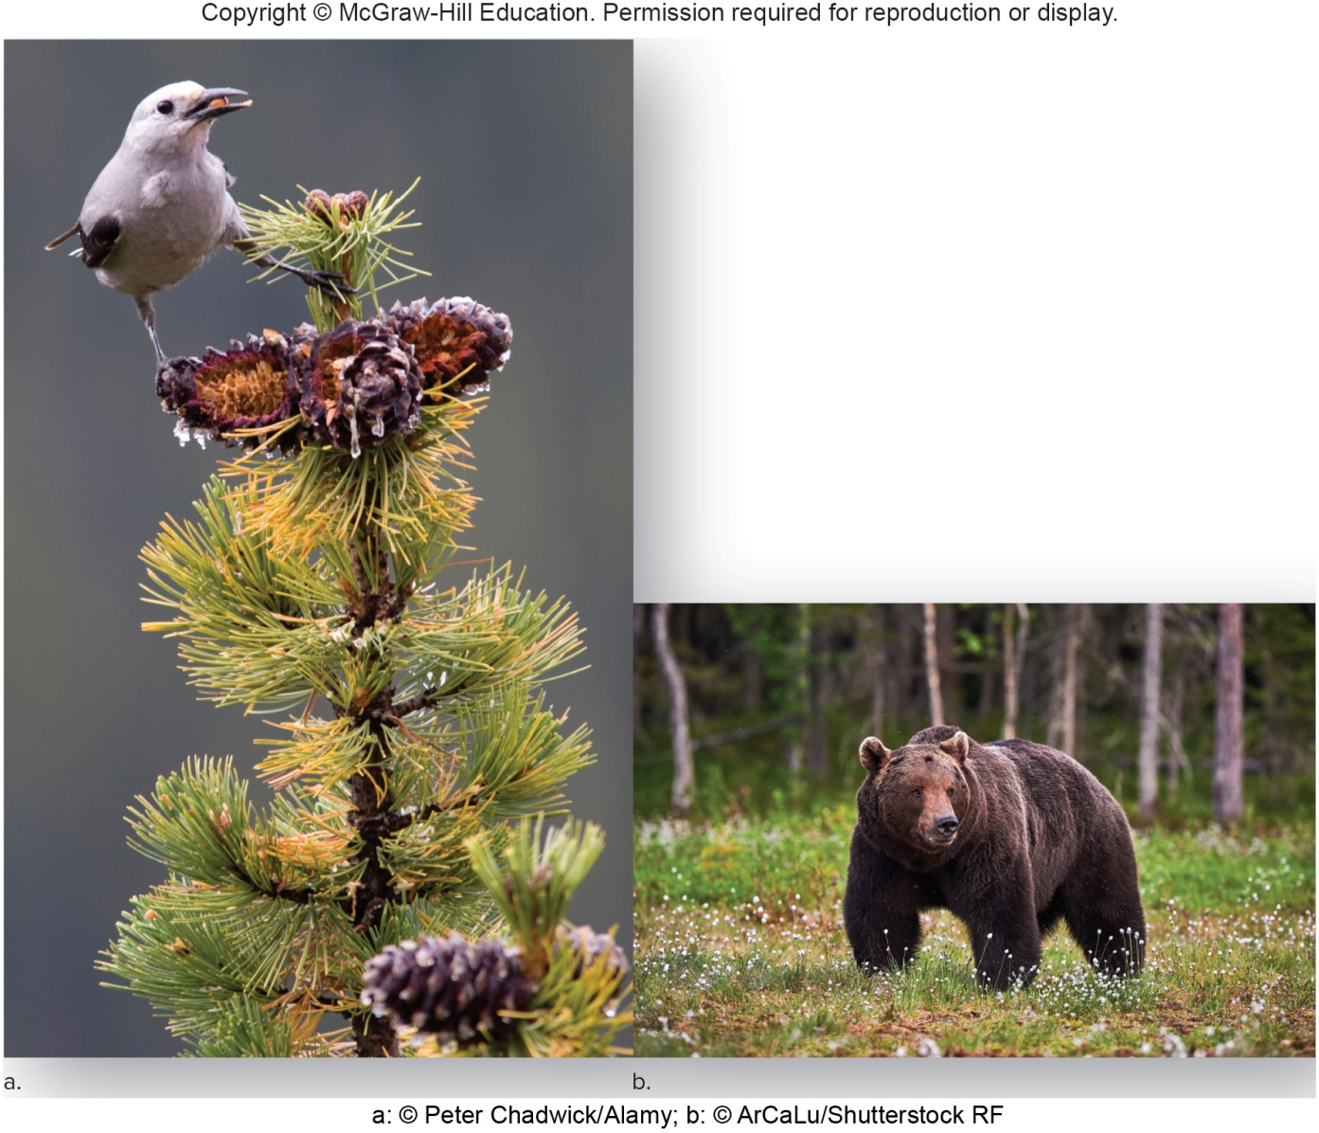
Figure 31.11 Interdependence of Species
a: © Peter Chadwick/Alamy; b: © ArCaLu/Shutterstock RF

Slide 31
Community Stability, 1
Fragile web of interdependencies
Keystone species—some communities have one species that stabilizes the community and holds the web together.
Not always the most numerous organism
Loss of keystone species can lead to extinction of other species.
Bats are keystone species in tropical rainforests.
Pollinators and dispersers of seeds
When bats are killed off, trees fail to reproduce.
Grizzly bears in the northwestern United States
Disperse thousands of berry seeds in one dung pile
Keep herbivore populations under control

Slide 32
Community stability, 2
Native versus exotic species
Native species—indigenous to an area and have evolved in that particular community
Exotic species—nonnative species, intentionally or accidentally introduced to an area by humans
Introduction disrupts community
Exotic species populations may grow exponentially if they are better competitors or lack a natural predator or disease.
Myrtle tree was introduced to Hawaii from Canary Islands.
Myrtle tree has mutualistic bacteria that fixes nitrogen so it outcompetes native vegetation.

Slide 33
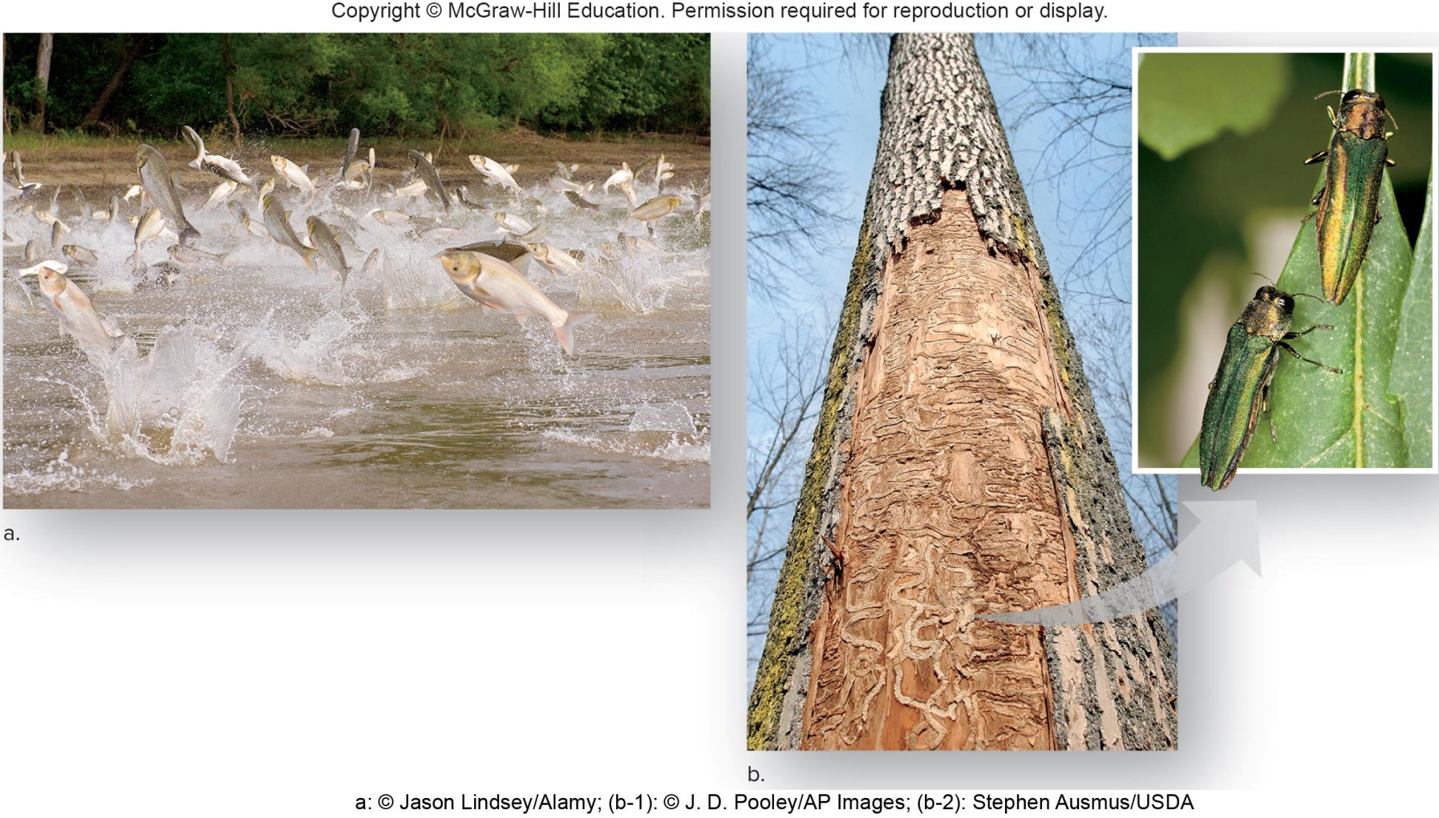
Figure 31.12 Exotic Species
a: © Jason Lindsey/Alamy; (b-1): © J. D. Pooley/AP Images; (b-2): Stephen Ausmus/USDA

Slide 34
31.2 Ecology of Ecosystems
Ecosystem more inclusive than a community
Includes interactions with physical environment
How an organism acquires food
Autotroph
Heterotroph

Slide 35
Autotrophs
Take in only inorganic nutrients (${CO}_{2}$and minerals) and an outside energy source to produce organic nutrients
Called producers because they produce food
Photoautotrophs are photosynthesizers.
Use energy of the sun
Algae and green plants
Release $O_{2}$ to atmosphere as by-product

Slide 36
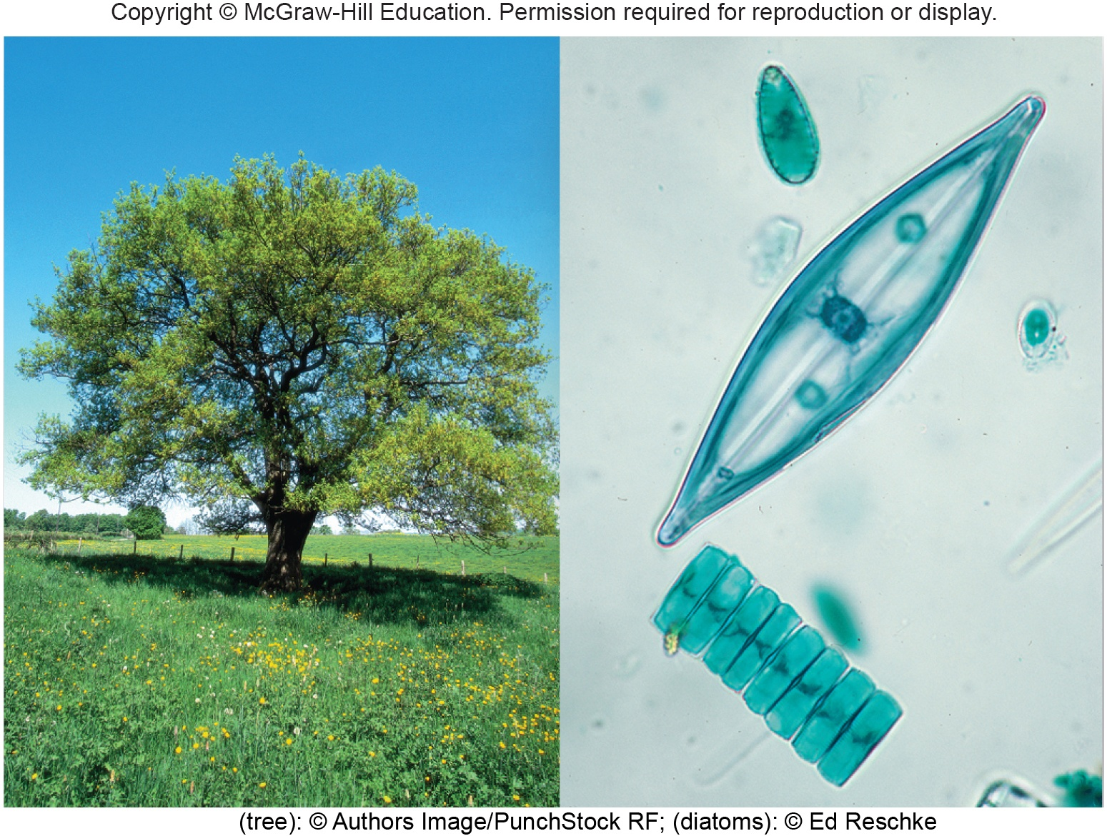
Figure 31.13 Producers
(tree): © Authors Image/PunchStock RF; (diatoms): © Ed Reschke

Slide 37
Chemoautotrophs
Some bacteria obtain energy by oxidizing inorganic compounds such as ammonia, nitrites, and sulfides.
Energy source to synthesize organic compounds
Found in caves and hydrothermal vents along deep sea oceanic ridges

Slide 38
Heterotrophs
Need a source of preformed organic nutrients
Release ${CO}_{2}$ to atmosphere
Called consumers because they consume food
Herbivores graze on algae or plants.
Zooplankton, caterpillars, giraffes
Carnivores eat other animals.
Primary, secondary, and tertiary consumers
Tertiary consumers are top predators.
Omnivores eat both plants and animals.
Humans

Slide 39
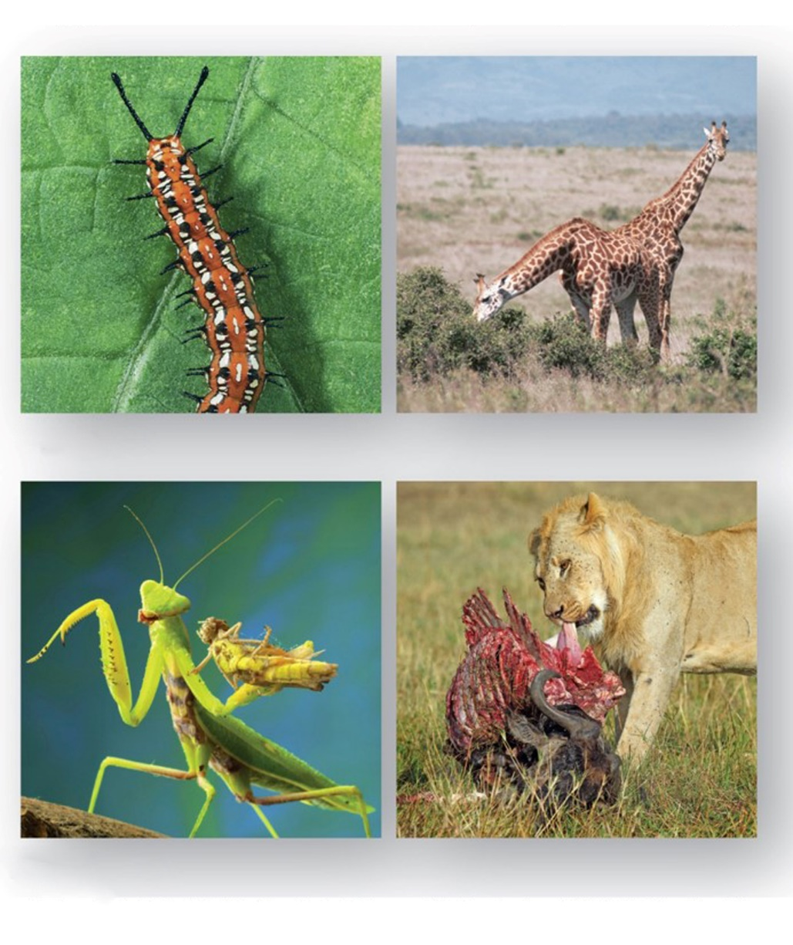
Figure 31.14 Consumers
Consumers
Primary consumer—caterpillar or giraffe
Secondary consumer—praying mantis
Tertiary consumer—osprey
Herbivores
Carnivores
a: (caterpillar): © Corbis RF; (giraffes): © George W. Cox; b: (mantis): © Kristina Postnikova/ Shutterstock RF; (lion): © Sue Green/Shutterstock RF

Slide 40
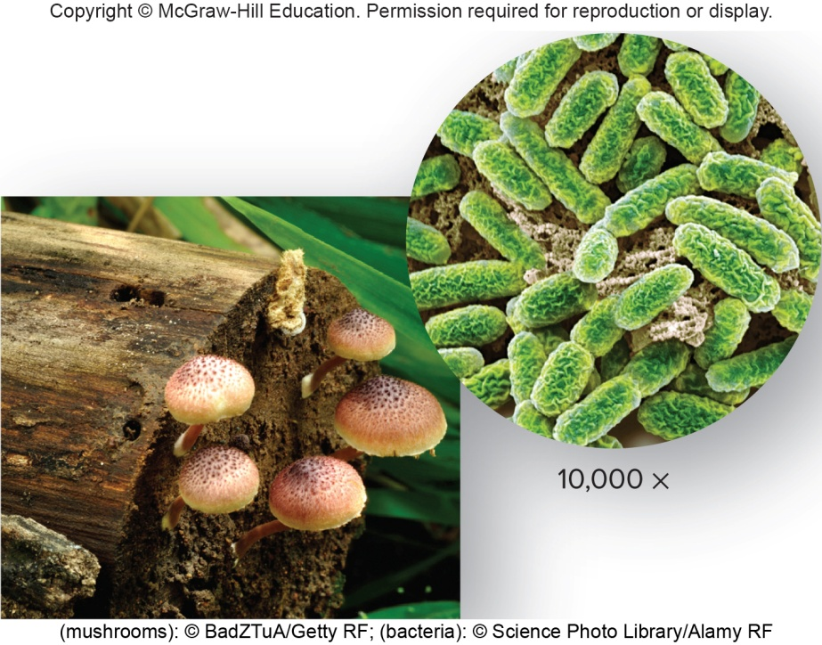
Figure 31.15 Decomposers
(mushrooms): © BadZTuA/Getty RF; (bacteria): © Science Photo Library/Alamy RF
Decomposers
Heterotrophic bacteria and fungi
Break down organic matter including animal waste
Very valuable service
Release inorganic nutrients that are taken up by plants once more
Detritus—remains of dead organisms plus bacteria and fungi aiding in decay

Slide 41
Energy Flow and Chemical Cycling, 1
Living components of ecosystems process energy and chemicals.
Energy flow through an ecosystem begins when producers absorb solar energy.
Chemical cycling begins when producers take in inorganic nutrients from the physical environment.
Producers convert solar energy and inorganic nutrients into chemical energy in the form of organic nutrients.
Energy flows through the ecosystem because organic nutrients pass from one component of the ecosystem to another.
Eventually energy dissipates into the environment as heat.
The vast majority of ecosystems cannot exist without a continual supply of solar energy.

Slide 42
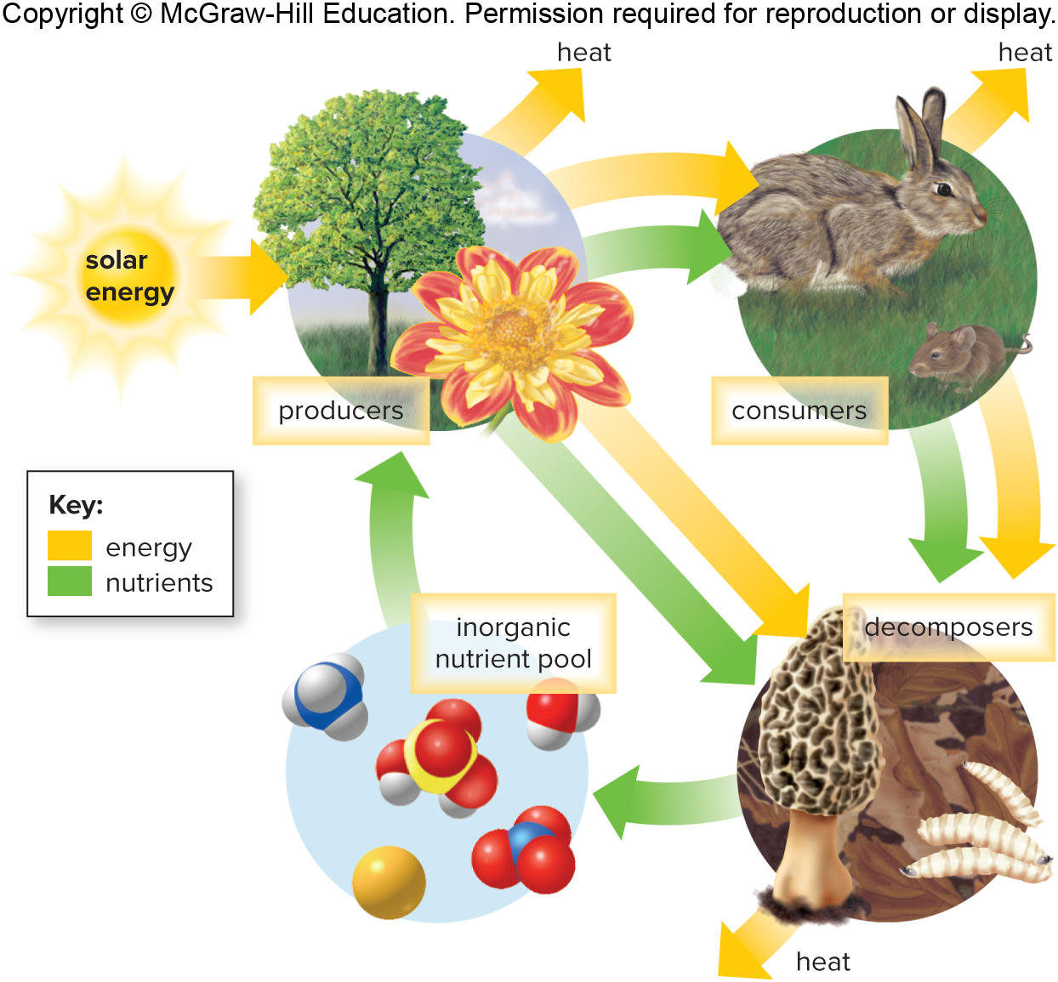
Figure 31.16 Chemical Cycling and Energy Flow

Slide 43
Energy Flow and Chemical Cycling, 2
Only a portion of the organic nutrients made by producers is passed on to consumers.
Plants use organic molecules to fuel their own cellular respiration.
Only a portion of nutrients consumed by lower-level consumers (herbivores) is available to higher-level consumers (predators).
Elimination of feces and urine or death of organisms does not mean organic nutrients are lost from an ecosystem.
Nutrients available to decomposers
Convert organic nutrients back into inorganic nutrients for release into soil or atmosphere

Slide 44
Energy Flow and Chemical Cycling, 3
Of the food eaten by an herbivore,
Some is never digested and eliminated as feces
Of the assimilated energy, a large proportion is used for the production of ATP.
Which also produces heat
Only energy converted into body weight or additional offspring is available to carnivores.

Slide 45
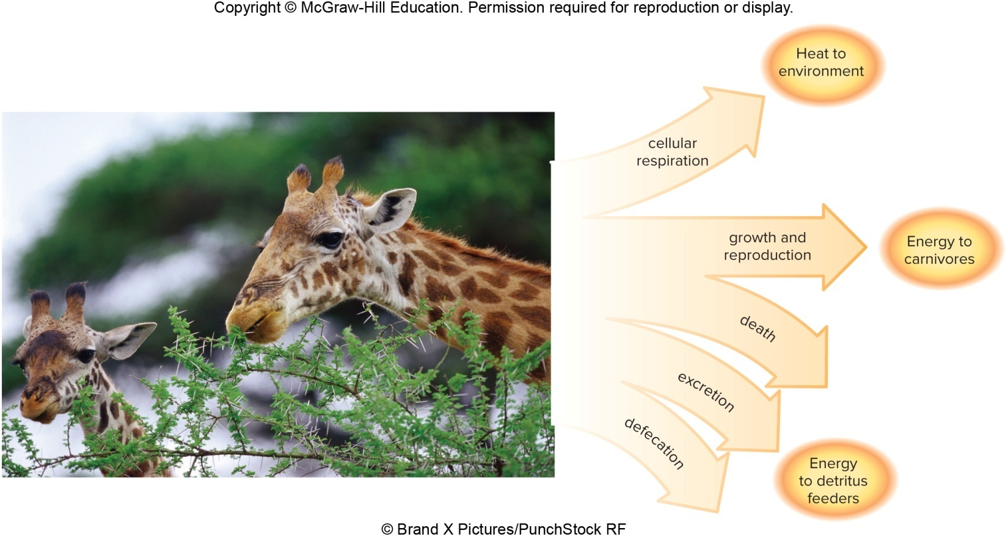
Figure 31.17 Energy Balances
© Brand X Pictures/PunchStock RF
Only about 10% of the nutrients and energy taken in by an herbivore is passed on to carnivores. A large portion goes to detritus feeders. Another large portion is used for cellular respiration.

Slide 46
Energy Flow
Food web—interconnecting paths of energy flow between components of an ecosystem
Grazing food web—begins with plants
Caterpillars and other herbivorous insects feed on the leaves of trees.
Other herbivores (mice, rabbits, deer) also feed on leaves.
Birds, chipmunks, and mice feed on fruits and nuts of trees.
Omnivores because they also eat caterpillars and insects
All provide food for carnivores
Detrital food web—begins with bacteria and fungi
Detritus is food for larger organisms.
Shrews and salamanders can become food for aboveground animals linking the detrital and grazing food webs.

Slide 47
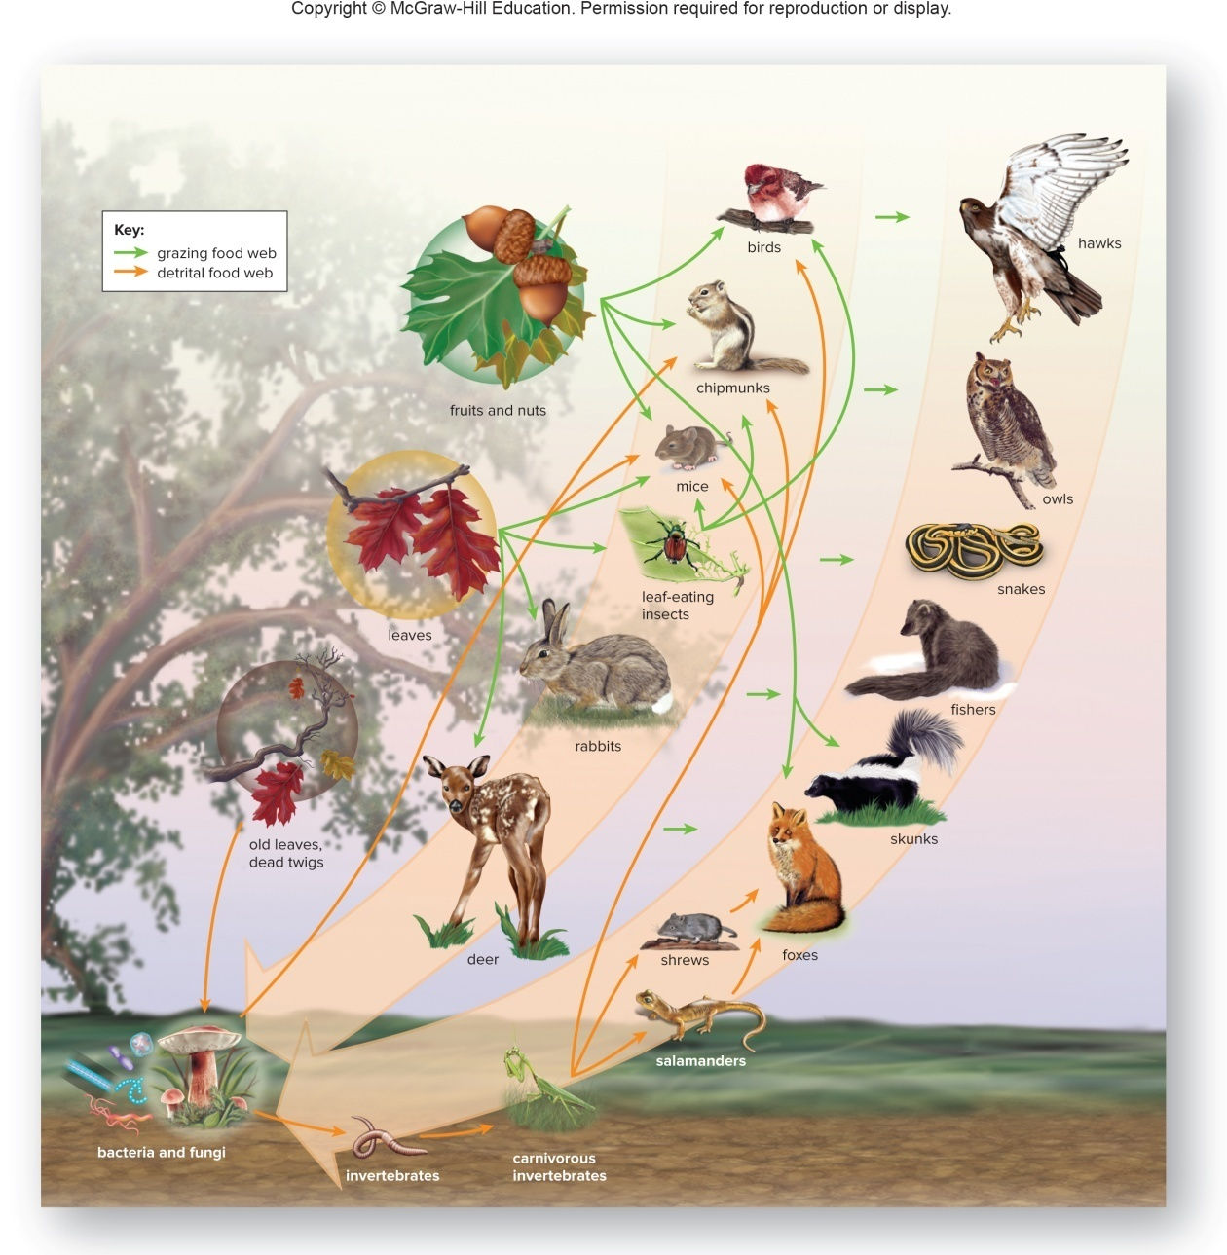
Figure 31.18 Food Webs

Slide 48
Trophic Levels and Ecological Pyramids
Food chain—diagrams that show a single path of energy flow in an ecosystem
Trophic level—level of nourishment within a food web or chain
First level—producers
Second level—herbivores
Third (and fourth) level—carnivores

Slide 49
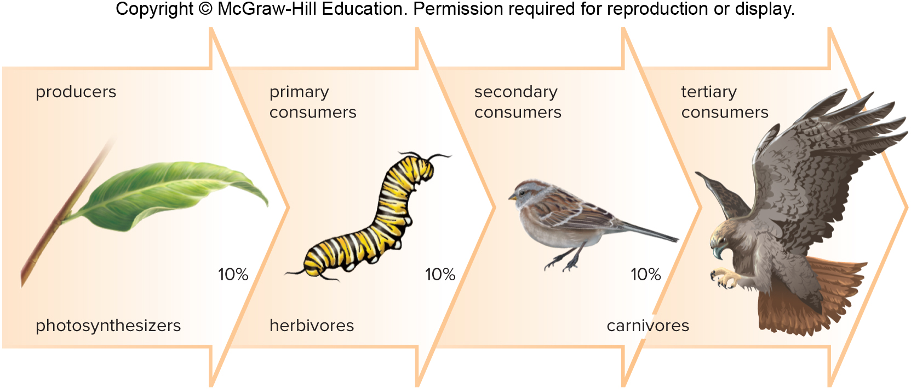
Figure 31.19 Food Chain

Slide 50
Food Chains
Food chains are short, because energy is lost between trophic levels
In general, only about 10% of the energy of one trophic level is available to the next level.
Explains why few carnivores can be supported in a food chain
Ecological pyramid depicts energy losses between tropic levels.

Slide 51
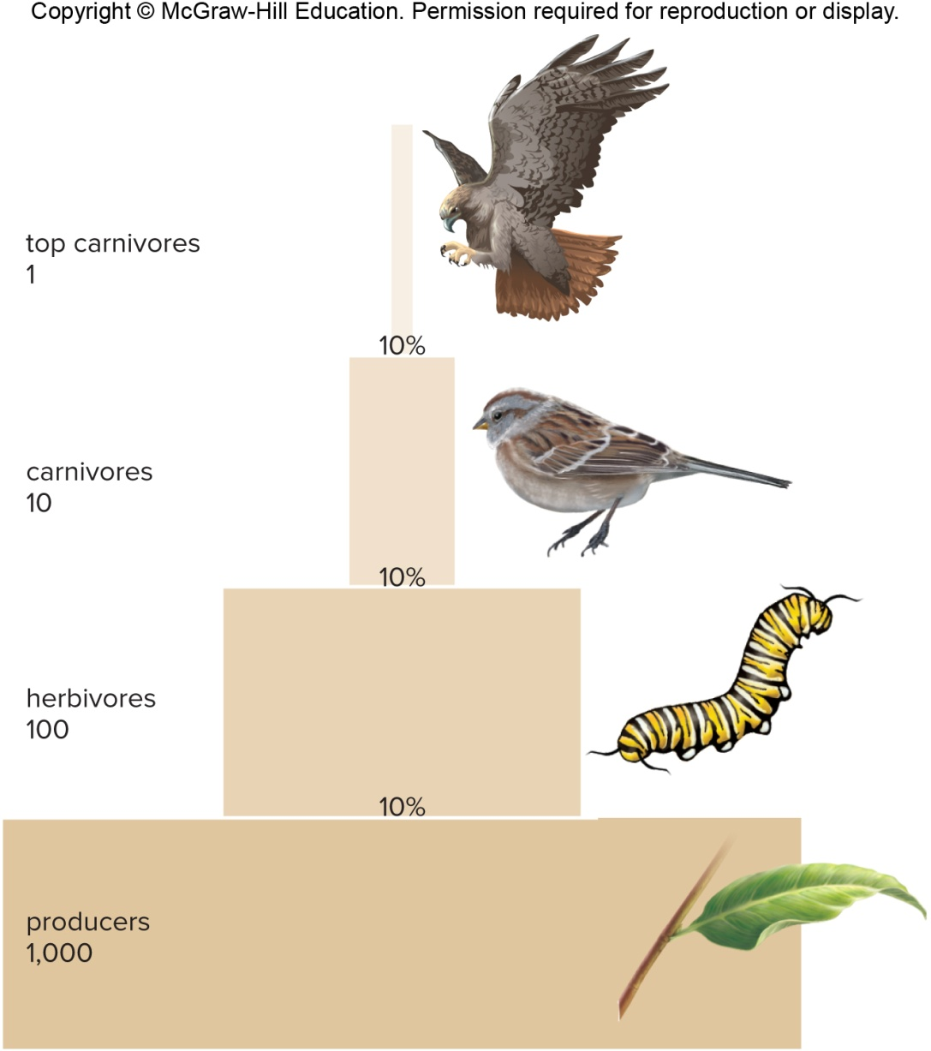
Figure 31.20 Ecological Pyramid

Slide 52
Chemical Cycling
Biogeochemical cycles—pathways by which chemicals cycle within ecosystems
Involves both living (producers, decomposers, consumers) and nonliving (inorganic nutrients, atmosphere) components
Two types of cycles
Sedimentary—chemical is absorbed from the sediment by plant roots, passed through the food chain, and eventually returned to the soil by decomposers.
Gaseous—element returns to and is withdrawn from the atmosphere as a gas.

Slide 53
Cycles May Involve
Reservoirs—source normally unavailable to organisms
Exchange pool—source from which organisms generally take elements
Biotic community—consists of autotrophic and heterotrophic species of an ecosystem that feed on each other

Slide 54
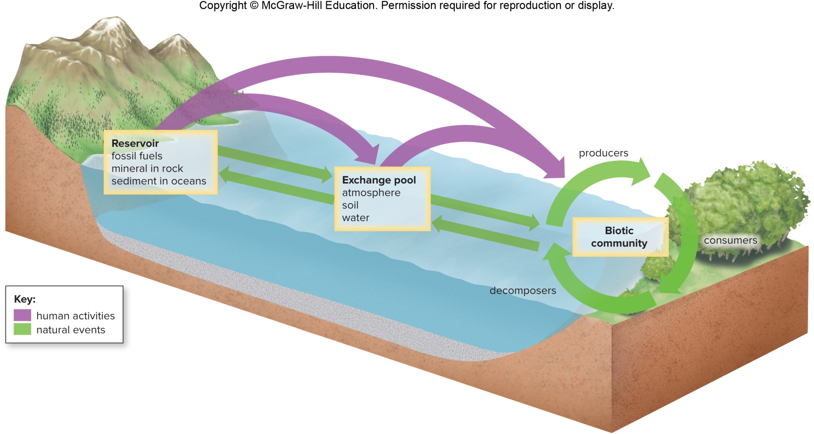
Figure 31.21 Model for Chemical Cycling

Slide 55
Phosphorus Cycle
On land, slow weathering of rocks adds phosphates (${PO}_{4}^{2−}$ and ${HPO}_{4}^{2−}$) to the soil.
Also runs off into aquatic systems
Producers use phosphates in a variety of molecules—phospholipids, ATP, nucleotides.
Decomposition of plant and animal materials makes phosphates available.
Phosphates usually a limiting inorganic nutrient in ecosystems
Limits plant growth and primary productivity

Slide 56
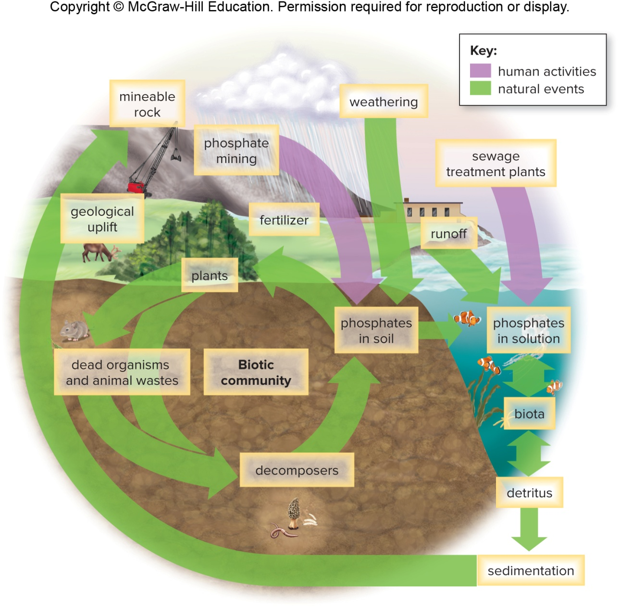
Figure 31.22 The Phosphorus Cycle

Slide 57
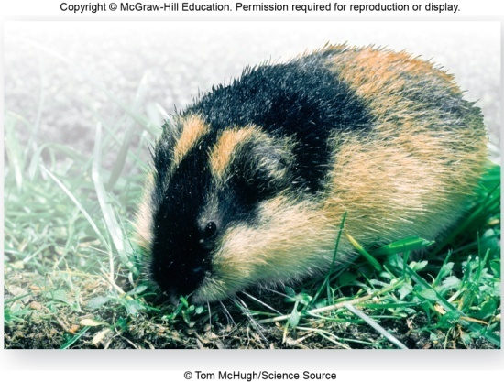
Figure 31.23 Lemmings
© Tom McHugh/Science Source
Lemmings illustrate the importance of phosphates and calcium to population growth.
Every four years or so, grasses and sedges of tundra become rich in minerals and lemming population explodes.
Grasses and sedges then decline due to overabundance of lemmings.
Now lemming population crashes.
Takes about four years before animals decompose and return minerals to producers
Cycle starts again.

Slide 58
Transfer Rate
Amount of nutrient that moves from one component of the environment to another within a specified amount of time
Human activities change transfer rates.
Humans mine phosphate ores and use them for fertilizer, animal feed supplement, and detergents.
Animal wastes from livestock, lawn fertilizer, and sewage discharge from cities adds excess phosphates to nearby waters.
Eutrophication—overenrichment of a body of water causing an algal bloom
When algae die and decay, oxygen is consumed, causing fish kills.

Slide 59
Nitrogen Cycle
Nitrogen gas ($N_{2}$) comprises 78% of the atmosphere by volume.
Plants cannot take up nitrogen gas.
Plants rely on various bacteria to make nitrogen available.
Plants take up ammonium (${NH}_{4}^{+}$) and nitrate (${NO}_{3}^{−}$) from the soil.
Incorporate it into amino acids and nucleic acids
Nitrogen fixation changes $N_{2}$ to ammonium.
Nitrification produces nitrates.
Denitrification converts nitrates to $N_{2}$.

Slide 60
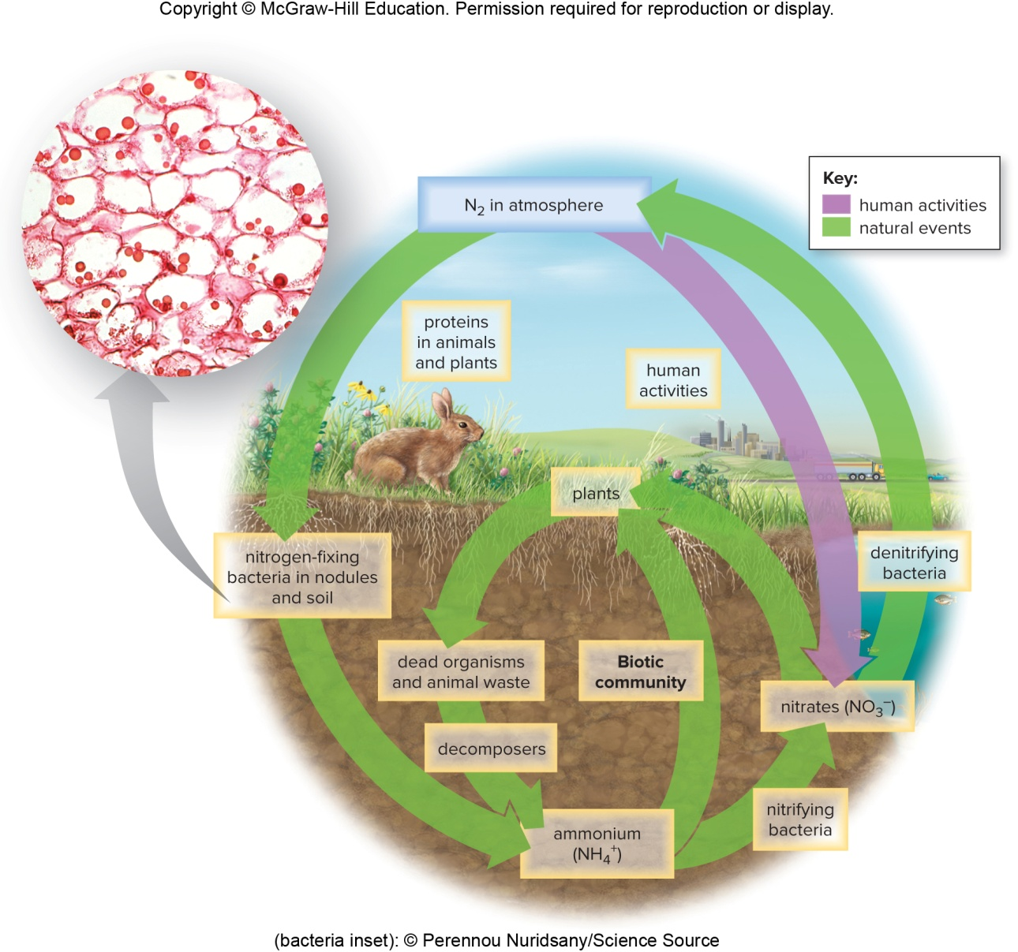
Figure 31.24 The Nitrogen Cycle
(bacteria inset): © Perennou Nuridsany/Science Source

Slide 61
Human Activity and Nitrogen Cycle
Human activities alter transfer rates by producing fertilizers from $N_{2}$.
Nitrate leaching can lead to eutrophication.
To cut back on fertilizer rates, it may be possible to engineer soil bacteria with increased nitrogen fixation rates or farmers could grow legumes that increase the soil nitrogen content.

Slide 62
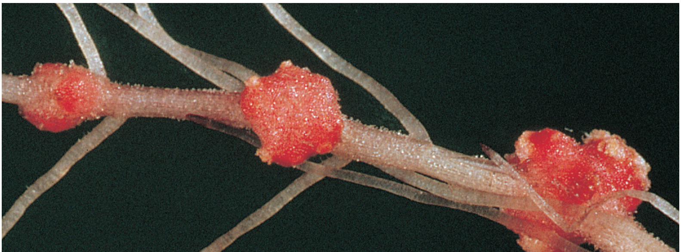
Figure 31.25 Root Nodules
© Biophoto Associates/Science Source

Slide 63
Carbon Cycle, 1
Organisms in both terrestrial and aquatic ecosystems exchange carbon dioxide with the atmosphere.
On land, plants take up carbon dioxide from the air and incorporate it into organic nutrients.
Aerobic organisms release carbon dioxide as a waste product.
In aquatic ecosystems, exchange of carbon dioxide with the atmosphere is indirect.
Carbon dioxide combines with water to form bicarbonate ion (${HCO}_{3}^{−}$).
Algae incorporate it into organic nutrients.
Respiration also releases carbon dioxide (that becomes bicarbonate ion in water).

Slide 64
Carbon Cycle, 2
Living and dead organisms contain organic carbon.
Reservoir for carbon cycle
If dead plant and animal materials fail to decompose they may be transformed in fossil fuels.
Most fossil fuels formed during Carboniferous period 286–360 million years ago.
Human activities
Transfer rates of carbon dioxide due to photosynthesis and respiration should be about even.
Humans burning fossil fuels and destroying forests are adding more carbon dioxide to the atmosphere.
Greenhouse effect—response to greenhouse gases absorbing and reradiating heat back to the Earth

Slide 65
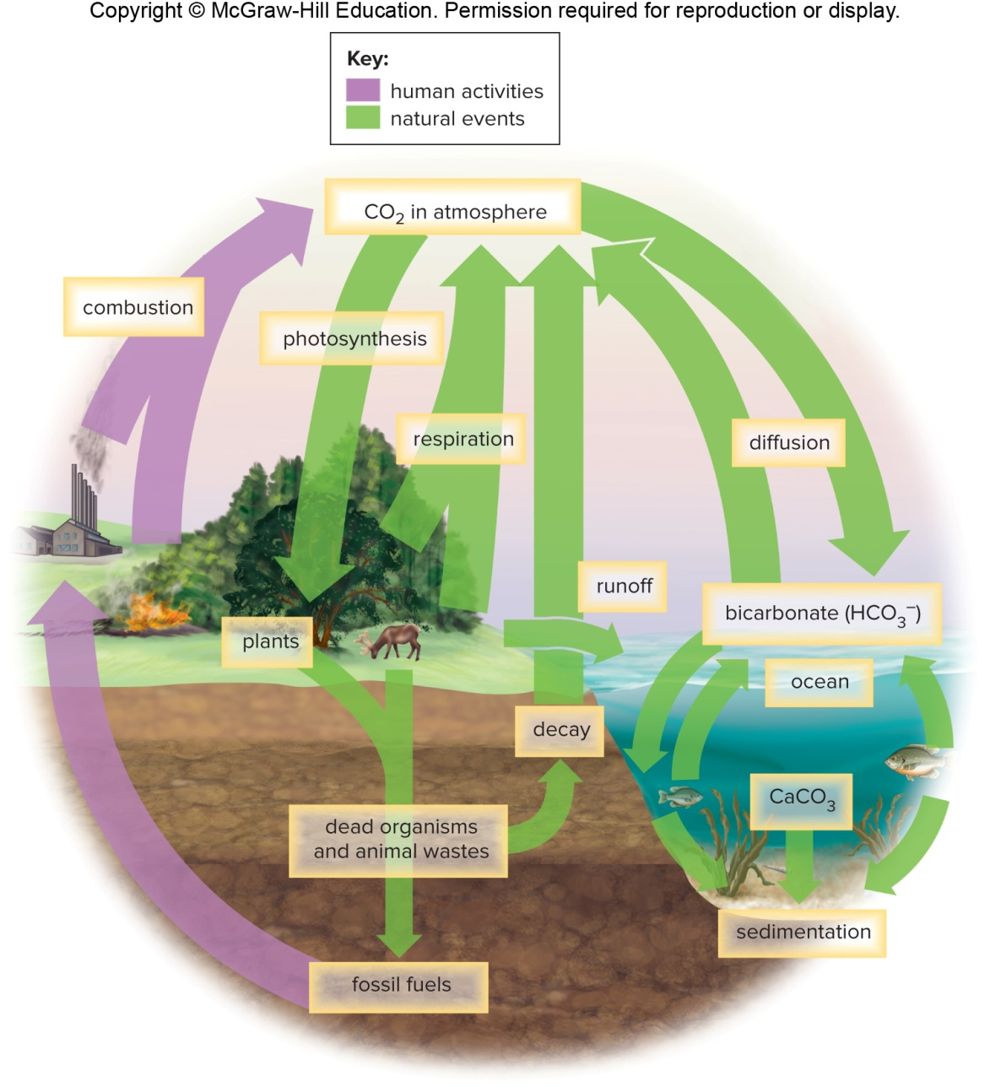
Figure 31.26 The Carbon Cycle

Slide 66
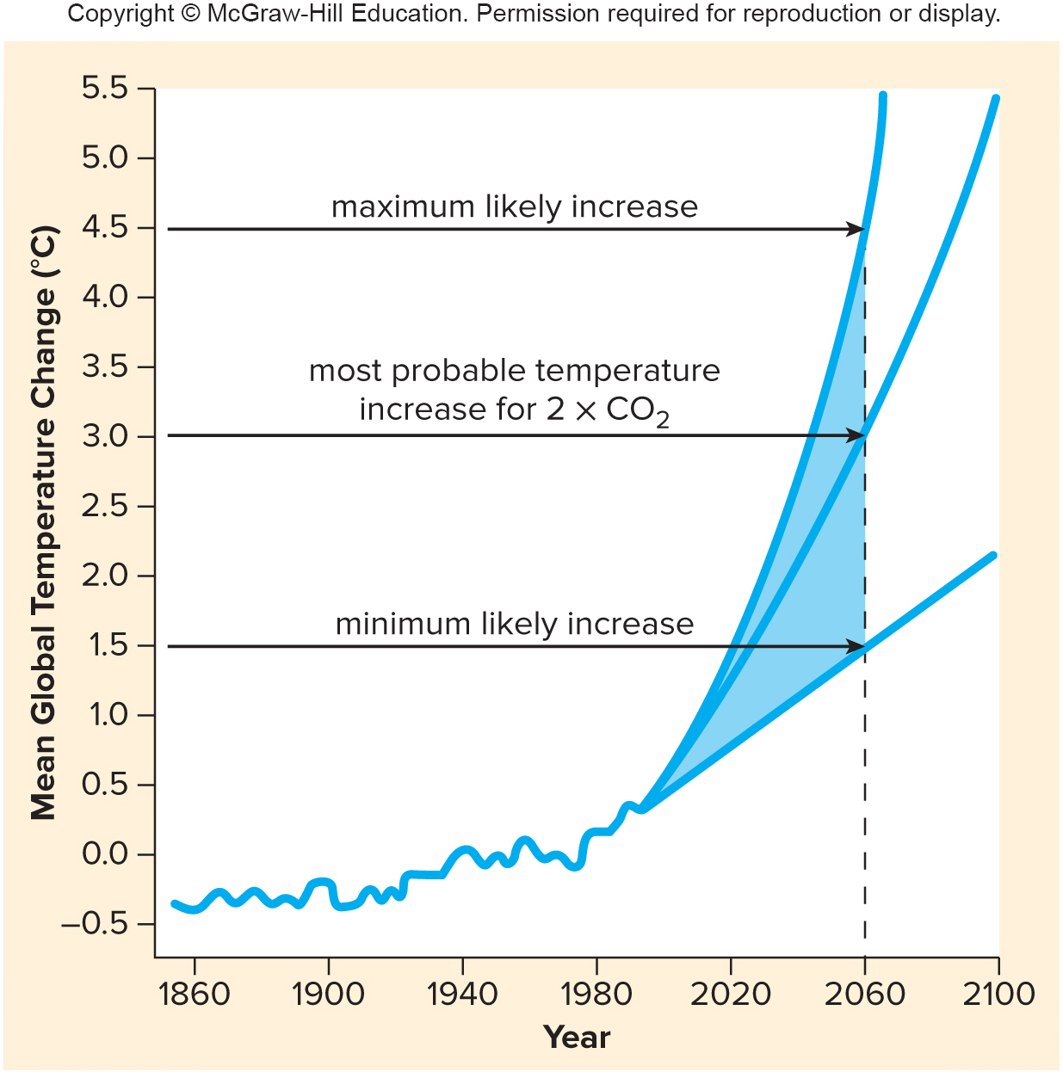
Figure 31.27 Global Warming

Slide 67
Global Warming
Mean global temperatures are forecasted to continue rising due to increase of greenhouse gases in atmosphere.
Climate patterns are changing resulting in drought, loss of polar ice, and flooding in coastal areas.
Increased range of mosquitos increases disease.
Economic as well as quality of life issues are consequences of global warming.
Humans are the only species that can reduce climate change through local and global activism.

Slide 68
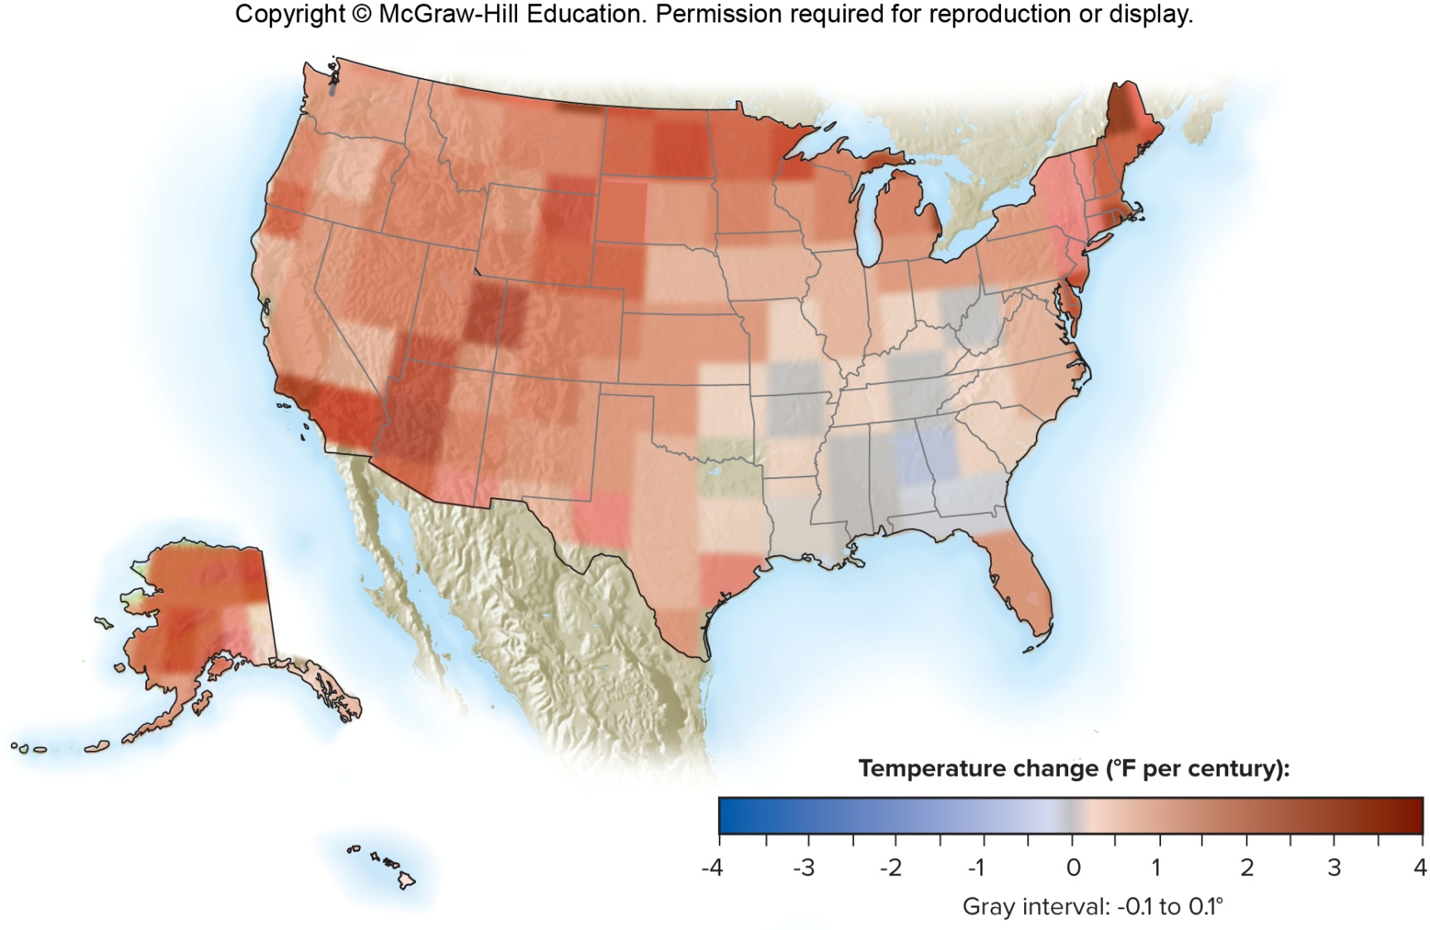
Figure 31.28 Climate Change in the United States

Slide 69
31.3 Ecology of Major Ecosystems
Biosphere—encompasses all the ecosystems on planet Earth and final level of biological organization
Aquatic ecosystems
Freshwater ecosystems
Standing water—lakes and ponds
Running water—rivers and streams
Saltwater (marine) ecosystems
Ocean is a marine ecosystem that covers 70% of Earth’s surface.

Slide 70
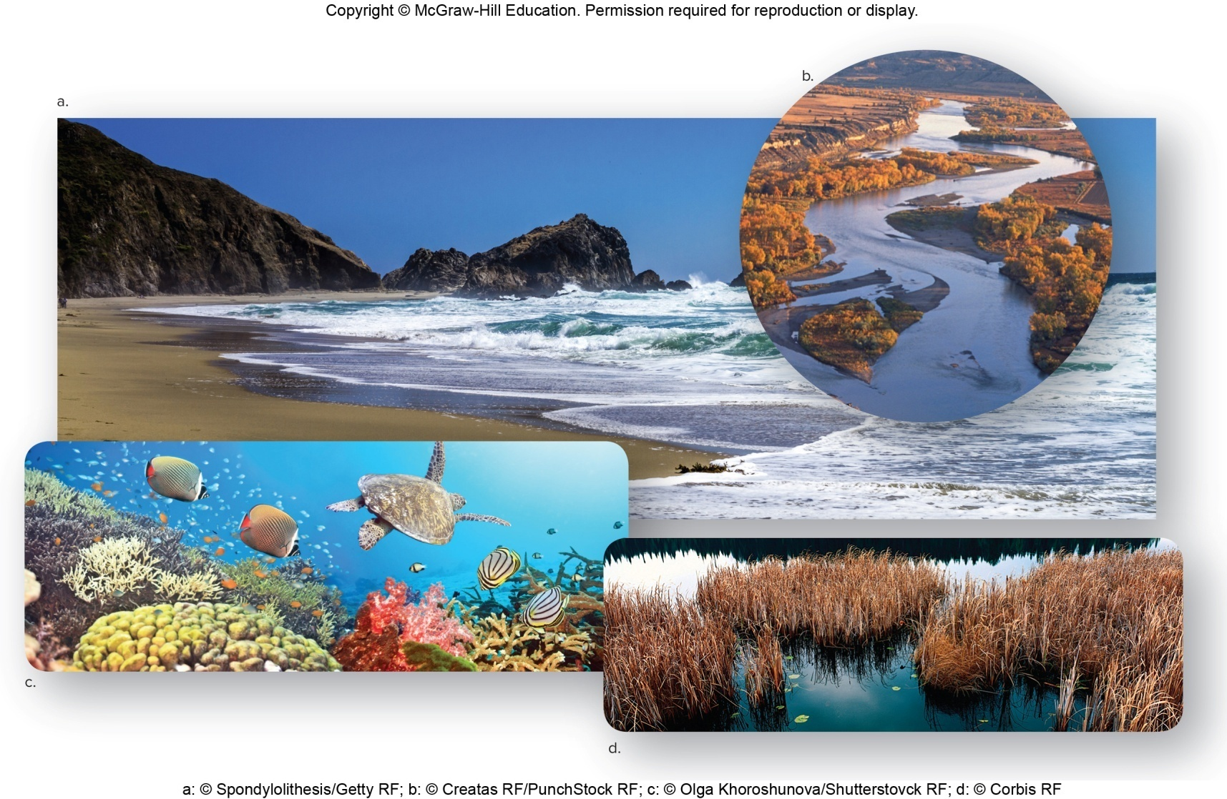
Figure 31.29 The Major Aquatic Ecosystems
a: © Spondylolithesis/Getty RF; b: © Creatas RF/Punchstock RF; c: © Olga Khoroshunova/Shutterstovck RF; d: © Corbis RF

Slide 71
Terrestrial Ecosystems (Biomes)
Temperature and rainfall define the biome.
Contains communities adapted to regional climate

Slide 72
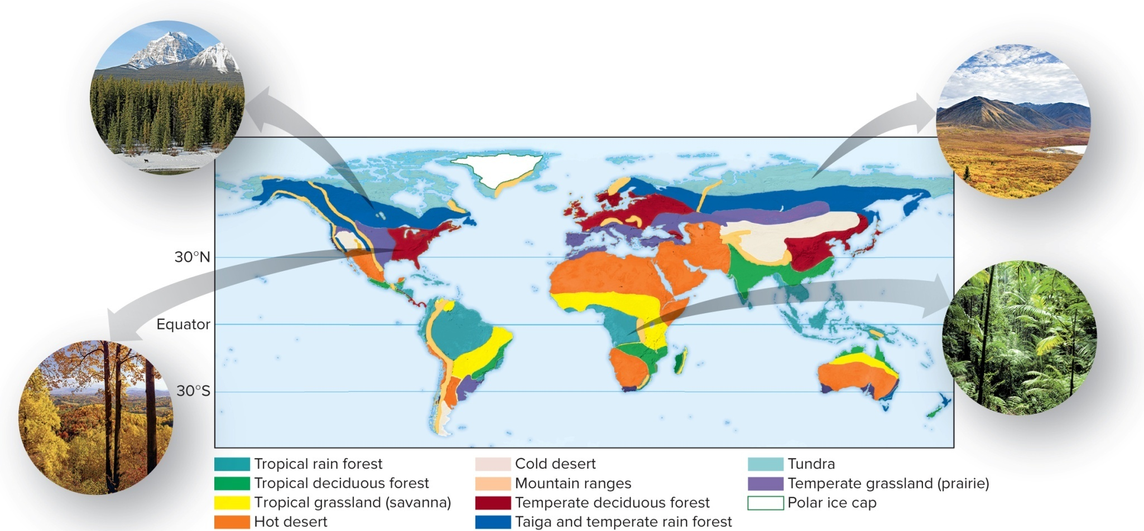
Figure 31.30 The Major Terrestrial Ecosystems
(taiga): © John E. Marriott/All Canada Photos/Getty Images; (temperate deciduous forest): © David Sucsy/E+/Getty RF; (tundra): © Stockbyte/Getty RF; (tropical rain forest): © Digital Vision/Getty RF

Slide 73
Terrestrial Biomes
Tundra
Northernmost biome
Permafrost persists even during summer in tundra; prevents large plants from becoming established.
Taiga
Very cold northern coniferous forest
Temperate grasslands
Receive less rainfall than temperate forests (in which trees lose their leaves during the winter) and more water than deserts, which lack trees
Temperate forests
Deserts
Savanna
Tropical grassland with alternating wet and dry seasons
Tropical rain forests
Occur at the equator
Have a high average temperature and greatest amount of rainfall of all biomes
Dominated by large evergreen, broad-leaved trees

Slide 74
Primary Productivity
Rate at which producers capture and store energy as organic nutrients over a certain length of time
One way to compare ecosystems
Influenced by temperature, moisture, and nature of soil
In terrestrial ecosystems
Lowest in high-latitude tundra and desert
Highest at equator—tropical rain forests
In aquatic communities
Largely dependent on availability of inorganic nutrients
High in estuaries, swamps, and marshes
Open ocean between desert and tundra
Coral reefs equivalent to tropical rain forests

Slide 75
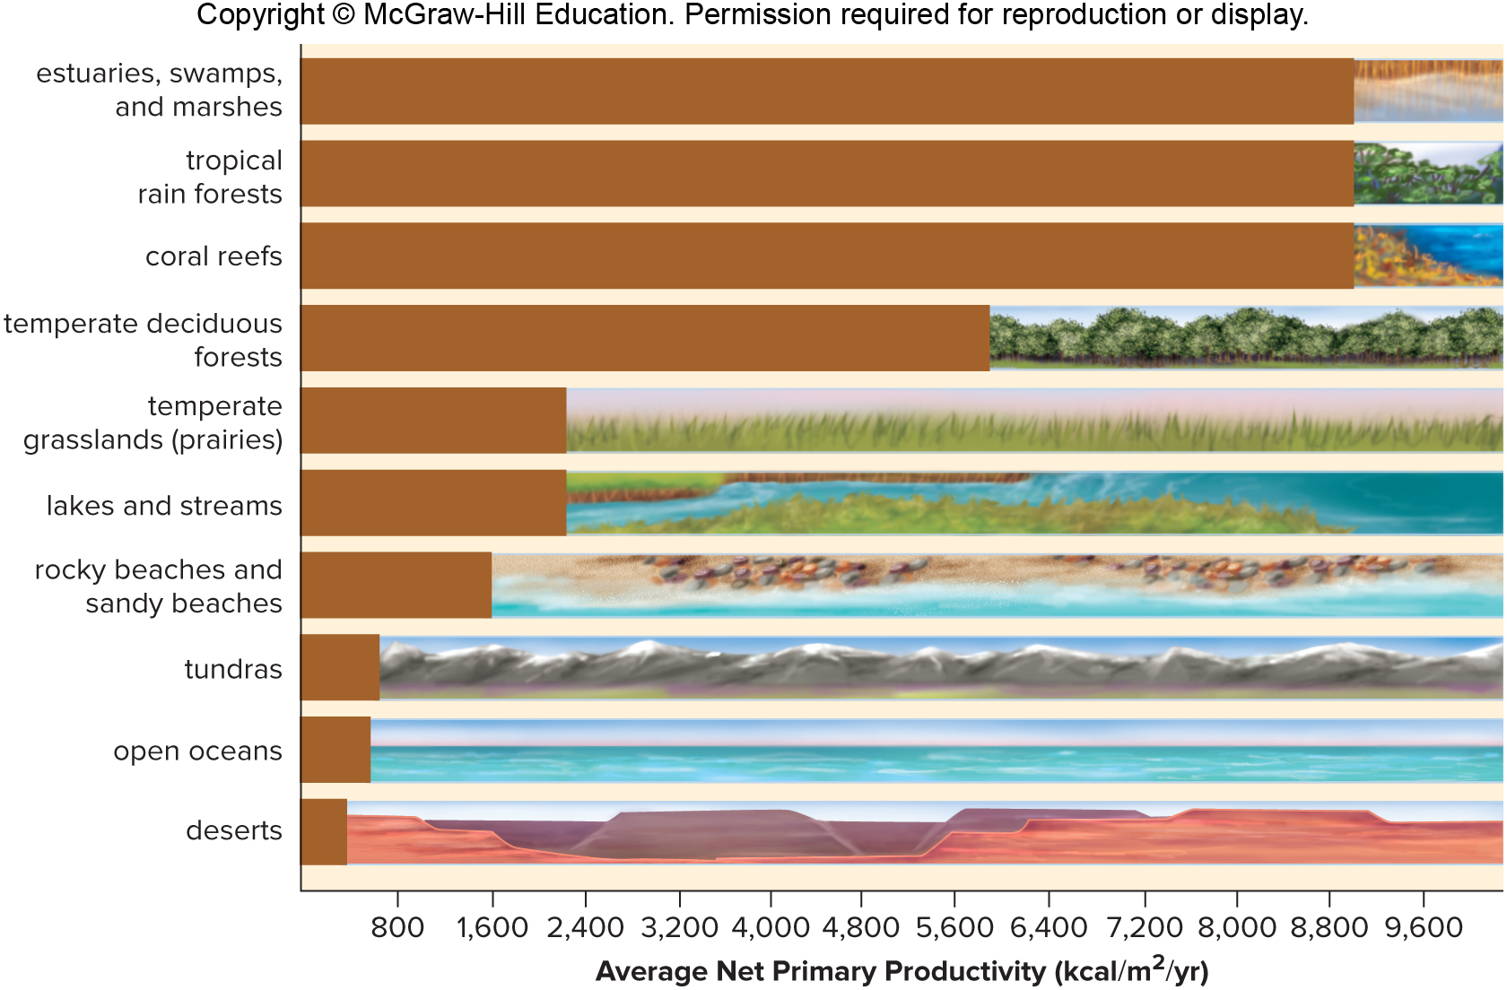
Figure 31.31 Primary Productivity
Average Net Primary Productivity (kcal/$m^{2}$/yr)

