Slide 1
Essentials of Biology
Sylvia S. Mader Michael Windelspecht
Chapter 30
Ecology and Populations
Lecture Outline
See separate FlexArt PowerPoint slides for all figures and tables pre-inserted into PowerPoint without notes.
Copyright © McGraw-Hill Education. All rights reserved. Authorized only for instructor use in the classroom. No reproduction or distribution without the prior written consent of McGraw-Hill Education.
Notes:
1

Slide 2
30.1 The Scope of Ecology
Ecology—scientific study of the interactions of organisms with each other and with their physical environment
Offers information key to the survival of all species, present and future
Helps us make informed decisions

Slide 3
Ecological Terms
Ecology involves the study of several levels of biological organization.
Organisms: focus on adaptations to an environment
Populations: describe changes in population over time
Community: all the various populations at a particular locale—study interactions between populations
Ecosystem: living organisms and their physical environment—presence of suspended particles affecting photosynthesis in algae
Biosphere: portion of Earth’s surface where living things exist—understand how various ecosystems contribute to biodiversity and dynamics of biosphere

Slide 4
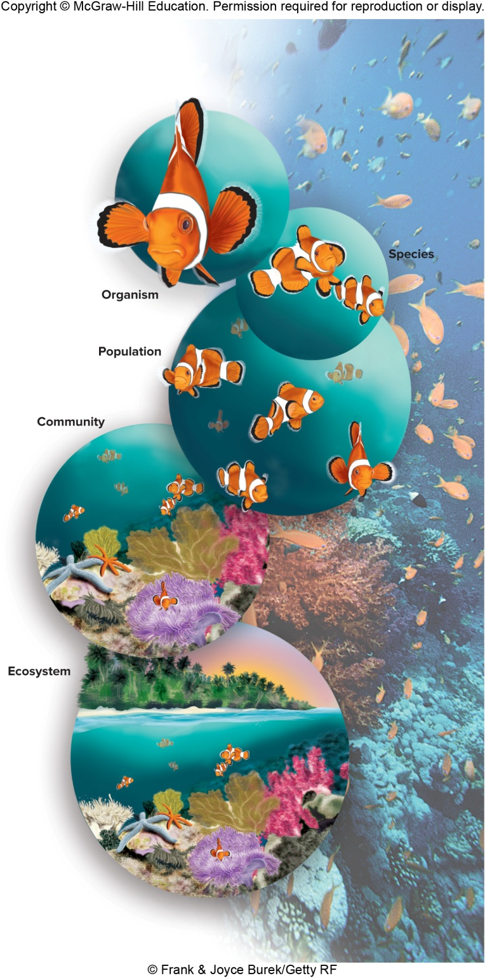
Figure 30.1 Levels of Organization
© Frank & Joyce Burek/Getty RF

Slide 5
History of Ecology
Ecology
Began as a part of natural history—observing and describing organisms in their environment
Now an experimental science
Central goal is to develop models that explain and predict distribution and abundance of populations based on their interactions within an ecosystem
Achieving such a goal involves testing hypotheses

Slide 6
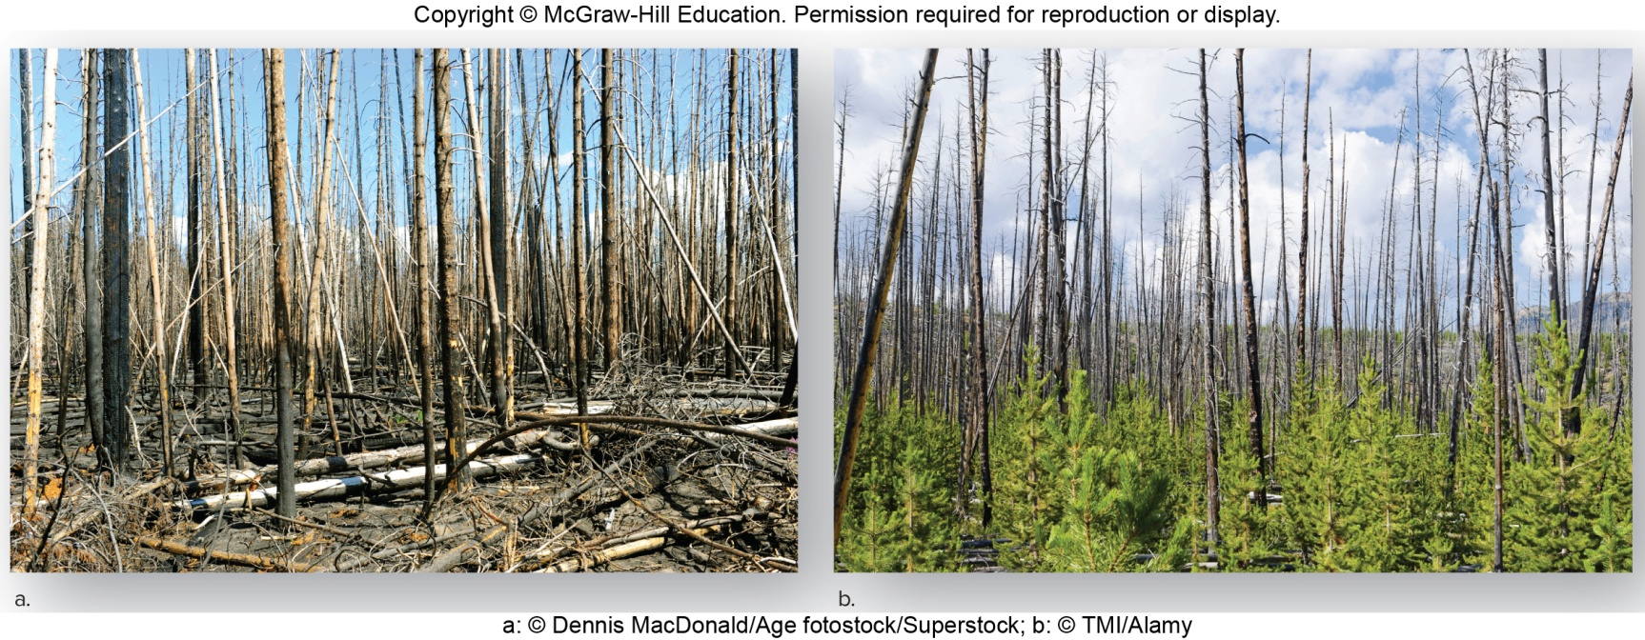
What Ecologists Study, 1
Ecologists might formulate and test hypotheses about the role fire plays in maintaining a lodgepole pine forest.
Could compare characteristics of a community before and after a prescribed burn
Figure 30.2 Studying the effects of fire
a: © Dennis MacDonald/Age fotostock/Superstock; b: © TMI/Alamy

Slide 7
What Ecologists Study, 2
Ecology and environmental science
Environmental science
Applies ecological principles to practical human concerns
Conservation biology
New discipline that studies all aspects of biodiversity
Goal of conserving natural resources including wildlife for benefit of future generations

Slide 8
30.2 The Human Population
Human population has a clumped distribution
59% of the world’s people live in Asia, and most live in China and India.
Mongolia has a population density of 0.25 persons per square kilometer.
Bangladesh has a density of over 1,000 persons per square kilometer.

Slide 9
Human Population Growth Trends
Present population growth
Growth of human population has been relatively slow.
Industrial Revolution brought an increase in production of food and jobs
Population began to increase steeply.

Slide 10
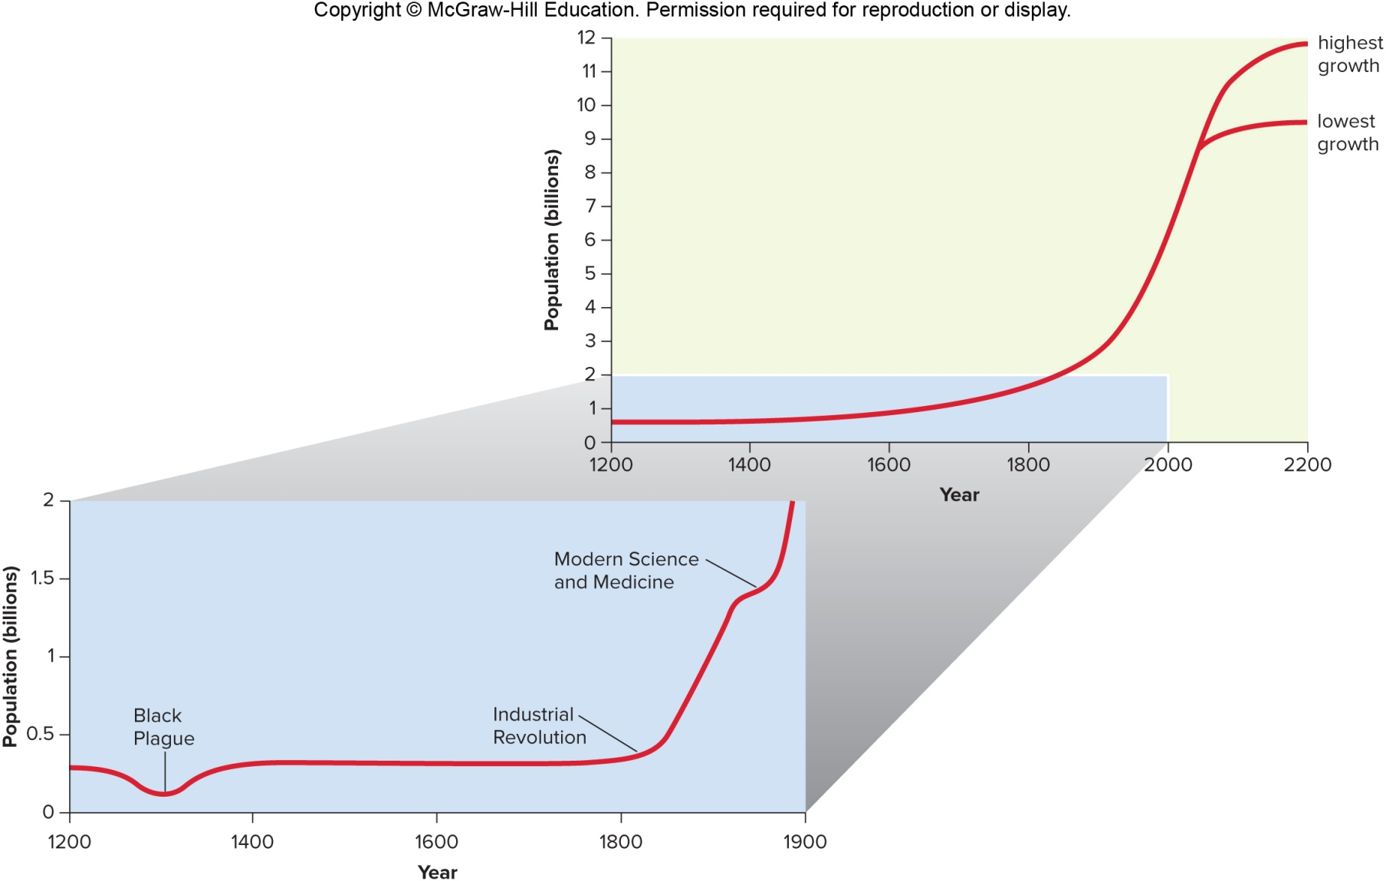
Figure 30.3 Human Population Growth

Slide 11
Rate of Human Population Growth, 1
Growth rate of population is the difference between the number of people born and the number of people who die each year.
Current global birthrate is 18.7 per 1,000 per year
Current global death rate is 7.9 per 1,000 per year
Current annual growth rate is
${(18.7−7.9)}/{1,000}={(10.8)}/{1,000=1.08\%}$

Slide 12
Rate of Human Population Growth, 2
Future population growth
Doubling time for human population is currently about 67 years
Doubling time—length of time it takes a population to double in size. Already there are areas across the globe where people have inadequate access to fresh water, food, and shelter.
In 67 years, we need to double the amount of food, water, energy, and other resources to maintain the present standard of living.
Rapid growth usually begins to decline when resources become scarce.
Population levels off at carrying capacity of the environment.
Earth’s carrying capacity for humans has not been determined.
Not all countries have the same growth rate.

Slide 13
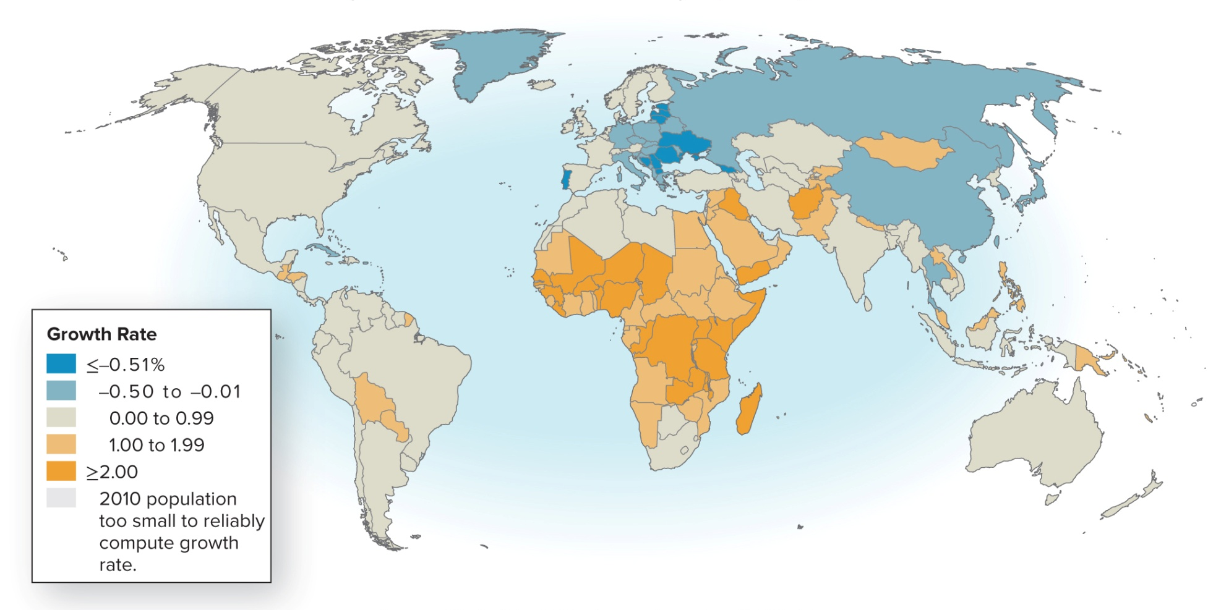
Figure 30.4 Global Population Growth Rates
Projected Annual Growth Rate of Country Populations, 2010-2050
Source: GlobalHealthFacts.org. Based on 2012 data.

Slide 14
More- vs. Less-Developed Countries
More-developed versus less-developed countries
More-developed countries (MDCs)
North America and Europe
Population growth is modest
People enjoy a fairly good standard of living.
Less-developed countries (LDCs)
Latin America, Asia, and Africa
Population growth dramatic
Majority of people live in poverty

Slide 15
More-Developed Countries
Did not always have a low growth rate
Between 1850 and 1950 their populations doubled.
Largely because of decline in death rate
Followed by decline in birthrate
Only modest growth since 1950
Demographic transition—sequence of events like this decline in death rate followed by decline in birthrate
Overall growth rate is 0.1%, but some countries are not growing at all or decreasing in size
Higher growth rate of United States (0.78%) due to immigration and large number of women of reproductive age

Slide 16
Less-Developed Countries
Death rates began to decline rapidly in LDCs after WWII (introduction of modern medicine)
Birthrate remained high
Collective growth rate of LDCs peaked at 2.5 % between 1960 and 1965
Rate has declined to 1.5%
Growth rates in majority of countries have not declined.
Population of LDCs is expected to jump to 8 billion by 2050.
The majority of growth will be in Asia.
Africa has a high death rate due to AIDS.

Slide 17
Age-Structure Diagrams
Age-structure diagram divided into three groups:
Prereproductive
Reproductive
Postreproductive
Many MDCs have a stable age structure—number in each category about the same
If replacement reproduction occurs (each couple has two children), then population remains the same.

Slide 18
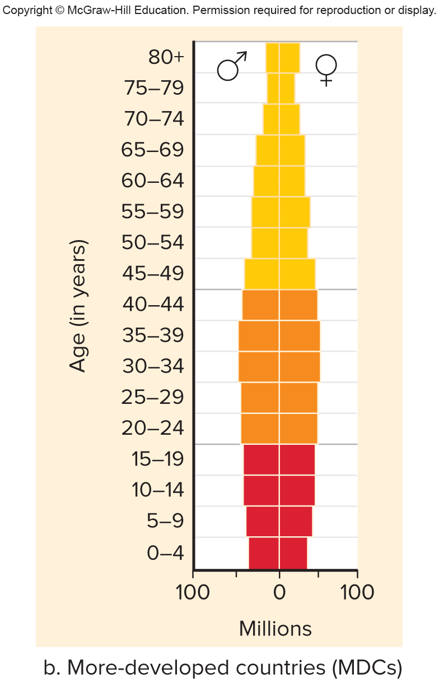
Figure 30.6b Age-Structure Diagrams
More-developed countries (MDCs)

Slide 19
LDC Pyramid Shape
Most LDCs have a pyramid-shaped age structure.
LDC population will continue to expand, even after replacement reproduction attained, as more young women reach reproductive age.

Slide 20
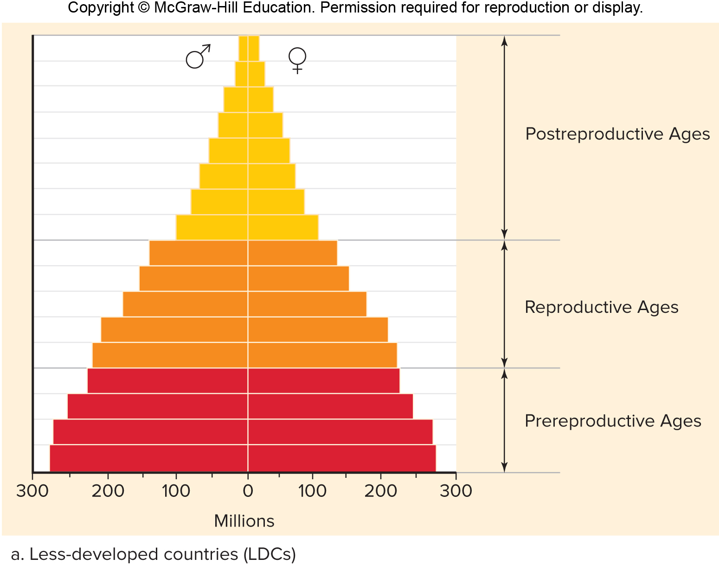
Figure 30.6a Age-Structure Diagrams
Less-developed countries (LDCs)

Slide 21
Population Growth and Environmental Impact
Increasing LDC populations might seem to be the main cause of future environmental degradation.
MDCs, however, consume a much larger percentage of the Earth’s resources.
Consumption leads to degradation.
Environmental impact (E.I.)
$E.I. =population size×resource consumption per capita$
= pollution per unit of resources used

Slide 22
Two Possible Causes of Environmental Impact
Overpopulation
More obvious in LDCs
Resource consumption
More obvious in MDCs
An average American family is the equivalent of 20 people in India in terms of per capita resource consumption and water requirements.
MDCs account for only 22% of world population but account for 90% of hazardous waste production.

Slide 23
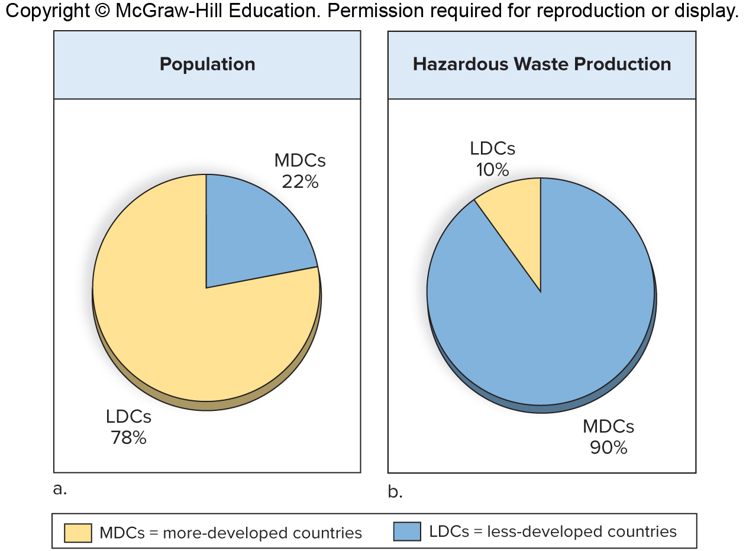
Figure 30.7a, b Environmental Impacts

Slide 24
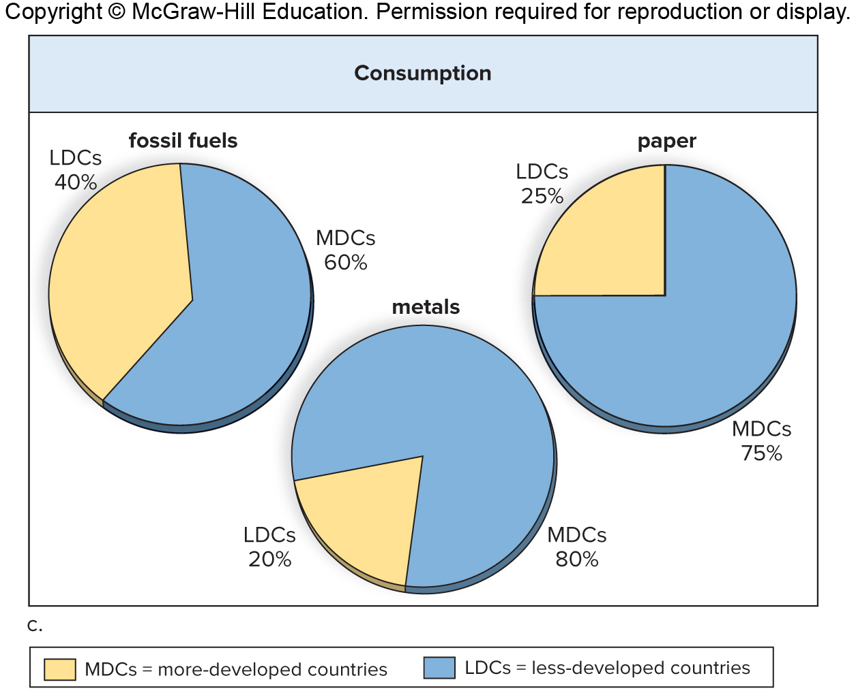
Figure 30.7c Environmental Impacts

Slide 25
30.3 Characteristics of Populations
Various characteristics of populations change over time.
Periodically subject to environmental instability
Individuals then under the pressure of natural selection
Better-adapted individuals leave behind more offspring than less-adapted individuals.

Slide 26
Distribution and Density, 1
Distribution and density
Resources—components of an environment that support its organisms
Light, water, space, mates, and food
Availability of resources influences the spatial distribution of individuals
Three spatial patterns—clumped, random, uniform
On a larger scale, members of a population are clumped within a range (portion of globe where species found) because they are located in areas suitable for their growth.
Population density—number of individuals per unit area or volume
Higher in areas with plentiful resources

Slide 27
Distribution and Density, 2
Three spatial patterns
Found that distribution of desert shrubs changes as the plants matured
Competition for belowground resources caused the distribution pattern to become uniform.

Slide 28
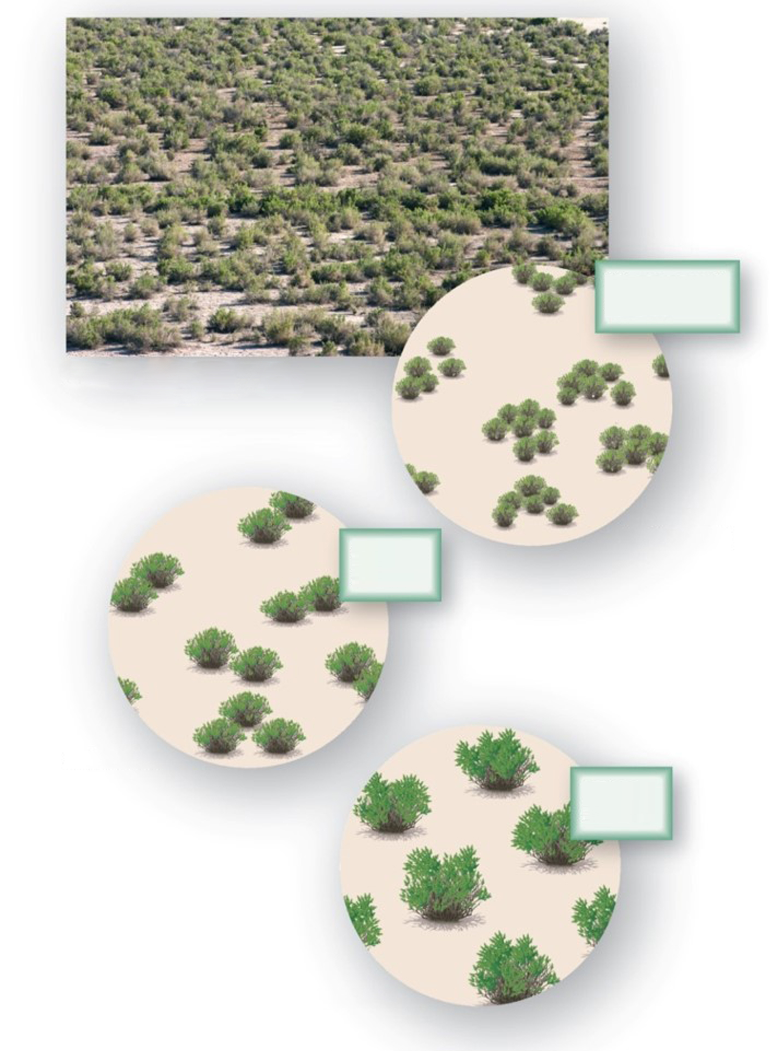
Figure 30.8 Patterns of Distribution Within a Population
Young, small shrubs
Mature desert shrubs
Medium shrubs
Clumped
Random
Large shrubs
Uniform
a: © Evelyn Jo Johnson

Slide 29
Population Growth
Population growth
Growth rate dependent on number of individuals born and number of individuals that die each year
Population grows when births exceed deaths
Population shrinks when deaths exceed births
Demographics
Characteristics of a population
Availability of resources and demographics influence growth rate of population

Slide 30
Population Age Structure
Age structure
Demographic characteristic
Births exceed death rate when prereproductive and reproductive individuals outnumber postreproductive.
If postreproductive individuals exceed the number of reproductive and/or prereproductive individuals, the population will decrease over time—deaths exceed births.
A stable population has approximately equal birth and death rates.

Slide 31
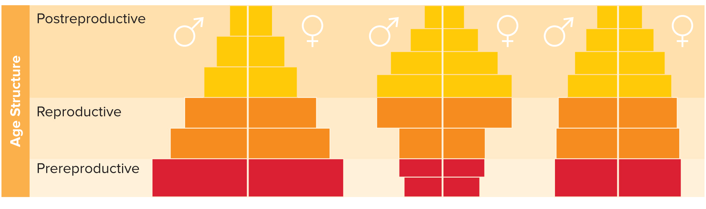
Figure 30.9 Age-Structure Diagrams
Increasing population
Decreasing population
Stable population

Slide 32
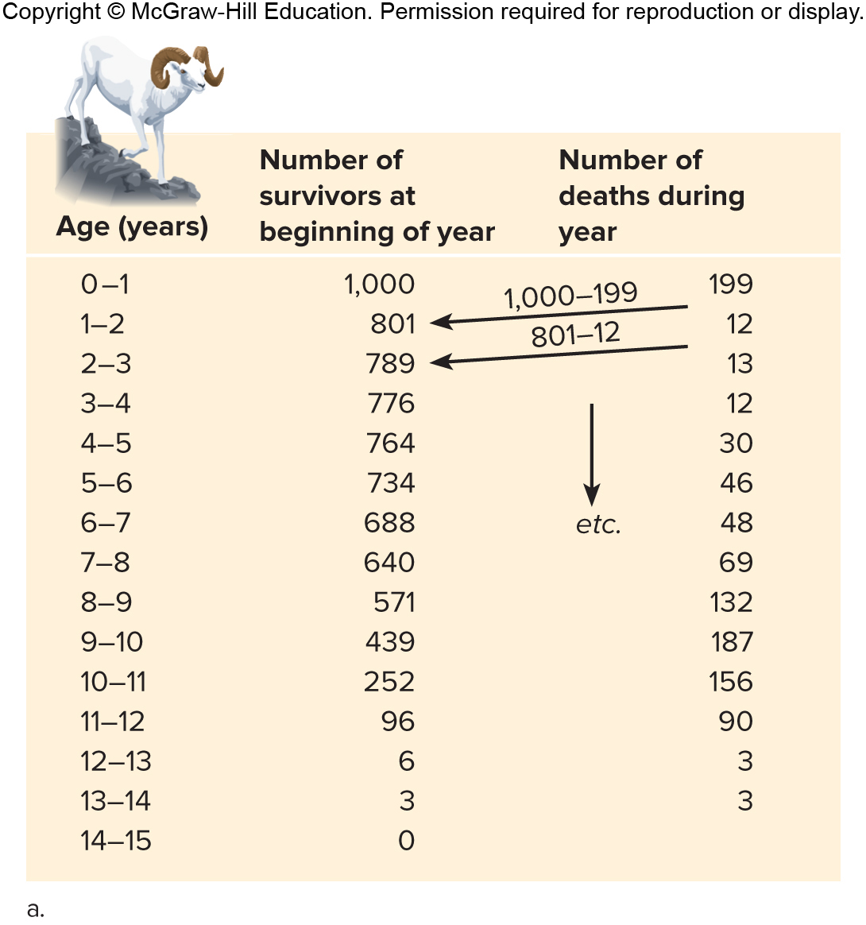
Figure 30.10a Life Table and Survivorship Curves
Survivorship
How the age at death influences population size
Life table—number of individuals that live or die at each age
Dall sheep example
Constructed using growth rings on horns to estimate time at death

Slide 33
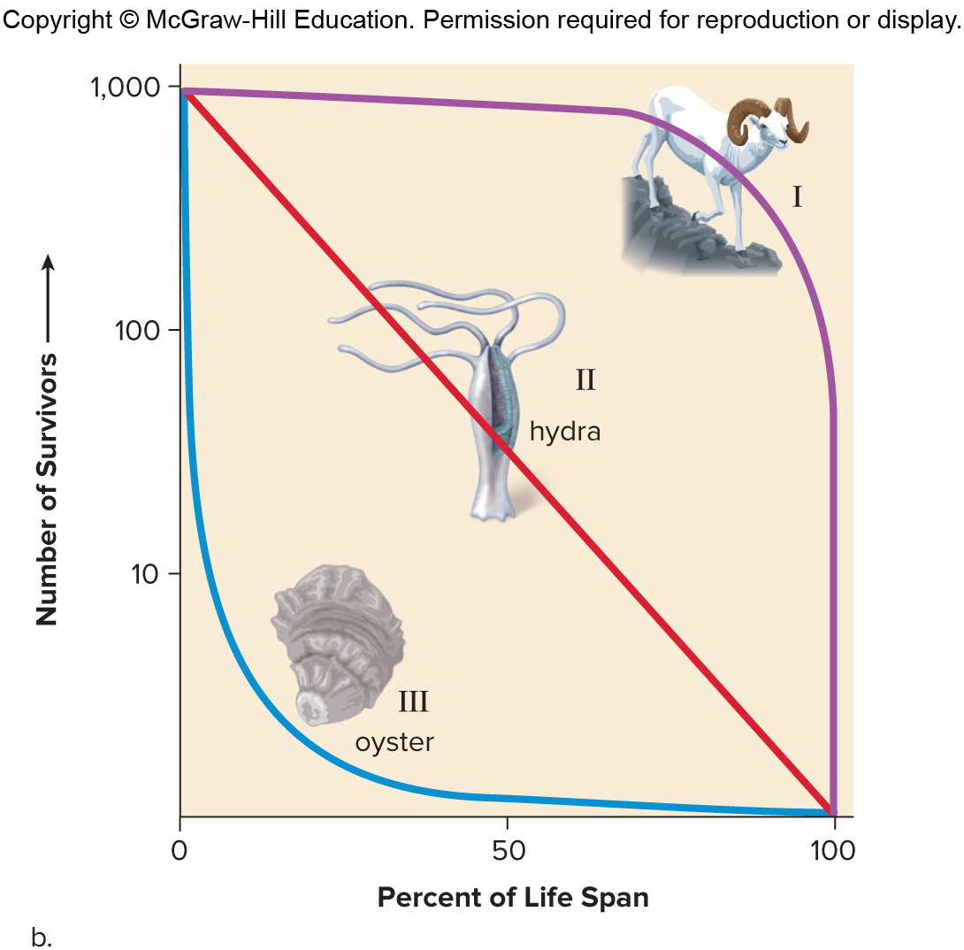
Figure 30.10b Life Table and Survivorship Curves
Survivorship curve
Plots number of survivors per 1,000 births against age
Type I
Survival high until old age
Type II
Possibility of death equally likely at any age
Type III
Death is likely among the young with few individuals reaching old age

Slide 34
Biotic Potential and Demographics, 1
Biotic potential
Highest potential rate of increase for a population when resources are unlimited
Whether potential is high or low depends on demographic characteristics of a population:
Availability of resources
Number of offspring per reproduction
Chances for survival until age of reproduction
How often each individual reproduces
Age at which reproduction begins

Slide 35
Biotic Potential and Demographics, 2
Biotic potential
Mice—high
Produce many offspring that reach maturity quickly
Rhinos—low
Only one or two offspring per infrequent reproductive event

Slide 36
Patterns of Population Growth, 1
Dependent on
Biotic potential of species and other demographics
Availability of resources
Two fundamental patterns
Exponential growth
Logistic growth

Slide 37
Patterns of Population Growth, 2
Exponential growth
J-shaped curve
Like compound interest at a bank
Phases
Lag phase—growth slow due to few individuals
Exponential growth phase—growth accelerating
Can continue only as long as resources are unlimited
Competition increases as population approaches number that can be supported by available resources

Slide 38
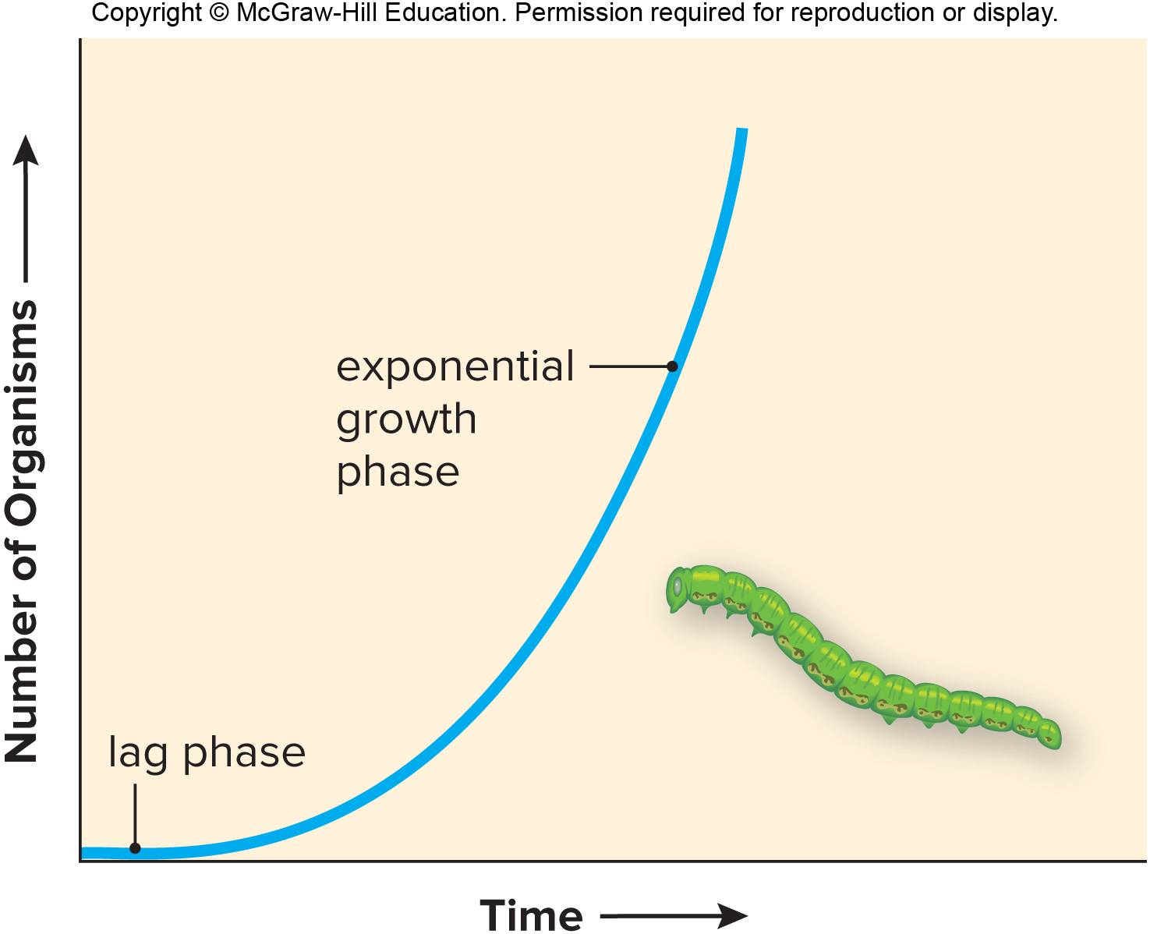
Figure 30.12 Exponential Growth

Slide 39
Patterns of Population Growth, 3
Logistic growth
Results in an S-shaped growth curve
Phases
Lag phase—growth slow with few individuals
Exponential growth phase—growth accelerating
Deceleration phase—rate of population growth slows due to competition for resources
Stable equilibrium phase—births and deaths about equal
Carrying capacity—total number of individuals that the resources can support
Number not constant and varies with circumstances

Slide 40
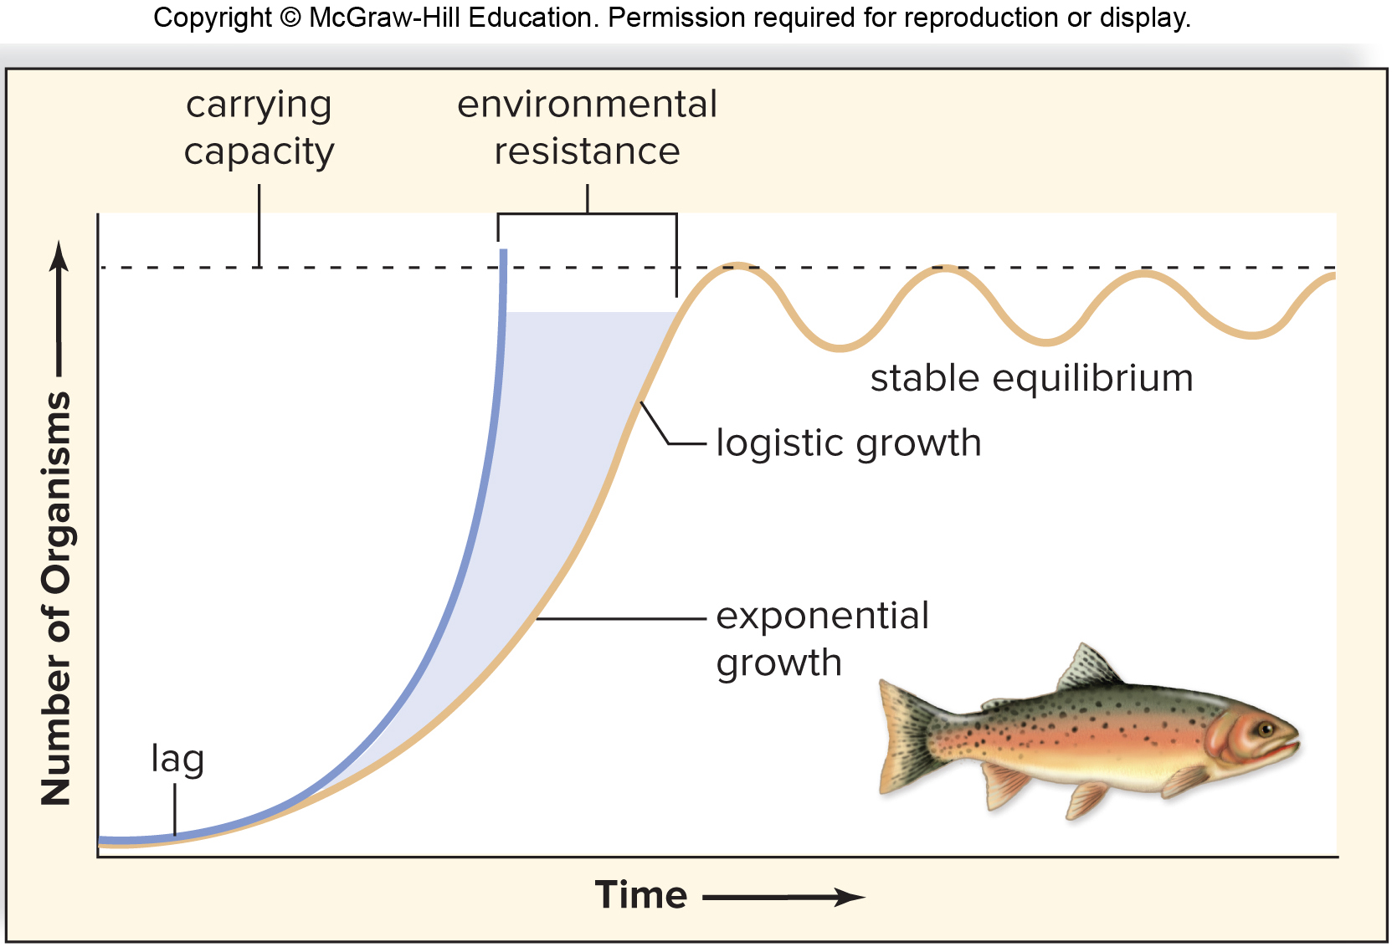
Figure 30.13 Logistic Growth

Slide 41
Logistic Growth
Applications of logistic growth knowledge
If humans using a fish population as a food source want to maintain fish population in exponential growth rate phase
Overfishing may push population into lag phase that takes years to recover
If people are trying to reduce the number of pests, it is best to reduce carrying capacity rather than reduce population size (encourages exponential growth).

Slide 42
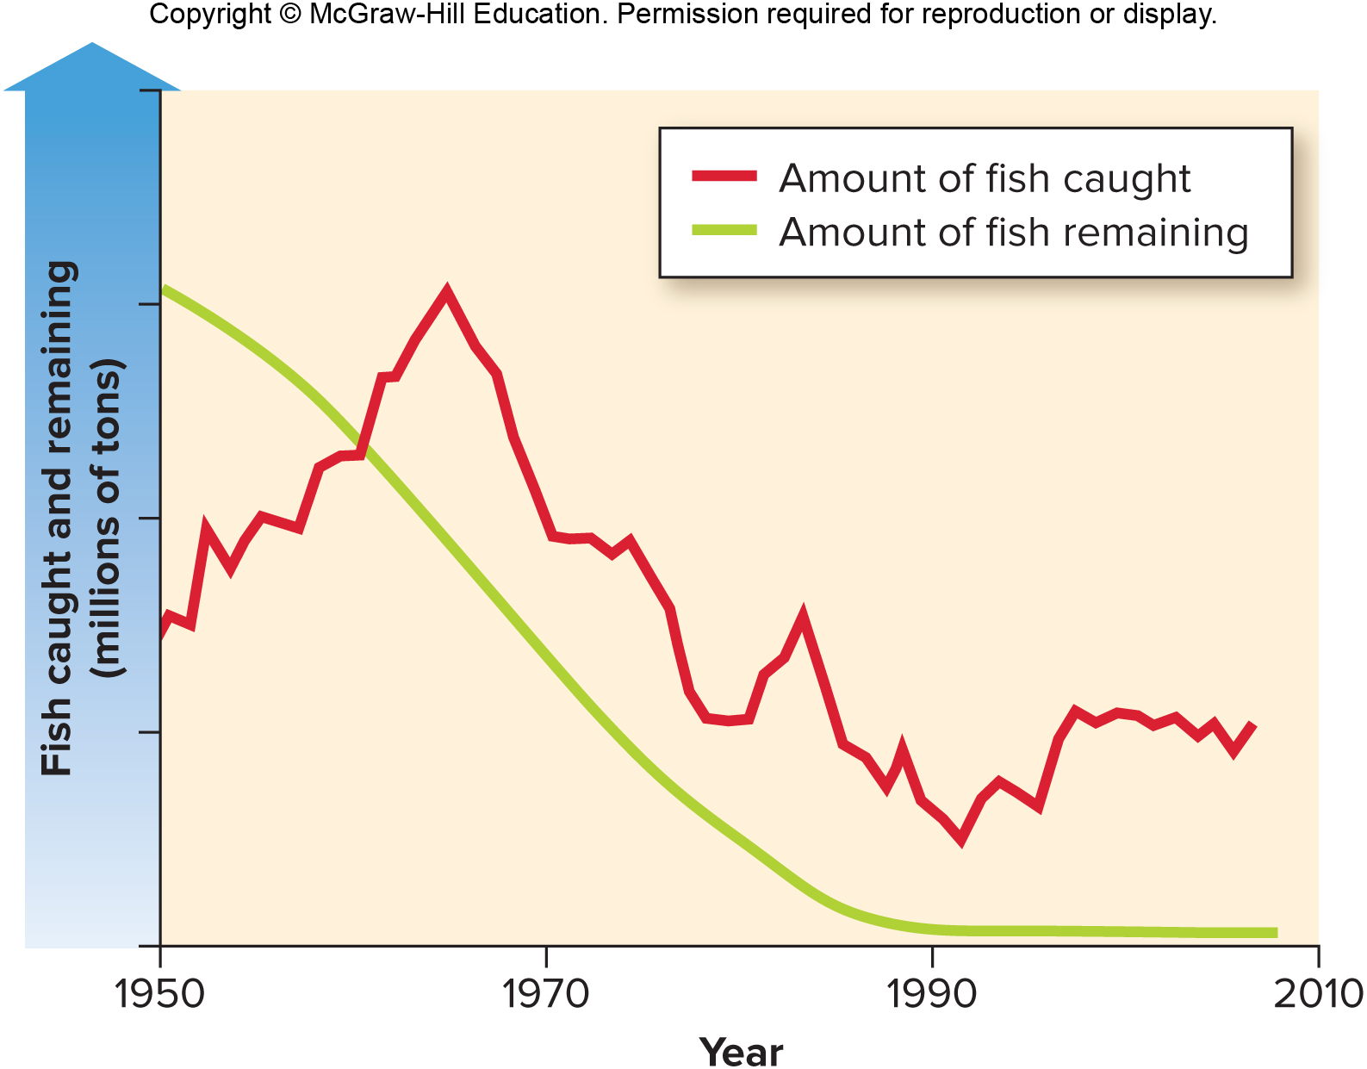
Figure 30.14 Sustainable Population Density

Slide 43
Regulating Population Growth
Factors that regulate population growth
Both biotic (living) and abiotic (nonliving) components regulate population size.
Density-independent factors
Abiotic factors, such as weather or natural disasters
Can cause sudden and catastrophic reductions in population size
Cannot in and of itself regulate population size
Intensity of effect does not increase with increased population size

Slide 44
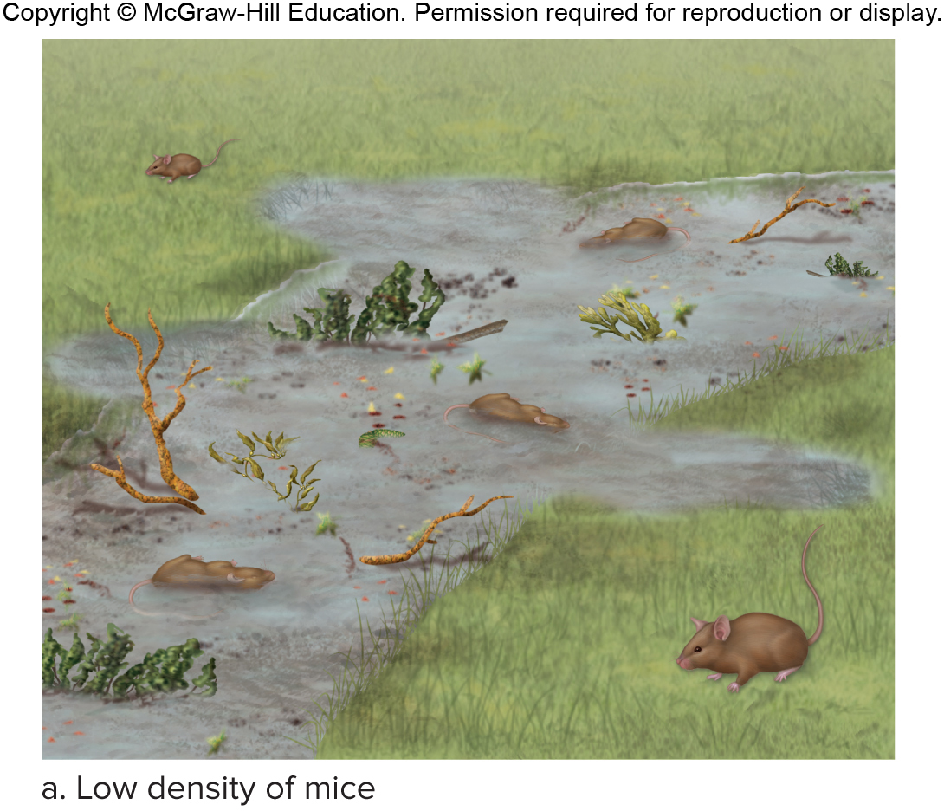
Figure 30.15a Density-Independent Effects
Density-independent factors
Two populations of field mice are in the path of a flash flood
Low-density population has 3 out of 5 mice drown = 60% death rate
Low density of mice

Slide 45
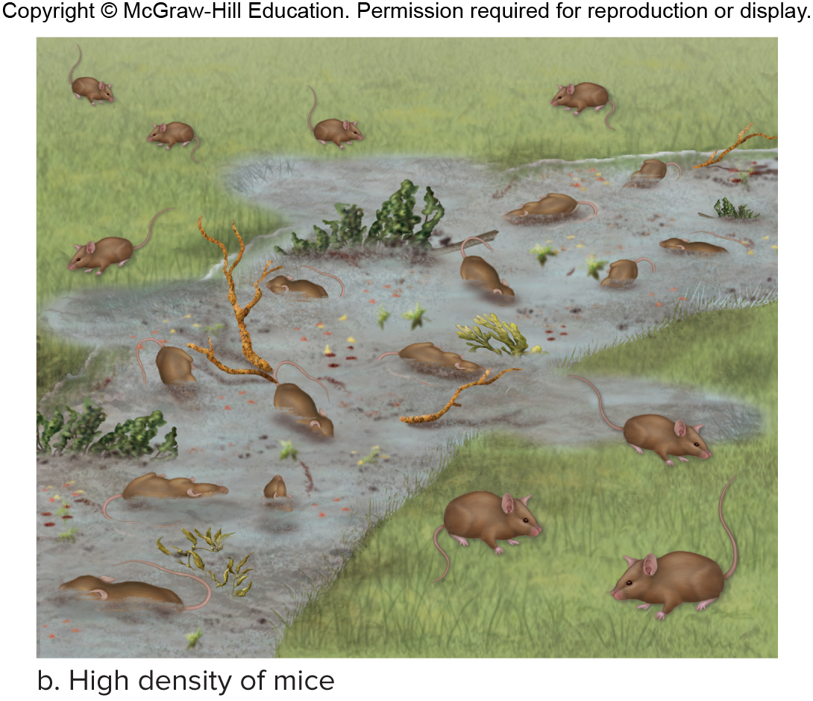
Figure 30.15b Density-Independent Effects
High-density population has 12 out of 20 mice drown = 60% death rate
Size of population did not change death rate
High density of mice

Slide 46
Density-Dependent Factors, 1
Density-dependent factors
Biotic factors—competition, predation, parasitism
Percentage of population affected does increase as population density increases
Intensity of effect increases as density increases
Competition
Members of a species compete to utilize resources—light, food, or space—that are in limited supply and necessary for survival.
Not all members can have access to a necessary degree.

Slide 47
Figure 30.16 Density-Dependent Effects—Competition
Competition
Woodpeckers compete for nesting sites.
Each pair requires a tree hole to raise offspring.
If there are more holes than pairs, every pair gets a hole.
If there are fewer holes than pairs, some pairs do not get a hole and do not reproduce.
Low density of birds
High density of birds

Slide 48
Density-Dependent Factors, 2
Density-dependent factors
Predation—predator eats prey
Lions kill zebras, blue whales strain krill, and deer eat leaves.
Effect of predation increases as prey population density increases
Prey easier to find when hiding places are limited

Slide 49
Figure 30.17 Density-Dependent Effects—Predation
Predation
Mice must have a hole to hide in to avoid being eaten.
If there are 102 mice but only 100 holes, 2 mice are in the open—if neither is eaten the predation rate is 0%.
If there are 200 mice and 100 holes, and if only half of the 100 mice without holes are eaten, the predation rate is 50/100 or 50%.
Increasing the density of prey has increased the proportion preyed upon.
Field with a low-density of mice.
Field with a high-density of mice.

Slide 50
Predator-Prey Population Cycles
Predator-prey population cycles
Some predator and prey populations increase and then decrease in population size.
Famous example of snowshoe hare and Canada lynx
Snowshoe hare is an herbivore that feeds on twigs of shrubs and small trees
Assumed lynx decreased hare population
Study found if lynx denied access to hares, cycling of hare population continued based on food availability
Observed pattern based on both hare-food cycle and lynx-hare cycle

Slide 51
Figure 30.18 Predator-Prey Cycling of a Lynx and a Snowshoe Hare, 1
© Alan Carey/Science Source

Slide 52
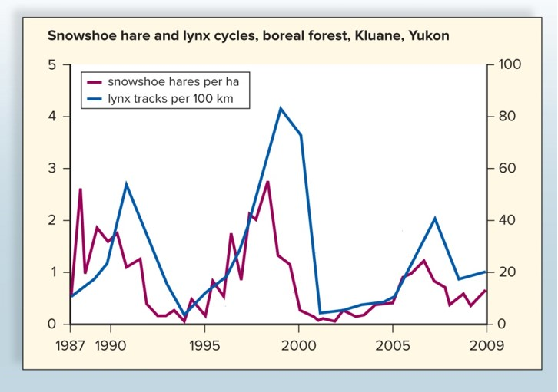
Figure 30.18 Predatory-Prey Cycling of a Lynx and a Snowshoe Hare, 2
Source: Krebs 2010
Number of pelts received by the Hudson Bay Company for 100 years
Shows pattern of 10-year cycles in population densities
Snowshoe hare population reaches peak a year or more before lynx population

Slide 53
30.4 Life History Patterns and Extinction
Two patterns of life history
Opportunistic life history pattern
Tends to exhibit exponential growth
Members of population are small in size, mature early, have short life span, and provide limited parental care for a large number of offspring
Tend to be regulated by density-independent effects
Population has high dispersal capacity
Examples—insects and weeds

Slide 54
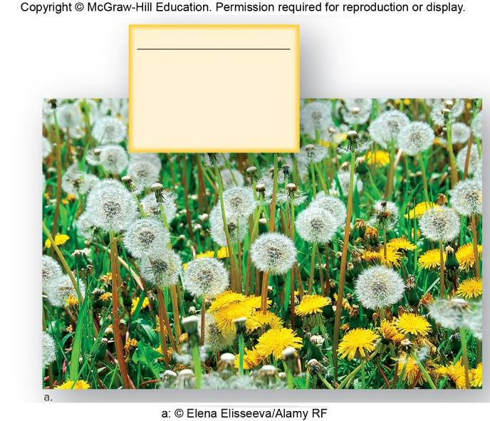
Figure 30.19a Life History Patterns
Opportunistic Pattern
Small individuals
Short life span
Fast to mature
Many offspring
Little or no care of offspring
a: © Elena Elisseeva/Alamy RF

Slide 55
Equilibrium Life History Pattern
Equilibrium life history pattern
Exhibit logistic population growth
Size of population remains close to or at carrying capacity
Members of the population are large, slow to mature, and have fairly long life spans.
Growth regulated by density-dependent effects
Examples—birds and mammals

Slide 56
Figure 30.19b Life History Patterns
Equilibrium Pattern
Large individuals
Long life span
Slow to mature
Few offspring
Much care of offspring
b: © Barrett Hedges/National Geographic/Getty RF

Slide 57
Species Extinctions
Extinction
Total disappearance of a species or higher group
Equilibrium species more apt to go extinct
Size of geographic range, degree of habitat tolerance, and size of local population can help determine danger of extinction

Slide 58
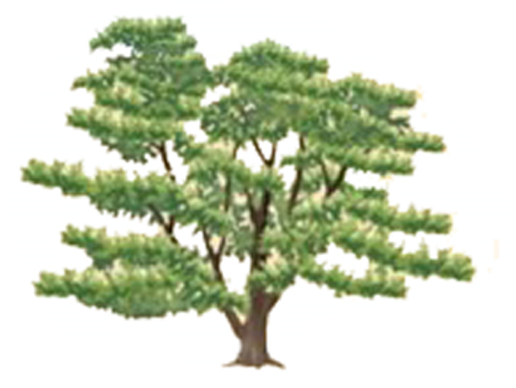
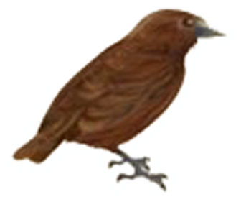
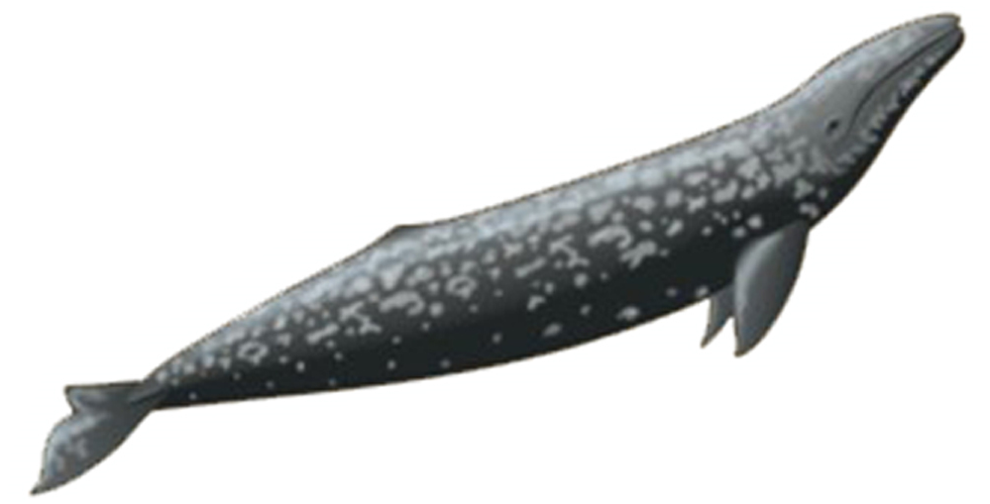
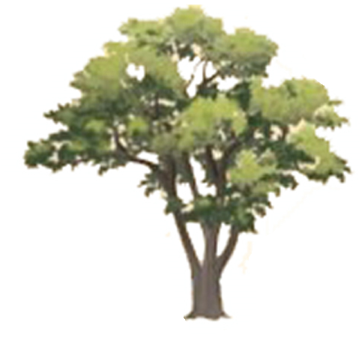
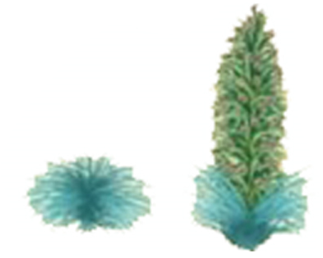
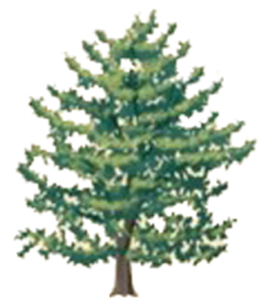
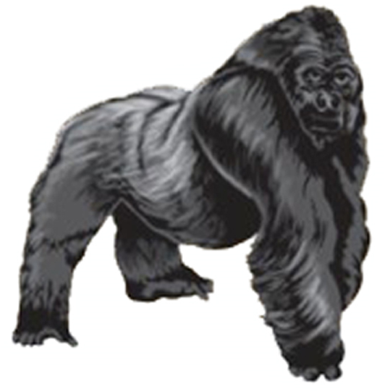
Figure 30.20 Vulnerability to Extinction
Most common
Species
Restricted geographic range
Broad habitat tolerance
Large local population
Galapagos medium ground finch
Monterey pine
Extensive geographic range
Narrow habitat tolerance
Large local population
California grey whale
Fremont cottonwood
Extensive geographic range
Broad habitat tolerance
Small local population
Tiger
Grass fern
Restricted geographic range
Narrow habitat tolerance
Large local population
Fish crow
Haleakala silversword
Restricted geographic range
Broad habitat tolerance
Small local population
Tasmanian devil
Welwitschia
Extensive geographic range
Narrow habitat tolerance
Small local population
Northern spotted owl
Pacific yew
Restricted geographic range
Narrow habitat tolerance
Small local population
Mountain gorilla
Pritchardia kaalae
Rarest

