Slide 1
Descent with Modification:
A Darwinian View of Life

Slide 2
History of Evolution
November 24th 1859 forever changed the course of Biology.
Charles Darwin published On the Origin of Species by Means of Natural Selection.
This has lead to what we know call the theory of evolution.
Evolution is a controversial topic in today’s society that brings about many different images…….

Slide 3
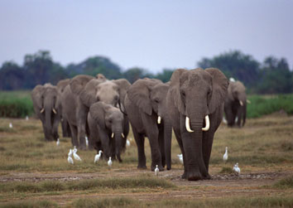
The theory of Evolution
Evolution is known as the gradual change in the genotypic frequency of a species over time.
A species being a group of organisms whose members look alike and successfully reproduce among themselves.

Slide 4
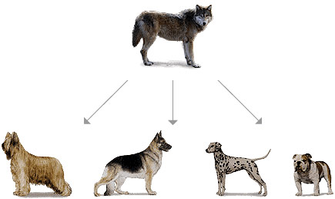
2 Main Types of Evolution
Micro-Changes in DNA that occur within a species that leads to differences but not new species.

Slide 5
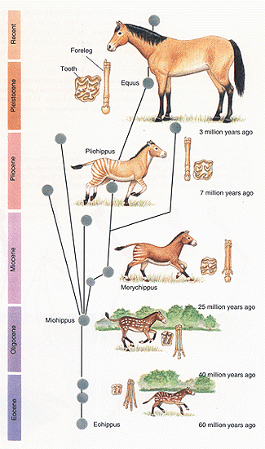
2 Main Types of Evolution (Cont.)
Macro Evolution-Changes in DNA of a population so dramatic that it leads to the formation of new species.

Slide 6
Overview: Endless Forms Most Beautiful
A new era of biology began in 1859 when Charles Darwin published The Origin of Species
Darwin noted that current species are descendants of ancestral species
Evolution can be broadly defined by Darwin’s phrase descent with modification
More specifically, evolution is the change in genotypic frequency of a population over time.
© 2011 Pearson Education, Inc.

Slide 7
The Darwinian revolution challenged traditional views of a young Earth inhabited by unchanging species
Darwin’s ideas had deep historical roots
© 2011 Pearson Education, Inc.

Slide 8
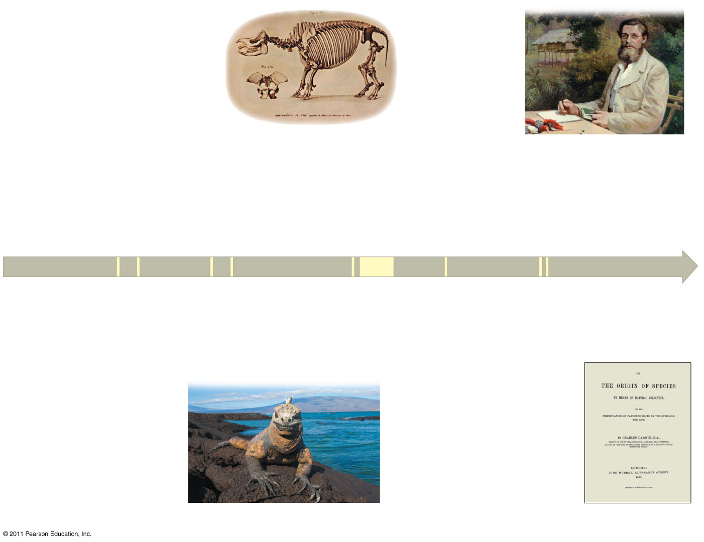
Figure 22.2
1809
Lamarck publishes his
hypothesis of evolution.
1798
Malthus publishes
“Essay on the Principle
of Population.”
1812
Cuvier publishes his extensive
studies of vertebrate fossils.
1858
1795
While studying species
in the Malay Archipelago,
Wallace sends Darwin
his hypothesis of natural
selection.
Hutton proposes
his principle of
gradualism.
1830
Lyell publishes
Principles of Geology.
1790
1870
1809
1831−36
1859
Charles Darwin
is born.
Darwin travels around
the world on HMS
Beagle.
On the Origin of
Species is published.
1844
Darwin writes his
essay on descent
with modification.
The Galápagos Islands
Notes:
Figure 22.2 The intellectual context of Darwin’s ideas.

Slide 9
Scala Naturae and Classification of Species
The Greek philosopher Aristotle viewed species as fixed and arranged them on a scala naturae
The Old Testament holds that species were individually designed by God
Carolus Linnaeus interpreted organismal adaptations as evidence that the Creator had designed each species for a specific purpose
Linnaeus was the founder of taxonomy, the branch of biology concerned with classifying organisms
He developed the binomial nomenclature, the format for naming species (for example, Homo sapiens) (2)
© 2011 Pearson Education, Inc.

Slide 10
Ideas About Change over Time
Fossils also provide evidence for evolution. Fossils are the remains of once-living things that are preserved in Earth’s rocks.
The study of fossils helped to lay the groundwork for Darwin’s ideas
Fossils are remains or traces of organisms from the past, usually found in sedimentary rock, which appears in layers or strata
They are a partial “snapshot” into life at that time.
© 2011 Pearson Education, Inc.

Slide 11
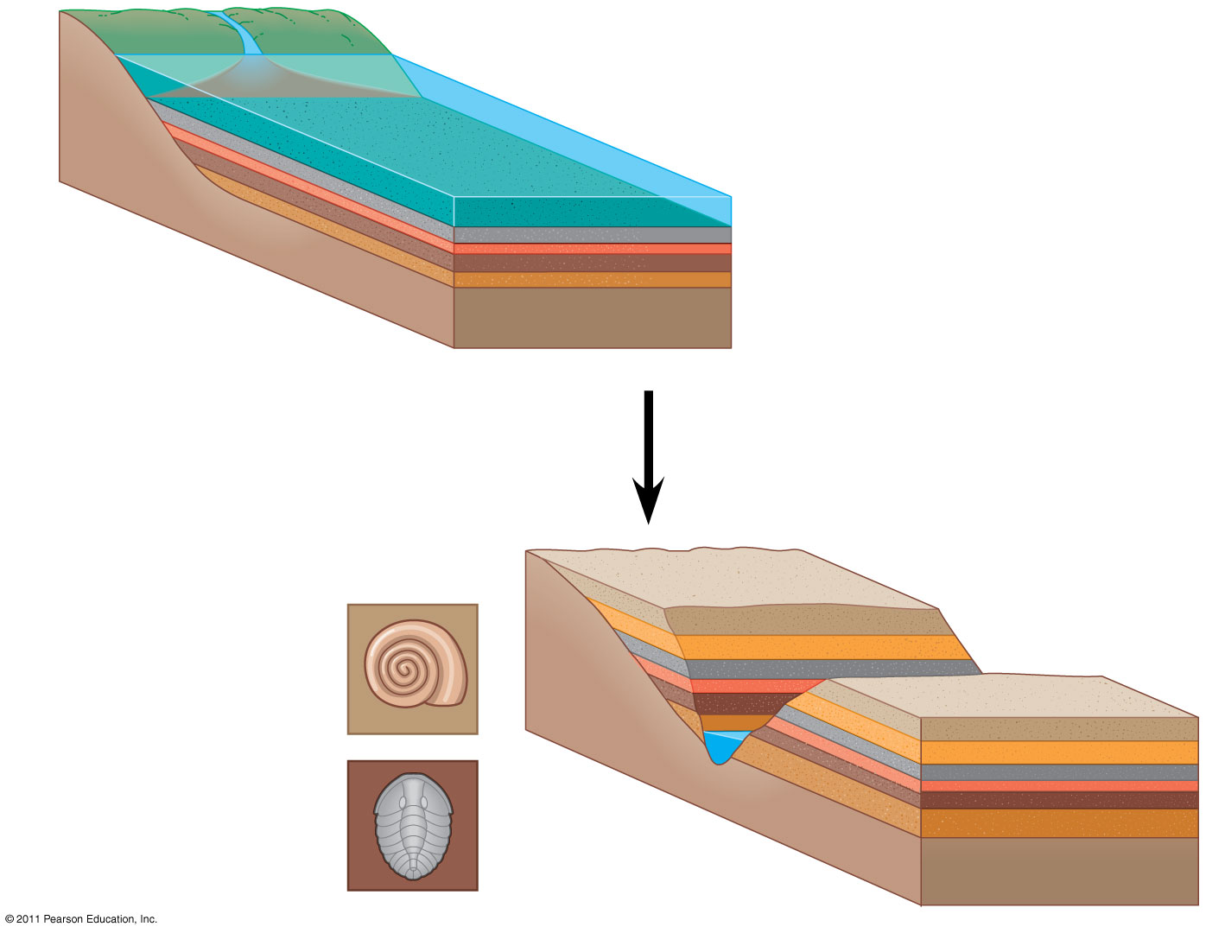
Figure 22.3
Sedimentary rock
layers (strata)
Younger stratum
with more recent
fossils
Older stratum
with older fossils
Notes:
Figure 22.3 Formation of sedimentary strata with fossils.

Slide 12
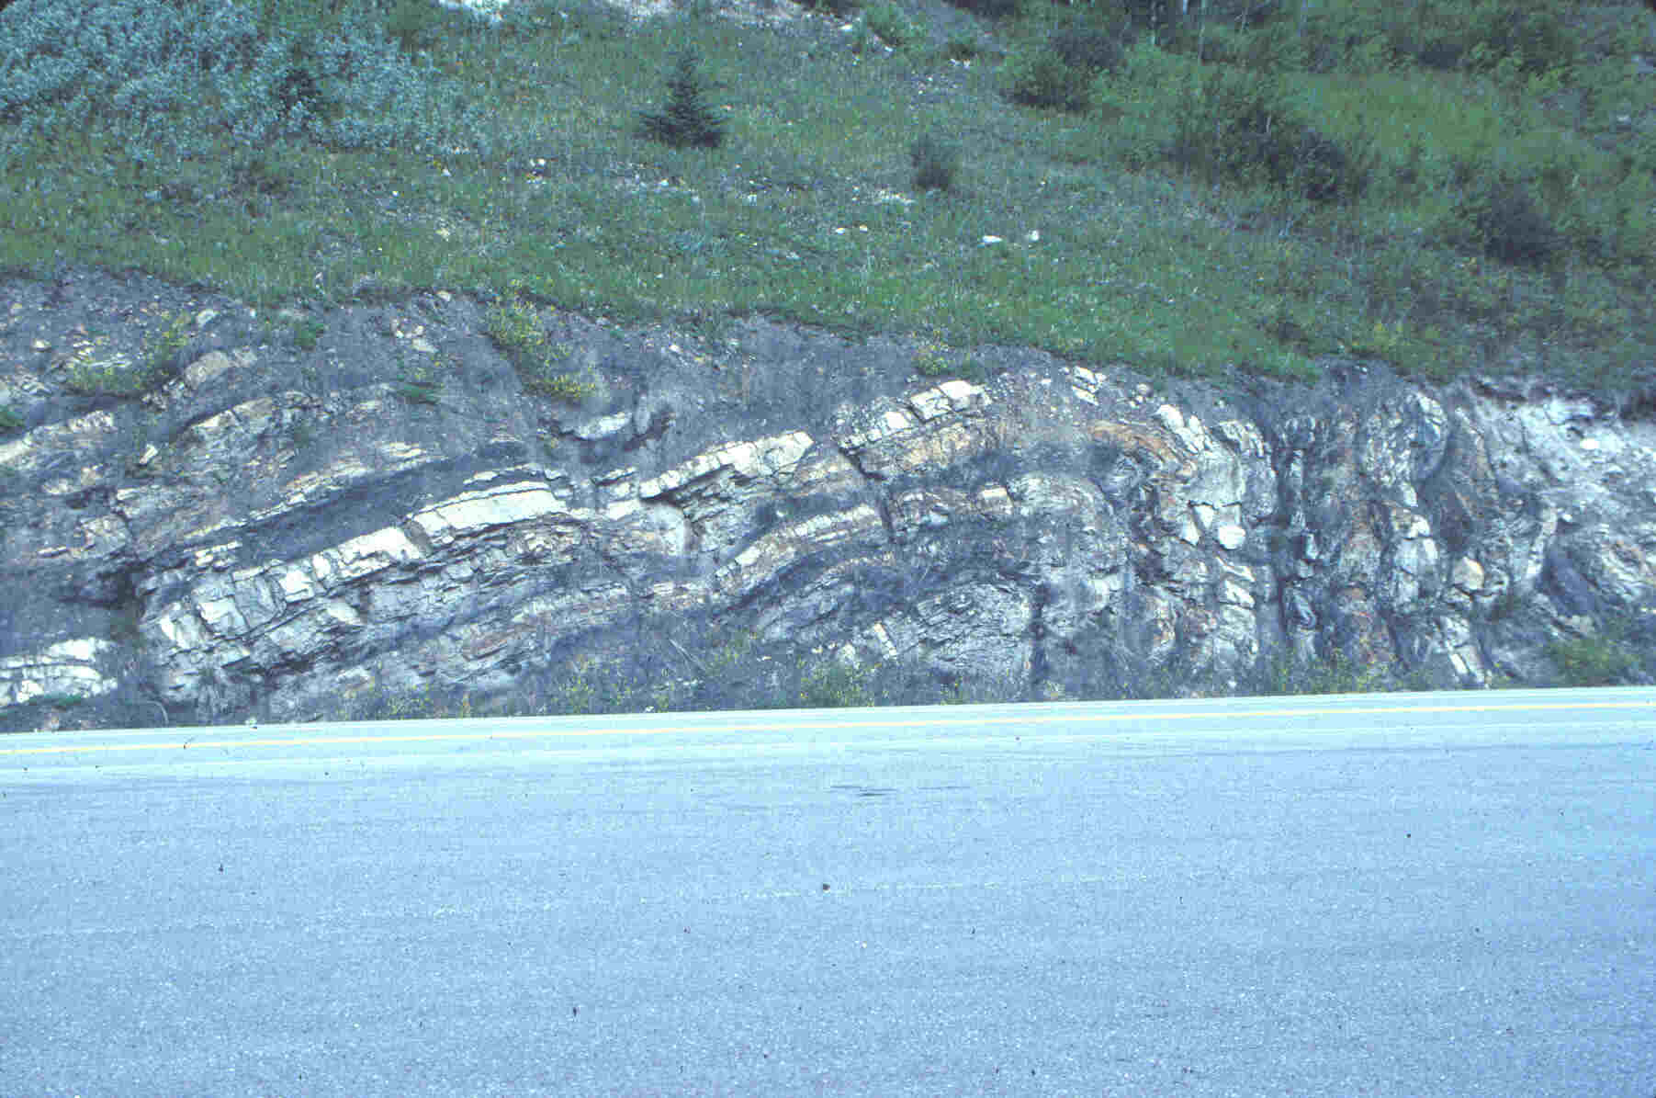
Evidence for Evolution
Fossils have found that many simpler life forms exist early in Earth’s history.
The oldest fossils found are bacteria that lived 3.8 billion years ago.

Slide 13
Types of Fossils
Trace Fossil
  indirect evidence left by an animal, like a footprint, trail, or burrow
Cast
  when minerals in rock fill a space left by a decayed organism
Mold
  When organism buried in sediment decays and leaves a space
Petrified or Premineralized
  when minerals fill in an organism
Amber or ice preserved
  when an entire organism is trapped in amber or ice

Slide 14
Paleontology, the study of fossils, was largely developed by French scientist Georges Cuvier
Cuvier advocated catastrophism, speculating that each boundary between strata represents a catastrophe
This goes well with the idea of punctuated equilibrium; there can be long periods of no change followed by rapid bursts of evolution and adaptation.
© 2011 Pearson Education, Inc.

Slide 15
Geologists James Hutton and Charles Lyell perceived that changes in Earth’s surface can result from slow continuous actions still operating today
Lyell’s principle of uniformitarianism states that the mechanisms of change are constant over time. Hutton agreed and an almost synonymous term of gradualism was applied.
This view strongly influenced Darwin’s thinking and demonstrated that small incremental changes can add up to something big over time.
© 2011 Pearson Education, Inc.

Slide 16
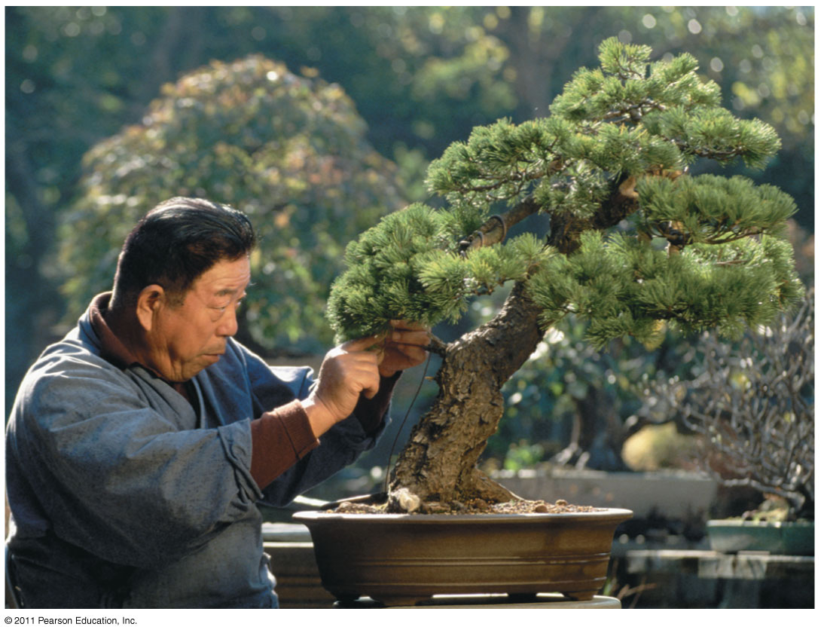
Lamarck’s Hypothesis of Evolution
Lamarck hypothesized that species evolve through use and disuse of body parts and the inheritance of acquired characteristics
The mechanisms he proposed are unsupported by evidence, but he did propose a mechanism for evolution.
© 2011 Pearson Education, Inc.

Slide 17
Darwin’s Research
As a boy and into adulthood, Charles Darwin had a consuming interest in nature
Darwin first studied medicine (unsuccessfully), and then theology at Cambridge University
After graduating, he took an unpaid position as naturalist and companion to Captain Robert FitzRoy for a 5-year around the world voyage on the Beagle
© 2011 Pearson Education, Inc.

Slide 18
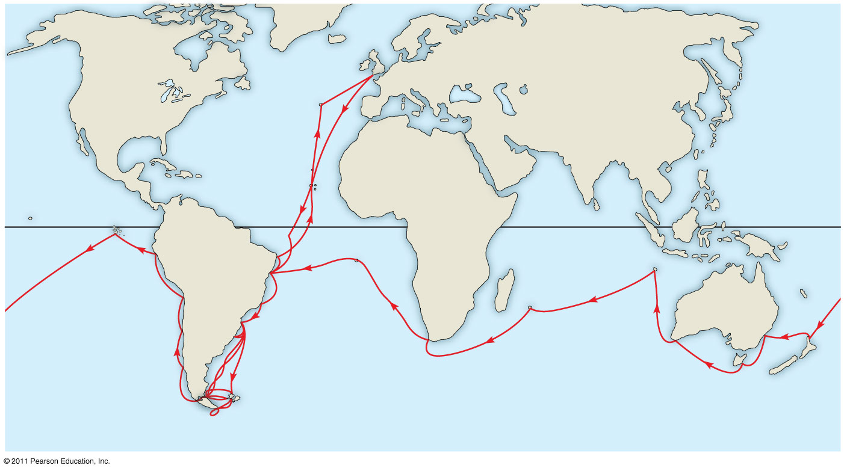
Figure 22.5a
Great
Britain
EUROPE
NORTH
AMERICA
ATLANTIC
OCEAN
The
Galápagos
Islands
AFRICA
Equator
Malay Archipelago
SOUTH
AMERICA
PACIFIC
OCEAN
Chile
Brazil
AUSTRALIA
PACIFIC
OCEAN
Andes Mtns.
Cape of
Good Hope
Argentina
Tasmania
Cape Horn
New
Zealand
Notes:
Figure 22.5 The voyage of HMS Beagle.

Slide 19
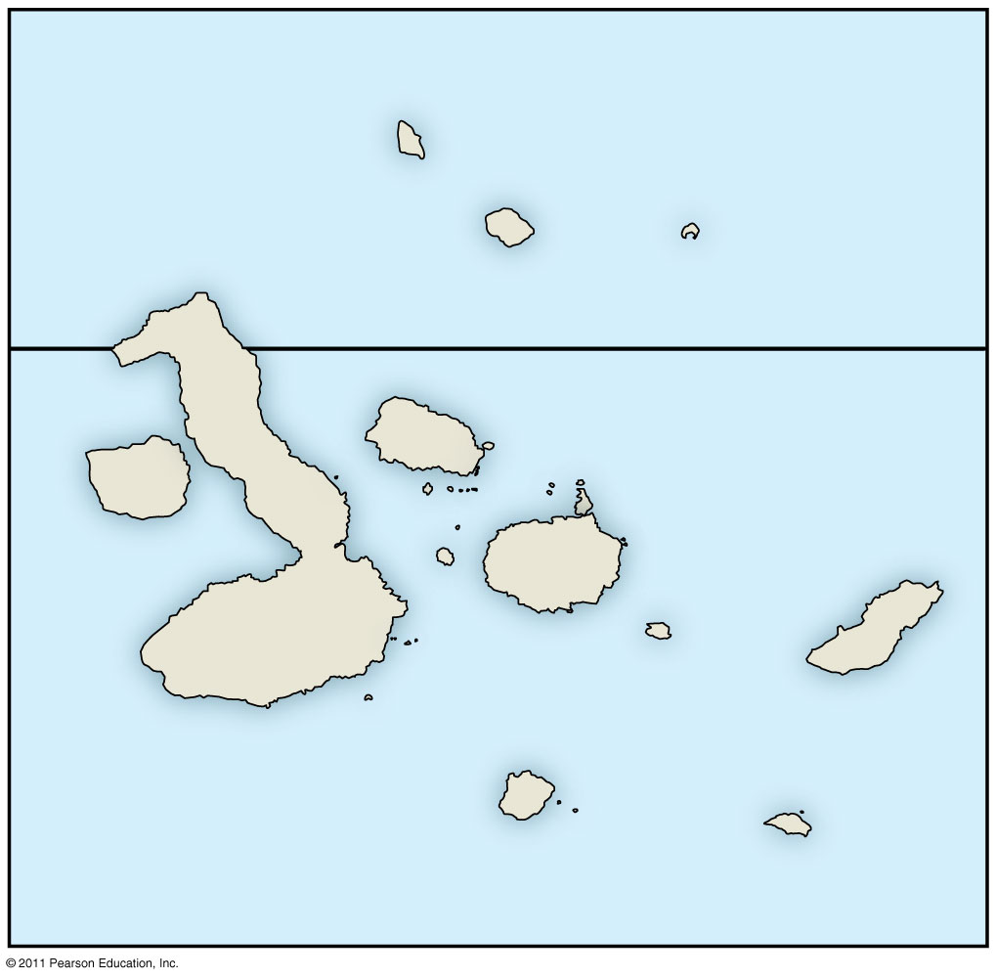
Figure 22.5c
The
Galápagos
Islands
PACIFIC
OCEAN
Pinta
Genovesa
Marchena
Equator
Santiago
Daphne
Islands
Fernandina
Pinzón
Isabela
Santa
Cruz
Santa
Fe
San
Cristobal
0
20
40
Florenza
Española
Kilometers
Notes:
Figure 22.5 The voyage of HMS Beagle.

Slide 20
Darwin’s Focus on Adaptation
In reassessing his observations, Darwin perceived adaptation to the environment and the origin of new species as closely related processes
Adaptation: A form or structure modification to fit a changed environment
Finches
From studies made years after Darwin’s voyage, biologists have concluded that this is what happened to the Galápagos finches
© 2011 Pearson Education, Inc.

Slide 21
In 1844, Darwin wrote an essay on natural selection as the mechanism of descent with modification, but did not introduce his theory publicly
Natural selection is a process in which individuals with favorable inherited traits are more likely to survive and reproduce
In June 1858, Darwin received a manuscript from Alfred Russell Wallace, who had developed a theory of natural selection similar to Darwin’s
Darwin quickly finished The Origin of Species and published it the next year
© 2011 Pearson Education, Inc.

Slide 22
Descent with Modification
Darwin never used the word evolution in the first edition of The Origin of Species
The phrase descent with modification summarized Darwin’s perception of the unity of life
The phrase refers to the view that all organisms are related through descent from an ancestor that lived in the remote past
© 2011 Pearson Education, Inc.

Slide 23
The Theory of Evolution
On the Origin of Species made two major points
  1. Many species living on Earth have descended from ancestral species that are different from the modern ones around today. (descent with modification)
  2. The mechanism for these changes is natural selection.

Slide 24
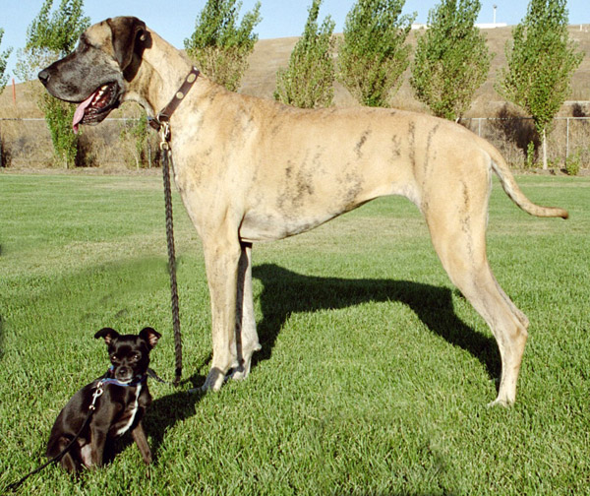
Artificial Selection, Natural Selection, and Adaptation
Darwin noted that humans have modified other species by selecting and breeding individuals with desired traits, a process called artificial selection
Darwin drew two inferences from four observations
© 2011 Pearson Education, Inc.

Slide 25
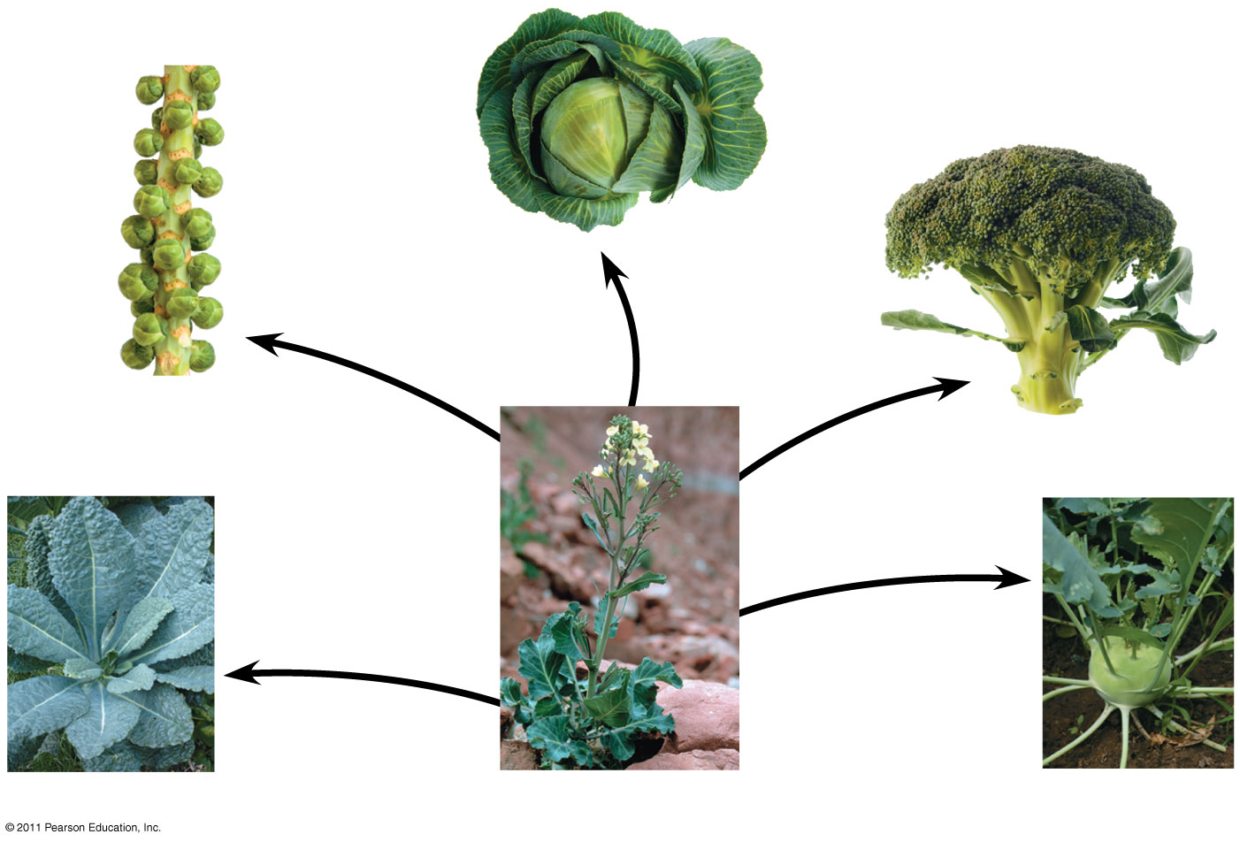
Figure 22.9
Cabbage
Selection for
apical (tip) bud
Brussels
sprouts
Selection for
axillary (side)
buds
Broccoli
Selection
for flowers
and stems
Selection
for stems
Selection
for leaves
Kale
Wild mustard
Kohlrabi
Notes:
Figure 22.9 Artificial selection.

Slide 26
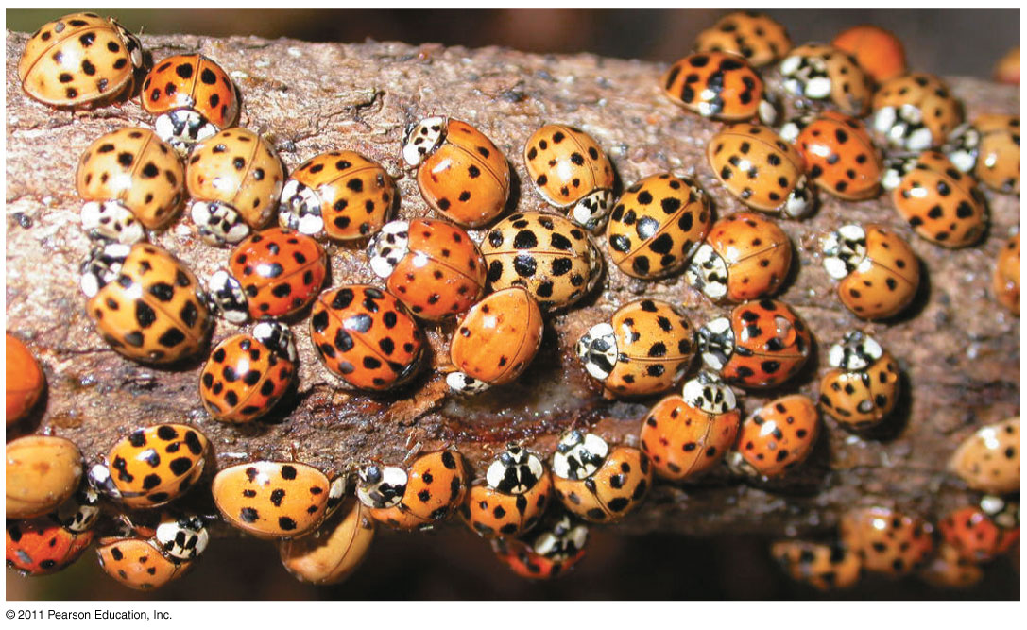
Observation #1: Members of a population often vary in their inherited traits
Obersvation #2 These variations are heritable
© 2011 Pearson Education, Inc.

Slide 27
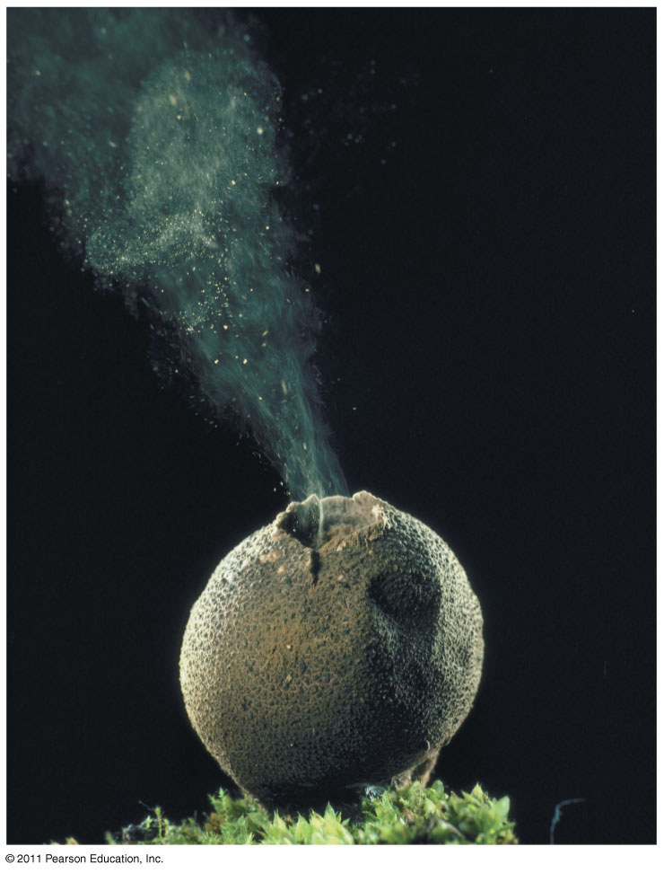
Observation #3: All species can produce more offspring than the environment can support,
Observation #4 Competition for limited resources; and many offspring fail to survive and reproduce
© 2011 Pearson Education, Inc.

Slide 28
Inference #1: Individuals whose inherited traits give them a higher probability of surviving and reproducing in a given environment tend to leave more offspring than other individuals
Inference #2: This unequal ability of individuals to survive and reproduce will lead to the accumulation of favorable traits in the population over generations
© 2011 Pearson Education, Inc.

Slide 29

Natural Selection: A Summary
Individuals with certain heritable characteristics survive and reproduce at a higher rate than other individuals
Natural selection increases the adaptation of organisms to their environment over time
If an environment changes over time, natural selection may result in adaptation to these new conditions and may give rise to new species (13)
Video: Seahorse Camouflage
© 2011 Pearson Education, Inc.

Slide 30
Note that individuals do not evolve; populations evolve over time
Natural selection can only increase or decrease heritable traits that vary in a population
Adaptations vary with different environments
© 2011 Pearson Education, Inc.

Slide 31
Direct Observations of Evolutionary Change
Two examples provide evidence for natural selection: natural selection in response to introduced plant species, and the evolution of drug-resistant bacteria
© 2011 Pearson Education, Inc.

Slide 32
Let’s See an Example of Natural Selection in Action……….
Imagine that there are 10 bacteria growing on your hand.

Slide 33
You use Germ-x to clean your hand everyday.

Slide 34
After 4 days, there are still 3 bacteria on your hands that have survived.

Slide 35
Is there anything special about these bacteria?
Well only to the point that their DNA had some differences that allowed them to survive.
** Key Point The bacteria did not instantly evolve new DNA, rather some rare DNA combination was suddenly favored.

Slide 36
Those 3 that are “resistant” will undergo asexual reproduction.

Slide 37
And after a short period of time, your hands will be covered with tons of bacteria that are ALL resistant to Germ-X. ☺

Slide 38
The Evolution of Drug-Resistant Bacteria
The bacterium Staphylococcus aureus is commonly found on people
One strain, methicillin-resistant S. aureus (MRSA) is a dangerous pathogen (16)
S. aureus became resistant to penicillin in 1945, two years after it was first widely used
S. aureus became resistant to methicillin in 1961, two years after it was first widely used
It also gained adaptations for increased disease and colonization on human tissue
© 2011 Pearson Education, Inc.

Slide 39
Natural Selection in Response to Introduced Plant Species
Soapberry bugs use their “beak” to feed on seeds within fruits
In southern Florida soapberry bugs feed on balloon vine with larger fruit; they have longer beaks
In central Florida they feed on goldenrain tree with smaller fruit; they have shorter beaks
Correlation between fruit size and beak size has also been observed in Louisiana, Oklahoma, and Australia
© 2011 Pearson Education, Inc.

Slide 40
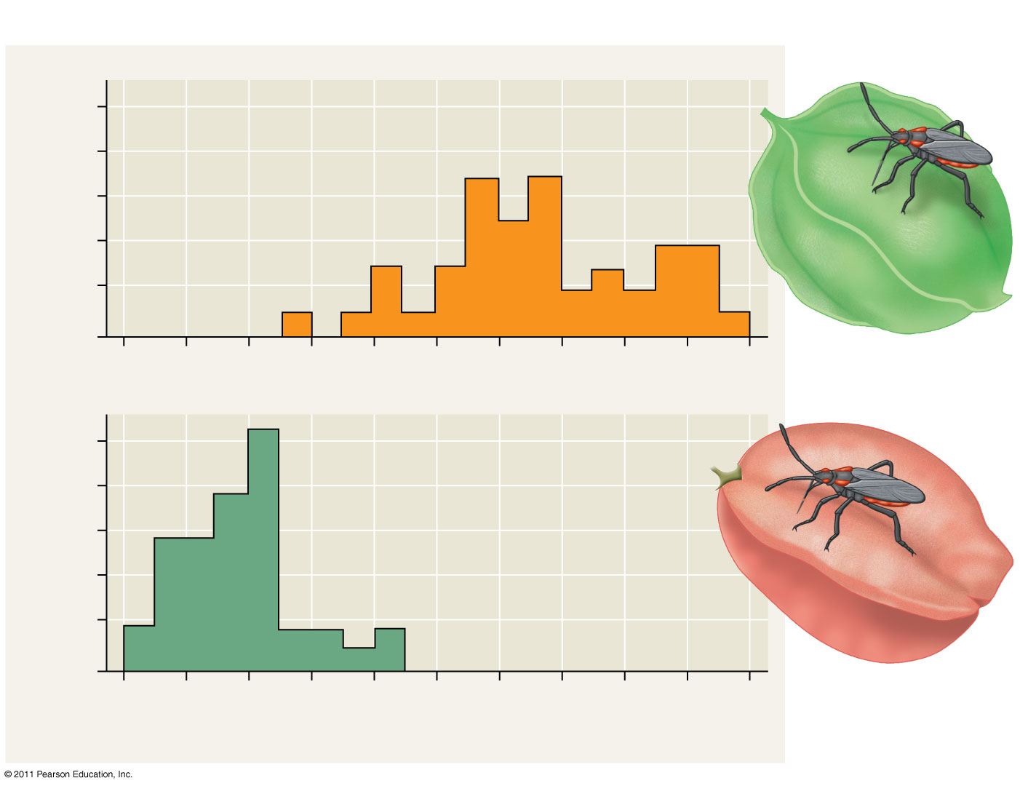
Figure 22.13b
RESULTS
Beak
10
On native species,
southern Florida
8
6
4
2
0
Number of individuals
Museum-specimen average
10
8
On introduced species,
central Florida
6
4
2
0
6
7
8
9
10
11
Beak length (mm)
Notes:
Figure 22.13 Inquiry: Can a change in a population’s food source result in evolution by natural selection?

Slide 41
Natural selection does not create new traits, but edits or selects for traits already present in the population
The local environment determines which traits will be selected for or selected against in any specific population
It “selects” for pre-existing variants; this is an important concept.
© 2011 Pearson Education, Inc.

Slide 42
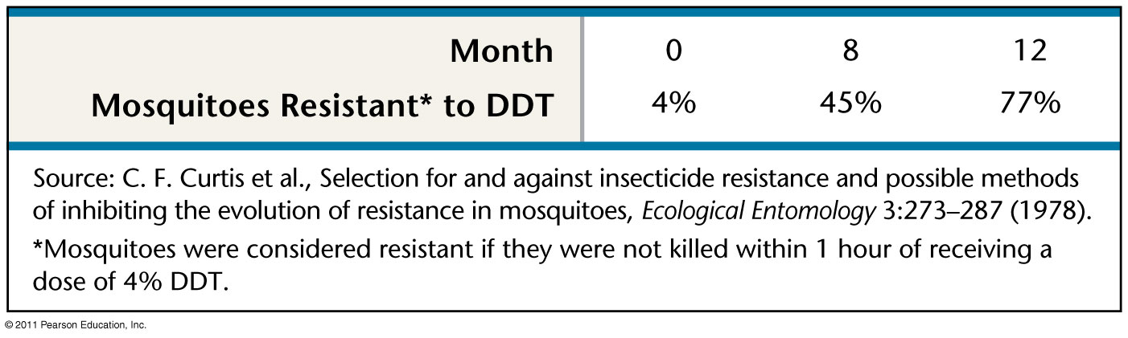
Figure 22.UN03
Notes:
Figure 22.UN03 Test Your Understanding, question 7

Slide 43
Evidence for Evolution
All living things contain similar DNA, RNA, and proteins.
By comparing DNA sequences of two organisms, scientists can determine whether or not the organisms are closely related.
The relationship can then be used to construct evolutionary pathways.

Slide 44
Homology
Homology is similarity resulting from common ancestry
The fossil record shows homology; organisms in the fossil record are “similar” to their modern day species, but yet distinctly different in some features.
© 2011 Pearson Education, Inc.

Slide 45
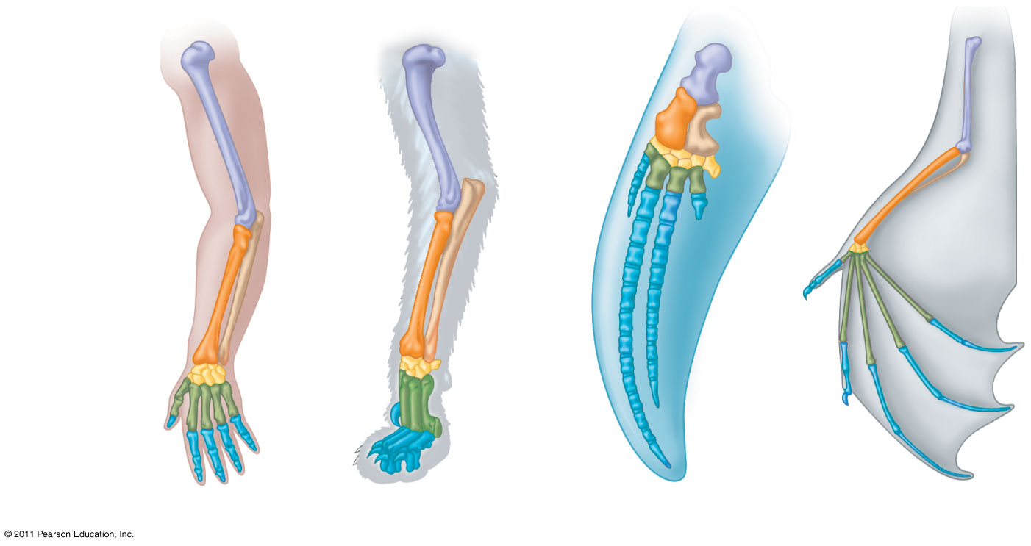
Figure 22.15
Homologous structures are anatomical resemblances that represent variations on a structural theme present in a common ancestor
Humerus
Radius
Ulna
Carpals
Metacarpals
Phalanges
Human
Cat
Whale
Bat
Notes:
Figure 22.15 Mammalian forelimbs: homologous structures.

Slide 46
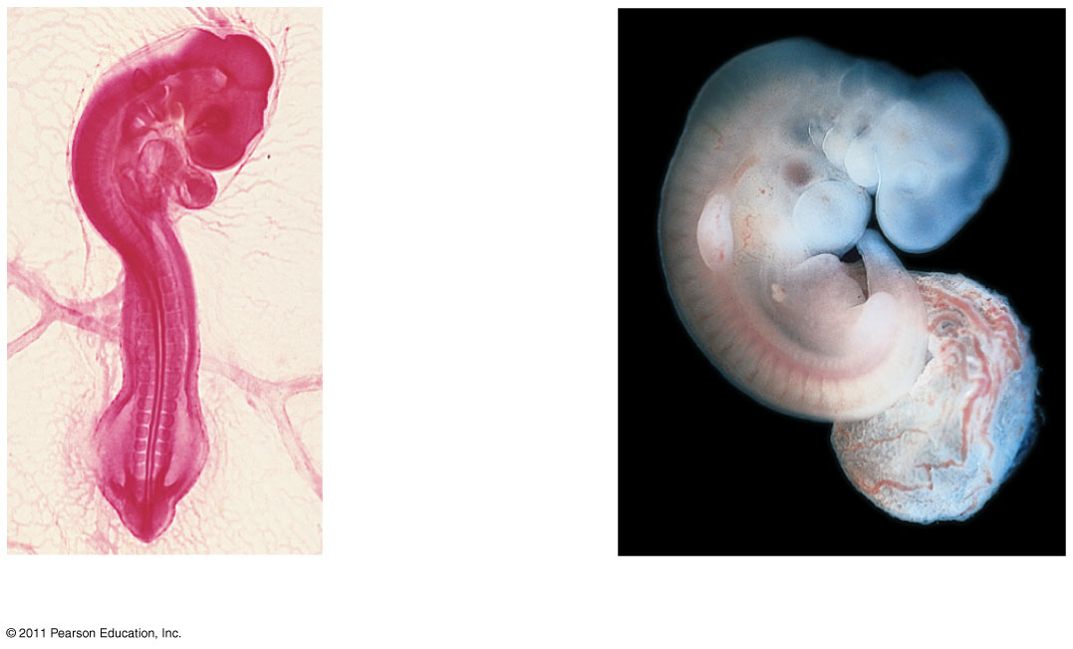
Comparative embryology reveals anatomical homologies not visible in adult organisms
Pharyngeal
pouches
Post-anal
tail
Chick embryo (LM)
Human embryo
© 2011 Pearson Education, Inc.

Slide 47
Vestigial structures are remnants of features that served important functions in the organism’s ancestors
Examples of homologies at the molecular level are genes shared among organisms inherited from a common ancestor
© 2011 Pearson Education, Inc.

Slide 48
A Different Cause of Resemblance: Convergent Evolution
Convergent evolution is the evolution of similar, or analogous structures/features in distantly related groups
Analogous traits arise when groups independently adapt to similar environments in similar ways
Convergent evolution does not provide information about ancestry
© 2011 Pearson Education, Inc.

Slide 49
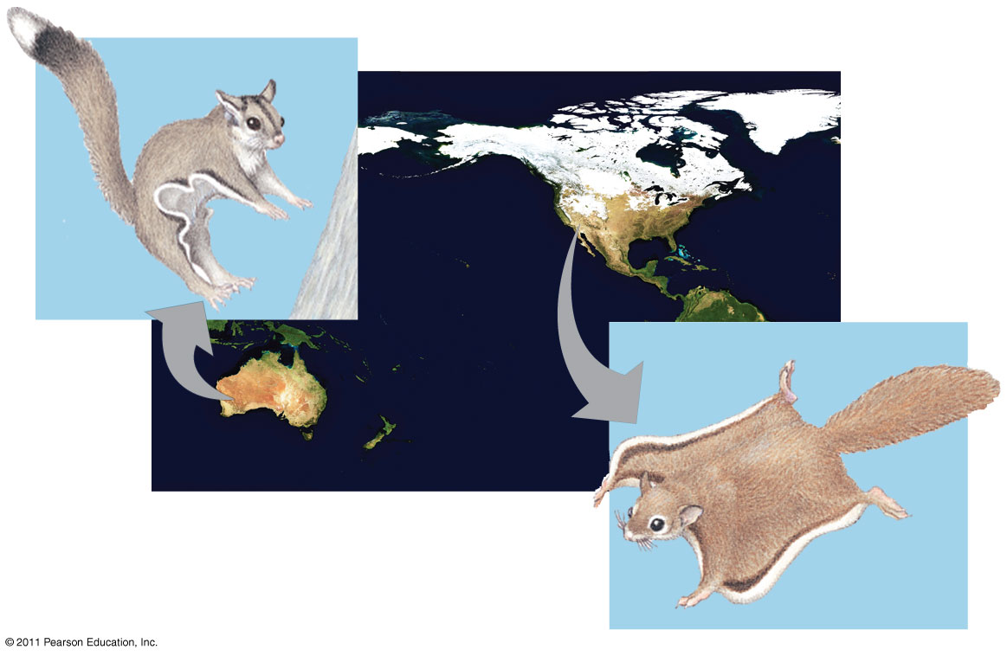
Anatomical
Analogous structures have body parts that are similar in function but different in structure. These indicate that the organisms had different yet related ancestors.

Slide 50
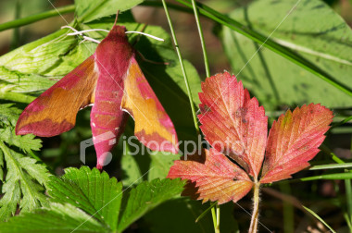
Anatomical
Some adaptations involve changes in the structure of body parts: mimicry and camouflage.
  Mimicry enables an organism to copy the appearance of another species.

Slide 51
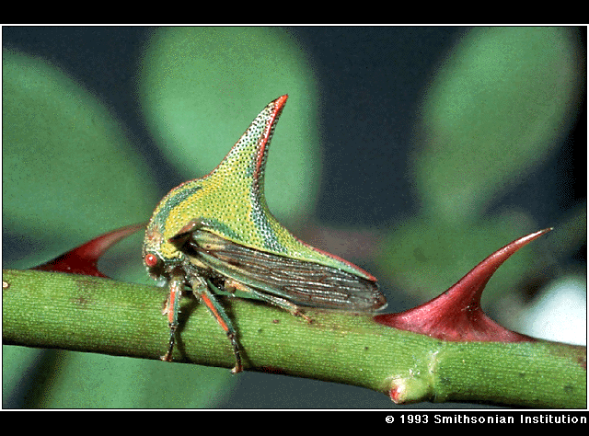
MIMICRY

Slide 52
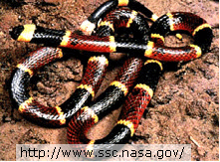
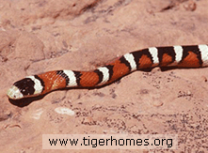
Milk Snake
Coral Snake

Slide 53
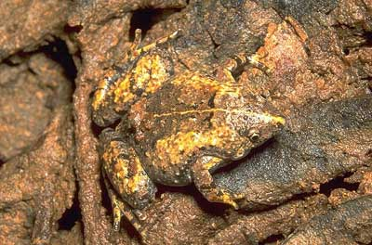
Anatomical
Some adaptations involve changes in the structure of body parts: mimicry and camouflage.
  Camouflage is a structural adaptation that enables an organism to blend in with its surroundings.

Slide 54
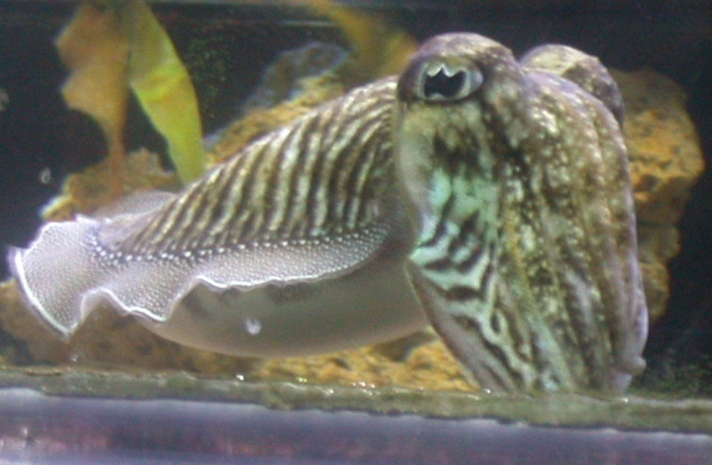
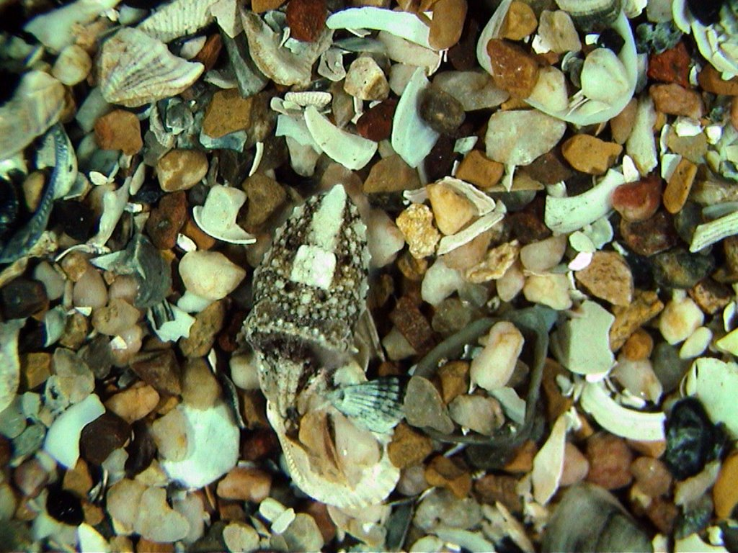
CAMOUFLAGE

Slide 55
Homologies and “Tree Thinking”
Evolutionary trees are hypotheses about the relationships among different groups
Homologies form nested patterns in evolutionary trees
Evolutionary trees can be made using different types of data, for example, anatomical and DNA sequence data
© 2011 Pearson Education, Inc.

Slide 56
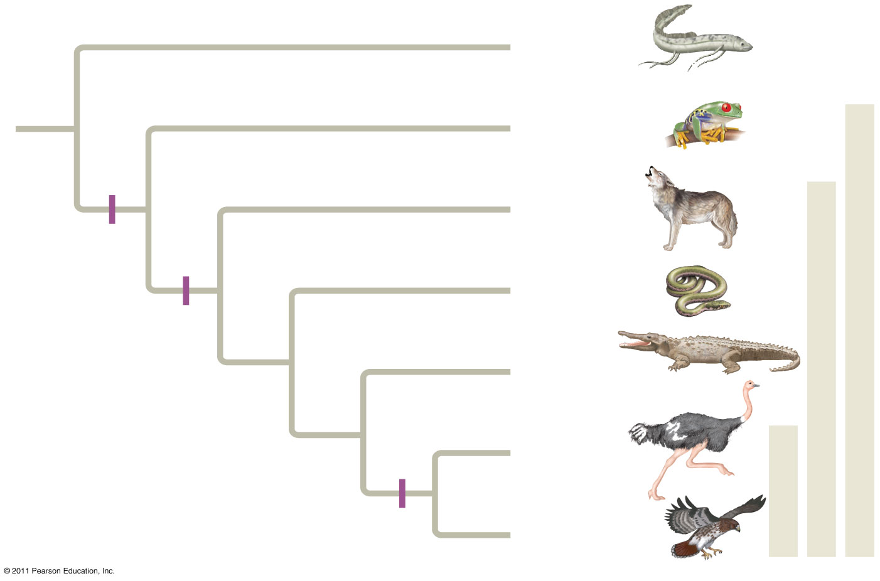
Figure 22.17
(24-27)
Branch point
Lungfishes
1
Amphibians
Tetrapods
2
Mammals
Digit-
bearing
limbs
Amniotes
3
Lizards
and snakes
Amnion
4
Crocodiles
Homologous
characteristic
5
Ostriches
6
Birds
Feathers
Hawks and
other birds
Notes:
Figure 22.17 Tree thinking: information provided in an evolutionary tree.

Slide 57
Biogeography
Biogeography, the geographic distribution of species, provides evidence of evolution
Earth’s continents were formerly united in a single large continent called Pangaea, but have since separated by continental drift
An understanding of continent movement and modern distribution of species allows us to predict when and where different groups evolved (30 here and on next slide)
© 2011 Pearson Education, Inc.

Slide 58
Endemic species are species that are not found anywhere else in the world
Islands have many endemic species that are often closely related to species on the nearest mainland or island
Darwin explained that species on islands gave rise to new species as they adapted to new environments
© 2011 Pearson Education, Inc.

Slide 59
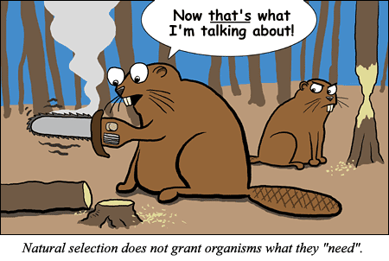
The Evolution of Populations

Slide 60
Variation Makes Evolution Possible
Natural Selection operates on heritable differences among individuals in a population
2 processes produce variation in gene pools that contribute to these differences
  Mutation
    Produce new genes/ alleles
    Changes in nucleotide sequence in DNA
    Less important
  Sexual recombination
    More important

Slide 61
Mutations
DNA Mutations
Chromosomal Mutations
Frame shift
  Addition
  Deletion
Base substitution
  Silent
  Nonsense
  missense
Translocation
Duplication
Deletion
Inversion

Slide 62
Mutations
All mutations must occur in gametes to be passed on!
Most probably harmless
  Noncoding DNA
  Redundancy of the genetic code
Organisms reflect thousands of years of past selection, a single mutational change is about as likely to improve the genome as blindly firing a gun through the hood of a car is likely to improve engine performance
Rarely, a mutant allele may make an organism better suited to its environment
  More likely when the environment is changing and mutations that were once selected against become favorable
Point Mutations

Slide 63
Mutations
Mutations that Alter Gene # or Sequence
Chromosomal mutations that delete, disrupt, or rearrange many loci at once are almost certain to be harmful
  If genes are left intact, effect on organism may be neutral
Gene Duplication: important source of variation
  Duplication of chromosome segments is almost always harmful
  Smaller pieces of DNA introduced into the genome through the activity of transposable elements may, over generations, provide expanded genome with new loci that may take on new functions by further mutation and selection
  New genes may arise through exon shuffling

Slide 64
Mutation Rates
Plants & Animals
Prokaryotes & Viruses
Long generation spans makes mutation rates low
  About 1 mutation in every 100,000 genes per generation
Short generation spans mean mutations rapidly generate variation
Example HIV:
  Generation span = 2 days
  RNA genome has higher mutation rate than DNA genome
  Makes single drug treatments an impossibility

Slide 65
Sexual Recombination
Refers to recombinational shuffling of already existing alleles in the gene pool
  Note: This allelic variation did originate from past mutation
Sexual recombination is far more important than mutation on a generation-to-generation time scale in producing variation that make adaptation possible
Sexual reproduction rearranges alleles into fresh combinations every generation

Slide 66
Prokaryotes & Viruses
Can also undergo recombination, though they do so less often than sexually reproducing organisms
Can often undergo recombination that allows them to cross species barriers
This can make them especially dangerous!

Slide 67
Overview: The Smallest Unit of Evolution
One misconception is that organisms evolve during their lifetimes
Natural selection acts on individuals, but only populations evolve
Consider, for example, a population of medium ground finches on Daphne Major Island
  During a drought, large-beaked birds were more likely to crack large seeds and survive
  The finch population evolved by natural selection
© 2011 Pearson Education, Inc.

Slide 68
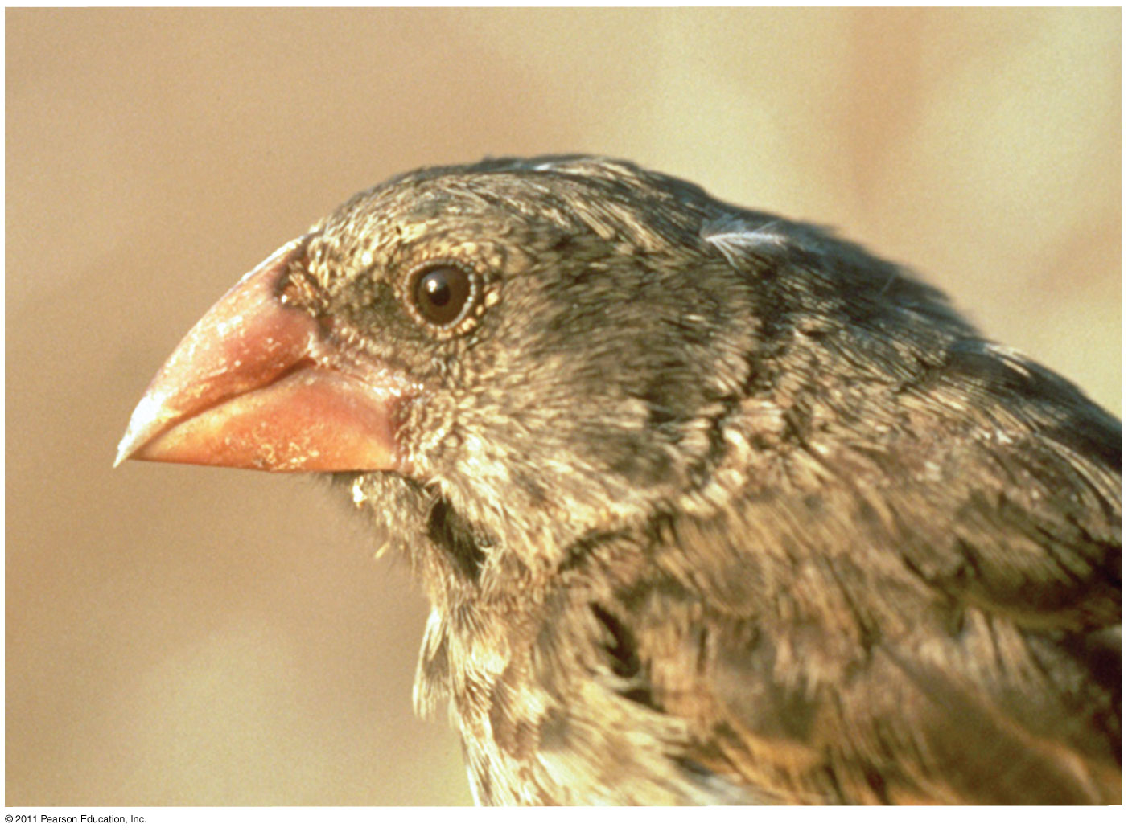
Figure 23.1
Notes:
Figure 23.1 Is this finch evolving?

Slide 69
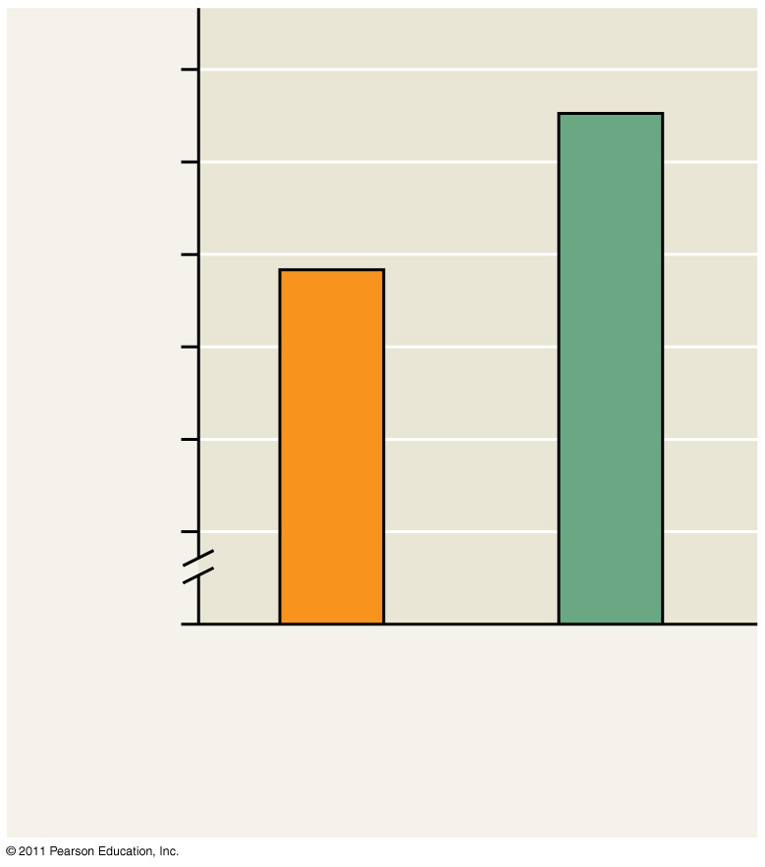
Figure 23.2
10
9
Average beak depth (mm)
8
0
1976
(similar to the
prior 3 years)
1978
(after
drought)
Notes:
Figure 23.2 Evidence of selection by food source.

Slide 70
Remember: Microevolution is a change in allele frequencies in a population over generations
Three mechanisms cause allele frequency change:
  Natural selection
  Genetic drift
  Gene flow
Only natural selection causes adaptive evolution
© 2011 Pearson Education, Inc.

Slide 71
Genetic variation makes evolution possible
Variation in heritable traits is a prerequisite for evolution
Mendel’s work on pea plants provided evidence of discrete heritable units (genes)
Genetic variation among individuals is caused by differences in genes or other DNA segments
Phenotype is the product of inherited genotype and environmental influences
Natural selection can only act on variation with a genetic component
© 2011 Pearson Education, Inc.

Slide 72
Variation Within a Population
Both discrete and quantitative characters contribute to variation within a population
Discrete characters can be classified on an either-or basis
Quantitative characters vary along a continuum within a population
© 2011 Pearson Education, Inc.

Slide 73
Genetic variation can be measured as gene variability or nucleotide variability
For gene variability, average heterozygosity measures the average percent of loci that are heterozygous in a population
Nucleotide variability is measured by comparing the DNA sequences of pairs of individuals
© 2011 Pearson Education, Inc.

Slide 74
Variation Between Populations
Most species exhibit geographic variation, differences between gene pools of separate populations
Some examples of geographic variation occur as a cline, which is a graded change in a trait along a geographic axis
A cline means different environments, thus different selection pressures suggesting natural selection
For example, mummichog fish vary in a cold-adaptive allele along a temperature gradient
  This variation results from natural selection
© 2011 Pearson Education, Inc.

Slide 75
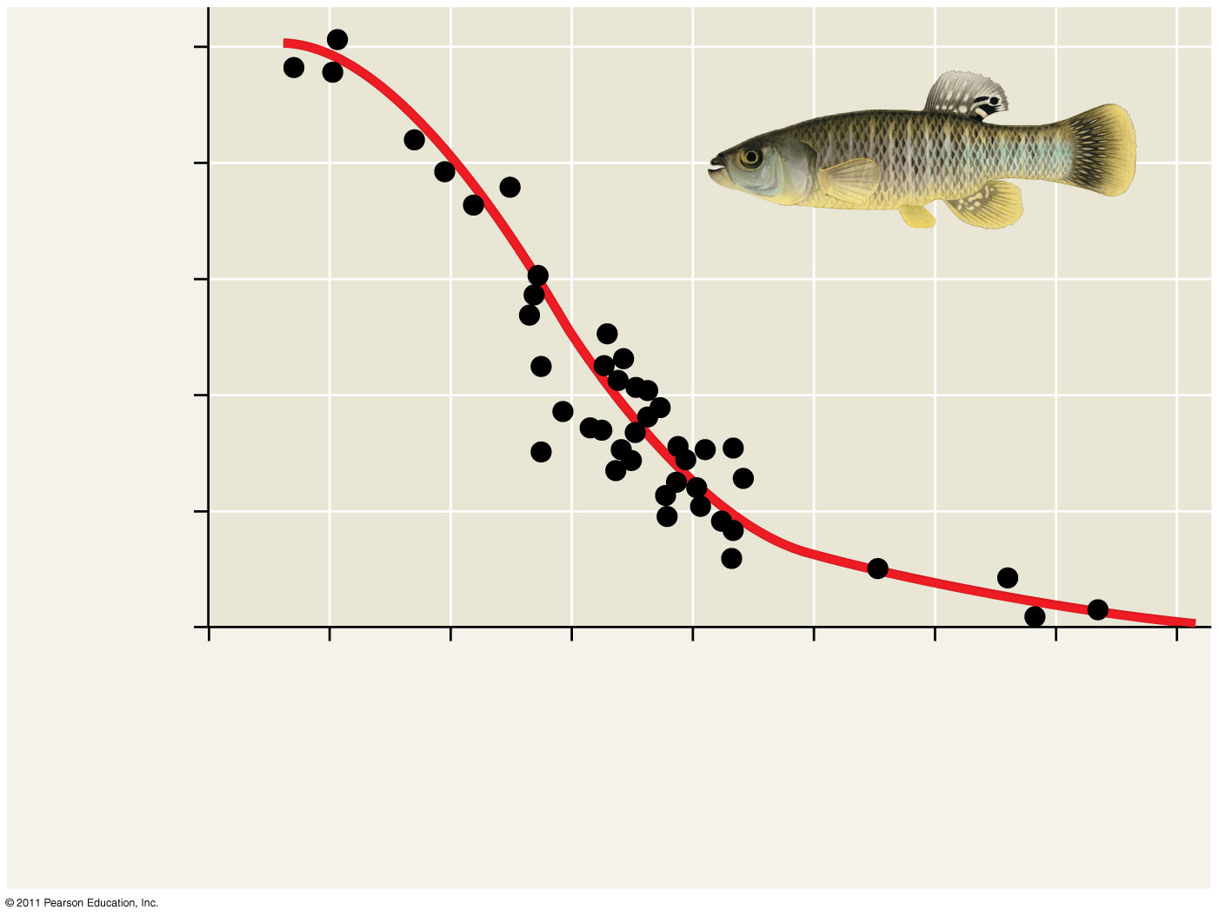
Figure 23.5 A cline determined by temperature.
1.0
0.8
0.6
Ldh-B^{b} allele frequency
0.4
0.2
0
46
44
42
40
38
36
34
32
30
Latitude (ºN)
Maine
Cold (6°C)
Georgia
Warm (21ºC)
Notes:
Figure 23.5 A cline determined by temperature.

Slide 76
Sources of Genetic Variation
New genes and alleles can arise by mutation or gene duplication and are only passed on through gametes.
Point mutations change a single base of DNA. This may not have any effect on phenotype due to codon redundancy and the mutation could occur in a non coding region of DNA.
Translocations rearrange the positions of genes on chromosomes could be beneficial or harmful.
How genetic diversity is created in meiosis
© 2011 Pearson Education, Inc.

Slide 77
Altering Gene Number or Position
Chromosomal mutations that delete, disrupt, or rearrange many loci are typically harmful
Duplication of small pieces of DNA increases genome size and is usually less harmful, duplications can happen during DNA replication.
Duplicated genes can take on new functions by further mutation
An ancestral odor-detecting gene has been duplicated many times: humans have 1,000 copies of the gene, mice have 1,300
© 2011 Pearson Education, Inc.

Slide 78
Sexual Reproduction
Sexual reproduction can shuffle existing alleles into new combinations
  1. Crossing Over
  2. Independent Assortment
  3. Random Fertilization
In organisms that reproduce sexually, recombination of alleles is more important than mutation in producing the genetic differences that make adaptation possible
© 2011 Pearson Education, Inc.

Slide 79
The Hardy-Weinberg equation can be used to test whether a population is evolving
The first step in testing whether evolution is occurring in a population is to clarify what we mean by a population
A population is a localized group of individuals capable of interbreeding and producing fertile offspring
A gene pool consists of all the alleles for all loci in a population
A locus is fixed if all individuals in a population are homozygous for the same allele
© 2011 Pearson Education, Inc.

Slide 80
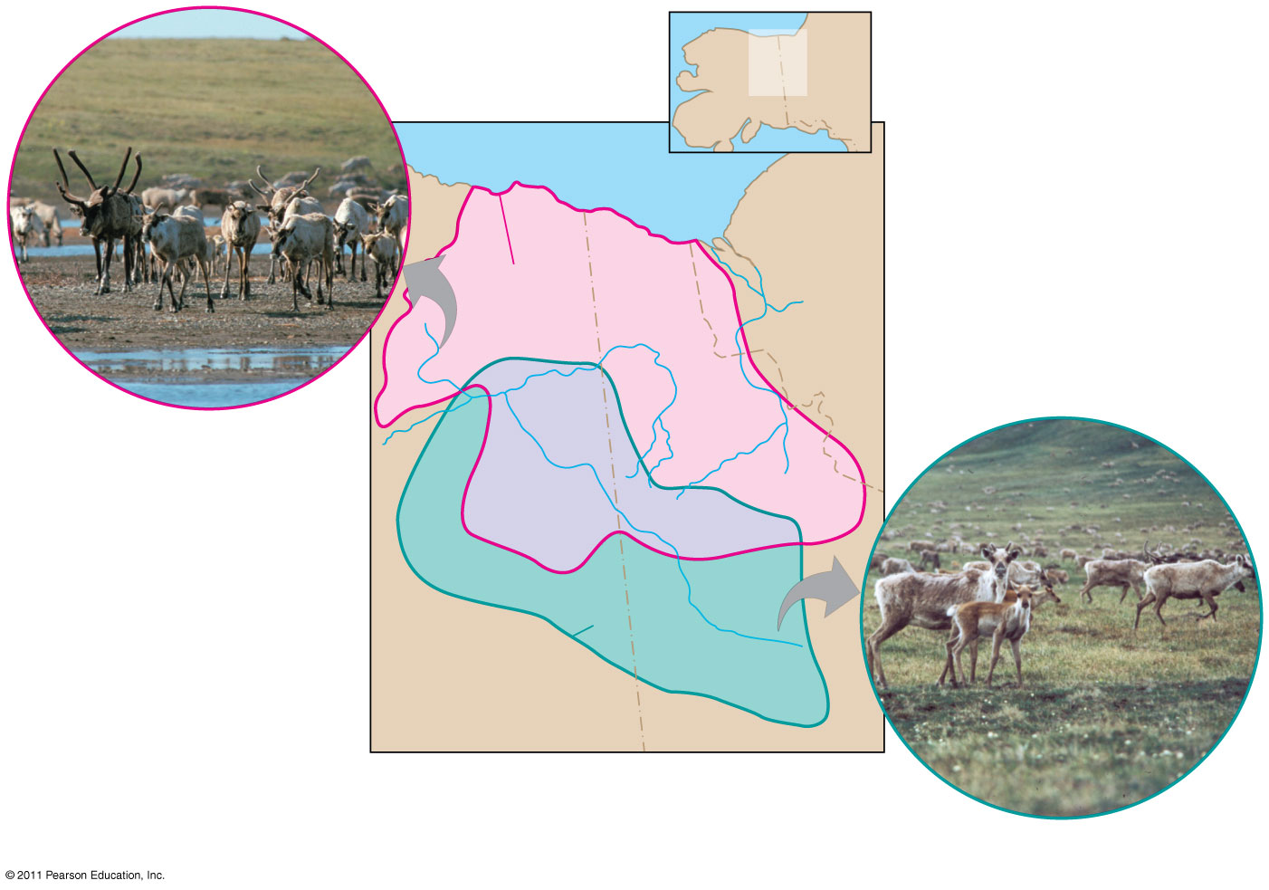
Figure 23.6
MAP
AREA
CANADA
ALASKA
Beaufort Sea
NORTHWEST
TERRITORIES
Porcupine
herd range
Porcupine herd
Fortymile
herd range
ALASKA
YUKON
Fortymile herd
Notes:
Figure 23.6 One species, two populations.

Slide 81
Hardy-Weinberg Equilibrium
The Hardy-Weinberg principle states that frequencies of alleles and genotypes in a population remain constant from generation to generation
In a given population where gametes contribute to the next generation randomly, allele frequencies will not change
Mendelian inheritance preserves genetic variation in a population
If a population does not meet the criteria of the Hardy-Weinberg principle, it can be concluded that the population is evolving
© 2011 Pearson Education, Inc.

Slide 82
Conditions for Hardy-Weinberg Equilibrium
The Hardy-Weinberg theorem describes a hypothetical population that is not evolving
In real populations, allele and genotype frequencies do change over time
© 2011 Pearson Education, Inc.

Slide 83
The five conditions for nonevolving populations are rarely met in nature:
No mutations
Random mating
No natural selection
Extremely large population size
No gene flow (16)
© 2011 Pearson Education, Inc.

Slide 84
The frequency of an allele in a population can be calculated (next several slides will set up the background info necessary to do 17-18)
  For diploid organisms, the total number of alleles at a locus is the total number of individuals times 2
  The total number of dominant alleles at a locus is 2 alleles for each homozygous dominant individual plus 1 allele for each heterozygous individual; the same logic applies for recessive alleles
  By convention, if there are 2 alleles at a locus, p and q are used to represent their frequencies. p=dominant allele q=recessive allele
© 2011 Pearson Education, Inc.

Slide 85
The frequency of all alleles in a population will add up to 1
  For example, p + q = 1
For example, consider a population of wildflowers that is incompletely dominant for color:
  320 red flowers (C^{R}C^{R})
  160 pink flowers (C^{R}C^{W})
  20 white flowers (C^{W}C^{W})
Calculate the number of copies of each allele:
  C^{R} = (320 × 2) + 160 = 800
  C^{W} = (20 × 2) + 160 = 200
© 2011 Pearson Education, Inc.

Slide 86
To calculate the frequency of each allele:
  p = freq C^{R} = 800 / (800 + 200) = 0.8
  q = freq C^{W} = 200 / (800 + 200) = 0.2
The sum of alleles is always 1
  0.8 + 0.2 = 1
Given above, you could work backwards and calculate the frequency of genotypes
p² + 2pq + q² = 1
  C^{R}C^{R} = p² = (0.8)² = 0.64=homozygous dominant
  C^{R}C^{W} = 2pq = 2(0.8)(0.2) = 0.32=heterozygous
  C^{W}C^{W} = q² = (0.2)² = 0.04=homozygous recessive
The frequency of genotypes can be confirmed using a Punnett square
© 2011 Pearson Education, Inc.

Slide 87
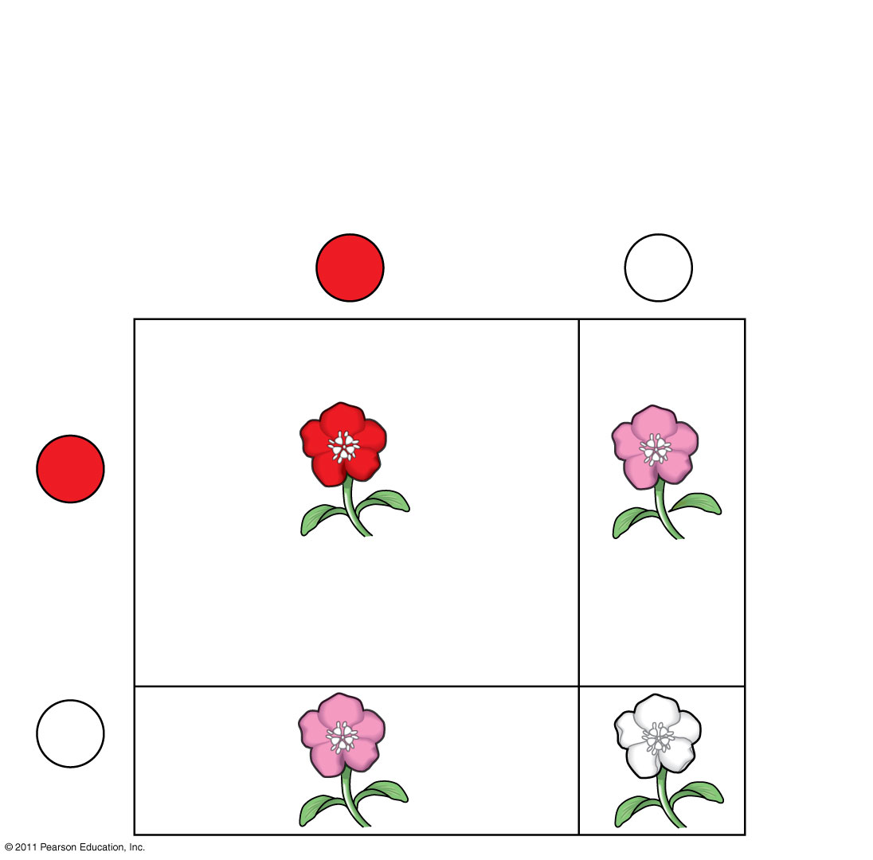
Figure 23.8a
80% C^{R} (p = 0.8)
20% C^{W} (q = 0.2)
Sperm
C^{R}
(80%)
C^{W}
(20%)
C^{R}
(80%)
64% (p²)
C^{R}C^{R}
16% (pq)
C^{R}C^{W}
Eggs
C^{W}
16% (qp)
C^{R}C^{W}
4% (q²)
C^{W}C^{W}
(20%)
Notes:
Figure 23.8 The Hardy-Weinberg principle.

Slide 88
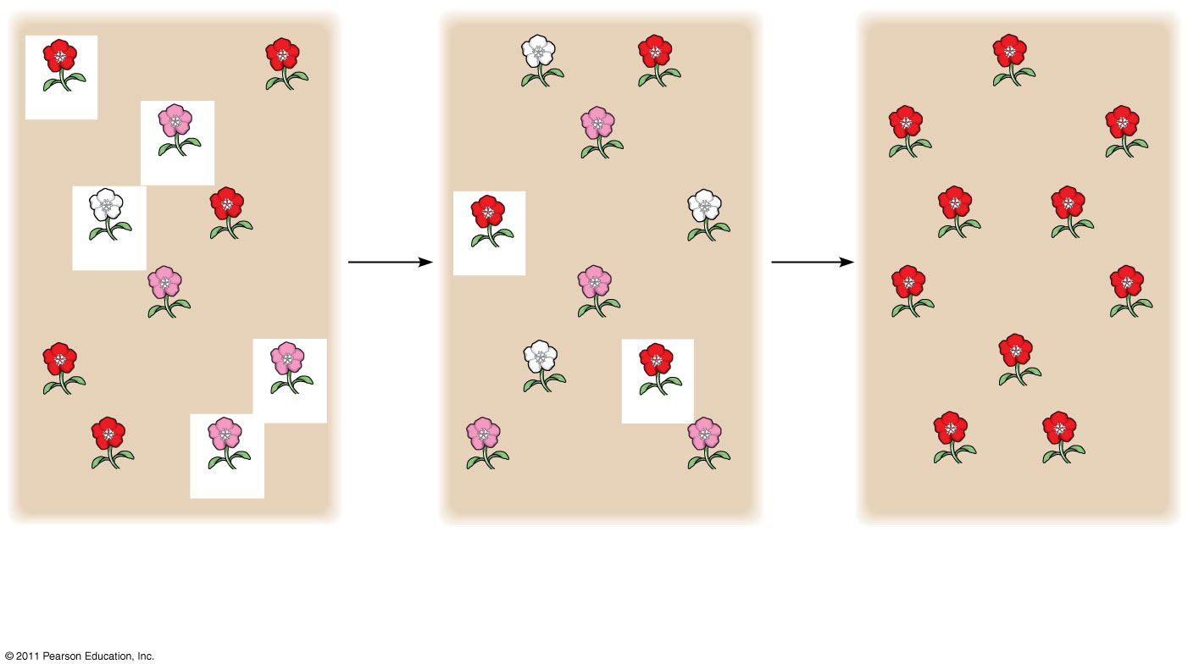
Figure 23.9-3
C^{R}C^{R}
5
plants
leave
off-
spring
C^{W}C^{W}
C^{R}C^{R}
2
plants
leave
off-
spring
C^{R}C^{R}
C^{R}C^{R}
C^{R}C^{W}
C^{R}C^{W}
C^{R}C^{R}
C^{R}C^{R}
C^{W}C^{W}
C^{R}C^{R}
C^{R}C^{R}
C^{W}C^{W}
C^{R}C^{R}
C^{R}C^{R}
C^{R}C^{W}
C^{R}C^{W}
C^{R}C^{R}
C^{R}C^{R}
C^{R}C^{R}
C^{R}C^{W}
C^{W}C^{W}
C^{R}C^{R}
C^{R}C^{R}
C^{R}C^{R}
C^{R}C^{W}
C^{R}C^{W}
C^{R}C^{W}
C^{R}C^{R}
C^{R}C^{R}
Generation 1
Generation 2
Generation 3
p (frequency of C^{R}) = 0.7
p = 0.5
p = 1.0
q (frequency of C^{W}) = 0.3
q = 0.5
q = 0.0
Notes:
Figure 23.9 Genetic drift.

Slide 89
Natural populations can evolve at some loci, while being in Hardy-Weinberg equilibrium at other loci….think about humans and PKU
© 2011 Pearson Education, Inc.

Slide 90
Applying the Hardy-Weinberg Principle
We can assume the locus that causes phenylketonuria (PKU) is in Hardy-Weinberg equilibrium given that:
The PKU gene mutation rate is low
Mate selection is random with respect to whether or not an individual is a carrier for the PKU allele
  Natural selection can only act on rare homozygous individuals who do not follow dietary restrictions
  The population is large
  Migration has no effect as many other populations have similar allele frequencies
© 2011 Pearson Education, Inc.

Slide 91
The occurrence of PKU is 1 per 10,000 births
  q² = 0.0001
  q = 0.01
The frequency of normal alleles is
  p = 1 – q = 1 – 0.01 = 0.99
The frequency of carriers is
  2pq = 2 × 0.99 × 0.01 = 0.0198
  or approximately 2% of the U.S. population
© 2011 Pearson Education, Inc.

Slide 92
Natural selection, genetic drift, and gene flow can alter allele frequencies in a population
Three major factors alter allele frequencies and bring about most evolutionary change:
  Natural selection
  Genetic drift
  Gene flow
© 2011 Pearson Education, Inc.

Slide 93
Natural Selection
Differential success in reproduction results in certain alleles being passed to the next generation in greater proportions
For example, an allele that confers resistance to DDT increased in frequency after DDT was used widely in agriculture
© 2011 Pearson Education, Inc.

Slide 94
Gene Flow
Gene flow consists of the movement of alleles among populations
Alleles can be transferred through the movement of fertile individuals or gametes (for example, pollen)
Gene flow tends to reduce variation among populations over time
© 2011 Pearson Education, Inc.

Slide 95
Genetic Drift
The smaller a sample, the greater the chance of deviation from a predicted result
Genetic drift describes how allele frequencies fluctuate unpredictably from one generation to the next
Genetic drift tends to reduce genetic variation through losses of alleles
Animation: Causes of Evolutionary Change
http://highered.mcgraw-hill.com/sites/9834092339/student_view0/chapter20/animation_-_mechanisms_of_evolution.html
© 2011 Pearson Education, Inc.

Slide 96
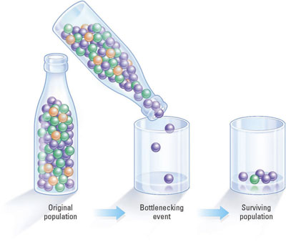
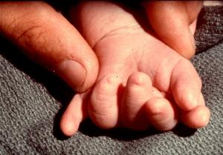
Genetic Drift
Because the founding gene pool was so small, polydactyl is common among the Amish
Bottleneck Effect
Founder Effect
A population bottleneck is a significant reduction in the size of a population that causes the extinction of many genetic lineages within that population, thus decreasing genetic diversity.
Genetic drift that occurs as a result of a drastic reduction in population by an event having little to do with the usual forces of natural selection.
The term "founder effect" refers to the observation that when a small group of individuals breaks off from a larger population and establishes a new population, chance plays a large role in determining which alleles are represented in the new population. The particular alleles may not be representative of the larger population. As the new population grows, the allele frequencies will usually continue to reflect the original small group.

Slide 97
Genetic drift and gene flow do not consistently lead to adaptive evolution as they can increase or decrease the match between an organism and its environment
© 2011 Pearson Education, Inc.

Slide 98
The Founder Effect
The founder effect occurs when a few individuals become isolated from a larger population
Allele frequencies in the small founder population can be different from those in the larger parent population
© 2011 Pearson Education, Inc.

Slide 99
The Bottleneck Effect
The bottleneck effect is a sudden reduction in population size due to a change in the environment
The resulting gene pool may no longer be reflective of the original population’s gene pool
If the population remains small, it may be further affected by genetic drift
© 2011 Pearson Education, Inc.

Slide 100
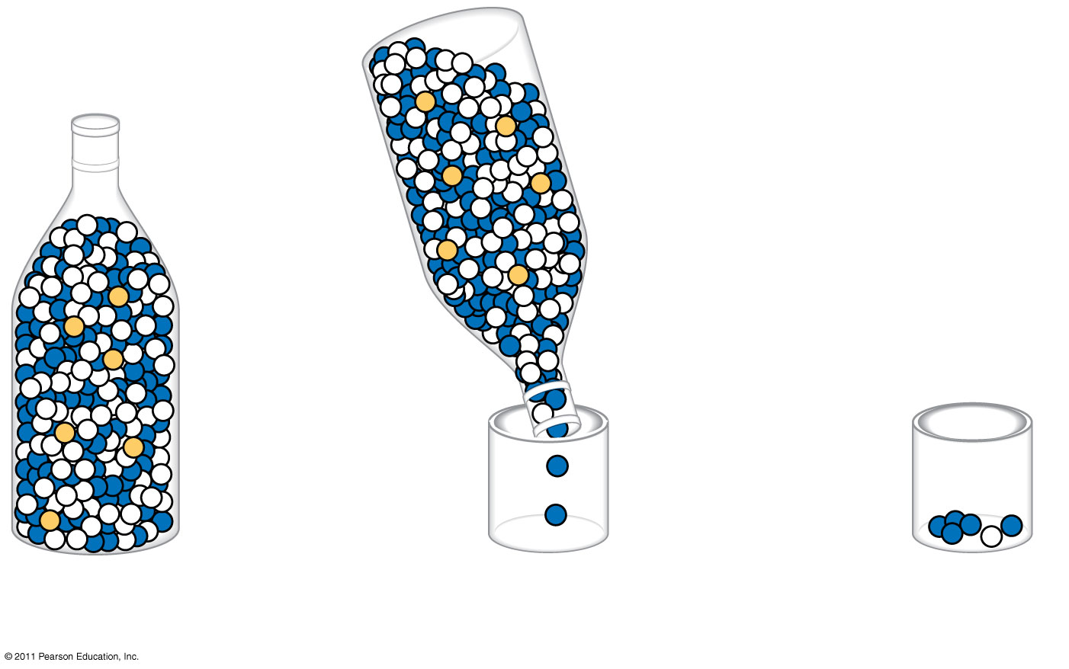
Figure 23.10-3
Original
population
Bottlenecking
event
Surviving
population
Notes:
Figure 23.10 The bottleneck effect.

Slide 101
Case Study: Impact of Genetic Drift on the Greater Prairie Chicken
Loss of prairie habitat caused a severe reduction in the population of greater prairie chickens in Illinois
The surviving birds had low levels of genetic variation, and only 50% of their eggs hatched
© 2011 Pearson Education, Inc.

Slide 102
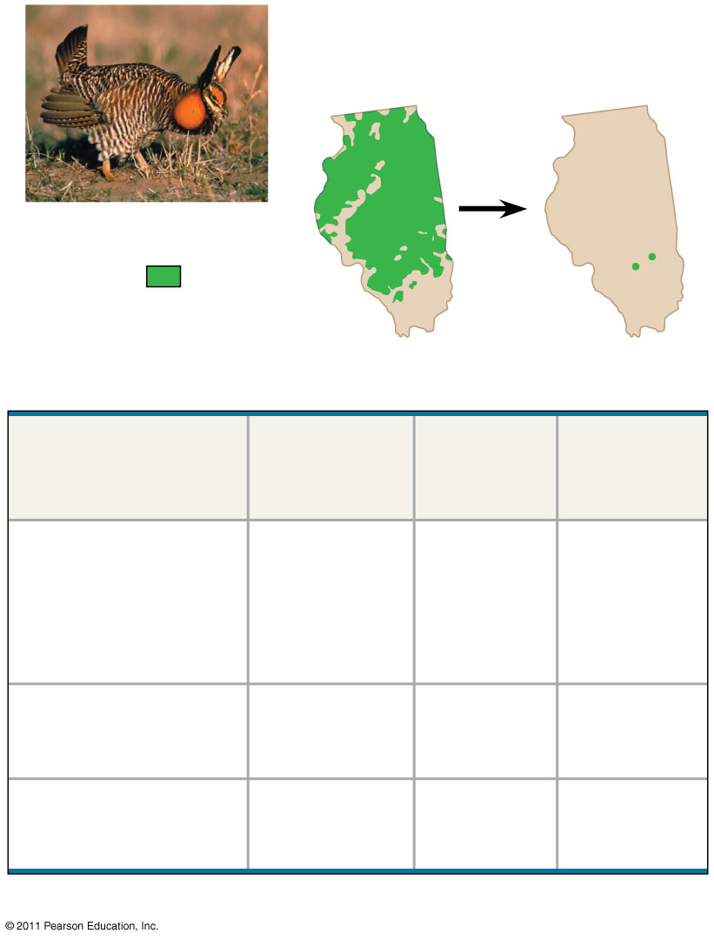
Figure 23.11
Pre-bottleneck
(Illinois, 1820)
Post-bottleneck
(Illinois, 1993)
Greater prairie chicken
Range
of greater
prairie
chicken
(a)
Population
size
Number
of alleles
per locus
Percentage
of eggs
hatched
Location
Illinois
1930–1960s
1993
1,000–25,000
<50
5.2
3.7
93
<50
Kansas, 1998
(no bottleneck)
750,000
5.8
99
Nebraska, 1998
(no bottleneck)
75,000–
200,000
5.8
96
(b)
Notes:
Figure 23.11 Genetic drift and loss of genetic variation.

Slide 103
Natural selection is the only mechanism that consistently causes adaptive evolution
Evolution by natural selection involves both change and “sorting”
  New genetic variations arise by chance
  Beneficial alleles are “sorted” and favored by natural selection
Only natural selection consistently results in adaptive evolution
© 2011 Pearson Education, Inc.

Slide 104
Relative Fitness
The phrases “struggle for existence” and “survival of the fittest” are misleading as they imply direct competition among individuals
Reproductive success is generally more subtle and depends on many factors
Relative fitness is the contribution an individual makes to the gene pool of the next generation, relative to the contributions of other individuals
Selection favors certain genotypes by acting on the phenotypes of certain organisms
© 2011 Pearson Education, Inc.

Slide 105
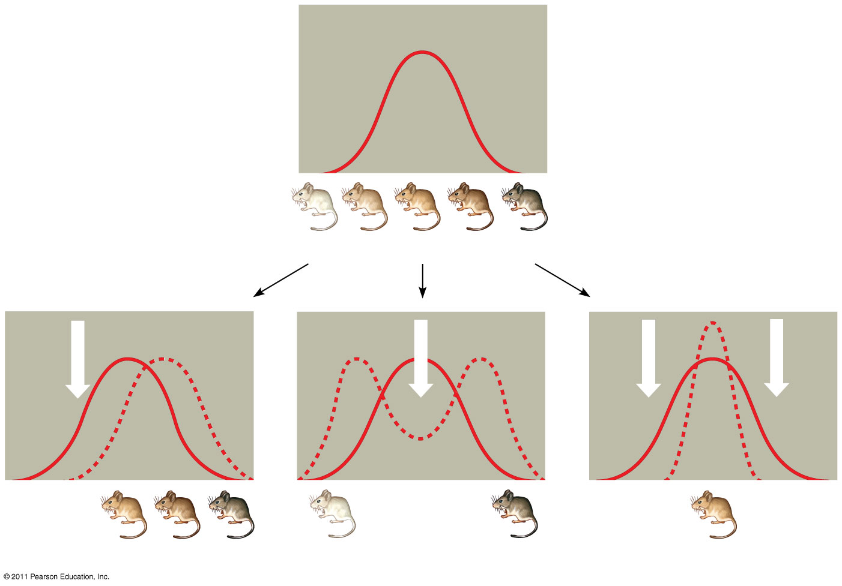
Figure 23.13
(26 here and on next slide)
Original population
Frequency of
individuals
Original
population
Evolved
population
Phenotypes (fur color)
(a) Directional selection
(b) Disruptive selection
(c) Stabilizing selection
Notes:
Figure 23.13 Modes of selection.

Slide 106
Directional, Disruptive, and Stabilizing Selection
Three modes of selection:
  Directional selection favors individuals at one end of the phenotypic range
  Disruptive selection favors individuals at both extremes of the phenotypic range
  Stabilizing selection favors intermediate variants and acts against extreme phenotypes
© 2011 Pearson Education, Inc.

Slide 107
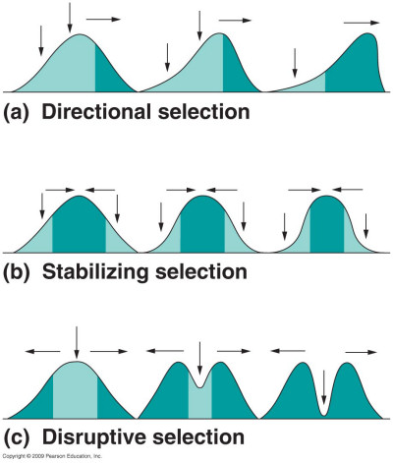
3 Types of Natural Selection
Directional
Disruptive
Stabilizing

Slide 108
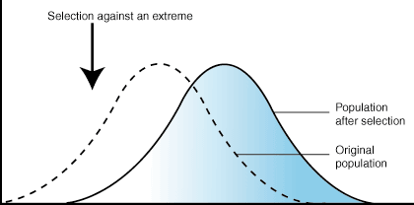
Directional Selection
Most common when a populations environment changes or when members migrate to a new habitat
Shifts frequency curve in one direction

Slide 109
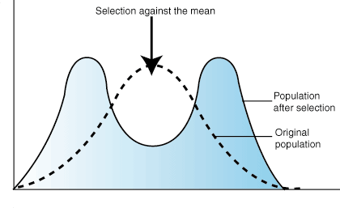
Disruptive Selection
When disruptive selection operates, individuals at the extremes contribute more offspring than those in the center, producing two peaks in the distribution of a particular trait

Slide 110
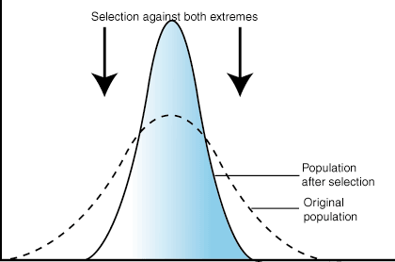
Stabilizing Selection
type of natural selection in which genetic diversity decreases as the population stabilizes on a particular trait value.
  extreme values of the character are selected against.
  probably the most common mechanism of action for natural selection.

Slide 111
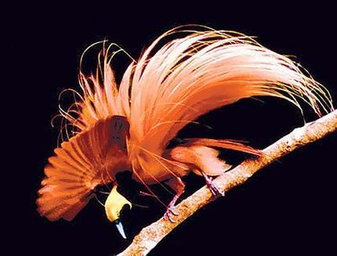
Sexual Selection
Sexual selection is natural selection for mating success
It can result in sexual dimorphism, marked differences between the sexes in secondary sexual characteristics which are not directly associated in reproduction
  Size
  Color
  Ornamentation …

Slide 112
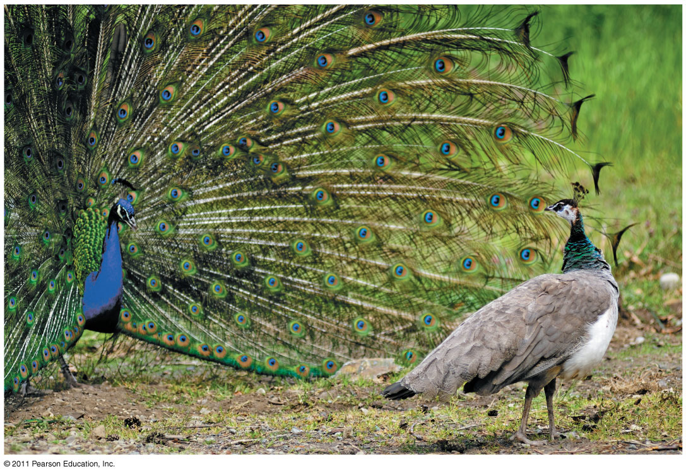
Figure 23.15
Notes:
Figure 23.15 Sexual dimorphism and sexual selection.

Slide 113
Intrasexual selection is competition among individuals of one sex (often males) for mates of the opposite sex
Intersexual selection, often called mate choice, occurs when individuals of one sex (usually females) are choosy in selecting their mates
Male showiness due to mate choice can increase a male’s chances of attracting a female, while decreasing his chances of survival
© 2011 Pearson Education, Inc.

Slide 114
The Preservation of Genetic Variation
Various mechanisms help to preserve genetic variation in a population
Balancing Selection
  Balancing selection occurs when natural selection maintains stable frequencies of two or more phenotypic forms in a population
Diploidy
  Diploidy maintains genetic variation in the form of hidden recessive alleles
  Heterozygotes can carry recessive alleles that are hidden from the effects of selection
© 2011 Pearson Education, Inc.

Slide 115
Heterozygote Advantage
Heterozygote advantage occurs when heterozygotes have a higher fitness than do both homozygotes
Natural selection will tend to maintain two or more alleles at that locus
The sickle-cell allele causes mutations in hemoglobin but also confers malaria resistance
© 2011 Pearson Education, Inc.

Slide 116
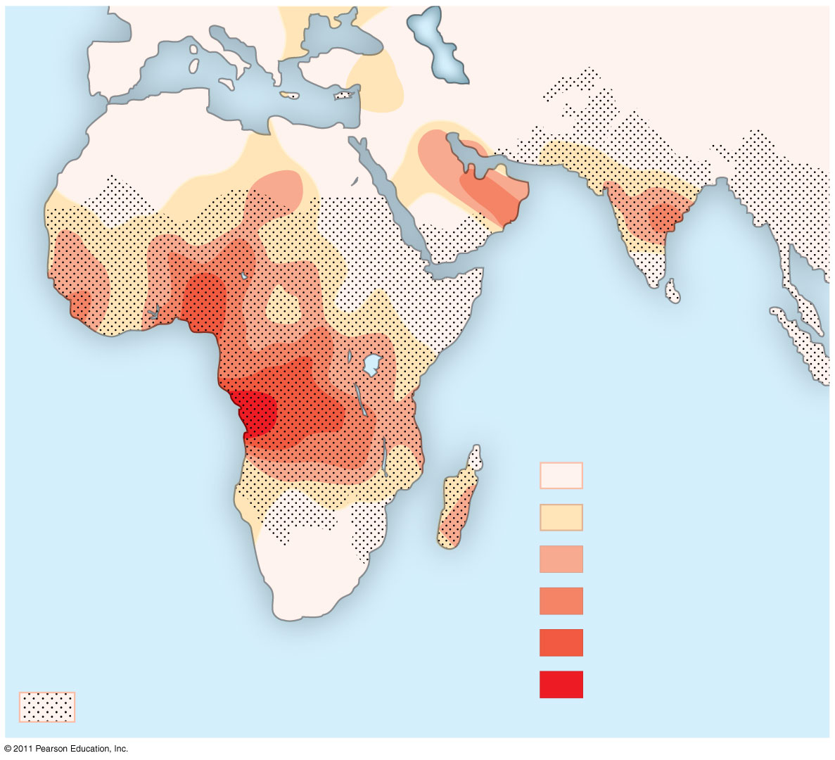
Figure 23.17
Key
Frequencies of the
sickle-cell allele
0–2.5%
2.5–5.0%
Distribution of
malaria caused by
Plasmodium falciparum
(a parasitic unicellular eukaryote)
5.0–7.5%
7.5–10.0%
10.0–12.5%
>12.5%
Notes:
Figure 23.17 Mapping malaria and the sickle-cell allele.

Slide 117
Why Natural Selection Cannot Fashion Perfect Organisms
Selection can act only on existing variations
Evolution is limited by historical constraints
Adaptations are often compromises
Chance, natural selection, and the environment interact
© 2011 Pearson Education, Inc.

Slide 118
What is a species?
Can actually be harder to define than you think…..scientists often debate on some organisms. Ex: Wolf and dog
This has led to “sub species” etc.
Most common used definition for a species used in our textbook is the biological species concept.

Slide 119
Biological Species Concept
First proposed in 1942 by Ernst Mayr
Biological Species Concept- defines a species as a population or group of populations whose members have the potential to interbreed in nature and produce viable fertile offspring.

Slide 120
Reproductive Isolation
The main defining criteria is reproductive compatibility.
The existence of biological barriers or factors preventing reproduction is called reproductive isolation.
  Prezygotic Barriers: impede mating or hinder fertilization if mating does occur.
    Habitat Isolation
    Temporal Isolation
    Behavioral Isolation
    Mechanical Isolation
    Gametic Isolation
  Postygotic Barriers: Prevent a hybrid zygote from developing into a viable fertile adult
    Reduced hybrid viability
    Reduced hybrid fertility
    Hybrid breakdown

Slide 121
Limitations
There is no way to apply reproductive isolation for fossils or asexually reproducing organisms.
Several alternatives
  Paleontological species concept-morphology
  Ecological Species concept-ecological niche
  Phylogenetic species concept-genetic history

Slide 122

Section 15.2 Summary– pages 404-413
Natural selection acts on variations
Natural selection can significantly alter the genetic equilibrium of a population’s gene pool over time.
Significant changes in the gene pool could lead to the evolution of a new species over time.

Slide 123
Section 15.2 Summary– pages 404-413
The Evolution of Species
The evolution of new species, a process called speciation (spee shee AY shun), occurs when members of similar populations no longer interbreed to produce fertile offspring within their natural environment.
Alloptric speciation-”Other Country”
Sympatric Speciation- ”Same Country”

Slide 124
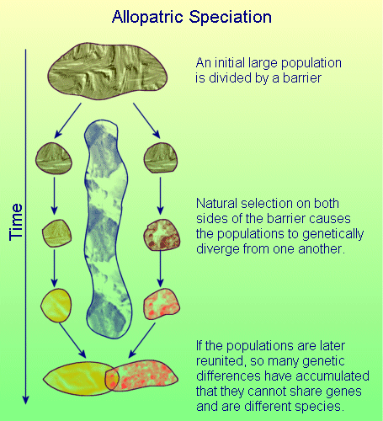

Slide 125
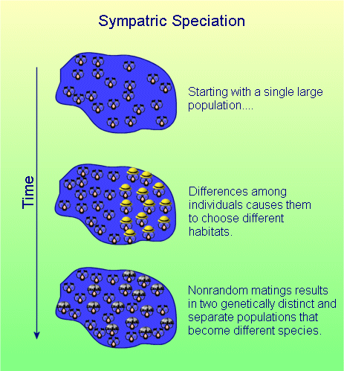

Slide 126
Section 15.2 Summary– pages 404-413
Physical barriers can prevent interbreeding
In nature, physical barriers can break large populations into smaller ones.
Geographic isolation occurs whenever a physical barrier divides a population.
A new species can evolve when a population has been geographically isolated.

Slide 127
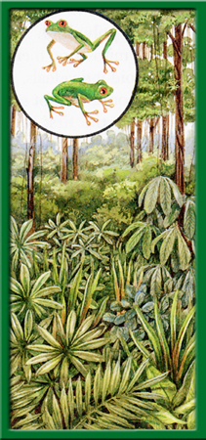
Section 15.2 Summary– pages 404-413
The Evolution of Species
When geographic isolation divides a population of tree frogs, the individuals no longer mate across populations.
Tree frogs are a single population.

Slide 128
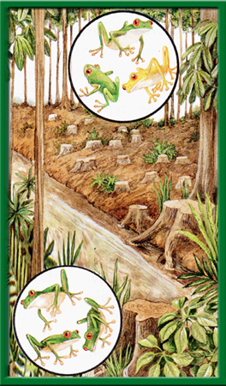
Section 15.2 Summary– pages 404-413
The Evolution of Species
The formation of a river may divide the frogs into two populations.

Slide 129
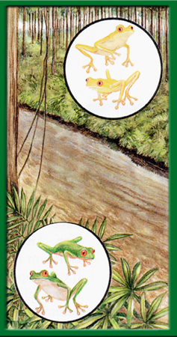
Section 15.2 Summary– pages 404-413
The Evolution of Species
Over time, the divided populations may become two species that may no longer interbreed, even if reunited.

Slide 130
Section 15.2 Summary– pages 404-413
Reproductive isolation can result in speciation
As populations become increasingly distinct, reproductive isolation can arise.
Reproductive isolation occurs when formerly interbreeding organisms can no longer mate and produce fertile offspring.

Slide 131
Section 15.2 Summary– pages 404-413
Reproductive isolation can result in speciation
There are different types of reproductive isolation.
One type occurs when the genetic material of the populations becomes so different that fertilization cannot occur.
Another type of reproductive isolation is behavioral.

Slide 132
Section 15.2 Summary– pages 404-413
A change in chromosome numbers and speciation
Chromosomes can also play a role in speciation.
Many new species of plants and some species of animals have evolved in the same geographic area as a result of polyploidy.
Any individual or species with a multiple of the normal set of chromosomes is known as a polyploid.

Slide 133

Section 15.2 Summary– pages 404-413
A change in chromosome numbers and speciation
Mistakes during mitosis or meiosis can result in polyploid individuals.
New
polyploid
species
Abnormal gametes (2n)
Fertilization
Zygote
(4n)
Nondisjunction
Sterile plant
Fertilization
Parent plant
(2n)
Meiosis begins
Normal
meiosis
Zygote
(3n)
Normal
gametes (n)

Slide 134
Section 15.2 Summary– pages 404-413
A change in chromosome numbers and speciation
Polyploidy may result in immediate reproductive isolation.
When a polyploid mates with an individual of the normal species, the resulting zygotes may not develop normally because of the difference in chromosome numbers.

Slide 135
Section 15.2 Summary– pages 404-413
A change in chromosome numbers and speciation
However, polyploids within a population may interbreed and form a separate species.
Polyploids can arise from within a species or from hybridization between species.
Many flowering plant species and many important crop plants, such as wheat, cotton, and apples, originated bypolyploidy.

Slide 136
Section 15.2 Summary– pages 404-413
Speciation rates
Scientists once argued that evolution occurs at a slow, steady rate, with small, adaptive changes gradually accumulating over time in populations.
Gradualism is the idea that species originate through a gradual change of adaptations.
Some evidence from the fossil record supports gradualism.

Slide 137
Section 15.2 Summary– pages 404-413
Speciation rates
In 1972, Niles Eldredge and Stephen J. Gould proposed a different hypothesis known as punctuated equilibrium.
This hypothesis argues that speciation occurs relatively quickly, in rapid bursts, with long periods of genetic equilibrium in between.

Slide 138

Section 15.2 Summary– pages 404-413
Speciation rates
Loxodonta
africana
Elephas
maximus
0
1
2
Millions of Years Ago
Mammuthus
primigenius
3
Elephas
4
Loxodonta
Mammuthus
5
6
Primelephas
Ancestral species
about 55 million years ago

Slide 139
Section 15.2 Summary– pages 404-413
Speciation rates
According to this hypothesis, environmental changes, such as higher temperatures or the introduction of a competitive species, lead to rapid changes in a small population’s gene pool that is reproductively isolated from the main population.
Speciation happens quickly—in about 10,000 years or less.

Slide 140
Section 15.2 Summary– pages 404-413
Speciation rates
Biologists generally agree that both gradualism and punctuated equilibrium can result in speciation, depending on the circumstances.

Slide 141
Section 15.2 Summary– pages 404-413
Patterns of Evolution
Biologists have observed different patterns of evolution that occur throughout the world in different natural environments.
These patterns support the idea that natural selection is an important agent for evolution.

Slide 142
Section 15.2 Summary– pages 404-413
Diversity in new environments
When an ancestral species evolves into an array of species to fit a number of diverse habitats, the result is called adaptive radiation.

Slide 143
Section 15.2 Summary– pages 404-413
Diversity in new environments
Adaptive radiation in both plants and animals has occurred and continues to occur throughout the world and is common on islands.
Adaptive radiation is a type of divergent evolution, the pattern of evolution in which species that were once similar to an ancestral species diverge, or become increasingly distinct.

Slide 144

Section 15.2 Summary– pages 404-413
Diversity in new environments
Amakihi
Extinct
mamo
Crested
honeycreeper
Possible
Ancestral
Lasan finch
Kauai
Niihau
Molokai
Oahu
Maui
Akialoa
Lanai
Akepa
Kahoolawe
Hawaii
Apapane
Maui parrotbill
Akiapolaau
Liwi
Grosbeak finch
Akikiki
Palila
Ou

Slide 145
Section 15.2 Summary– pages 404-413
Diversity in new environments
Divergent evolution occurs when populations change as they adapt to different environmental conditions, eventually resulting in new species.

Slide 146
Section 15.2 Summary– pages 404-413
Different species can look alike
A pattern of evolution in which distantly related organisms evolve similar traits is called convergent evolution.
Convergent evolution occurs when unrelated species occupy similar environments in different parts of the world.

Slide 147
Section 2 Check
Question 1
The fur of an Arctic fox turns white in the winter. Is this an example of natural selection? Why or why not?

Slide 148

Section 2 Check
The answer is no. An individual cannot evolve a new phenotype (in this case, changing the color of its fur) within its lifetime in response to its environment.

Slide 149
Section 2 Check
Question 2
Which type of natural selection does NOT favor the evolution of new species?
A. divergent
B. disruptive
C. stabilizing
D. directional

Slide 150
Section 2 Check
The answer is C. Stabilizing selection reduces variation in a population.

Slide 151
Section 2 Check
Question 3
Which of the following rarely affects a population’s genetic equilibrium?
A. genetic drift
B. lethal mutations
C. gene flow
D. disruptive selection

Slide 152
Section 2 Check
The answer is B. Organisms with lethal mutations do not survive. Therefore, organisms with lethal mutations cannot produce enough offspring to affect a population’s genetic equilibrium.

Slide 153
Section 2 Check
Question 4
Why are the Galapagos Islands rich in unique species of organisms?
A. The islands are an area exhibiting an
abnormal number of mutations.
B. The islands are geographically isolated.
C. The island species have been subjected
to increased gene flow.
D. The island species have been subjected
to stabilizing selection.

Slide 154



Section 2 Check
The answer is B. Geographic isolation has helped to keep the islands’ species unique.

Slide 155

Chapter Summary – 15.1
Natural Selection and the Evidence for Evolution
After many years of experimentation and observation, Charles Darwin proposed the idea that species originated through the process of natural selection.
Natural selection is a mechanism of change in populations. In a specific environment, individuals with certain variations are likely to survive, reproduce, and pass these variations to future generations.

Slide 156
Chapter Summary – 15.2
Mechanisms of Evolution
Evolution can occur only when a population’s genetic equilibrium changes. Mutation, genetic drift, and gene flow can change a population’s genetic equilibrium, especially in a small, isolated population. Natural selection is usually a factor that causes change in established gene pools—both large and small.

Slide 157
Chapter Summary – 15.2
Mechanisms of Evolution
The separation of populations by physical barriers can lead to speciation.
There are many patterns of evolution in nature. These patterns support the idea that natural selection is an important mechanism of evolution.

Slide 158
Chapter Summary – 15.2
Mechanisms of Evolution
Gradualism is the hypothesis that species originate through a gradual change in adaptations. The alternative hypothesis, punctuated equilibrium, argues that speciation occurs in relatively rapid bursts, followed by long periods of genetic equilibrium. Evidence for both evolutionary rates can be found in the fossil record.

Slide 159

Chapter Assessment
Question 1
Why does disruptive selection favor speciation?
Answer
Disruptive selection favors extreme variations of a trait. Over time, it is less likely that species with extreme variations will mate, therefore giving rise to new species.

Slide 160
Chapter Assessment
Question 2
Are the physical similarities between a dolphin and a shark evidence of convergent or divergent evolution?

Slide 161


Chapter Assessment
The answer is convergent evolution. Dolphins and sharks are unrelated organisms that have evolved similar traits because they share similar environmental pressures.

Slide 162
Chapter Assessment
Question 3
Niles Eldredge and Stephen J. Gould proposed _______.
A. gradualism
B. reproductive isolation
C. punctuated equilibrium
D. directional selection
The answer is C.

Slide 163
Chapter Assessment
Question 4
Which of the following pairs of terms is NOT related?
A. gradualism – speciation
B. natural selection – disruptive selection
C. gene pool – allelic frequency
D. polyploid – gene flow
The answer is D.

Slide 164
Chapter Assessment
Question 5
Why do some insects and bacteria evolve adaptations more rapidly than other species?

Slide 165


Chapter Assessment
Insects and bacteria are examples of species that reproduce in large numbers and many times in a relatively short span of time, allowing adaptations to be more easily observed.

Slide 166
Chapter Assessment
Question 6
Why is most of the evidence for evolution indirect rather than direct evidence?
Answer
Evolutionary processes are difficult for humans to observe directly. The short scale of human life spans makes it difficult to comprehend evolutionary processes that occur over millions of years.

Slide 167
Chapter Assessment
Question 7
Are the fangs of a rattlesnake and the fangs of a spider homologous structures or analogous structures, and why?

Slide 168


Chapter Assessment
The fangs of these organisms are analogous structures. They share the same function in each organism, to deliver venom, but the organisms do not share a common evolutionary origin.

Slide 169
Chapter Assessment
Question 8
How do bird bones show an adaptation to flying that the bones of the flightless organisms, though homologous, do not?

Slide 170
Chapter Assessment
Question 9
Why is the presence of pelvic bones in the baleen whale considered to be evidence of evolution?

Slide 171

Chapter Assessment
Pelvic bones are evidence that whales once possessed hind limbs. Since whales now have no hind limbs, their loss must be the result of an evolutionary change.

Slide 172

Early Earth and the Origin of Life

Slide 173

Phylogeny
Traces life backward to common ancestors.
How did life get started?

Slide 174

Fossil Record
Earth - 4.5 billion years old.
Earliest life- 3.5 billion years old.
Life on earth started relatively soon after the earth was formed.
Fossil Modern

Slide 175

Bacterial Mats

Slide 176

Chemical Evolution
1. Monomer Formation
2. Polymer Formation
3. Protobiont Formation
4. Origin of Heredity
Primitive Earth
Reducing atmosphere present.
Simple molecules
  Ex: H₂O vapor
  CH₄ methane
  Hydrogen H₂,
  Ammonia NH₃

Slide 177

Complex Molecule Formation
Requires energy sources:
  UV radiation
  Radioactivity
  Heat
  Lightning

Slide 178
Early Ideas About Origins of Life
Oparin and Haldane
Miller and Urey
1920s
Hypothesized steps of chemical evolution from primitive earth conditions.
1953
Tested Oparin and Haldane’s hypothesis.
Experiment - to duplicate primitive earth conditions in the lab

Slide 179


Slide 180
Results
Miller & Urey Results
Other Investigator's Results
Organic monomers formed including Amino Acids.
All 20 Amino Acids
Sugars
Lipids
Nucleotides
ATP

Slide 181
Hypothesis
Early earth conditions could have formed monomers for life's origins.
Problem:
  Monomers dilute in concentration.
  No enzymes for bond formation.
Possible Solution
1. Clay: Lattice to hold molecules, increasing concentrations.
2. Iron Pyrite: Metal ions present which can act as catalysts.

Slide 182

Protobionts
Aggregates of abiotically produced molecules.
Exhibit some properties of life.
  Ex: Osmosis
  Electrical Charge
  Fission
Will form spontaneously from abiotically produced organic compounds.

Slide 183
Summary
Protobionts have membrane-like properties and are very similar to primitive cells.
Start for selection process that lead to cells?

Slide 184
Question ?
Where did the energy come from to run these early cells?

Slide 185
Answer
ATP.
Reduction of sulfur compounds.
Fermentation.

Slide 186
Genetic Information
DNA → RNA → Protein
Too complex for early life.
Other forms of genetic information?

Slide 187
RNA Hypothesis
RNA as early genetic information.
  RNA polymerizes easily.
  RNA can replicate itself.
  RNA can catalyze reactions including protein synthesis.
  Ribozymes

Slide 188


Slide 189
RNA as 1st Genetic Material
Ribozymes
Molecular Cooperation
RNA catalysts found in modern cells.
  e.g. ribosomes
Possible relic from early evolution?
Interaction between RNA and the proteins it made.
Proteins formed may serve as RNA replication enzymes
Works best inside a membrane.
RNA benefits from the proteins it made.
RNA/protein complexes inside membranes were favored as the most likely to survive and reproduce.

Slide 190


Slide 191

Alternate View
Life developed in Volcanic Vents.

Slide 192
Volcanic Vents
Could easily supply the energy and chemical precursors for chemical evolution.
Most primitive life forms are the prokaryotes found in or near these vents.

Slide 193
Modern Earth
Oxidizing atmosphere.
Life present.
Prevents new abiotic formation of life.
Hypothesis:
  Life as a natural outcome of chemical evolution.
  Life possible on many planets in the universe.

Slide 194
Kingdom
Highest Taxonomic category
Old system - 2 Kingdoms
  1. Plant
  2. Animal

Slide 195


Slide 196
Main Characteristics
Cell Type
Structure
Nutrition Mode

Slide 197

Monera
Ex: Bacteria, Cyanobacteria
Prokaryotic

Slide 198
Protista
Ex: Amoeba, Paramecium
Eukaryotic
Unicellular or Colonial
Heterotrophic

Slide 199
Fungi
Ex: Mushrooms, Molds
Eukaryotic
Unicellular or Multicellular
Heterotrophic - external digestion
Cell wall of chitin

Slide 200
Plantae
Ex: Flowers, Trees
Eukaryotic
Multicellular
Autotrophic
Cell wall of Cellulose/Silicon

Slide 201
Animalia
Ex: Animals, Humans
Eukaryotic
Multicellular
Hetrotrophic - internal digestion
No cell wall
Motile

Slide 202
Other Systems
Multiple Kingdoms – split life into as many as 8 kingdoms.
Domains – a system of classification that is higher than kingdom.

Slide 203
3 Domain System
Based on molecular structure for evolutionary relationships.
Prokaryotes are not all alike and should be recognized as two groups.
Gaining wider acceptance.

Slide 204
3 Domains
1. Bacteria – prokaryotic.
2. Archaea – prokaryotic, but biochemically similar to eukaryotic cells.
3. Eucarya – the traditional eukaryotic cells.

Slide 205
Summary
Systematics is still evaluating the evolutionary relationships of life on earth.
Be familiar with the conditions of primitive earth.
Know the steps of chemical evolution.

Slide 206
Summary
Recognize the 5 Kingdoms.
Know about Domains.

