Slide 1
Mendel and the Gene Idea

Slide 2
Definitions You Need to Know
Gene: sequence of DNA that codes for a protein and thus determines a trait
Allele: 1 of a number of different forms of a gene
Homozygous: pair of identical alleles for a trait
Heterozygous: Having 2 different alleles for a trait
Genotype: an organisms genetic makeup
Phenotype: an organisms outward appearance
Gamete: A reproductive cell having the haploid number of chromosomes, especially a mature sperm or egg capable of fusing with a gamete of the opposite sex to produce the fertilized egg

Slide 3
Mendel’s Experimental, Quantitative Approach
Advantages of pea plants for genetic study
There are many varieties with distinct heritable features, or characters (such as flower color); character variants (such as purple or white flowers) are called traits
Mating can be controlled
Each flower has sperm-producing organs (stamens) and egg-producing organ (carpel)
Cross-pollination (fertilization between different plants) involves dusting one plant with pollen from another
© 2011 Pearson Education, Inc.

Slide 4
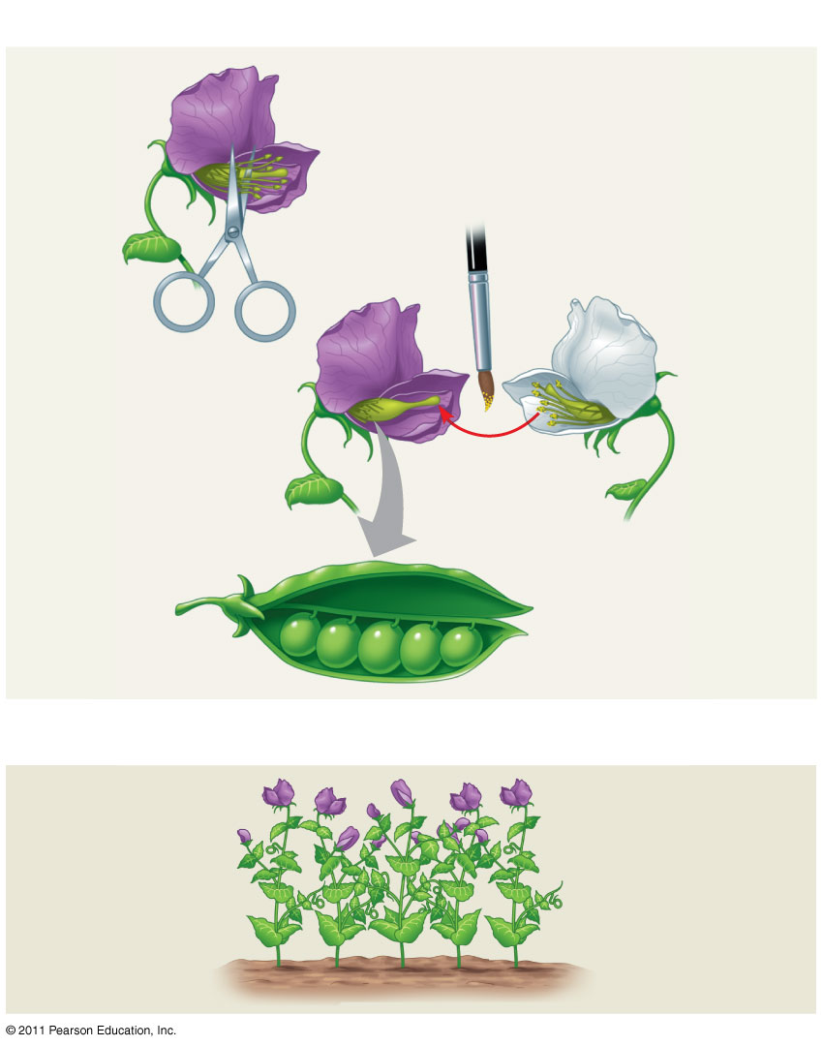
Figure 14.2
TECHNIQUE
1
2
Parental generation (P)
Stamens
3
Carpel
4
RESULTS
First filial generation offspring (F₁)
5
Notes:
Figure 14.2 Research Method: Crossing Pea Plants

Slide 5
Mendel chose to track only those characters that occurred in two distinct alternative forms
He also used varieties that were true-breeding (plants that produce offspring of the same variety when they self-pollinate)
© 2011 Pearson Education, Inc.

Slide 6
In a typical experiment, Mendel mated two contrasting, true-breeding varieties, a process called hybridization
The true-breeding parents are the P generation
The hybrid offspring of the P generation are called the F₁ generation
When F₁ individuals self-pollinate or cross- pollinate with other F₁ hybrids, the F₂ generation is produced (4)
© 2011 Pearson Education, Inc.

Slide 7
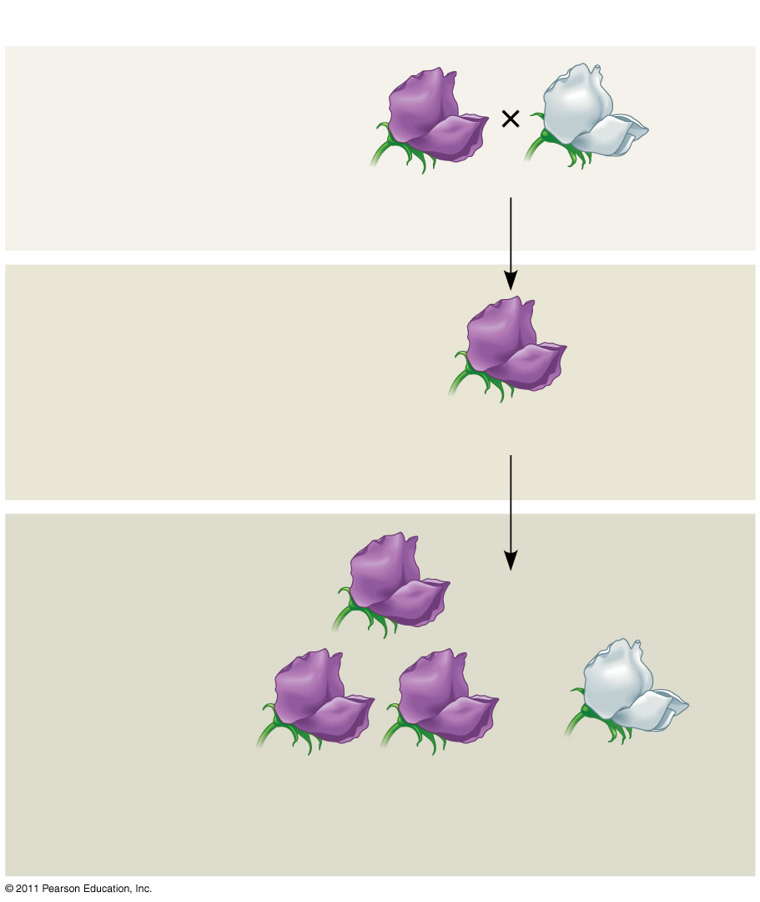
Figure 14.3-3
EXPERIMENT
P Generation
(true-breeding parents)
Purple flowers
White flowers
(5)
F₁ Generation (hybrids)
All plants had purple flowers
Self- or cross-pollination
F₂ Generation
705 purple- flowered plants
224 white flowered plants
Notes:
Figure 14.3 Inquiry: When F₁ hybrid pea plants self- or cross-pollinate, which traits appear in the F₂ generation?

Slide 8
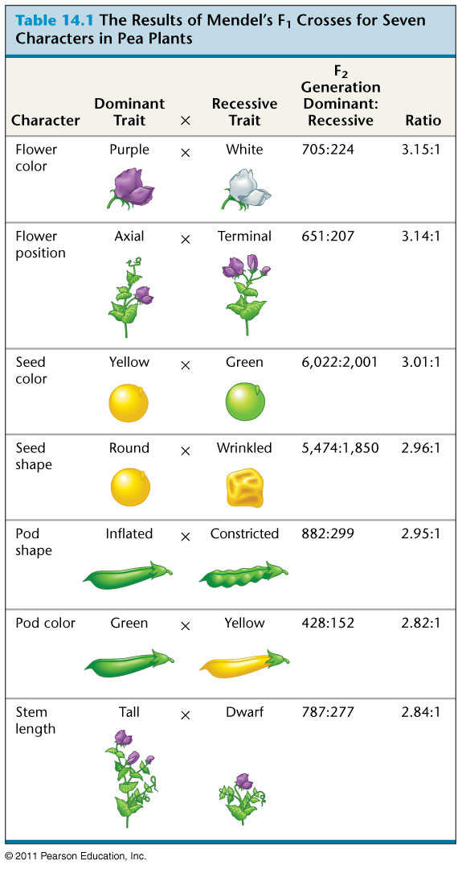
Table 14.1
Notes:
Table 14.1 The Results of Mendel’s F₁ Crosses for Seven Characters in Pea Plants

Slide 9
Mendel’s Model
Mendel developed a hypothesis to explain the 3:1 inheritance pattern he observed in F₂ offspring
Four related concepts make up this model
These concepts can be related to what we now know about genes and chromosomes
© 2011 Pearson Education, Inc.
© 2011 Pearson Education, Inc.

Slide 10
First: alternative versions of genes (alleles) account for variations in inherited characters
For example, the gene for flower color in pea plants exists in two versions, one for purple flowers and the other for white flowers
These alternative versions of a gene are now called alleles
Each gene resides at a specific locus on a specific chromosome
© 2011 Pearson Education, Inc.

Slide 11
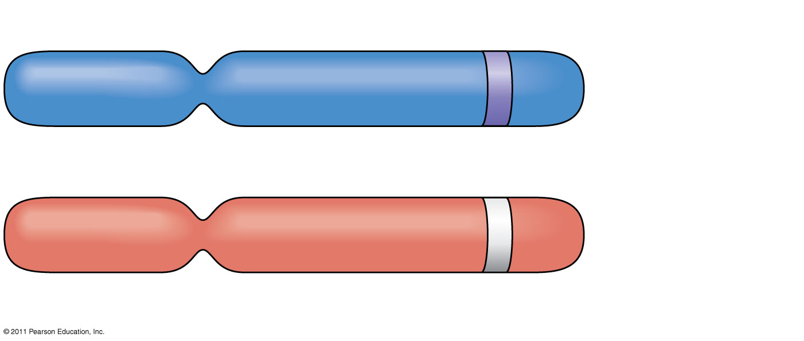
Figure 14.4
Demonstrates the Law of Segregation
Allele for purple flowers
Pair of homologous chromosomes
Locus for flower-color gene
Allele for white flowers
Notes:
Figure 14.4 Alleles, alternative versions of a gene.

Slide 12
Second: for each character, an organism inherits two alleles, one from each parent
Mendel made this deduction without knowing about the role of chromosomes
The two alleles at a particular locus may be identical, as in the true-breeding plants of Mendel’s P generation
Alternatively, the two alleles at a locus may differ, as in the F₁ hybrids
© 2011 Pearson Education, Inc.

Slide 13
Third: if the two alleles at a locus differ, then one (the dominant allele) determines the organism’s appearance, and the other (the recessive allele) has no noticeable effect on appearance
In the flower-color example, the F₁ plants had purple flowers because the allele for that trait is dominant
© 2011 Pearson Education, Inc.

Slide 14
Fourth: (now known as the law of segregation): the two alleles for a heritable character separate (segregate) during gamete formation and end up in different gametes
Thus, an egg or a sperm gets only one of the two alleles that are present in the organism
This segregation of alleles corresponds to the distribution of homologous chromosomes to different gametes in meiosis
© 2011 Pearson Education, Inc.

Slide 15
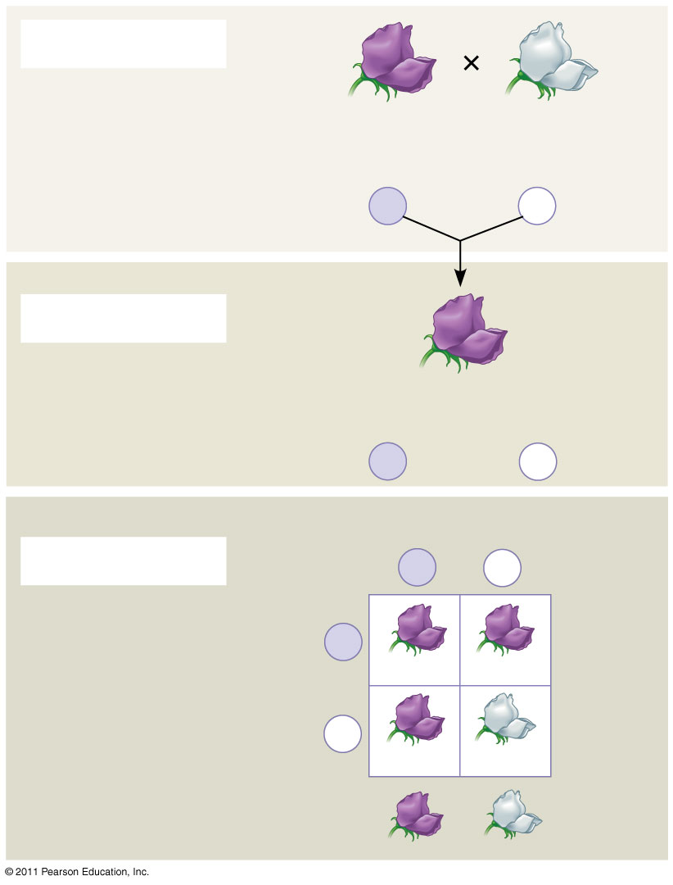
Figure 14.5-3
P Generation
Appearance:
Purple flowers
White flowers
Genetic makeup:
PP
pp
Gametes:
P
p
(9)
F₁ Generation
Appearance:
Purple flowers
Genetic makeup:
Pp
Gametes:
¹/₂
P
¹/₂
p
Sperm from F₁ (Pp) plant
F₂ Generation
P
p
P
Eggs from F₁ (Pp) plant
PP
Pp
p
Pp
pp
3
: 1
Notes:
Figure 14.5 Mendel’s law of segregation.

Slide 16
Figure 14.6
Phenotype
Genotype
Purple
PP (homozygous)
1
3
Purple
Pp (heterozygous)
2
Purple
Pp (heterozygous)
1
White
pp (homozygous)
1
Ratio 3:1
Ratio 1:2:1
Notes:
Figure 14.6 Phenotype versus genotype.

Slide 17
The Testcross
How can we tell the genotype of an individual with the dominant phenotype?
Such an individual could be either homozygous dominant or heterozygous
The answer is to carry out a testcross: breeding the mystery individual with a homozygous recessive individual
If any offspring display the recessive phenotype, the mystery parent must be heterozygous
© 2011 Pearson Education, Inc.

Slide 18
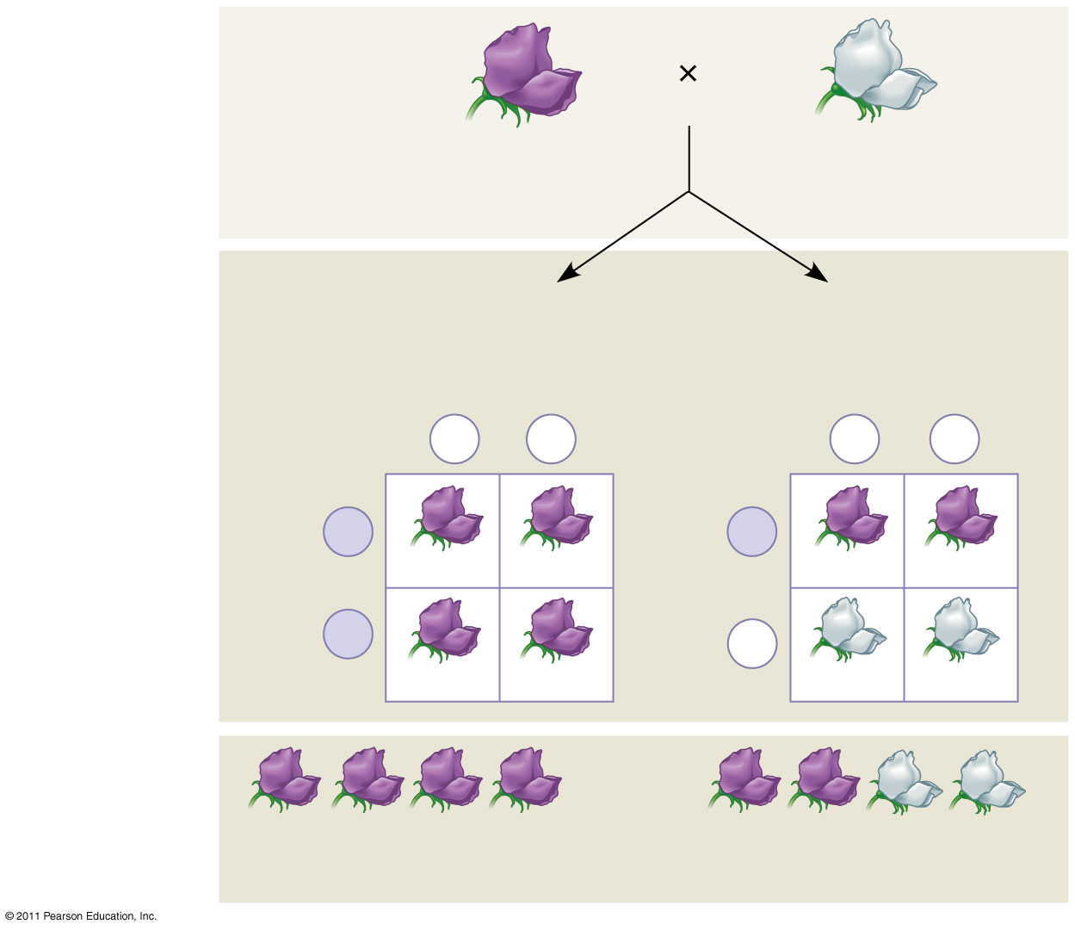
Figure 14.7
TECHNIQUE
Dominant phenotype, unknown genotype: PP or Pp?
Recessive phenotype, known genotype: pp
Predictions
If purple-flowered parent is PP
or
If purple-flowered parent is Pp
Sperm
Sperm
p
p
p
p
P
P
Eggs
Pp
Pp
Eggs
Pp
Pp
P
p
Pp
Pp
pp
pp
RESULTS
or
All offspring purple
¹/₂ offspring purple and ¹/₂ offspring white
Notes:
Figure 14.7 Research Method: The Testcross

Slide 19
The Law of Independent Assortment
Mendel derived the law of segregation by following a single character
The F₁ offspring produced in this cross were monohybrids, individuals that are heterozygous for one character
A cross between such heterozygotes is called a monohybrid cross
Mendel identified his second law of inheritance by following two characters at the same time
Crossing two true-breeding parents differing in two characters produces dihybrids in the F₁ generation, heterozygous for both characters
A dihybrid cross, a cross between F₁ dihybrids, can determine whether two characters are transmitted to offspring as a package or independently
© 2011 Pearson Education, Inc.

Slide 20
Some traits are inherited together because they’re close together on the same chromosome Male = EeDd X Female = EeDd
First
Outer
Inner
Last
First
Outer
Inner
Last
ED
ED
Ed
Ed
eD
eD
ed
ed

Slide 21
ED
Ed
eD
ed
ED
EEDD
Ed
eD
eeDD
ed
Eedd

Slide 22
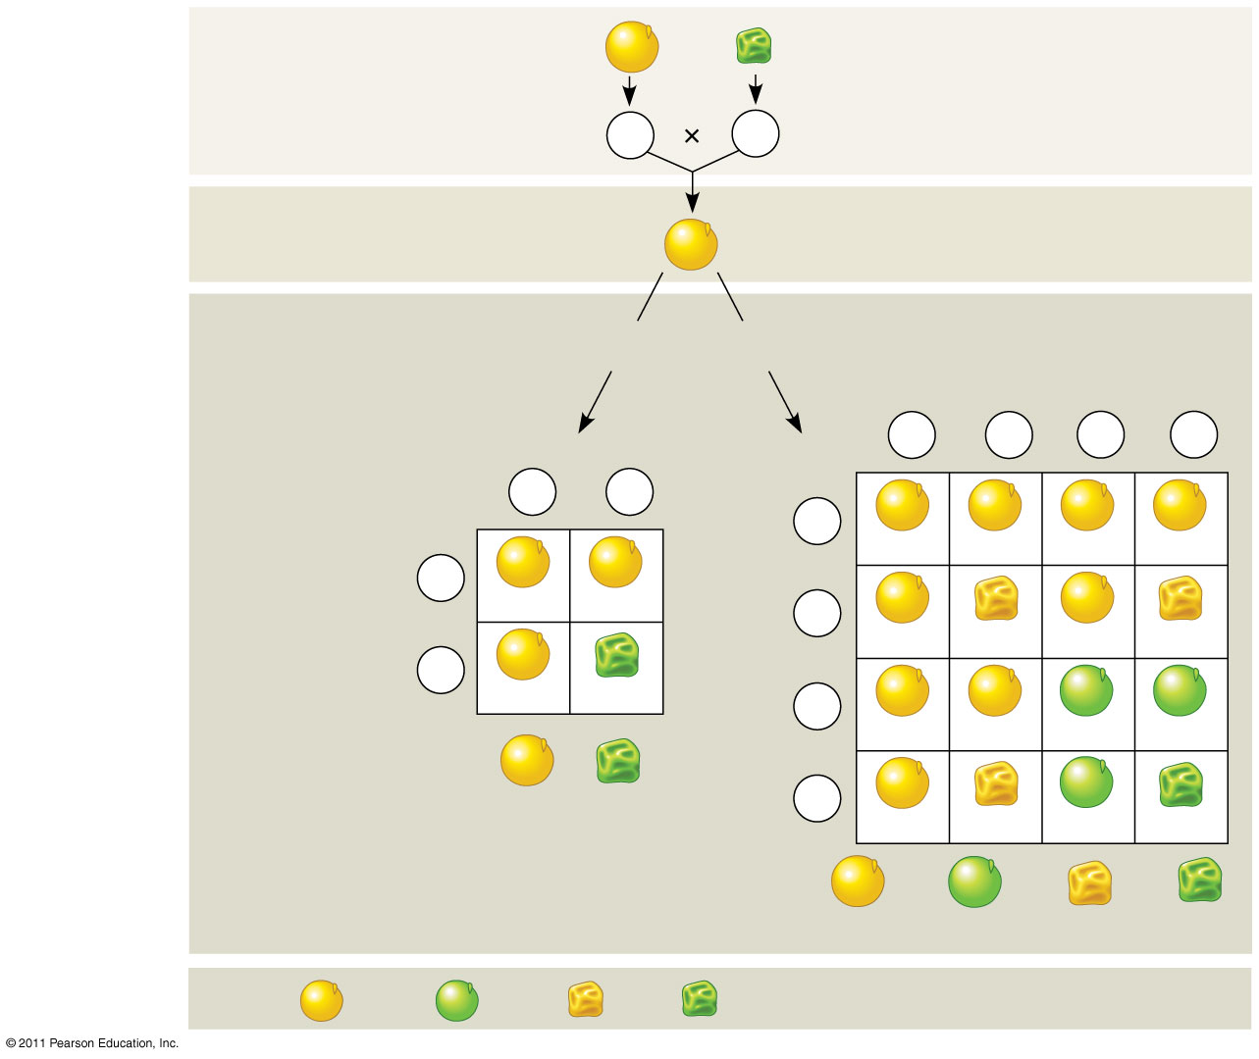
Figure 14.8
EXPERIMENT
P Generation
YYRR
yyrr
Gametes
YR
yr
(12-13)
F₁ Generation
YyRr
Predictions
Hypothesis of dependent assortment
Hypothesis of independent assortment
or
Sperm
Predicted offspring of F₂ generation
¹/₄
YR
¹/₄
Yr
¹/₄
yR
¹/₄
yr
Sperm
¹/₂
YR
¹/₂
yr
¹/₄
YR
YYRR
YYRr
YyRR
YyRr
¹/₂
YR
YYRR
YyRr
¹/₄
Yr
Eggs
YYRr
YYrr
YyRr
Yyrr
¹/₂
yr
Eggs
YyRr
yyrr
¹/₄
yR
YyRR
YyRr
yyRR
yyRr
³/₄
¹/₄
Phenotypic ratio 3:1
¹/₄
yr
YyRr
Yyrr
yyRr
yyrr
⁹/₁₆
³/₁₆
³/₁₆
¹/₁₆
Phenotypic ratio 9:3:3:1
RESULTS
315
108
101
32
Phenotypic ratio approximately 9:3:3:1
Notes:
Figure 14.8 Inquiry: Do the alleles for one character assort into gametes dependently or independently of the alleles for a different character?

Slide 23
Using a dihybrid cross, Mendel developed the law of independent assortment
The law of independent assortment states that each pair of alleles segregates independently of each other pair of alleles during gamete formation
Strictly speaking, this law applies only to genes on different, nonhomologous chromosomes or those far apart on the same chromosome
Genes located near each other on the same chromosome tend to be inherited together (14)
© 2011 Pearson Education, Inc.

Slide 24
Concept 12: The laws of probability govern Mendelian inheritance
Mendel’s laws of segregation and independent assortment reflect the rules of probability
When tossing a coin, the outcome of one toss has no impact on the outcome of the next toss
In the same way, the alleles of one gene segregate into gametes independently of another gene’s alleles
The probability of an event is the number of desired outcomes/number of possible outcomes
© 2011 Pearson Education, Inc.

Slide 25
The Multiplication and Addition Rules Applied to Monohybrid Crosses
The multiplication rule states that the probability that two or more independent events will occur together is the product of their individual probabilities (independent events have no link/impact with each other)
Probability in an F₁ monohybrid cross can be determined using the multiplication rule
Segregation in a heterozygous plant is like flipping a coin: Each gamete has a chance of carrying the dominant allele and a chance of carrying the recessive allele
© 2011 Pearson Education, Inc.

Slide 26
The addition rule states that the probability that any one of two or more exclusive events will occur is calculated by adding together their individual probabilities
The rule of addition can be used to figure out the probability that an F₂ plant from a monohybrid cross will be heterozygous rather than homozygous
© 2011 Pearson Education, Inc.

Slide 27
Figure 14.UN01
Probability of YYRR
=
¹/₄ (probability of YY)
×
¹/₄ (RR)
=
¹/₁₆
Probability of YyRR
=
¹/₂ (Yy)
×
¹/₄ (RR)
=
¹/₈
Notes:
Figure 14.UN01 In-text figure, p. 270

Slide 28
Figure 14.UN02
ppyyRr
¹/₄ (probability of pp) × ¹/₂ (yy) × ¹/₂ (Rr)
= ¹/₁₆
ppYyrr
¹/₄ × ¹/₂ × ¹/₂
= ¹/₁₆
Ppyyrr
¹/₂ × ¹/₂ × ¹/₂
= ²/₁₆
PPyyrr
¹/₄ × ¹/₂ × ¹/₂
= ¹/₁₆
ppyyrr
¹/₄ × ¹/₂ × ¹/₂
= ¹/₁₆
Chance of at least two recessive traits
= ⁶/₁₆ or ³/₈
Notes:
Figure 14.UN02 In-text figure, p. 270

Slide 29
Extending Mendelian Genetics for a Single Gene
Inheritance of characters by a single gene may deviate from simple Mendelian patterns in the following situations:
When alleles are not completely dominant or recessive
When a gene has more than two alleles
When a gene produces multiple phenotypes
© 2011 Pearson Education, Inc.

Slide 30
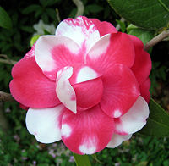
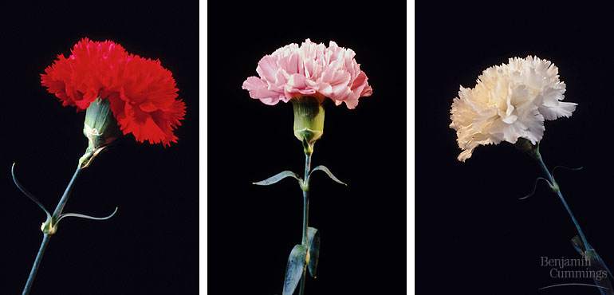
Degrees of Dominance
Complete dominance occurs when phenotypes of the heterozygote and dominant homozygote are identical
In incomplete dominance, the phenotype of F₁ hybrids is somewhere between the phenotypes of the two parental varieties
In codominance, two dominant alleles affect the phenotype in separate, distinguishable ways
© 2011 Pearson Education, Inc.

Slide 31
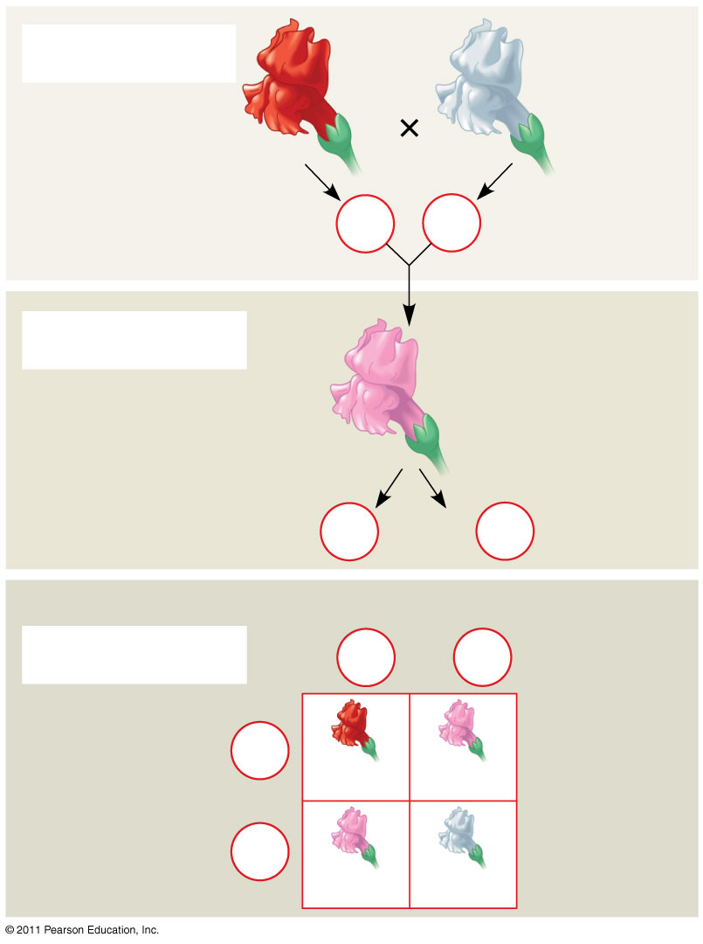
Figure 14.10-3
P Generation
Red
White
C^{R}C^{R}
C^{W}C^{W}
Gametes
C^{R}
C^{W}
F₁ Generation
Pink
C^{R}C^{W}
Gametes
¹/₂
C^{R}
¹/₂
C^{W}
Sperm
F₂ Generation
¹/₂
C^{R}
¹/₂
C^{W}
¹/₂
C^{R}
Eggs
C^{R}C^{R}
C^{R}C^{W}
¹/₂
C^{W}
C^{R}C^{W}
C^{W}C^{W}
Notes:
Figure 14.10 Incomplete dominance in snapdragon color.

Slide 32
The Relation Between Dominance and
Phenotype
A dominant allele does not subdue a recessive allele; alleles don’t interact that way
Alleles are simply variations in a gene’s nucleotide sequence
For any character, dominance/recessiveness relationships of alleles depend on the level at which we examine the phenotype
© 2011 Pearson Education, Inc.

Slide 33
Tay-Sachs disease is fatal; a dysfunctional enzyme causes an accumulation of lipids in the brain
At the organismal level, the allele is recessive
At the biochemical level, the phenotype (i.e., the enzyme activity level) is incompletely dominant
At the molecular level, the alleles are codominant
© 2011 Pearson Education, Inc.

Slide 34
Multiple Alleles
Most genes exist in populations in more than two allelic forms
For example, the four phenotypes of the ABO blood group in humans are determined by three alleles for the enzyme (I) that attaches A or B carbohydrates to red blood cells: I^{A}, I^{B}, and i.
The enzyme encoded by the I^{A} allele adds the A carbohydrate, whereas the enzyme encoded by the I^{B} allele adds the B carbohydrate; the enzyme encoded by the i allele adds neither
© 2011 Pearson Education, Inc.

Slide 35
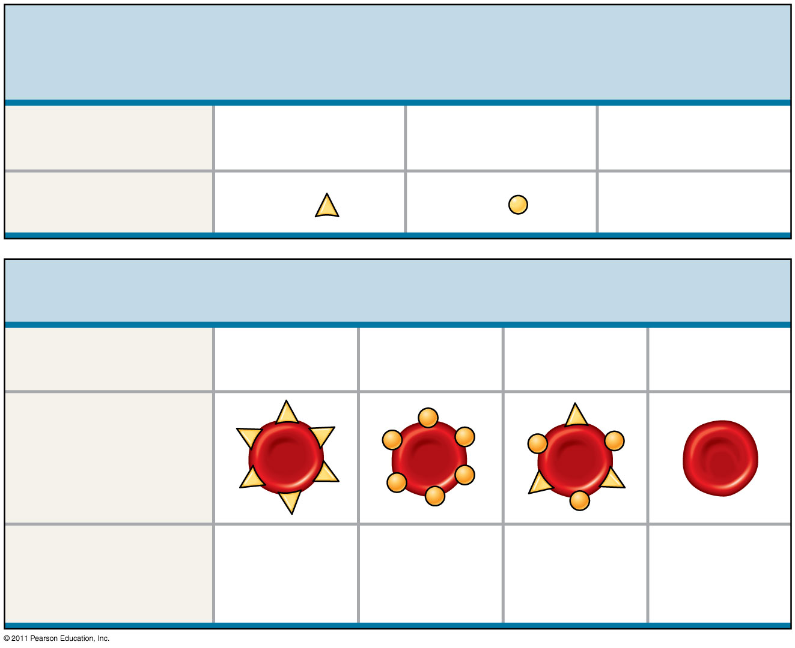
Figure 14.11
(a) The three alleles for the ABO blood groups and their carbohydrates
(24)
Allele
I^{A}
I^{B}
i
Carbohydrate
A
B
none
(b) Blood group genotypes and phenotypes
Genotype
I^{A}I^{A} or I^{A}i
I^{B}I^{B} or I^{B}i
I^{A}I^{B}
ii
Red blood cell appearance
Phenotype (blood group)
A
B
AB
O
Notes:
Figure 14.11 Multiple alleles for the ABO blood groups.

Slide 36
Polygenic Inheritance
Quantitative characters are those that vary in the population along a continuum
Quantitative variation usually indicates polygenic inheritance, an additive effect of two or more genes on a single phenotype
Skin color in humans is an example of polygenic inheritance
© 2011 Pearson Education, Inc.

Slide 37
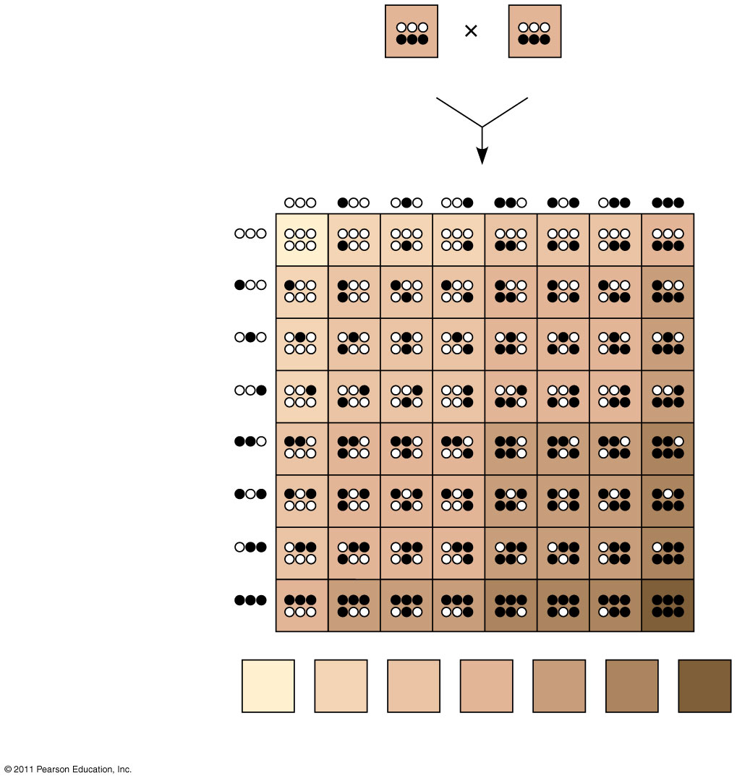
Figure 14.13
AaBbCc
AaBbCc
Sperm
¹/₈
¹/₈
¹/₈
¹/₈
¹/₈
¹/₈
¹/₈
¹/₈
¹/₈
¹/₈
¹/₈
¹/₈
Eggs
¹/₈
¹/₈
¹/₈
¹/₈
Phenotypes:
¹/₆₄
⁶/₆₄
¹⁵/₆₄
²⁰/₆₄
¹⁵/₆₄
⁶/₆₄
¹/₆₄
Number of dark-skin alleles:
0
1
2
3
4
5
6
Notes:
Figure 14.13 A simplified model for polygenic inheritance of skin color.

Slide 38
Concept 4: Many human traits follow Mendelian patterns of inheritance
Humans are not good subjects for genetic research
Generation time is too long
Parents produce relatively few offspring
Breeding experiments are unacceptable
However, basic Mendelian genetics endures as the foundation of human genetics
© 2011 Pearson Education, Inc.

Slide 39
Pedigree Analysis
A pedigree is a family tree that describes the interrelationships of parents and children across generations
Inheritance patterns of particular traits can be traced and described using pedigrees
© 2011 Pearson Education, Inc.

Slide 40
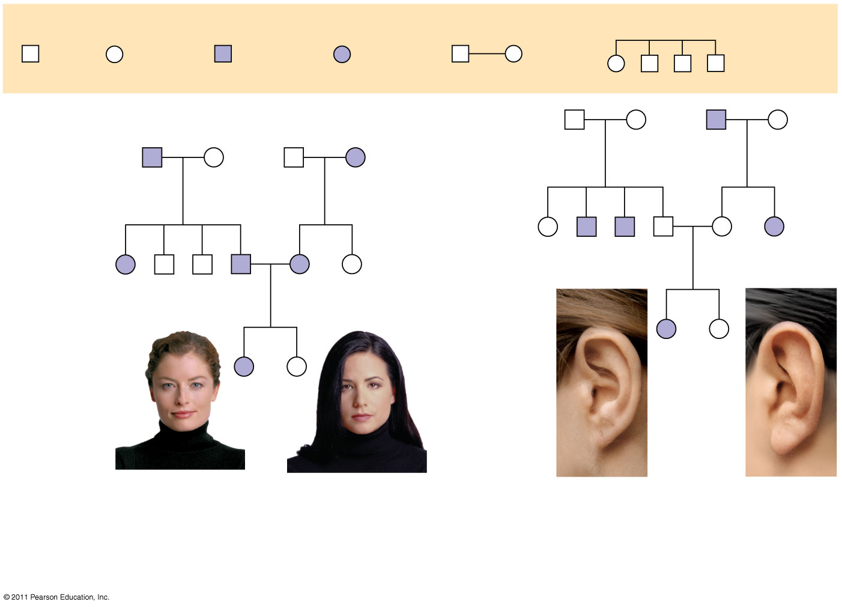
Figure 14.15
(33-34)
Key
Male
Female
Affected male
Affected female
Mating
Offspring
1st generation
1st generation
Ff
Ff
ff
Ff
Ww
ww
ww
Ww
2nd generation
2nd generation
FF or Ff
ff
ff
Ff
Ff
ff
Ww
ww
ww
Ww
Ww
ww
3rd generation
3rd generation
ff
FF or Ff
WW or Ww
ww
Widow’s peak
No widow’s peak
Attached earlobe
Free earlobe
(a)
Is a widow’s peak a dominant or recessive trait?
b)
Is an attached earlobe a dominant or recessive trait?
Notes:
Figure 14.15 Pedigree analysis.

Slide 41
The Behavior of Recessive Alleles
Recessively inherited disorders show up only in individuals homozygous for the allele
Carriers are heterozygous individuals who carry the recessive allele but are phenotypically normal; most individuals with recessive disorders are born to carrier parents
Albinism is a recessive condition characterized by a lack of pigmentation in skin and hair
© 2011 Pearson Education, Inc.
© 2011 Pearson Education, Inc.

Slide 42
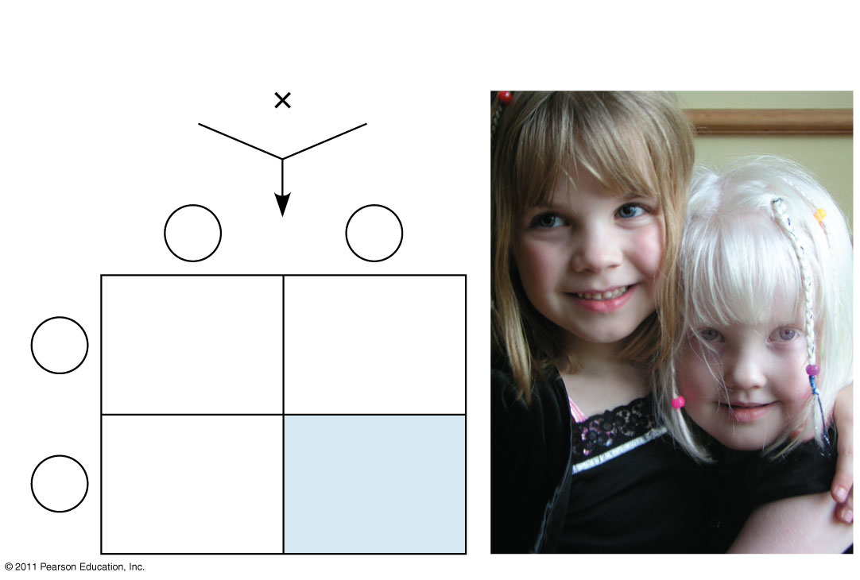
Figure 14.16
Parents
Normal Aa
Normal Aa
Sperm
A
a
Eggs
AA
Normal
Aa
Normal (carrier)
A
Aa
Normal (carrier)
a
aa
Albino
Notes:
Figure 14.16 Albinism: a recessive trait.

Slide 43
Cystic Fibrosis
Cystic fibrosis is the most common lethal genetic disease in the United States,striking one out of every 2,500 people of European descent
The cystic fibrosis allele results in defective or absent chloride transport channels in plasma membranes leading to a buildup of chloride ions outside the cell
Symptoms include mucus buildup in some internal organs and abnormal absorption of nutrients in the small intestine (35 on next several slides)
© 2011 Pearson Education, Inc.

Slide 44
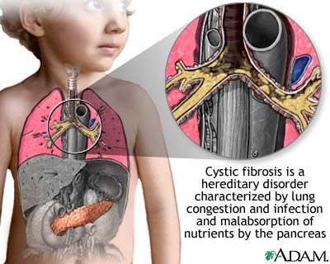

Slide 45
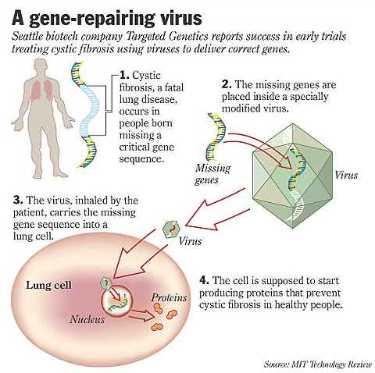
Most common lethal genetic disease in the U.S.
Most frequent in Caucasian populations
1 in 28 is a carrier
1 in 2,500 children have the disease

Slide 46
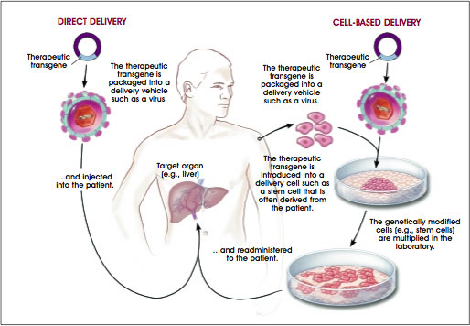

Slide 47
Sickle-Cell Disease: A Genetic Disorder with Evolutionary Implications
Sickle-cell disease affects one out of 400 African-Americans
The disease is caused by the substitution of a single amino acid in the hemoglobin protein in red blood cells
In homozygous individuals, all hemoglobin is abnormal (sickle-cell)
Symptoms include physical weakness, pain, organ damage, and even paralysis
© 2011 Pearson Education, Inc.

Slide 48
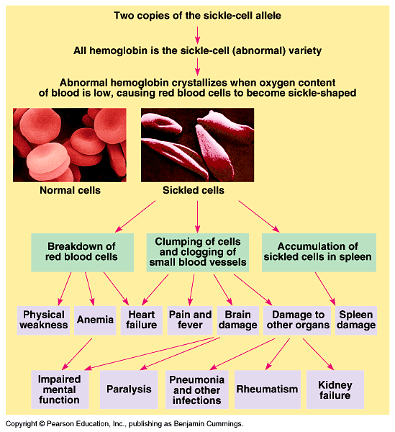

Slide 49
Fig. 14-UN1
Heterozygotes (said to have sickle-cell trait) are usually healthy but may suffer some symptoms
About one out of ten African Americans has sickle cell trait, an unusually high frequency of an allele with detrimental effects in homozygotes
Heterozygotes are less susceptible to the malaria parasite, so there is an advantage to being heterozygous
© 2011 Pearson Education, Inc.

Slide 50
Metabolic Disorders
Enzymes are chemical compounds that increase the rate at which reactions take place in a living organism.
as a group these chemical reactions are referred to as metabolism
Without enzymes, most chemical changes in an organism would proceed so slowly that the organism could not survive.
If an enzyme is missing from the body or not functioning as it should, a metabolic disorder may develop.

Slide 51
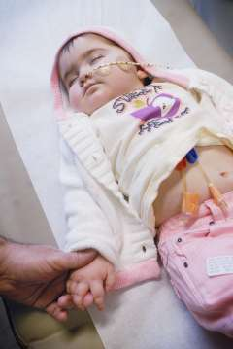
Tay-Sachs Disease
Is a fatal genetic lipid storage disorder in which harmful quantities of a fatty substance called ganglioside GM2 build up in tissues and CNS
Is common to people of Jewish and eastern European descent

Slide 52
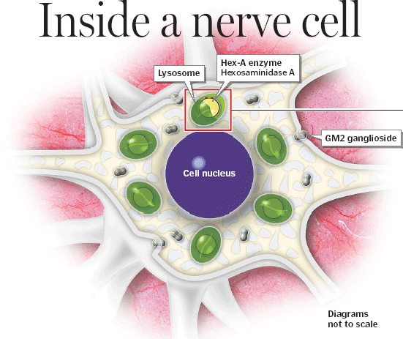

Slide 53
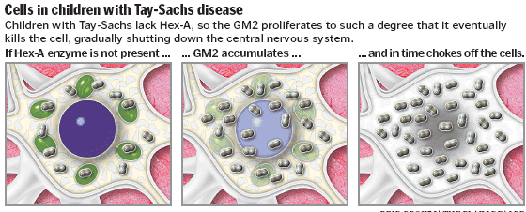

Slide 54
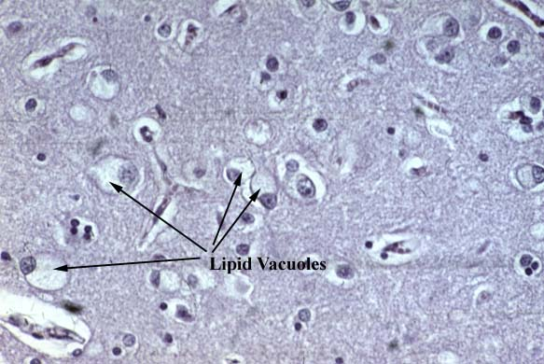
Tay-Sachs Disease
Inheriting this recessive disorder results in your bodies inability to make a functional enzyme called beta-hexosaminidase A
normally breaks down acidic fatty materials known as gangliosides that are produced and stored in tissues of the CNS, causing the lipid to accumulate in the cells

Slide 55
Tay-Sachs
Infants with Tay-Sachs disease appear to develop normally for the first few months of life.
As nerve cells become distended with fatty material, a relentless deterioration of mental and physical abilities occurs.
Child becomes blind, deaf, and unable to swallow. Muscles begin to atrophy and paralysis sets in

Slide 56
Phenylketonuria (PKU)
Phenylketonuria (PKU) is a genetic disorder that is characterized by an inability of the body to utilize the essential amino acid, phenylalanine.
Homozygous PKU infants appear normal at first because the mothers functional enzyme prevented the accumulation of the phenylalanine
Once the infant begins nursing, the phenylalanine rich milk accumulates causing mental retardation

Slide 57
PKU
In 'classic PKU', the enzyme that breaks down phenylalanine phenylalanine hydroxylase, is completely or nearly completely deficient.
This enzyme normally converts phenylalanine to the amino acid, tyrosine.
Without this enzyme, phenylalanine and its' breakdown chemicals from other enzyme routes, accumulate in the blood and body tissues.

Slide 58
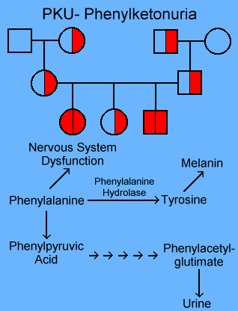

Slide 59
PKU Symptoms
Early symptoms: vomiting, irritability, an eczema-like rash, and a mousy odor to the urine
Later, severe brain problems occur, such as mental retardation and seizures.
Other commonly noted features in untreated children include: microcephaly (small head), prominent cheek and upper jaw bones with widely spaced teeth, poor development of tooth enamel, and decreased body growth.

Slide 60
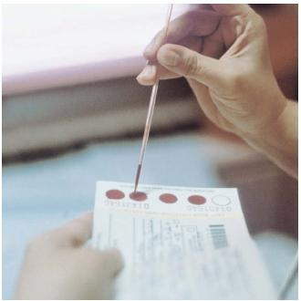
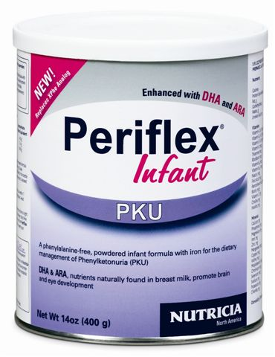
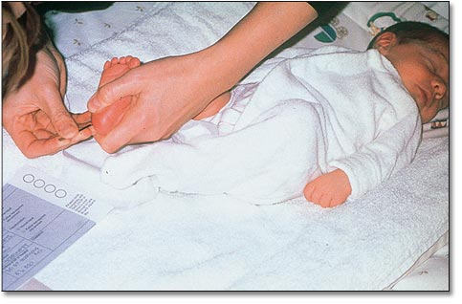
PKU Diagnosis Treatment
Today infants are tested for PKU and if positive are fed special diets low in phenylalanine until their brains are fully developed
This helps avoid toxic effects of the disorder

Slide 61
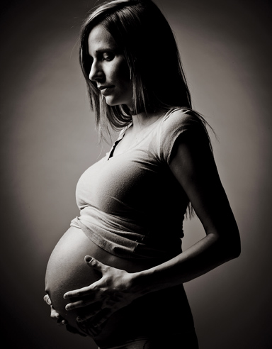
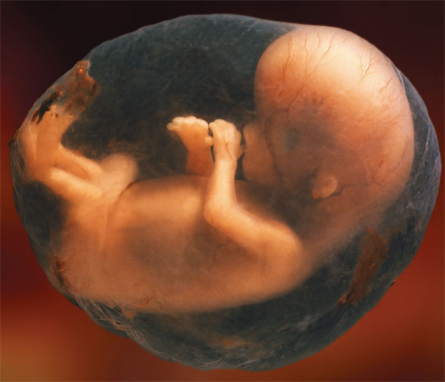
PKU… A New Problem
Women who are homozygous for PKU still have high levels of phenylalanine in their bodies that can injure their child
The child can be injured even if it is heterozygous and would normally be okay

Slide 62
Recessive Patterns of Heredity
Usually rare.
Skips generations.
Occurrence increases with consaguineous matings.
Often an enzyme defect.

Slide 63
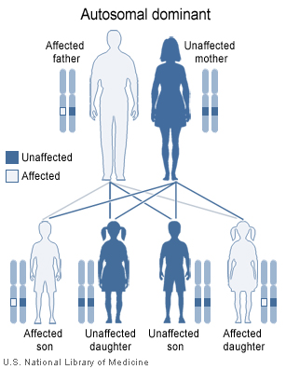
Dominantly Inherited Disorders
Some human disorders are caused by dominant alleles
Dominant alleles that cause a lethal disease are rare and arise by mutation
Achondroplasia is a form of dwarfism caused by a rare dominant allele
© 2011 Pearson Education, Inc.

Slide 64
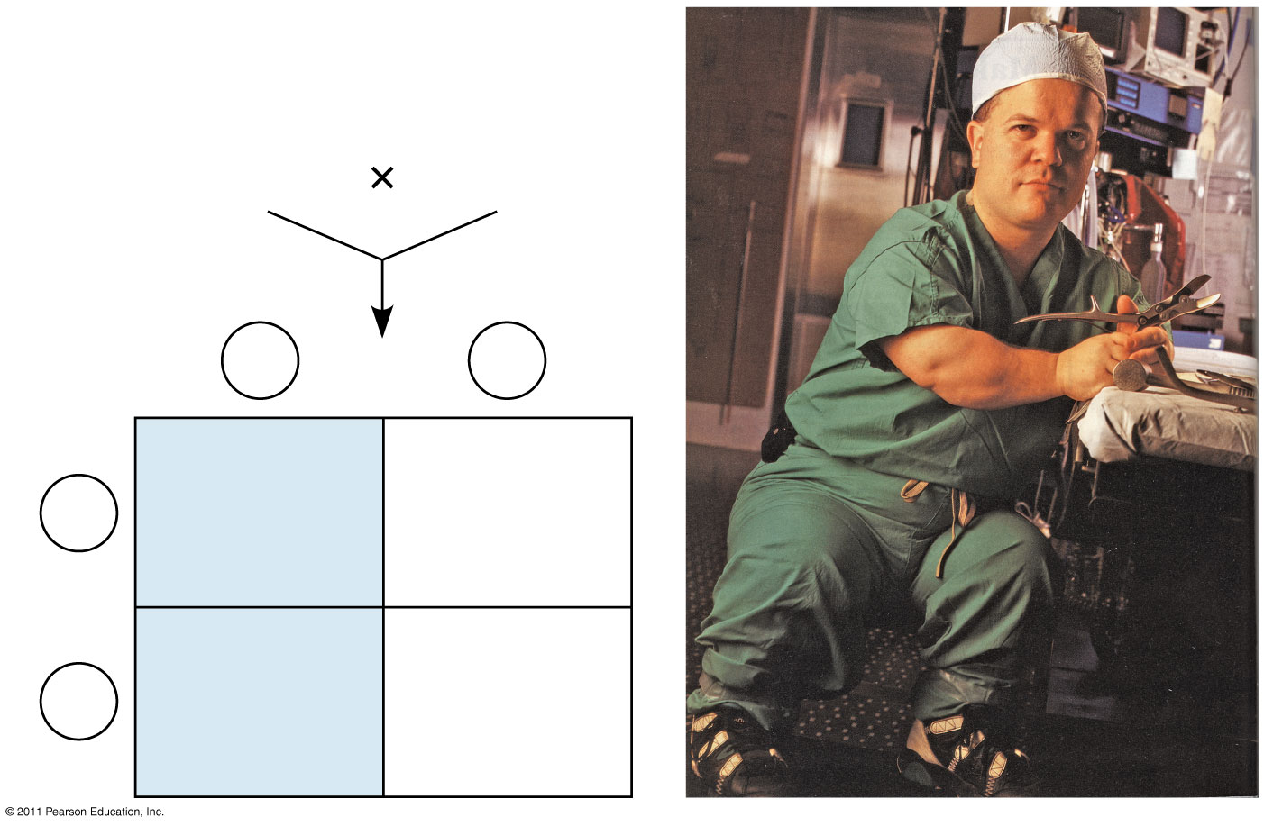
Figure 14.17
Parents
Dwarf Dd
Normal dd
Sperm
D
d
Eggs
Dd
Dwarf
dd
Normal
d
Dd
Dwarf
dd
Normal
d
Notes:
Figure 14.17 Achondroplasia: a dominant trait.

Slide 65
Huntington’s Disease: A Late-Onset Lethal Disease
The timing of onset of a disease significantly affects its inheritance
Huntington’s disease is a degenerative disease of the nervous system
The disease has no obvious phenotypic effects until the individual is about 35 to 40 years of age
Once the deterioration of the nervous system begins the condition is irreversible and fatal
© 2011 Pearson Education, Inc.

Slide 66
Human Dominant Disorders
Inheritance Pattern
Each affected individual had one affected parent.
Doesn’t skip generations.
Homozygous cases show worse phenotype symptoms.
May have post-maturity onset of symptoms.
Affected Female
Affected Male

Slide 67
Huntingtons Disease
A lethal genetic disorder caused by a dominant allele
(HD) results from genetically programmed degeneration of brain cells, called neurons, in certain areas of the brain.
Degeneration causes uncontrolled movements, loss of intellectual faculties, and emotional disturbance.

Slide 68
Huntingtons Disease
Individuals with HD have a progressive loss of cells in the part of the brain called the basal ganglia.
These cells are dying and are not being replaced.
Over time, thousands of brain cells will be lost, and with their loss, patients experience a decline in emotional, physical and reasoning abilities

Slide 69
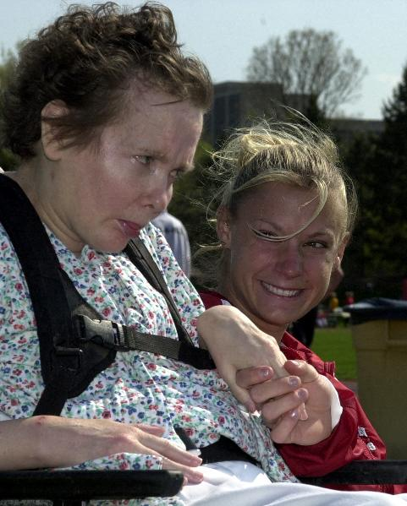
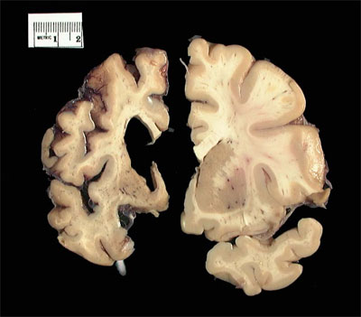
Huntingtons Disease
The onset of Huntington's disease occurs between the ages of 30-50
This means affected individual can have children and pass the deadly disease onto them

Slide 70
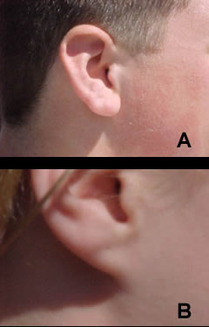
Random Dominantly Inherited Traits
Cleft chin
Widows peak
Unattached earlobes
Hitch hikers thumb
Almond shaped eyes
Presence of hair on middle section of fingers
Thick lips

Slide 71
Genetic Screening
Risk assessment for an individual inheriting a trait.
Uses probability to calculate the risk.

Slide 72
Fetal Testing
In amniocentesis, the liquid that bathes the fetus is removed and tested
In chorionic villus sampling (CVS), a sample of the placenta is removed and tested
Other techniques, such as ultrasound and fetoscopy, allow fetal health to be assessed visually in utero
© 2011 Pearson Education, Inc.

Slide 73
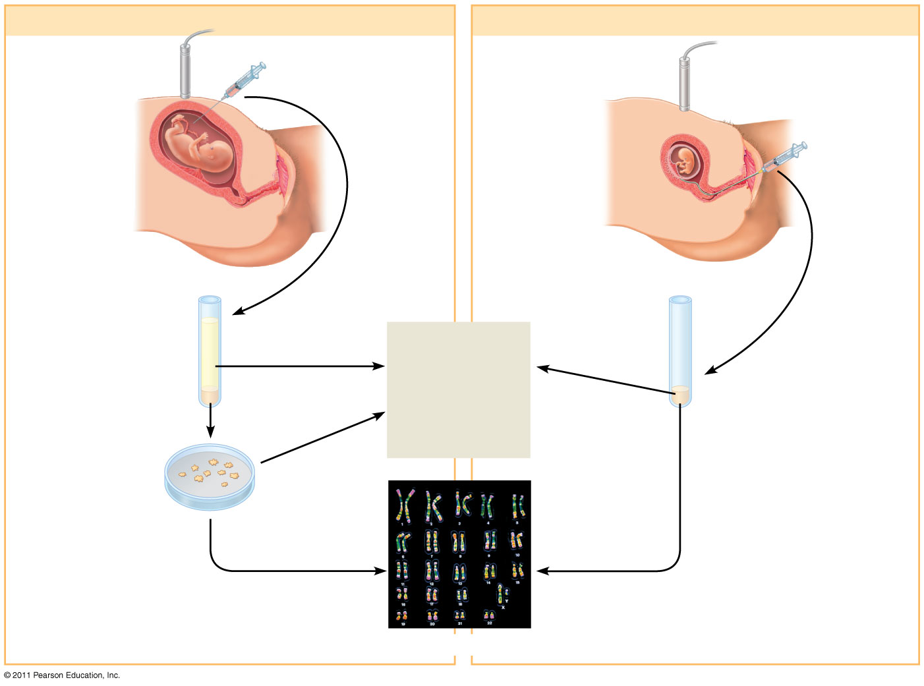
Figure 14.19
(a) Amniocentesis
(b) Chorionic villus sampling (CVS)
1
Ultrasound monitor
Amniotic fluid withdrawn
Ultrasound monitor
Fetus
1
Fetus
Placenta
Suction tube inserted through cervix
Placenta
Chorionic villi
Uterus
Cervix
Cervix
Uterus
Centrifugation
Fluid
Several hours
Several hours
2
Biochemical and genetic tests
Fetal cells
Several weeks
Fetal cells
2
(36 & 38 on your own)
Several weeks
Several hours
3
Karyotyping
Notes:
Figure 14.19 Testing a fetus for genetic disorders.

Slide 74
The Chromosomal Basis of Inheritance

Slide 75
Concept 1: Mendelian inheritance has its physical basis in the behavior of chromosomes
Mitosis and meiosis were first described in the late 1800s
The chromosome theory of inheritance states:
Mendelian genes have specific loci (positions) on chromosomes
Chromosomes undergo segregation and independent assortment
The behavior of chromosomes during meiosis can account for Mendel’s laws of segregation and independent assortment
© 2011 Pearson Education, Inc.

Slide 76
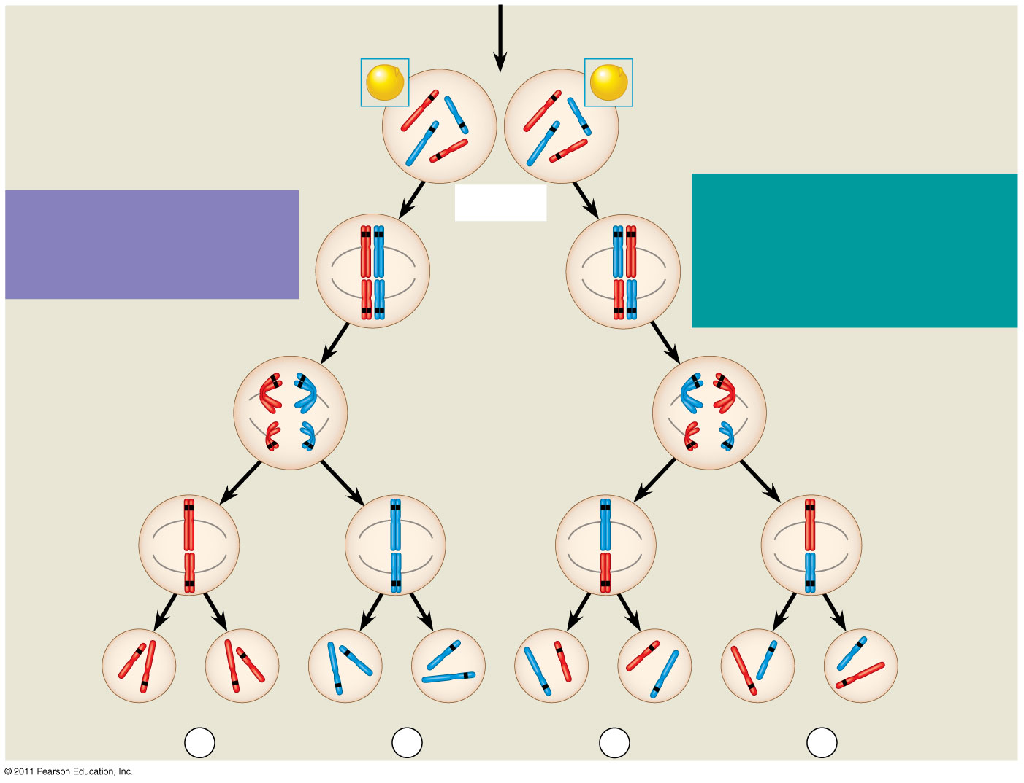
Figure 15.2b
All F₁ plants produce yellow-round seeds (YyRr).
(Apply to answer2-3)
F₁ Generation
R
R
r
y
r
y
Y
Y
Meiosis
LAW OF INDEPENDENT ASSORTMENT Alleles of genes on nonhomologous chromosomes assort independently during gamete formation.
LAW OF SEGREGATION The two alleles for each gene separate during gamete formation.
R
r
r
R
Metaphase I
Y
y
Y
y
1
1
R
r
r
R
Anaphase I
Y
y
Y
y
R
r
Metaphase II
r
R
2
2
Y
y
Y
y
Y
Y
y
y
Y
Y
y
y
Gametes
r
R
R
r
r
r
R
R
¹/₄
YR
¹/₄
yr
¹/₄
Yr
¹/₄
yR
Notes:
Figure 15.2 The chromosomal basis of Mendel’s laws.

Slide 77
Morgan’s Experimental Evidence: Scientific Inquiry
The first solid evidence associating a specific gene with a specific chromosome came from Thomas Hunt Morgan, an embryologist
Morgan’s experiments with fruit flies provided convincing evidence that chromosomes are the location of Mendel’s heritable factors
© 2011 Pearson Education, Inc.

Slide 78
Morgan’s Choice of Experimental Organism
Several characteristics make fruit flies a convenient organism for genetic studies
They produce many offspring
A generation can be bred every two weeks
They have only four pairs of chromosomes (4)
© 2011 Pearson Education, Inc.

Slide 79
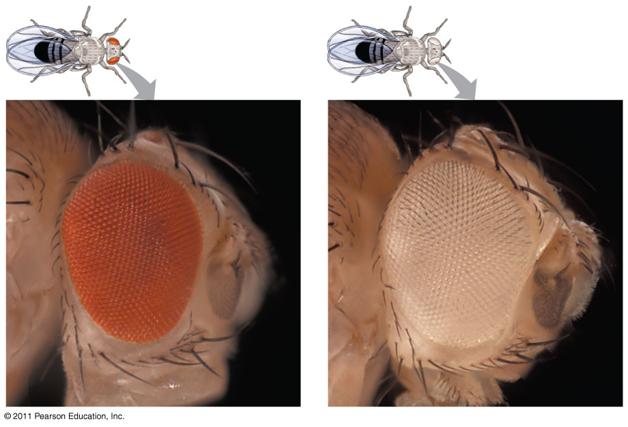
Morgan noted wild type, or normal, phenotypes that were common in the fly populations
Traits alternative to the wild type are called mutant phenotypes (5 from knowledge)
© 2011 Pearson Education, Inc.

Slide 80
Correlating Behavior of a Gene’s Alleles with Behavior of a Chromosome Pair
In one experiment, Morgan mated male flies with white eyes (mutant) with female flies with red eyes (wild type)
The F₁ generation all had red eyes
The F₂ generation showed the 3:1 red:white eye ratio, but only males had white eyes (6-7)
Morgan determined that the white-eyed mutant allele must be located on the X chromosome
Morgan’s finding supported the chromosome theory of inheritance
© 2011 Pearson Education, Inc.

Slide 81
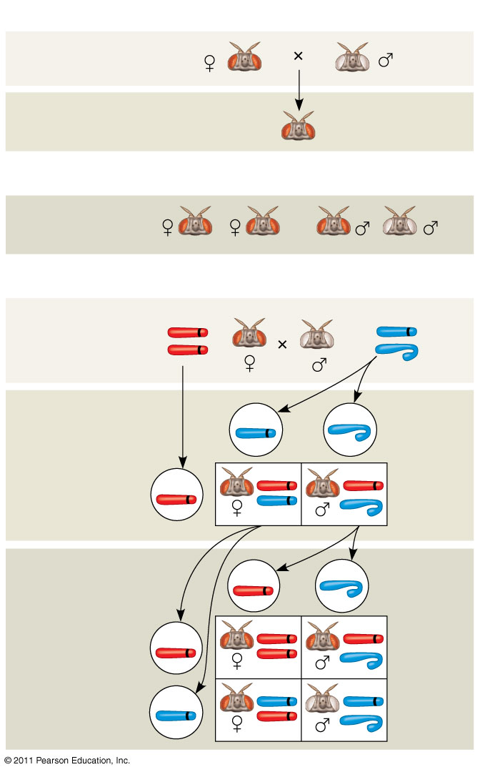
Figure 15.4
EXPERIMENT
P Generation
F₁ Generation
All offspring had red eyes.
RESULTS
F₂ Generation
CONCLUSION
P Generation
X
w⁺
X
w
X
w⁺
Y
w
Sperm
Eggs
F₁ Generation
w⁺
w⁺
w⁺
w
w⁺
Sperm
Eggs
F₂ Generation
w⁺
w⁺
w⁺
w⁺
w
w
w
w⁺
Notes:
Figure 15.4 Inquiry: In a cross between a wild-type female fruit fly and a mutant white-eyed male, what color eyes will the F₁ and F₂ offspring have?

Slide 82
The Chromosomal Basis of Sex
In humans and other mammals, there are two varieties of sex chromosomes: a larger X chromosome and a smaller Y chromosome
Only the ends of the Y chromosome have regions that are homologous with corresponding regions of the X chromosome
The SRY gene on the Y chromosome codes for a protein that directs the development of male anatomical features
© 2011 Pearson Education, Inc.

Slide 83
A gene that is located on either sex chromosome is called a sex-linked gene
Genes on the Y chromosome are called Y-linked genes; there are few of these
Genes on the X chromosome are called X-linked genes
X chromosome have genes for many characters unrelated to sex, whereas the Y chromosome mainly encodes genes related to sex determination
© 2011 Pearson Education, Inc.

Slide 84
Review of Inheritance
X-linked genes follow specific patterns of inheritance
For a recessive X-linked trait to be expressed
A female needs two copies of the allele (homozygous)
A male needs only one copy of the allele (hemizygous)
X-linked recessive disorders are much more common in males than in females
© 2011 Pearson Education, Inc.

Slide 85
Some disorders caused by recessive alleles on the X chromosome in humans
Color blindness (mostly X-linked)
Duchenne muscular dystrophy
Hemophilia
© 2011 Pearson Education, Inc.

Slide 86
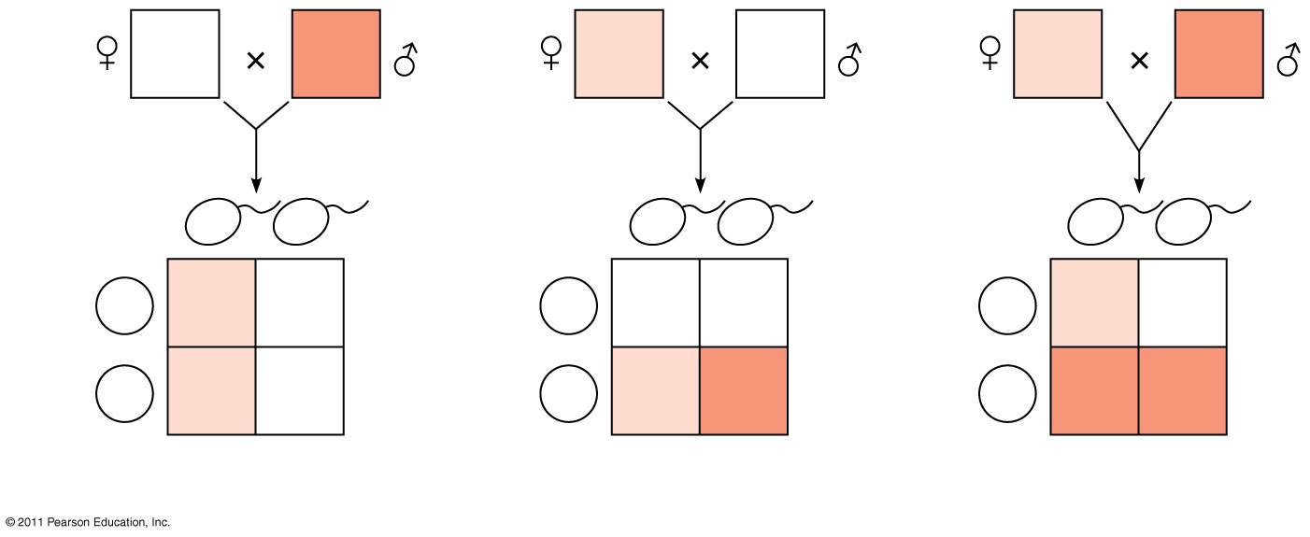
Figure 15.7
(13)
X^{N}X^{N}
X^{n}Y
X^{N}X^{n}
X^{N}Y
X^{N}X^{n}
X^{n}Y
Sperm
X^{n}
Y
Sperm
X^{N}
Y
Sperm
X^{n}
Y
Eggs
X^{N}
X^{N}X^{n}
X^{N}Y
Eggs
X^{N}
X^{N}X^{N}
X^{N}Y
Eggs
X^{N}
X^{N}X^{n}
X^{N}Y
X^{N}
X^{N}X^{n}
X^{N}Y
X^{n}
X^{N}X^{n}
X^{n}Y
X^{n}
X^{n}X^{n}
X^{n}Y
(a)
(b)
(c)
Notes:
Figure 15.7 The transmission of X-linked recessive traits.

Slide 87
Concept 3: Linked genes tend to be inherited together because they are located near each other on the same chromosome
Each chromosome has hundreds or thousands of genes (except the Y chromosome)
Genes located on the same chromosome that tend to be inherited together are called linked genes
Linked genes don’t sort independently, in fact they are a “package deal” unless crossing over occurs between two alleles located on the same chromosome.
© 2011 Pearson Education, Inc.

Slide 88
How Linkage Affects Inheritance
Morgan did other experiments with fruit flies to see how linkage affects inheritance of two characters
Morgan crossed flies that differed in traits of body color and wing size
© 2011 Pearson Education, Inc.

Slide 89
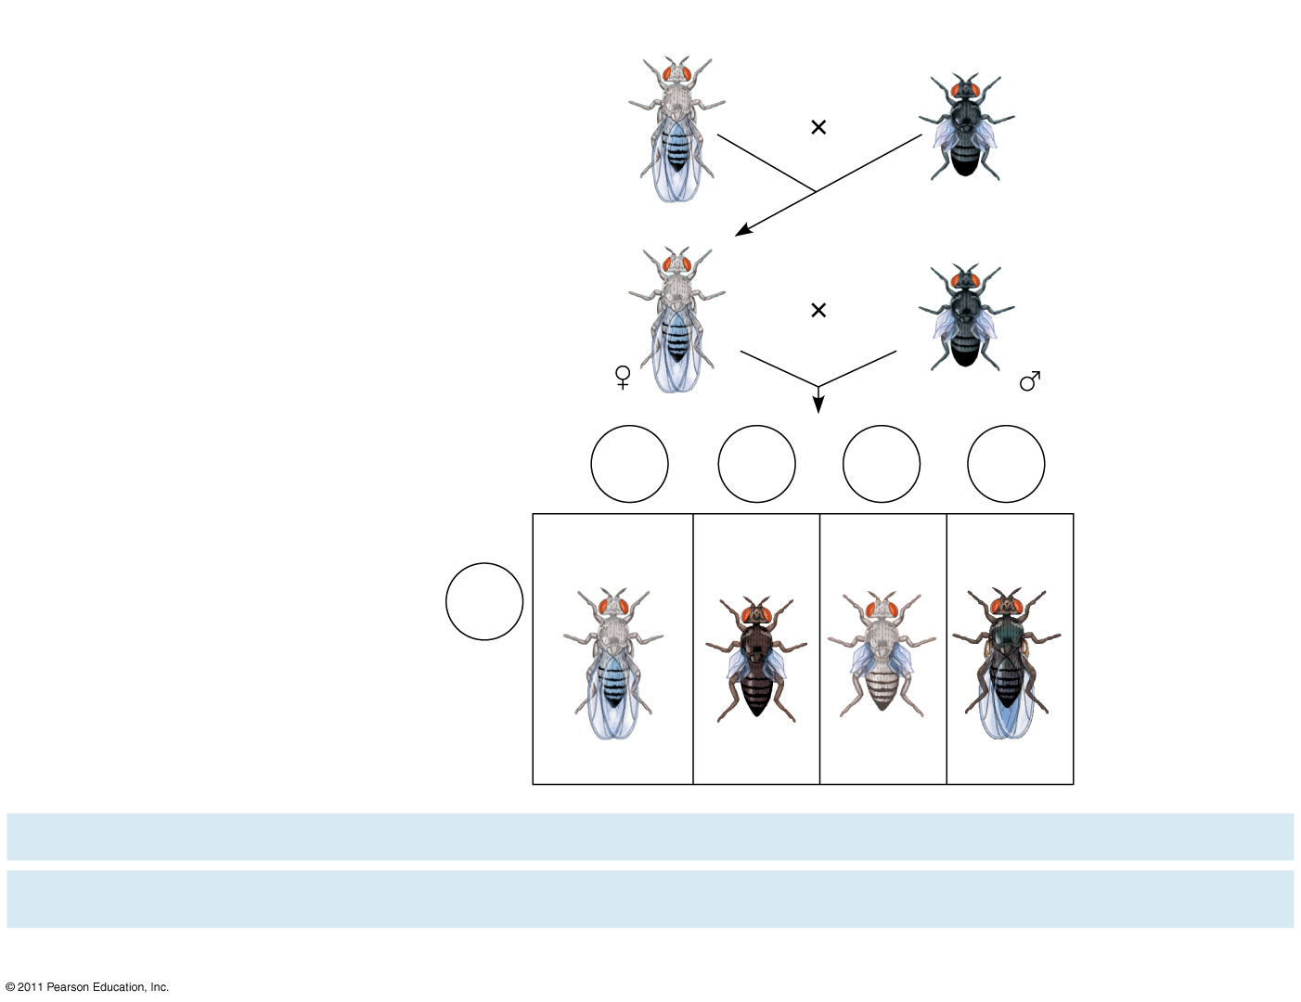
Figure 15.9-4
EXPERIMENT
P Generation (homozygous)
Double mutant (black body, vestigial wings)
Wild type (gray body, normal wings)
b⁺ b⁺ vg⁺ vg⁺
b b vg vg
F₁ dihybrid (wild type)
TESTCROSS
Double mutant
b⁺ b vg⁺ vg
b b vg vg
Testcross offspring
Eggs
b⁺ vg⁺
b vg
b⁺ vg
b vg⁺
Wild type (gray-normal)
Black- vestigial
Gray- vestigial
Black- normal
b vg
Sperm
b⁺ b vg⁺ vg
b b vg vg
b⁺ b vg vg
b b vg⁺ vg
PREDICTED RATIOS
If genes are located on different chromosomes:
1
:
1
:
1
:
1
If genes are located on the same chromosome and parental alleles are always inherited together:
1
:
1
:
0
:
0
RESULTS
965
:
944
:
206
:
185
Notes:
Figure 15.9 Inquiry: How does linkage between two genes affect inheritance of characters?

Slide 90
Morgan found that body color and wing size are usually inherited together in specific combinations (parental phenotypes)
He noted that these genes do not assort independently, and reasoned that they were on the same chromosome
However, nonparental phenotypes were also produced
Understanding this result involves exploring genetic recombination, the production of offspring with combinations of traits differing from either parent
© 2011 Pearson Education, Inc.

Slide 91
Recombination of Linked Genes: Crossing Over
Morgan discovered that genes can be linked, but the linkage was incomplete, because some recombinant phenotypes were observed
He proposed that some process must occasionally break the physical connection between genes on the same chromosome
That mechanism was the crossing over of homologous chromosomes
© 2011 Pearson Education, Inc.

Slide 92
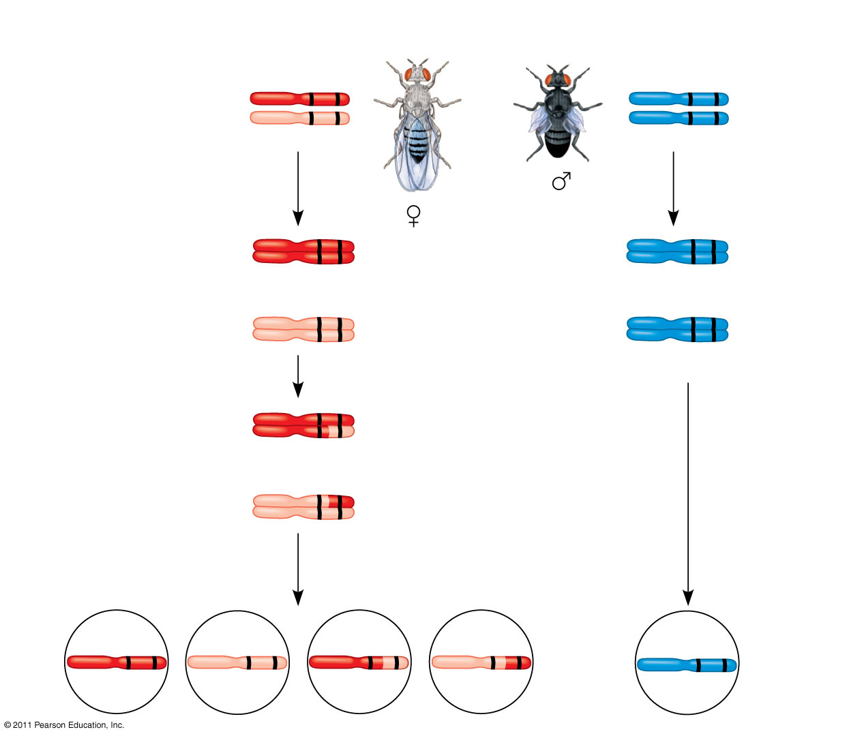
Figure 15.10a
Testcross parents
Gray body, normal wings (F₁ dihybrid)
Black body, vestigial wings (double mutant)
b⁺ vg⁺
b vg
b vg
b vg
Replication of chromosomes
Replication of chromosomes
b⁺ vg⁺
b vg
b⁺ vg⁺
b vg
b vg
b vg
Meiosis I
b vg
b vg
b⁺ vg⁺
Meiosis I and II
b⁺ vg
b vg⁺
Meiosis II
b vg
Recombinant chromosomes
b⁺vg⁺
b vg
b⁺ vg
b vg⁺
b vg
Eggs
Sperm
Notes:
Figure 15.10 Chromosomal basis for recombination of linked genes.

Slide 93
Concept 4: Alterations of chromosome number or structure cause some genetic disorders
Large-scale chromosomal alterations in humans and other mammals often lead to spontaneous abortions (miscarriages) or cause a variety of developmental disorders
Plants tolerate such genetic changes better than animals do
In nondisjunction, pairs of homologous chromosomes do not separate normally during meiosis
As a result, one gamete receives two of the same type of chromosome, and another gamete receives no copy (23)
© 2011 Pearson Education, Inc.

Slide 94
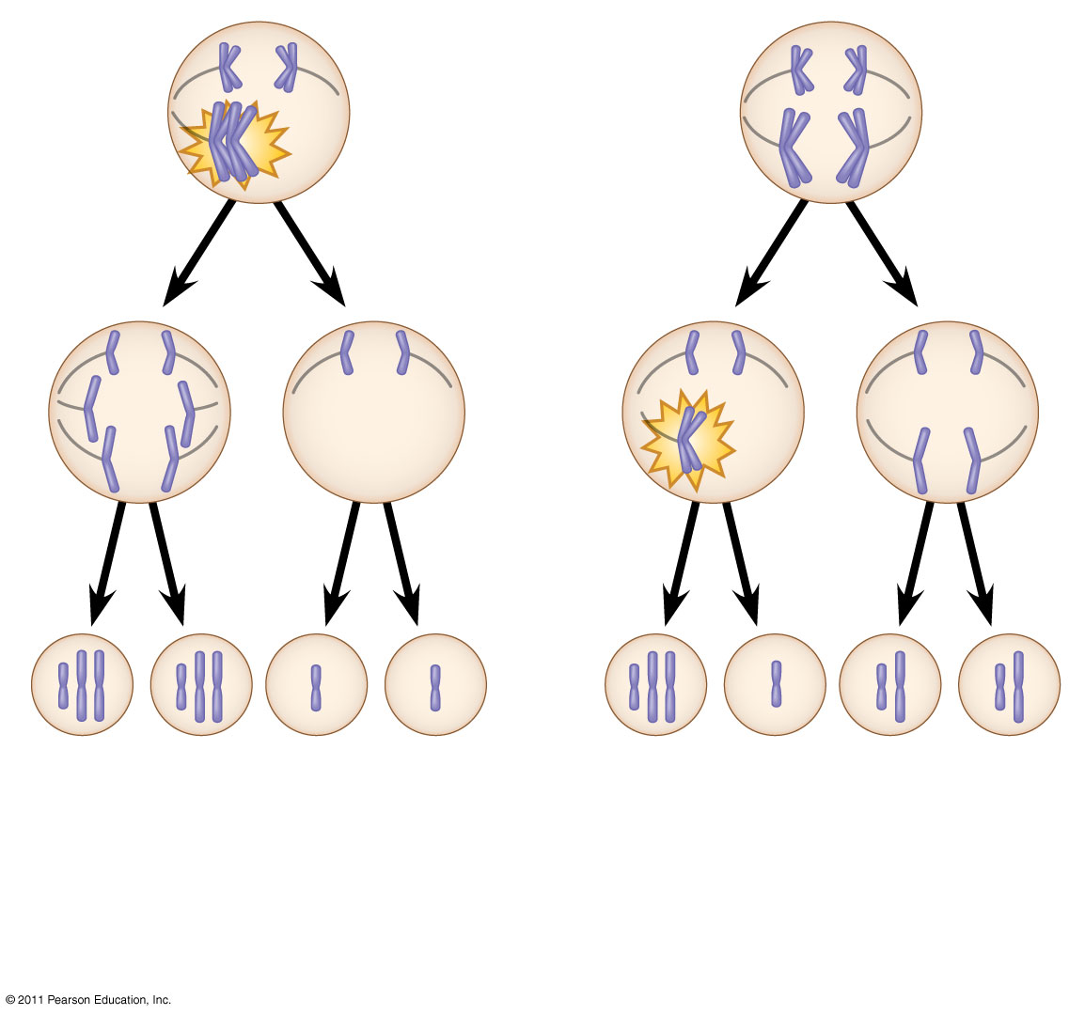
Figure 15.13-3
Meiosis I
Nondisjunction
Meiosis II
Non- disjunction
Gametes
n + 1
n + 1
n − 1
n − 1
n + 1
n − 1
n
n
Number of chromosomes
(a)
Nondisjunction of homo- logous chromosomes in meiosis I
(b)
Nondisjunction of sister chromatids in meiosis II
Notes:
Figure 15.13 Meiotic nondisjunction.

Slide 95
Aneuploidy results from the fertilization of gametes in which nondisjunction occurred
Offspring with this condition have an abnormal number of a particular chromosome
A monosomic zygote has only one copy of a particular chromosome
A trisomic zygote has three copies of a particular chromosome
© 2011 Pearson Education, Inc.

Slide 96
Polyploidy is a condition in which an organism has more than two complete sets of chromosomes
Triploidy (3n) is three sets of chromosomes
Tetraploidy (4n) is four sets of chromosomes
Polyploidy is common in plants, but not animals
Polyploids are more normal in appearance than aneuploids
© 2011 Pearson Education, Inc.

Slide 97
Down Syndrome (Trisomy 21)
Down syndrome is an aneuploid condition that results from three copies of chromosome 21
It affects about one out of every 700 children born in the United States
The frequency of Down syndrome increases with the age of the mother, a correlation that has not been explained
Symptoms include mental retardation, stunted growth, altered facial features, flexible ligaments etc.
© 2011 Pearson Education, Inc.

Slide 98
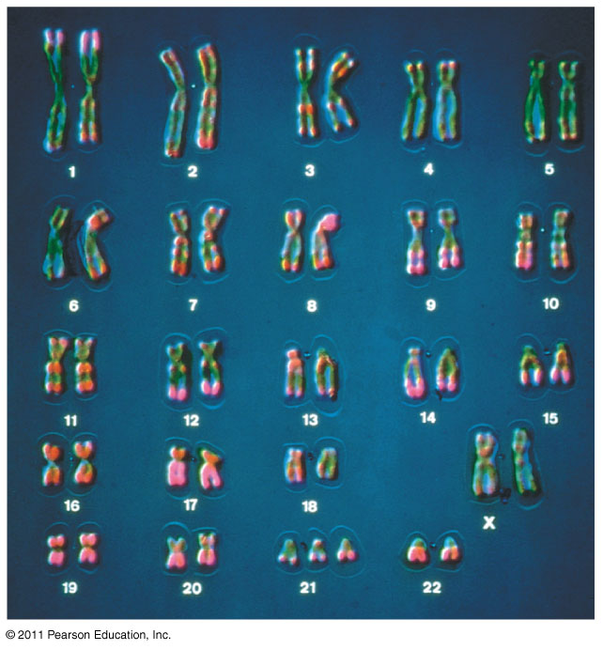
Figure 15.15b
Notes:
Figure 15.15 Down syndrome.

Slide 99
Aneuploidy of Sex Chromosomes
Nondisjunction of sex chromosomes produces a variety of aneuploid conditions
Klinefelter syndrome is the result of an extra chromosome in a male, producing XXY individuals (1 in 500)
Monosomy X, called Turner syndrome, produces X0 females, who are sterile; it is the only known viable monosomy in humans (1 in 3000)
Trisomy of X (XXX 47) results in a phenotypically indistinguishable female(1 in 1000).
XYY Trisomy results in a phenotypically indistinguishable male (1 in 1000) (26)
© 2011 Pearson Education, Inc.

Slide 100
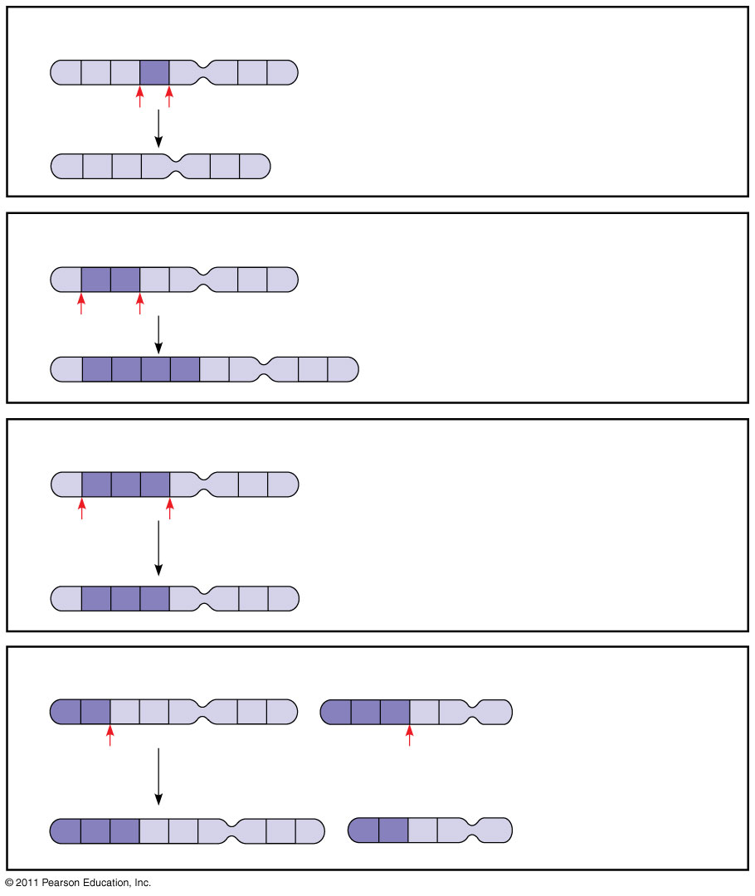
Figure 15.14
(a) Deletion
A
B
C
D
E
F
G
H
A deletion removes a chromosomal segment.
A
B
C
E
F
G
H
(27)
(b) Duplication
A
B
C
D
E
F
G
H
A duplication repeats a segment.
A
B
C
B
C
D
E
F
G
H
(c) Inversion
A
B
C
D
E
F
G
H
An inversion reverses a segment within a chromosome.
A
D
C
B
E
F
G
H
(d) Translocation
A
B
C
D
E
F
G
H
M
N
O
P
Q
R
A translocation moves a segment from one chromosome to a nonhomologous chromosome.
M
N
O
C
D
E
F
A
B
P
Q
R
G
H
Notes:
Figure 15.14 Alterations of chromosome structure.

Slide 101
Concept 15: Some inheritance patterns are exceptions to standard Mendelian inheritance
There are two normal exceptions to Mendelian genetics
One exception involves genes located in the nucleus, and the other exception involves genes located outside the nucleus
In both cases, the sex of the parent contributing an allele is a factor in the pattern of inheritance
© 2011 Pearson Education, Inc.

Slide 102
Inheritance of Organelle Genes
Extranuclear genes (or cytoplasmic genes) are found in organelles in the cytoplasm
Mitochondria, chloroplasts, and other plant plastids carry small circular DNA molecules
Extranuclear genes are inherited maternally because the zygote’s cytoplasm comes from the egg
The first evidence of extranuclear genes came from studies on the inheritance of yellow or white patches on leaves of an otherwise green plant
Mitochondrial myopathy is a mitochondria inherited disease.
© 2011 Pearson Education, Inc.

