Slide 1
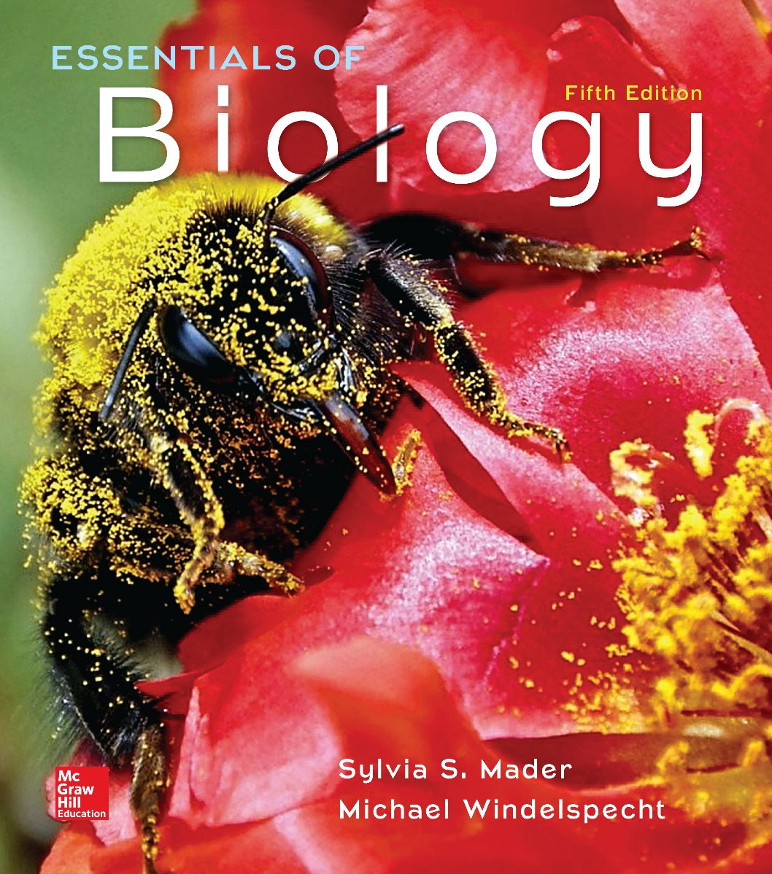
Essentials of Biology
Sylvia S. Mader Michael Windelspecht
Chapter 32 Human Impact on the Biosphere
Lecture Outline
See separate FlexArt PowerPoint slides for all figures and tables pre-inserted into PowerPoint without notes.
Copyright © McGraw-Hill Education. All rights reserved. Authorized only for instructor use in the classroom. No reproduction or distribution without the prior written consent of McGraw-Hill Education.
Notes:
1

Slide 2
32.1 Conservation Biology
Conservation biology is a field of science that focuses on conserving natural resources for this and future generations.
Unique among the life sciences, because it supports a variety of ethical principles:
(1) Biodiversity is good for the Earth and therefore good for humans.
(2) Extinctions are undesirable.
(3) The interactions within ecosystems support biodiversity and are beneficial to humans.
(4) Biodiversity is the result of evolutionary change and has great value to humans.

Slide 3
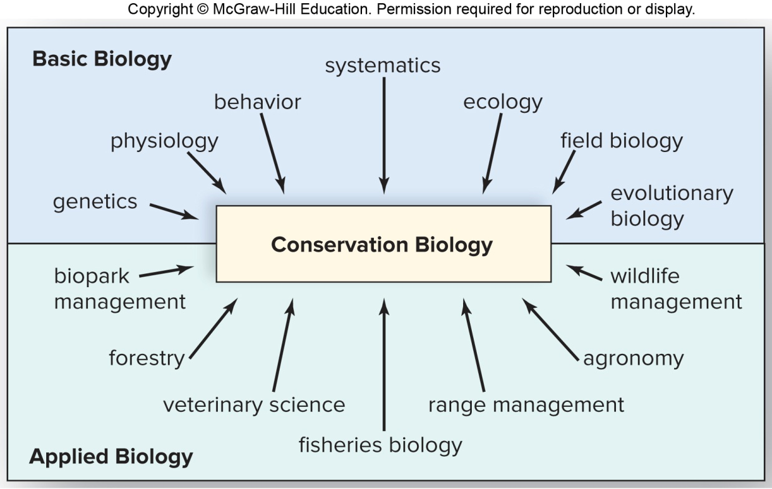
Conservation Biology
Multiple subfields of biology blend together to form the concepts for conservation biology.

Slide 4
32.2 Biodiversity
Defined as the variety of life on Earth
Described in terms of the number of different species
Presently in a biodiversity crisis
In the United States, 85% of plants and animals in danger of extinction involving habitat loss
Conservation biology tries to reverse the trend of extinctions.

Slide 5
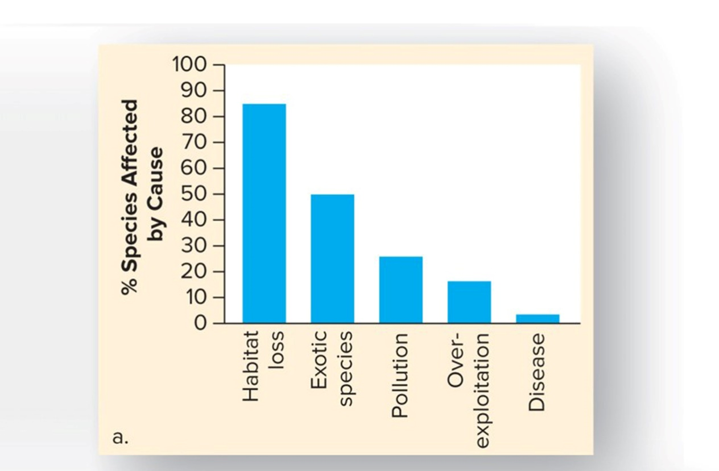
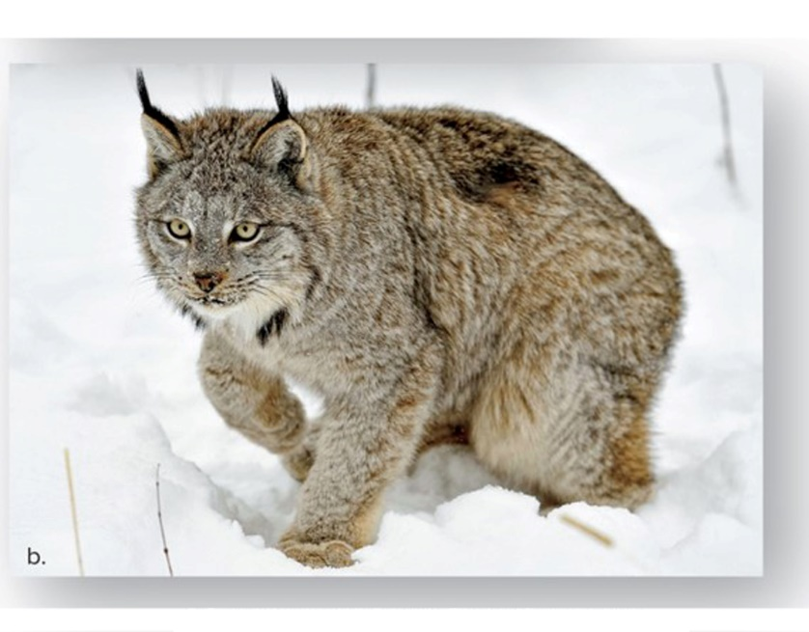
Figure 32.1 Habitat Loss
© Don Johnston/All Canada Photos/Getty Images

Slide 6
Biodiversity Hotspots
Biodiversity is not evenly distributed over the Earth.
It is highest at tropics and declines toward the poles.
Covering only 2.4% of the Earth’s surface, hotspots contain over 50% of all known plant species and 43% of all known terrestrial vertebrate species.
Hotspots should be prioritized by conservation efforts in order to preserve and protect biodiversity.

Slide 7
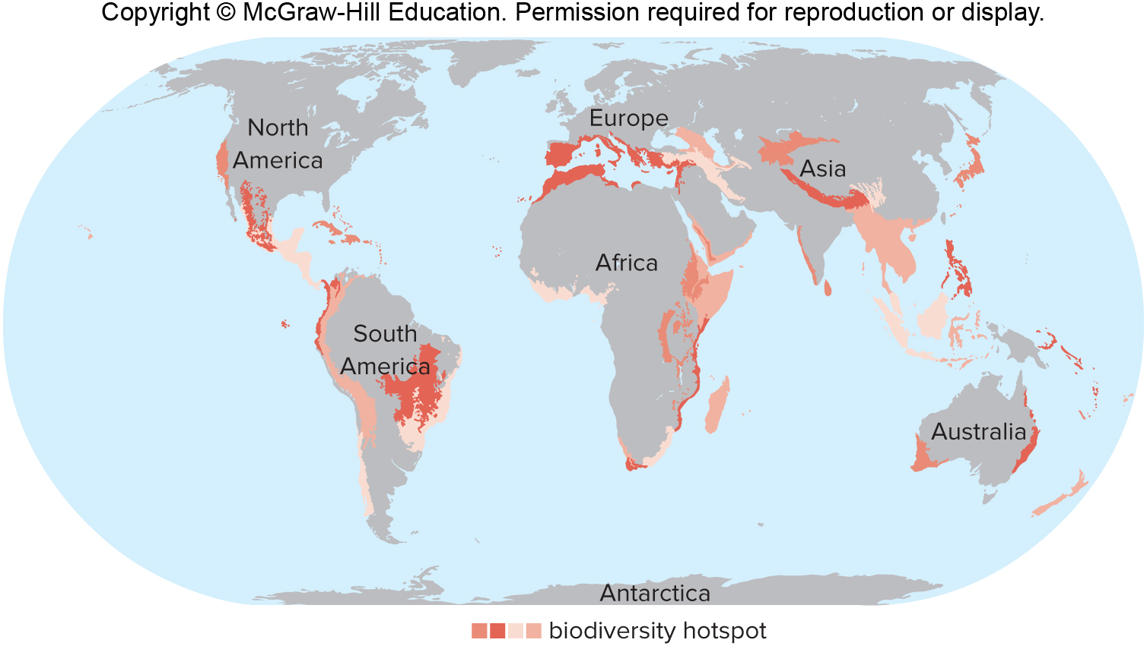
Figure 32.2 Biodiversity Hotspots

Slide 8
Direct Values of Biodiversity
Medicinal value
Most prescription drugs originally derived from organisms
Chemicals from rosy periwinkle from Madagascar used to treat two forms of cancer—survival rate for childhood leukemia went from 10% to 90%
Antibiotic penicillin derived from a fungus
Nine-banded armadillo used to study leprosy—bacteria will not grow in the laboratory

Slide 9
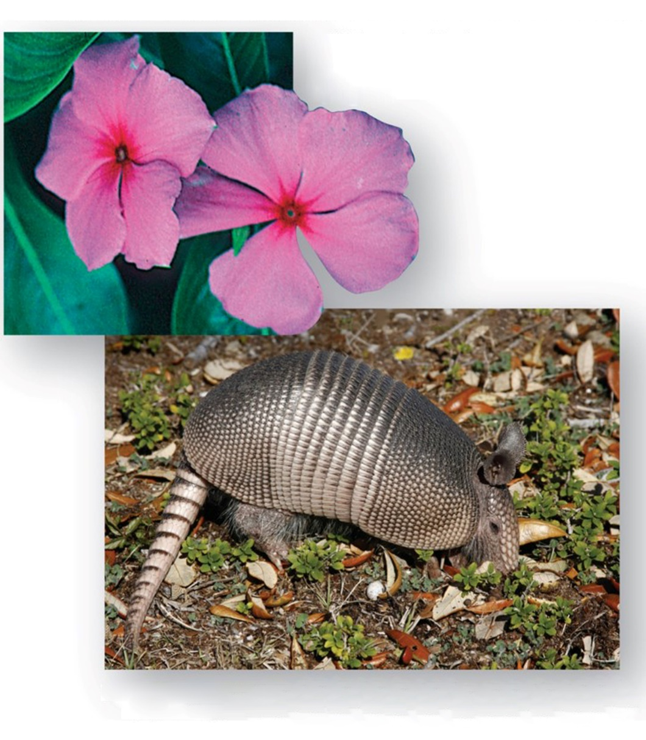
Figure 32.3 Medicinal Value of Biodiversity
Wild species, like the rosy periwinkle, are sources of many medicines.
Wild species, like the nine-banded armadillo, play a role in medical research
a: © Steven P. Lynch; b: © Steve Bower/Shutterstock RF

Slide 10
Agricultural Value
Crops such as wheat, corn, and rice derived from wild plants
When cultivated rice crops in Africa were being attacked by a virus, researchers grew thousands of wild rice samples to find a gene for resistance to the virus.
Biological pest controls (natural predators and parasites) are often preferable to chemical pesticides.
Pollinators of flowering plants
Domesticated honeybee pollinates $10 billion worth of food crops annually in United States.
Mites wiping out 10% of honeybee population—looking for help from wild bees

Slide 11
Consumptive Use Value
Some products gathered in the wild for sale
Wild fruits and vegetables, skins, fibers, beeswax, and seaweed
Many trees still felled in the natural environment for their wood

Slide 12
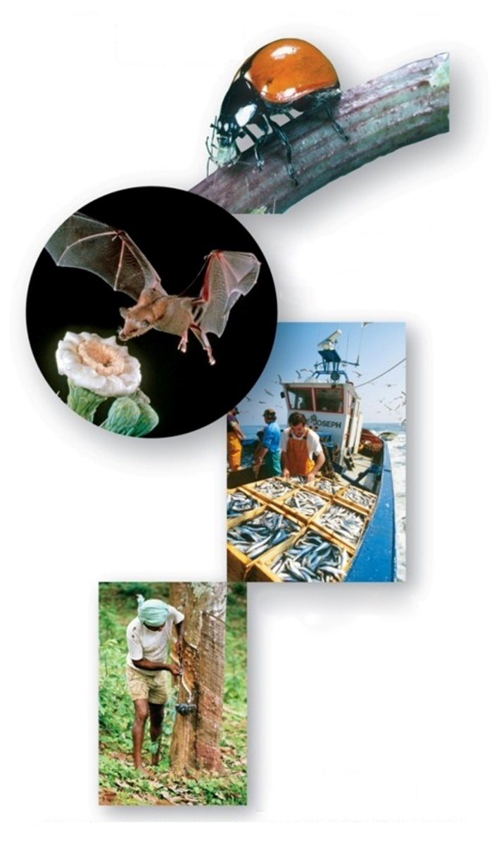
Figure 32.4 Agriculture and Consumptive Value of Wildlife
Wild species, like ladybugs, play a role in biological control of agricultural pests.
Wild species, like the long-nosed bat, are pollinators of agricultural and other plants.
Wild species, like many marine species, provide us with food.
Wild species, like rubber trees, can provide a product indefinitely if the forest is not destroyed.
(ladybug): © Anthony Mercieca/Science Source; (bat): © Dr. Merlin D. Tuttle/Bat Conservation International/Science Source; (fishing boat): © Herve Donnezan/Science Source;
(rubber tree): © Bryn Campbell/Stone/Getty

Slide 13
Indirect Values of Biodiversity, 1
Services are wide-ranging and not easily perceptible.
Biogeochemical cycles
Workings of cycles depend on biodiversity.
Technology has been unable to artificially contribute or create any of the biogeochemical cycles.
Waste disposal
If not for decomposition, waste would soon cover the entire surface of the planet.

Slide 14
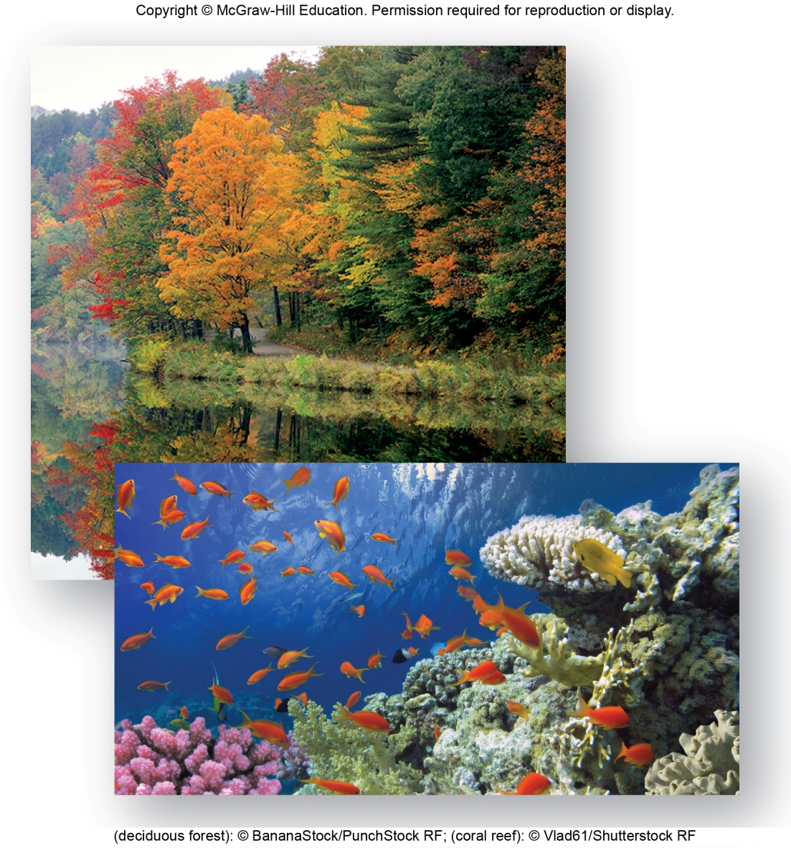
Figure 32.5 Indirect Value of Ecosystems
(deciduous forest): © BananaStock/PunchStock RF; (coral reef): © Vlad61/Shutterstock RF

Slide 15
Indirect Values of Biodiversity, 2
Provision of fresh water
Few terrestrial organisms are adapted to living in a salty environment.
No substitute for fresh water
Cost of desalinization four to eight times the average cost of freshwater acquired through the water cycle
Forests and other ecosystems exert a sponge effect.
Soak up water and release it at a regular rate
Reduces possibility and degree of flooding
Prevention of soil erosion
Regulation of climate
Forests take up carbon dioxide, a greenhouse gas.

Slide 16
Indirect Values of Biodiversity, 3
Ecotourism
In United States, nearly 100 million people enjoy vacationing in a natural setting.
To do so, they spend $5 billion each year on fees, travel, lodging, and food.

Slide 17
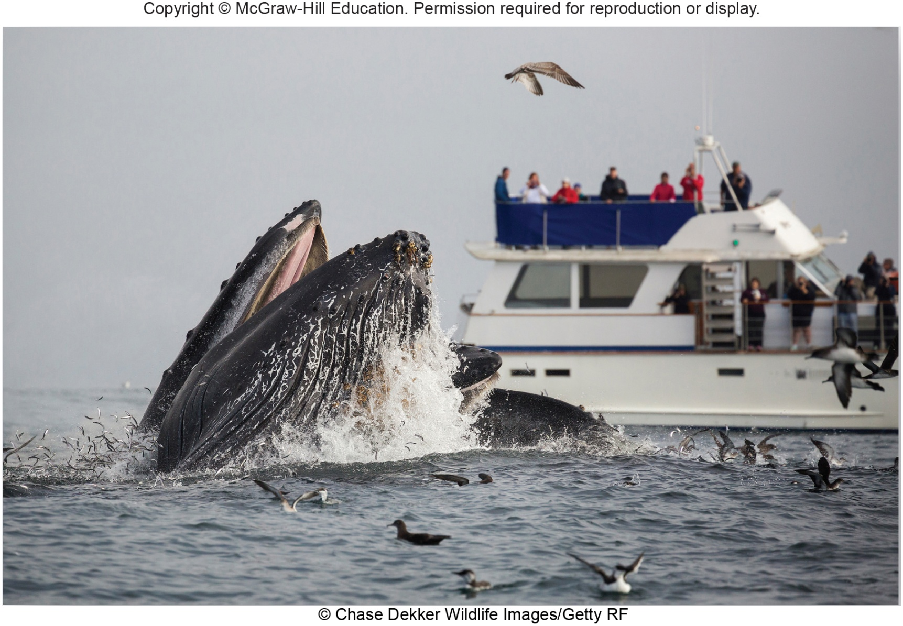
Figure 32.6 Ecotourism
© Chase Dekker Wildlife Images/Getty RF

Slide 18
32.3 Resources and Environmental Impact
Human beings have certain basic needs.
They use resources to meet these needs.
Land, water, food, energy, and minerals are the maximally used resources.

Slide 19
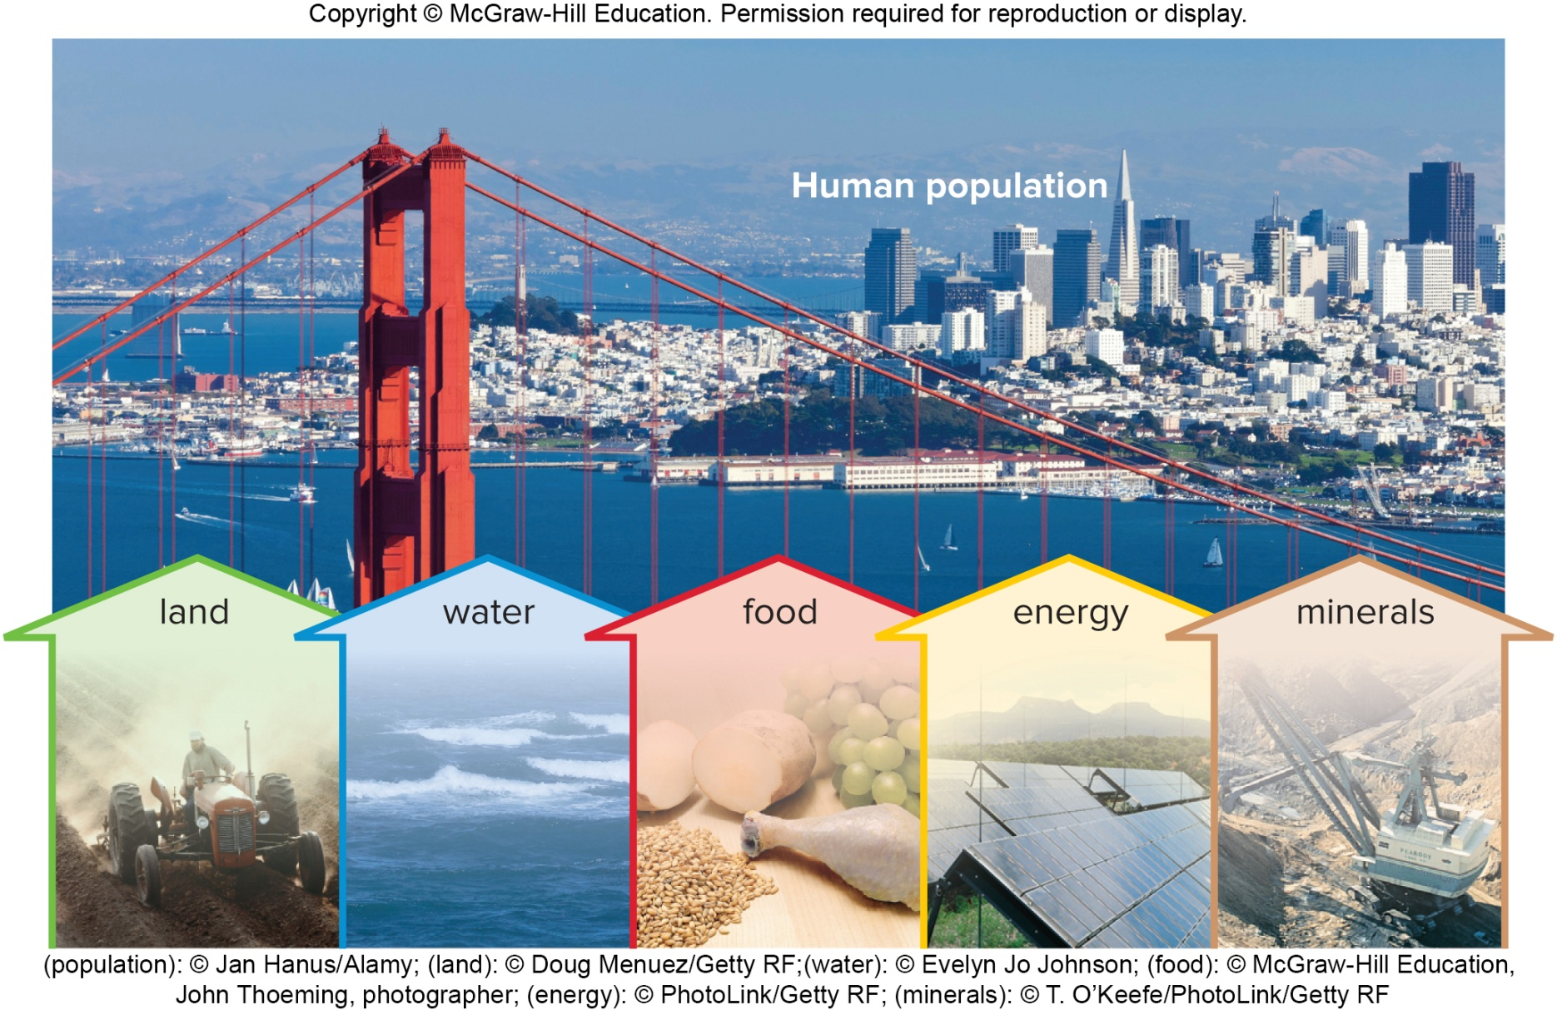
Figure 32.7 Resources
(population): © Jan Hanus/Alamy; (land): © Doug Menuez/Getty RF;(water): © Evelyn Jo Johnson; (food): © McGraw-Hill Education, John Thoeming, photographer; (energy): © PhotoLink/Getty RF; (minerals): © T. O’Keefe/PhotoLink/Getty RF

Slide 20
Resources and Pollution
Nonrenewable resources
Limited in supply, will eventually run out
Amount of land, fossil fuels, and minerals
Renewable resources
Unlimited in supply
We can use water, certain forms of energy (e.g., solar energy), and harvest plants and animals for food.
Pollution
Alteration of environment in an undesirable way
Side effect of resource consumption
Impact of humans on the environment proportional to the size of the population

Slide 21
Resources—Land
People require physical places to live.
Currently more than 32 people for each square kilometer of all available land
Includes Antarctica, jungles, deserts, etc.
Land also needed for agriculture, plants, highways, hospitals, schools, etc.
Beaches
At least 40% of world’s population lives within 100 km of a coastline.
Estimated 70% of world’s beaches eroding
Beginning efforts at protecting coastal wetlands
Wildlife areas and buffer against storm surges and beach erosion

Slide 22
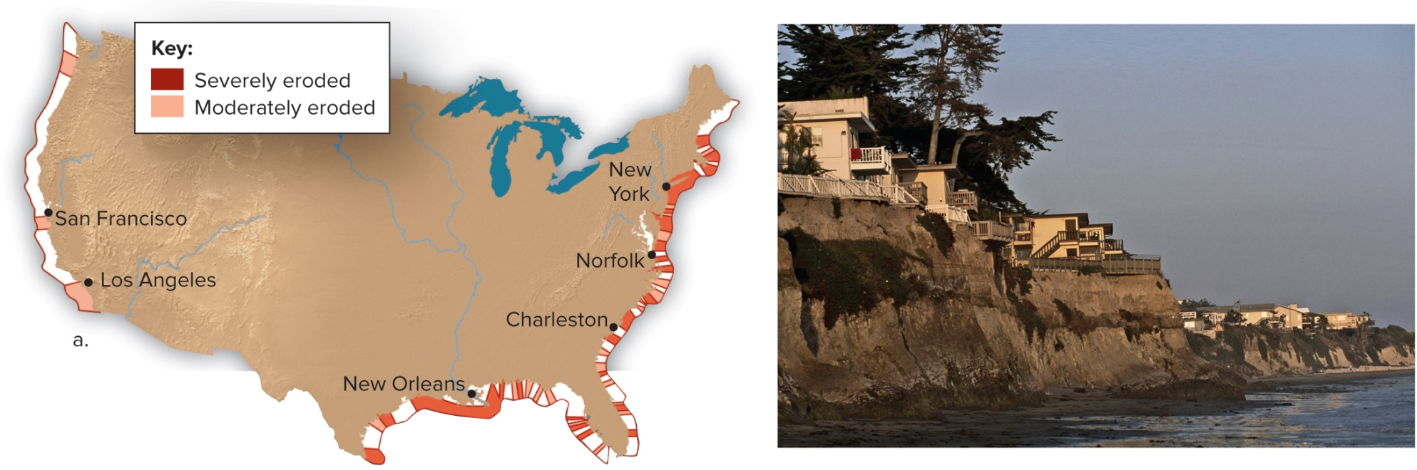
Figure 32.8 Beach Erosion
b: © Tyrone Turner/Getty Images

Slide 23
Semiarid Lands and Human Habitation
40% of the Earth’s lands are already deserts.
Any land adjacent to a desert is in danger of becoming a desert if improperly managed.
Desertification—conversion of semiarid land to desertlike conditions
Often begins when humans allow animals to overgraze the land
Three-fourths of all rangeland worldwide in danger of desertification

Slide 24
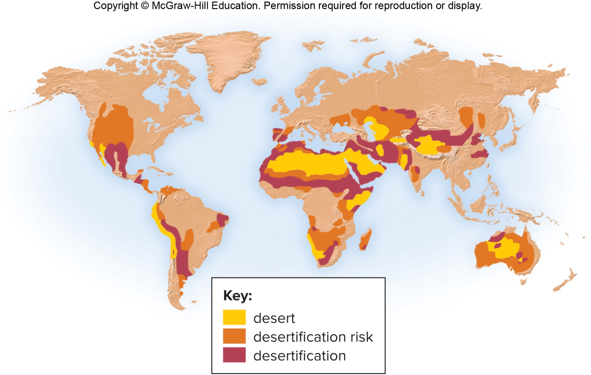
Figure 32.9 Desertification

Slide 25
Tropical Rain Forest and Human Habitation
Deforestation—removal of trees
Allowed humans to live where forests once covered the land
Land where tropical rain forest is removed is subject to desertification
Soil often thin and nutrient-poor
When trees (and accompanying nutrients) are removed and land is used for grazing or agriculture, land quickly loses fertility.
Deforestation also results in loss of biodiversity (unique animals left without homes or food) and an increase in atmospheric carbon dioxide (no trees to take up carbon dioxide for photosynthesis).

Slide 26
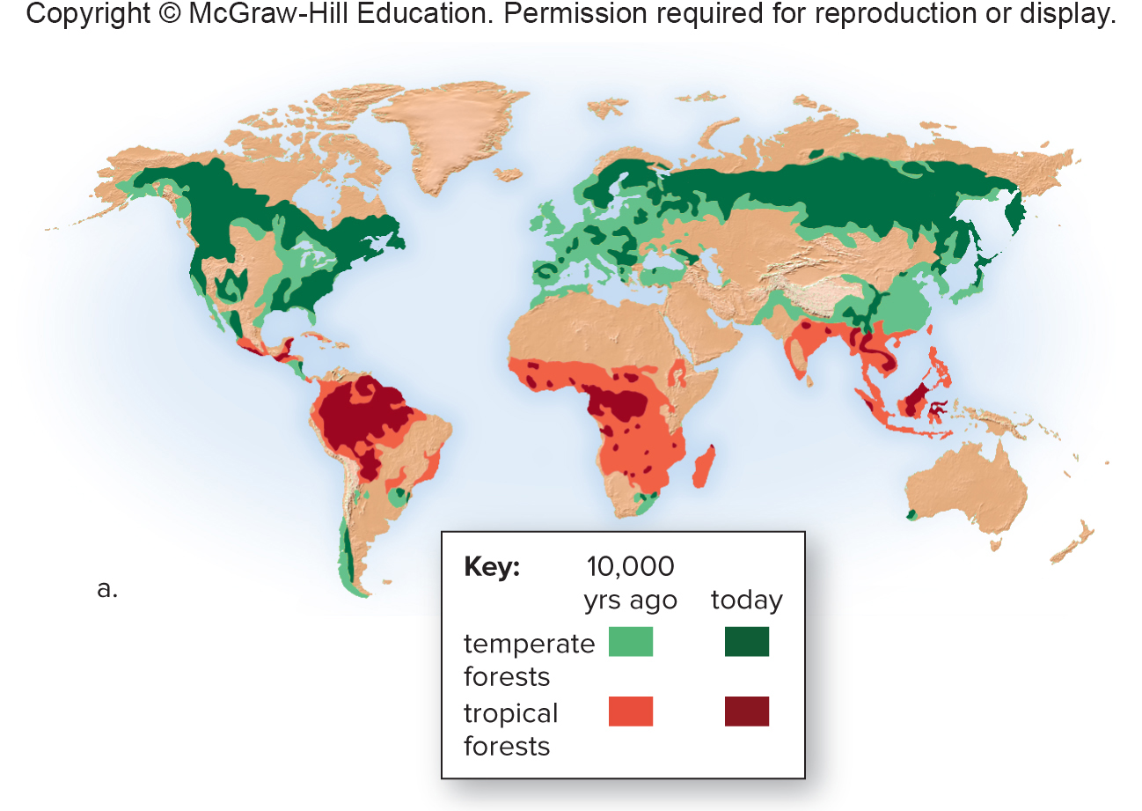
Figure 32.10a Deforestation

Slide 27
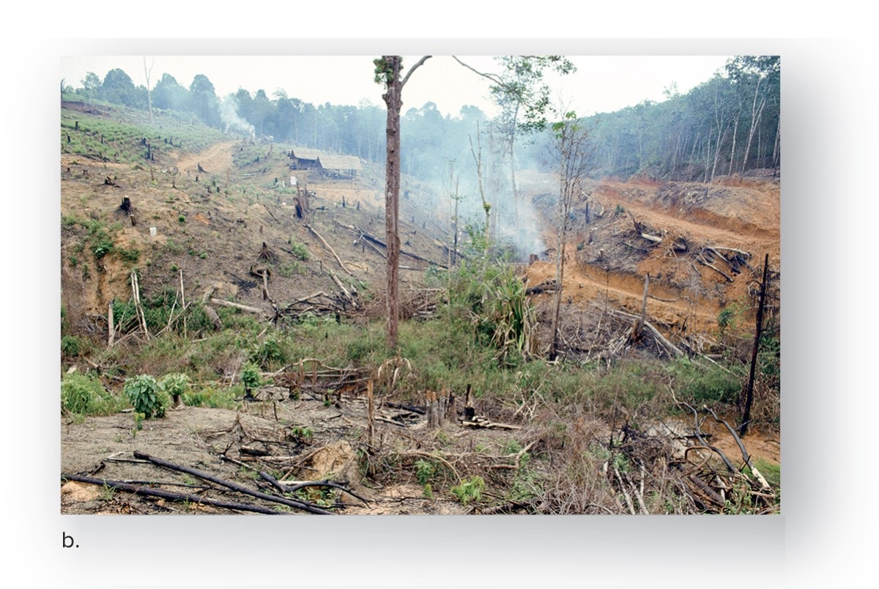
Figure 32.10b Deforestation
b: © Eco Images/Universal Images Group/Getty Images

Slide 28
Water
Most fresh water used by agriculture and industry
39% of all fresh water in United States used to irrigate crops
More-developed countries (MDCs) use more water for bathing, flushing toilets, and watering lawns than for drinking and cooking.
Increasing water supplies
In certain regions of United States and world, needs of human population exceed renewable supply of water
Supplies of fresh water can be increased by damming rivers or withdrawing water from aquifers.

Slide 29
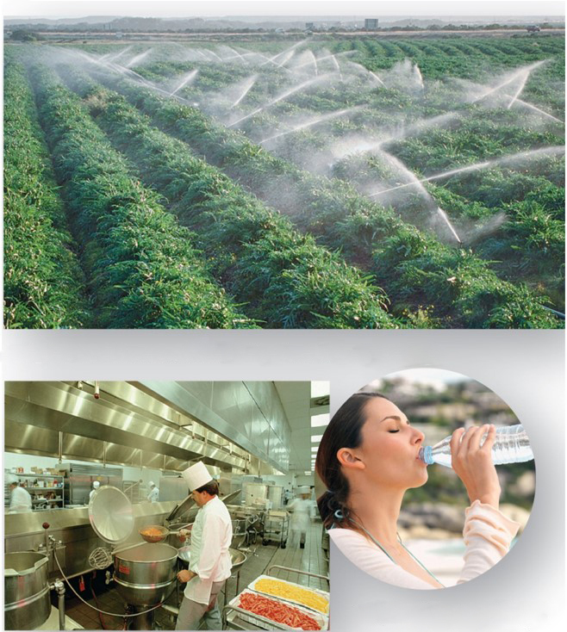
Figure 32.11 Global Water Use
Agriculture uses most of the fresh water consumed.
Domestic use of water is about half that of industrial use.
Industrial use of water is about half that of agricultural use.
(a): © Corbis RF; (b): © Jeremy Samuelson/Photolibrary/Getty Images; (c): © Stockbyte/PunchStock RF

Slide 30
Dams
World’s 45,000 large dams catch 14% of all precipitation runoff
Provide water for up to 40% of irrigated land
Give some 65 countries more than half of their electricity
Drawbacks
Some rivers no longer flow as they once did.
Reservoirs lose water to evaporation.
Salt left behind can make water unusable.
Sediment buildup reduces capacity.
Negative impact on wildlife

Slide 31
Aquifers
Natural reservoirs found just below the surface of the Earth
In the past 50 years, groundwater depletion has become a problem in many areas of the world.
Environmental consequences
Causes land subsidence—settling of the soil as it dries out—sinkholes
Saltwater intrusion—as water is withdrawn, water table lowers to the point where saltwater backs up into streams and aquifers along the coast

Slide 32
Conservation of Water
By 2025, two-thirds of the world’s population will be living in countries facing serious water shortages.
Some solutions might be planting drought- and salt-tolerant crops and drip irrigation (saves 50% and increases crop yields).

Slide 33
Figure 32.12 Conservation Measures to Save Water
Drip irrigation
Drought-resistant plants
a: © Bruno Barbier/Getty Images; b: © Inga Spence/Alamy

Slide 34
Food
In 1950, 2.5 billion humans with enough food for about 2,000 calories per person per day
Now, over 7.4 billion people with more than 2,500 calories per person per day
Food comes from growing crops, raising animals, and fishing the seas.
Modern farming has harmful practices.
Planting few genetic varieties
Heavy use of fertilizers, pesticides, and herbicides
Generous irrigation
Excessive fuel consumption

Slide 35
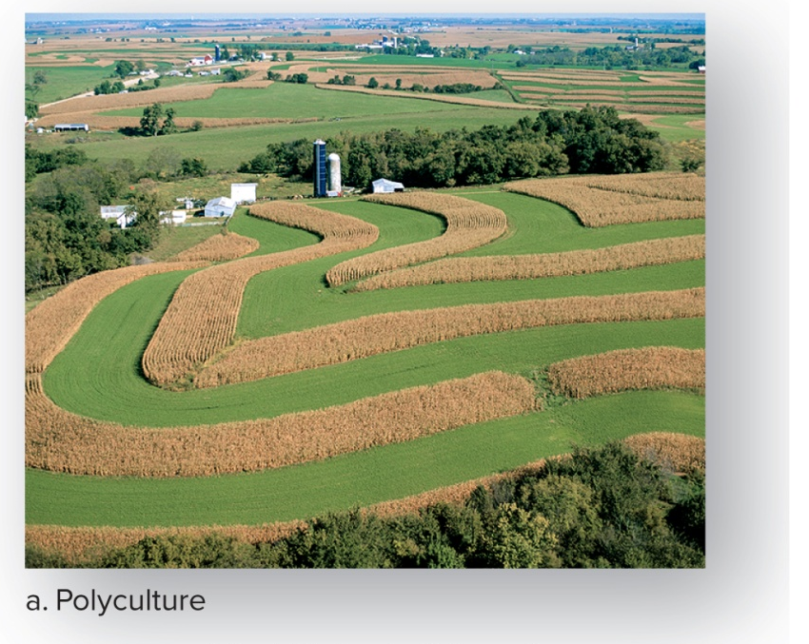
Figure 32.13a Conservation Methods
Ways to minimize the harmful effects of modern farming practices
Polyculture reduces the ability of one parasite to wipe out an entire crop and reduces the need to use a herbicide to kill weeds. This farmer has planted alfalfa between strips of corn, which also replenishes the nitrogen content of the soil (instead of adding fertilizers).
a: © David R. Frazier/Science Source

Slide 36
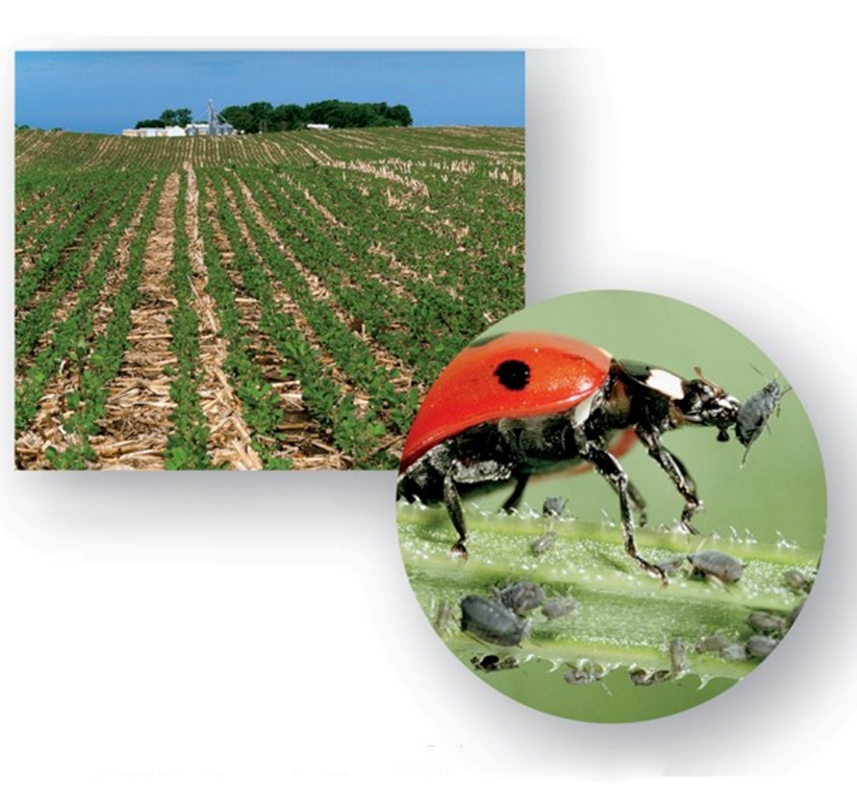
Figure 32.13b,c Conservation Methods
Contour with no-till farming
Biological pest control
b: © AgStock Images, Inc./Alamy; c: © Perennou Nuridsany/Science Source
Contour tilling decreases runoff.
Instead of pesticides, natural predators such as ladybugs can take care of pests such as cottony cushion scale insects on citrus trees.

Slide 37
Soil Loss and Degradation
Land suitable for farming or grazing is being degraded worldwide.
Soil erosion occurs and topsoil is lost when bare soil is acted on by water and wind.
Marginal farmland becomes desert.
The custom of planting the same crop in straight rows has caused the United States and Canada to have one of the highest soil erosion rates in the world.
Croplands that are irrigated are prone to salinization—accumulation of mineral salts deposited through irrigation.

Slide 38
Green Revolution
About 50 years ago, scientists began to breed tropical wheat and rice varieties specifically for LDCs.
Helped the world food supply keep pace with rapid increase in world population
Most are “high responders”—plants that need high levels of fertilizer, water, and pesticides to produce a high yield.
Genetic engineering could produce transgenic plants that are resistant to insects and herbicides or salt, drought, and cold tolerant.
Concerns about genetically engineered crops

Slide 39
Domestic Livestock
Low-protein, high-carbohydrate diet can lead to malnutrition
In LDCs, kwashiorkor caused by severe protein deficiency; seen in infants and children ages one to three after they are no longer breast-fed
In MDCs, many people have more than enough protein in their diet.
Almost two-thirds of U.S. cropland devoted to producing livestock feed
Large percentage of fossil fuel, fertilizer, water, herbicides, and pesticides we use are for raising livestock

Slide 40
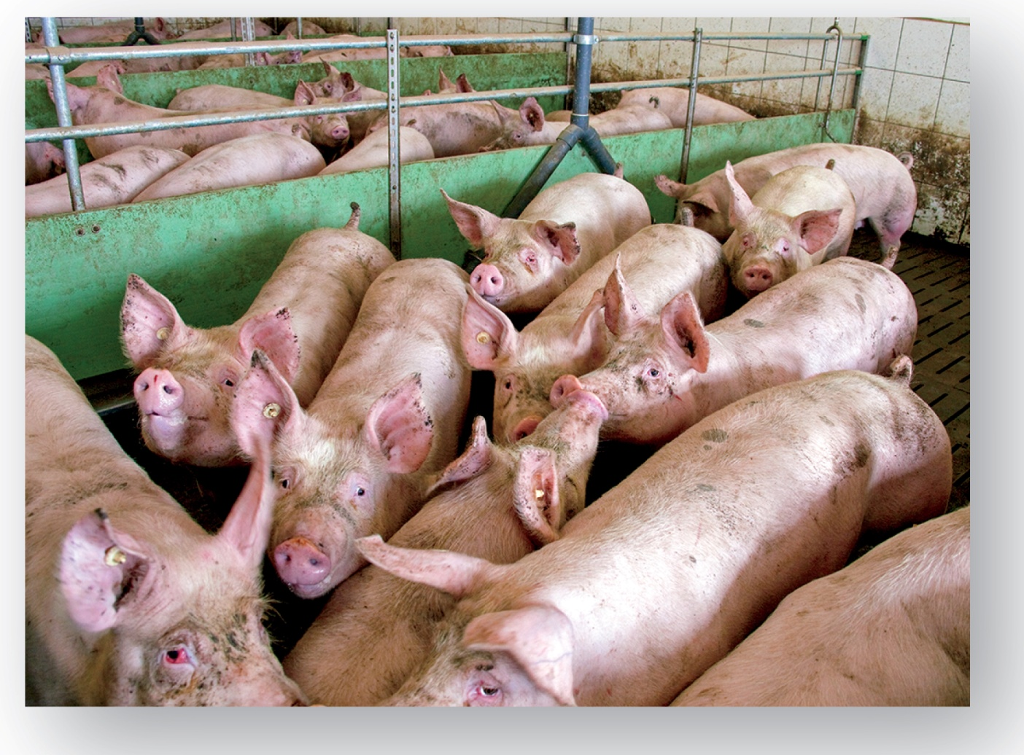
Figure 32.14 Crowding of Livestock
© Arterra Picture Library/Alamy

Slide 41
Fishing, 1
Worldwide, between 1970 and 1990, the number of large boats devoted to fishing doubled to 1.2 million.
Result of increased number and efficiency of fishing boats is a severe reduction of fish catch
Number of North Atlantic swordfish caught in United States declined 70% from 1980 to 1990
Average weight fell from 115 to 60 pounds

Slide 42
Figure 32.15 Fishing
Fishing by use of a drag net
Aqua farming
a: © StrahilDimitrov/Getty RF; b: © Michael Pole/Corbis

Slide 43
Fishing, 2
Modern fishing practices also impact biodiversity.
World’s shrimp fishery catches 1.8 million tons of shrimp annually, but discards 9.5 million tons of other animals caught.
Aqua farming has reduced pressure on wild populations.
Over 90% of shrimp available in United States produced through aqua farming

Slide 44
Energy
Presently, most of world’s energy supply comes from two finite, nonrenewable sources.
Nuclear power: 6%
Concerns about nuclear power dangers and radioactive wastes
Fossil fuels: 81%
Oil, natural gas, and coal
Compressed remains of organisms that died long ago
Each person in a MDC uses approximately as much energy in one day as each person in a LDC does in one year.
United States has a good supply of coal, but coal doesn’t burn as cleanly as oil.
Burning any fossil fuel releases pollutants to the air.

Slide 45
Fossil Fuels
By-product pollutants include an assortment of greenhouse gases (including ${CO}_{2}$), various acids, volatile organic molecules, and even radioactive material.
Global climate has already warmed since the Industrial Revolution, when fossil fuels began to serve as the world’s primary source of energy.
A temperature rise of only a few degrees kills coral reefs; much of the Great Barrier Reef has been killed from coral bleaching.

Slide 46
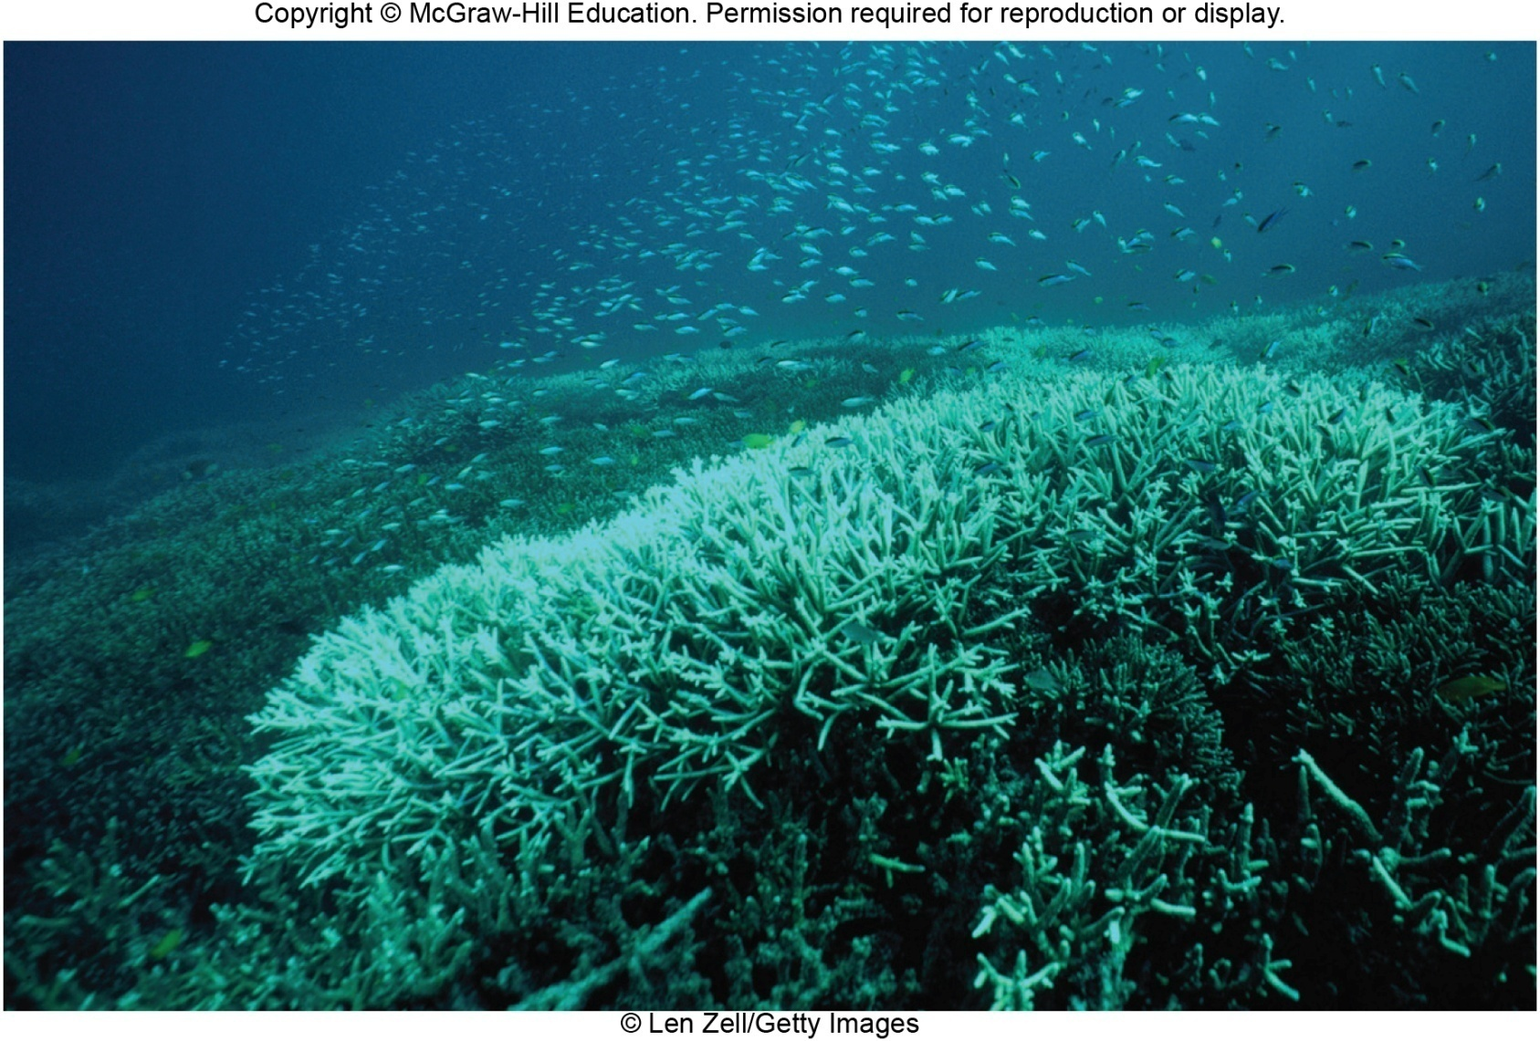
Figure 32.16 Effects of Fossil Fuel Use
© Len Zell/Getty Images

Slide 47
Renewable Energy Sources
Wind power
Expected to account for a significant percentage of energy needs in future
Hydropower
Hydroelectric plants convert falling water into electricity.
Almost 67% of renewable energy use in United States
Construction of enormous dams has detrimental environmental effects.
Geothermal energy
Elements undergoing radioactive decay below the Earth’s surface heat the surrounding rocks.
Steam generated can be piped to the surface to supply hot water for home heating or to run steam-driven turbogenerators.

Slide 48
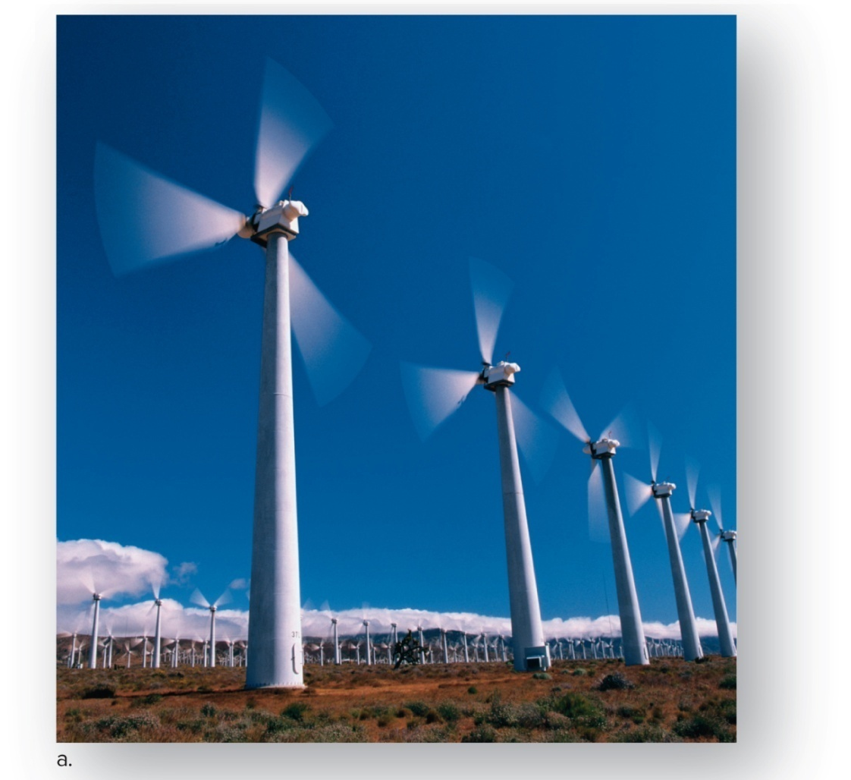
Figure 32.17a Renewable Energy Sources, Wind
Communities that generate electricity can help solve uneven energy production by selling electricity back when wind energy is in excess, and buying energy back when wind power is in short supply.
a: © Glen Allison/Getty RF

Slide 49
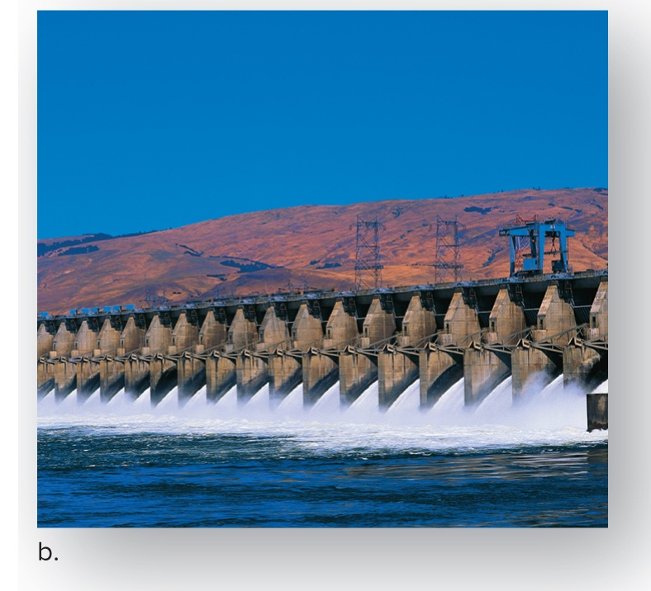
Figure 32.17b Renewable Energy Sources, Hydropower
Hydropower dams provide a clean form of energy, but can be ecologically disastrous in other ways. Small scale dams have less environmental impact.
b: © Corbis RF

Slide 50
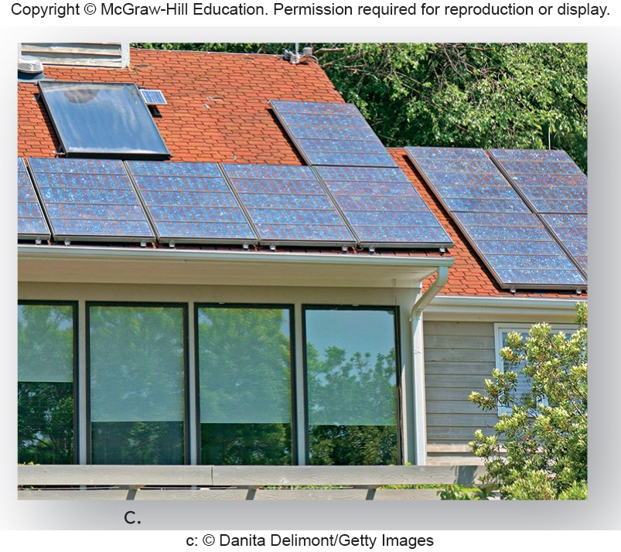
Figure 32.17c Renewable Energy Sources, Photovoltaic Cells
Photovoltaic (solar) cells on rooftops can collect diffuse solar energy more affordably than in the past.
c: © Danita Delimont/Getty Images

Slide 51
Solar-Hydrogen Revolution
Solar energy is diffuse and must be collected, converted to another form, and stored.
Photovoltaic cells are wafers of an electron-emitting metal in contact with another metal that collects the electrons and passes them on into wires in a steady stream.
Working on possibility of using solar energy to extract hydrogen from water via electrolysis
Hydrogen can then be used as a clean-burning fuel.

Slide 52
Advantages of a Solar-Hydrogen Revolution Would Be at Least Twofold:
The world would no longer be dependent on oil.
Environmental problems, such as acid rain and smog, would begin to lessen.

Slide 53
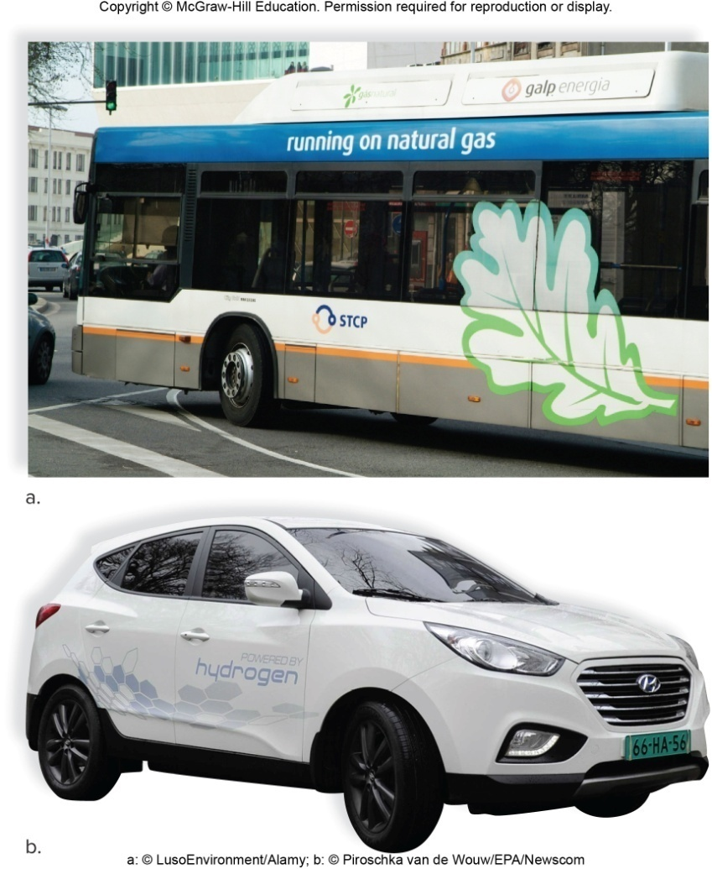
Figure 32.18 Solar-Hydrogen Revolution
a: © LusoEnvironment/Alamy; b: © Piroschka van de Wouw/EPA/Newscom
Hydrogen fuel bus and fuel-cell hybrid vehicle

Slide 54
Minerals
Nonrenewable raw materials in the Earth’s crust that can be mined (extracted)
Include fossil fuels, nonmetallic raw materials (sand, gravel, phosphate), and metals (aluminum, iron, lead, gold)
Subject to depletion—will eventually run out
We can conserve to extend the supply.
Metals can be recycled.

Slide 55
Strip Mining
Strip mining is a form of surface mining.
Afterward, the land is devoid of vegetation and prone to runoff and erosion of toxic waste deposits.
Legislation now requires that strip miners restore the land to its original condition, a process that can take years to complete.

Slide 56
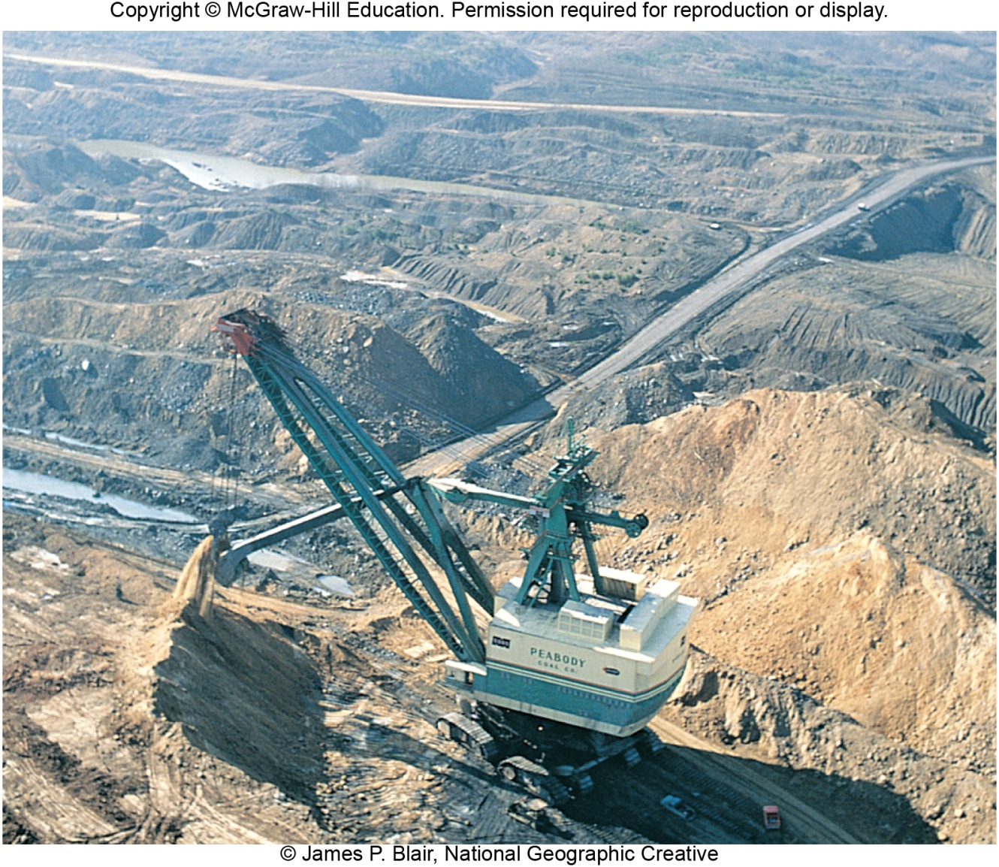
Figure 32.19 Modern Mining Capabilities
© James P. Blair, National Geographic Creative

Slide 57
Other Sources of Pollution
Synthetic organic compounds
Role in the production of plastics, pesticides, herbicides, cosmetics, coatings, solvents, and hundreds of others
Include halogenated hydrocarbons like chlorinated fluorocarbons (CFCs)
Chlorine and fluorine atoms replace some of the hydrogen atoms.
Thinned the Earth’s ozone shield
Banned in most MDCs

Slide 58
Wastes
Every year, billions of tons of solid waste discarded
Some on land, some in fresh and marine waters
Solid wastes are visible wastes.
Industrial wastes
Generated during mining and production of a product
Legislation in early 1970s prevented venting wastes to atmosphere and waterways
Turned to unregulated land disposal
Five billion metric tons improperly discarded in United States between 1950 to 1975
Reaction was creation of Environmental Protection Agency (EPA)
Among the most commonly found contaminants are heavy metals (lead, arsenic, cadmium, chromium) and organic compounds (trichloroethylene, toluene, benzene, polychlorinated biphenyls [PCBs], and chloroform).

Slide 59
Biological Magnification
Decomposers are unable to break down certain wastes.
Enter and remain in the bodies of organisms because they are not excreted
Become more concentrated as they pass along a food chain
Effect is most apt to occur in aquatic food chains, which have more links than terrestrial food chains

Slide 60
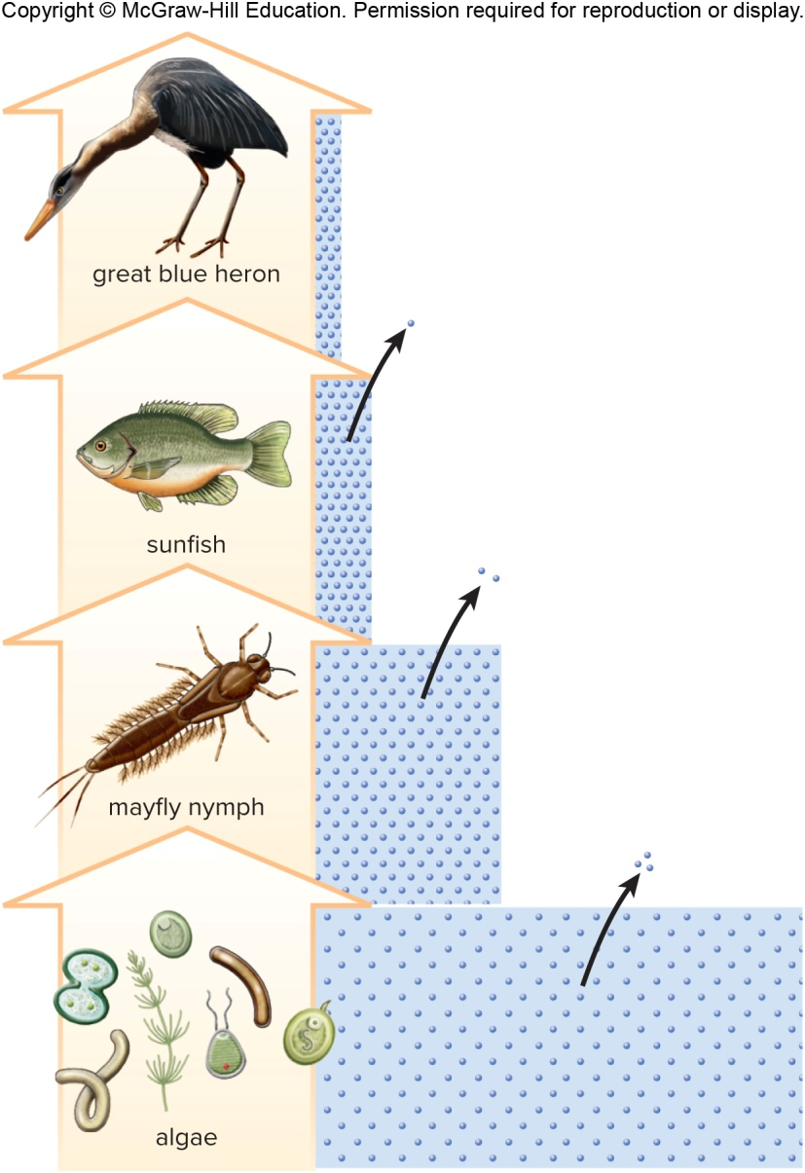
Figure 32.20 Biological Magnification
A poison, such as DDT, that is excreted in relatively small amounts (arrows) becomes maximally concentrated as it passes along a food chain due to the reduced size of the trophic levels.

Slide 61
32.4 Sustainable Societies
A sustainable society would be able to provide the same goods and services for future generations of human beings as it does now.
At the same time, biodiversity would be preserved.
Today’s society is not sustainable.

Slide 62
Evidence That Today’s Society Not Sustainable, 1
A considerable proportion of land, and therefore natural ecosystems, is presently being used for human purposes (homes, agriculture, factories, etc.).
Agriculture requires large inputs of nonrenewable fossil fuel energy, fertilizer, and pesticides, which create much pollution.
More fresh water is used for agriculture than in homes.
At least half of the agricultural yield in the United States goes toward feeding animals.
It is wasteful for citizens in MDCs to eat as much meat as they do, and animal sewage pollutes water.

Slide 63
Evidence That Today’s Society Not Sustainable, 2
Even though fresh water is a renewable resource, we are running out of the available supply.
Our society primarily utilizes nonrenewable fossil fuel energy, which leads to acid precipitation, smog, and various other pollutants entering the ecosystems.
Minerals are nonrenewable, and the mining, processing, and use of minerals are responsible for much environmental pollution.

Slide 64
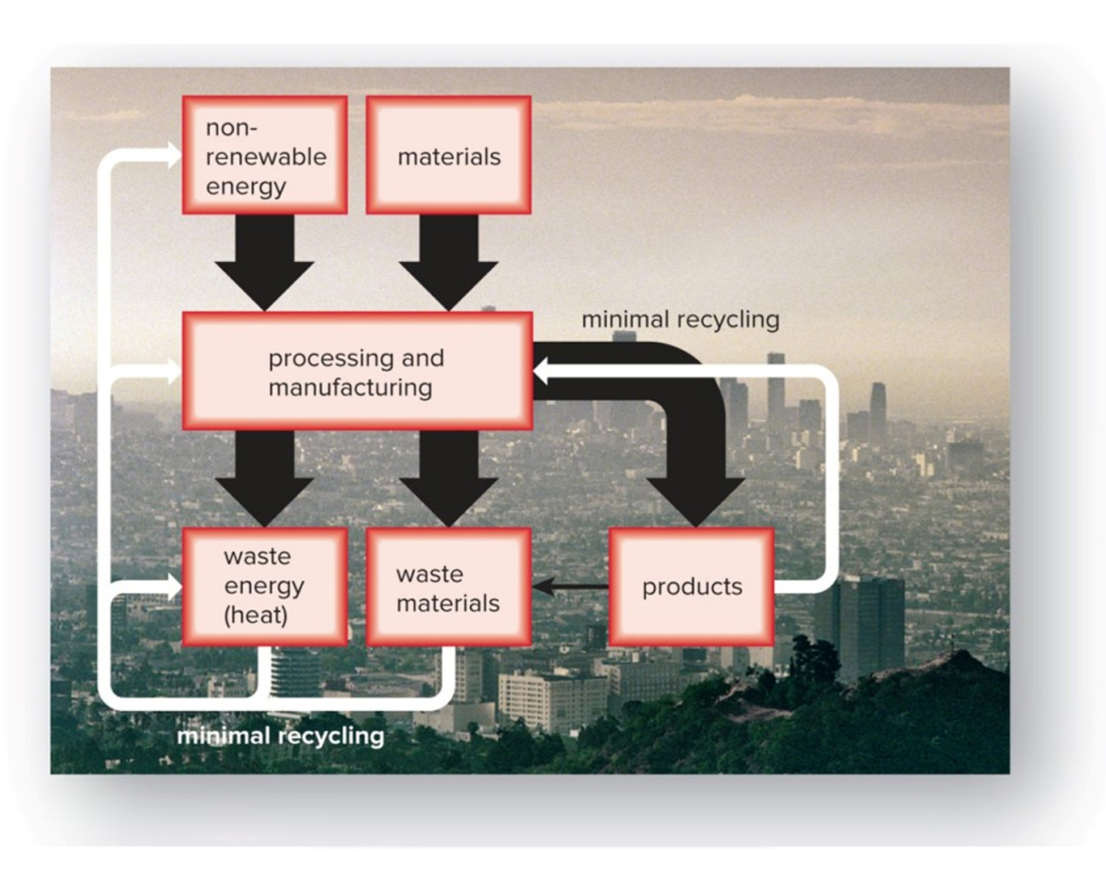
Figure 32.21a Current Human Society Versus a Sustainable Society—Present Society
Human society at present
a: © Kent Knudson/PhotoLink/Getty RF

Slide 65
Characteristics of a Sustainable Society
Should be using renewable energy sources and recycling materials
Growing populations of LDCs straining the environment, but excessive resource consumption of MDCs also stressing the environment
Sustainability is incompatible with the kinds of consumption and waste patterns currently practiced in MDCs.

Slide 66
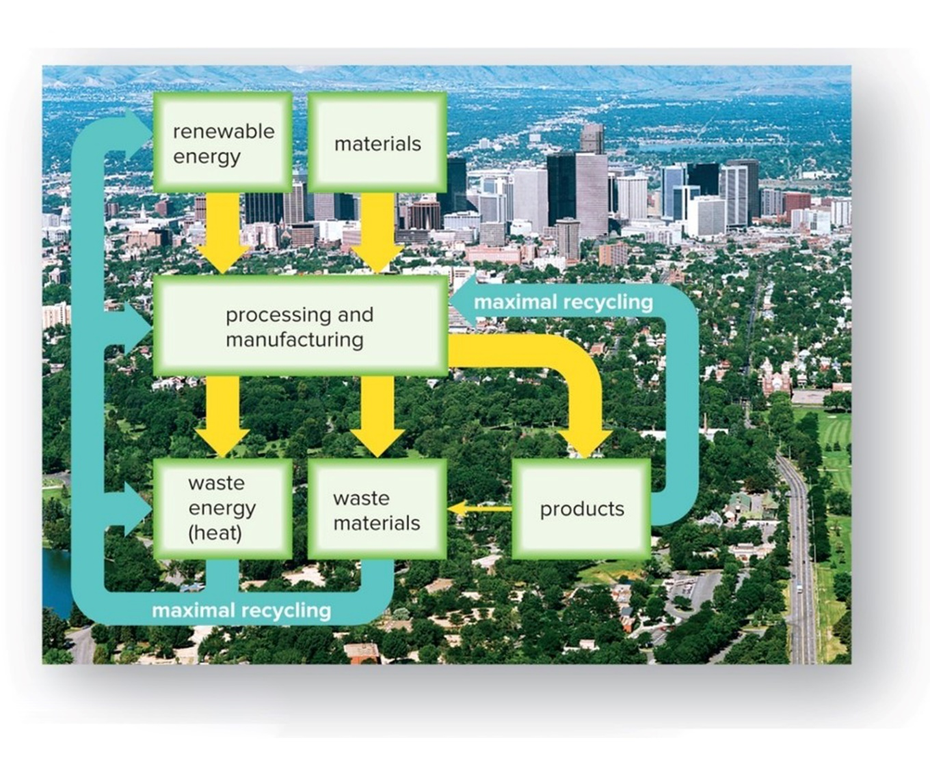
Figure 32.21b Current Human Society Versus a Sustainable Society—Sustainable Possibilities
Sustainable society
b: © Scenics of America/PhotoLink/Getty RF

Slide 67
Rural Sustainability
Plant cover crops.
Practice multiuse, or polyculture, farming.
Preserve topsoil and rebuild soil nutrients.
Conserve water.
Use precision farming.
Use integrated pest management.
Plant a variety of species, including natives.
Plant multipurpose trees.
Maintain and restore wetlands.
Use renewable forms of energy.
Support local farmers, fishermen, and feed stores.

Slide 68
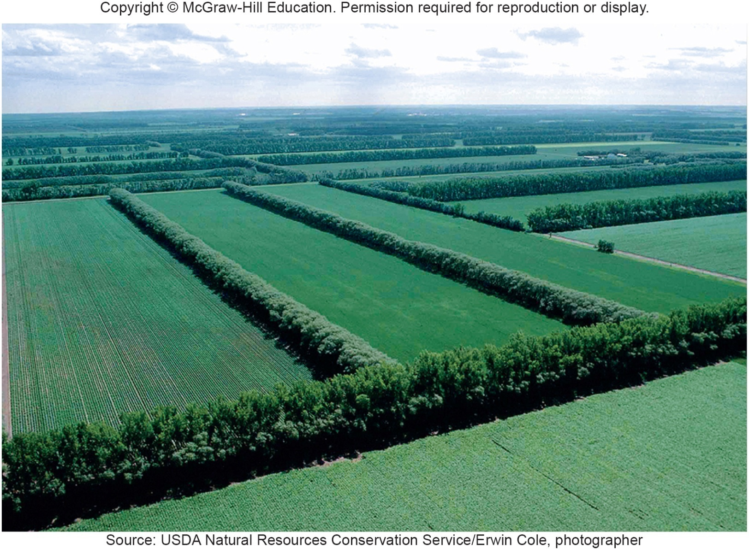
Figure 32.22 Rural Sustainability
Source: USDA Natural Resources Conservation Service/Erwin Cole, photographer

Slide 69
Urban Sustainability
Energy-efficient transportation
Conservation methods used in building operations
Green roofs
Create greenbelt regions.
Improve storm-water management.
Plant native species.
Revitalize old sections before developing new ones.
Recycle
Direct light downward.
Noise control

Slide 70
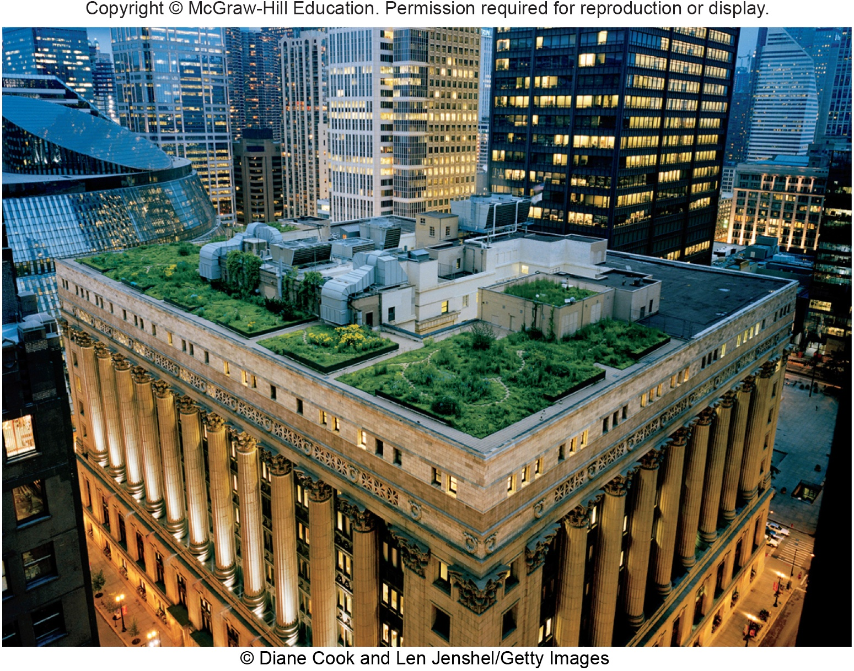
Figure 32.23 Urban Sustainability
© Diane Cook and Len Jenshel/Getty Images

