Slide 1
The Molecular Basis of Inheritance

Slide 2
The Search for the Genetic Material: Scientific Inquiry
When T. H. Morgan’s group showed that genes are located on chromosomes, the two components of chromosomes—DNA and protein—became candidates for the genetic material
The key factor in determining the genetic material was choosing appropriate experimental organisms
The role of DNA in heredity was first discovered by studying bacteria and the viruses that infect them
Protein and amino acid diversity is greater compared to nucleic acid/nucleotides so they were thought to be the likely genetic material
© 2011 Pearson Education, Inc.

Slide 3
Evidence That DNA Can Transform Bacteria
The discovery of the genetic role of DNA began with research by Frederick Griffith in 1928
Griffith worked with two strains of a bacterium, one pathogenic and one harmless
R-Strain-Non-pathogenic
S-Strain-Pathogenic*His goal was to make vaccine
The Difference lies in the presence or absence of a capsule
Capsule helps cause disease by aiding in adherence to target cells and resisiting phagocytosis from immune cells
© 2011 Pearson Education, Inc.

Slide 4
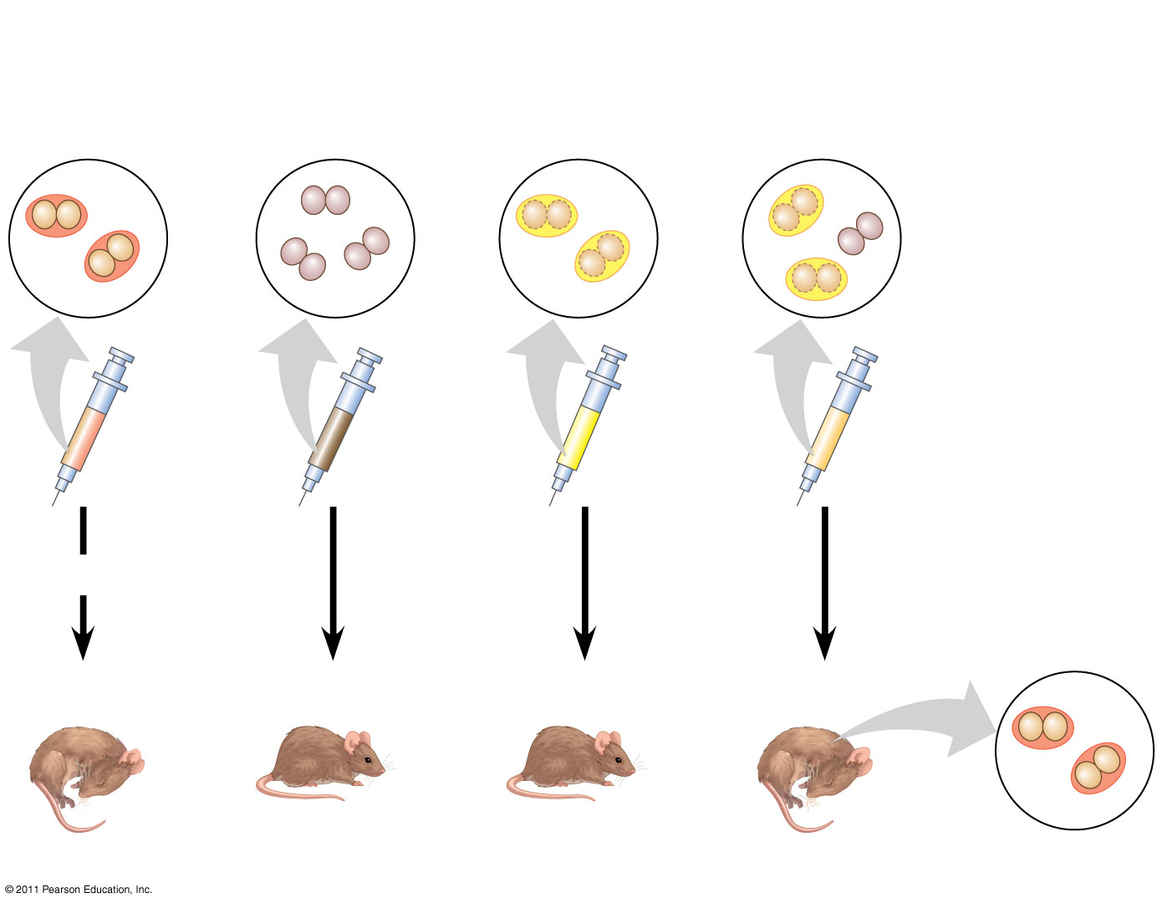
Figure 16.2
EXPERIMENT
Mixture of heat-killed S cells and living R cells
Heat-killed S cells (control)
Living S cells (control)
Living R cells (control)
(5)
RESULTS
Mouse dies
Mouse healthy
Mouse healthy
Mouse dies
Living S cells
Notes:
Figure 16.2 Inquiry: Can a genetic trait be transferred between different bacterial strains?

Slide 5
When he mixed heat-killed remains of the pathogenic strain with living cells of the harmless strain, some living cells became pathogenic
He called this phenomenon transformation, now defined as a change in genotype and phenotype due to assimilation of foreign DNA (6)
© 2011 Pearson Education, Inc.

Slide 6
In 1944, Oswald Avery, Maclyn McCarty, and Colin MacLeod announced that the transforming substance was DNA
Their conclusion was based on experimental evidence that only DNA worked in transforming harmless bacteria into pathogenic bacteria
Many biologists remained skeptical, mainly because little was known about DNA (7)
© 2011 Pearson Education, Inc.

Slide 7
Evidence That Viral DNA Can Program Cells
More evidence for DNA as the genetic material came from studies of viruses that infect bacteria
Such viruses, called bacteriophages (or phages), are widely used in molecular genetics research
*Does not eat bacteria……..bacteriophages destroy cells by turning them into a virus producing factory that eventually bursts from the thousands of viruses it produces. (9)
© 2011 Pearson Education, Inc.

Slide 8
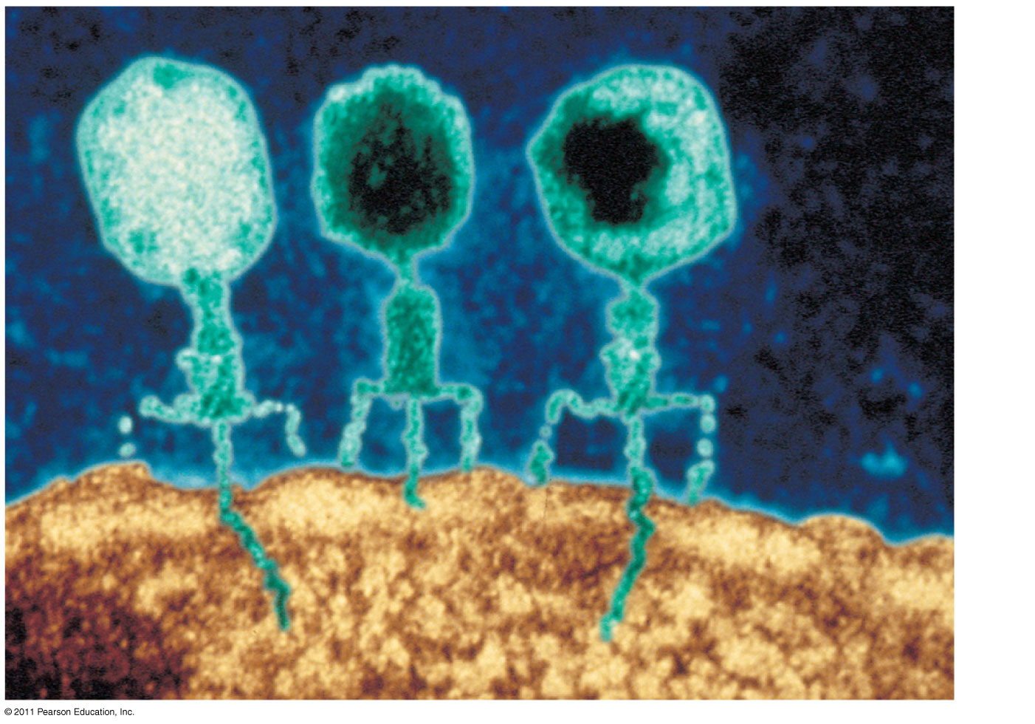
Figure 16.3
Phage head
(8)
Tail sheath
Tail fiber
DNA
100 nm
Bacterial cell
Notes:
Figure 16.3 Viruses infecting a bacterial cell.

Slide 9
In 1952, Alfred Hershey and Martha Chase performed experiments showing that DNA is the genetic material of a phage known as T2
To determine this, they designed an experiment showing that only one of the two components of T2 (DNA or protein) enters an E. coli cell during infection
They concluded that the injected DNA of the phage provides the genetic information
© 2011 Pearson Education, Inc.

Slide 10
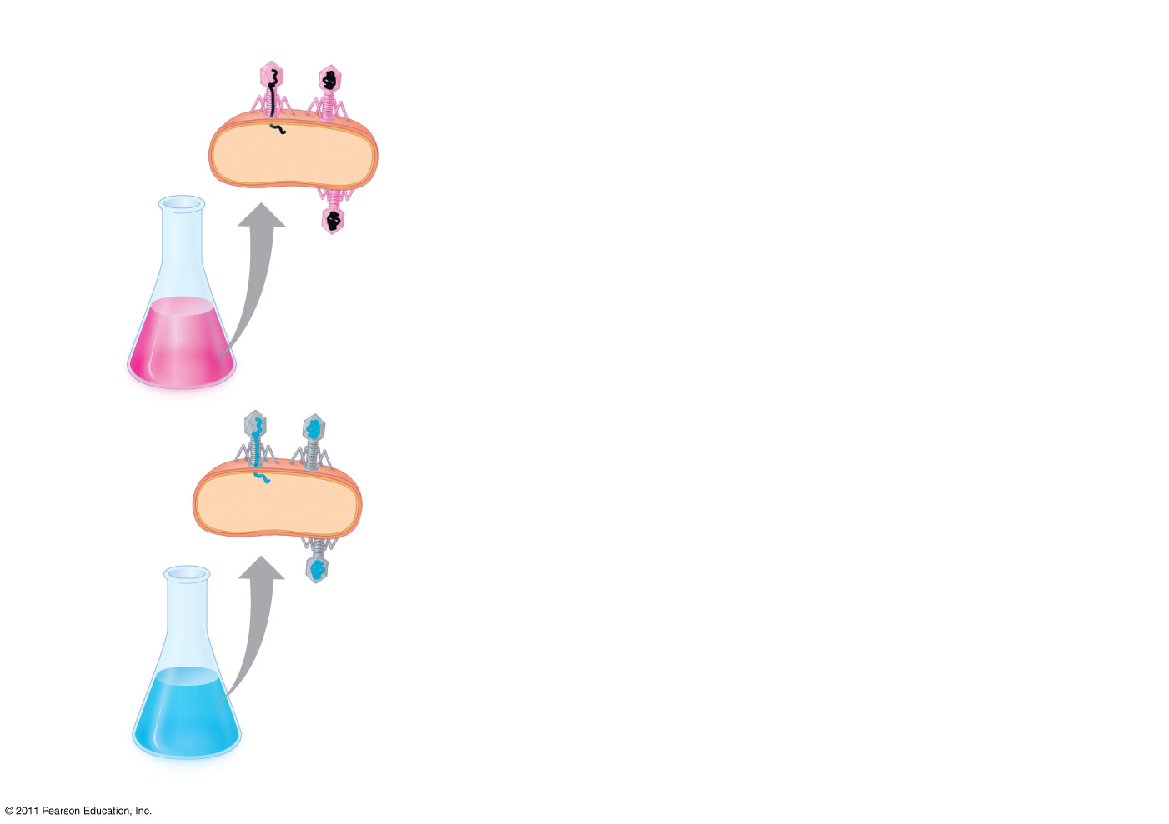
Figure 16.4-1
EXPERIMENT
Radioactive protein
Phage
Bacterial cell
(10)
Batch 1: Radioactive sulfur (³⁵S)
DNA
Radioactive DNA
Batch 2: Radioactive phosphorus (³²P)
Notes:
Figure 16.4 Inquiry: Is protein or DNA the genetic material of phage T2?

Slide 11
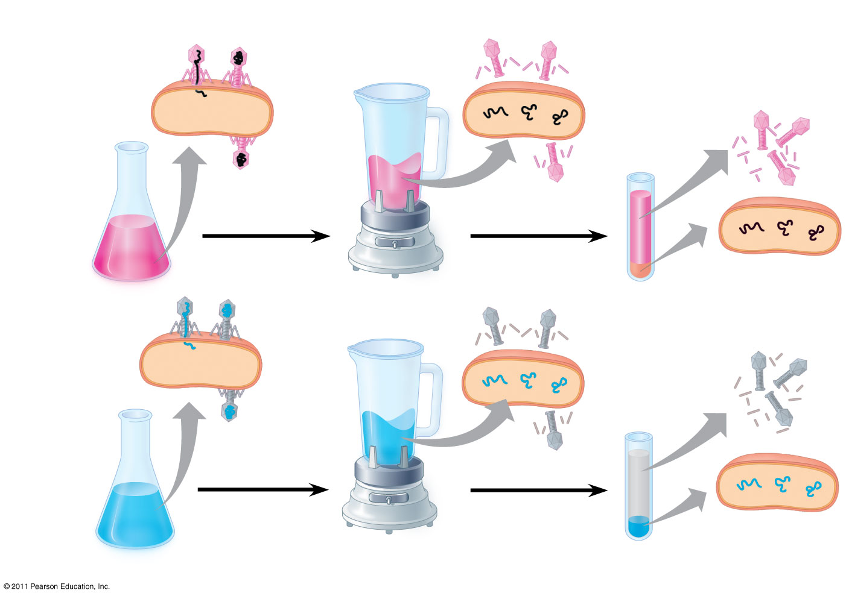
Figure 16.4-3
EXPERIMENT
(11)
Radioactive protein
Empty protein shell
Phage
Radioactivity (phage protein) in liquid
Bacterial cell
Batch 1: Radioactive sulfur (³⁵S)
DNA
Phage DNA
Centrifuge
Radioactive DNA
Pellet (bacterial cells and contents)
Batch 2: Radioactive phosphorus (³²P)
Centrifuge
Radioactivity (phage DNA) in pellet
Pellet
Notes:
Figure 16.4 Inquiry: Is protein or DNA the genetic material of phage T2?

Slide 12
Additional Evidence That DNA Is the Genetic Material
It was known that DNA is a polymer of nucleotides, each consisting of a nitrogenous base, a sugar, and a phosphate group
In 1950, Erwin Chargaff reported that DNA composition varies from one species to the next
This evidence of diversity made DNA a more credible candidate for the genetic material
© 2011 Pearson Education, Inc.

Slide 13
Two findings became known as Chargaff’s rules
The base composition of DNA varies between species
In any species the number of A and T bases are equal and the number of G and C bases are equal
The basis for these rules was not understood until the discovery of the double helix
© 2011 Pearson Education, Inc.

Slide 14
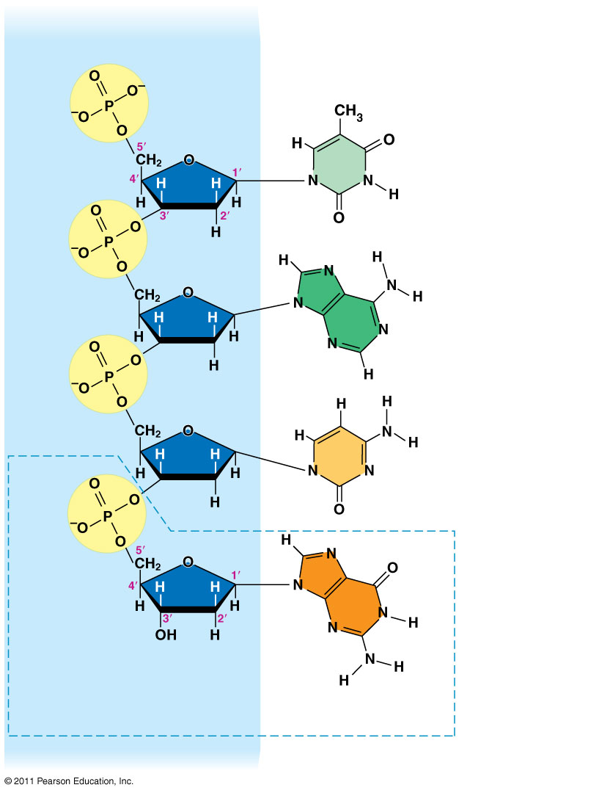
Figure 16.5
Sugar–phosphate backbone
Nitrogenous bases
5′ end
Thymine (T)
Adenine (A)
Cytosine (C)
Phosphate
Guanine (G)
Sugar (deoxyribose)
DNA nucleotide
Nitrogenous base
3′ end
Notes:
Figure 16.5 The structure of a DNA strand.

Slide 15
Building a Structural Model of DNA: Scientific Inquiry
Watson & Crick were awarded the Nobel prize for their molecular model of DNA
After DNA was accepted as the genetic material, the challenge was to determine how its structure accounts for its role in heredity
Maurice Wilkins and Rosalind Franklin were using a technique called X-ray crystallography to study molecular structure
Franklin produced a picture of the DNA molecule using this technique
© 2011 Pearson Education, Inc.

Slide 16
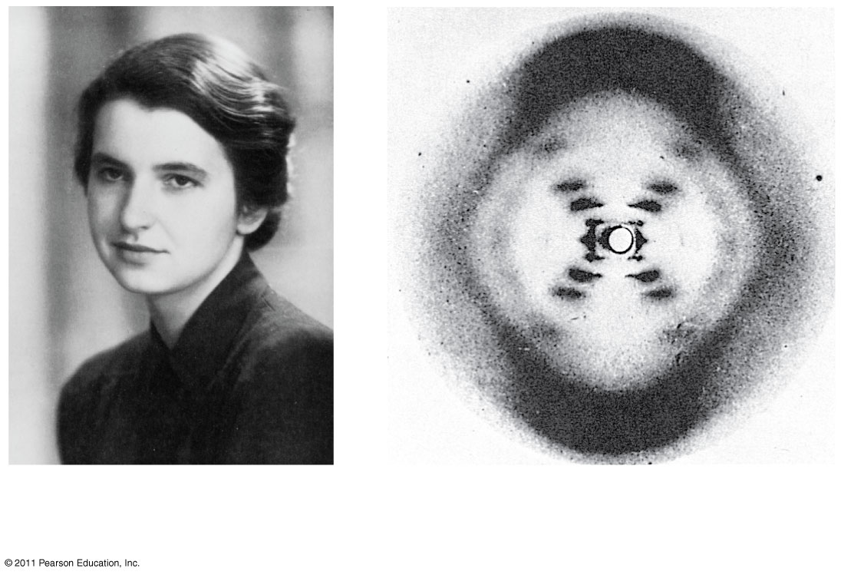
Figure 16.6
(a) Rosalind Franklin
(b)
Franklin’s X-ray diffraction photograph of DNA
Notes:
Figure 16.6 Rosalind Franklin and her X-ray diffraction photo of DNA.

Slide 17
Franklin’s X-ray crystallographic images of DNA enabled Watson to deduce that DNA was helical
The X-ray images also enabled Watson to deduce the width of the helix and the spacing of the nitrogenous bases
The pattern in the photo suggested that the DNA molecule was made up of two strands, forming a double helix
© 2011 Pearson Education, Inc.

Slide 18
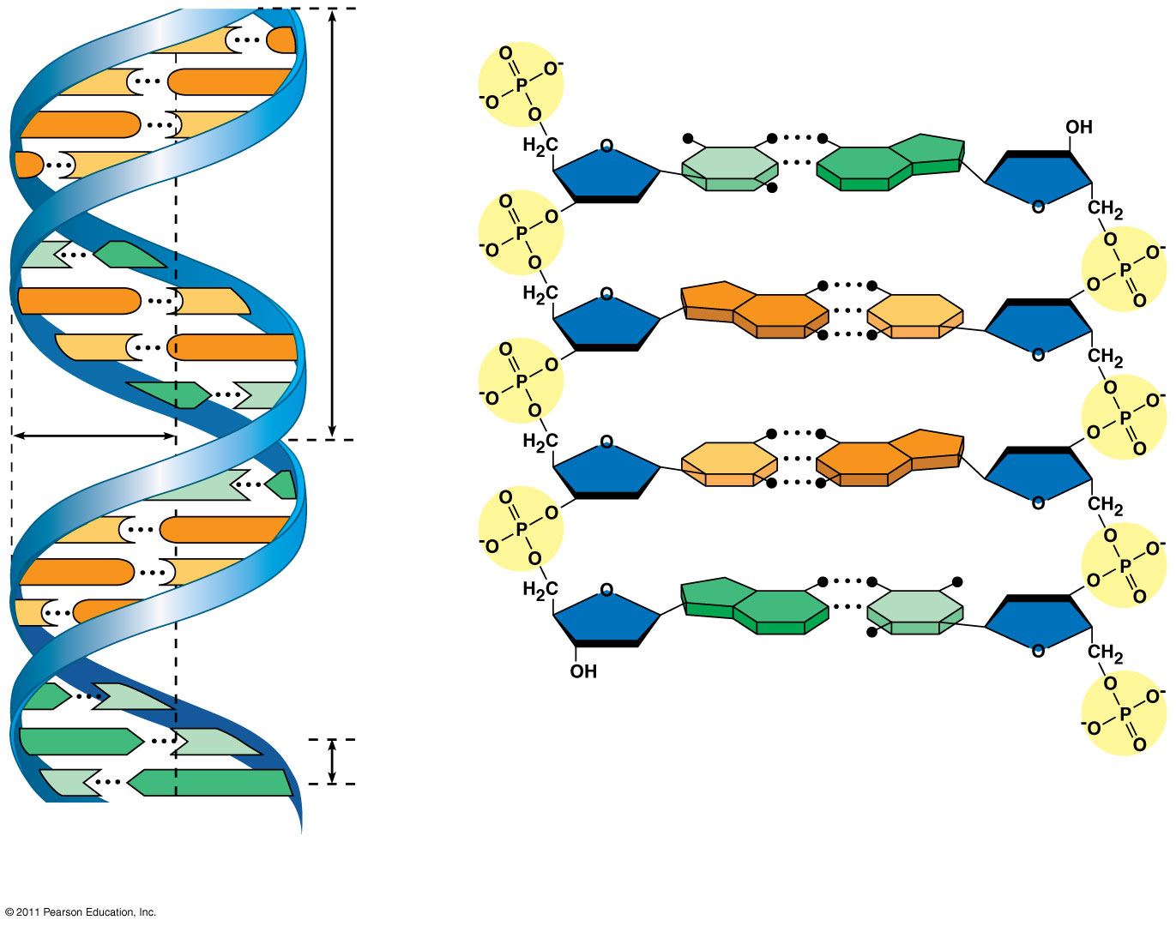
Figure 16.7a
5′ end
C
G
C
G
Hydrogen bond
3′ end
G
C
G
C
T
A
3.4 nm
T
A
G
C
G
C
C
G
A
T
1 nm
C
G
T
A
C
G
G
C
C
G
A
T
A
T
3′ end
A
T
0.34 nm
T
A
5′ end
(a)
Key features of DNA structure
(b) Partial chemical structure
Notes:
Figure 16.7 The double helix.

Slide 19
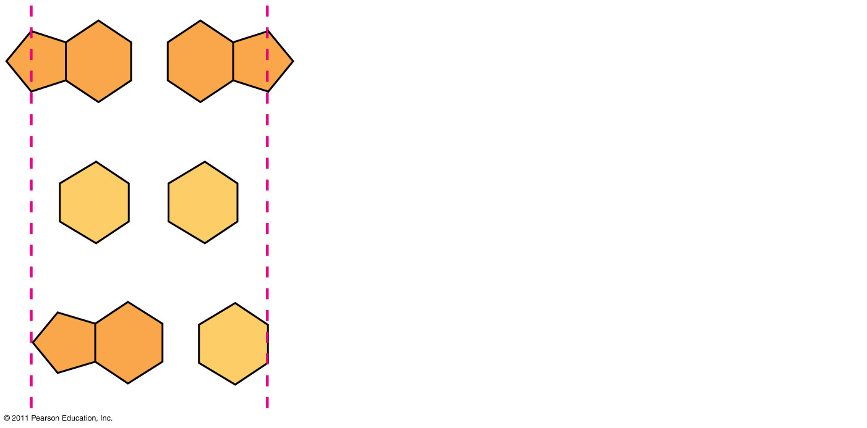
Figure 16.UN01
Purine + purine: too wide
Pyrimidine + pyrimidine: too narrow
Purine + pyrimidine: width consistent with X-ray data
Notes:
Figure 16.UN01 In-text figure, p. 310

Slide 20
Watson and Crick reasoned that the pairing was more specific, dictated by the base structures
They determined that adenine (A) paired only with thymine (T), and guanine (G) paired only with cytosine (C)
The Watson-Crick model explains Chargaff’s rules: in any organism the amount of A = T, and the amount of G = C
(17 & 18 apply knowledge)
© 2011 Pearson Education, Inc.

Slide 21
Many proteins work together in DNA replication and repair
The relationship between structure and function is manifest in the double helix
Watson and Crick noted that the specific base pairing suggested a possible copying mechanism for genetic material
© 2011 Pearson Education, Inc.

Slide 22
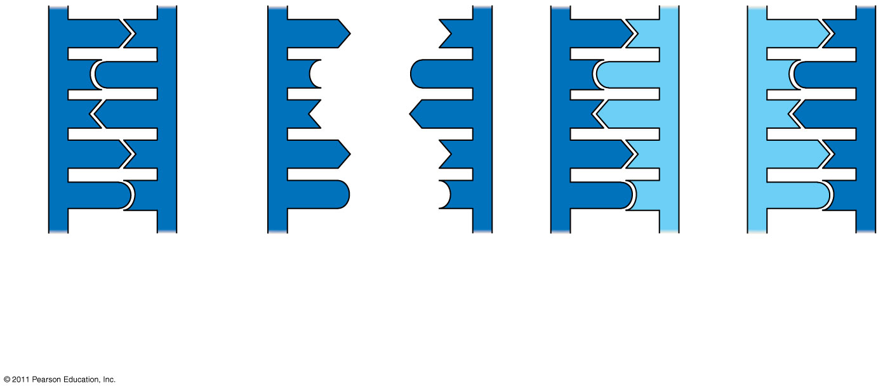
Figure 16.9-3
A
T
A
T
A
T
A
T
C
G
C
G
C
G
C
G
T
A
T
A
T
A
T
A
A
T
A
T
A
T
A
T
G
C
G
C
G
C
G
C
(a) Parent molecule
(b)
Separation of strands
(c)
“Daughter” DNA molecules, each consisting of one parental strand and one new strand
Notes:
Figure 16.9 A model for DNA replication: the basic concept.

Slide 23
Watson and Crick’s semiconservative model of replication predicts that when a double helix replicates, each daughter molecule will have one old strand (derived or “conserved” from the parent molecule) and one newly made strand
Competing models were the conservative model (the two parent strands rejoin) and the dispersive model (each strand is a mix of old and new)
© 2011 Pearson Education, Inc.

Slide 24
DNA Replication: A Closer Look
The copying of DNA is remarkable in its speed and accuracy
More than a dozen enzymes and other proteins participate in DNA replication
© 2011 Pearson Education, Inc.

Slide 25
Getting Started
Replication begins at particular sites called origins of replication, where the two DNA strands are separated, opening up a replication “bubble”
A eukaryotic chromosome may have hundreds or even thousands of origins of replication
Replication proceeds in both directions from each origin, until the entire molecule is copied (28)
© 2011 Pearson Education, Inc.

Slide 26
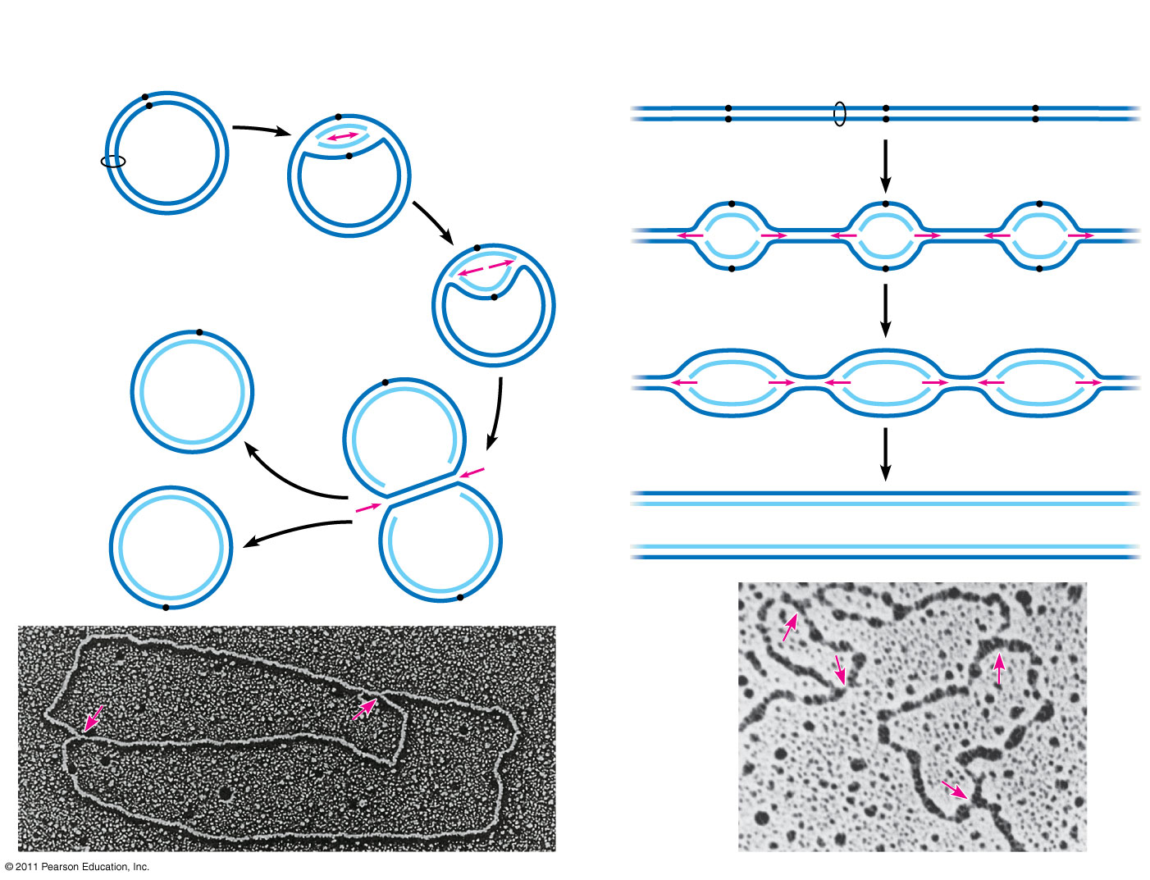
Figure 16.12
(a) Origin of replication in an E. coli cell
(b) Origins of replication in a eukaryotic cell
Origin of replication
Parental (template) strand
Double-stranded DNA molecule
Origin of replication
Daughter (new) strand
Parental (template) strand
Daughter (new) strand
Replication fork
Double- stranded DNA molecule
Replication bubble
Bubble
Replication fork
Two daughter DNA molecules
Two daughter DNA molecules
0.5 μm
0.25 μm
Notes:
Figure 16.12 Origins of replication in E. coli and eukaryotes.

Slide 27
At the end of each replication bubble is a replication fork, a Y-shaped region where new DNA strands are elongating
Helicases are enzymes that untwist the double helix at the replication forks
Single-strand binding proteins bind to and stabilize single-stranded DNA
Topoisomerase corrects “overwinding” ahead of replication forks by breaking, swiveling, and rejoining DNA strands
© 2011 Pearson Education, Inc.

Slide 28
DNA polymerases cannot initiate synthesis of a polynucleotide; they can only add nucleotides to the 3′ end
The initial nucleotide strand is a short RNA primer
An enzyme called primase can start an RNA chain from scratch and adds RNA nucleotides one at a time using the parental DNA as a template
The primer is short (5–10 nucleotides long), and the 3′ end serves as the starting point for the new DNA strand
© 2011 Pearson Education, Inc.

Slide 29
Synthesizing a New DNA Strand
Enzymes called DNA polymerases catalyze the elongation of new DNA at a replication fork
Most DNA polymerases require a primer and a DNA template strand
The rate of elongation is about 500 nucleotides per second in bacteria and 50 per second in human cells
© 2011 Pearson Education, Inc.

Slide 30
Each nucleotide that is added to a growing DNA strand is a nucleoside triphosphate
dATP supplies adenine to DNA and is similar to the ATP of energy metabolism
The difference is in their sugars: dATP has deoxyribose while ATP has ribose
As each monomer of dATP joins the DNA strand, it loses two phosphate groups as a molecule of pyrophosphate
© 2011 Pearson Education, Inc.

Slide 31
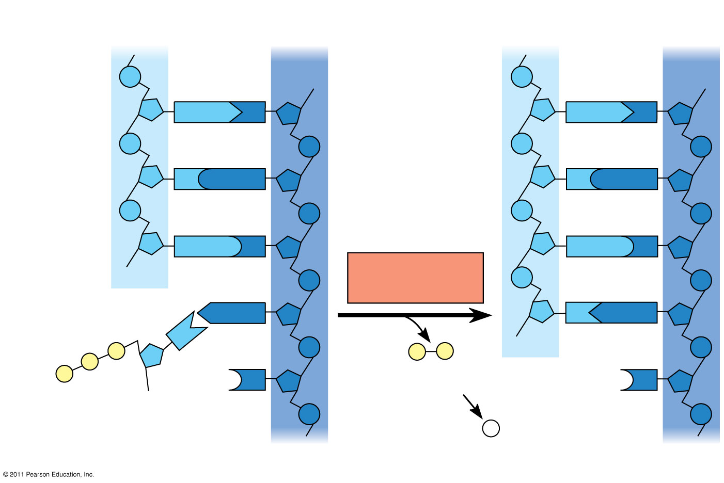
Figure 16.14
New strand
Template strand
5′
3′
5′
3′
Sugar
A
T
A
T
Phosphate
Base
C
G
C
G
G
C
G
C
OH
DNA polymerase
3′
A
T
A
T
P
P
P _{i}
OH
P
P
C
Pyrophosphate
3′
C
OH
Nucleoside triphosphate
2 P _{i}
5′
5′
Notes:
Figure 16.14 Incorporation of a nucleotide into a DNA strand.

Slide 32
The antiparallel structure of the double helix affects replication
DNA polymerases add nucleotides only to the free 3′ end of a growing strand; therefore, a new DNA strand can elongate only in the 5′ to 3′ direction
Along one template strand of DNA, the DNA polymerase synthesizes a leading strand continuously, moving toward the replication fork
To elongate the other new strand, called the lagging strand, DNA polymerase must work in the direction away from the replication fork
The lagging strand is synthesized as a series of segments called Okazaki fragments, which are joined together by DNA ligase
© 2011 Pearson Education, Inc.

Slide 33
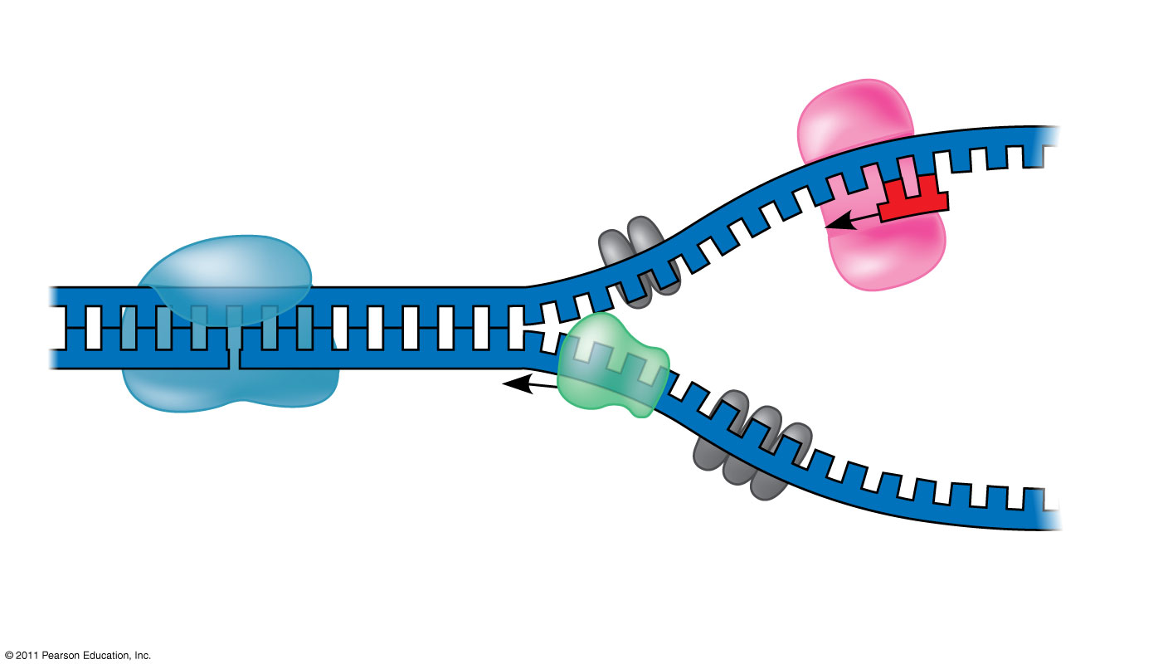
Figure 16.13
Primase
3′
Topoisomerase
5′
RNA primer
3′
5′
3′
Helicase
5′
Single-strand binding proteins
Notes:
Figure 16.13 Some of the proteins involved in the initiation of DNA replication.

Slide 34
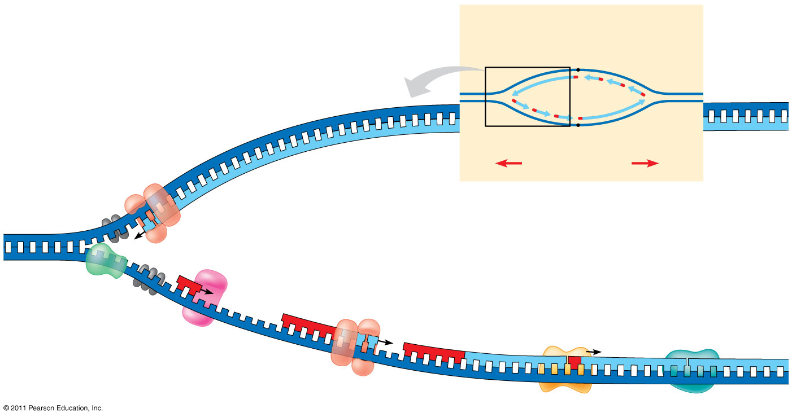
Figure 16.17
Overview
Leading strand
Origin of replication
Lagging strand
Leading strand
Lagging strand
Leading strand
Overall directions of replication
5′
DNA pol III
3′
Primer
Primase
3′
5′
3′
Parental DNA
DNA pol III
Lagging strand
5′
DNA pol I
4
3′
DNA ligase
5′
3′
3
2
1
5′
Notes:
Figure 16.17 A summary of bacterial DNA replication.

Slide 35
The DNA Replication Complex
The proteins that participate in DNA replication form a large complex, a “DNA replication machine”
The DNA replication machine may be stationary during the replication process
Recent studies support a model in which DNA polymerase molecules “reel in” parental DNA and “extrude” newly made daughter DNA molecules
© 2011 Pearson Education, Inc.

Slide 36
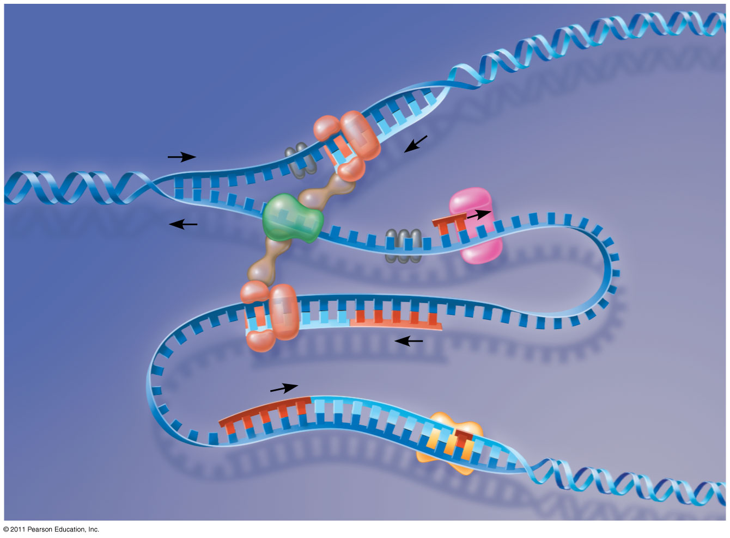
Figure 16.18
DNA pol III
Parental DNA
Leading strand
5′
5′
3′
3′
3′
3′
5′
5′
Connecting protein
Helicase
3′
5′
Lagging strand template
DNA pol III
Lagging strand
5′
3′
Notes:
Figure 16.18 A current model of the DNA replication complex.

Slide 37
Proofreading and Repairing DNA
DNA polymerases proofread newly made DNA, replacing any incorrect nucleotides
In mismatch repair of DNA, repair enzymes correct errors in base pairing
DNA can be damaged by exposure to harmful chemical or physical agents such as cigarette smoke and X-rays; UV radiation can lead to T-T dimers (two adjacent Ts on same strand bond)
In nucleotide excision repair, a nuclease cuts out and replaces damaged stretches of DNA
© 2011 Pearson Education, Inc.

Slide 38
Evolutionary Significance of Altered DNA Nucleotides
Error rate after proofreading repair is low but not zero (from 1 in 100,000 to 1 in 1,000,000,000)
Sequence changes may become permanent and can be passed on to the next generation
These changes (mutations) are the source of the genetic variation upon which natural selection operates
© 2011 Pearson Education, Inc.

Slide 39
Replicating the Ends of DNA Molecules
Limitations of DNA polymerase create problems for the linear DNA of eukaryotic chromosomes
The usual replication machinery provides no way to complete the 5′ ends, so repeated rounds of replication produce shorter DNA molecules with uneven ends
This is not a problem for prokaryotes, most of which have circular chromosomes
© 2011 Pearson Education, Inc.

Slide 40
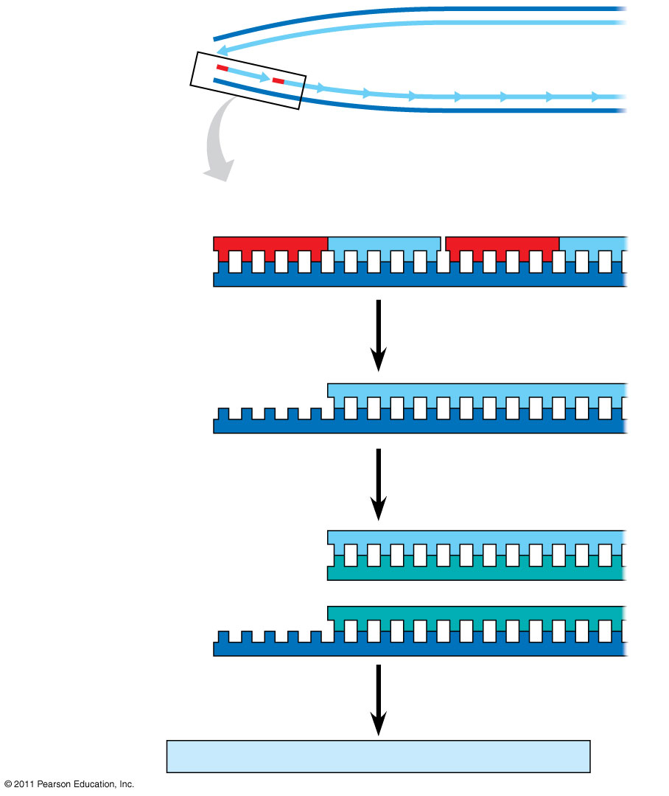
Figure 16.20
5′
Ends of parental DNA strands
Leading strand
Lagging strand
3′
Last fragment
Next-to-last fragment
Lagging strand
RNA primer
5′
3′
Parental strand
Removal of primers and replacement with DNA where a 3′ end is available
5′
3′
Second round of replication
5′
New leading strand
3′
New lagging strand
5′
3′
Further rounds of replication
Shorter and shorter daughter molecules
Notes:
Figure 16.20 Shortening of the ends of linear DNA molecules.

Slide 41
Eukaryotic chromosomal DNA molecules have special nucleotide sequences at their ends called telomeres
Telomeres do not prevent the shortening of DNA molecules, but they do postpone the erosion of genes near the ends of DNA molecules
It has been proposed that the shortening of telomeres is connected to aging
If chromosomes of germ cells became shorter in every cell cycle, essential genes would eventually be missing from the gametes they produce
An enzyme called telomerase catalyzes the lengthening of telomeres in germ cells
© 2011 Pearson Education, Inc.

Slide 42
The shortening of telomeres might protect cells from cancerous growth by limiting the number of cell divisions
There is evidence of telomerase activity in cancer cells, which may allow cancer cells to persist (39)
© 2011 Pearson Education, Inc.

Slide 43
Chromatin, a complex of DNA and protein, is found in the nucleus of eukaryotic cells
Chromosomes fit into the nucleus through an elaborate, multilevel system of packing
© 2011 Pearson Education, Inc.
Notes:
For the Cell Biology Video Cartoon and Stick Model of a Nucleosomal Particle, go to Animation and Video Files.

Slide 44
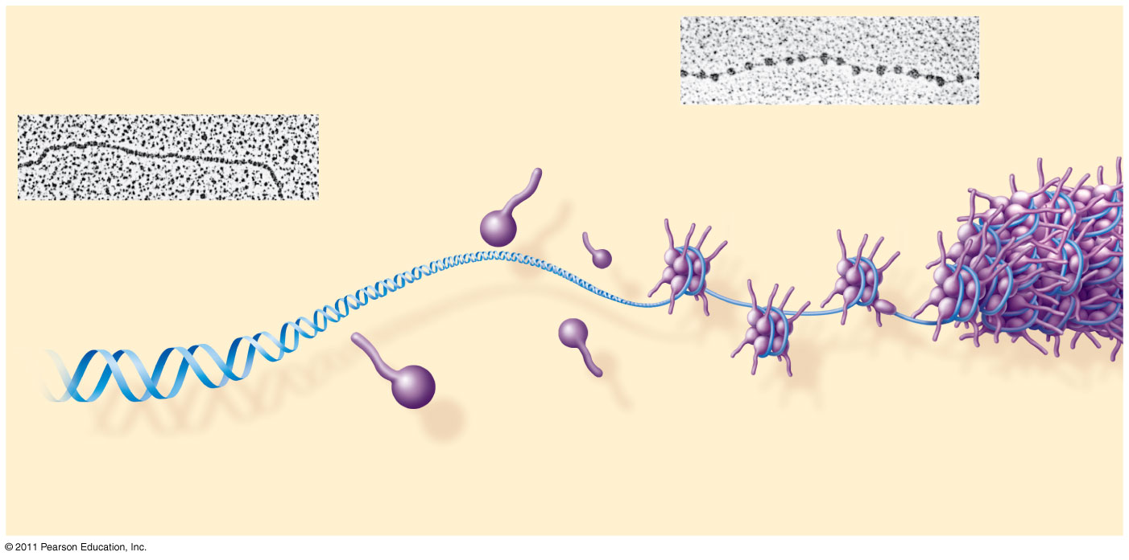
Figure 16.22a
(40 part)
Nucleosome (10 nm in diameter)
DNA double helix (2 nm in diameter)
H1
Histone tail
Histones
Nucleosomes, or “beads on a string” (10-nm fiber)
DNA, the double helix
Histones
Notes:
Figure 16.22 Exploring: Chromatin Packing in a Eukaryotic Chromosome

Slide 45
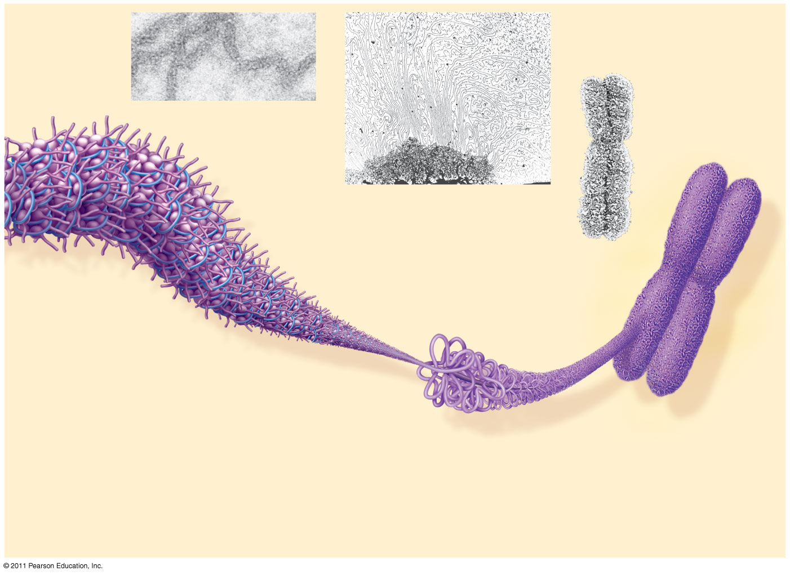
Figure 16.22b
Chromatid (700 nm)
30-nm fiber
Loops
Scaffold
300-nm fiber
30-nm fiber
(40)
Replicated chromosome (1,400 nm)
Looped domains (300-nm fiber)
Metaphase chromosome
Notes:
Figure 16.22 Exploring: Chromatin Packing in a Eukaryotic Chromosome

Slide 46
The Flow of Genetic Information
The DNA inherited by organisms leads to specific traits by dictating synthesis of proteins
The process by which DNA directs protein synthesis is called Gene Expression
Transcription
Translation
In other words, Proteins are the link between genotype & Phenotype!

Slide 47
Basic Principles of Transcription & Translation
RNA is the bridge between genes and the proteins for which they code
Transcription is the synthesis of RNA under the direction of DNA (DNA to mRNA in nucleus)
Transcription produces messenger RNA (mRNA)
Translation is the synthesis of a polypeptide, using information in the mRNA (mRNA to protein)
Ribosomes are the sites of translation
© 2011 Pearson Education, Inc.
Notes:
47

Slide 48
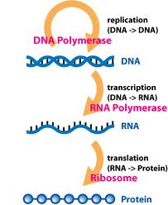
Central Dogma
The central dogma is the concept that cells are governed by a cellular chain of command:
DNA → RNA → protein
It has been modified since due to new discoveries, but it basically remains the same

Slide 49
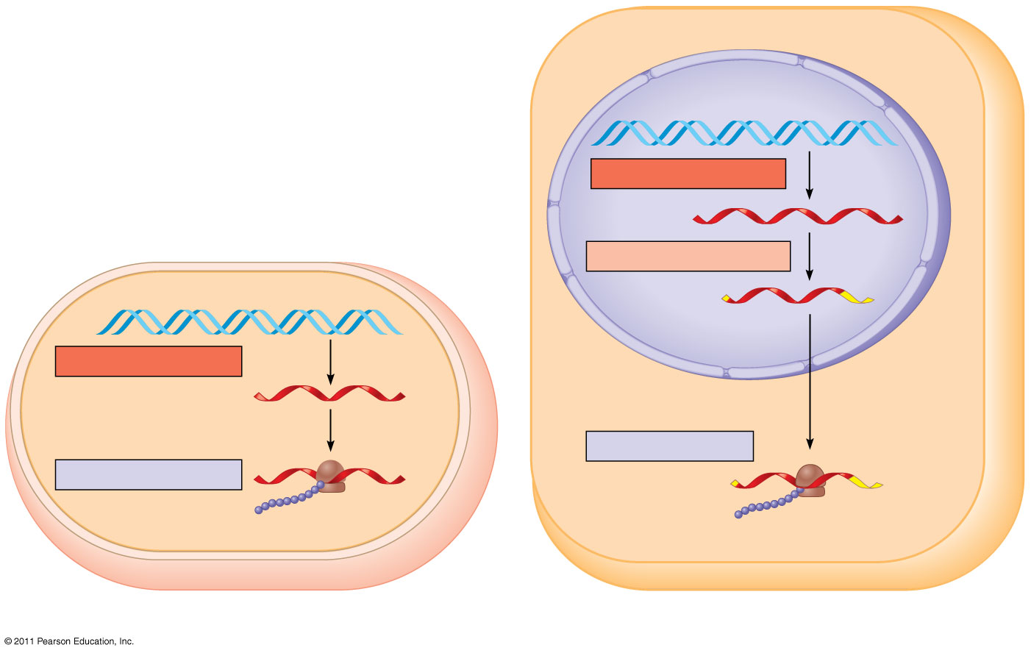
Figure 17.3
Nuclear envelope
TRANSCRIPTION
DNA
RNA PROCESSING
Pre-mRNA
mRNA
TRANSCRIPTION
DNA
mRNA
Ribosome
TRANSLATION
Ribosome
TRANSLATION
Polypeptide
Polypeptide
(a) Bacterial cell
(b) Eukaryotic cell
Notes:
Figure 17.3 Overview: the roles of transcription and translation in the flow of genetic information.

Slide 50
Basic Principles of Transcription & Translation
Transcription
Translation
The synthesis of a complementary strand of RNA under the direction of DNA template
Same language as DNA → nucleotides
Occurs in the nucleus
The synthesis of an amino acid chain (polypeptide) under the direction of RNA
Change in language → from nucleotides to amino acids
Occurs outside of the nucleus on a ribosome
Secretory proteins are transcribed on ribosomes attached to the ER
Proteins for internal cell use are transcribed on free ribosomes

Slide 51
Transcription Overview
DNA is transcribed into pre-messenger RNA by RNA Polymerase in the nucleus
Initiation
Elongation
Termination
This pre-mRNA undergoes RNA processing yielding a finished mRNA
This primary transcript is now ready to leave the nucleus and undergo translation

Slide 52
The Genetic Code
How are the instructions for assembling amino acids into proteins encoded into DNA?
There are 20 amino acids, but there are only four nucleotide bases in DNA
© 2011 Pearson Education, Inc.
Notes:
52

Slide 53
Codons: Triplets of Nucleotides
The flow of information from gene to protein is based on a triplet code: a series of non-overlapping, three-nucleotide words.
The words of a gene are transcribed into complementary non-overlaping three-nucleotide words of mRNA
These words are then translated into a chain of amino acids, forming a polypeptide
© 2011 Pearson Education, Inc.
Notes:
53

Slide 54
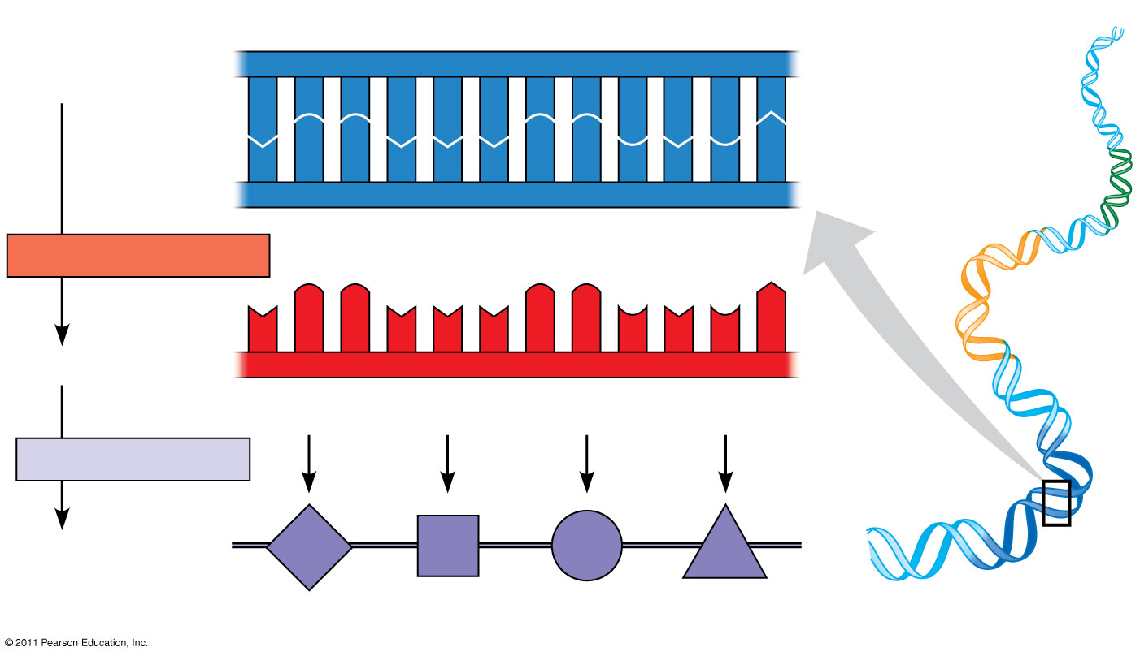
Figure 17.4
Template=non coding strand
Nontemplate=coding strand (20)
DNA template strand
3′
5′
DNA
A
C
C
A
A
A
C
C
G
A
G
T
molecule
T
G
G
T
T
T
G
G
C
T
C
A
Gene 1
5′
3′
TRANSCRIPTION
Gene 2
U
G
G
U
U
U
G
G
C
U
C
A
5′
3′
mRNA
Codon
TRANSLATION
Protein
Trp
Phe
Gly
Ser
Gene 3
Amino acid
Notes:
Figure 17.4 The triplet code.

Slide 55
The Genetic Code
If each arrangement of 3 consecutive bases specifies one amino acid, it is possible to specify up to 64 amino acids (4³)
There are only 20 amino acids, so this immediately indicates that there must be some redundancy within the code
This is an important safety that helps us survive mutations in our DNA!

Slide 56
Codons & Amino Acids
Each nucleotide triplet is called a codon, and each codon specifies only 1 amino acid
Obviously, each amino acid may be specified by more than one codon
Remember, this redundancy is important in our ability to survive DNA mutations
This means that a polypeptide containing 100 amino acids must have a minimum of how many nucleotides?

Slide 57
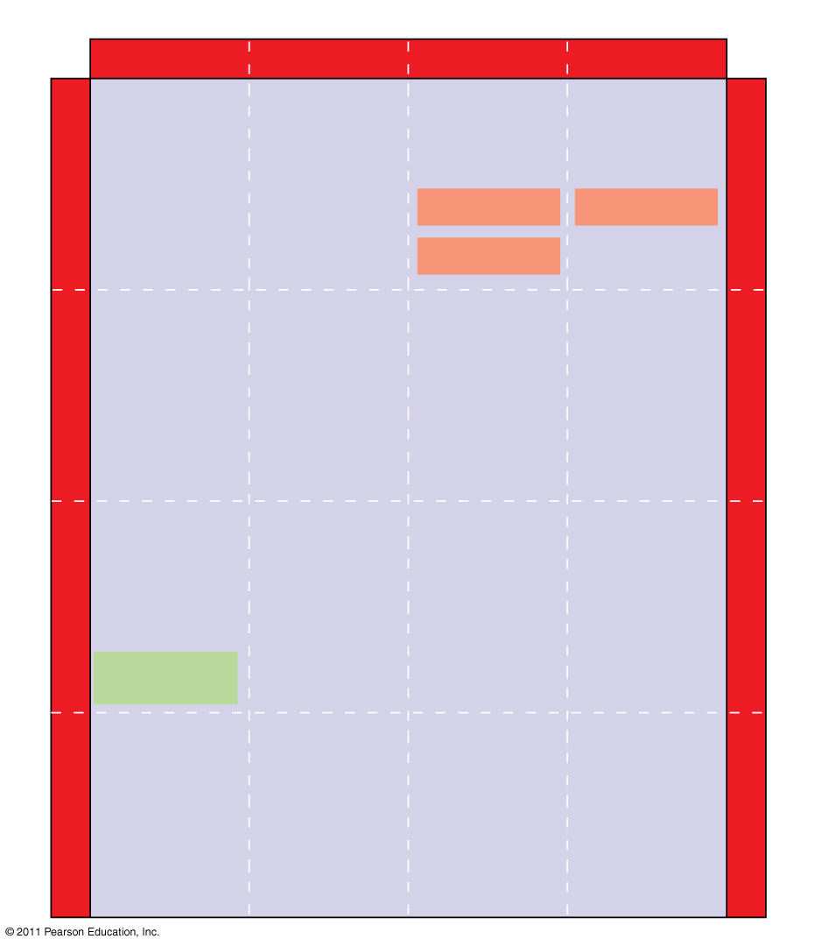
Figure 17.5
Second mRNA base
U
C
A
G
UUU
UCU
UAU
UGU
U
Phe
Tyr
Cys
U
UUC
UCC
UAC
UGC
C
Ser
UUA
UCA
UAA Stop
UGA Stop
A
Leu
UUG
UCG
UAG Stop
UGG
Trp
G
CUU
CCU
CAU
CGU
U
His
C
CUC
CCC
CAC
CGC
C
Leu
Pro
Arg
CUA
CCA
CAA
CGA
A
Gln
CUG
CCG
CAG
CGG
G
First mRNA base (5′ end of codon)
Third mRNA base (3′ end of codon)
AUU
ACU
AAU
AGU
U
Asn
Ser
A
AUC
Ile
ACC
AAC
AGC
C
Thr
AUA
ACA
AAA
AGA
A
Lys
Arg
AUG
Met or start
ACG
AAG
AGG
G
GUU
GCU
GAU
GGU
U
Asp
G
GUC
GCC
GAC
GGC
C
Val
Ala
Gly
Gly
GUA
GCA
GAA
GGA
A
Glu
GUG
GCG
GAG
GGG
G
Notes:
Figure 17.5 The codon table for mRNA.

Slide 58
Evolution of the Genetic Code
The genetic code refers to the “code” of 1 codon specifying 1 amino acid
This genetic code thus far appears to be shared universally among all life forms, from bacteria to mammals
Slight variations exist in organelle genes and in some unicellular eukaryotes
“A shared genetic vocabulary is a reminder of the kinship that bonds life on Earth”

Slide 59
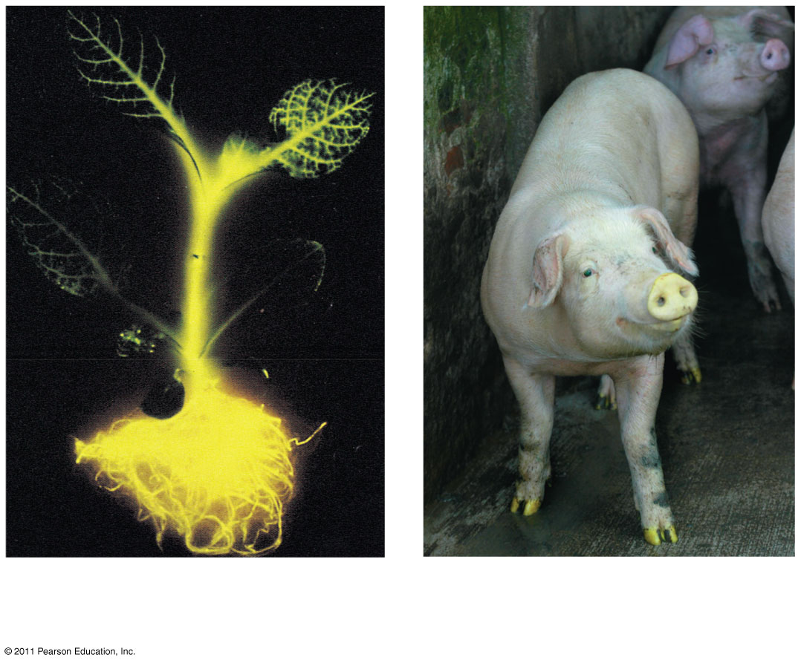
Evolution of the Genetic Code
The genetic code is nearly universal, shared by the simplest bacteria to the most complex animals
Genes can be transcribed and translated after being transplanted from one species to another
Firefly and jellyfish
© 2011 Pearson Education, Inc.
Notes:
59

Slide 60
Methionine
The codon AUG codes for the amino acid methionine
AUG is known as the start codon, and thus methionine is at the beginning of every polypeptide synthesized
That is not to say that every finished protein has methionine as its 1st amino acid, methionine may be excised later during protein finishing

Slide 61
Molecular Components of Transcription
Transcription is the first stage of gene expression
RNA synthesis is catalyzed by RNA polymerase, which pries the DNA strands apart and hooks together the RNA nucleotides without a primer
RNA Polymerase does NOT need a primer and can start an existing strand from scratch
The RNA is complementary to the DNA template strand
RNA synthesis follows the same base-pairing rules as DNA, except that uracil substitutes for thymine
© 2011 Pearson Education, Inc.
Notes:
61

Slide 62
The DNA sequence where RNA polymerase attaches is called the promoter; in bacteria, the sequence signaling the end of transcription is called the terminator
The stretch of DNA that is transcribed is called a transcription unit
© 2011 Pearson Education, Inc.
Notes:
62

Slide 63
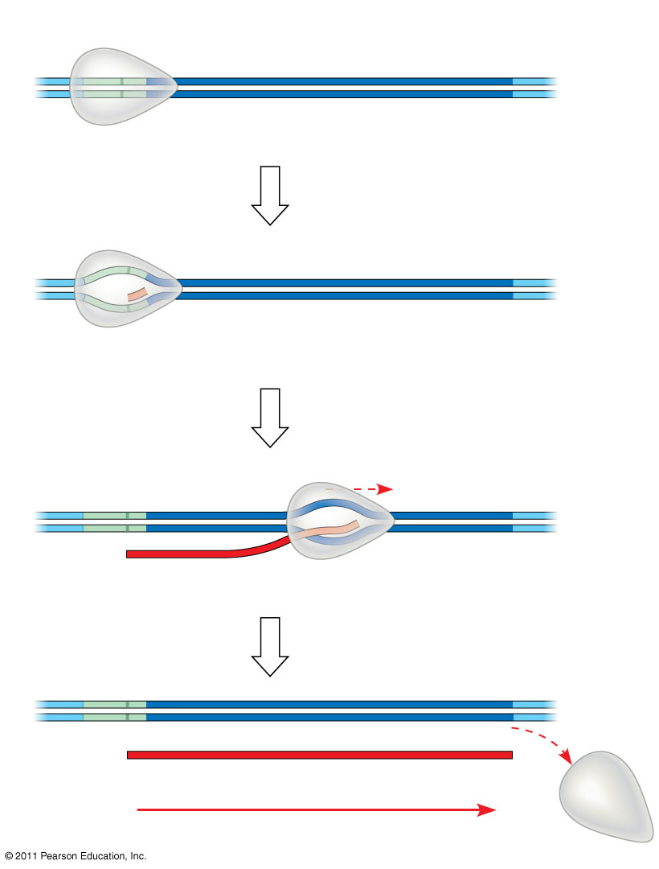
Figure 17.7-4
Promoter
Transcription unit
5′
3′
3′
DNA
5′
Start point
RNA polymerase
1
Initiation
(34)
Nontemplate strand of DNA
5′
3′
3′
5′
RNA transcript
Template strand of DNA
Unwound DNA
2
Elongation
Rewound DNA
5′
3′
3′
3′
5′
5′
RNA transcript
3
Termination
5′
3′
3′
5′
5′
Completed RNA transcript
3′
Direction of transcription (“downstream”)
Notes:
Figure 17.7 The stages of transcription: initiation, elongation, and termination.

Slide 64
Transcription is Divided into 3 Stages
Initiation
RNA Polymerase recognizes and binds to promoter
Elongation
Termination
Stages of Transcription Animation

Slide 65
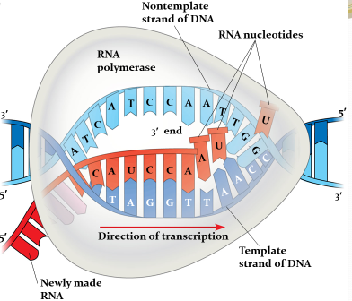
Elongation of the RNA Strand
As RNA polymerase moves along the DNA, it untwists the double helix, 10 to 20 bases at a time
A gene can be transcribed simultaneously by several RNA polymerases
Nucleotides are added to the 3′ end of the growing RNA molecule
Notes:
65

Slide 66
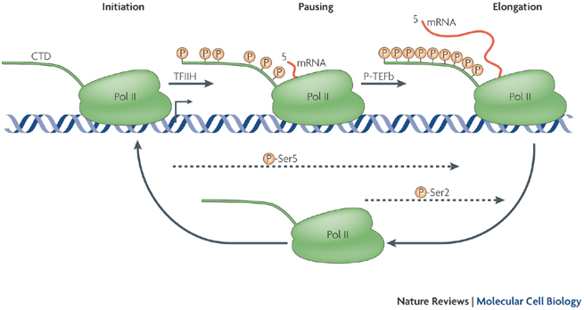
Elongation
A single gene can be transcribed simultaneously by several RNA Polymerases following each other one after another
Transcription Animation

Slide 67
Concept 17.3: Eukaryotic cells modify RNA after transcription
Enzymes in the eukaryotic nucleus modify pre-mRNA (RNA processing) before the genetic messages are dispatched to the cytoplasm
During RNA processing, both ends of the primary transcript are usually altered
Also, usually some interior parts of the molecule are cut out, and the other parts spliced together
© 2011 Pearson Education, Inc.
Notes:
67

Slide 68
Alteration of mRNA Ends
Each end of a pre-mRNA molecule is modified in a particular way
The 5′ end receives a modified nucleotide 5′ cap
The 3′ end gets a poly-A tail
These modifications share several functions
They seem to facilitate the export of mRNA
They protect mRNA from hydrolytic enzymes
They help ribosomes attach to the 5′ end
© 2011 Pearson Education, Inc.
Notes:
68

Slide 69
Split Genes and RNA Splicing
Most eukaryotic genes and their RNA transcripts have long noncoding stretches of nucleotides that lie between coding regions
These noncoding regions are called intervening sequences, or introns
The other regions are called exons because they are eventually expressed, usually translated into amino acid sequences
RNA splicing removes introns and joins exons, creating an mRNA molecule with a continuous coding sequence
© 2011 Pearson Education, Inc.
Notes:
69

Slide 70
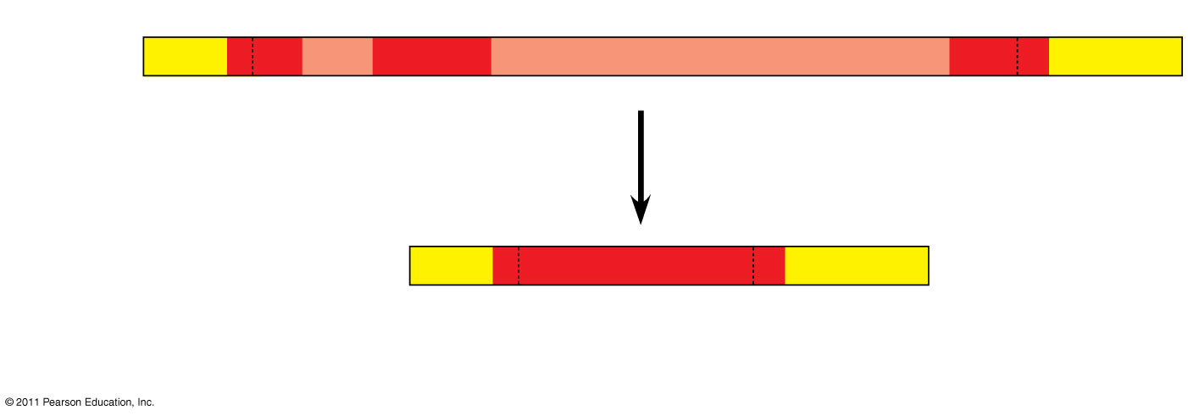
Figure 17.11
(43)
5′
Exon Intron
Exon
Intron
Exon
3′
Pre-mRNA Codon numbers
5′
Cap
Poly-A tail
1−30
31−104
105− 146
Introns cut out and exons spliced together
mRNA
5′
Cap
Poly-A tail
1−146
5′
UTR
3′
UTR
Coding segment
Notes:
Figure 17.11 RNA processing: RNA splicing.

Slide 71
Translation is the RNA-directed synthesis of a polypeptide: a closer look
DNA’s genetic information flows to protein through the process of translation.
Type of RNA | Description | Function
mRNA | (Messenger) | Carries DNA’s code for proteins to ribosomes
tRNA | (Transfer) | Translates mRNA codons to amino acids
rRNA | (Ribosomal) | Plays catalytic and structural roles in ribosomes
© 2011 Pearson Education, Inc.
Notes:
71

Slide 72
Molecular Components of Translation
A cell translates an mRNA message into protein with the help of transfer RNA (tRNA)
tRNA transfer amino acids to the growing polypeptide in a ribosome
Molecules of tRNA are not identical
Each carries a specific amino acid on one end
Each has an anticodon on the other end; the anticodon base-pairs with a complementary codon on mRNA (54)
© 2011 Pearson Education, Inc.
Notes:
72

Slide 73
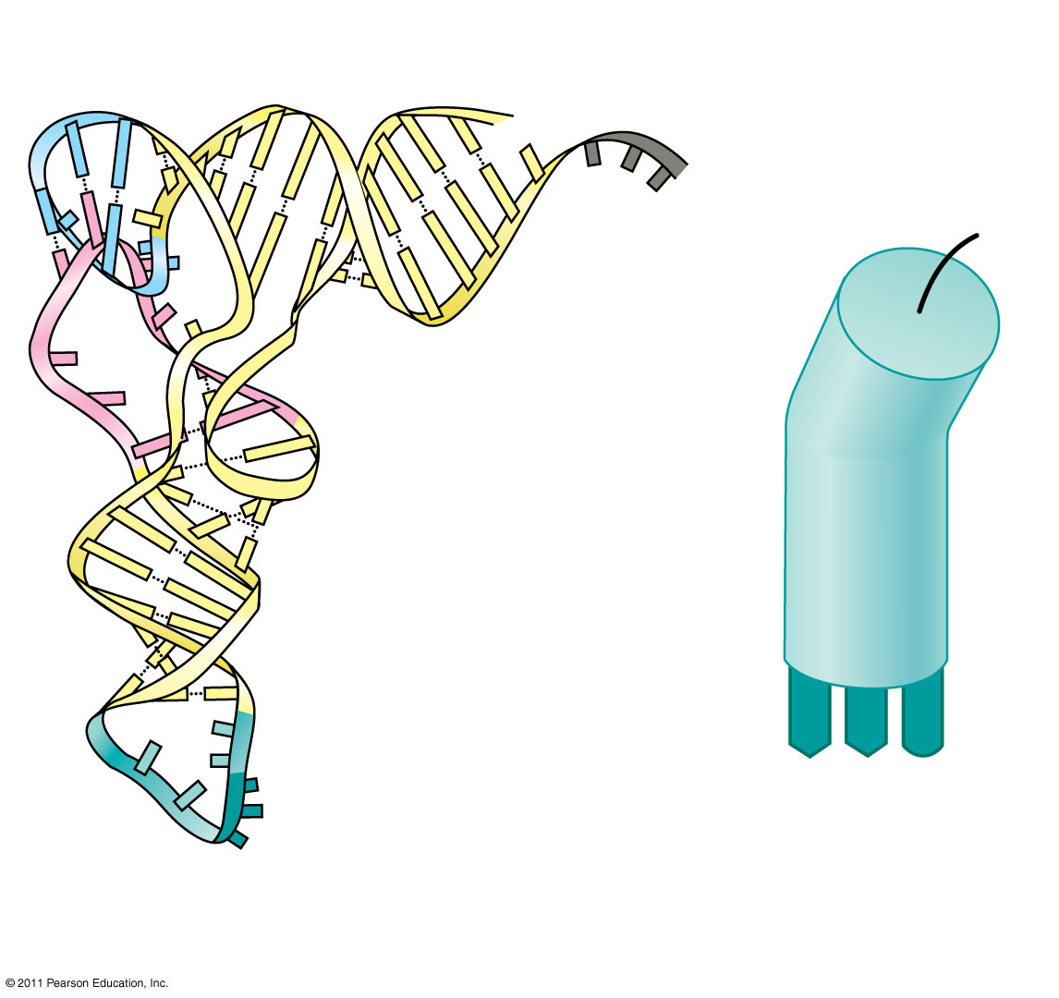
Amino acid attachment site
5′
3′
(55)
Hydrogen bonds
BioFlix: Protein Synthesis
A
A
G
3′
5′
Anticodon
Anticodon
(c) Symbol used
(b) Three-dimensional structure
in this book
© 2011 Pearson Education, Inc.
Notes:
73

Slide 74
Accurate translation requires two steps
First: a correct match between a tRNA and an amino acid, done by the enzyme aminoacyl-tRNA synthetase
Second: a correct match between the tRNA anticodon and an mRNA codon
aminoacyl-tRNA synthetase animation
There are 20 aminoacyl-tRNA synthetases (1 for each amino acid) and 45 different tRNAs.
Flexible pairing at the third base of a codon is called wobble and allows some tRNAs to bind to more than one codon
© 2011 Pearson Education, Inc.
Notes:
74

Slide 75
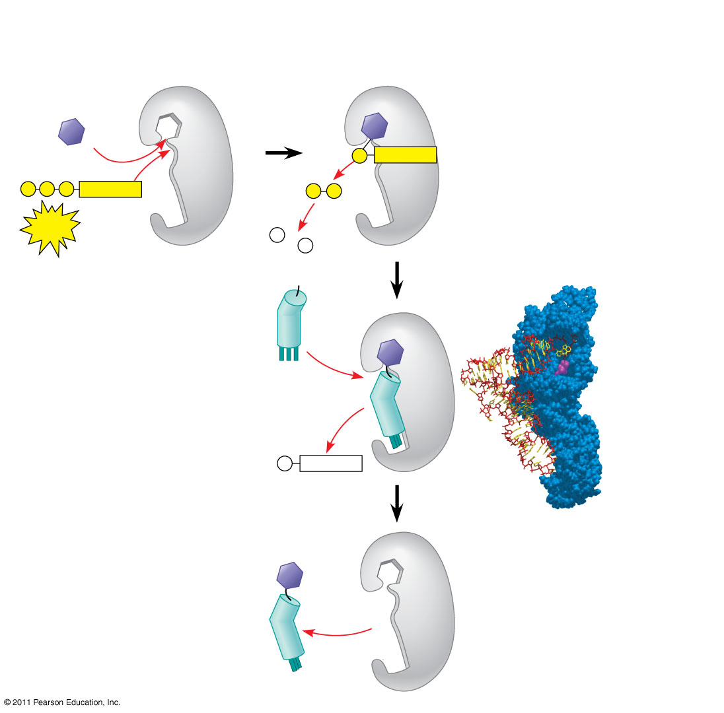
Figure 17.16-4
Aminoacyl-tRNA synthetase (enzyme)
Amino acid
P
Adenosine
P
P
P
Adenosine
P
P
i
ATP
Aminoacyl-tRNA synthetase
P
i
P
tRNA
i
tRNA
(58)
Amino acid
P
Adenosine
AMP
Computer model
Aminoacyl tRNA (“charged tRNA”)
Notes:
Figure 17.16 An aminoacyl-tRNA synthetase joining a specific amino acid to a tRNA.

Slide 76
Ribosomes
Ribosomes facilitate specific coupling of tRNA anticodons with mRNA codons in protein synthesis
The two ribosomal subunits (large and small) are made of proteins and ribosomal RNA (rRNA)
Bacterial and eukaryotic ribosomes have are somewhat similar but have different sized sub units and other differences
Eukaryotes have larger ribosomes
Prokaryotes have smaller ribosomes
© 2011 Pearson Education, Inc.
Notes:
76

Slide 77
Ribosomes
In both prokaryotes and eukaryotes both ribosomal subunits only join to form a complete functional ribosome when attached to an mRNA

Slide 78
Significance
The differences between prokaryotic and eukaryotic ribosomes are small but significant
Many of our antibacterial drugs work by inactivating bacterial ribosomes without inhibiting eukaryotic ribosomes
Tetracycline
Streptomycin
Binds to the S12 Protein of the 30S subunit of the bacterial ribosome, interfering with the binding of formyl-methionyl-tRNA to the 30S subunit.
This prevents initiation of protein synthesis and leads to death of microbial cells

Slide 79
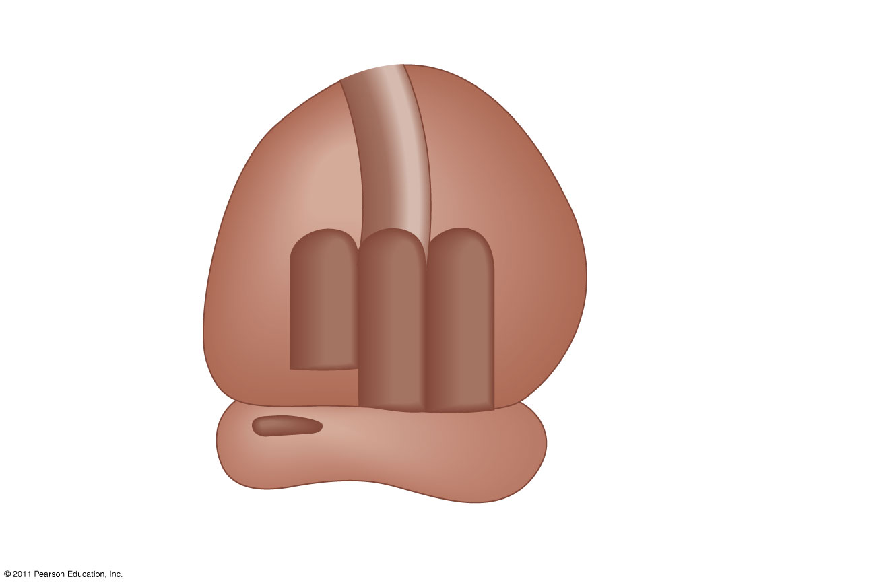
Figure 17.17b
P site (Peptidyl-tRNA binding site)
Exit tunnel
A site (Aminoacyl- tRNA binding site)
E site (Exit site)
E
P
A
Large subunit
mRNA binding site
Small subunit
(b) Schematic model showing binding sites
(61)
Notes:
Figure 17.17 The anatomy of a functioning ribosome.

Slide 80
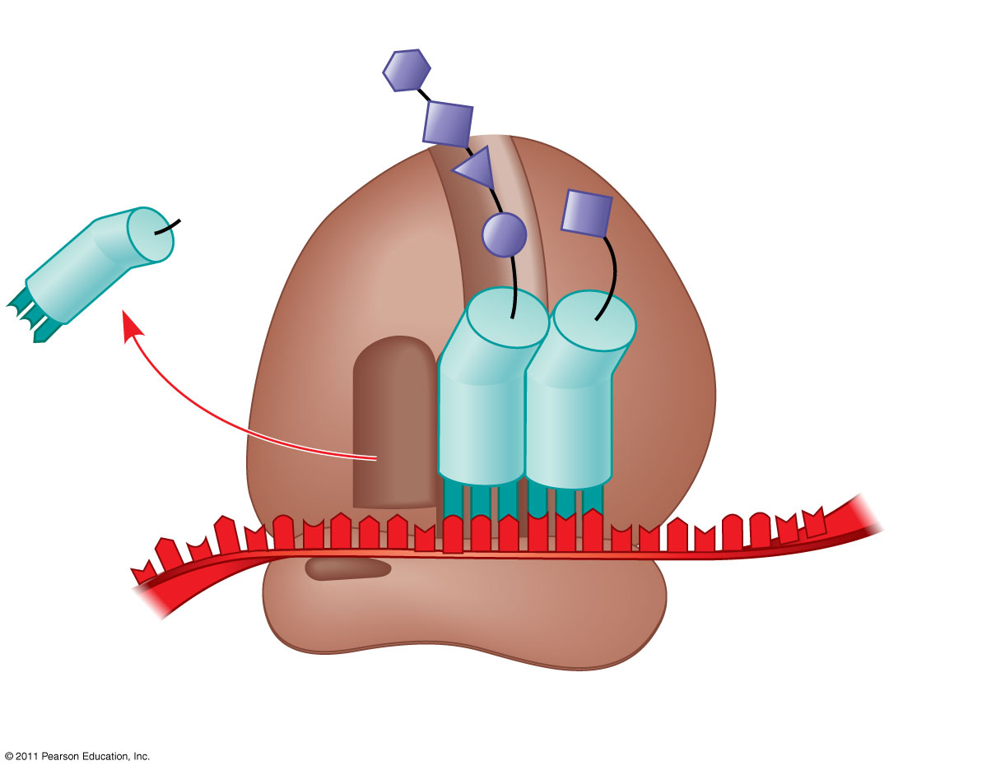
Figure 17.17c
Growing polypeptide
Amino end
Next amino acid to be added to polypeptide chain
E
tRNA
mRNA
3′
5′
Codons
(c) Schematic model with mRNA and tRNA
Notes:
Figure 17.17 The anatomy of a functioning ribosome.

Slide 81
Building a Polypeptide
The three stages of translation
Initiation
Elongation
Termination
All three stages require protein “factors” that aid in the translation process
© 2011 Pearson Education, Inc.
Notes:
81

Slide 82
Ribosome Association and Initiation of Translation
The initiation stage of translation brings together mRNA, a tRNA with the first amino acid, and the two ribosomal subunits
First, a small ribosomal subunit binds with mRNA and a special initiator tRNA
Then the small subunit moves along the mRNA until it reaches the start codon (AUG)
Proteins called initiation factors bring in the large subunit that completes the translation initiation complex
© 2011 Pearson Education, Inc.
Notes:
82

Slide 83
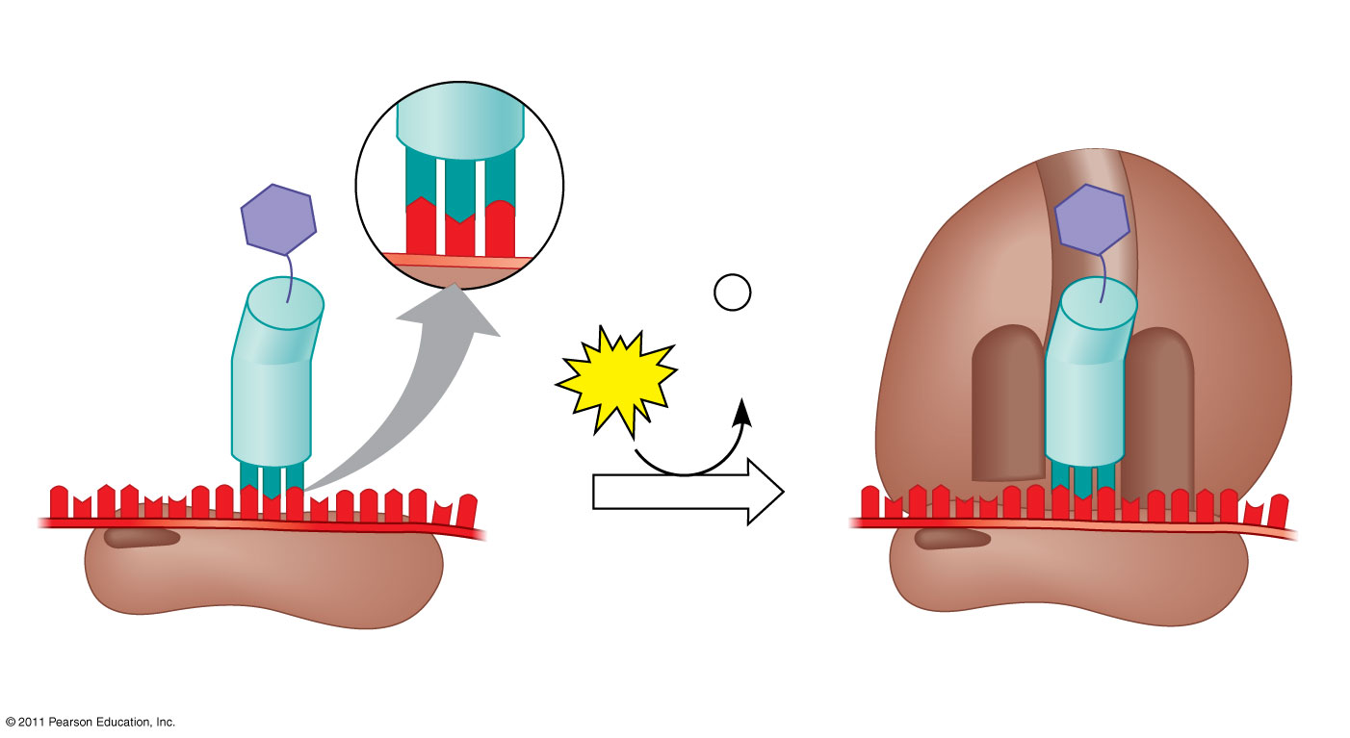
Figure 17.18
(63-64)
Large ribosomal subunit
3′
U
A
C
5′
P site
Met
5′
A
U
G
3′
Met
P
i
Initiator tRNA
+
GTP
GDP
E
A
mRNA
5′
5′
3′
3′
Start codon
Small ribosomal subunit
mRNA binding site
Translation initiation complex
Translation Initiation Animation
Notes:
Figure 17.18 The initiation of translation.

Slide 84
Elongation of the Polypeptide Chain
During the elongation stage, amino acids are added one by one to the preceding amino acid at the C-terminus of the growing chain
Each addition involves proteins called elongation factors and occurs in three steps: codon recognition, peptide bond formation, and translocation
Translation proceeds along the mRNA in a 5′ to 3′ direction
© 2011 Pearson Education, Inc.
Notes:
84

Slide 85
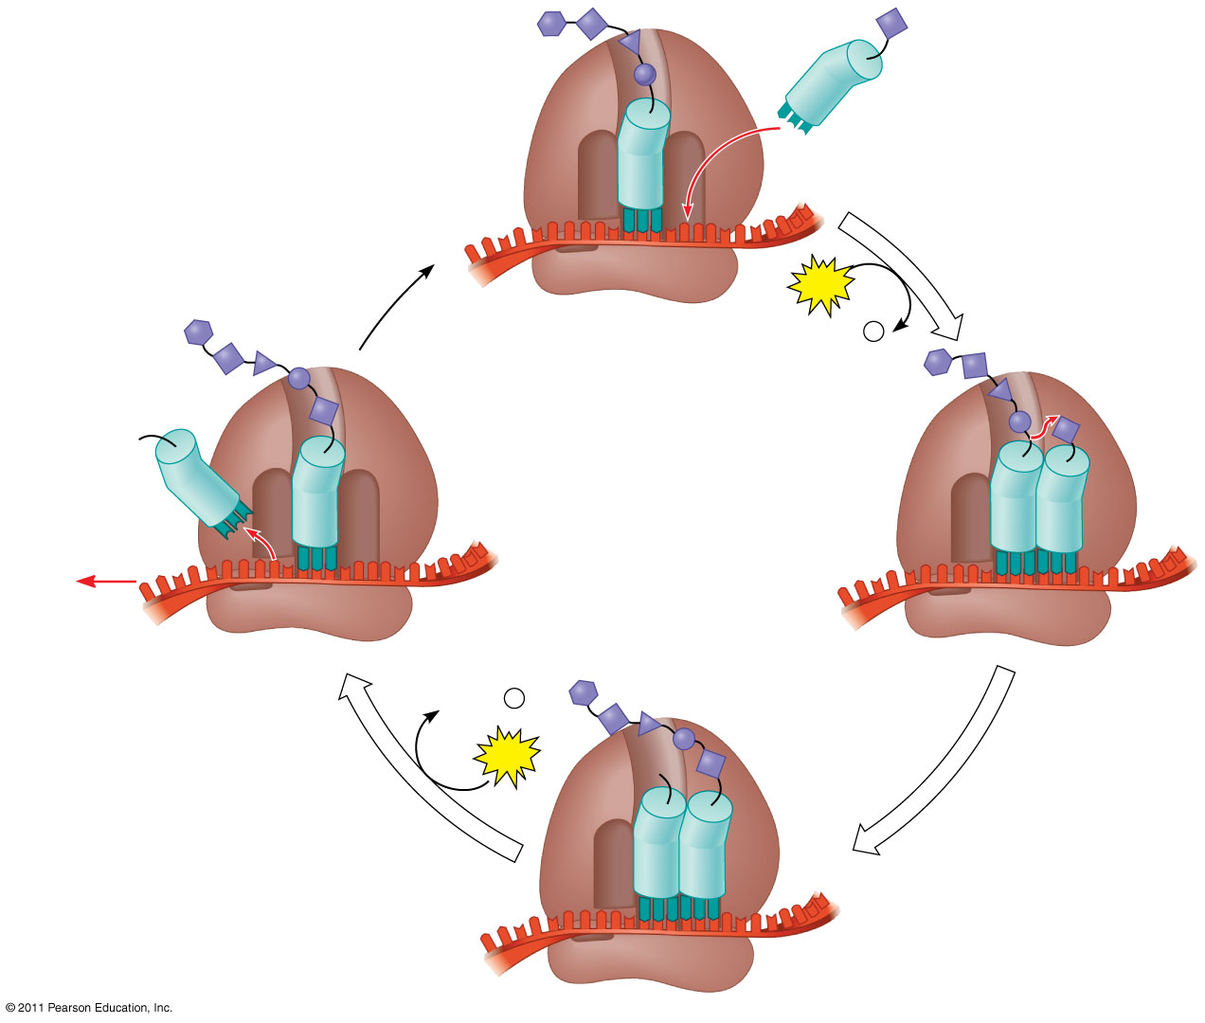
Figure 17.19-4
Amino end of polypeptide
E
3′
mRNA
Ribosome ready for next aminoacyl tRNA
P site
A site
5′
GTP
GDP
+
P
i
E
E
P
A
P
A
GDP
+
P
i
(65)
GTP
E
P
A
Notes:
Figure 17.19 The elongation cycle of translation.

Slide 86
3 Steps of Elongation
1st is Codon Recognition
Requires hydrolysis of GTP
2nd Peptide Bond Formation between amino acids in the A and P sites, catalyzed by the ribosome
Removes the amino acid from the tRNA that carried it
3rd Translocation of tRNA in the A site to the P site, while at the same time moving the tRNA in the P site to the E site
mRNA is moved through the ribosome 5’end 1st
http://highered.mheducation.com/sites/0072943696/student_view0/chapter3/animation__how_translation_works.html

Slide 87
Termination of Translation
Termination occurs when a stop codon in the mRNA reaches the A site of the ribosome
The A site accepts a protein called a release factor
The release factor causes the addition of a water molecule instead of an amino acid
This reaction releases the polypeptide, and the translation assembly then comes apart
Translation Termination Animation
© 2011 Pearson Education, Inc.
Notes:
87

Slide 88
Figure 17.20-3
Release factor
Free polypeptide
5′
3′
3′
5′
5′
2
GTP
3′
Stop codon
2
GDP
+
2
P
i
(UAG, UAA, or UGA)
Notes:
Figure 17.20 The termination of translation.

Slide 89
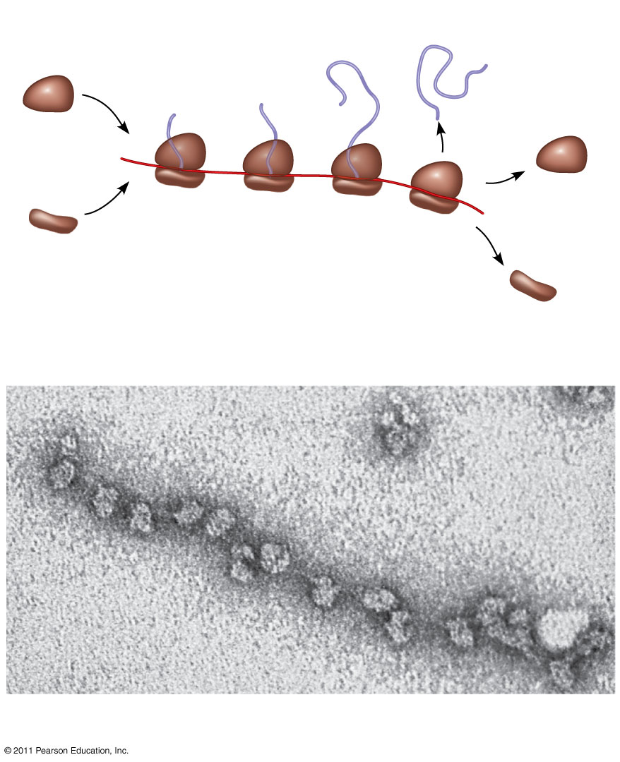
Figure 17.21
Completed polypeptide
Growing polypeptides
Incoming ribosomal subunits
A number of ribosomes can translate a single mRNA simultaneously, forming a polyribosome (or polysome)
Polyribosome
Start of mRNA (5′ end)
End of mRNA (3′ end)
(a)
Ribosomes
mRNA
(b)
0.1 μm
Notes:
Figure 17.21 Polyribosomes.

Slide 90
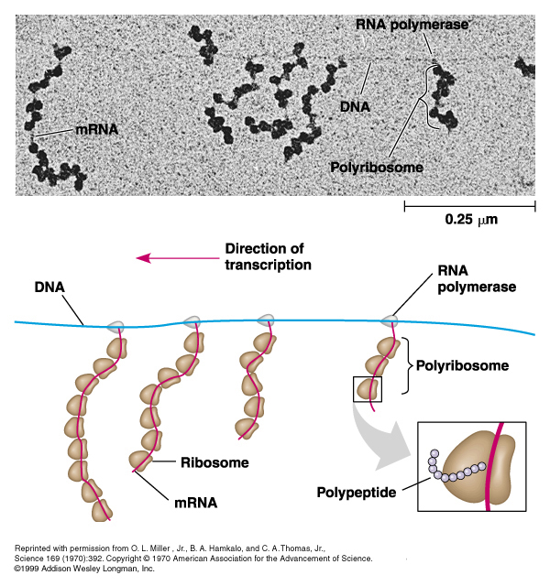
What kind of cell is this & how do you know?

Slide 91
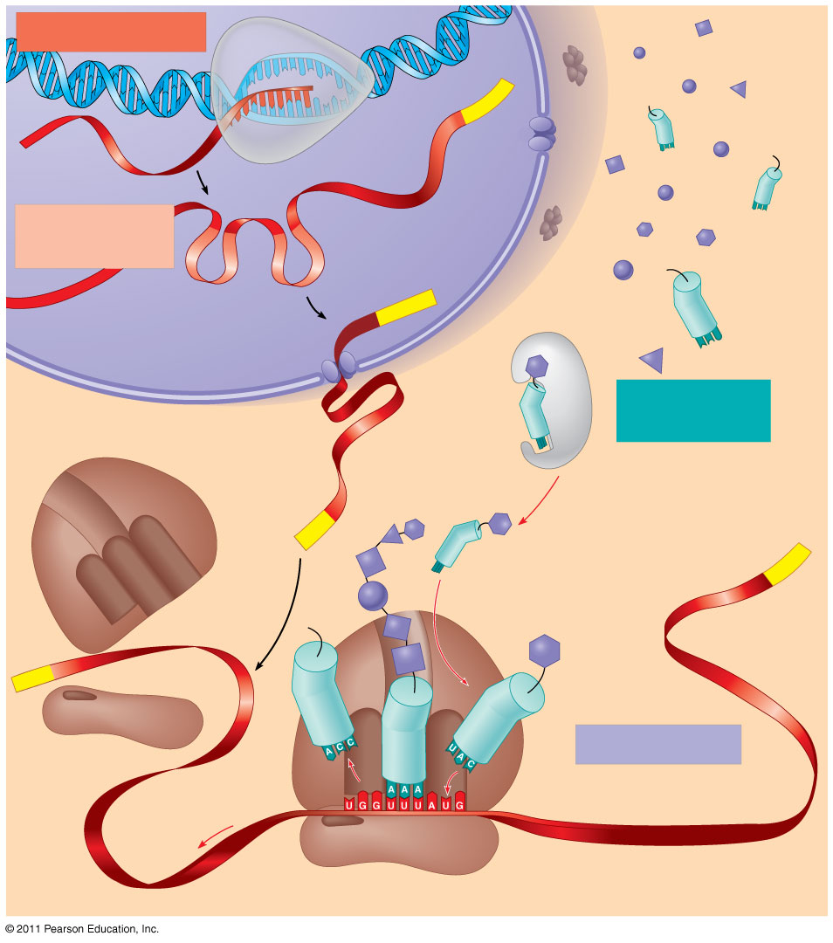
Figure 17.26
TRANSCRIPTION
DNA
3′
Poly-A
RNA
5′
RNA
polymerase
transcript
Exon
RNA
RNA transcript
PROCESSING
(pre-mRNA)
Intron
Aminoacyl-
Poly-A
tRNA synthetase
NUCLEUS
Amino acid
tRNA
AMINO ACID
CYTOPLASM
ACTIVATION
mRNA
Growing polypeptide
(81)
5′ Cap
3′
A
Aminoacyl (charged) tRNA
Poly-A
P
E
Ribosomal
subunits
5′ Cap
TRANSLATION
E
A
Anticodon
Codon
Ribosome
Notes:
Figure 17.26 A summary of transcription and translation in a eukaryotic cell.

Slide 92
Comparing Prokaryotes to Eukaryotes
Processing of Gene Information Animation

Slide 93
Protein Folding and Post-Translational Modifications
During and after synthesis, a polypeptide chain spontaneously coils and folds into its three-dimensional shape
Proteins may also have amino acids modified to attach sugars, lipids, phosphate groups etc.
Some polypeptides are activated by enzymes that cleave them
Other polypeptides are brought together to form the subunits of a multi-domained protein
© 2011 Pearson Education, Inc.
Notes:
93

Slide 94
Targeting Polypeptides to Specific Locations
Two populations of ribosomes are evident in cells: free ribsomes (in the cytosol) and bound ribosomes (attached to the ER)
Free ribosomes mostly synthesize proteins that function in the cytosol
Bound ribosomes make proteins of the endomembrane system and proteins that are secreted from the cell
Ribosomes are identical and can switch from free to bound
© 2011 Pearson Education, Inc.
Notes:
94

Slide 95
Mutations of one or a few nucleotides can affect protein structure and function
Mutations are changes in the genetic material of a cell or virus
Point mutations are chemical changes in just one base pair of a gene
Frameshift mutations change the reading frame (insertions or deletions)
The change of a single nucleotide in a DNA template strand can lead to the production of an abnormal protein
© 2011 Pearson Education, Inc.
Notes:
95

Slide 96
Sickle Cell Anemia
Sickle cell is a group of disorders inherited codominantly in humans due to a point mutation
Sickle-cell anemia is most common in people of African descent
About 1 in 12 African Americans are heterozygous for the disease
Individuals with this mutation produce a hemoglobin molecule that is different by only 1 amino acid

Slide 97
Sickle Cell
Sickle Cell-anemia
Sickle Cell-trait
Both copies of genes are defective
Mutated hemoglobin forms crystal like structures that change the shape of the red blood cells
Normal red blood cells are disc shaped
Affected red blood cells are sickle, or half moon shaped
Individuals who are heterozygous produce both normal and sickled hemoglobin
They produce enough normal hemoglobin that they do not have the serious health problems of those homozygous for the disease
They are said to have the sickle cell trait because they show some signs of the disease

Slide 98
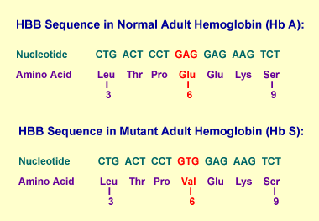
The change in shape occurs after the hemoglobin delivers oxygen to the cells, in the narrow capillaries
Abnormally shaped blood cells slow blood flow, block small vessels, and result in tissue damage
Sickle-Cell Anemia is very painful and can shorten a persons life span

Slide 99
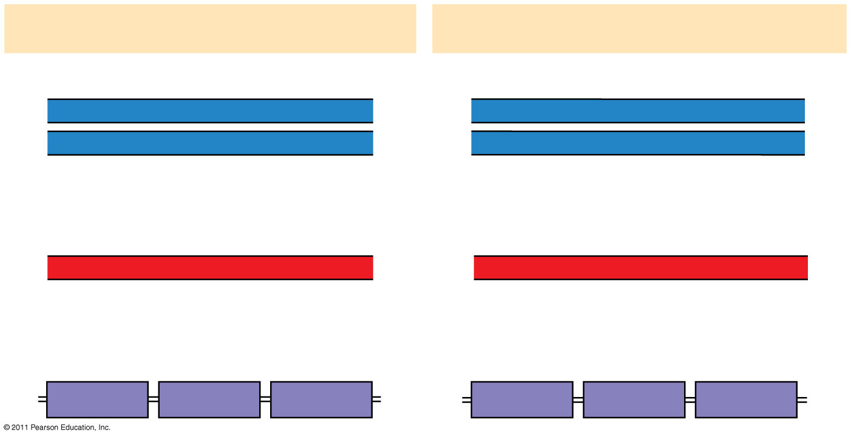
Figure 17.23
Wild-type hemoglobin
Sickle-cell hemoglobin
Wild-type hemoglobin DNA
Mutant hemoglobin DNA
3′
C
T
T
5′
3′
C
A
T
5′
5′
G
A
A
3′
5′
G
T
A
3′
mRNA
mRNA
5′
G
A
A
3′
5′
G
U
A
3′
Normal hemoglobin
Sickle-cell hemoglobin
Glu
Val
Notes:
Figure 17.23 The molecular basis of sickle-cell disease: a point mutation.

Slide 101
Substitutions
A nucleotide-pair substitution replaces one nucleotide and its partner with another pair of nucleotides
Silent mutations have no effect on the amino acid produced by a codon because of redundancy in the genetic code
Missense mutations still code for an amino acid, but not the correct amino acid
Nonsense mutations change an amino acid codon into a stop codon, nearly always leading to a nonfunctional protein
© 2011 Pearson Education, Inc.
Notes:
101

Slide 102
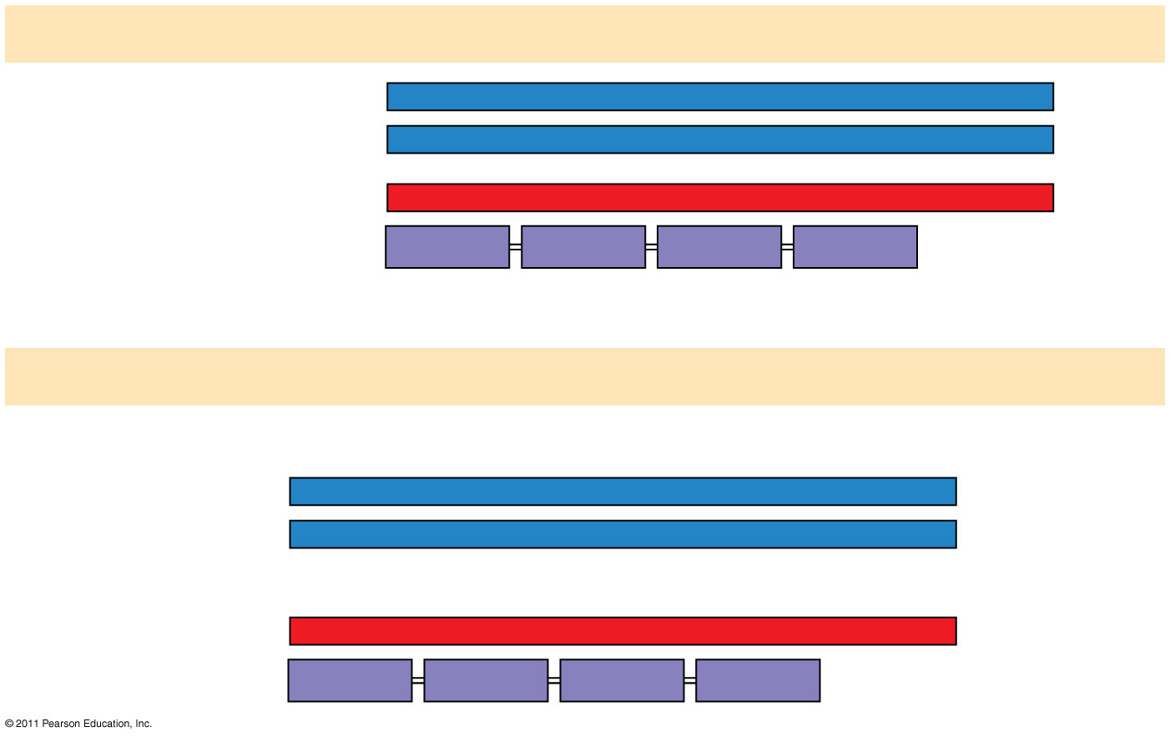
Figure 17.24a
Wild type
DNA template strand
3′
T
A
C
T
T
C
A
A
A
C
C
G
A
T
T
5′
5′
A
T
G
A
A
G
T
T
T
G
G
C
T
A
A
3′
mRNA5′
A
U
G
A
A
G
U
U
U
G
G
C
U
A
A
3′
Protein
Met
Lys
Phe
Gly
Stop
Amino end
Carboxyl end
(a) Nucleotide-pair substitution: silent
A instead of G
3′
T
A
C
T
T
C
A
A
A
C
C
A
A
T
T
5′
5′
A
T
G
A
A
G
T
T
T
G
G
T
T
A
A
3′
U instead of C
5′
A
U
G
A
A
G
U
U
U
G
G
U
U
A
A
3′
Met
Lys
Phe
Gly
Stop
Notes:
Figure 17.24 Types of small-scale mutations that affect mRNA sequence.

Slide 103
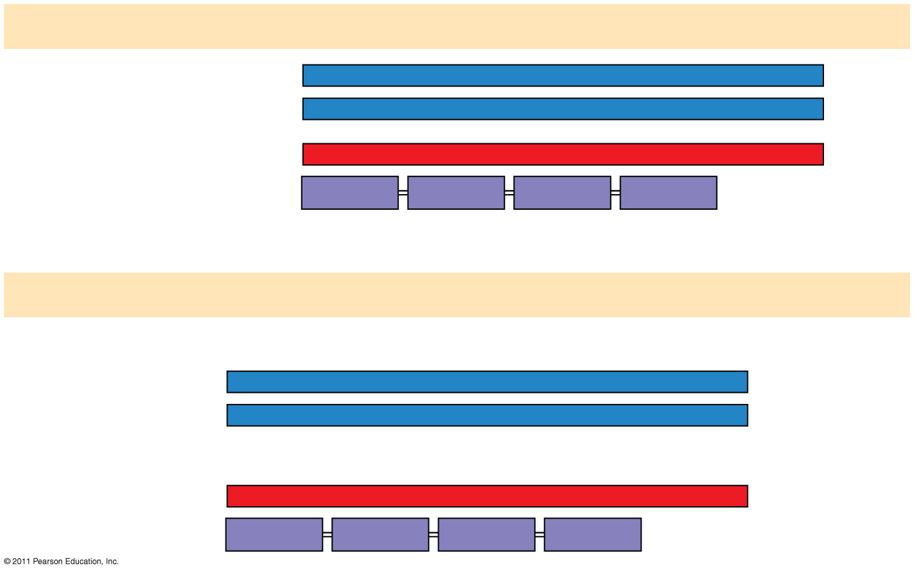
Figure 17.24b
Wild type
DNA template strand
3′
T
A
C
T
T
C
A
A
A
C
C
G
A
T
T
5′
5′
A
T
G
A
A
G
T
T
T
G
G
C
T
A
A
3′
mRNA5′
A
U
G
A
A
G
U
U
U
G
G
C
U
A
A
3′
Protein
Met
Lys
Phe
Gly
Stop
Amino end
Carboxyl end
(a) Nucleotide-pair substitution: missense
T instead of C
3′
T
A
C
T
T
C
A
A
A
T
C
G
A
T
T
5′
5′
A
T
G
A
A
G
T
T
T
A
G
C
T
A
A
3′
A instead of G
5′
A
U
G
A
A
G
U
U
U
A
G
C
U
A
A
3′
Met
Lys
Phe
Ser
Stop
Notes:
Figure 17.24 Types of small-scale mutations that affect mRNA sequence.

Slide 104
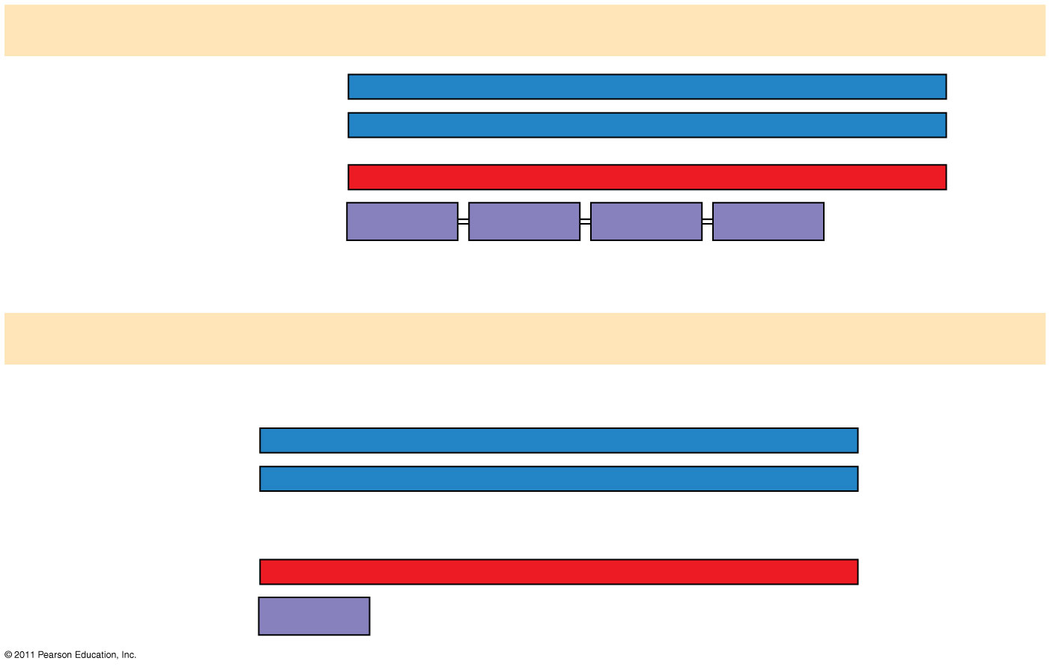
Figure 17.24c
Wild type
DNA template strand
3′
T
A
C
T
T
C
A
A
A
C
C
G
A
T
T
5′
5′
A
T
G
A
A
G
T
T
T
G
G
C
T
A
A
3′
mRNA5′
A
U
G
A
A
G
U
U
U
G
G
C
U
A
A
3′
Protein
Met
Lys
Phe
Gly
Stop
Amino end
Carboxyl end
(a) Nucleotide-pair substitution: nonsense
A instead of T
T instead of C
3′
T
A
C
A
T
C
A
A
A
C
C
G
A
T
T
5′
5′
A
T
G
T
A
G
T
T
T
G
G
C
T
A
A
3′
U instead of A
5′
A
U
G
U
A
G
U
U
U
G
G
C
U
A
A
3′
Met
Stop
Notes:
Figure 17.24 Types of small-scale mutations that affect mRNA sequence.

Slide 105
Mutagens
Spontaneous mutations can occur during DNA replication, recombination, or repair
Mutagens are physical or chemical agents that can cause mutations
Physical-Xrays, UV rays etc.
Chemicals-they can cause existing bases to pair incorrectly, be substituted into the DNA as bases, or cause DNA shape distortions.
© 2011 Pearson Education, Inc.
Notes:
105

