Slide 1
KEY CONCEPT All living things are based on atoms and their interactions.

Slide 2
Objectives
Identify elements common to all living things
Describe how ions form
Compare ionic and covalent bonding

Slide 3
Vocabulary
Atom
Element
Compound
Ion
Ionic bond
Covalent bond
Molecule
Proton
Neutron
Electron
Nucleus
Atomic Number
Atomic Mass

Slide 4
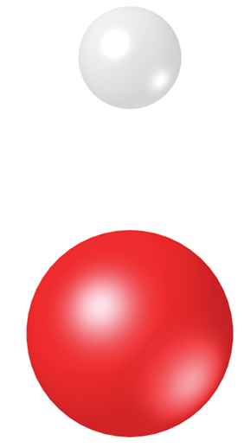
Living things consist of atoms of different elements.
An atom is the smallest basic unit of matter.
An element is one type of atom.
Hydrogen atom (H)
H
Oxygen atom (O)
O

Slide 5
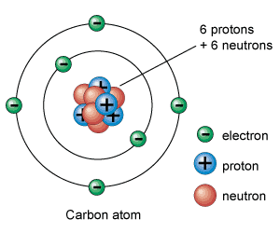
Atoms are made of different subatomic particles.
Protons have a positive charge
Electrons have a negative charge
Neutrons are neutral, so have no charge

Slide 6
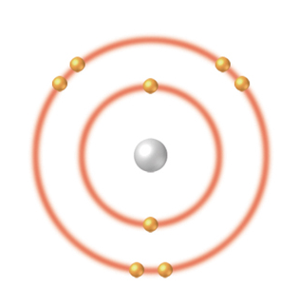
An atom has a nucleus and electrons.
The nucleus has protons and neutrons.
Electrons are in energy levels outside nucleus.
The outermost energy level determines the activity of the atom
Oxygen atom (O)
outermost energy level: 6 electrons (-)
Nucleus: 8 protons (+) 8 neutrons
inner energy level: 2 electrons (-)

Slide 7
Each element has different numbers of protons, neutrons, and electrons than each other element
A particular element always has the same number of protons
You know how many protons an element has by looking at the periodic table
The atomic number always identifies the number of protons in an atom

Slide 8
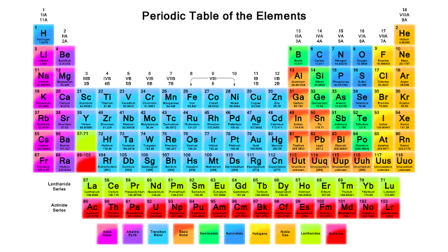
Elements are listed in order on the periodic table from lowest atomic number to the highest

Slide 9
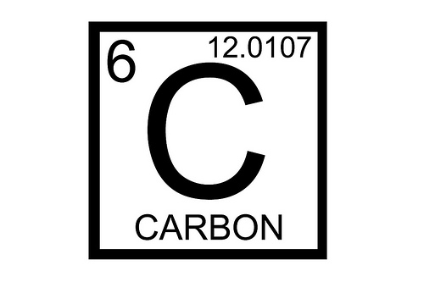
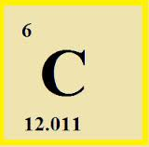
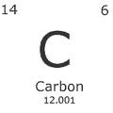
Different periodic tables may list the atomic weight and atomic number in different places

Slide 10
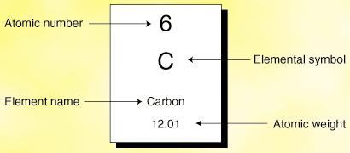
How many protons does carbon have?

Slide 11
Each element has different numbers of protons, neutrons, and electrons than each other element
Atoms usually have the same number of electrons as they do protons
The number of electrons is equal to the number of protons in “neutral” atoms

Slide 12
How many electrons does carbon have?

Slide 13
Each element has different numbers of protons, neutrons, and electrons than each other element
The atomic weight tells you how many protons, electrons, and neutrons are in an atom
Electrons are very small and don’t contribute much to weight

Slide 14
Each element has different numbers of protons, neutrons, and electrons than each other element
If you round the atomic weight to the nearest whole number we call that the atomic mass
If you subtract the number of protons from the atomic mass, that will tell you how many neutrons are in the atom

Slide 15
How many neutrons does carbon have?
1st round the atomic weight to the nearest whole # to get the atomic mass
12.01 → 12
2nd subtract the # of protons from the atomic mass
12 - 6 = 6

Slide 16
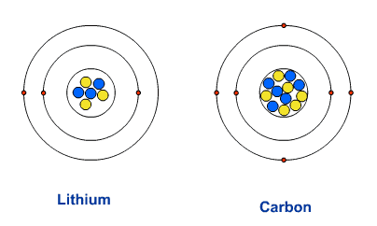
Electrons are found in energy levels
Atoms have many energy levels
Each level can hold a different number of electrons
1st energy level wants 2 electrons
2nd energy level wants 8 electrons
3rd energy level wants either 8 or 18 electrons

Slide 17
Atoms want to be stable
Energy levels want to be full of electrons
Lower energy levels always fill up before higher energy levels
The 3rd energy level wont have any electrons unless 1 and 2 are full
If the energy level isn’t full, the atom is not stable and will react with other atoms and form bonds and become stable

Slide 18
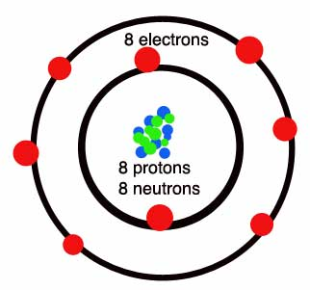
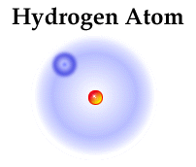
Atoms can gain, lose, or share electrons to become stable
Oxygen atom

Slide 19
Valence Electrons
The outermost energy level of an atom is called its valence shell
Electrons in the outermost energy level are called valence electrons
It’s the valence electrons that determine
what types of bonds will form
How many bonds will form
How many valence electrons does Oxygen have?

Slide 20
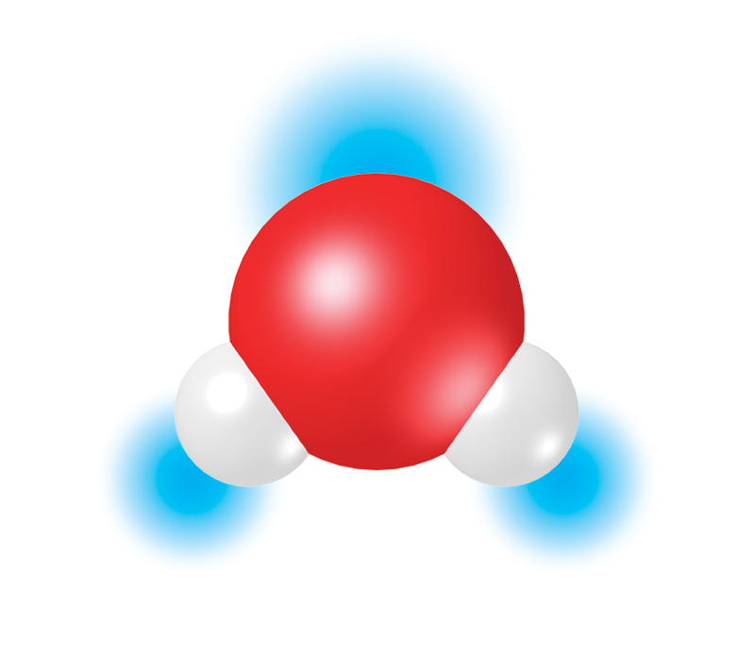
A compound is made of atoms of different elements bonded together.
water (H₂O)
_
O
H
H
+
+

Slide 21
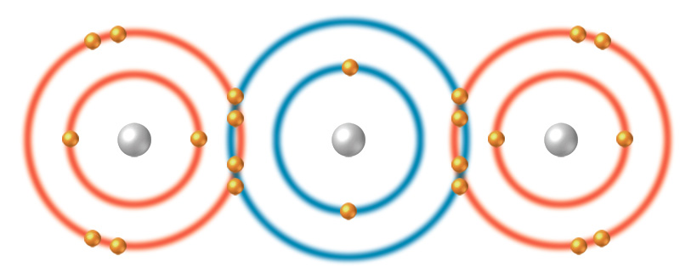
A compound is made of atoms of different elements bonded together.
carbon dioxide (CO₂)

Slide 22
Different Compounds are held together by different types of bonds
Covalent Bonds
Compounds held together by covalent bonds are called molecules
Ionic Bonds
Hydrogen Bonds
The type of bond that will form depends on the number of valence electrons

Slide 23
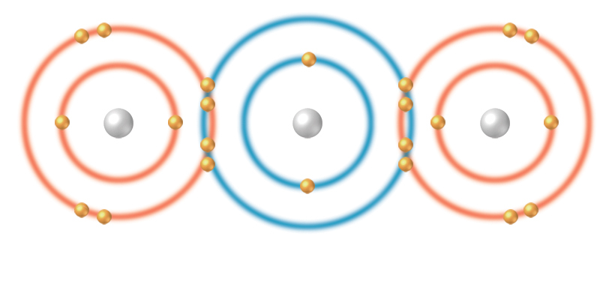
Atoms share pairs of electrons in covalent bonds.
A covalent bond forms when atoms share a pair of electrons.
The number of covalent bonds depends on the number of valence electrons an atom has to share
covalent bonds
Oxygen atom (O)
Carbon atom (C)
Oxygen atom (O)
Carbon dioxide (CO₂ )

Slide 24
Ionic Bonds
Covalent bonds are when atoms share electrons
Sometimes its easier for an atom to gain or lose an electron than to share
Atoms that gain electrons
Are called anions
what kind of charge will an anion have?
Atoms that lose electrons
Are called cations
what kind of charge will an cation have?

Slide 25
Ions form when atoms gain or lose electrons.
An ion is an atom that has gained or lost one or more electrons.
Ionic bonds form between oppositely charged ions.
Opposites Attract
gained electron
Na loses an electron to CI
ionic bond
Sodium atom (Na)
Chlorine atom (CI)
Sodium ion (Na⁺)
Chloride ion (CI⁻)

Slide 26
What distinguishes one element from another?

Slide 27
Describe the formation of an ionic compound

Slide 28
What is the difference between an ionic and a covalent bond?

Slide 29
How does a molecule differ from an atom?

Slide 30
Explain why a Hydrogen atom can become either an ion or a part of a molecule?

Slide 31
A sodium atom has one outer electron, and a carbon atom has 4 outer electrons. How might this difference be related to types of compounds formed by atoms of these 2 elements?

Slide 32
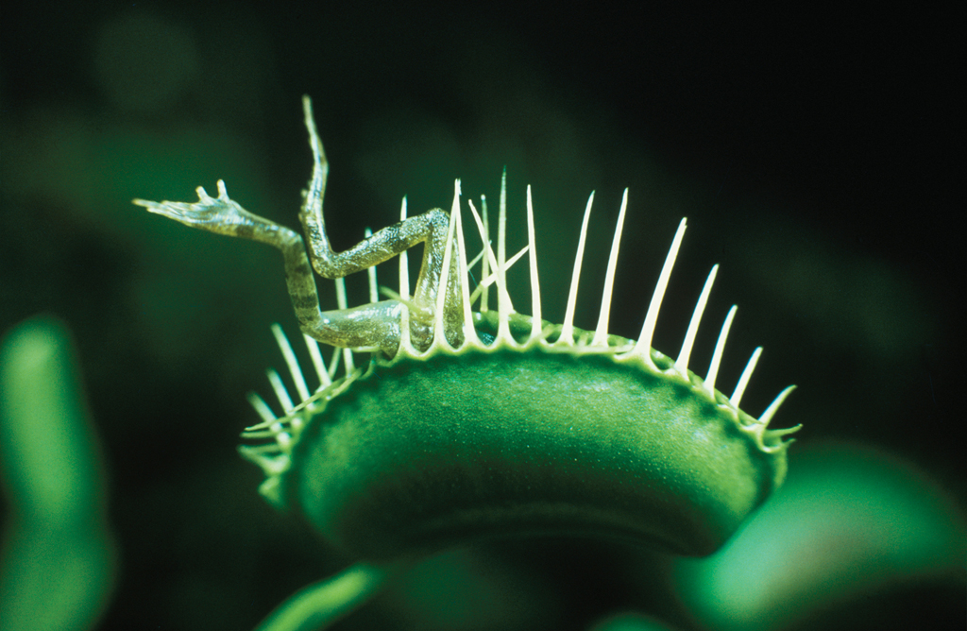
KEY CONCEPT Water’s unique properties allow life to exist on Earth.

Slide 33
Objectives
Recognize the importance of hydrogen bonding
Explain why many compounds dissolve in water
Compare acids and bases

Slide 34
Vocabulary
Hydrogen bond
Cohesion
Adhesion
Solution
Solvent
Solute
Acid
Base
pH
Hydrogen ion

Slide 35
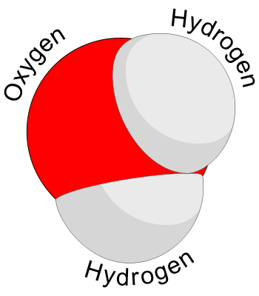
Life depends on hydrogen bonds in water.
Water is the only common substance found naturally in all three common states of matter and it is essential for all life on Earth
What kind of bonds are holding these 2 hydrogen atoms to the oxygen in this compound?

Slide 36
Life depends on hydrogen bonds in water.
Its true that these are covalent bonds holding the hydrogen atoms to the oxygen and so they are sharing electrons
O
H
H
BUT oxygen does not share the electrons equally with the hydrogen atoms
Electrons spend more time on the oxygen side than the hydrogen side
What kind of charge will oxygen have?

Slide 37
Life depends on hydrogen bonds in water.
Water is a polar molecule.
Polar molecules have slightly charged regions.
_
O
H
H
+
+
Nonpolar molecules do not have charged regions.
Hydrogen bonds form between slightly positive hydrogen atoms and slightly negative atoms.

Slide 38
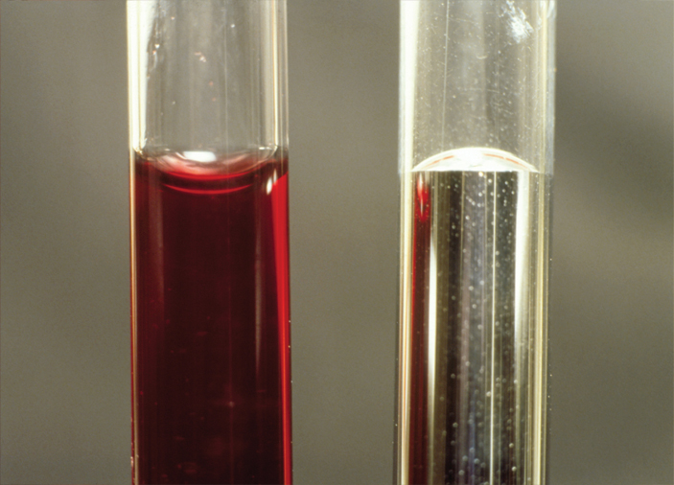
Hydrogen bonds are responsible for three important properties of water.
high specific heat
cohesion
adhesion

Slide 39
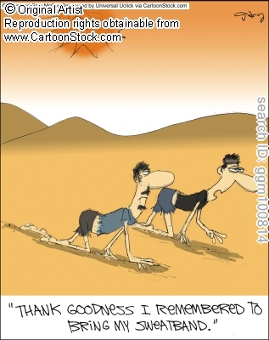
Specific Heat Capacity
Water has a high specific heat capacity
This means it requires a lot of heat energy to raise the temperature of water
This makes water resist changing temperature so its good at moderating Earth's climate
Because water can absorb the heat from the air when its hotter, and release the heat when its cooler outside

Slide 40
Capillary Action and Surface Tension are products of adhesion & cohesion
Cohesion
Adhesion
Water molecules are attracted to other water molecules
Water sticks to itself
Water molecules are attracted to other polar molecules
Water sticks to things
EX: water sticks to the side of you cold soda cup on a hot day

Slide 41
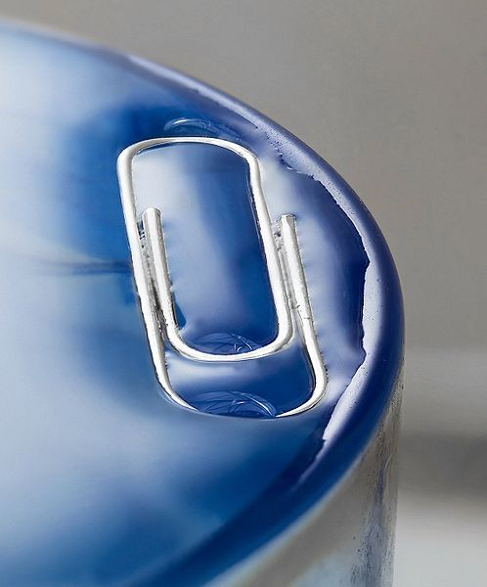
Capillary Action and Surface Tension are products of adhesion & cohesion
Surface Tension
Capillary Action
A thin “skin” across the surface of water due to cohesion
https://www.youtube.com/watch?v=45yabrnryXk
water rises into a narrow tube against the force of gravity.
Water adheres to the inside wall of the tube and surface tension tends to straighten the surface causing a surface rise and more water is pulled up through cohesion

Slide 42
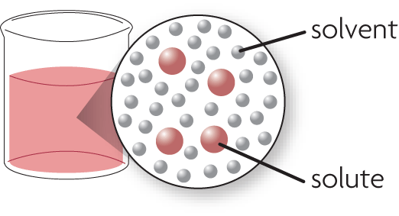
Many compounds dissolve in water.
A solution is formed when one substance dissolves in another.
A solution is a homogeneous mixture.
Solvents dissolve other substances.
Solutes dissolve in a solvent.
solution

Slide 43
“Like dissolves like.”
Polar solvents dissolve polar solutes.
Hydrophilic: water loving
Nonpolar solvents dissolve nonpolar solutes.
Hydrophobic: water fearing
Polar substances and nonpolar substances generally remain separate.
think oil (nonpolar) & water
vinegar (polar) & water

Slide 44
Some compounds form acids or bases.
An acid releases a hydrogen ion (H+) when it dissolves in water.
high H⁺ concentration
pH less than 7
stomach acid pH between 1 and 3
more acidic

Slide 45
A base removes hydrogen ions from a solution.
low H⁺ concentration
pH greater than 7
bile pH between 8 and 9
more basic

Slide 46
A neutral solution has a pH of 7.
pure water pH 7

Slide 47
What causes a molecule to be polar?

Slide 48
How do polar molecules form hydrogen bonds?

Slide 49
What are some of waters properties

Slide 50
How do organisms depend on waters properties to survive

Slide 51
What determines whether a compound will dissolve in water

Slide 52
Make a chart that compares acids and bases
Acids
Bases

Slide 53
How do polar molecules differ from nonpolar molecules? How does this difference affect their interaction?

Slide 54
Describe an example of cohesion or adhesion that you might observe in your daily life

Slide 55
When sugars are broken down to produce usable energy a large amount of heat is released. Explain how the water inside a cell helps to keep the cells temperature constant.

Slide 56
KEY CONCEPT Carbon-based molecules are the foundation of life.

Slide 57
Objectives
Describe the bonding properties of carbon atoms
Compare carbohydrates, proteins, lipids, and nucleic acids

Slide 58
Vocabulary
Monomer
Polymer
Carbohydrate
Monosaccharide
Lipid
Phospholipid
Starch
Cellulose
Protein
Amino acid
Peptide bond
Nucleic acid
Nucleotide

Slide 59
Carbon atoms have unique bonding properties.
How many electrons does a carbon atom have?
How many of those electrons are valence electrons?
How many more electrons does carbon need to be stable?
How many covalent bonds do you think carbon will make to accomplish this?

Slide 60
Carbon atoms have unique bonding properties.
Carbon forms covalent bonds with up to four other atoms, including other carbon atoms.
Carbon-based molecules have three general types of structures.
straight chain
branched chain
ring

Slide 61
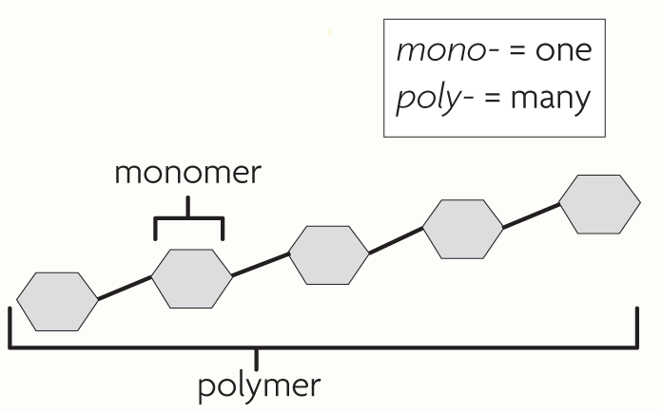
Many carbon-based molecules are made of many small subunits called monomers bonded together to form polymers.
Monomers are the individual subunits.
Polymers are made of many monomers.

Slide 62
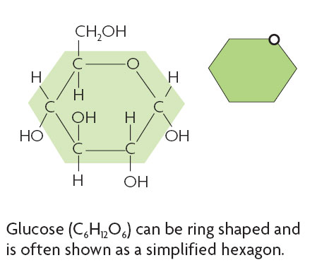
Four main types of carbon-based molecules are found in living things.
Carbohydrates are made of carbon, hydrogen, and oxygen.
Notice the ratio of C:H:O
This ratio is maintained for ALL sugars

Slide 63
Four main types of carbon-based molecules are found in living things.
Carbohydrates include sugars and starches
Monomers→Monosaccharides
Glucose
Fructose
Polymers→ Polysaccharides
Starch
Cellulose

Slide 64
Carbohydrates can be broken down to provide energy for cells.
Some carbohydrates are part of cell structure.
Polymer (starch)
Starch is a polymer of glucose monomers that often has a branched structure.
Polymer (cellulose)
Cellulose is a polymer of glucose that is found in the cell walls of plants
monomer

Slide 65
Lipids are nonpolar molecules that include fats, oils, and cholesterol.
Many contain carbon chains called fatty acids.
Fats and oils contain fatty acids bonded to glycerol.
Triglyceride
Glycerol
Fatty Acid

Slide 66
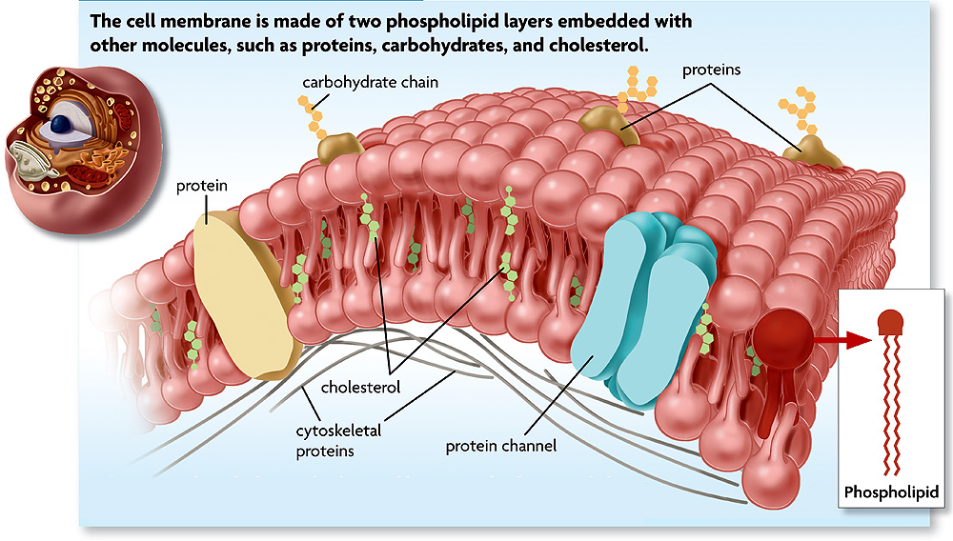
Lipids have several different functions.
broken down as a source of energy
make up cell membranes
used to make steroid hormones

Slide 67
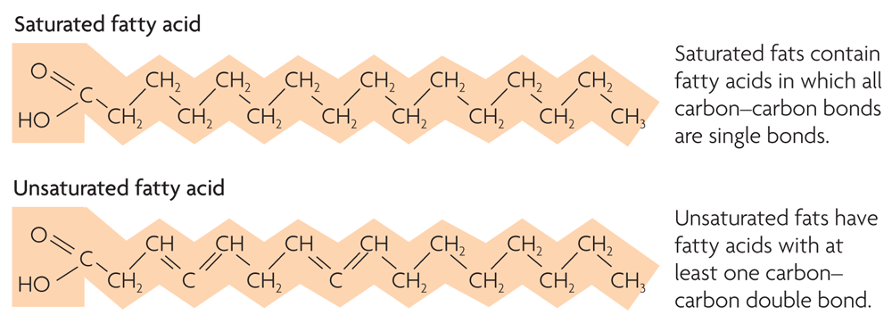
Fats and oils have different types of fatty acids.
saturated fatty acids
unsaturated fatty acids

Slide 68
Phospholipids make up all cell membranes.
Polar phosphate “head”
Nonpolar fatty acid “tails”
Phospholipid

Slide 69
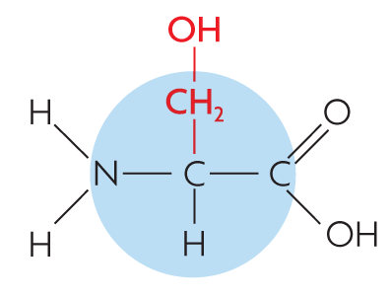
Proteins are polymers of amino acid monomers.
Twenty different amino acids are used to build proteins in organisms.

Slide 70
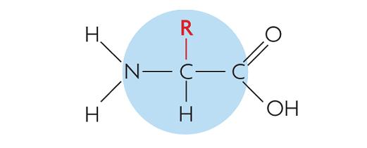
Proteins are polymers of amino acid monomers.
Twenty different amino acids are used to build proteins in organisms.
Amino acids differ in side groups, or R groups.

Slide 71
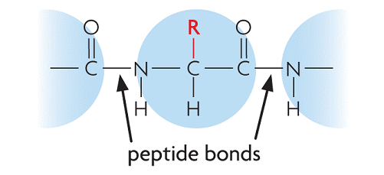
Proteins are polymers of amino acid monomers.
Twenty different amino acids are used to build proteins in organisms.
Amino acids differ in side groups, or R groups.
Amino acids are linked by peptide bonds.

Slide 72
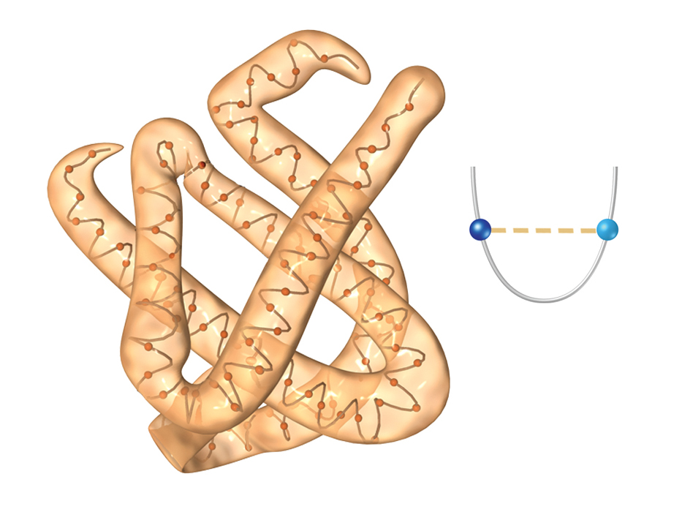
Proteins differ in the number and order of amino acids.
Amino acids interact to give a protein its shape.
Hemoglobin
hydrogen bond
Incorrect amino acids change a protein’s structure and function.

Slide 73
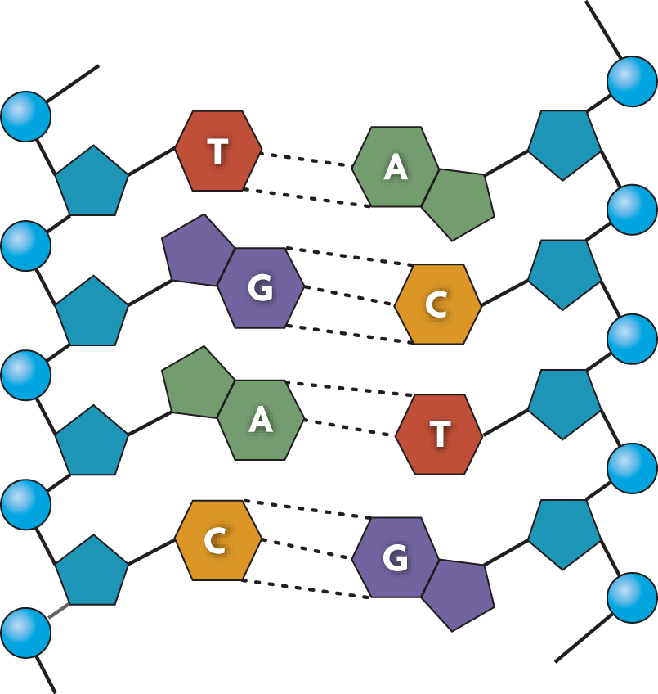
Nucleic acids are polymers of monomers called nucleotides.

Slide 74
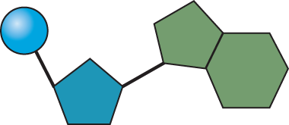
Nucleic acids are polymers of monomers called nucleotides.
Nucleotides are made of a sugar, phosphate group, and a nitrogen base.
A phosphate group
nitrogen-containing molecule, called a base
deoxyribose (sugar)

Slide 75
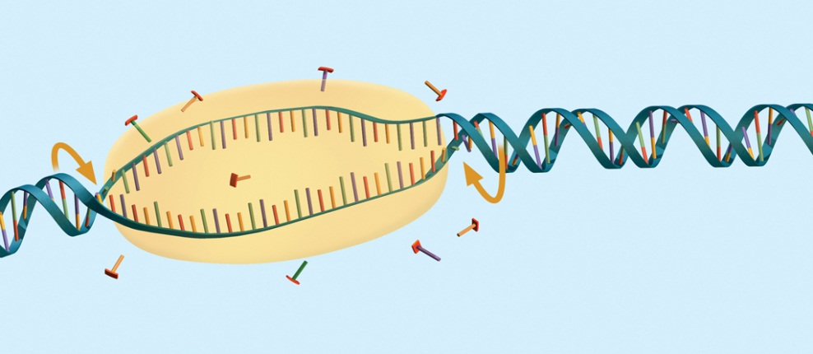
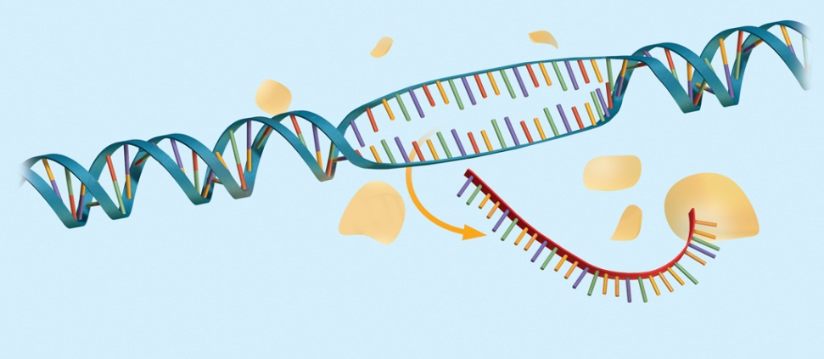
Nucleic acids are polymers of monomers called nucleotides.
Nucleotides are made of a sugar, phosphate group, and a nitrogen base.
DNA stores genetic information .
DNA
RNA is used to build proteins.
RNA

Slide 76
What is the relationship between a polymer and a monomer

Slide 77
Explain how both nucleic acids and proteins are are polymers. Be sure to describe the monomers that make up the polymers.
Proteins
Nucleic Acids
They’re both polymers because they’re both made of smaller units bonded together

Slide 78
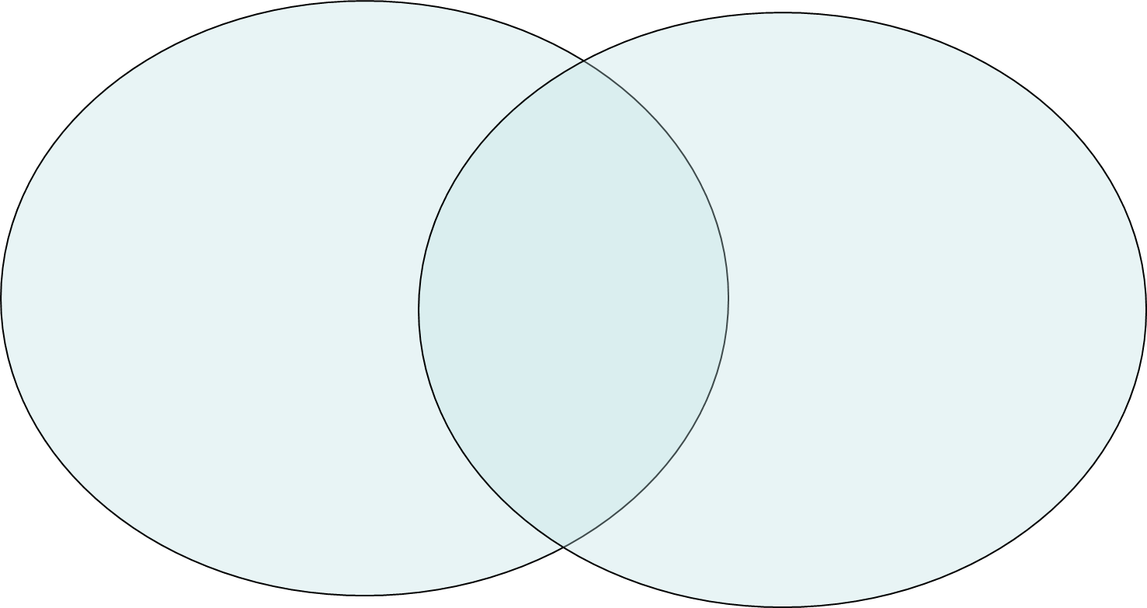
How are carbohydrates and lipids similar? How are they different
Lipids
Carbohydrates
-Both
made of
__________
-Broken down as a source of energy
-Have some structural functions

Slide 79
Explain how the bonding properties of carbon atoms result in the large variety of carbon-based molecules in living things

Slide 80
Why might fatty acids, amino acids, and nucleic acids increase the hydrogen ion (H+) concentration of a solution? Explain your answer.

Slide 81
KEY CONCEPT Life depends on chemical reactions.

Slide 82
Objectives
Describe how bonds break and reform during chemical reactions
Explain why chemical reactions release or absorb energy

Slide 83
Vocabulary
Chemical reaction
Reactant
Product
Bond energy
Equilibrium
Activation energy

Slide 84
Bonds break and form during chemical reactions.
Chemical reactions change substances into different ones by breaking and forming chemical bonds.
Reactants are changed during a chemical reaction.
Products are made by a chemical reaction.
Some chemical reactions are used to build things
Reactant + Reactant
Product
Some chemical reactions are used to break things down
Reactant
Product + Product

Slide 85
Bond energy is the amount of energy that breaks a bond.
Energy is added to break bonds.
Energy is released when bonds form.
A reaction is at equilibrium when reactants and products form at the same rate.
CO₂ + H₂O H₂CO₃

Slide 86
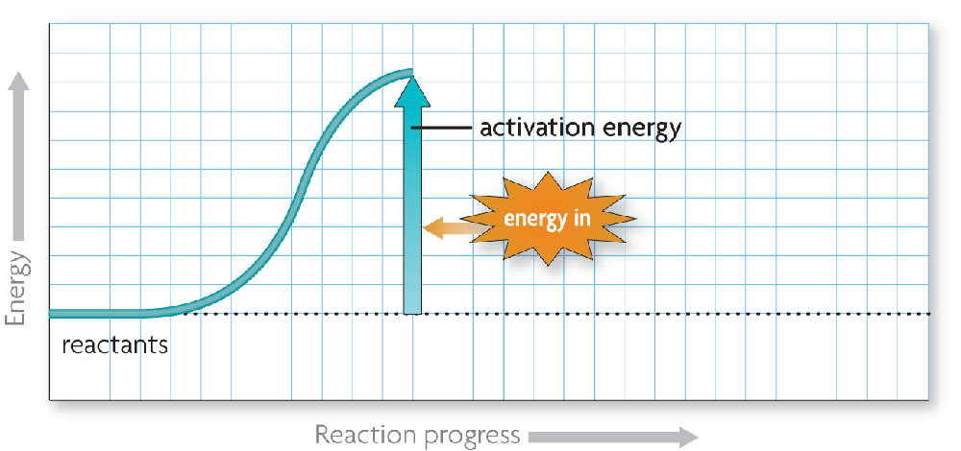
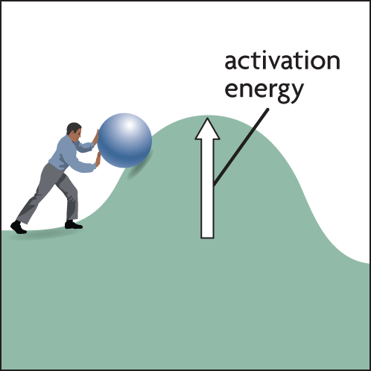
Chemical reactions release or absorb energy.
Activation energy is the amount of energy that needs to be absorbed to start a chemical reaction.

Slide 87
Hydrogen peroxide (H₂O₂) breaks down into water (H₂O) and oxygen (O₂). A) Explain why this is a chemical reaction. B) what are the reactants? C) what are the products?

Slide 88
How do endothermic and exothermic reactions differ?

Slide 89
The process below is exothermic. What must be true about the bond energies of the reactants and the products? Explain. 6O₂ + C₆H₁₂O₆ → 6CO₂ + 6H₂O

Slide 90
Why might it not always be possible to determine the reactants and the products in a reaction? Explain your answer in terms of chemical equilibrium.

Slide 91
A chemical reaction can start when enough activation energy is added to the reactants. Do you think the activation energy for chemical reactions in living things is high or low? Explain your answer.

Slide 92
KEY CONCEPT Enzymes are catalysts for chemical reactions in living things.

Slide 93
Objectives
Explain the effect of a catalyst on activation energy
Describe how enzymes regulate chemical reactions

Slide 94
Vocabulary
Catalyst
Enzyme
Substrate
Active site

Slide 95
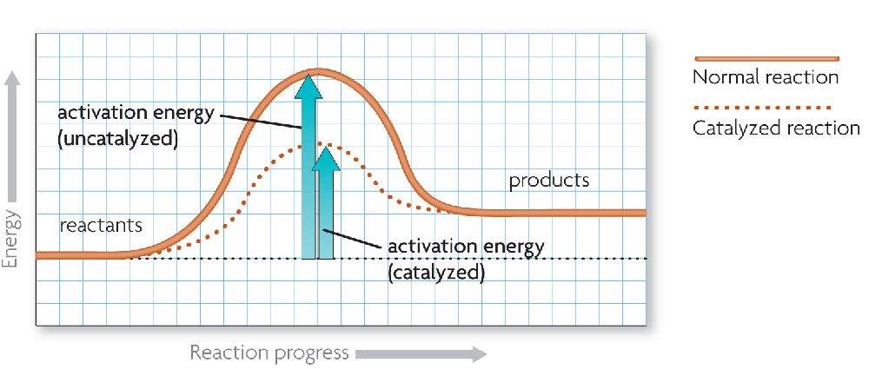
A catalyst lowers activation energy.
Catalysts are substances that speed up chemical reactions.
decrease activation energy
increase reaction rate

Slide 96
Enzymes allow chemical reactions to occur under tightly controlled conditions.
Enzymes are catalysts in living things.
Enzymes are needed for almost all processes.
Most enzymes are proteins.

Slide 97
Disruptions in homeostasis can prevent enzymes from functioning.
Enzymes function best in a small range of conditions.
Changes in temperature and pH can break hydrogen bonds.
An enzyme’s function depends on its structure.

Slide 98
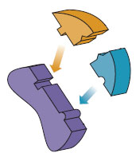
An enzyme’s structure allows only certain reactants to bind to the enzyme.
Substrates
active site: the
“active” part of
the enzyme
The part the
substrate binds to
substrates (reactants)
enzyme
Substrates bind to an enzyme at certain places called active sites.

Slide 99
The lock-and-key model helps illustrate how enzymes function.
substrates brought together
bonds in substrates weakened
Substrates bind to an enzyme at certain places called active sites.
The enzyme brings substrates together and weakens their bonds.
The catalyzed reaction forms a product that is released from the enzyme.

Slide 100
How does a catalyst affect the activation energy and rate of a reaction

Slide 101
Describe how the interaction between an enzyme and its substrates changes a chemical reaction

Slide 102
Some organisms live in very hot or acidic environments. Would their enzymes function in a persons cells? Why or why not?

Slide 103
Suppose that the amino acids that make up an enzymes active site are changed. How might this change affect the enzyme?

Slide 104
Organisms need to maintain homeostasis, or stable internal conditions. Why is homeostasis important for the function of enzymes?

