Slide 1
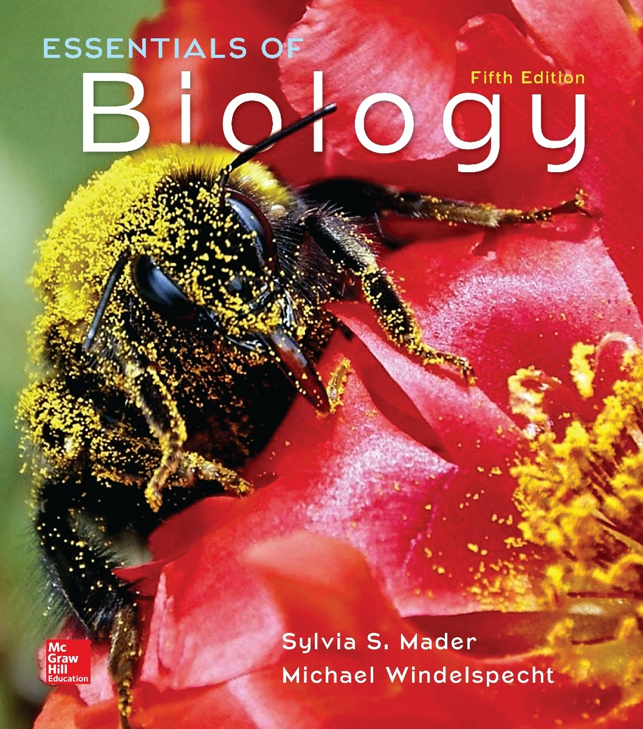
Essentials of Biology
Chapter 16
Evolution on a Large Scale
Notes:
1

Slide 2
16.1 Speciation and Macroevolution
Macroevolution—changes in a population over a very long period of time
Speciation—splitting of one species into two or more new species
Species originate, adapt to their environment, and then may become extinct.

Slide 3
Biological Species Concept, 1
Members of a species:
Interbreed
Have a shared gene pool
Each species reproductively isolated from every other species
Not based on appearance
Gene flow occurs between populations of a species but not between populations of different species.
Flycatchers look similar but are different species.
Humans can look very different but are the same species.

Slide 4
Figure 16.2 Three Species of Flycatchers
Flycatchers may look similar and yet do not interbreed in nature—they are different species.
Acadian flycatcher, Empidonax virescens
Willow flycatcher, Empidonax trailli
Least flycatcher, Empidonax minimus
(Acadian): © James Mundy/Alamy; (Willow): © All Canada Photos/Alamy; (Least): © Rick & Nora Bowers/Alamy

Slide 5
Biological Species Concept, 2
The biological species concept only applies to living, sexually reproducing organisms.
Other definitions of species:
Category of classification below rank of genus
Species in the same genus share a recent common ancestor.

Slide 6
Reproductive Barriers
Isolating mechanisms that prevent successful reproduction (producing fertile offspring) from occurring
Prezygotic—before formation of a zygote
Habitat isolation
Temporal isolation
Behavioral isolation
Mechanical isolation
Gamete isolation
Postzygotic—after formation of a zygote
Zygote mortality
Hybrid sterility
$F_{2}$ fitness

Slide 7
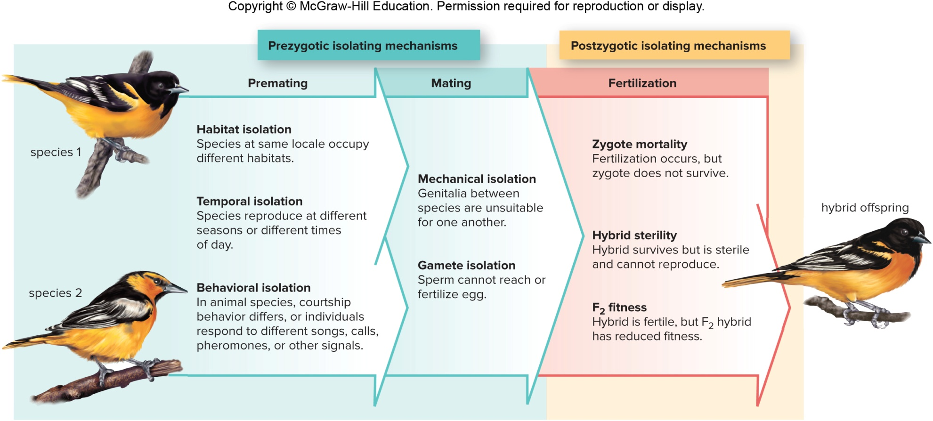
Figure 16.4 Reproductive Barriers

Slide 8
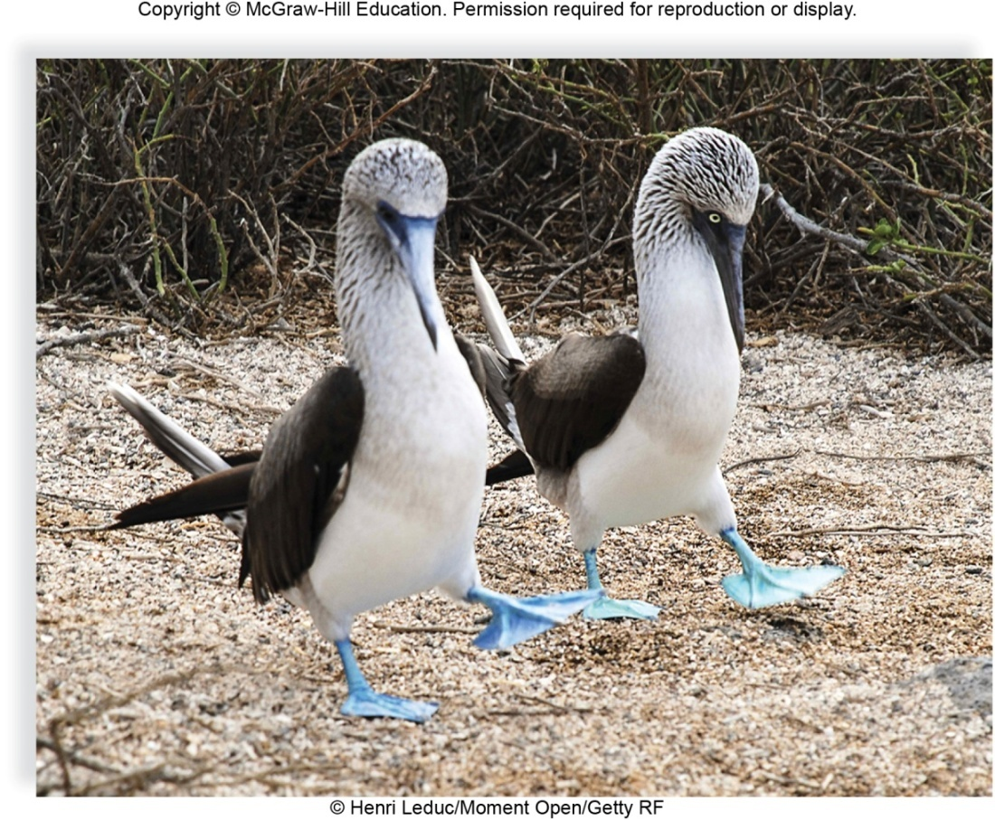
Figure 16.5 Prezygotic Isolating Mechanism
Elaborate courtship displays are species-specific.
© Henri Leduc/Moment Open/Getty RF

Slide 9
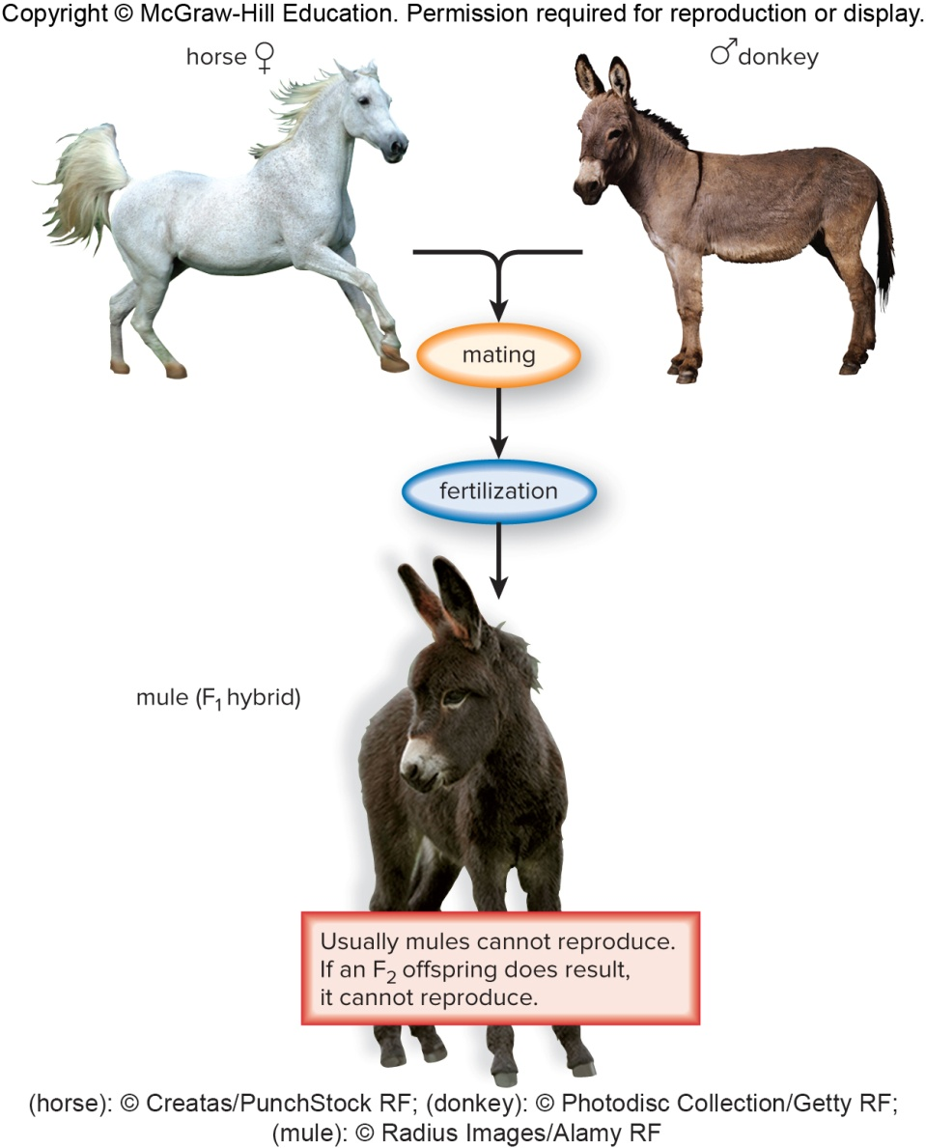
Figure 16.6 Postzygotic Isolating Mechanism
Mules are infertile due to a difference in chromosomes inherited from their parents.
(horse): © Creatas/PunchStock RF; (donkey): © Photodisc Collection/Getty RF; (mule): © Radius Images/Alamy RF

Slide 10
Models of Speciation
Allopatric—speciation model based on geographic isolation
Ensatina salamanders in California
Sympatric—population develops into two or more reproductively isolated groups without prior geographic isolation
Found among plants due to polyploidy
Formation of bread wheat

Slide 11
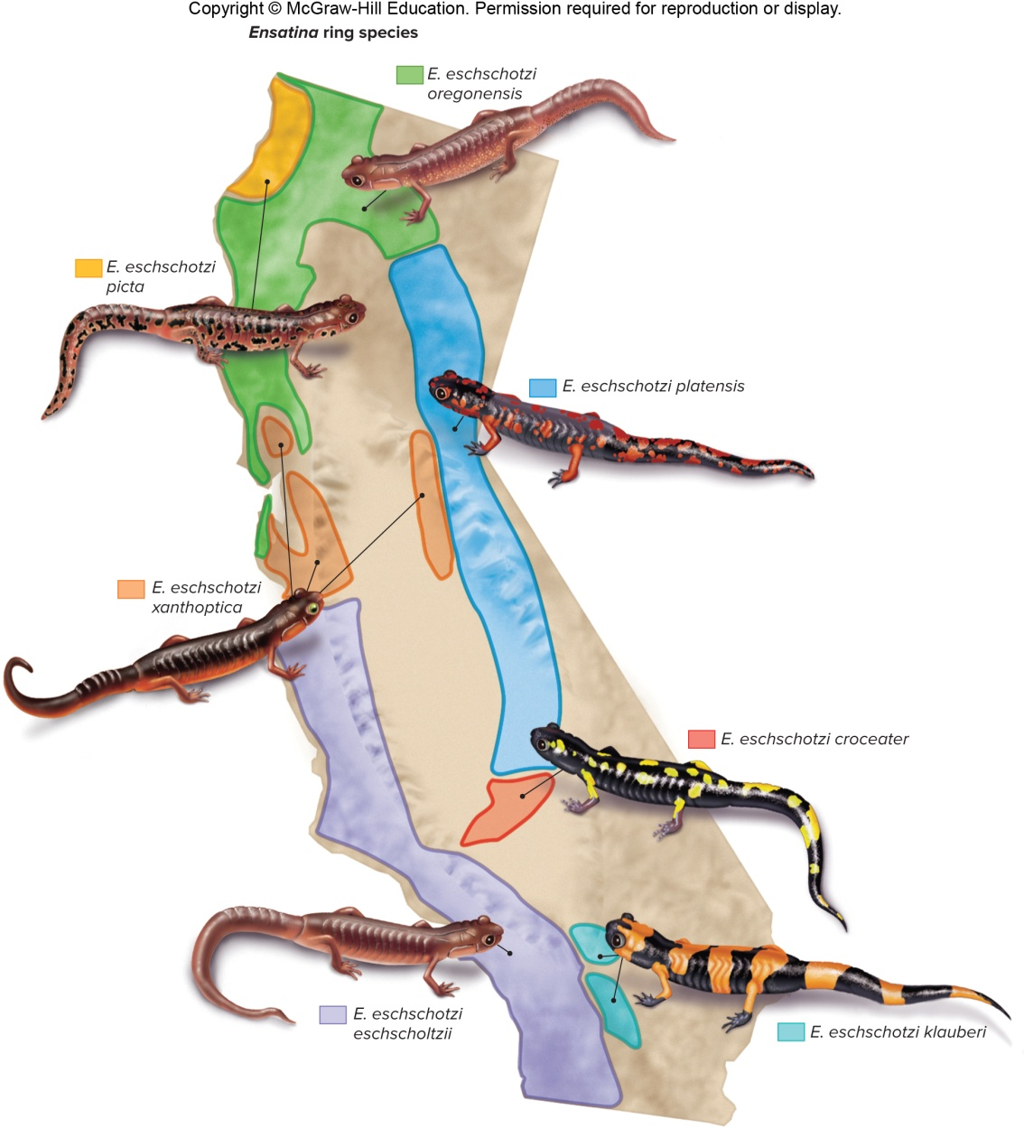
Figure 16.7 Allopatric Speciation

Slide 12
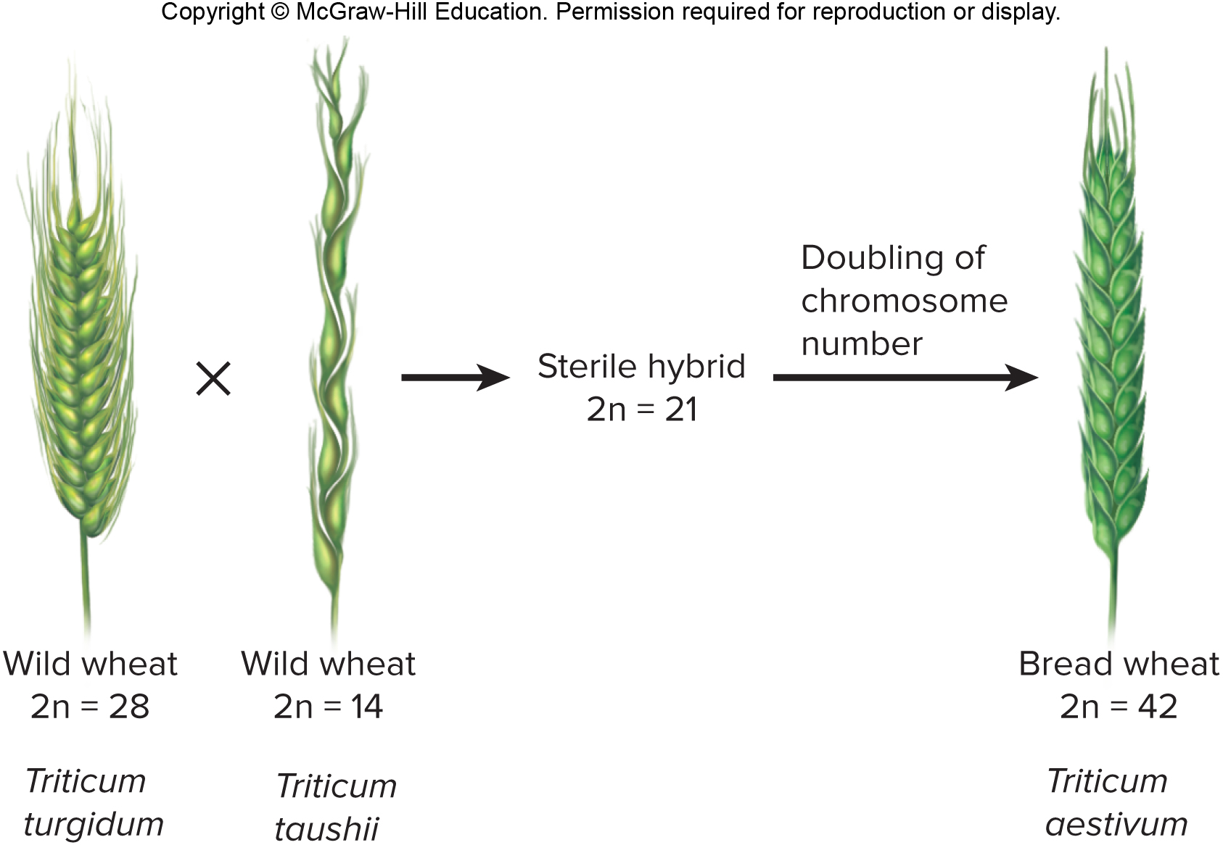
Figure 16.8 Sympatric Speciation

Slide 13
Adaptive Radiation
New species evolve from a single ancestral species.
Galápagos Islands finches
Populations on different islands subjected to founder effect involving genetic drift, genetic mutations, and the process of natural selection
Each population became adapted to a particular habitat on its island.
New finch species do not interbreed.

Slide 14
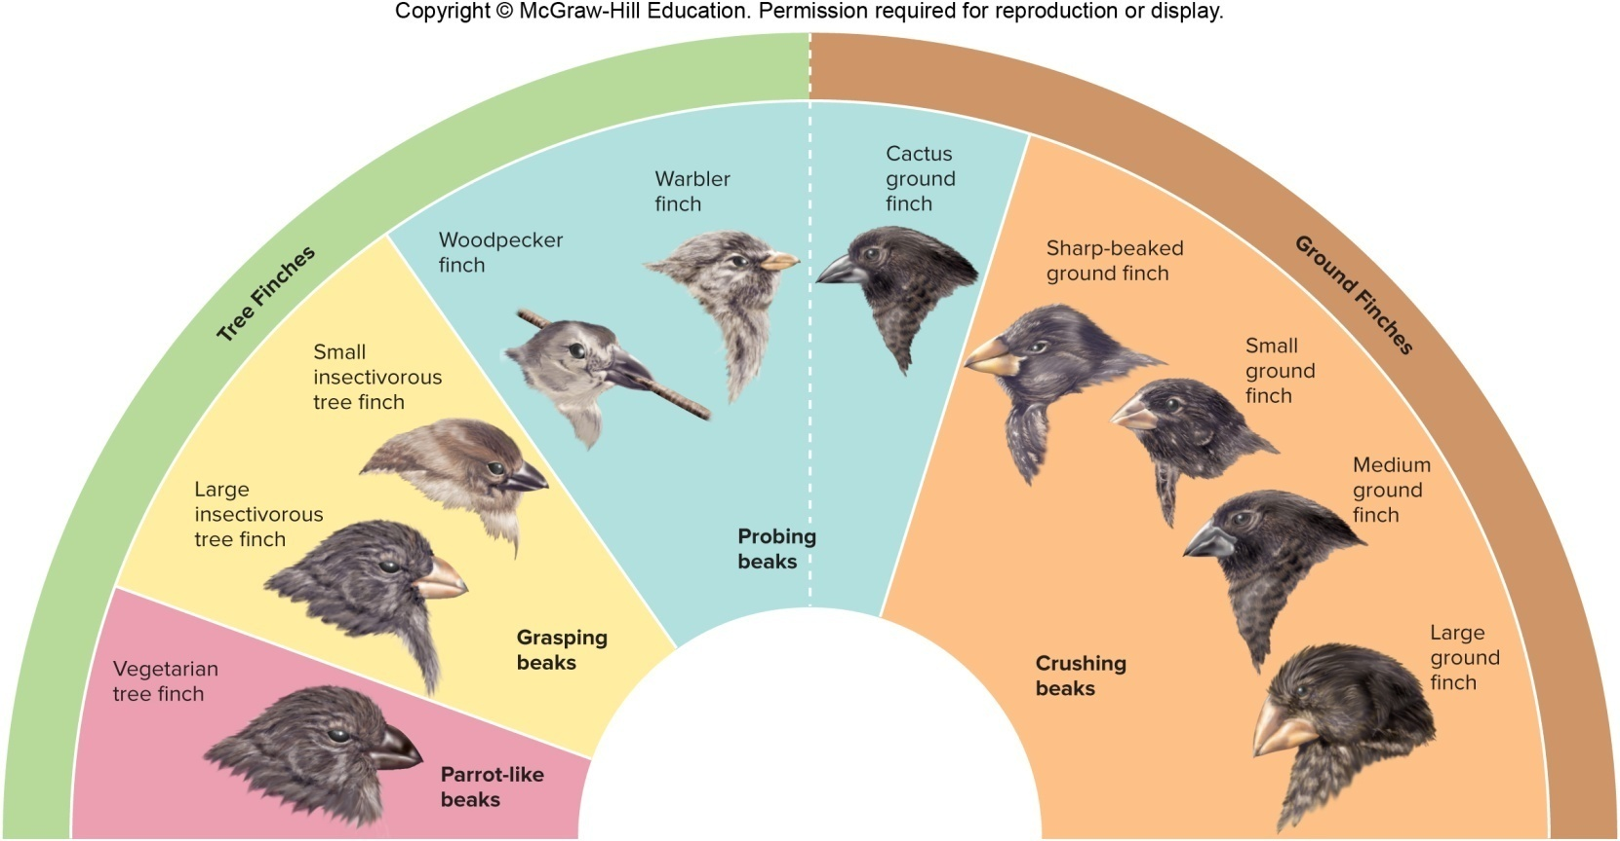
Figure 16.9 Darwin’s Finches
Each species adapted to eating a different type of food.

Slide 15
16.2 The Fossil Record
Fossils—traces and remains of past life or any other direct evidence of past life
Paleontology—science of discovering and studying the fossil record and making decisions about the history of species
Geological timescale
Humans have only been around for 0.04% of the history of life.

Slide 16
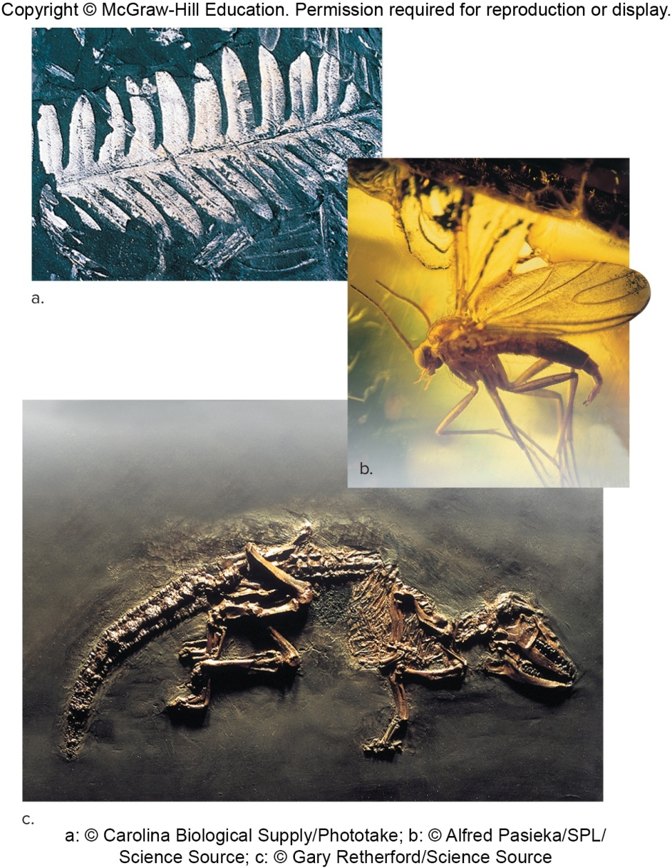
Figure 16.10 Fossils
a: © Carolina Biological Supply/Phototake; b: © Alfred Pasieka/SPL/ Science Source; c: © Gary Retherford/Science Source

Slide 17
Table 16.1 The Geological Timescale: Major Divisions of Geological Time and a Summary of Major Evolutionary Events, Cenozoic Era
Table 16.1 The Geological Timescale: Major Divisions of Geological Time and Some of the Major Evolutionary Events of Each Time Period
Millions of Years Ago (MYA)
Era
Period
Epoch
Plant Life
Animal Life
Cenozoic
Quaternary
Holocene
current
Humans influence plant life.
Age of Homo sapiens
Significant Extinction Event Underway
Quaternary
Pleistocene
0.01
Herbaceous plants spread and diversify.
Presence of ice age mammals. Modern humans appear.
Neogene
Pliocene
2.6
Herbaceous angiosperms flourish.
First hominids appear.
Neogene
Miocene
5.3
Grasslands spread as forests contract.
Apelike mammals and grazing mammals flourish; insects flourish.
Neogene
Oligocene
23.0
Many modern families of flowering plants evolve; appearance of grasses.
Browsing mammals and monkeylike primates appear.
Paleogene
Eocene
33.9
Subtropical forests with heavy rainfall thrive.
All modern orders of mammals are represented.
Paleogene
Paleocene
55.8
Flowering plants continue to diversify.
Ancestral primates, herbivores, carnivores, and insectivores appear.
Jump to long description

Slide 18
Table 16.1 The Geological Timescale: Major Divisions of Geological Time and a Summary of Major Evolutionary Events, Mesozoic Era
Table 16.1 The Geological Timescale: Major Divisions of Geological Time and Some of the Major Evolutionary Events of Each Time Period
Millions of Years Ago (MYA)
Era
Period
Epoch
Plant Life
Animal Life
Mass Extinction: 50% of all species, dinosaurs and most reptiles
Mesozoic
Cretaceous
65.5
Flowering plants spread; conifers persist.
Placental mammals appear; modern insect groups appear.
Jurassic
145.5
Flowering plants appear.
Dinosaurs flourish; birds appear.
Mass Extinction: 48% of all species, including corals and ferns
Triassic
199.6
Forests of conifers and cycads dominate.
First mammals appear;
first dinosaurs appear;
corals and molluscs dominate seas.

Slide 19
Pace of Speciation
Gradualistic model
Darwin thought evolutionary changes occurred gradually.
Often shows evolutionary history as an evolutionary tree
Difficult to indicate when speciation has occurred because of transitional links
Punctuated equilibrium
Period of equilibrium (no change) is punctuated (interrupted) by speciation
Transitional links less likely to form fossils and less likely to be found
Differences between models are subtle— “sudden” in geological time may be thousands of years.

Slide 20
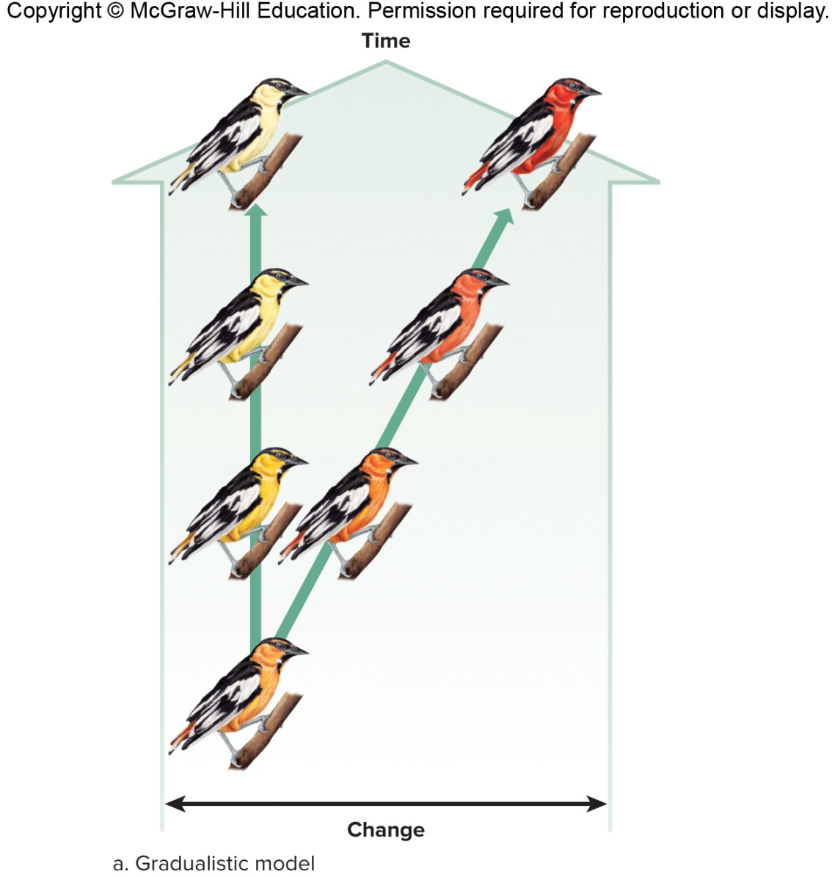
Figure 16.12a Pace of Evolution, Gradualistic Model

Slide 21
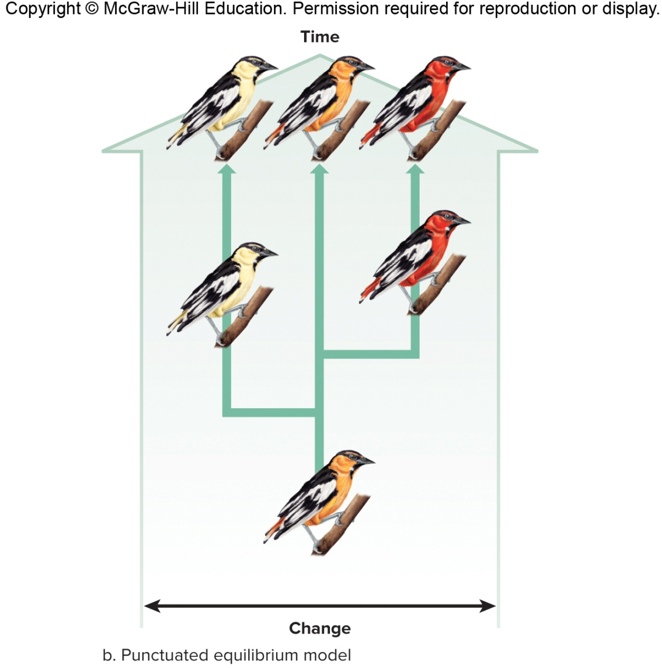
Figure 16.12b Pace of Evolution, Punctuated Equilibrium Model

Slide 22
Mass Extinctions of Species
Disappearance of a large number of species or a higher taxonomic group within a relatively short period of time
Occurrence of five mass extinctions
End of Ordovician, Devonian, Permian, Triassic, and Cretaceous periods
Significant mammalian extinction at the end of the Pleistocene epoch
Many factors contribute
Continental drift—movement of continents can lead to massive habitat changes
Impact of meteorites—proposed as primary cause of Cretaceous extinction

Slide 23
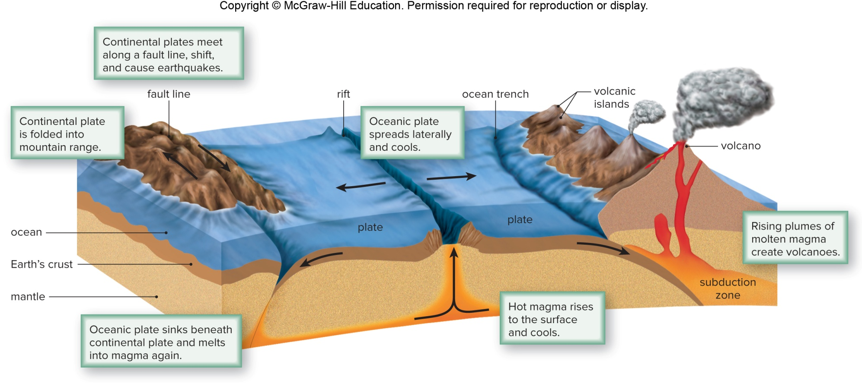
Figure 16.13 Plate Tectonics

Slide 24
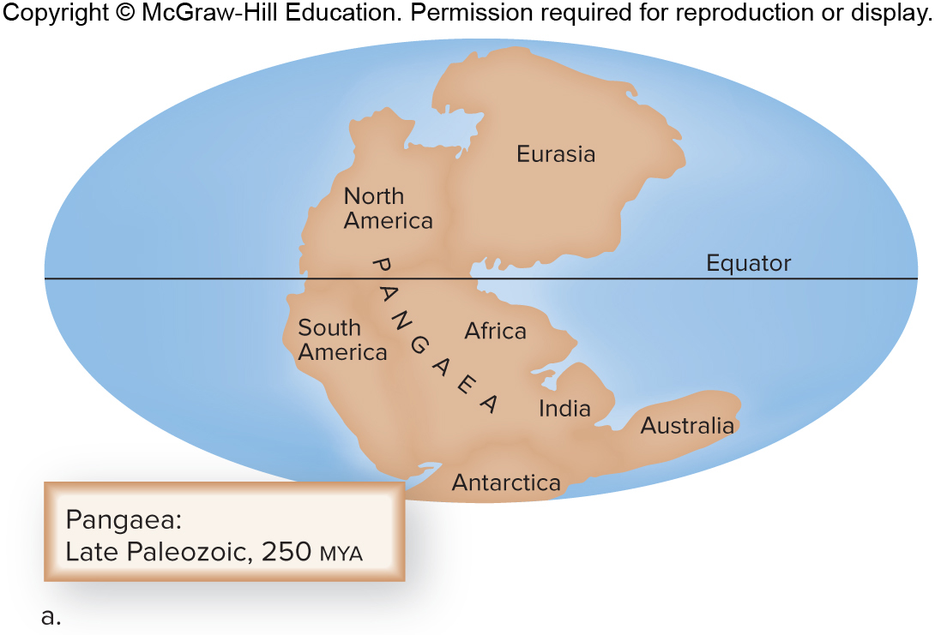
Figure 16.14a Continental Drift, Pangaea

Slide 25
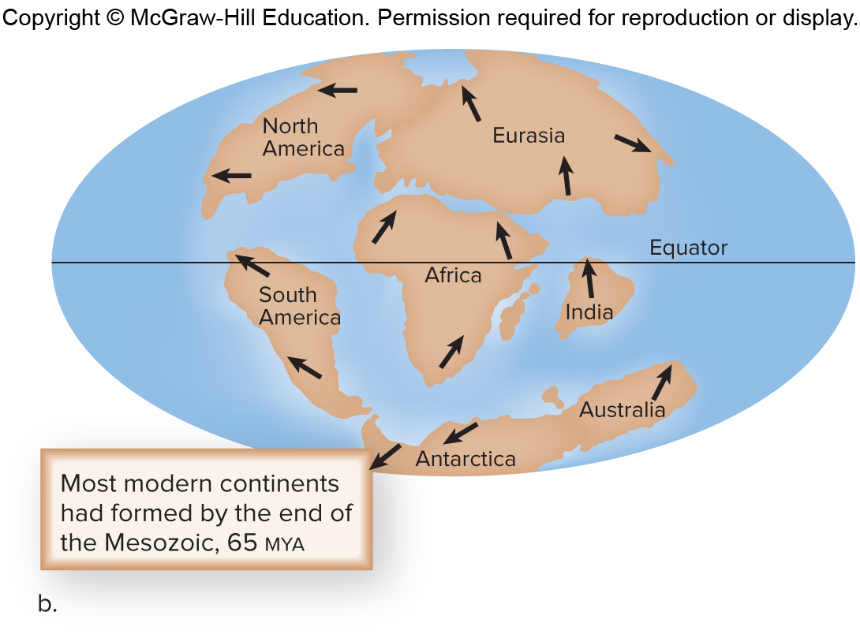
Figure 16.14b Continental Drift—Most Modern Continents Formed by End of Mesozoic Era

Slide 26
16.3 Systematics
Study of evolutionary history of life on Earth
One goal is to determine phylogeny.
Evolutionary history of a group of organisms
Taxonomy—identifying, naming, and classifying organisms

Slide 27
Linnaean Classification
Binomial system—genus and specific epithet
Naming rules—genus capitalized, italics, genus can be abbreviated
Cypripedium acaule
Hierarchical system—higher the category, the more inclusive

Slide 28
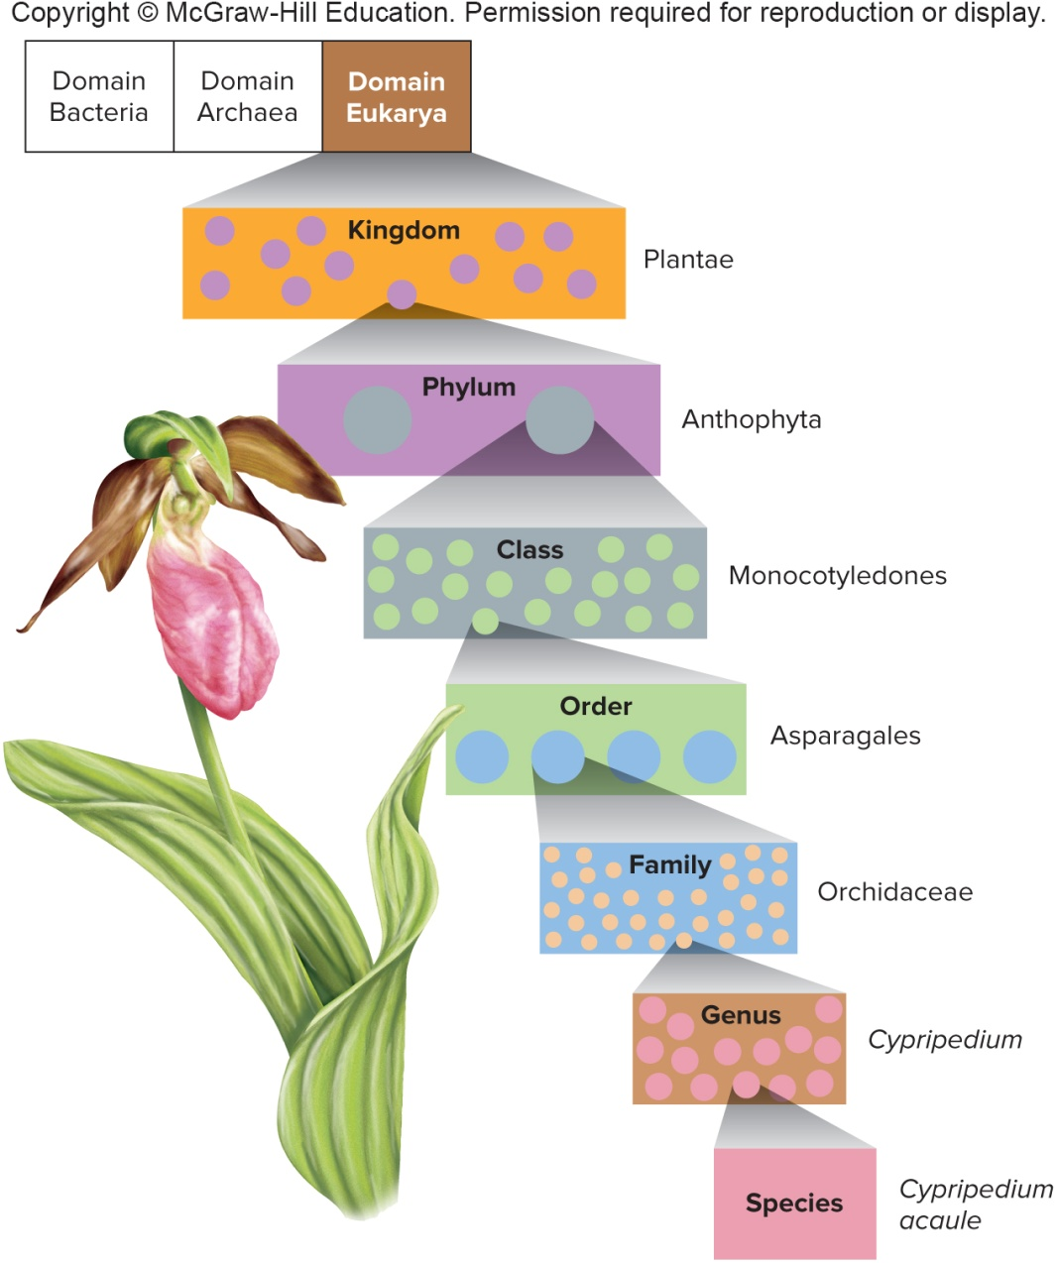
Figure 16.15 Taxonomy Hierarchy

Slide 29
Phylogenetic Trees
Diagram that indicates common ancestors and lines of descent (lineages)
Common ancestor at the base of the tree has traits shared by all the other groups in the tree

Slide 30
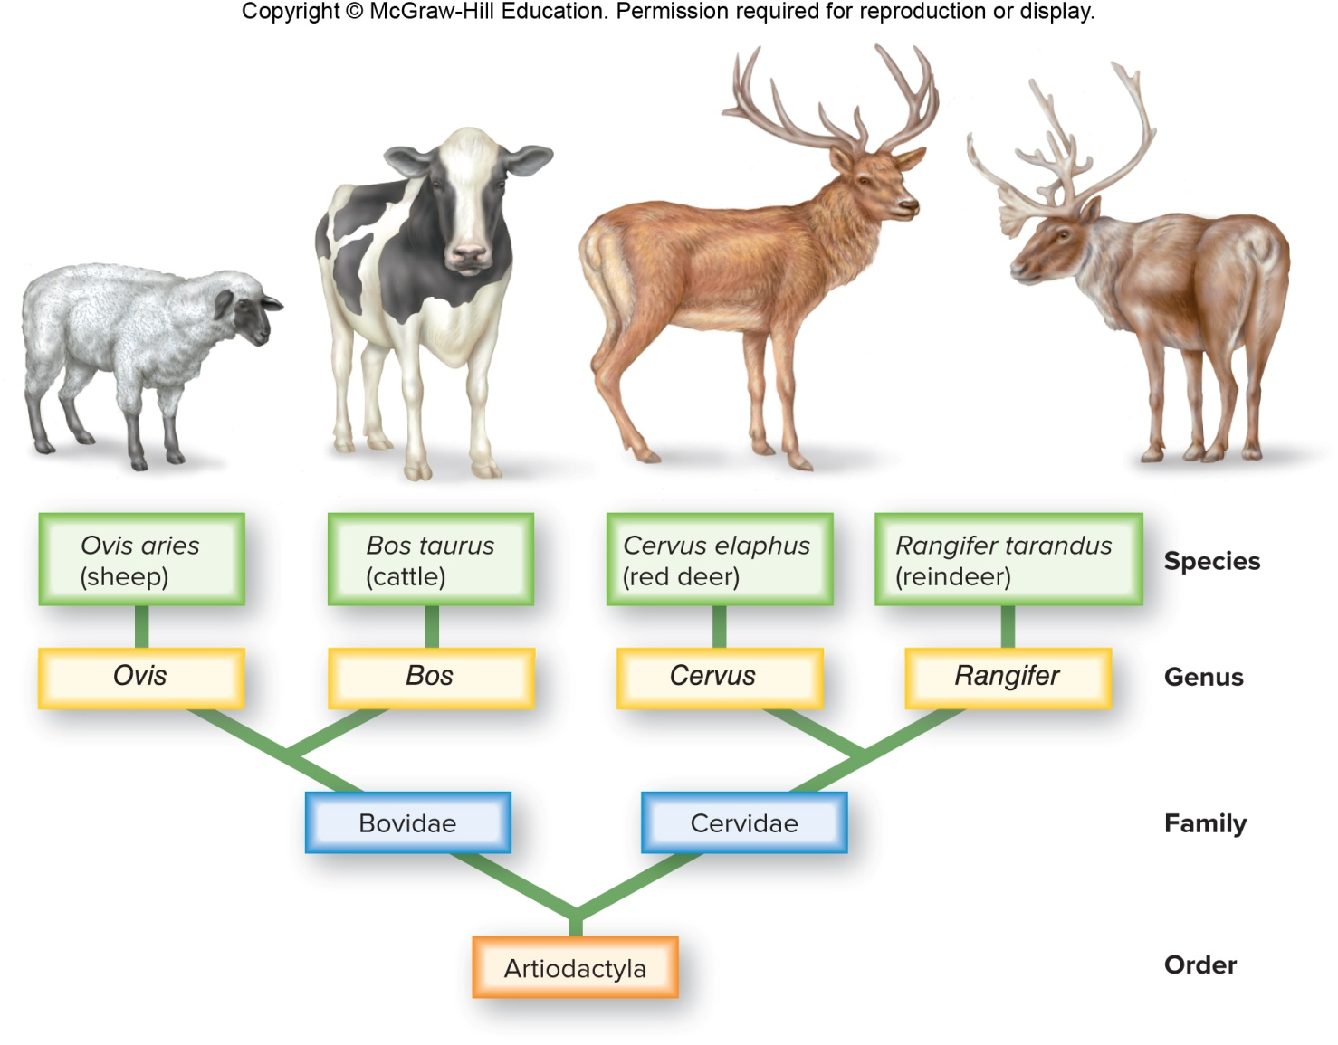
Figure 16.16 Classification and Phylogeny

Slide 31
Tracing Phylogeny
Uses a multitude of data to discover evolutionary relationships between species
Morphological data
Homologous structures are related to each other through common descent—forelimbs of vertebrates
Sometimes difficult due to convergent evolution
Acquisition of the same or similar traits in distantly related lines due to adaptations to the same environment
Analogous structures—same function but no recent common ancestor

Slide 32
Molecular Data and Phylogeny
The more closely related species are, the more similar their DNA.
Ribosomal RNA changes little and can be a reliable indicator.

Slide 33
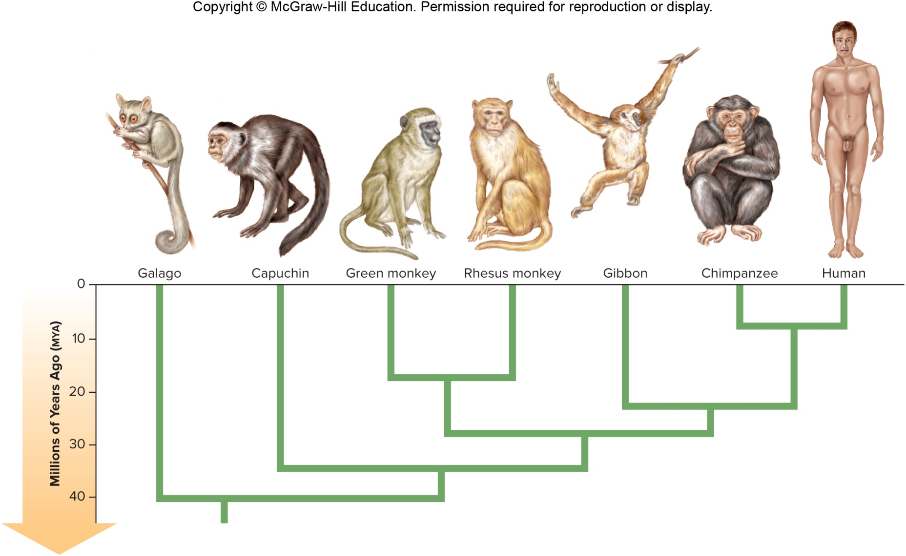
Figure 16.17 Interpretation of Molecular Data

Slide 34
Cladistics
Way to trace evolutionary history of a group by using shared traits derived from a common ancestor to determine relationships
Cladogram—depicts evolutionary history of a group based on available data
Outgroup—not part of study group
Ingroup—part of study group
Parsimony—least number of assumptions is the most probable
Construct cladogram that minimizes number of assumed evolutionary changes
Shared derived traits—homologies shared by only certain species of the study group
Ancestral trait—present in common ancestor to ingroup and outgroup

Slide 35
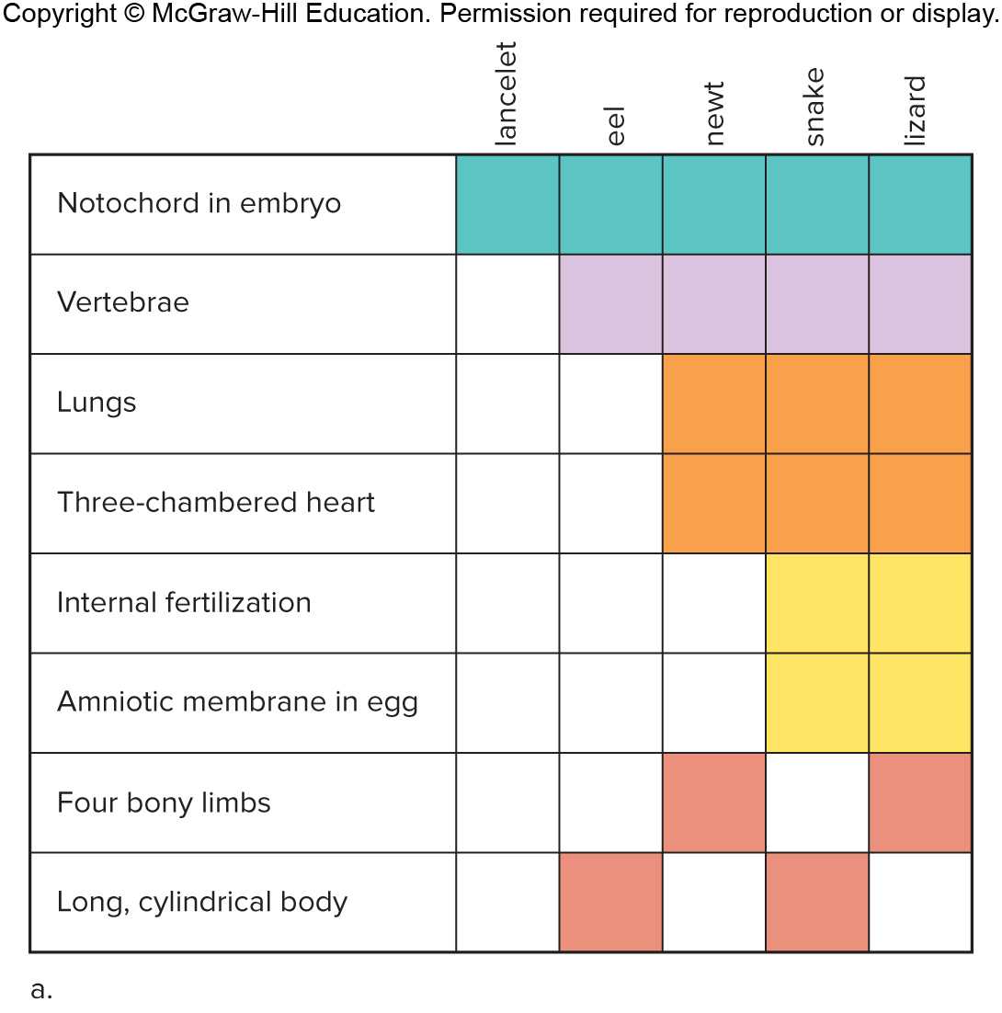
Figure 16.18a Constructing a Cladogram

Slide 36
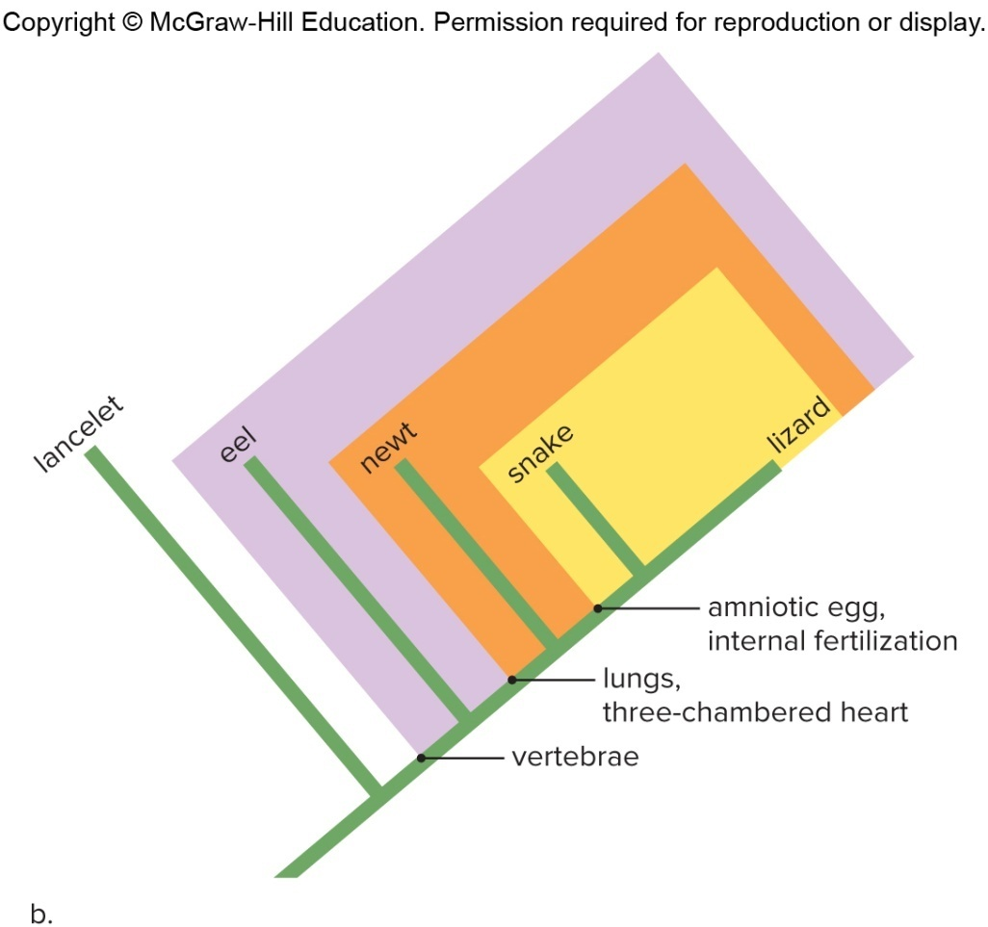
Figure 16.18b Constructing a Cladogram
Outgroup—lancelets are not vertebrates
Ingroup—members of study group
This cladogram has three clades.
Following principle of parsimony, this is the sequence traits must have evolved
Any other arrangement would be more complicated

Slide 37
Linnaean Classification Versus Cladistics
Linnaean classification places birds in their own group, but cladistics places them in a clade with crocodiles.
May modify Linnaean classification or construct an entirely different system

Slide 38
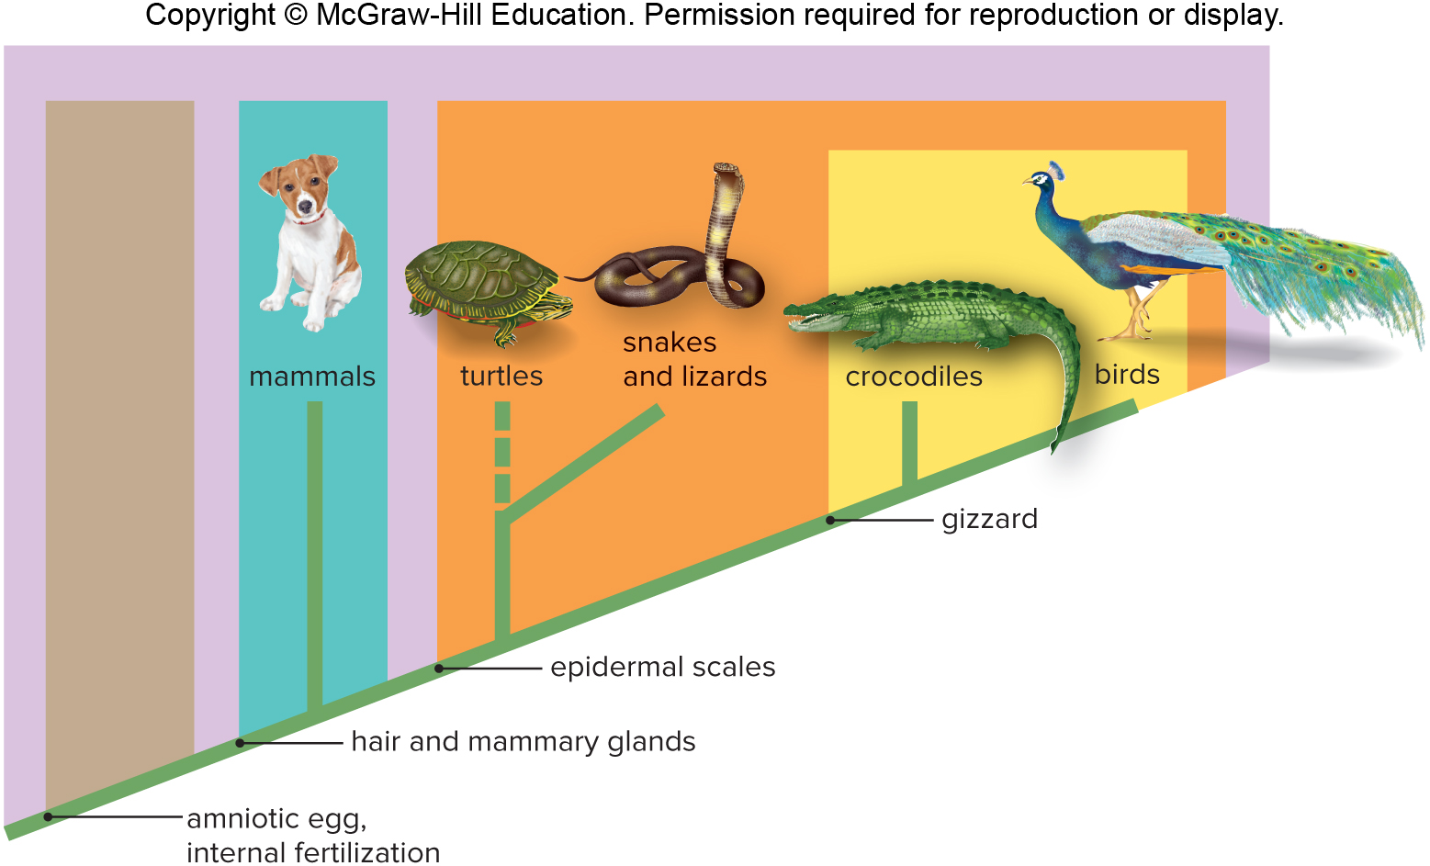
Figure 16.19 Cladistic Classification

Slide 39
Three-Domain System
Five-kingdom system changed based on rRNA sequencing data
Domain Bacteria
Arose first, prokaryotic cells
Domain Archaea
Arose next, also prokaryotic cells
Domain Eukarya
Last to evolve, eukaryotic cells
Kingdoms for protists, plants, fungi, and animals

Slide 40
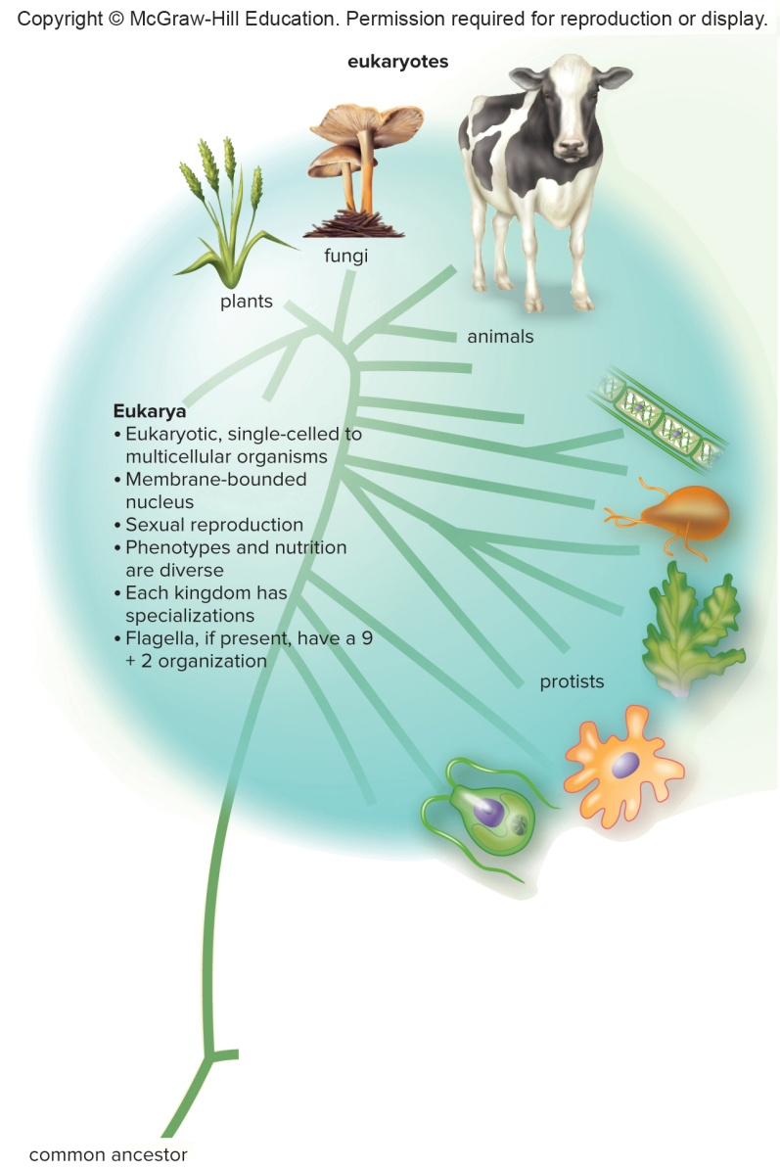
Figure 16.20 Three-Domain System, Eukaryotes

Slide 41
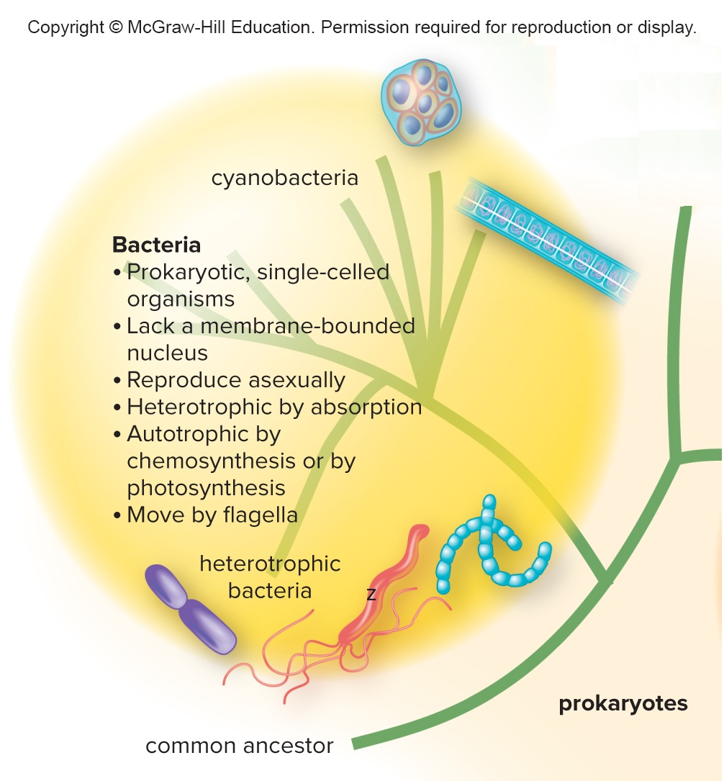
Figure 16.20 Three-Domain System, Bacteria

Slide 42
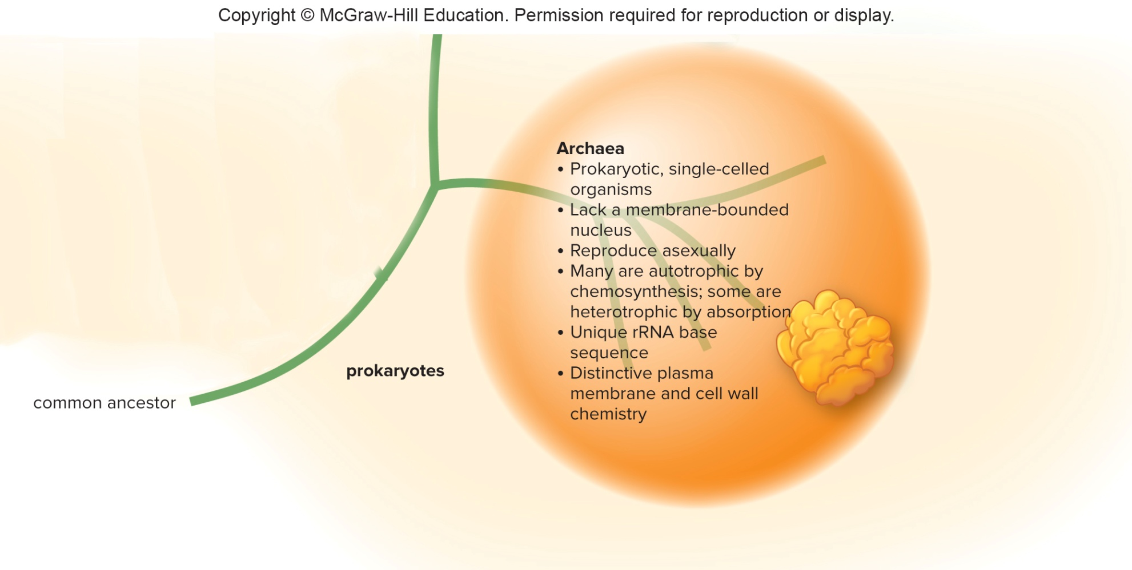
Figure 16.20 Three-Domain System, Archaea
Jump to long description

Slide 43
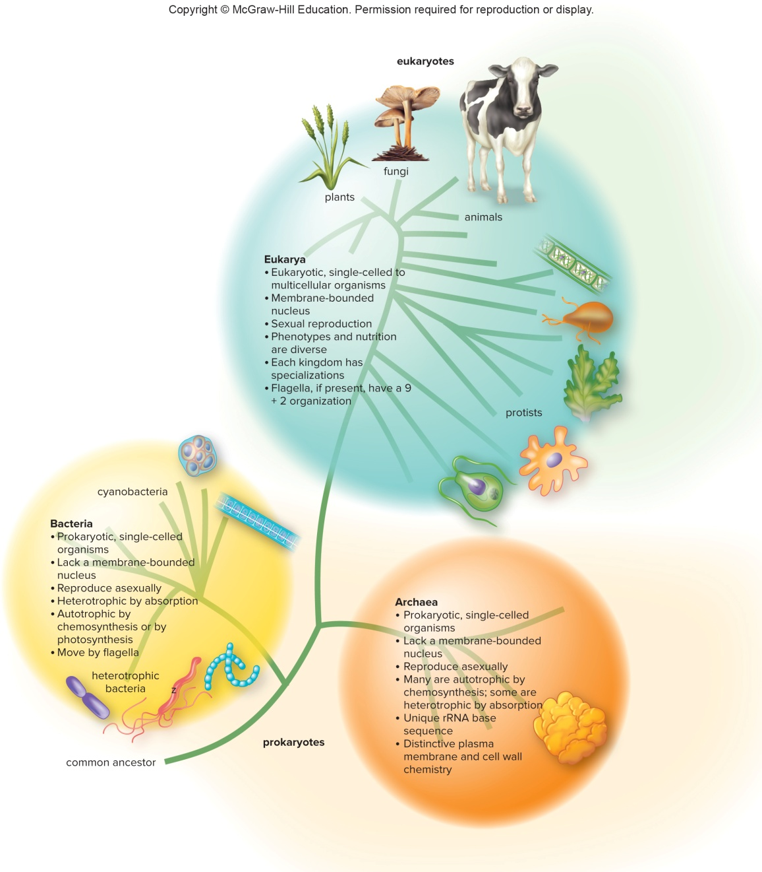
Figure 16.20 Three-Domain System

Slide 44
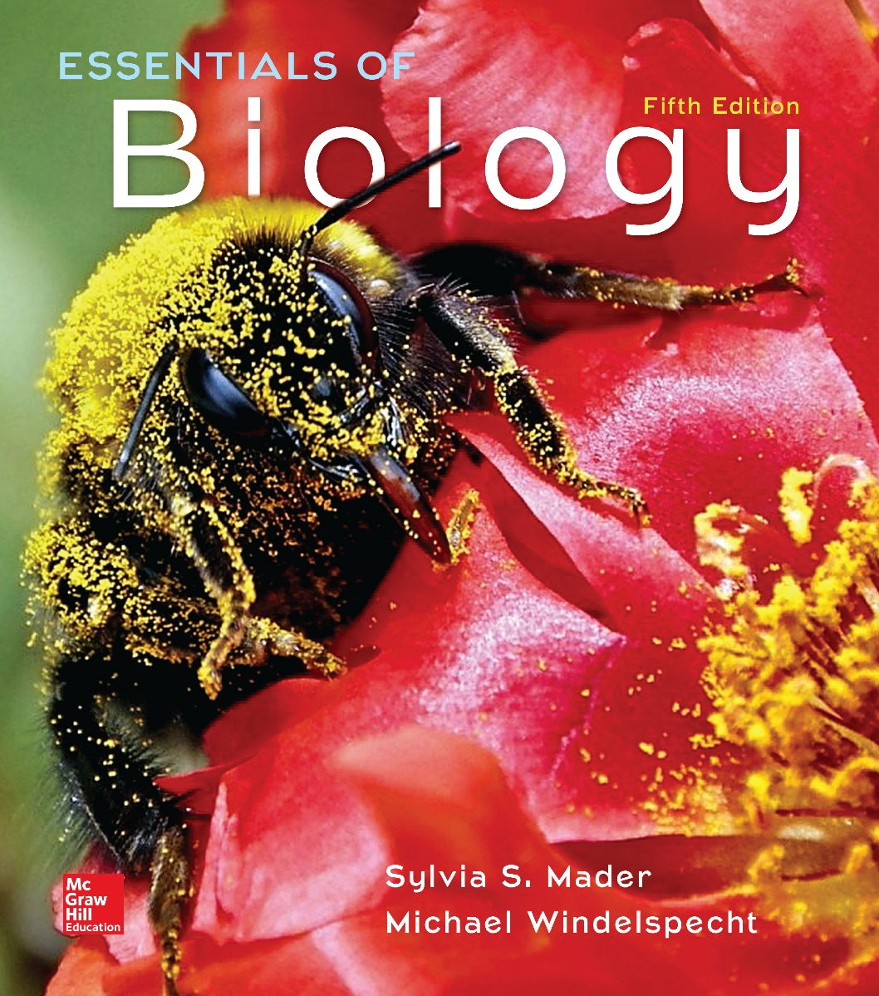
Essentials of Biology
Chapter 17
The Microorganisms: Viruses, Bacteria, and Protists
Notes:
44

Slide 45
17.1 The Viruses
Viruses are not included in the classification of organisms.
Noncellular
Obligate intracellular parasites
Alive or not?
Two parts to every virus
Outer capsid—composed of protein subunits
Inner core—either DNA or RNA
Viral genome very small
Some viruses have
Spikes for attachment to host cell
Outer envelope

Slide 46
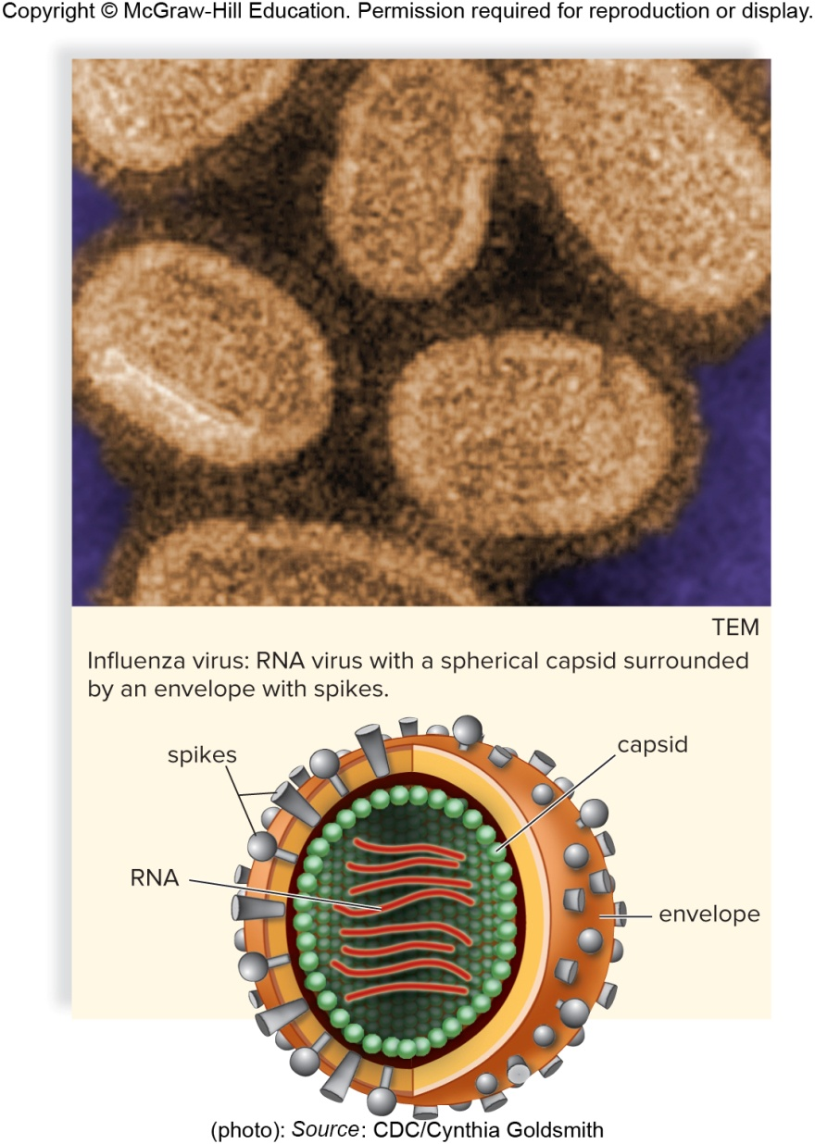
Figure 17.1 Anatomy of an Influenza Virus
Influenza virus: RNA virus with a spherical capsid surrounded by an envelope with spikes.
(photo): Source: CDC/Cynthia Goldsmith

Slide 47
Viral Reproduction
Viral reproduction
Specific to a particular host cell
Must be able to attach
Once inside host cell, viral genome takes over the metabolic machinery of the host cell to make more viruses
Reproduction of bacteriophages or phages
Virus that reproduces inside a bacterium
Lytic or lysogenic cycles

Slide 48
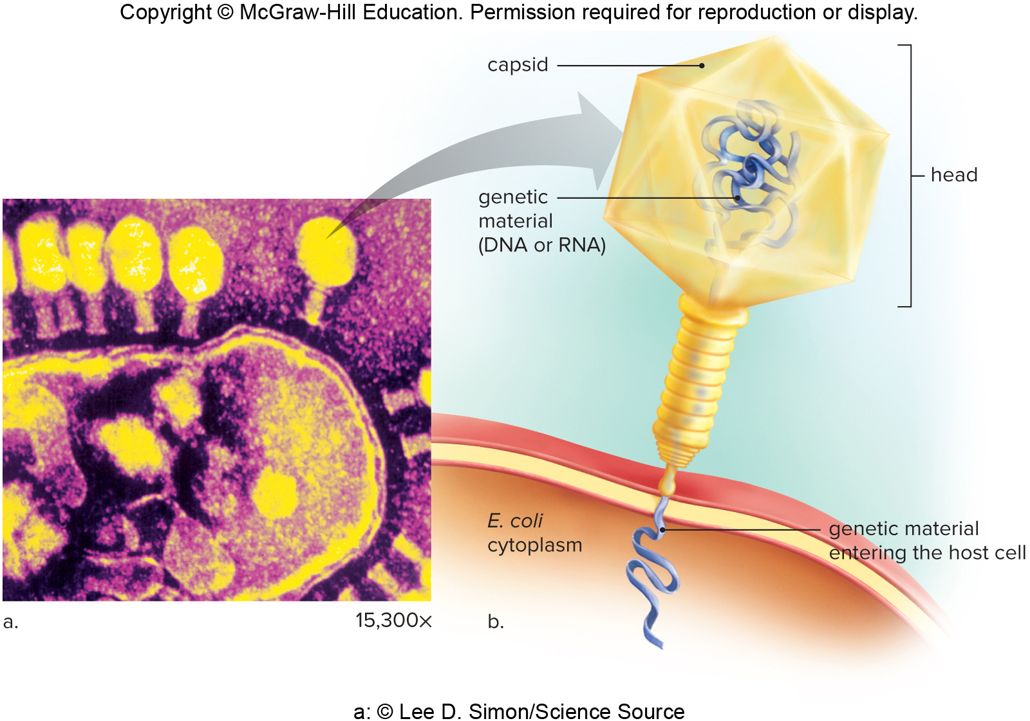
Figure 17.2 Bacteriophage Lambda (λ)
a: © Lee D. Simon/Science Source

Slide 49
Lytic and Lysogenic Cycle
Lytic cycle
Virus takes over immediately
Bacteria dies immediately after virus release
Five stages—attachment, penetration, biosynthesis, maturation, and release
Lysogenic cycle
Phage lies latent until triggered to enter lytic cycle
Bacteria does not die until phage enters lytic cycle
After attachment and penetration, phage integrates into host chromosome as a prophage
Trigger causes phage to enter lytic cycle with biosynthesis, maturation, and release

Slide 50
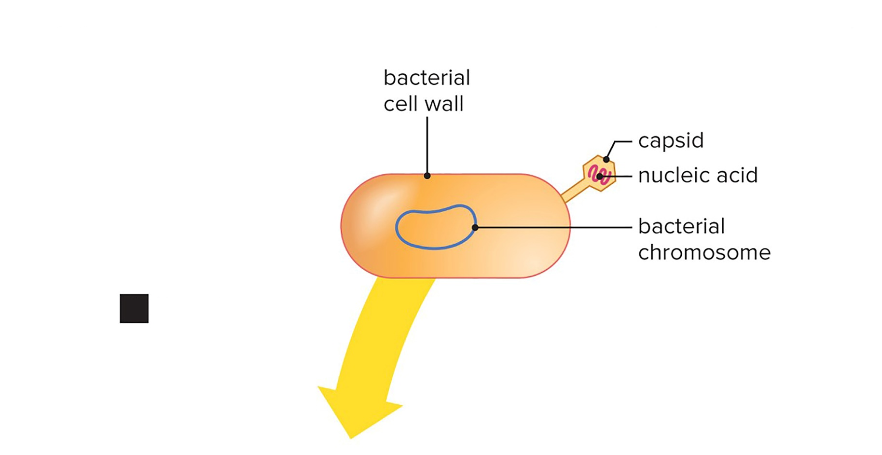
Figure 17.3 Lytic and Lysogenic Cycles of a Virus Called Lambda, Attachment
Attachment: Capsid combines with receptor.

Slide 51
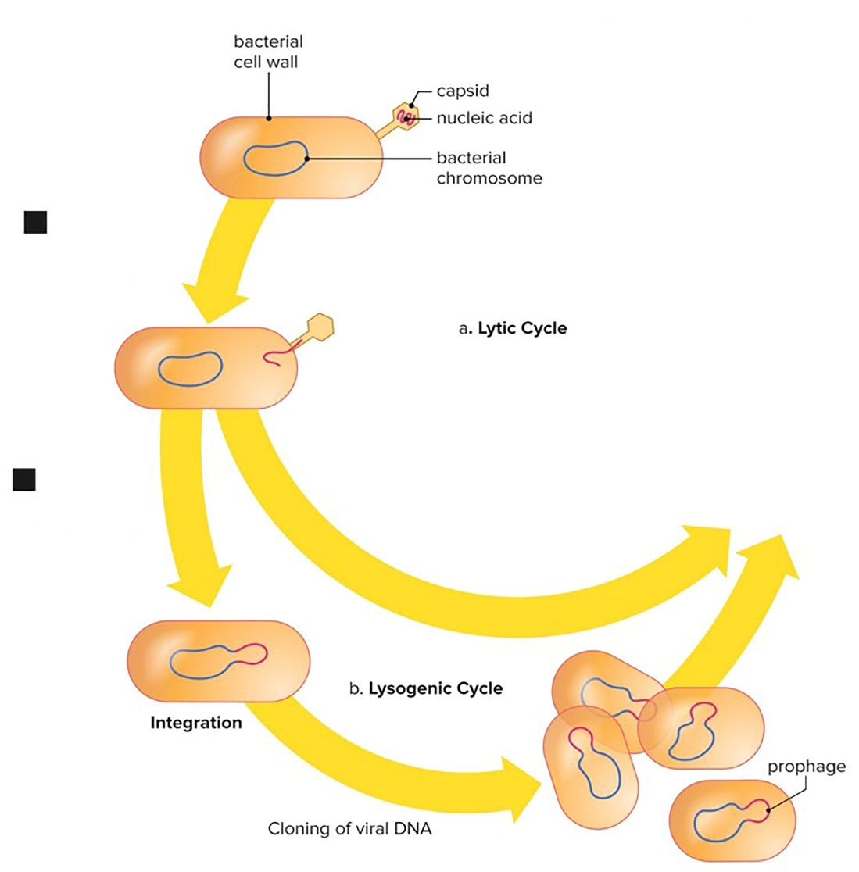
Figure 17.3 Lytic and Lysogenic Cycles of a Virus Called Lambda, Penetration
Attachment: Capsid combines with receptor.
Penetration: Viral DNA enters host.

Slide 52
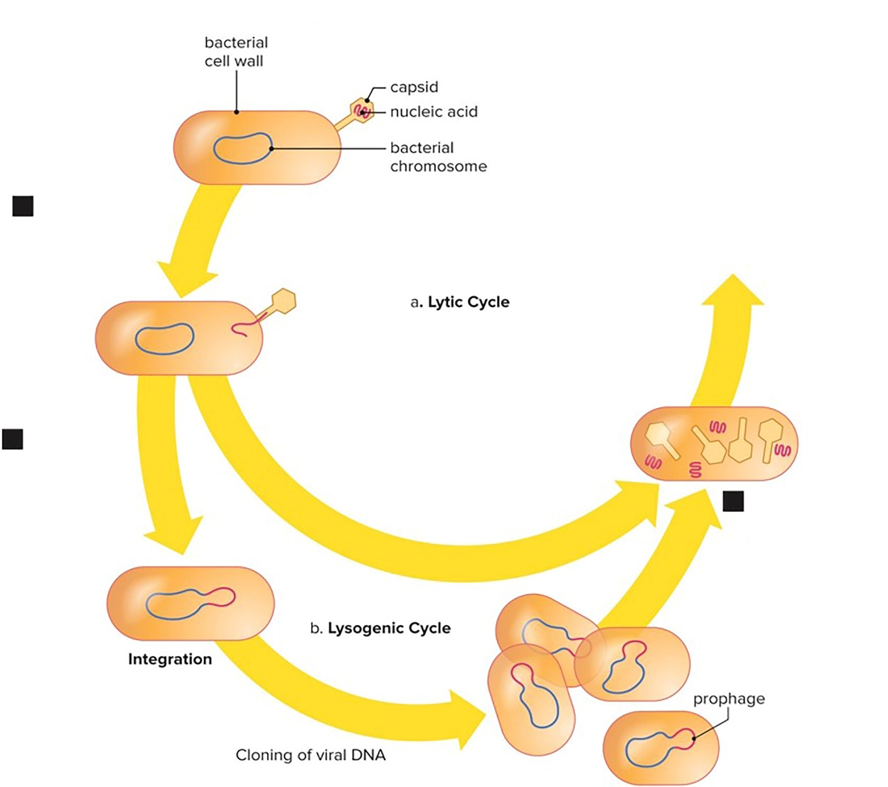
Figure 17.3 Lytic and Lysogenic Cycles of a Virus Called Lambda, Biosynthesis
Attachment: Capsid combines with receptor.
Penetration: Viral DNA enters host.
Biosynthesis: Viral components are synthesized.

Slide 53
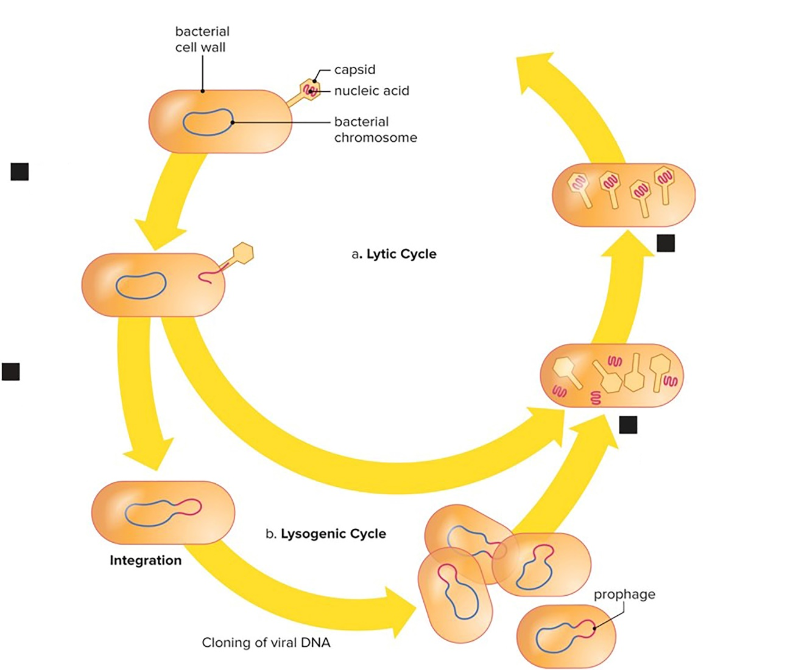
Figure 17.3 Lytic and Lysogenic Cycles of a Virus Called Lambda, Maturation
Attachment: Capsid combines with receptor.
Maturation: Viral components are assembled.
Penetration: Viral DNA enters host.
Biosynthesis: Viral components are synthesized.

Slide 54
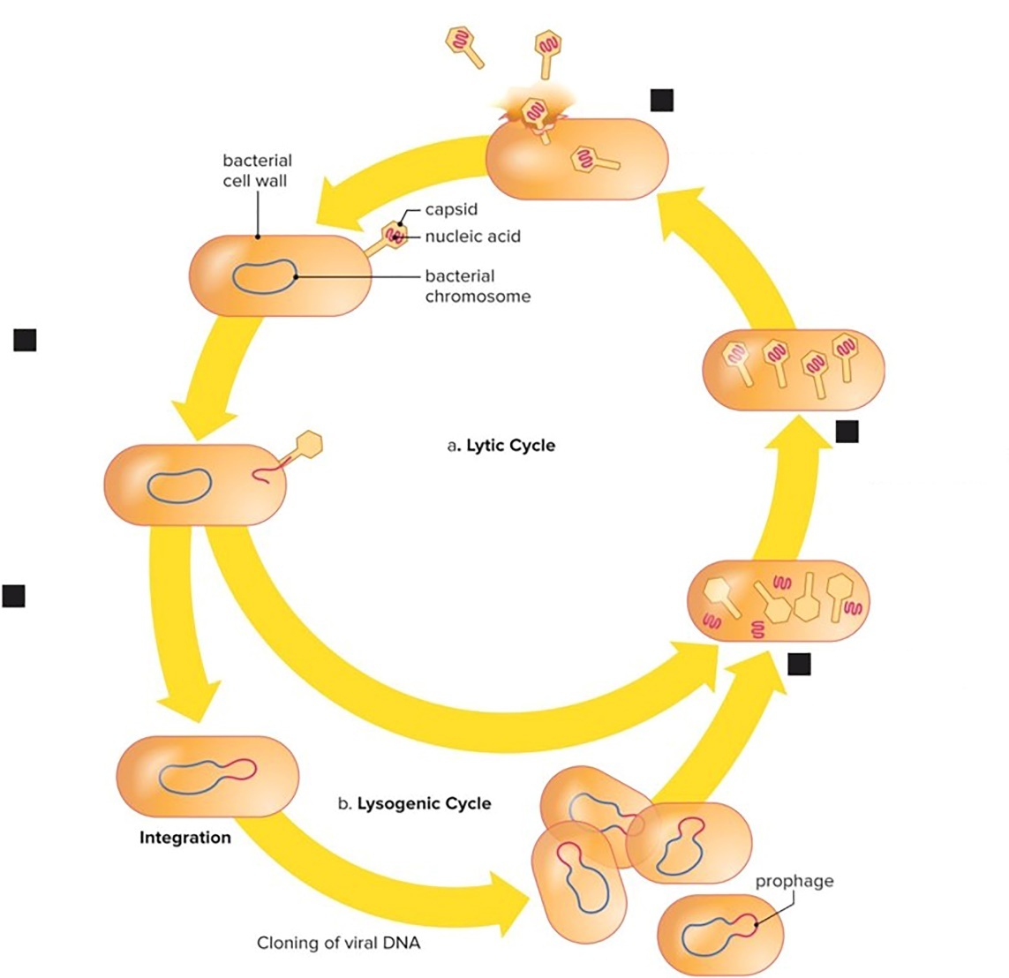
Figure 17.3 Lytic and Lysogenic Cycles of a Virus Called Lambda, Release
Release: New viruses leave host cell.
Attachment: Capsid combines with receptor.
Maturation: Viral components are assembled.
Penetration: Viral DNA enters host.
Biosynthesis: Viral components are synthesized.

Slide 55
Figure 17.3 Lytic and Lysogenic Cycles of a Virus Called Lambda, Overview
Release: New viruses leave host cell.
Attachment: Capsid combines with receptor.
Maturation: Viral components are assembled.
Penetration: Viral DNA enters host.
Biosynthesis: Viral components are synthesized.

Slide 56
Plant Viruses
Plant viruses
Tend to enter through damaged tissues
Move through plasmodesmata
Tobacco mosaic virus
Until recently, the only way to control viruses was to destroy symptomatic plants and control insect vector (if there is one).
With bioengineering, possible to transfer genes for disease resistance between plants
Creation of transgenic papaya plants in Hawaii resistant to PRSV

Slide 57
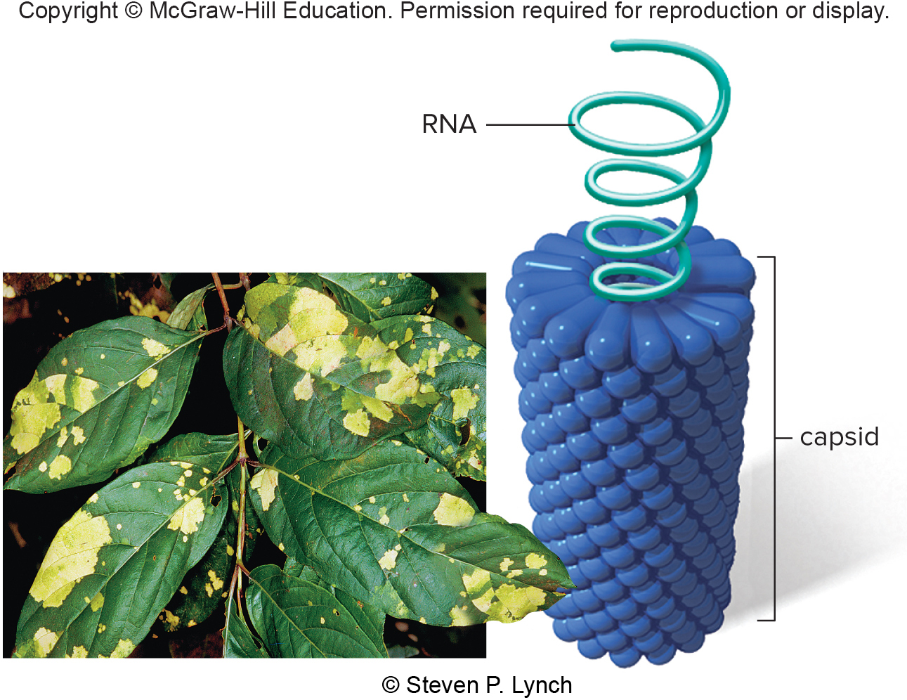
Figure 17.4 Infected Tobacco Plant
© Steven P. Lynch

Slide 58
Animal Viruses
Animal viruses
Reproduce similar to bacteriophages
Some, but not all, will have an outer membranous envelope beyond capsid
Made from host cell plasma membrane
Herpesviruses (cause cold sores, genital herpes, and chickenpox in humans) are infections that remain latent most of the time
Stress can cause them to enter the lytic cycle
Retroviruses
RNA animal viruses with a DNA stage
HIV—causes AIDS
Reverse transcriptase makes DNA from RNA template

Slide 59
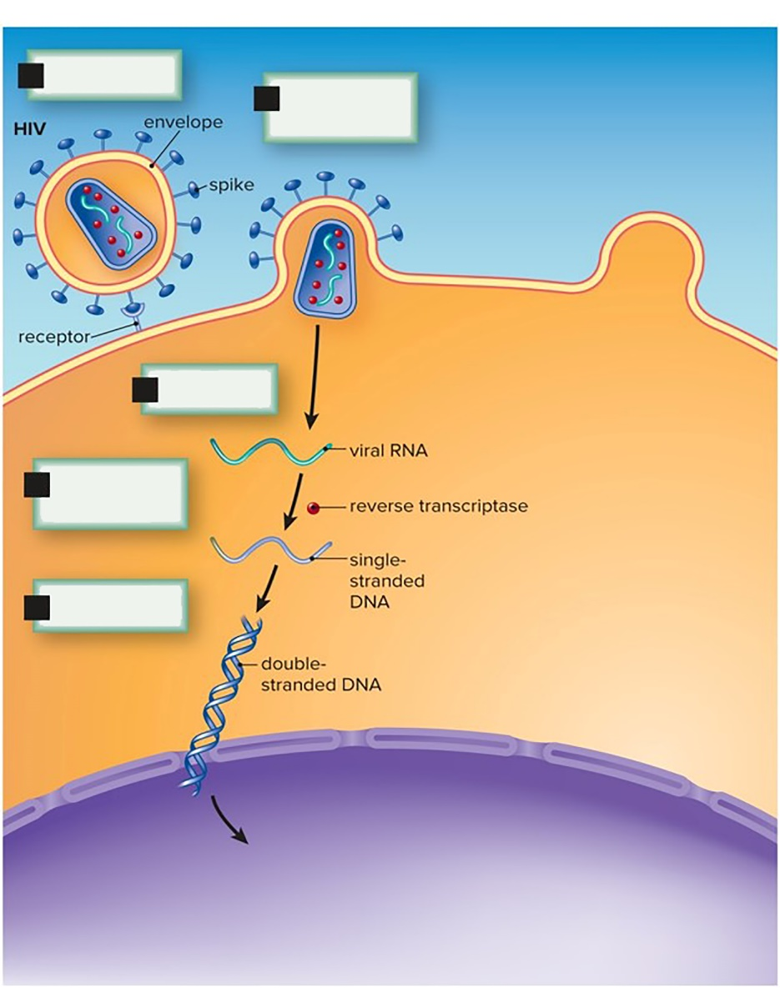
Figure 17.5 Reproduction of HIV, Attachment Through Replication
Attachment
Fusion and entry
Uncoating
Reverse transcription
Replication

Slide 60
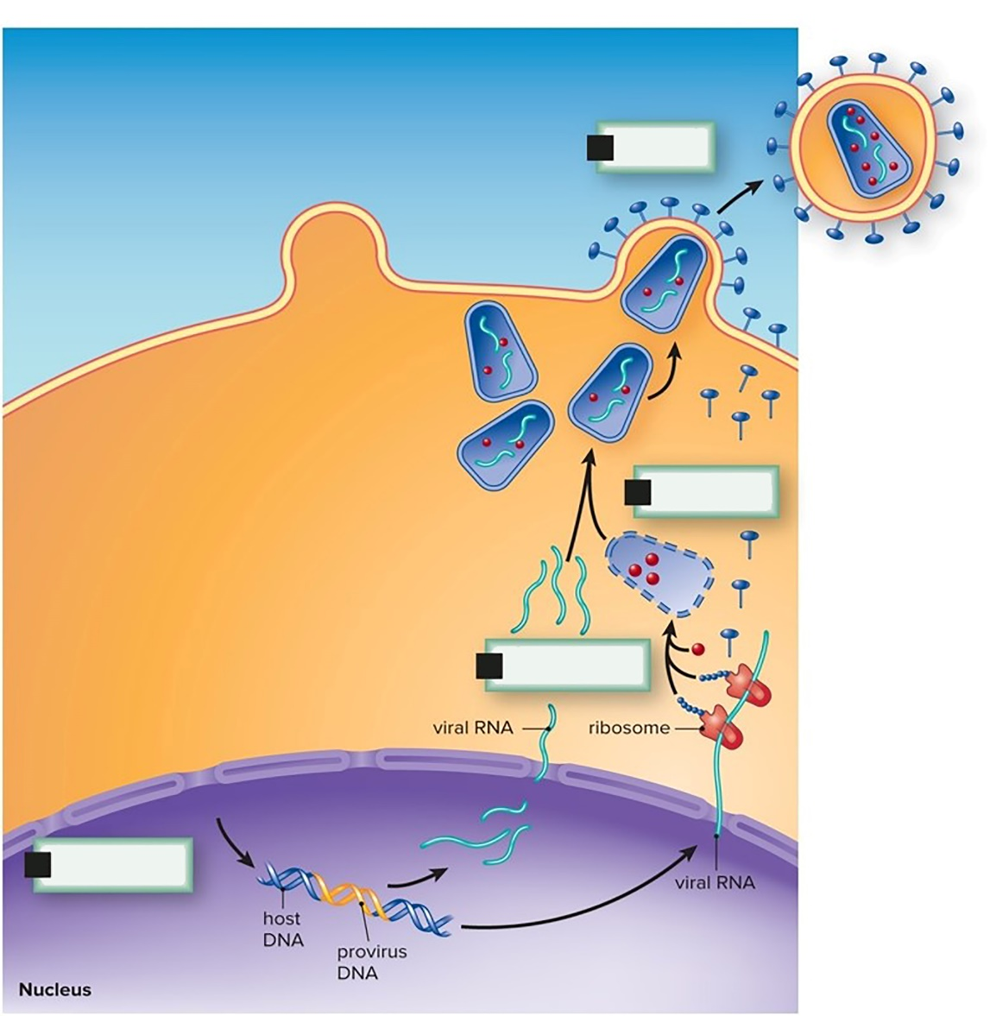
Figure 17.5 Reproduction of HIV, Integration to Release
Release
Maturation
Biosynthesis
Integration

Slide 61
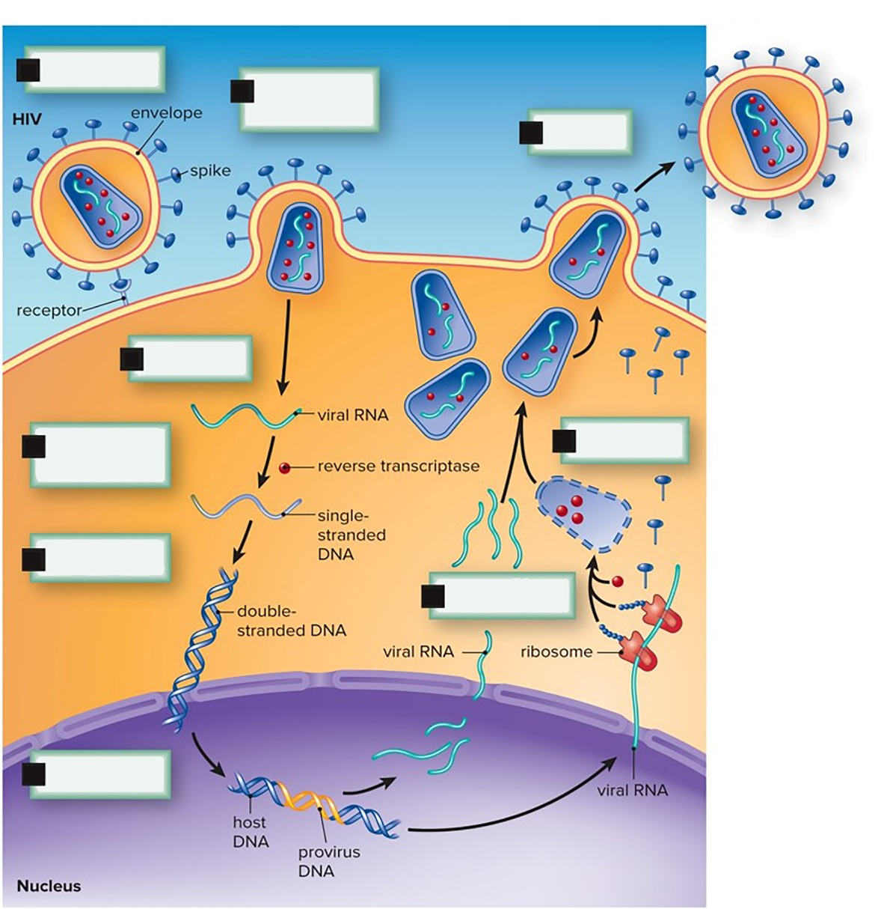
Figure 17.5 Reproduction of HIV, Overview
Attachment
Fusion and entry
Release
Uncoating
Reverse transcription
Maturation
Replication
Biosynthesis
Integration

Slide 62
Emerging Viruses
Causative agent of a disease that only recently has infected large numbers of people
HIV, West Nile virus, SARS virus, hantavirus, Ebola virus, avian influenza (H5N1) virus
Emerge in several ways
Transported to new location
Able to infect new species
New mode of transmission

Slide 63
Drug Control of Human Viral Diseases
Difficult to develop—uses cell’s own machinery
Some drugs structurally similar to nucleotides to interfere in viral genome synthesis
Some block viral enzymes like reverse transcriptase in HIV

Slide 64
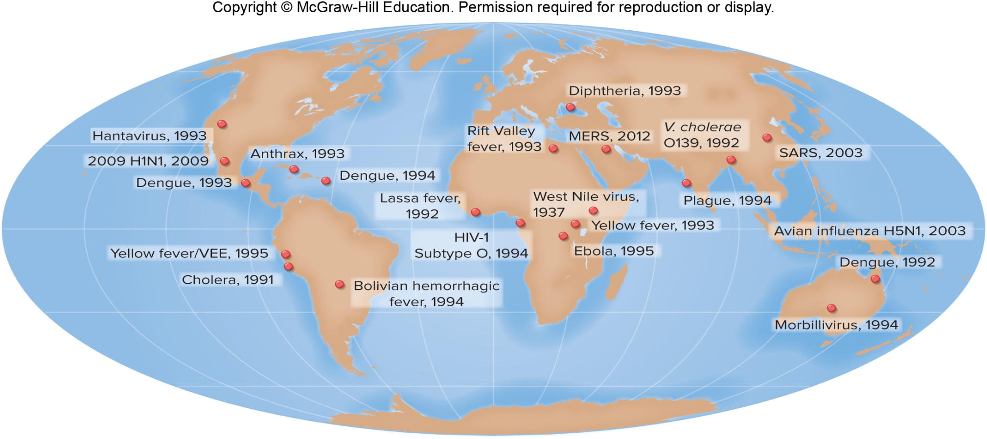
Figure 17.6 Emerging Diseases

Slide 65
17.2 Viroids and Prions
Viroids
Naked strands of RNA not covered by capsid
Like a virus, takes over cell to make more viroids
About a dozen crop diseases
Prions
Proteinaceous infectious particles
Misshapen protein changes normal protein into more misshapen protein
Discovered as cause of kuru
Also mad cow disease and Creutzfeldt-Jakob disease

Slide 66
Kuru
Affected the Fore people of Papua New Guinea
Prior to the 1950s, participated in cannibalistic practices
Brain most likely to pass kuru

Slide 67
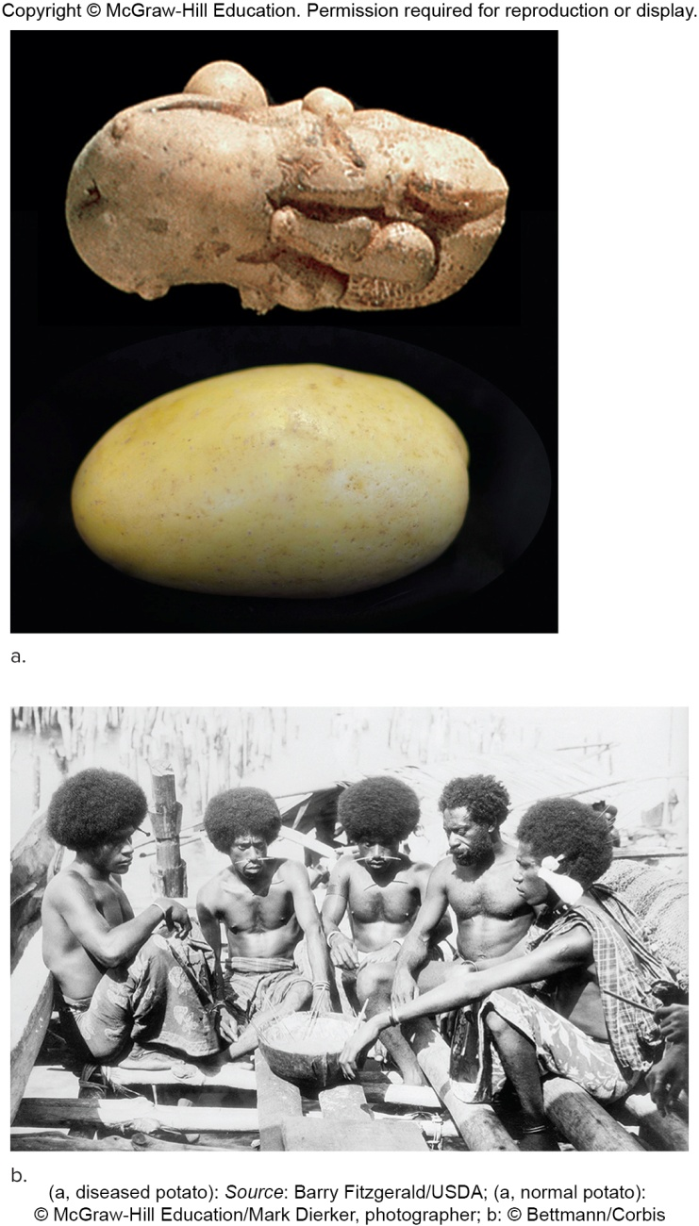
Figure 17.7 Viroid Disease
(a, diseased potato): Source:Barry Fitzgerald/USDA; (a, normal potato): © McGraw-Hill Education/Mark Dierker, photographer; b: © Bettmann/Corbis

Slide 68
17.3 The Prokaryotes
No nucleus to contain genome
No sealed compartments
No membrane-bounded organelles
Far greater metabolic capabilities than more complex organisms
Bacteria and archaea

Slide 69
Origin of Cells, 1
First living cells were prokaryotes
Found in rocks 3.5 billion years old
May have existed before that but no fossils found yet
Conditions on early Earth very different from today
Temperatures high, little free oxygen
Abiotic synthesis of organic molecules with input from energy sources
Lightning, sunlight, meteorite impact, volcanic activity, radioactive decay

Slide 70
Origin of Cells, 2
Protocells
Cell-like structures complete with outer membrane
May have resulted from self-assembly of macromolecules
Gave rise to cellular life
Some researchers think the first hereditary molecule was RNA.
Over time the more stable DNA became the long-term solution.

Slide 71
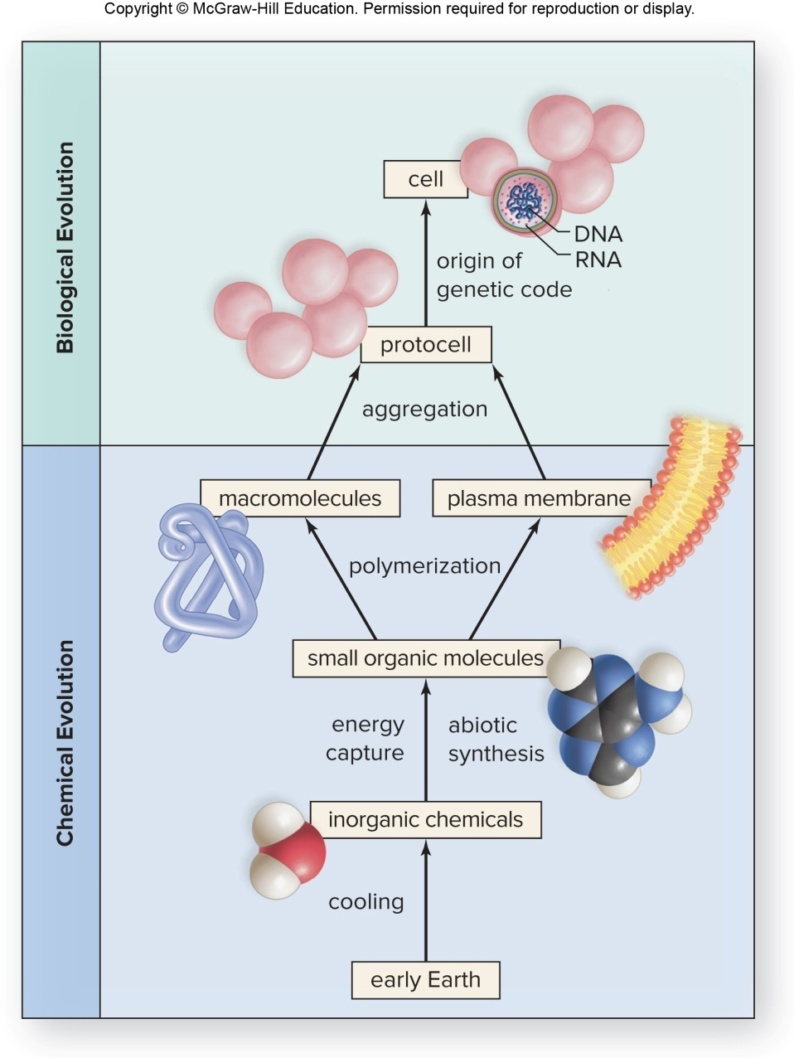
Figure 17.8 Origin of the First Cell(s)

Slide 72
Bacteria, 1
Most diverse and prevalent organisms on Earth
Tens of thousands of different bacteria identified
Likely many more exist
Structure
Most common three shapes—rods (bacilli), spheres (cocci), and spirals (spirilla or spirochetes)
Some form chains or bunches
No nucleus—single circular chromosome found in nucleoid (region of cell)
Plasmids—extrachromosomal DNA in some

Slide 73
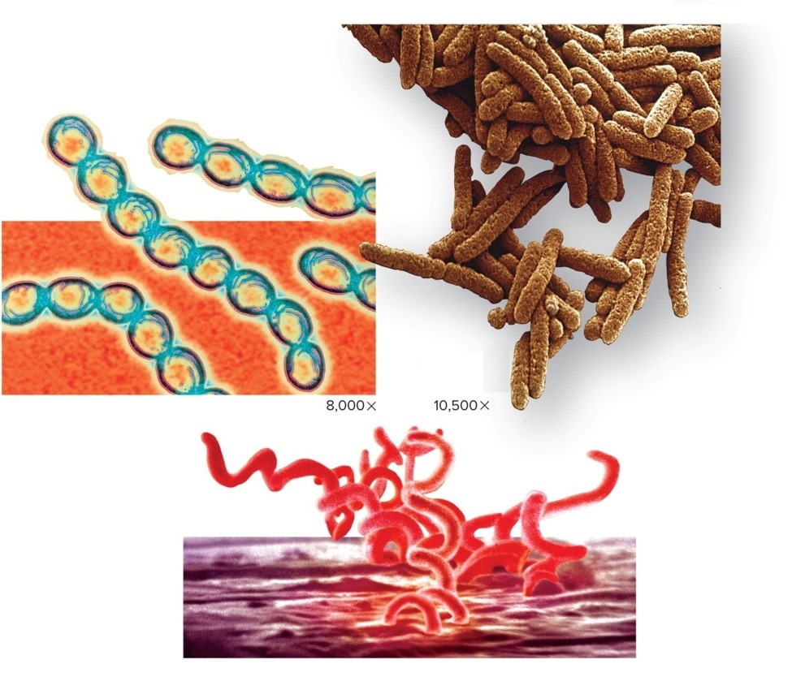
Figure 17.9 Shapes of Bacteria
Rod-shaped E. coli
Sphere-shaped streptococci
Spirochete, T. pallidum
a: © Alfred Pasieka/SPL/Science Source; b: © David Scharf/SPL/Science Source; c: © Science Source

Slide 74
Bacteria, 2
Bacteria have ribosomes but no membrane-bounded organelles.
Motile bacteria generally have flagella but never cilia—not like eukaryotic flagella.
Outer cell wall strengthened by peptidoglycan
Prevents bursting or collapsing
May have additional capsule outside cell wall

Slide 75
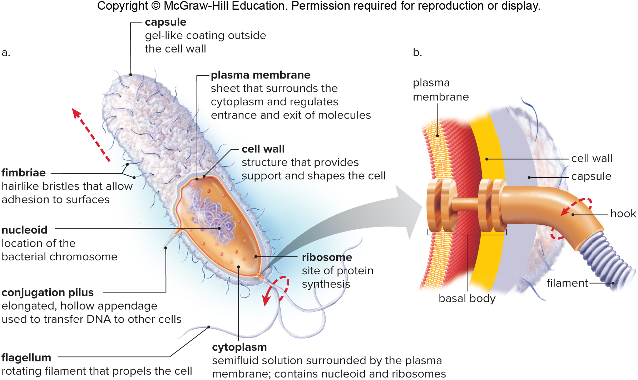
Figure 17.10 Flagella

Slide 76
Bacteria Reproduce Asexually
Bacteria (and archaea) reproduce asexually by binary fission.
Genetic diversity due to three processes
Conjugation—donor cell passes DNA to recipient
Transformation—picks up free DNA from environment
Transduction—phage carries DNA to new cell

Slide 77
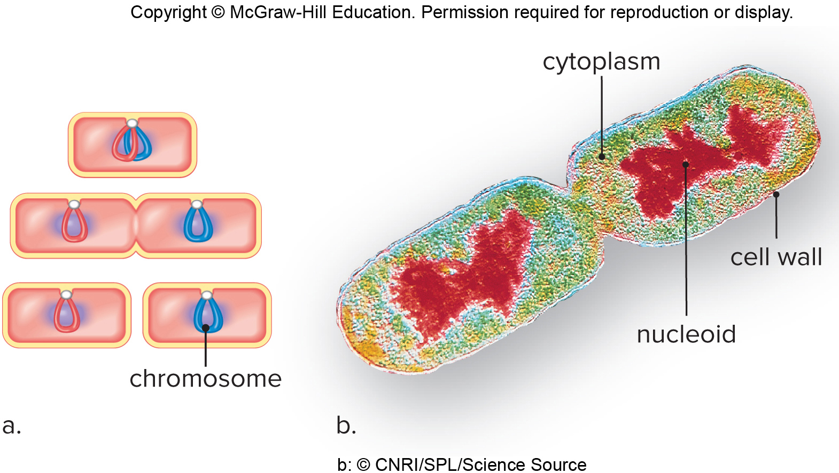
Figure 17.11 Binary Fission
b: © CNRI/SPL/Science Source

Slide 78
Endospores
Endospores
Dehydrate and collapse inside three heavy spore coats
Can survive harshest environments
Survive for very long periods of time
Anthrax and uncommon type of food poisoning (botulism)

Slide 79
Bacterial Nutrition
Photoautotrophs
Cyanobacteria
Use solar energy and carbon dioxide to make food
Like plants
Chemoautotrophs
Don’t use solar energy to reduce carbon dioxide
Like deep sea vent bacteria living inside tube worms
Chemoheterotrophs
Take in organic molecules as source of energy and carbon
First cells most likely this
Like animals
Saprotrophs—send enzymes into environment to digest food

Slide 80
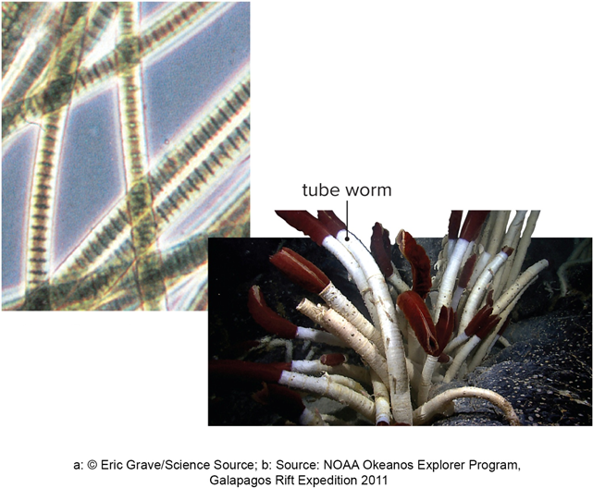
Figure 17.12 Bacterial Autotrophs
Cyanobacterium
Hosts for Chemoautotrophic bacteria
a: © Eric Grave/Science Source; b: Source: NOAA Okeanos Explorer Program, Galapagos Rift Expedition 2011

Slide 81
Relationships
Relationships
Heterotrophic bacteria may be free-living
Or may form symbiotic relationships
Commensalism—one partner benefits, the other is not harmed or benefited
Mutualism—both partners benefit
Bacteria in human intestines make vitamins
Parasitism—one partner benefits, the other is harmed
Disease-causing bacteria

Slide 82
Bacteria in the Environment, 1
Decomposers digest dead organic remains to return inorganic nutrients to producers.
Life would halt without decomposers.
Nitrogen cycle
Plants unable to fix atmospheric nitrogen ($N_{2}$ gas)
Bacteria fix $N_{2}$ into form plants use
Mutualistic bacteria live inside root nodules.

Slide 83
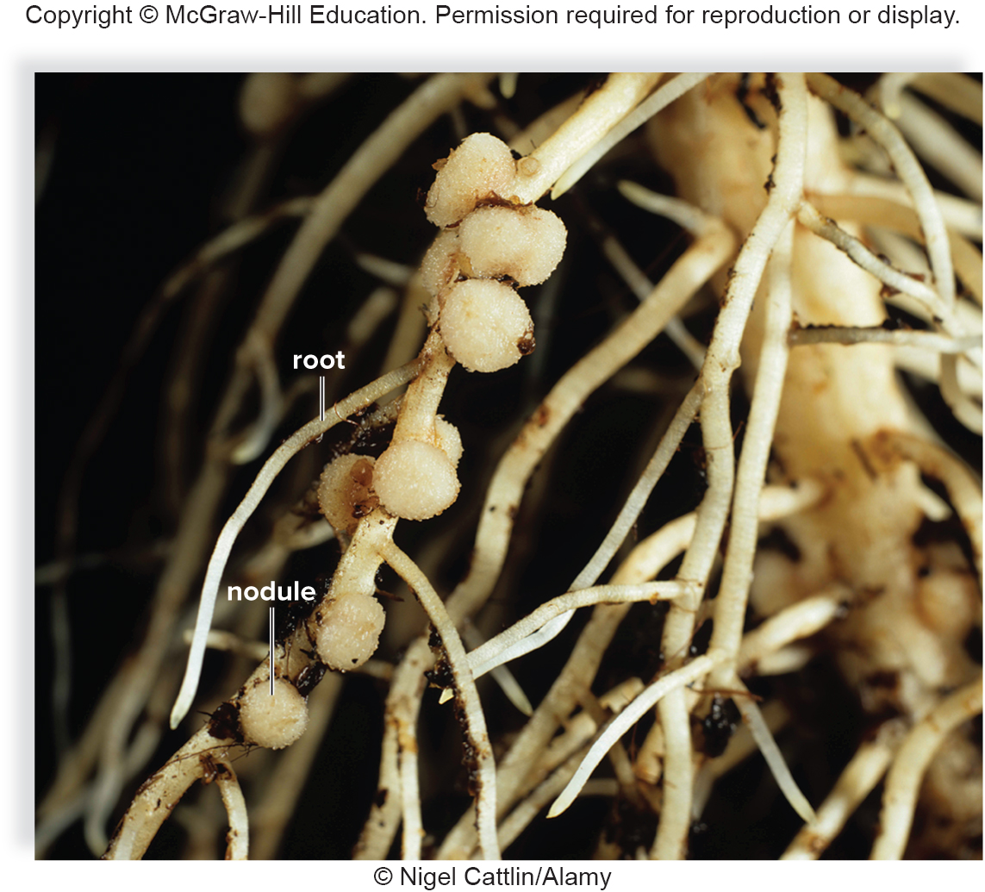
Figure 17.13 Nodules of a Legume
© Nigel Cattlin/Alamy

Slide 84
Bacteria in the Environment, 2
Bioremediation
Ability of bacteria to break down pollutants exploited
Some bioengineered

Slide 85
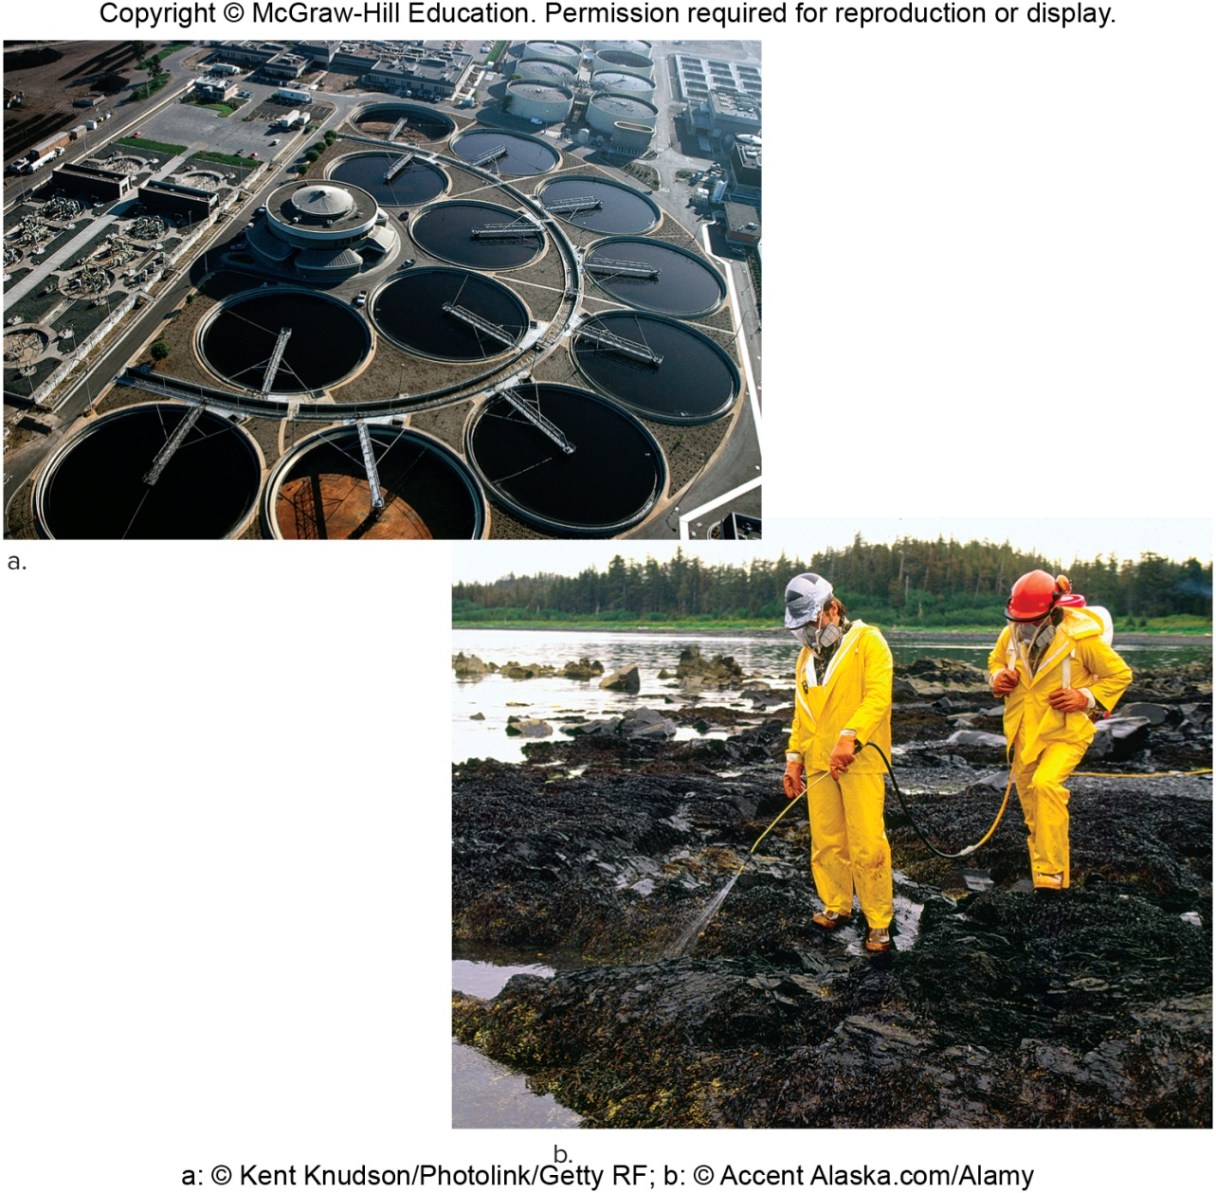
Figure 17.14 Bioremediation
a: © Kent Knudson/Photolink/Getty RF ; b: © Accent Alaska.com/Alamy

Slide 86
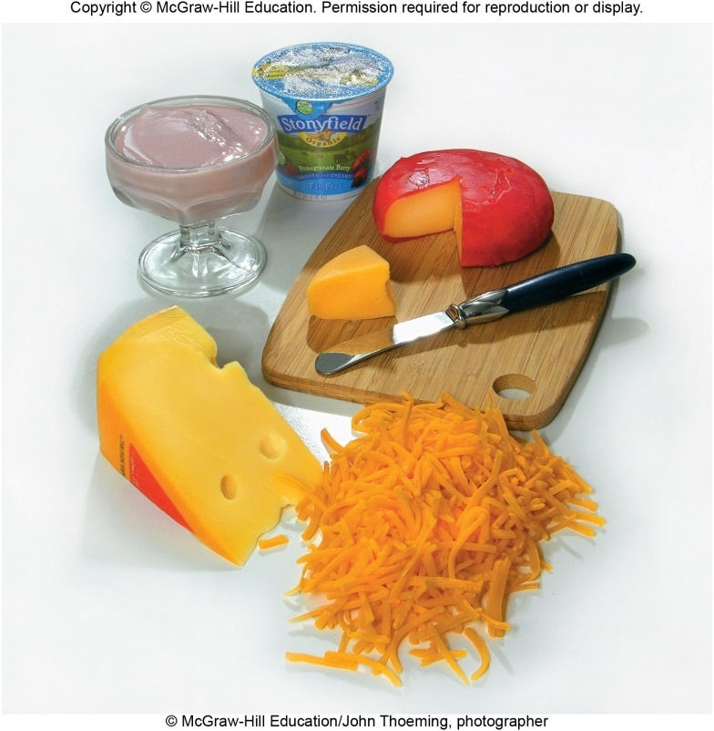
Figure 17.15 Bacteria in Food Processing
Bacteria in food science and biotechnology
Wide variety of foods use bacteria
Fermentation produces lactic acid
Pickles cucumbers, curdles milk into cheese, and gives tangy flavor
Most antibiotics discovered in soil bacteria
Bacteria can be bioengineered to produce medicine.
Insulin, human growth hormone, and vaccines
© McGraw-Hill Education /John Thoeming, photographer

Slide 87
Bacterial Diseases in Humans
Pathogens are able to produce a toxin and/or adhere to surfaces and sometimes invade organs or cells.
Toxins are small organic molecules or pieces of bacteria released when bacteria die.
Often toxins cause more problems than growth of the microbe itself.
Clostridium tetani causes tetanus (lock jaw).
Soil bacteria thrives in puncture wounds
Bacteria never leave site of injury but toxin circulates in blood
Toxin prevents muscle relaxation
Person suffocates when diaphragm can no longer relax
Antibiotics generally either inhibit protein synthesis or inhibit cell wall production.

Slide 88
Archaea
One of the three domains
Eukarya evolved from these organisms—share some characteristics
Structure
Plasma membranes contain unusual lipids allowing them to function at high temperatures.
Diverse cell wall types
No peptidoglycan like bacteria

Slide 89
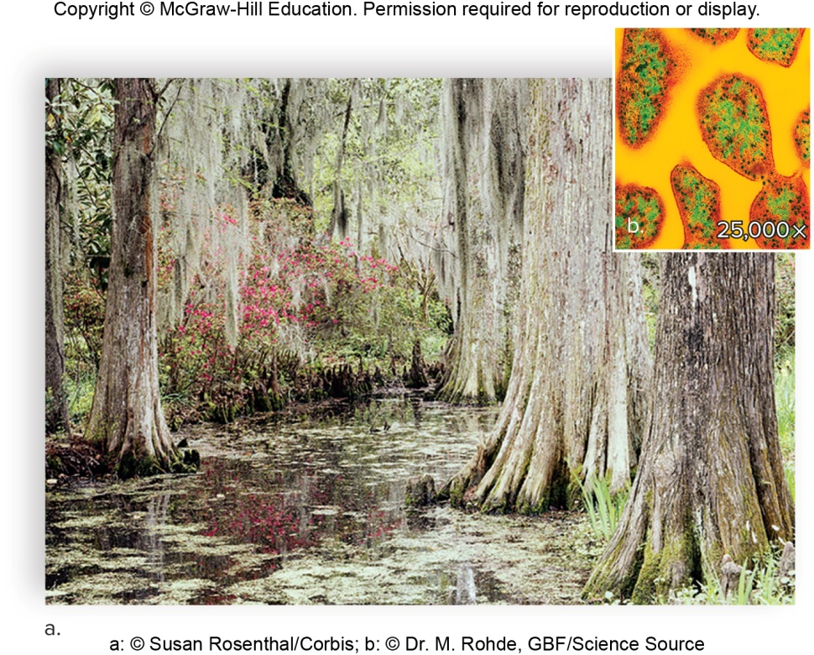
Types of Archaea, 1
Methanogens—chemoautotrophs couple production of methane to ATP synthesis, swamps and animal intestines
Figure 17.16 Methanogen habitat and structure
a: © Susan Rosenthal/Corbis; b: © Dr. M. Rohde, GBF/Science Source

Slide 90
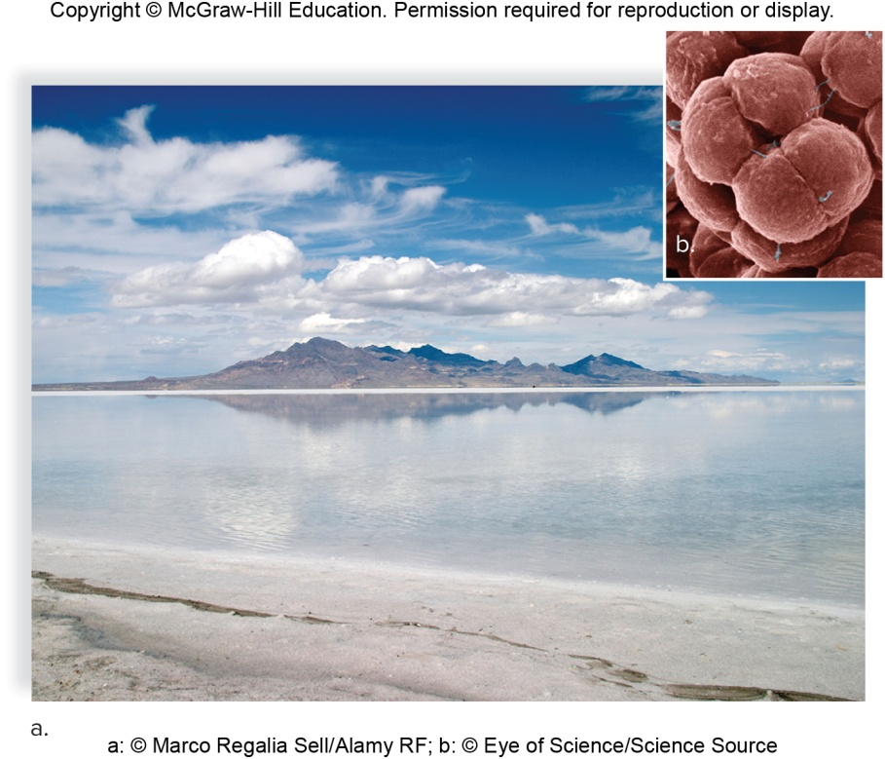
Types of Archaea, 2
Halophiles—require high salt concentrations to grow
Use pigments to absorb light energy to pump chloride and to synthesize ATP
Figure 17.17 Halophile habitat and structure
a: © Marco Regalia Sell/Alamy RF; b: © Eye of Science/Science Source

Slide 91
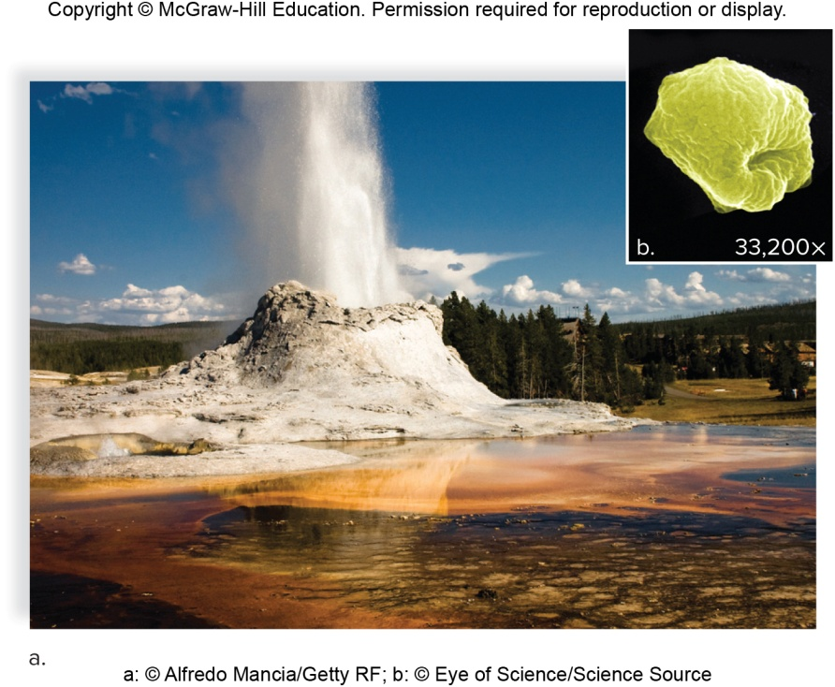
Types of Archaea, 3
Figure 17.18 Thermoacidophile habitat and structure
Thermoacidophiles—extremely hot, acidic environments like hot springs and submarine thermal vents
Survive best above 80°C (water boils at 100°C)
Grow best at pH 1 or 2
a: © Alfredo Mancia/Getty RF; b: © Eye of Science/Science Source

Slide 92
17.4 The Protists
Diversity is their outstanding feature.
All are eukaryotes with a nucleus and organelles.
Many are unicellular.
Endosymbiotic hypothesis—organelles of eukaryotes arose from symbiotic associations
Supported by mitochondria and chloroplasts having double membranes, DNA, and bacteria-like ribosomes

Slide 93
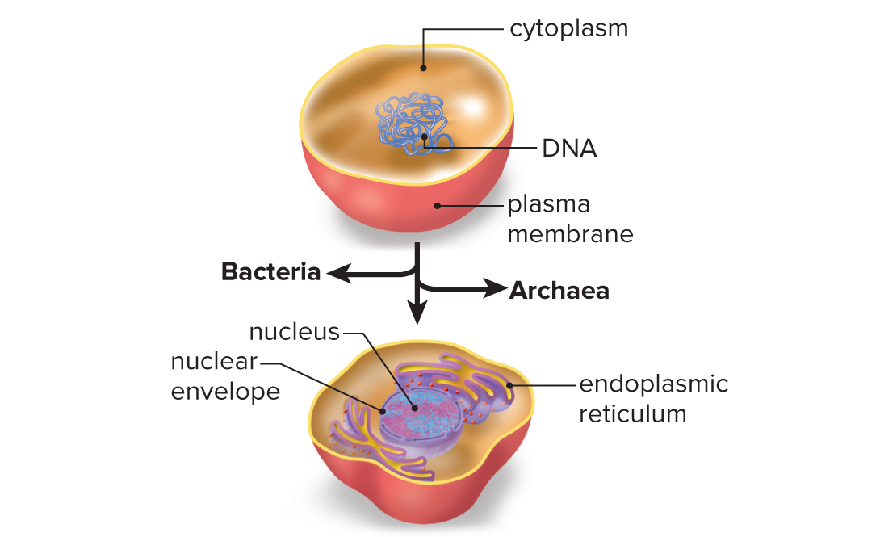
Figure 17.19 Evolution of the Eukaryotic Cell, 1
Common ancestor
Cell has nucleus and endoplasmic reticulum.

Slide 94
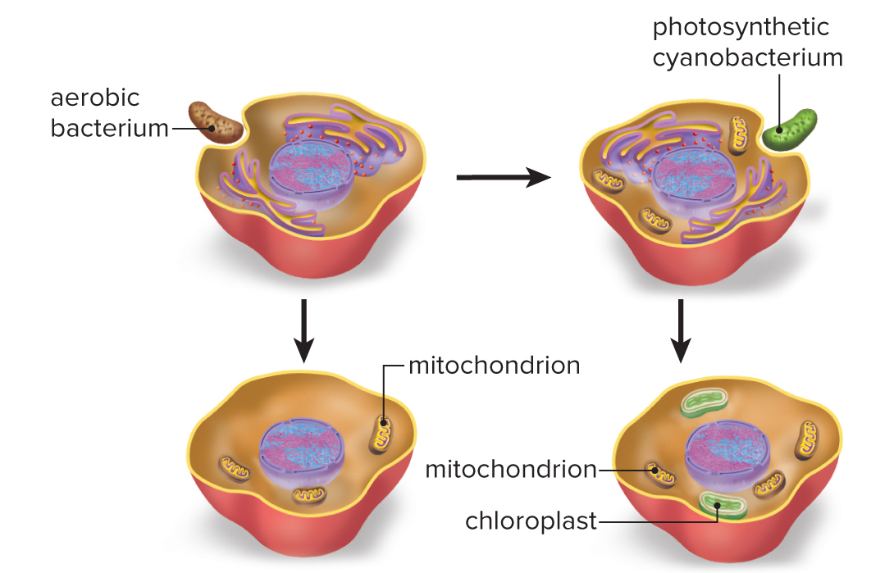
Figure 17.19 Evolution of the Eukaryotic Cell, 2
eukaryotic cell with mitochondria only (i.e., animal cell)
eukaryotic cell with both mitochondria and chloroplasts (i.e., plant cell)
Notes:
94

Slide 95
Figure 17.19 Evolution of the Eukaryotic Cell, overview
Common ancestor
eukaryotic cell with mitochondria only (i.e., animal cell)
eukaryotic cell with both mitochondria and chloroplasts (i.e., plant cell)

Slide 96
Classification of Protists
Difficult to classify due to diversity
May be not one but several kingdoms
Grouped by source of energy and nutrients
Algae are photosynthesizers.
Produce food and oxygen
May be aquatic or terrestrial
Partners in coral and lichens
Protozoa are chemoheterotrophic.
Most are free-living, some are human pathogens
Slime molds and water molds are also chemoheterotrophic.
Slime molds ingest their food while water molds are saprotrophic.

Slide 97
The Protozoans
Unicellular with complex cells
Some have more than one nucleus
Usually reproduce asexually by binary fission
Heterotrophic—many are phagocytic
Usually motile
Ciliates move by cilia—Paramecium
Amoeboids move using pseudopods—amoebas
Entamoeba histolitica causes amoebic dysentery.
Zooflagellates move by flagella.
Trypanosomes cause African sleeping sickness.
Giardia lamblia causes severe diarrhea.
Apicomplexans do not move.
One causes malaria—most widespread and dangerous protozoan disease

Slide 98
Figure 17.21 Examples of Green Algae
Chlamydomonas
Volvox
Spirogyra
a: © Andrew Syred/Science Source; b: © John Hardy, University of Washington, Stevens Point Department of Biology; c: © M.I. Walker/Science Source

Slide 99
Figure 17.25 A Paramecium
A paramecium is a ciliate, a type of complex protozoan that moves by cilia.
© Dr. David Patterson/SPL/Science Source

Slide 100
Figure 17.27 Examples of Excavata
a. Euglena has both animal- and plant-like characteristics.
b. Giardia is an intestinal parasite of a number of mammals, including humans.
a: © Kage Mikrofotograffie/Phototake; b: © Cultura RM/Alamy

Slide 101
Figure 17.28 An Amoeba

Slide 102
Essentials of Biology
Chapter 18 The Plants and Fungi
Notes:
102

Slide 103
18.1 Overview of The Plants
Kingdom Plantae—multicellular, photosynthetic eukaryotes that have become adapted to a land existence
Gametes, zygote, and embryo must be protected from drying out
Most likely plants evolved from a form of freshwater algae 500 MYA
Share chlorophylls a and b
Store excess carbohydrates as starch
Have cellulose in cell walls

Slide 104
Evolutionary Events Characterizing Plants
Five evolutionary events characterize the plants
Embryo protection—all plants protect their embryos
Algae do not
Mosses—lack vascular tissue but do protect their embryos
Vascular tissue—Lycophytes
For water transport, have true roots, stems, and leaves
Megaphylls—Ferns
Increases amount of photosynthesis and carbohydrates produced
Seeds—Gymnosperms
Contains embryo and stored organic nutrients inside a protective coat
Flowers—Angiosperms
Reproductive structure to attract pollinators and give rise to fruits

Slide 105
Figure 18.2 Evolution of Land Plants

Slide 106
Alternation of Generations
Each type of plant exists in two forms.
Sporophyte
Diploid (2n)
Produces haploid (n) spores by meiosis
Spore—reproductive cell that develops into new organism without the need to fuse with another reproductive cell
Gametophyte
Haploid
Produces gametes by mitosis
Gametes fuse to form diploid sporophyte

Slide 107
18.2 Diversity of Land Plants
Nonvascular plants
Bryophytes
Do not have true roots, stems, and leaves
No vascular tissue
Gametophyte dominant generation
Sporophyte dependent on gametophyte
Most familiar are liverworts and mosses

Slide 108
Nonvascular Plants
Nonvascular plants, continued
Flagellated sperm must swim in film of water
Sporophyte produces spores in sporangium
Not every plant named “moss” is a bryophyte
Irish moss is an alga; Spanish moss is an angiosperm
Hornwort
Liverwort gametophyte
Moss
(hornwort): © Steven P. Lynch; (liverwort): © Hal Horwitz/Corbis; (moss): © Steven P. Lynch

Slide 109
Vascular Plants
Vascular plants
All other land plants
Usually have true roots, stems, and leaves
Vascular tissue consists of xylem (conducts water and minerals) and phloem (conducts organic nutrients)
Xylem reinforced by lignin
Seedless vascular plants
Lycophytes and ferns
Seed plants

Slide 110
Seedless Vascular Plants
Seedless vascular plants
Dominant sporophyte, independent gametophyte
Lycophytes—club mosses
Among first land plants to have vascular tissue
Small leaves called microphylls

Slide 111
Ferns
Have megaphylls or fronds
Large leaves with branched veins
Larger surface area for photosynthesis
Better able to make food, grow, and reproduce
Sporangia located in sori on the underside of fronds
Small independent gametophyte
Flagellated sperm

Slide 112
Figure 18.7 Diversity of Ferns
(leatherleaf fern): © Gregory Preest/Alamy; (tree fern):© Danita Delimont/Getty Images; (hart’s tongue fern): © Organics image library/Alamy RF

Slide 113
Figure 18.9 The Carboniferous Period
© Field Museum Library/Contributor/Archive Photos/Getty Images

Slide 114
Seed Plants, 1
Most plentiful land plants today
Seed coat and stored food protect sporophyte embryo and allow it to survive until environmental conditions become favorable
Survival advantage of seeds accounts for the dominance of seed plants

Slide 115
Figure 18.10 Seed Anatomy
© David Moyer

Slide 116
Seed Plants, 2
Seed plants have:
Two types of spores
Two kinds of gametophytes
Pollen grains are drought-resistant male gametophytes.
Female gametophyte develops inside ovule
Ovule becomes the seed
Embryo inside seed is the sporophyte
Gymnosperms—ovule not enclosed by sporophyte tissue at pollination—“naked” seeds
Angiosperms—ovule completely enclosed in tissue that will become the fruit
No external water need for fertilization

Slide 117
Figure 18.11 Production of a Seed, 1
c: © Ed Reschke/Photolibrary/Getty Images

Slide 118
Figure 18.11 Production of a Seed, 2

Slide 119
Gymnosperms
Ovules and seeds are exposed on the surface of a cone scale.
“Naked seed”
Cycads are ancient gymnosperms that have been around since the Carboniferous period.
Conifers have become a dominant plant group today.

Slide 120
Conifers
Pines, spruces, firs, cedars, hemlocks, redwoods, cypresses, and others
Conifer—bears cones containing the reproductive structure of the plant
Coastal redwood is tallest living vascular plant
Nearly 100 meters in height
Bristlecone pine is oldest living tree
One is 4,900 years old

Slide 121
Figure 18.13a Conifers, Pines
a: (forest): © Steven P. Lynch; (pollen cones): © Maria Mosolova/Photolibrary/Getty RF; (seed cones):© Steven P. Lynch

Slide 122
Figure 18.13 b,c Conifers
b: © Ed Reschke/Peter Arnold/Getty Images; c: (tree): © T. Daniel/Bruce Coleman/Photoshot; (juniper berries): © Evelyn Jo Johnson

Slide 123
Angiosperms
Angiosperms or flowering plants
Means covered seeds
Exceptionally large and successful group of land plants
Six times the number of species of all other plant groups combined
First fossils 135 million years old

Slide 124
Figure 18.14 Amborella Trichopoda and 18.15 Generalized Flower
© Stephen McCabe

Slide 125
The Flower
Most have certain parts despite dissimilar appearances
Sepals—collectively called calyx, protect flower bud
Petals—collectively called corolla, quite diverse in size, shape, and color
Stamen—stalk is filament, pollen produced in anther
Carpel—ovary at base contains ovules, style elevates stigma, which receives pollen grains

Slide 126
Flowering Plant Life Cycle
Pollen is transported to stigma where it germinates
Pollen tube carries two sperm to ovule
Ovary contains several ovules, each eventually holding an egg-bearing female gametophyte (embryo sac)
Double fertilization
One sperm unites with egg nucleus, forming diploid zygote
Other sperm unites with two other nuclei forming triploid (3n) endosperm—stored food for embryo
Ultimately, ovule becomes a seed containing the sporophyte embryo
In some seeds, endosperm absorbed by cotyledons
Fruit derived from ovary and possible other flower parts

Slide 127
Adaptations of Angiosperms
Adaptations of angiosperms
Successful completion of sexual reproduction requires effective dispersal of pollen and then seeds.
Pollination
Insect- and bird-pollinated flowers are often showy
Night-blooming flowers are often white and aromatic to attract mammals or insects
Many flowers attract only specific pollinators.
Bee-pollinated flowers have UV shading indicating the location of nectar.
Fruit dispersal
Transported by wind, gravity, water, or animals
Fleshy fruit to attract animals

Slide 128
Figure 18.17 Pollinators
a: © IT Stock Free/Alamy RF; b: © H. Eisenbeiss/Science Source; c: © Anthony Mercieca/Science Source; d: © Nicolas Reusens/Getty RF

Slide 129
Fruits
Bananas
Coconuts
Grains—corn, wheat, rice
Pods that contains beans or peas

Slide 130
18.3 The Fungi
Not plants—no chloroplasts and can’t photosynthesize
Not animals—fungi are chemoheterotrophs like animals
Animals ingest their food, fungi grow into it
Animals are motile, most fungi are not
Fungal life cycle has windblown spores during both sexual and asexual life cycle

Slide 131
Figure 18.19 Evolutionary Relationship of the Major Groups of Fungi
Basidiomycota (club fungi)
Ascomycota (sac fungi)
Glomeromycota (AM fungi)
common ancestor
Zygomycota (zygospore fungi)**
Chytridiomycota (chytrids)
Microsporidia (single-celled parasites)*
* Recently placed in the kingdom Fungi
** Molecular data suggests the Zygomycota may have multiple evolutionary origins.
Table 18.1 How Fungi Differ from Plants and Animals
Feature | Fungi | Plants | Animals
Nutrition | Chemoheterotrophic by absorption | Photosynthetic | Chemoheterotrophic by ingestion
Movement | Most nonmotile | Nonmotile | Motile
Body | Mycelium of hyphae | Specialized tissues/organs | Specialized tissues/organs
Adult chromosome number | Haploid | Haploid/diploid | Diploid
Cell wall | Composed of chitin | Composed of cellulose | No cell wall
Reproduction | Most have spores/mating hyphae | Spores/gametes | Gametes

Slide 132
Figure 18.20 Body of a Fungus
a: © Matt Meadows/Peter/Arnold/Getty Images

Slide 133
General Biology of a Fungus
Hyphae—thin filaments of cells making up all parts of a typical fungus
Hyphae pack together to make mushroom
Main body of fungus is not the mushroom or puffball—these are only temporary reproductive structures
Main body of fungus is mass of hyphae called mycelium

Slide 134
Fungi Structure
Fungi structure
Fungal cells typically have thick cell walls.
Do not contain cellulose like plants
Contain chitin, like exoskeleton of crabs and lobsters
Wall or septa divides the cells of a hyphae in many fungi
Hyphae give mycelium large surface area for absorption of nutrients

Slide 135
Figure 18.24 Types of Sac Fungi
Morel
Cup fungi
Yeast
a: © Robert Marien/Corbis RF; b: © Carol Wolfe; c: © Science Photo Library RF/Getty RF

Slide 136
Figure 18.25 Carnivorous Fungus
© L. West/Science Source

Slide 137
Figure 18.26 Lichens
Crustose lichen
Fruticose lichen
Foliose lichen
b: (crustose): © James Cade/123RF; (fruticose): © Steven P. Lynch; (foliose): © Yogesh More/Alamy RF

Slide 138
Ecological Benefits of Fungi
Most fungi are saprotrophs.
Decompose remains of plants, animals, and microbes
Indispensable role in environment, returning inorganic nutrients to photosynthesizers
Some fungi eat animals as a nitrogen source.
The oyster fungus has a compound that anesthetizes roundworms so they can be digested.

Slide 139
Mutualistic Relationships
Two different species live together and help each other out.
Lichens
Fungus and cyanobacteria or green algae
Fungal partner acquires nutrients and moisture
Photosynthetic partner makes food

Slide 140
Figure 18.27 Plant Roots Showing Mycorrhizae
© Dr. Jeremy Burgess/Science Source

Slide 141
Mycorrhizal Fungi
From mutualistic relationships with roots of most plants
Help plants grow more successfully in dry or poor soils (especially if deficient in inorganic nutrients)
Hyphae increase surface area for absorption of food and nutrients.
May live on outside of roots, enter between root cells, or penetrate root cells
Fungus and plant exchange nutrients
Relationship an ancient one—found in fossils
Truffles are fruiting bodies of mycorrhizal fungi

Slide 142
Fungi Products
Fungi produce medicines and many types of foods.
Penicillium the original source of penicillin
Yeast fermentation used to make bread, beer, wine
Mushroom consumption has steadily increased in the United States.
In the United States, the average person consumes over 2.6 pounds of mushrooms annually.
In addition to being used as food, mushrooms such as shiitake are also connected to health benefits.

Slide 143
Fungi and Plant Diseases
Serious crop losses
Bananas, rice, corn, and fruit trees are all susceptible to fungal disease.
As much as 1/3 of the world’s rice crop is destroyed each year by rice blast disease.

Slide 144
Figure 18.28 Plant Fungal Diseases
a: © David Hancock/Alamy; b: © Marvin Dembinsky Photo/Associates/Alamy; c: © Monty Lovette/Alamy RF

Slide 145
Fungi and Animal Diseases
Ergot fungus grows on grains and can cause hysteria, convulsions, and even death.
Mycoses—fungal diseases
Cutaneous—only affect epidermis
Subcutaneous—affects deeper layers
Systemic—can spread throughout body
Opportunistic fungal infections in AIDS
Candida albicans
“Yeast” infections in women, thrush in the mouth
Ringworm
Caused for the most part by fungus Tinea
Fungal colony grows outward in a ring
Athlete’s foot is a form of Tinea

Slide 146
Figure 18.29 Human Fungal Diseases
a: © Dr. M.A. Ansary/Science Source; b: © John Hadfield/SPL/Science Source; c: © P. Marazzi/SPL/Science Source

Slide 147
Chytridiomycotis
Chytridiomycotis
Caused by parasitic chytrid
Results in cutaneous infection of frogs worldwide
Decimated frog populations
Because fungi are eukaryotes and more closely related to humans than bacteria, it is hard to design an antibiotic against fungi that does not also harm animals.
Try to exploit any differences between animals and fungi

Slide 148
Figure 18.30 Brown Bats in a Hibernation Cave Exhibiting Fungal Growth on Their Muzzles
© New York State Department of Environmental Conservation/AP Images

Slide 149
Essentials of Biology
Chapter 19
The Animals
Lecture Outline
Copyright © McGraw-Hill Education. All rights reserved. Authorized only for instructor use in the classroom. No reproduction or distribution without the prior written consent of McGraw-Hill Education.
Notes:
149

Slide 150
19.1 Evolution of Animals
Animals are multicellular eukaryotes.
Like protists, plants, and fungi
Animals are chemoheterotrophs.
Unlike autotrophic plants
Like fungi, but animals ingest food and digest internally while fungi digest food externally
Animals usually undergo sexual reproduction.
Begin life as a fertilized diploid egg
Undergo developmental changes
Organism with specialized tissues
Muscle and nerve tissue characterize animals

Slide 151
Figure 19.1 General Characteristics of Animals
a: © Salvanegra/istock/Getty RF; b: © Mike Raabe/Getty RF; c: © iStockphoto/Getty RF; d: © Carolina Biological Supply/Phototake

Slide 152
The Evolutionary Tree of Animals
Based on molecular data and developmental biology
Trends
Multicellularity
Parazoans vs. eumetazoans
2 to 3 germ layers (ectoderm, mesoderm, endoderm)
Symmetry—radial vs. bilateral
Bilateral organisms with cephalization
Protostome vs. deuterostome
Blastopore becomes mouth or anus
Protostomes can be acoelomate, pseudocoelomates, or coelomates
Deuterostomes are coelomates
Segmentation—leads to specialization

Slide 153
Figure 19.4 The Animal Evolutionary Tree

Slide 154
Symmetry
Radial symmetry—animal is organized circularly
Bilateral symmetry—animal has right and left halves
Accompanied by cephalization—localization of brain and specialized sensory organs at the anterior end of animal

Slide 155
Figure 19.5 Radial Versus Bilateral Symmetry
radial symmetry
bilateral symmetry

Slide 156
Protostomes and Deuterostomes Compared
Protostomes
Flatworms, roundworms, molluscs, annelids, arthropods
Deuterostomes
Echinoderms and chordates
Distinguished based on embryological development
Cell division pattern is different
First embryonic opening is called blastopore
In protostomes, becomes mouth
In deuterostomes, becomes anus

Slide 157
Figure 19.6 Development in Protostomes and Deuterostomes
Protostomes
Deuterostomes

Slide 158
Coelom
Coelom—body cavity
Acoelomate—no body cavity
Packed solid with mesoderm
Pseudocoelomates—body cavity incompletely lined with mesoderm
Coelomate—body cavity completely lined with mesoderm
Mesentery supports internal organs
Body movements are freer because outer wall can move independently of organs
Organs have more space to become complex.
In animals without a skeleton, the coelom acts as a hydrostatic (fluid-filled) skeleton.

Slide 159
Figure 19.7 Type of Body Cavity
Coelomate (molluscs, annelids, arthropods, echinoderms, chordates)
Acoelomate (flatworms)
Pseudocoelomate (roundworms)

Slide 160
19.2 Sponges and Cnidarians: The Early Animals
Sponges: multicellularity
Saclike bodies with many pores
Aquatic, largely marine
Multicellular but lack organized tissues
Cellular level of organization
Interior of sponge lined with flagellated cells called collar cells or choanocytes
Filter feeder—filters food out of water using pores and collar cell microvilli
Reproduce both sexually and asexually
Asexual fragmentation or budding

Slide 161
Cnidarians
Cnidarians: true tissues
Rich fossil record
Radially symmetrical
Capture prey using ring of tentacles that bear cnidocytes
Cnidocyte contains nematocyst that may trap or penetrate and inject toxin
Aquatic, mostly marine
Two germ layers—ectoderm and endoderm
Tissue level of organization
Two basic body forms
Polyp—mouth directed upward from substrate
Medusa—mouth directed downward

Slide 162
Figure 19.9 c,d Cnidarians
Portuguese man-of-war
Cup coral
c: © NHPA/Charles Hood/Photoshot RF; d: © Ron Taylor/Bruce Coleman/Photoshot

Slide 163
19.3 Flatworms, Molluscs, and Annelids: The Lophotrochozoans
Flatworms: bilateral symmetry
Have three germ layers
Acoelomate
Planarians are free-living flatworms
Several body systems, including a nervous system
Cephalization—brain, eyespots, and chemosensitive organs on the auricles
Incomplete digestive system—only one opening
Muscular pharynx
Hermaphrodites
Both male and female sex organs
Cross-fertilize

Slide 164
Figure 19.10a Anatomy of a Planarian: External Appearance
External appearance

Slide 165
Flatworms
Parasitic flatworms
Tapeworms
Endoparasites (internal parasites)
Vary in size from a few millimeters to 20 meters
Scolex used to attach to host
Flukes
Endoparasites
Oral sucker and at least one other sucker for attachment
Named for organ they inhabit; for example, there are blood, liver, and lung flukes
Nearly 243 million people each year require treatment from blood fluke (Schistosoma) infections

Slide 166
Figure 19.11 Parasitic Flatworms
Tapeworm
Blood fluke
a: © C. James Webb/Phototake; b: © NIBSC/SPL/Science Source

Slide 167
Molluscs
Coelomates with complete digestive tract
All molluscs have a body with at least three parts:
Visceral mass—internal organs
Foot—muscular portion used for locomotion
Mantle—envelopes but does not enclose visceral mass
May secrete an exoskeleton called a shell
Radula—tonguelike with many teeth

Slide 168
Three Classes of Molluscs, 1
Three classes of molluscs: gastropods, cephalopods, bivalves
Gastropods
Nudibranchs, conchs, and snails
Herbivores or carnivores
Terrestrial snails use mantle as lung
(Land snail): © Ingram Publishing/Superstock RF; (Nudibranch): © Kenneth W. Fink/Bruce Coleman/Photoshot

Slide 169
Three Classes of Molluscs, 2
Cephalopods
Octopuses, squids, and nautiluses
Foot evolved into tentacles around head
Well-developed nervous system
Complex sensory organs
Large brain
Octopuses are highly intelligent
(Octopus): © Alex Kerstitch/Bruce Coleman/Photoshot; (Nautilus): © Douglas Faulknear/Science Source

Slide 170
Three Classes of Molluscs, 3
Bivalves
Clams, oysters, scallops, and mussels
Two parts to the shell
Filter feeders
(Scallop): © ANT Photo Library/Science Source; (Mussels): © Michael Lustbader/Science Source

Slide 171
Annelids, 1
Annelids: segmented worms
Segmented—can be seen externally in rings encircling body of earthworm
Septa divide fluid-filled coelom
Used as hydrostatic skeleton
Complete digestive tract with specialized parts
Pharynx, esophagus, crop, gizzard, intestine, and accessory glands
Extensive closed circulatory system
Nervous system has brain and ventral nerve cord
Ganglia in each segment
Nephridia in excretory system
Nephridium collects waste and excretes it through opening in body wall

Slide 172
Figure 19.14a Earthworm Anatomy

Slide 173
Figure 19.14b Earthworm Anatomy

Slide 174
Annelids, 2
Annelids
Polychaetes
Have many setae per segment
The clam worm is a predator
Others are sedentary tube worms that are filter feeders
Oligochaeates
Few setae per segment
Earthworms
Scavengers in soil
a: © Heather Angel/Natural Visions; b: © Diane R. Nelson

Slide 175
Annelids, 3
Annelids, concluded
Leeches
No setae
Most freshwater, but some marine or terrestrial
Some free-living but most are fluid feeders
Hirudin is a powerful anticoagulant.
Medicinal leech
c: © St. Bartholomews Hospital/Science Source

Slide 176
19.4: Roundworms and Arthropods: The Ecdysozoans
Roundworms: Pseudocoelomates
Body cavity—pseudocoelom
Incompletely lined with mesoderm
Complete digestive tract
Both mouth and anus
Nonsegmented
Occur almost everywhere—sea, fresh water, and soil
Free-living or parasitic
Examples—Ascaris (intestinal), Trichinosis (skeletal muscle), Elephantiasis (lymphatic vessels), pinworms, and hookworms

Slide 177
Arthropods
Extremely diverse—over one million species
As many as 30 million may exist
Most are insects
Success due to six characteristics
Jointed appendages—various modifications
Exoskeleton—made of chitin, must be molted
Segmentation—repeating body units
Well-developed nervous system
Variety of respiratory organs
Metamorphosis
Larvae and adult may have different lifestyle

Slide 178
Figure 19.17 Body Plan of an Arthropod

Slide 179
Figure 19.18 Monarch Butterfly Metamorphosis
(a, c-e): © Creatas/Punchstock RF; b: © PBNJ Productions/Getty RF

Slide 180
Figure 19.19 Crustacean Diversity
a:© Melba Photo Agency/Punchstock RF; b: © Ales Veluscek/Getty RF; c: © Sandy Franz/Getty RF; d: © L. Newman & A. Flowers/Science Source
Arthropods
Crustaceans—barnacles, shrimp, lobsters, crabs, crayfish, and pillbugs
Head bears pair of compound eyes and five pairs of appendages
Head and thorax fused into cephalothorax
Gills above walking legs

Slide 181
Types of Arthropods, 1
Arachnids—spiders, scorpions, ticks, mites, and harvestmen (“daddy longlegs”)
Spiders
Narrow waist separates cephalothorax from abdomen
Most inject venom and digest food externally before sucking it up.
Book lungs
Scorpions
Among the oldest terrestrial arthropods
Nocturnal
a: © Mark Kostich/Getty RF; b: © John Bell/Bruce Coleman/Photoshot

Slide 182
Types of Arthropods, 2
Mites and ticks are parasites.
Chiggers are larvae of certain mites.
Horseshoe crabs
First pair of appendages pincerlike
Great interest to medical sciences
Centipedes—one pair of appendages per segment
Carnivorous
Millipedes—two pairs of appendages per segment
Herbivorous
c: © Sandy Franz/Getty RF; d: © L. Newman & A. Flowers/Science Source

Slide 183
Types of Arthropods, 3
Insects
Very numerous and diverse
Entomology—study of insects
Adapted to active life on land
Some have secondarily invaded aquatic habitats
Body—head, thorax, abdomen
Mouthparts adapted to each species’ particular way of life
Three pairs of legs
One or two pairs of wings (or none)

Slide 184
Figure 19.21 Insect Diversity
(cottony cushion scale): © Nancy Nehring/Getty RF; (snout beetle): © Kjell Sandved/Bruce Coleman/Photoshot; (Housefly): © L. West/ Bruce Coleman/Photoshot; (Green lacewing): © InsectWorld/Shutterstock RF; (Walking Stick): © Creatas Images/PictureQuest RF; (Honeybee): © Daniel Prudek/Shutterstock RF; (Flea): © Kallista Images/Getty Images; (Aedes mosquito): Source: USDA; (Dragonfly): © Creatas Images/PictureQuest RF; (Grasshopper): © David Moyer; Luna moth): © Charles Brutlag/Shutterstock RF

Slide 185
19.5 Echinoderms and Chordates: The Deuterostomes
Both deuterostomes
Echinoderms
Larva is free-swimming filter feeder with bilateral symmetry
Adults are radially symmetric without a head, brain, or segmentation
Nerve ring around mouth extends outward
Locomotion depends on water vascular system
Water enters through sieve plate, or madreporite
Pumped into tube feet, which produce a suction
No complex respiratory, excretory, or circulatory system
Fluids in coelomic cavity and water vascular system carry out these functions

Slide 186
Figure 19.23 Echinoderm Diversity
Sea lily (above), feather star (right)
Sea cucumber
Brittle star
Sea urchins (left), sand dollar (right)
a: (sea lily): © Borut Furlan/WaterFrame/Getty Images; (feather star): © Reinhard Dirscherl/WaterFrame/Getty Images; b: © Andrey Nekrasov/Alamy RF; c: © Diane Nelson; d: (sea urchins): © Fuse/Getty RF; (sand dollar): © Andrew J. Martinez/Science Source

Slide 187
Figure 19.24 Anatomy of a Sea Star

Slide 188
Chordates
At some time in their life history, a chordate has four characteristics:
Dorsal supporting rod called a notochord
Vertebrates have an endoskeleton of cartilage or bone.
Dorsal tubular nerve cord
Pharyngeal pouches
Postanal tail

Slide 189
Figure 19.25 The Four Chordate Characteristics

Slide 190
Evolutionary Trends Among the Chordates
Evolutionary trends among the chordates
Presence of vertebrae
Jaws
Bony skeleton
Lungs
Jointed appendages
Amniotic egg
Mammary glands

Slide 191
Figure 19.27 Evolutionary Tree of Chordates

Slide 192
Fishes, 1
Fishes: first jaws and lungs
First vertebrates were jawless fishes
Three living classes of fishes
Jawless
Cartilaginous
Bony
Two latter groups have jaws
Believed to have evolved from first pair of gill arches

Slide 193
Figure 19.28 Evolution of Jaws

Slide 194
Fishes, 2
Jawless fishes
Cylindrical and up to a meter long
Smooth, scaleless skin
No jaws or paired fins
Hagfish are scavengers.
Some lampreys are parasites.
Cartilaginous fishes
Sharks, skates, and rays
Skeletons of cartilage, not bone
Three well-developed senses enable sharks and rays to detect prey:
Sense electric currents in water
Lateral line system
Keen sense of smell

Slide 195
Figure 19.29 Jawless and Cartilaginous Fishes
Lamprey, a jawless fish
Bull shark, a cartilaginous fish
a: © Heather Angel/Natural Visions; b: © Ingram Publishing/Alamy RF

Slide 196
Bony Fishes
Most numerous and diverse of all vertebrates
Ray-finned fishes—fins supported by bony spikes
Perch, trout, salmon, haddock, etc.
Filter feeders, opportunists, or predacious carnivores
Swim bladder serves as buoyancy organ.
Can change density to go up or down in water
Single-circuit circulatory system
Heart has nondivided atrium and ventricle

Slide 197
Figure 19.30 Bony Fish
A lionfish
Internal anatomy of bony fish
a: © powerofforever/Getty Rf

Slide 198
Lobe-Finned Fishes
Most had a lung for respiration
Evolved into amphibians
Fleshy appendages could be adapted to land locomotion

Slide 199
Figure 19.31 Evolution of Amphibians
b: © imageBroker/Alamy RF

Slide 200
Amphibians, 1
Amphibians: jointed vertebrate limbs
Frogs, toads, newts, and salamanders
Features not seen in bony fish
Jointed limbs
Eyelids
Ears
Sound-producing larynx
Larger brain
Three-chambered heart

Slide 201
Amphibians, 2
Amphibians, continued
Adults usually have small lungs.
Air enters through mouth and is forced into lungs
Supplemental gas exchange through moist skin
Three chambered heart
Mixed blood sent to all parts of body
Blood sent to skin—further oxygenated
Larval stage lives in water; adults live on land
Amphibious life
Metamorphosis is a characteristic but some are direct developers

Slide 202
Reptiles
Reptiles: amniotic egg
Diversified and were most abundant between 245 and 66 million years ago
Included dinosaurs
Bipedal stance of some reptiles preadaptive for evolution of wings in birds
Turtles, crocodiles, snakes, lizards, and birds
Body covered in scales
Well-developed lungs enclosed by protective rib cage
Three-chambered heart

Slide 203
Figure 19.32 The Amniotic Egg
a: © Heinrich van den Berg/Gallo Images/Getty Images

Slide 204
Significance of Amniotic Egg
Eliminated need of water environment for development
Provides developing embryo with oxygen, food, and water; removes nitrogenous waste; protects the embryo
Uses extraembryonic membranes
Ectothermic—body temperature matches outside environment
Fishes, amphibians, and reptiles (other than birds)
Must move to warmer or cooler area to regulate temperature

Slide 205
Birds
Share common ancestor with crocodiles
Traits show they are reptiles
Tail with vertebrae, clawed feet, scales
Feathers are modified reptilian scales
Exact history still in dispute
Nearly every anatomical feature related to flight
Forelimbs modified into wings
Hollow, light bones laced with air cavities
Horny beak instead of heavy jaws
Slender neck and compact torso
Efficient respiration using air sacs
Completely separated four-chambered heart
Acute vision and well-developed brains
Endotherms—generate internal heat

Slide 206
Figure 19.34 Bird Beaks
A cardinal’s beak allows it to crack tough seeds.
Cardinal, Cardinalis cardinalis
A flamingo’s beak strains food from the water with bristles that fringe the mandibles.
Flamingo, Phoenicopterus ruber
A bald eagle’s beak allows it to tear prey apart.
Bald eagle, Haliaetus leucocephalus
a: © Graeme Teague; b: © Medford Taylor/Getty Images; c: © Dale DeGabriele/Getty Images

Slide 207
Mammals, 1
Mammals: hair and mammary glands
Amniotes
Endotherms
Two chief characteristics of mammals
Hair—provides insulation against heat loss
Mammary glands—enable female to feed young without leaving them to find food

Slide 208
Mammals, 2
Mammals
Marsupials
Born in immature condition
Newborns complete development inside female’s pouch
Virginia opossum only marsupial north of Mexico
Mainly in Australia—koalas, kangaroos, Tasmanian wolf (extinct)
Monotremes
Have cloaca (like birds) and lay hard-shelled amniote eggs
Spiny anteater and duckbill platypus

Slide 209
Placental Mammals
Vast majority of living mammals
Extraembryonic membranes of amniote egg modified for internal development within uterus of female
Adapted to active life on land
Well-developed brain—expansion of cerebral hemispheres
Four-chambered heart
Internal temperature is constant
Distinguished by methods of obtaining food and locomotion

Slide 210
19.6 Human Evolution
All primates share a common ancestor.
Prosimians—lemurs, tarsiers, and lorises
Anthropoids—monkeys, apes, and humans
Primates adapted to arboreal life (life in trees)
Mobile limbs
Opposable thumbs and big toes
Trend toward larger and more complex brain
Evolutionary tree indicates humans most closely related to African apes
Humans did not evolve from apes
Believed to share a common ancestor about 7 million years ago

Slide 211
Figure 19.37 Evolutionary Tree of Primates

Slide 212
Human Evolution
Evolution of humanlike hominins
To be a hominin, must have anatomy suitable for standing erect and walking on two feet—bipedalism
Hominid includes apes, chimpanzees, humans and closest extinct relatives of humans
Early hominins
Sahelanthropus tchadensis—dated to 7 million years ago
Braincase apelike, suggestions of bipedalism
Ardipithecus ramidus—4.5 million years ago
Only skull fragments
Possibly bipedal
Teeth intermediate between earlier apes and later hominids

Slide 213
Figure 19.38 Human Evolution
Homo
distinct forehead flat face 700-1,300 cc brain.
Australopithecines
low forehead projecting face 400 cc brain
Early humanlike hominins
Very low forehead projecting face 370 cc brain
(Ardipithecus ramidus): © Richard T. Nowitz/Science Source; (Australopithecus afarensis): © Scott Camazine/Alamy; (Australopithecus africanus): © Philippe Plailly/ Science Source; (Homo habilis): © Kike Calvo VWpics/superstock; (Homo sapiens): © Kenneth Garrett/Getty Images

Slide 214
Figure 19.39 Ardipithecines
(both): © HO/Reuters/Corbis

Slide 215
Australopithecines
Australopithecines
Possibly direct ancestor of humans
In Africa about 4 million years ago
Australopithecus afarensis—“Lucy”
Brain small (apelike) but she stood upright and walked bipedally (humanlike)
Trail of footprints dated to 3.7 million years ago
Mosaic evolution—not all body parts change at the same rate

Slide 216
Homo Habilis
Homo habilis
Dated between 2.0 and 1.9 million years ago
May be ancestral to modern humans
45% larger brain than A. afarensis
Cheek teeth smaller—likely omnivorous
Stone tools
Enlarged portion of brain dealing with speech
Beginnings of culture—encompasses human behavior and products and is dependent upon capacity to speak and transmit knowledge

Slide 217
Homo Erectus
Homo erectus
Fossils found in Africa, Asia, and Europe
Dated between 1.9 and 0.3 million years ago
Similar in appearance but may be several species
Larger brain and flatter face compared to H. habilis
Much taller
Robust and muscled skeleton still like australopithecines
Believed to have appeared in Africa and migrated into Asia and Europe
First to use fire
Fashioned more advanced tools

Slide 218
Evolution of Modern Humans
Evolution of modern humans
Replacement model or out-of-Africa hypothesis
Modern humans evolved from archaic humans only in Africa and then migrated to Asia and Europe, where they replaced archaic species about 100,000 BP.
Being challenged by new genomic information

Slide 219
Neandertals
Neandertals (Homo neandertalensis)
Take name from German valley
Neandertals had massive brow ridges
Nose, jaws, and teeth protruded far forward
Forehead low and sloping
No chin
Eventually supplanted by modern humans
New evidence suggests they interbred with Homo sapiens
Heavily muscled with larger brain than H. sapiens
Sturdy build may have helped conserve body heat in last Ice Age
Culturally advanced
Most lived in caves but may have built homes
Variety of stone tools
Buried dead with flowers and tools—religion?

Slide 220
Cro-Magnons
Cro-Magnons (Homo sapiens)
Thoroughly modern appearance
Advanced tools
May have been first to make knifelike blades and throw spears
May be responsible for extinction of many larger mammals like giant sloth, mammoth, saber-toothed tiger, and giant ox
Hunted cooperatively
Perhaps first to have language
Culture included art

