Slide 1
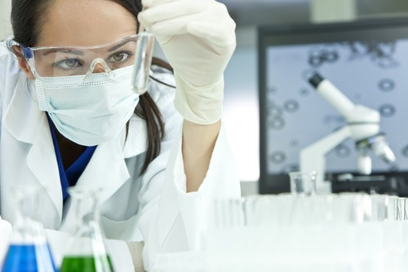
Cancer & Its Causes

Slide 4
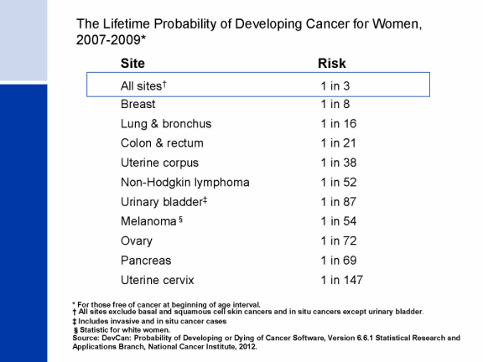

Slide 6
Phenotype of a Cancer Cell
The Six Hallmarks of Cancer
Resistance to cell death
Activated anti-cell death signalling
Sustained angiogenesis
Activated VEGF signaling
Invasion & metastasis
Loss of cell-to-cell interactions

Slide 7
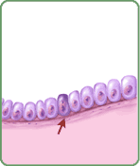
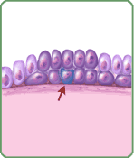
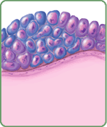
How Cancer Starts
Cancer is a broad group of various diseases, all involving unregulated cell growth
To understand cancer, we must begin with an understanding of the process of cell division and by looking at the various factors that regulate it

Slide 8
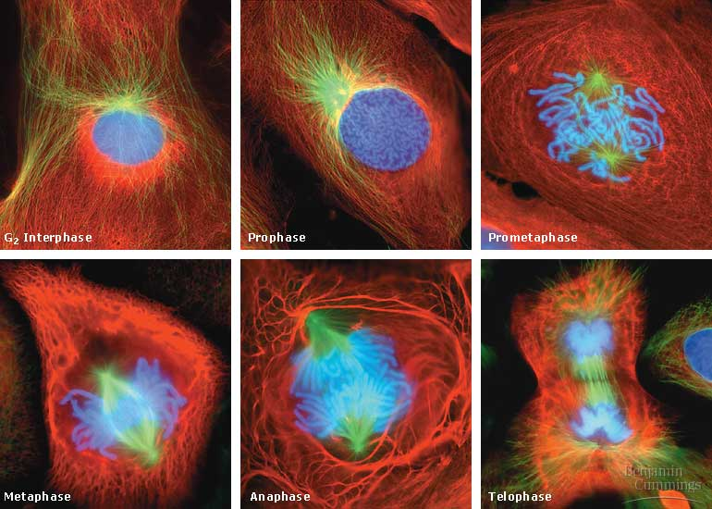
Review of Cell Division

Slide 9
The Eukaryotic Cell Cycle is Regulated by a Molecular Control System
The frequency of cell division varies with the type of cell
These differences result from regulation at the molecular level
Cancer cells manage to escape the usual controls on the cell cycle

Slide 10
The Cell Cycle is Regulated by Internal & External Controls
There are specific checkpoints where the cell cycle stops until a go-ahead signal is received
Two types of regulatory proteins involved in cell cycle control: cyclins and cyclin-dependent kinases (Cdks)
An example of an internal signal is that kinetochores not attached to spindle microtubules send a molecular signal that delays anaphase
Some external signals are growth factors, proteins released by certain cells that stimulate other cells to divide. For example, platelet-derived growth factor (PDGF) stimulates the division of human fibroblast cells in culture

Slide 11
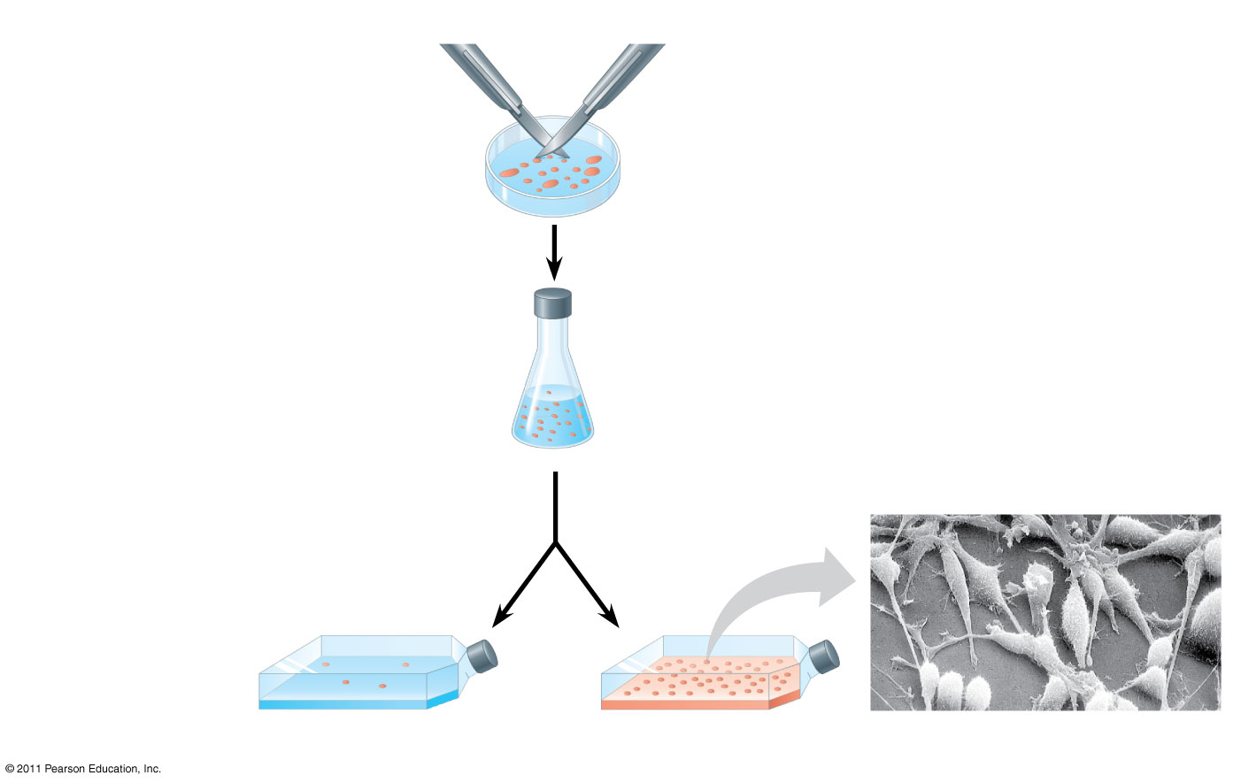
Figure 12.18
1
A sample of human connective tissue is cut up into small pieces.
Scalpels
PDGF is a ligand for RTKs and results in division …wounds secrete this to stimulate division/healing (41)
Petri dish
2
Enzymes digest the extracellular matrix, resulting in a suspension of free fibroblasts.
4
PDGF is added to half the vessels.
10 μm
3
Cells are transferred to culture vessels.
Without PDGF
With PDGF
Notes:
Figure 12.18 The effect of platelet-derived growth factor (PDGF) on cell division.

Slide 12
Other External Signals that Control Cell Division
A clear example of external signals is density-dependent inhibition, in which crowded cells stop dividing
Most animal cells also exhibit anchorage dependence, in which they must be attached to a substratum in order to divide
Cancer cells exhibit neither density-dependent inhibition nor anchorage dependence

Slide 13
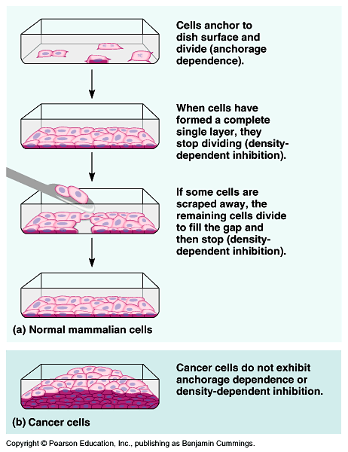

Slide 14
Loss of Cell Cycle Controls in Cancer
Cancer cells do not respond normally to the body’s control mechanisms
Cancer cells may not need growth factors to grow and divide
They may make their own growth factor
They may convey a growth factor’s signal without the presence of the growth factor
They may have an abnormal cell cycle control system

Slide 15
Loss of Cell Cycle Controls in Cancer
A normal cell is converted to a cancerous cell by a process called transformation
Cancer cells that are not eliminated by the immune system, form tumors, masses of abnormal cells within otherwise normal tissue
If abnormal cells remain at the original site, the lump is called a benign tumor
Malignant tumors invade surrounding tissues and can metastasize, exporting cancer cells to other parts of the body, where they may form additional tumors

Slide 16
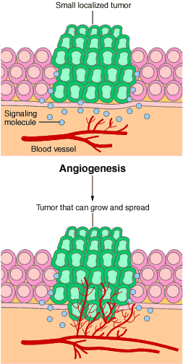
Angiogenesis
New blood vessel growth
Diffusion limit is a few millimeters
Growth of new vessels is required for tumor growth once tumor is the size of a pea
Tumor cells induce angiogenesis by giving off signals used in normal development and wound healing.

Slide 17
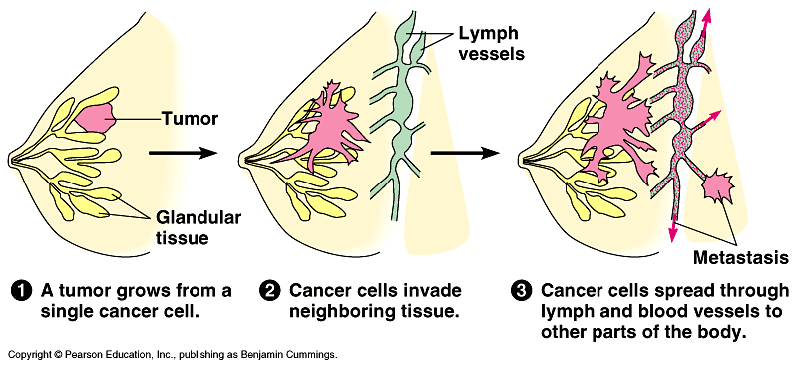
Cancer Angiogenesis

Slide 18
Tumor Progression

Slide 19
Causes of Cancer
Regulation of cell division is a balance between:
Mitosis - making new cells.
Apoptosis - cell suicide or death
Cancer can result if either process doesn’t work.
Proteins and regulatory RNAs involved in regulating these processes ultimately contribute to development of the disease

Slide 20
Cellular damage elicits abnormal proliferation
Damage
No repair
Death
Damage
No repair
Cancer cell
Damage
repair
Cell Death is important for Damage Control

Slide 21
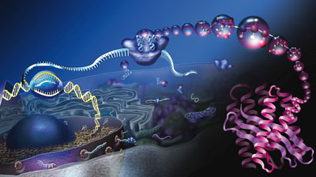
The Central Dogma
DNA
RNA
Protein

Slide 22
Causes of Cancer
Because ultimately all proteins are encoded for by the DNA within the host cell genome, it is here that we have to look for the cause of cancer
A gene is a segment of DNA that codes for a protein

Slide 23
DNA is the template to build RNA
Occurs in the nucleus
Occurs on a ribosome in the cytoplasm or attached to the RER
AATCCGTCTATG
TTAGGCAGATAC
AAUCCGUCUAUG
Asparagine
The sequence of bases is read in groups of 3
Each group of 3 bases is called a codon and specifies 1 amino acid
Proline
TRANSCRIPTION
TRANSLATION
REPLICATION
Serine
Methionine

Slide 24
Cancer Arises From Gene Mutations
Germline mutation
Somatic mutations
Parent
Child
Mutation in egg or sperm
All cells affected in offspring
Somatic mutation (eg, breast)
Present in egg or sperm
Are heritable
Cause cancer family syndromes
Occur in tissues
Are nonheritable

Slide 25
Mutations & Cancer
Some mutations are spontaneous
Some mutations are caused by environmental mutagens (agents that increase chances of a mutation), such as:
Radiation
Organic chemicals

Slide 26
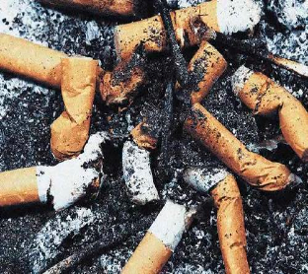
Mutations & Cancer
Cancer is a genetic disorder caused by a failure in the regulation of gene activity, usually caused by mutation
Carcinogens are mutagens that increase the risk of cancer
Tobacco smoke contains a number of known carcinogens
Hence, lung cancer is #1 lethal cancer in US

Slide 27
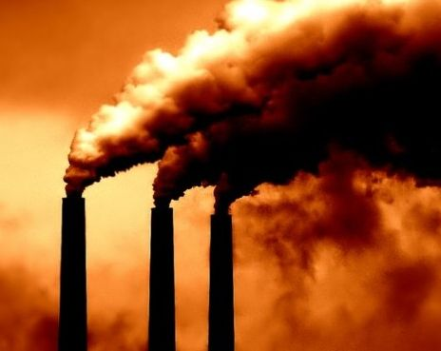
It is possible to inherit a gene that predisposes someone to cancer
Example = BRCA1 & BRCA2 genes (breast cancer) - BRAC Analysis
Other known carcinogens are highly linked to certain cancers, for instance:
Tobacco = lung
UV radiation = skin
Human Papilloma Virus (HPV) = cervix

Slide 28
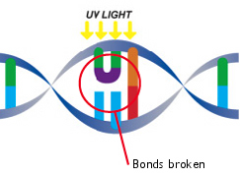
Radiation Effects
Ionizing radiation (X-rays & gamma rays) creates free radicals (ionized atoms with unpaired electrons)
Free radicals react with & alter the structure of molecules like DNA
UV radiation absorbed by pyrimidines (C, T) may cause thymine dimers when 2 thymines are next to each other
Repair enzymes usually fix this problem (cut out, make new, seal in place)

Slide 29
Mutations in DNA Alter Protein Structure
ACTCCGTCTATG
TGAGGCAGATAC
ACUCCGUCUAUG
Threonine
Proline
TRANSCRIPTION
TRANSLATION
REPLICATION
Serine
Methionine

Slide 30
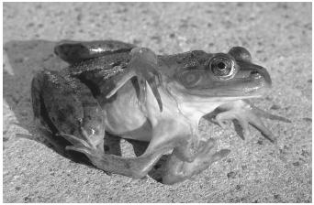
Effect of Mutations on Protein Activity
Effects of mutations on protein activity range from no effect to complete inactivity
Point mutations involve a change in a single DNA nucleotide
Point mutations can lead to normal protein (silent mutation), stop codon (nonsense mutation), or faulty protein because of a change in a single amino acid (missense mutation).

Slide 31
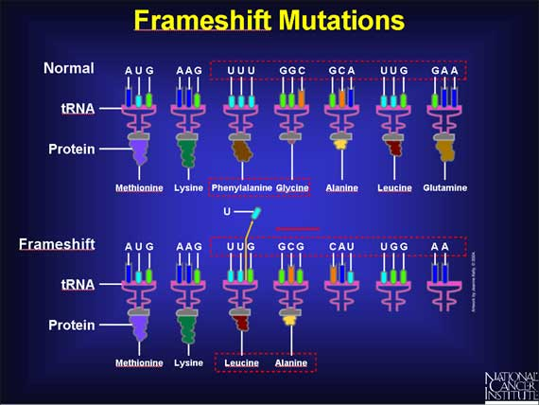
Nonfunctional Proteins
Frameshift mutations occur when one or more nucleotides are inserted or deleted from DNA (results in new codons & nonfunctional proteins)
Nonfunctional proteins can have a dramatic effect on phenotype

Slide 32
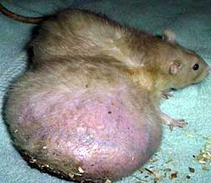
Regulation of cell cycle
A tumor is an irregular mass of cells (mutations that cause cell to repeatedly enter the cell cycle)
Proto-oncogenes are genes that promote cell cycle
Tumor-suppressor genes are genes that inhibit cell cycle
Each class of genes involves growth factors (extracellular signaling molecules), along with other genes and proteins that determine which class of genes is active

Slide 33
Oncogenes
A mutation or increased expression may cause a proto-oncogene to become an oncogene (cancer-causing gene)
This may code for a faulty receptor, abnormal protein product, or abnormally high levels of product
Researchers have identified over 100 oncogenes that cause increased growth and lead to tumors

Slide 34
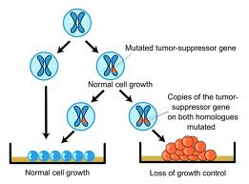
Tumor-Suppressor genes
Tumor-suppressor genes, and the proteins for which they code, either
have a dampening or repressive effect on the regulation of the cell cycle
or promote apoptosis
sometimes both

Slide 35
4 Major Classes of Tumor Suppressor Genes
Repression of genes that are essential for the continuing of the cell cycle. If these genes are not expressed, the cell cycle does not continue, effectively inhibiting cell division
Coupling the cell cycle to DNA damage. As long as there is damaged DNA in the cell, it should not divide. If the damage can be repaired, the cell cycle can continue.
Initiation of apoptosis (programmed cell death)
DNA repair proteins are usually classified as tumor suppressors as well

Slide 36
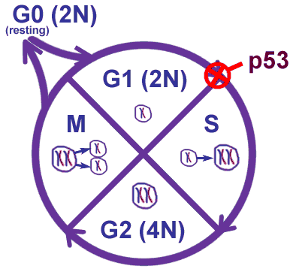
p53 gene
The p53 gene (chromosome 17) is a common example of a tumor suppressor gene
This gene is more frequently mutated in human cancers than any other known gene (nearly 1/2 of all cancers)
The p53 protein is a transcription factor that regulates the cell cycle & also stimulates apoptosis

Slide 37
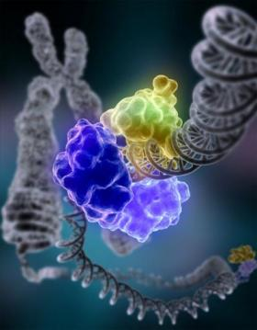
p53 gene
If DNA is damaged, p53 protein inhibits cell cycle (so enzymes can repair damage)
If DNA damage persists, p53 leads to apoptosis
Many tumors lack active p53 (no PCD) and some cancers increase bcl-2 (protein that inactivates p53)
Role of p53 in cell animation

Slide 38
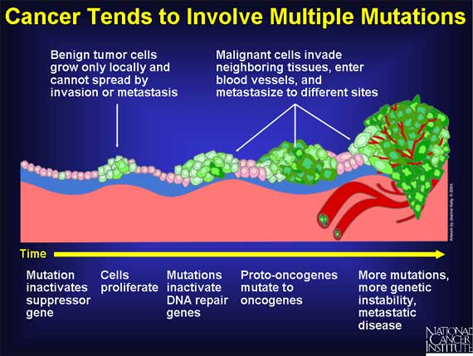
Cancer involves Multiple Mutations

Slide 39
Cancer Associated Genes

Slide 40
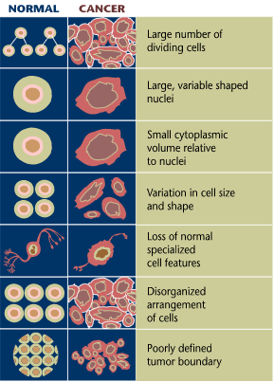
Cancer Cells Don’t Just Grow More than Healthy Cells, they Differ in their Morphology as well

Slide 41
Tying It All Together
Cancer arises from a complex interplay among multiple genes and between genes
Genes can be altered or mutated in many ways
Mutations alter the normal processes that a cell uses to regulate its actions
When the processes are disrupted, control is lost, tumor development follows
http://www.cancerquest.org/images/FLV/fullDocumentary/English/fullDocInterfaceEng.swf

Slide 42
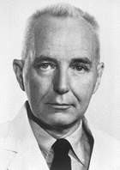
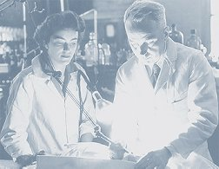
Charles Huggins
“The thing about cancer is to cure it”
Notes:
Removed organs responsible for producing hormones and prostate tumor shrank
Laid the foundation for hormonal therapies for breast and prostate cancer

