Slide 1
Cell Differentiation
Chapter 10.4

Slide 2
Objectives
Explain how cells become specialized for different functions
Define Stem cell
Evaluate possible benefits and costs associated with stem cell research

Slide 3
Vocabulary
Zygote
Embryo
Differentiation
Totipotent
Pluripotent
Multipotent
Blastocyst
Stem cell

Slide 4
Think about it…
The human body contains about 100,000,000,000,000 (one hundred trillion)cells
All of them come from the single cell (zygote) formed when a sperm fertilizes an egg
This single cell must undergo many rounds of cell division and DIFFERENTIATION to produce the many different tissues that we need to maintain homeostasis

Slide 5
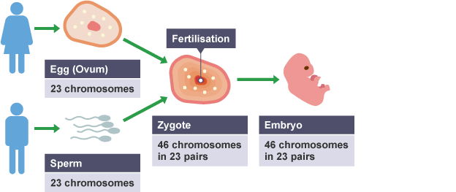
How do cells become specialized for different functions?
Each of us starts life as 1 cell called a zygote
A zygote undergoes mitosis to produce an embryo, an early developmental stage of an organism
During the developmental process, an organisms cells become more and more differentiated and specialized for particular functions

Slide 6
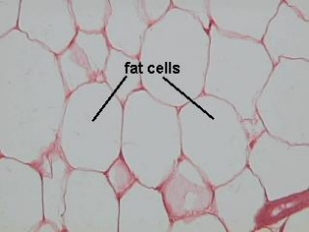
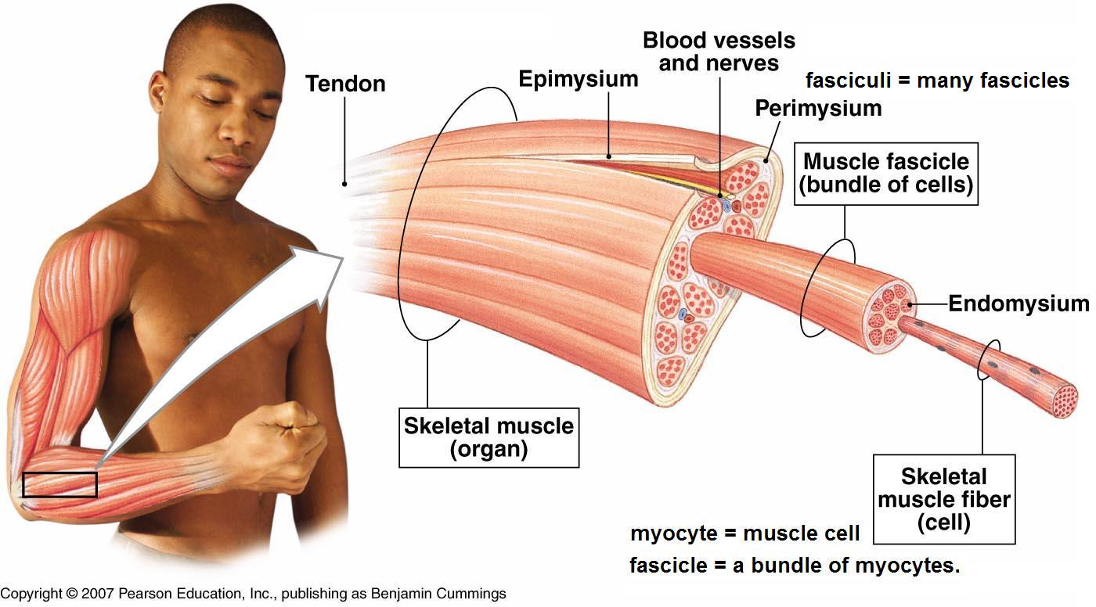
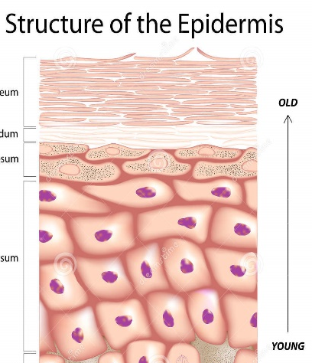
Defining Differentiation
The process by which cells become specialized is known as differentiation
During development of an organism, cells differentiate into many types each with a specific function specialized to accomplish a specific task
Muscle cells contract and expand to move the body
Adipose cells store energy
Neurons carry electrical signals throughout the body
Skin cells create a barrier protecting us from pathogens
The cells of our intestines absorb nutrients from the food
we’ve eaten

Slide 7
How cells acquire different functions
Cells acquire these different functions by the proteins they expressed
All cells in 1 organism have the same genome
The human genome codes for about 30,000 different proteins, but each cell only expresses a small portion of those genes
A typical human cell will only express about 10,000 genes
Every cell expresses a different collection of genes
Different collections of proteins allow different cells to accomplish different tasks

Slide 8
Stem Cells & Development
Cells turn genes “on” and “off” to differentiate
Once a cell turns a collection of genes off, it is said to be “differentiated”
Once a gene is turned off, it is very difficult to turn back on
Stem Cells are unspecialized cells from which all differentiated cells develop
Stem cells are able to turn “on” any gene

Slide 9
Types of Stem Cells
Totipotent
Pluripotent
The zygote and early embryo are made of totipotent stem cells which means they can literally develop into any cell of the body
After just 4 days of development, an embryos cells have already started to become specialized, turning some genes “off”
These cells are said to be pluripotent because they can develop into most but not all of the body cells

Slide 10
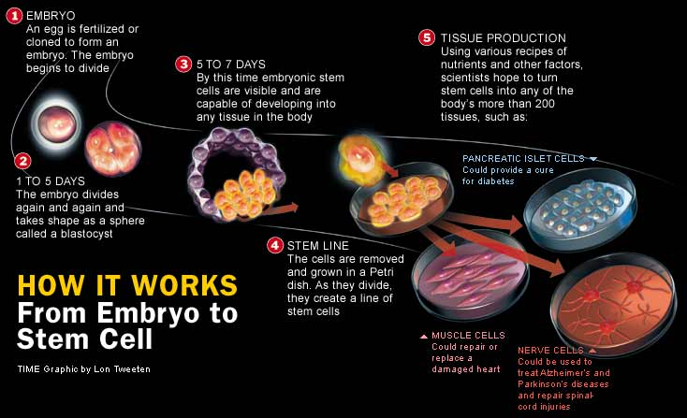

Slide 11
Where can we get stem cells
Stem cells can also be obtained the Umbilical cord of a newborn
Adults have stem cells too, mainly found in the bone marrow
Embryonic stem cells come from early embryos
Embryonic stem cells raise some ethical concerns because harvesting these cells destroys the embryo
Human embryonic stem cell research is controversial because arguments for it and against it both involve ethical issues of life and death

Slide 12
Potential Benefits of Stem Cell Research
Not all human cells have the ability to go through the cell cycle and replicate.
If these cells are damaged, there can be severe irreversible damage to a persons quality of lifeSpinal cord injuries leave people paralyzed
Heart attacks destroy cardiac muscle preventing the heart from functioning properly
Strokes destroy brain cells
Stem cells offer the potential benefit of using undifferentiated healthy cells to replace or repair badly damaged cells or tissues

