Slide 1
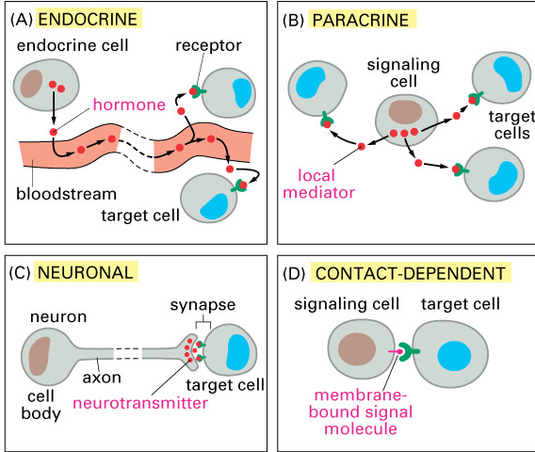
Overview of Cellular Signaling Mechanisms

Slide 2
Overview: Cellular Messaging
Cell-to-cell communication is essential for both multicellular and unicellular organisms
Biologists have discovered some universal mechanisms of cellular regulation
Cells most often communicate with each other via chemical signals
For example, the fight-or-flight response is triggered by a signaling molecule called epinephrine (adrenaline)
© 2011 Pearson Education, Inc.

Slide 3
Local and Long-Distance Signaling
Cells in a multicellular organism communicate by chemical messengers
Animal and plant cells have cell junctions that directly connect the cytoplasm of adjacent cells
In local signaling, animal cells may communicate by direct contact, or cell-cell recognition
© 2011 Pearson Education, Inc.

Slide 4
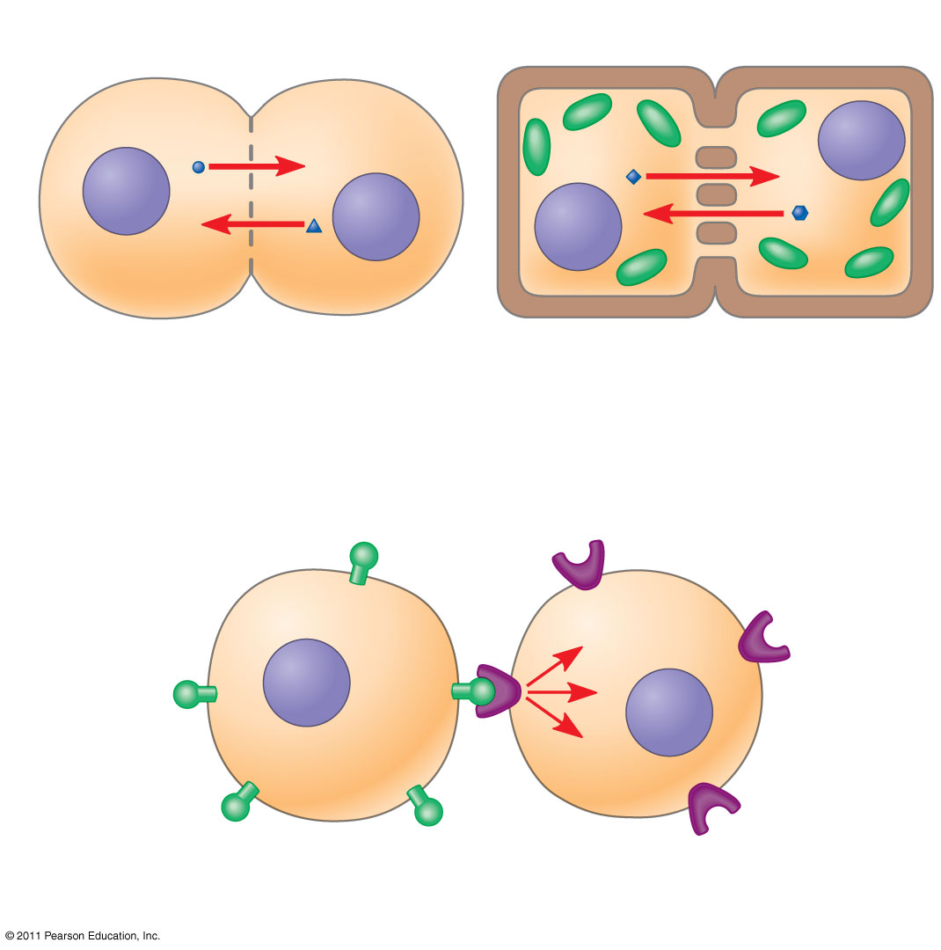
Figure 11.4
Plasma membranes
Gap junctions between animal cells
Plasmodesmata between plant cells
(a) Cell junctions
(b) Cell-cell recognition
Notes:
Figure 11.4 Communication by direct contact between cells.

Slide 5
In many other cases, animal cells communicate using local regulators, messenger molecules that travel only short distances
In long-distance signaling, plants and animals use chemicals called hormones
The ability of a cell to respond to a signal depends on whether or not it has a receptor specific to that signal
© 2011 Pearson Education, Inc.

Slide 6
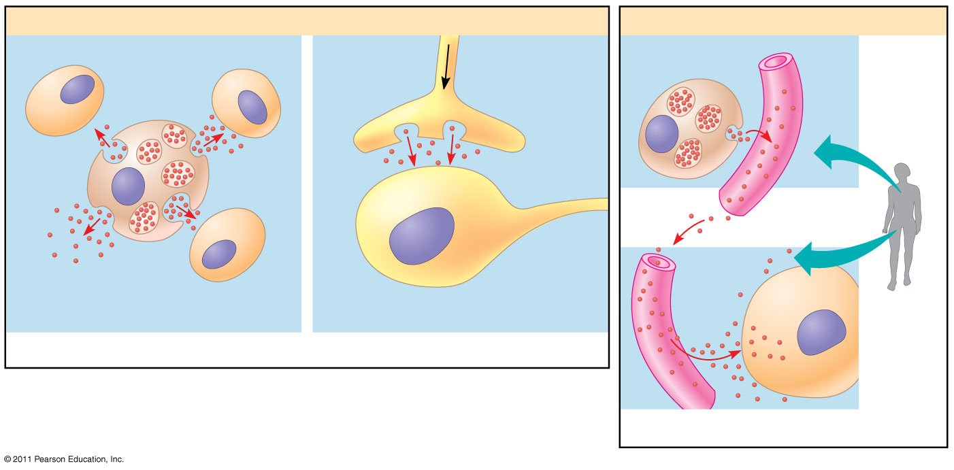
Figure 11.5
(3,4,5)
Local signaling
Long-distance signaling
Target cell
Electrical signal along nerve cell triggers release of neurotransmitter.
Endocrine cell
Blood vessel
Secreting cell
Secretory vesicle
Neurotransmitter diffuses across synapse.
Hormone travels in bloodstream.
Target cell specifically binds hormone.
Local regulator diffuses through extracellular fluid.
Target cell is stimulated.
(a) Paracrine signaling
(b) Synaptic signaling
(c) Endocrine (hormonal) signaling
Notes:
Figure 11.5 Local and long-distance cell signaling by secreted molecules in animals.

Slide 7
The Three Stages of Cell Signaling: A Preview
Earl W. Sutherland discovered how the hormone epinephrine acts on cells
Sutherland suggested that cells receiving signals went through three processes
Reception
Transduction
Response
Animation: Overview of Cell Signaling
© 2011 Pearson Education, Inc.

Slide 8
Figure 11.6-1
EXTRACELLULAR FLUID
CYTOPLASM
Plasma membrane
1
Reception
Receptor
Signaling molecule
Notes:
Figure 11.6 Overview of cell signaling.

Slide 9
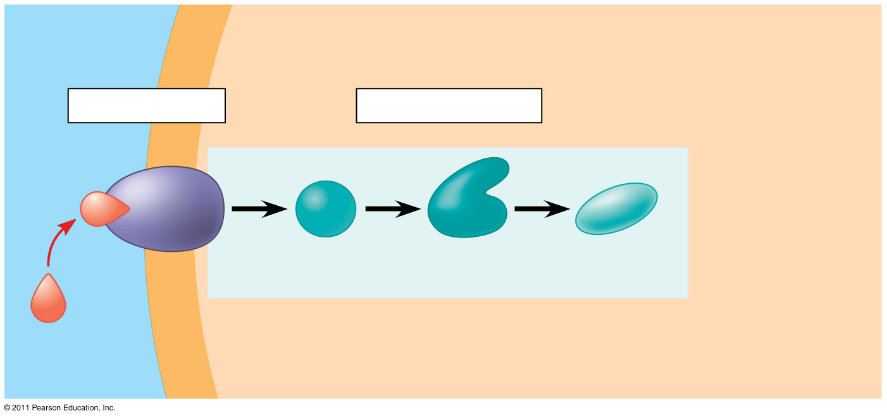
Figure 11.6-2
EXTRACELLULAR FLUID
CYTOPLASM
Plasma membrane
1
Reception
2
Transduction
Receptor
Relay molecules in a signal transduction pathway
Signaling molecule
Notes:
Figure 11.6 Overview of cell signaling.

Slide 10
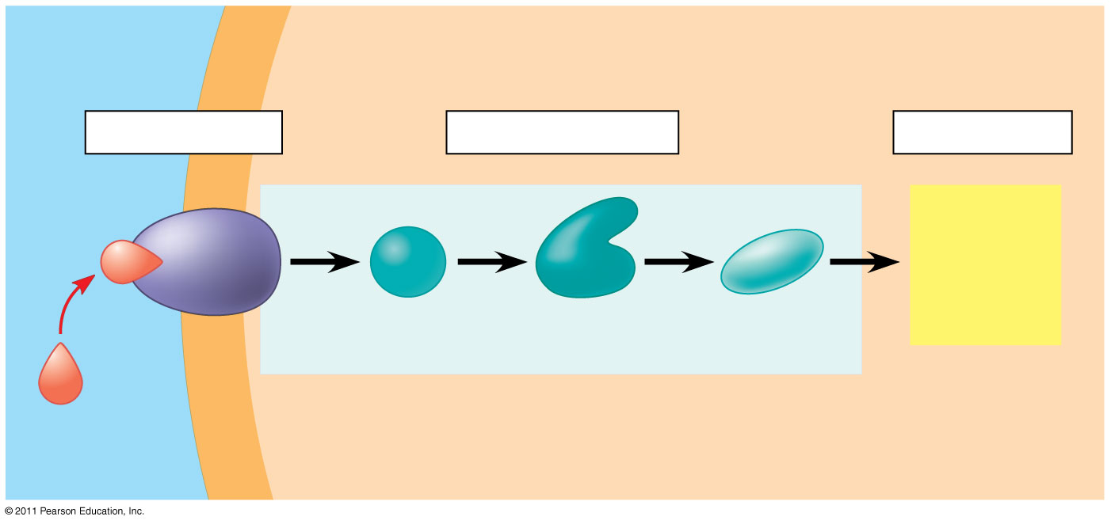
Figure 11.6-3
(6)
EXTRACELLULAR FLUID
CYTOPLASM
Plasma membrane
1
Reception
2
Transduction
3
Response
Receptor
Activation of cellular response
Relay molecules in a signal transduction pathway
Signaling molecule
Notes:
Figure 11.6 Overview of cell signaling.

Slide 11
Concept 11.2: Reception: A signaling molecule binds to a receptor protein, causing it to change shape
The binding between a signal molecule (ligand) and receptor is highly specific
A shape change in a receptor is often the initial transduction of the signal
Most signal receptors are plasma membrane proteins (7)
© 2011 Pearson Education, Inc.

Slide 12
Receptors in the Plasma Membrane
Most water-soluble signal molecules bind to specific sites on receptor proteins that span the plasma membrane
There are three main types of membrane receptors
G protein-coupled receptors
Receptor tyrosine kinases
Ion channel receptors
© 2011 Pearson Education, Inc.

Slide 13
G-protein-coupled receptor (GPCRs) are the largest family of cell-surface receptors
A GPCR is a plasma membrane receptor that works with the help of a G protein
The G protein acts as an on/off switch: If GDP is bound to the G protein, the G protein is inactive
(8)
© 2011 Pearson Education, Inc.

Slide 14
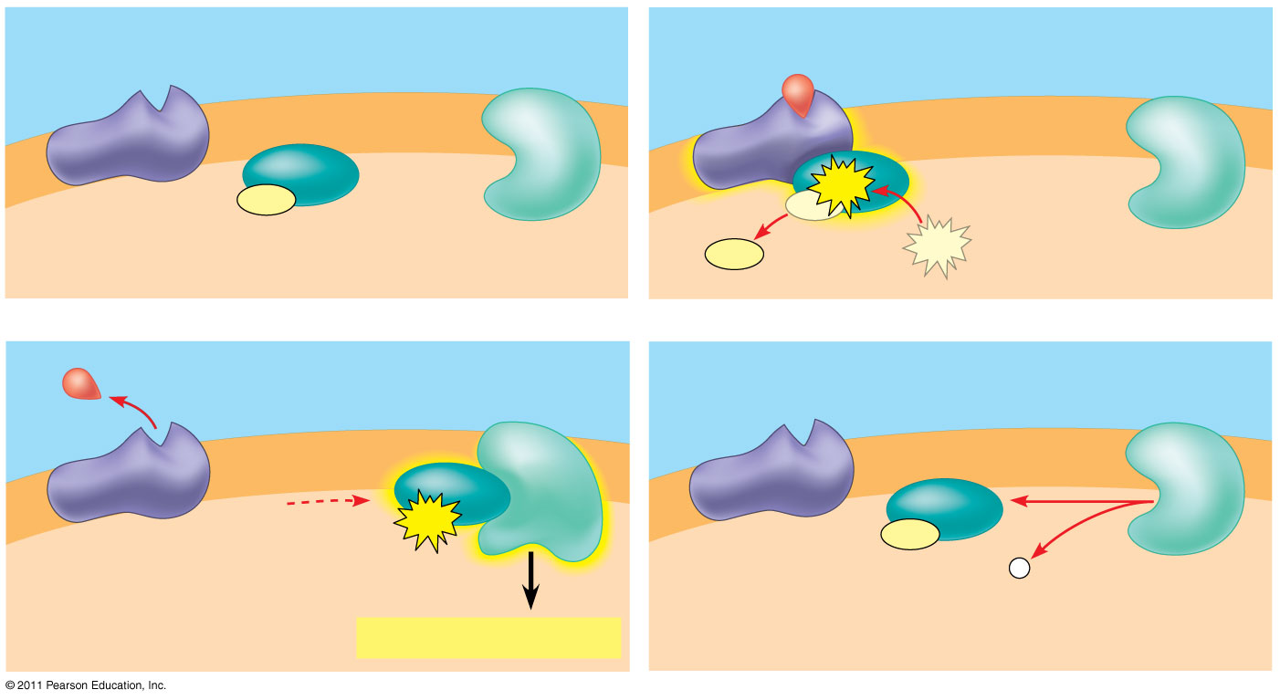
Figure 11.7b
(9-13)
G protein-coupled receptor
Plasma membrane
Activated receptor
Signaling molecule
Inactive enzyme
GDP
GTP
CYTOPLASM
GDP
G protein (inactive)
Enzyme
GDP
GTP
1
2
Activated enzyme
GTP
GDP
P _{i}
3
Cellular response
4
Notes:
Figure 11.7 Exploring: Cell-Surface Transmembrane Receptors

Slide 15
Receptor tyrosine kinases (RTKs) are membrane receptors that attach phosphates to tyrosines
A receptor tyrosine kinase can trigger multiple signal transduction pathways at once
Abnormal functioning of RTKs is associated with many types of cancers (14)
© 2011 Pearson Education, Inc.

Slide 16
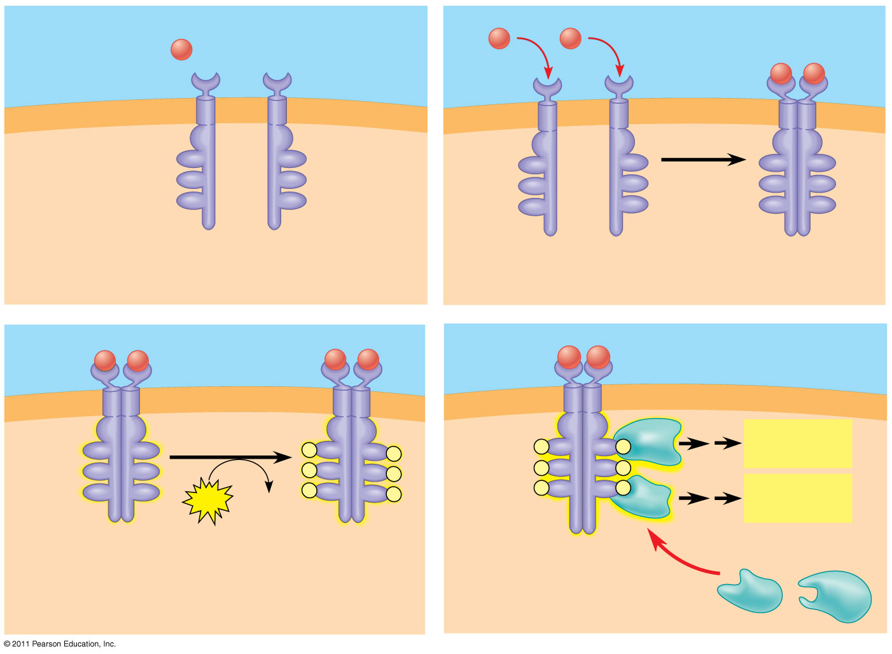
Figure 11.7c
(15-21)
Signaling molecule (ligand)
Ligand-binding site
α helix in the membrane
Signaling molecule
Tyrosines
Tyr
Tyr
Tyr
Tyr
Tyr
Tyr
Tyr
Tyr
Tyr
Tyr
Tyr
Tyr
Tyr
Tyr
Tyr
Tyr
Tyr
Tyr
CYTOPLASM
Receptor tyrosine kinase proteins (inactive monomers)
Dimer
1
2
Activated relay proteins
Cellular response 1
Tyr
Tyr
P
Tyr
Tyr
P
P
Tyr
Tyr
P
Tyr
Tyr
P
Tyr
Tyr
P
P
Tyr
Tyr
P
Tyr
Tyr
P
Tyr
Tyr
P
P
Tyr
Tyr
P
Cellular response 2
6 ATP
6 ADP
Activated tyrosine kinase regions (unphosphorylated dimer)
Fully activated receptor tyrosine kinase (phosphorylated dimer)
Inactive relay proteins
3
4
Notes:
Figure 11.7 Exploring: Cell-Surface Transmembrane Receptors

Slide 17
A ligand-gated ion channel receptor acts as a gate when the receptor changes shape
When a signal molecule binds as a ligand to the receptor, the gate allows specific ions, such as Na⁺ or Ca²⁺, through a channel in the receptor
(22 or on next slide)
© 2011 Pearson Education, Inc.

Slide 18
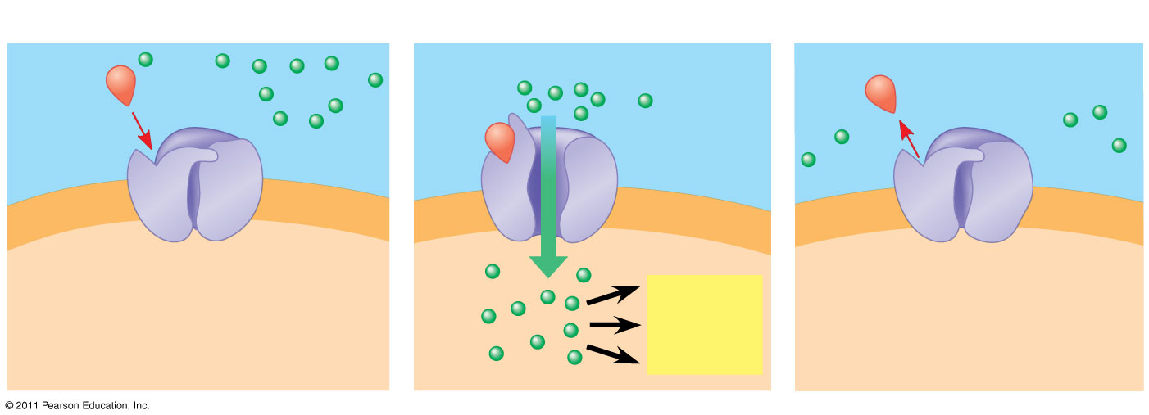
Figure 11.7d
(22-25)
1
2
3
Gate closed
Ions
Gate open
Gate closed
Signaling molecule (ligand)
Ligand-gated ion channel receptor
Plasma membrane
Cellular response
Notes:
Figure 11.7 Exploring: Cell-Surface Transmembrane Receptors

Slide 19
Intracellular Receptors
Intracellular receptor proteins are found in the cytosol or nucleus of target cells
Small or hydrophobic chemical messengers can readily cross the membrane and activate receptors
Examples of hydrophobic messengers are the steroid and thyroid hormones of animals
An activated hormone-receptor complex can act as a transcription factor, turning on specific genes (26)
© 2011 Pearson Education, Inc.

Slide 20
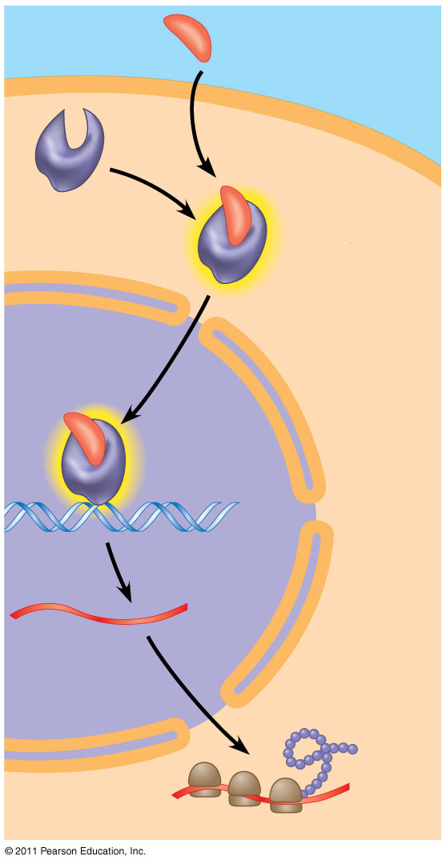
Figure 11.9-5
Hormone (testosterone)
EXTRACELLULAR FLUID
(27)
Ligand diffuses in
Transcription factors are activators of gene transcription………can be general or specific. (28)
Plasma membrane
Receptor protein
Ligand binds receptor shape change to enter nucleus
Hormone- receptor complex
Hrc binds DNA (transcription factor)
DNA
mRNA
Transcription of response protein
NUCLEUS
New protein
New protein gives phenotype
CYTOPLASM
Notes:
Figure 11.9 Steroid hormone interacting with an intracellular receptor.

Slide 21
Concept 11.3: Transduction: Cascades of molecular interactions relay signals from receptors to target molecules in the cell
Signal transduction usually involves multiple steps
Multistep pathways can amplify a signal: A few molecules can produce a large cellular response
Multistep pathways provide more opportunities for coordination and regulation of the cellular response (29)
© 2011 Pearson Education, Inc.

Slide 22
Signal Transduction Pathways
The molecules that relay a signal from receptor to response are mostly proteins
Like falling dominoes, the receptor activates another protein, which activates another, and so on, until the protein producing the response is activated
At each step, the signal is transduced into a different form, usually a shape change in a protein
© 2011 Pearson Education, Inc.

Slide 23
Protein Phosphorylation and Dephosphorylation
In many pathways, the signal is transmitted by a cascade of protein phosphorylations
Protein kinases transfer phosphates from ATP to protein, a process called phosphorylation
Protein phosphatases remove the phosphates from proteins, a process called dephosphorylation
This phosphorylation and dephosphorylation system acts as a molecular switch, turning activities on and off or up or down, as required (30)
© 2011 Pearson Education, Inc.

Slide 24
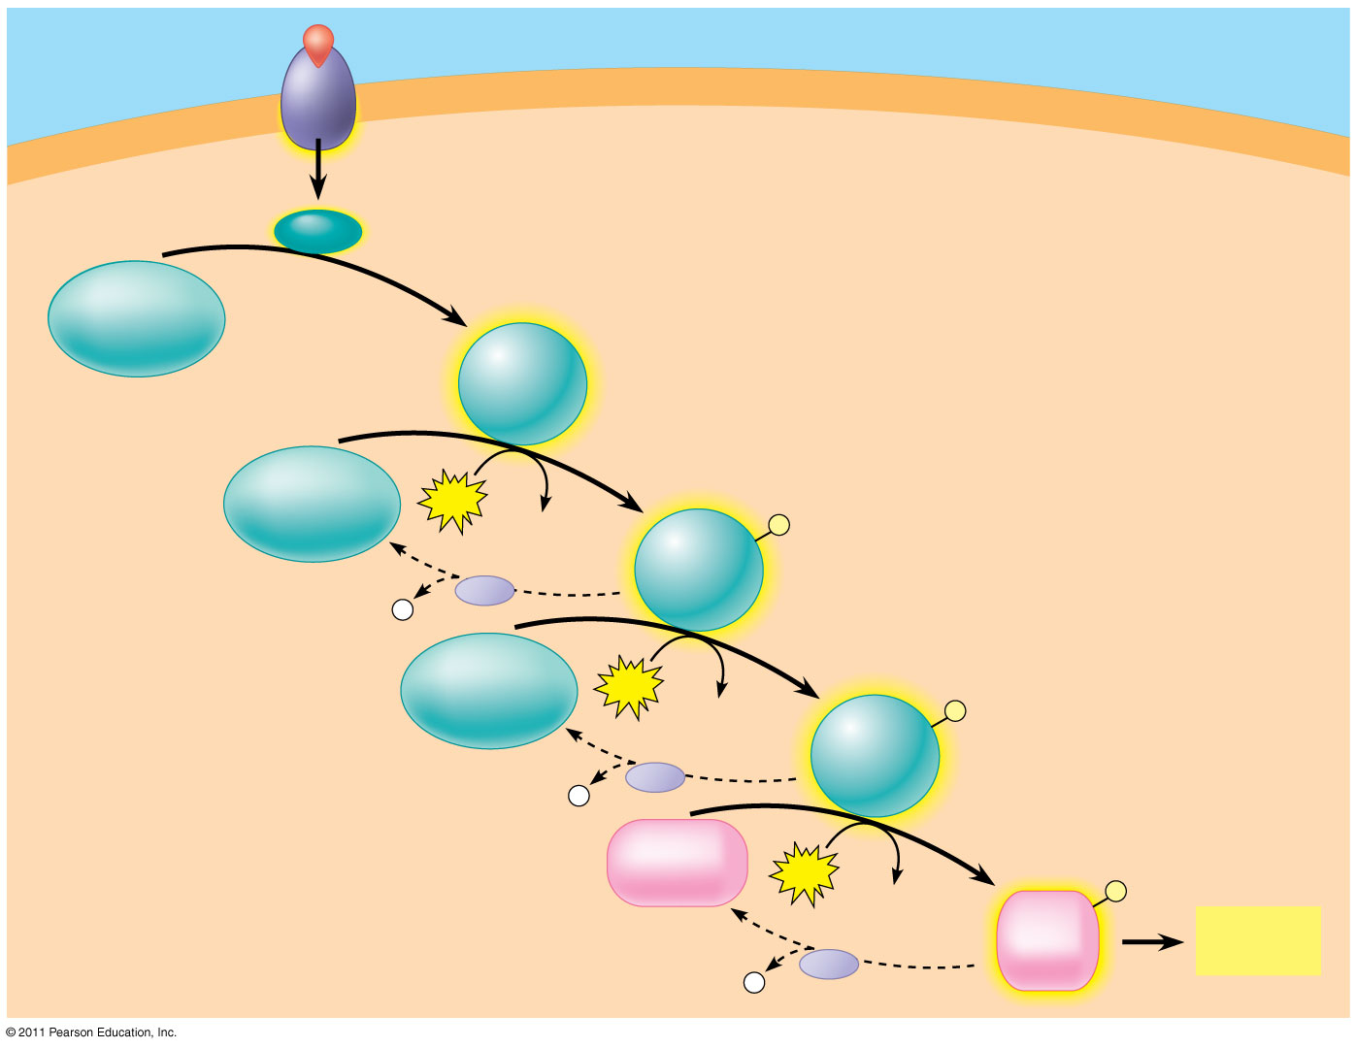
Figure 11.10
Signaling molecule
Receptor
Activated relay molecule
Inactive protein kinase 1
Active protein kinase 1
Inactive protein kinase 2
ATP
Phosphorylation cascade
ADP
Active protein kinase 2
P
P _{i}
PP
Inactive protein kinase 3
ATP
ADP
Active protein kinase 3
P
P _{i}
PP
Inactive protein
ATP
P
ADP
Active protein
Cellular response
P _{i}
PP
Notes:
Figure 11.10 A phosphorylation cascade.

Slide 25
Nuclear and Cytoplasmic Responses
Ultimately, a signal transduction pathway leads to regulation of one or more cellular activities
The response may occur in the cytoplasm or in the nucleus
Many signaling pathways regulate the synthesis of enzymes or other proteins, usually by turning genes on or off in the nucleus or by activating cytoplasmic enzymes or inhibiting them.
The final activated molecule in the signaling pathway may function as a transcription factor
(39 40)
© 2011 Pearson Education, Inc.

Slide 26
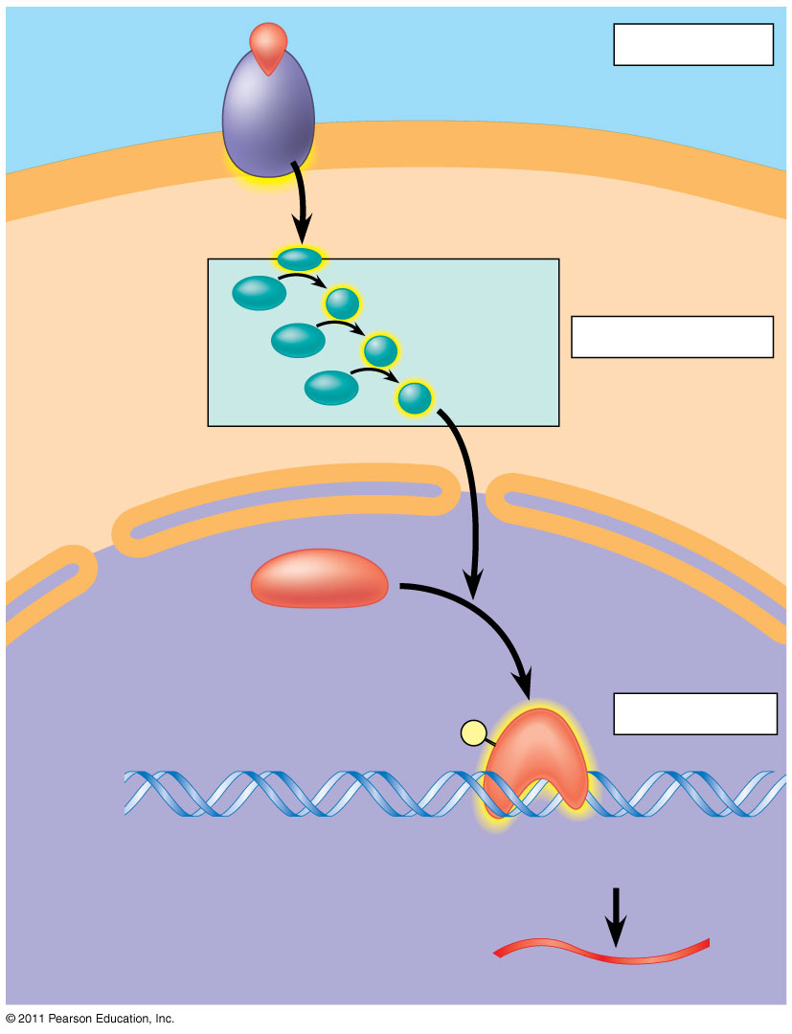
Figure 11.15
Growth factor
Reception
Receptor
Phosphorylation cascade
Transduction
CYTOPLASM
Inactive transcription factor
Active transcription factor
Response
P
DNA
Gene
NUCLEUS
mRNA
Notes:
Figure 11.15 Nuclear responses to a signal: the activation of a specific gene by a growth factor.

Slide 27
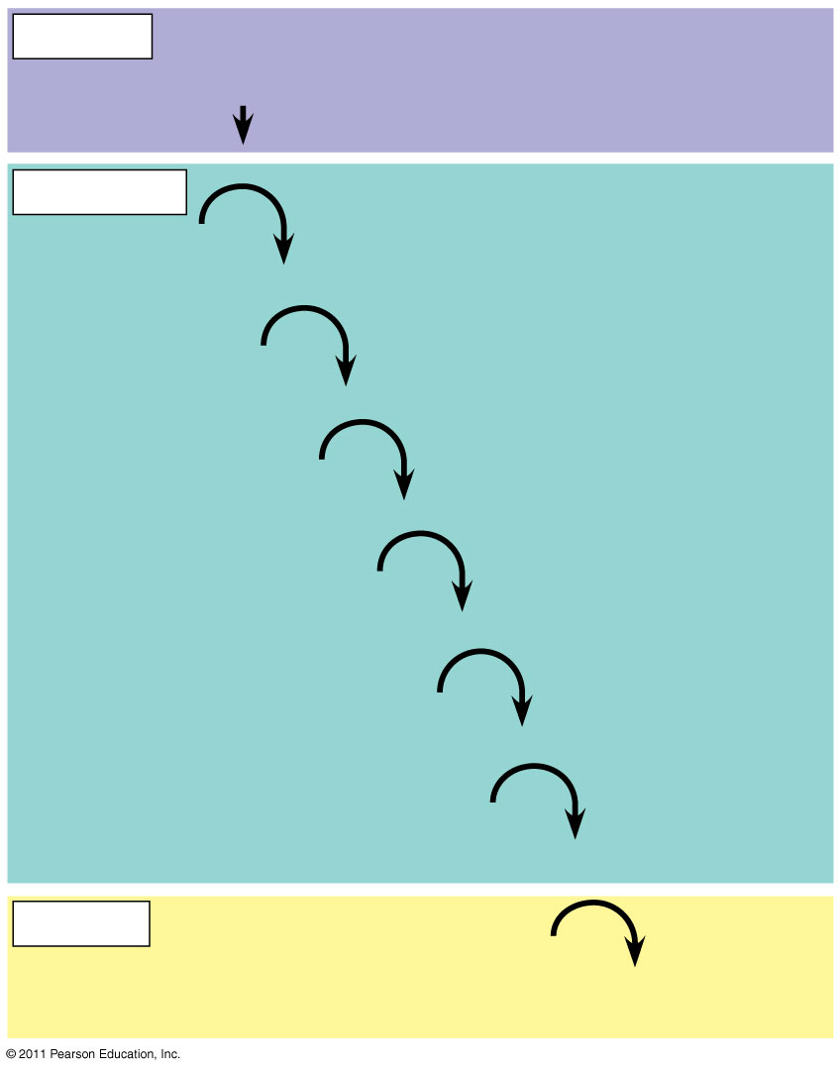
Figure 11.16
Reception
Binding of epinephrine to G protein-coupled receptor (1 molecule)
Transduction
(41)
Inactive G protein
Active G protein (10² molecules)
Inactive adenylyl cyclase
Active adenylyl cyclase (10²)
ATP
Cyclic AMP (10⁴)
Inactive protein kinase A
Active protein kinase A (10⁴)
Inactive phosphorylase kinase
Active phosphorylase kinase (10⁵)
Inactive glycogen phosphorylase
Active glycogen phosphorylase (10⁶)
Response
Glycogen
Glucose 1-phosphate (10⁸ molecules)
Notes:
Figure 11.16 Cytoplasmic response to a signal: the stimulation of glycogen breakdown by epinephrine.

