Slide 1
A Tour of the Cell

Slide 2
History of Cells
Robert Hooke - Observed cells in cork.
Coined the term "cells” in 1665
1838 - M.J. Schleiden, all plants are made of cells.
1839 - T. Schwann, all animals are made of cells.

Slide 3
Overview: The Cell Theory
All organisms are made of cells
The basic unit of life is the cell
All cells come from preexisting cells
© 2011 Pearson Education, Inc.
Notes:
For the Discovery Video Cells, go to Animation and Video Files.

Slide 4
Concept 1: Biologists use microscopes and the tools of biochemistry to study cells
Though usually too small to be seen by the unaided eye, cells can be complex
Three important parameters of microscopy
Magnification, the ratio of an object’s image size to its real size
Resolution, the measure of the clarity of the image, or the minimum distance of two distinguishable points
Contrast, visible differences in parts of the sample (1)
© 2011 Pearson Education, Inc.

Slide 5
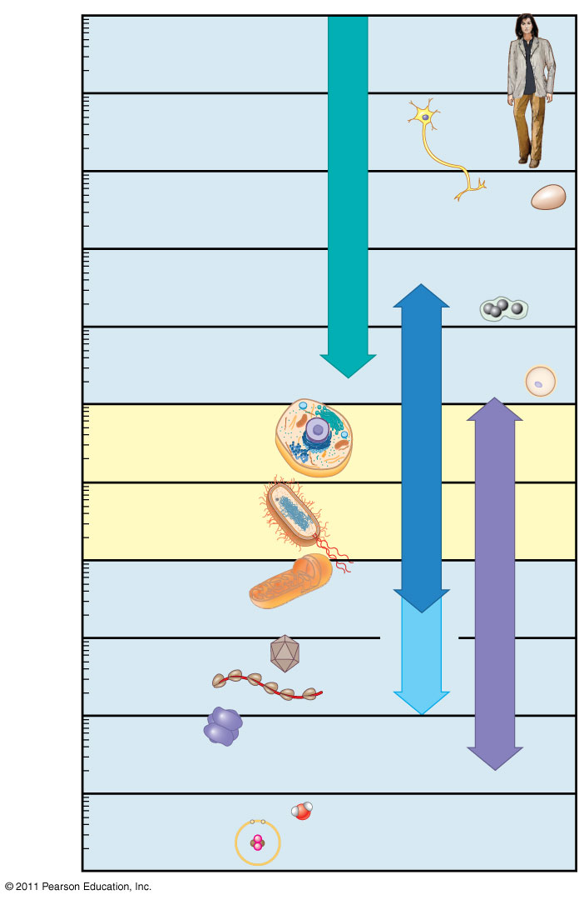
Figure 6.2
10 m
Human height
1 m
Length of some nerve and muscle cells
0.1 m
Unaided eye
Chicken egg
1 cm
Frog egg
1 mm
100 μm
Human egg
Most plant and animal cells
Light microscopy
10 μm
Nucleus
Most bacteria
1 μm
Mitochondrion
Smallest bacteria
Electron microscopy
100 nm
Super- resolution microscopy
Viruses
Ribosomes
10 nm
Proteins
Lipids
1 nm
Small molecules
0.1 nm
Atoms
Notes:
Figure 6.2 The size range of cells.

Slide 6
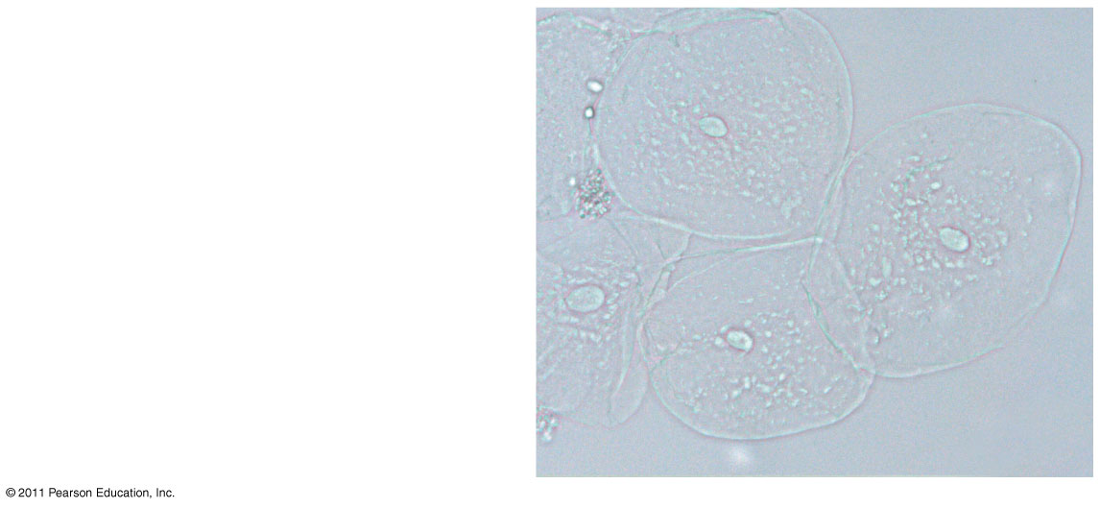
Figure 6.3a
Brightfield
(unstained specimen)
50 μm
Notes:
Figure 6.3 Exploring: Microscopy

Slide 7
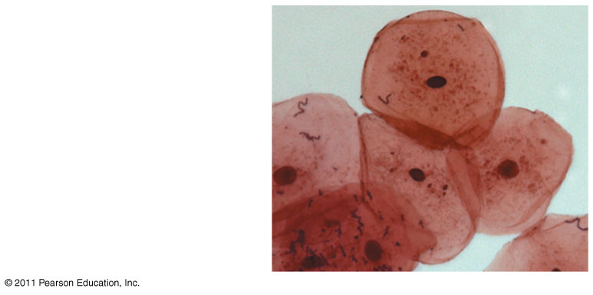
Figure 6.3b
Brightfield
(stained specimen)
Notes:
Figure 6.3 Exploring: Microscopy

Slide 8
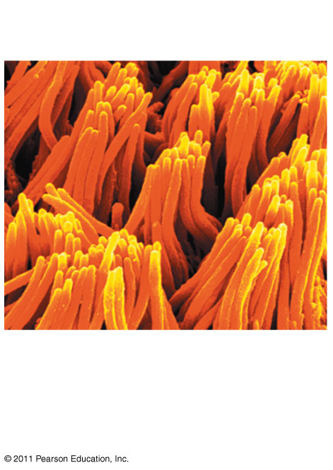
Figure 6.3i
Cilia
2 μm
Scanning electron microscopy (SEM) (2 & 3)
Notes:
Figure 6.3 Exploring: Microscopy

Slide 9
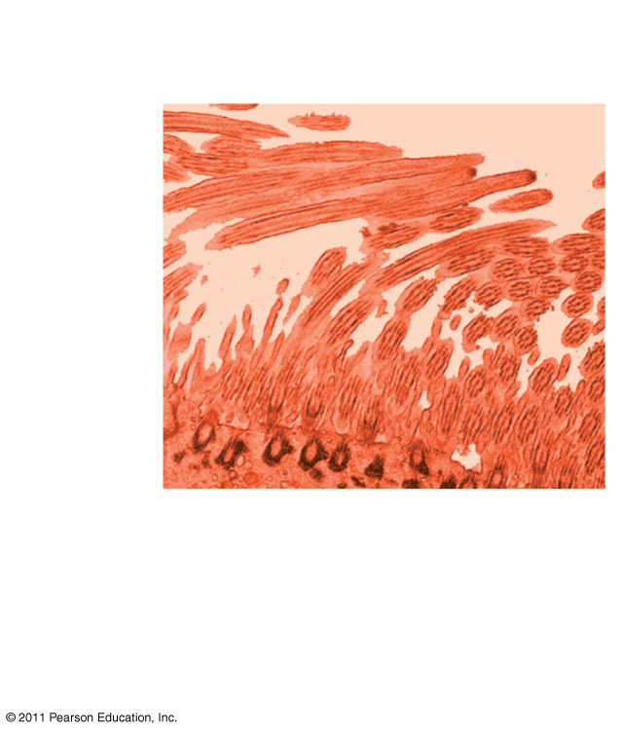
Figure 6.3j
Longitudinal section of cilium
Cross section of cilium
2 μm
Transmission electron microscopy (TEM) (2 & 3)
Notes:
Figure 6.3 Exploring: Microscopy

Slide 10
Concept 2: Eukaryotic cells have internal membranes that compartmentalize their functions
The basic structural and functional unit of every organism is one of two types of cells: prokaryotic or eukaryotic
Only organisms of the domains Bacteria and Archaea consist of prokaryotic cells
Protists, fungi, animals, and plants all consist of eukaryotic cells
© 2011 Pearson Education, Inc.

Slide 11
Comparing Prokaryotic and Eukaryotic Cells
Basic features of all cells
Plasma membrane
Semifluid substance called cytosol
Chromosomes (carry genes)
Ribosomes (make proteins)
© 2011 Pearson Education, Inc.

Slide 12
Eukaryotic cells are characterized by having
DNA in a nucleus that is bounded by a membranous nuclear envelope
Membrane-bound organelles
Cytoplasm in the region between the plasma membrane and nucleus
Eukaryotic cells are generally much larger than prokaryotic cells
© 2011 Pearson Education, Inc.

Slide 13
Prokaryotic cells are characterized by having
No nucleus
DNA in an unbound region called the nucleoid (unlike eukaryotes; in nucleus) (6)
No membrane-bound organelles
Cytoplasm bound by the plasma membrane
© 2011 Pearson Education, Inc.

Slide 14
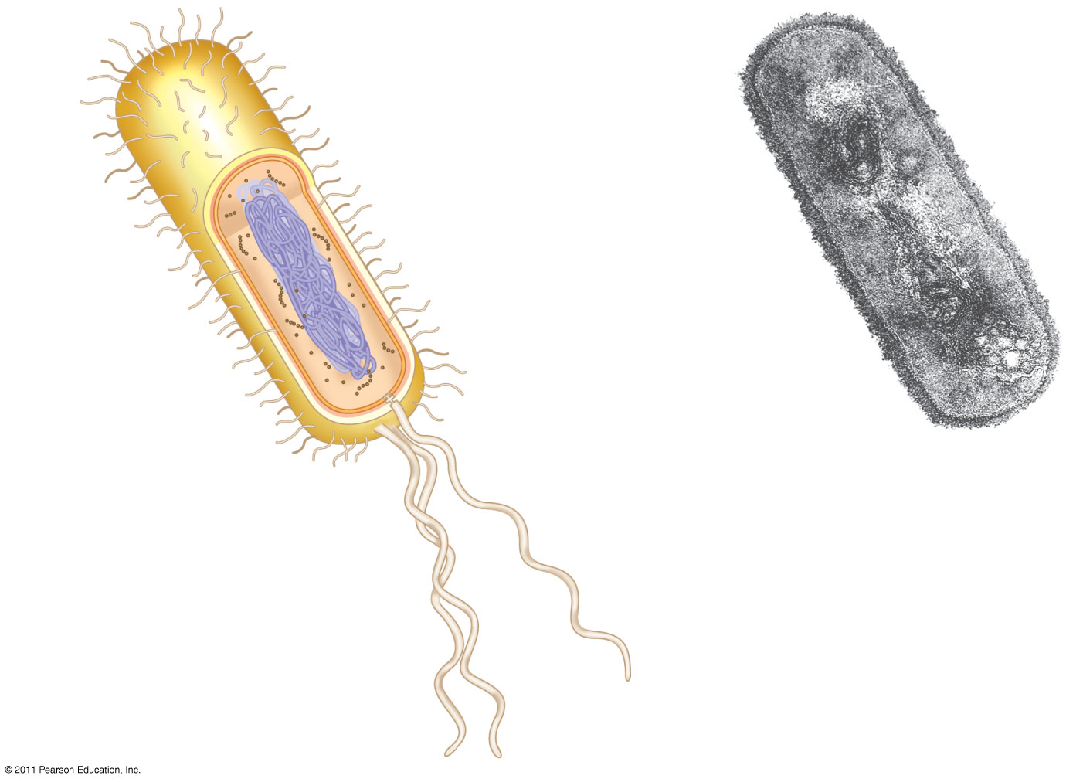
Figure 6.5
Fimbriae
7.
Nucleoid
Ribosomes
Plasma membrane
Bacterial chromosome
Cell wall
Capsule
0.5 μm
(a)
A typical rod-shaped bacterium
Flagella
(b)
A thin section through the bacterium Bacillus coagulans (TEM)
Notes:
Figure 6.5 A prokaryotic cell.

Slide 15
Metabolic requirements set upper limits on the size of cells
The surface area to volume ratio of a cell is critical
As the surface area increases by a factor of n², the volume increases by a factor of n³
Small cells have a greater surface area relative to volume
(8)
© 2011 Pearson Education, Inc.

Slide 16
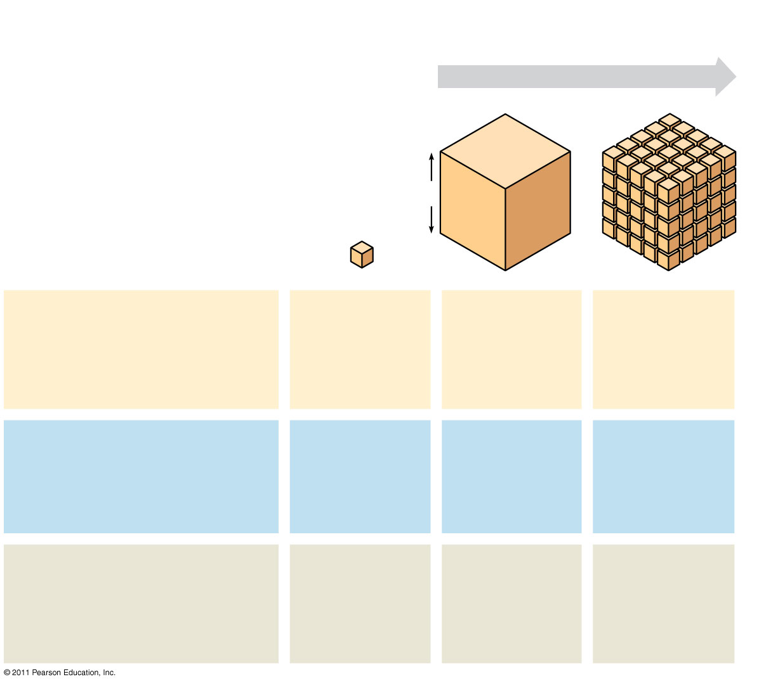
Figure 6.7
Surface area increases while total volume remains constant
5
1
1
Total surface area [sum of the surface areas (height × width) of all box sides × number of boxes]
6
150
750
Total volume [height × width × length × number of boxes]
1
125
125
Surface-to-volume (S-to-V) ratio [surface area ÷ volume]
6
1.2
6
Notes:
Figure 6.7 Geometric relationships between surface area and volume.

Slide 17
A Panoramic View of the Eukaryotic Cell
A eukaryotic cell has internal membranes that partition the cell into organelles
Plant and animal cells have most of the same organelles
VCAC Animation
© 2011 Pearson Education, Inc.

Slide 18
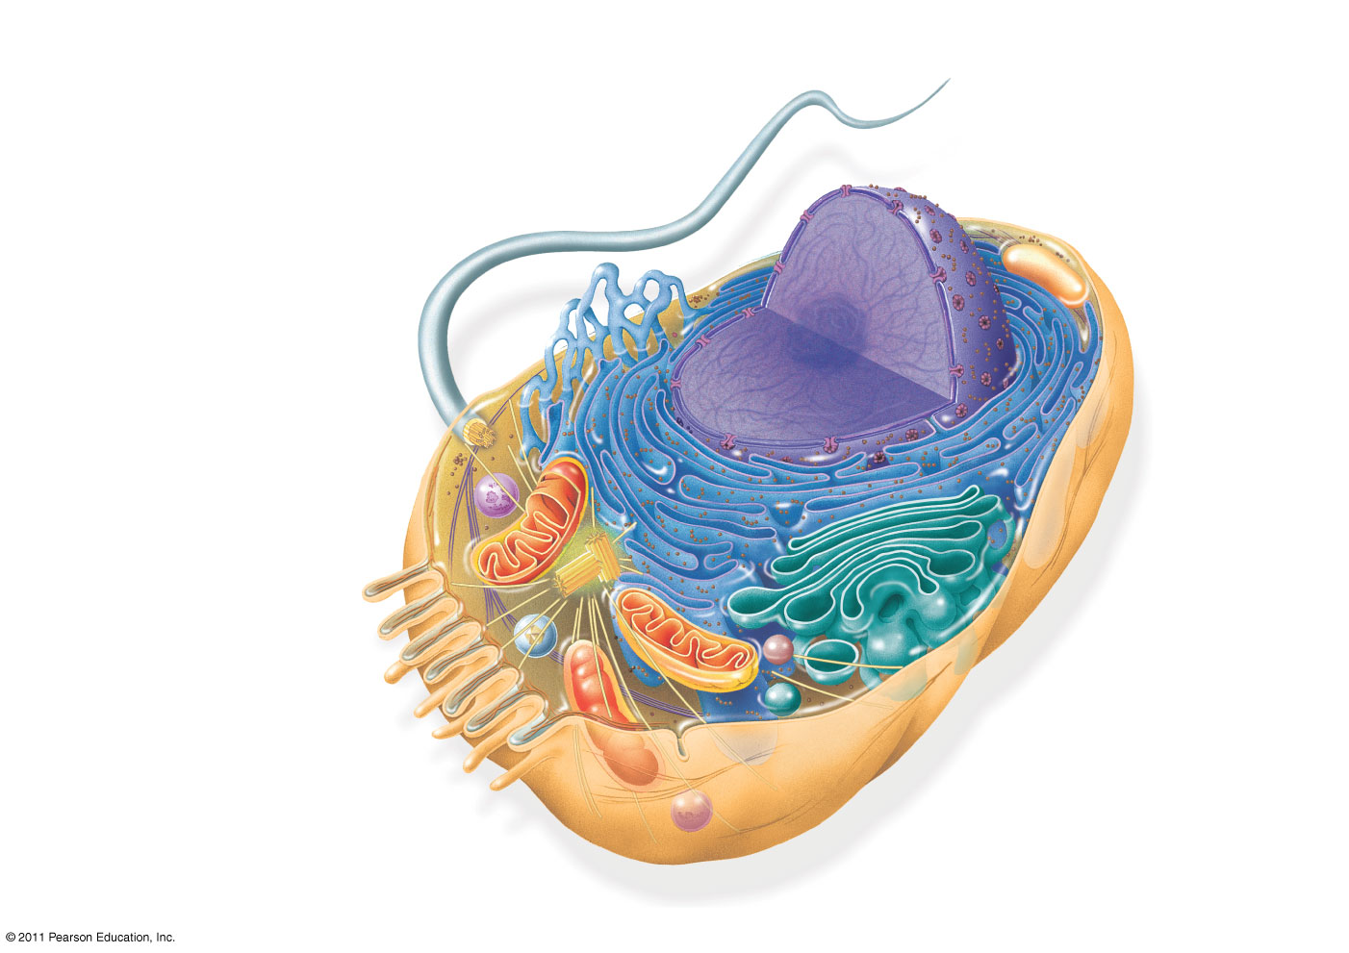
Figure 6.8a
ENDOPLASMIC RETICULUM (ER)
Smooth ER
Nuclear envelope
9.
Rough ER
Flagellum
NUCLEUS
Nucleolus
Chromatin
Centrosome
Plasma membrane
CYTOSKELETON:
Microfilaments
Intermediate filaments
Microtubules
Ribosomes
Microvilli
Golgi apparatus
Peroxisome
Mitochondrion
Lysosome
Notes:
Figure 6.8 Exploring: Eukaryotic Cells

Slide 19
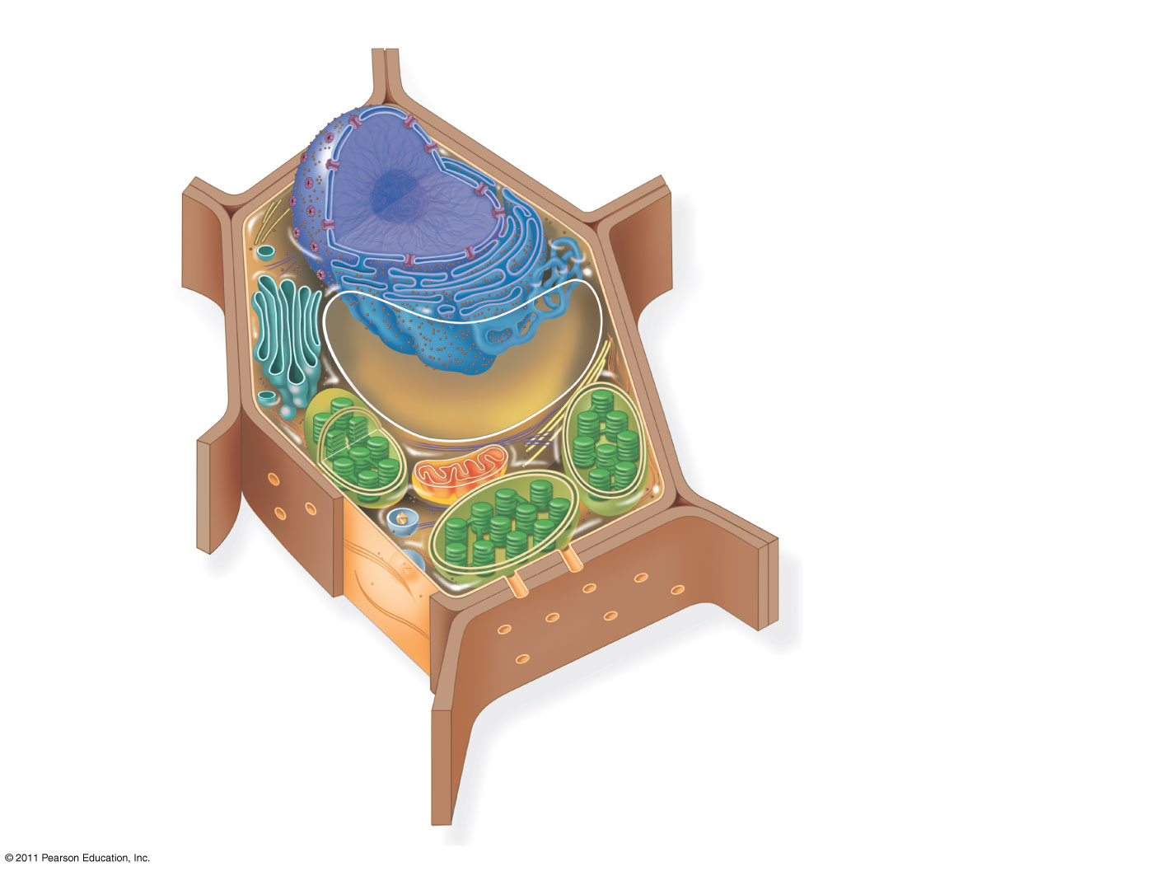
Figure 6.8c
Nuclear envelope
Rough endoplasmic reticulum
NUCLEUS
Smooth endoplasmic reticulum
Nucleolus
Chromatin
Ribosomes
Central vacuole
Golgi apparatus
Microfilaments
Intermediate filaments
CYTOSKELETON
Microtubules
Mitochondrion
Peroxisome
Plasma membrane
Chloroplast
Cell wall
Plasmodesmata
Wall of adjacent cell
Notes:
Figure 6.8 Exploring: Eukaryotic Cells

Slide 20
Concept 3: The eukaryotic cell’s genetic instructions are housed in the nucleus and carried out by the ribosomes
The nucleus contains most of the DNA in a eukaryotic cell
Ribosomes use the information from the DNA to make proteins
© 2011 Pearson Education, Inc.

Slide 21
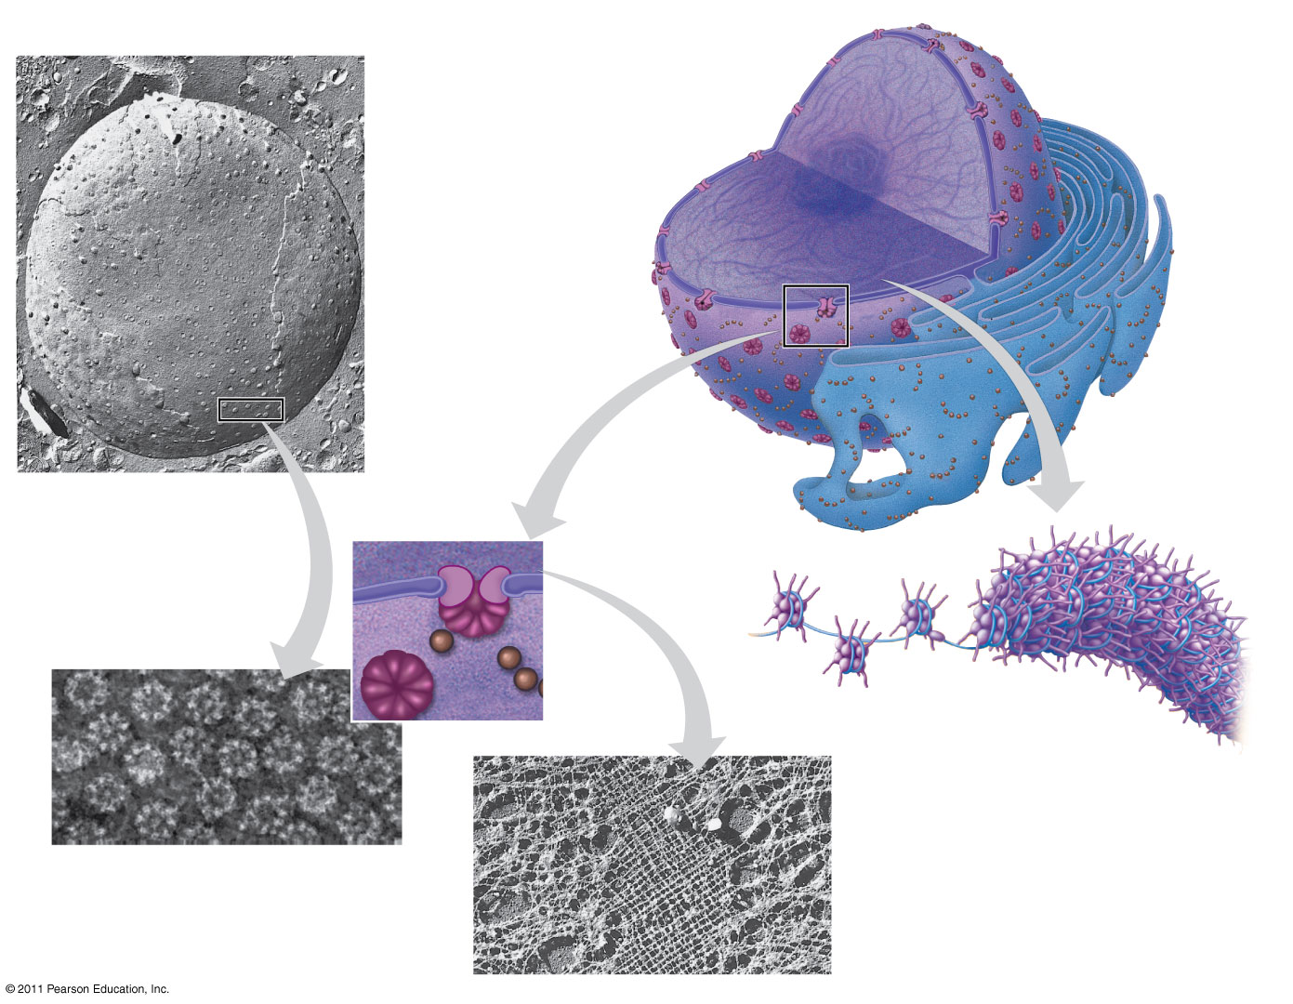
Figure 6.9
1 μm
10 11
14
Nucleus
Nucleolus
Chromatin
Nuclear envelope:
Inner membrane
Outer membrane
Nuclear pore
Rough ER
Pore complex
Surface of nuclear envelope
Ribosome
Close-up of nuclear envelope
0.25 μm
Chromatin
1 μm
Pore complexes (TEM)
Nuclear lamina (TEM)
Notes:
Figure 6.9 The nucleus and its envelope.

Slide 22
Pores regulate the entry and exit of molecules from the nucleus
the nuclear matrix is the network of fibers found throughout the inside of a cell nucleus and is somewhat analogous to the cell cytoskeleton
© 2011 Pearson Education, Inc.

Slide 23
In the nucleus, DNA is organized into discrete units called chromosomes
Each chromosome is composed of a single DNA molecule associated with proteins
The DNA and proteins of chromosomes are together called chromatin
Chromatin condenses to form discrete chromosomes as a cell prepares to divide
The nucleolus is located within the nucleus and is the site of ribosomal RNA (rRNA) synthesis (13)
© 2011 Pearson Education, Inc.

Slide 24
Ribosomes: Protein Factories
Ribosomes are particles made of ribosomal RNA and protein
Ribosomes carry out protein synthesis in two locations
In the cytosol (free ribosomes)-”in house” proteins
On the outside of the endoplasmic reticulum or the nuclear envelope (bound ribosomes)-secreted proteins
© 2011 Pearson Education, Inc.
Notes:
For the Cell Biology Video Staining of Endoplasmic Reticulum, go to Animation and Video Files.

Slide 25
Concept 4: The endomembrane system regulates protein traffic and performs metabolic functions in the cell
Components of the endomembrane system (17)
Nuclear envelope
Endoplasmic reticulum
Golgi apparatus
Lysosomes
Vacuoles
Plasma membrane
These components are either continuous or connected via transfer by vesicles
© 2011 Pearson Education, Inc.

Slide 26
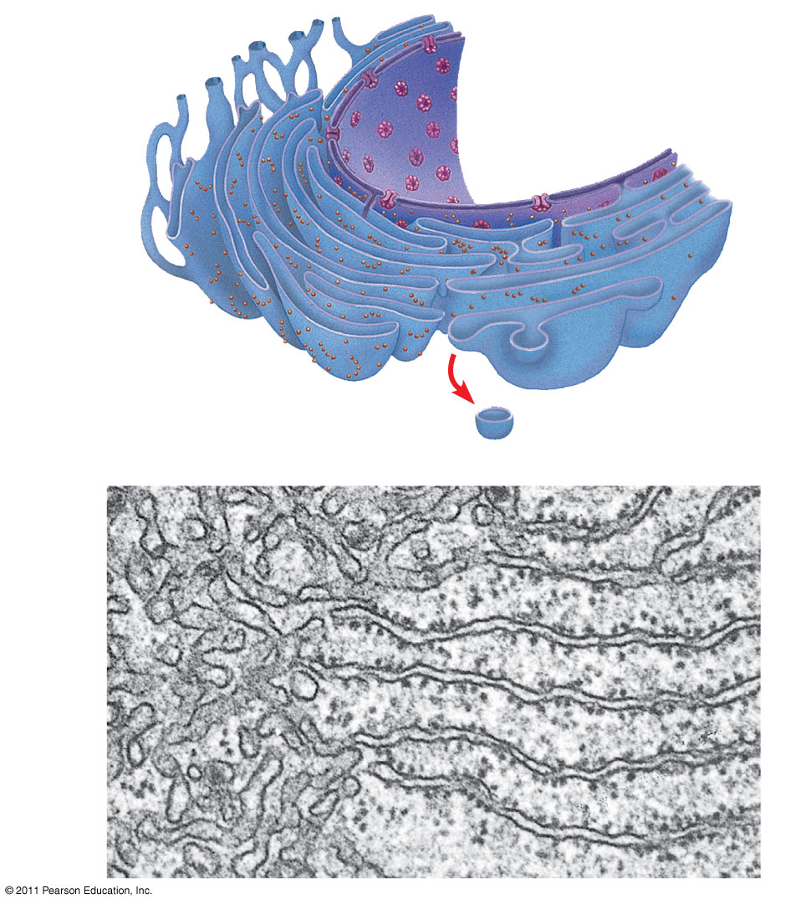
Figure 6.11
Smooth ER
Nuclear envelope
Rough ER
18
ER lumen
Cisternae
Transitional ER
Ribosomes
Transport vesicle
200 nm
Smooth ER
Rough ER
Notes:
Figure 6.11 Endoplasmic reticulum (ER).

Slide 27
Functions of Smooth ER
The smooth ER
Synthesizes lipids
Metabolizes carbohydrates
Detoxifies drugs and poisons
Stores calcium ions
© 2011 Pearson Education, Inc.

Slide 28
Functions of Rough ER
The rough ER
Has bound ribosomes, which secrete glycoproteins (proteins covalently bonded to carbohydrates)
Distributes transport vesicles, proteins surrounded by membranes
Is a membrane factory for the cell
(21 & 22)
© 2011 Pearson Education, Inc.

Slide 29
The Golgi Apparatus: Shipping and Receiving Center
The Golgi apparatus consists of flattened membranous sacs called cisternae
Functions of the Golgi apparatus
Modifies products of the ER
Manufactures certain macromolecules
Sorts and packages materials into transport vesicles
© 2011 Pearson Education, Inc.
Notes:
For the Cell Biology Video ER to Golgi Traffic, go to Animation and Video Files.
For the Cell Biology Video Golgi Complex in 3D, go to Animation and Video Files.
For the Cell Biology Video Secretion From the Golgi, go to Animation and Video Files.

Slide 30
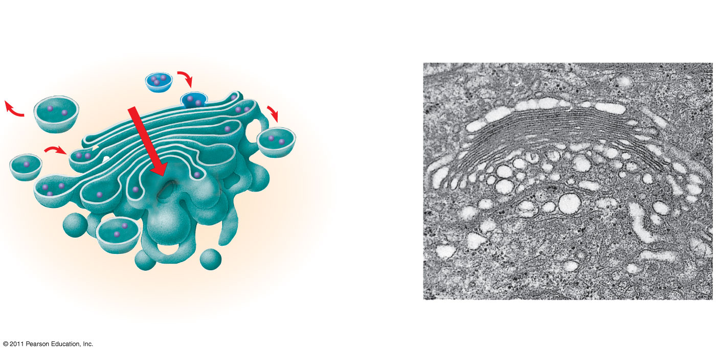
Figure 6.12
23
cis face (“receiving” side of Golgi apparatus)
0.1 μm
Cisternae
trans face (“shipping” side of Golgi apparatus)
TEM of Golgi apparatus
Notes:
Figure 6.12 The Golgi apparatus.

Slide 31
Lysosomes: Digestive Compartments
A lysosome is a membranous sac of hydrolytic enzymes that can digest macromolecules
Lysosomal enzymes can hydrolyze proteins, fats, polysaccharides, and nucleic acids
Lysosomal enzymes work best in the acidic environment inside the lysosome
© 2011 Pearson Education, Inc.

Slide 32
Some types of cell can engulf another cell by phagocytosis; this forms a food vacuole
Ex. Macrophages
A lysosome fuses with the food vacuole and digests the molecules
Lysosomes also use enzymes to recycle the cell’s own organelles and macromolecules, a process called autophagy
Tay Sach’s is a lysosomal disorder that results in the buildup of a lipid in nerve cells impairing their function.
© 2011 Pearson Education, Inc.
Notes:
For the Cell Biology Video Phagocytosis in Action, go to Animation and Video Files.

Slide 33
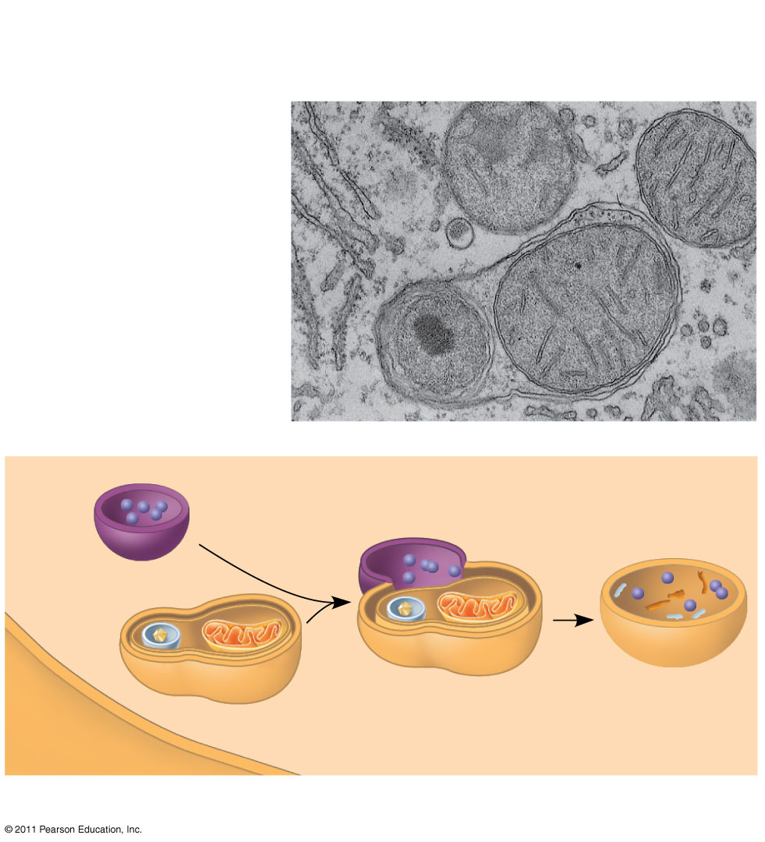
Figure 6.13b
Vesicle containing two damaged organelles
1 μm
Mitochondrion fragment
Peroxisome fragment
Lysosome
Peroxisome
Mitochondrion
Digestion
Vesicle
(b) Autophagy
Notes:
Figure 6.13 Lysosomes.

Slide 34
Vacuoles: Diverse Maintenance Compartments
A plant cell or fungal cell may have one or several vacuoles, derived from endoplasmic reticulum and Golgi apparatus
Food vacuoles are formed by phagocytosis
Contractile vacuoles, found in many freshwater protists, pump excess water out of cells
Central vacuoles, found in many mature plant cells, hold organic compounds and water
© 2011 Pearson Education, Inc.

Slide 35
The Endomembrane System: A Review
The endomembrane system is a complex and dynamic player in the cell’s compartmental organization
© 2011 Pearson Education, Inc.

Slide 36
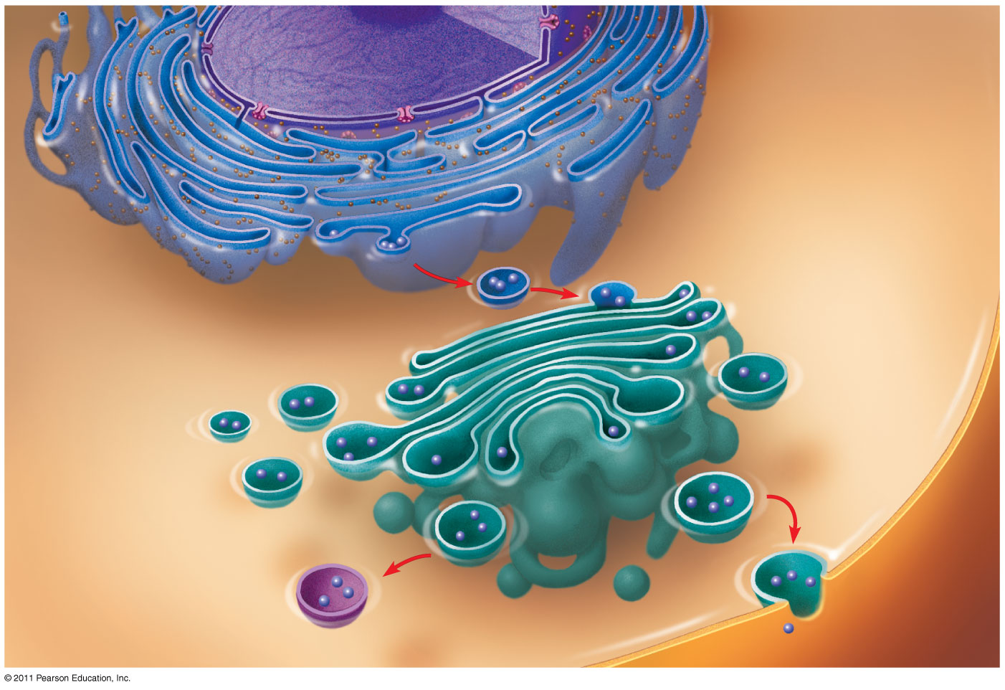
Figure 6.15-3
Nucleus
Rough ER
Smooth ER
cis Golgi
Plasma membrane
trans Golgi
Notes:
Figure 6.15 Review: relationships among organelles of the endomembrane system.

Slide 37
Concept 5: Mitochondria and chloroplasts change energy from one form to another
Mitochondria are the sites of cellular respiration, a metabolic process that uses oxygen to generate ATP
Chloroplasts, found in plants and algae, are the sites of photosynthesis
© 2011 Pearson Education, Inc.
Notes:
For the Cell Biology Video ER and Mitochondria in Leaf Cells, go to Animation and Video Files.
For the Cell Biology Video Mitochondria in 3D, go to Animation and Video Files.
For the Cell Biology Video Chloroplast Movement, go to Animation and Video Files.

Slide 38
The Endosymbiont theory
endosymbiont-“internal symbiont”
An early ancestor of eukaryotic cells engulfed a nonphotosynthetic prokaryotic cell, which formed an endosymbiont relationship with its host
The host cell and endosymbiont merged into a single organism, a eukaryotic cell with a mitochondrion
At least one of these cells may have taken up a photosynthetic prokaryote, becoming the ancestor of cells that contain chloroplasts
© 2011 Pearson Education, Inc.

Slide 39
The Evolutionary Origins of Mitochondria and Chloroplasts
Mitochondria and chloroplasts have similarities with bacteria
Enveloped by a double membrane
Contain free ribosomes and circular DNA molecules
Grow and reproduce somewhat independently in cells
© 2011 Pearson Education, Inc.

Slide 40
Mitochondria: Chemical Energy Conversion
Mitochondria are in nearly all eukaryotic cells
They have a smooth outer membrane and an inner membrane folded into cristae
The inner membrane creates two compartments: intermembrane space and mitochondrial matrix
Some metabolic steps of cellular respiration are catalyzed in the mitochondrial matrix
Cristae present a large surface area for enzymes that synthesize ATP (32, 34, & 36 Next slide)
© 2011 Pearson Education, Inc.

Slide 41
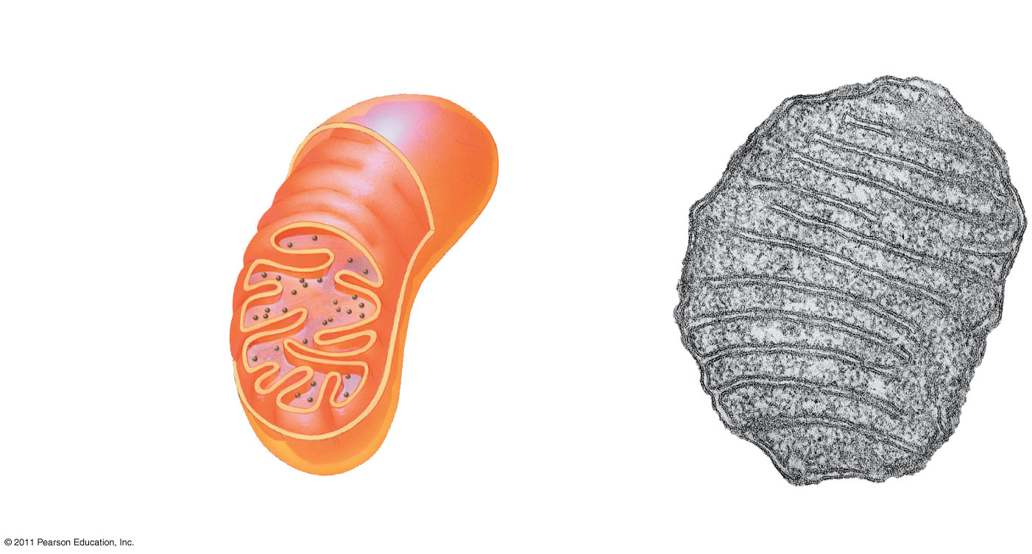
Figure 6.17a
Intermembrane space
Outer
membrane
DNA
Inner
Free ribosomes in the mitochondrial matrix
membrane
Cristae
Matrix
0.1 μm
(a) Diagram and TEM of mitochondrion
Notes:
Figure 6.17 The mitochondrion, site of cellular respiration.

Slide 42
Chloroplast structure includes
Thylakoids, membranous sacs, stacked to form a granum
Stroma, the internal fluid
The chloroplast is one of a group of plant organelles, called plastids
© 2011 Pearson Education, Inc.

Slide 43
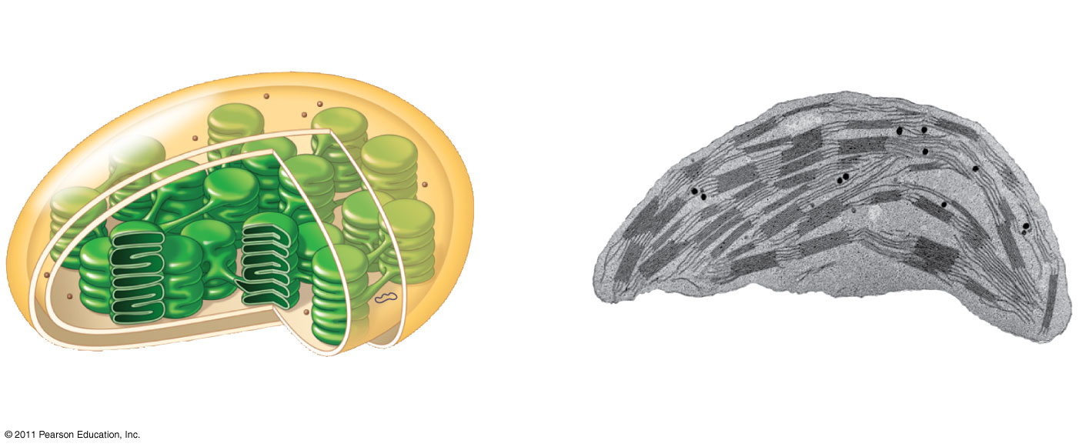
Figure 6.18a
Ribosomes
Stroma
Inner and outer
membranes
Granum
DNA
Thylakoid
Intermembrane space
1 μm
(a) Diagram and TEM of chloroplast
Notes:
Figure 6.18 The chloroplast, site of photosynthesis.

Slide 44
Concept 6: The cytoskeleton is a network of fibers that organizes structures and activities in the cell
The cytoskeleton is a network of fibers extending throughout the cytoplasm
It organizes the cell’s structures and activities, anchoring many organelles in place and used as in internal “highway” on which to transport materials
It is composed of three types of molecular structures
Microtubules
Microfilaments
Intermediate filaments
© 2011 Pearson Education, Inc.
Notes:
For the Cell Biology Video The Cytoskeleton in a Neuron Growth Cone, go to Animation and Video Files
For the Cell Biology Video Cytoskeletal Protein Dynamics, go to Animation and Video Files.

Slide 45
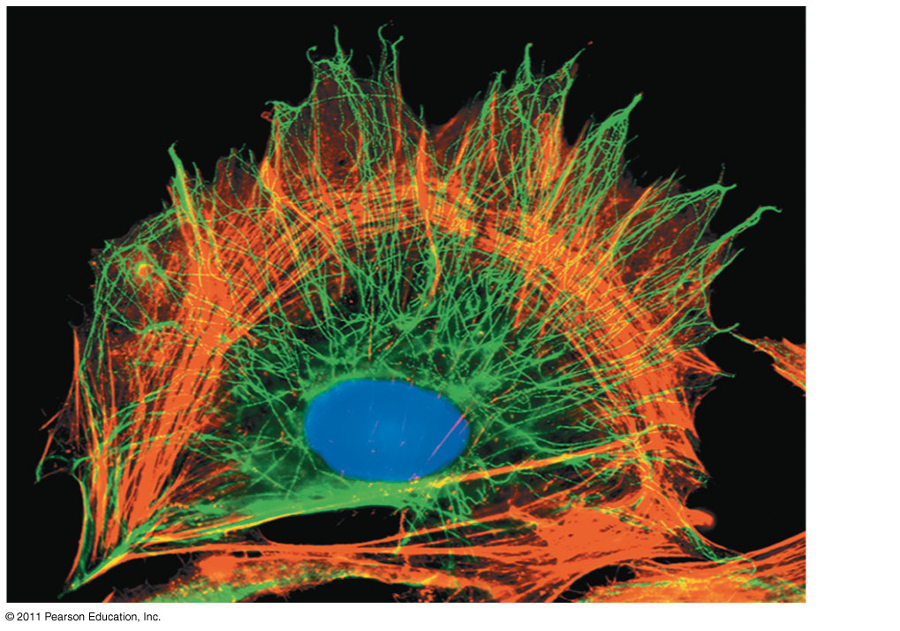
Figure 6.20
10 μm
Notes:
Figure 6.20 The cytoskeleton.

Slide 46
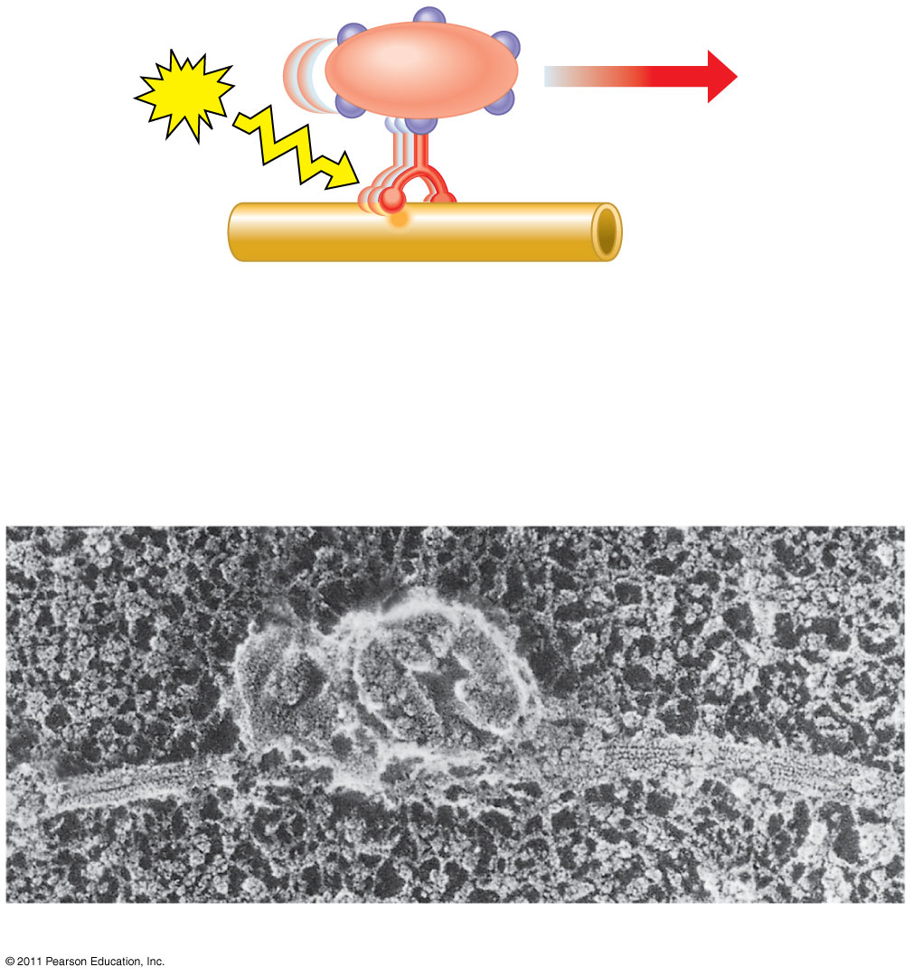
Figure 6.21
Vesicle
ATP
Receptor for motor protein
Motor protein (ATP powered)
Microtubule of cytoskeleton
(a)
Microtubule
Vesicles
0.25 μm
(b)
Notes:
Figure 6.21 Motor proteins and the cytoskeleton.

Slide 47
Centrosomes and Centrioles
In many cells, microtubules grow out from a centrosome near the nucleus
The centrosome is a “microtubule-organizing center”
In animal cells, the centrosome has a pair of centrioles, each with nine triplets of microtubules arranged in a ring that are “thought” to be involved with cell division
(41)
© 2011 Pearson Education, Inc.

Slide 48
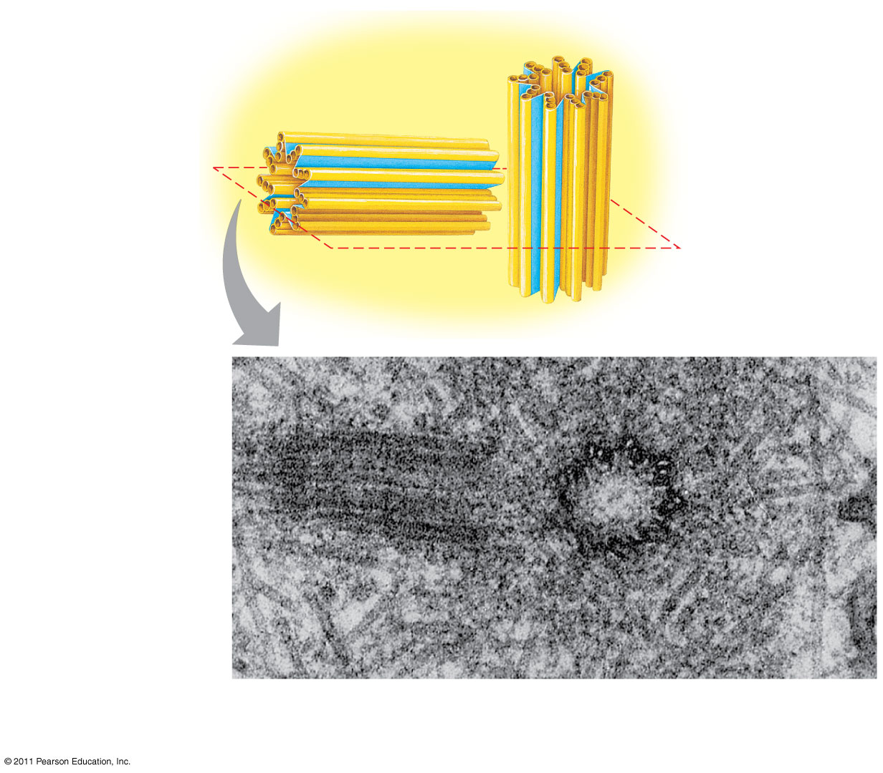
Figure 6.22
Centrosome
Microtubule
Centrioles
43
0.25 μm
Longitudinal section of one centriole
Microtubules
Cross section of the other centriole
Notes:
Figure 6.22 Centrosome containing a pair of centrioles.

Slide 49
Cilia and Flagella
Microtubules control the beating of cilia and flagella, locomotor appendages of some cells
Cilia and flagella differ in their beating patterns
© 2011 Pearson Education, Inc.

Slide 50
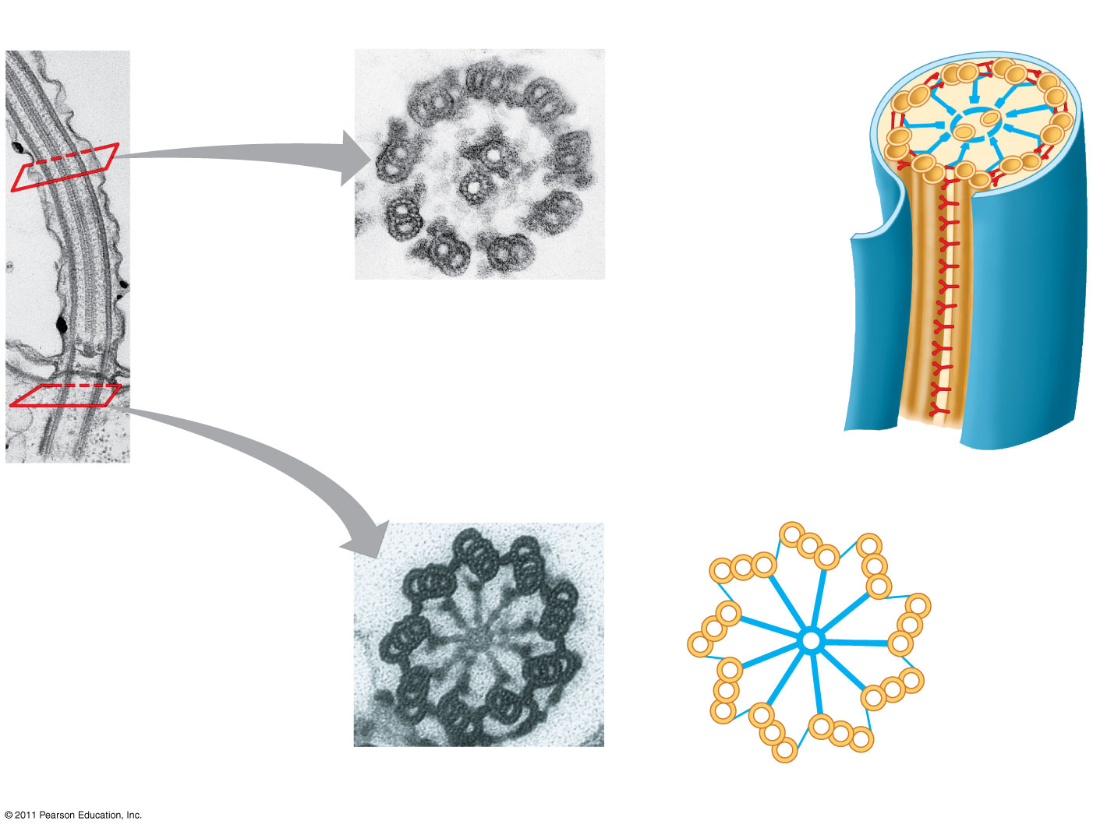
Figure 6.24
0.1 μm
Outer microtubule doublet
Plasma membrane
44
Dynein proteins
Central microtubule
Radial spoke
Microtubules
Cross-linking proteins between outer doublets
(b)
Cross section of motile cilium
Plasma membrane
Basal body
0.5 μm
0.1 μm
(a)
Longitudinal section of motile cilium
Triplet
(c)
Cross section of basal body
Notes:
Figure 6.24 Structure of a flagellum or motile cilium.

Slide 51
Microfilaments that function in cellular motility contain the protein myosin in addition to actin
In muscle cells, thousands of actin filaments are arranged parallel to one another
Thicker filaments composed of myosin interdigitate with the thinner actin fibers
(48)
© 2011 Pearson Education, Inc.

Slide 52
Concept 7: Cell Walls
The cell wall is an extracellular structure that distinguishes plant cells from animal cells
Prokaryotes, fungi, and some protists also have cell walls
The cell wall protects the plant cell, maintains its shape, and prevents excessive uptake of water
Plant cell walls are made of cellulose and fungi chitin.
© 2011 Pearson Education, Inc.

Slide 53
The Extracellular Matrix (ECM) of Animal Cells
Animal cells lack cell walls but are covered by an elaborate extracellular matrix (ECM)
The ECM is made up of glycoproteins such as collagen, proteoglycans, and fibronectin
ECM proteins bind to receptor proteins in the plasma membrane called integrins
© 2011 Pearson Education, Inc.
Notes:
For the Cell Biology Video Cartoon Model of a Collagen Triple Helix, go to Animation and Video Files.
For the Cell Biology Video Staining of the Extracellular Matrix, go to Animation and Video Files.
For the Cell Biology Video Fibronectin Fibrils, go to Animation and Video Files.

Slide 54
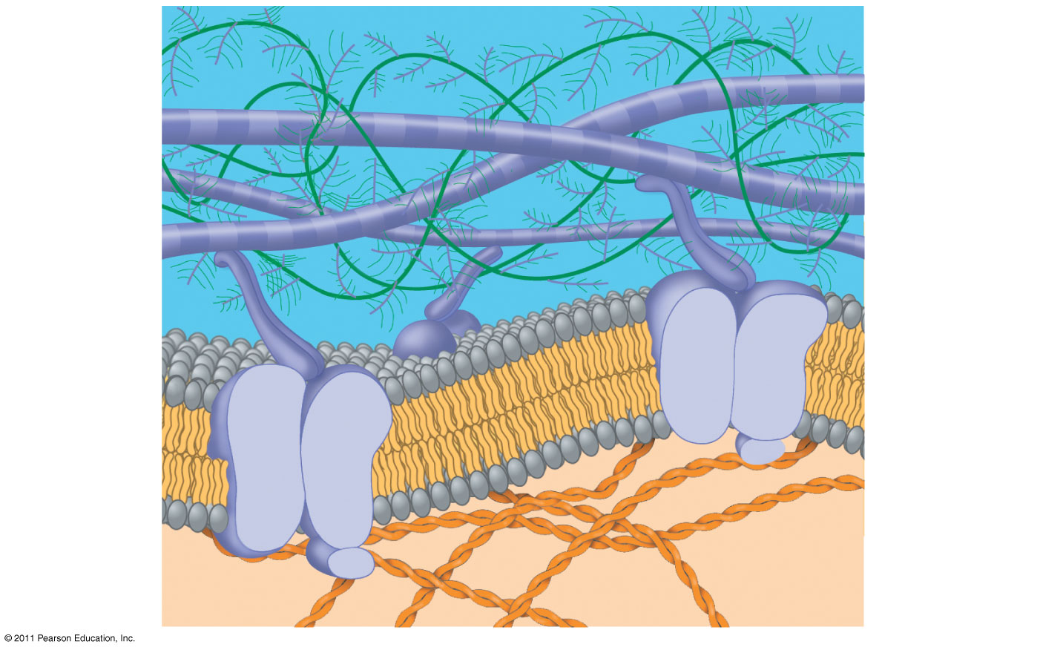
Figure 6.30a
56
Collagen
EXTRACELLULAR FLUID
Proteoglycan complex
Fibronectin
Integrins
Functions of the ECM
Support
Adhesion
Movement
Regulation
Plasma membrane
Micro-
filaments
CYTOPLASM
Notes:
Figure 6.30 Extracellular matrix (ECM) of an animal cell.

Slide 55
Membrane Structure and Function

Slide 56
Concept 1: Cellular membranes are fluid mosaics of lipids and proteins
Phospholipids are the most abundant lipid in the plasma membrane
Phospholipids are amphipathic molecules, containing hydrophobic and hydrophilic regions
The fluid mosaic model states that a membrane is a fluid structure with a “mosaic” of various proteins embedded in it
© 2011 Pearson Education, Inc.
Notes:
For the Cell Biology Video Structure of the Cell Membrane, go to Animation and Video Files.

Slide 57
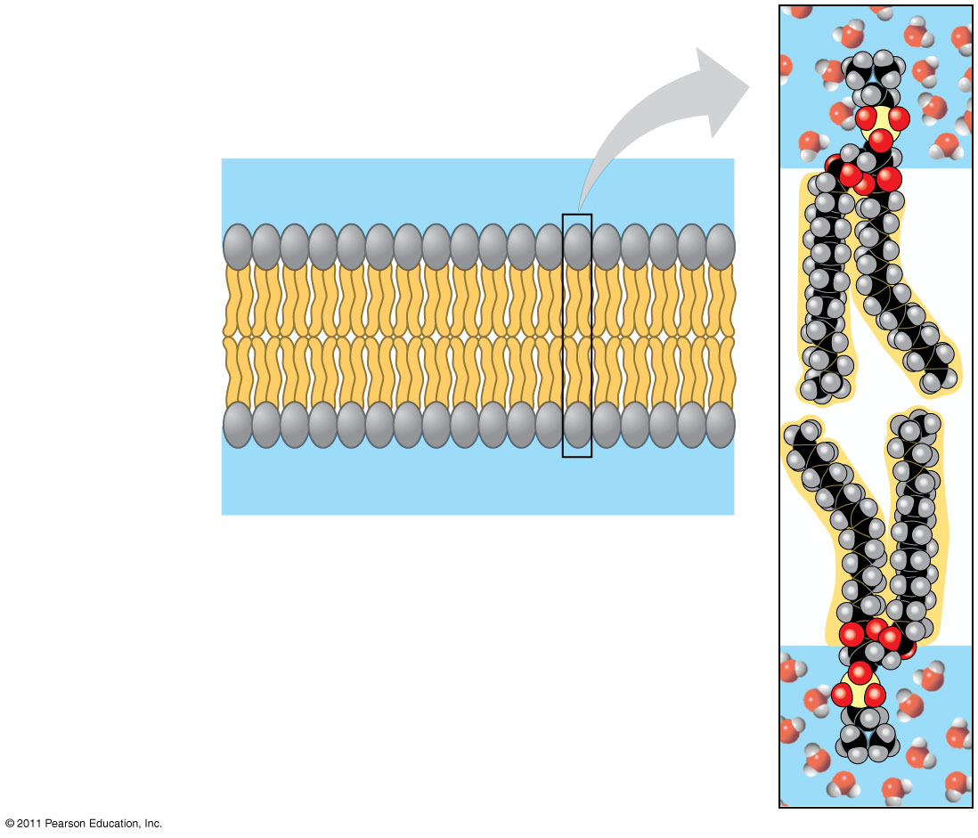
Figure 7.2
WATER
Hydrophilic head
Hydrophobic tail
WATER
Notes:
57
Figure 7.2 Phospholipid bilayer (cross section).

Slide 58
The Fluidity of Membranes
Phospholipids in the plasma membrane can move within the bilayer
Most of the lipids, and some proteins, drift laterally
The membrane is also somewhat flexible, able to adapt to external pressures without instantly breaking.
Rarely does a molecule flip-flop transversely across the membrane
© 2011 Pearson Education, Inc.

Slide 59
As temperatures cool, membranes switch from a fluid state to a solid state
The temperature at which a membrane solidifies depends on the types of lipids
Membranes rich in unsaturated fatty acids are more fluid than those rich in saturated fatty acids
Membranes must be fluid to work properly; they are usually about as fluid as salad oil(5)
© 2011 Pearson Education, Inc.

Slide 60
The steroid cholesterol has different effects on membrane fluidity at different temperatures
At warm temperatures (such as 37°C), cholesterol restrains movement of phospholipids
At cool temperatures, it maintains fluidity by preventing tight packing
© 2011 Pearson Education, Inc.

Slide 61
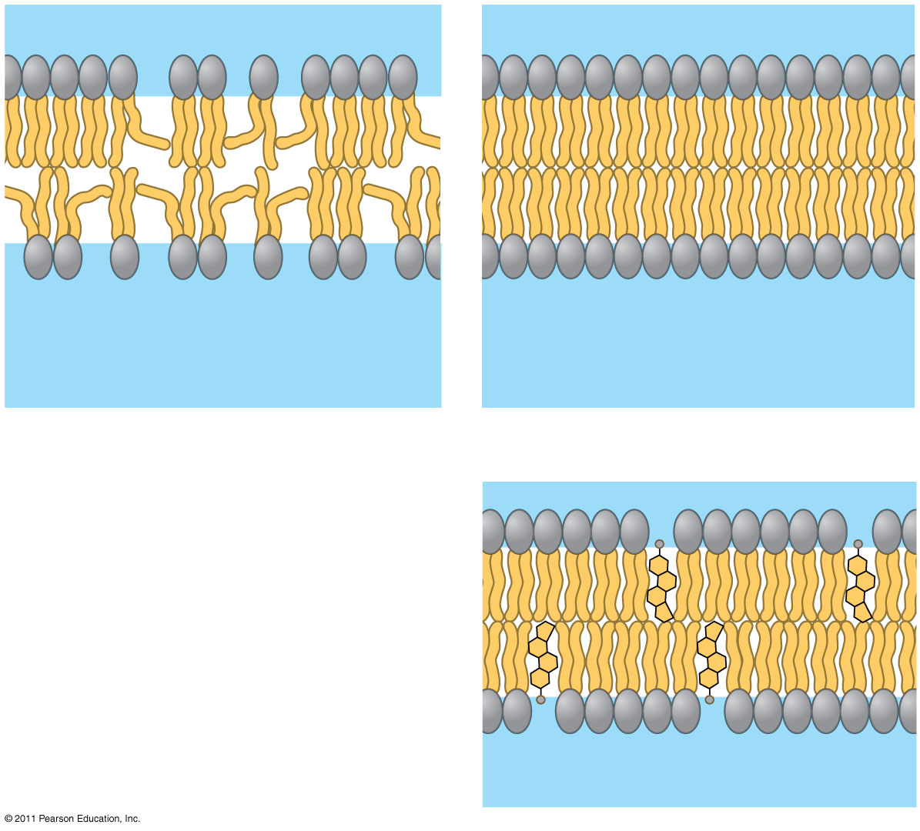
Figure 7.8
Fluid
Viscous
Unsaturated hydrocarbon tails
Saturated hydrocarbon tails
(a) Unsaturated versus saturated hydrocarbon tails
(b) Cholesterol within the animal cell membrane
Cholesterol
Notes:
61
Figure 7.8 Factors that affect membrane fluidity.

Slide 62
Six major functions of membrane proteins
Transport
Enzymatic activity
Signal transduction
Cell-cell recognition
Intercellular joining
Attachment to the cytoskeleton and extracellular matrix (ECM)
© 2011 Pearson Education, Inc.

Slide 63
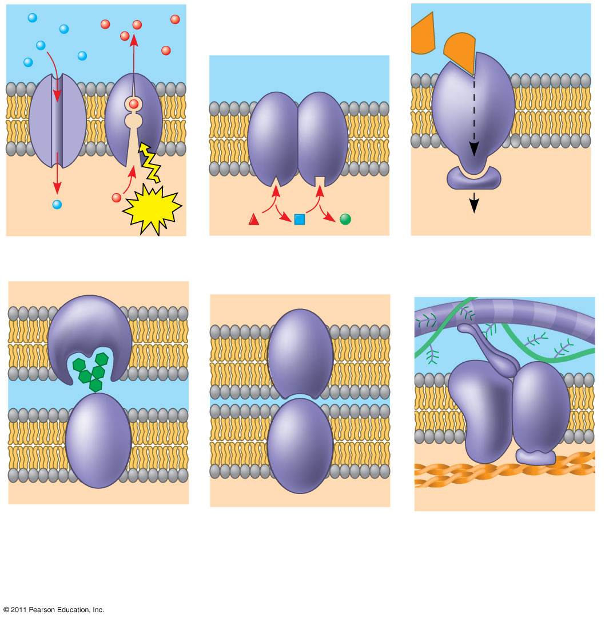
Figure 7.10
Signaling molecule
Enzymes
Receptor
7
ATP
Signal transduction
(a) Transport
(b) Enzymatic activity
(c) Signal transduction
Glyco- protein
(d) Cell-cell recognition
(e) Intercellular joining
(f) Attachment to the cytoskeleton and extracellular matrix (ECM)
Notes:
63
Figure 7.10 Some functions of membrane proteins.

Slide 64
The Role of Membrane Carbohydrates in Cell-Cell Recognition
Cells recognize each other by binding to surface molecules, often containing carbohydrates, on the extracellular surface of the plasma membrane
Membrane carbohydrates may be covalently bonded to lipids (forming glycolipids) or more commonly to proteins (forming glycoproteins)
Carbohydrates on the external side of the plasma membrane vary among species, individuals, and even cell types in an individual
© 2011 Pearson Education, Inc.

Slide 65
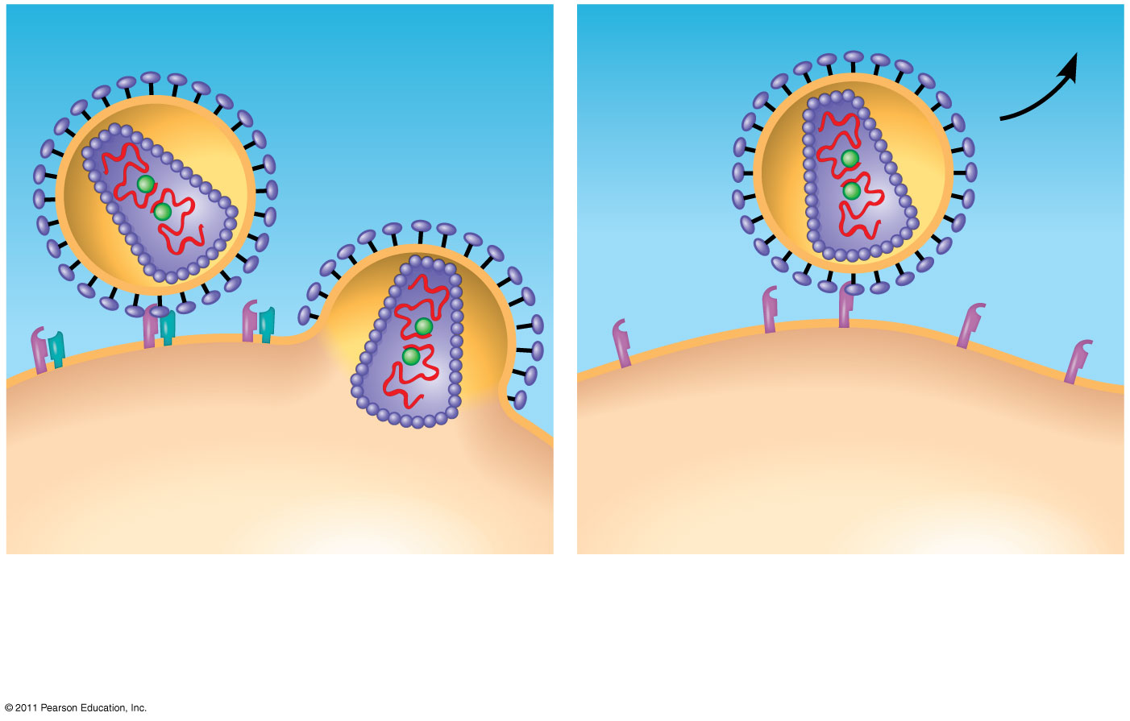
Figure 7.11
HIV
Receptor (CD4)
Receptor (CD4) but no CCR5
Co-receptor (CCR5)
Plasma membrane
HIV can infect a cell that has CCR5 on its surface, as in most people.
HIV cannot infect a cell lacking CCR5 on its surface, as in resistant individuals.
Notes:
65
Figure 7.11 IMPACT: Blocking HIV Entry into Cells as a Treatment for HIV Infections

Slide 66
Cell Signaling
Earl W. Sutherland discovered how the hormone epinephrine acts on cells
Sutherland suggested that cells receiving signals went through three processes
Reception
Transduction
Response
© 2011 Pearson Education, Inc.

Slide 67
Figure 11.6-1
EXTRACELLULAR FLUID
CYTOPLASM
Plasma membrane
1
Reception
Receptor
Signaling molecule
Notes:
Figure 11.6 Overview of cell signaling.

Slide 68
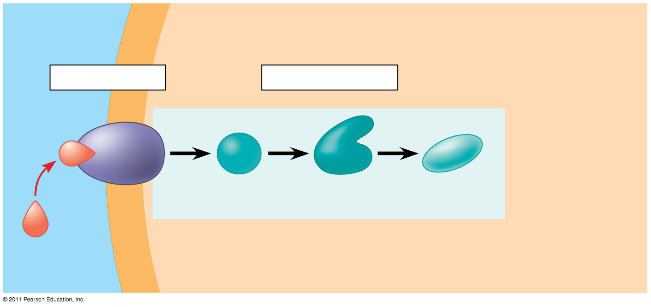
Figure 11.6-2
EXTRACELLULAR FLUID
CYTOPLASM
Plasma membrane
1
Reception
2
Transduction
Receptor
Relay molecules in a signal transduction pathway
Signaling molecule
Notes:
Figure 11.6 Overview of cell signaling.

Slide 69
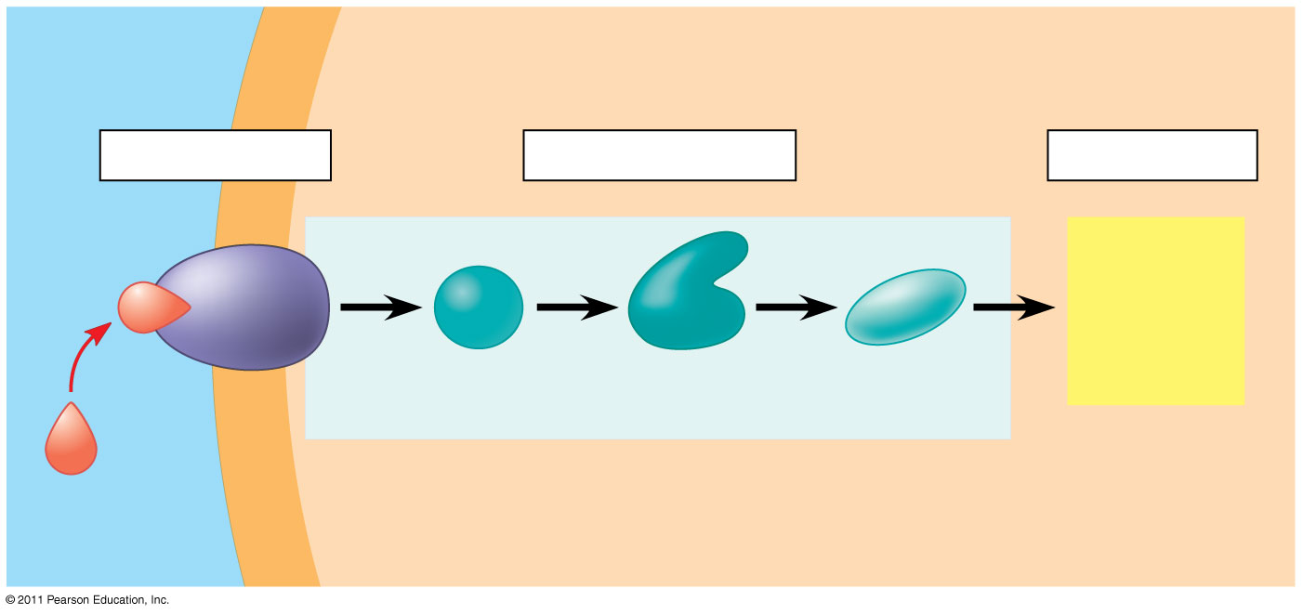
Figure 11.6-3
(6)
EXTRACELLULAR FLUID
CYTOPLASM
Plasma membrane
1
Reception
2
Transduction
3
Response
Receptor
Activation of cellular response
Relay molecules in a signal transduction pathway
Signaling molecule
Notes:
Figure 11.6 Overview of cell signaling.

Slide 70
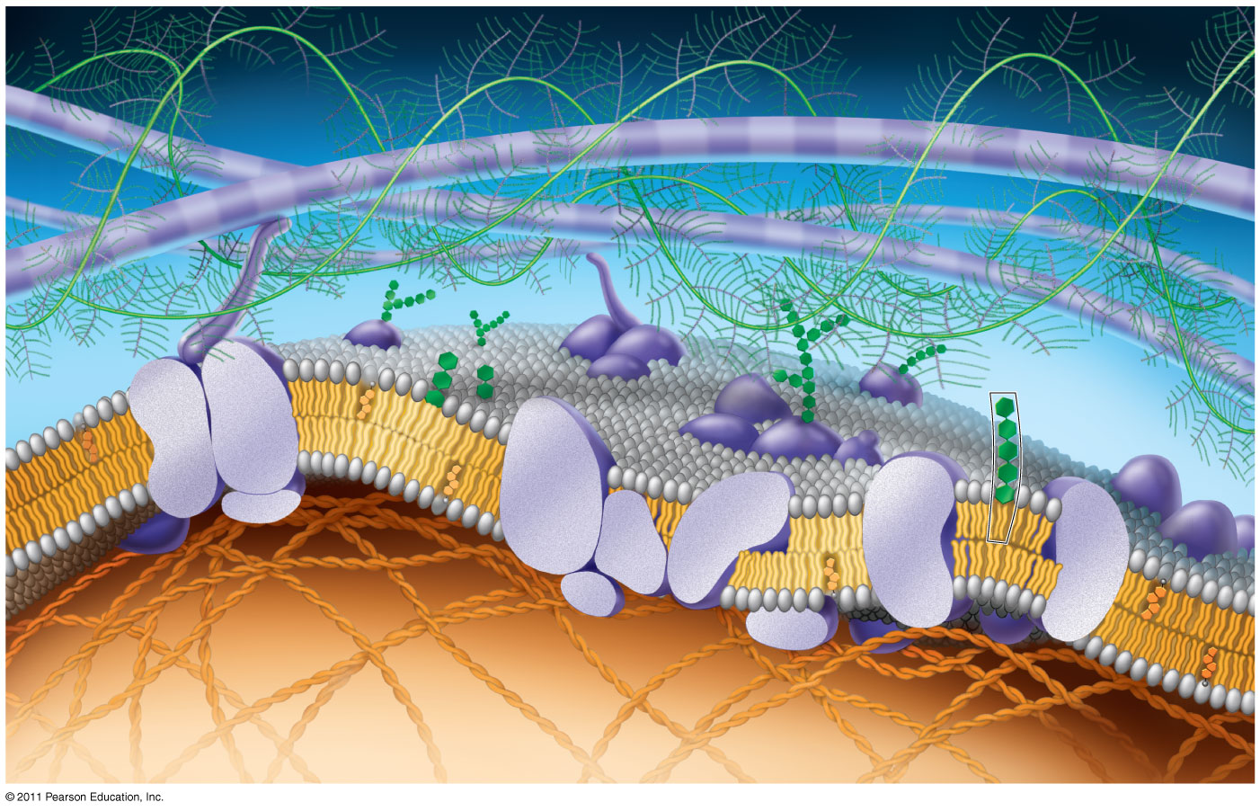
Attachment & ECM Proteins
Fibers of extra- cellular matrix (ECM)
Glyco- protein
Carbohydrate
Glycolipid
EXTRACELLULAR SIDE OF MEMBRANE
Cholesterol
Microfilaments of cytoskeleton
Peripheral proteins
Integral protein
CYTOPLASMIC SIDE OF MEMBRANE
Notes:
70
Figure 7.5 Updated model of an animal cell’s plasma membrane (cutaway view).

Slide 71
Transport Proteins
Transport proteins allow passage of hydrophilic substances across the membrane
Some transport proteins, called channel proteins, have a hydrophilic channel that certain molecules or ions can use as a tunnel
Channel proteins called aquaporins facilitate the passage of water
Other transport proteins, called carrier proteins, bind to molecules and change shape to shuttle them across the membrane
A transport protein is specific for the substance it moves
© 2011 Pearson Education, Inc.

Slide 72
The Permeability of the Lipid Bilayer
Hydrophobic (nonpolar) molecules, such as hydrocarbons, can dissolve in the lipid bilayer and pass through the membrane rapidly
Polar molecules, such as sugars, do not cross the membrane easily
C0₂, O₂, can enter through diffusion
H₂0 can enter during osmosis through aquaporins
Glucose and H⁺ can enter through faciliatated diffusion involving proteins pumps/channels.
© 2011 Pearson Education, Inc.

Slide 73
Concept 3: Passive transport is diffusion of a substance across a membrane with no energy investment
Diffusion is the tendency for molecules to spread out evenly into the available space
Although each molecule moves randomly, diffusion of a population of molecules may be directional
At dynamic equilibrium, as many molecules cross the membrane in one direction as in the other
© 2011 Pearson Education, Inc.

Slide 74
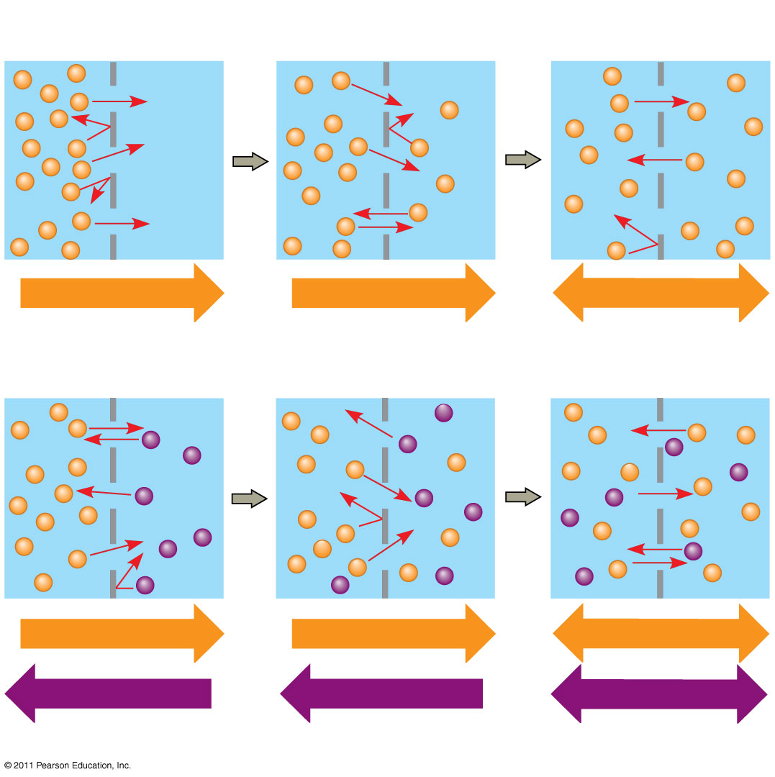
Figure 7.13
Molecules of dye
Membrane (cross section)
WATER
Net diffusion
Net diffusion
Equilibrium
(a) Diffusion of one solute
Net diffusion
Net diffusion
Equilibrium
Net diffusion
Net diffusion
Equilibrium
(b) Diffusion of two solutes
Notes:
74
Figure 7.13 The diffusion of solutes across a synthetic membrane.

Slide 75
Substances diffuse down their concentration gradient, the region along which the density of a chemical substance increases or decreases
No work must be done to move substances down the concentration gradient
The diffusion of a substance across a biological membrane is passive transport because no energy is expended by the cell to make it happen
© 2011 Pearson Education, Inc.

Slide 76
Effects of Osmosis on Water Balance
Osmosis is the diffusion of water across a selectively permeable membrane
Water diffuses across a membrane from the region of lower solute concentration to the region of higher solute concentration until the solute concentration is equal on both sides
© 2011 Pearson Education, Inc.

Slide 77
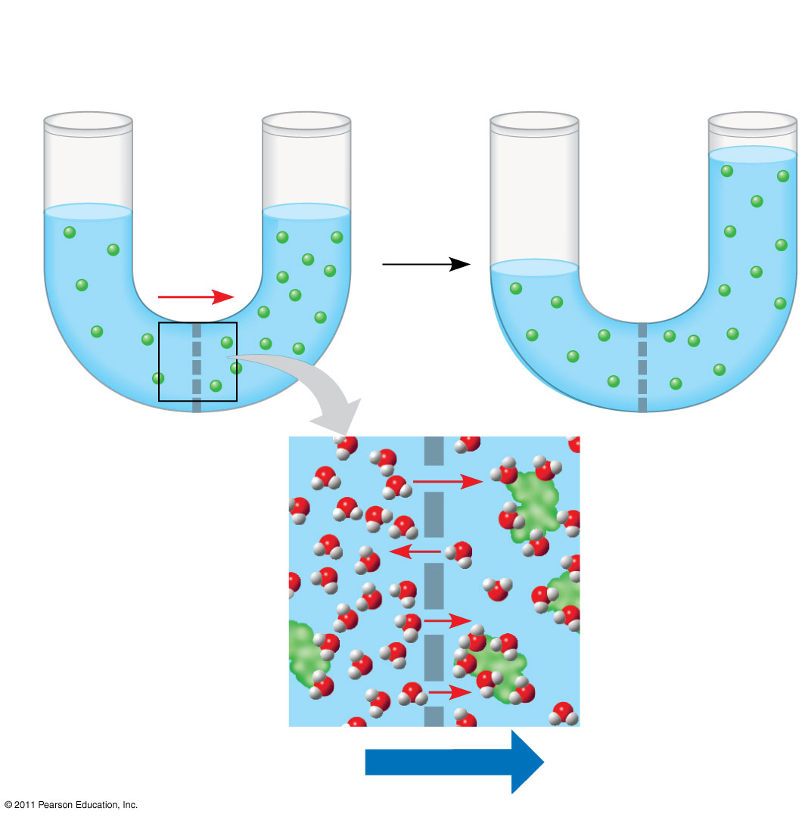
Figure 7.14
Lower concentration of solute (sugar)
Higher concentration of solute
Same concentration of solute
Sugar molecule
H₂O
Selectively permeable membrane
Osmosis
Notes:
77
Figure 7.14 Osmosis.

Slide 78
Water Balance of Cells Without Walls
Tonicity is the ability of a surrounding solution to cause a cell to gain or lose water
Isotonic solution: Solute concentration is the same as that inside the cell; no net water movement across the plasma membrane
Hypertonic solution: Solute concentration is greater than that inside the cell; cell loses water
Hypotonic solution: Solute concentration is less than that inside the cell; cell gains water
© 2011 Pearson Education, Inc.

Slide 79
Water Balance of Cells with Walls
Cell walls help maintain water balance
A plant cell in a hypotonic solution swells until the wall opposes uptake; the cell is now turgid (firm)
If a plant cell and its surroundings are isotonic, there is no net movement of water into the cell; the cell becomes flaccid (limp), and the plant may wilt
In a hypertonic environment, plant cells lose water; eventually, the membrane pulls away from the wall, a usually lethal effect called plasmolysis
© 2011 Pearson Education, Inc.

Slide 80
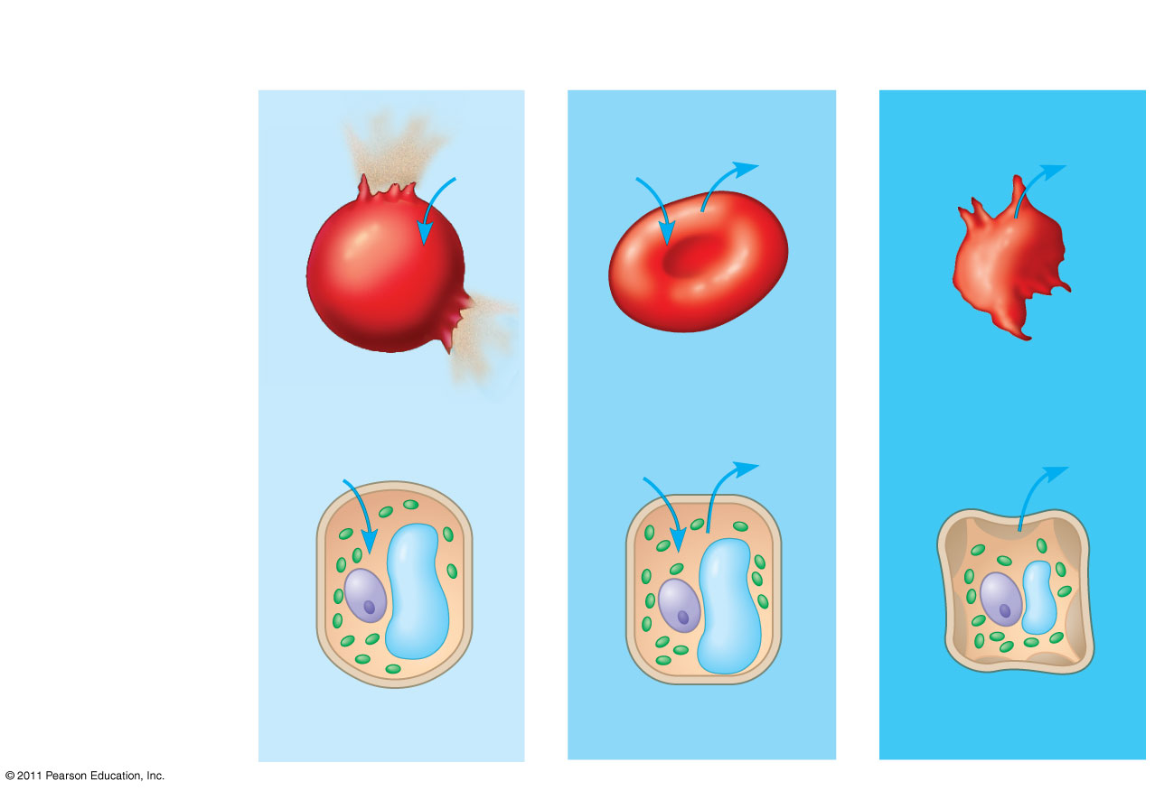
Figure 7.15
Hypotonic solution
Isotonic solution
Hypertonic solution
(a) Animal cell
H₂O
H₂O
H₂O
H₂O
Lysed
Normal
Shriveled
H₂O
Cell wall
H₂O
H₂O
H₂O
(b) Plant cell
18 & 19
Turgid (normal)
Flaccid
Plasmolyzed
Osmosis
Notes:
80
Figure 7.15 The water balance of living cells.

Slide 81
Facilitated Diffusion: Passive Transport Aided by Proteins
In facilitated diffusion, transport proteins speed the passive movement of molecules across the plasma membrane
Channel proteins provide corridors that allow a specific molecule or ion to cross the membrane
Channel proteins include
Aquaporins, for facilitated diffusion of water
Ion channels that open or close in response to a stimulus (gated channels)
© 2011 Pearson Education, Inc.
Notes:
For the Cell Biology Video Water Movement through an Aquaporin, go to Animation and Video Files.

Slide 82
The Need for Energy in Active Transport
Active transport moves substances against their concentration gradient
Active transport requires energy, usually in the form of ATP
Active transport is performed by specific proteins embedded in the membranes
© 2011 Pearson Education, Inc.

Slide 83
Active transport allows cells to maintain concentration gradients that differ from their surroundings
The sodium-potassium pump is one type of active transport system
© 2011 Pearson Education, Inc.
Notes:
For the Cell Biology Video Na⁺/K⁺ATPase Cycle, go to Animation and Video Files.

Slide 84
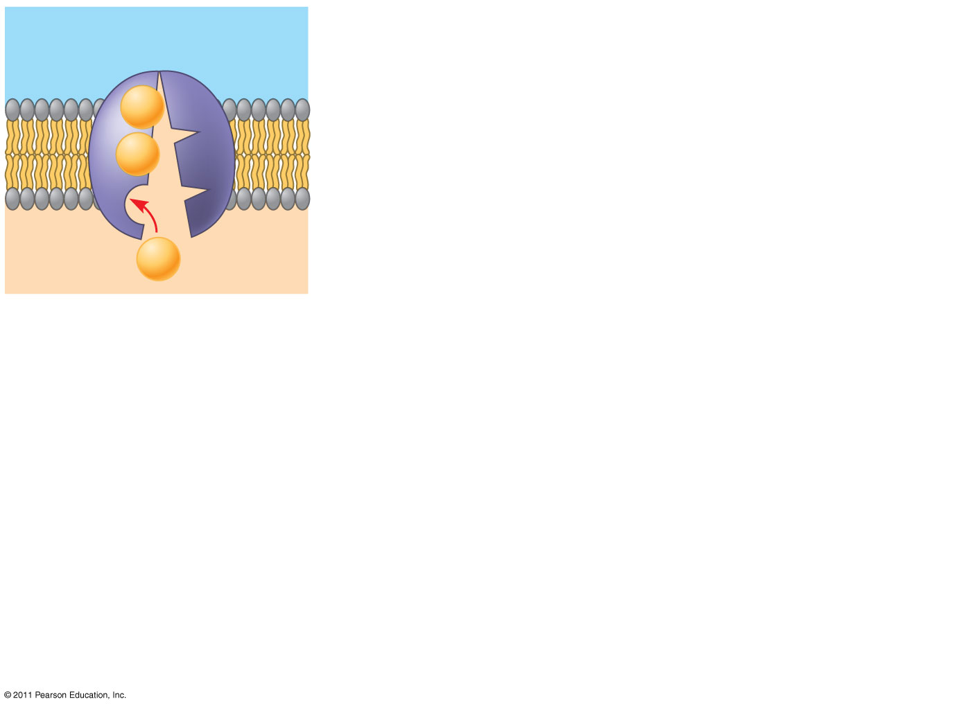
Figure 7.18-1
EXTRACELLULAR FLUID
[Na⁺] high
[K⁺] low
Na⁺
21 next few graphics
Na⁺
CYTOPLASM
Na⁺
[Na⁺] low
1
[K⁺] high
Notes:
84
Figure 7.18 The sodium-potassium pump: a specific case of active transport.

Slide 85
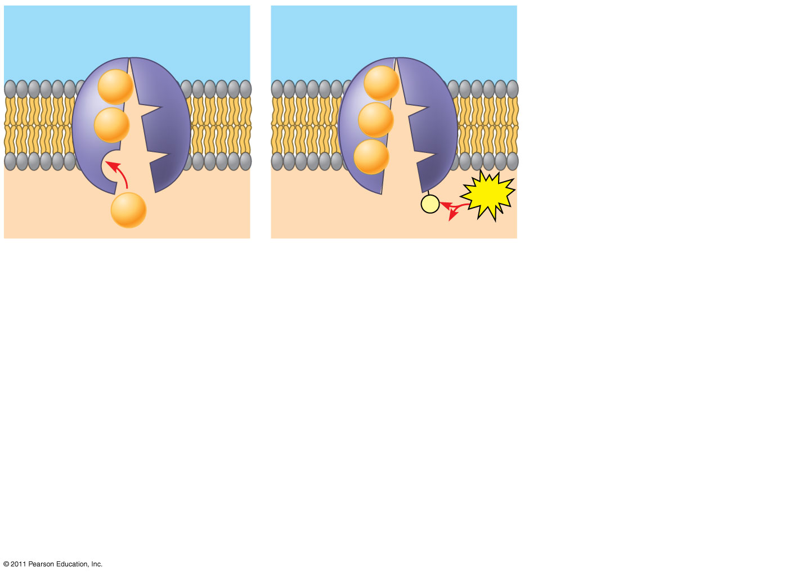
Figure 7.18-2
EXTRACELLULAR FLUID
[Na⁺] high
[K⁺] low
Na⁺
Na⁺
Na⁺
Na⁺
Na⁺
CYTOPLASM
[Na⁺] low
P
ATP
Na⁺
[K⁺] high
1
2
ADP
Notes:
85
Figure 7.18 The sodium-potassium pump: a specific case of active transport.

Slide 86
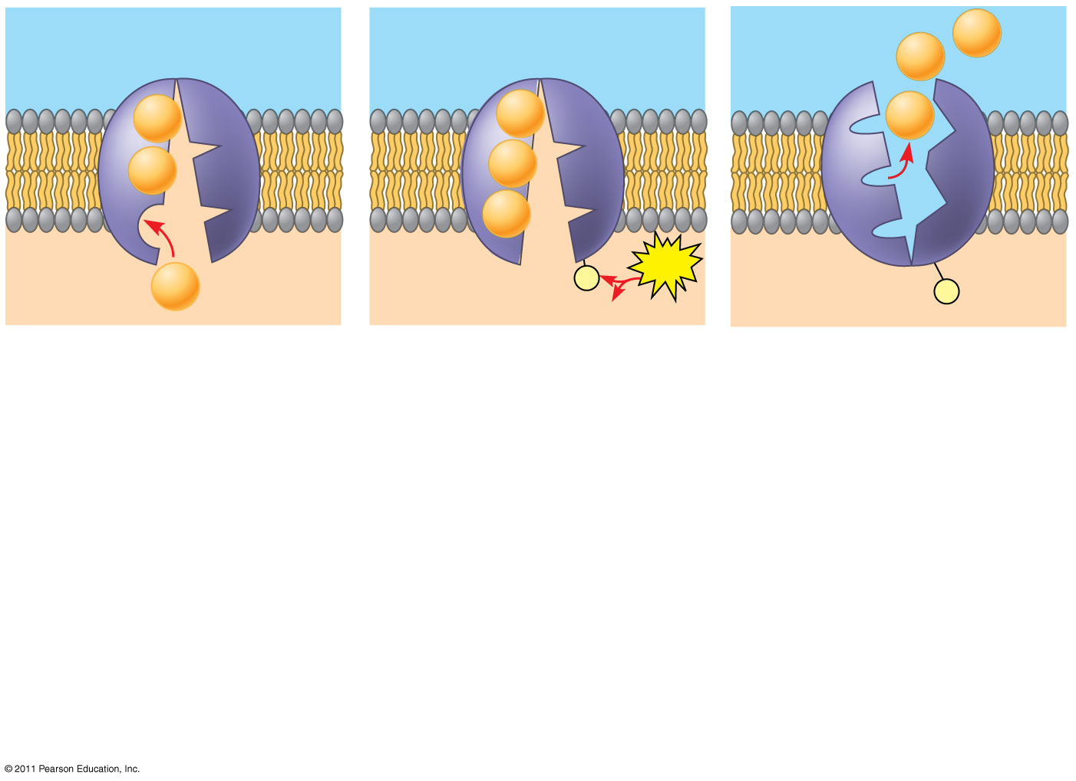
Figure 7.18-3
EXTRACELLULAR FLUID
[Na⁺] high
Na⁺
[K⁺] low
Na⁺
Na⁺
Na⁺
Na⁺
Na⁺
Na⁺
Na⁺
CYTOPLASM
[Na⁺] low
P
ATP
Na⁺
[K⁺] high
P
1
2
ADP
3
Notes:
86
Figure 7.18 The sodium-potassium pump: a specific case of active transport.

Slide 87
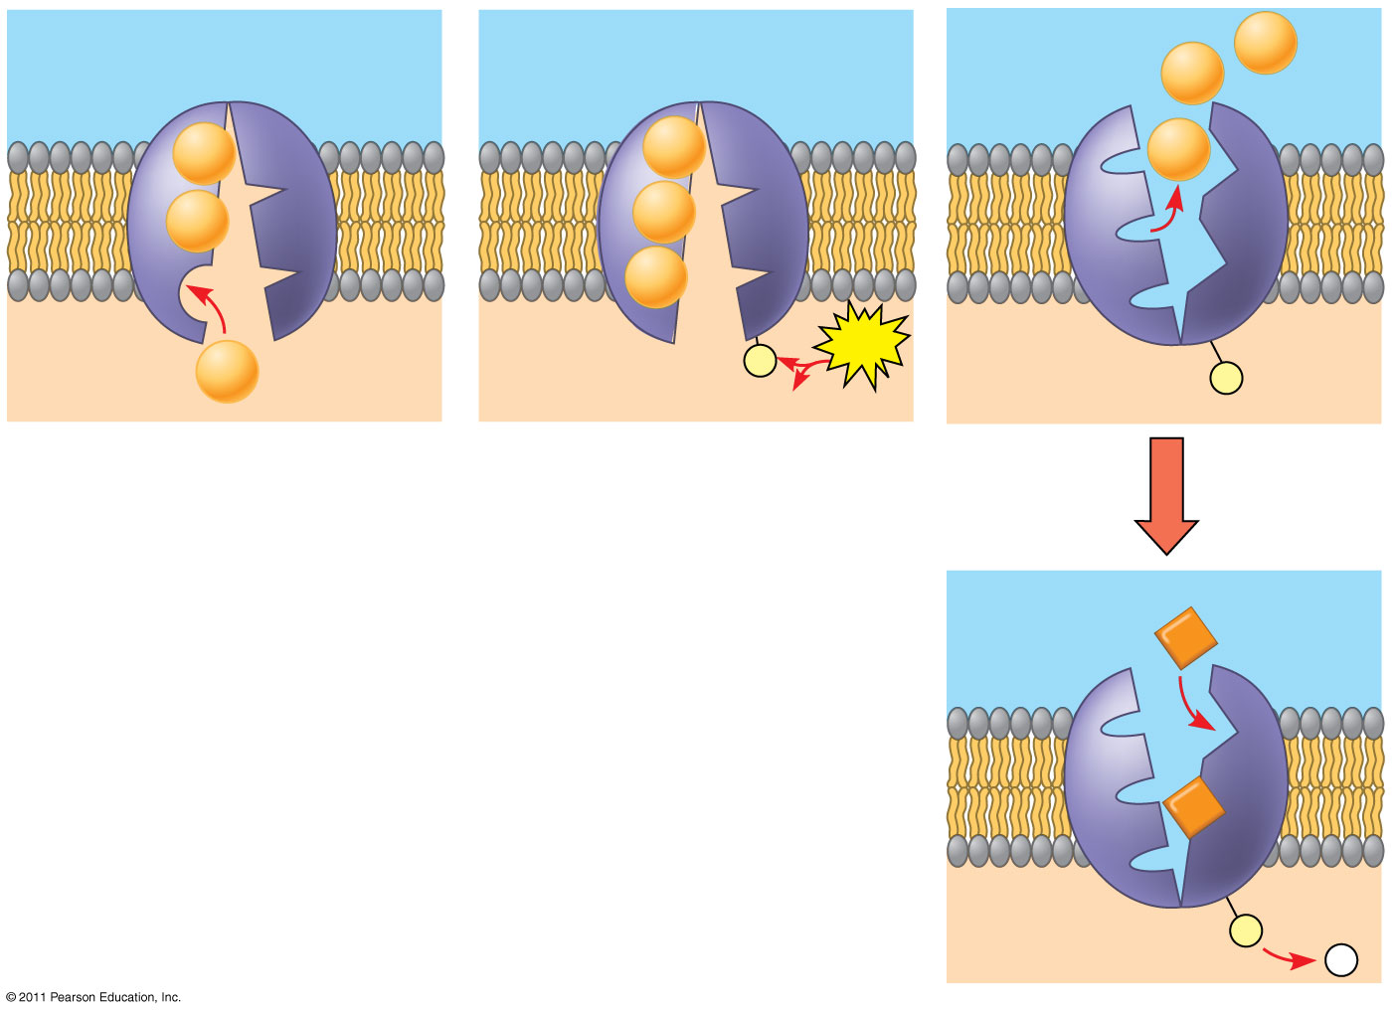
Figure 7.18-4
EXTRACELLULAR FLUID
[Na⁺] high
Na⁺
[K⁺] low
Na⁺
Na⁺
Na⁺
Na⁺
Na⁺
Na⁺
Na⁺
CYTOPLASM
[Na⁺] low
P
ATP
Na⁺
[K⁺] high
P
1
2
ADP
3
K⁺
K⁺
P
4
P _{i}
Notes:
87
Figure 7.18 The sodium-potassium pump: a specific case of active transport.

Slide 88
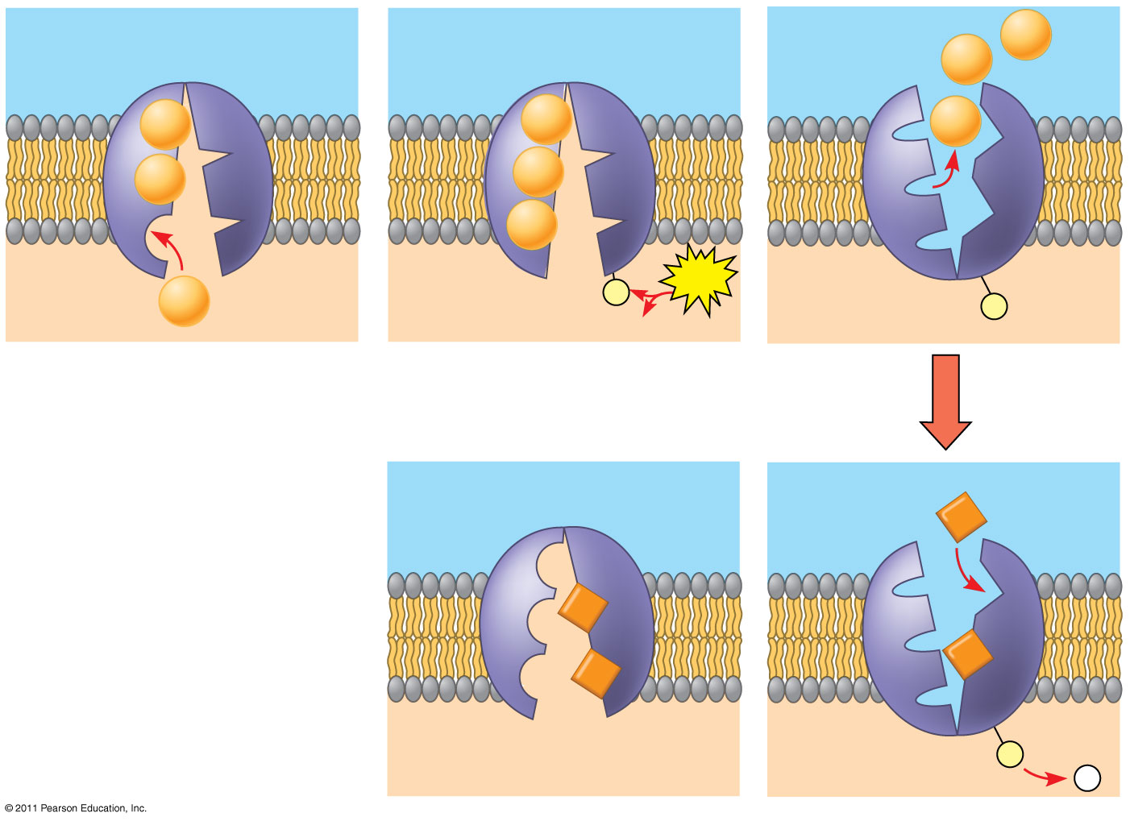
Figure 7.18-5
EXTRACELLULAR FLUID
[Na⁺] high
Na⁺
[K⁺] low
Na⁺
Na⁺
Na⁺
Na⁺
Na⁺
Na⁺
Na⁺
CYTOPLASM
[Na⁺] low
P
ATP
Na⁺
[K⁺] high
P
1
2
ADP
3
K⁺
K⁺
K⁺
K⁺
P
5
4
P _{i}
Notes:
88
Figure 7.18 The sodium-potassium pump: a specific case of active transport.

Slide 89
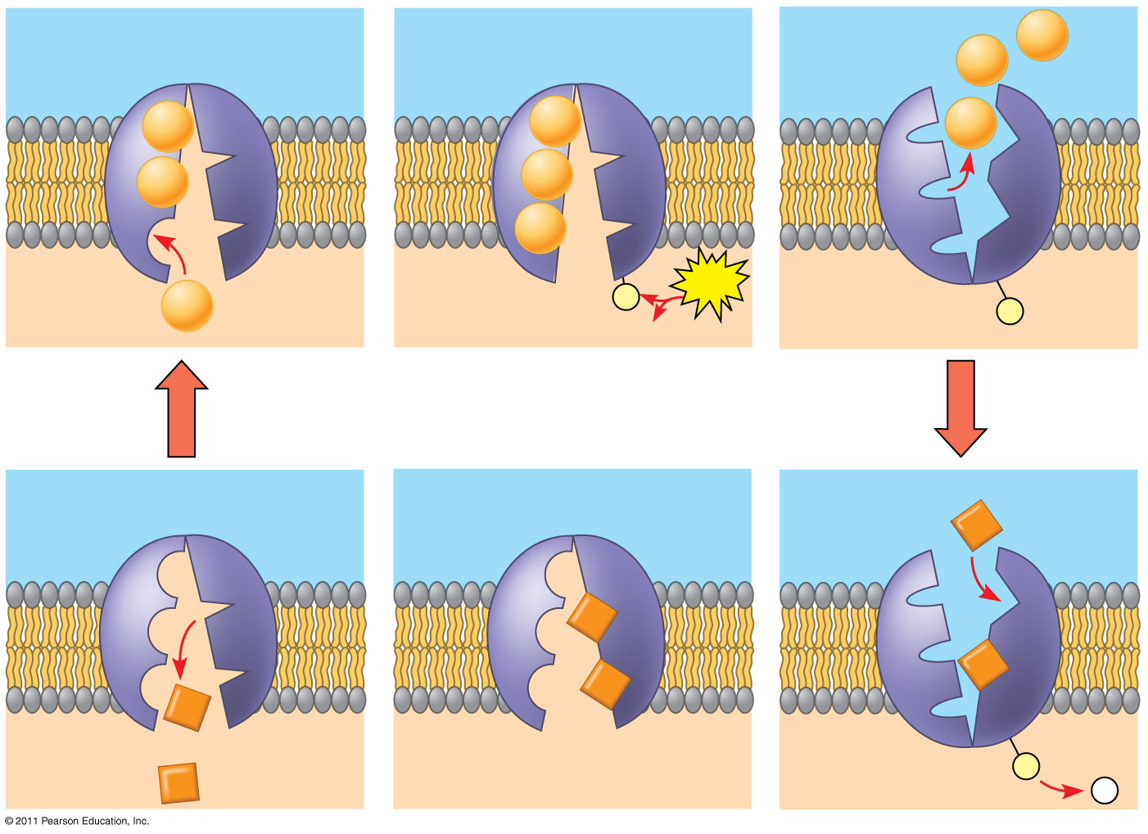
Figure 7.18-6
EXTRACELLULAR FLUID
[Na⁺] high
Na⁺
[K⁺] low
Na⁺
Na⁺
Na⁺
Na⁺
Na⁺
Na⁺
Na⁺
CYTOPLASM
[Na⁺] low
P
ATP
Na⁺
[K⁺] high
P
1
2
ADP
3
K⁺
K⁺
K⁺
K⁺
K⁺
P
6
K⁺
5
4
P _{i}
Notes:
89
Figure 7.18 The sodium-potassium pump: a specific case of active transport.

Slide 90
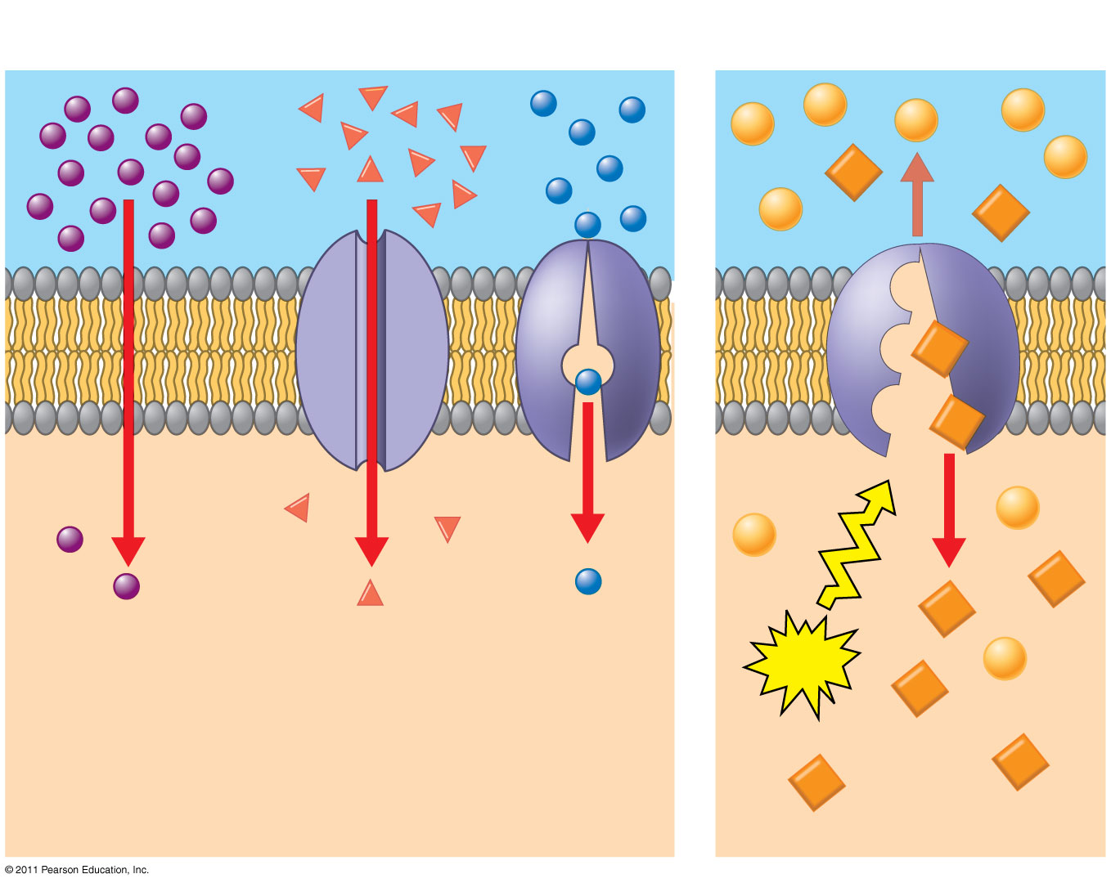
Figure 7.19
Passive transport
Active transport
Diffusion
Facilitated diffusion
ATP
22
Notes:
90
Figure 7.19 Review: passive and active transport.

Slide 91
How Ion Pumps Maintain Membrane Potential
Membrane potential is the voltage difference across a membrane
Voltage is created by differences in the distribution of positive and negative ions across a membrane
Outside of the membrane is positive and inside negative.
© 2011 Pearson Education, Inc.

Slide 92
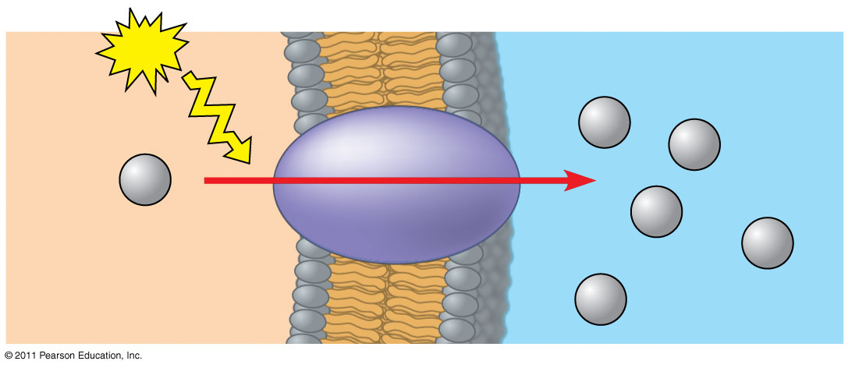
Figure 7.20
ATP
−
+
EXTRACELLULAR FLUID
−
+
H⁺
Proton pump
H⁺
H⁺
H⁺
−
+
H⁺
CYTOPLASM
−
+
H⁺
Notes:
92
Figure 7.20 A proton pump.

Slide 93
Two combined forces, collectively called the electrochemical gradient, drive the diffusion of ions across a membrane
A chemical force (the ion’s concentration gradient)
An electrical force (the effect of the membrane potential on the ion’s movement)
© 2011 Pearson Education, Inc.

Slide 94
An electrogenic pump is a transport protein that generates voltage across a membrane
The sodium-potassium pump is the major electrogenic pump of animal cells
The main electrogenic pump of plants, fungi, and bacteria is a proton pump
Electrogenic pumps help store energy that can be used for cellular work
© 2011 Pearson Education, Inc.

Slide 95
Cotransport: Coupled Transport by a Membrane Protein
Cotransport occurs when active transport of a solute indirectly drives transport of other solutes
Plants commonly use the gradient of hydrogen ions generated by proton pumps to drive active transport of nutrients into the cell
Certain diarrhea treatments can cause uptake of ions and other solutes that results in water reabsorption into cells; preventing dehydration
© 2011 Pearson Education, Inc.

Slide 96
Exocytosis
In exocytosis, transport vesicles migrate to the membrane, fuse with it, and release their contents
Many secretory cells use exocytosis to export their products
© 2011 Pearson Education, Inc.

Slide 97
Endocytosis
In endocytosis, the cell takes in macromolecules by forming vesicles from the plasma membrane
Endocytosis is a reversal of exocytosis, involving different proteins
There are three types of endocytosis
Phagocytosis (“cellular eating”)
Pinocytosis (“cellular drinking”)
Receptor-mediated endocytosis
© 2011 Pearson Education, Inc.

Slide 98
In phagocytosis a cell engulfs a particle in a vacuole
The vacuole fuses with a lysosome to digest the particle
In pinocytosis, molecules are taken up when extracellular fluid is “gulped” into tiny vesicles
© 2011 Pearson Education, Inc.
Notes:
For the Cell Biology Video Phagocytosis in Action, go to Animation and Video Files.

Slide 99
In receptor-mediated endocytosis, binding of ligands to receptors triggers vesicle formation
A ligand is any molecule that binds specifically to a receptor site of another molecule
© 2011 Pearson Education, Inc.

Slide 100
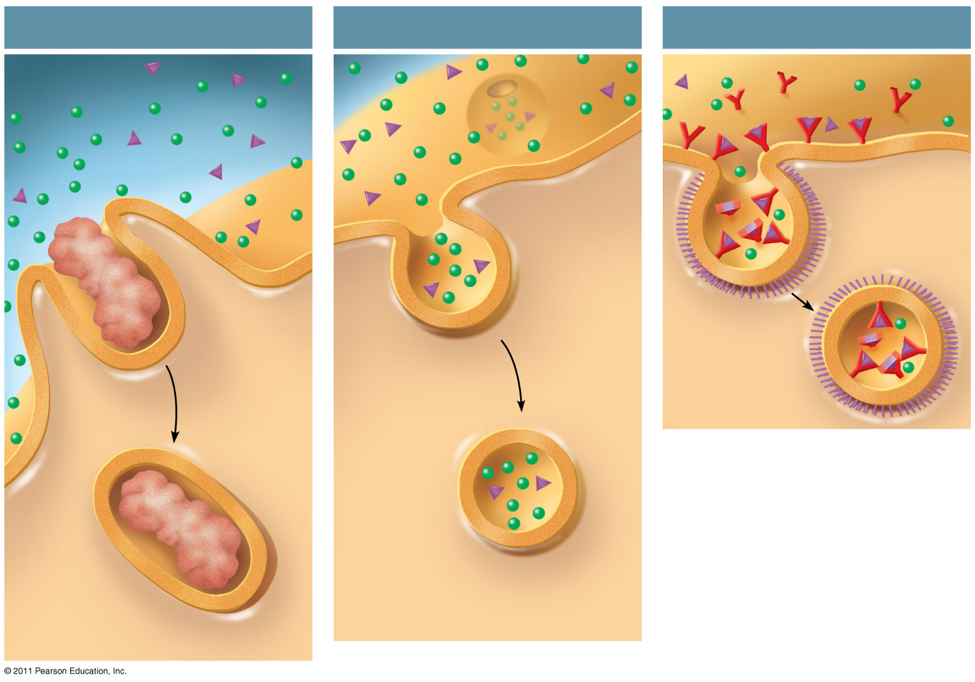
Figure 7.22
Phagocytosis
Pinocytosis
Receptor-Mediated Endocytosis
EXTRACELLULAR FLUID
Solutes
Pseudopodium
Receptor
Plasma membrane
Ligand
Coat proteins
Coated pit
“Food” or other particle
Coated vesicle
Vesicle
Food vacuole
CYTOPLASM
Notes:
100
Figure 7.22 Exploring: Endocytosis in Animal Cells

Slide 101
An Introduction to Metabolism

Slide 102
Concept 1: An organism’s metabolism transforms matter and energy, subject to the laws of thermodynamics
Metabolism is the totality of an organism’s chemical reactions
Metabolism is an emergent property of life that arises from interactions between molecules within the cell
© 2011 Pearson Education, Inc.

Slide 103
Organization of the Chemistry of Life into Metabolic Pathways
A metabolic pathway begins with a specific molecule and ends with a product
Each step is catalyzed by a specific enzyme
Enzyme 1
Enzyme 2
Enzyme 3
A
B
C
D
Reaction 1
Reaction 2
Reaction 3
Starting molecule
Product
© 2011 Pearson Education, Inc.

Slide 104
Catabolic pathways release energy by breaking down complex molecules into simpler compounds
Cellular respiration, the breakdown of glucose in the presence of oxygen, is an example of a pathway of catabolism
Anabolic pathways consume energy to build complex molecules from simpler ones
The synthesis of protein from amino acids is an example of anabolism
© 2011 Pearson Education, Inc.

Slide 105
Forms of Energy
3 & 4
Kinetic energy is energy associated with motion
Heat (thermal energy) is kinetic energy associated with random movement of atoms or molecules
Potential energy is energy that matter possesses because of its location or structure
Chemical energy is potential energy available for release in a chemical reaction
Energy can be converted from one form to another
Animation: Energy Concepts
© 2011 Pearson Education, Inc.

Slide 106
Concept 2: The free-energy change of a reaction tells us whether or not the reaction occurs spontaneously
Biologists want to know which reactions occur spontaneously and which require input of energy
To do so, they need to determine energy changes that occur in chemical reactions
© 2011 Pearson Education, Inc.

Slide 107
Exergonic and Endergonic Reactions in Metabolism
An exergonic reaction proceeds with a net release of free energy and is spontaneous
An endergonic reaction absorbs free energy from its surroundings and is nonspontaneous
© 2011 Pearson Education, Inc.

Slide 108
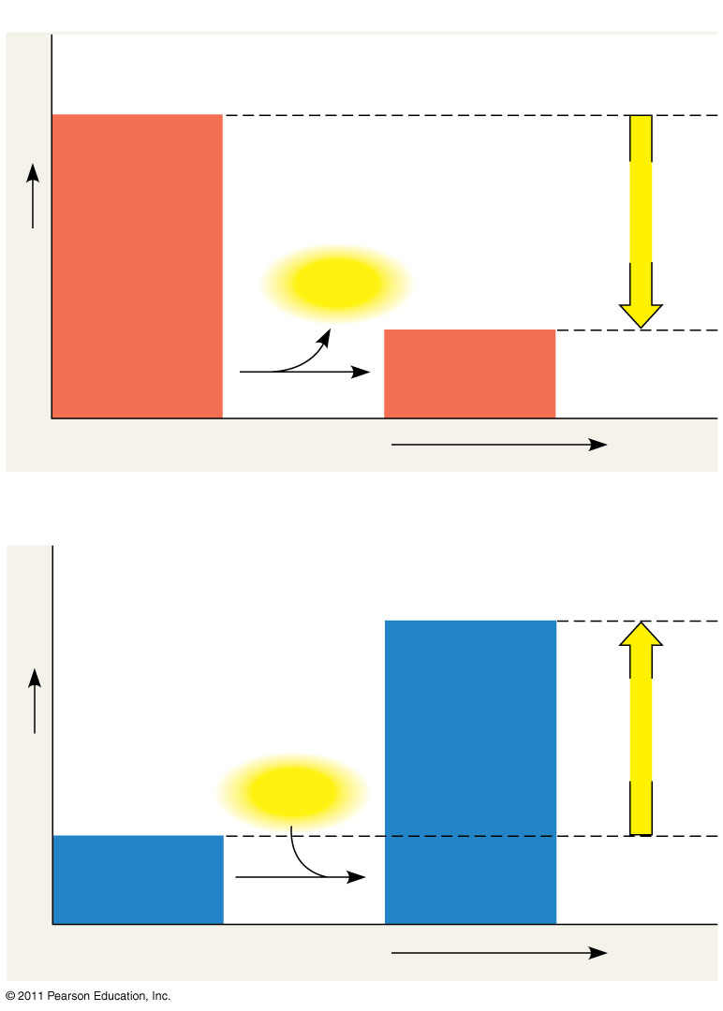
Figure 8.6
(a) Exergonic reaction: energy released, spontaneous
Reactants
Amount of energy released (ΔG < 0)
Free energy
Energy
Products
Progress of the reaction
(b) Endergonic reaction: energy required, nonspontaneous
Products
Amount of energy required (ΔG > 0)
Free energy
Energy
Reactants
Progress of the reaction
Notes:
108
Figure 8.6 Free energy changes (ΔG) in exergonic and endergonic reactions.

Slide 109
Concept 3: ATP powers cellular work by coupling exergonic reactions to endergonic reactions
A cell does three main kinds of work
Chemical
Transport
Mechanical
To do work, cells manage energy resources by energy coupling, the use of an exergonic process to drive an endergonic one
Most energy coupling in cells is mediated by ATP
© 2011 Pearson Education, Inc.

Slide 110
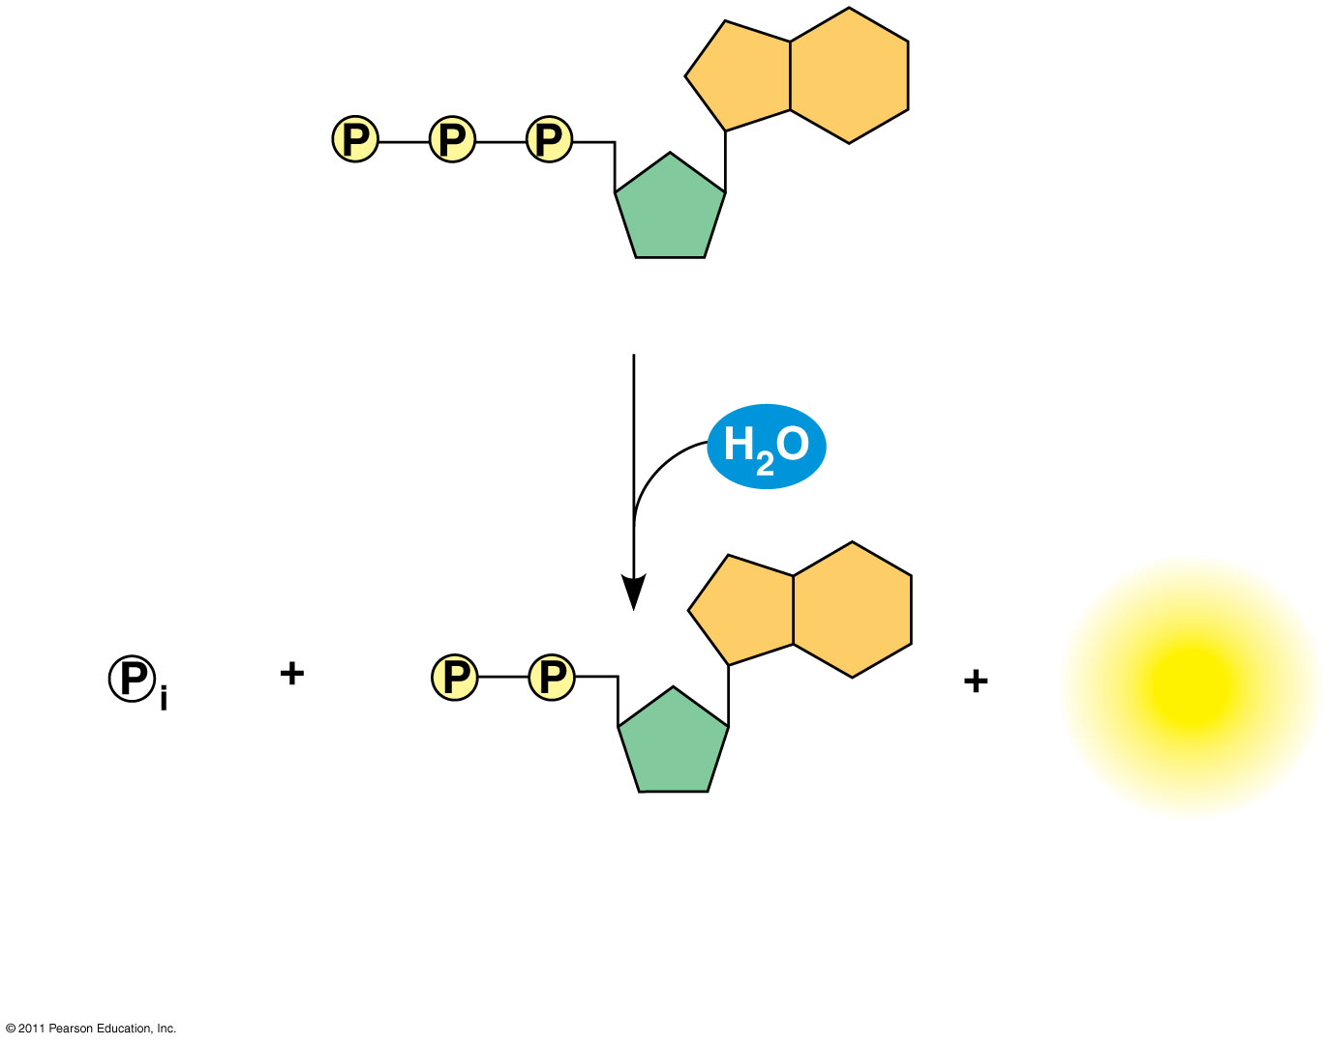
Figure 8.8b
12
Adenosine triphosphate (ATP)
Energy
Inorganic phosphate
Adenosine diphosphate (ADP)
(b) The hydrolysis of ATP
Notes:
110
Figure 8.8 The structure and hydrolysis of adenosine triphosphate (ATP).

Slide 111
The bonds between the phosphate groups of ATP’s tail can be broken by hydrolysis
Energy is released from ATP when the terminal phosphate bond is hydrolyzed
In other words, it requires energy to break bonds but when the phosphate group forms bonds with something else energy is released!
This release of energy comes from the chemical change to a state of lower free energy, not from the phosphate bonds themselves
© 2011 Pearson Education, Inc.
Notes:
For the Cell Biology Video Stick Model of ATP (Adenosine Triphosphate), go to Animation and Video Files.

Slide 112
In the cell, the energy from the exergonic reaction of ATP hydrolysis can be used to drive an endergonic reaction
Overall, the energy coupled reactions are exergonic
ATP drives endergonic reactions by phosphorylation, transferring a phosphate group to some other molecule, such as a reactant
The recipient molecule is now called a phosphorylated intermediate
© 2011 Pearson Education, Inc.

Slide 113
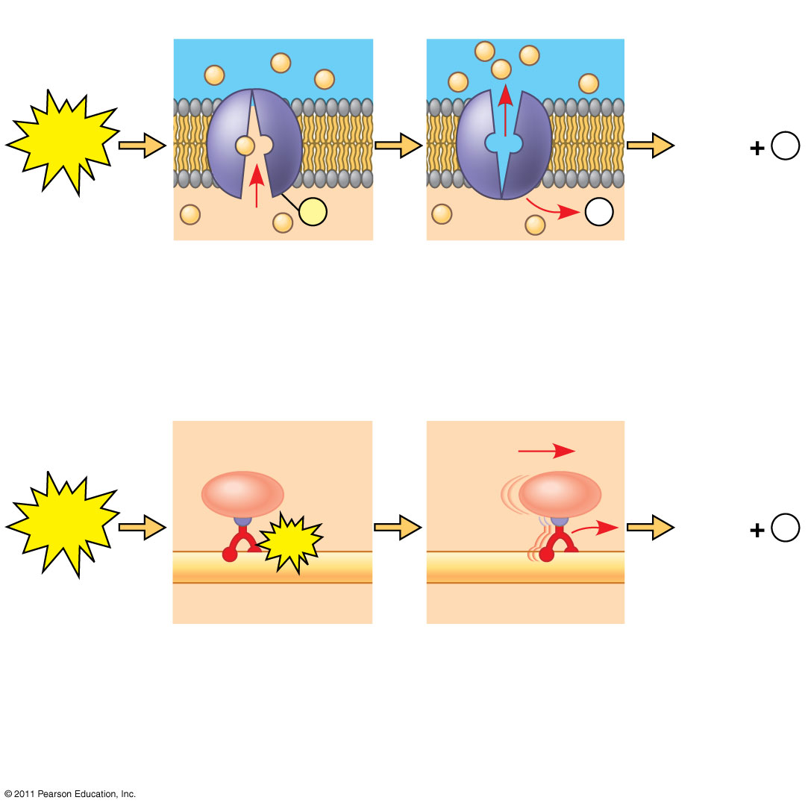
Figure 8.10
Transport protein
Solute
ATP
ADP
P _{i}
P
P _{i}
Solute transported
(a) Transport work: ATP phosphorylates transport proteins.
Vesicle
Cytoskeletal track
ATP
ADP
P _{i}
ATP
Motor protein
Protein and vesicle moved
(b) Mechanical work: ATP binds noncovalently to motor proteins and then is hydrolyzed.
Notes:
113
Figure 8.10 How ATP drives transport and mechanical work.

Slide 114
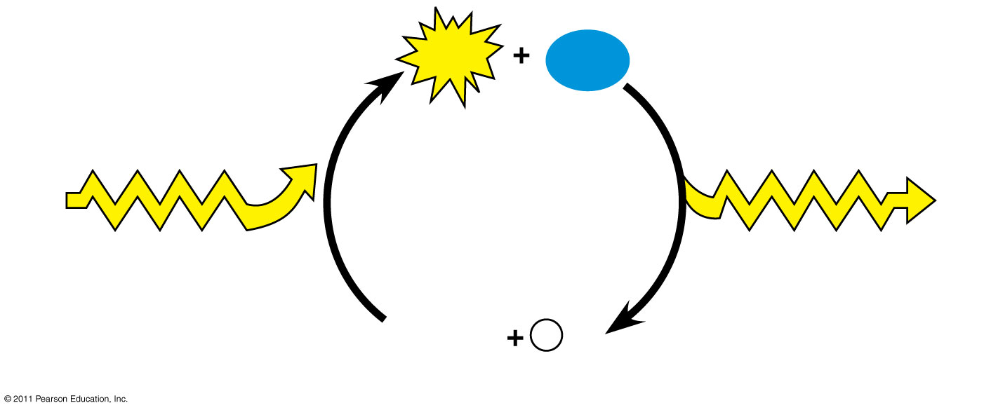
Figure 8.11
ATP
H₂O
Energy from catabolism (exergonic, energy-releasing processes)
Energy for cellular work (endergonic, energy-consuming processes)
ADP
P _{i}
Notes:
114
Figure 8.11 The ATP cycle.

Slide 115
Concept 4: Enzymes speed up metabolic reactions by lowering energy barriers
A catalyst is a chemical agent that speeds up a reaction without being consumed by the reaction
An enzyme is a catalytic protein
Hydrolysis of sucrose by the enzyme sucrase is an example of an enzyme-catalyzed reaction (17)
© 2011 Pearson Education, Inc.

Slide 116
The Activation Energy Barrier
Every chemical reaction between molecules involves bond breaking and bond forming
The initial energy needed to start a chemical reaction is called the free energy of activation, or activation energy (E_{A})
Activation energy is often supplied in the form of thermal energy that the reactant molecules absorb from their surroundings (18)
© 2011 Pearson Education, Inc.

Slide 117
How Enzymes Lower the E_{A} Barrier
Enzymes catalyze reactions by lowering the E_{A} barrier
Enzymes do not affect the change in free energy (∆G); instead, they hasten reactions that would occur eventually
Animation: How Enzymes Work
© 2011 Pearson Education, Inc.

Slide 118
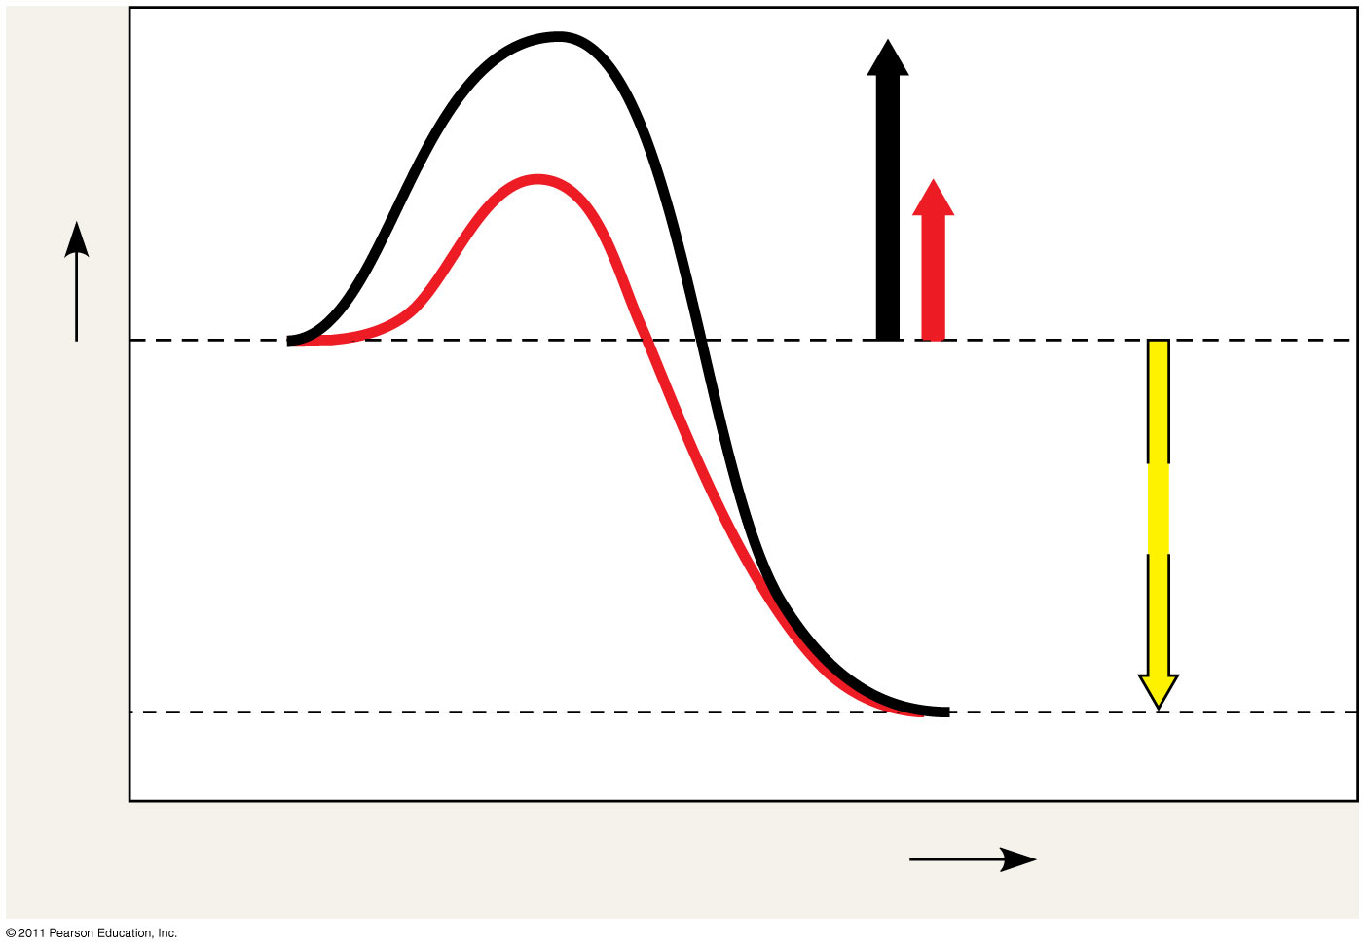
Figure 8.13
Course of reaction without enzyme
E_{A} without enzyme
E_{A} with enzyme is lower
Reactants
Free energy
Course of reaction with enzyme
ΔG is unaffected by enzyme
Products
Progress of the reaction
19
Notes:
118
Figure 8.13 The effect of an enzyme on activation energy.

Slide 119
Substrate Specificity of Enzymes
The reactant that an enzyme acts on is called the enzyme’s substrate
The enzyme binds to its substrate, forming an enzyme-substrate complex
The active site is the region on the enzyme where the substrate binds
Induced fit of a substrate brings chemical groups of the active site into positions that enhance their ability to catalyze the reaction
© 2011 Pearson Education, Inc.
Notes:
For the Cell Biology Video Closure of Hexokinase via Induced Fit, go to Animation and Video Files.

Slide 120
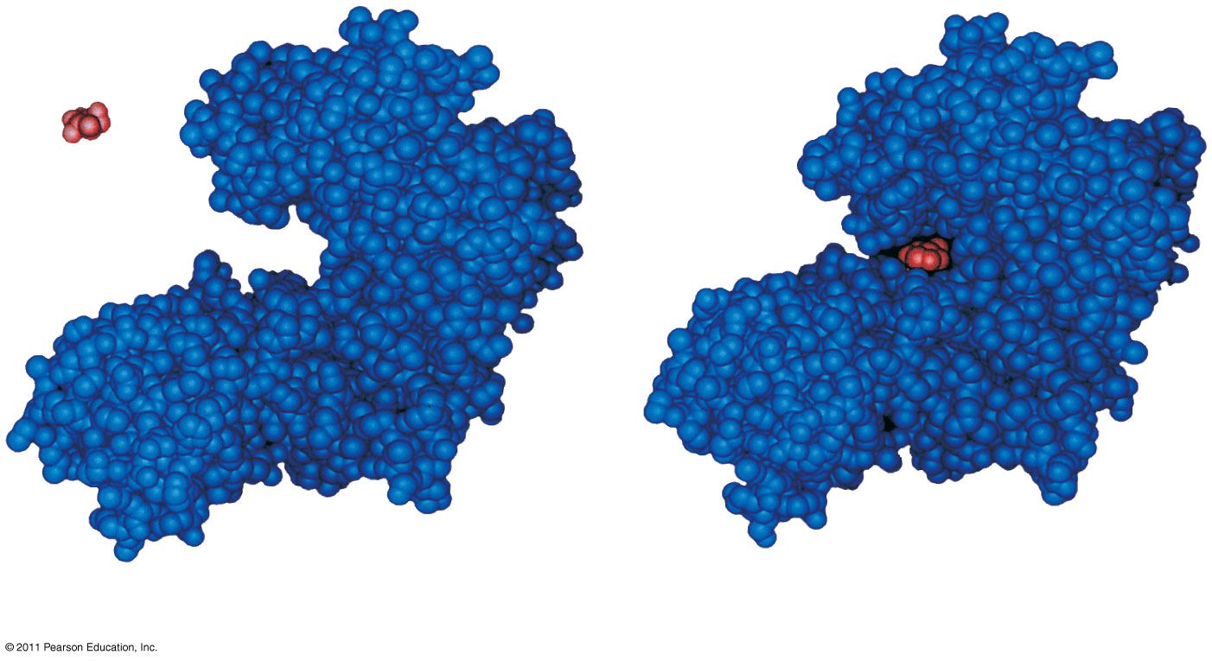
Figure 8.14
22
Substrate
Active site
Enzyme
Enzyme-substrate complex
(a)
(b)
Notes:
120
Figure 8.14 Induced fit between an enzyme and its substrate.

Slide 121
Catalysis in the Enzyme’s Active Site
In an enzymatic reaction, the substrate binds to the active site of the enzyme
The active site can lower an E_{A} barrier by
Orienting substrates correctly
Straining substrate bonds
Providing a favorable microenvironment
Covalently bonding to the substrate
© 2011 Pearson Education, Inc.

Slide 122
Effects of Local Conditions on Enzyme Activity
An enzyme’s activity can be affected by
General environmental factors, such as temperature, salt concentrations and pH
Chemicals that specifically influence the enzyme
Substrate availability: Enzymes need to have substrate to work, their concentrations in solution affect enzyme activity.
© 2011 Pearson Education, Inc.

Slide 123
Effects of Temperature and pH
Each enzyme has an optimal temperature in which it can function
Each enzyme has an optimal pH in which it can function
Optimal conditions favor the most active shape for the enzyme molecule
Remember: Change in Structure = Change in Function
© 2011 Pearson Education, Inc.

Slide 124
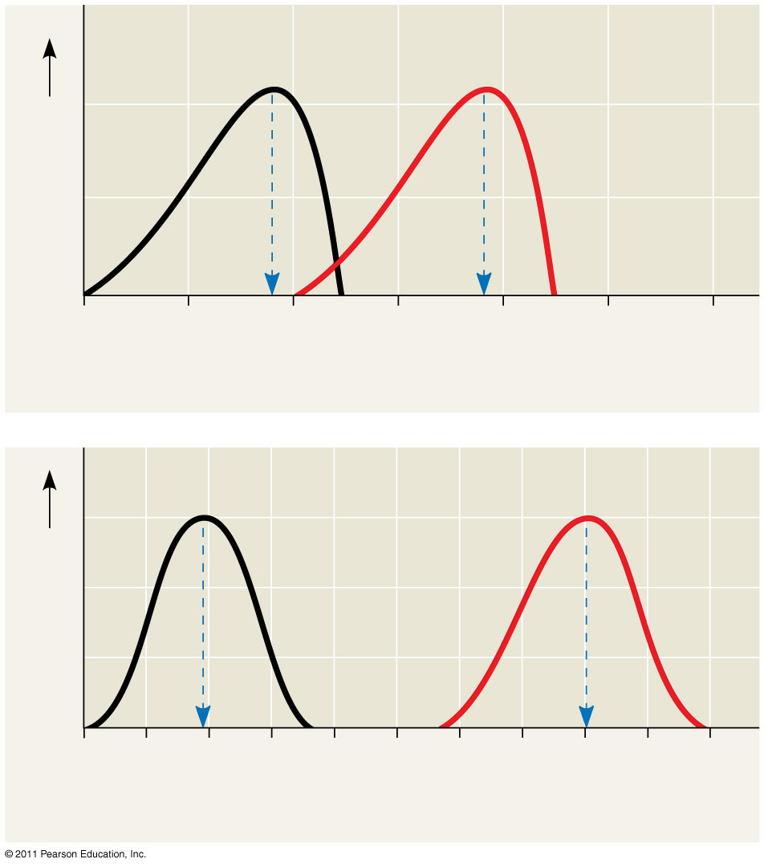
Figure 8.16
Optimal temperature for typical human enzyme (37°C)
Optimal temperature for enzyme of thermophilic (heat-tolerant) bacteria (77°C)
Rate of reaction
26
0
20
40
60
80
100
120
Temperature (°C)
(a) Optimal temperature for two enzymes
Optimal pH for pepsin (stomach enzyme)
Optimal pH for trypsin (intestinal enzyme)
Rate of reaction
0
1
2
3
4
5
6
7
8
9
10
pH
(b) Optimal pH for two enzymes
Notes:
124
Figure 8.16 Environmental factors affecting enzyme activity.

Slide 125
Cofactors
Cofactors are nonprotein enzyme helpers
Cofactors may be inorganic (such as a metal in ionic form) or organic
An organic cofactor is called a coenzyme
Coenzymes include vitamins (27)
© 2011 Pearson Education, Inc.

Slide 126
Enzyme Inhibitors
Competitive inhibitors bind to the active site of an enzyme, competing with the substrate
Noncompetitive inhibitors bind to another part of an enzyme, causing the enzyme to change shape and making the active site less effective
Examples of inhibitors include toxins, poisons, pesticides, and antibiotics
© 2011 Pearson Education, Inc.

Slide 127
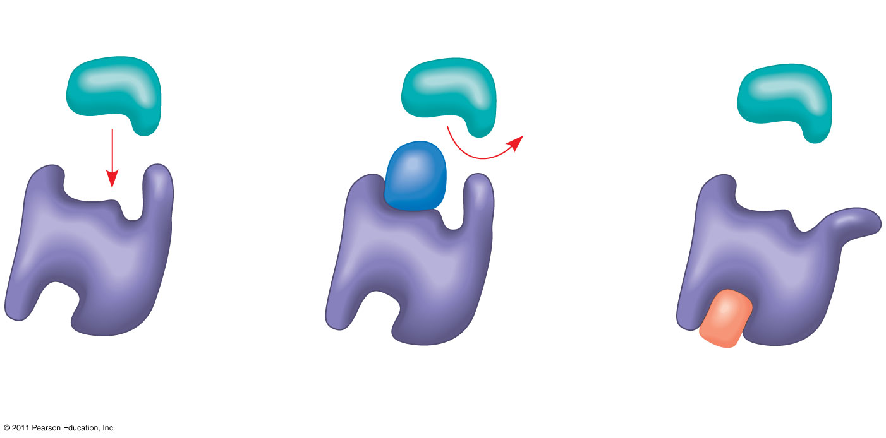
Figure 8.17
(a) Normal binding
(b) Competitive inhibition
(c) Noncompetitive inhibition
Substrate
Active site
Competitive inhibitor
Enzyme
Noncompetitive inhibitor
Notes:
127
Figure 8.17 Inhibition of enzyme activity.

Slide 128
Concept 5: Regulation of enzyme activity helps control metabolism
Chemical chaos would result if a cell’s metabolic pathways were not tightly regulated
A cell does this by switching on or off the genes that encode specific enzymes or by regulating the activity of enzymes
© 2011 Pearson Education, Inc.

Slide 129
Allosteric Regulation of Enzymes
Concept 5: Regulation of enzyme activity helps control metabolism
Allosteric regulation may either inhibit or stimulate an enzyme’s activity
Allosteric regulation occurs when a regulatory molecule binds to a protein at one site and affects the protein’s function at another site
© 2011 Pearson Education, Inc.

Slide 130
Allosteric Activation and Inhibition
Most allosterically regulated enzymes are made from polypeptide subunits
Each enzyme has active and inactive forms
The binding of an activator stabilizes the active form of the enzyme
The binding of an inhibitor stabilizes the inactive form of the enzyme
© 2011 Pearson Education, Inc.

Slide 131
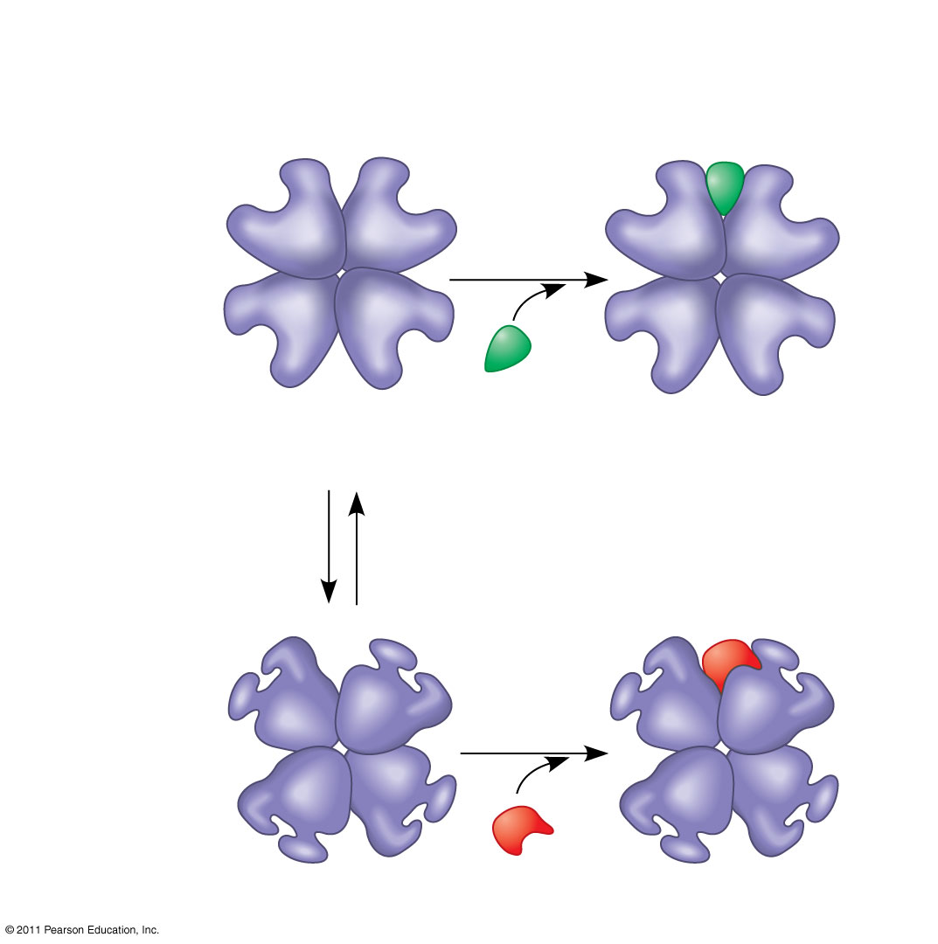
Figure 8.19a
(a) Allosteric activators and inhibitors
Allosteric enzyme with four subunits
Active site (one of four)
Regulatory site (one of four)
Activator
Active form
Stabilized active form
Oscillation
Nonfunctional active site
Inhibitor
Inactive form
Stabilized inactive form
Notes:
131
Figure 8.19 Allosteric regulation of enzyme activity.

Slide 132
Relevant FYIs
Allosteric regulators are attractive drug candidates for enzyme regulation because of their specificity
In eukaryotic cells, some enzymes reside in specific organelles; for example, enzymes for cellular respiration are located in mitochondria
© 2011 Pearson Education, Inc.

Slide 133
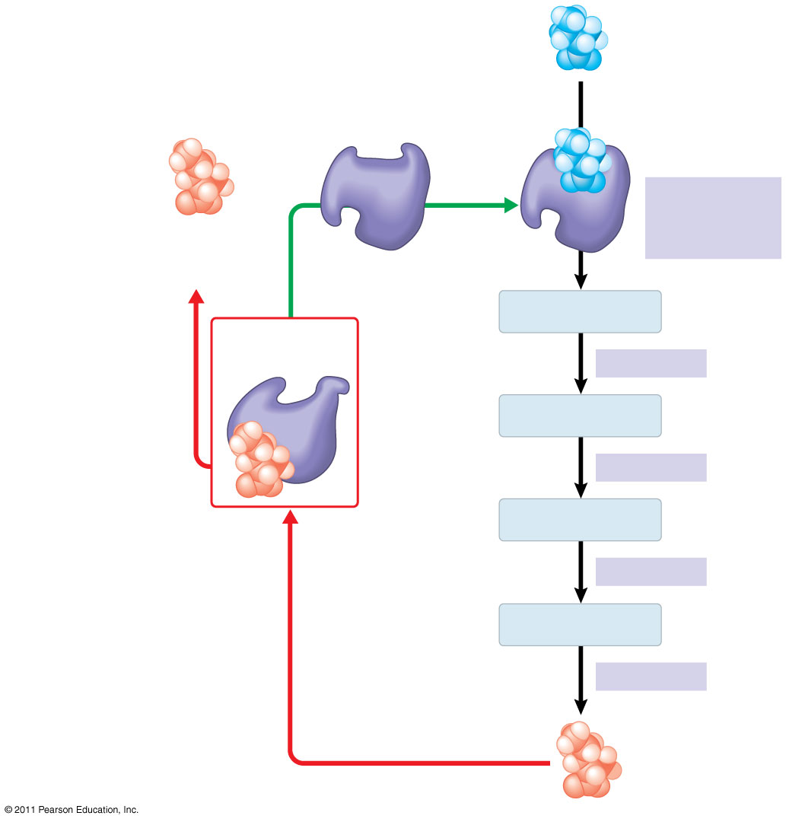
Figure 8.21
Initial substrate (threonine)
Active site available
Threonine in active site
Enzyme 1 (threonine deaminase)
Isoleucine used up by cell
Active site of enzyme 1 is no longer able to catalyze the conversion of threonine to intermediate A; pathway is switched off.
Intermediate A
Feedback inhibition
Enzyme 2
Intermediate B
Enzyme 3
Intermediate C
Isoleucine binds to allosteric site.
Enzyme 4
Intermediate D
Enzyme 5
End product (isoleucine)
Notes:
133
Figure 8.21 Feedback inhibition in isoleucine synthesis.

