Slide 1
Genomes & Their Evolution

Slide 2
Objectives
Discuss 2 approaches to genome sequencing
Identify advances in bioinformatics and their applications
Summarize what has been learned from the genomes that have been sequenced
Describe the composition of the human genome
Evaluate current ideas about how genomes evolve

Slide 3
Genomics
Over the last 10 years we have sequenced the entire genomes of many different organisms including
Humans
Chimpanzees (our closest biological relative)
Fruit flies
Corn
And many others
With the genomes of so many species fully sequenced, scientists can now study whole sets of genes and their interactions in an approach called genomics

Slide 4
Genomics & Bioinformatics
With the technologies to sequence and analyze genomes becoming more efficient and cost effective, we are generating more data than we can handle
Bioinformatics is the application of computational methods to the storage and analysis of biological data

Slide 5
Human genome project
Officially began in 1990 and involved 20 large sequencing centers spread throughout 6 countries
The sequencing was complete in 2003, and it took scientists another 3 years to analyze and describe each chromosome in a series of papers, the last of which was published in 2006
2 major approaches to genome sequencing
3 stage approach
Shotgun approach

Slide 6
3 stage approach to genome sequencing
1st construct a linkage map based on recombination frequencies
Ordering of genetic markers such as RFLPs, STRs and other polymorphisms (~200/chromosome)
2nd construct a physical map
Ordering of large overlapping fragments cloned in YAC and BAC vectors, followed by ordering of smaller fragments cloned in phage and plasmid vectors
3rd DNA Sequencing
Determining nucleotide sequences of each small fragment and assembly of partial sequences into the complete genome sequence

Slide 7
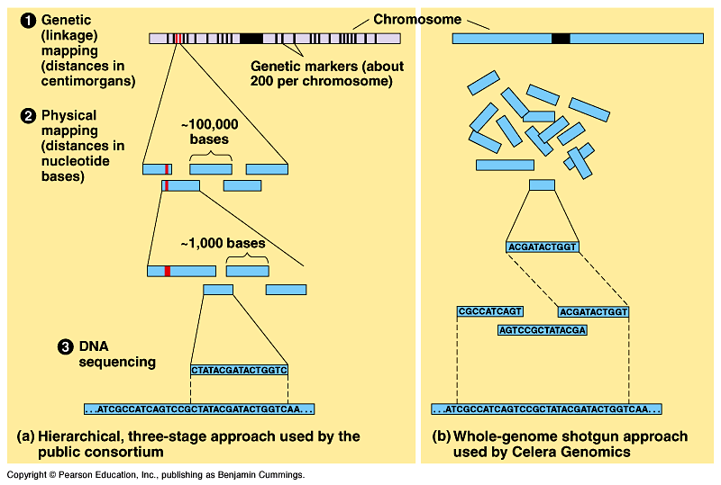

Slide 8
Shotgun approach to genome sequencing
Developed in 1992 by Craig Venter, who set up the company Celera Genomics in 1998
The shotgun approach essentially skips the linkage mapping and physical mapping stages and goes straight to direct sequencing of randomly cut fragments of DNA
Powerful computer programs then assemble the individual sequences into one continuous sequences
Venter claimed in 1998 that he’d sequence the entire human genome within 5 years

Slide 9
The $ of sequencing
The 1st human genome took 13 years an $100 million dollars
In 2007 James Watson had his genome sequenced within 4 months for $1 million dollars
In 2010 scientists were able to rapidly sequence an entire human genome for about $4,400
Life Technologies, based in Carlsbad, Calif., announced that it will debut a new sequencing machine this year that will eventually be capable of decoding entire human genomes in a day for less than $1,000.

Slide 10
metagenomics
Metagenomics is an approach in which DNA from a group of species is collected from an environmental sample and sequenced
Computer software then sorts out the partial sequences and assembles them into specific genomes
This has been used to try to source track microbial outbreaks in aquatic populations and identify the range of microbiota that constitute normal inhabitants of the human intestines

Slide 11
Bioinformatics
Volumes of DNA sequence data are being churned out every second of every day (about20000 bp’s/second)
Government officials began establishing banks of databases to store all this data, and to provide software scientists could use to analyze the data
The National Center for Biotechnology Information (NCBI) was born out of this, and maintains a website with extensive bioinformatic data
Several similar sites have been created by other counteries including China & Japan

Slide 12
NCBI
The NCBI database of sequences is called GenBank
includes about 119 million fragments of genomic DNA, and is updated daily doubling the amount of data it contains about every 18 months
Is available anywhere you have internet access
BLAST
A software program available through NCBI that allows you to compare DNA sequences with every sequence in the GenBank library, base by base
There’s another program that allows for comparisons of protein sequences
A 3rd program allows you to compare specific domains within proteins, looking only at specific stretches of amino acids, for which a function is known or suspected.
A 4th program allows you to compare nucleotide sequences or amino acid sequences, and diagram them in an evolutionary tree based on sequence relationships

Slide 13
Gene annotation
The process of identifying all protein coding genes in a sequence, and ultimately their functions, is called gene annotation
Its sort of a reverse genetics,
Traditional genetics, infer genotypes by studying phenotypes
Reverse genetics, learn the genotype and figure out what phenotype it imparts
Process has become largely automated, using software to scan stored sequences for
transcriptional and translational start and stop signals
RNA splice sites

Slide 14
proteomics
The identity of only about half of the human genes was known before the completion of the HGP
Clues about the identities of the other half came from comparing unknown human sequences to known sequences of other organisms whose function is well understood
Due to redundancy in the genetic code, however, the gene sequence itself may vary considerably more than the amino acid sequence of the protein
Proteomics is the approach in which scientists study and analyze entire proteomes (sets/ collections of proteins)

Slide 15
Applications to medicine
The Cancer Genome Atlas is an example of systems biology in which a large group of interacting genes and gene products are analyzed together
Aims to determine how changes in biological systems leads to cancer
A 3 year pilot project started in 2007 aimed to determine all the mutations in 3 common/ lethal types of cancer; lung, ovarian, and glioblastoma
It has been so successful in providing new targets for therapy that the project has been extended to include 10 other forms of cancer

Slide 16
Comparing Genomes
By 2010 about 1,200 genomes had been completely sequenced
1000 from Eubacteria
80 from Archaebacteria
124 eukaryotic species consisting of the Domain Eukarya
some animals (vertebrates and invertebrates)
Plants
Protists
Fungi
Genomes vary in size, number of genes, and gene density

Slide 17
Genome size
Most bacterial genomes (from eubacteria and archea) are much smaller than those of eukaryotes
E. coli bacteria ~ 4.6Mb
Yeast (single celled eukaryote) ~100Mb
Fruit flies ~ 165 Mb
Humans ~ 3,000Mb
Despite these general differences, comparisons of eukaryotic genome fails to reveal any systematic relationship between genome size and phenotype
Polychaos dubia (a single celled amoeba) has about ~670,000Mb
A particular flowering plant has 124,000 MB
Both considerably larger than a human genome, but with less complex phenotypes

Slide 18
Number of genes
Bacteria & Archaea generally have fewer genes than eukaryotes
Free living prokaryotes typicallly have between 1,500-7,500 genes
Eukaryotes have between
~5,000 genes for unicellular fungi
Upwards of ~40,000 genes for some multicellular eukaryotes
Humans have ~21,000 genes at the best count made in 2010
We get more bang for our genetic buck by engaging in alternative splicing of RNA transcripts
A typical human gene contains about 10 exons
Its estimated that 93% of these multi exon genes are spliced in at least 2 different forms
Some genes are expressed in hundreds of alternatively spliced forms
Additional polypeptide diversity can be accounted for through post-translational modifications

Slide 19
Gene density & noncoding dna
Gene density refers to how many genes are there in a given length of DNA
Eukaryotes have larger, but less dense genomes
Most of our genome does not code for protein
We have both introns and exons
We have many regulatory sequences
In other words, our genes are more spread out
Prokaryotes have very little noncoding DNA, and so their chromosomes are very gene-dense
most of their DNA codes for protein, rRNA, or tRNA
They don’t have introns, only exons

Slide 20
Organization of the Eukaryotic genome
The bulk of eukaryotic genomes consists of DNA that neither codes for proteins nor transcribes RNAs with known functions
This DNA used to be known as “junk DNA” however evidence is accumulating that it plays important roles in cells, supported by its persistence in diverse genomes over many hundereds of generations
Example: comparing mice, rats, humans
There are over 500 regions of noncoding DNA that are identical between all 3 species
This is a higher level of sequence conservation than seen in proteni coding genes
There must be a selective advantage to maintaining these sequences within the genomes

Slide 21
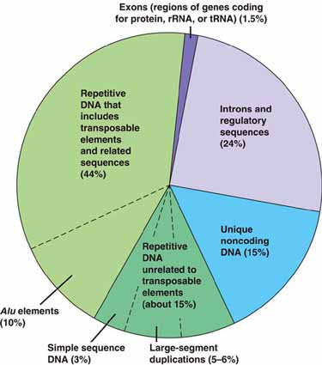
Types of DNA Sequences in the Human genome

Slide 22
Noncoding DNA
Sequences that code for protein or tRNA or rRNA account for only 1.5% of the human genome
Gene related regulatory sequences account for only 5% of the human genome
Introns account for only 20%
The other roughly 75% of the human genome is made up of various types of noncoding DNA including
Pseudogenes: former genes that have accumulated mutations and no longer produce functional protein (about 15%)
Repetitive DNA: consists of sequences that are present in multiple copies
About 60% of the genome is repetitive
75% of this is made up of units called transposable elements

Slide 23
Transposable elements
Transposable elements are stretches of DNA that can move from one location to another within the genome in a process called transposition
Both prokaryotes and eukaryotes have transposable elements
Transposable elements are sometimes called “jumping genes”
During transposition, a transposable element moves from one site in a cells DNA to a target site through a type of recombination
Discovered in the 1940s by Barbara McClintock who was studying changes in corn kernel color through multiple generations
People didn’t believe her for a long time
She received the Nobel Prize in 1983 for this discovery

Slide 24
Types of Transposable elements
More Common in Eukaryotic Genomes
Transposons
Retrotransposons
Move within the genome by means of a DNA intermediate
Requires the enzyme transposase
Moves through either:
A cut and paste mechanism
OR
A copy and paste mechanism
Move by means of an RNA intermediate that is a transcript of the retrotransposon DNA
Always leave a copy at the original site within the genome
Must be converted back to DNA through reverse transcriptase
A 2nd enzyme catalyzes insertion into the genome

Slide 25
Sequences related to transposable elements
Transposable elements and sequences related to them make up 25-50% of most mammalian genomes, and higher percentages in amphibians and plants
up to 85% in certain corn genomes
Sequences related to transposable elements include the genes that code for the enzymes that do the cutting, copying, pasting, and reverse transcribing
In primates (including humans) about 10% of our genome is made up of a transposable element known as the Alu elements
Alu elements are only about 300 nucleotides long
They code for RNA, but not protein
The function of Alu RNA is currently unknown

Slide 26
Other repetitive dna
Repetitive DNA that is not related to transposable elements probably arises from mistakes in DNA replication or recombination
This DNA accounts for about 14% of the human genome
Simple Sequence DNA: contains many copies of tandemly repeated short sequences
GTTACGTTACGTTACGTTACGTTACGTTAC

Slide 27
Simple Sequence DNA
Repeats may contain as few as 2 nucleotides or as many as 500
When the unit contains between 2-5 nucleotides its referred to as a Short Tandem Repeat (STR)
The number of times the unit is repeated varies from person to person, and so is used in paternity testing and criminal investigations
Much simple sequence DNA is located near telomeres and centromers suggesting a structural role

Slide 28
Genes & multigene families
Less than half of all eukaryotic genes are present in only 1 copy per haploid set
This means many genes are present as collections of 2 or more identical or very similar genes known as a Multigene Family
Genes within a multigene family are usually clustered tandemly
Most (except for those that code for histone proteins) have RNA’s as their final product
Example: The 3 largest rRNA molecules exist as a multigene family
Theyre transcribed as a single transcriptional unit repeated tandemly hundereds or thousands of times
Helps make millions of ribosomes very fast and efficiently

Slide 29
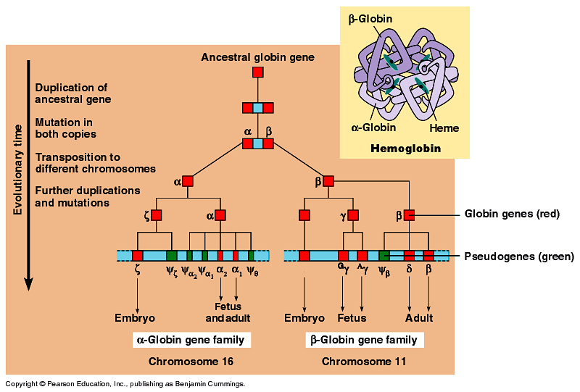
Multigene families & Hemoglobin
The classic example of multigene families of nonidentical genes encode the globins
One family located on chromosome 16 in humans codes various forms of α globin
Another family located on chromosome 11 encodes various forms of βglobin

Slide 30
Genome Evolution
The basis of change at the genetic level is mutation, which underlies much of genome evolution
Its likely that early forms of life had a minimum number of genes, only those necessary for survival and reproduction
This implies a mechanism for increasing the size of the genome, with this new extra genetic material providing raw material for gene diversification
Its now believed that gene duplication, rearrangement, and mutation contribute to genome evolution

Slide 31
Duplication of entire chromosome sets
Accidents in meiosis can result in 1 or more extra sets of chromosomes (polyploidy)
Most of these would be lethal, but in rare cases could facilitate the evolution of genes
In a polyploid organism, one set of genes can provide essential functions of the organism, while the other is free to accumulate mutations and diverge
These mutations can persist if the organism successfully reproduces allowing genes with novel functions to evolve over time

Slide 32
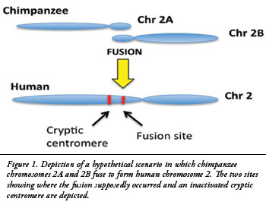
Alterations of chromosome structure
Scientists have long known that over the course of evolution, chromosomes sometimes fuse so that a modern species may have fewer (albeit larger) chromosomes than an ancestor
Example, scientists have determined that the human chromosome number 2 stems from a fusion of chromosomes 12 & 13 in an ancestor that gave rise to both the chimp and the human
Duplications and inversions of large portions of chromosomes thought to contribute to the generation of new species

Slide 33
Duplication: Errors during meiosis can also lead to duplications of chromosomal regions
Template Slippage
Unequal Crossing Over
Slippage can also occur during DNA replication such that the template shifts with respect to the new complementary strand
This can cause part of the template to be skipped leading to a deletion, or part of the template to be copied twice leading to a duplication
Unequal crossing over during prophase I can result in 1 chromosome with a deletion, and the other with a duplication of a particular gene
Additionally, transposable elements can provide homologous sites where nonsister chromatids can cross over in areas where chromatids aren’t correctly aligned

Slide 34
Evolution of Genes With related functions
Duplication events can lead to the evolution of genes with related functions, such as those of the α-globin and β-globin gene families
A comparison of gene sequences within multigene families can suggest the order in which the genes arose
This approach suggests they all evolved from one ancestral globin gene that underwent duplication and divergence into the α-globin and β-globin ancestral genes about 450-500 million years ago
Each of these was later duplicated several times, and the copies then diverged from each other yielding the current gene families
This ancestral gene also gave rise to the oxygen binding muscle protein called myoglobin

Slide 35
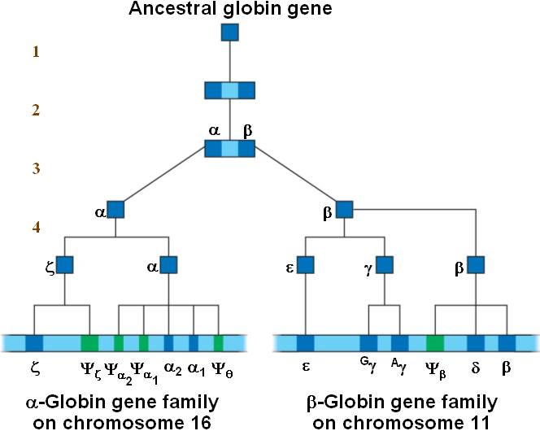
Model for the evolution of the human globin gene families from a single ancestral globin gene

Slide 36
Evolution of the Globin gene family
Differences between genes of the globin gene families would arise as mutations accumulate over time
Mutations that lead to increased affinity for binding oxygen would impart and advantage on the organism increasing survival and reproduction, allowing natural selection to propagate the mutation within the population
The similarity between the globin gene families supports this hypothesis
Additionally, there are several pseudogenes among the functional globin genes that provides additional evidence for the evolution of the globin genes from a common ancestral gene

Slide 37
Exon Duplication & exon shuffling
Rearrangement of genes or parts of genes may also have contributed to evolution
The presence of introns in most eukaryotic genes facilitate duplication and rearrangement of exons in the genome
Exons typically code for a domain, a distinct structural or functional part of a protein
Duplicating or deleting a particular exon would then, in turn modify protein structure and function.
Duplication can often enhance a proteins ability to do its job by increasing its affinity for ligand
Exon shuffling: Occasionally, you can have mixing and matching of exons within one gene or even between different genes due to errors in meiotic recombination

Slide 38
Transposable elements & genome evolution
The persistence of transposable elements in genomes is consistent with its important role in shaping genome evolution over time by
Transposable elements help shape genome evolution by
Promoting recombination:
transposable elements scattered throughout the genome provide homologous regions for crossing over
Most are probably detrimental
Disrupting cellular genes or their control elements
Can prevent transcription of a normal treanscript if it inserts into the middle of it (as in McClintocks corn kernels)
If it inserts into a regulatory region it can increase or decrease expression of a gene
Carrying entire genes or individual exons to new locations
Explaining why the α-globin & β-globin genes are located on different chromosomes even though they arose from a common ancestral gene
Facilitates exon shuffling between different genes

Slide 39
Comparing genome sequences
The more similar in sequence the genes and genomes of different species are, the more closely related those species are in their evolutionary
Comparing genomes of closely related species sheds light on more recent evolutionary events, whereas comparing genomes of very distantly related species history helps us understand ancient history

Slide 40
Comparing genome sequences
Distantly Related Species
Closely Related Species
Determining which genes have remained similar, or are highly conserved, helps clarify evolutionary relationships
Additionally, these comparative genomes studies confirms the relevance of researching model organisms
Knowing the genome sequence of one species accelerates the mapping of genomes of closely related species
We can trace some of the genetic mutations that caused us to evolve into humans vs chimps from our common ancestor about 6 million years ago

Slide 41
Genome evolution: human vs chimp
Human differs from chimp DNA by only 1.2%, with a further 2.7% due to insertions or deletions in one species but not the other
There are a number of genes that are evolving faster in humans than in chimps or other mammals for that matter
Genes involved in defense against malaria & tuberculosis
At least 1 gene that regulates brain size
When classified by function, the genes that are evolving the fastest are transcription factors
FOXP2 is a human transcription factor showing rapid evolution
Seems to function in vocalization in vertebrates
Mutations in this gene produce severe speech and language impairment in humans
Gene is also expressed in song birds at the precise times they’re learning their songs

Slide 42
Its about to get sci-fi in here!
If you knockout the FOXP2 gene in mice totally, they have malformed brains
If you knockout 1 copy of the FOXP2 gene in mice, they cant vocalize appropriately
So what do we do, replace the mouse copy of FOXP2 with a human copy to see what happens!
This produces healthy mice
with slightly different vocalizations than a normal mouse
When you look at their brains they showed changes in brain cells in circuits consistent with those that produce human speech

Slide 43
comparing genomes within a species
Comparing genomes within a species allows us to understand the range o genetic variations between individual members of the human population
Humans have only been around for about 200,000 years, and so there is little variation between our members
Much of our diversity seems to be in the form of Single Nucleotide Polymorphisms (SNPs)
There’s about 1 SNP in every 100-300 bases
Copy-Number Variants (CNVs)
Loci where some individuals have one or multiple copies of a particular gene or genetic region, rather than the standard 2
Result from duplications or deletions
Make up 13% of the genes in the genome
More likely to have phenotypic consequences than SNPs

Slide 44
Evo-Devo
Biologists in the field of evolutionary developmental biology compare the developmental processes of different multicellular organisms
They try to understand how these processes have evolved and how changes in them can modify existing organismal features or lead to new ones
We are beginning to realize that the genomes of related species with strikingly different forms may have only minor differences in in gene sequence or regulation

Slide 45
Homeotic genes & the homeobox
There is widespread conservation of developmental genes among animals
Remember from ch18 that homeotic genes are responsible for body segmentation in drosophila
Molecular analysis of homeotic genes show that they all include a 180-nucleotide sequence called the homeobox
Specifies a particular domain 670 amino acids long in its protein called the homeodomain
This domain has ben identified in the homeotic genes of most animals, vertebrates and invertebrates alike
Resemblance of these genes between species even extends to the organization of the genes on chromosomes
Homeobox containing sequences have even been found in such distantly related organisms as plants and yeast

Slide 46
Hox genes
Homeotic genes in animals were named Hox genes short for Homeobox-containing genes
Researchers have discovered that homeobox encoded homeodomain is the part of the protein that binds DNA when the protein functions as a transcriptional regulator
The shape of the homeodomain allows it to bind any DNA segment (in other words, its not sequence specific)
These proteins regulate development by coordinating transcription of many developmental genes at once

Slide 47
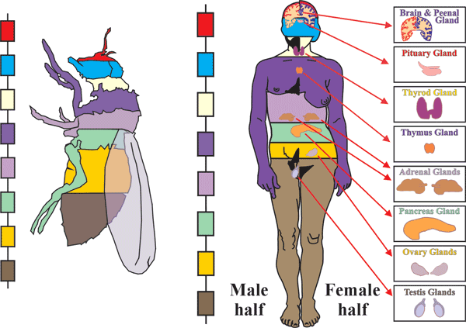
Conservation of homeotic genes in a fruit fly and a human

Slide 48
How can the same genes be involved in the development of animals whose forms are so different
In some cases, small changes in regulatory sequences of particular genes that cause changes in gene expression patterns that can lead to major changes in body form
Similar genes may direct differing developmental processes in different organisms, resulting in different body shapes
Some research suggests that the same Hox gene product may have subtly different effects in different species
Turning on new genes
Turning on the same genes at different levels

