Slide 1
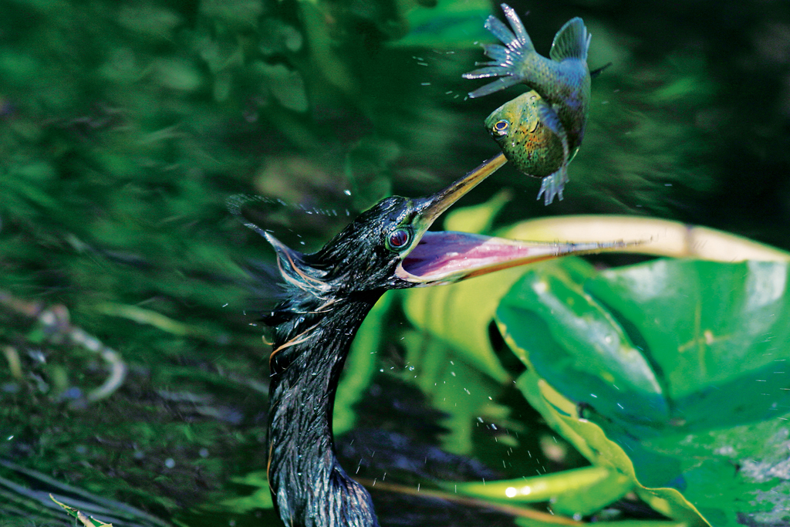
KEY CONCEPT Ecology is the study of the relationships among organisms and their environment.

Slide 2
Objectives
Summarize the levels of organization that an ecologist studies
Identify biotic and abiotic factors in an ecosystem
Describe how a change in 1 factor in an ecosystem can affect others

Slide 3
Vocabulary
Section 3.1
Section 3.2
Biosphere
Species
Population
Community
Ecology
Ecosystem
Biome
Biotic factor
Abiotic factor
Keystone species
Autotroph
Primary producer
Photosynthesis
Chemosynthesis
Heterotroph
Consumer
Carnivore
Herbivore
Omnivore
Decomposer
Detritivore

Slide 4
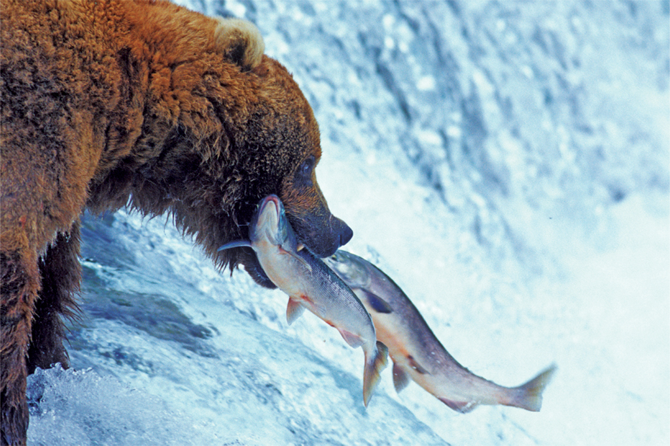
Ecologists study environments at different levels of organization.
Ecology is the study of the interactions among living things, and between living things and their surroundings.

Slide 5
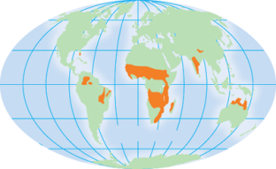
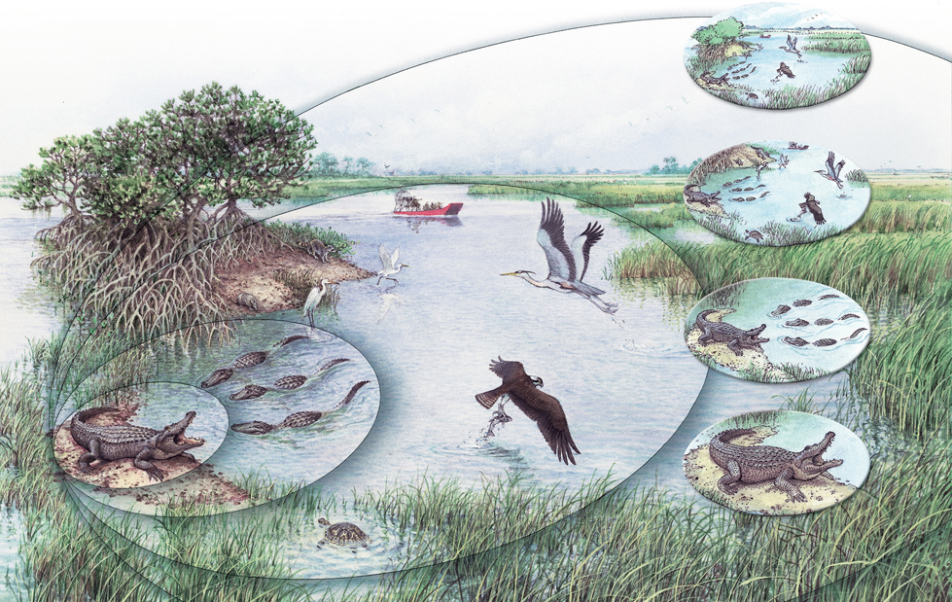
An organism is an individual living thing, such as an alligator.
Organism
Organism

Slide 6
A population is a group of the same species that lives in one area.
Population
Population
Organism
Organism

Slide 7
A community is a group of different species that live together in one area.
Community
Community
Population
Population
Organism
Organism

Slide 8
An ecosystem includes all of the organisms as well as the climate, soil, water, rocks and other nonliving things in a given area.
Ecosystem
Ecosystem
Community
Community
Population
Population
Organism
Organism

Slide 9
A biome is a major regional or global community of organisms characterized by the climate conditions and plant communities that thrive there.
Biome
Ecosystem
Ecosystem
Community
Community
Population
Population
Organism
Organism

Slide 10
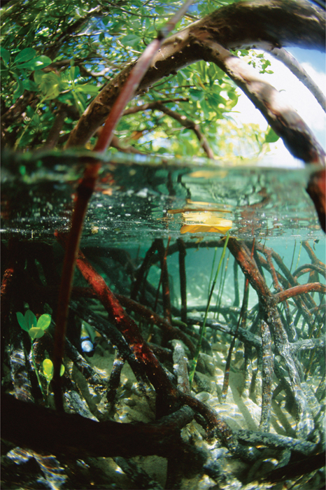
An ecosystem includes both biotic and abiotic factors.
Biotic factors are living things.
Plants
Animals
Fungi
Bacteria
plants

Slide 11
Abiotic factors are nonliving things.
moisture
temperature
wind
sunlight
soil
sunlight
moisture

Slide 12
Changing one factor in an ecosystem can affect many other factors.
Biodiversity is the assortment, or variety, of living things in an ecosystem.
Rain forests have more biodiversity than other locations in the world, but are threatened by human activities.

Slide 13
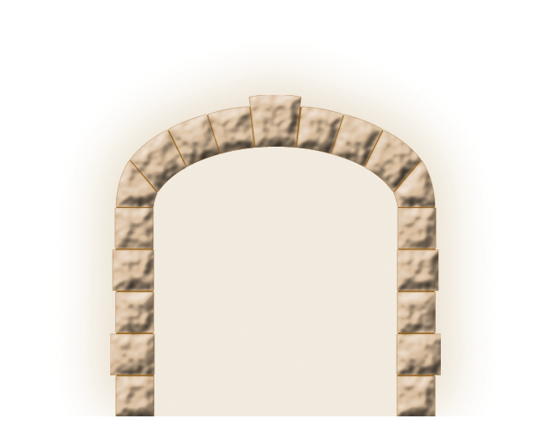
A keystone species is a species that has an unusually large effect on its ecosystem.
keystone

Slide 14
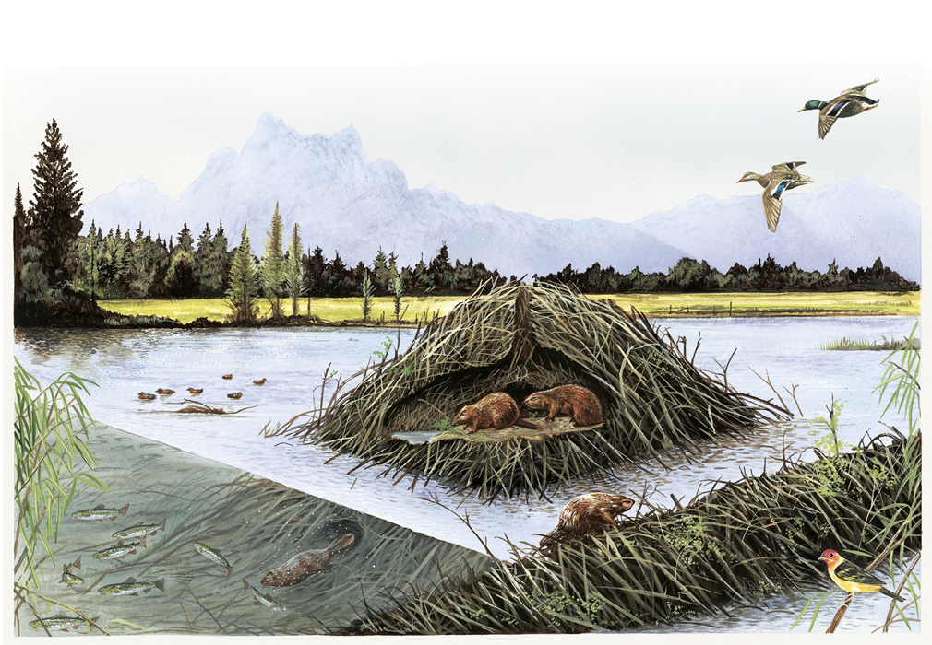
Keystone species form and maintain a complex web of life.
creation of
wetland
ecosystem
increased waterfowl
Population
keystone species
increased fish
population
nesting sites for birds

Slide 15
1) Assessment: What are the 5 different levels of organization studied by ecologists?
Organism
Population
Community
Ecosystem
Biome
Smallest/ most specific
Largest/ most broad

Slide 16
2) Assessment: How do the principles of Ecology relate to understanding how adaptations occur?
Species are adapted to their environments.
This concept is directly related to the study of ecology, in which the interactions between organisms and the environment are studied
By understanding the interactions within an ecosystem, scientists can develop an understanding of how populations evolve in response to their environments

Slide 17
3) Assessment: Describe the biotic and abiotic factors that exist in the Lake Michigan ecosystem.
Biotic
Abiotic

Slide 18
4) Assessment: How would the removal of a keystone species affect biodiversity?
Removal of a keystone species would decrease biodiversity

Slide 19
5) Assessment: explain how a change in an abiotic factor such as sunlight would affect biodiversity
Changes in the amount of sunlight might affect local temperatures, leading to a change in the number and types of species that live in the ecosystem
New species may move into the area, taking the place of those that cannot survive

Slide 20
6) Assessment: Humans are sometimes described as being a keystone species. Does this label fit? Why or why not?
Keystone species are those that help to establish and maintain complex web of life.
Humans do NOT fit this label because human activities often decreas, rather than increase biodiversity

Slide 21
7) Assessment: What role might an abiotic factor such as temperature play in the evolution of a species?
A long term temperature change could result in selective pressure that selects for individuals that are better adapted to the new temperature, causing populations to evolve.
Temperature changes could alter the types of food available, again creating selective pressure towards individuals that can take advantage of the different food sources.

Slide 22
KEY CONCEPT Life in an ecosystem requires a source of energy.

Slide 23
Objectives
Describe the roles of producers and consumers in ecosystems
Compare photosynthesis to chemosynthesis

Slide 24
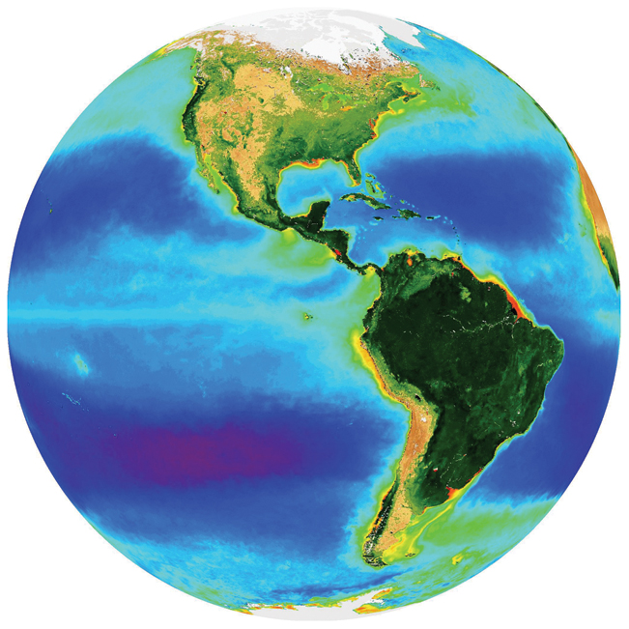
Producers provide energy for other organisms in an ecosystem.
Producers get their energy from non-living resources.
Producers are also called autotrophs because they make their own food.

Slide 25
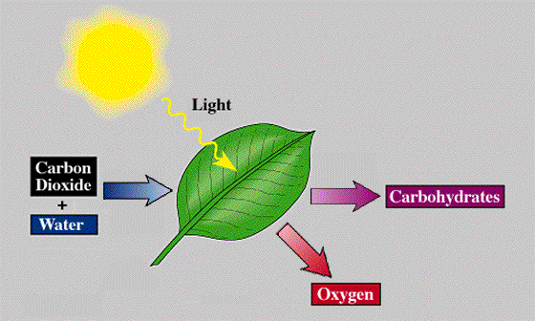
Almost all producers obtain energy from sunlight
Photosynthesis in most producers is the process by which light energy is captured and used to power chemical reactions that convert carbon dioxide and water into carbohydrates and oxygen

Slide 26
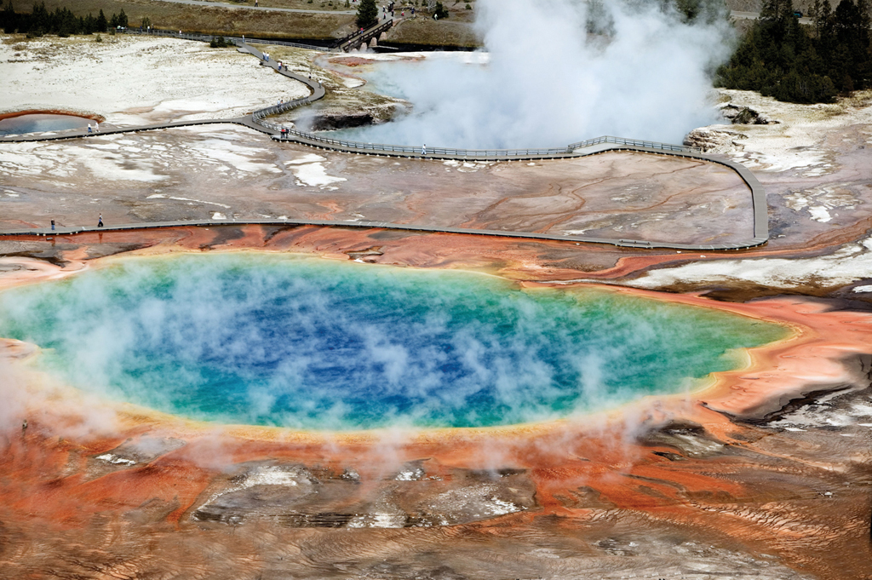
Life without Light
Chemosynthesis in prokaryote producers uses chemicals as an energy source to produce carbohydrates
Chemosynthetic bacteria live in harsh environments like near deep sea volcanic vents and hot springs
carbon dioxide + water +hydrogen sulfide + oxygen → sugar + sulfuric acid

Slide 27
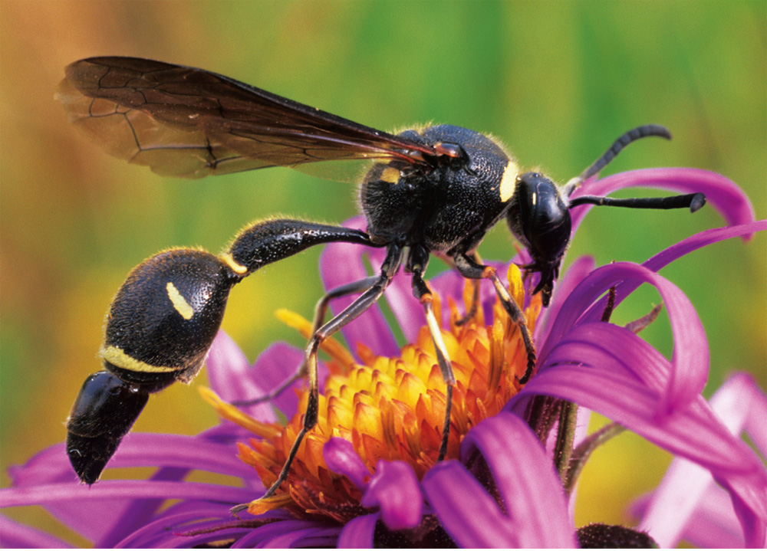
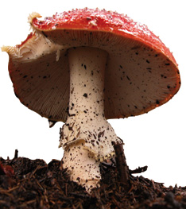
Producers provide energy for other organisms in an ecosystem.
Consumers are organisms that get their energy by eating other living or once-living resources.
Consumers are also called heterotrophs because they feed off of different things.

Slide 28
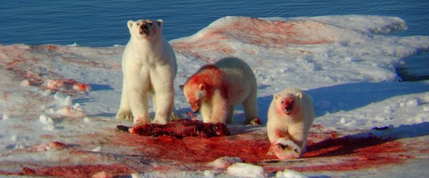
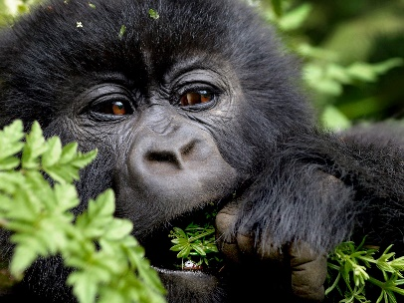
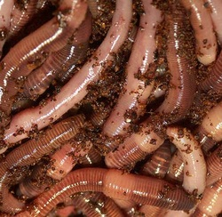
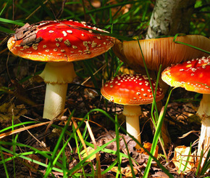
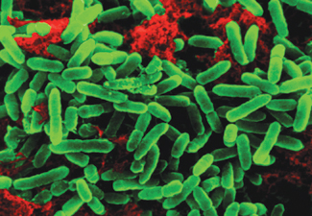
Types of Consumers
Scavengers: animals that consume the carcass of other animals that have been killed by predators or died of other causes
Carnivores: kill and eat other animals
Omnivores: animals whose diets naturally include a variety of different foods including both plants and animals
Herbivores : eat only plants
Detritivores: feed on pieces of dead plants or animals, chewing on them and grinding them into smaller pieces
Decomposers: bacteria and fungi “feed” by chemically breaking down organic matter

Slide 29
1) Assessment: How does the stability of an ecosystem depend on its producers?
Producers bring energy into an ecosystem

Slide 30
2) Assessment: What are the 2 processes used by producers to obtain energy?
Photosynthesis & Chemosynthesis

Slide 31
3) Assessment: Few producers live deep below a lakes surface. Suggest an explanation for this pattern
Sunlight cannot penetrate the water to a great depth, so photosynthesizing organisms are more common near the surface

Slide 32
4) Assessment: could producers survive without consumers? Explain why or why not.
Producers do not require consumers to fill material needs as a food source. So, in that sense, produces do not need consumers to survive.

Slide 33
5) Assessment: How might chemosynthetic organisms help scientists to understand how life evolved?
Chemosynthetic organisms live in environments that may be similar to those that existed on Earth billions of years ago , when life was beginning to develop.
Studying these organisms enables scientists to infer how different life forms may have evolved as Earth changed

Slide 34
KEY CONCEPT Food chains and food webs model the flow of energy in an ecosystem.

Slide 35
Objectives
Describe the structure of a food chain
Explain how food chains and trophic levels are related
Analyze feeding relationships in a food web

Slide 36
Chapter 3.3 Vocabulary
Food chain
Food web
Zooplankton
Phytoplankton
Trophic level
Ecological pyramid
Biomass
Specialist

Slide 37
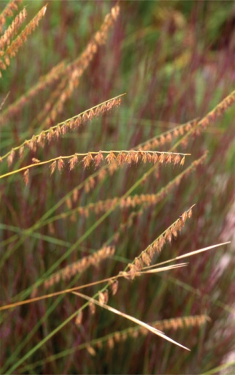
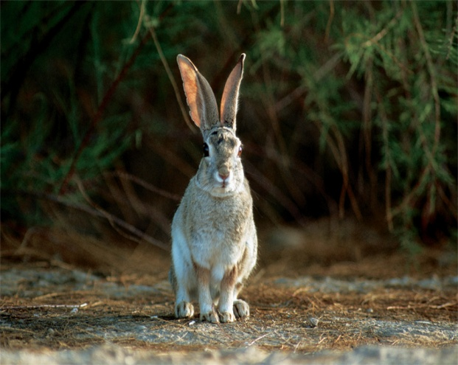
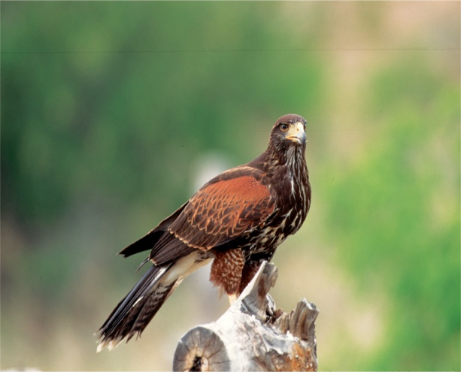
A food chain is a model that shows a sequence of feeding relationships.
A food chain links species by their feeding relationships.
A food chain follows the connection between one producer and a single chain of consumers within an ecosystem.
GRAMA GRASS
DESERT COTTONTAIL
HARRIS’S HAWK

Slide 38
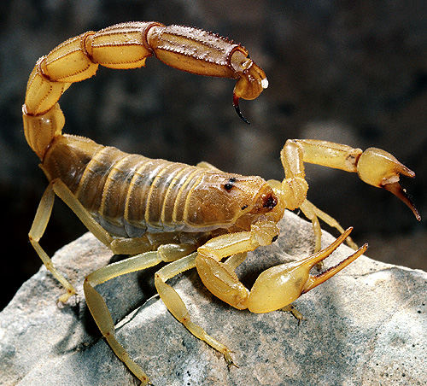
Consumers are not all alike.
Herbivores eat only plants.
Carnivores eat only animals.
Omnivores eat both plants and animals.
Detritivores eat dead organic matter.
Decomposers are detritivores that break down organic matter into simpler compounds.
carnivore
decomposer

Slide 39
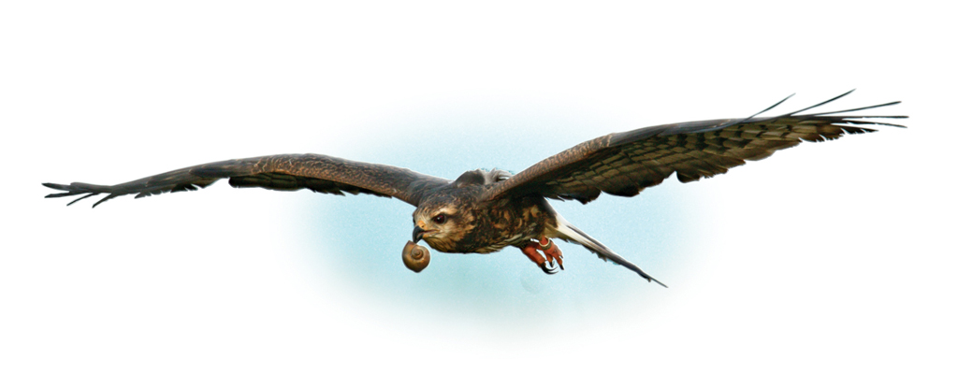
Specialists are consumers that primarily eat one specific organism or a very small number of organisms.
Generalists are consumers that have a varying diet.

Slide 40
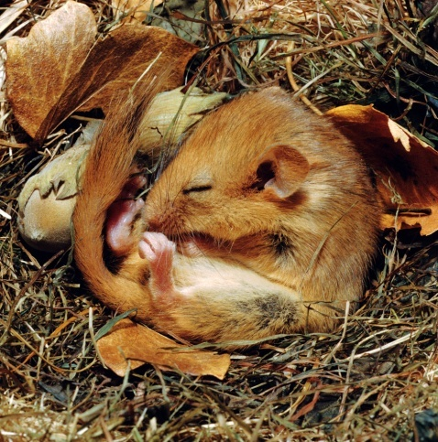
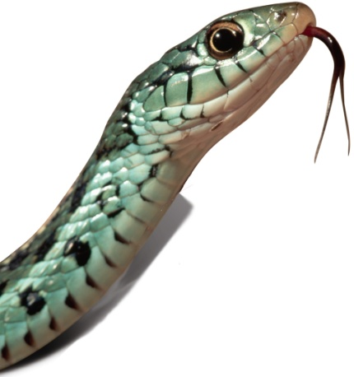
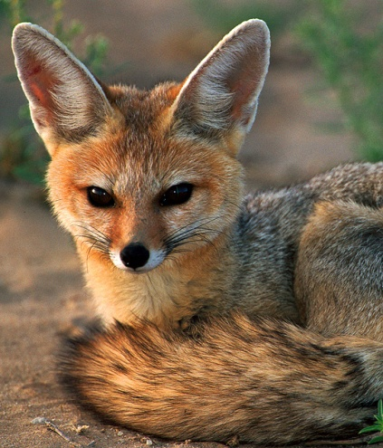
Trophic levels are the nourishment levels in a food chain.
Primary consumers are herbivores that eat producers.
Secondary consumers are carnivores that eat herbivores.
Tertiary consumers are carnivores that eat secondary consumers.
Omnivores, such as humans that eat both plants and animals, may be listed at different trophic levels in different food chains.

Slide 41
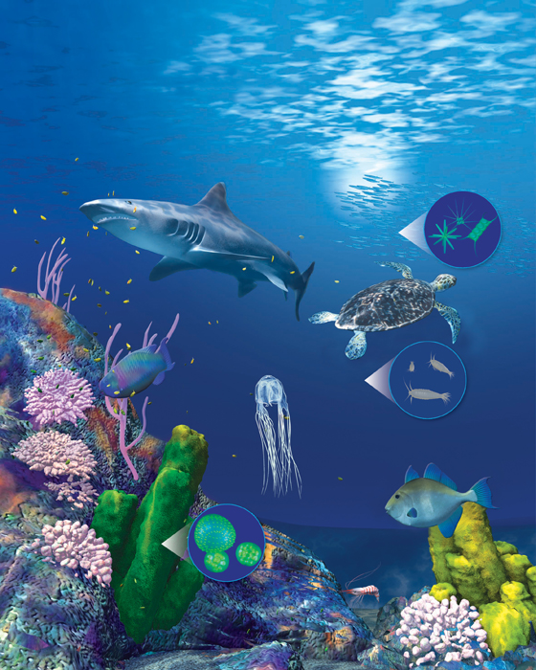
A food web shows a complex network of feeding relationships.
An organism may have multiple feeding relationships in an ecosystem.
A food web emphasizes complicated feeding relationships and energy flow in an ecosystem.
Plankton make up the foundation of aquatic food chains
Phytoplankton: plankton like algae that do photosynthesis
Zooplankton: very small swimming animals like krill or fish eggs

Slide 42
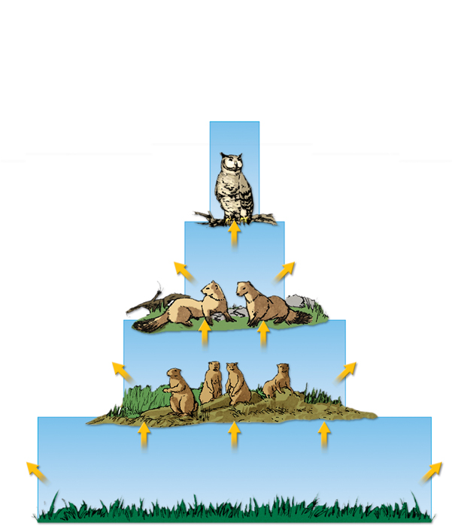
An energy pyramid shows the distribution of energy among trophic levels.
Energy pyramids compare energy used by producers and other organisms on trophic levels.
Between each tier of an energy pyramid, up to 90 percent of the energy is lost into the atmosphere as heat.
Only 10 percent of the energy at each tier is transferred from one trophic level to the next.
energy
lost
energy transferred

Slide 43
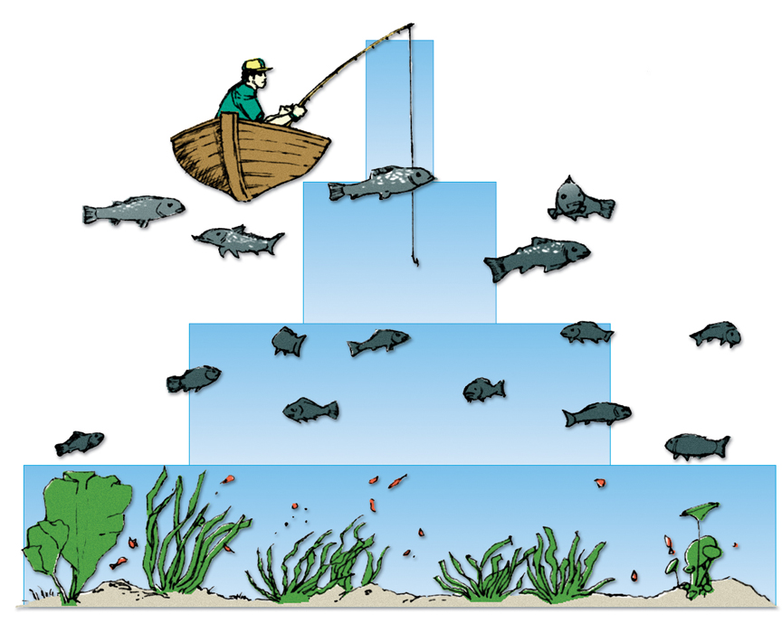
Other pyramid models illustrate an ecosystem’s biomass and distribution of organisms.
Biomass is a measure of the total dry mass of organisms in a given area.
A pyramid of biomass illustrates the relative amount of living organic matter available at each trophic level
tertiary
consumers
75 g/m2
150g/m2
secondary
consumers
primary
consumers
675g/m2
2000g/m2
producers
2000g/m2
producers

Slide 44
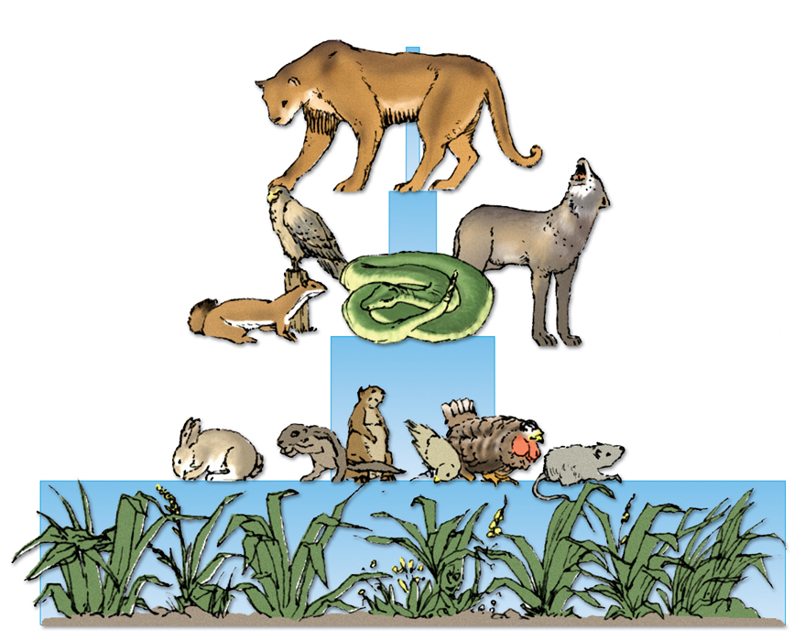
A pyramid of numbers shows the numbers of individual organisms at each trophic level in an ecosystem.
tertiary
consumers
5
secondary
consumers
5000
primary
consumers
500,000
producers
5,000,000
producers
5,000,000
A vast number of producers are required to support even a few top level consumers.

Slide 45
1) Assessment: Why are food chains especially useful for describing the relationships of specialists?
Specialists have specific diets that include only 1 type of organism, which produces a simple food chain

Slide 46
2) Assessment: what happens to energy as it flows through an ecosystem?
Some energy is stored in the organism, but much of the energy is dissipated (lost) to the environment, usually in the form of heat

Slide 47
3) Assessment: Only a small percentage of all consumers are specialists. What danger does a specialist face that a generalist does not?
If a specialists food source becomes scarce or disappears, the population may die out.
A generalist facing the loss of one of its food sources can shift to a different food source.

Slide 48
4) Assessment: how might the stability of an ecosystem be affected if all its decomposers were suddenly removed?
The stability of the ecosystem would be negatively affected because without decomposers, vital nutrients would not be returned to the environment
In general any decrease in biodiversity leads to instability of the ecosystem

Slide 49
5) Assessment: Why is a herbivorous diet more energy efficient than a carnivorous one? Explain.
A herbivorous diet is more energy efficient because it is the closest trophic level to the producers, meaning there is more available energy to use.

Slide 50
6) Assessment: how might an oil spill in the ocean affect an aquatic food web? What might happen to the food web on the land located near the oil spill? Explain.
The entire food web would be affected by an oil spill
Oily water may kill off the phytoplankton
The loss of smaller fish would affect the larger fish, which would, in turn, affect tertiary consumers.
Plants and animals that live along the coast would also be affected as oil seeped onto the shore.
The overall affect would be a decline in the availability of food sources both within and outside the ocean, and so a loss of biodiversity

Slide 51
7) Assessment: how does an energy pyramid help to describe energy flow in a food web?
An energy pyramid shows the relative contribution to energy flow made by each trophic level in an ecosystem

Slide 52
8) Assessment: What is the difference between a biomass pyramid and a pyramid of numbers?
A biomass pyramid compares the mass of organisms that make up each trophic level in an ecosystem
A pyramid of numbers compares the number of individual organisms that make up a trophic level

Slide 53
9) Assessment: Draw a pyramid of numbers for a dog with fleas.
Lots of Fleas
1 dog

Slide 54
10) Assessment: if each level in a food chain typically loses 90% of the energy it takes in, and the producer level uses 1000kcal of energy, how much of that energy is left after the 3rd trophic level?
The 1st trophic level uses 1000kcal; the 2nd trophic level uses 100kcal, leaving 10kcal at the 3rd trophic level
10 kcal
100 kcal
1000 kcal

Slide 55
KEY CONCEPT Matter cycles in and out of an ecosystem.
Pyramids model the distribution of energy and matter in an ecosystem.

Slide 56
Objectives
Summarize Earths hydrologic and biogeochemical cycles
Relate cycling of matter to an ecosystem
Trace the flow of energy through an ecosystem, using an energy pyramid
Relate energy pyramids to food chains and trophic levels
Compare and contrast a biomass pyramid and pyramid of numbers

Slide 57
Chapter 3.4 Vocabulary
Biogeochemical cycle
Nutrient
Nitrogen fixation
Denitrification
Limiting nutrient
Transpiration
Precipitation
Evaporation
Biomass
Pyramid of energy
Pyramid of numbers
Pyramid of biomass

Slide 58
Elements essential for life also cycle through ecosystems.
A biogeochemical cycle is the movement of a particular chemical through the biological and geological parts of an ecosystem.
Unlike the one way flow of energy, matter is recycled within and between ecosystems
The main processes involved in the oxygen cycle are photosynthesis and respiration.

Slide 59
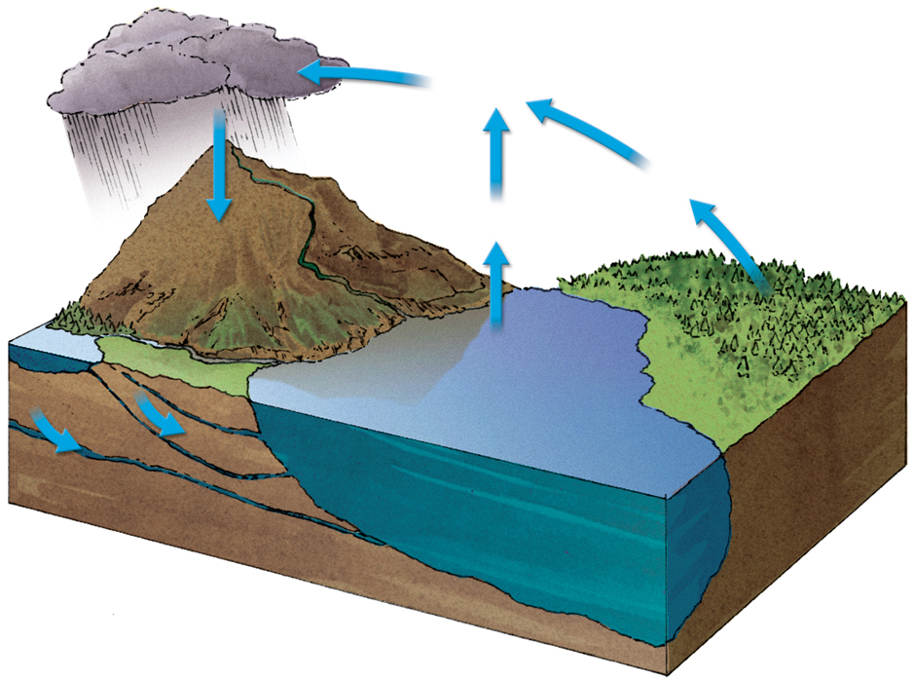
Water cycles through the environment.
The hydrologic, or water, cycle is the circular pathway of water on Earth.
Organisms all have bodies made mostly of water.
precipitation
condensation
transpiration
evaporation
surface
runoff
lake
water storage
in ocean
groundwater
seepage

Slide 60
Nutrient Cycles
Every organism needs nutrients to build tissues and carry out life functions like metabolism.
Like water. Nutrients pass through the organisms and the environment through biogeochemical cycles.
The 3 cycles that move carbon, nitrogen, and phosphorous through the biosphere are especially critical for life.

Slide 61
Carbon Cycle
Life is Carbon-based
Carbon is a major component of all organic compounds, including carbohydrates, lipids, nucleic acids, and proteins
The main processes that move carbon through an ecosystem include
Photosynthesis
Cellular respiration
Combustion of fossil fuels
Decomposition

Slide 62
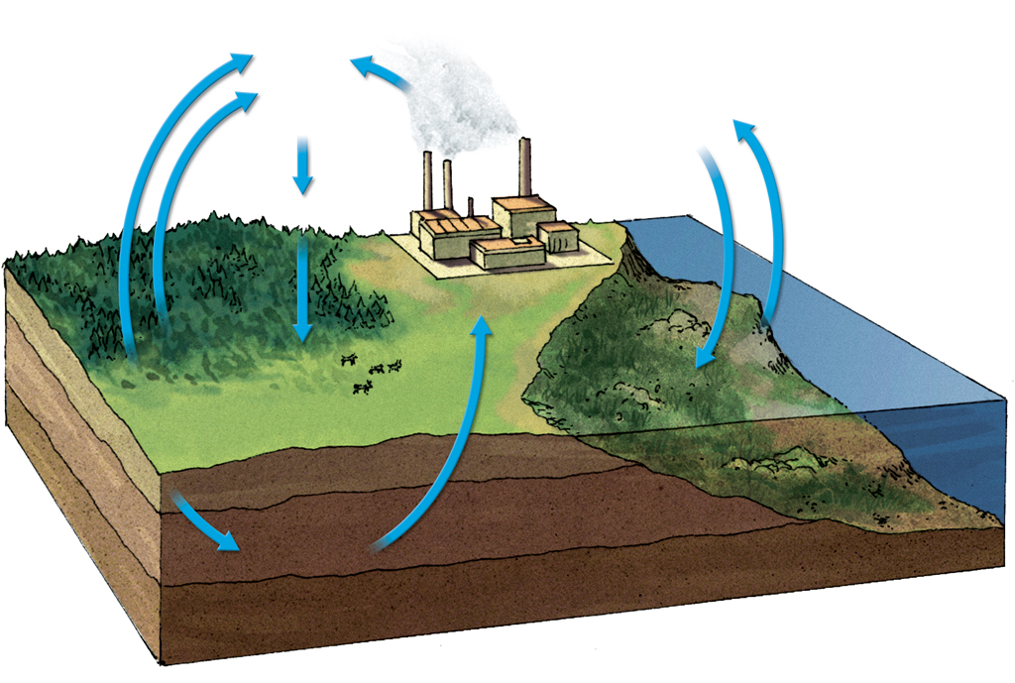
Carbon is the building block of life.
The carbon cycle moves carbon from the atmosphere, through the food web, and returns to the atmosphere.
Carbon is emitted by the burning of fossil fuels.
Some carbon is stored for long periods of time in areas called carbon sinks.
carbon
dioxide
in air
combustion
respiration
photosynthesis
respiration
decomposition
of organisms
photosynthesis
carbon dioxide
dissolved in water
fossil fuels

Slide 63
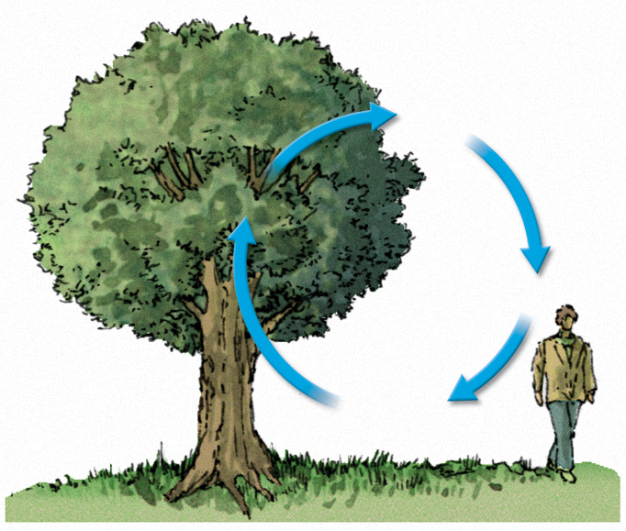
Oxygen cycles indirectly through an ecosystem by the cycling of other nutrients.
oxygen
photosynthesis
respiration
carbon
dioxide

Slide 64
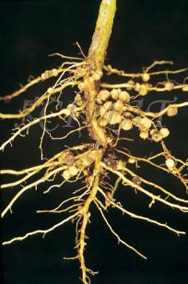
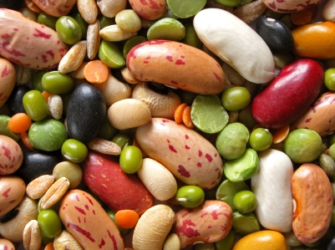
The Nitrogen Cycle
All organisms require nitrogen to make amino acids for proteins and nucleotides for nucleic acids like DNA, RNA, and ATP
The nitrogen cycle mostly takes place underground.
Nitrogen gas makes up 78% of the atmosphere
Only certain types of bacteria can directly use nitrogen gas through a process of nitrogen fixation

Slide 65
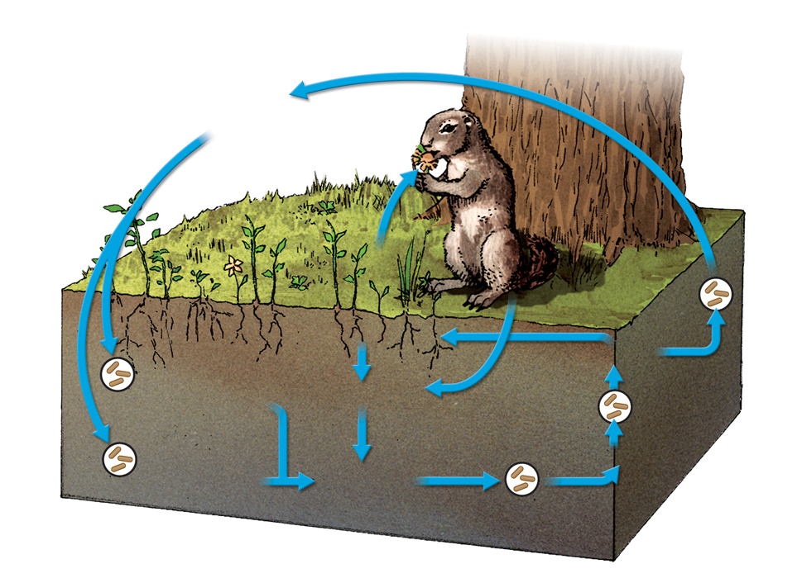
Ammonia released into the soil is transformed into ammonium.
Nitrifying bacteria change the ammonium into nitrate.
Nitrogen moves through the food web and returns to the soil during decomposition.
nitrogen in
atmosphere
animals
plant
nitrates
nitrogen-fixing
bacteria in roots
decomposers
nitrifying
bacteria
ammonification
nitrogen-fixing
bacteria in soil
nitrites
ammonium
nitrifying
bacteria
denitrifying
bacteria

Slide 66
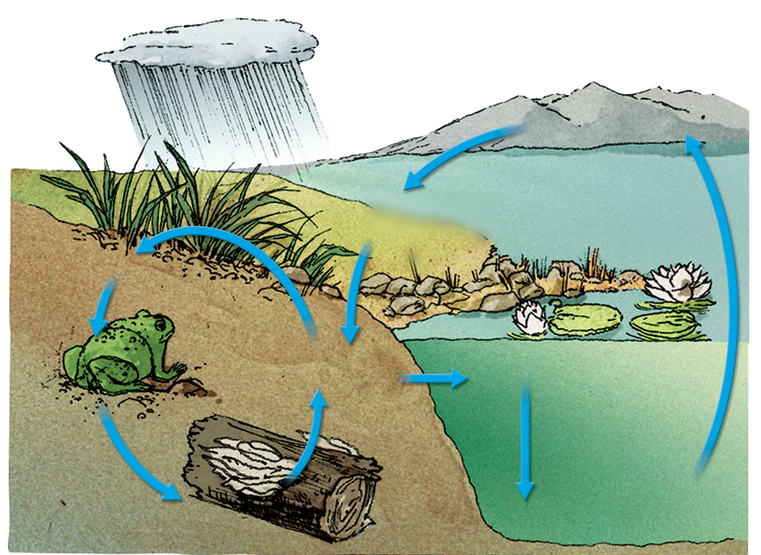
The phosphorus cycle takes place at and below ground level.
Phosphate is released by the weathering of rocks.
Phosphorus moves through the food web and returns to the soil during decomposition.
Phosphorus leaches into groundwater from the soil and is locked in sediments.
Both mining and agriculture add phosphorus into the environment.
rain
geologic uplifting
weathering of
phosphate from rocks
runoff
plants
animals
phosphate
in soil
phosphate in solution
leaching
sedimentation
forms new rocks
decomposers

Slide 67
1) Assessment: How does the hydrologic cycle move water through the environment?
Precipitation falls to earth, while transpiration and evaporation transfer water back into the atmosphere as water vapor
Transpiration
Evaporation
Precipitation
Snow/rain/sleet

Slide 68
2) Assessment: What are 4 elements that cycle through ecosystems, and why are they important?
Oxygen (O₂)
Carbon (CO₂)
Nitrogen (NO₃⁻, NH₄⁺, or NH₃)
Phospherous
They are all necessary for life on earth

Slide 69
3) Assessment: Why might farmers plant legumes such as peas to improve the nitrogen levels in the soil?
Legumes have root nodules, which contain nitrogen fixing bacteria.
Increased nitrogen levels increase the fertility of the soil

Slide 70
4) Assessment: Explain the importance of decomposers to the overall biogeochemical cycle
Decomposers break down organisms and release various elements, including nitrogen and phosphorous, which other organisms can then use.

Slide 71
5) Assessment: how might Earths biogeochemical cycles help scientists to understand the early history of life on Earth?
Studies of the biogeochemical cycles and how they interact may help scientists reconstruct the sequence of events that led to changes at Earths surface that would enable different types of organisms to evolve.

