Slide 1
Determining Cell Viability

Slide 2
Cell Viability
In biological systems, viability often refers to an ability to maintain homeostasis
Plasma membrane integrity, DNA synthesis, DNA content, enzyme activity, presence of ATP, and cellular reducing conditions are known indicators of cell viability and cell death.
A viability assay is an assay to determine the ability of cells or tissues to maintain or recover its viability
Cytolysis or membrane leakage assays
ReDox assays
Caspase assays
Functional assays
Genomic and proteomic assays
Cell Titer

Slide 3
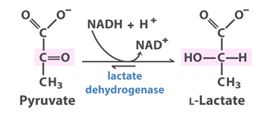
Cytolysis & Membrane Leakage Assays
This category includes the lactate dehydrogenase assay, a stable enzyme common in all cells which can be readily detected when cell membranes are no longer intact.
Lactate dehydrogenase catalyzes the interconversion of pyruvate and lactate with concomitant interconversion of NADH and NAD⁺.

Slide 4
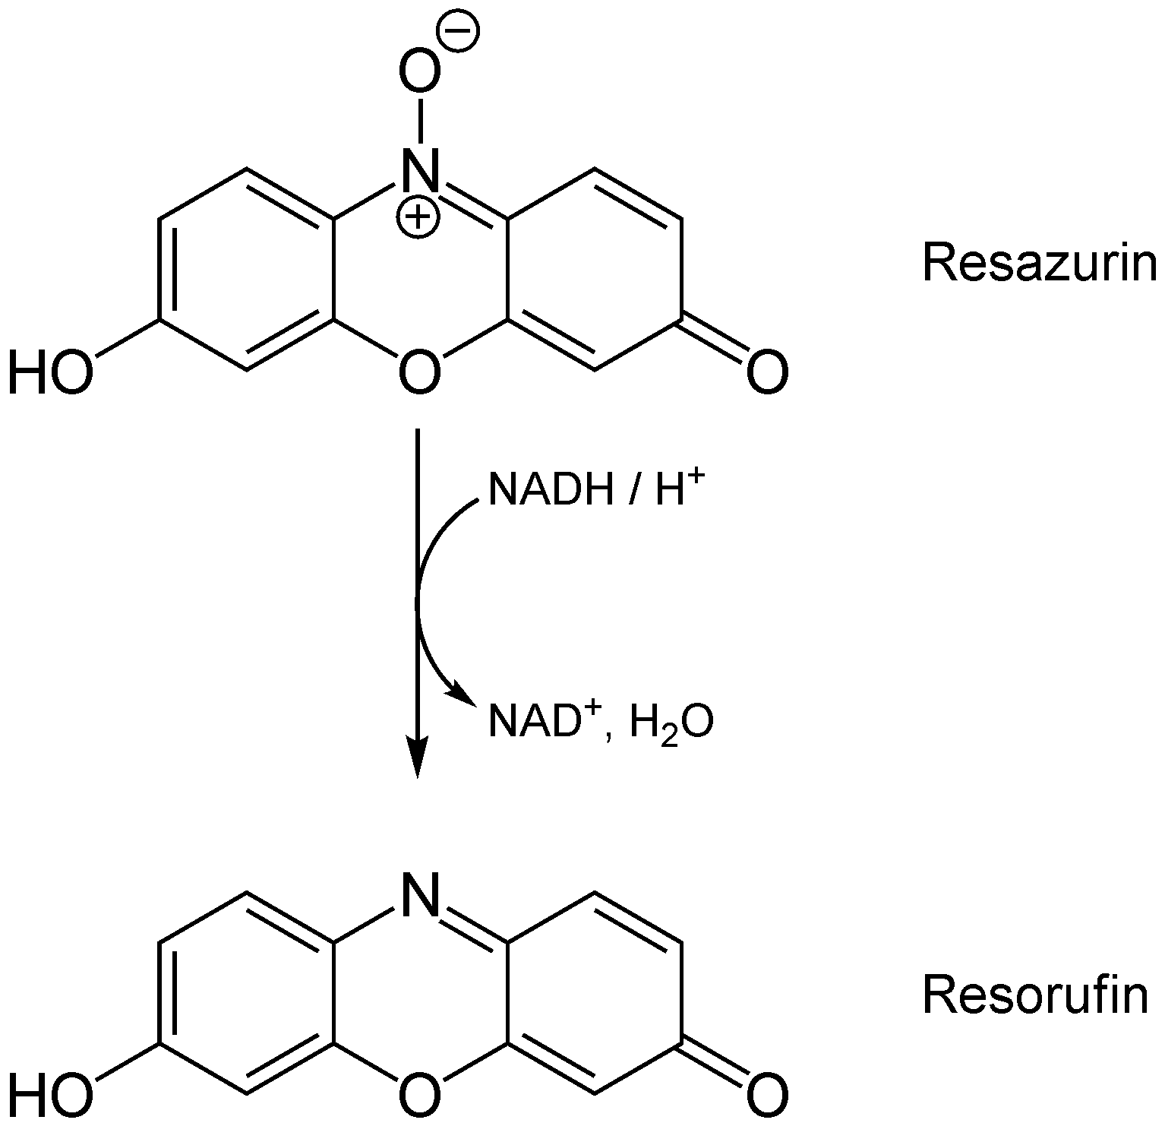
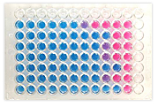
ReDox Assays
Resazurin is a non-toxic, cell permeable compound that is blue in color and virtually non-fluorescent.
Upon entering cells, resazurin is reduced to resorufin, a compound that is red in color and highly fluorescent.
Viable cells continuously convert resazurin to resorufin, increasing the overall fluorescence and color of the media surrounding cells.

Slide 5
ReDox Assays: Alamar Blue
AlamarBlue® cell viability reagent uses Resazurin and functions as a cell health indicator by using the reducing power of living cells to quantitatively measure the proliferation of various cell lines, allowing you to establish relative cytotoxicity of agents within various chemical classes.
When cells are alive they maintain a reducing environment within the cytosol of the cell.

Slide 6
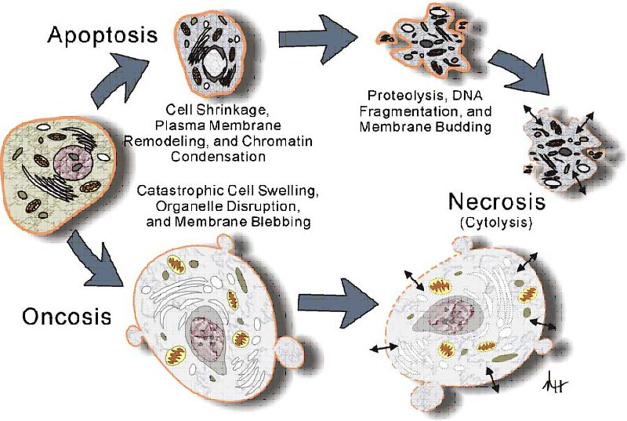
Review of Apoptosis
the process of programmed cell death (PCD) that may occur in multicellular organisms.
Biochemical events lead to characteristic cell changes in morphology and death, including
blebbing,
cell shrinkage,
nuclear fragmentation,
chromatin condensation,
and chromosomal DNA fragmentation.

Slide 7
Caspase Assays for Measuring Apoptosis
Caspases (cysteinyl aspartate-specific proteases) are a family of important signaling molecules with various tasks depending on the subtype and organ involved.
The activation of various caspases is a marker for cellular damage
Caspase-3 is a protease that has been implicated as an “effector” caspase associated with the initiation of the “death cascade”
it is responsible for chromatin condensation and DNA fragmentation
is an important marker of the cell’s entry point into the apoptotic signaling pathway.
Capsase 7 is activated upon cell death stimuli and induces apoptosis

Slide 8
Functional Assays
Assays of cell function will be highly specific to the types of cells being assayed.
For example:
motility is a widely-used assay of sperm cell function.
Fertility can be used to assay gamete survival
Red blood cells have been assayed in terms of deformability, osmotic fragility, hemolysis, ATP level, and hemoglobin content

Slide 9
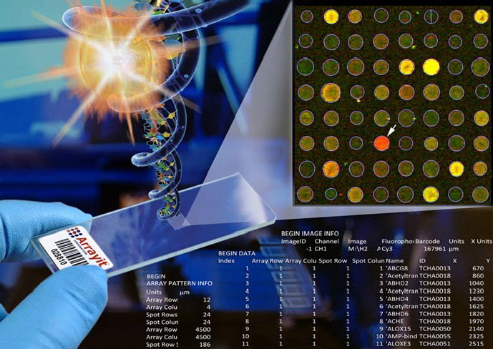
Genomic & Proteomic Assays
Cells can be assayed for activation of stress pathways using DNA microarrays and protein chips

