Slide 1
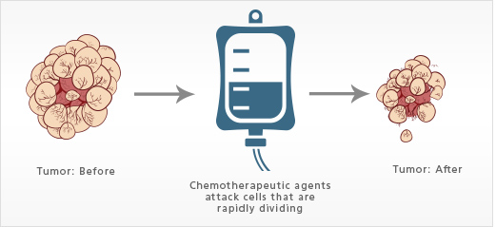
Chemotherapeutics & Their Modes of Action

Slide 2
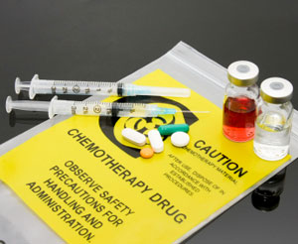
Chemotherapy
Chemotherapy is the treatment of cancer with one or more cytotoxic antineoplastic drugs ("chemotherapeutic agents") as part of a standardized regimen.
Chemotherapy may be given with a curative intent or it may aim to prolong life or to palliate symptoms.
It is often used in conjunction with other cancer treatments, such as radiation therapy or surgery.

Slide 3
Chemotherapy
Traditional chemotherapeutic agents act by killing cells that divide rapidly, one of the main properties of most cancer cells.
This means that chemotherapy also harms cells that divide rapidly under normal circumstances:
cells in the bone marrow
digestive tract
hair follicles.
This results in the most common side-effects of chemotherapy:
myelosuppression
mucositis (inflammation of the lining of the digestive tract)
alopecia

Slide 4
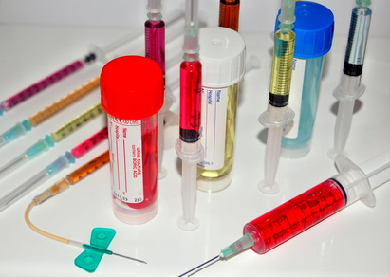
Types of Chemotherapy
Chemotherapy drugs can be divided into several groups based on factors such as:
how they work
their chemical structure
their relationship to another drug
Because some drugs act in more than one way, they may belong to more than one group.
Knowing how the drug works is important in predicting side effects.

Slide 5
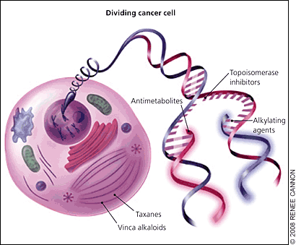
Types of Chemotherapy
The majority of chemotherapeutic drugs can be divided into:
Alkylating agents
Antimetabolites
Anthracyclines
Plant alkaloids
Some newer agents do not directly interfere with DNA
Monoclonal antibodies
Tyrosine kinase inhibitors, which directly target a molecular abnormality in certain types of cancer
In addition, some drugs that modulate tumor cell behavior without directly attacking those cells may be used.
Example: Hormone treatments
All of these drugs affect cell division or DNA synthesis and function in some way.
Notes:
Mechanisms of traditional chemotherapy. These drugs act on rapidly dividing cells, which include normal tissues (e.g., hair, gastrointestinal epithelium, bone marrow) in addition to cancer cells. Alkylating agents interfere with DNA base pairing, leading to strand breaks and arresting DNA replication. Topoisomerase inhibitors prevent DNA uncoiling. Taxanes and vinca alkaloids interfere with micro-tubule function required for cell mitosis. Antimetabolites block the formation and use of nucleic acids essential for DNA replication.

Slide 6
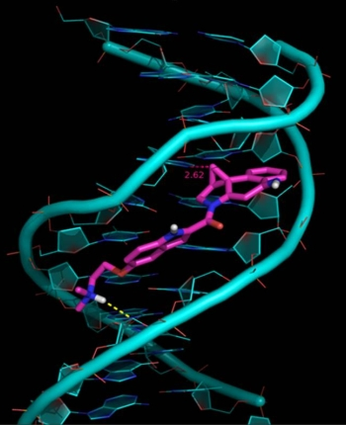
Alkylating agents directly damage DNA to prevent the cancer cell from reproducing.
Target Cancers
Common Side Effects
Alkylating agents are used to treat many different cancers, including:
Leukemia
Lymphoma
Hodgkins disease
multiple myeloma
Sarcoma
cancers of the lung, breast, and ovary
Because these drugs damage DNA, they can cause long-term damage to the bone marrow.
In rare cases, this can eventually lead to acute leukemia.
The risk of leukemia from alkylating agents is “dose-dependent,”
The risk of leukemia after getting alkylating agents is highest about 5 to 10 years after treatment.
The platinum drugs (cisplatin, carboplatin, and oxalaplatin) are sometimes grouped with alkylating agents because they kill cells in a similar way. These drugs are less likely than the alkylating agents to cause leukemia later on.
Notes:
As a class of drugs, these agents are not phase-specific; in other words, they work in all phases of the cell cycle.
Examples include: Nitrogen mustards: such as mechlorethamine (nitrogen mustard), chlorambucil, cyclophosphamide (Cytoxan®), ifosfamide, and melphalan Nitrosoureas: which include streptozocin, carmustine (BCNU), and lomustine Alkyl sulfonates: busulfan Triazines: dacarbazine (DTIC) and temozolomide (Temodar®) Ethylenimines: thiotepa and altretamine (hexamethylmelamine

Slide 7
Antimetabolites interfere with DNA and RNA growth by substituting for Nucleotides.
Target Cancers
Common Side Effects
Leukemias
Breast cancer
Ovarian cancer
Cancers of the intestinal tract
Nausea
Alopecia
Stomatitis
Severe myelosuppression
Notes:
These agents damage cells during the S phaseExamples include: 5-fluorouracil (5-FU)
6-mercaptopurine (6-MP)
Capecitabine (Xeloda®)
Cladribine
Clofarabine
Cytarabine (Ara-C®)
Floxuridine
Fludarabine
Gemcitabine (Gemzar®)
Hydroxyurea
Methotrexate
Pemetrexed (Alimta®)
Pentostatin
Thioguanine

Slide 8
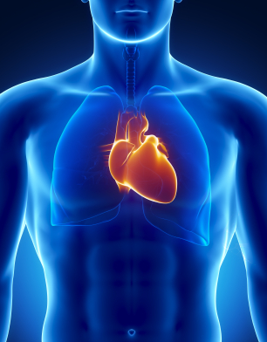
Anthracyclines are anti-tumor antibiotics that interfere with enzymes involved in DNA replication
Target Cancers
Common Side Effects
Prostate cancer
Breast cancer
Lymphoma
Leukemia
A major consideration when giving these drugs is that they can permanently damage the heart if given in high doses.
For this reason, lifetime dose limits are often placed on these drugs.
Notes:
these drugs work:
in all phases of the cell cycle
Examples include
Daunorubicin
Doxorubicin (Adriamycin®)
Epirubicin
Idarubicin
Other anti-tumor antibiotics
Anti-tumor antibiotics that are not anthracyclines include:
Actinomycin-D
Bleomycin
Mitomycin-C

Slide 9
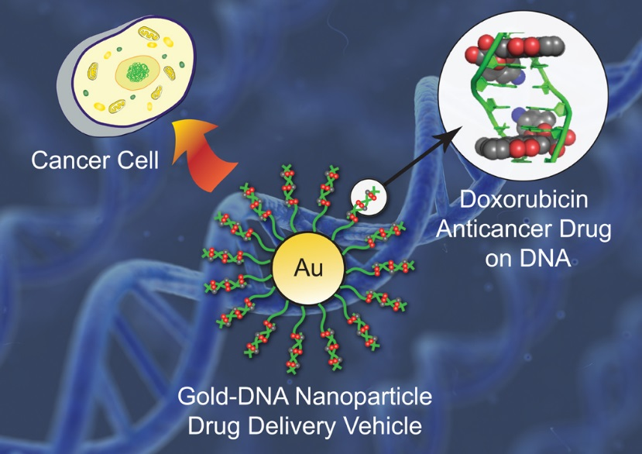
Topoisomerase inhibitors
Target Cancers
Common Side Effects
Certain leukemias
Lung cancer
Ovarian cancer
Gastrointestinal
cancer
Other cancers
Treatment with topoisomerase II inhibitors increases the risk of a second cancer — acute myelogenous leukemia (AML).
With this type of drug, a secondary leukemia can be seen as early as 2 to 3 years after the drug is given.
Notes:
is a drug used in cancer chemotherapy. It is an anthracycline antibiotic, closely related to the natural product daunomycin, and like all anthracyclines, it works by intercalating DNA, with the most serious adverse effect being life-threatening heart damage

Slide 10
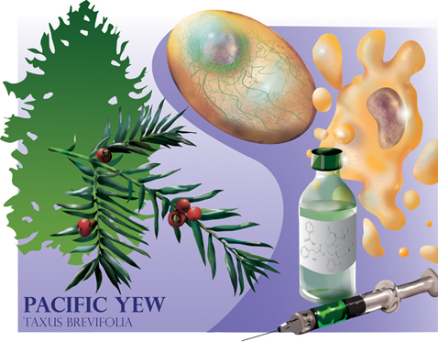
Mitotic inhibitors are often plant alkaloids and can stop mitosis or inhibit enzymes from making proteins needed for cell reproduction.
Target Cancers
Common Side Effects
Breast cancer
Lung cancer
Myelomas
Lymphomas
Leukemias
Known for their potential to cause peripheral nerve damage, which is a dose-limiting side effect.
Notes:
these drugs work during the M phase of the cell cycle but can damage cells in all phases
Examples include:
Taxanes: paclitaxel (Taxol®) and docetaxel (Taxotere®)
Epothilones: ixabepilone (Ixempra®)
Vinca alkaloids: vinblastine (Velban®), vincristine (Oncovin®), and vinorelbine (Navelbine®)
Estramustine (Emcyt®)

Slide 11
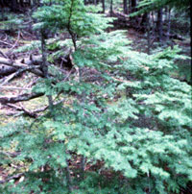
Paclitaxel
Paclitaxel is a mitotic inhibitor used in cancer chemotherapy
to treat patients with
Lung cancer
Ovarian cancer
Breast cancer
Head and neck cancer
Advanced forms of Kaposi's sarcom
It was discovered in1967 after being isolated
it from the bark of the Pacific yew tree,
Taxus brevifolia
it was named taxol.

Slide 12
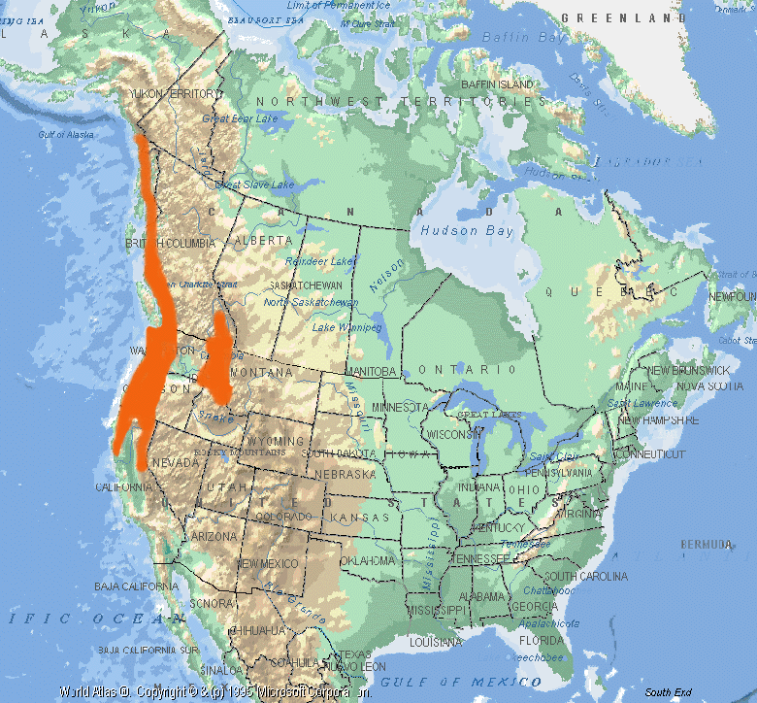
TAXOL
1962--as part of the exploratory program bark from the pacific Yew was collected by USDA. It showed activity in an initial in vitro screen.
1971--Dr. Monroe Wall reports the isolation and identification of taxol.
1972--Shows only moderate activity against murine tumor cell lines
1975--Shows strong activity against melanoma
1977--Accepted as a drug candidate for NCI preclinical development
1980--toxicology studies begin
1983--Phase I clinical trial begins (cremophor)
Supply dwindling (1 tree/treatment)
Taxol is now synthesized by semi-synthetic route using leaves from tree

Slide 13
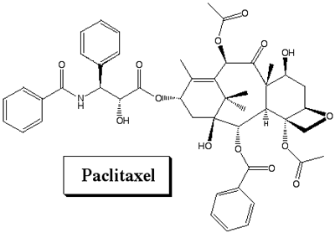
TAXOL: Lessons learned
Use human tumor cells for screening instead of murine cells
Formulation issues need to be addressed early on
Mechanism of action is important in drug development process
Critical need to address supply issue at an early stage of development

Slide 14
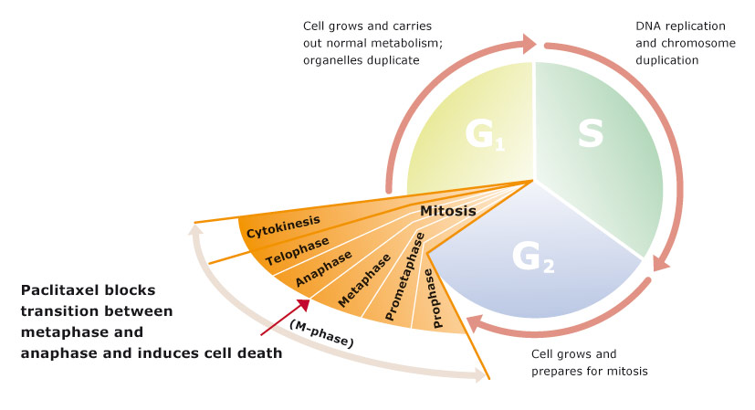
Paclitaxel Mode of Action
Paclitaxel stabilizes microtubules and as a result, interferes with the normal breakdown of microtubules during cell division.

Slide 15
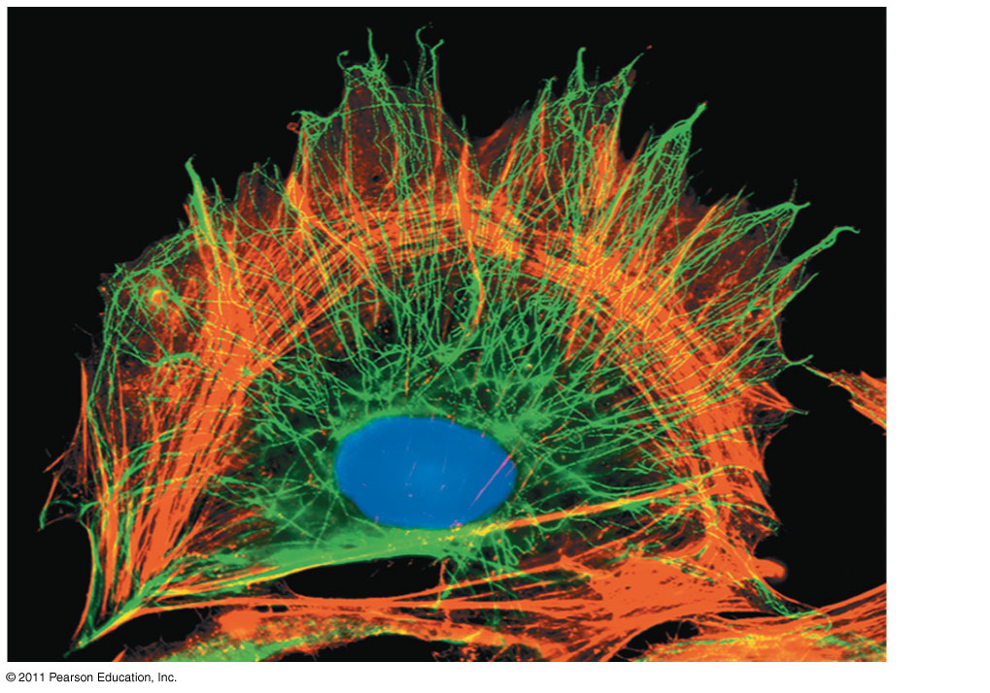
Roles of Microtubules in the cell
The cytoskeleton is a network of fibers extending throughout the cytoplasm
It organizes the cell’s structures and activities, anchoring many organelles
It is composed of three types of molecular structures
Microtubules
Microfilaments
Intermediate filaments
Notes:
For the Cell Biology Video The Cytoskeleton in a Neuron Growth Cone, go to Animation and Video Files
For the Cell Biology Video Cytoskeletal Protein Dynamics, go to Animation and Video Files.

Slide 16
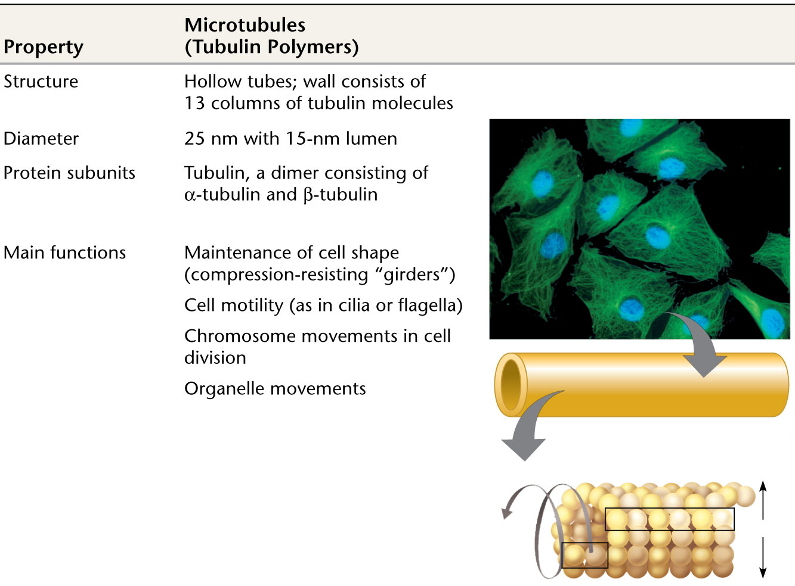
Microtubules
Microtubules are hollow rods about 25 nm in diameter and about 200 nm to 25 microns long
Functions of microtubules
Shaping the cell
Guiding movement of organelles
Separating chromosomes during cell division
Notes:
For the Cell Biology Video Transport Along Microtubules, go to Animation and Video Files.
For the Cell Biology Video Movement of Organelles in Vivo, go to Animation and Video Files.
For the Cell Biology Video Movement of Organelles in Vitro, go to Animation and Video Files.

Slide 17
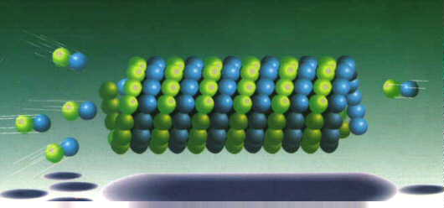
Microtubule Formation
In the cell itself, microtubules are formed in an area near the nucleus called the "aster".
This is also called the Microtubule Organizing Center (MTOC).
The first stage of formation is called "nucleation".
The process requires tubulin, Mg++ and GTP.
This stage is relatively slow until the microtubule is initially formed.
During "nucleation", an alpha and a beta tubulin molecule join to form a heterodimer.
In the second phase called “elongation” these attach to other dimers to form oligomers which elongate to form protofilaments.
http://sites.sinauer.com/cooper5e/animation1203.html
Usually the minus end is the anchor point in the MTOC
Microtubules are polar with a plus end (fast growing) and a minus end (slow growing).
+
-

Slide 18
Cilia and Flagella
Microtubules control the beating of cilia and flagella, locomotor appendages of some cells
Cilia and flagella share a common structure
A core of microtubules sheathed by the plasma membrane
A basal body that anchors the cilium or flagellum
A motor protein called dynein, which drives the bending movements of a cilium or flagellum

Slide 19
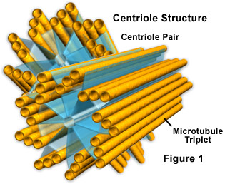
Centrosomes and Centrioles
In many cells, microtubules grow out from a centrosome near the nucleus
The centrosome is a “microtubule-organizing center”
In animal cells, the centrosome has a pair of
centrioles, each with nine triplets of microtubules
arranged in a ring that are “thought” to be involved
with cell division

Slide 20
Polymerization and depolymerization microtubule dynamics
Microtubules consisting of α/β heterodimers elongate to form cylindrical microtubules of 13 protofilaments with a plus (+) end and minus (−) end.
Tubulin-bound GTP binds to plus (+) end of microtubule and GTP is hydrolyzed to GDP + Pi forming a GTP cap.
The GTP cap stabilizes the microtubules plus (+) end and stabilization is further enhanced by addition of the taxanes, paclitaxel and docetaxel, which bind to β-tubulin sites causing polymerization of microtubules.
Depolymerization occurs when the tubulin − GTP / GDP + Pi cap is lost, Pi is released from tubulin, destabilization occurs and the tubulin-bound GDP dissociates from the plus (+) end causing depolymerization

Slide 21
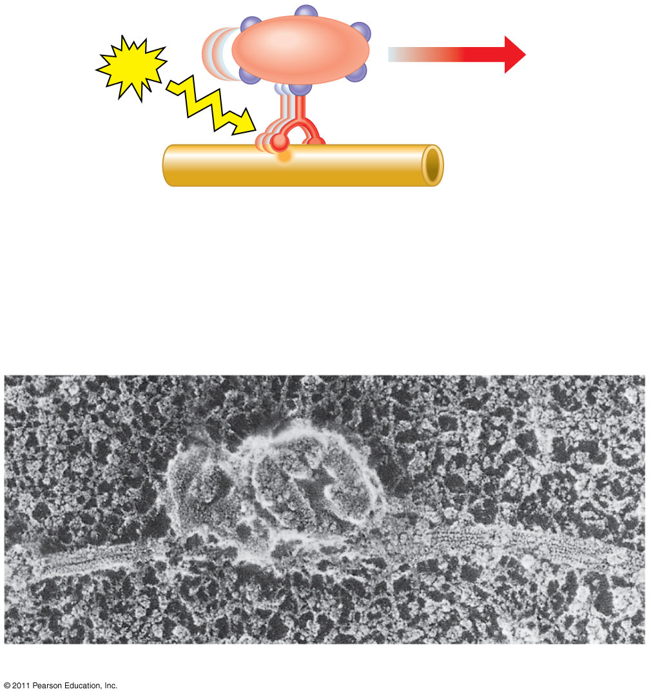
Figure 6.21
Vesicle
ATP
Receptor for motor protein
Motor protein (ATP powered)
Microtubule of cytoskeleton
(a)
Microtubule
Vesicles
0.25 μm
Notes:
Figure 6.21 Motor proteins and the cytoskeleton.

Slide 22
Microtubules are dynamic
Dynamic instability refers to the coexistence of assembly and disassembly at the (+) end of a microtubule.
The microtubule can dynamically switch between growing and shrinking phases in this region.
This constant growing and shrinking is necessary for microtubules to carry out their functions
During polymerization, both the α- and β-subunits of the tubulin dimer are bound to a molecule of GTP
The GTP bound to α-tubulin is stable and it plays a structural function in this bound state.
GTP bound to β-tubulin may be hydrolyzed to GDP shortly after assembly resulting in the addition of new dimer

Slide 23
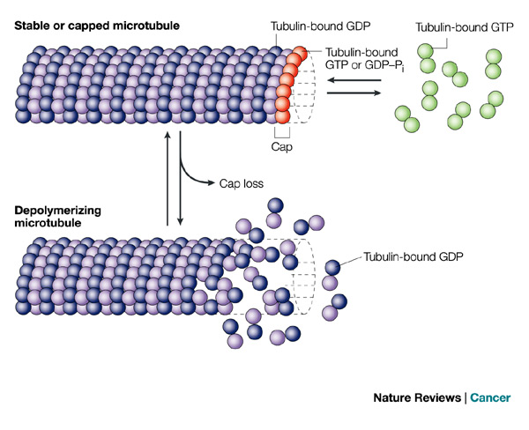
The kinetics of GDP-tubulin are different from those of GTP-tubulin
GDP-tubulin is prone to depolymerization
Tubulin adds onto the end of the microtubule only in the GTP-bound state
A cap of GTP-bound tubulin at the tip of the microtubule can protect it from disassembly.
When hydrolysis catches up to the tip of the microtubule, it begins a rapid depolymerization and shrinkage
Notes:
A GDP-bound tubulin subunit at the tip of a microtubule will fall off
GDP-bound tubulin in the middle of a microtubule cannot spontaneously pop out

Slide 24
Paclitaxel binds to the interior surface of the microtubule at the taxane-binding site, suppressing microtubule dynamics
Paclitaxel has a specific binding site on the microtubule polymer, and has the ability to polymerize tubulin in the absence of cofactors like guanosine triphosphate and microtubule-associated proteins

