Slide 1
Title: The Endosymbiont Theory
Date: 11-1-12

Slide 2
The Endosymbiont Theory
Word Parts
Endo means within
Syn means together
Biosis means living
Based on this write a definition for Endosymbiosis

Slide 3
The Endosymbiont Theory
The Endosymbiont Theory states that mitochondria & chloroplasts originated through symbiosis between multiple microorganisms.
According to this theory, certain organelles originated as free-living bacteria that were taken inside another cell as endosymbionts.

Slide 4
The Endosymbiont Theory
The Endosymbiont Theory explains the evolution of Eukaryotes
Evidence that supports the Endosymbiont Theory includes:
Both mitochondria & chloroplasts have their own DNA
Both mitochondria & chloroplasts have their own ribosomes
Both mitochondria & chloroplasts are about the same size as bacteria
Both mitochondria & chloroplasts reproduce through a process called binary fission, which is how bacteria reproduce

Slide 5
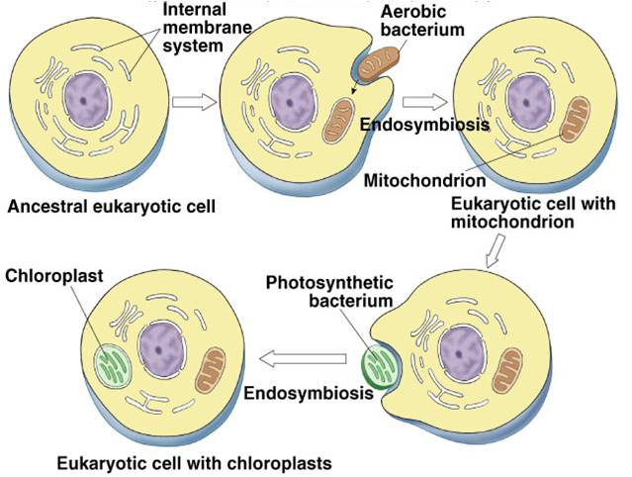
The Endosymbiont Theory
Became Animal Cells
Became Plant Cells

