Slide 1
From Gene to Protein

Slide 2
Proteins are the link between Genotype & Phenotype
The DNA inherited by organisms leads to specific traits by dictating synthesis of proteins
The process by which DNA directs protein synthesis is called Gene Expression
Transcription
Translation

Slide 3
Basic Principles of Transcription & Translation
Transcription
Translation
The synthesis of a complementary strand of RNA under the direction of DNA template
Same language as DNA → nucleotides
Occurs in the nucleus
The synthesis of an amino acid chain (polypeptide) under the direction of RNA
Change in language → from nucleotides to amino acids
Occurs outside of the nucleus on a ribosome
Secretory proteins are transcribed on ribosomes attached to the ER
Proteins for internal cell use are transcribed on free ribosomes

Slide 4
Why do we need an RNA intermediate?
In other words, why can’t we just use DNA as the template to build a polypeptide
Using RNA provides protection for DNA
Using an RNA intermediate allows for more then one polypeptide to be synthesized at once

Slide 5
Differences Between DNA & RNA
DNA
RNA
Double Stranded
Deoxyribose sugar
Long term storage of information
Nitrogenous bases
Adenine
Thymine
Cytosine
guanine
Single Stranded
Ribose Sugar
Temporary storage of information
Nitrogenous bases
Adenine
Uracil
Cytosine
guanine

Slide 6
Transcription Overview
DNA is transcribed into pre-messenger RNA by RNA Polymerase in the nucleus
Initiation
Elongation
Termination
This pre-mRNA undergoes RNA processing yielding a finished mRNA
This primary transcript is now ready to leave the nucleus and undergo translation

Slide 7
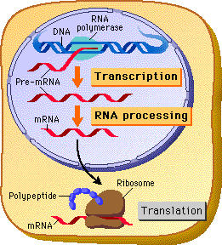
Central Dogma
The central dogma in biology for many years was :
DNA → RNA → protein
It has been modified since due to new discoveries, but it basically remains the same

Slide 8
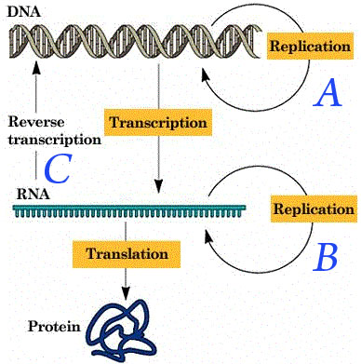
Central Dogma

Slide 9
The Genetic Code
Triplets of nucleotide bases are the smallest units of uniform length that can specify all 20 amino acids
If each arrangement of 3 consecutive bases specifies one amino acid, it is possible to specify up to 64 amino acids (4³)
There are only 20 amino acids, so this immediately indicates that there must be some redundancy within the code
This is an important safety that helps us survive mutations in our DNA!

Slide 10
Important DNA Distinctions
DNA is double Stranded
Only one of the 2 strands actually “codes” for a protein, while the complementary strand acts as the template on which to build the RNA
Template Strand
Nontemplate strand
vs
Non coding strand
RNA Polymerase travels this strand
mRNA will be complementary to this
Coding strand
RNA Polymerase will not travel this strand
mRNA will be identical to this sequence
(except for nitrogenous base and sugar)

Slide 11
Other Important Things
Remember how DNA polymerase can only travel in the 3’ → 5’ direction of the template strand
The new daughter DNA strand is synthesized (grows) in the 5’ → 3’ direction
RNA polymerase also can only travel in the 3’ → 5’ direction on the template strand
mRNA is synthesized in the 5’ → 3’ direction
mRNA is always read in the 5’ →3’ direction

Slide 12
For Example
The DNA codong strand could be 5’ –TGG- 3’
The DNA template strand would be 3’ –ACC- 5’
The mRNA would be 5’ –UGG- 3’
mRNA is always read, written, and synthesized in the 5’ → 3’ direction

Slide 13
Codons & Amino Acids
Each nucleotide triplet is called a codon, and each codon specifies only 1 amino acid
Obviously, each amino acid may be specified by more than one codon
Remember, this redundancy is important in our ability to survive DNA mutations
This means that a polypeptide containing 100 amino acids must have a minimum of how many nucleotides?

Slide 14
Cracking the Code
Marshall Nirenburg of the NIH began cracking the genetic code in the early 1960’s
He synthesized an artificial mRNA consisting only of uracil, this way, no matter where translation began it would only have one reading option UUUUUUU…
He then put this in an artificial stystem designed to undergo translation and what he found was a polypeptide composed solely of the amino acid phenylalanine

Slide 15
Methionine
The codon AUG codes for the amino acid methionine
AUG is known as the start codon, and thus methionine is at the beginning of every polypeptide synthesized
That is not to say that every finished protein has methionine as its 1st amino acid, methionine may be excised later during protein finishing

Slide 16
Evolution of the Genetic Code
The genetic code refers to the “code” of 1 codon specifying 1 amino acid
This genetic code thus far appears to be shared universally among all life forms, from bacteria to mammals
Slight variations exist in organelle genes and in some unicellular eukaryotes
“A shared genetic vocabulary is a reminder of the kinship that bonds life on Earth”

Slide 17
Molecular Components of Transcription
RNA Polymerase is the enzyme responsible for separating the 2 strands of DNA and building a pre-mRNA molecule according to the base pairing rules on the DNA strand
RNA Polymerase can only read DNA in a 3’ → 5’ direction, and so can only build RNA in a 5’ → 3’ direction
RNA polymerase does NOT need a primer, and so can start from scratch

Slide 18
Special Sequences in DNA
Promoter: this is a sequence of DNA recognized by RNA Polymerase, marking where the gene begins
This is the site where RNA Polymerase actually attaches and initiates transcription

Slide 19
Lingo
Downstream
Upstream
The direction of transcription is said to be downstream
The direction opposite of transcription is said to be upstream
So is the promoter upstream or downstream of the terminator?
Transcription Unit: the entire stretch of DNA that is transcribed is called the transcription unit

Slide 20
Transcription
Prokaryotes
Eukaryotes
Have a single type of RNA polymerase capable of making all types of RNA
mRNA
tRNA
rRNA
Have 3 types of RNA polymerase called:
RNA Polymerase I
RNA Polymerase II
Makes mRNA
RNA Polymerase III

Slide 21
Transcription is Divided into 3 Stages
Initiation
RNA Polymerase recognizes and binds to promoter
Elongation
Termination

Slide 22
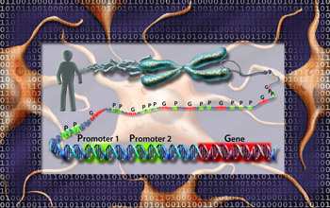
Initiation & the Promoter
The promoter of a gene includes the transcription start point and extends several dozen nucleotides upstream of the “start point”
Serves as a binding site for RNA Polymerase
Determines which of the 2 strands of the DNA helix will be used as the template

Slide 23
Initiation & the Promoter
Eukaryotes
A collection of proteins called Transcription Factors mediate the binding of RNA Polymerase to the promoter
Only after certain TF’s are bound to the promoter will RNA Polymerase recognize and bind to it
Transcription Initiation Complex: the completed assembly of TF’s and RNA polymerase bound to a promoter

Slide 24
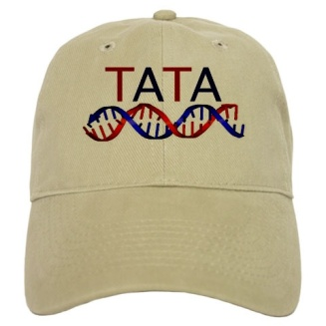
Eukaryotes & the TATA Box
Eukaryotic promoters often include a TATA box, which is the nucleotide sequence TATA located about 25 nucleotides upstream of the transcriptional start point
There are several TF’s that must bind to the DNA in order for RNA polymerase to bind, one of these TF’s has a binding site for the TATA box

Slide 25
Elongation
As RNA Polymerase travels down the DNA strand it continues untwisting the DNA and adding nucleotides to the 3’end of a growing nucleotide chain
Unlike DNA replication where the newly synthesized daughter DNA stays associated with the parent DNA strand, the RNA disassociates immediately after the covalent linkage between sugars is made, and DNA reassociates back into its double helix
Transcription progresses at a rate of about 60 nucleotides / second

Slide 26
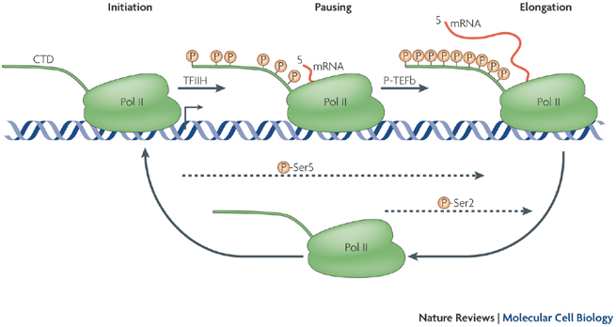
Elongation
A single gene can be transcribed simultaneously by several RNA Polymerases following each other one after another

Slide 27
Termination
Eukaryotes
RNA Polymerase transcribes a polyadenylation signal sequence (AAUAAA)
At about 10-35 nucleotides past this sequence, an enzyme comes and cuts loose the pre-mRNA
RNA Polymerase will continue transcribing perhaps hundreds of nucleotides past the end of the gene until it falls off

Slide 28
Eukaryotic Cells Modify mRNA After Transcription
1st the 5’ Cap: the 5’ end of an mRNA chain is capped off with a modified guanine called m7GTP
2nd the poly-A tail: between 50-250 adenines are added to the 3’ end of a completed mRNA
Functions of the 5’ cap & poly-A tail include:
Facilitate export of mature mRNA out of nucleus
Protect mRNA from degradation my hydrolytic 3nzymes
Facilitate proper ribosome attachment

Slide 29
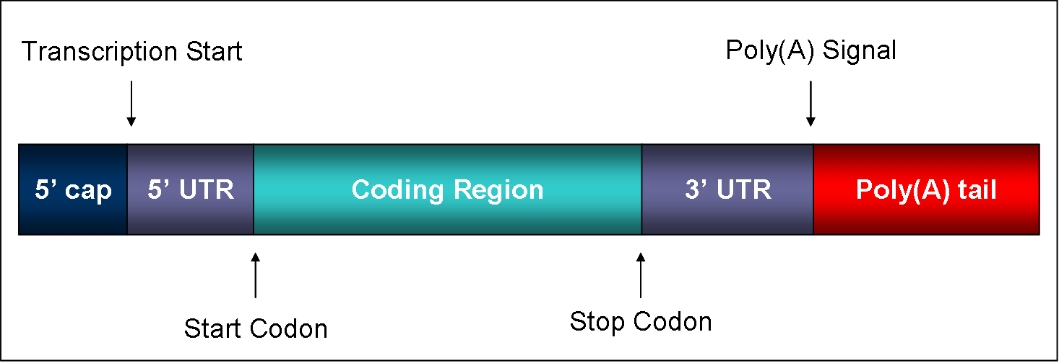
UTR’s
UTR’s are parts of the mRNA that will not be translated into protein, but have other necessary functions such as ribosome binding

Slide 30
RNA Splicing
Pre-mRNA is composed of coding regions called exons (because they are eventually expressed and will exit the nucleus), and noncoding regions called introns (because they are intervening sequences between exons)
RNA Polymerase II transcribes both introns and exons forming pre-mRNA
The introns must be removed before the finished mRNA will be able to exit the nucleus

Slide 31
RNA Splicing
The signal for RNA splicing is a short nucleotide sequence at each end of the intron
These short sequences are recognized by small nuclear ribonucleoproteins or snRNP’s (pronounced snurps):
Located in the nucleus
Composed of RNA & Protein
The RNA in snRNP’s is known as small nuclear RNA or snRNA
Each snRNA is about 150 nucleotides long

Slide 32
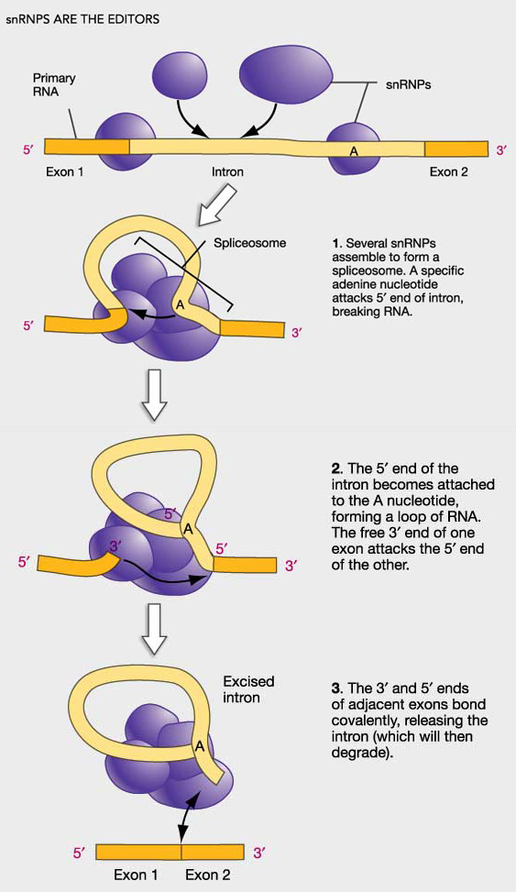
Spliceosome
Several different snRNP’s join with other proteins to form a spliceosome
Spliceosomes are almost as large as a ribosome
The spliceosome interacts with the RNA cutting out the introns and splicing together the exons

Slide 33
Functional & Evolutionary Importance of Introns
Some introns contain sequences that control gene activity, and so have a regulatory role
Splicing is necessary for the mRNA to leave the nucleus
Also, because there are introns and exons, that leads to the idea that perhaps 1 gene/mRNA could be spliced in several different ways to produce several different gene products

Slide 34
Alternative Splicing
A single gene can, in fact, code for more than one polypeptide, depending on which segments are treated as introns and which are treated as exons
Example: the differences between a male and female fruit fly are due mainly to alternative splicing of the same genes
Alternative splicing also provides a possible answer to why we humans get along as well as we do with such little genetic information (we really only have about double that of a fruit fly)

Slide 35
Protein Domains & Alternative Splicing
Proteins are structured in such a way that they have discrete structural & functional regions called domains
So, one domain may include an active site, while another domain on the same protein may be responsible for attaching to the cell membrane
In many cases, the different exons code for the different domains of a protein

Slide 36
Exon Shuffling
The presence of introns in a gene may facilitate the evolution of new and potentially useful proteins by increasing the probability of crossing over between the exons of different alleles!
Exon shuffling could lead to new proteins with novel combinations of functions (or it could lead to a completely nonfunctional product, and then you die ☹

Slide 37
Translation
RNA Directed Synthesis of a Polypeptide

Slide 38
Translation
In the process of translation, a cell interpets a genetic message by reading the codons on a strand of mRNA, and builds a polypeptide accordingly
The interpreter of the of this message is a molecule called transfer RNA or tRNA
The job of tRNA is to transfer amino acids from the cytoplasmic pool of amino acids to ribosomes
The ribosome than catalyzes the covalent linkage of 1 amino acid to another through a condensation reaction, forming a peptide bond

Slide 39
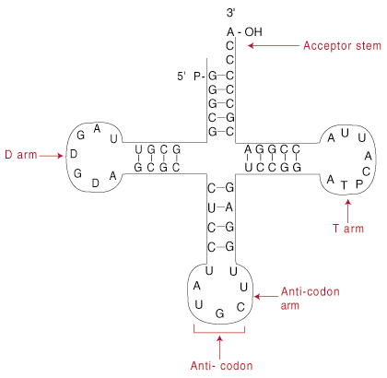
tRNA
Not all tRNA molecules are the same
There are almost as many tRNA molecules as there are codons (45)
Each tRNA molecule has a nucleotide triplet called an anticodon which is complementary to, and so base pairs with the codon

Slide 40
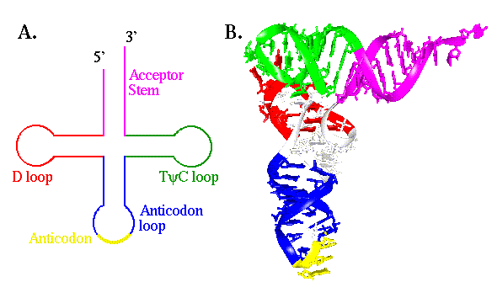
tRNA
Made of RNA off of a DNA template
Can be reused over and over
About 80 nucleotides long with stretches of complementary bases which allows for hydrogen bonding between complementary bases giving it its characteristic shape

Slide 41
Aminoacyl-tRNA Synthetases
A family of related enzymes whose job it is to correctly match up amino acids with the correct tRNA molecule
The active site of each aminoacyl-tRNA synthetase molecule fits only one combintaion of amino acid and tRNA
There are 20 different synthetases, one for each amino acid
This means the synthetase is able to bind all tRNA’s with anticodons for their amino acid

Slide 42
Aminoacyl-tRNA Synthetases
The Aminoacyl-tRNA Synthetases catalyzes the covalent linkage of the amino acid to the tRNA through hydrolysis of ATP
Once an amino acid is attached to a tRNA, it is called a charged tRNA
Charged tRNA’s are released from the Aminoacyl-tRNA Synthetases and available to deliver its amino acid to a ribosome to be incorporated into a growing polypeptide

Slide 43
Wobble
1st recognition process involved matching appropriate a.a. with correct tRNA
2nd recognition process involves matching correct tRNA with codon
Wobble: the flexible base pairing at the 3rd codon position
Because there are only 45 tRNA, there must be some versatility in base pairing allowed
This occurs with the 3rd base on the codon & anticodon
Base pairing rules are relaxed here
This allows one anticodon to base pair w/ several different codons, as long as the 1st 2 bases pair correctly

Slide 44
Ribosomes
Facilitate the specific coupling of tRNA anticodons with mRNA codons during protein synthesis
There are 2 ribosomal subunits, each composed of ribosomal RNA or rRNA
Genes on chromosomal DNA are transcribed, and the RNA is processed and assembled with proteins imported from the cytoplasm
This occurs in the nucleolus
The completed ribosomal subunits are then exported through a nuclear pore

Slide 45
Ribosomes
In both prokaryotes and eukaryotes both ribosomal subunits only join to form a complete functional ribosome when attached to an mRNA

Slide 46
Ribosomes are always composed of 2 subunits, a large subunit and a small subunit
Eukaryotic
Large subunit is called the 60s
Composed of 3 strands of rRNA
Small subunit is called the 40s
Composed of 1 strand of rRNA
= a complete ribosome of 80s ribosome

Slide 47
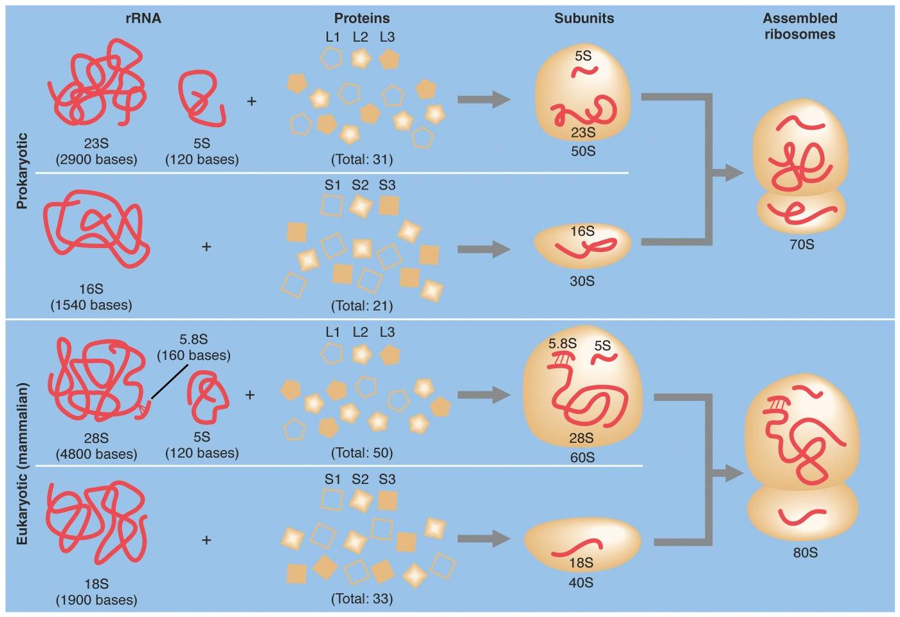

Slide 48
Structure of a Ribosome
In addition to a binding site for mRNA, each ribosome has 3 binding sites for tRNA
P site:
peptidyl tRNA site
Holds the tRNA carrying the growing polypeptide chain while…
A site
Aminoacyl tRNA site
Holds the tRNA carrying the next amino acid to be added
E site: exit site for discharged tRNA’s

Slide 49
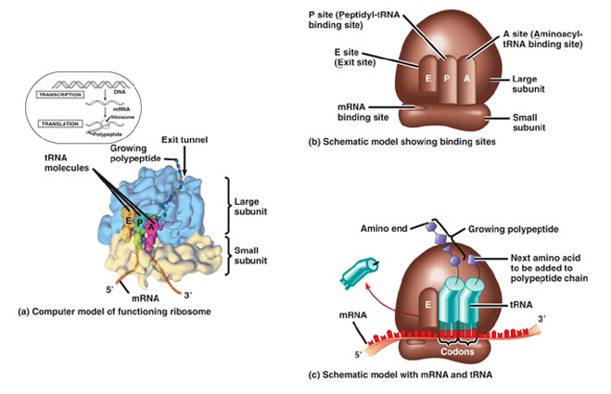

Slide 50
3 Stages to Building a Polypeptide
Initiation
Elongation
Termination

Slide 51
Translation: Initiation
Eukaryotes
Small subunit with initiator tRNA already bound, binds the 5’ cap of mRNA
It then scans downstream along the mRNA until it reaches the AUG start codon
This is important cause it establishes the codon reading frame

Slide 52
Translation Initiation Complex
So basically, initiation brings together mRNA, the 2 subunits of the ribosome, and a tRNA bearing the 1st amino acid of a polypeptide
The union of the above is followed by attachment of the large ribosomal subunit
This completes the translation initiation complex
Proteins called initiation factors are required to bring all of these components together

Slide 53
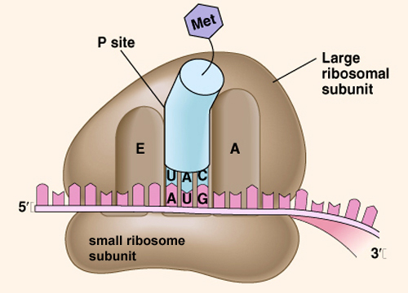
Translation Initiation Complex

Slide 54
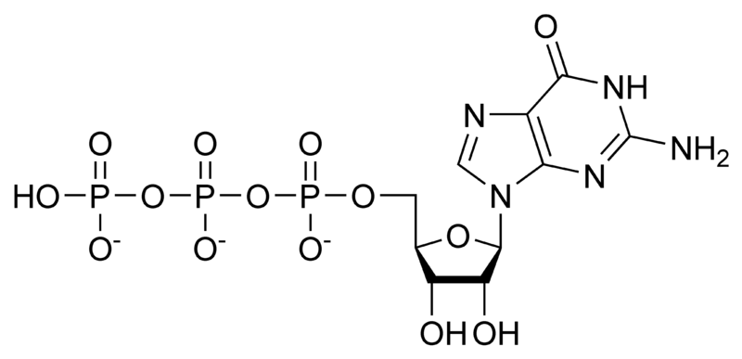
Energy
The cell expends energy forming the translation initiation complex
The energy comes from hydrolysis of the GTP molecule, or guanosine triphosphate

Slide 55
Translation: Elongation
In the elongation phase, amino acids are added 1 by 1 to the preceding amino acid
Each addition involves participation of proteins called elongation factors
Elongation occurs in a 3 step cycle
Energy expenditure by hydrolysis of GTP occurs in the 1st and 3rd steps

Slide 56
3 Steps of Elongation
1st is Codon Recognition
Requires hydrolysis of GTP
2nd Peptide Bond Formation between amino acids in the A and P sites, catalyzed by the ribosome
Removes the amino acid from the tRNA that carried it
3rd Translocation of tRNA in the A site to the P site, while at the same time moving the tRNA in the P site to the E site
mRNA is moved through the ribosome 5’end 1st

Slide 57
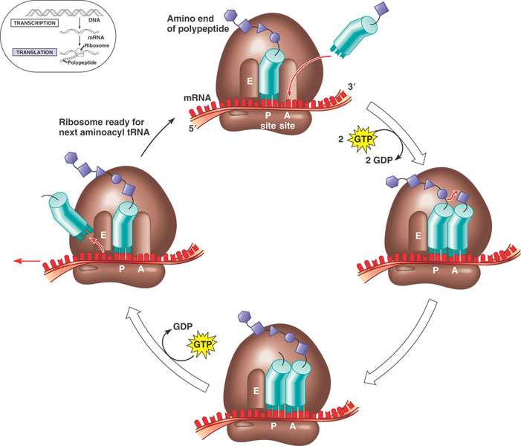

Slide 58
Termination of Translation
Once a stop codon reaches the A site of the ribosome they signal the end of translation
Stop codons do not code for an amino acid and include
UAG
UAA
UGA
A protein called a release factor binds directly to the stop codon in the A site

Slide 59
Release Factors
Causes addition of a water molecule instead of an amino acid
This reaction hydrolyzes (breaks) the bond between the completed polypeptide and the tRNA in the P site, releasing the polypeptide through the exit tunnel of the ribosome
Exit tunnel is NOT the E site
Exit tunnel is a special tunnel in the ribosome through which the polypeptide is released

Slide 60
Polyribosomes
A single ribosome can make an average polypeptide in less then a minute
Typically, many ribosomes translate a single mRNA at the same time
A single mRNA is used to make many copies of a polypeptide simultaneously
Once a ribosome moves past the start codon, another can bind
Strings of ribosomes on a single mRNA are called polyribosomes

Slide 61
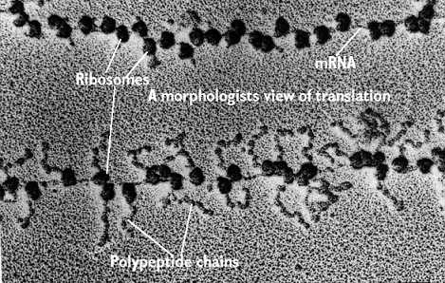
Polyribosomes
mRNA
Ribosomes
Polypeptide chains
As seen with an electron microscope

Slide 62
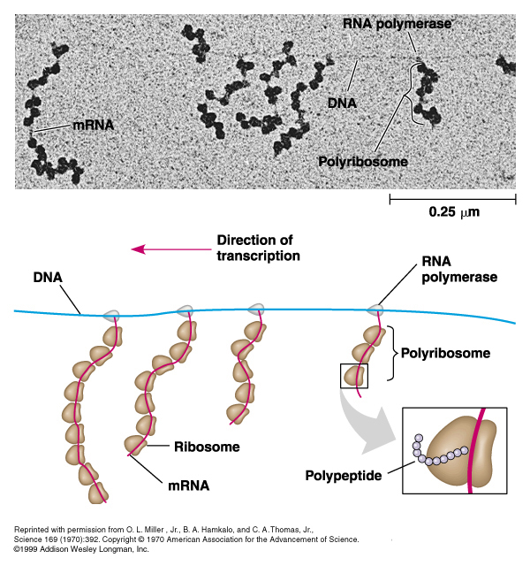
What kind of cell is this & how do you know?

Slide 63
Completing & Targeting the Functional Protein
Translation alone is not sufficient to make a functional protein
Proteins must undergo posttranslational modifications and correct folding be functional

Slide 64
Protein Folding
During translation a polypeptide begins to spontaneously fold and coil as a direct consequence of the properties of its amino acids and how they are strung together (primary structure)
This creates a protein with a specific 3-D shape (secondary & tertiary structure)
Chaperone proteins are necessary to help the protein fold correctly

Slide 65
Important
The sequence of DNA (or the gene) determines protein primary structure (amino acid sequence)
Protein primary structure then determines secondary and tertiary structure
So… DNA is ultimately responsible for protein structure and so protein function

Slide 66
Post-Translational Modifications
Sometimes even correctly folded proteins must be modified before the protein can do its job
Amino acids may be chemically modified through
Attachment of sugars, phosphate groups, lipids…
Enzymes may remove one or more amino acids from the leading end
A polypeptide chain be enzymaticaly cleaved into 2 or more pieces
Sometimes 2 separate polypeptides must work together (quarternary structure) → hemoglobin

Slide 67
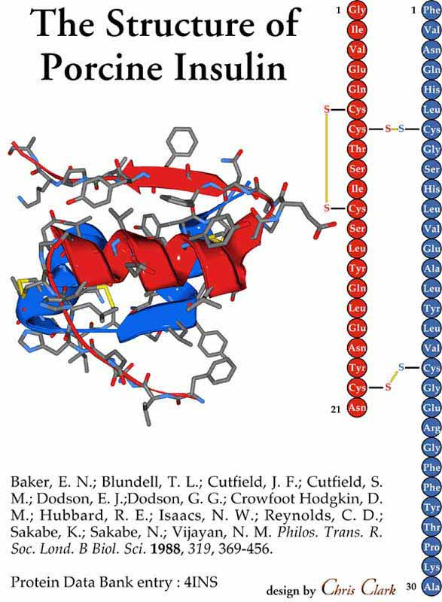
Example: Insulin Yay Kaitlin☺
Insulin is 1st synthesized as a single polypeptide chain, but only becomes active after an enzyme cuts out a central part of the chain
This leaves a protein composed of 2 polypeptide chains connected through disulfide bridges

Slide 68
Ribosomes
Free ribosome
Bound ribosomes
Suspended in the cytosol
Make proteins that will remain in the cytosol for internal cellular use
Bound to the cytosolic face of the RER or nuclear envelope
Make proteins of the:
Endomembrane System
Nuclear envelope
Golgi
Lysosome
Vacuoles
Plasma membrane
As well as proteins that are to be secreted (like insulin)

Slide 69
Targeting Polypeptides to Specific Locations
Protein synthesis always begins in the cytosol where a free ribosome begins translation of an mRNA molecule
There the process continues until completion unless the growing polypeptide itself signals the ribosome to attach to the ER
Polypeptides destined for the endomembrane system or secretion are marked by signal peptides

Slide 70
Signal Peptides
Target the protein to the ER
About 20a.a.’s long at or near the leading end of the polypeptide
Signal peptides are recognized as they emerge from the ribosome by a complex called a signal-recognition particle (SRP)
SRP’s bring the ribosome to a receptor protein built into the ER which is part of a translocation complex

Slide 71
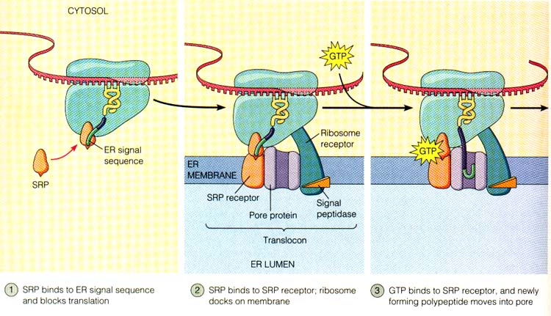

Slide 72
Translation
Translation then continues on the ribosome bound to the translocation complex until the growing polypeptide snakes across the ER membrane into the lumen via a protein pore
If it to be a membrane bound protein, only part of the peptide will enter the lumen, while another part remains embedded in the membrane
If it will be secreted, the entire polypeptide is released to the lumen
Signal peptides are usually removed by an enzyme

Slide 73
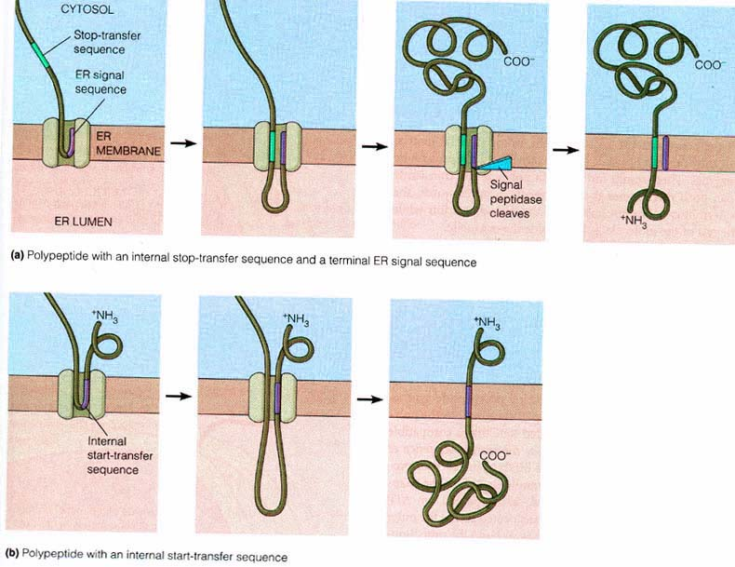

Slide 74
Targeting to Other Organelles
Different signal sequences are used to target proteins to different organelles
Translation is always completed before a protein is targeted to an organelle other than the ER
Mitochondria
Chloroplast
Interior of the nucleus
Lysosome

Slide 75
Point Mutations
Point mutations are chemical changes to a single base pair of a gene
Insertions
Deletions
Substitutions

Slide 76
Substitutions
A base pair substitution is the replacement of one nucleotide and its partner with another pair of nucleotides
So it may look like this
AATTCCCGATCAG AATTCTCGATCAG
TTAAGGGCTAGTC TTAAGAGCTAGTC
http://animation

Slide 77
3 Main Types of Substitutions
Silent mutation: the new codon codes for the same amino acid as the original, and so there is no net change in protein structure or function
No disease
Missense mutations: mutations in which the new codon codes for a different amino acid
May or may not cause disease
Nonsense mutations: causes premature termination of polypeptide

Slide 78
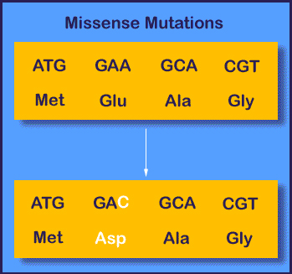
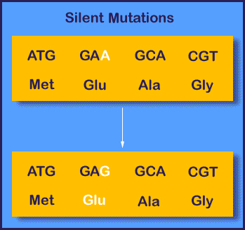
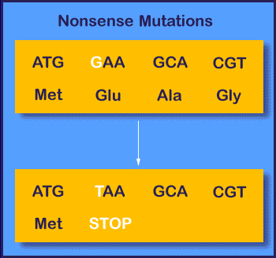

Slide 79
Insertions & Deletions
When the ribosome moves along the mRNA it reads the nucleotides in groups of 3, codons
This is called the reading frame
Insertions are the addition of a nucleotide pair, while deletions are the removal of a nucleotide pair
Both insertions and deletions change the reading frame of the genetic message and so are termed frameshift mutations
The only time they do not alter the reading frame is when a multiple of 3 nucleotides is inserted or deleted

Slide 80
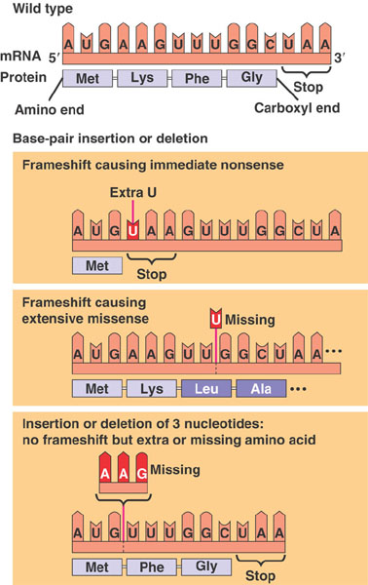
Farmeshift Mutations
Frameshift mutations have disastrous effects on resulting proteins, more so than do substutions
animation

Slide 81
Example: Tay Sachs
Tay-Sachs disease is an autosomal recessive disorder affecting the CNS.
Results from mutations in the gene encoding hexosaminidase A, a lysosomal enzyme.
78 mutations in the Hex A gene have been described and include 65 single base substitutions, one large and 10 small deletions, and two small insertions.
45 of the single base substitutions cause missense mutations;
39 of these are disease causing,
3 are benign but cause a change in phenotype,
3 are neutral polymorphisms.
6 nonsense mutations and 14 splice site lesions result from single base substitutions, and all but one of the splice site lesions cause a severe form of Tay-Sachs disease.
8 frameshift mutations arise from 6 deletion- and 2 insertion-type lesions.

Slide 82
Eukaryotic Gene Expression
All organisms must regulate which genes are expressed at any given time
Organisms must be able to continuously an selectively turn genes on and off in response to signals from both their internal and external environment
Regulation of gene expression is essential for differentiation and specialization of multicellular organisms

Slide 83
Differential Gene Expression
A typical human cell probably expresses about 20% of its genes at any given time
Highly differentiated cells like muscle or nerve cells probably express less
The differences between cell types are not due to different genes, they all have the same genome, but rather to differential gene expression

Slide 84
Human Genome
Only 1.5% of DNA in humans codes for protein
Some of the rest codes for RNA
mRNA
tRNA
rRNA
snRNA
Over 98% of DNA ha no known function!

Slide 85
Eukaryotic Gene Expression can be Regulated at any stage
Regulation of chromatin structure
The location of a genes promoter relative to a nucleosome & the sites where DNA attaches to the chromosomal scaffold or nuclear lamina can affect whether a gene is transcribed
Genes in heterochromatin usually aren’t expressed
Regulation of transcription initiation
Post transcriptional regulation

Slide 86
Regulation of Chromatin Structure
Histone Modifications
DNA Methylation
Epigenetic Inheritance

Slide 87
DNA Methylation
In general DNA is methylated on cytosine residues and methylation leads to gene inactivation
Once methylated, genes usually stay that way through successive cell divisions
Parent strands not only act as a template to build new daughter strands, but also to correctly methylate daughter strands
These methylation patterns are tissue specific, and accounts for genomic imprinting

Slide 88
Regulation of Chromatin Structure
Histone Modifications
Epigenetic Inheritance
Histone acetylation leads to increased transcription
Deacetylation inhibits transcription
Histone methylation = no transcription
Histone methylation+ phosphorylation = more gene expression
Inheritance of traits transmitted by mechanisms not directly involving the nucleotide sequence is called epigenetic inheritance
These can be reversed

Slide 89
Regulation of Transcription Initiation
Chromatin modifying enzymes provide initial control of gene expression by making a region of DNA either more or less accessible to transcriptional machinery
Control elements: segments of noncoding DNA that help regulate transcription by binding certain proteins

Slide 90
Regulation of Transcription Initiation: The Role of Transcription Factors
General TF’s
Specific tf’s
Transcription factors that are essential for transcription of all protein coding genes
Some bind the DNA directly, others bind other proteins like RNA Pol II
Only once the Initaition Complex is complete can RNA Pol II begin to move
Responsible for high levels of gene expression of particular genes at specific times in specific tissues
Often works with Enhancers

Slide 91
Regulation of Transcription Initiation: Enhancers
Located sometimes thousands of nucleotides upstream or downstream of a gene, even sometimes within an intron
A given gene may have multiple enhancers, each active at a different time or in a different cell type
Each enhancer is associated with only one gene

Slide 92
Regulation of Transcription Initiation: Enhancers
In eukaryotes, the rate of gene expression can be strongly influenced by the binding of proteins, either activators or repressors, to the enhancers
Because of the distance of the enhancer from the gene this typically involves the folding back of the DNA onto itself and interactions with mediator proteins

Slide 93
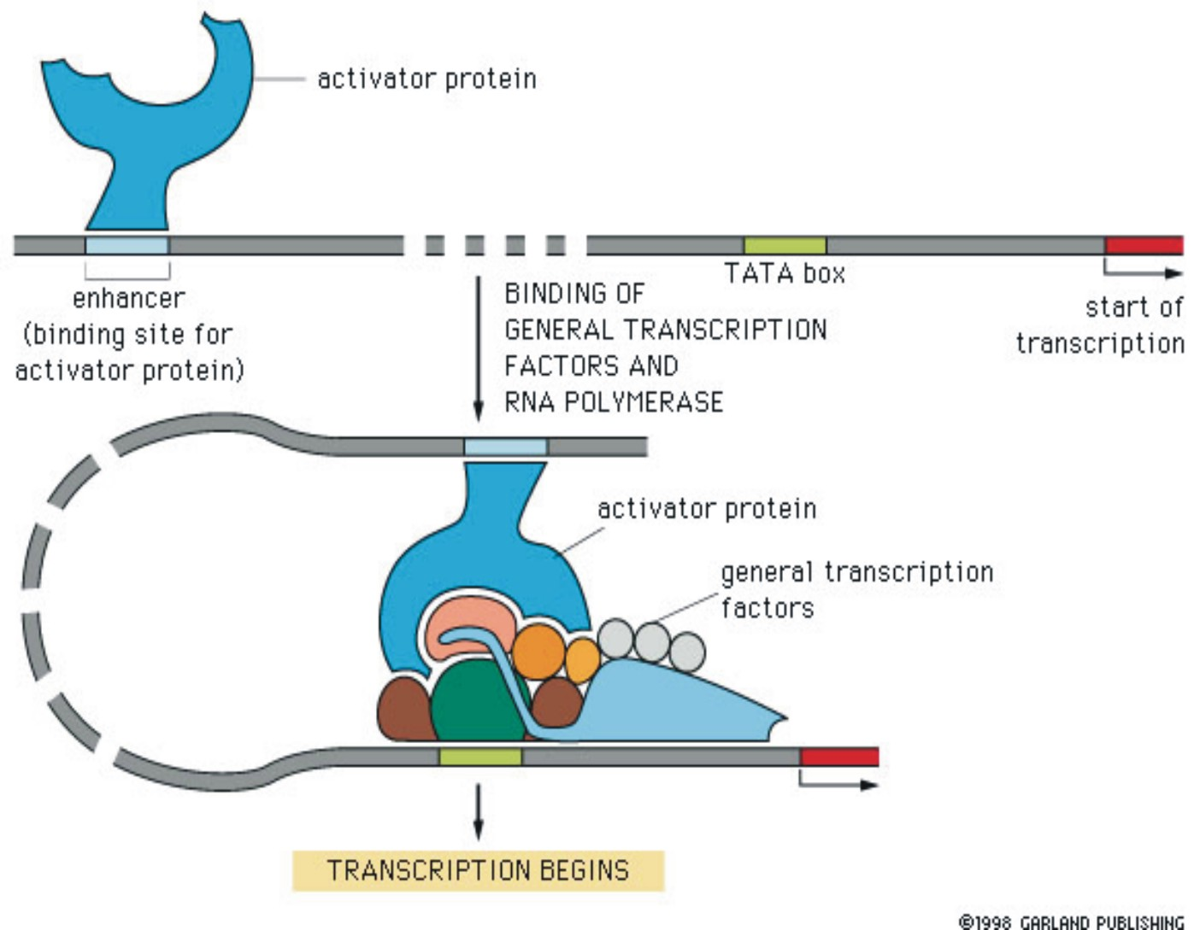

Slide 94
Repressors
Some bind directly to DNA blocking activator binding
Some are able to turn off transcription even when activators are present
Some affect chromatin structure by de-acetylating histones
This is know as Gene Silencing
Some activators work by acetylating histones

Slide 95
Coordinately Controlled Genes in Eukaryotes
Sometimes genes with related functions need to be turned on or off at the same time
Sometimes these genes will be clustered together in which they can be regulated together through
Changes in chromatin structure that make the entire group available or unavailable for transcription
Rarely in eukaryotes, but occasionaly they will share the same promoter

Slide 96
Coordinately Controlled Genes in Eukaryotes
More commonly genes are scattered over several chromosomes
Coordinate gene expression in these cases depends on associations between specific combinations of control elements
Many activators may bind to the many genes at the same time to promote simultaneous transcription

