Slide 1
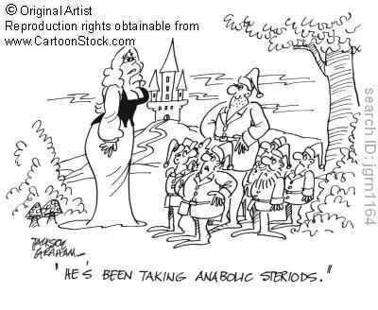
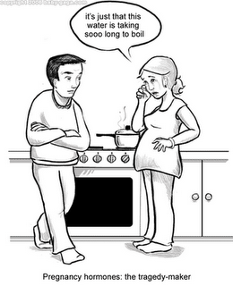
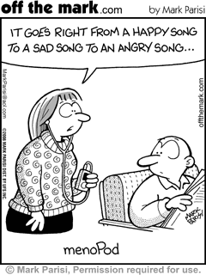
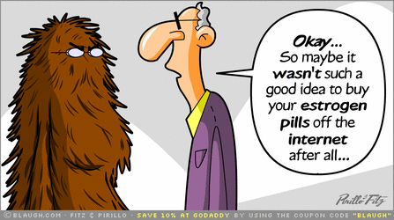
Hormones & the Endocrine System

Slide 2
Hormones
Hormone: a chemical signal that is secreted into the extracellular fluid, is carried by the circulatory system (in blood or hemolymph) and communicates a regulatory message within the body
Hormones can travel throughout the entire body, but only target cells are equipped to respond
Thus, a given hormone traveling through the body elicits specific responses , such as a change in metabolism , from its target cells while other cell types remain unaffected by that particular hormone

Slide 3
Regulation of Animal Physiology
Animals have 2 systems of internal communication
Endocrine system: the collection of hormone secreting cells
Nervous system: conveys high speed electrical signals along specialized cells called neurons
The endocrine system and the nervous system act individually and together in regulating an animals physiology

Slide 4
Hormones
Hormones coordinate slower but longer lasting responses to stimuli such as stress, dehydration, and low blood glucose levels
Regulate long term developmental processes by informing different parts of the body how fast to grow or when to develop characteristics that
Distinguish male from female
Distinguish juvenile from adult

Slide 5
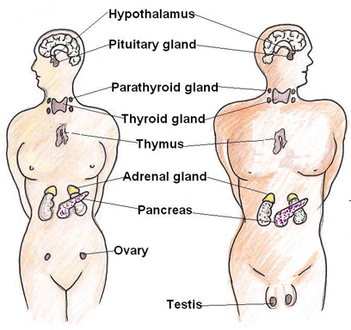
Endocrine Glands
Secrete their chemical messengers (hormones) directly into the extracellular fluid allowing for quick diffusion and circulation

Slide 6
Overlap Between Endocrine & Nervous Regulation
Neurosecretory cells blur the line between nervous and endocrine regulation
Release hormones into the blood via the extracellular fluid
Sometimes called neurohormones to distinguish from classic hormones
Some hormones function as both endocrine hormones and and chemical signals in the nervous system
Epinephrine→ fight or flight
Nervous system plays a role in sustained responses by increasing or decreasing secretion from endocrine glands

Slide 7
Feedback Loops: Back to Basics
A receptor on/in a cell is bound by a molecule
Signal transduction pathways allow the cell to detect the stimulus and sends the information to its control center
The incoming information is compared to a desired value, and the control center sends out a signal that directs an effector to respond

Slide 8
Control Pathways and Feedback Loops
Now apply this to hormones…
In endocrine and neuroendocrine pathways, the outgoing signal, called an efferent signal is a hormone or neurohormone which acts on particular effector tissues and elicits physiological or developmental changes
There are about 20 different hormones we will be learning about, and each acts via one of the 3 following pathways

Slide 9
Basic Patterns of Simple Hormonal Control Pathways
Simple Endocrine Pathway
Simple Neurohormone Pathway
Simple Neuroendocrine Pathway
In each pathway a receptor (blue) detects a change in some internal or external variable - the stimulus- and informs the control center (gold)
The control center then sends out an efferent signal
Hormone (red circles)
Neurohormone (red squares)
Endocrine cells carry out both receptor and effector functions

Slide 10
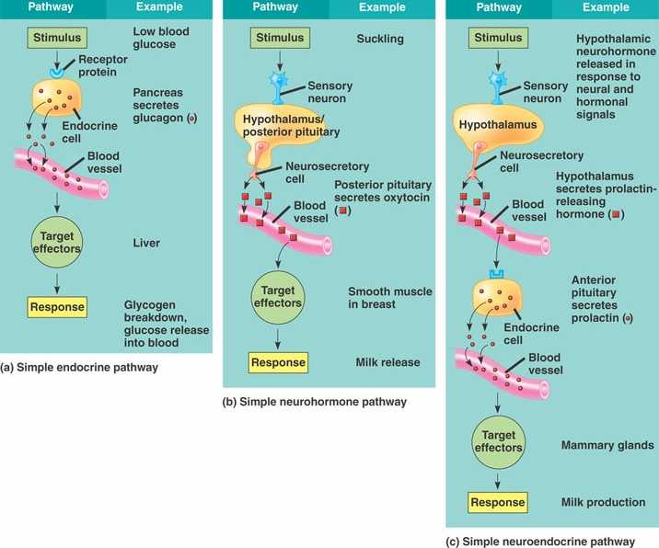

Slide 11
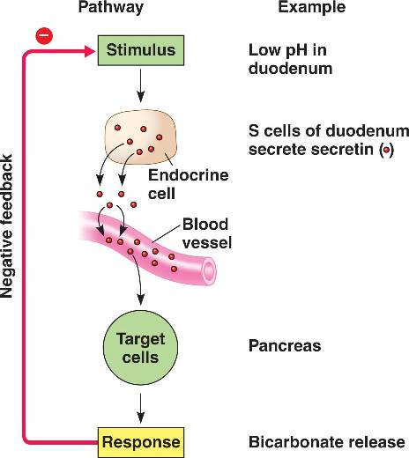
Control Pathways & Feedback Loops
Feedback loops connect the response to the initial stimulus
Negative feedback: the effector response reduces the initial stimulus
Prevents overreaction by the system and wild fluctuations in the variable being regulated
Operates in many endocrine and nervous pathways, especially those necessary for maintaining homeostasis!

Slide 12
Control Pathways & Feedback Loops
Feedback loops connect the response to the initial stimulus
Positive Feedback: reinforces the stimulus and leads to an even greater response
Example: the neurohormone pathway regulating the release of milk by a nursing mother
Suckling stimulates sensory nerves in the nipple
Nipple sends nervous signals to hypothalamus (control center)
Hypothalamus triggers release of neurohormone oxytocin from the posterior pituitary gland
Oxytocin causes mammary gland to secrete more milk
Release of milk leads to more suckling, stimulating pathway more

Slide 13
3 Major Classes of Molecules Function as Hormones
Proteins and peptides
Amines derived from amino acids
Steroids (not soluble in water)
Water Soluble

Slide 14
3 Key Events in Hormone Signalling
Reception of the signal: occurs when signal molecule binds receptor protein in/on target cell
Receptors usually bound to plasma membrane or nuclear envelope
Signal Transduction:
usually via signaling cascades involving phosphorylation of proteins
OR direct up-regulation of transcription of target genes
Response: via change in cells behavior or phenotype

Slide 15
Cell Surface Receptors for Water Soluble Hormones
Receptors for most water soluble hormones are embedded in the plasma membrane projecting outward from the cell surface
Binding of hormone to its receptor initiates a signal transduction pathway
A series of changes in cellular proteins that converts the extracellular chemical signal to a specific intracellular response
Activation of an enzyme
Changes in uptake or secretion of molecules
Rearrangement of cytoskeleton
Regulation of transcription

Slide 16
Cell Surface Receptors for Water Soluble Hormones: Example
The ability of frogs to change the color of their skin is an adaptation that helps camouflage the frog in changing light
Skin cells called melanocytes contain dark brown pigments called melanin in cytoplasmic organelles called melanosomes
The frogs skin appears light when melanosomes cluster tightly around the cell nuclei and darker when melanosomes spread throughout the cytoplasm

Slide 17
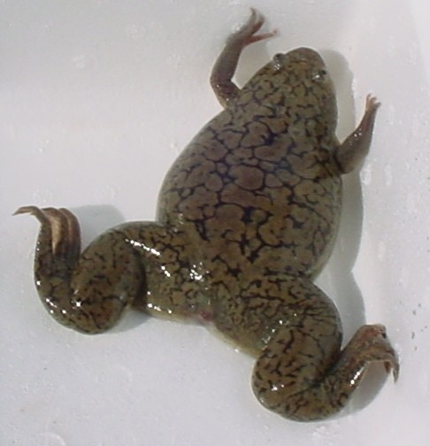
Camouflaging a Frog
A peptide hormone called melanocyte stimulating hormone controls the arrangement of melanosomes
Adding MSH to the interstitial fluid causes melanosomes to disperse
Direct injection into a cell does not…
WHY?

Slide 18
Intracellular Receptors for Lipid Soluble Hormones
Steroid hormones are small, nonpolar (hydrophobic) molecules that diffuse easily through the hydrophobic interior of the plasma membrane
Intracellular proteins / receptors
function as receptors for
Steroid hormones
Thyroid hormones
Hormonal form of vitamin D
usually perform the vital task of transducing a signal within a target cell
Usually the hormone-receptor complex acts as a transcription factor
Usually located in the nucleus

Slide 19
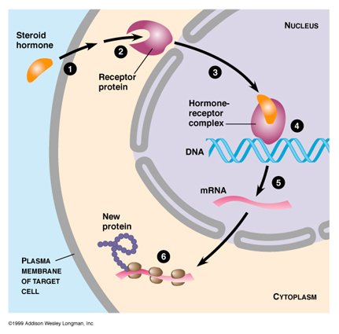
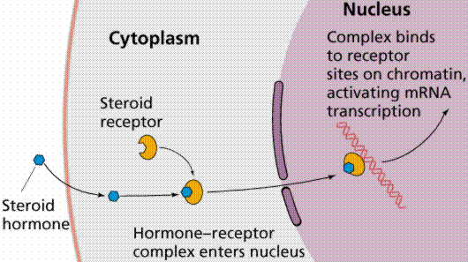

Slide 20
Paracrine Signaling by Local Regulators
Paracrine Signaling: local regulators that convey messages to neighboring cells
Takes seconds or milliseconds to elicit a response
Some have cell surface receptors, others use intracellular receptors
Examples of Paracrine Signaling Molecules
Neurotransmitters
Cytokines
Growth factors
Nitric oxide
Prostaglandins
In Case you didn’t get this, paracrine signalling is the OPPOSITE of endocrine signaling

Slide 21
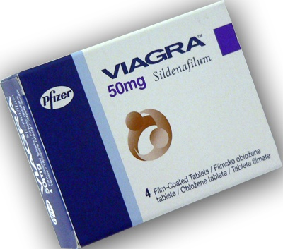
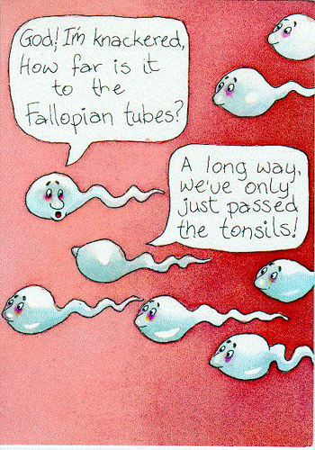
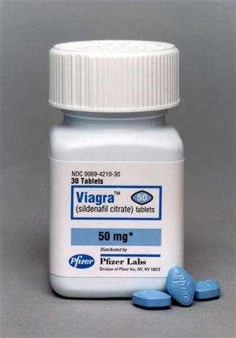
Paracrine Signaling
Nitric Oxide (NO)
Prostaglandin (PG)
Modified fatty acids derived from lipids in the plasma membranes
1st discovered in semen secreted from the PROSTATE GLAND (hence the name)
Help stimulate contraction of the uterine wall to help the swimmers make it to the egg (also during child birth to increase contractions)
Immune response: increased fever & inflammation
Also involved in blood clotting
When blood O2 levels fall it activates enzymes that relaxes smooth muscle→ vessel dilation →increased blood flow
Increases blood flow to the penis during male sexual arousal
Release the Prostaglandins !!

Slide 22
What you need to learn…
Physiological Effects of the Primary Vertebrate Hormones
The Role of endocrine signaling in adjusting the bodies activities to changing environmental and developmental conditions
Memorize Table 45.1 on page 949

Slide 23
Relationship Between the Hypothalamus & the Pituitary Gland
Hypothalamus plays an important role in integrating the endocrine and nervous system
Hypothalamus receives info from other parts of brain or body and initiates appropriate endocrine responses
Example: brain passes sensory info about seasonal changes and mate availability to the hypothalamus via nerve signals; hypothalamus then triggers release of reproductive hormones
Contains 2 sets of neurosecretory cells whose hormonal secretions are stored in or regulate the pituitary
Pituitary: Composed of 2 fused glands located at the base of the hypothalamus

Slide 24
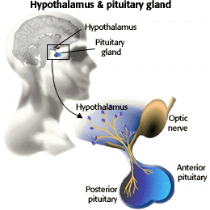

Slide 25
Posterior Pituitary
An extension of the hypothalamus stores and secretes 2 hormones (made by the hypothalamus) both of which function via the simple neurohormone pathway
Antidiuretic Hormon (ADH): acts on kidneys increasing water retention and thus decreasing urine volume
Helps regulate osmolarity of blood
Negative feedback pathways
Oxytocin: induces in uterus to contract in child birth, and causes mammary glands to eject milk
Positive feedback pathways

Slide 26
Anterior Pituitary
Consists of endocrine cells that synthesize and secrete at least 6 different hormones
Tropic hormones: are hormones produced and secreted by the anterior pituitary that target endocrine glands.
Thyroid-stimulating hormone (TSH ) –promotes normal development of the thyroid and stimulates the thyroid gland to make and release thyroid hormone
Luteinizing hormone (LH) – stimulates the release of steroid hormones in gonads—the ovary and testes
Follicle-stimulating hormone (FSH) – stimulates the maturation of eggs and production of sperm.
Adrenocorticotropic hormone (ACTH ) –a peptide hormone that stimulates the adrenal cortex to release glucocorticoids
All 4 anterior pituitary tropic hormones participate in complex neuroendocrine pathways in which signals to the brain stimulate release of an anterior pituitary tropic hormone; which then acts on its target endocrine tissue, stimulating secretion of yet another hormone that exerts systemic metabolic or developmental effects
FSH, LH, & TSH are all similar glycoproteins
FSH & LH are also called gonadotropins because they stimulate activities of the gonads

Slide 27
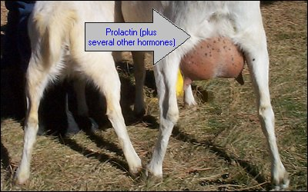
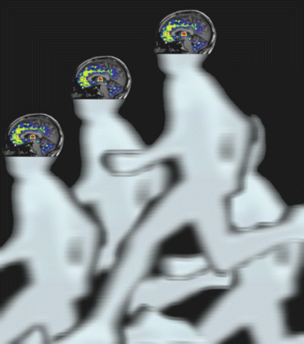
Nontropic Hormones of the Anterior Pituitary
Prolactin (PRL): stimulates mammary gland growth & milk synthesis in vertebrates
Melanocyte-stimulating hormone (MSH): regulates activity in pigment containing cells in the skin of some fishes, amphibians, and reptiles
In mammals acts on neurons in the brain inhibiting hunger
My MSH is defective
Endorphins: bind receptors in the brain and dull the perception of pain
Responsible for “runners high”

Slide 28
One More Anterior Pituitary Hormone: Growth Hormone
Acts on a wide variety of tissues exhibiting both tropic and nontropic effects
Signals liver to release Insulin Like Growth Factors (IGFs): circulate in the blood and directly stimulate bone and cartilage growth
Necessary for proper skeletal development

Slide 29
Thyroid Gland
Thyroid gland : one of the largest endocrine glands in the body.
Produces 2 hormones, both derived from the amino acid tyrosine, which both bind to the same receptor located in the target cells nucleus
Triiodothyronine (T3)
Thyroxine (T4)
Hypothalamus & anterior pituitary control secretion of thyroid hormones

Slide 30
Thyroid Hormones
Basically he thyroid controls how quickly the body uses energy, makes proteins, and controls how sensitive the body should be to other hormones
The thyronines act on nearly every cell in the body.
increase the basal metabolic rate
affect protein synthesis
help regulate long bone growth and neuronal maturation
increase the body's sensitivity to s adrenaline
are essential to proper development and differentiation of all cells of the human body.
regulate protein, fat, and carbohydrate metabolism ,affecting how human cells use energetic compounds.
stimulate vitamin metabolism
Thyroid hormone plays an important role in the hibernation cycles of mammals and the moulting behaviour of birds.

Slide 31
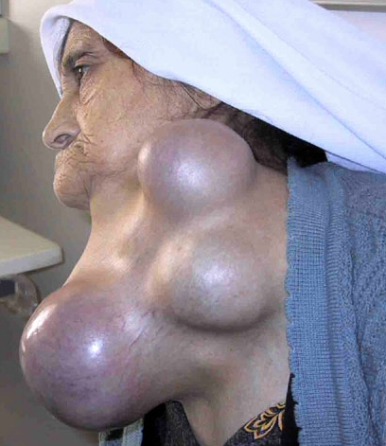
Thyroid Malfunction
Goiter: is a swelling in the thyroid gland, which can lead to a swelling of the neck or larynx (voice box).
most common cause for goiter is iodine deficiency
Deficiency of iodine in diet prohibits the thyroid from making adequate amounts of T3 and T4
This results in low blood levels of T3 & T4 which cant exert the usual negative feedback on the hypothalamus & anterior pituitary
Consequently, the pituitary continuse to secrete TSH
TSH stimulates the thyroid to grow, forming a goiter

Slide 32
Other Problems of the Thyroid
Hypothyroidism (underactive thyroid)
Hyperthyroidism (overactive thyroid)
Graves' disease is an autoimmune disease where the thyroid is diffusely enlarged and overactive, producing an excessive amount of thyroid hormones
caused by autoantibodies to the TSH-receptor (TSHR-Ab) that activate that TSH-receptor, thereby stimulating thyroid hormone synthesis and secretion and thyroid growth

Slide 33
Parathyroid Hormone & Calcitonin
Ca₂⁺ ions are critical to functioning of all cells, so control of blood calcium levels must be maintained
If Ca₂⁺ are too low, muscles contract convulsively in a condition known as tetany
If uncorrected its fatal
Parathyroid hormone & Calcitonin have opposing actions that regulate blood Ca₂⁺ levels
Parathyroid hormone (PTH) produced by parathyroid gland
Converts Vitamin D to its active hormone form which stimulates uptake of Ca₂^{+ from food}
Calcitonin produced by thyroid has opposite effects of PTH and lowers levels of Ca₂⁺ in blood

Slide 34
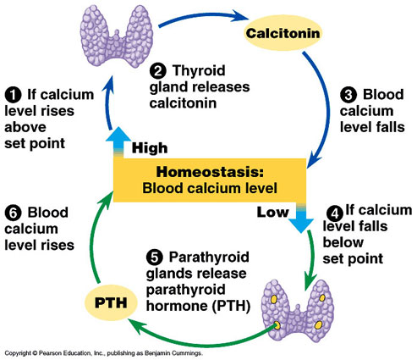

Slide 35
Pancreas
The pancreas is a gland organ in the digestive and endocrine system of vertebrates.
It is both an endocrine gland producing several important hormones, including
Insulin
Glucagon
somatostatin
as well as an exocrine gland, secreting pancreatic juice containing digestive enzymes that pass to the small intestine

Slide 36
Islets of Langerhans
Clusters of endocrine cells called Islets of Langerhans (about 1-2% 0f the pancreas) are scattered throughout the exocrine tissue (98-99% of pancreatic tissue)
Each Islet has a population of
α cells which produce glucogon
β cells which produce insulin
Both of these proteins are secreted to the extracellular fluid and enter the circulatory system
They are antagonistic hormones that regulate concentration of glucose in the blood
Metabolic homeostasis requires maintaining blood glucose concentrations near about 90 mg/100 mL

Slide 37
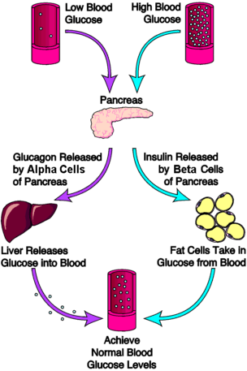
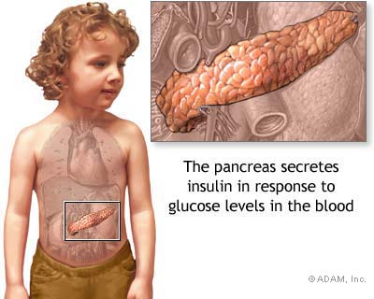
Insulin & Glucagon
Insulin lowers blood glucose levels by stimulating virtually all body cells except those of the brain to take up glucose from the blood, and also slows down break down of glycogen in the liver

Slide 38
Diabetes Mellitus
a condition in which a person has a high blood sugar either because the body doesn't produce enough insulin, or because body cells don't properly respond to the insulin
The most common types of diabetes are:
Type 1 diabetes: results from the body's failure to produce insulin, and presently requires the person to inject insulin.
Type 2 diabetes: results from insulin resistance, a condition in which cells fail to use insulin properly, sometimes combined with an absolute insulin deficiency.
Gestational diabetes: is when pregnant women with no history of diabetes, have a high blood glucose level during pregnancy.
Test for diabetes include direct testing of blood sugar levels via finger prick or testing for sugar levels in the urine
High levels of sugar in urine may give it a sweet odor

Slide 39
Adrenal Glands
triangular-shaped endocrine glands that sit on top of the kidneys.
They are chiefly responsible for releasing hormones in conjunction with stress through the synthesis of corticosteroids and catecholamines, including cortisol and adrenaline (epinephrine)

Slide 40
Catecholamines (see p957)
released by the adrenal glands in response to stress.
They are part of the sympathetic nervous system
epinephrine (adrenaline): is a hormone and neurotransmitter
it increases heart rate, contracts blood vessels and dilates air passages and participates in the fight-or-flight response
norepinephrine (noradrenaline): is a hormone and neurotransmitter
is a stress hormone affects parts of the brain where attention and responding actions are controlled.
underlies the fight-or-flight response, directly increasing heart rate, triggering the release of glucose from energy stores, and increasing blood flow to skeletal muscle

Slide 41
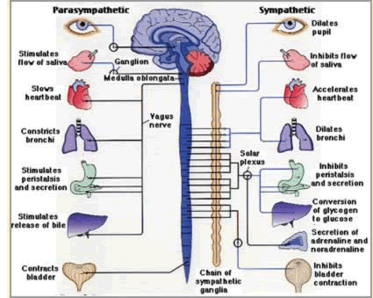

Slide 42
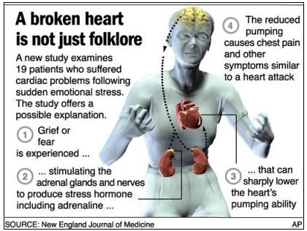
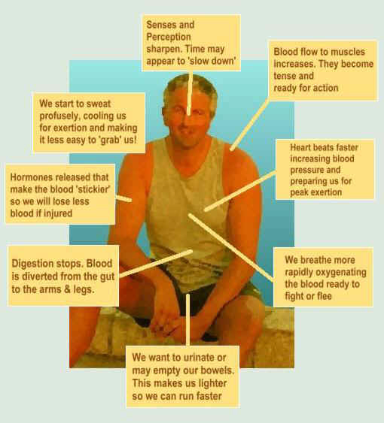
Adrenal Hormones: Response to Stress

Slide 43
Steroid Hormones from the Adrenal Cortex
Catecholamines
Epinepherine
Norepinephrine
Corticosteroids
Glucocorticoides
Mineralocorticoides
Sex Hormones
All synthesized from cholesterol
Mainly androgens (male hormones) some estrogens and progestines (female hormones)

Slide 44
Steroid Hormones from the Adrenal Cortex
Hormones from the adrenal cortex function in response to stress induced endocrine signals
Stressful stimuli cause hypothalamus to release a hormone that stimulates the anterior pituitary to release ACTH
When ACTH reaches adrenal cortex via blood stream it stimulates the endocrine cells to synthesize and secrete corticosteroids
Corticosteroids work via negative feedback to suppress ACTH secrtetion

Slide 45
2 Main Types of Corticosteroids
Glucocorticoids: class in the regulation of the metabolism of glucose and are part of the feedback mechanism in the immune system that turns immune activity (inflammation) down
Cortisol
Used to treat autoimmune diseases and arthritis
Mineralocorticoid: influence on salt and water balances
Stimulates kidneys to reabsorb sodium ions and water
Evidence suggests both are involved in the bodys ability to maintain homeostasis over extended periods of stress

Slide 46
Gonadal Sex Hormones
Gonads are the primary source of sex hormones
Gonads produce and secrete 3 major classes of steroid hormones
Androgens
Estrogens
Progestins
All 3 types are found in both males and females, just proportions are different

Slide 47
Androgens
Testes produce mainly androgens
Main androgen is testosterone
Androgens stimulate development and maintenance of the male reproductive system
At puberty high concentrations of androgens are responsible for development of human male secondary sex characteristics
Patterns of hair growth
Low voice
Increased muscle and bone mass

Slide 48
Estrogens & Progestins
Both are components of complex neuroendocrine pathways
Synthesis is controlled by gonadotropins FSH & LH
Estrogens: Most importat is estradiol
Responsible for maintenance of female reproductive system and development of female secondary sex characteristics
Progestins: include progesterone
Primarily involved in preparing and maintaining the uterus which supports growth and development of an embryo

Slide 49
Melatonin & Biorythyms
Pineal gland: synthesizes and secretes the hormone melatonin, a modified amino acid
Depending on the species the pineal gland contains light sensitive cells or has nervous connections from the eyes that control its secretory activity
Melatonin regulates functions related to light and seasons marked by changes in day length
Is secreted at night
Decreases the activity of certain neurons in the brain, and thus mediates rhythyms

Slide 50
Invertebrate Regulatory Systems
Invertebrate regulatory systems also involve endocrine and nervous system interactions
We know the most about invertebrate hormones involved in reproduction
Hydra have a hormone that stimulates budding while preventing sexual reproduction
In molluscs specialized nerve cells secrete a neurohormone that that stimulates the laying of thousands of eggs and also inhibits feeding and locomotion (activities that interfere with reproduction)

Slide 51
In Arthropods Molting is Triggered by a Hormone
Most insects go through a series of larval stages, controlled by hormones, with each molt leading to a larger larva. Molting of the final larval stage gives rise to a pupa, in which metamorphosis produces and adult.
Three hormones control insect development
Brain Hormone (BH): stimulates release of ecdysone
Ecdysone: promotes molting and development of adult characteristics
Juvenile Hormone (JH): promotes retention of larval (juvenile) characteristics

Slide 52
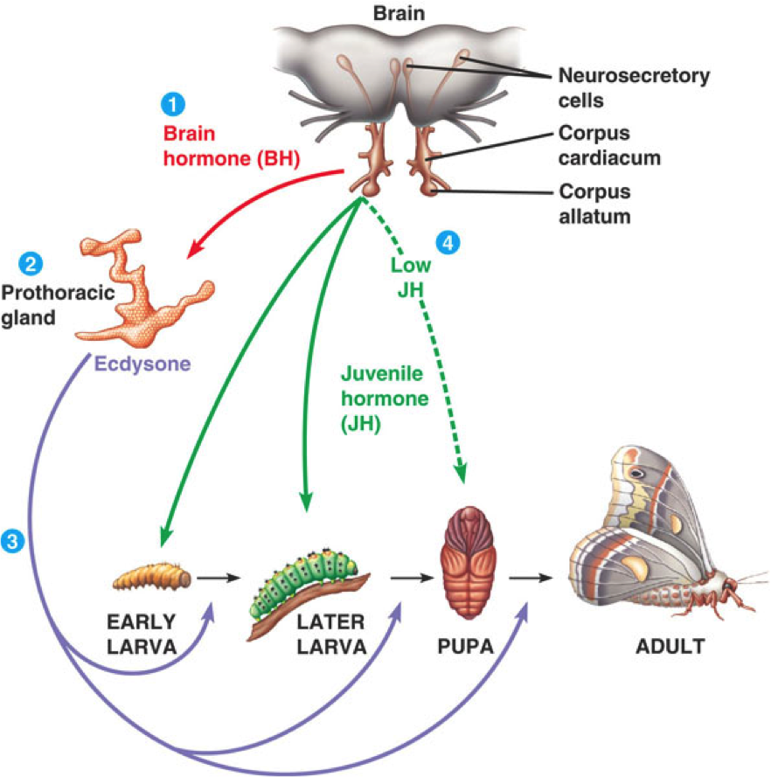
In Arthropods Molting is Triggered by a Hormone
1. Neurosecretory cells in the brain produce BH which is stored in the corpus cardiacum until release
JH secreted by the corpora allata, determines the result of the molt. At relatively high concentrations of JH, ecdysone-stimulated molting produces another larval stage. JH supresses metamorphosis. But when levels are low a pupa forms at the next ecdysone-induced molt. The adult insect emerges from the pupa
2. BH stimulates its main target organ the prothoracic , to produce the hormone ecdysone
3. Ecdysone secretion is episodic with each release stimulating a molt

