Slide 1
Human Mitochondrial DNA

Slide 2
1st Review: Cell Theory
All organisms are composed of cells.
All cells come from preexisting cells
The cell is the basic unit of structure & organization of organisms

Slide 3
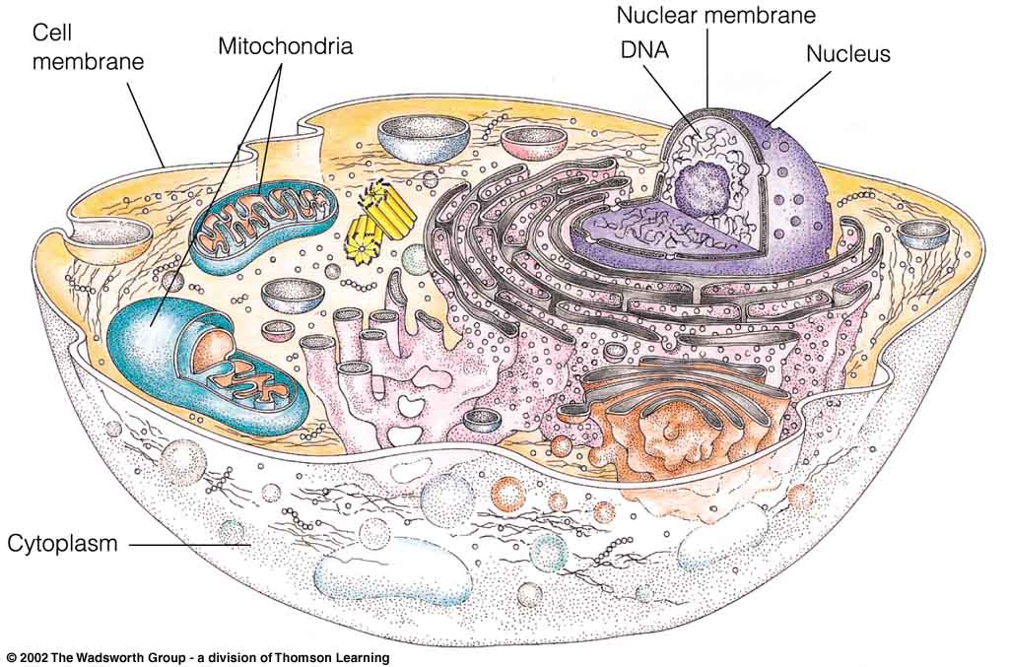
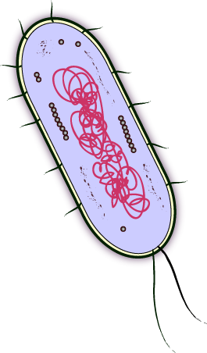
2 Main Divisions of Cells
Prokaryotic
Bacteria
Eukaryotic
Animals
Plants
Fungi
Protists

Slide 4
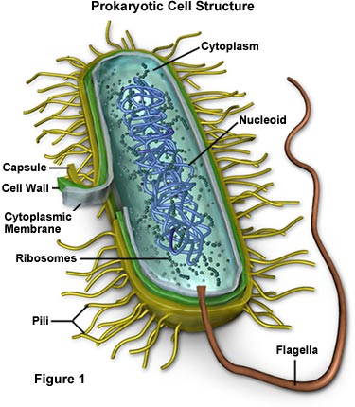
Prokaryotic Cells
Unicellular
Bacteria
Simple in Structure
Cell wall
Plasma membrane
DNA (1 circular chromosome)
Ribosomes

Slide 5
Eukaryotic Cell Structures
Plasma Membrane
Nucleus
Smooth & Rough Endoplasmic Reticulum
Mitochondria
Ribosome
Golgi
Lysosomes (not in plants)
Centrosome
Vessicles
Other Organelles in Plants:
Chloroplast
Cell walls
Central Vacuoles

Slide 6
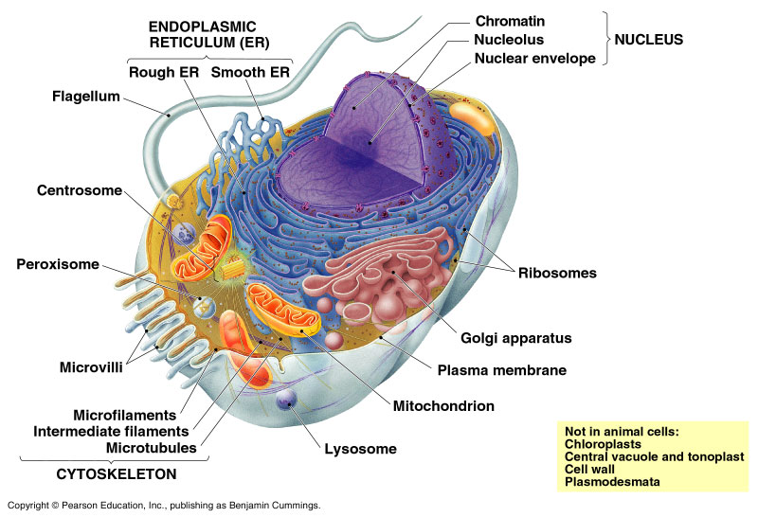

Slide 7
Mitochondria
Structure: 2 membranes.
The inner membrane has more surface area than the outer membrane.
Matrix: inner space.
Intermembrane space: area between the membranes.
Found in most eukaryotic cells
Sometimes described as "cellular power plants" because they generate most of the cell's supply of adenosine triphosphate (ATP)
ATP is used as a source of chemical energy.

Slide 8
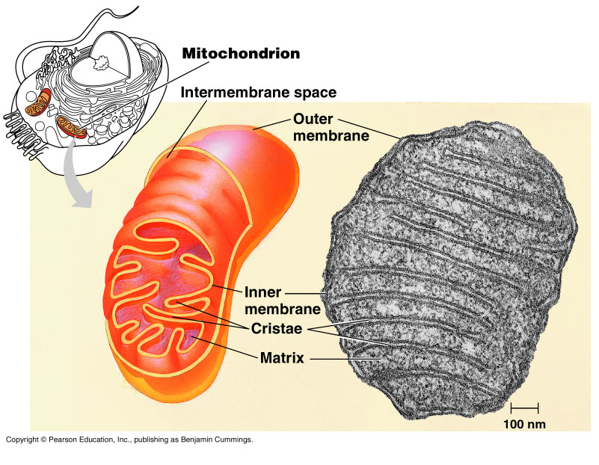
Inner-membrane
Folded into cristae.
Amount of folding depends on the level of cell activity.
Contains many enzymes.
ATP generated here.

Slide 9
Origins of Mitochondria
There is strong evidence that mitochondria once existed as free living bacteria, which were taken up by primitive ancestors of eukaryotic cells
The mitochondria were an example of endosymbionts, prokaryotic species that lived within larger prokaryotes.
The host cell (the larger prokaryote) provided a ready source of energy rich nutrients , and the mitochondrion provided a means to extract energy using oxygen
This attribute was key to survival as oxygen accumulated in the early atmosphere

Slide 10
Endosymbiont Theory
Chloroplasts are thought to have descended from endosymbiotic photosynthesising prokaryotes living in larger cells.
Mitochondria are postulated to be descendants of prokaryotic aerobic heterotrophs that may have been parasites or undigested prey of larger prokaryotes.
It is believed that the association progressed from parasitism or predation to mutualism.

Slide 11
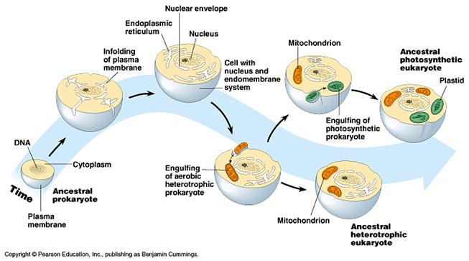
Origins of the Mitochondria
Endosymbiont Theory:

Slide 12
Evidence that Supports the Endosymbiont Theory
Are appropriate size to be descendants of eubacteria,
in other words, mitochondria and chloroplast are the same size as most eubacteria
Have inner membranes containing several enzymes and transport systems similar to those on prokaryotic plasma membranes.
Replicate through binary fission, independent of the cell they are in

Slide 13
Evidence that Supports the Endosymbiont Theory
DNA is circular and not associated with histones or other proteins, as in prokaryotes.
There are very few introns (noncoding) sequences in the mitochondrial genome
Contain their own components for DNA transcription and translation into proteins
Have ribosomes similar to prokaryotic ribosomes
-molecular systematics lends evidence to support this theory

Slide 14
Mitochondrial DNA
In addition to the 46 chromosomes found in the nucleus of human cells, each mitochondrion in the cells cytoplasm has several copies of its own genome
The mitochondrial genome contains only 37 genes
Mt genes code for proteins that are involved in the process of oxidative phosphorylation
Energy production and storage in ATP

Slide 15
Mitochondrial Genome
The entire DNA sequence of the mitochondrial genome is 16,569 nucleotides long
The mt genome was sequenced in 1981, well before the completion of the human genome project
There is a small noncoding region of approximately 1,200 nucleotides that contains signals which control the replication of the chromosome and transcription of mt genes
This region is known as the mt “control region”

Slide 16
Mitochondrial Control Region
The DNA sequence of the mitochondrial control region is termed hypervariable
It accumulates mutations at approximately 10 times the rate of nuclear DNA
This high mutation rate results in unique patterns of single nucleotide polymorphisms (SNP’s) which are inherited through generations

Slide 17
A Universal Family Tree
In the 1980s Alan Wilson at the University of California at Berkeley used mt DNA polymorphisms to create a “family tree” showing ancestral relationships between modern populations
He reasoned that all human populations arose from a common ancestor in the distant evolutionary past
Wilsons group calculated how long it would take to accumulate the patterns of mutations observed in modern populations

Slide 18
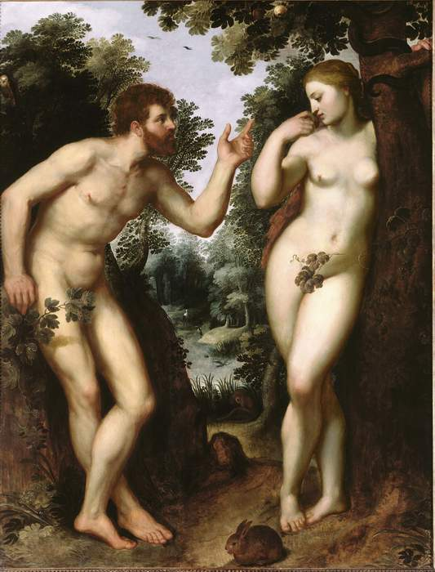
Adam & Eve?
They concluded that the ancestor of all modern humans arose in Africa about 200,000 years ago
This common ancestor is known as the mitochondria Eve
Wait a minute…. What about Adam?
Sorry Adam, the mitochiondria is inherited completely maternally with no contribution from the father

Slide 19
Mitochondrial Eve
is defined as the woman who is the matrilineal most recent common ancestor for all living humans.
Passed down from mother to offspring, all mitochondrial DNA (mtDNA) in every living person is directly descended from hers.
Mitochondrial Eve is the female counterpart of Y-chromosomal Adam, the patrilineal most recent common ancestor, although they lived thousands of years apart

Slide 20
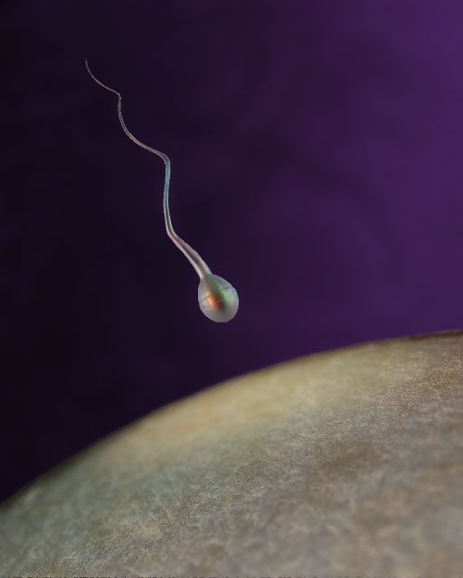
Why are mitochondria inherited only maternally?
At fertilization, only the nucleus of the sperm enters the egg cell
This means that the mother contributes all of the cytoplasm and organelles to the developing zygote
Hundreds of maternal mitochondria are passed on to each daughter cell

Slide 21
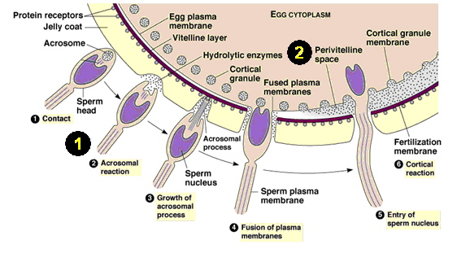

Slide 22
mtDNA is Important in Forensic Biology
While each cell contains only 2 copies of a given nuclear gene (one inherited maternally and one inherited paternally), there are hundreds to thousands of copies of a given mitochondrial gene in a cell
Thus mitochondrial DNA analysis is important in forensic biology
especially in cases where the tissue is very old or the nuclear DNA is badly degraded

Slide 23
mtDNA analysis has been used to
Identify the remains of an unknown soldier killed in the Vietnam War
Identify the remains of the Romanov royal family killed in the Russian Revolution
Determine the relationship of Neandertal remains (30,000+ years old) to modern humans

Slide 24
This Experiment
PCR will be used to amplify a 440 nucleotide sequence within the control region of the mt genome
It will allow you to visualize a discreet region of your own genetic material
A mtDNA sequence will be amplified several thousand fold over a nuclear sequence that has only 2 copies
The source of template DNA will be several thousand squamous cells obtained from either your cheeks or hair sheaths

