Slide 1
Title: Isotopes & Isomers
9-26-13

Slide 2
Isotopes
Isotopes: when an atom has the same number of protons but different numbers of neutrons
C
Atomic mass → 12
# of Protons → 6

Slide 3
Isotopes
Isotopes: when an atom has the same number of protons but different numbers of neutrons
C C C
Atomic mass → 12
# of Protons → 6
Atomic mass → 13
# of Protons → 6
Atomic mass → 14
# of Protons → 6
 | C-12 | C-13 | C-14
Protons | 6 | 6 | 6
Neutrons | 6 | 7 | 8
Atomic mass | 12 | 13 | 14

Slide 4
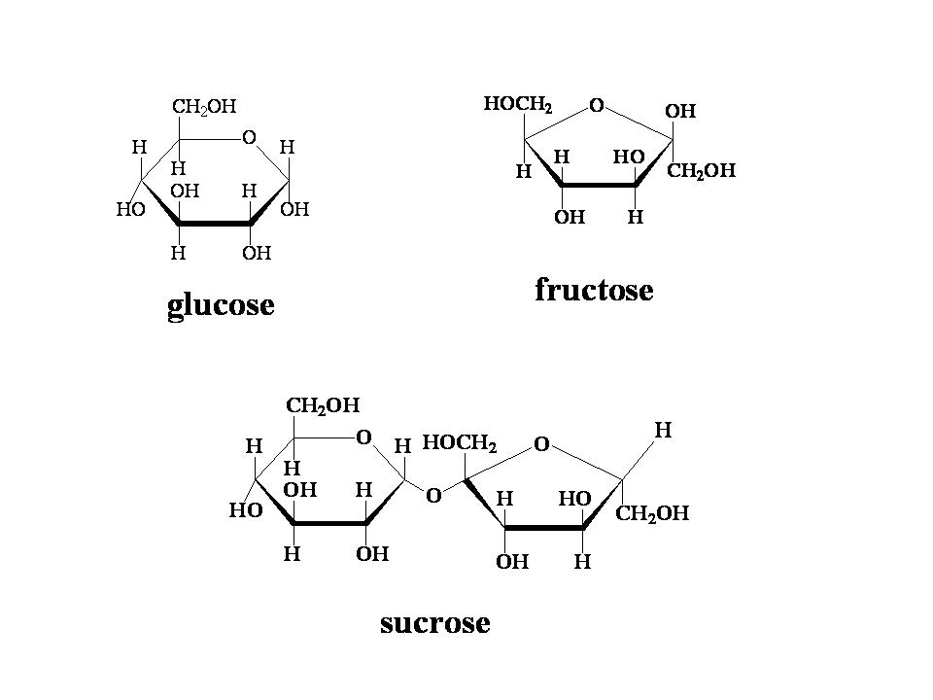
Isomer
Isomers are compounds with the same chemical formula but different shapes
For example is glucose & fructose

