Slide 1
Title: Measurement Lab
9-5-2012

Slide 2
Measurement lab
Purpose: To become familiar with proper measuring techniques in a science lab
New Vocabulary
Accuracy: how close a measurement is to its actual (true) value
Precision: how reproducible something is

Slide 3
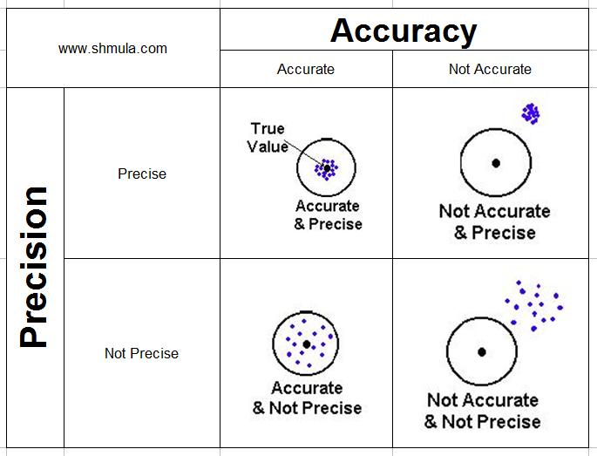

Slide 4
Materials
Balance
Meter stick
10 mL Graduated cylinder
50 mL Graduated cylinder
2mL plastic pipette
50mL Beaker
Book
Water
Paper cup

Slide 5
Procedure 1: Measuring Length
1st: choose any book and using the yard stick measure the length, width, and height of the book in cm
Convert those measurement to m
Create a chart like the one below to record your data
 | cm | m
L
W
H

Slide 6
Procedure 2: Measuring Volume & Mass
Use the balance to determine the mass of the paper cup, record that in your journal
Next, use the 10mL graduated cylinder to measure 10 mL of water
Pour that into the paper cup and determine the mass of 10mL of water (make sure to subtract the mass of the paper cup!)
Repeat this process 3 times

Slide 7
Procedure 2 cont.
Now, repeat steps 2-4 with your
50mL graduated cylinder
Your 50mL beaker
Your 1mL plastic pipette

Slide 8
Data
 | Trial 1 (mass in g) | Trial 2 (mass in g) | Trial 3 (mass in g)
10mL graduated Cylinder
50 mL graduated cylinder
50mL beaker
1mL plastic Pipette

Slide 9
Conclusions:
Which tool is the most accurate for measuring 10mL of water? Explain.
What tool is the most precise for measuring 10mL of water? Explain.
How many cL is 10mL?
Convert 10mL to L

