Slide 1
The Task of Neuroscience
The task of neuroscience is to understand the mental processes by which we perceive, act, learn and remember.
Questions we will consider:
How does the brain produce the remarkable individuality f human action
Are mental processes localized to specific regions of the brain, or do they represent emergent properties of the brain as an organ?
To what extent are mental processes hardwired into the neural architecture of the brain?
What do genes contribute to behavior, and how is gene expression in nerve cells regulated by developmental and learning processes?
How does experience alter the way the brain processes subsequent events

Slide 2
The Nervous System
We will start by looking at the basics of learning and memory
We will study the branches of the nervous system & anatomy of the brain
Next we will consider the degree to which mental functions can be located in specific regions of the brain
We will learn how neurons are organized into signaling pathways and how they communicate by means of synaptic transmission
We will examine the extent to which behavior can be understood in terms of the properties of specific nerve cells and their interconnections in one region of the brain
Notes:
The human brain is a network of 100 billion individual nerve cells interconnected in systems that construct our perceptions of the external world, fix our attention, and control the machinery of our actions.

Slide 3
Introduction to Learning & Memory

Slide 4
Issues Central to learning & memory
What are the different types of memory?
Where in the brain is memory located?
How does memory work?
What types of changes occur in the nervous system when a memory is formed and stored, are there particular genes and proteins that are involved in memory, and how can a memory last for a lifetime?
Is the issue of importance to many people, especially as we age: How can memory be maintained and improved, and how can it be fixed when it is broken?

Slide 5
Different types of memory
Declarative memory
Nondeclarative memory
A type of long term memory acquired and used unconsciously, that can affect thoughts and behaviors. Includes:
Memories for skills and habits
Priming
Associative learning→ think classical conditioning
Nonassociative learning
Habituation
Sensitization
One of its most common forms is procedural memory, which helps people performing certain tasks without conscious awareness of these previous experiences.
“knowing how”
Memory of facts or events
Refers to memories that can be consciously recalled
Information that is explicitly stored and retrieve
“knowing what”

Slide 6
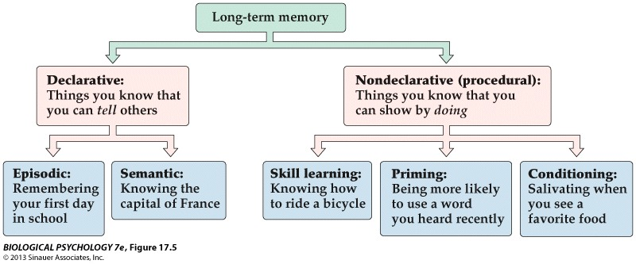

Slide 7
Neurobiology & the brain

Slide 8
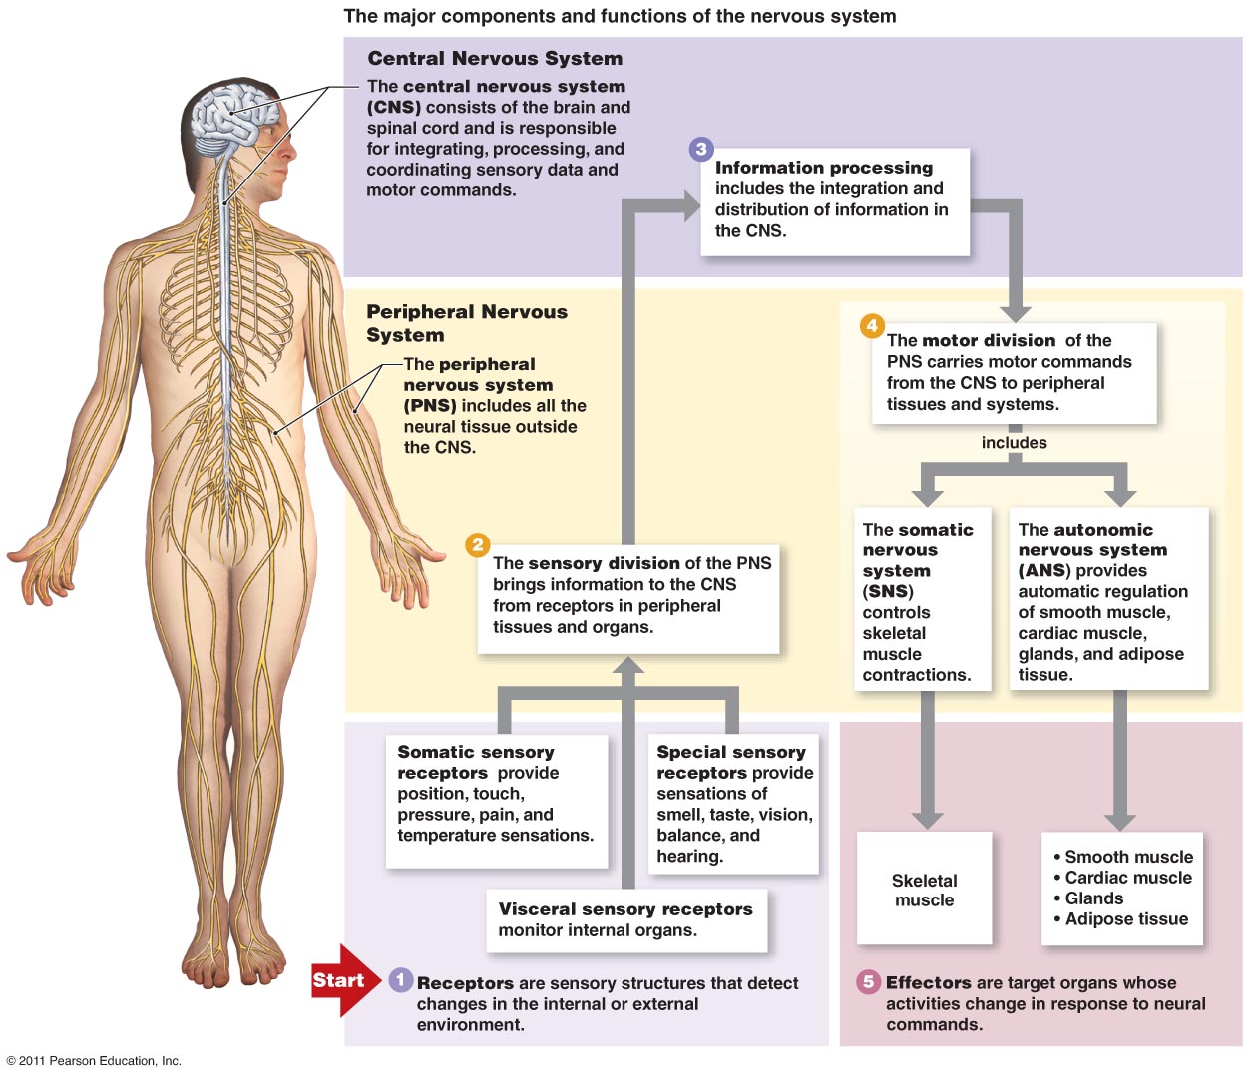

Slide 9
The Human brain
What we commonly call the mind is a set of operations carried out by the brain.
The task of neural science is to explain behavior in terms of the activities of the brain
To dos this we must first consider to what degree mental functions are located in specific regions of the brain and to what degree such local mental processes can be understood in terms of the properties of specific nerve cells & their interconnections

Slide 10
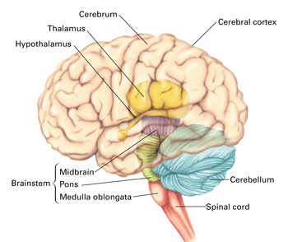
The brain has distinct functional regions
The central nervous system is a bilateral and essentially symmetrical structure with 7 main parts:
Spinal cord
Medulla oblongata
Pons
Cerebellum
Midbrain
Diencephalon
Cerebral hemispheres

Slide 11
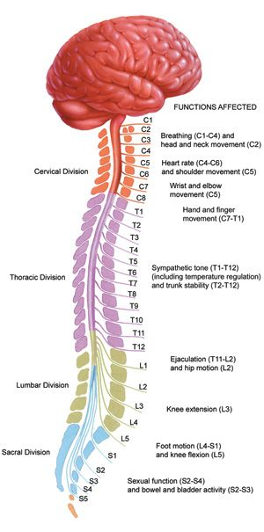
The Spinal cord
Receives & processes sensory information from the skin, joints, and muscles of the limbs and trunk and controls movement of the limbs and trunk.
Subdivided into cervical, thoracic, lumbar, and sacral regions
Cervical part of the spinal cord is continuous with the brainstem

Slide 12
The brain stem
Receives sensory information from the skin and muscles of the head. It also conveys information from the spinal cord to the brain and from the brain to the spinal cord.
It regulates levels of arousal and awareness
Contains collections of cell bodies called cranial nerve nuclei that
receive information from the skin and muscles of the head
control motor output to muscles of the face, neck and eyes
are specialized for information from special senses including hearing, taste, and balance

Slide 13
The Brain Stem has 3 parts
Medulla oblongata: lies directly above the spinal cord and includes centers vital for autonomic functions like breathing, digestion, and control of heart rate
Pons: lies above the medulla and conveys information about movement from the cerebral hemisphere to the cerebellum
Midbrain: controls many sensory and motor functions including eye movement and coordination of visual and auditory reflexes

Slide 14
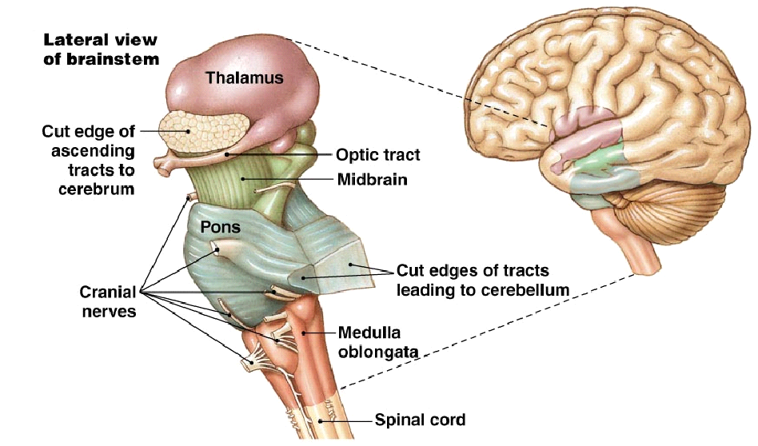

Slide 15
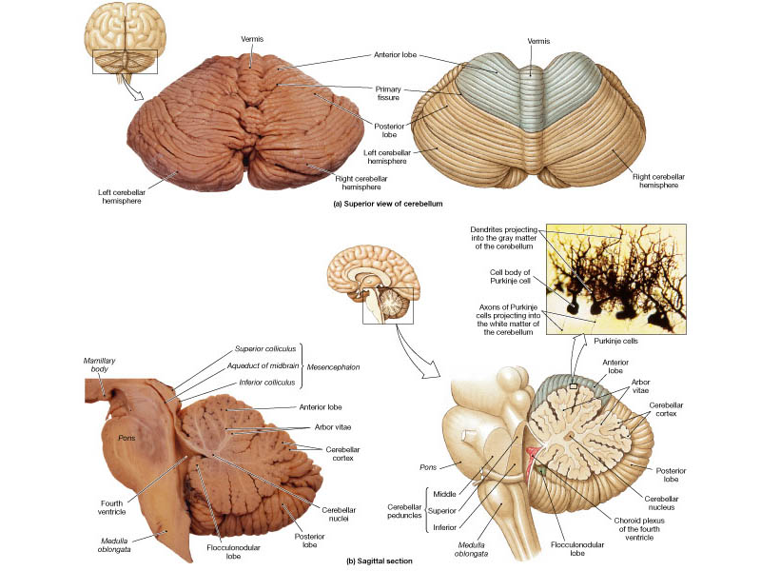
The cerebellum
Lies behind the pons and is connected to the brainstem by several major fiber tracts called peduncles
Modulates the force and range of movement and is involved in the learning of motor skills
Helps provide smooth, coordinated, body movements

Slide 16
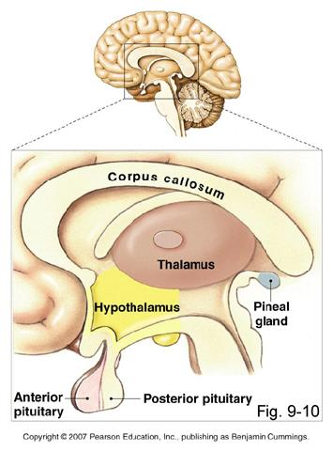
diencephalon
Located above the midbrain and contains 2 structures
Thalamus: processes most of the information reaching the cerebral cortex from the rest of the CNS
Hypothalamus: regulates autonomic, endocrine, and visceral functions

Slide 17
Cerebral hemispheres
Consists of a heavily wrinkled outer layer – the cerebral cortex- and 3 deep lying structures
The basal ganglia: regulate motor performance
The hippocampus: involved in memory storage
The amygdala: coordinate autonomic and endocrine responses of emotional states

Slide 18
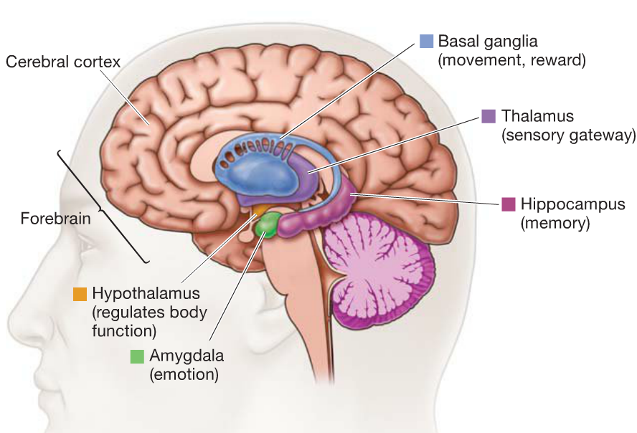

Slide 19
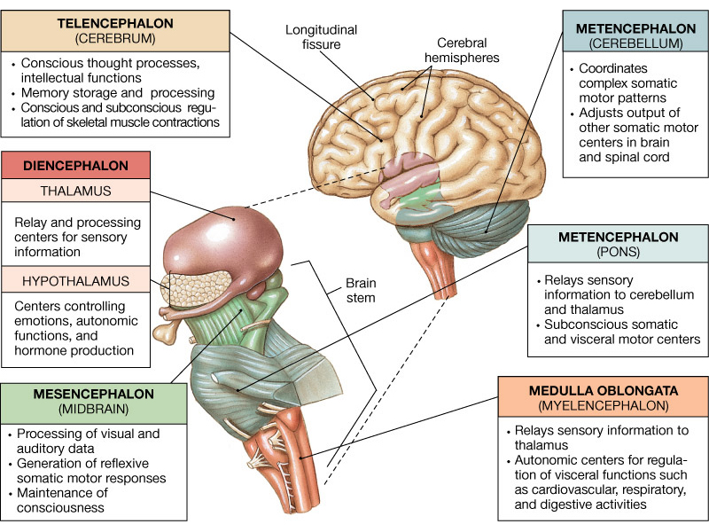

Slide 20
3 divisions of the brain
Hindbrain: medulla, pons, cerebellum
Midbrain: brainstem
Forebrain: diencephalon & cerebral hemispheres

Slide 21
Cognitive Functions are localized within the cerebral cortex
In each of the brains two hemispheres the overlying cortex is divided into 4 anatomically distinct lobes
Frontal: largely concerned with planning future action and controlling movement
Parietal: concerned with somatic sensation. Forming body image, and with relating ones body image with extrapersonal space
Temporal : concerned with hearing and through its deep structures- the hippocampus & amygdala- with aspects of learning, memoy, & emotion
Occipital: concerned with vision

Slide 22
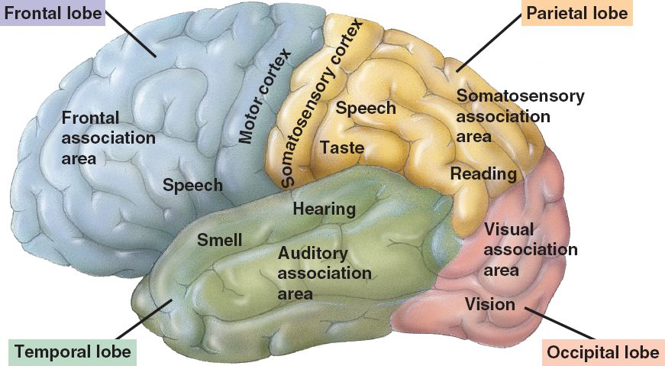
The cerebral cortex is divided into 4 lobes

Slide 23
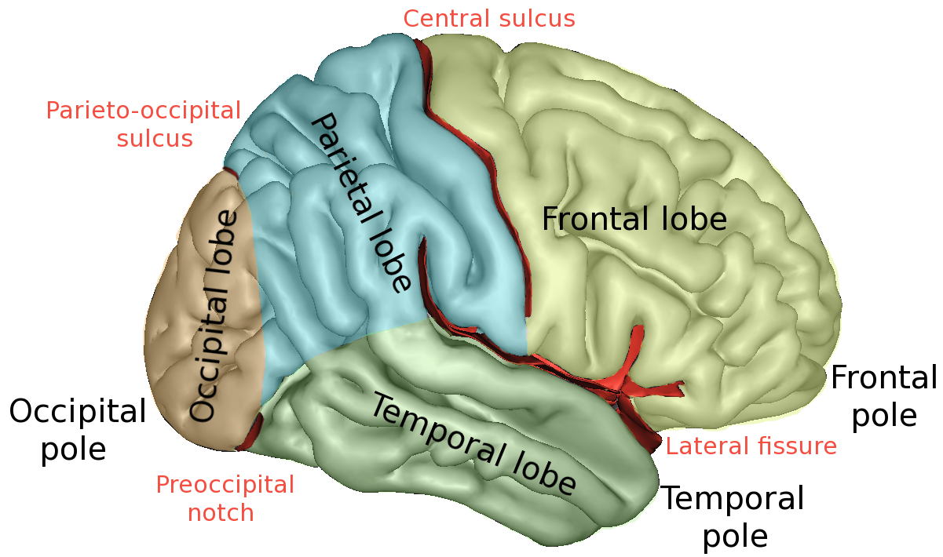
Anatomy of the cerebral cortex
Critical Thinking- what do you think is the evolutionary advantage to a cerebral cortex with gyri and sulci, over one that is smooth
Each lobe has several characteristic deep infoldings composed of crests called gyri, and grooves called sulci or fissures
Notes:
The more prominent gyri and sulci are similar in everyone and have specific names. For example, the central sulcus which separates the precentral gyrus from the post central gyrus

Slide 24
Organization of the Cerebral Cortex
The organization of the cerebral cortex is characterized by 2 important features
Each hemisphere is concerned primarily with sensory and motor processes on the contralateral (opposite) side of the body
Although the hemispheres are similar in appearance they are not completely symmetrical in structure nor equivalent in function

Slide 25
So how did we figure all of this out?
To illustrate the role of the cerebral cortex in cognition we will take a historical approach and trace the development of our understanding of the neural basis of language, using it as an example of how we have progressed in localizing mental functions in the brain
Much of what we know about the localization of language comes from studies of aphasia, a language disorder found most often in patients that have suffered a stroke
Strokes are caused by the occlusion or rupture of a blood vessel supplying oxygen to a portion of the cerebral hemisphere

Slide 26
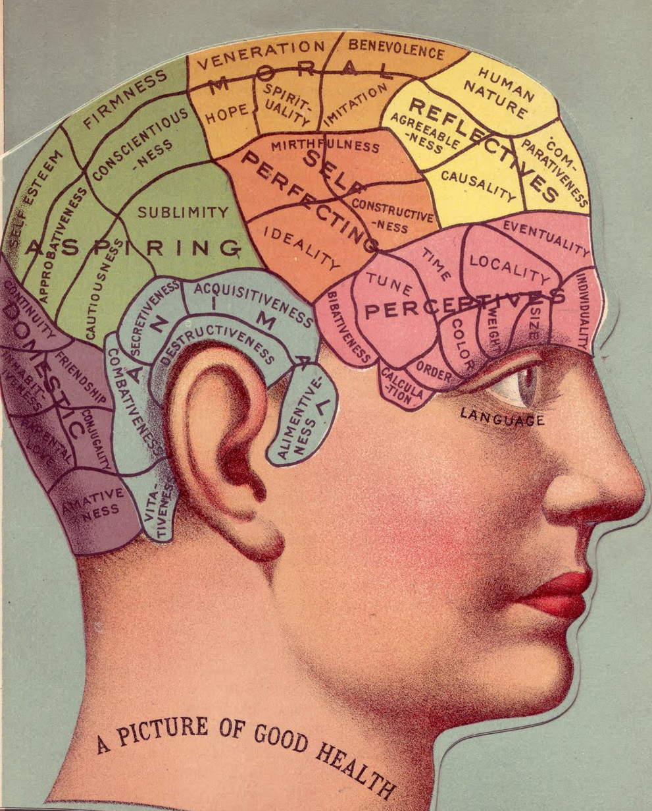
phrenology
Proposed by Franz Joseph Gall in 1796
The idea that particular regions of the cerebral cortex corresponded to specific mental functions such as generosity, secretiveness, or religiosity and that the center for each function grew with use or shrunk with disuse.
This caused the overlying skull to bulge creating a pattern of bumps and ridges indicating which brain regions were most developed

Slide 27
Foundation of neuropsychology
Pierre Paul Broca-1861 was influenced by Gall & the idea that functions could be localized
Extended Galls thinking arguing that the attempt to localize the functions should be based on examining damage to the brain produced by clinical lesions rather than the distribution of bumps on the outside of the head.
“I had thought that if there were ever a phrenological science, it would be the phrenology of convolutions in the cortex, and not the phrenology of bumps on the head”

Slide 28
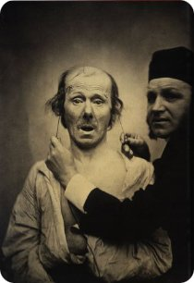
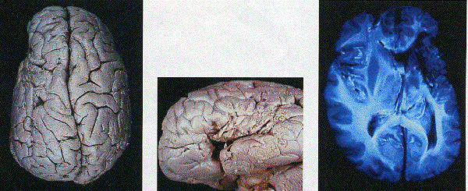
2 important patients
In 1861 Broca described a patient named Leborgne, who could understand language but couldn’t speak it.
The patient had none of the conventional motor deficits of the tongue, mouth, or vocal cords
He could utter isolated words, whistle, and sing a melody, but could not speak grammatically or create complete sentences, nor express his ideas in writing
Lelong was another patient of Broca. He could only say five words. "yes", "no", "three", "always", and "lelo" (a mispronunciation of his own name).
Postmortem examination of their brains showed lesions in the posterior region of the frontal lobe. These two cases led Broca to believe that speech was localized to this particular area, now called Bocas area

Slide 29
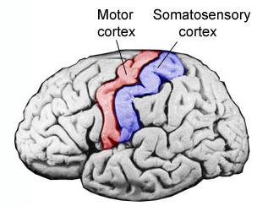
The search for the cortical sites of other behavioral functions
1870- Gustav Fritsch & Eduard Hitzig showed that characteristic and discreet limb movements in dogs could be produced by electrically stimulating localized regions of the precentral gyrus of the brain
These regions were always located in the contralateral motor cortex
Thus the right hand, the one most humans use for writing and skilled movements, is controlled by the left hemisphere which we also know controls speech

Slide 30
Karl Wernicke- 1876
Published a now classic paper titled “ The Symptom-Complex of Aphasia: A Psychological Study on an Anatomical Basis”
In this paper he described another type of aphasia where patients fail to comprehend language rather than to speak it.
A receptive rather than expressive malfunction
Patients could speak but not understand
The lesions associated with this malfunction was found in a different part of the brain, the posterior part of the temporal lobe where it joins the parietal and occipital lobes

Slide 31
Karl Wernicke
Based on his findings he proposed that only the most basic mental functions such as those concerned with simple perceptual or motor activity are localized to single areas of the cortex
More complex cognitive functions result from interconnections between several functional sites

Slide 32
Modern approaches to studying the brain
Imaging: Modern imaging techniques like fMRI (functional magnetic resonance imaging) or PET (positron emission tomography) allows one to “see” areas of the brain that are active during specific brain tasks. If a subject is placed in an fMRI scanner and given a memory test, one can determine what areas of the brain are active, and that activity presumably is related to where in the brain the memory is processed and/or stored.
Brain Lesions: In this experimental procedure, small parts of the brains of mice or rats are surgically removed or chemically inactivated and the animals are systematically examined to determine whether the lesion affected any memory system.
Brain Disease & Injury: Here scientists take advantage of individuals who have had unfortunate brain injuries, for example, through stroke or through a brain tumor in a specific area of the brain. If one finds a memory deficit in the patient, it is likely that the region of the brain that was injured is involved in that memory.

Slide 34
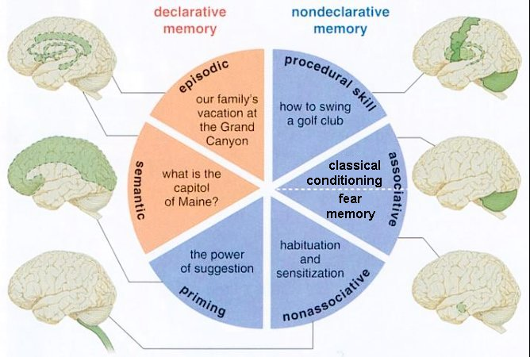

Slide 35
Assignment: To create a 3-d model of a brain
Model must include the following:
Parts of the brain:
Medulla oblongata
Pons
Cerebellum
Midbrain
Diencephalon including thalamus and hypothalamus, extra points for anterior and posterior pituitary and pineal gland
Cerebral hemispheres including
frontal
parietal
occipital
temporal lobes including amygdala and hippocampus
Color coded key
Labels with name and description of major functions for each part

