Slide 1
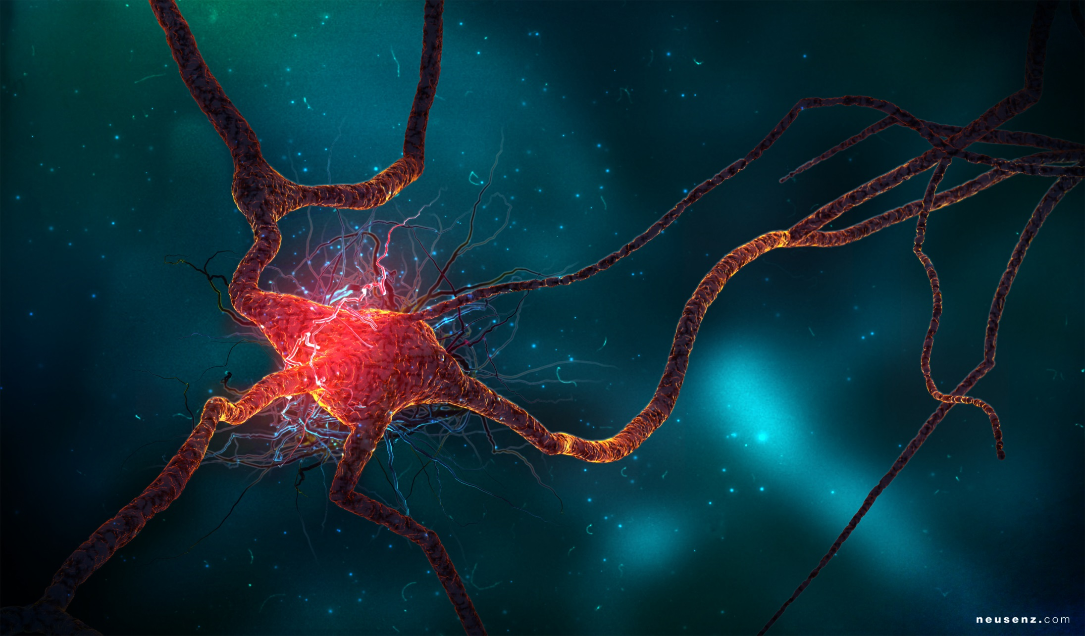
Neurons & CIPN

Slide 2
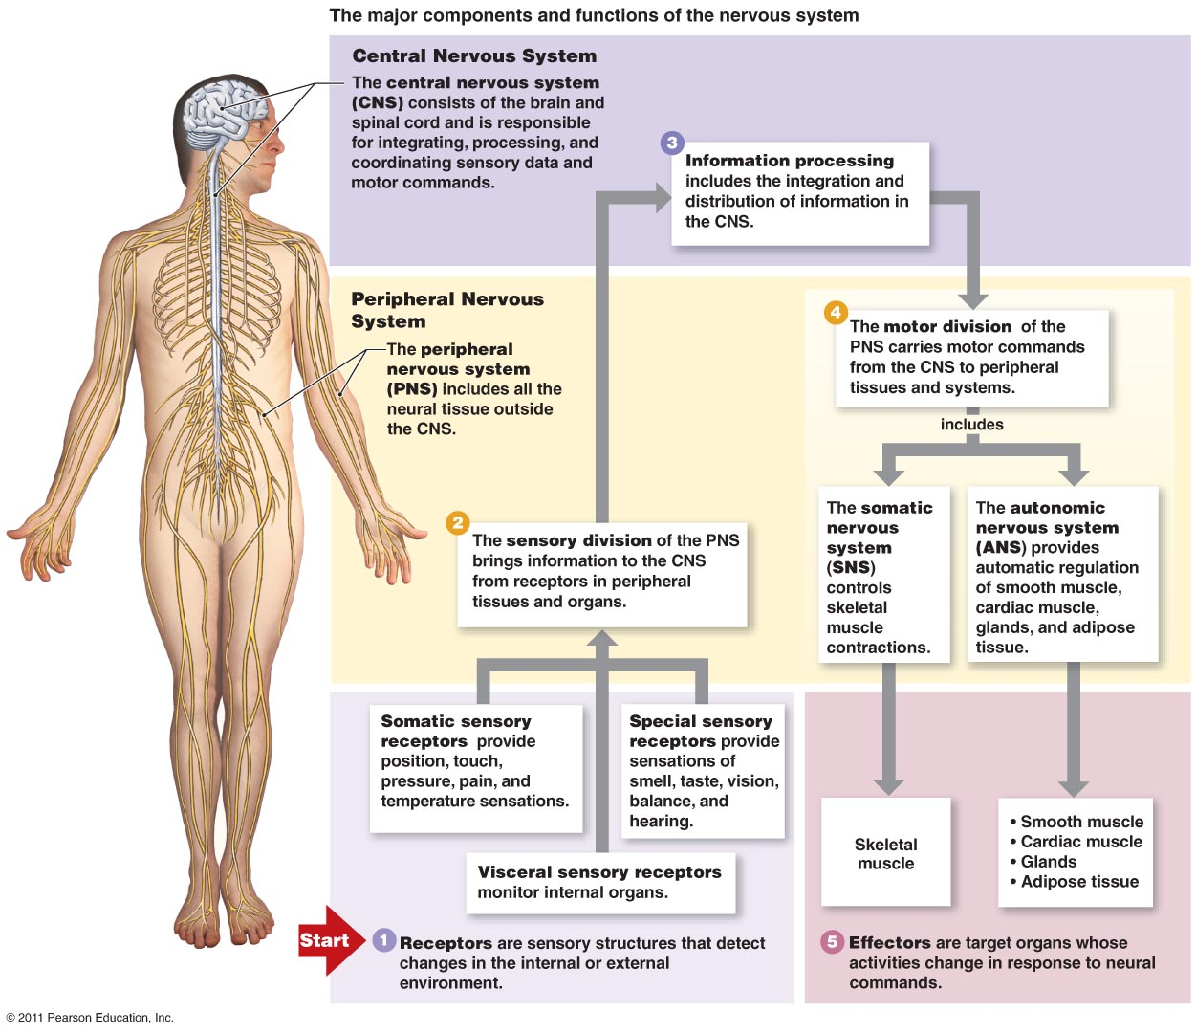
Major Components of the Nervous System

Slide 3
The Peripheral Nervous System

Slide 4
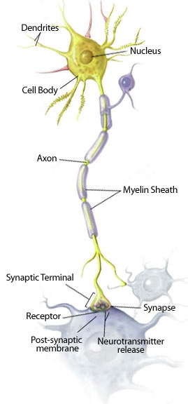
Neuron Structure
Most of neurons organelles (including its nucleus) are located in its cell body
2 types of extensions arise from the cell body
Numerous dendrites: receive signals
A single axon: transmit signals
Axon hillock: conical region of axon where it joins cell body, and that typically generates the signal that travels the length of the axon
Myelin sheath: mostly lipid layer that insulates the axon

Slide 5
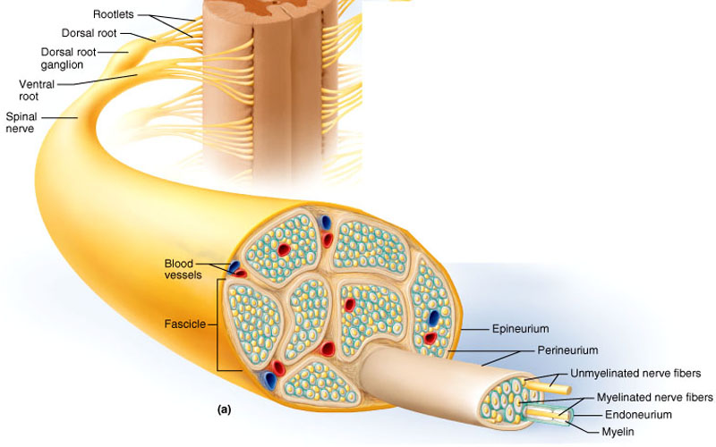
A peripheral nerve has an outer covering called the epineurium.
Often a nerve will run together with an artery and vein and their connective coverings will merge.
Nerve fibers, which are axons, organize into bundles known as fascicles with each fascicle surrounded by the perineurium.
Between individual nerve fibers is an inner layer of endoneurium
Individual Neurons are Organized into Nerves

Slide 6
Types of Nerves
Motor nerves - These carry messages from the brain to the muscles.
Autonomic nerves - These carry messages back and forth between internal organs and the brain. They control the actions of muscles that aren’t under our voluntary control.
Sensory nerves - These carry messages from the body to the brain. These nerves have endings (receptors) that are sensitive to sensations such as pain, temperature, touch and vibration.
Although we are not aware of it, our brain is constantly receiving messages from sensory nerves throughout our body.
These messages tell our brain where each part of our body is and are important for balance, coordination and walking
anticancer drugs most likely affect these

Slide 7
Roles of Sensory Receptors
All stimuli represent forms of energy
Sensation involves converting this energy into a change in the membrane potential of sensory receptors
Sensory receptors perform four functions in this process
Sensory transduction
Amplification
Transmission
Integration

Slide 8
Types of Sensory Receptors
Based on the energy they transduce, sensory receptors fall into five categories
Mechanoreceptors
Chemoreceptors
Electromagnetic receptors
Thermoreceptors
Pain receptors

Slide 9
Neurons & MIcrotubules
The size, shape, and compartmentalization of neurons must be generated and supported by the cytoskeletal systems of intracellular transport.
One of the major systems is the microtubule-based transport system along which kinesin and dynein motor proteins generate force and drive the traffic of many cellular components.
If microtubules loose their dynamic instability and become fixed, neurons will be unable to transport vesicles around the cell

Slide 10
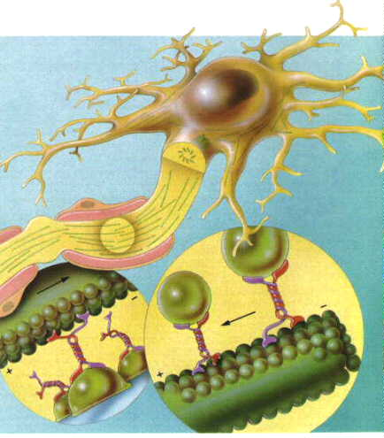
Paclitaxel & MIcrotubules
This figure shows a neuron with its processes containing microtubules.
The vesicles are seen attached to MAPs (microtubule associated proteins) and moving along the microtubule conveyer belt.
The MAPs include kinesins and dynein which "walk" along the microtubules in opposite directions.
http://www.youtube.com/watch?v=y-uuk4Pr2i8 -

Slide 11
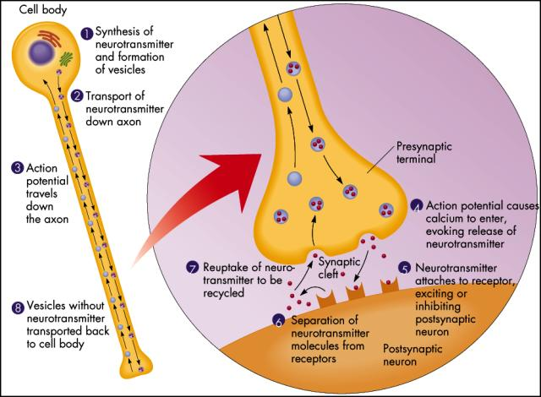
Microtubule-based transport is essential for neuronal function due to the large distances that must be traveled by various building blocks and cellular materials

Slide 12
Mechanism of Taxane Induced Neuropathy
Dendrites contain organelles and proteins, including rough endoplasmic reticulum, the Golgi complex, and neurotransmitter receptors, that are rare in axons
For axons to get proteins and organelles made in the cell body, they must be carried down the length of the axon along microtubules
Impairment of intracellular transport is detrimental to neurons and has emerged as a common factor in several neurological disorders

Slide 13
CIPN
Chemotherapy-induced peripheral neuropathy (CIPN) describes the damage to the peripheral nervous system incurred by a patient who has received a chemotherapeutic agent that is known to be neurotoxic.
While each class of agents has its own mechanism of action, the CIPN that develops is thought to be a length dependent neuropathy that affects distal sites first, and as cumulative doses increase symptoms progress in severity and to more proximal areas.

Slide 14
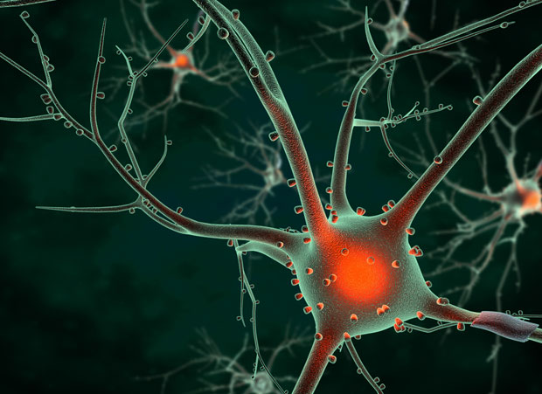
CIPN
Affects 30-40% patients undergoing chemotherapy
Vinca alkaloids: vincristine & vinblastine
Taxanes: paclitaxel & docetaxel
Proteasome inhibitors: bortezomib
Platinium based: cisplatin, carboplatin, oxaliplatin
Epothilones: ixabepilone
Increases in severity as treatment continues
May be irreversible
Is usually bilateral
Most common reason cancer patients stop treatment early
Notes:
Epothilones – new class of drugs
Stabilize microtubules

Slide 15
Taxane Induced Neuropathy
This neurotoxicity is dose-related and nearly 95% of patients exposed to 500-800 mg/m2 will develop paclitaxel-associated neuropathy and/or pain following the termination of paclitaxel therapy.

Slide 16
Symptoms
Sensory nerves are the ones usually affected and may cause the following:
Pain
Numbness
Burning
Tingling
Sharp, shooting, electrical pain
Exaggerated pain response to something that would not normally cause pain such as stroking
Motor nerves may cause the following:
Weakness
Difficulty with walking or balance
Difficulty with fine motor skills: writing, buttoning buttons, tying shoe laces
Muscle cramps
Autonomic nerves may cause the following:
Constipation/Diarrhea
Urinary retention/ incontinence
Blood pressure alterations ( either high blood pressure or low)
Pain often can be helped with drug treatment but numbness resistant to therapy

Slide 18
Taxane Induced Neuropathy
Paclitaxel induces paresthesias, loss of sensation and dysesthetic pain in the feet and hands.
Pre-existing neuropathy and co-administration of other chemotherapy agents also enhance the risk of neuropathic pain.
Pain was described as radiating, shooting, aching, stabbing, and pulsating and it was mostly located in the back, hips, shoulders, legs and feet.

