Slide 1
Neuronal Control of Mood, Emotion, and State of Awareness

Slide 2
Diffuse modulatory systems
In contrast to rapid point to point transfer of information within sensory and motor pathways, diffuse modulatory systems are types of neuronal circuits are present that operate on a slower time scale and have broader, less defined targets
One of the best examples is the autonomic nervous system
Preganglionic neurons that function in the sympathetic division are located in the thoracic and upper lumbar portions of the spinal cord, while those of the parasympathetic division originate in the brain stem
Preganglionic fibers project to postganglionic motorneurons that provide dual and antagonistic innervation of glands and smooth muscle
The brainstem coordinates the autonomic responses receiving direct input from the amygdala and hypothalamus , but no direct input from them somatic motor cortex and so there is no conscious control of autonimic function

Slide 3
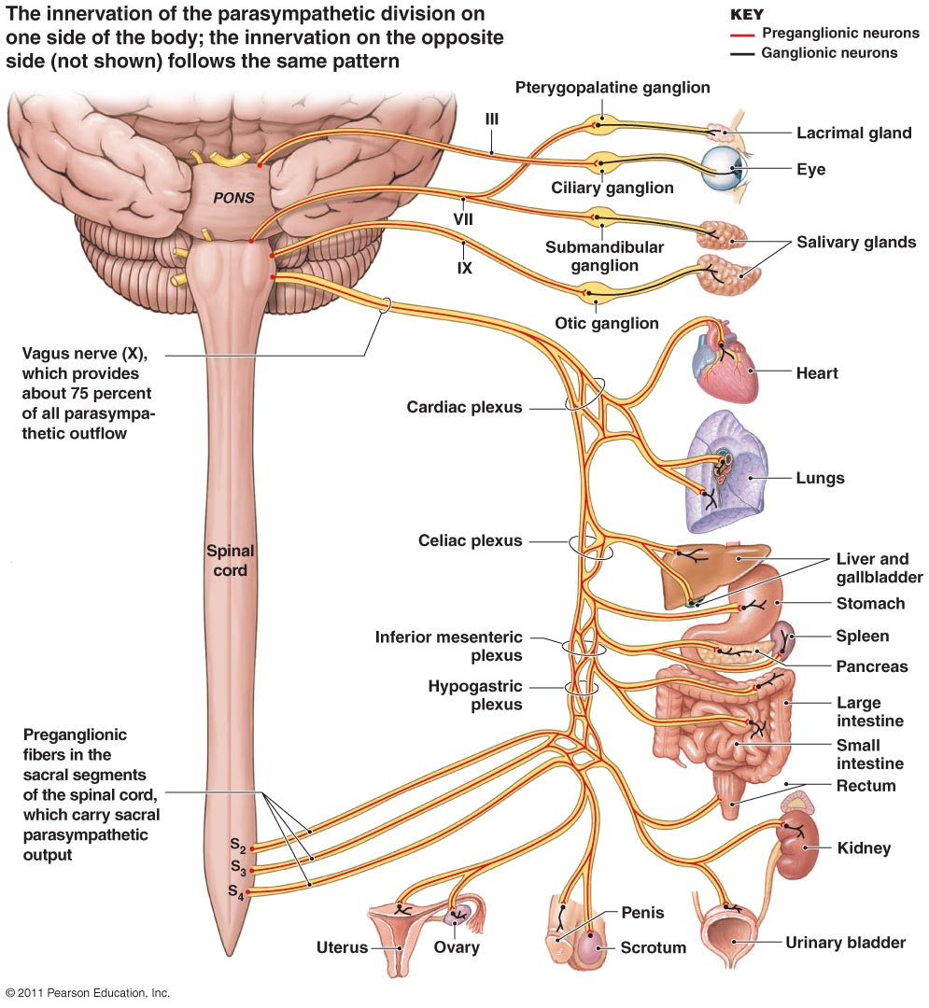
Example: The Vagus Nerve
The vagus nerve originates from a small group of neurns in the vagal motor nucleus of the medulla
These neurons provide preganglionic fibers that synapse in a large number of parasympathetic neurons controlling muscles to the esophagus, heart, peritoneal cavity, and intestines
Actin potentials here evoke relatively slow, sustained responses that are coordinated throughout the target tissues with the vagal motor nucleus functioning as the master control point reciving and summating a wide range of sensory inputs and sending signals to elicit a whole body response

Slide 4
Emotions Related to autonomic nervous system function
Strong emotional feelings are often associated with strong autonomic responses
Coordinated parasympathetic responses evoke a “vegetative” state that generates an overall relaxed, pleasurable feeling
They are often linked to eating behavior and can be triggered by food related sensory stimuli
The opposite is true for coordinated responses from the sympathetic division
In these cases sympathetic pathways coordinate protective responses preparing the individual to flee from perceived danger or to engage in aggressive behavior
Individuals often experience feelings of fear, anxiety, and anger

Slide 5
Internal cues & autonomic responses
It is not just external cues like smelling food or danger that initiates an autonomic response, internal cues can as well
Recalling past experiences that were particularly pleasurable to anxiety producing can cause strong sympathetic and parasympathetic responses
The ANS provides the major mechanism by which elements of mood and emotion are expressed by the body
Other structures in the CNS are involved in producing the emotion but much of their pitput is routed through the ANS to the appropriate target tissues

Slide 6
Opposing theories about fear
James-Lange Theory
Cannon- Bard Theory
Holds that fear is experienced in response to perception of danger and activation of appropriate cortical areas and that the resulting sympathetic response is triggered after the fright is experienced
Suggests that the presentation of a frightening stimulus leads 1st to the sympathetic response. The change in the bodies sympathetic-parasympathetic tone then is monitored by higher centers in the CNS, and its this change that’s synonymous with the emotional experience of fear
Notes:
Most likely, both theories are correct to some degree though the 1st is the more acepted

Slide 7
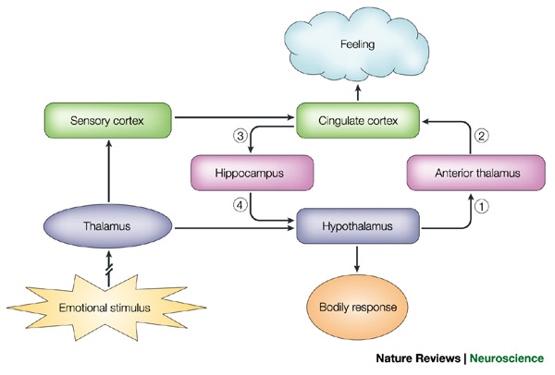
The Papez Circuit
One of the cortical areas associated with the general emotional state is that limbic system consisting of the
Cingulate cortex & hippocampus
Form a C-shaped structure surrounding the rostral elements of the brainstem
The limbic system links with other structures including the anterior nuclei of the thalamus and the hypothalamus
All of these together form a pathway known as the Papez Circuit
Notes:
Papez⁷ argued that sensory messages concerning emotional stimuli that arrive at the thalamus are then directed to both the cortex (stream of thinking) and the hypothalamus (stream of feeling). Papez proposed a series of connections from the hypothalamus to the anterior thalamus (1) and on to the cingulate cortex (2). Emotional experiences or feelings occur when the cingulate cortex integrates these signals from the hypothalamus with information from the sensory cortex. Output from the cingulate cortex to the hippocampus (3) and then to the hypothalamus (4) allows top–down cortical control of emotional responses

Slide 8
Cingulate Cortex
Based on experience with patients having lesions in these brain areas, it has been proposed that the Papez circuit is responsible for linking the experience and the expression of emotion
The proposed site of emotional experience is the cingulate cortex which receives sensory information directly through the thalamus and from sensory areas in the cerebral cortex
Output through the cingulate cortex is through the hippocampus and projects via a band of fibers known as the fornix to the hypothalamus where its translated to the expression of emotion through autonomic and other responses
Because the hypothalamus projects back to the thalamus this could be an example of positive feedback loops

Slide 10
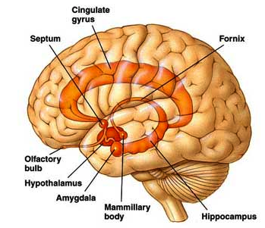
Aggressive behavior
The hypothalamus and amygdala play a direct role in mediating aggressive behavior
In animal models we see that bilateral ablation of the amygdala reduces fear and decreases certain forms of aggression
Direct electrical stimulation of the amygdala in humans elicits fear and anxiety
These effects are mediated through the hypothalamus

Slide 11
2 distinct types of aggressive behavior
Affective Aggression
Predatory Aggression
Expressed by assuming a threatening or defensive posture
Can be induced with electrical stimulation of medial hypothalamus
Involves attacks against members of a different species for the purposs of obtaining food
Can be induced with electrical stimulation of lateral regions of hypothalamus
Notes:
It has been shown in primates that in primates that the amygdala provides excitatory impulses to the medial hypothalamus playing an important role in maintaining an active level of affective aggression necessary for maintain position in social hierarchy, and has an opposite effect on the lateral hypothalamus suppressing predatory aggression

Slide 12
The emotional reward pathway
Underlying cellular mechanisms responsible for emotional perception or emotionally driven behavior are difficult to assess
Its difficult to assess the emotional state of an animal
Rats will repeatedly self-stimulate electrodes implanted in the brain only when they are placed in certain areas suggesting the presence of a pleasure center
Other sources of information com from patients that require surgical removal of specific brain areas that act as trigger zones for severe epilepsy, which requires them to be awake
Patients repeatedly report that the following areas (which are comparable to results from mouse studies) evoke intensely pleasurable sensations
Septal area
Lateral hypothalamus
Ventral tegemental area
Dorsal pans
Medial forebrain bundle (a fiber tract that connects the other areas)
Notes:
These pleasure centers may provide the physiologcal basis for reinforcement of normal survival behaviors such as, eating, drinking, & sex; as well as abnormal behaviors such as use of addictive drugs or alcohol

Slide 13
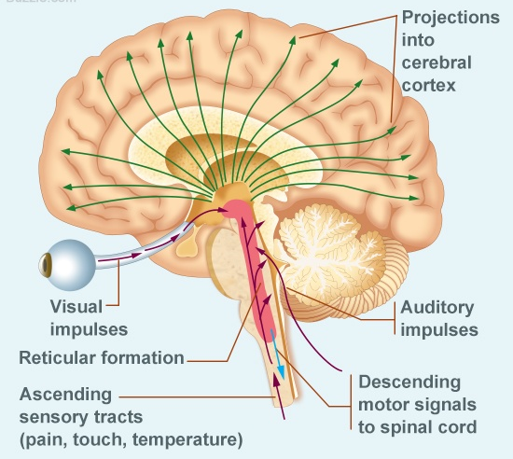
The reticular activating system
The reticular activating system connects the brain stem, to the cerebral cortex,
The stem controls most of the involuntary functions, as well as reflexes of the body, while the cerebral cortex is the seat of consciousness and thinking abilities.
The system forms a link between these two different regions, helping our consciousness put together an internal world, through assimilation of sensory information, gathered from all body parts.

Slide 14
The reticular activating system
The system projects out of the brain stem, through the thalamus, to connect with the cerebral cortex.
The neurons from the stem radiate upwards and terminate at the thalamus, at diffuse thalamic nuclei, which in turn, project further into the cerebrum.
The system also involves neurons projecting out of the sensory pathways, directly into the sensory cortex.
Studies have revealed that there are two most important parts of the RAS.
ascending system
descending system (which is connected to the cerebellum and many sensory nerves).

Slide 15
Ascending Diffuse Modulatory systems
Median Forebrain
Locus Corealus
Raphe Nuclei
Ascends the brainstem
Contains neuronal fibers from neurons that release neurotransmitters at widely spread innervation sites across the brain
Norepenepherine
Serotonin
Dopamine
Noradrenergic fibers with the most diffuse connections
A single locus corealus neuron makes 250,000 synapses that spread from the cerebral cortex to the cerebellum
Serotenergic neurons located near the midline of the brainstem provide the 3rd ascending system that innervates most of the brain
Together form the reticular activating system which alerts the brain to novel incoming sensory stimuli
Notes:
The behavioral response to an abrupt presentation of a new stimulus, such as a loud noise, is an immediate reorientation of the had and sometimes the body toward the novel stimulusand a general increase in awareness and attentiveness

Slide 16
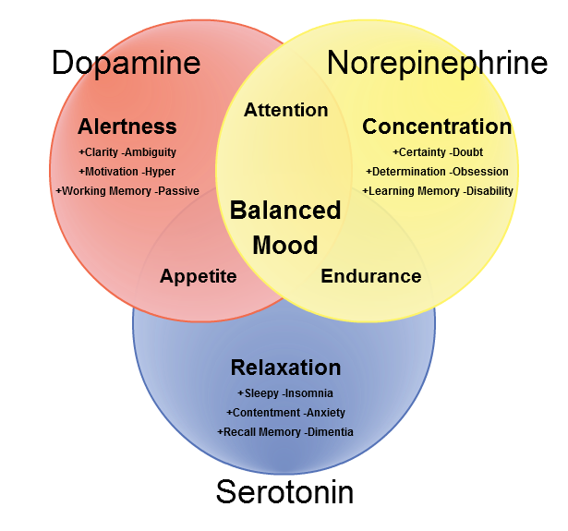

Slide 17
Ascending Diffuse Modulatory systems
Most of the currently used psychoactive drugs act directly on the neurotransmitter systems that are components of the Diffuse Modulatory systems subserving the positive reinforcement and ascending reticular-activating systems
Most of these drugs are analogs (molecular mimics) of norepenipherine, dopamine, or serotonin

Slide 18
Arousal
The RAS represents 1 mechanism that controls the overall functional state of the brain
Its activity helps maintain the awake, interactive state
Different functional states are associated with specific patterns of electrical activity in the cortex that can be recorded with an EEG
EEGs are the result of large populations of cortical pyramidal cells firing at rates and degrees of synchrony that change in response to different states of arousal
High frequency firing rates and low amplitude responses that are relatively desynchronized in activity are indicative of an awake/ alert state
During slow wave sleep pyramidal cells are in a state of reduced responsiveness as sensory input is diminished , and they fire more synchronously

Slide 19
EEG patterns Measuring Brain activity
Beta rhythms: when cortex is activated
Theta rhythms or delta rhythms: during most stages of sleep
Alpha rhythms: generated during quiet waking states
REM sleep is associated with dreaming and occurs as a result of brain activity changing dramatically to patterns more characteristic of the aroused state

Slide 20
Meditation & Brain Waves
Many studies on mindfulness meditation, assessed in a review by Cahn and Polich in 2006, have linked lower frequency alpha waves, as well as theta waves, to meditation.
Much older studies report more specific findings, such as decreased alpha blocking and increased frontal lobe specific theta activity.
Alpha blocking is a phenomenon where the active brain, normally presenting beta wave activity, cannot as easily switch to alpha wave activity often involved in memory recall.
These findings would suggest that in a meditative state a person is more relaxed but maintains a sharp awareness.

Slide 21
Prolonged meditative practice & changes in Brain Wave activity
Brain trait changes have also been observed in neuroimaging studies, most often employing fMRI.
In a meta-analysis of 21 neuroimaging studies, eight brain regions were found to be consistently altered, including
areas key to meta-awarenes (frontopolar cortex/Brodmann area),
exteroceptive and interoceptive body awareness (sensory cortex and insular cortex),
memory consolidation and reconsolidation (hippocampus),
self and emotion regulation (anterior cingulate cortex and orbitofrontal cortex),
and intra- and interhemispheric communication (superior longitudinal fasciculus; corpus callosum)

Slide 22
Prolonged meditative practice & changes in Brain Wave activity
These changes were distinguished by density increases in grey matter regions and white matter pathways in the brains of individuals who meditate in comparison to individuals who do not.
Of all areas with reported findings, a greater number of structural changes were found in the left hemisphere.
There is also evidence to suggest meditation plays a protective role against the natural reduction in grey matter volume associated with aging
Long-term meditation practitioners have also shown to have a higher tolerance for pain.
This effect has been correlated to altered function and structure in somatosensory cortices and an increased ability to decouple regions in the brain associated with the cognitive appraisal of pain

