Slide 1
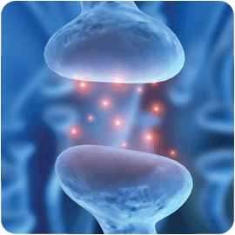
Nervous System

Slide 2
Overview: Lines of Communication
•Neurons are nerve cells that transfer information within the body
•Neurons use two types of signals to communicate: electrical signals (long-distance) and chemical signals (short-distance)
•Interpreting signals in the nervous system involves sorting a complex set of paths and connections
•Processing of information takes place in simple clusters of neurons called ganglia or a more complex organization of neurons called a brain

Slide 3
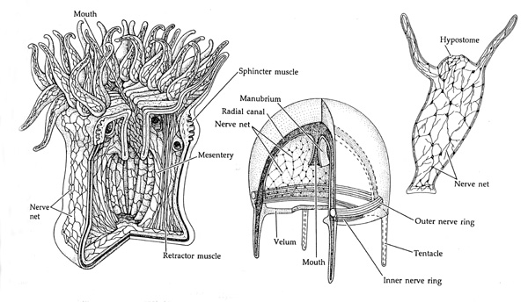
Evolution of the Nervous System
All animals except sponges have some type of nervous system
Cnidarians
radial symmetry
simplest animals with nervous system
Neurons controlling contraction and expansion of gastrovascular cavity arranged in diffuse nerve nets

Slide 4
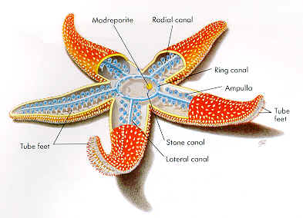
Organization of Nervous Systems
Nervous systems of more complex animals contain nerve nets as well as nerves
Nerves: bundles of fiber like extensions of neurons
Sea Stars: have a nerve net in each arm connected to a central nerve ring

Slide 5
Cephalization
Clustering of neurons in a brain near the anterior end in animals with elongated bilaterally symmetrical bodies
Allows for greater complexity of the nervous system and more complex behavior

Slide 6
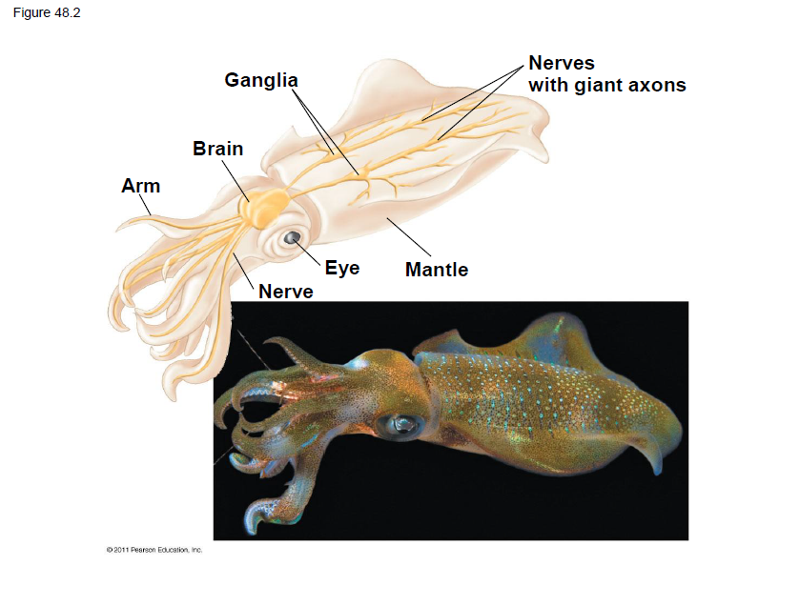

Slide 7
Organization of the Nervous System
Central Nervous System
Peripheral Nervous System
the part of the nervous system that coordinates the activity of all parts of the bodies of bilaterial animal
all multicellular animals except sponges and radially symmetric animals such as jellyfish.
It contains the majority of the nervous system and consists of the brain and the spinal cord, as well as the retina
The main function of the PNS is to connect the CNS to the limbs and organs.
Unlike the CNS, the PNS is not protected by bone or by the blood-brain barrier, leaving it exposed to toxins and mechanical injuries.
The peripheral nervous system is divided into the somatic nervous system and the autonomic nervous system

Slide 8
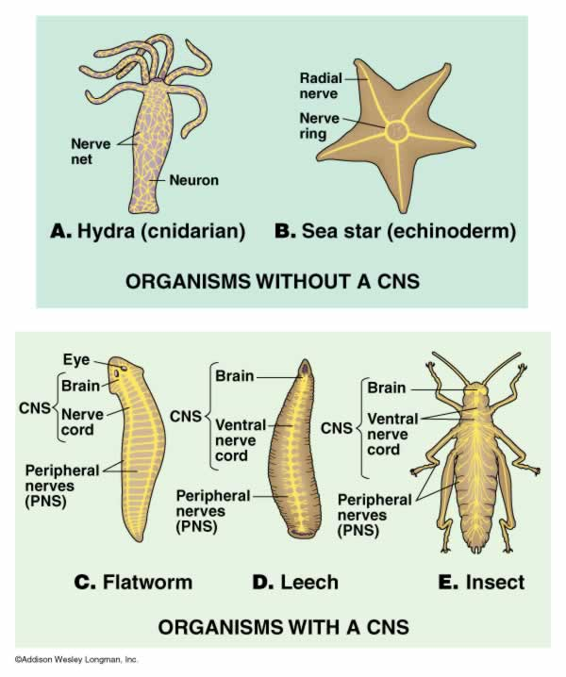

Slide 9
3 Stages of Information Processing
•Sensors detect external stimuli and internal conditions and transmit information along sensory neurons
•Sensory information is sent to the brain or ganglia, where interneurons integrate the information
•Motor output leaves the brain or ganglia via motor neurons, which trigger muscle or gland activity

Slide 11
Neuron Structure & Function
•Most of a neuron’s organelles are in the cell body
•Most neurons have dendrites, highly branched extensions that receive signals from other neurons
•The axon is typically a much longer extension that transmits signals to other cells at synapses
•The cone-shaped base of an axon is called the axon hillock

Slide 12
Synapse
Near its end, each axon usually divides into several branches each of which ends in a synaptic terminal where neurotransmitters are released
The site of communication between one synaptic terminal and another is called synapse
presynaptic cell : transmitting neuron
Postsynaptic cell: receiving neuron

Slide 13
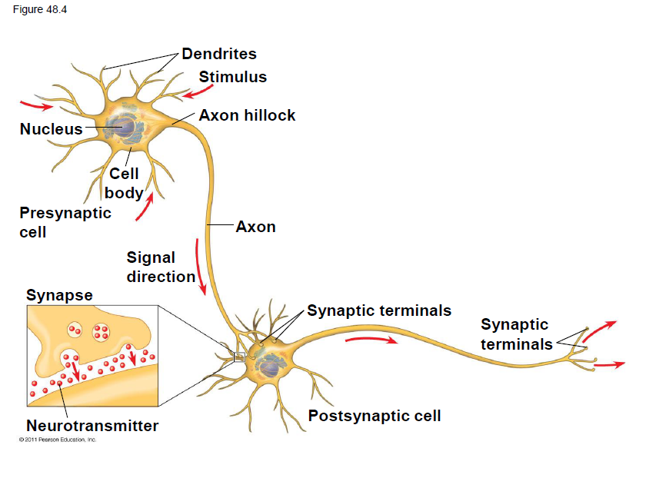
The Synaptic Terminal of one axon passes information across the synapse in the form of chemical messengers called chemical messengers called neurotransmitters
A synapse is a junction between an axon & another cell

Slide 14
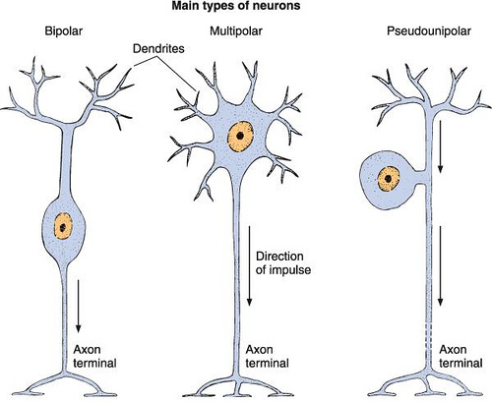
3 Main Types of Neurons

Slide 15
Information Passage
Information is transmitted from a presynaptic cell (neuron) to a post synaptic cell (neuron, muscle, or gland)

Slide 16
Supporting Cells
Glia: supporting cells necessary for the structural integrity of the nervous system and for normal functioning of neurons
Several Types of Glial Cells
Astrocytes
Radial glia
Oligodendrocytes
Schwann cells

Slide 17
Supporting Cells
Astrocytes
Radial glia
Both act as stem cells giving rise to new neurons and glial cells
Provide structural support for neurons and regulate extracellular concentrations of ions and neurotransmitters
During development facilitate formation of tight junctions between cells that line the capillaries in the brain and spinal cord resulting in the blood brain barrier which restricts the passage of most substances in the CNS
Form tracks along which newly formed neurons migrate from the neural tube (the structure that gives rise to the CNS)

Slide 18
Supporting Cells
Oligodendrocytes
Schwann cells
In CNS
Form the myelin sheaths around the axons of many vertebrate neurons
In PNS
Form the myelin sheaths around the axons of many vertebrate neurons

Slide 19
Ion pumps & ion channels establish the resting potential of a neuron
•Every cell has a voltage (difference in electrical charge) across its plasma membrane called a membrane potential
•The resting potential is the membrane potential of a neuron not sending signals
•Changes in membrane potential act as signals, transmitting and processing information

Slide 20
Formation of Resting Potential
•In a mammalian neuron at resting potential, the concentration of K+ is highest inside the cell, while the concentration of Na+ is highest outside the cell
•Sodium-potassium pumps use the energy of ATP to maintain these K+ and Na+ gradients across the plasma membrane
•These concentration gradients represent chemical potential energy
In neurons the membrane potential is between-60 & -80 milliVolts (mV) when the cell is not transmitting signals
The minus sign indicates that the inside of the cell is negative relative to the outside

Slide 22
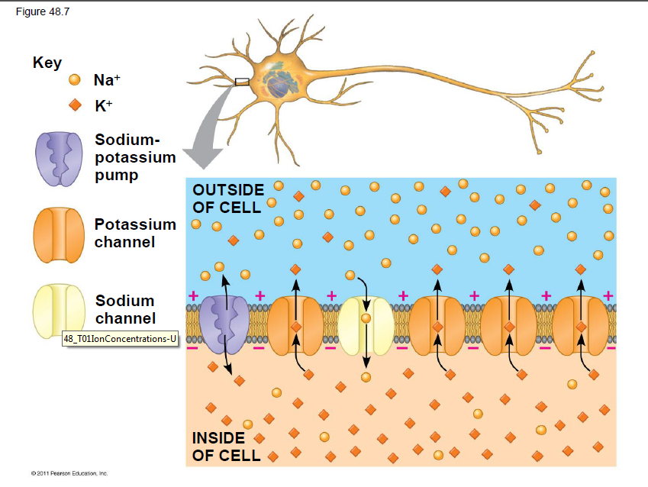

Slide 23
Resting Potential
Arises from ionic gradients maintained by the semi-permeability of the plasma membrane and one-way channels
This is the basis of nearly ALL electrical signals in the nervous system: The membrane potential can change from its resting value when the membranes permeability to a particular ion changes

Slide 24
Action Potentials are Signals Conducted by Axons

Slide 25
Graded Potentials: Hyperpolarization
If a cell has gated ion channels, its membrane potential may change in response to stimuli that open or close those channels
Hyperpolarization: an increase in the magnitude of membrane potential (the inside of the membrane becomes more negative)
Due to opening/closing of K+channels

Slide 26
Gated Ion Channels
Gated ion channels: open or close in response to 1 of 3 kinds of stimuli
Stretch gated ion channels: found in cells that sense stretch and open then the membrane is deformed
Ligand gated ion channels: found at synapses and open/close in response to specific chemical (like neurotransmitters) binding the channel
Voltage gated ion channels: found in axons (and sometimes in dendrites and cell bodies) respond to changes in membrane potential

Slide 27
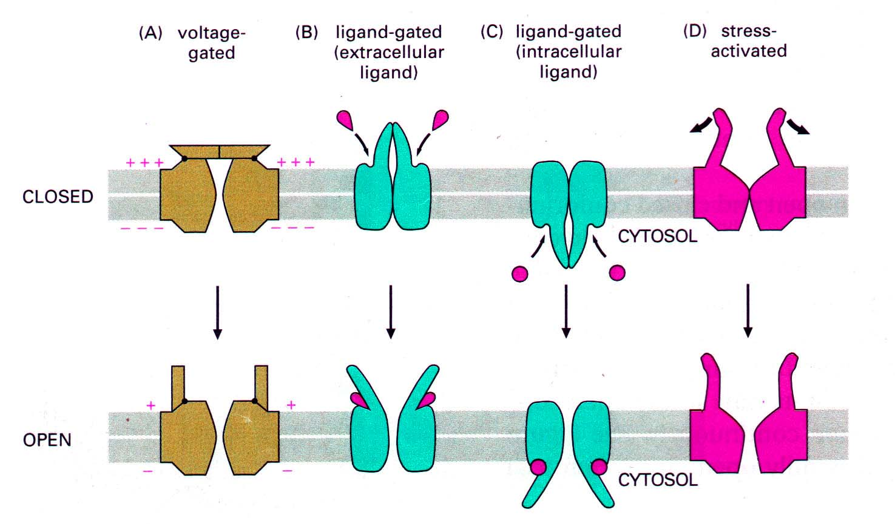

Slide 28
Equilibrium Potential
In a biological membrane, the reversal potential (also known as the Nernst potential) of an ion is the membrane potential at which there is no net (overall) flow of ions from one side of the membrane to the other.
Expressed as E _{ion}
Example E_{Na} or E_{K}

Slide 29
Production of Action Potentials
•If a depolarization shifts the membrane potential sufficiently, it results in a massive change in membrane voltage called an action potential
•Action potentials have a constant magnitude, are all-or-none, and transmit signals over long distances
•They arise because some ion channels are voltage-gated, opening or closing when the membrane potential passes a certain level

Slide 30
Action Potentials
All or nothing phenemenon
Once triggered, it has a magnitude independent of the stimulus that triggered it
Action potentials of most neurons usually very brief, 1-2milliseconds
Brief AP’s allow neurons to produce them more frequently
Neurons encode information in their action potential frequency

Slide 31
Generation of Action Potentials: A Closer Look
An action potential can be considered as a series of stages
At resting potential
1.Most voltage-gated sodium (Na+) channels are closed; most of the voltage-gated potassium (K+) channels are also closed

Slide 33
Role of Voltage Gated Ion Channel in Production of an Action Potential
Na+ has 2 gates, an activation gate and an inactivation gate, both of which must be open for Na+ to diffuse across the membrane
2: depolarization of membrane rapidly opens activation gates and slowly closes inactivation gates for Na+
3.During the rising phase, the threshold is crossed, and the membrane potential increases

Slide 34
Role of Voltage Gated Ion Channel in Production of an Action Potential
Once threshold is crossed, positive feedback quickly brings the membrane potential close to the equilibrium potential of Na+ during the rising phase
(the more Na+ ions, the more Na+ gates open to let in more Na+ ions)

Slide 35
Role of Voltage Gated Ion Channel in Production of an Action Potential
2 events prevent membrane potential from reaching E_{Na}
inactivation gates close halting Na+ influx
and activation gates on most K+ channels open, bringing the membrane potential back down during the falling phase

Slide 36
When an action potential is generated ….
4. Upon depolarization the K+ gate slowly opens
This is the falling phase
voltage-gated Na+ channels become inactivated;
voltage-gated K+ channels open, and K+ flows out of the cell

Slide 37
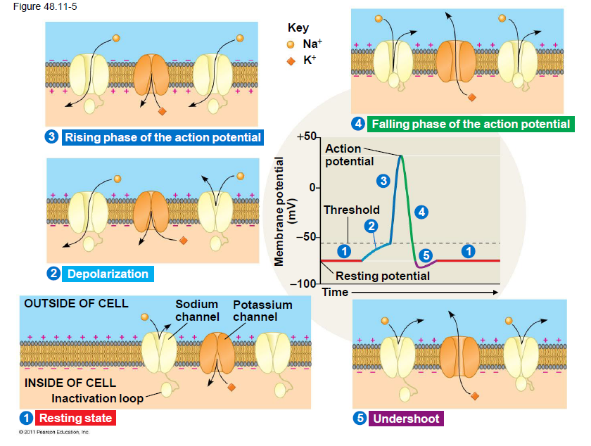

Slide 38
Refractory Period
5. During the undershoot, membrane permeability to K+ is at first higher than at rest, then voltage-gated K+ channels close and resting potential is restored
During the refractory period after an action potential, a second action potential cannot be initiated
•The refractory period is a result of a temporary inactivation of the Na+ channels

Slide 39
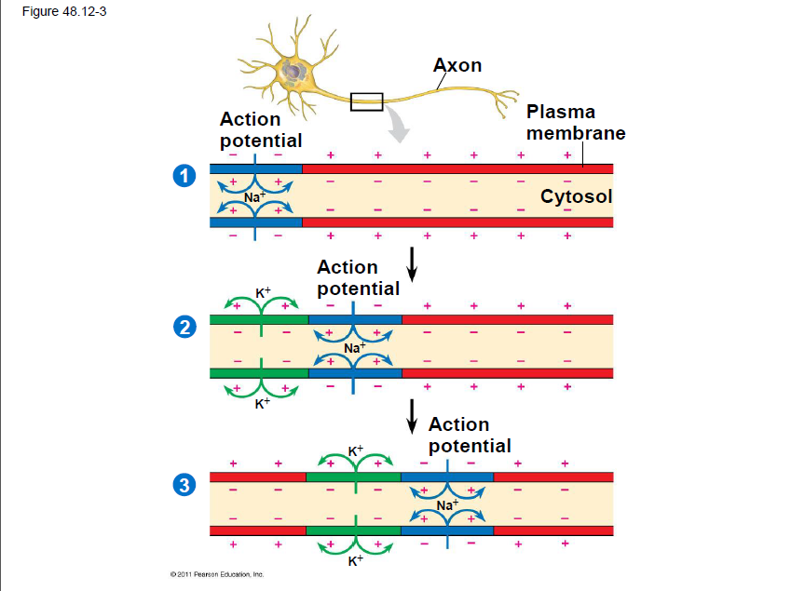

Slide 40
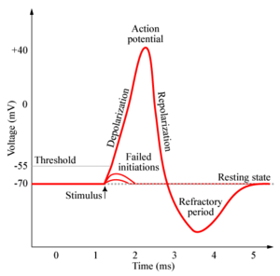

Slide 41
Conduction of Action Potentials
For an AP to function as a long distance signal, it must travel without diminishing from the cell body to the synaptic terminals
It does so by regenerating itself along the axon

Slide 42
Conduction of Action Potentials
At the site where an AP is initiated, usually an axon hillock, Na+ influx depolarizes the neighboring region of an axon membrane
The depolarization in the neighboring region is large enough to reach threshold, causing an AP to be reinitiated there
This process is repeated many times along the length of the axon

Slide 44
Evolutionary Adaptation of Axon Structure
The speed of an action potential increases with the axon’s diameter
•In vertebrates, axons are insulated by a myelin sheath, which causes an action potential’s speed to increase
•Myelin sheaths are made by glia— oligodendrocytes in the CNS and Schwann cells in the PNS

Slide 45
Myelin Sheath
In a myelinated axon, voltage gated Na+ and K+ channels are concentrated at gaps in the myelin sheath called nodes of Ranvier
Extracellular fluid is in contact with axon only at nodes
As a result, AP’s are not generated in between the nodes

Slide 46
•Action potentials in myelinated axons jump between the nodes of Ranvier in a process called saltatory conduction

Slide 47
An Important Safety Mechanism
Immediately behind the zone of depolarization due to Na+ influx, is a zone of repolarization due to K+ eflux
Because Na+ inactivation gates are closed behind the repolarized zone, the inward current necessary to depolarize the axon membrane ahead of the action potential can not produce another AP behind it
AP’s move in 1 direction

Slide 48
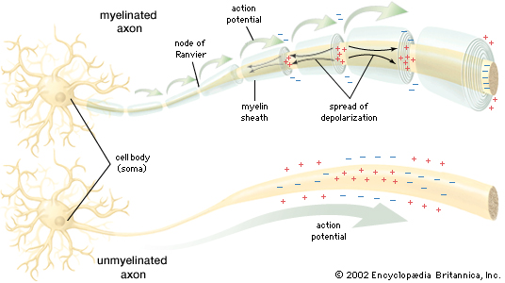

Slide 49
Neurons communicate with other cells at synapses
•At electrical synapses, the electrical current flows from one neuron to another
•At chemical synapses, a chemical neurotransmitter carries information across the gap junction
•Most synapses are chemical synapses

Slide 50
OK…So what happens when an AP reaches the end of an axon?
2 types of synapses can be at the end of an axons terminals
Electrical synapses
Less common
Gap junctions
Allows for electrical current to flow from cell to cell
Chemical synapses
More common
Involve the release of neurotransmitters by the presynaptic neuron

Slide 51
Synapses
•The presynaptic neuron synthesizes and packages the neurotransmitter in synaptic vesicles located in the synaptic terminal
•The action potential causes the release of the neurotransmitter
•The neurotransmitter diffuses across the synaptic cleft and is received by the postsynaptic cell

Slide 52
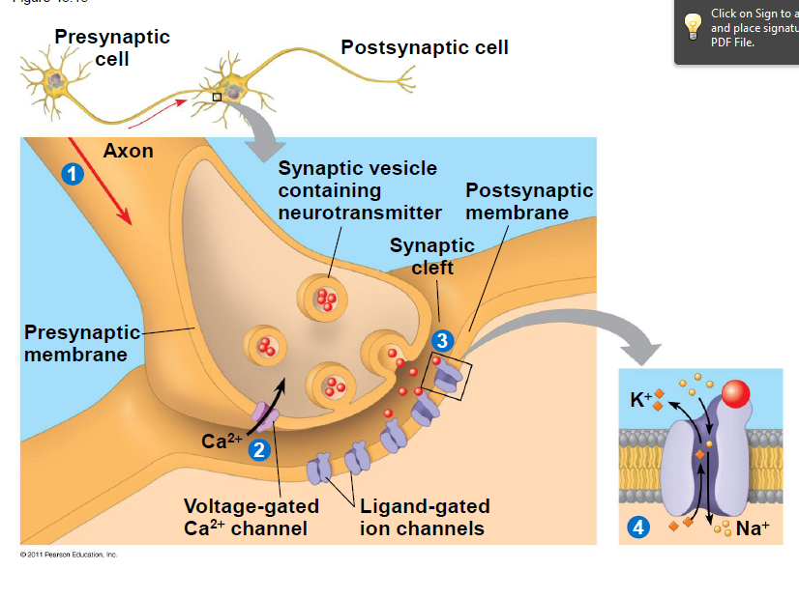

Slide 53
Generation of Postsynaptic Potentials
•Direct synaptic transmission involves binding of neurotransmitters to ligand-gated ion channels in the postsynaptic cell
•Neurotransmitter binding causes ion channels to open, generating a postsynaptic potential

Slide 54
•Postsynaptic potentials fall into two categories
–Excitatory postsynaptic potentials (EPSPs) are depolarizations that bring the membrane potential toward threshold
–Inhibitory postsynaptic potentials (IPSPs) are hyperpolarizations that move the membrane potential farther from threshold

Slide 55
Chemical Synapses
Presynaptic neurons synthesize neurotransmitters and package them in synaptic vesicles which are stored in the neurons terminals
Hundreds of synaptic vessicles may interact with a cell body or dendrites of a postsynaptic neuron

Slide 56
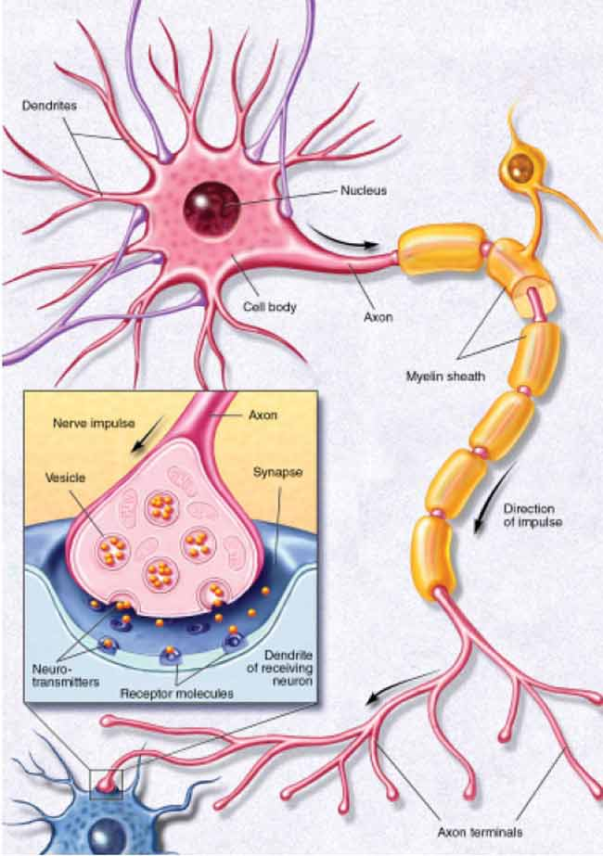

Slide 57
Synaptic Cleft
A narrow cleft/ gap that can separates the presynaptic neuron from the post synaptic cell
The effect of neurotransmitters on the post synaptic cell may be either
Direct: neurotrasmitter binds ligand gated ion channels allowing specific ions to diffuse across a plasma membrane changing membrane potential
Indirect: neurotransmitter binds receptors not associated with ion channels

Slide 58
Direct Chemical Synapses
When an AP depolarizes the plasma membrane of the axon terminals, it opens voltage gated Ca2+ channels triggering an influx of Ca2+
The elevated Ca2+ in the terminals causes synaptic vessicles to fuse with the presynaptic membrane , releasing neurotransmitters to the synaptic cleft

Slide 59
Direct Chemical Synapses
The neurotransmitter binds the receptor portion of a ligand gated ion channel in the post synaptic membrane, opening the channels of the membrane and allowing an influx of it particular ion (Na+ or K+)
Eventually the neurotransmitter is released from the receptor and
Taken back up by the presynaptic cell
Degraded
Otherwise diffuses out of the synaptic cleft

Slide 60
Summation of postsynaptic potentials in direct synaptic transmission
Unlike AP’s which are all or none, postsynaptic potentials are graded
Magnitude of postsynaptic potential depends on
Amount of neurotransmitter released
Frequency of postsynaptic AP
1 AP causing a presynaptic cell to release neurotransmitter is probably not enough to elicit a response out of the postsynaptic cell
Multiple APs in a presynaptic cell are required to initiate a new AP in a post synaptic cell
Temporal Summation

Slide 61
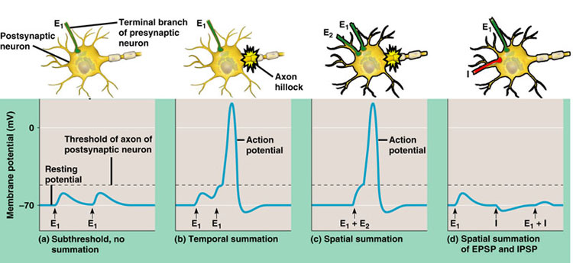
Summation of postsynaptic potentials in direct synaptic transmission
Temporal summation
Spatial summation
When EPSPs occur in rapid succession at a single synapse, the 2nd EPSP may begin before the postsynaptic cells membrane potential has reached resting potential and so the 2 EPSPs add together
EPSPs produced nearly simultaneously by different synapses on the same postsynaptic neuron can have the same additive effect

Slide 62
EPSPs & IPSPs
The interplay between the multiple EPSPs and IPSPs is the essence of integration in the nervous system
The axon hillock is the neurons integrating center , the region where the membrane potential at any instant represents the summed effects of EPSPs and IPSPs
Whenever the membrane potential at the axion hillock reaches threshold, an AP is generated

Slide 63
Indirect Synaptic Transmission
In indirect synaptic transmission, a neurotransmitter binds to a receptor that is not part of an ion channel
Activates signal transduction pathways involving second messengers in the postsynaptic cell
Have slower onsets than direct transmission, but longer lasting effects

Slide 64
Neurotransmitters
•There are more than 100 neurotransmitters, belonging to five groups:
Acetylcholine
biogenic amines
amino acids
Neuropeptides
and gases
•A single neurotransmitter may have more than a dozen different receptors

Slide 66
Neurotransmitters
Neurotransmitters are chemicals which relay, amplify, and modulate signals between a neurons and other cells
Neurotransmitters are packaged into synaptic vesicles that cluster beneath the membrane on the presynaptic side of a synapse
They are released into the synaptic cleft, where they bind to receptors in the membrane on the postsynaptic side of the synapse.

Slide 67
Acetylcholine
•Acetylcholine is a common neurotransmitter in vertebrates and invertebrates
•It is involved in muscle stimulation, memory formation, and learning
•Vertebrates have two major classes of acetylcholine receptor, one that is ligand gated and one that is metabotropic
In vertebrates Acetylcholine has functions both in the (PNS) and in the (CNS) as a neuromodulator

Slide 68
Nicotine & Acetylcholine
Binds the same receptors as acetylcholine
In vertebrate cardiac muscle acetylcholine/nicotine receptors initiate signal transduction pathways (via G protein coupled receptors)whose effects ultimately reduce the strength and rate of contraction

Slide 69
Biogenic Amines
are neurotransmitters and neuromodulators that contain one amino group that is connected to an aromatic ring by a two-carbon chain
Biogenic amines include
Epinephrine
Norepinephrine
Dopamine
Serotonin
They are active in the CNS and PNS

Slide 70
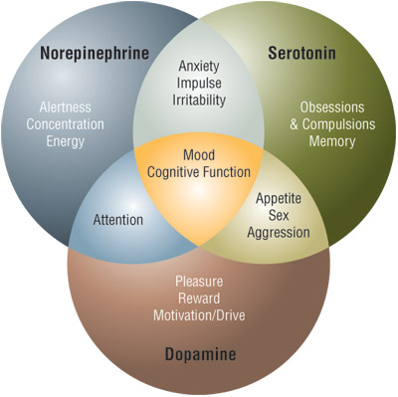

Slide 71
Psychedelic Drugs & Depression
Some psychoactive drugs such as LSD and mescaline produce their hallucinatory effects by binding brain receptors for serotonin and dopamine
Depression is often treated with drugs that increase production of serotinin and norepinepherine
Prozac enhances effects of serotonin by inhibiting its re-uptake after its release

Slide 72
Amino Acids Neurotransmitters
•Amino acid neurotransmitters are active in the CNS and PNS
Known to function in the CNS are
Glutamate
Gamma-aminobutyric acid (GABA) : produces IPSPs in the brain
Glycine
Asparatate

Slide 73
Neuropeptides
•Several neuropeptides, relatively short chains of amino acids, also function as neurotransmitters
•Neuropeptides include substance P and endorphins, which both affect our perception of pain
Endorphins: function as natural analgesics decreasing pain perception
Also stimulate ADH secretion aand so decrease urin output
Depress respiration
Produce euphoria
•Opiates bind to the same receptors as endorphins and can be used as painkillers

Slide 74
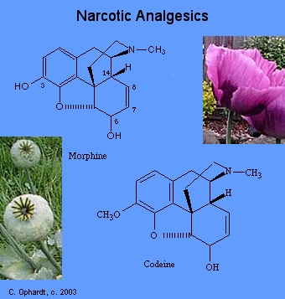
Opiates
Opiates like heroine and morphine mimic endorphins and bind their receptors

Slide 75
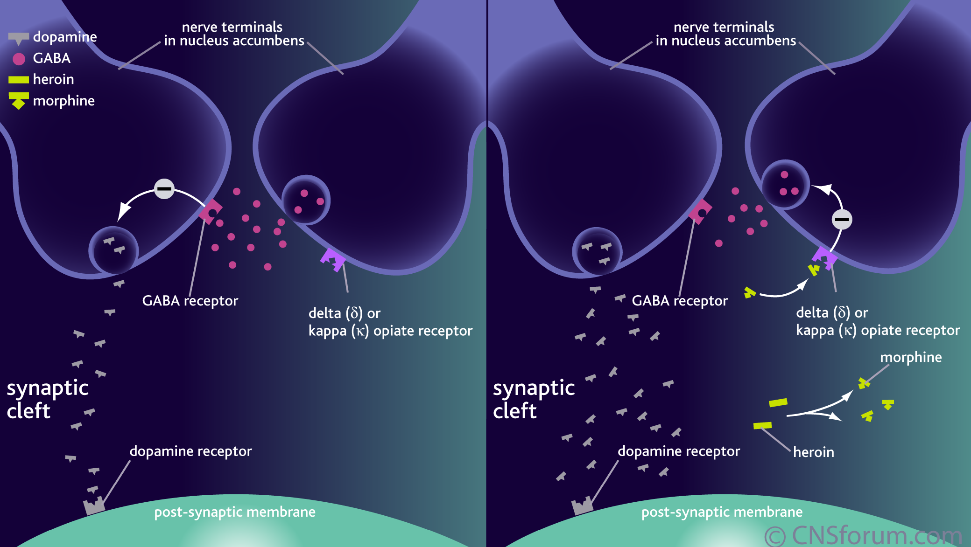

Slide 76
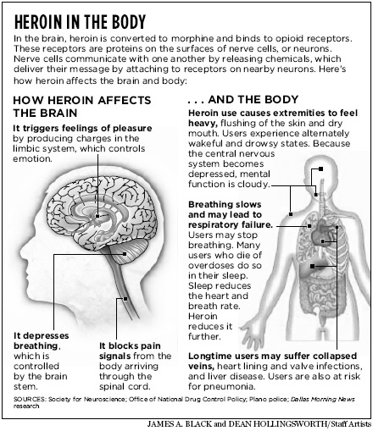

Slide 77
Gases
Nitric Oxide (no)
Carbon monoxide (co)
Certain neurons release no into the penis during arousal = vasodilation = erection
In the brain CO regulates release of hypothalamic hormones
In the PNS acts as a neuroinhibitory neurotransmitter that hyperpolarizes interstitial smoothe muscle cells
Not stored in vessicles, rather are synthesized on demand
Diffuse into neighboring target cells to produce an effect and are broken down in a matter of seconds

Slide 79
The vertebrate brain is regionally specialized
•Specific brain structures are particularly specialized for diverse functions
•These structures arise during embryonic development

Slide 80
Specialized Regions of the Vertebrate Nervous System
In all vertebrates, nervous system shows cephalization & distinct CNS & PNS
Brain provides integrative power underlying complex behavior
Spinal cord
Runs the length of the vertebral column (spine)
Integrates simple responses to certain stimuli and conveys info to and from the brain

Slide 81
Ventral Nerve Cord vs Spinal Cord
Unlike the ventral nerve cord of invertebrates , the vertebrate spinal cord runs along the dorsal side of the body and does not contain segmental ganglia
There are segmental ganglia just outside of the spinal cord and the arrangement of neurons in the spinal cord clearly shows an underlying segmental organization

Slide 82
Embryonic Development of Vertebrate Nervous System
The vertebrate CNS is derived from the dorsal embryonic nerve cord (which is hollow)
Phylogenetic hallmark of chordates
Feature persists in adults as
central canal of spinal cord
4 ventricles of brain
Both filled with cerebrospinal fluid: formed in brain via filtration of blood

Slide 86
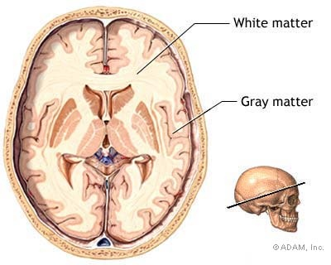
Brain
White Matter
Gray matter
Axons within the CNS are often found in well defined bundles whose myelin sheathes give them a white appearance
Consists mainly of dendrites, cell bodies, and unmyelinated axons

Slide 87
Peripheral Nervous System
Cranial nerves
Spinal nerves
Cranial nerves originate in the brain and terminate mainly in the organs of the head and the upperbody
Mammals have 12 pairs
Spinal nerves originate in the spinal cord and extend to parts of the body below the head
Mammals have 31 pairs
Both contain both sensory and motor neurons

Slide 89
Peripheral Nervous System
Somatic Nervous System
Autonomic nervous system
Carries signals to and from skeletal muscles mainly in response to external stimuli
Voluntary nervous system because subject to conscious control
Regulates internal environment by controlling smooth and cardiac muscles and organs of the digestive, cardiovascular, excretory, and endocrine systems
Involuntary
3 divisions
Sympathetic
Parasympathetic
Enteric

Slide 90
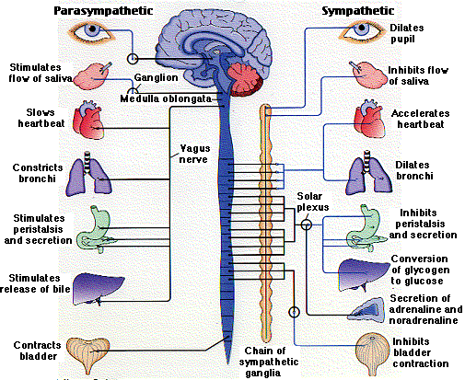

Slide 91
Autonomic Nervous System
Sympathetic nervous system
Parasympathetic Nervous System
general action is to mobilize the body's resources under stress; to induce the flight-or-fight response
It is, however, constantly active at a basal level in order to maintain homeostasis
The actions of the parasympathetic nervous system can be summarized as "rest and digest".
ENTERIC NERVOUS SYSTEM
directly controls the gastrointestinal system

Slide 92
Embryonic Development of the Brain
In the developing vertebrate, the neural tube is the embryo's precursor to the central nervous system
The neural groove gradually deepens as the neural folds become elevated, and ultimately the folds meet and coalesce in the middle line and convert the groove into a closed tube, the neural tube or neural canal

Slide 93
Embryonic Development of the Brain
In all vertebrates3 parts of the neural tube become evident as the embryo develops
Forebrain
Midbrain
Hindbrain
During vertebrate evolution the brain further divided structurally

Slide 94
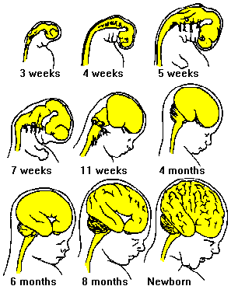
Human Embryonic Development of the Brain
By the 5th week of human embryonic development 5 brain regions have formed from 3 primary bulges
Forebrain →Telencephalon & Diencephalon
Midbrain → Mesencephalon
Hindbrain → Metencephalon & Myelencephalon
Most profound changes occur in the telencephalon which gives rise to the cerebrum during the 2nd and 3rd months

Slide 95
Major Centers that Develop from…
Diencephalon is the forebrain division that evolved earliest in vertebrate history
Thalamus
Hypothalamus
Hypothalamus
Epithalamus
Midbrain & Hindbrain
Brainstem: consists of the midbrain, pons, medulla oblangata
Cerebellum

Slide 96
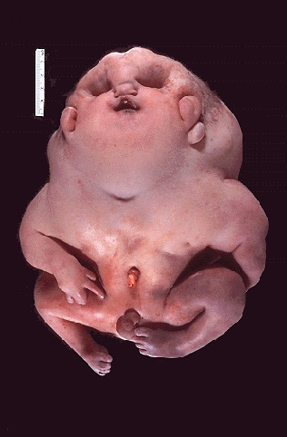
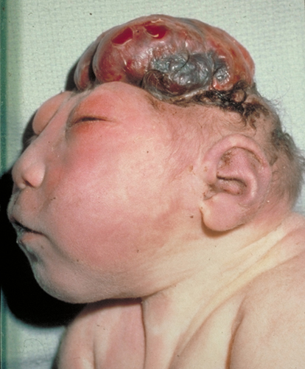
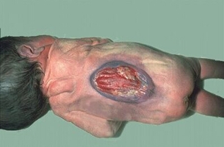
Neural Tube Defects
Neural tube defects are birth defects of the brain and spinal cord. The two most common neural tube defects are
spina bifida: fetal spinal column doesn't close completely during the first month of pregnancy
Usually nerve damage
Anencephaly: much of the brain does not develop.
http://highered.mcgraw-hill.com/sites/0072495855/student_view0/chapter3/animation__fetal_development_and_risk.html
Babies with anencephaly are either stillborn or die shortly after birth.

Slide 97
Brain Stem
One of the evolutionarily older parts of the vertebrate brain
Known as the “lower brain”
Functions in maintaining homeostasis, coordination of movement, and conduction of information to higher brain centers
3 parts of the Brain Stem
Medulla oblingata
Pons
Midbrain

Slide 98
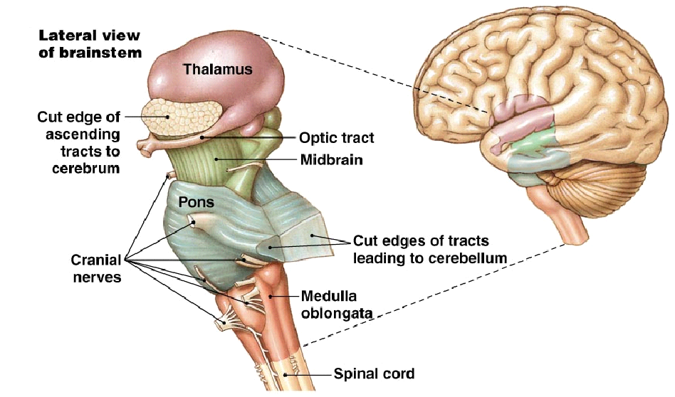

Slide 99
Brain Stem
The brain stem provides the main motor and sensory innervation to the face and neck via the cranial nerves.
nerve connections of the motor and sensory systems from the main part of the brain to the rest of the body pass through the brain stem.
corticospinal tract (motor)
posterior column-medial lemniscus pathway (fine touch, vibration sensation)
spinothalamic tract (pain, temperature, itch and crude touch).
The brain stem also plays an important role in the regulation of cardiac and respiratory function. It also regulates the central nervous system, and is pivotal in maintaining consciousness and regulating the sleep cycle.

Slide 100
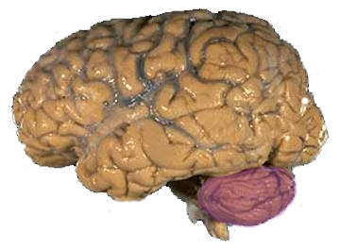
Cerebellum
plays an important role in motor control
The cerebellum does not initiate movement, but it contributes to
Coordination (especially hand eye coordination)
Precision
accurate timing
It integrates inputs to fine tune motor activity.
damage to the cerebellum does not cause paralysis, but instead produces disorders in fine movement, equilibrium, posture, and motor learning
involved in some cognitive functions such as attention and language and probably in some emotional functions such as regulating fear and pleasure responses

Slide 101
Diencephalon
Develops into 3 adult brain regions
Epithalamus: includes the
pineal gland: produces melatonin
Choroid plexus: produces cerebrospinal fluid
Thalamus:
main input center for sensory info going to the cerebrum
Main output center for motor information leaving the cerebrum
Hypothalamus : one of the most important brain regions for HOMEOSTATIC REGULATION
Contains bodys thermostat
Produces posterior pituitary hormones
Controls anterior pituitary hormone output
Regulates hunger, thirst, and basic survival mechanisms
Sexual/ mating behavior
Fight or flight
Pleasure center

Slide 102
SCN maintain Circadian Rhythms
An internal time keeper known as the “biological clock” maintains circadian rhythms
In mammals the biological clock is a pair of hypothalamic structures called suprachiasmatic nuclei (SCN)
Biological clocks regulate a variety of physiological phenomenon including hunger, hormone release, and heightened sensitivity to external stimuli

Slide 103
Circadian Rhythms
is a roughly 24-hour cycle in the biochemical, physiological, or behavioral processes of living entities, including plants, animals, fungi and cyanobacteria
Although circadian rhythms are endogenous, they are adjusted to the environment by external cues, the primary one of which is daylight.

Slide 104
Cerebrum
Develops from the telencephalon
Arose early in vertebrate evolution as a region supporting olfactory, auditory, and visual perception
Divided into left and right cerebral hemispheres
with the assistance of the cerebellum, controls all voluntary actions in the body

Slide 105
Arousal & Sleep
The brainstem and cerebrum control arousal and sleep
The core of the brainstem has a diffuse network of neurons called the reticular formation
This regulates the amount and type of information that reaches the cerebral cortex and affects alertness
The hormone melatonin is released by the pineal gland and plays a role in bird and mammal sleep cycles

Slide 106
Sleep is essential and may play a role in the consolidation of learning and memory
Dolphins sleep with one brain hemisphere at a time and are therefore able to swim while “asleep”

Slide 107
Biological Clock Regulation
•Cycles of sleep and wakefulness are examples of circadian rhythms, daily cycles of biological activity
•Mammalian circadian rhythms rely on a biological clock, molecular mechanism that directs periodic gene expression
•Biological clocks are typically synchronized to light and dark cycles

Slide 108
•In mammals, circadian rhythms are coordinated by a group of neurons in the hypothalamus called the suprachiasmatic nucleus (SCN)
•The SCN acts as a pacemaker, synchronizing the biological clock

Slide 109
Emotions
•Generation and experience of emotions involves many brain structures including the amygdala, hippocampus, and parts of the thalamus
•These structures are grouped as the limbic system
•The limbic system also functions in motivation, olfaction, behavior, and memory

Slide 111
Emotion
•Generation and experience of emotion also require interaction between the limbic system and sensory areas of the cerebrum
•The structure most important to the storage of emotion in the memory is the amygdala, a mass of nuclei near the base of the cerebrum

Slide 112
Each Cerebral Hemisphere Consists of 3 Main Parts
Cerebral cortex: an outer covering composed of gray matter
Largest part of mammalian brain
Sensory information is analyzed
Motor commands issued
Language is generated
Region known as neocortex evolved in mammals
Internal white matter
Basal nuclei: groups of neurons located deep within the white matter
Function in planning and learning movement sequences
Damage in this region can cause paralysis

Slide 113
Cerebral Cortex
Left side receives info from, and controls movement of the right side of the organism & vice versa
corpus callosum: a thick band of axons that enables communication between the right and left cerebral cortices

Slide 114
Cerebral Cortex
Each side of the cerebral cortex has 4 lobes
Frontal
Occipital
Parietal
Temporal
Controls cognitive functions including
Language and speech
Emotions
Memory and learning
consciousness

Slide 115
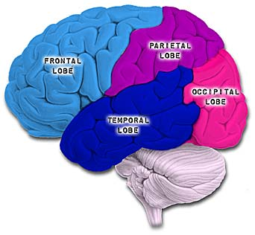

Slide 116
Cerebral Cortex
Primary sensory areas
Association areas
Receive and process specific types of information
Integrate information from various parts of the brain
The major increase in the size of the neocortex that occurred during mammalian evolution was mostly an expansion of the association areas that integrate higher cognitive functions and make more complex learning and behavior possible

Slide 117
Information Processing in the Cerebral Cortex
Most sensory information is directed via the thalamus to primary sensory areas within the lobes
Visual info → occipital lobe
Auditory input → temporal lobe
Taste →parietal lobe
Somatosensory info → parietal lobe
Touch
Pain
Pressure
Temperature
Position of muscles & limbs
Olfactory info → 1st primitive regions of cortex →frontal lobe

Slide 118
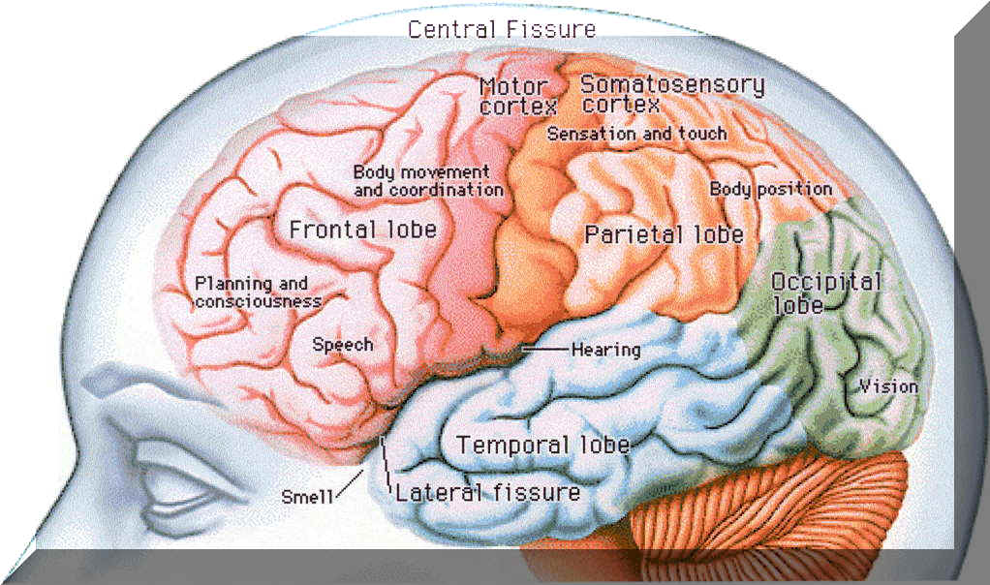

Slide 119
Notice that the cortical surface area devoted to certain parts of the body is not indicative of the size of the body, but rather to the number of sensory neurons that innervate that part

Slide 120
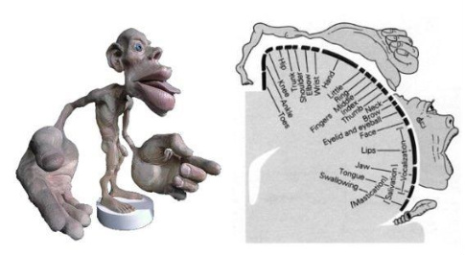
1⁰ Motor & Somatosensory Cortex

Slide 121
Lateralization of Cortical Function
Left Hemisphere
Right hemisphere
Language
Math
Logical operations
Serial processing of sequence information
Has a bias for detailed, speed optimized activities required for skeletal muscle control & processing of fine visual & auditory details
Pattern recognition
Face recognition
Spatial relations
Nonverbal thinking
Emotional processing
Simultaneous processing of many kinds of information
Understanding & generating stress & intonation patterns of speech that convey emotional content
Perceiving relationships between image & context
Corpus Callosum ties them together
https://www.youtube.com/watch?v=9CEr2GfGilw

Slide 122
Limbic System
A ring of structures around the brainstem consisting of 3 parts
Amygdala
Hippocampus
Olfactory bulb
Interact with sensory areas of the neocortex & mediate primary emotions that manifest themselves in behaviors
Laughing
Crying
Also attaches “feelings” to basic survival related functions: EX. Extended nurturing of infants

Slide 123
Memory & Learning
Short term memory
Long term memory
Held in frontal lobes for a short time, then we release it (forget) or send it to long term memory
Hippocampus mediates long term memory
Transfer of information from short to long term memory is enhanced
by rehearsal (practice makes perfect)
+ or – emotional states mediated by the amygdala
Association of new data w/data already in long term memory

Slide 124
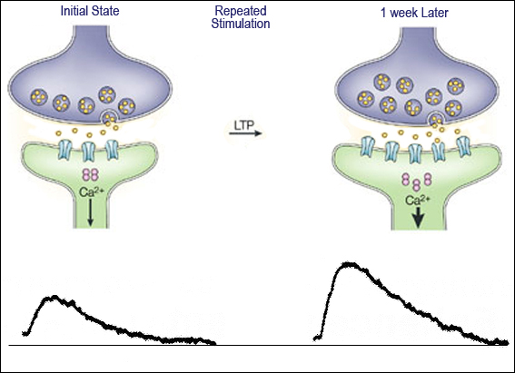
Cellular Mechanisms of Learning
Long Term Potentiation: a form of learning in the vertebrate brain that involves an increase in the strnegth of synaptic transmission that occur when presynaptic neurons produce a brief high frequency series of AP’s
Can last for days or weeks and so determine what information is converted to a long term memory and thus learned

Slide 125
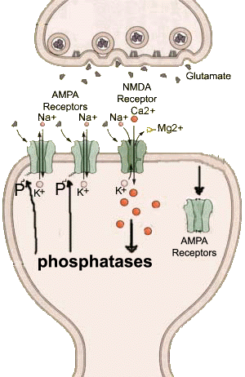
Presynaptic neurons release neurotransmitter glutamate
Postsynaptic neurons have 2 types of glutamate receptors
AMPA receptors: ligand gated ion channels that when glutamate binds allow Na+ & K+ to diffuse depolarizing the postsynaptic membrane
NMDA receptors: part of channels that are both ligand and voltage gated
Open only if glutamate is bound AND membrane is depolarized
Binding of glutamate to these 2 receptors leads to an LTP

Slide 126
CNS Injury & Disease
Unlike the PNS the CNS can not fully repair itself when injured or diseased
Surviving neurons in the brain can make new connections and thus compensate for damage to some extent
Generally speaking, brain & spinal cord injuries, disease, or strokes have devastating and often permanent effects

Slide 127
Diseases & Disorders of the Nervous System
Schizophrenia
Depression
-Strong genetic component
-Amphetamines (speed) (dopamine receptor) & PCP (NMDA receptor) stimulate schizophrenic like behavior
-So… Treatment
block the receptors those things bind to = alleviation of symptoms
-Side Effects include motor deficits that resemble Parkinsons so people stop taking their medication
Severe mental disturbance characterized by psychotic episodes in which patients lose the ability so distinguish reality
Symptoms
Hallucination
Delusions
Blunted emotions
Distractability
Lack of initiative
Poverty of speech
Bipolar Disorder:
involves mood swings from high to low
1% of the population
Genetic component
In its milder forms often associated with great creativity
Keats
Hemmingway
Tolstoy
Schumann
Major Depression
Low mood most of the time
5% of the population
Genetic component

Slide 128
Diseases & Disorders of the Nervous System
Parkinsons
Alzheimers
At 65 yrs old 1% of people have it
At 85 yrs old 5% have it
Symptoms result from death of neurons in midbrain
Results from combination of environmental and genetic factors
No cure but symptoms can be managed
Progressive brain illness leading to motor disorder characterized by difficulty in initiating movements, slowness of movement, and rigidity
Muscle tremors
Poor balance
Flexed posture
Shuffling gate
A progressive mental deterioration (dementia), characterized by confusion, memory loss, and various other symptoms
10% of people at 65yrs old
35% of people at 85yrs old
Due to neuron death in huge areas of the brain

