Slide 1
Chapter 18
Regulation of Gene Expression

Slide 2
Overview: Conducting the Genetic Orchestra
Prokaryotes and eukaryotes alter gene expression in response to their changing environment
In multicellular eukaryotes, gene expression regulates development and is responsible for differences in cell types
RNA molecules play many roles in regulating gene expression in eukaryotes
© 2011 Pearson Education, Inc.

Slide 3
Concept 18.1: Bacteria often respond to environmental change by regulating transcription
Natural selection has favored bacteria that produce only the products needed by that cell, cells don’t want to unnecessarily expend energy to make products they don’t need in a competitive environment.
A cell can regulate the production of enzymes by feedback inhibition or by gene regulation
Gene expression in bacteria is controlled by the operon model (1-2)
© 2011 Pearson Education, Inc.

Slide 4
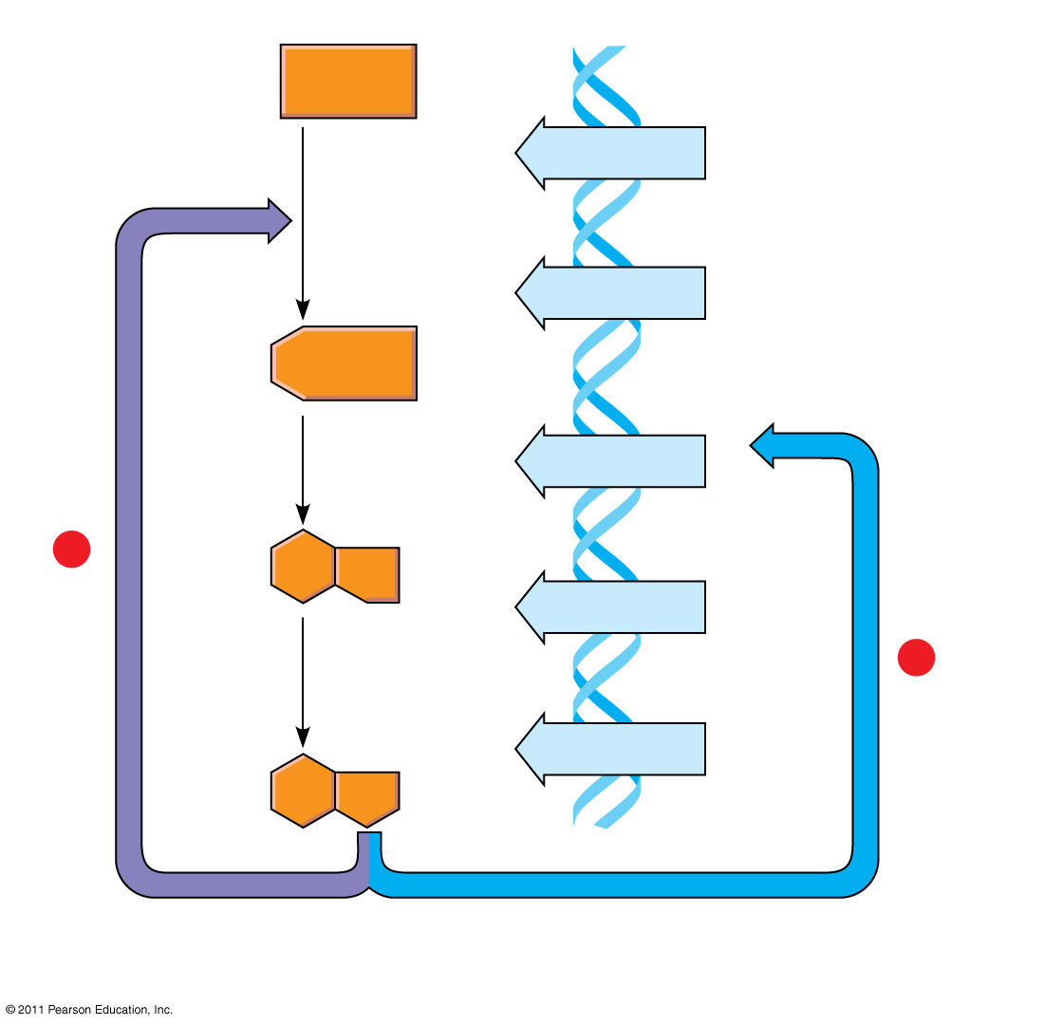
Figure 18.2
Precursor
Feedback inhibition
trpE gene
(3)
Enzyme 1
trpD gene
Regulation of gene expression
Enzyme 2
trpC gene
−
trpB gene
Enzyme 3
−
trpA gene
Tryptophan
(a)
Regulation of enzyme activity
(b)
Regulation of enzyme production
Notes:
Figure 18.2 Regulation of a metabolic pathway.

Slide 5
Operons: The Basic Concept
A cluster of functionally related genes can be under coordinated control by a single “on-off switch”
The regulatory “switch” is a segment of DNA called an operator usually positioned within the promoter
An operon is the entire stretch of DNA that includes the operator, the promoter, and the genes that they control
Promoter-A sequence of nucleotides upstream of the start of gene that must bind with RNA polymerase for transcription to proceed. (4-7)
© 2011 Pearson Education, Inc.

Slide 6
The operon can be switched off by a protein repressor
The repressor prevents gene transcription by binding to the operator and blocking RNA polymerase
The repressor is the product of a separate regulatory gene (8-9)
A corepressor is a molecule that cooperates with a repressor protein to switch an operon off
© 2011 Pearson Education, Inc.

Slide 7
Repressible and Inducible Operons: Two Types of Negative Gene Regulation
A repressible operon is one that is usually on; binding of a repressor to the operator shuts off transcription
The trp operon is a repressible operon
An inducible operon is one that is usually off; a molecule called an inducer inactivates the repressor and turns on transcription (10 part)
© 2011 Pearson Education, Inc.

Slide 8
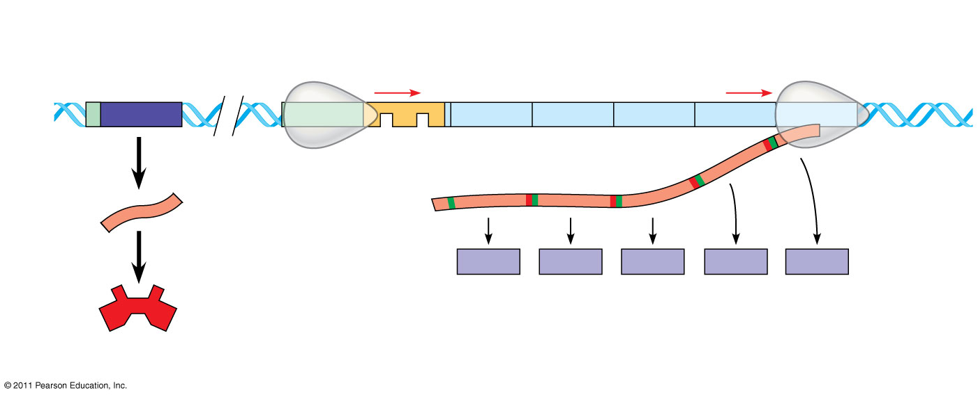
Figure 18.3a
trp operon
Promoter
Promoter
Genes of operon
DNA
trpR
trpE
trpD
trpC
trpB
trpA
Operator
Regulatory gene
RNA polymerase
Start codon
Stop codon
3′
mRNA
mRNA 5′
5′
E
D
C
B
A
Protein
Inactive repressor
Polypeptide subunits that make up enzymes for tryptophan synthesis
(a) Tryptophan absent, repressor inactive, operon on
Notes:
Figure 18.3 The trp operon in E. coli: regulated synthesis of repressible enzymes.

Slide 9
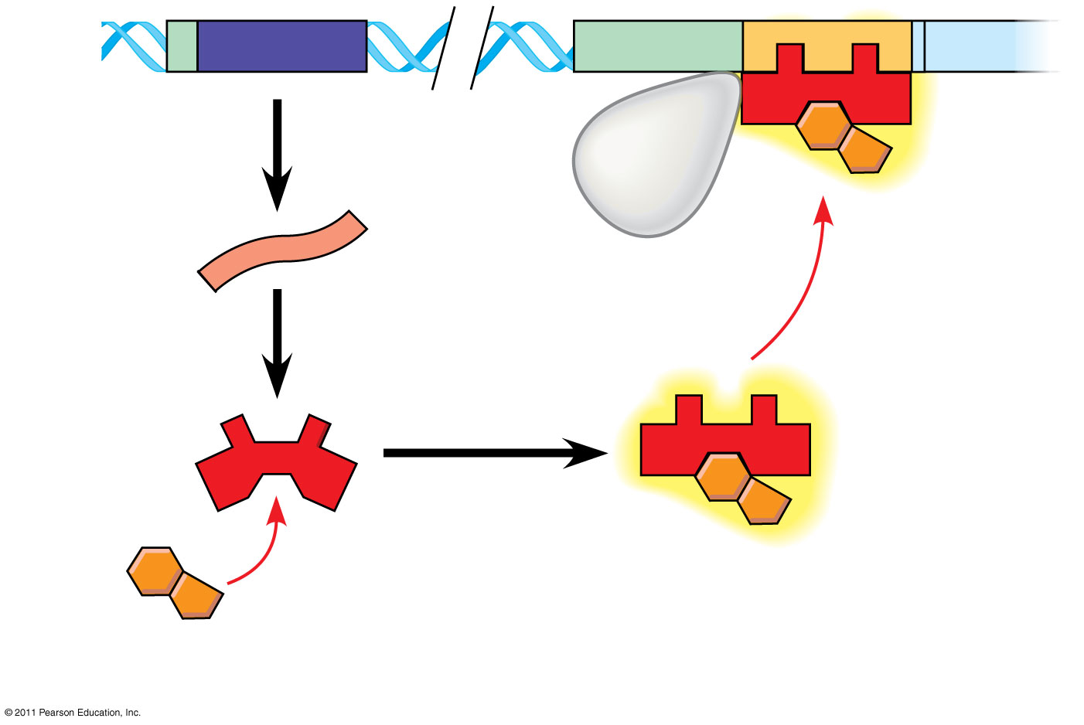
DNA
No RNA made
mRNA
Protein
Active repressor
Tryptophan (corepressor)
(b) Tryptophan present, repressor active, operon off

Slide 10
Figure 18.3b-2
DNA
No RNA made
mRNA
Protein
Active repressor
Tryptophan (corepressor)
(b) Tryptophan present, repressor active, operon off
http://highered.mcgraw-hill.com/olcweb/cgi/pluginpop.cgi?it=swf::535::535::/sites/dl/free/0072437316/120080/bio26.swf::The%20Tryptophan%20Repressor
Notes:
Figure 18.3 The trp operon in E. coli: regulated synthesis of repressible enzymes.

Slide 11
The lac operon is an inducible operon and contains genes that code for enzymes used in the hydrolysis and metabolism of lactose
By itself, the lac repressor is active and switches the lac operon off
A molecule called an inducer inactivates the repressor to turn the lac operon on (10 other part)
© 2011 Pearson Education, Inc.

Slide 12
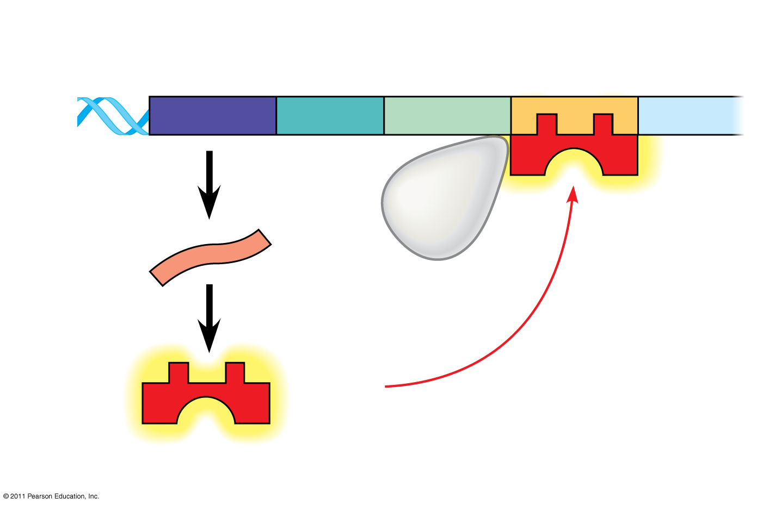
Figure 18.4a
Regulatory gene
Promoter
Operator
DNA
DNA
lacI
lacZ
No RNA made
3′
mRNA
RNA polymerase
5′
Active repressor
Protein
(a) Lactose absent, repressor active, operon off
Notes:
Figure 18.4 The lac operon in E. coli: regulated synthesis of inducible enzymes.

Slide 13
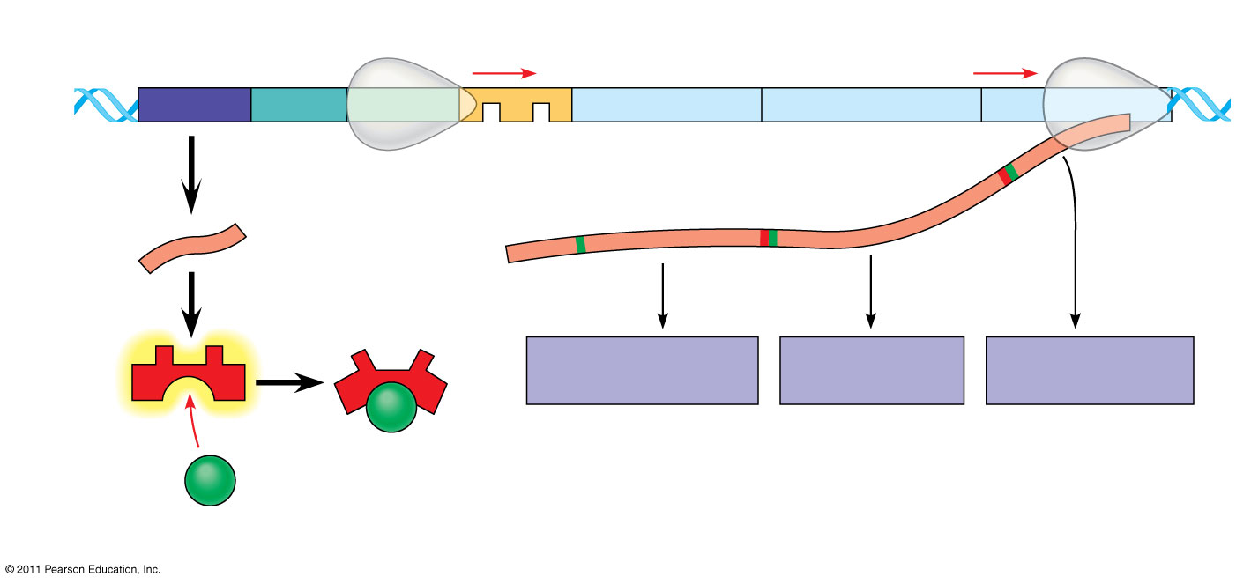
lac operon
DNA
lacI
lacZ
lacY
lacA
RNA polymerase
mRNA
mRNA 5′
Protein
β-Galactosidase
Permease
Transacetylase
Allolactose (inducer)
Inactive repressor
(b) Lactose present, repressor inactive, operon on

Slide 14
Figure 18.4b
lac operon
DNA
lacI
lacZ
lacY
lacA
RNA polymerase
3′
mRNA
mRNA 5′
5′
Protein
β-Galactosidase
Permease
Transacetylase
Allolactose (inducer)
Inactive repressor
(b) Lactose present, repressor inactive, operon on
(11)
http://vcell.ndsu.edu/animations/lacOperon/movie-flash.htm
Notes:
Figure 18.4 The lac operon in E. coli: regulated synthesis of inducible enzymes.

Slide 15
Inducible enzymes usually function in catabolic pathways; their synthesis is induced by a chemical signal
Repressible enzymes usually function in anabolic pathways; their synthesis is repressed by high levels of the end product
Regulation of the trp and lac operons involves negative control of genes because operons are switched off by the active form of the repressor
(12-13 from previous knowledge)
© 2011 Pearson Education, Inc.

Slide 16
Positive Gene Regulation
Some operons are also subject to positive control through a stimulatory protein, such as catabolite activator protein (CAP), an activator of transcription
When glucose (a preferred food source of E. coli) is scarce, CAP is activated by binding with cyclic AMP (cAMP)
Activated CAP attaches to the promoter of the lac operon and increases the affinity of RNA polymerase, thus accelerating transcription (14-16 carried over on next page)
© 2011 Pearson Education, Inc.

Slide 17
When glucose levels increase, CAP detaches from the lac operon, and transcription returns to a normal rate
CAP helps regulate other operons that encode enzymes used in catabolic pathways
© 2011 Pearson Education, Inc.

Slide 18
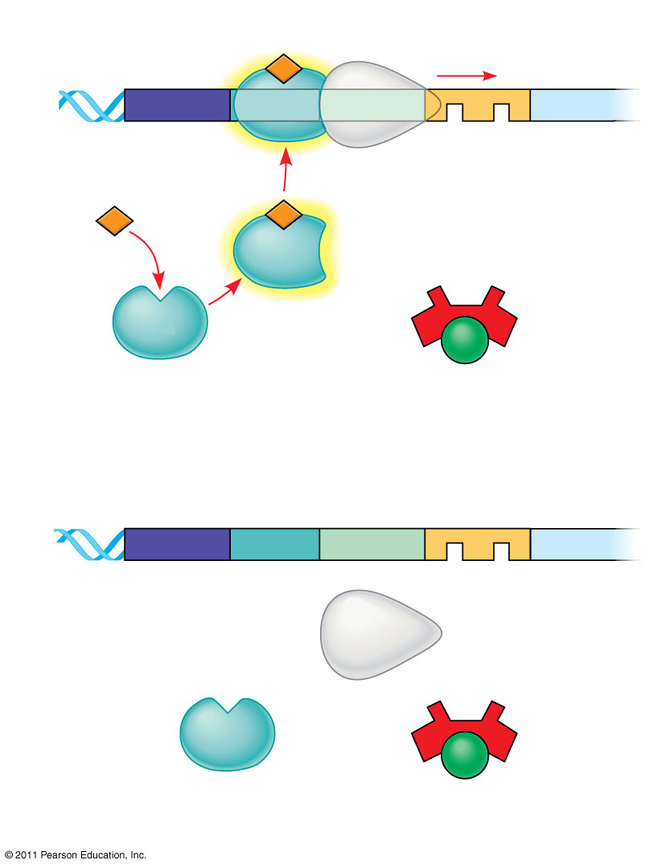
Figure 18.5
Promoter
DNA
lacI
lacZ
CAP-binding site
RNA polymerase binds and transcribes
Operator
Active CAP
cAMP
Inactive CAP
Inactive lac repressor
Allolactose
(a)
Lactose present, glucose scarce (cAMP level high): abundant lac mRNA synthesized
Promoter
DNA
lacI
lacZ
CAP-binding site
Operator
RNA polymerase less likely to bind
Inactive CAP
Inactive lac repressor
(b)
Lactose present, glucose present (cAMP level low): little lac mRNA synthesized
Notes:
Figure 18.5 Positive control of the lac operon by catabolite activator protein (CAP).

Slide 19
Differential Gene Expression
Almost all the cells in an organism are genetically identical
Differences between cell types result from differential gene expression, the expression of different genes by cells with the same genome
Only about 5-15% of a cells genes are being expressed at any given time.
Abnormalities in gene expression can lead to diseases including cancer
Gene expression is regulated at many stages most commonly at the level of DNA (18-20)
© 2011 Pearson Education, Inc.

Slide 20
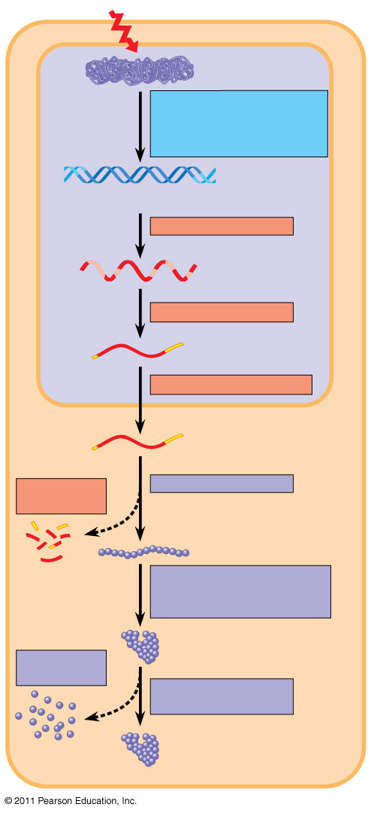
Figure 18.6
Signal
NUCLEUS
Chromatin
Chromatin modification: DNA unpacking involving histone acetylation and DNA demethylation
DNA
Gene available for transcription
Gene
Transcription
RNA
Exon
Primary transcript
Intron
RNA processing
Tail
Cap
mRNA in nucleus
Transport to cytoplasm
CYTOPLASM
mRNA in cytoplasm
Degradation of mRNA
Translation
Polypeptide
Protein processing, such as cleavage and chemical modification
Degradation of protein
Active protein
Transport to cellular destination
Cellular function (such as enzymatic activity, structural support)
Notes:
Figure 18.6 Stages in gene expression that can be regulated in eukaryotic cells.

Slide 21
Regulation of Chromatin Structure
Genes within highly packed heterochromatin are usually not expressed, while loosely packed euchromatin are.
Chemical modifications to histones and DNA of chromatin influence both chromatin structure and gene expression (21)
© 2011 Pearson Education, Inc.

Slide 22
Histone Modifications
In histone acetylation, acetyl groups are attached to positively charged lysines in histone tails
This loosens chromatin structure, thereby promoting the initiation of transcription
The addition of methyl groups (methylation) can condense chromatin; the addition of phosphate groups (phosphorylation) next to a methylated amino acid can loosen chromatin (22)
Animation: DNA Packing
© 2011 Pearson Education, Inc.

Slide 23
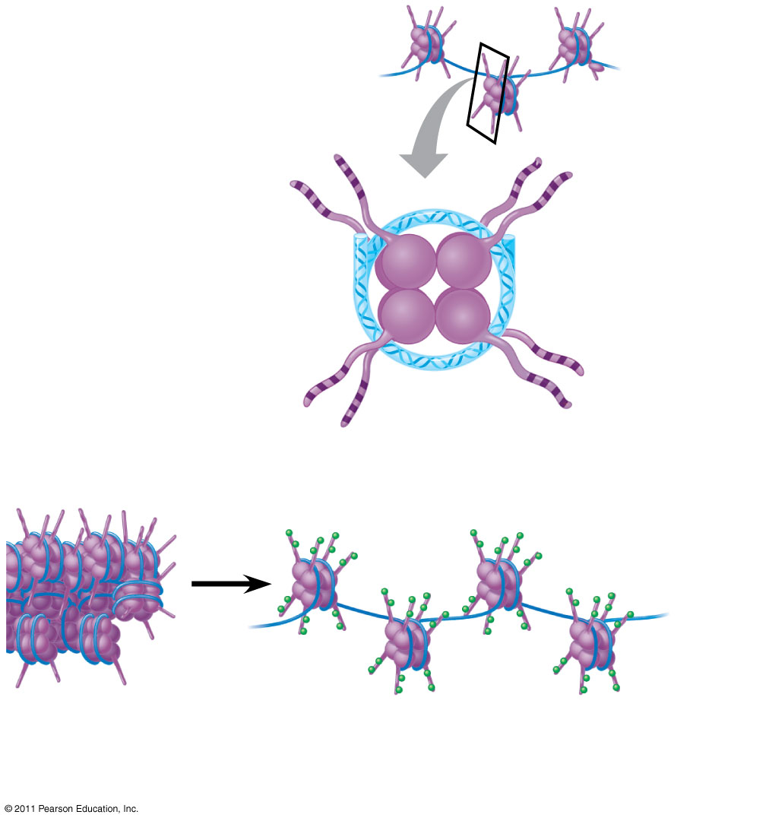
Figure 18.7
Histone tails
DNA double helix
Amino acids available for chemical modification
Nucleosome (end view)
(a) Histone tails protrude outward from a nucleosome
Unacetylated histones
Acetylated histones
(b)
Acetylation of histone tails promotes loose chromatin structure that permits transcription
Notes:
Figure 18.7 A simple model of histone tails and the effect of histone acetylation.

Slide 24
DNA Methylation
DNA methylation, the addition of methyl groups to certain bases in DNA, is associated with reduced transcription in some species
DNA methylation can cause long-term inactivation of genes in cellular differentiation
In genomic imprinting, methylation regulates expression of either the maternal or paternal alleles of certain genes at the start of development. This is maintained through chromatin structure and various proteins. (23-25)
© 2011 Pearson Education, Inc.

Slide 25
Epigenetic Inheritance
Although the chromatin modifications just discussed do not alter DNA sequence, they may be passed to future generations of cells
The inheritance of traits transmitted by mechanisms not directly involving the nucleotide sequence is called epigenetic inheritance (26)
This can led to some of the cell differentiation seen in early development.
© 2011 Pearson Education, Inc.

Slide 26
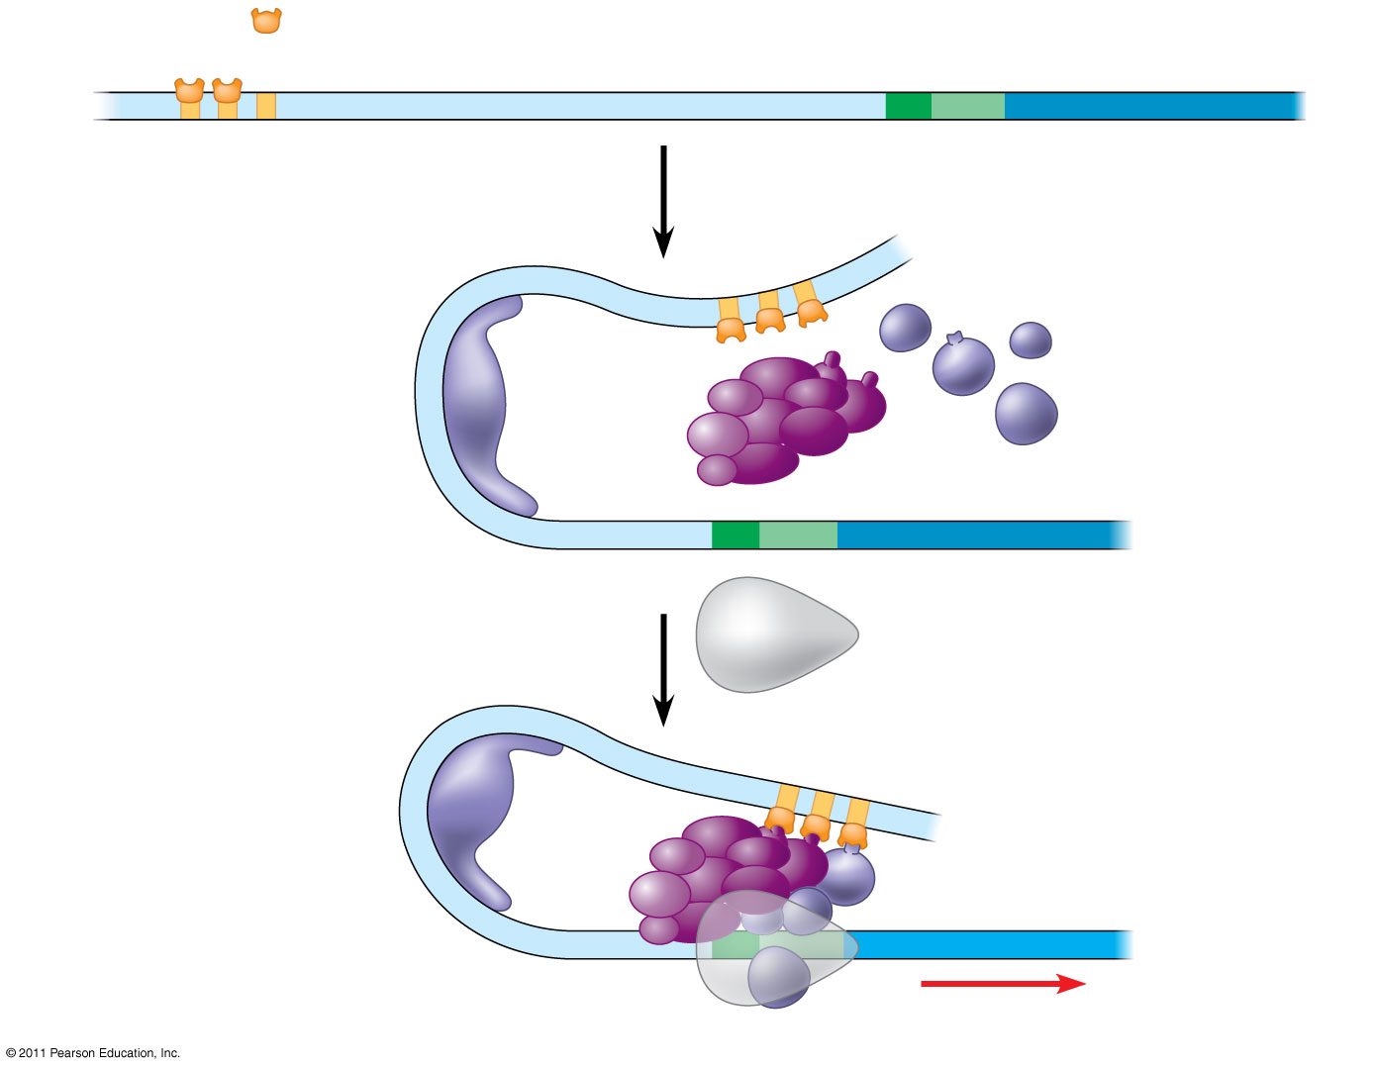
Figure 18.10-3
Activators
Promoter
Gene
DNA
Distal control element
TATA box
Enhancer
General transcription factors
DNA- bending protein
Group of mediator proteins
RNA polymerase II
(27)
RNA polymerase II
Transcription initiation complex
RNA synthesis
Notes:
Figure 18.10 A model for the action of enhancers and transcription activators.

Slide 27
Organization of a Typical Eukaryotic Gene
Associated with most eukaryotic genes are multiple control elements, segments of noncoding DNA that serve as binding sites for transcription factors that help regulate transcription
Control elements and the transcription factors they bind are critical to the precise regulation of gene expression in different cell types
© 2011 Pearson Education, Inc.

Slide 28
Coordinately Controlled Genes in Eukaryotes
Unlike the genes of a prokaryotic operon, each of the co-expressed eukaryotic genes has a promoter and control elements
These genes can be scattered over different chromosomes, but each has the same combination of control elements
Copies of the activators recognize specific control elements and promote simultaneous transcription of the genes (28-29)
© 2011 Pearson Education, Inc.

Slide 29
Nuclear Architecture and Gene Expression
Loops of chromatin extend from individual chromosomes into specific sites in the nucleus
Loops from different chromosomes may congregate at particular sites, some of which are rich in transcription factors and RNA polymerases
These may be areas specialized for a common function
© 2011 Pearson Education, Inc.

Slide 30
RNA Processing
In alternative RNA splicing, different mRNA molecules are produced from the same primary transcript, depending on which RNA segments are treated as exons and which as introns (30)
Animation: RNA Processing
© 2011 Pearson Education, Inc.

Slide 31
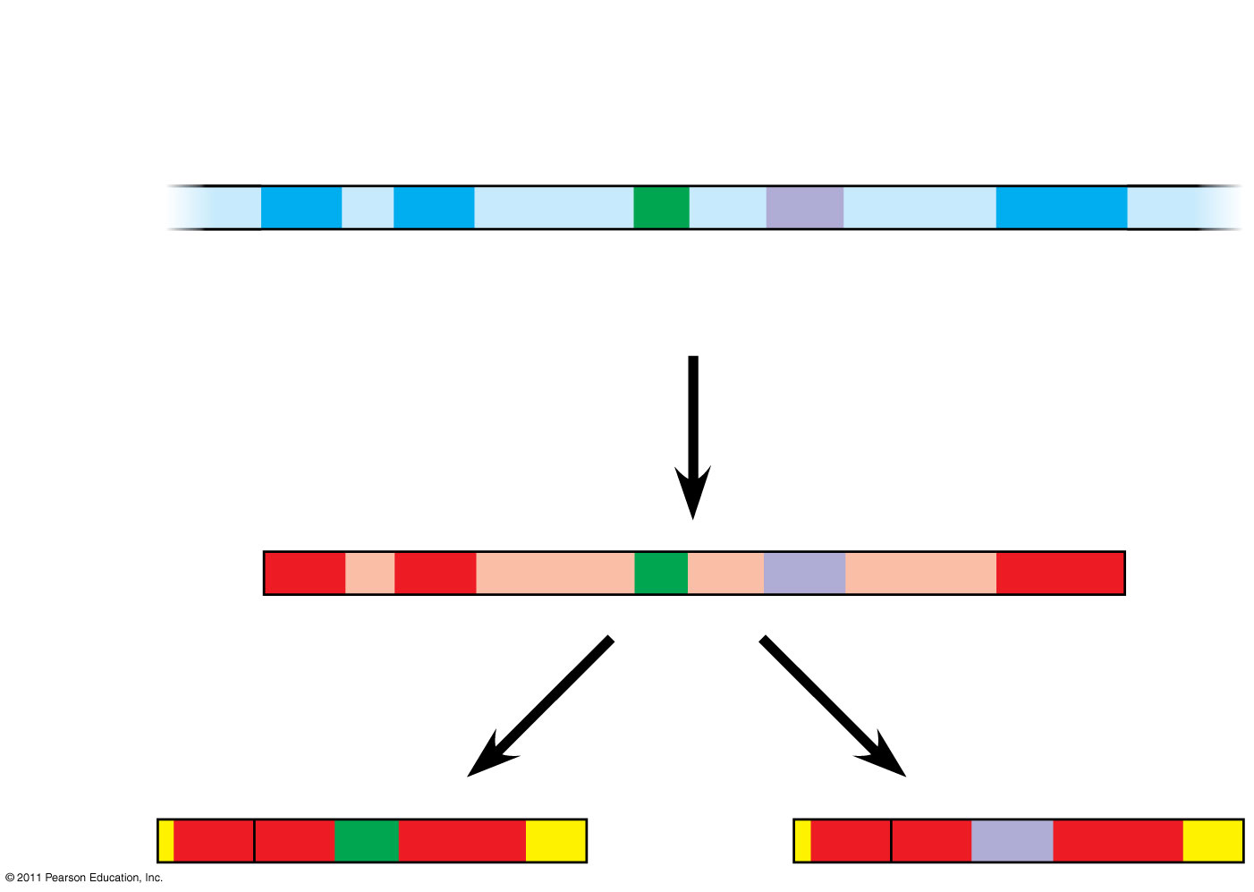
Figure 18.13
Exons
DNA
1
2
3
4
5
Troponin T gene
Primary RNA transcript
1
2
3
4
5
RNA splicing
mRNA
1
2
3
5
or
1
2
4
5
Notes:
Figure 18.13 Alternative RNA splicing of the troponin T gene.

Slide 32
mRNA Degradation
The life span of mRNA molecules in the cytoplasm is a key to determining protein synthesis
Eukaryotic mRNA is more long lived than prokaryotic mRNA
Nucleotide sequences that influence the lifespan of mRNA in eukaryotes reside in the untranslated region (UTR) at the 3′ end of the molecule (31)
Animation: mRNA Degradation
© 2011 Pearson Education, Inc.

Slide 33
Initiation of Translation
The initiation of translation of selected mRNAs can be blocked by regulatory proteins that bind to sequences or structures of the mRNA
Alternatively, translation of all mRNAs in a cell may be regulated simultaneously
For example, translation initiation factors are simultaneously activated in an egg following fertilization
Animation: Blocking Translation
© 2011 Pearson Education, Inc.

Slide 34
Protein Processing and Degradation
After translation, various types of protein processing, including cleavage and the addition of chemical groups, are subject to control
Proteasomes are giant protein complexes that bind protein molecules and degrade them (32)
Animation: Protein Processing
Animation: Protein Degradation
© 2011 Pearson Education, Inc.

Slide 35
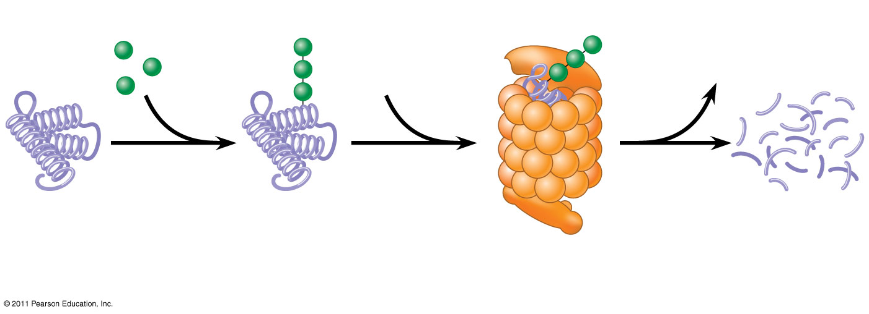
Figure 18.14
(34)
Proteasome and ubiquitin to be recycled
Ubiquitin
Proteasome
Protein to be degraded
Ubiquitinated protein
Protein fragments (peptides)
Protein entering a proteasome
Notes:
Figure 18.14 Degradation of a protein by a proteasome.

Slide 36
Concept 18.3: Noncoding RNAs play multiple roles in controlling gene expression
Only a small fraction of DNA codes for proteins, and a very small fraction of the non-protein-coding DNA consists of genes for RNA such as rRNA and tRNA
A significant amount of the genome may be transcribed into noncoding RNAs (ncRNAs)
Noncoding RNAs regulate gene expression at two points: mRNA translation and chromatin configuration (35)
© 2011 Pearson Education, Inc.

Slide 37
Effects on mRNAs by MicroRNAs and Small Interfering RNAs
MicroRNAs (miRNAs) are small single-stranded RNA molecules that can bind to mRNA
These can degrade mRNA or block its translation
Control of gene expression in eukaryotes
http://highered.mcgraw-hill.com/sites/9834092339/student_view0/chapter16/control_of_gene_expression_in_eukaryotes.html
© 2011 Pearson Education, Inc.

Slide 38
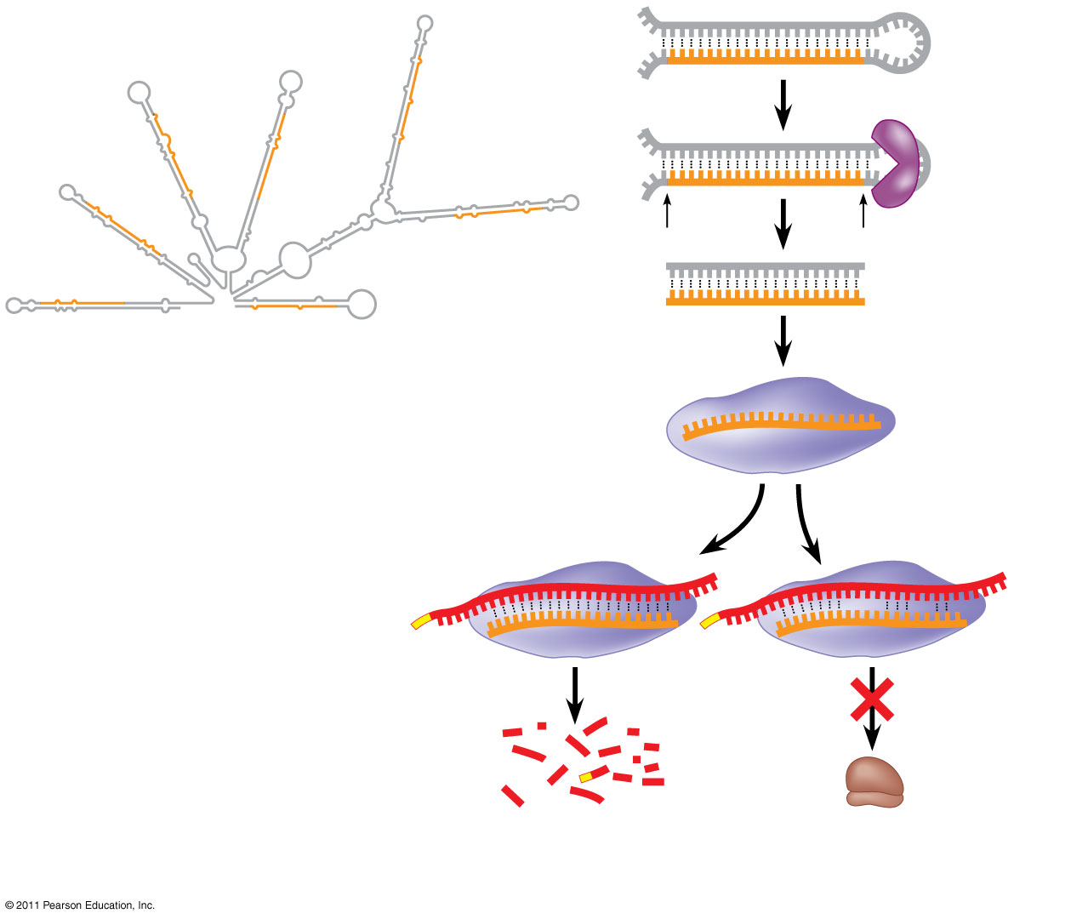
Figure 18.15
Hairpin
miRNA
Hydrogen bond
Dicer
5′
3′
(a) Primary miRNA transcript
miRNA
miRNA- protein complex
(36)
mRNA degraded
Translation blocked
(b) Generation and function of miRNAs
Notes:
Figure 18.15 Regulation of gene expression by miRNAs.

Slide 39
The phenomenon of inhibition of gene expression by RNA molecules is called RNA interference (RNAi)
RNAi is caused by small interfering RNAs (siRNAs)
siRNAs and miRNAs are similar but form from different RNA precursors
© 2011 Pearson Education, Inc.

Slide 40
A Genetic Program for Embryonic Development
The transformation from zygote to adult results from cell division, cell differentiation, and morphogenesis (37)
© 2011 Pearson Education, Inc.

Slide 41
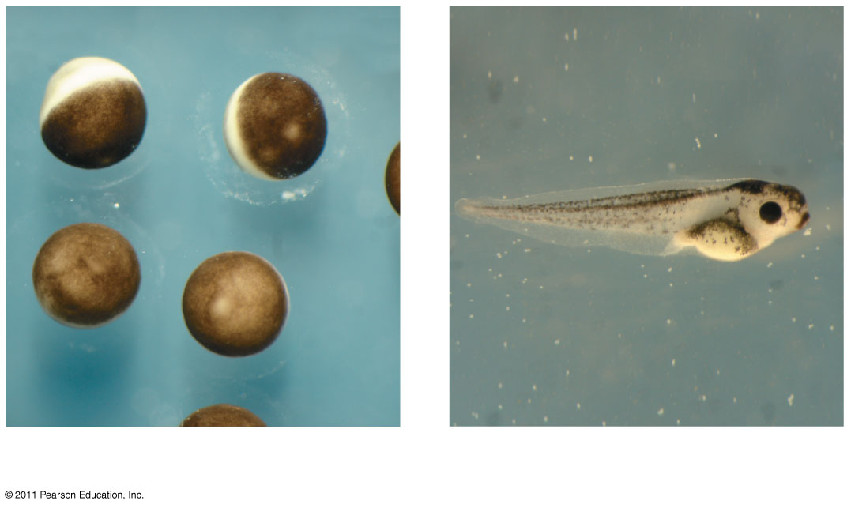
Figure 18.16
1 mm
2 mm
(a) Fertilized eggs of a frog
(b) Newly hatched tadpole
Notes:
Figure 18.16 From fertilized egg to animal: What a difference four days makes.

Slide 42
Cell differentiation is the process by which cells become specialized in structure and function
The physical processes that give an organism its shape constitute morphogenesis
Differential gene expression results from genes being regulated differently in each cell type
Materials in the egg can set up gene regulation that is carried out as cells divide (38)
© 2011 Pearson Education, Inc.

Slide 43
Cytoplasmic Determinants and Inductive Signals
An egg’s cytoplasm contains RNA, proteins, and other substances that are distributed unevenly in the unfertilized egg
Cytoplasmic determinants are maternal substances in the egg that influence early development
As the zygote divides by mitosis, cells contain different cytoplasmic determinants, which lead to different gene expression (39a)
© 2011 Pearson Education, Inc.

Slide 44
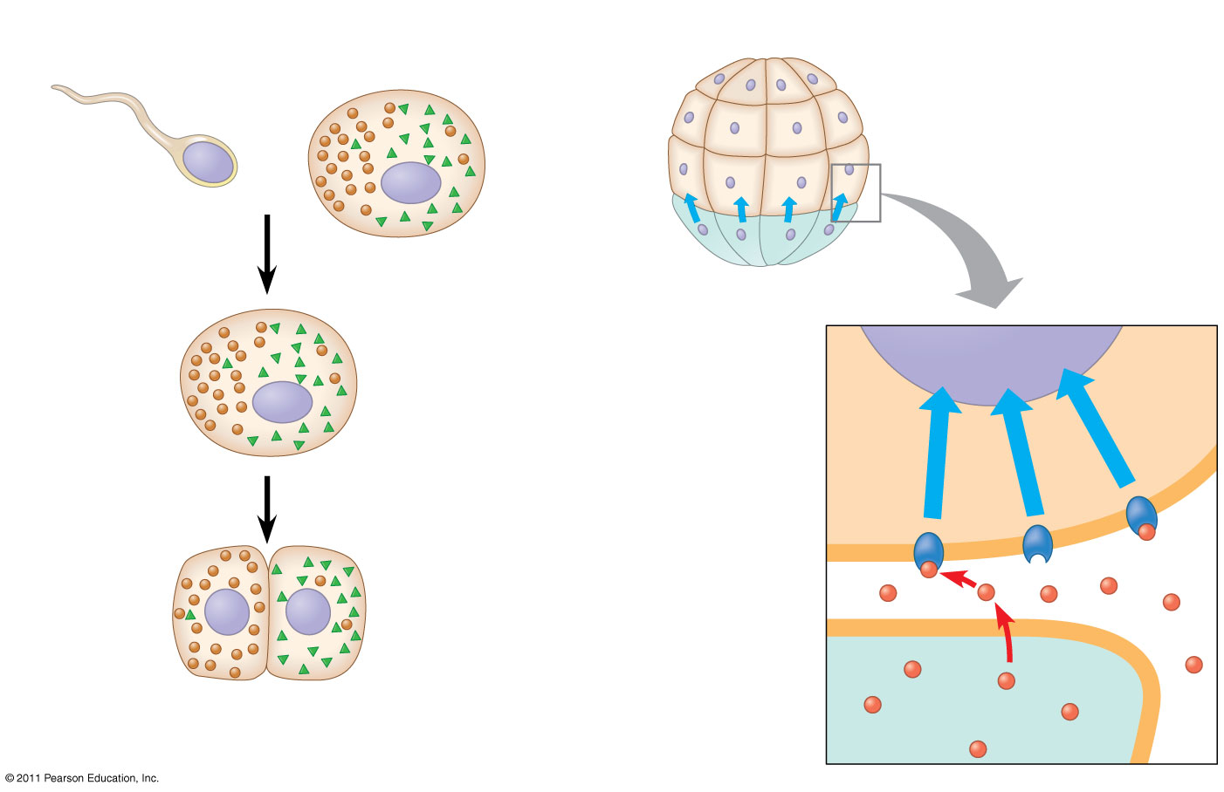
Figure 18.17
(a) Cytoplasmic determinants in the egg
(b) Induction by nearby cells
Unfertilized egg
Early embryo (32 cells)
Sperm
Nucleus
Fertilization
Molecules of two different cytoplasmic determinants
NUCLEUS
Zygote (fertilized egg)
Mitotic cell division
Signal transduction pathway
Signal receptor
Two-celled embryo
Signaling molecule (inducer)
Notes:
Figure 18.17 Sources of developmental information for the early embryo.

Slide 45
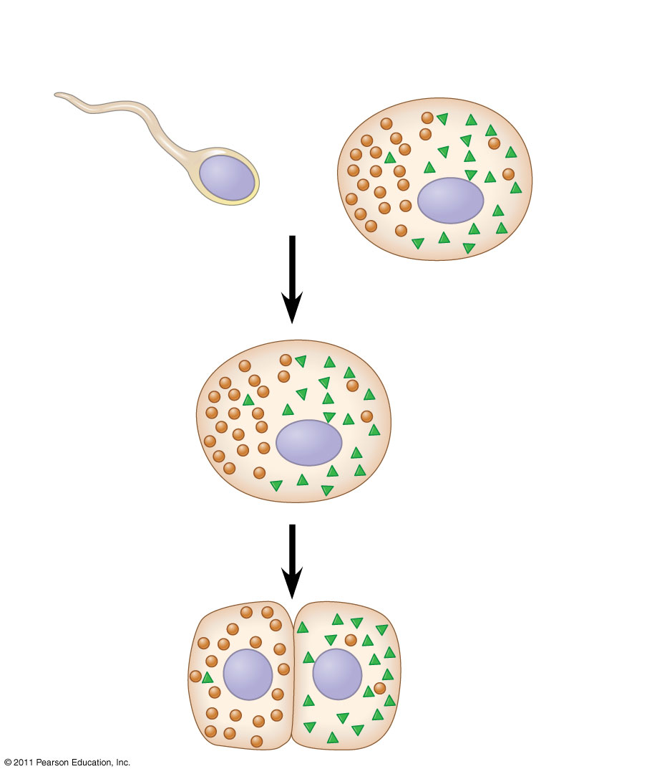
Figure 18.17a
(a) Cytoplasmic determinants in the egg
Unfertilized egg
Sperm
Nucleus
Fertilization
Molecules of two different cytoplasmic determinants
Zygote (fertilized egg)
Mitotic cell division
Two-celled embryo
Notes:
Figure 18.17 Sources of developmental information for the early embryo.

Slide 46
The other important source of developmental information is the environment around the cell, especially signals from nearby embryonic cells
In the process called induction, signal molecules from embryonic cells cause transcriptional changes in nearby target cells
Thus, interactions between cells induce differentiation of specialized cell types (39b)
Animation: Cell Signaling
© 2011 Pearson Education, Inc.

Slide 47
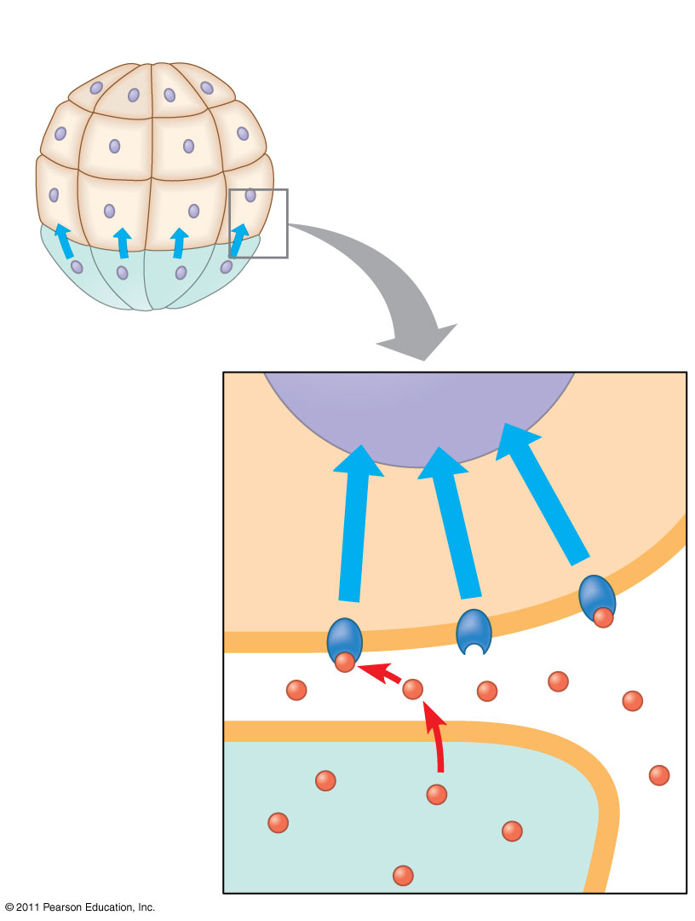
Figure 18.17b
(b) Induction by nearby cells
Early embryo (32 cells)
NUCLEUS
Signal transduction pathway
Signal receptor
Signaling molecule (inducer)
Notes:
Figure 18.17 Sources of developmental information for the early embryo.

Slide 48
Sequential Regulation of Gene Expression During Cellular Differentiation
Determination commits a cell to its final fate
Determination precedes differentiation
Cell differentiation is marked by the production of tissue-specific proteins (40)
© 2011 Pearson Education, Inc.

Slide 49
Pattern Formation: Setting Up the Body Plan
Pattern formation is the development of a spatial organization of tissues and organs
In animals, pattern formation begins with the establishment of the major axes
Positional information, the molecular cues that control pattern formation, tells a cell its location relative to the body axes and to neighboring cells (41)
© 2011 Pearson Education, Inc.

Slide 50
Genetic Analysis of Early Development: Scientific Inquiry
Edward B. Lewis, Christiane Nüsslein-Volhard, and Eric Wieschaus won a Nobel 1995 Prize for decoding pattern formation in Drosophila
Lewis discovered the homeotic genes, which control pattern formation in late embryo, larva, and adult stages (42)
© 2011 Pearson Education, Inc.

Slide 51
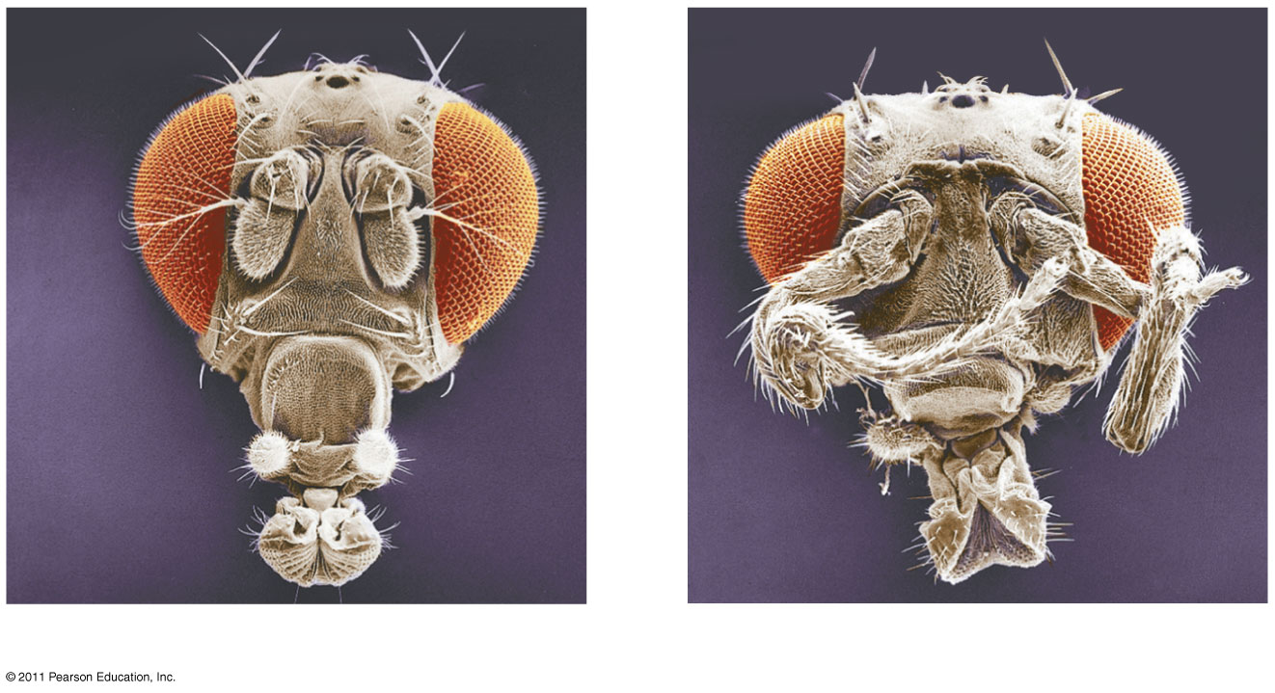
Figure 18.20
Eye
Leg
Antenna
Wild type
Mutant
Notes:
Figure 18.20 Abnormal pattern formation in Drosophila.

Slide 52
Nüsslein-Volhard and Wieschaus studied segment formation
They created mutants, conducted breeding experiments, and looked for corresponding genes
Many of the identified mutations were embryonic lethals, causing death during embryogenesis
They found 120 genes essential for normal segmentation
© 2011 Pearson Education, Inc.

Slide 53
Types of Genes Associated with Cancer
Cancer can be caused by mutations to genes that regulate cell growth and division
Tumor viruses can cause cancer in animals including humans
© 2011 Pearson Education, Inc.

Slide 54
Oncogenes are cancer-causing genes
Proto-oncogenes are the corresponding normal cellular genes that are responsible for normal cell growth and division
Conversion of a proto-oncogene to an oncogene can lead to abnormal stimulation of the cell cycle (43)
© 2011 Pearson Education, Inc.

Slide 55
Proto-oncogenes can be converted to oncogenes by
Movement of DNA within the genome: if it ends up near an active promoter, transcription may increase
Amplification of a proto-oncogene: increases the number of copies of the gene
Point mutations in the proto-oncogene or its control elements: cause an increase in gene expression (44)
© 2011 Pearson Education, Inc.

Slide 56
Tumor-Suppressor Genes
Tumor-suppressor genes help prevent uncontrolled cell growth
Mutations that decrease protein products of tumor-suppressor genes may contribute to cancer onset
Tumor-suppressor proteins
Repair damaged DNA
Control cell adhesion
Inhibit the cell cycle in the cell-signaling pathway
© 2011 Pearson Education, Inc.

Slide 57
Interference with Normal Cell-Signaling Pathways
Mutations in the ras proto-oncogene and p53 tumor-suppressor gene are common in human cancers
Mutations in the ras gene can lead to production of a hyperactive Ras protein and increased cell division
Can get a “double whammy” effect in cancer by losing p53 (loss of growth supression) function and mutating ras (increased growth signals) (46)
© 2011 Pearson Education, Inc.

Slide 58
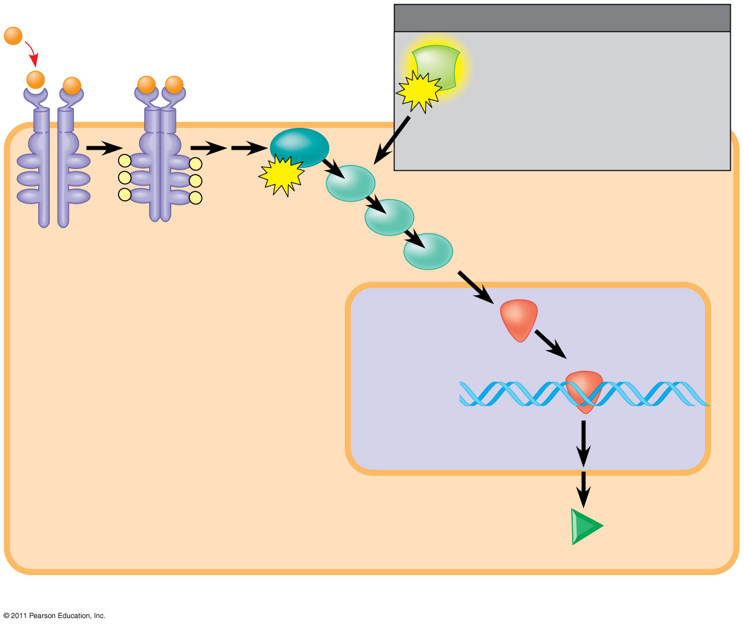
Figure 18.24a
1
Growth factor
(45)
MUTATION
Ras
Hyperactive Ras protein (product of oncogene) issues signals on its own.
3
G protein
GTP
Ras
P
P
P
P
GTP
P
P
2
Receptor
4
Protein kinases (phosphorylation
cascade)
NUCLEUS
5
Transcription factor (activator)
DNA
Gene expression
Protein that
stimulates the cell cycle
(a) Cell cycle–stimulating pathway
Notes:
Figure 18.24 Signaling pathways that regulate cell division.

Slide 59
The Multistep Model of Cancer Development
Multiple mutations are generally needed for full-fledged cancer; thus the incidence increases with age
At the DNA level, a cancerous cell is usually characterized by at least one active oncogene and the mutation of several tumor-suppressor genes
© 2011 Pearson Education, Inc.

Slide 60
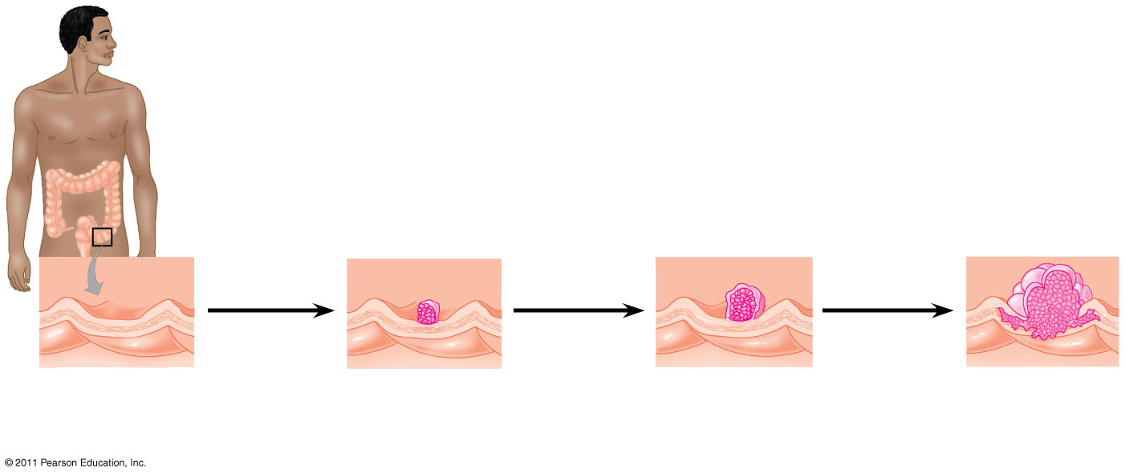
Figure 18.25
Colon
1
Loss of tumor- suppressor gene APC (or other)
4
Loss of tumor- suppressor gene p53
2
Activation of ras oncogene
3
5
Colon wall
Loss of tumor- suppressor gene DCC
Additional mutations
Normal colon epithelial cells
Small benign growth (polyp)
Larger benign growth (adenoma)
Malignant tumor (carcinoma)
Notes:
Figure 18.25 A multistep model for the development of colorectal cancer.

