Slide 1
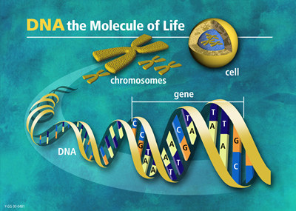
The Central Dogma of Biology
Why It’s Important
DNA contains instructions for making proteins, which determine an organism’s traits

Slide 2
Learning Outcomes
Identify the levels of biological organization and explain their relationships
Summarize the process of transcription.
Relate the role of codons to the sequence of amino acids that results after translation.
Explain the Central Dogma of Biology and its importance in genetic engineering

Slide 3
Vocabulary
Organism
Cell
Central Dogma
DNA
RNA
Transcription
Translation
Amino acid
Nucleotide
Tissue
Organ
Protein
Eukaryote
Nucleic acid
Nucleus
Genetic Code
Gene Expression

Slide 4
Organisms & Their Components
Working in any area of medicine requires a thorough understanding of the characteristics of life and the structures that compose organisms
You must have at least a minimal understanding of
Biochemistry
Cytology
Anatomy
Physiology

Slide 5
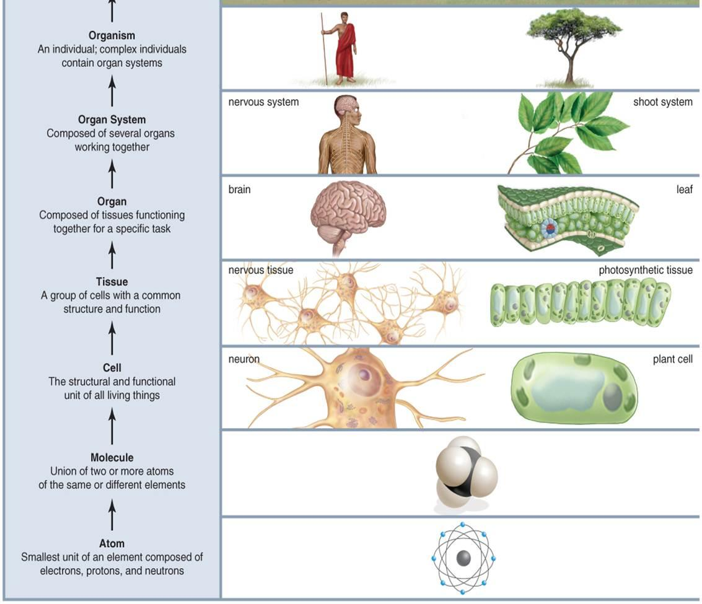
Biological Organization

Slide 6
Decoding the Information in DNA
Traits, such as eye color, are determined by _____________ that are built according to instructions ________ in DNA.
The instructions for making each protein are contained in small segments of our DNA called _______________
A single molecule of DNA has thousands of genes lined up like __________ ________.
proteins
coded
genes
train
cars

Slide 7
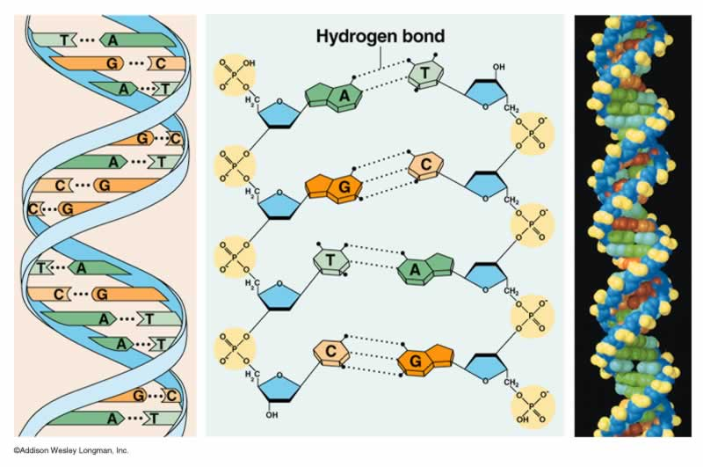

Slide 8
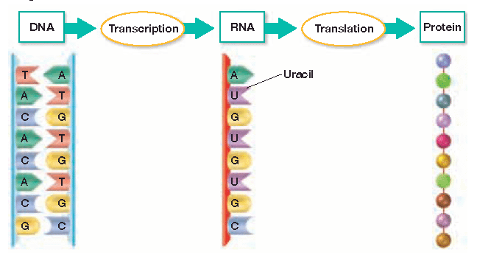
Nucleus
Ribosome in the cytoplasm

Slide 9
Critical Thinking
If all cells within one organism have the same set of DNA (in other words, the DNA in your nerve cells is identical to the DNA in the epithelium of your little toe), how is it that all cells are not the same?

Slide 10
Overview of Gene Expression
DNA is composed of long stretches of nucleotides covalently linked together
Genetic information lies in the sequence of nitrogenous bases
There are 5 nitrogenous bases
DNA: adenine, cytosine, guanine, thymine
RNA: adenine, cytosine, guanine, uracil
Cytosine on 1 strand always pairs with guanine on the other strand
Adenine pairs with either thymine or Uracil

Slide 11
The Genetic Code: Three-Nucleotide “Words”
In order for a protein to be made, the code stored in mRNA must be __________________
The code is stored in a series of ________ nucleotide sequences on mRNA called _______________
Each codon codes for a specific __________ _________ that will be placed in a protein
translated
three
codons
amino
acid

Slide 13
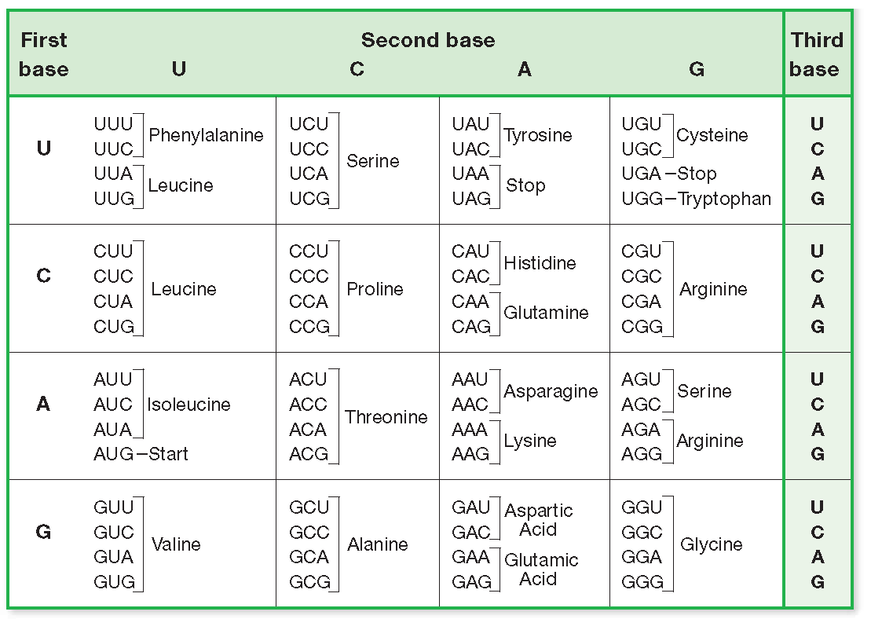

Slide 14
What does CCC code for?
proline

Slide 15
DNA is the template to build RNA
Occurs in the nucleus
Occurs on a ribosome in the cytoplasm or attached to the RER
AATCCGTCTATG
TTAGGCAGATAC
AAUCCGUCUAUG
Asparagine
The sequence of bases is read in groups of 3
Each group of 3 bases is called a codon and specifies 1 amino acid
Peptide bonds are a type of covalent bond that hold amino acids together
Proline
What type of reaction forms peptide bonds?
TRANSCRIPTION
TRANSLATION
REPLICATION
Serine
Methionine

