Slide 1
Structure & Packaging of DNA
Chapter 12.2 & 10.2

Slide 2
12.2 & 10.2 Objectives
Describe the three components of a nucleotide.
Develop a model of the structure of a DNA molecule.
Evaluate the contributions of Chargaff, Franklin, and Wilkins in helping Watson and Crick determine the double-helical structure of DNA.
Relate the role of the base-pairing rules to the structure of DNA.
Differentiate between a gene, a DNA molecule, a chromosome, and a chromatid.

Slide 3
New Vocabulary
Section 12.2
Double helix
Nucleotide
Deoxyribose
Base-pairing rules
Complementary base pair
Section 10.2
Gene
Chromosome
Chromatid
Centromere
homologous chromosome

Slide 4
DNA
Quick review…
What does DNA stand for?
What subunits make up
DNA?
What three parts do the
subunits consist of?
deoxyribonucleic acid
nucleotides
phosphate group, sugar, base

Slide 5
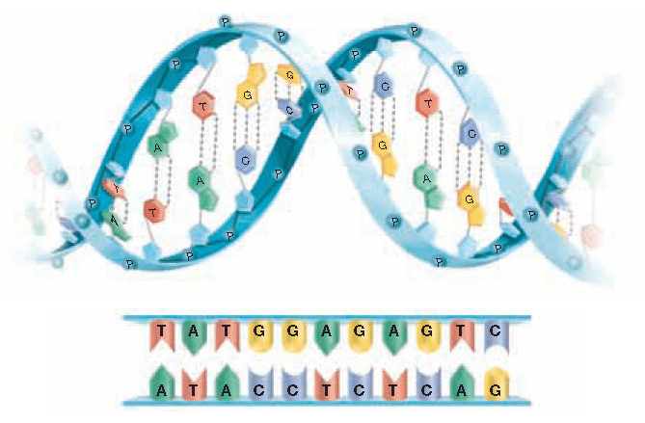
Watson
Crick
In 1953, James __________ and Francis _________ determined that a DNA molecule is a ____________ __________
Meaning that it consists of ______ strands __________ around each other like a winding staircase
double
helix
two
twisted

Slide 6
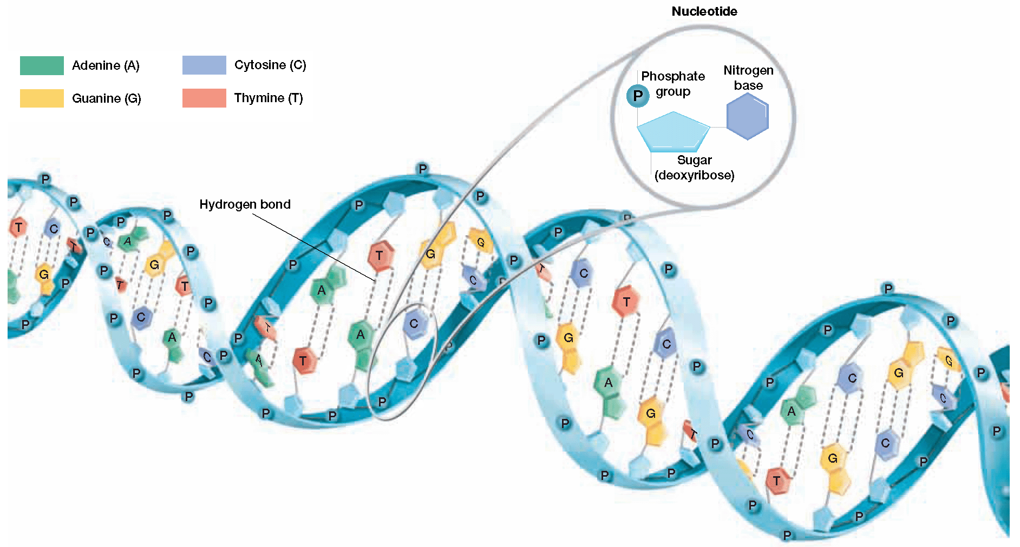
A Winding Staircase
Each strand is made of ___________ nucleotides, which consist of three parts…
A phosphate group
A 5 carbon sugar called _____________
A ____________ base
joined
deoxyribose
nitrogenous

Slide 7
One nucleotide is circled for you…
Circle several more nucleotides
Label a the 5 carbon sugar deoxyribose
D
D
D
D

Slide 8
Note how DNA resembles a ___________________
The side rails or _________________ of each strand consist of the…
__________________
__________________
The phosphate and the sugar are held together by __________________ bonds
ladder
backbones
phosphate
sugar
covalent

Slide 9
The rungs of the ladder are made of the nitrogenous __________
They are held together by _______________ bonds
bases
hydrogen

Slide 10
While each DNA nucleotide contains the _______ sugar and phosphate group, the nitrogenous ____________ may be any one of the four different kinds…
____________________
____________________
____________________
____________________
same
bases
Adenine (A)
Guanine (G)
Cytosine (C)
Thymine (T)

Slide 11
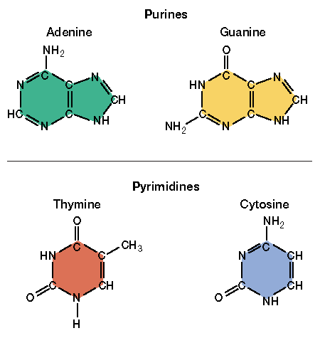
Adenine and guanine contain ____________ rings, which are classified as _________________
Thymine and cytosine consist of ___________ rings, which are classified as _________________
double
purines
single
pyrimidines

Slide 12
Which bases look larger…
Purines or pyrimidines?
purines

Slide 13
How were Watson and Crick able to determine the double helical structure of DNA?
They based their structure on __________ acquired from ___________ scientists
data
other

Slide 14
Erwin _________________
Chargaff
In 1949, Erwin Chargaff observed that for each organism he studied, the amount of adenine always equaled the amount of thymine… _______ = ______
Likewise, the amount of guanine always equaled the amount of cytosine… _____ = _____
However, the amount of each equal pair _________ between different species of organisms.
A
T
C
G
differs

Slide 15
In 1952, they took many photographs of sections of DNA using a method called ___________ ___________________
In the process, X-ray beams were bounced off of DNA and the rays were diffracted or ______________ onto a piece of film
This method is similar to shining a light on an object and analyzing its ____________
X-ray
crystallography
angled
shadow

Slide 16
Maurice __________ and Rosalind ______________
Wilkins
Franklin
In 1952, they took many photographs of sections of DNA using a method called X-Ray Crystallography
The X-ray photos clearly showed that DNA is composed of _____ strands that are _________
In 1962 Watson, Crick, and Wilkins were awarded a ____________ prize for their work
Rosalind Franklin was not recognized as a reward recipient because she had already died of cancer likely caused by too much X-ray ______________
2
twisted
nobel
exposure

Slide 17
Based on all of the compiled data, Watson and Crick determined that a _______________ on one strand of the DNA is always paired with a ______________ on the opposite strand
Since adenine and
thymine are always
found in equal
amounts…
___ pairs with ____
purine
pyrimidine
A
T

Slide 18
Likewise, guanine and cytosine are found in equal amounts, so ____ pairs with ____
C
G

Slide 19
2
A and T form ____ hydrogen bonds
G and C form ____ hydrogen bonds
3

Slide 20
Before a cell can divide, the DNA must first be __________ and then _______________ to new cells
Why does each new cell need an identical copy of DNA?
copied
distributed
DNA codes for the proteins made by
the cell…incorrect DNA will lead to
altered proteins

Slide 21
Eukaryotic Cells
When eukaryotic cells are not dividing, their DNA is ____________ and referred to as _______________
Recall that DNA is a _____________ helix made up of subunits called _________________
uncoiled
chromatin
double
nucleotides

Slide 22
Your DNA is normally uncoiled because the _________ it contains is being used to make _______________
Recall that specific segments of your DNA, called ___________, code for the production of _____________ proteins
code
proteins
genes
different

Slide 23
Before a eukaryotic cell divides, the DNA is ____________, and it __________ up to form a chromosome
First, DNA coils around
proteins called _________
to form small structures
called ______________
copied
coils
histones
nucleosomes
nucleosome

Slide 24
Next, the nucleosomes actually end up coiling __________ on themselves to form a _________________
twice
supercoil

Slide 25
This supercoil is tightly packed in a structure called a ________________
chromosome

Slide 26
Chromosomes have two ________________ sides because they contain DNA that has already been ____________
Each side is called a sister _____________ and they are attached at a point called a _________________
identical
copied
chromatid
centromere

Slide 27
These sister chromatids _______________ at the centromere during cell division to ensure that each new cell has the _________ genetic information as the original cell
separate
same

Slide 28
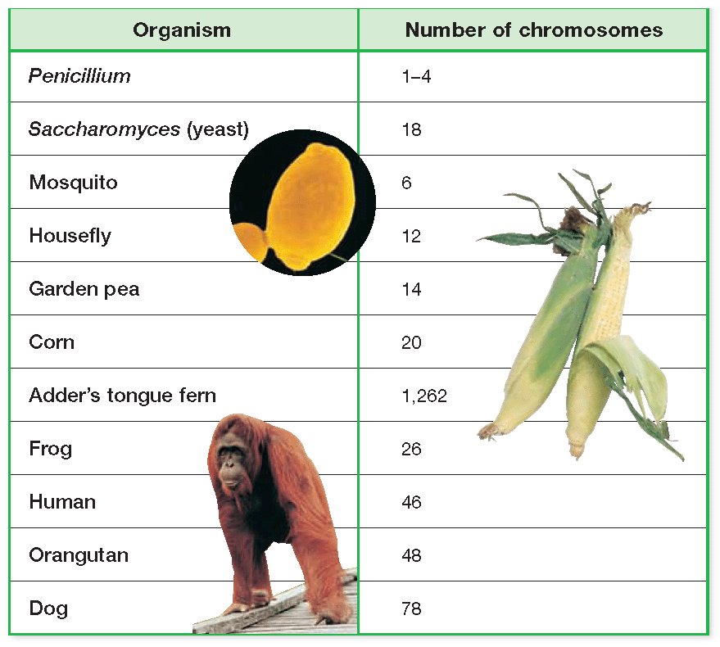
Different species contain different numbers of chromosomes Ex: Humans have ______ chromosomes while a dog has _______ chromosomes
46
78

