Slide 1
The Chemical Senses
Smell & Taste

Slide 2
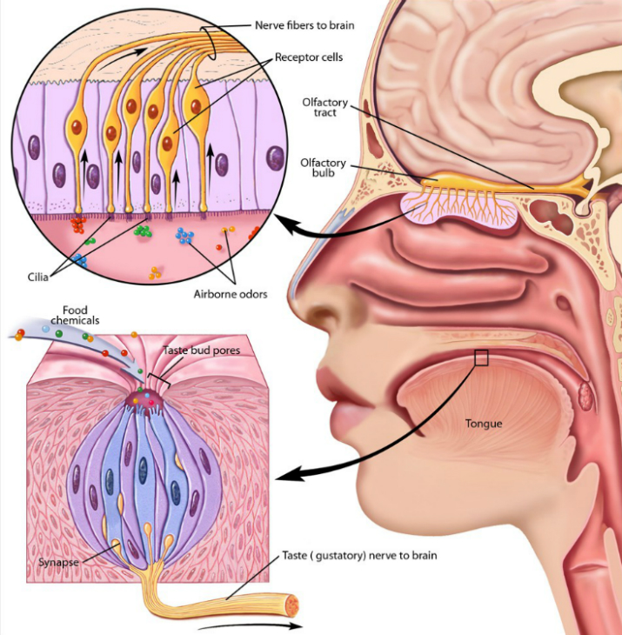
The Chemical Senses
The chemical senses involve a direct interaction of chemical substances in the environment with receptor sites on sensory cells
Thus compounds must be taken into the body through either aspiration or ingestion to elicit a smell or taste

Slide 3
receptor cells
Taste receptor cells
Olfactory receptor cells
Taste receptor cells are modified epithelial cells and turn over every -8 weeks
True neurons with cell bodies in the nasal mucosa and axons that project directly into brain structures
Unlike many other neurons, these olfactory neurons continually reproduce throughout life from stem cells in the nasal mucosa
Notes:
Even with receptor renewal, there is marked decline of ability to taste and smell with age

Slide 4
Olfactory Receptors
3 major cell types involved in olfaction
Olfactory receptor neurons
Supporting or sustentacular cells
Basal cells→ act as stem cells to replace olfactory neurons
Bowmans glands are interspersed among these cells and produce the mucus covering the nasal lining
Mucus is totally replaced every 10min
Is composed mainly of a mucopolysaccharide solution consisting of enzymes, antibodies, salts, and special proteins that help bind odorous molecules

Slide 5
Odorant Molecules
Odorant binding proteins bind to odorous molecules acting like a molecular sieve that traps and concentrates substances to facilitate their interaction olfactory neurons
Humans can recognize about 10,000 different odors naturally, but with training we can increase that number by tenfold
It does not appear that separate binding proteins within the mucus exist for each recognizable odor, rather a protein binds a collection of odors
Odorant receptor proteins on receptor cells (neurons) do show a high degree of binding specificity and its estimated we have more than 1,000 distinct receptor proteins, with each neuron producing only 1 (or a very few) of them
Only 20% of all recognizable odors are pleasant, the rest are unpleasant and represent potentially dangerous substances
Humans can sense certain molecules at a concentration of a few parts per trillion because of these proteins, but olfactory receptors require concentrations a thousand times greater to generate an AP

Slide 6
The Olfactory Bulb
Olfactory neurons are among the smallest (and so slowest to conduct an AP) in the body, each having a single axon that extends from the cell body to the olfactory bulb in the brain located just above the level of the eyes
Cells in the olfactory bulb are arranged into structures called glomeruli, which contain the axonal endings of olfactory receptors and the dendrites of about 100 second order olfactory neuros
Each glomerulus receives input from about 25,000 primary olfactory neurons, and each primary neuron synapses with several of the secondary neurons

Slide 7
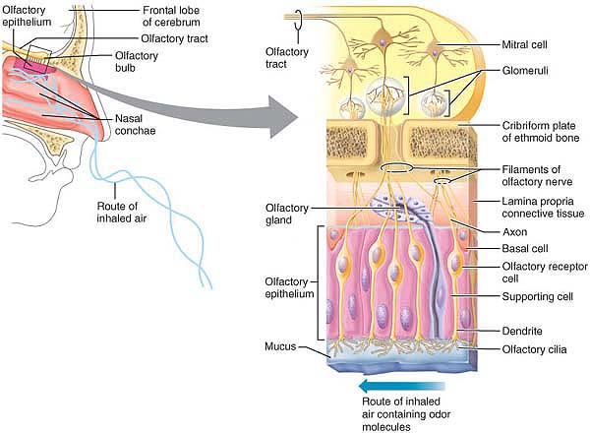

Slide 8
Olfactory Bulb
There are 2 types of second order olfactory neurons
mitral cells
tufted cells
These synapse with 2 types of interneurons
Periglomerular cells: provide short feedback loops
Granule cells: provide inhibitory feedback loops that ultimately lead to the release of GABA which inhibits mitral & tufted cells

Slide 9
The Olfactory Cortex
Mitral & tufted cells send processes within the lateral olfactory tract to the primary olfactory cortex located on the inferior surface of the temporal lobe
Neurotransmitters used in this pathway include excitatory neuropeptides and amino acids such as glutamate and aspartate
The primary olfactory cortex overlies the hippocampal formation which is used to generate olfactory memory, and also connects to the amygdala which provides emotional context to odor recognition
The secondary olfactory pathway has a relay in the thalamus before projecting to a cortical region.
It is also adjacent to the primary taste cortex and it is probably here that joint projections of taste and smell combine to form flavor

Slide 10
Overview of the Gustatory System
The elemental role of the gustatory system is to distinguish between food and potential toxins
Two components are required to accomplish this
A detection system of receptor cells capable of responding to the great diversity of substances in the environment that might be ingested
Neuronal pathways refer taste information to appropriate cortical structures in order to elicit pleasant or unpleasant sensations
Pleasing sensations are necessary to maintain appetite and initiate appropriate digestive and respiratory responses
Unpleasant sensations associated with potential toxins elicit protective reflexes like choking, vomiting, or gagging

Slide 11
The Gustatory System is Highly Modifiable
Some taste responses are inborn such as a preference for sweet foods and an aversion to bitter tastes
We “train: our gustatory system through experience
Illness that occurs shortly after ingesting a particular food can greatly diminish subsequent preference for that food
Tastes can also be acquired so that some bitter tastes, such as quinine, are tolerated or enjoyed
Bodily needs can also make a food seem more appetizing
A nutritional deficiency in salt can create cravings for salty foods

Slide 12
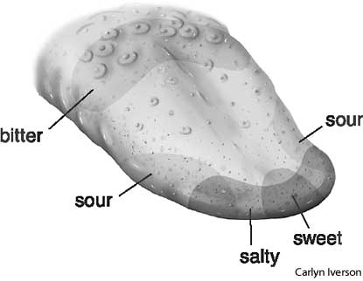
Taste Receptors
Taste receptors are classified as modified epithelial cells and are organized into cluster called tatse buds
Each taste bud contains 50-100 receptor cells arranged like slices of an orange with a central opening or pore open to the surface of the tongue
They also contain basal cells necessary for the regeneration of new receptors
Taste receptors synapse on the dendrites of afferent gustatory fibers projecting into the taste bud

Slide 13
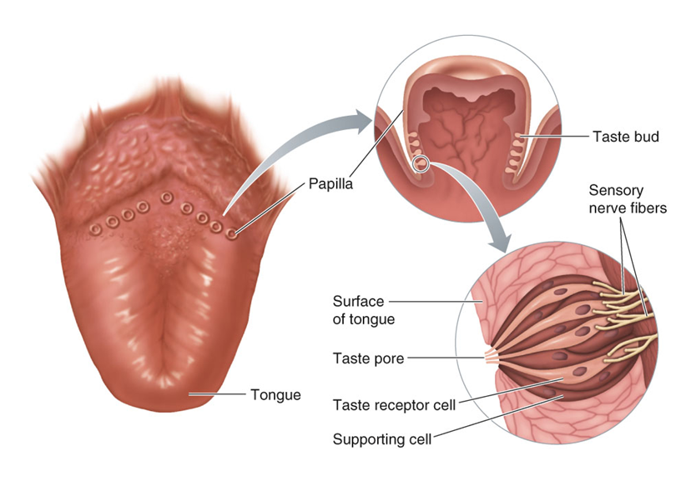
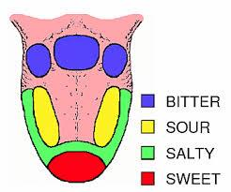
5 Basic Tastes
Salt
Sour
Sweet
Bitter
umami

Slide 14
Tastes Cause Transmitter Release From Taste Receptors Through 4 Mechanisms
Direct passage of ions through ion channels
Blockage of in channels
Opening of ion channels
Activation of second messenger systems through ligand interactions with membrane receptors

Slide 15
5 Basic Tastes
Sour
Salt
Umami
A sour taste is associated with acidic substances that affect our sour-taste receptors in 2 ways
Acids in solution H+ that can permeate the sodium channels used in salt detection & so cause depolarization stimulated release of neurotransmitter
H+ also block a potassium selective channel within the membrane which causes depolarization because normal movement of potassium out of the cell is blocked, &more positively charged K+ ions are trapped intracellularly
You must have both of these pathways functioning to perceive a taste as sour, if only the sodium channel works you will perceive the taste as salty
Sodium ions are largely responsible for establishing salty taste
Sodium ins diffuse through the pore of the taste bud and enter the taste receptor cell through sodium ion channels in the cell membrane
Entry of positively charged ions depolarizes the taste receptor cell, opens voltage gated calcium channels increasing the influx of calcium leading to the release of neurotransmitter
This taste is associated with certain amino acids such as glutamate and arginine
These bind to and activate a cation-permeable channel causing depolarization

Slide 16
5 Basic Tastes
Sweet
Bitter
Specific membrane receptors on some taste buds bind sugars and other sweet tasting substances
Binding to these receptor sites activates a second messenger system coupled to a G-protein that activates protein kinase A and causes it to phosphorylate and block a potassium selective channel
As a result sweet sensitive taste cells are depolarized
Because many toxic compounds have an unpleasant bitter taste, receptor cells that respond to bitter substances can function as poison detectors; however some bitter foods are not necessarily unpleasant or toxic
Several different transduction mechanisms are involved in detection of bitter foods
Some decrease conductance of potassium channels
Some bind specific receptors and activate second messengers systems that lead to depolarization
Some trigger production od IP3 which acts as an intracellular message to release Ca2+ without depolarization leading to neurotransmitter release

Slide 17
Central Gustatory Pathways
Taste receptors synapse with dendrites of the primary afferent neurons of the gustatory pathway causing the neurons to fire in response to appropriate stimuli above their threshold level
Projections from these nerve ganglia enter the brainstem along the lateral medulla and converge to make synaptic contact with cells in the medulla and the thalamus
Thalamic neurons then project to the primary gustatory cortex in the insular and orbitofrontal regions

