Slide 1
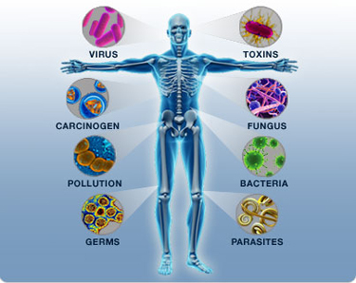
The Immune System http://www.dnatube.com/video/1188/Apoptosis-animation

Slide 2
Under Attack
Animals are constantly under attack by pathogens
Infectious agents that cause disease
Types
Virus
Bacteria
Protists
Fungi
Parasitic worms

Slide 3
The Immune System
Is a system of biological structures and processes within an organism that protects against disease by identifying and killing pathogens and tumor cells.
Can distinguish self from non-self and even altered self (cancer cells)

Slide 4
2 Components to the Immune System
Innate immune system | Adaptive immune system
Response is non-specific | Pathogen and antigen specific response
Exposure leads to immediate maximal response | Lag time between exposure and maximal response
Cells: Macrophages & Natural Killer Cells | Cell-mediated (T cells) and humoral (B cells) components
No immunological memory | Exposure leads to immunological memory
Found in nearly all forms of life | Found only in jawed vertebrates

Slide 5
Several barriers protect organisms from infection as part of the innate immune response
Physical/ mechanical
Chemical
mechanical barriers are the 1st line of defense against infection
The waxy cuticle of many leaves
exoskeleton of insects
shells and membranes of externally deposited eggs
skin
Sneezing/ coughing
The skin and respiratory tract secrete antimicrobial peptides such as the defensins
Enzymes such as lysozyme in saliva, tears, and breast milk
Vaginal secretions serve as a chemical barrier following menarche when they become slightly acidic, while semen contains defensins and zinc to kill pathogens
In the stomach, gastric acid and proteases serve as powerful chemical defenses against ingested pathogens.

Slide 6
The immune system protects organisms from infection with layered defenses of increasing specificity.
1. physical barriers prevent pathogens from entering the organism.
2. If a pathogen breaches these barriers, the innate immune system provides an immediate, but non-specific response.
3. If pathogens successfully evade the innate response, the adaptive immune system (vertebrates only), is activated
Here, the immune system adapts its response during an infection to improve its recognition of the pathogen.
This improved response is then retained after the pathogen has been eliminated, in the form of an immunological memory,
allows the adaptive immune system to mount faster and stronger attacks each time this pathogen is encountered

Slide 7
Innate Immunity
The innate response is usually triggered when microbes are identified by pattern recognition receptors, which recognize components that are conserved among broad groups of microorganisms.
Innate immune defenses are non-specific, meaning these systems respond to pathogens in a generic way.
This system does not confer long-lasting immunity against a pathogen.

Slide 8
Cellular Innate Defenses
White blood cells (leukocytes) recognize pathogens through Toll-Like Receptors
TLRs are non-catalytic receptors that recognize structurally conserved molecules derived from pathogens.
Once these microbes have breached physical barriers such as the skin or intestinal tract mucosa, they are recognized by TLRs which activates innate immune cell responses.

Slide 9
Innate Immune Functions: Phagocytosis
Phagocytosis: the ingestion and digestion of bacteria and other foreign substances by phagocytic cells
Upon ingestion, phagocytes also secrete cytokines
Cytokines are proteins that help activate lymphocytes
Phagocytic cells
Neutrophils *
Macrophage *
Eosinophils
Dendritic cells

Slide 10
Innate Immunity & Antimicrobial Proteins
Cytokines: any of numerous secreted proteins that regulate the intensity and duration of the immune response by exerting a variety of effects on lymphocytes and other immune cells
Defensins: secreted by activated mØ and damage broad groups of pathogens through various mechanisms
Lysozyme: an enzyme that digests microbial cell walls
Complement System

Slide 11
Complement
The complement system is a biochemical cascade that attacks the surfaces of foreign cells.
It contains over 20 different proteins and is named for its ability to “complement” the killing of pathogens by antibodies.
Many species have complement systems, including non-mammals like plants, fish, and some invertebrates

Slide 12
3 results of Complement Activation
Inflammation
Opsonization
Formation of Membrane Attack Complex (MAC)
Forms holes in target cell membranes leading to cell lysis

Slide 13
Innate Immunity & Antimicrobial Proteins
3 Types of Interferon
α & β
Provide innate defense against viral infections
Secreted by virus infected body cells
Induce neighboring uninfected cells to produce substances that inhibit viral reproduction
Helps limit spread of infection
γ
helps activate mØ and enhances phagocytic ability

Slide 14
Innate Immunity & Inflammation
Inflammation is one of the first responses of the immune system to infection.
Symptoms
Redness
Swelling
Caused by increased blood flow into a tissue.
Inflammatory Responses via:
Complement activation
Histamine is released by mast cells in response to damage or infection
Histamine triggers dilation and increased permeability of near by capillaries

Slide 15
Innate Immunity & Inflammation
Vascular changes help deliver antimicrobial proteins to area
Chemokines: direct migration of phagocytes and help increase their production of microbe killing compounds
A secreted polypeptide that mediates chemotaxis for different leukocytes and regulates the expression and/or adhesiveness of leukocyte integrins
Chemotaxis: agents that cause leukocytes to move up their concentration gradients

Slide 16
Natural Killer Cells
Class of large, granular, cytotoxic lymphocytes that do not have T or B cell receptors
Are antibody independent and cause virally infected and cancer cells to undergo apoptosis
Can participate in antibody dependant cell mediated cytotoxicity

Slide 17
Adaptive/Acquired Immunity
The adaptive immune system evolved in early vertebrates and allows for a stronger immune response as well as immunological memory,
where each pathogen is "remembered" by a signature antigen
The adaptive immune response is antigen-specific and requires the recognition of specific “non-self” antigens during a process called antigen presentation.
Antigen specificity allows for the generation of responses that are tailored to specific pathogens or pathogen-infected cells.

Slide 18
Lymphocytes
The cells of the adaptive immune system are special types of leukocytes, called lymphocytes
2 Classes of Lymphocytes
B Cells: involved in humoral response
T cells: involved in cell mediated responses
Helper T Cells
TH1
TH2
Cytotoxic T Cells (T_{C})
Both are derived from hematopoietic stem cells in the bone marrow

Slide 19
The Humoral Immune Response
B cells are the main cells of the humoral immune response
Develop entirely in the bone marrow
Have both Class I and Class II MHC receptors, and a BCR
Act as Antigen Presenting Cells
Naïve B cells have never encountered antigen, and don’t secrete antibodies
Plasma B cells are formed when a naïve B cell interacts with an antigen causing it to secrete antibodies

Slide 20
The Cell Mediated Immune Response
T cells are the main component of the cellular immune response
Begin development in the bone marrow, but migrate to the thymus and finish development there
Have Class I MHC receptors and TCR
2 Subtypes of cells
Cytotoxic T cells
Helper T cells

Slide 21
Lymphocytes
B Cell
T Cell
B Cell Receptor (BCR) for antigen is a Y-shaped nmolecule consisting of 4 polypeptide chains
2 identical heavy chains
2 identical light chains linked to the heavy chains via disulfide bridges
Each heavy and light chain has a variable region and a constant region
Secrete Antibodies
(a.k.a. immunoglobulins)
5 different classes
See p912 for AB Classes
T Cell Receptors (TCR) for an antigen consists of 2 different polypeptide chains
α chain
β chain
Each α and β chain has a variable region and a constant region
TCRs only recognize and bind to AG presented by MHC molecules

Slide 22
Antibodies
are immunoglobulin proteins that are found in blood or other bodily fluids of vertebrates
used by the immune system to identify and neutralize foreign objects, such as bacteria and viruses
Five different antibody isotypes are known in mammals, which perform different roles, and help direct the appropriate immune response for each different type of foreign object they encounter

Slide 23
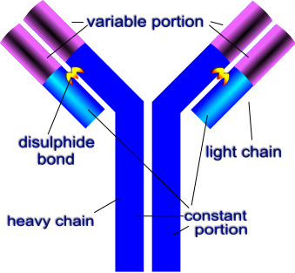

Slide 24
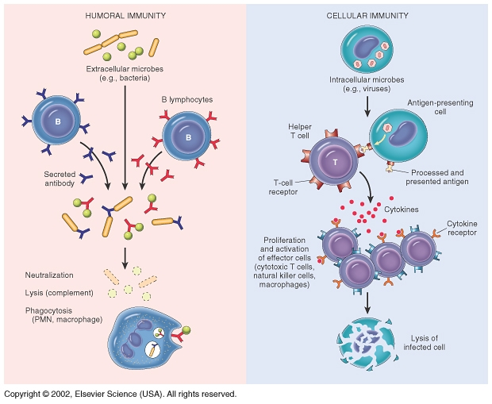

Slide 25
Major Histocompatibility Complex (MHC)
a large genomic region found in most vertebrates that plays an important role in the immune system and autoimmunity
The proteins encoded by the MHC are expressed on the surface of cells in all jawed vertebrates, and display both self antigens and nonself antigens to T cells
which has the capacity to kill or coordinate the killing of pathogens in infected or malfunctioning cells.

Slide 26
Antigen Presentation
is a process in the body's immune system by which macrophages, dendritic cells and other cell types capture antigens and then enable their recognition by T-cells.
There are 2 classes of MHC Molecules used to present different types of antigen
Class I MHC
Class II MHC

Slide 27
Major Histocompatibility Complex
Class 1 MHC
Class II MHC
Intracellular antigens
produced by viruses replicating within a host cell
derive from cytoplasmic bacteria
Derived from the host cell's own proteins in cancerous cells
MHC Class I molecules present antigen to CD8⁺ cytotoxic T cells
Class I MHC is found on almost all body cells
Exogenous antigens are usually displayed on MHC Class II molecules, which interact with CD4⁺ helper T cells
Exogenous antigens include toxins, bacteria that do not enter cells
Expression of Class II is more restricted than Class I.
High levels of Class II are found on dendritic cells
activated macrophages
B cells
several other host cell types in inflammatory conditions

Slide 28
Vocab
Antigen: any substance usually foreign that binds specifically to an antibody or a T cell receptor aka: immunogen
Antibody: a protein (immuglobulin)consisting of two identical heavy chains and 2 identical light chains that recognize a specific epitope on an antigen and facilitates clearance of that antigen. Membrane bound antibody is expressed by B cells that have not encountered antigen; secreted antibody is produced by plasma cells

Slide 29
Vocab
Antigen Presentation: Degradation of antigens by one of 2 pathways yielding antigenic peptides which are presented bound to MHC molecules on the surface of antigen presenting cells or altered self cells
Antigen Presenting Cell: any cell that can process and present antigenic peptides in association with Class II MHC molecules and deliver a costimulatory signal necessary for T-cell activation.
Macrophages, dendritic cells and B cells constitute the professional APC’s
Express class II MHC
Nonprofessional APC’s include vascular endothelial cells and thymic epithelial cells; can only function as APC’s for short periods of time

Slide 30
Vocab
Antibody dependant cell mediated cytotoxicitiy (ADCC): a cell mediated reaction in which nonspecific cytotoxic cells that express Fc receptors recognize bound antibody on a target cell and subsequent cause lysis of the target cell
Epitope: the portion of an antigen that is recognized and bound by an antibody or a TCR-MHC complex; aka antigenic determinant

Slide 31
3 key events in formation of T & B lymphocytes
Generation of lymphocyte diversity by gene rearrangement
Testing and removal of self reactive lymphocytes
Clonal selection of lymphocytes

Slide 32
3 key events in formation of T & B lymphocytes
Generation of lymphocyte diversity by gene rearrangement
40 variable regions for light chain
5 joining regions for light chain
Over 200 possible light chain gene products
Gene rearrangement done randomly by recombinase

Slide 33
3 key events in formation of T & B lymphocytes
Testing and removal of self reactive lymphocytes
Self tolerance is important in preventing autoimmune diseases

Slide 34
3 key events in formation of T & B lymphocytes
Clonal selection of lymphocytes: each antigen by binding to specific receptors selectively activates a tiny fraction of cells from the bodies diverse pool of lymphocytes; this relatively small number of selected cells gives rise to clones of thousands of cells all specific for and dedicated to eliminating that antigen
Soluble antigen or antigen presented on the surface of a class I MHC cell due to viral infection or cancer causes B and T cell selection
Activates lymphocytes leading to cell division forming 2 types of clones
Effector cells
Memory cells

Slide 35
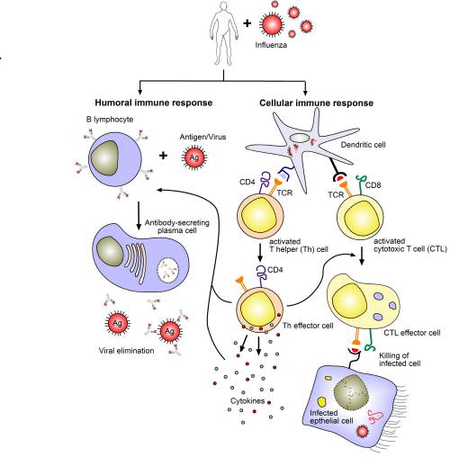

Slide 36
Major Histocompatibility Complex
Class I MHC | Class II MHC
Class I MHC are found on the surface of almost all nucleated cells | Class II MHC are found on the surface of B cells, macrophages, and dendritic cells aka: Antigen Presenting Cells
Recognized by cytotoxic T cells | Interact with T helper cells

Slide 37
Primary Immune Response
Primary immune response upon initial exposure to antigen peaks around 10-17 days after exposure
During this time selected B cells generate antibody secreting effector B cells called plasma cells
Selected T cells are activated to their effector form
CD8+
T cells with the CD8+ receptor are called cytotoxic T cells
secrete IFNγ, and so activate mØ
CD4+
T cells that express the CD4+ receptor are called the T helper cells
TH1
TH2

Slide 38
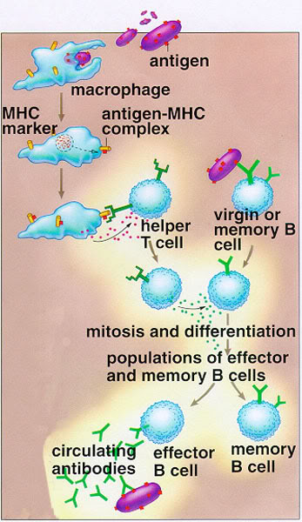

Slide 39
Secondary Immune Response
Secondary Immune response upon a second exposure to an antigen
Response is faster between 2-7 days
More robust
Antibodies are more numerous
Antibodies have greater affinity for antigen
longer lasting
“Imunological Memory”

Slide 40
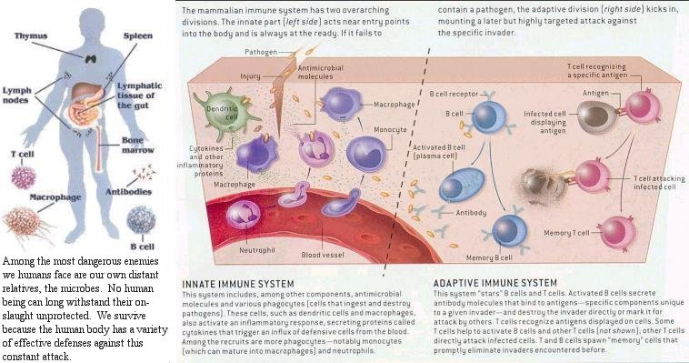

Slide 41
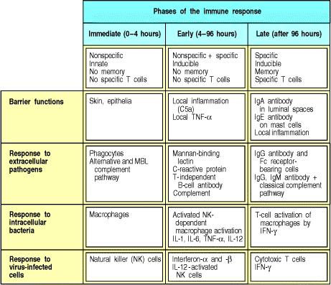

Slide 42
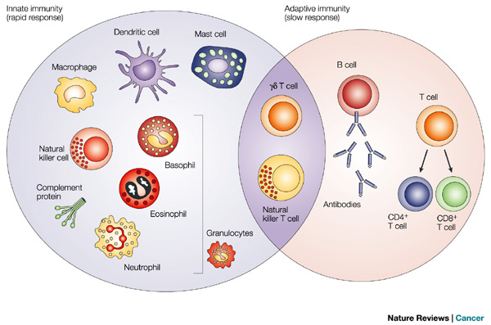

Slide 43
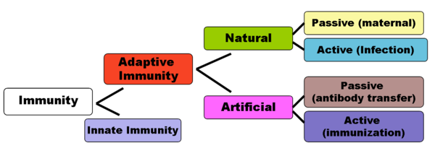
Immunization & Vaccination

