Slide 1
1.1
Chapter 1: The Nature of Life
Science is a way of thinking, questioning, and gathering evidence.
http://www.sevengablesscience.com/

Slide 2
1.1 Objectives:
1.1
Identify the different elements of scientific inquiry
Create testable hypotheses
Differentiate between independent variables and dependent variables
Explain the importance of a control group

Slide 3
Chapter 1.1 Vocabulary
1.1
Science | Constants/ Controlled Variables
Hypothesis | Independent Variable
Observation | Dependent Variable
Control Group | Data

Slide 4
What is Science
1.1
Science is an organized way of gathering and analyzing evidence about the natural world
Science deals only with the natural world
Scientists collect and organize information in an orderly way, looking for patterns and connections
Scientists propose explanations based on evidence, not belief
Science is a way of knowing
The goals of science are to provide natural explanations for events in the natural world. Science aims to use those explanations to understand patterns in nature and to make useful predictions about natural events
Think of Science
as a VERB
not a noun

Slide 5
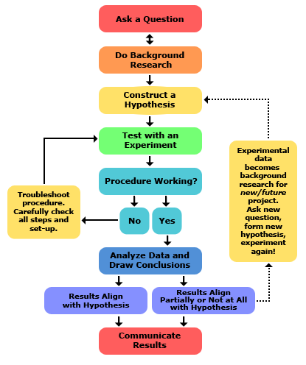
Like all science, biology is a process of inquiry
1.1
Scientists make careful and systematic observations.
Scientists record observations as data.
Scientists form a hypothesis as a possible answer to a question.
Scientists test their hypotheses and analyze their data.
Experiment

Slide 6
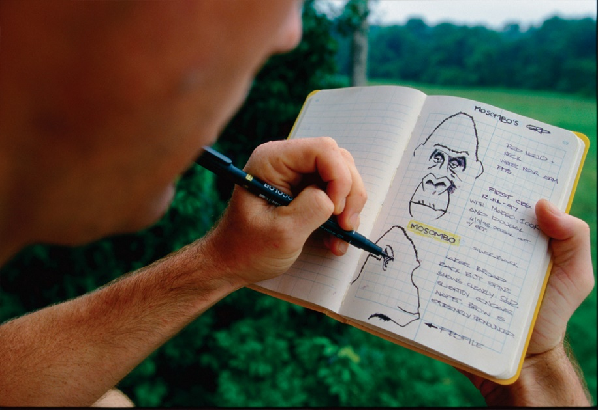
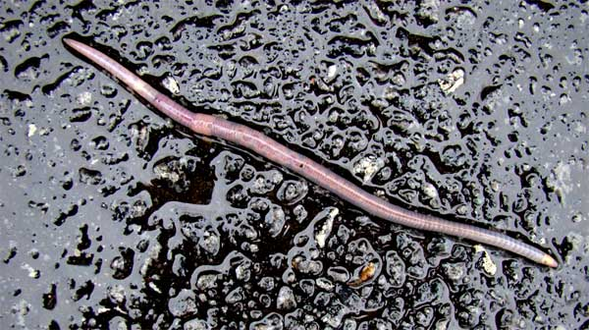
Observing & Asking Questions
1.1
Scientific investigations begin with observations, the act of noticing and describing events or processes in a careful orderly way
It involves more than just looking at things
“Think something that nobody else has thought yet while looking at something that everybody sees” Arthur Schopenhauer

Slide 7
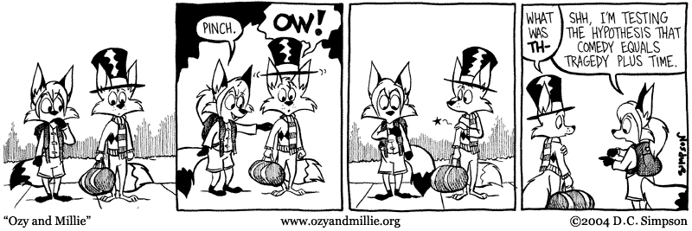
Inferring and Forming a Hypothesis
1.1
An inference is a conclusion or opinion that is formed because of known facts or evidence
Inferences and creative imagination lead to the formation of a hypothesis
A hypothesis is a scientific explanation for a set of observations that can be tested in ways that support or reject it

Slide 8
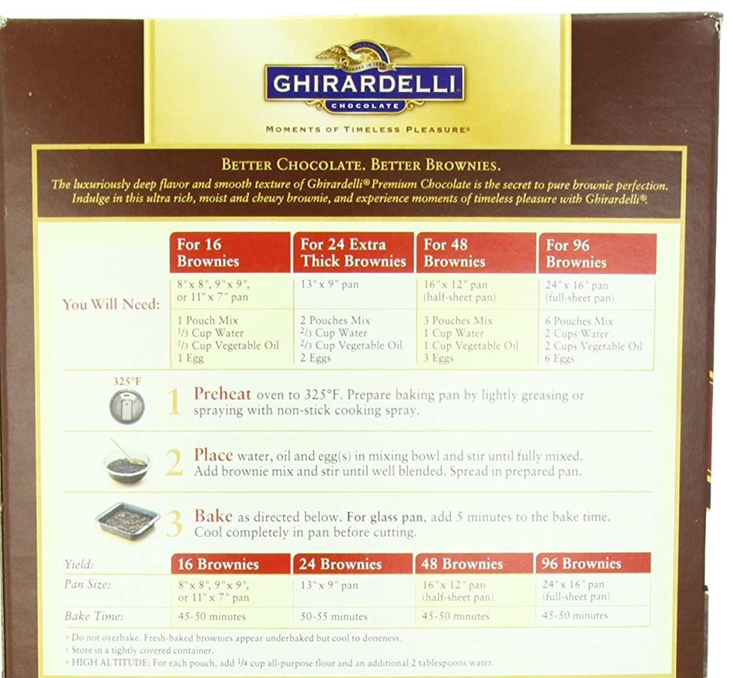
Designing a Controlled Experiment
1.1
To design a controlled experiment, you must have 2 groups
Experimental group: this is the group that you will be testing
Control group: this is the group that you’ll compare your experimental group to. This is how you can see if what your testing causes your experimental group to change in some way, and allows you to see if your hypothesis is supported or rejected
Butter
Oil

Slide 9
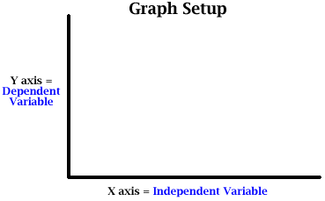
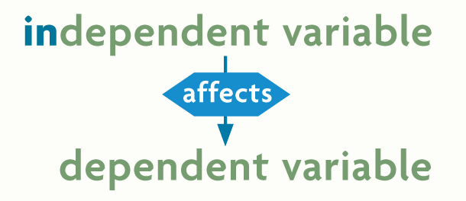
Designing Controlled Experiments
1.1
Experimental studies allow scientists to determine what causes a phenomenon
There are 3 types of variables scientists focus on in experiments
Independent Variables: are manipulated.
Dependent Variables: are observed and measured
Controlled Variables: all of the things kept the same between the experimental group and the control group.

Slide 10
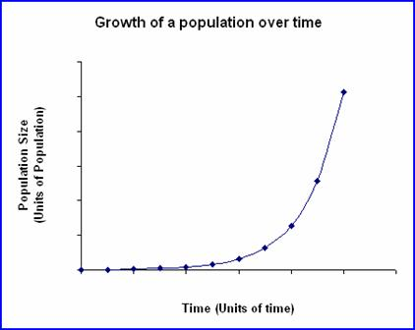
Practice: Independent variable and dependent variables
1.1
What’s the Independent Variable?
How do you know?
What’s the Dependent Variable?
How do you know?
What’s the relationship between the independent and dependent variable?
Blooms Taxonomy: Apply & Evaluate

Slide 11
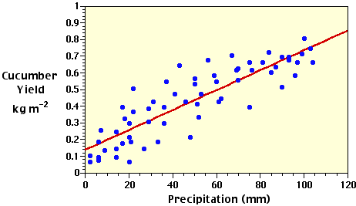
Practice: Independent variable and dependent variables
1.1
What’s the Independent Variable?
How do you know?
What’s the Dependent Variable?
How do you know?
What’s the relationship between the independent and dependent variable?
Blooms Taxonomy: Apply & Evaluate

Slide 12
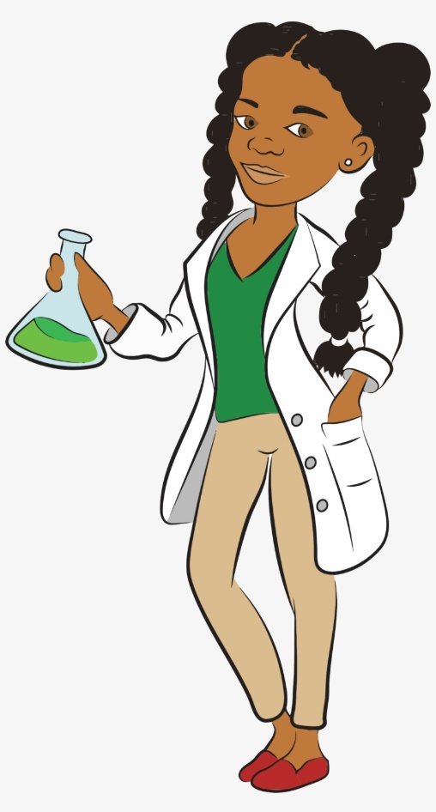
A Hypothesis Should Always:
1.1
Be a statement, not a question
Explain what you think will happen
Be clear and understandable
Identify the variables
Be "testable."

Slide 13
Practice: For each pair, identify which hypothesis is better and explain why
Hypothesis Pair 1:
When there is less oxygen in the water, rainbow trout suffer more lice.
Do rainbow trout have more lice when there’s more or less oxygen in the water?
Hypothesis Pair 2:
Our universe is surrounded by another, larger universe, with which we can have absolutely no contact.
The more high temperature gasses in galaxies the more x-rays they will emit.
Blooms Taxonomy: Evaluate

Slide 14
Practice: For each pair, identify which hypothesis is better and explain why
Hypothesis Pair 3:
Aphid-infected plants that are exposed to ladybugs will have fewer aphids after a week than aphid-infected plants which are left untreated.
Ladybugs are a good natural pesticide for treating aphid infected plants.
Blooms Taxonomy: Evaluate

Slide 15
Practice: Putting it all together
1.1
In the experiment outlined in the table, 5 identical tomato seedlings are planted in 5 identical pots, placed in the same location, and watered on identical schedules.
Identify the following
Independent variable
Dependent variable
Controlled variables
Write a hypothesis for this experiment.
Seedling | Soil | Soil Appearance | Plant Height at 10 days
1 | Yard dirt | Damp, light | 6 inches
2 | Sand | Dry, course | 1 inch
3 | Clay | Wet, dense | 2 inches
4 | Miracle grow potting soil | Damp, nutrient rich | 10 inches
5 | none | Empty pot | 0 inches
Blooms Taxonomy: Apply, analyze, evaluate

Slide 16
For more resources including printable notes, worksheets, and links to online practice visit my website at http://www.sevengablesscience.com/
Like and Subscribe to my YouTube channel “McQuades Learn Biology Channel” to keep learning.
Remember, never stop learning ☺

